Slide 1
Thoughts on Long-Term Merged Total Ozone Data Sets and Their Use in Chemistry Climate Models
Richard S. Stolarski
Department of Earth and Planetary Sciences
Johns Hopkins University
Baltimore, MD USA

Slide 2
Part I: Merging Total Ozone Data Sets
Instrument calibration can drift
Calibrations can be offset from one instrument to another
How do we best merge the data from multiple instruments into a consistent data set?
What is the long-term trend uncertainty of the merged data set?

Slide 3
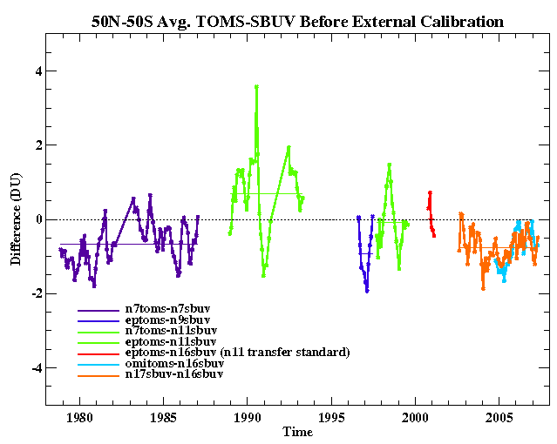
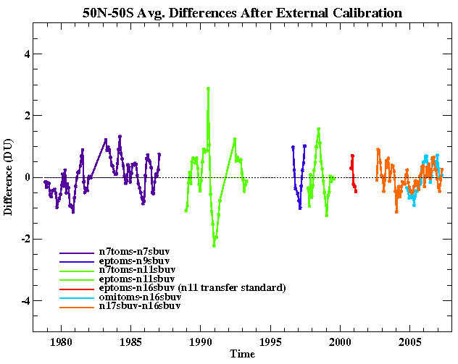
Offsets Can be Determined from Measurement Overlap
50S-50N Average Offset
Before Adjustment
After Adjustment
+4 DU
-4 DU
1980
2005
1980
2005
Year
Year
Offsets in earlier version of merged total ozone data were significantly larger

Slide 4
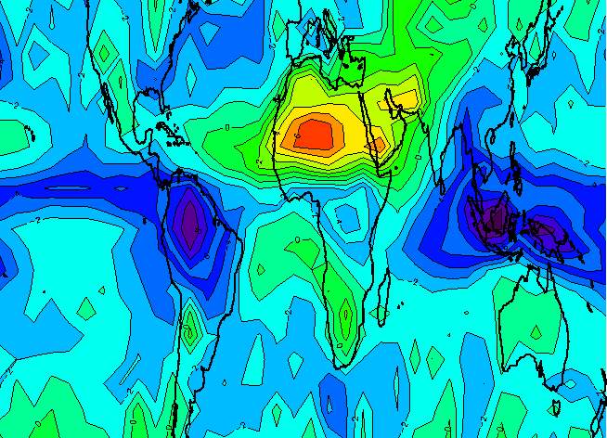
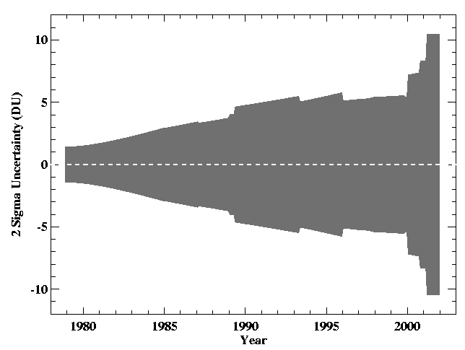
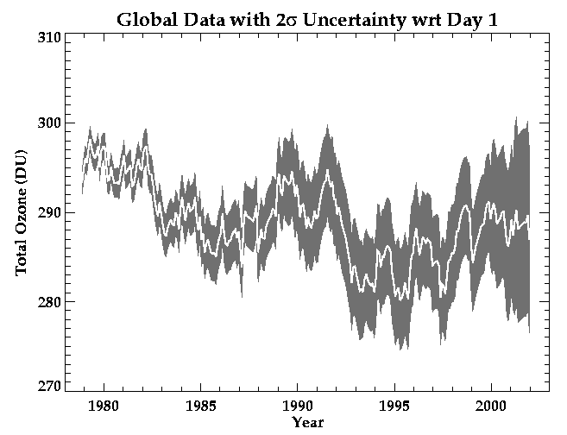
Uncertainty analysis with respect to drift/long-term changes is crucial
Example from Stolarski and Frith (ACP, 2006) using a Monte-Carlo drift and offset model for uncertainty estimation from a multi-instrument time series
Needs to be updated with extended data and improved uncertainty estimates
Even years of overlap may not remove all differences because of systematic differences between measurements

Slide 5
Importance of Making Data Readily Available
For merged data, traceability to original sources
Clearly labeled version with modification history
http://acdb-ext.gsfc.nasa.gov/Data_services/merged/

Slide 6
Conclusions: Part I
Early merging of TOMS/SBUV data required significant offset adjustments to account for inter-calibration differences
Version 8.6 SBUV data has been inter-calibrated by the processing team and can/should now be merged without any adjustments
Evaluation of uncertainty is crucial to providing a robust data set (offset plus drift of individual instrument measurements)
Availability and traceability of merged data sets is necessary for general use of data

Slide 7
Part II: Using Total Ozone Data to Confront Models
Total ozone is used as a semi-quantitative self-examination for entrance into the ozone response and prediction game
I will suggest that more can be done using total ozone for quantitative evaluation of models
Problems revealed by failure to simulate total ozone features cannot be understood without additional data; ozone profiles first and then measurements that reveal processes in the atmosphere

Slide 8
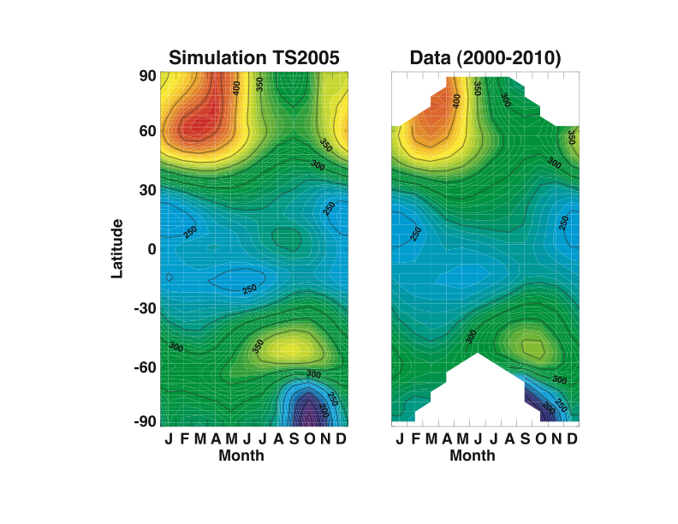
Dobson (or Dütsch) Diagram
This is a typical first comparison of model with ozone data
Provides a good qualitative or semi-quantitative model evaluation
Much more can be done with total column ozone data

Slide 9
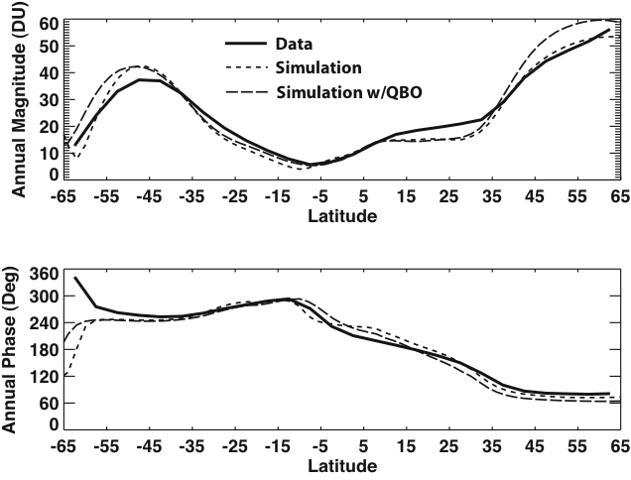
Magnitude and phase of the annual cycle deduced from total ozone as a function of latitude

Slide 10
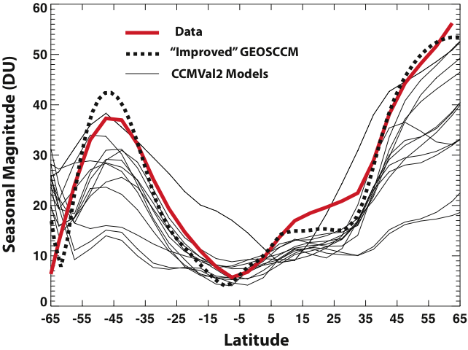
Comparison to the suite of models contributing to CCMVal2

Slide 11
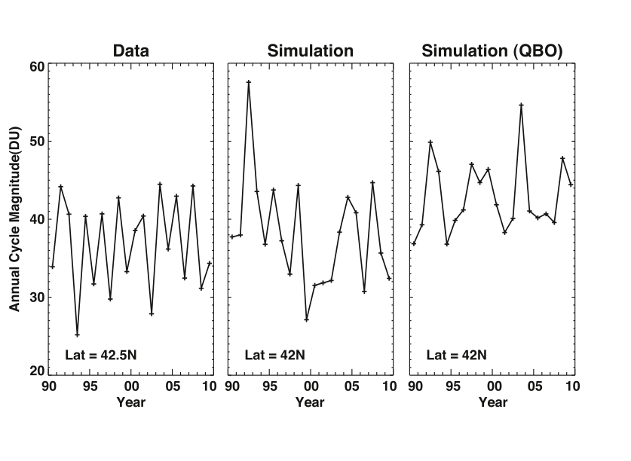
We can learn even more from the variability of the magnitude of the seasonal cycle from year to year

Slide 12
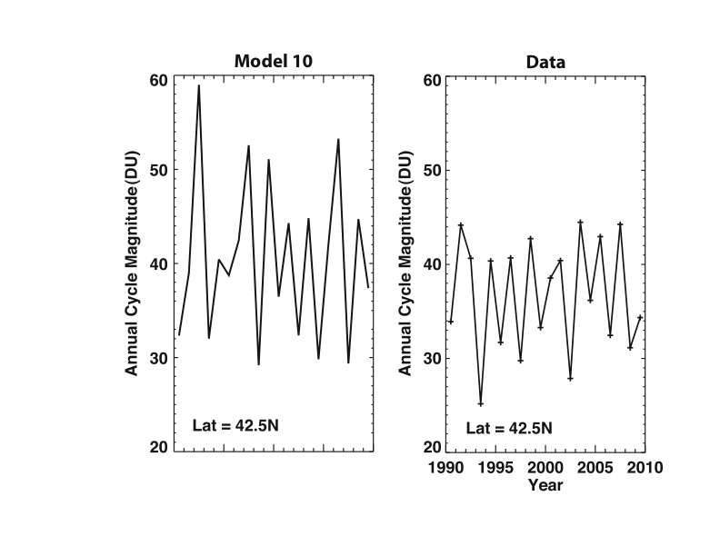
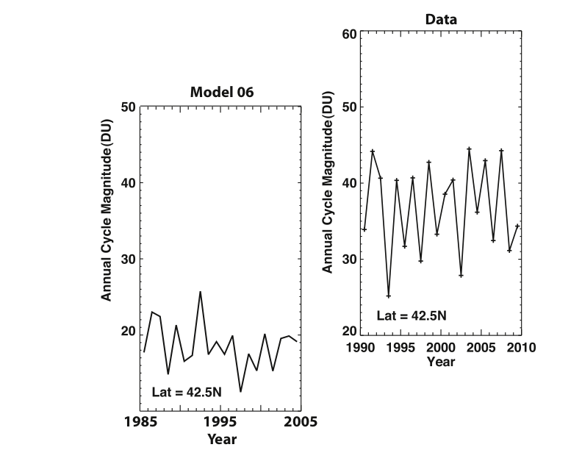
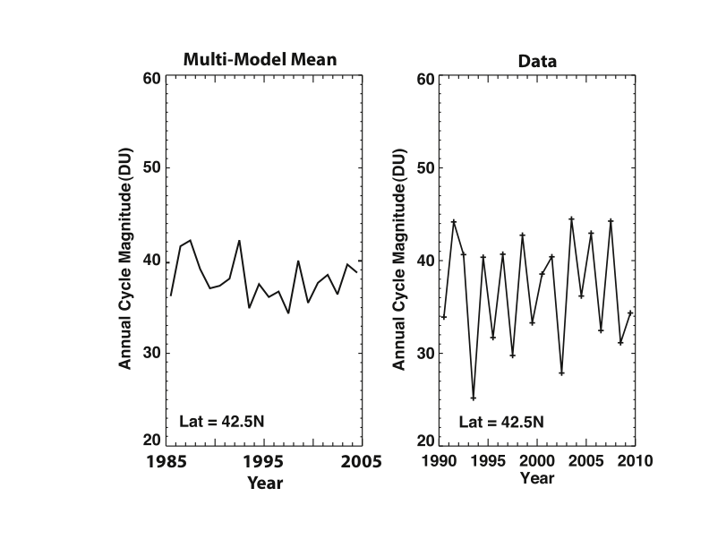
Comparison to several models and the “multi-model mean”

Slide 13
CCMVal (Chemistry-Climate Model Validation): Two Evaluations Using Process-Oriented Comparisons of Model Simulations with Data
Summarized in papers by Eyring et al. (2007,2009)
Example process-oriented comparison of age of air vs latitude
Recent Strahan et al. paper shows that process tests give more consistent results than ozone comparisons

Slide 14
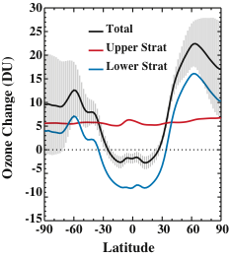
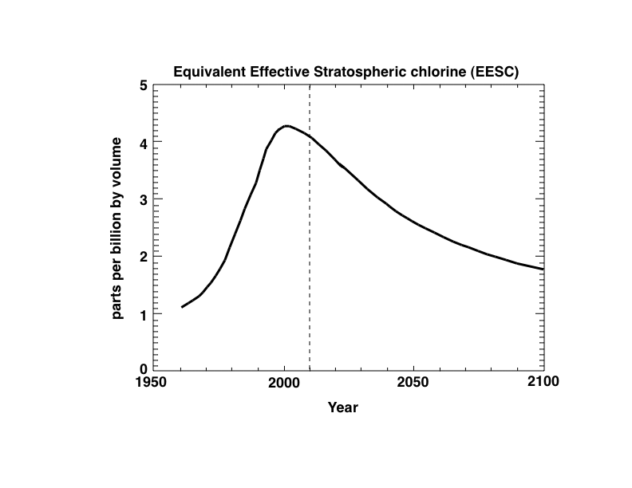
Major Issue Facing our Field is the Detection/Attribution of Ozone Recovery
Models predict a speed-up of the residual circulation leading to a “super-recovery” of ozone at mid to high latitudes and a possible “sub-recovery” near the equator
Ozone Response to GHGs
Ozone Response to ODSs

Slide 15
Conclusions: Part II
More can be done with total ozone data from satellites and ground-based systems
  Measurers should be asking: “What are the robust features of our measurements that should be simulated by state-of-the-art models?”
  Modelers should be asking: “What am I simulating that could be tested with additional data analyses or with additional measurements?”
Understanding model/measurement disagreement requires
  data beyond just total ozone
  Analyses focused on atmospheric processes that determine the distribution of total ozone
Separating ozone response to GHGs and ODSs is critical to attribution of expected ozone recovery

