Slide 1
The “lifetime” problem:
The Executive Summary of the 2010 WMO/UNEP Ozone Assessment cites lifetime problems and problems associated with lifetimes:
  “Evidence is emerging that lifetimes for some important ODSs (e.g., CFC-11) may be somewhat longer than reported in past assessments. In the absence of corroborative studies, however, the CFC-11 lifetime reported in this Assessment remains unchanged at 45 years. Revisions in the CFC-11 lifetime would affect estimates of its global emission derived from atmospheric changes and calculated values for Ozone Depletion Potentials (ODPs) and best-estimate lifetimes for some other halocarbons.”
  “Carbon tetrachloride (CCl₄) tropospheric abundances have declined less rapidly than expected. Emissions derived from data reported to the United Nations Environment Programme (UNEP) are highly variable and on average appear smaller than those inferred from observed abundance trends. Although the size of this discrepancy is sensitive to uncertainties in our knowledge of how long CCl4 persists in the atmosphere (its “lifetime”), the variability cannot be explained by lifetime uncertainties.”
  “A stronger BDC would:
      decrease the abundance of tropical lower stratospheric ozone,
      increase poleward transport of ozone, and
      could reduce the atmospheric lifetimes of long-lived ODSs and other trace gases.”

Slide 2
Issues of global data series of CCl₄
Stable interhemispheric gradient: sources in N-Hemisphere?
Global sources: 70 Gg (lifetime: 26 years)
Lifetime uncertain (ocean sink, soil sink)
Summed regional sources from inverse modelling : ~20 Gg
Ozone Assessment (2007):
Overall the budget of CCl₄ remains poorly understood.

Slide 3
The “lifetime” problem
Lifetimes of many long-lived atmospheric trace gases may be seriously error. At GSFC we have estimated lifetimes using met fields from the GEOS5-GCM coupled chemistry model in an offline GMI simulation. Our current best models are yielding lifetimes that differ from values estimated from older models and observations.
Compound GMI (yrs) WMO 2007 (yrs)
CFC-11 ~61 45
CFC-12 106 100
CH₃CCl₃ 7.5 5.0
HCFC-22 17.1 12
CCl₄ 59 * 26
CFC-113 92.5 85
CH₄ 14.5 –
N₂O 120. 114
*The GMI CTM has no ocean sink for CCl₄ so the GMI lifetime is too long.

Slide 4
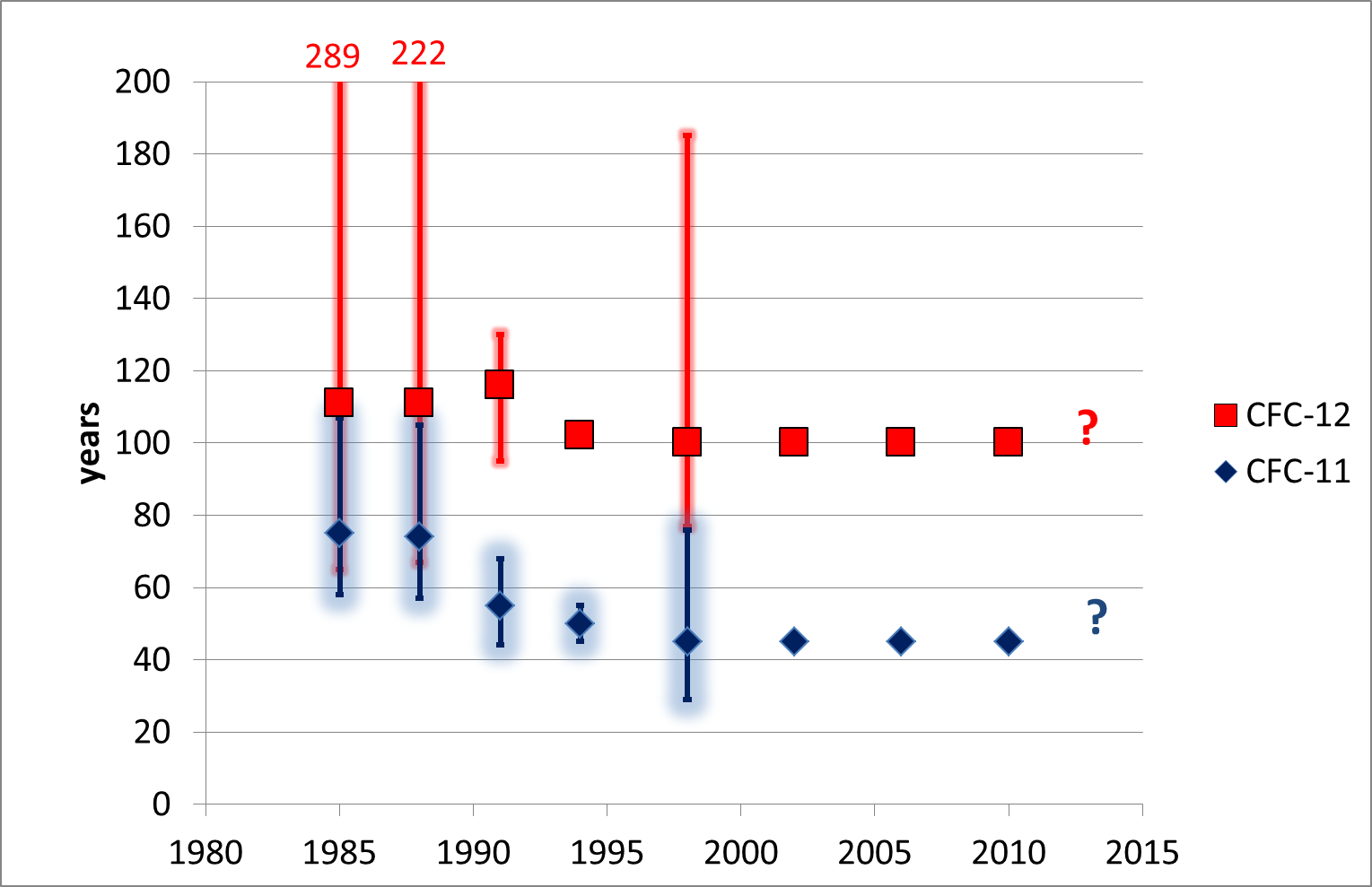
History of lifetimes in previous ozone assessments

Slide 5
Started lifetime re-evaulation within SPARC
Stratospheric Processes And their Role in Climate
Scope of the re-evaluation
Estimate the numerical values for lifetimes
Estimate the uncertainties for numerical values for lifetimes
Assess the influence/use of different lifetime definitions (e.g. steady-state /instantaneous lifetimes)
Assess lifetime changes associated with the changing climate
P. Newman, S. Strahan, M. Ko, S. Reimann

Slide 6
Lifetimes to reevaluate
Compound Formula Lifetime (yrs)
Priority 1:
1. CFC-11 CCl₃F 45
2. CFC-12 CCl₂F₂ 100
3. Carbon Tetrachloride CCl₄ 26
4. Methyl Chloroform CH₃CCl₃ 5.0
5. HCFC-22 CHClF₂ 12
6. Nitrous oxide N₂O 114
7. Methane CH₄ 8.7* (lifetime)
12.0* (pulse decay
Priority 2:
8. Halon-1211 CBrClF₂ 16
9. Halon-1301 CBrF₃ 65
10. CFC-113 CCl₂FCClF₂ 85
11. CFC-115 CF₃CClF₂ 1020
12. HFC-134a CH₂FCF₃ 13.4
13. HFC-143a CF₃CH₃ 47.1
14. HFC-23 CHF₃ 222
Priority 3:
15. CFC-114 CClF₂CClF₂ 190
16. HCFC-141b CH₃CCl₂F 9.2
17. HCFC-142b CH₃CClF₂ 17.2
18. Methyl Chloride CH₃Cl 1.0
19. Methyl Bromide CH₃Br 0.8
20. Halon-1202 CBr₂F₂ 2.9
21. Halon-2402 CBrF₂CBrF₂ 20

Slide 7
Structure of the lifetime re-evaluation
Executive Committee: Malcolm Ko, Susan Strahan, Stefan Reimann, Paul Newman
Chapter 1: importance of global lifetimes, history of lifetimes
  Lead authors: Executive Committee
Chapter 2: Theory of estimating lifetimes using models and observations
  Lead authors: Alan Plumb/Richard Stolarski
Chapter 3: Update on kinetic data that determined lifetimes (cross sections etc.)
  Lead authors: James Burkholder/Wahid Mellouki
Chapter 4: Inferred lifetimes from observed trace-gas distributions
  Lead authors: Andreas Engel/Elliot Atlas
Chapter 5: Model estimates of lifetimes
  Lead authors: Martyn Chipperfield/Qing Liang
Chapter 6: Summary
  Lead authors: chapter leads and executive committee

Slide 8
Timetable
Feb. 2011, Presentation to SPARC SG
Feb. 2011, Comments solicited from scientific community on scope
Apr. 2011, Scope redefined, author teams formed.
2011
May 2011, Chapter outlines drafted
Jul. 2011, Begin of model simulations
Dec. 2011, model simulation completed.
May. 2012, 1st drafts complete; circulated for internal review.
2012
Sep. 2012, 2nd drafts complete, start peer review.
Dec. 2012, 3rd draft complete.
Jan. 2013, Open meeting with reviewers
Feb. 2013, Final draft, including Executive Summary,
Apr. 2013, Document released

Slide 9
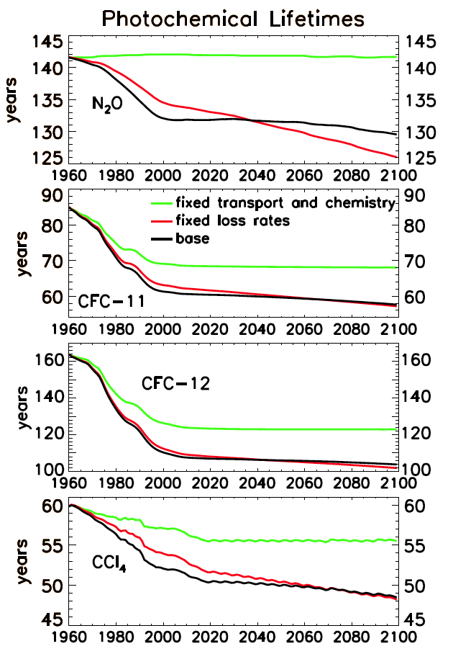
The lifetime of a specie changes with time
Fleming et al. (ACPD, 2011) Figure 13
Black lines show lifetimes for N₂O, CFC-11, CFC-12, and CCl₄
Red lines are with a fixed loss rate for 1960 values.
Green lines use chemistry and transport fixed at 1960 values illustrating the effect of the changing atmospheric burden.

