Slide 1
Key Aspects of GOME-2 Calibration
Rose Munro, Rűdiger Lang, Yakov Livschitz, Richard Dyer, Antoine Lacan
EUMETSAT

Slide 2
Calibration Activities
On-ground Characterisation
  Radiometric calibration (radiance and irradiance)
  Instrument BSDF characterisation
  Spectral calibration
  Polarisation sensitivity characterisation
  Slit Function characterisation
In-flight Calibration
  Dark signal, PPG, etalon, straylight correction
  Spectral calibration
  Radiometric calibration
  Degradation correction

Slide 3
GOME-2 FM2 (for Metop-B) Delta-Calibration
  Changes from last calibration campaign ~five years ago
    Instrument or measurement problem?
  Changes in slit function, irradiance response, PMD spectral calibration (one PMD), polarisation sensitivity
  Calibration campaign extended for further measurements and investigations (on-going)

Slide 4
GOME-2 FM2 (for Metop-B) Delta-Calibration
Slit Function
  Slit function FWHM has changed by up to 20% in some channels
  Predominantly FWHM not shape(?) but TBC but detailed analysis
  Not a problem if stable and well characterised but is this a stable change?
  Investigations suggest an on-ground to in-flight change in GOME-2 FM3 on Metop-A plus long-term changes
  Possible source – small changes in thermal or mechanical stress on the gratings → relevant to other instruments?

Slide 5
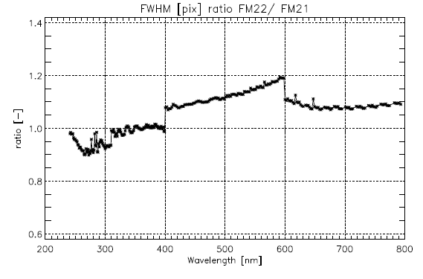
Slit function from FM2/Metop-B
On-ground calibration FM2-1 vs FM2-2

Slide 6
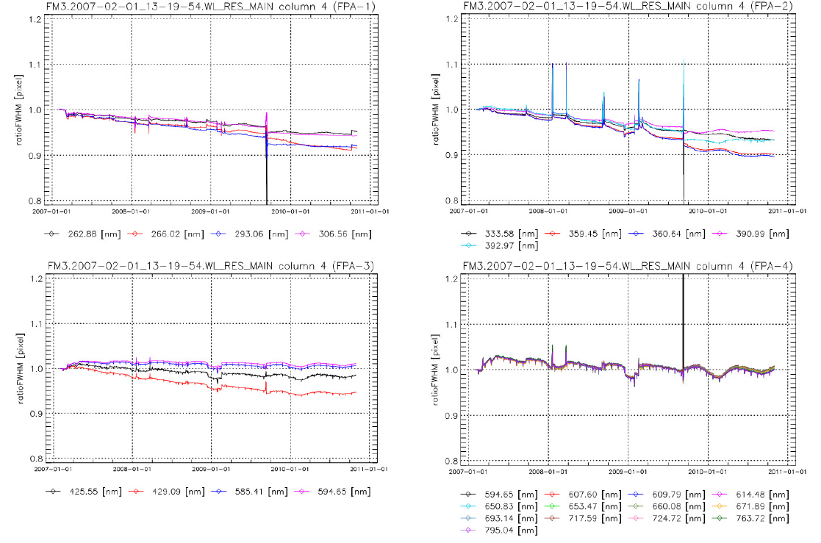
FWHM FM3 from on-board spectral light source
TNO FM2 delta calibration campaign (Kenter et al.)

Slide 7
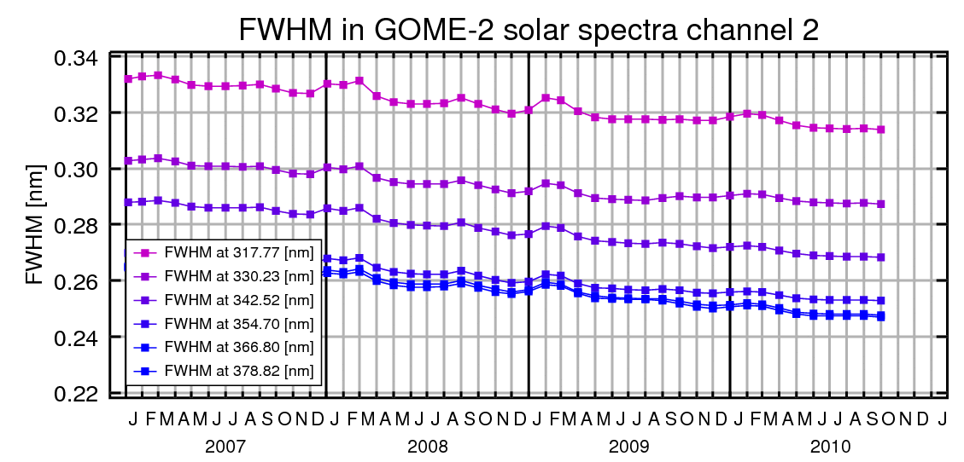
FWHM in GOME-2 solar spectra
Degradation study IUP Bremen (Dikty/Richter)
In calibration of GOME-2 solar spectra on Kurucz Fraunhofer atlas the FWHM (of a Gaussian slit function) is also fitted
FWHM changes consistently over channel 2
FWHM decreases over time
No effect of throughput test

Slide 8
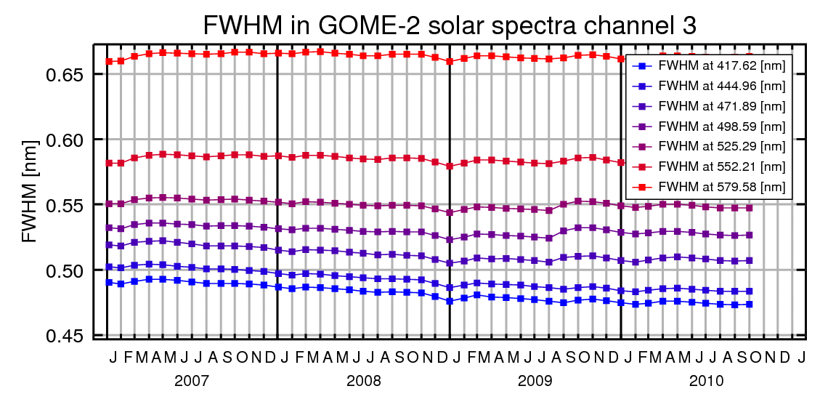
FWHM in GOME-2 solar spectra
Degradation study IUP Bremen (Dikty/Richter)
FWHM changes also in channel 3
FWHM decreases over time, but more so at shorter wavelengths
Slight effect of throughput test ?

Slide 9
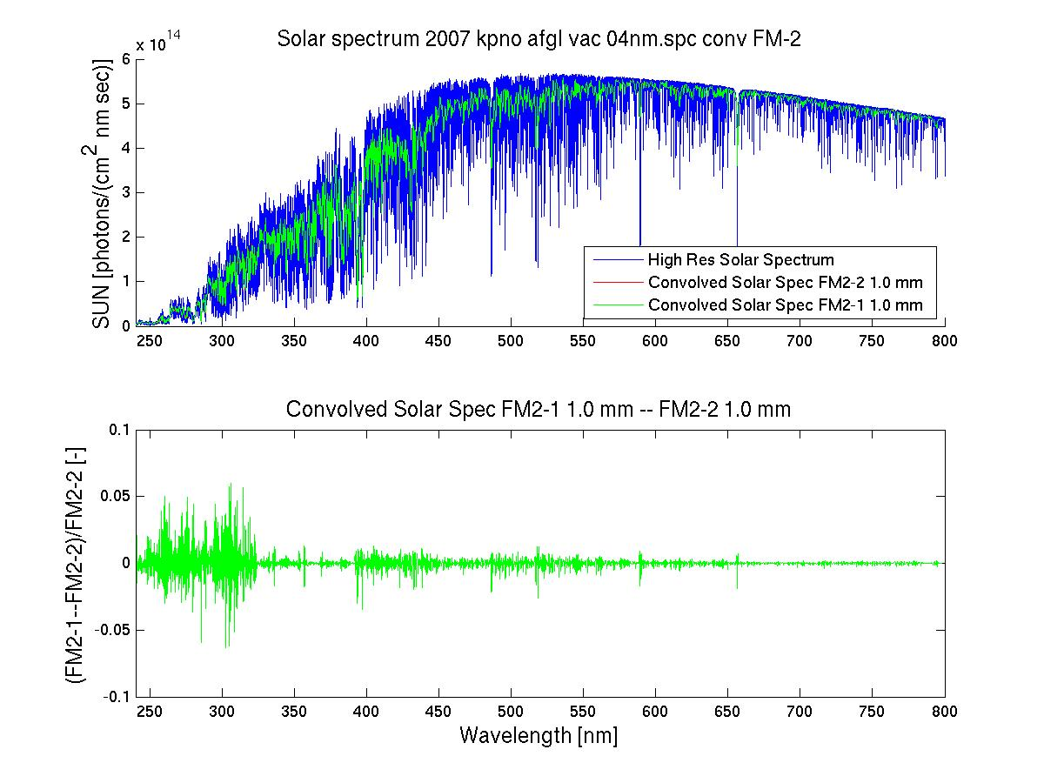
Slit function from FM2/Metop-B
On-ground calibration FM2-1 vs FM2-2

Slide 10
GOME-2 FM2 (for Metop-B) Delta-Calibration
Radiometric calibration (analysis on-going)
  First measurements (NIST FEL irradiance standard) showed significant differences w.r.t. previous calibration
  Radiance calibration (Earth path) → improved analysis resolved discrepancies
  Irradiance calibration → many measurements made and still showing significant variability; issues with setup suspected although not obvious and still under analysis
  Sun simulator and integrating sphere used as cross-reference for BSDF (as compared to FEL radiance/irradiance)
  → FEL lamps difficult to handle for irradiance calibration (they produce a lot of light) so use multiple sources for cross-reference and verification

Slide 11
GOME-2 FM2 (for Metop-B) Delta-Calibration
  Polarisation Response
  Repeat measurements suggest that changes may be real – analysis on- going
  Alignment issues critical during measurement
  PMD Spectral Calibration
  Changes probably real
  Spectral calibration measured in orbit
  In case of in-stability in-orbit spectral co-registration of PMD bands could be affected but not expected to have significant impact

Slide 12
GOME-2 Long-term throughput changes
Solar Mean Reference (SMR) spectrum
Slow onset of degradation observed after 2nd throughput test in channel 1 and 2.
Instrument is stable now in channel 3 and 4.
Reprocessed signals PPF 4.0 until January 2011
relative to February 2007

Slide 13
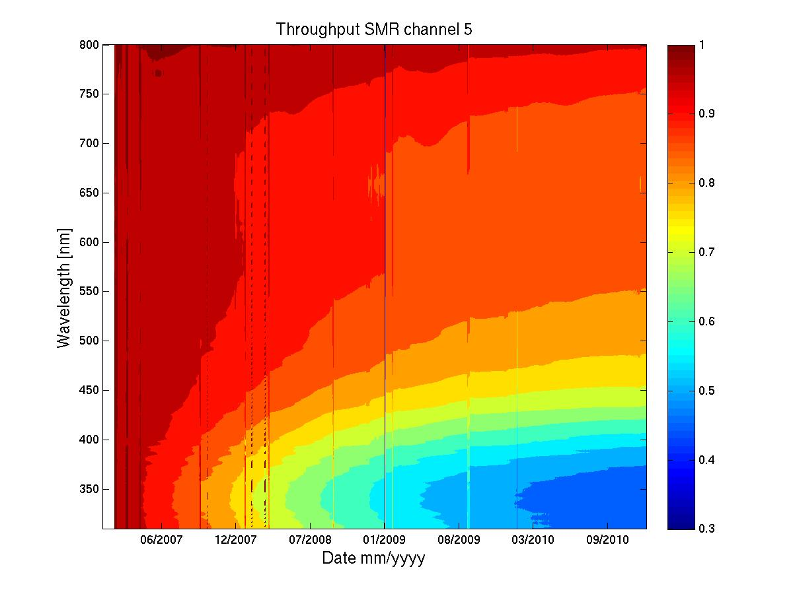
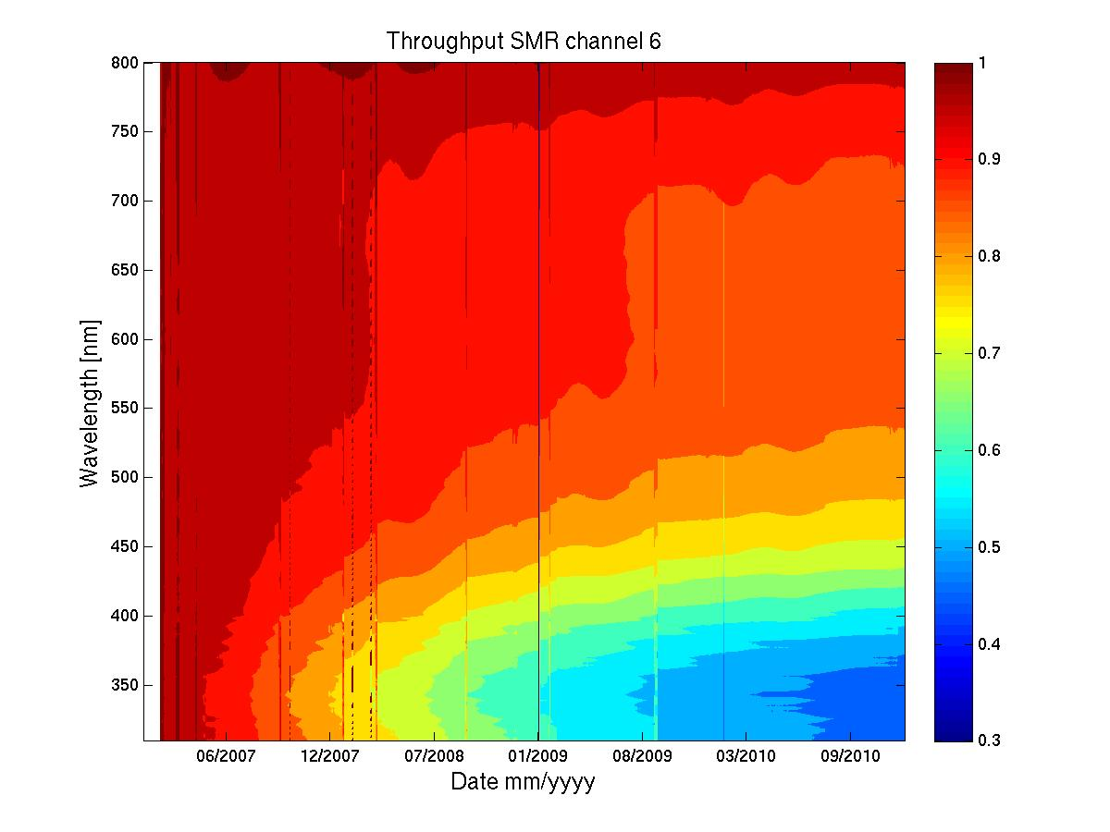
GOME-2 Long-term throughput changes
Solar Mean Reference (SMR) spectrum
PMD-P
PMD-S
Reprocessed signals PPF 4.0 until January 2011
relative to February 2007

Slide 14
GOME-2 instrument degradation
Hypothesis by the ESA/EUMETSAT/Industry GOME-2 tiger team
Contamination expected to take place on the detectors:
  Coldest points
  Consistency of the LED measurements with the other measurements
For GOME-2 there are 5 times more conformal coatings in the vicinity of the detectors than on GOME-1 (read-out electronics has been moved close to the detectors to speed-up read-out time)
First out-gassing test for PCBs in the lab (ESA) shows some consistency with the in-orbit observations (general spectral pattern)

Slide 15
GOME-2 instrument degradation
Hypothesis by the ESA/EUMETSAT/Industry GOME-2 tiger team
However…
The migration of the contaminant from the top plane of the instrument (location of PCBs) and through the exhaust pipes back into the detector enclosures is very difficult
Impact modeling from the observed residual Etalon suggests only a 10 nm contaminant layer present on the detectors. This is in principle not enough to explain the observed degradation

Slide 16
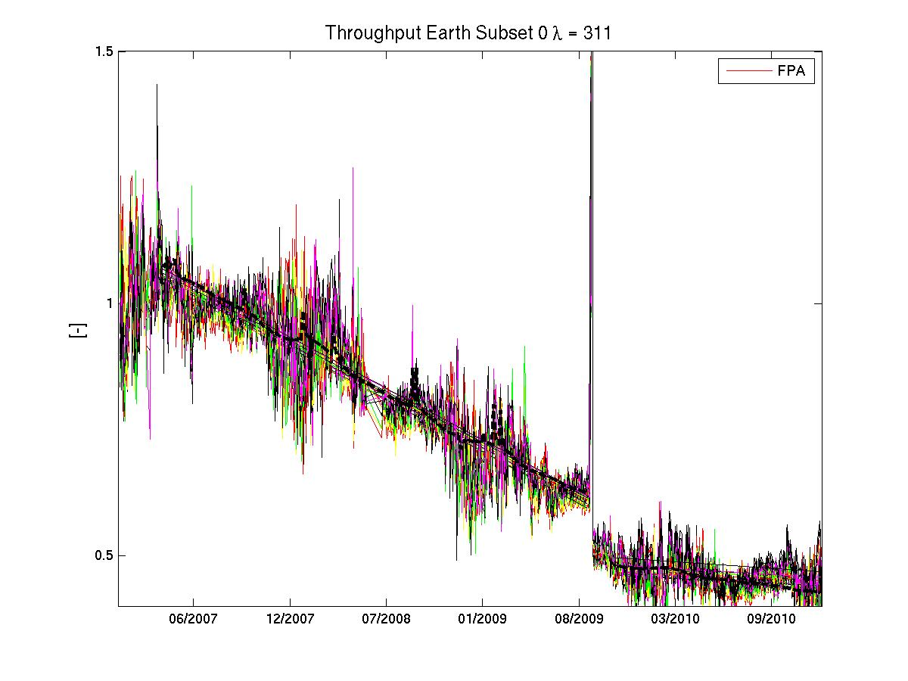
Earthshine degradation until December 2010
Sahara – 311nm – relative to mean of 2007
Earthshine Sahara
Normalised to 2007
Every 2nd scanner angle position is used (coloured solid lines)
Solar Mean Reference (black dashed line)
Low outliers are due to interfering narrow scan
Preliminary Analysis!

Slide 17
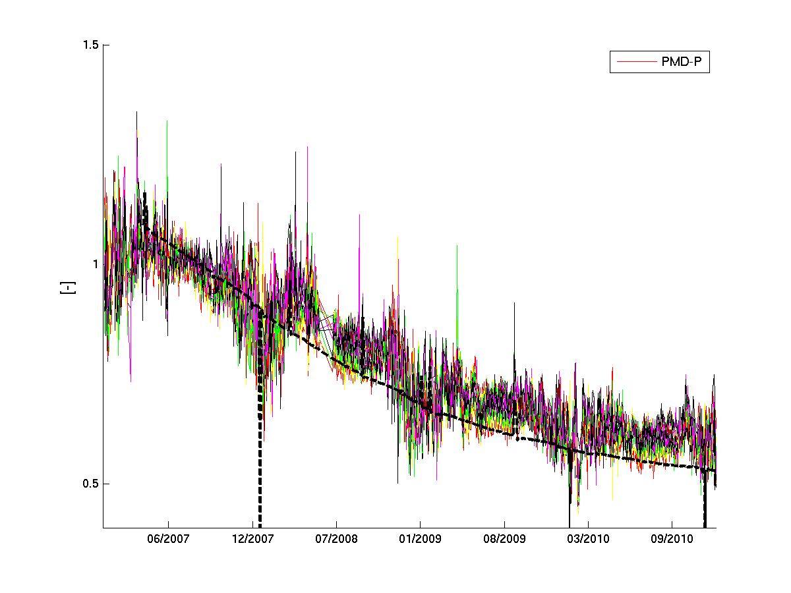
Earthshine degradation until December 2010
Sahara – 311nm – relative to mean of 2007 – PMD-P
Earthshine Sahara
Normalised to 2007
Every 2nd scanner angle position is used (coloured solid lines)
Solar Mean Reference (black dashed line)
Low outliers are due to interfering narrow scan
Preliminary Analysis!

Slide 18
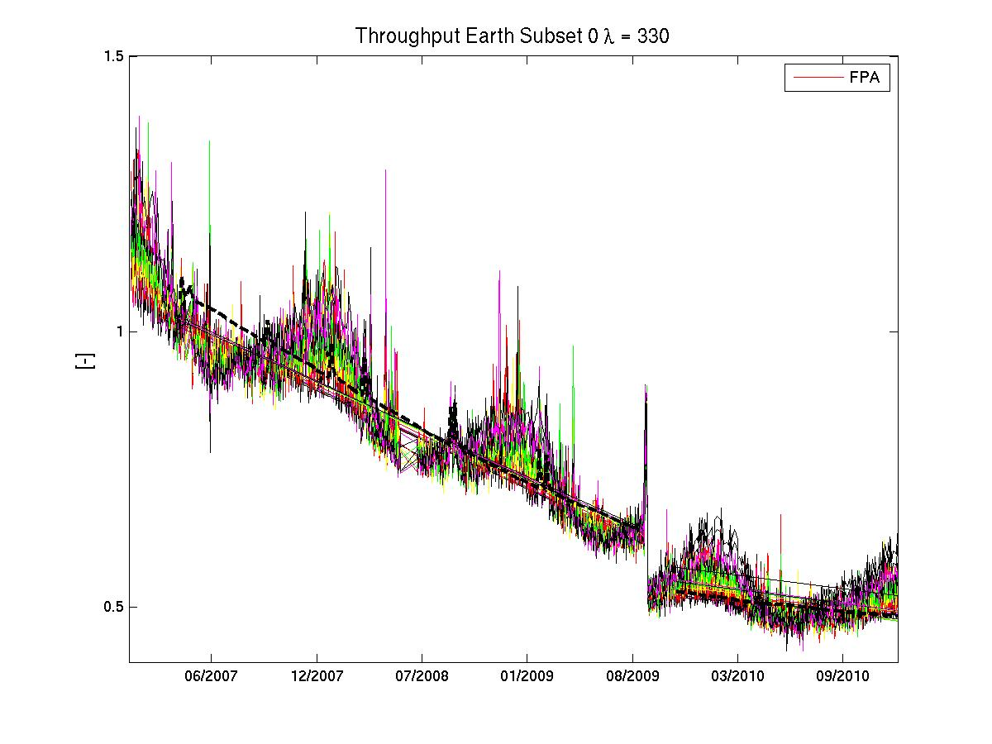
Earthshine degradation until December 2011
Sahara – 330nm – relative to mean of 2007
Earthshine Sahara
Normalised to 2007
Every 2nd scanner angle position is used (coloured solid lines)
Solar Mean Reference (black dashed line)
Low outliers are due to interfering narrow scan
Preliminary Analysis!

Slide 19
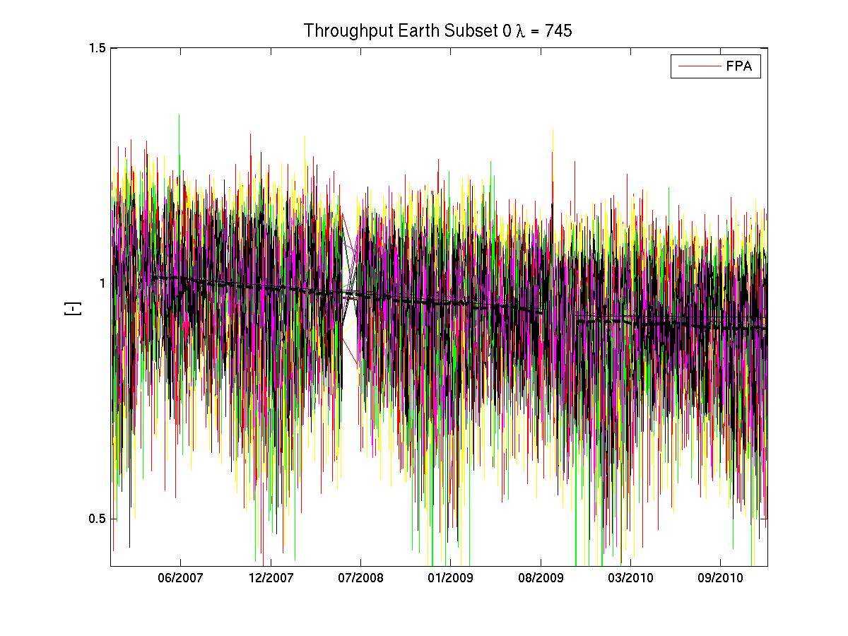
Earthshine degradation until December 2010
Sahara – 745 nm – relative to mean of 2007
Earthshine Sahara
Normalised to 2007
Every 2nd scanner angle position is used (coloured solid lines)
Solar Mean Reference (black dashed line)
Low outliers are due to interfering narrow scan
Preliminary Analysis!

Slide 20
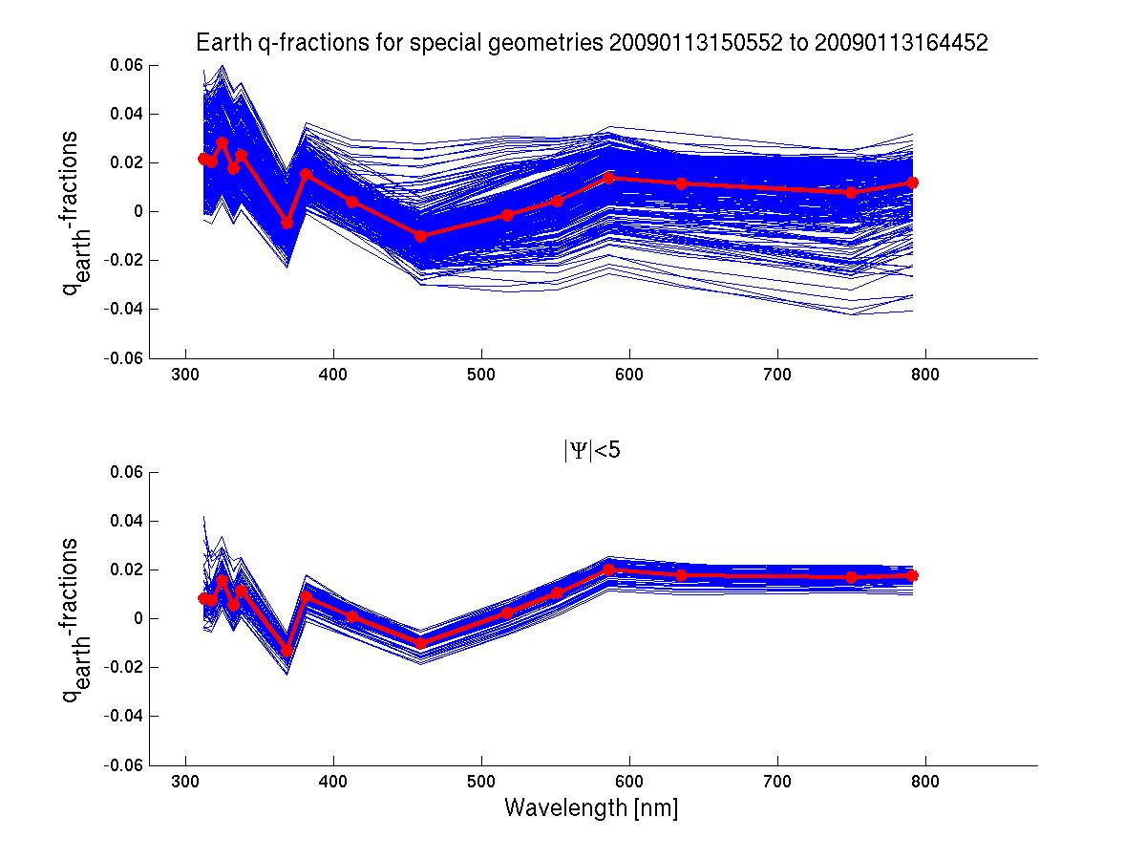
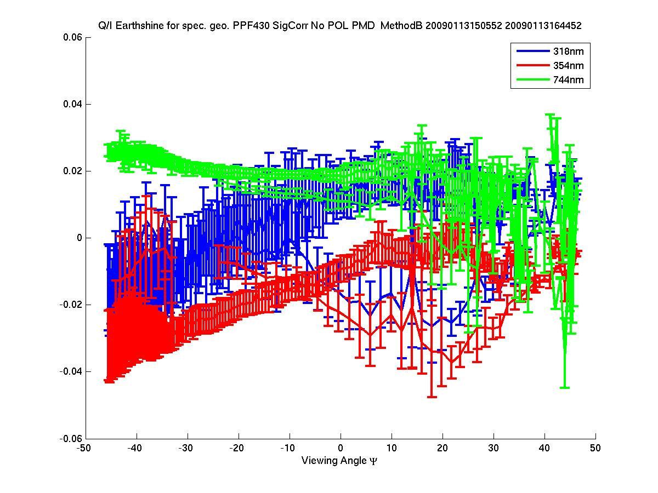
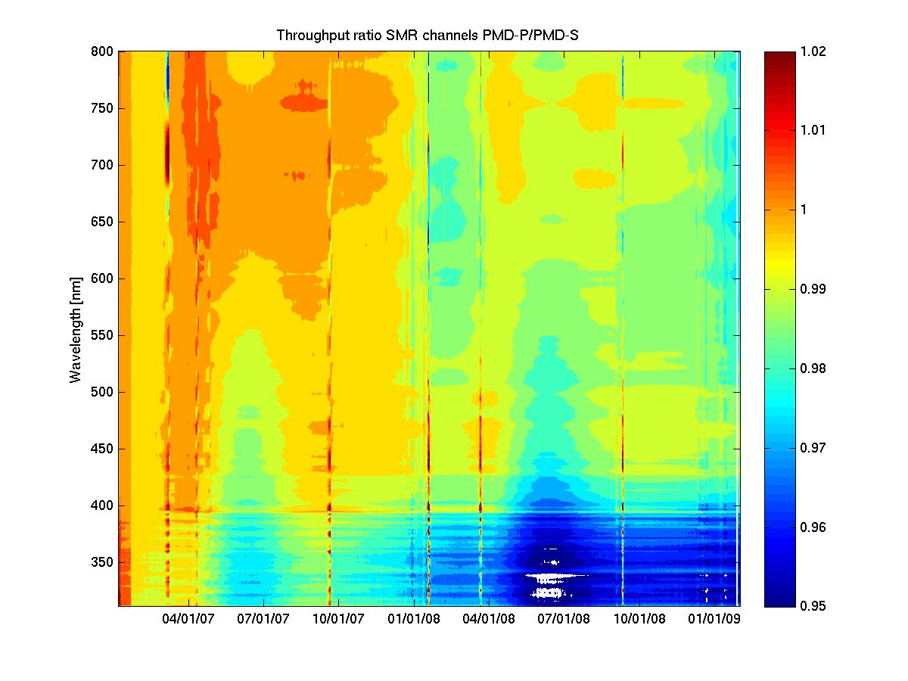
Quality of Polarisation Correction / Stokes fractions
Online Stokes fraction correction
New development:
Online correction to keydata in 3D space
Spectral space
from approx. 1 day of
special geometry band readouts
Viewing angle
Temporal domain

Slide 21
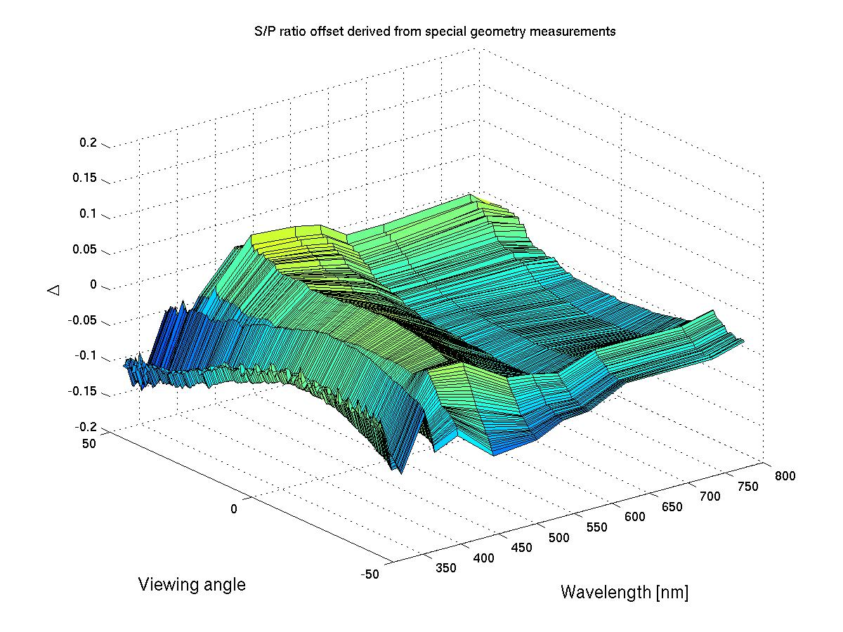
Quality of Polarisation Correction / Stokes fractions
Online Stokes fraction correction
New development:
Online correction scheme in 3D space
(PPF 4.3 18th August 2009)
from approx. 1 day of
special geometry band readouts

Slide 22
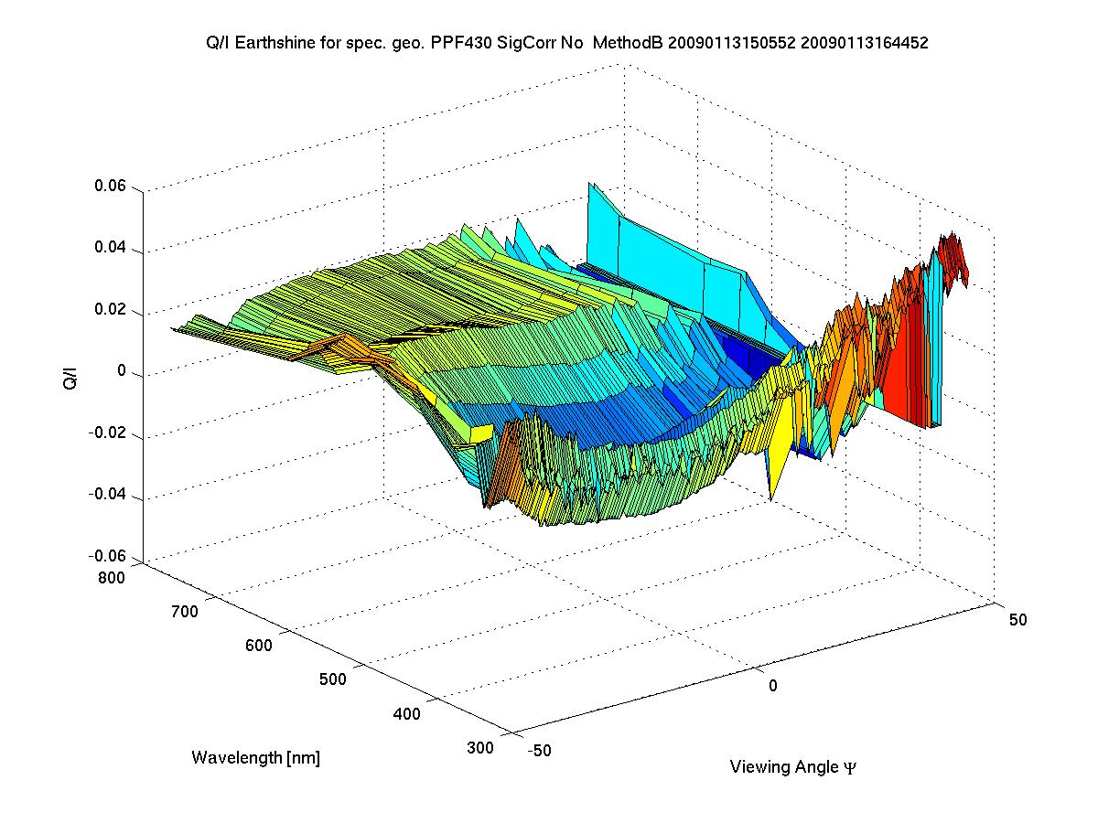
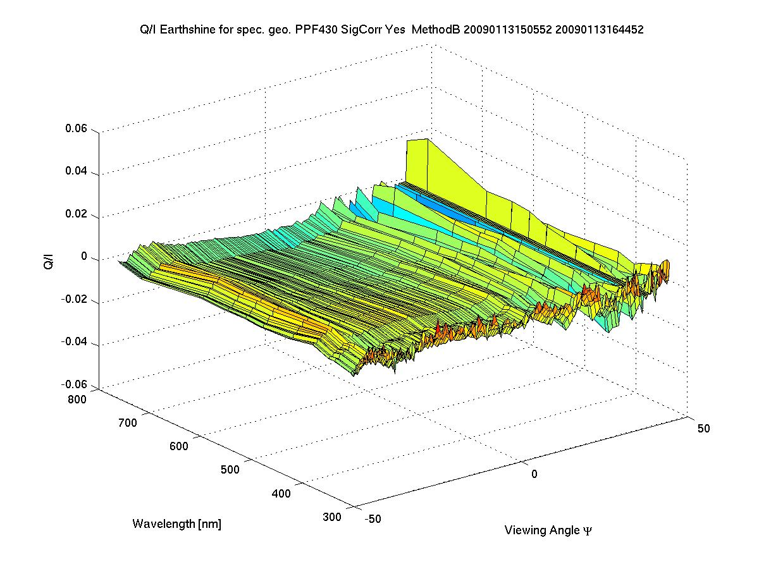
Quality of Polarisation Correction / Stokes fractions
Online Stokes fraction correction
New development:
Online correction scheme in 3D space
(PPF 4.3 18th August 2009)
Uncorrected Stokes fractions q for special geometry
Corrected Stokes fractions q using
Δ at the following day

Slide 23
Quality of Polarisation Correction / Stokes fractions
Scan-angle + Instrument degradation + C-shape correction – Results
Stokes fraction
for special geometry
No online correction
up to PPF 4.2

Slide 24
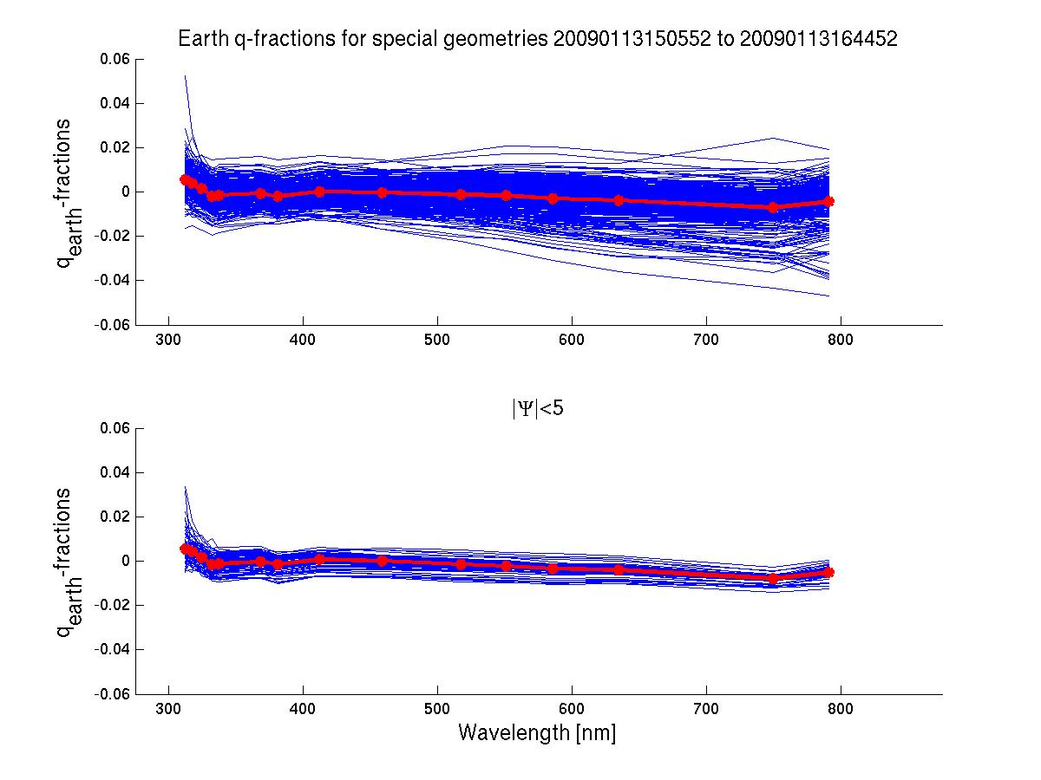
Quality of Polarisation Correction / Stokes fractions
Scan-angle + Instrument degradation + C-shape correction – Results
Stokes fraction
for special geometry
Online correction
Starting with PPF 4.3
August 2009

Slide 25
Quality of Polarisation Correction / Stokes fractions
Scan-angle + Instrument degradation + C-shape correction – Results
Stokes fraction
for special geometry
No online correction
up to PPF 4.2

Slide 26
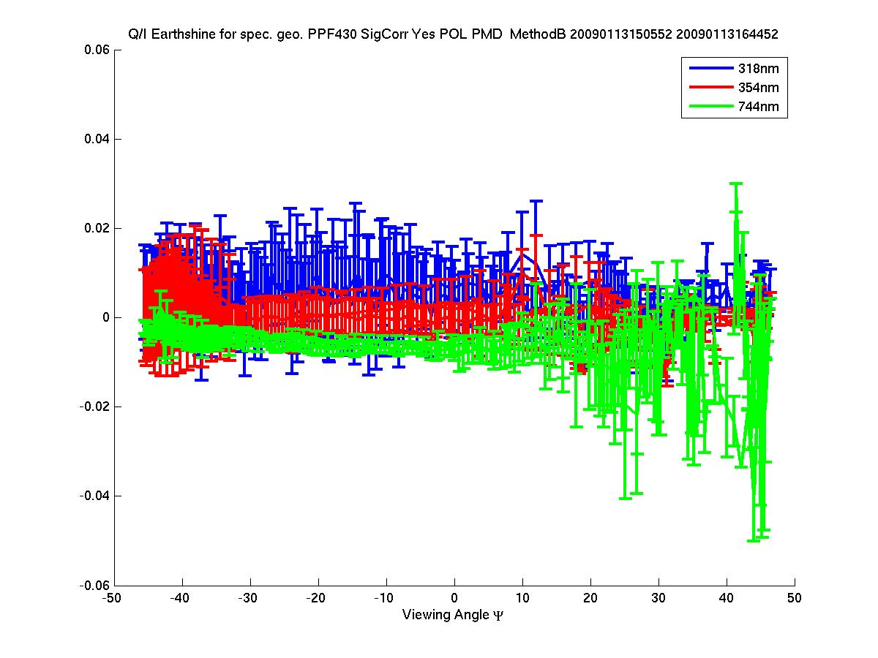
Quality of Polarisation Correction / Stokes fractions
Scan-angle + Instrument degradation + C-shape correction – Results
Stokes fraction
for special geometry
Online correction
Starting with PPF 4.3
August 2009

Slide 27
Open issues
...predominantly on key-data
1) Individual absolute radiometric calibration for PMDs both for Earth and Sun
Note, the Stokes fraction quality is not affected by this because they are derived from improved (see before) key-data related to the P/S ratio!
2) Angular dependence of the diffuser reflectivity for the solar irradiance radiometric response
3) Observed Slit-function changes (both on ground and in-orbit)

Slide 28
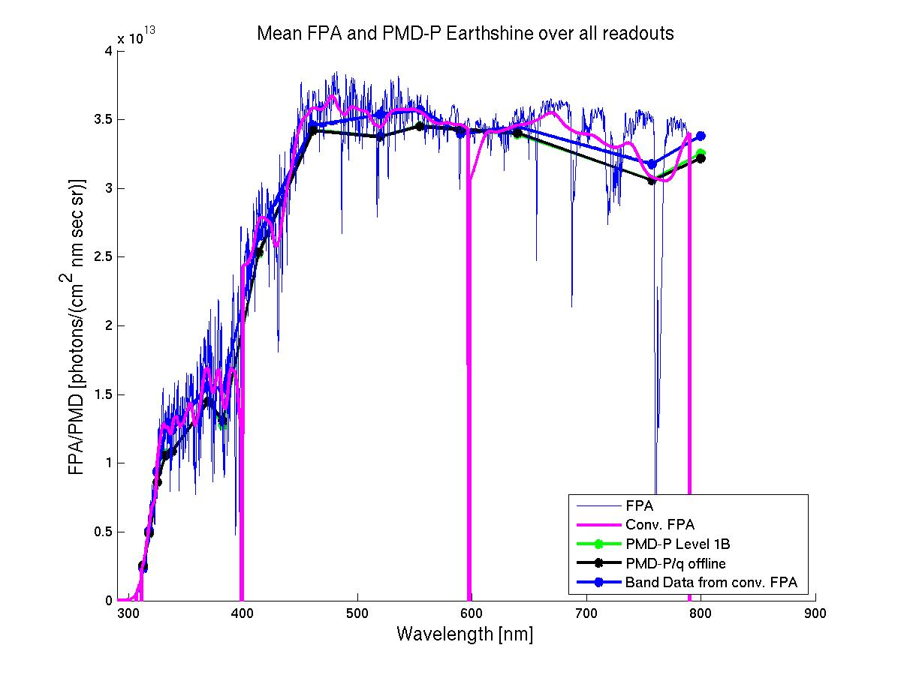
New PPF 5.?: Calibration of PMD signals
Comparison FPA vs PMD for Earthshine

Slide 29
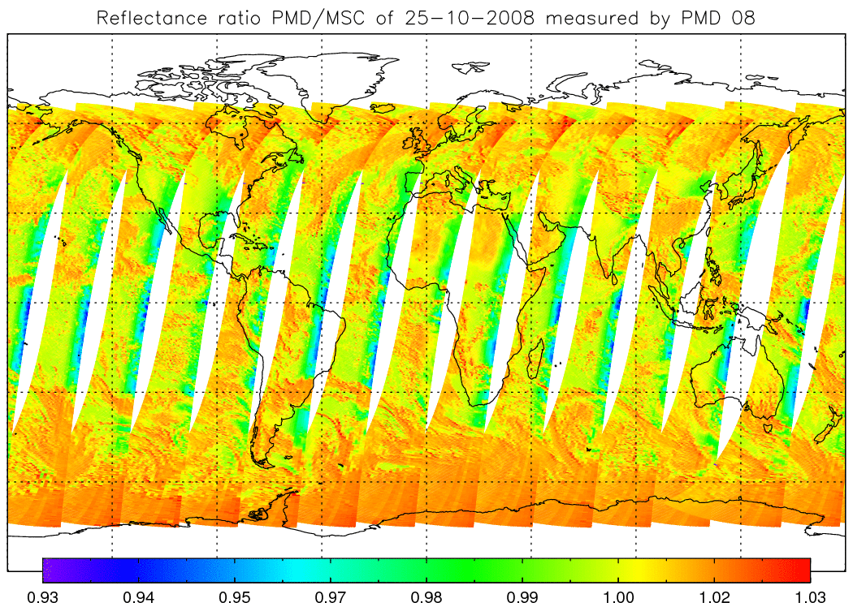
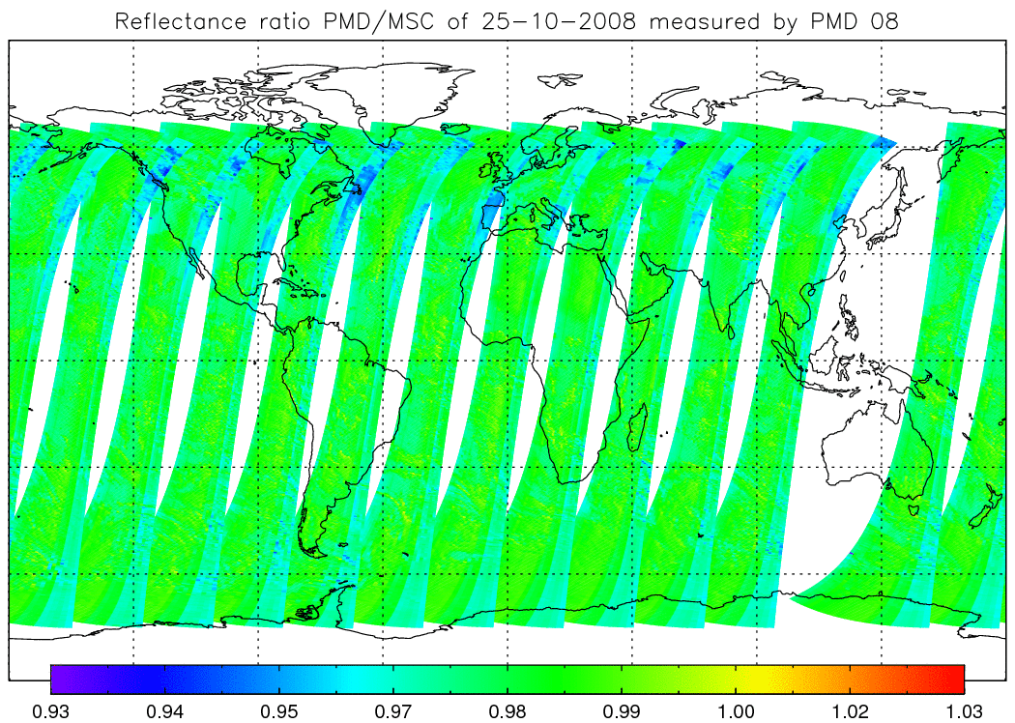
New PPF 5.?: Calibration of PMD signals
Comparison FPA vs PMD for Earthshine
First improvement: Update of key-data for angular dependence radiometric signal (κ)
Ratio PMD-P/FPA
Ratio PMD-P/FPA
Tilstra, 2011, KNMI
Old situation (current PPFs):
κ from FPAs is also used for PMDs
New situation (offline test PPF):
Dedicated κ for PMDs as provided by TNO is used

Slide 30
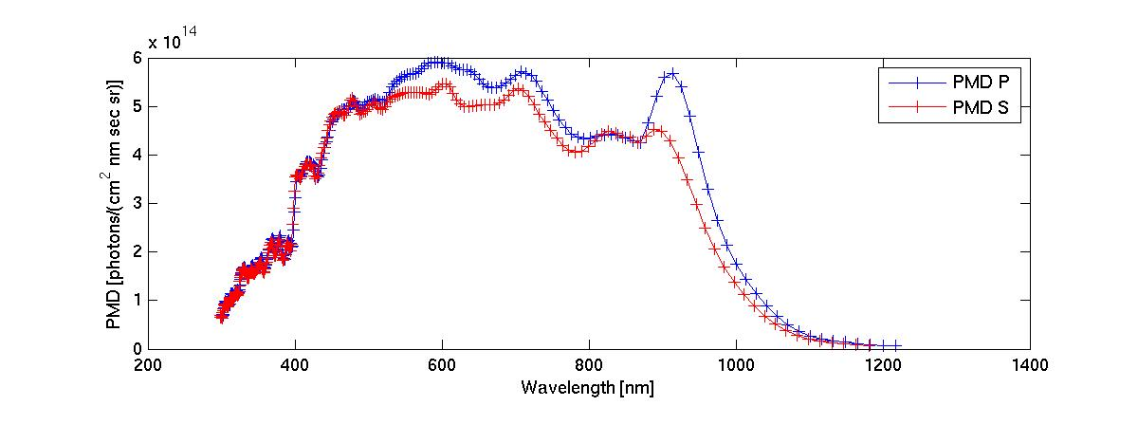
New PPF 5.?: Calibration of PMD signals
Comparison FPA vs PMD for solar measurements
Which one is correct?
December 2006 – First solar measurement

Slide 31
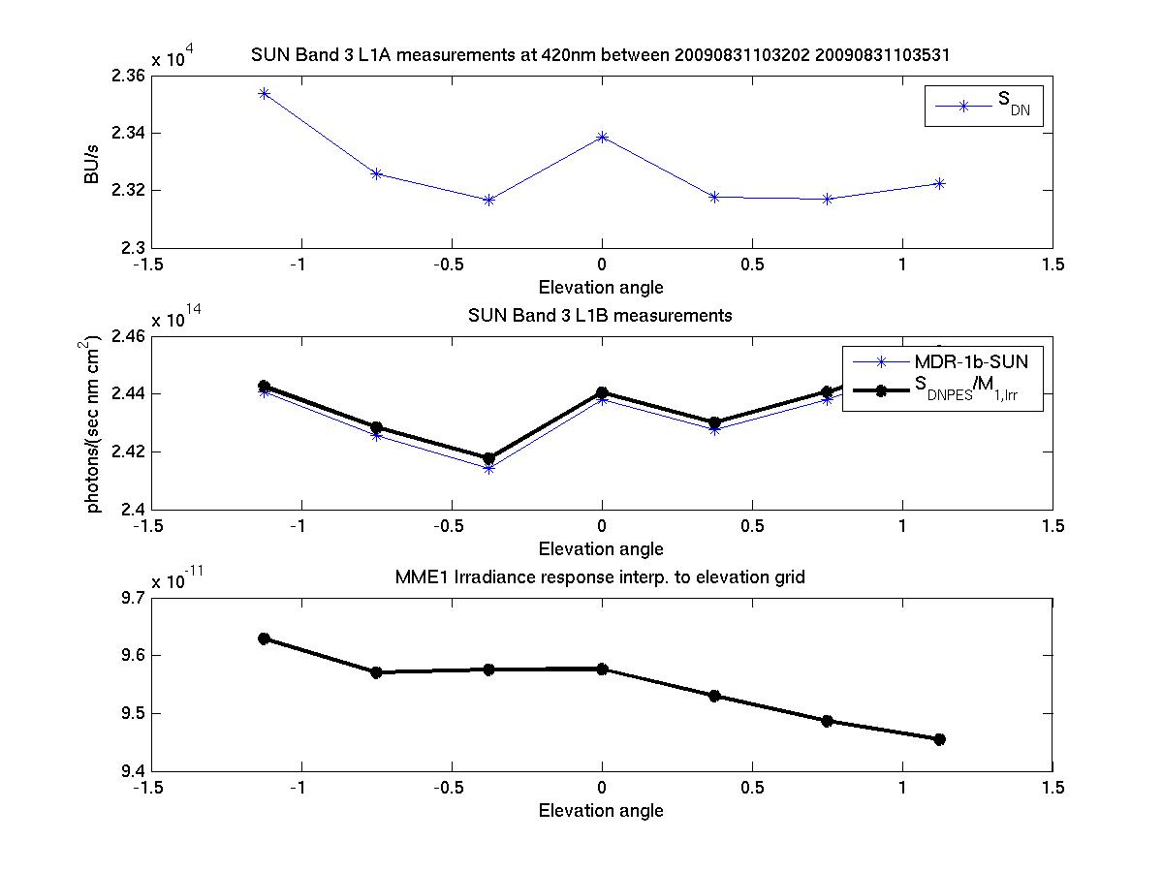
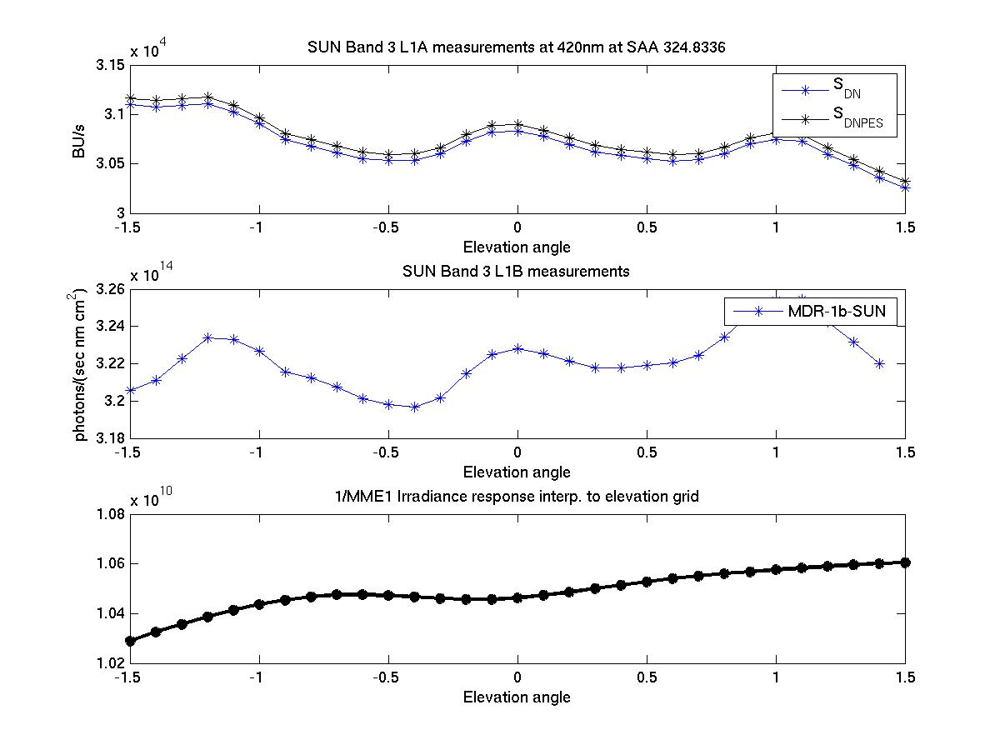
AIRR (Angular dependence for Solar Measurements)
Comparison between current key-data and high res. elevation angle grid
Band 3 solar signals at 420 nm
raw
calibrated
key-data
Solar Elevation angle
Solar Elevation angle
Key-data – angle resolution
Offline – increased angular resolution

Slide 32
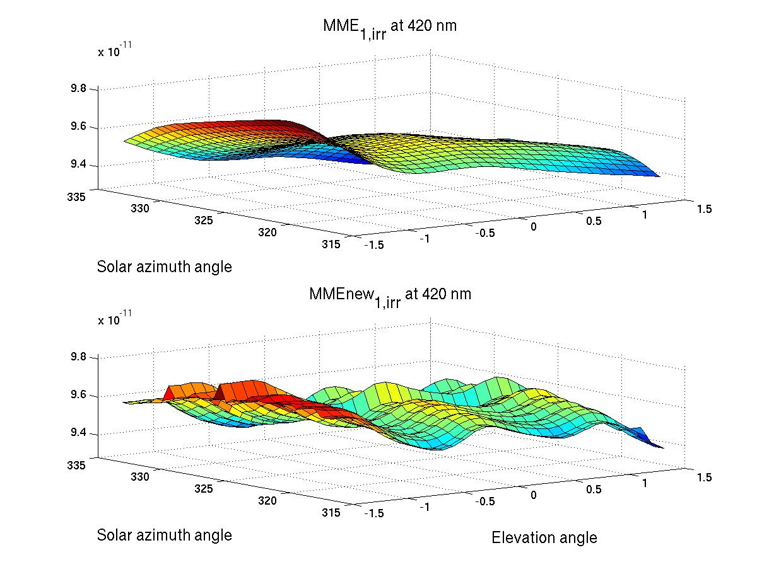
Improved AIRR measurements for FM-2
In-flight data modelled AIRR (one year of data from 2007)
SAA: 0.5 resolution (317 to 333)
Elevation: 0.1 resolution (-1.5 to 1.5)
FM3 key-data
In-flight data

Slide 33
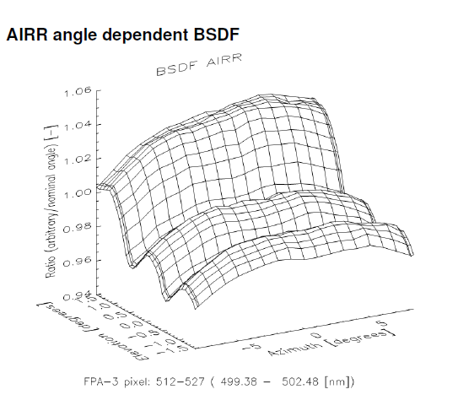
Improved AIRR measurements for FM-2
TNO FM2 delta calibration campaign (Kenter et al.)
SAA: 0.5 resolution (317 to 333)
Elevation: 0.1 resolution (-1.5 to 1.5)
Similar to L1-processor angle fine-grid as defined in initialisation file!
FM2 Metop/B
Calibration campaign result

Slide 34
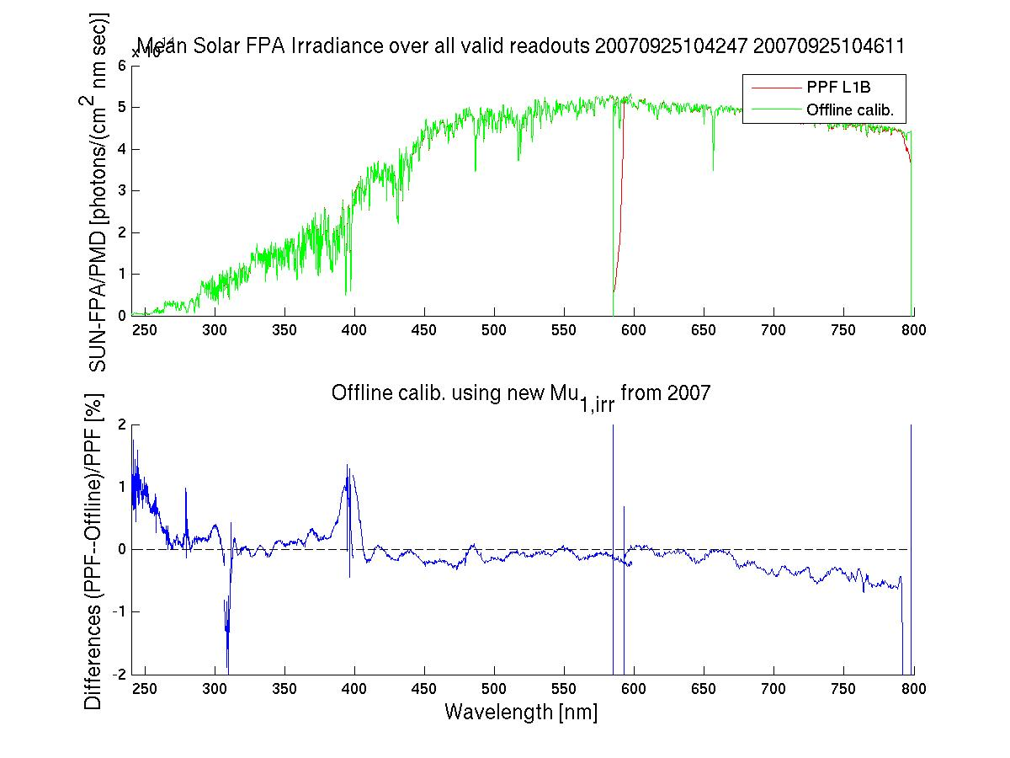
AIRR
Application of modelled AIRR (de-trended) to real data
25th Sep
2007

Slide 35
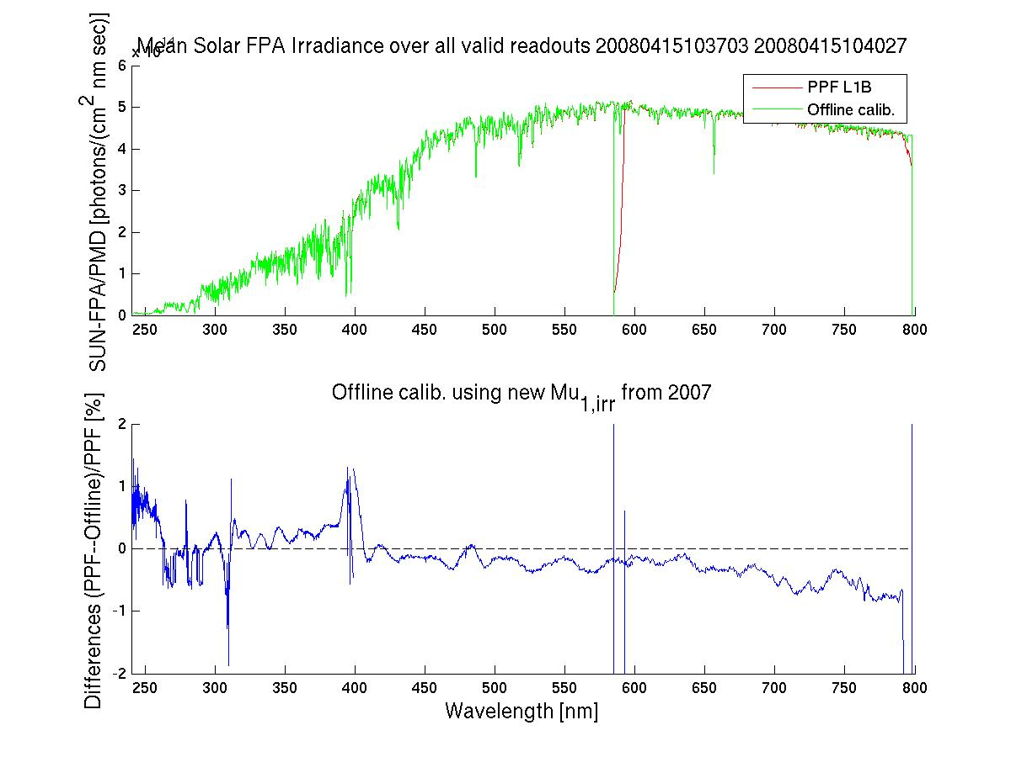
AIRR
Application of modelled AIRR (de-trended) to real data
15th April
2008

Slide 36
Ongoing Activities
Degradation assessment level 0 and 1 by ESA/EUM/Galileo/TNO “tiger team”
  Initiated in September 2010. Final report expected for summer 201
Degradation assessment of level 2 by IUP Bremen
  Final report expected October 2011.
  Additional investigations on “noise” and solar calibration with EUMETSAT.
TNO delta calibration of FM-2 (Metop-B).
  Contribution to degradation assessment team (via FM-2 throughput tests)
  -> so far inconclusive (partly due to measurement problems)
  Update of FM3 key-data following in-orbit experience
FM3 (Metop-A) in-flight key-data assessment
GOME-2/AVHRR inter-calibration (GSICS)

Slide 37
Ongoing Activities
Reprocessing campaign R2 for level 1 data 2007 to 2010
  Start in April 2011 (data upload to EUMETSAT Data Centre Oct. 2011)
  Derivation of offline degradation characterisation matrix
Launch preparation Metop-B
  SIOV and Cal/Val commissioning phase planning started
Exploitation of additional PMD data for aerosol and ozone retrievals
  PMD calibration: evaluation by KNMI (Tilstra et al.)
  Investigations at EUM on applying Stokes fraction correction scheme for radiometric calibration of PMD
  Start of multi-sensor (GOME-2, AVHRR, IASI) aerosol retrieval development work at EUMETSAT (Grzegorski, Poli)
Stray-light investigations
  V-Lidort has been implemented at EUMETSAT
Etalon correction
  Evaluation of the accuracy of the ETALON correction especially after 2nd throughput test – seems to be good

Slide 38
The end

Slide 39
Metop-B Launch / IOV / Level 1 commissioning
SIOV
Level 1B Commissioning
Commissioning
Pre-operational 1B data
First SUN L+39 7th May
2nd Monthly CAL sequence L+48
16th May
Launch 2nd April
1st Monthly CAL sequence L+41
9th May
Start of release of data to ops users / beta users (on request)
August
Start of release of data to all users
End December
April
May
June
July
December

Slide 40
Metop-A & Metop-B Tandem Operations #1
Constraints
  The orbits for all Metop satellites are essentially the same.
  Mean Local Solar Time (MLST) of the descending node of 9:30, the same semi-major axis, inclination, eccentricity and argument of perigee. Also the tolerances for the MLST of 2 min. and for the ground track of 5 km driven by some of the payload instruments have to be the same
  The duration of an orbit is approximately 101.4 min
  The full repeat cycle is 29 days, after which the ground track of a given satellite is repeated
  Within these orbit-related constraints, flexibility exists for the relative separation in time of the Metop satellites, i.e. the phasing.
  The phasing translates into a shift of the respective ground tracks of consecutive orbits by the two satellites.
  This shift of the ground track between consecutive orbits would be maximised for a phasing by half an orbit (~ 51 min.) being about 1400 km at the equator.
  Phasing baseline has an exact value 48.93 minutes

Slide 41
Metop-A & Metop-B Tandem Operations #2
GOME-2 Operations
  During tandem operations we propose to operate both GOME-2 instruments with 960km swath to reduce the ground pixel size by a factor of two whilst retaining effectively the same coverage
  Data will be temporally separated by 48.93 mins
  Data from both satellite/instruments will be interleaved
  Operating at full 1920km swath would mean overlapping swaths
  Could be used for dedicated cross-calibration activities?

Slide 42
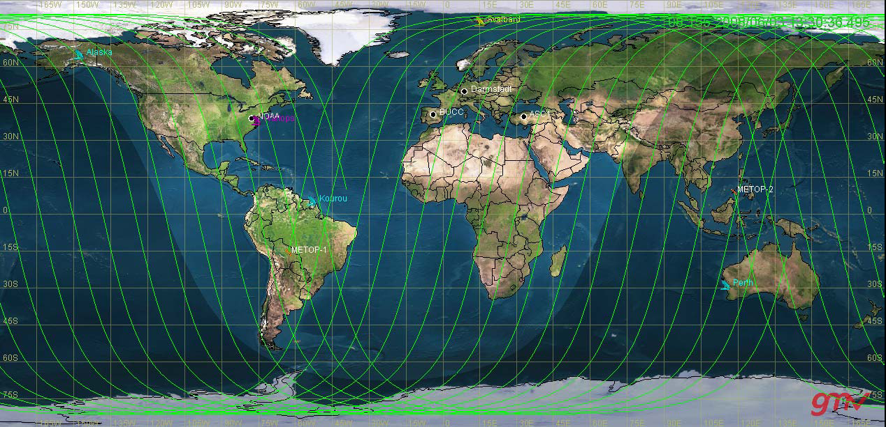
Metop-A & Metop-B Tandem Operations #3 (for information only)

Slide 43
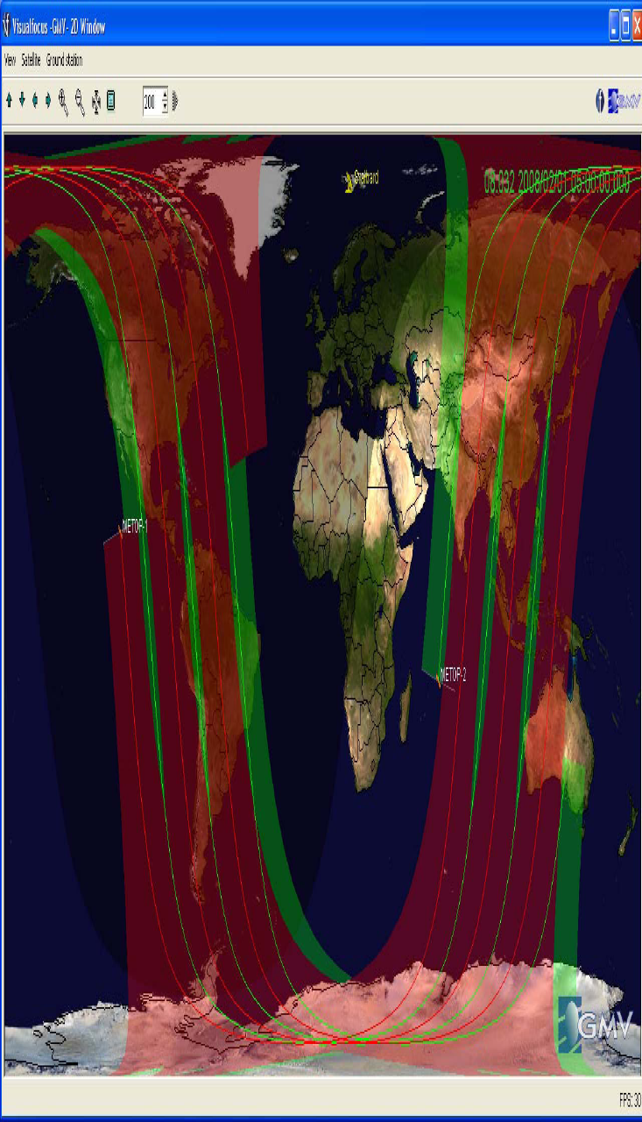
Metop-A & Metop-B Tandem Operations #4 (for information only)

Slide 44
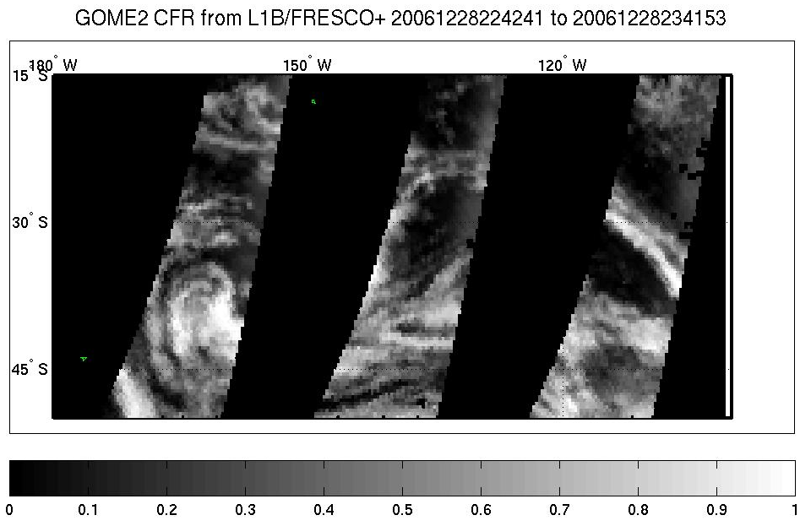
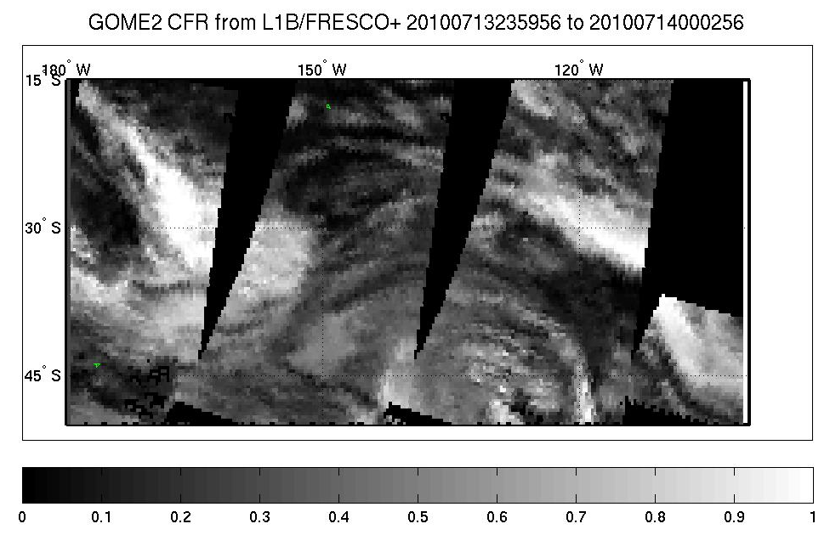
Metop-A & Metop-B Tandem Operations #5 (for information only)
NOT 960
NOT 1920
960 km swath, 24 across pixel, ~40x40 km2
Total coverage: 2 days Metop-A/B
1920 km swath, 24 across pixel, ~40x80 km2
Total coverage: 2 days Metop-A
1 day Metop-A/B

Slide 45
Metop-A & Metop-B Tandem Operations #6 (for information only)
Proposed Timeline
  Launch at date “L”
  Initial operations with a 1920km swath
    Commissioning of Metop-B including initial validation of level 1b products “L+4”
    Initial validation of level 2 products from Metop-B “L+6”
    Cross-validation of Metop-A and Metop-B level 1b and level 2 data products “L+8”
    Decision point for operation of both Metop-A and Metop-B with 960km swath
  Data from both satellite/instruments will be interleaved
  Test period of two(?) months with a 960km swath width
    Validation of level 1b and 2 products from Metop-A and Metop-B with 960km swath
    Final decision point for operation of both Metop-A and Metop-B with 960km swath

Slide 46
Summary degradation rate for selected wavelengths
Before 2nd throughput test (Sep. 2009)
Channel (wavelength) | WLS | SMR | SLS | LED
1 @ 311 nm | -22 %/year | -18 %/year | -16 %/year | -9 %/year
2 @ 420 nm | -13 %/year | -11%/year | -12 %/year | -8 %/year
3 @ 541 nm | -6 %/year | -5 %/year | -7 %/year | -8 %/year
4 @ 754 nm | -6 %/year | -3 %/year | -5 %/year | -8 %/year
To be updated with post 2nd TTT numbers!!!

Slide 47
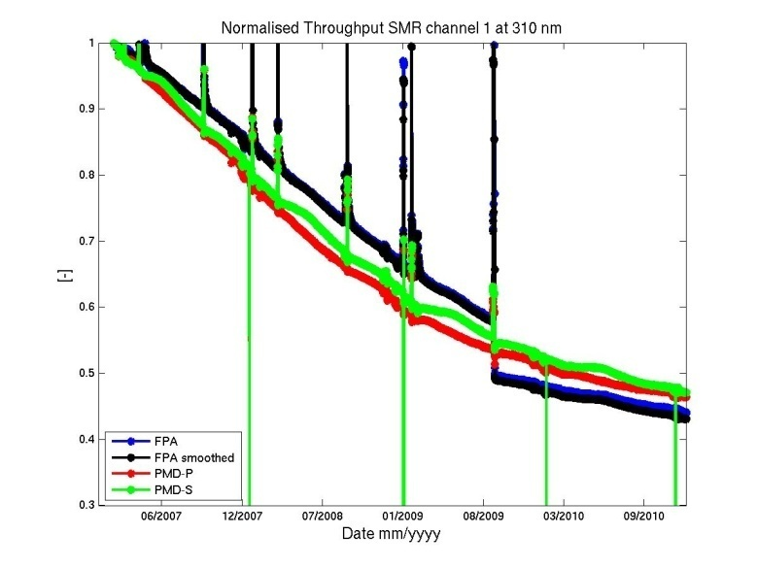
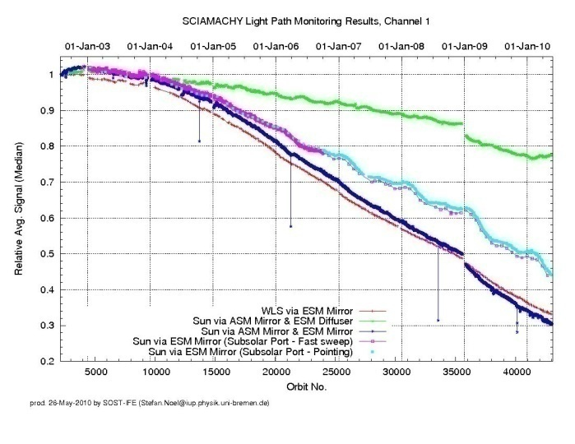
Summary of observed degradation features (I)
Long-term degradation
Long-term degradation GOME-2, SCIAMACHY, GOME-1
GOME-2
SCIAMACHY
GOME-1
All three instruments degrade differently. However, within the current lifetime of GOME-2 (~16% loss/year in UV), GOME-1 (~7% loss/year in UV) and SCIAMACHY (~6% loss/year in UV) were degrading according to their expected mirror degradation in the UV part of the spectrum.
The estimated contribution from the scan mirror is approx. 15 to 20% for GOME-2 around 300 nm. The total degradation is 55% at 311 nm with 35 to 40% of unknown origin.

Slide 48
Summary of observed degradation features (II)
Long-term degradation
Throughput Evolution
Comparison to GOME-1

Slide 49
Reflectivity offset at 331 nm
NOAA results by Larry Flynn (41st GSAG)
Version 8 331-nm Reflectivity for a box in the Equatorial Pacific.
The unadjusted values in the top plot reach a minimum of 8% (higher than expected for the open ocean) for the Nadir scan position.
A single calibration adjustment lowers this value to 4% and also flattens out the scan dependence for West-viewing positions. The East-viewing results are not as good.
|Lat|<5
Lon<-100
EAST
WEST

