Slide 1
Report on NOAA and Satellite Measurements of Total Ozone and Ozone Profiles
L. Flynn
(with contributions from many)
NOAA/NESDIS/STAR
June 21-22 ACC-7
Columbia MD
Notes:
Report on NOAA Satellite Measurements of Total Ozone and Ozone Profiles
Total Ozone and GEOSS; Paths forward for Total Ozone ECVs

Slide 2
Internal Activities
Continuing V8 Profile/Total Ozone processing and reprocessing of NOAA-16, -17, -18, -19 SBUV/2
Continuing NRT V8 Total Ozone processing of Metop-A GOME-2 (No current reprocessing.)
Preparing for NRT and Cal/Val for OMPS on NPP (Launch 10/2011)
Developing V8 Profile/Total Ozone reprocessing for NPP OMPS (Launch October 2011)
ICVS Monitoring under Products Demonstration at
  http://www.star.nesdis.noaa.gov/smcd/spb/icvs/

Slide 3
External Interactions
Working with NASA/GSFC on V8 SBUV(/2) CDR
Working with CMA on V8 for FY-3A & -3B TOU & SBUS
Working with EuMetSat & O3SAF on GOME-2
Working with NASA, KNMI and FMI on OMI
Working with NASA NPP ST on OMPS Limb Profiler
Provide data and consult on SBUV/2 results for 2000-2010 comparisons to European satellite measurement ozone profiles
Various GSICS activities
https://gsics.nesdis.noaa.gov/wiki/Home
Daily Ozone Maps at EC
http://exp-studies.tor.ec.gc.ca/cgi-bin/clf2/dailyMaps

Slide 4
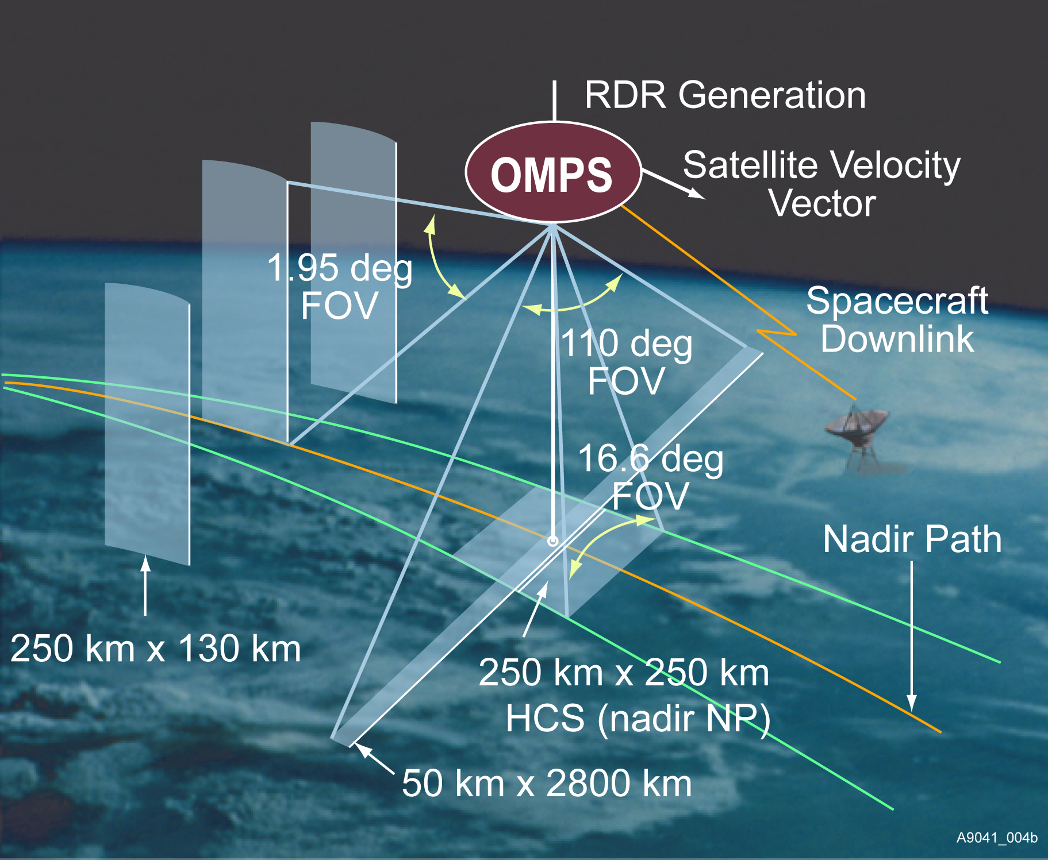
OMPS Instrument Design NPP Launch October 2011
http://www.youtube.com/watch?v=LLqJdtOzFv8
Total Ozone Mapper
UV Backscatter, grating spectrometer, 2-D CCD
TOMS, SBUV(/2), GOME(-2), OMI, SCIAMACHY
110 deg. cross track, 300 to 380 nm spectral, 1.1nm FWHM bandpass
Nadir Profiler
UV Backscatter, grating spectrometer, 2-D CCD
SBUV(/2), GOME(-2), SCIAMACHY, OMI
Nadir view, 250 km cross track, 270 to 310 nm spectral, 1.1 nm FWHM bandpass
Limb Profiler
UV/Visible Limb Scatter, prism, 2-D CCD array
SOLSE/LORE, OSIRIS, SAGE III, SCIAMACHY
Three 100-KM vertical slits, 290 to 1000 nm spectral
The calibration concept
uses working and
reference solar diffusers.
Diffuser
Entrance Aperture
Entrance Aperture
Earth
Sun
Notes:
Updated schematic from Scott Asbury.
Some changes in numbers (2.23 degrees to 1.9 degrees) and position of components.
Old instrument picture.
Heritage instruments are providing product development, and algorithm and application testing.
For example, SAGE III limb measurements pointing
For example, OMI Products into assimilation systems
CCD Charge-Coupled Device
TOMS Total Ozone Mapping Spectrometer
SBUV Solar Backscatter Ultraviolet instrument
GOME Global Ozone Monitoring Experiment
OMI Ozone Monitoring Instrument
SCIAMACHY SCanning Imaging Absorption spectroMeter for Atmospheric CartograpHY
SOLSE Shuttle Ozone Limb Sounding Experiment
LORE Limb Ozone Retrieval Experiment
OSIRIS Optical Spectrograph and InfraRed Imager System
SAGE Stratospheric Aerosol and Gas Experiment
OMPS` Ozone Mapping and Profiler Suite

Slide 5
Ozone Sensitivity of OMPS Limb Profiler 600 nm channel
Altitude in KM
% Radiance change / % Ozone change (in 1 KM Layers)

Slide 6
V8 Total Ozone Algorithm
Uses B-Pair (318 Ozone, 331 or 340 Reflectivity)
  Absolute Calibration of Reflectivity can be checked by vicarious means
  Absolute calibration of ozone can be checked by using D-Pair (308 and 313), and comparisons to ground-based and Satellite DOAS results
Adjustments for profile shape (A-Pair) and Aerosols
RT Look-Up Tables use Brion-Daumont-Malicet cross sections and include Ring corrections
Standard profiles by latitude and total ozone
Output contains residuals, efficiencies, and sensitivities.

Slide 7
V8 Ozone Profile Algorithm
Maximum likelihood retrieval using wavelengths from 250 to 318 nm (reflectivity from 340 nm)
  Absolute Calibration of Reflectivity channels is checked by vicarious means
  Absolute calibration of ozone is checked/validated by Ascending/Descending comparisons, ground-based comparisons, and inter-satellite no-local-time comparisons
A Priori profiles by latitude and month (LLM)
RT Look-Up Tables use Brion-Daumont-Malicet cross sections and include Ring corrections
Output contains A Priori, residuals, Averaging Kernels, Measurement Contributions, and Jacobians.

Slide 8
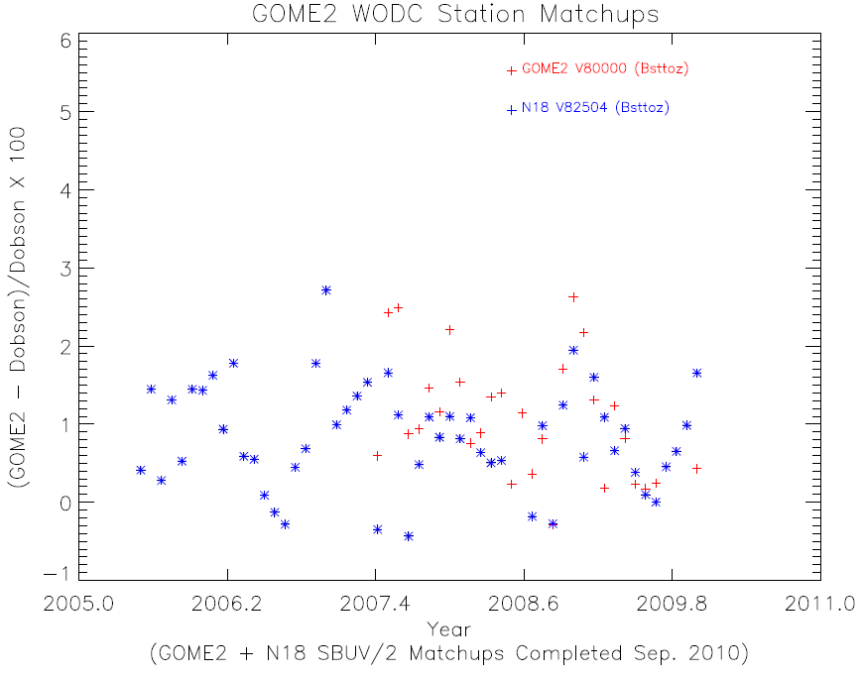

Slide 9
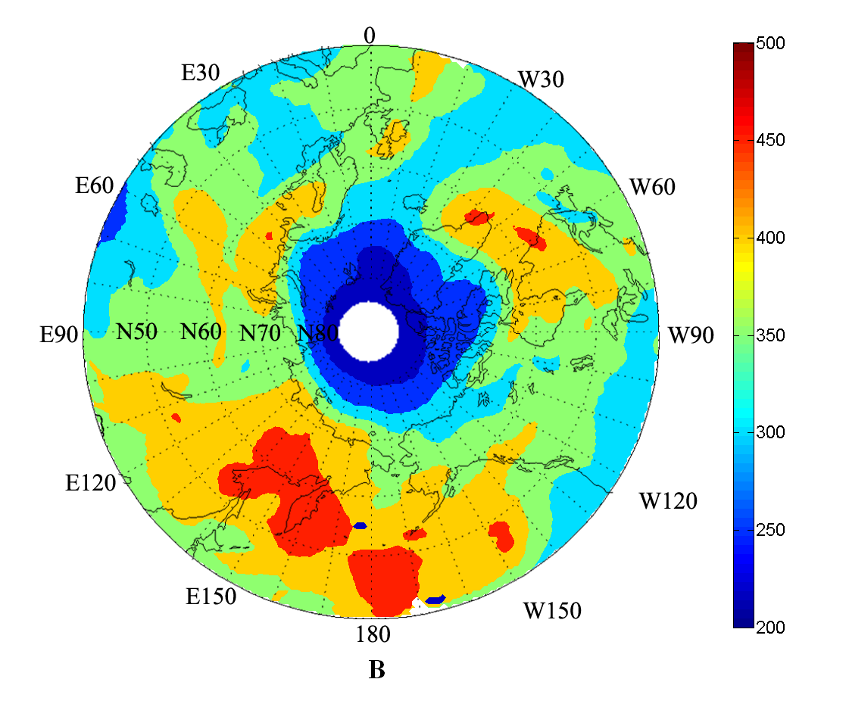
Data from FY-3A TOU for 2011 3/14
Huang F-X and Wang W-H CMA/NSMC

Slide 10
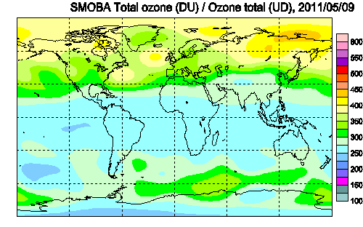
SBUV/2 + HIRS Polar

Slide 11
