Slide 1
Total Ozone and GEOSS; Paths forward for Total Ozone ECVs
Consistency, consistency, consistency*
Retrievals
  V8 TOZ (TOMS, SBUV/2, OMI, OMPS, GOME-2, TOU, SBUS, SCIA)
  DOAS (Compare to V8 for OMI and GOME-2)
  Optimal Estimation Profiles (V8, etc.)
Inputs/Intermediate Products
  Cross sections and temperature dependence
  Ozone Profile Climatologies / Standard Profiles
  Surface, clouds, snow/ice and reflectivity (cloud fraction, cloud top pressure)
  Aerosol index
Output
  A Priori Profile Shapes, Climatology, Efficiency (Averaging kernels and sensitivities)
Long-term Stability
  Solar diffusers, On-board lamps
  Vicarious Reflectivity calibration: Ice, Eq. Pacific, Libyan Desert
  D-Pair, Profile Totals
  Ascending/Descending
  No-local-time Differences
Validation with GB Dobson and Brewer
*Call me a hobgoblin.

Slide 2
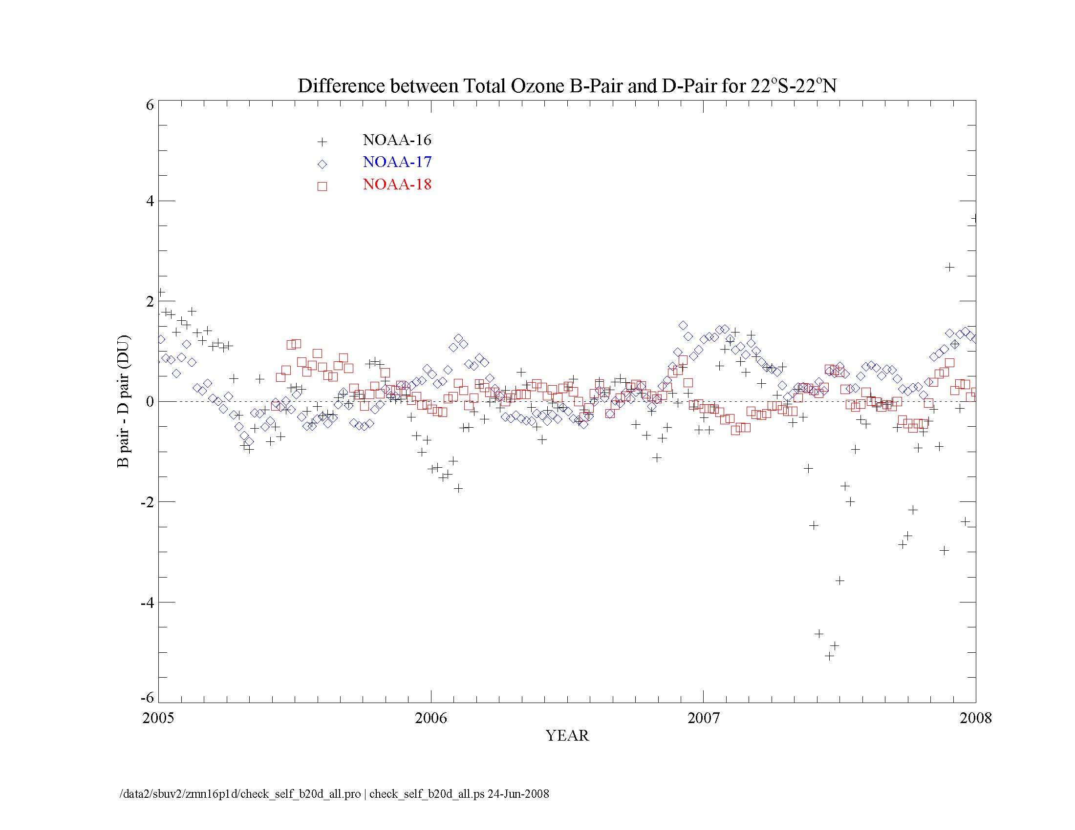
Reprocessed SBUV/2 Total Ozone, B/D Pair difference 22S-22N
2 DU
YEAR
Notes:
Attached is a figure for the comparison of SBUV/2 V8 total ozone between the best total ozone and the D-pair total ozone. The data are from the current calibrations. Therefore, N18 shows no apparent step in Jan 2007. The seasonal variations in N16 are also less prominent. Note that N16 orbit has drifted close to terminator in 2007, the D-pair is not much useful for the soft calibration. I think it is fine to show audience how the D-pair can be used to make the soft calibration even though we have been using the profile total to make the pair adjustments. Most important, we are fortunately able to avoid using the pair comparison for time dependence in the calibration of the latest SBUV/2 instruments.
L.-K. Huang

Slide 3
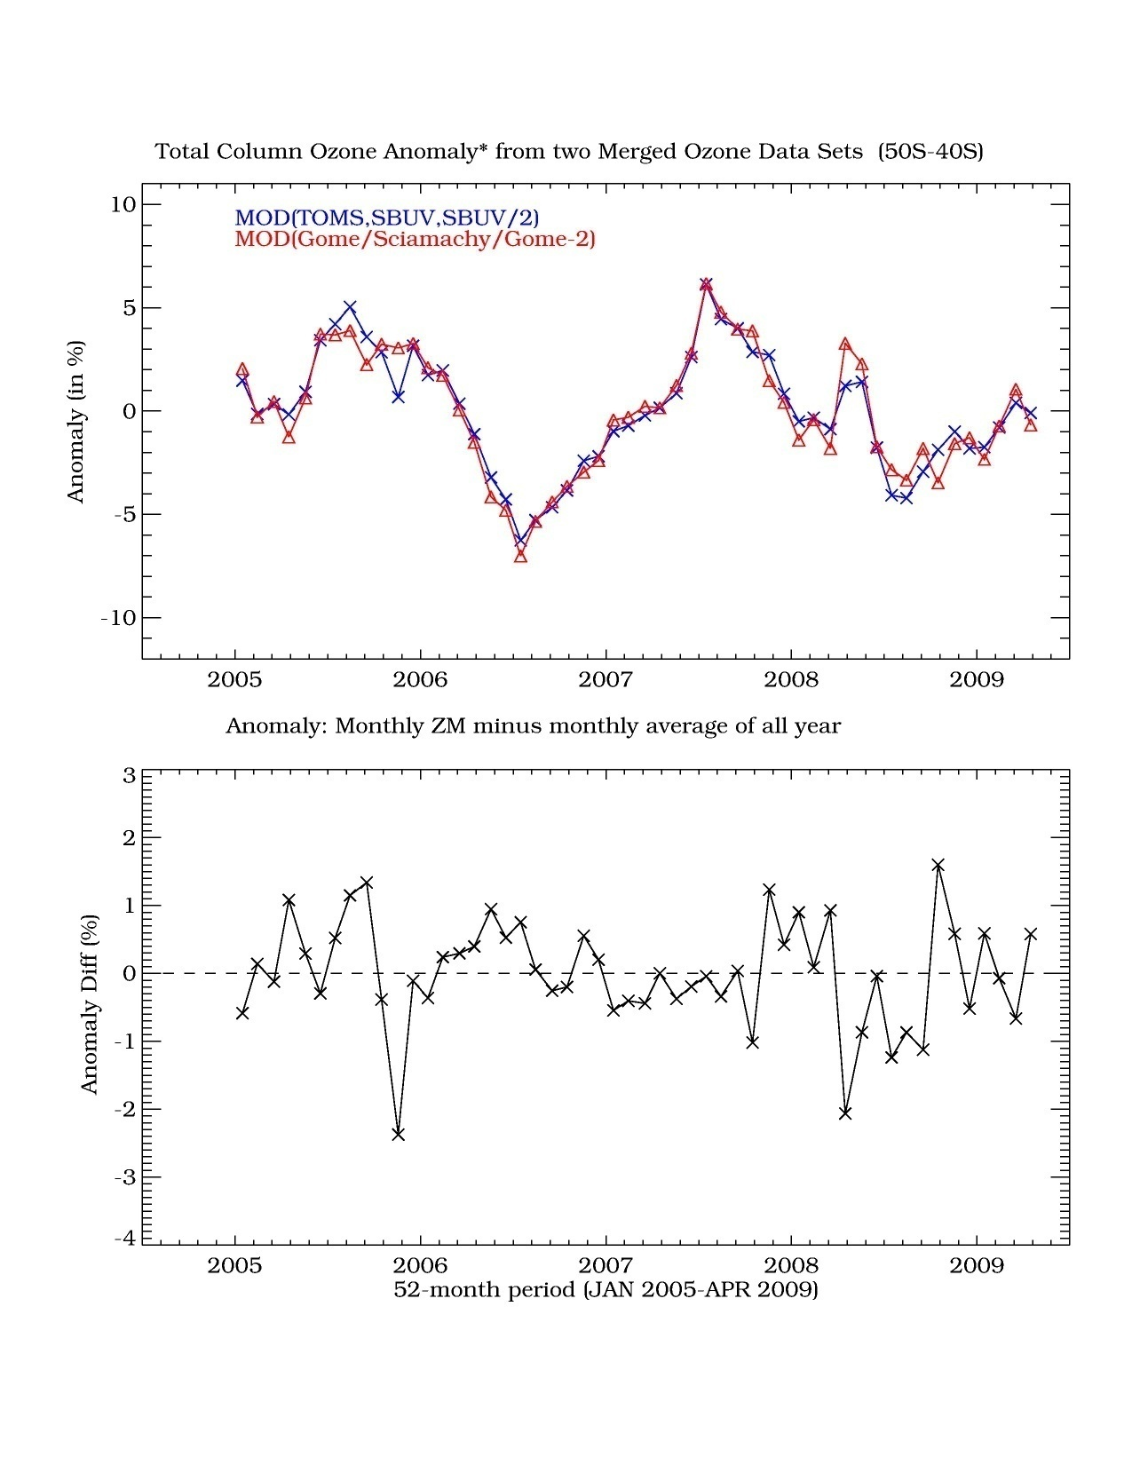
Recent Results
by Er-woon Chiou, ADNET for NASA

Slide 4
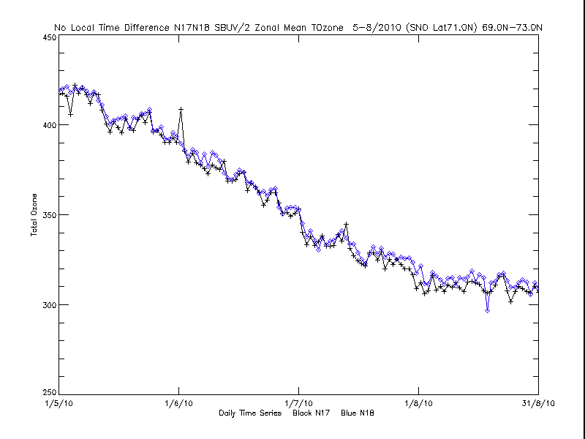
No Local Time Difference Comparisons, NOAA-17 SBUV/2 & NOAA-18 SBUV/2

Slide 5
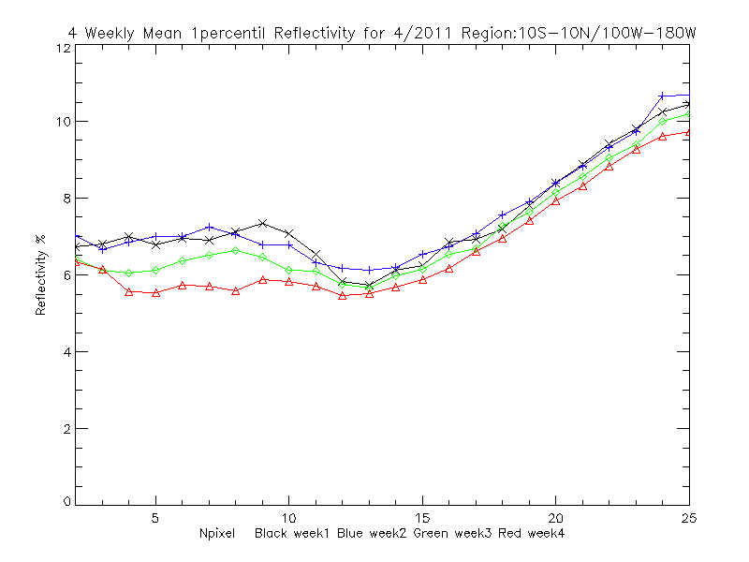
Weekly 1-percentile Reflectivity for Equatorial Pacific Box

Slide 6
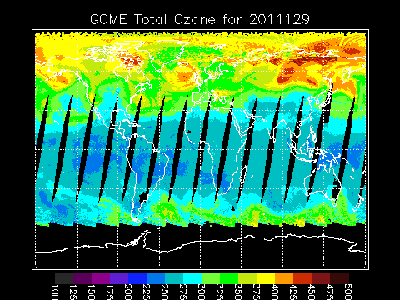
V8 TOZ from MetOp-A GOME-2

Slide 7
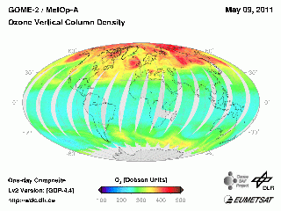
O3SAF DOAS Total Ozone from MetOp-A GOME-2

Slide 8
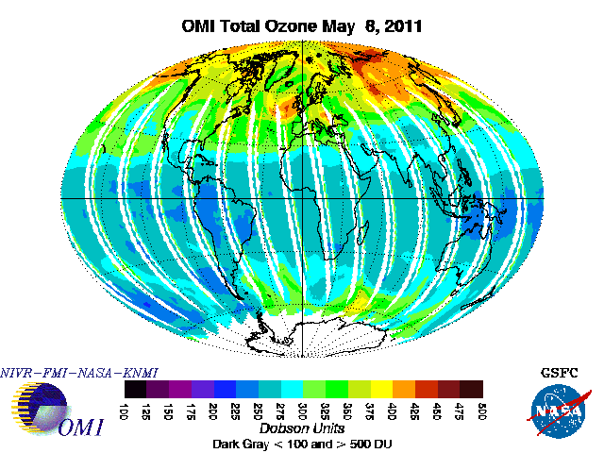
V8.6 Total Ozone EOS Aura OMI

Slide 9
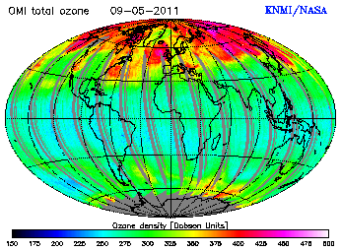
DOAS Total Ozone EOS Aura OMI

Slide 10
Background on some NOAA Atmospheric Composition Activities
L.Flynn

Slide 11
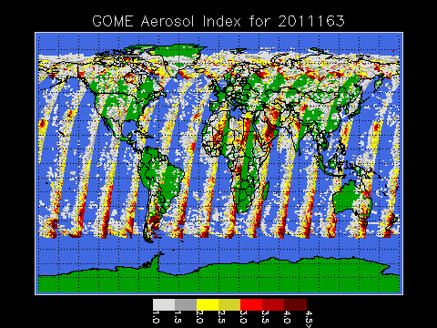
Aerosol Index
The Aerosol Index (360 nm residual when reflectivity is calculated from the 331 nm measurement) varies with viewing and solar angles and surface/cloud reflectivity.

Slide 12
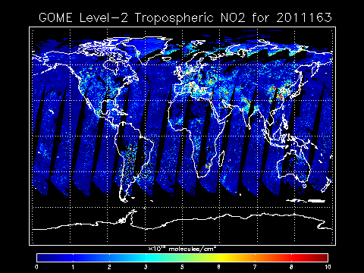
NO2 Products http://www.osdpd.noaa.gov/ml/air/gome.html

Slide 13
first agenda outline:
- first half day: brief Space Agency Reports (max. 3 slides or just oral
reporting on the main activities during the last year) and status of ongoing
ACC activities (including the final Air Quality ACC Position Paper, Volcanic
Ash project, GCOS Implementation Plan review, new ACC/IPCC project ...)
- second half day: review of existing total ozone records per instrument
(including algorithm status, advantage/disadvantage of the different sensors,
geophysical validation, error characterisation, still needed/planned quality
improvements)
- third half day: how to combine the different satellite data sets (including
the review of different techniques, what do climate modeller really need,
lessons learned from previous assessment reports, time-scale of ongoing
projects ...)
- final 2 hours: definition of concrete actions to be performed by early 2013
to create a total ozone climate record

