Slide 1
Quality of SBUV & TOMS Total Ozone Datasets
Pawan K Bhartia¹, Steven Taylor³, Matthew DeLand³ Richard McPeters¹, Lawrence Flynn²
¹NASA Goddard Space Flight Center, Greenbelt, Maryland, USA
²NOAA/NESDIS, Camp Springs, Maryland, USA
³Science Systems & Applications Inc (SSAI), Lanham, Maryland, , USA
CEOS Atm Composition Constellation Meeting, Columbia, Maryland
June 21-22, 2011

Slide 2
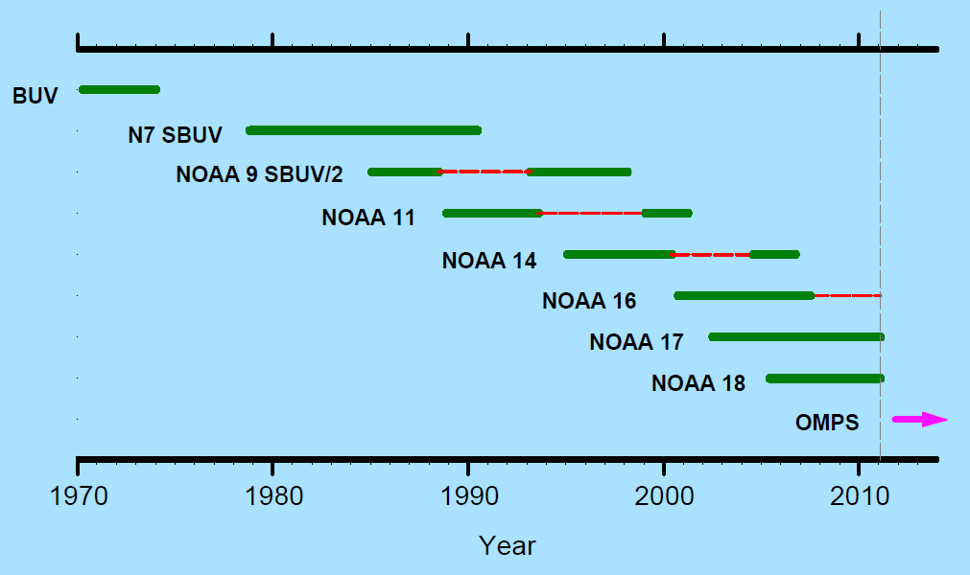
9 SBUV-like instruments have flown since April 1970. NOAA 19, launched in Feb, 2009, not shown. Red dashes indicate terminator orbit.

Slide 3
SBUV Instruments- Key Features
Contains double monochromator, single PMT detector, and depolarizer
  Single optical path covers 250-340 nm with low straylight and high S/N. Optical degradation tends to be roughly linear with λ.
Chopper wheel with up/down counter (except N4/BUV).
  no charged particle effect down to 250 nm
Nimbus-7 SBUV operating modes (others vary)
  Nadir measurements only
  Normal mode: steps thru 12 discrete λs in 32 sec
  FOV: 200 km x 200 km
  Sweep mode: Scans thru 180-400 nm with 5 samples/bandpass. Weekly for Sun, monthly for Earth.

Slide 4
Calibration History
Nimbus 4/BUV: No solar meas, no sweep data
  Radiance corrected using Hohenp/Payerne sonde data
Nimbus 7/SBUV: “Day 1” Solar only
  Radiance drift corrected using “soft” calibration techniques
NOAA 9/11/14 SBUV-2: Limited solar data
  Many instrument problems. Total O₃ is relatively unaffected.
  Absolute calibration tied to Shuttle SBUV (SSBUV).
NOAA 16/17/18/19: Calibrated solar diffuser
  Absolute calibration tied to NOAA 17/SBUV-2

Slide 5
Total O₃ Algorithms
Wavelength pair method (e.g., TOMS)
  TOMS V8 mostly uses 317.5/331.2 nm pair (B-pr)
  Radiance ratio varies by 0.17%/DU @30˚ SZA
  B-pr becomes sensitive to upper strat* climatology at SZA>70˚
Spectral fitting methods (e.g., DOAS)
  Standard algorithm uses 325-335 nm window
  Differential signal varies by 0.035%/DU @30˚ SZA
  Algorithm becomes sensitive to upper strat* climatology at SZA>77˚.
By integration of retrieved O₃ profile (e.g., SBUV V8)
  Insensitive to upper strat* climatology
  306 nm radiance varies by 1%/DU @30˚ SZA
* All algorithms have similar sensitivity to trop O₃ climatology

Slide 6
SBUV V8.6 Algorithm
Based on Rodgers’ Optimal Estimation Method
  Algorithm has been optimized to track long-term changes by constructing appropriate covariance matrices.
  Short-term variability is underestimated at large SZA.
Uses variable wavelength window
  Wavelengths significantly contaminated by UV-absorbing aerosols (smoke and desert dust) are not used
  Longest wavelength varies from 302 nm at low sza to 317.5 nm near the terminator. (331 nm is used for reflectivity everywhere.)
Total O₃ estimated by integrating the profile
  Reliable measurements up to 88˚ sza.

Slide 7
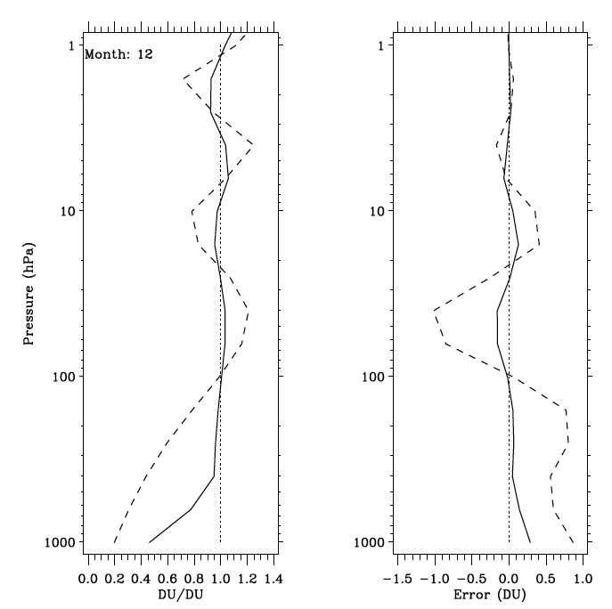
Total O₃ Avg Kernel
Effect of 10% incr in AP
Lat 62.5N, SZA 84˚
Lat 62.5S, SZA 40˚

Slide 8
Soft Calibration Methods
Wavelength independent calibration/drift is determined using ice radiances.
  Results validated using minimum reflectivity of land and water and zonally averaged reflectivities.
Wavelength dependent calibration:
  Key assumption: instrument degradation varies monotonically and roughly linearly with λ.
  Wavelength accuracy monitored using sweep solar data.
  Sweep data has been used to look for any non-monotonic instrumental changes.

Slide 9
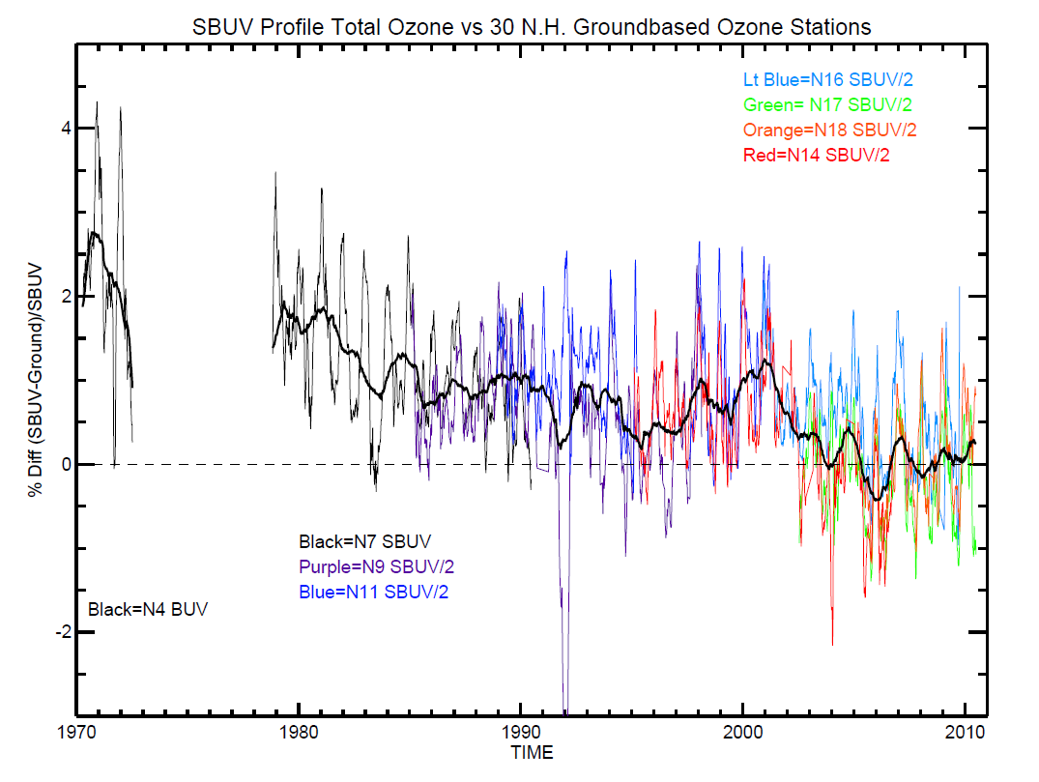
SBUV vs 30 N. Hem. Stations
Nimbus-7 SBUV

Slide 10
Nimbus-7/SBUV Soft calibration
Pair Justification Method (Herman et al.,1991)
  Used D-pr ozone to correct drift in total O₃.
Langley Plot Method (Bhartia et al., 1995)
  Compared data from ascending/descending parts of orbit to check λ-dep calibration errors.
Sweep mode data analysis (Joiner & Bhartia, 1997)
  Compared total O₃ derived from a spectral fitting algorithm with standard processing.
It is unlikely that SBUV drifted by ~2 DU in the first 2-3 years as seen in SBUV/ground stn comparison.

Slide 11
The “D-pair” Method
Key assumption
  SBUV calibration error varies roughly linearly with wavelength over its full 90 nm spectral range.
D-pair total O₃ error estimate
  D-pr (305.8/312.5 nm) radiance ratio is assumed to be known to better than 0.5%.
  D-pr radiance radiance changes by 0.5%/DU at low SZA, has weak dependence on O₃ profile.
  Estimated error in D-pair ozone is <1 DU at low SZA.
D-pr O₃ can be derived at low SZA only.

Slide 12
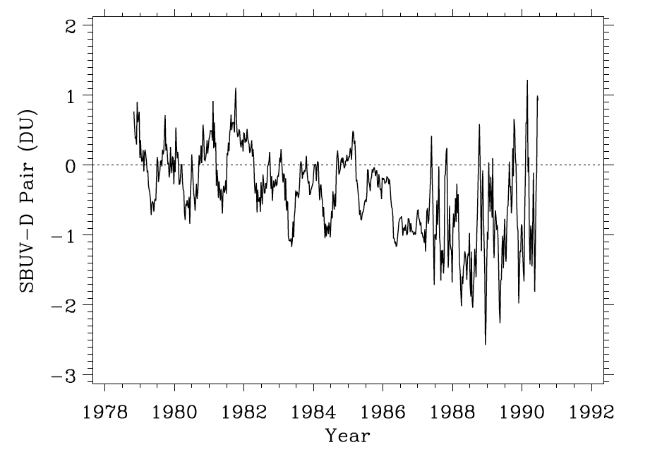
Nimbus-7 SBUV profile and D-pr total O₃ comparison
Lat: 5S- 5N

Slide 13
SBUV Total O₃ Data Quality Summary
Calibration Accuracy:
  1-2 DU for Nimbus-7 & NOAA 16/17/18, 2-3 DU for others
Algorithm Accuracy (not incl O₃ x-section error):
  Short-term: 3 DU (1σ) at low sza, ~5 DU at 88˚ SZA
  Long-term: 0.5 DU (1σ) at low SZA, 1-2 DU at 88˚
  Surface-25 km column has similar accuracy as total O₃.
  Strat column has similar accuracy at SZA>75˚, 2-3 times worse at lower SZAs.
Effect of Volcanic Aerosols: TBD but small

Slide 14
TOMS Instruments- Key Features
Single monochromator, single PMT, and depolarizer
Helical scanning mirror: Incidence and reflection angles do not change as the mirror scans
  produces 2600 km swath, 50 x 50 km nadir pixel
Chopper wheel with up & down counter
  eliminates charged particle contamination
Fixed slits sample 6 wavelengths near simultaneously
  less cloud noise than SBUV but more than GOME/OMI.
  Spectral coverage: 312-380 nm for Nimbus-7 & Meteor-3 TOMS (308-360 for EP/TOMS)

Slide 15
TOMS Calibration History
N7/TOMS: Only “day 1” solar measurements used
  -radiance corrected using techniques similar to SBUV
Meteor-3/TOMS: “day 1” solar measurements only
  Calibration uncertainties caused by precessing orbit
  Affected by Mt. Pinatubo aerosols
EP/TOMS: Variety of instrument problems
    Data corrected using NOAA SBUV-2 and ice radiances.
OMI/TOMS: good solar data
  Calibration accuracy; ~3 DU absolute, ~1 DU relative

Slide 16
SBUBV/TOMS Data Quality Comparison
TOMS algorithm is optimized for tracking short-term variability, SBUV for long-term variability.
  Difference is significant only at large SZA.
TOMS is somewhat more sensitive to surface reflectivity, clouds, and UV-absorbing aerosols
  Location dependent errors have been seen in TOMS data.
TOMS monthly mean total O₃ may be 2-3 times less accurate than SBUV.
  The plan is to adjust TOMS & OMI/TOMS calibration to SBUV before reprocessing using Brion et al. O₃ x-section.

Slide 17
Recommendations
Validation/correction of SBUV total O₃ record
  Nimbus/7 SBUV & post-NOAA/16 SBUV-2 data shouldn’t be adjusted to ground-based data. These records are at least as good as ground data.
  Ground data could be used to inter-calibrate Nimbus 4 to Nimbus 7 and to correct NOAA 9/11/14 SBUV-2 record.
  Best way to validate SBUV at SZA>70˚ is to compare partial columns with Limb/occultation and sonde instruments.
Existing TOMS & OMI/TOMS data need to be adjusted to SBUV until a new version is released.
Brewer ZS data should be reprocessed using a satellite-like algorithm.
  Fioletov et al., 2011 algorithm is a good start, but SBUV-like algorithm is needed at large SZA.

Slide 18
References
Herman et al., 1991: A new self-calibration method applied to TOMS and SBUV Backscattered Ultraviolet data to determine long-term global ozone change. J. Geophys. Res., 96, 7531-7545.
Bhartia et al., 1995: Application of the Langley Plot method to the calibration of SBUV instrument on Nimbus-7 satellite. J. Geophys. Res., 100, 2997-3004.
Joiner, J. and P. K. Bhartia, 1997: Accurate determination of total ozone using SBUV continuous spectral scan measurements. J. Geophys. Res.,102, 12,957-12,970.
Fioletov, et al., 2011: New method for deriving total ozone from Brewer zenith sky observations. J. Geophys. Res.,116, D08301, doi:10.1029/2010JD015399.

