Slide 1
NOAA/NESDIS Air Quality Projects and Plans
Current Ongoing work
  NESDIS developing satellite products for various air quality applications (monitoring and forecasting)
  Aerosol and ozone assimilation to improve air quality forecasting
Preparing for future satellite missions by developing algorithms/products
  GOES-R
  JPSS
NASA-NOAA Collaboration
  Transitioned and enhanced IDEA (Infusing satellite Data into Environmental Applications) tool to NOAA
  Adapted NASA OMI trace gas algorithms for GOME-2 at NOAA for operational dissemination of data
  Participation in multiple NASA working groups (e.g., GEO-CAPE)
EPA-NOAA collaboration
  Daily download of NOAA satellite data into EPA’s Remote Sensing Information Gateway (RSIG) for exceptional events monitoring
  Enhancing EPA AIRNow with GOME-2 NO2 data

Slide 2
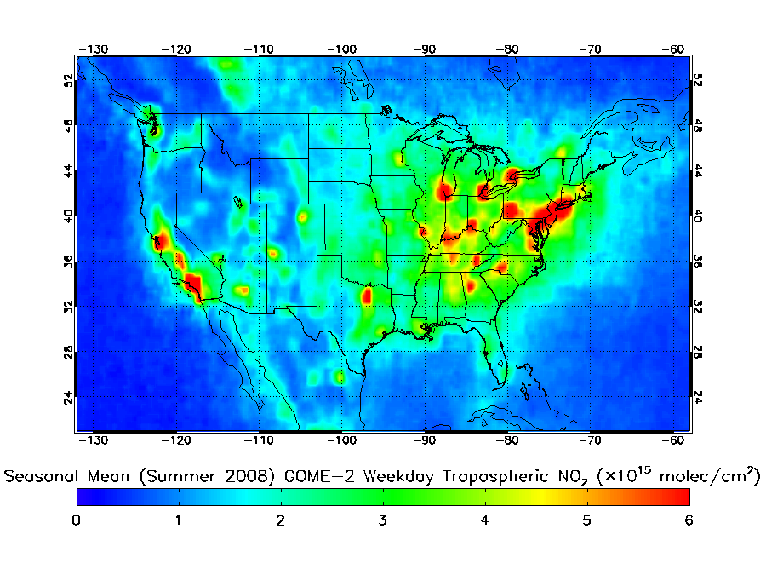
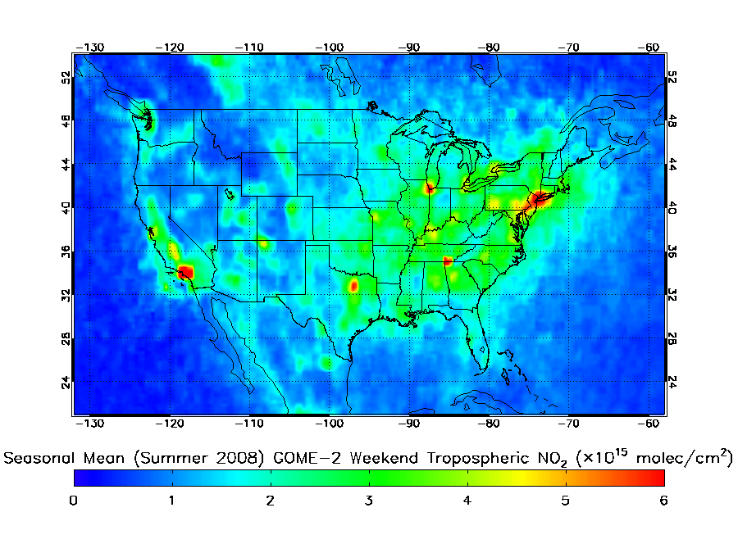
Tracking NOx Emissions using GOME-2
Weekday
Prior studies:
  Satellite data (SCIAMACHI, GOME, OMI) to track long-term NOx emissions trends and weekday/weekend differences (Richter et al., 2005; Boresma et al., 2007)
  Power plant emissions vs. mobile emissions in models (Kim et al., 2009).
NOAA investigating if multiple satellite datasets can be used to evaluate diurnal variation in NOx emissions in air quality models (see next slide).
Weekend
http://www.osdpd.noaa.gov/ml/air/gome.html

Slide 3
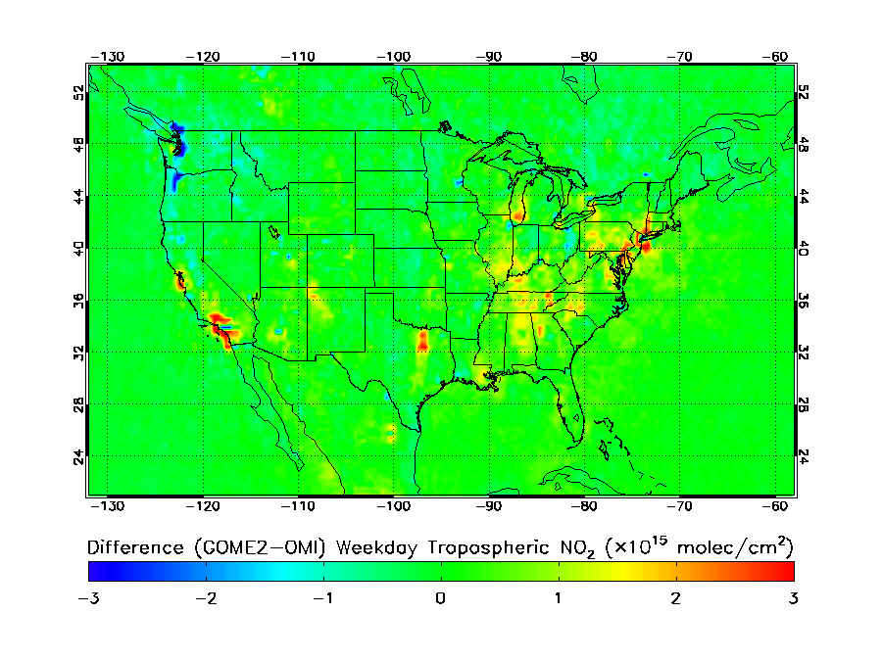
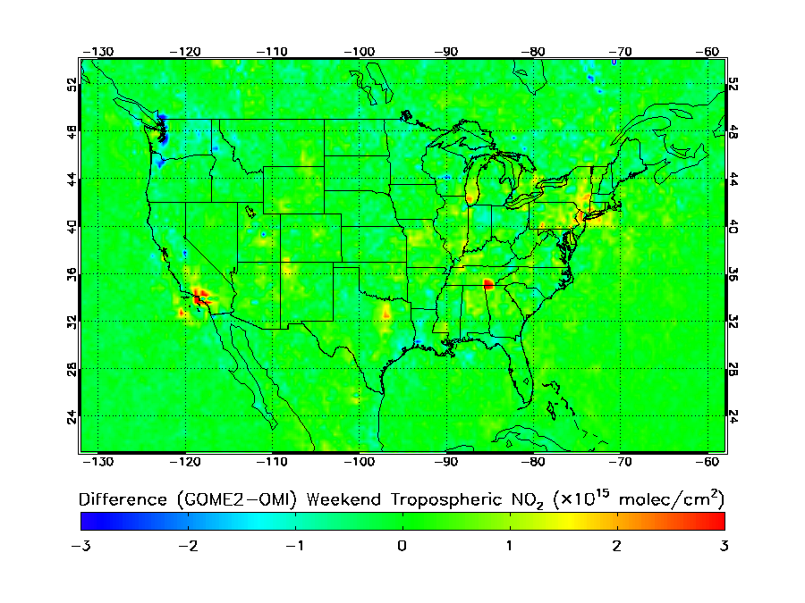
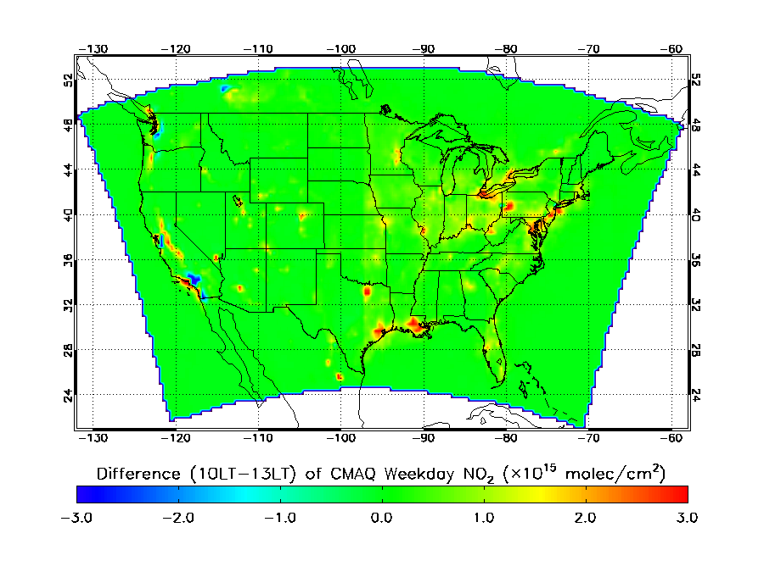
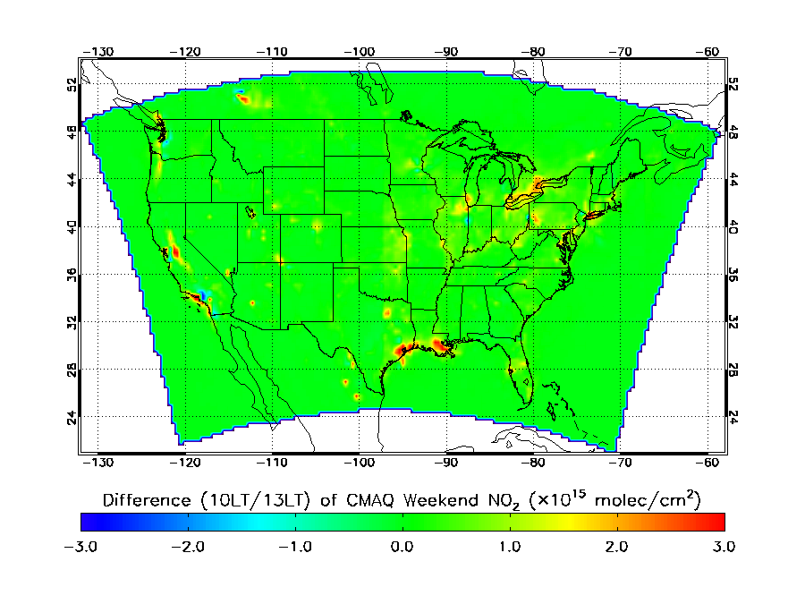
Diurnal Difference in Tropospheric NO₂
Seasonal Mean (Weekdays)
Seasonal Mean (Weekends)
GOME2-OMI
Seasonal Mean (Weekdays)
Seasonal Mean (Weekends)
CMAQ (10 LST – 13 LST)
http://www.osdpd.noaa.gov/ml/air/gome.html

Slide 4
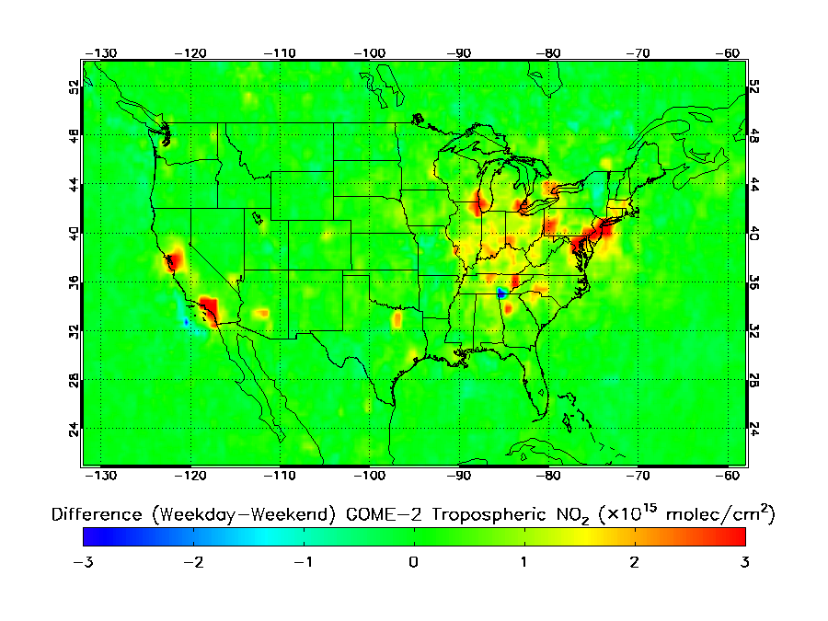
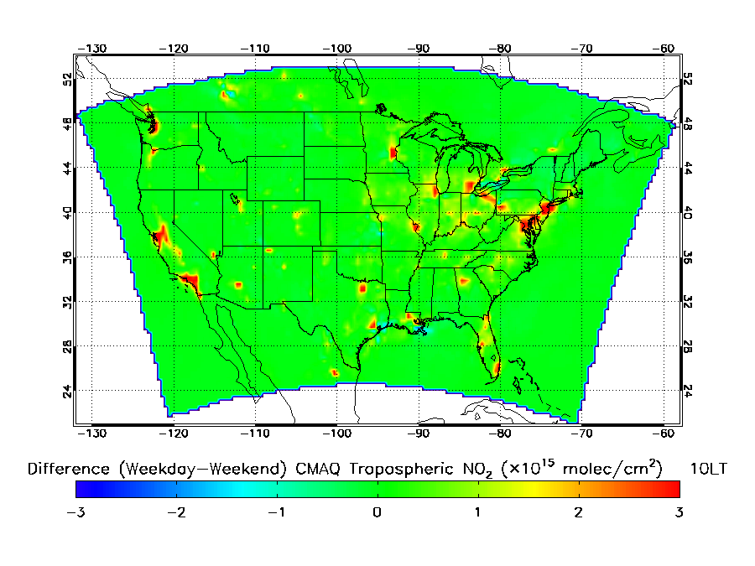
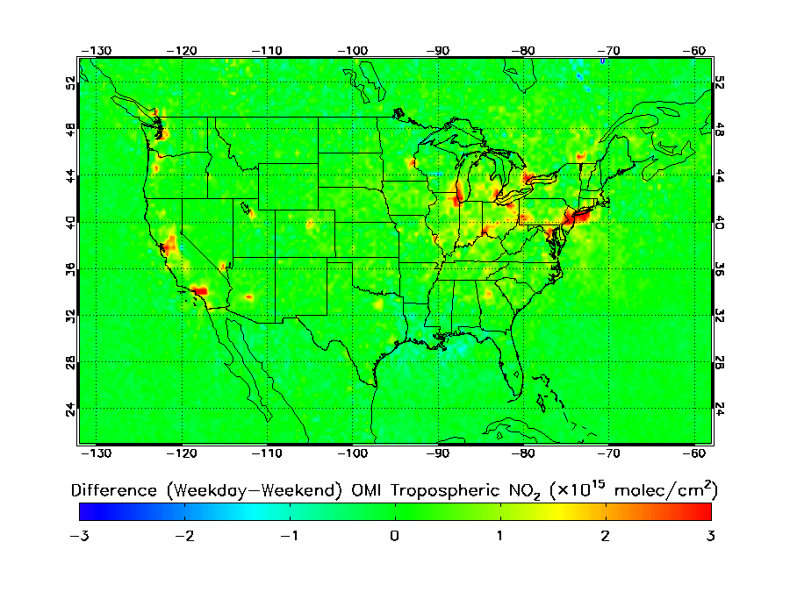
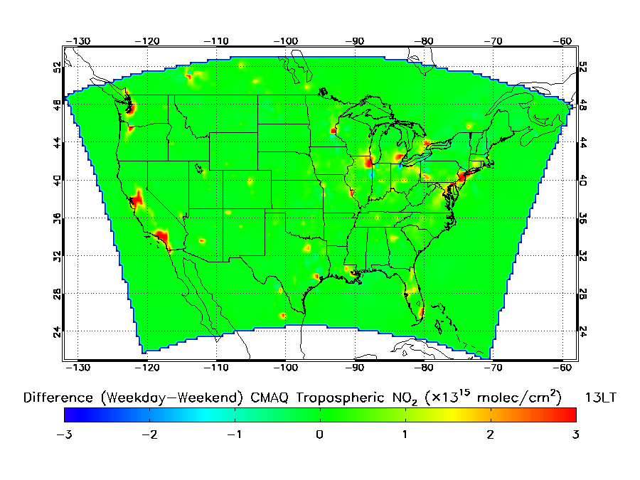
Observed and Modeled Weekday/Weekend Difference in Tropospheric NO₂
GOME-2
CMAQ at 10 LST
OMI
CMAQ at 13 LST
http://www.osdpd.noaa.gov/ml/air/gome.html
Notes:
Figures in this slide show weekday/weekend difference in NO2. Top left is for GOME-2, bottom left is for OMI, top right is for CMAQ at 10 LST (GOME-2 time) and bottom right is for CMAQ at 13 LST (OMI time). GOME-2 shows a very large weekday/weekend difference compared to CMAQ. GOME-2 shows differences in the West Virginia, Tennessee, Ohio, and in general the whole mid-western region whereas CMAQ does not really show much of a weekday/weekend difference. OMI also shows weekday/weekend difference in NO2 but not as large as GOME-2. That is because between GOME-2 and OMI observing time period, NO2 values decrease and this is well captured in observations. Again, CMAQ NO2 for this observation time period does not show a big weekday/weekend differences like OMI.

Slide 5
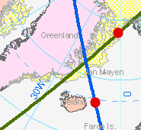
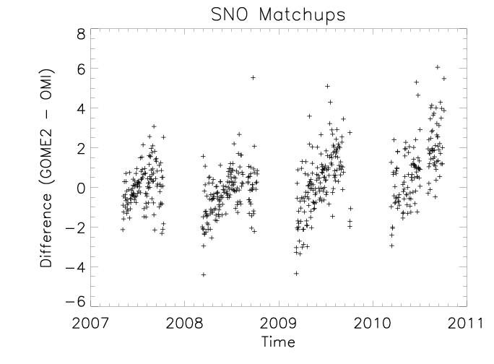
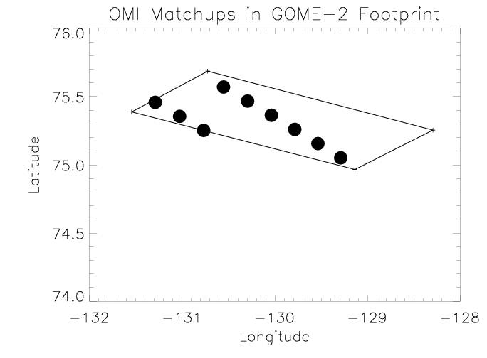
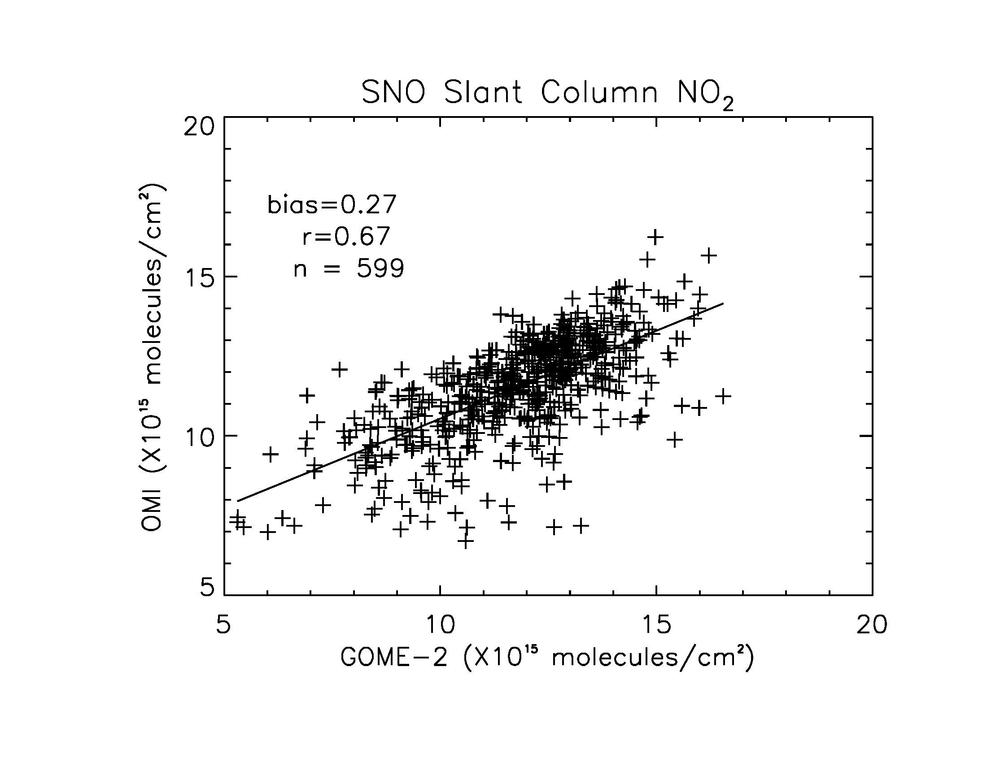
Product Quality
Simultaneous Nadir Overpass (SNO) analysis shows an excellent agreement between OMI and GOME-2 when they are sampling the same atmosphere at the same time.

Slide 6
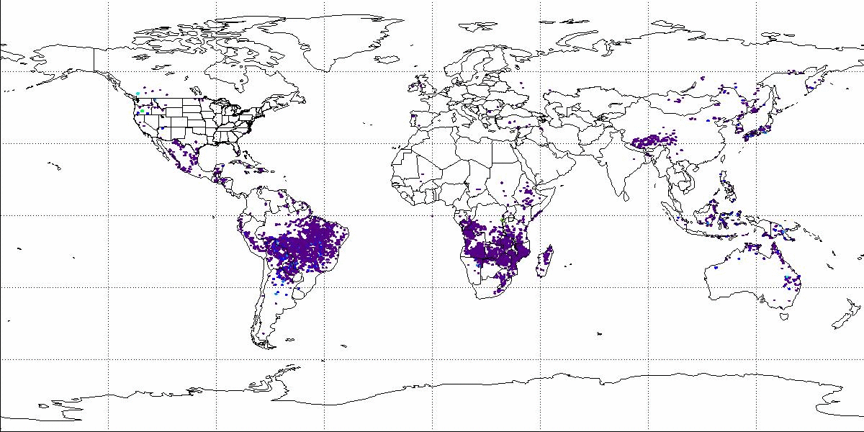

Hourly Biomass Burning Aerosols (PM2.5) Estimated from a Network of Geostationary Satellites on Sept. 16, 2009
No coverage over high latitudes by GOES
ftp://satepsanone.nesdis.noaa.gov/EPA/GBBEP/
GOES
MET09
MTS01
Product pre-operational and running near real time on research computers

Slide 7
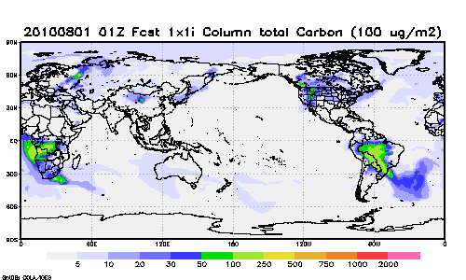
GFS-GOCART Simulations using Biomass Burning Emissions from Multiple Geostationary Satellites
Simulations by Ho-Chun Huang, NCEP
QFED Data from Arlindo DeSilva, NASA
Notes:
Key: QFED – Quick Fire Emissions Data from NASA; GBBEP – Global Biomass Burning Emissions Product from NESDIS

