Slide 1
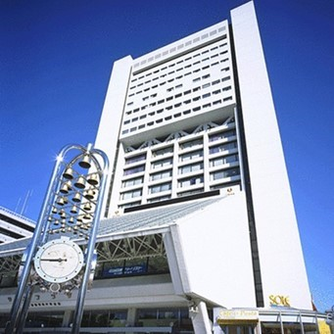
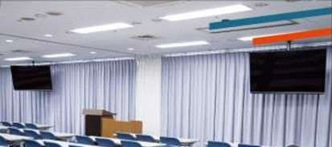
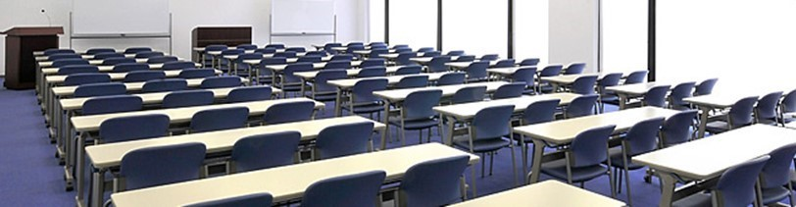
AC-VC TOKYO 2019
Nakano Sun Plaza (conference and hotel)
CEOS AC-VC TOKYO 2019
June 10 (Mon) GHG
June 11-12 (Tue-Wed) AQ, O3 trends, AQ-GHG synergy
https://www.sunplaza.jp/en/
Meeting room for 123
Need another small room?

Slide 2
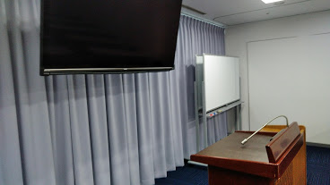
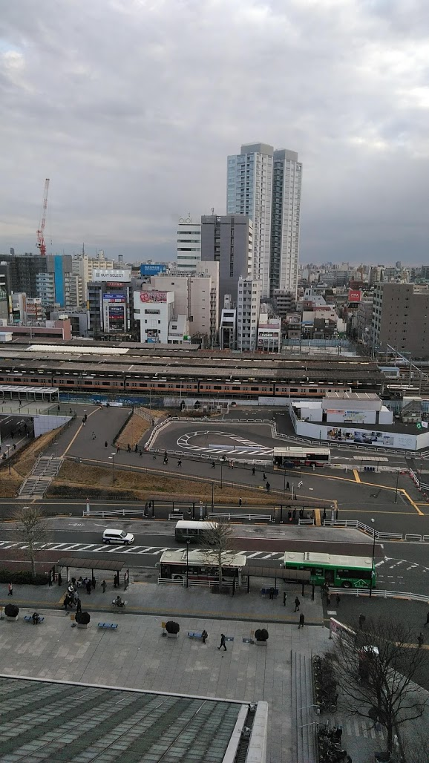
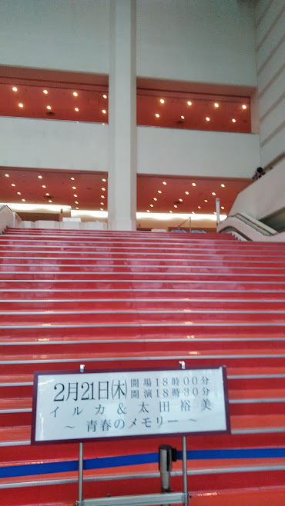
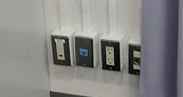
AC-VC TOKYO 2019
Nakano Sun Plaza (conference and hotel)
Full day meeting 9:00-21:00
June 10, 11, 12
Free WIFI
Meeting room is located at the 8th floor.
Please use the Elevator West
(Elevator East are for restaurants and hotel)
2 TV Screen + 1 big screen for the projector.
Up to 123 (three per desk)
The best for 80 (two per desk)
JR and Subway Nakano Station from the Sun Plaza (8th floor)
1st floor the concert hall

Slide 3
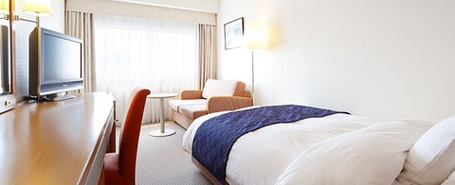
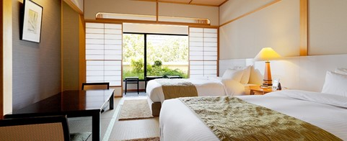
AC-VC TOKYO 2019
Accommodation
Deluxe: Many in Shinjjuku (15 min walk + 4 min train ride) (Hyatt, Hilton, Keio Plaza …)
Standard : Nakano Sun Plaza Hotel ( 0 min) \10,000-30,000
Please ask the Sun Plaza for the JAXA meeting rate (10% discount) when you reserve.
Economy: https://www.hotelmets.jp/koenji/ (10 min walk 2 min train ride) \10,000
Japanese deluxe

Slide 4
AC-VC TOKYO 2019
Venue
Keisei Sky liner
Subway Tozai-line
JR Chuo-line
Narita✈
Nakano
Shinjuku
Tokyo
JR NEX Narita Exp.
JR Shinkansen
Keikyu Airport
Shibuya
Shinjuku >Nakano 4 min, every 2-6 min
Tokyo> Nakano 19 min, every 2-6 min
Nakano> Haneda Airport bus 35 min
Shinagawa
Haneda✈

Slide 5
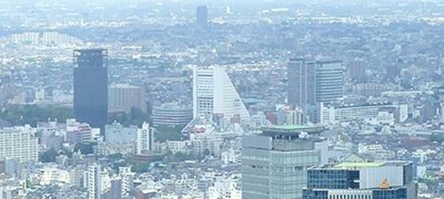
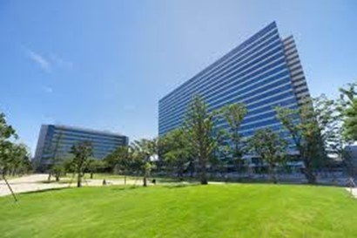
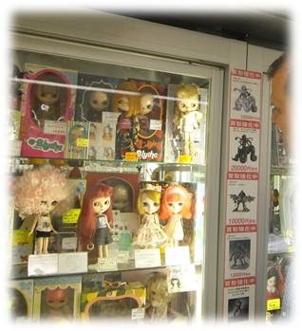
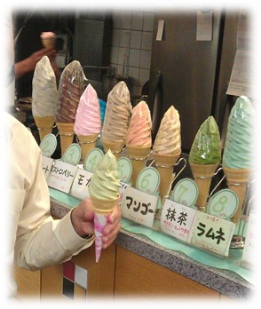
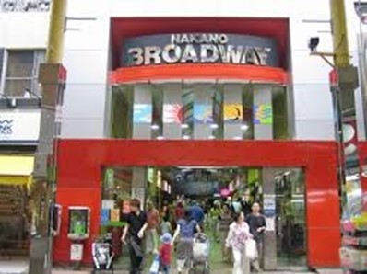
AC-VC TOKYO 2019
Nakano Town
Nakano Central park, three universities, Kirin Brewery HQ

Slide 6
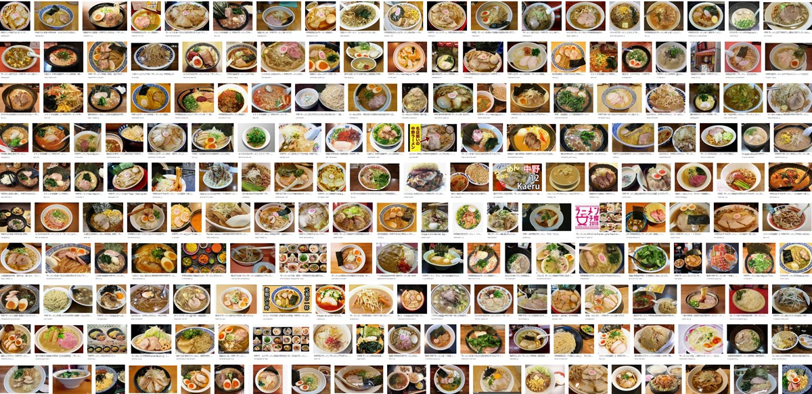
Home of Ramen
More than 100 Ramen Restaurants within a 10-minute walk

