Slide 1
Effects of COVID-19 lockdowns on fine particulate matter concentrations
Melanie S. Hammer
Aaron van Donkelaar, Randall V. Martin, Erin E. McDuffie
Alexei Lyapustin (GSFC), Andrew M. Sayer (GSFC), N. Christina Hsu (GSFC), Robert C. Levy (GSFC), Michael J. Garay (JPL), Olga V. Kalashnikova (JPL), and Ralph A. Kahn (GSFC)
AC-VC Topical Seminar on “Covid-19 impact: what can be learnt from satellite observations and the emission changes?”
June 13, 2021

Slide 2
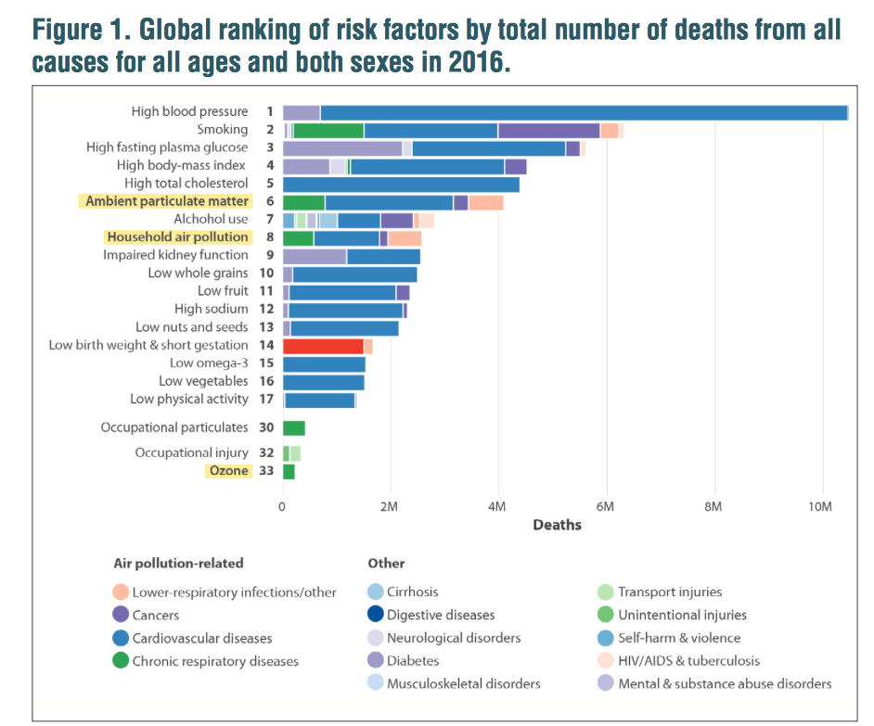
What was the impact of COVID-19 lockdowns on PM_{2.5} concentrations?
PM_{2.5} exposure: leading environmental risk factor for premature death
Responsible for 4.1 million deaths in 2016 worldwide
STATE OF GLOBAL AIR / 2018

Slide 3
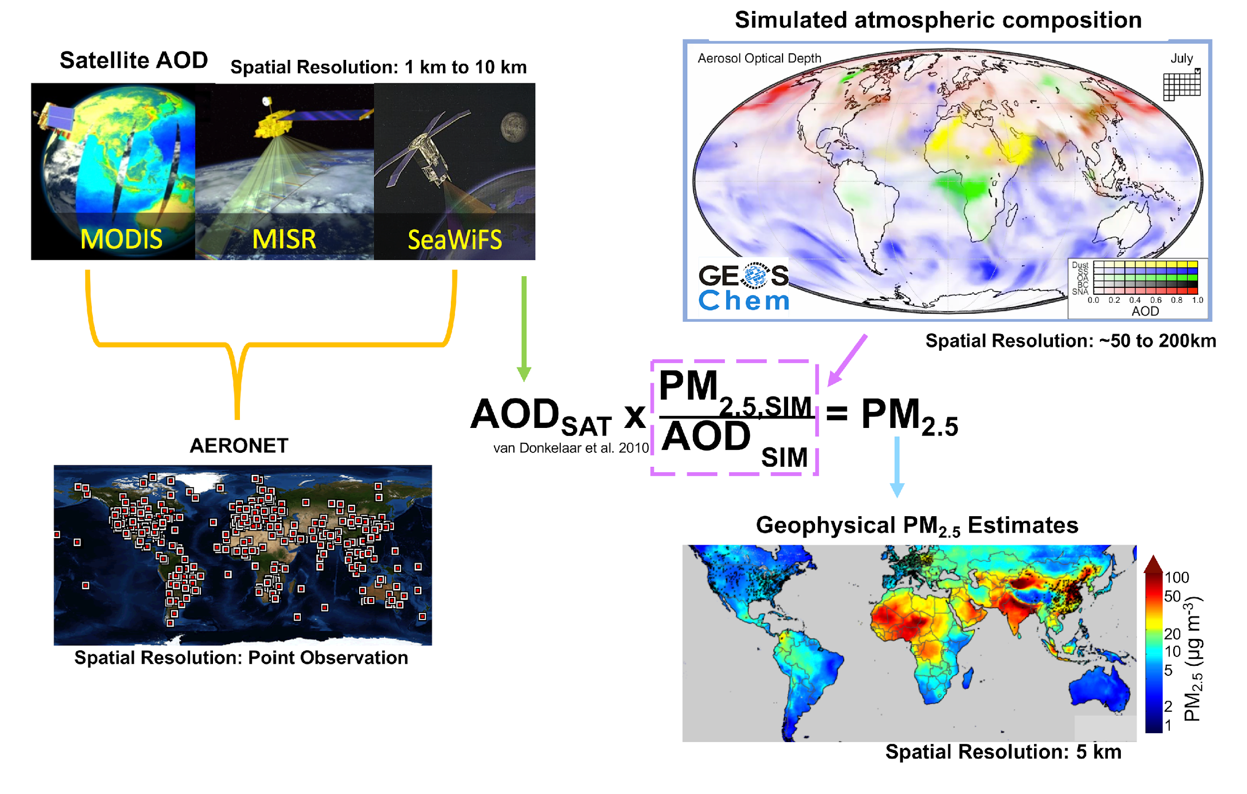
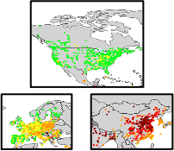
Obtaining Monthly Regional Surface PM_{2.5} Estimates
MODIS Deep Blue
MODIS Dark Target
MISR
MAIAC
AERONET: high accuracy AOD measurements
(function of: aerosol size, composition, diurnal variability, relative humidity, and vertical structure of aerosol extinction)
Monthly Regional Ground Monitor Data
Statistical Fusion
(van Donkelaar et al. 2019)
Spatial resolution: 1 km
Monthly Regional Hybrid PM_{2.5} Estimates
van Donkelaar et al., ES&T, 2019; Hammer et al., ES&T, 2020; Hammer et al., Sci Adv, 2021

Slide 4
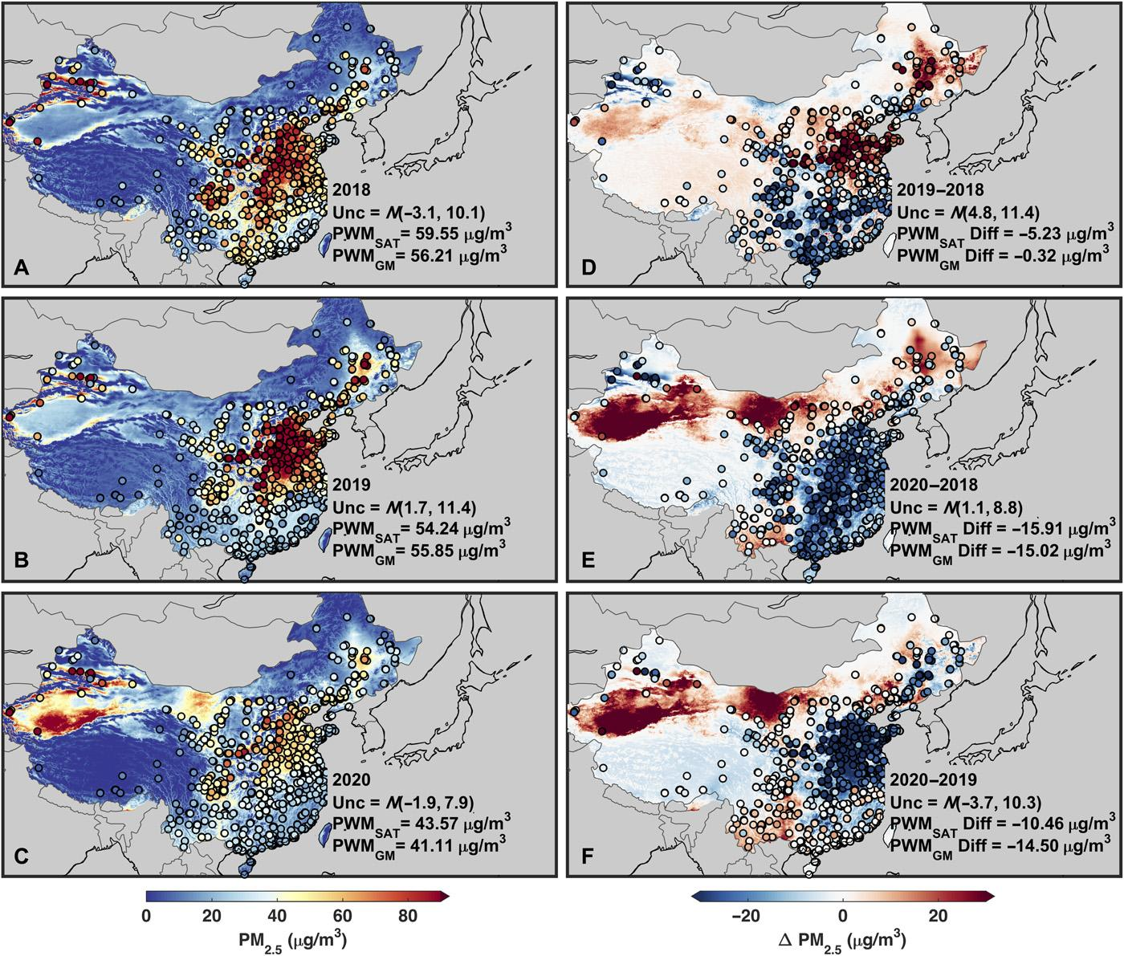
Monthly mean PM2.5 concentrations over China for February
Hammer et al., Sci Adv, 2021

Slide 5
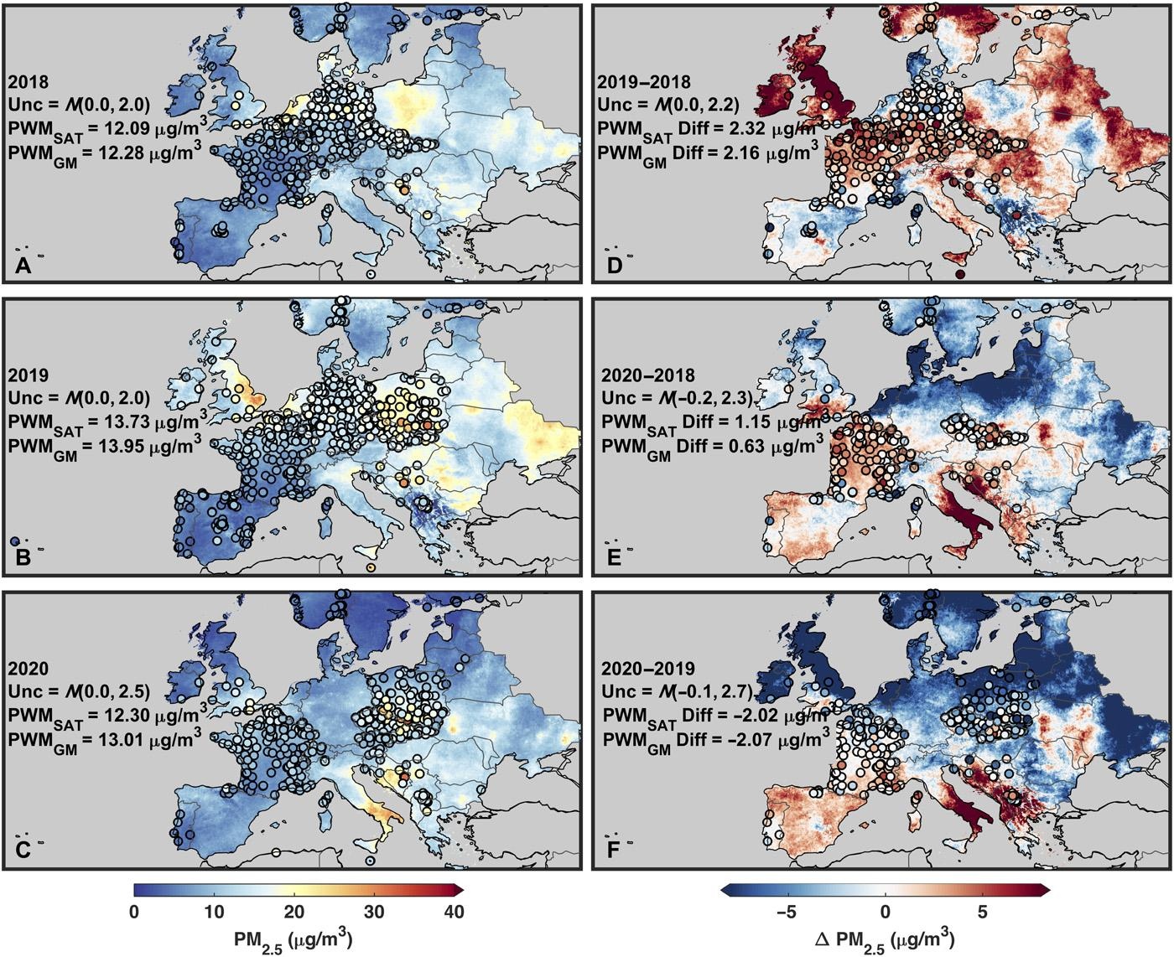
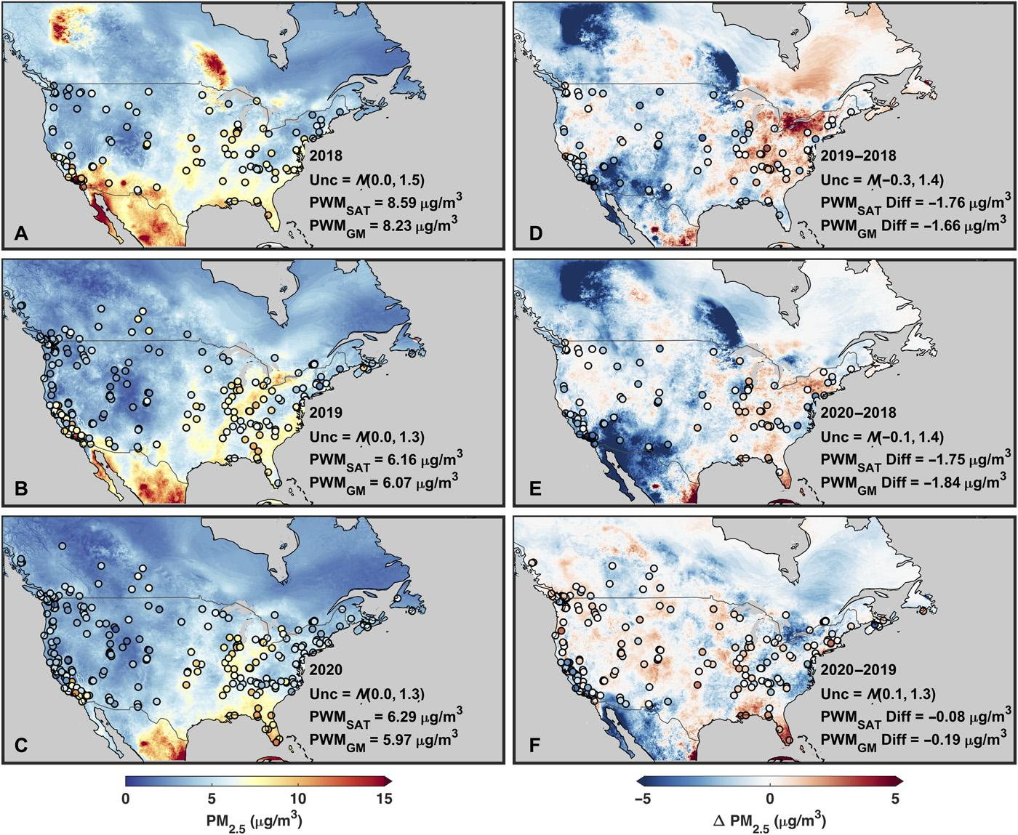
Monthly mean PM2.5 concentrations over Europe and North America for April
Hammer et al., Sci Adv, 2021

Slide 6
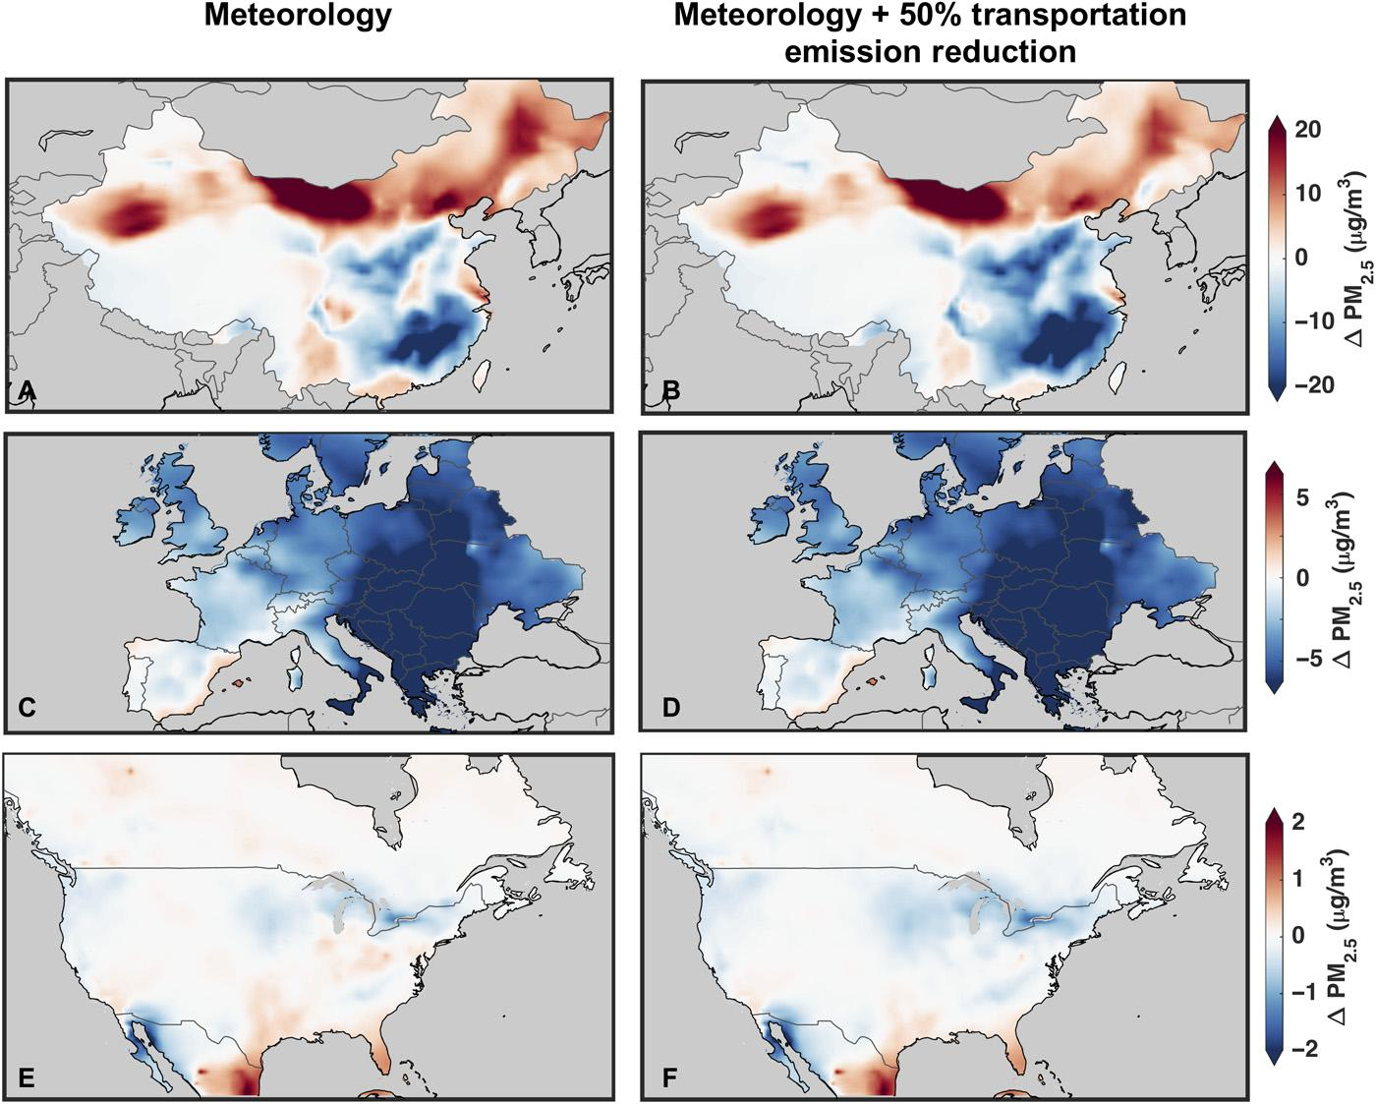
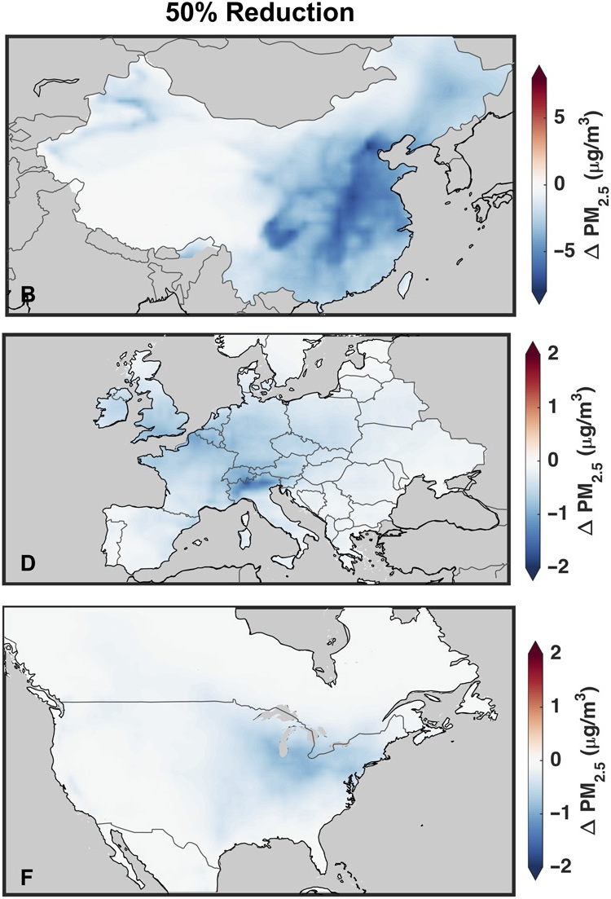
Change in simulated PM2.5 during the lockdown periods due to emissions and meteorology
Transportation emissions
Hammer et al., Sci Adv, 2021

Slide 7
Conclusions
Derive monthly regional satellite-derived PM_{2.5} estimates over China, Europe, and North America to examine the effects of COVID-19 lockdowns on PM_{2.5} concentrations
Evidence of a substantial decrease in PM_{2.5} concentrations over the North China Plain region; combination of natural variability and emission reductions
Complex relationship between PM_{2.5} and emission sources
Importance of natural variability on short term changes in PM_{2.5}
M. S. Hammer, A. van Donkelaar, R. V. Martin, E. E. McDuffie, A. Lyapustin, A. M. Sayer, N. C. Hsu, R. C. Levy, M. J. Garay, O. V. Kalashnikova, R. A. Kahn, Effects of COVID-19 lockdowns on fine particulate matter concentrations. Sci. Adv. 7, eabg7670 (2021).
DOI: 10.1126/sciadv.abg7670

