Slide 1
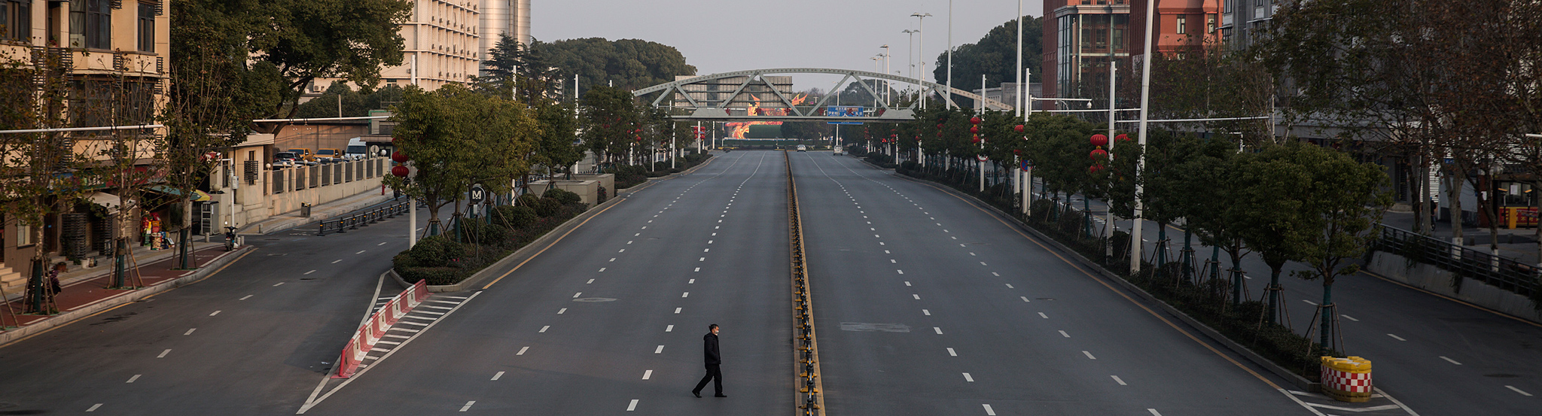
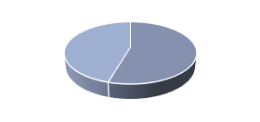












Wuhan’s quarantine 2020
The Global Impacts of COVID-19 Lockdowns on Urban Air Quality:
A Critical Review and Recommendations
F
M
Georgios
Gkatzelis
Jessica
Gilman
Brian
McDonald
Anne
Lange
Chelsea
Thompson
Henk Eskes
Andreas
Petzold
Rita
Gomes
Jeff
Peischl
Steve
Brown
Astrid
Kiendler-Scharr

Slide 2


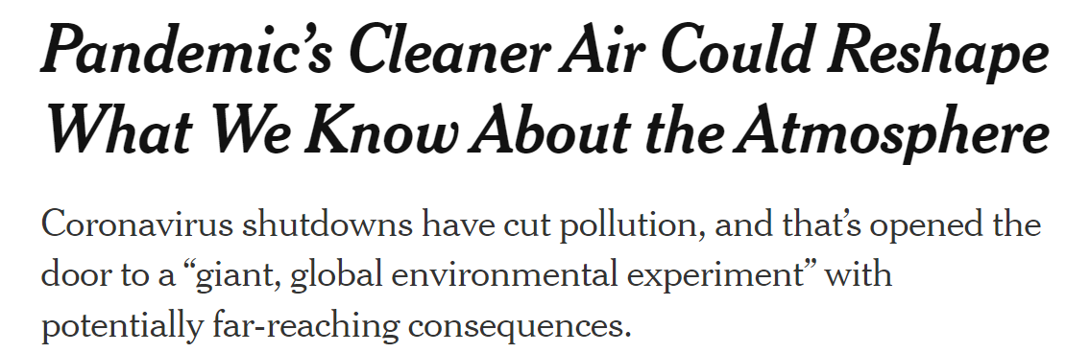
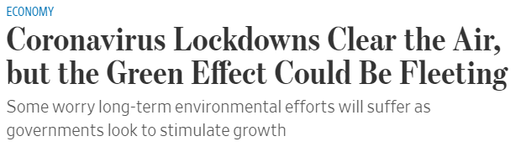
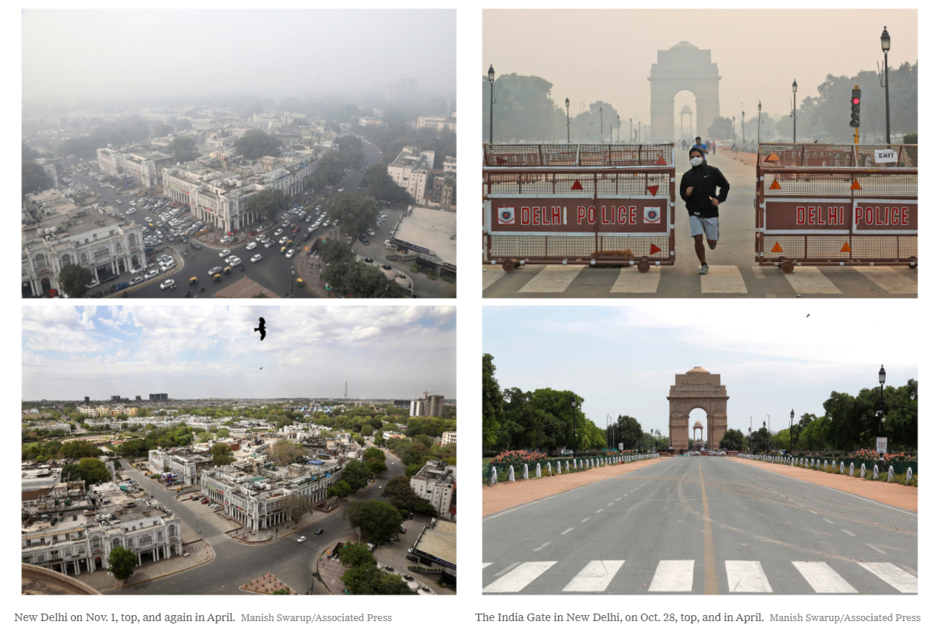

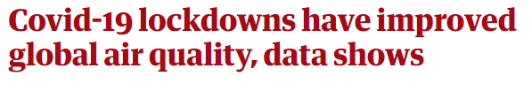

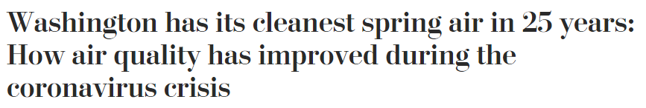
Nov. 1
Oct. 25
Apr. 1
Apr. 1
New Delhi
India Gate, New Delhi

Slide 3
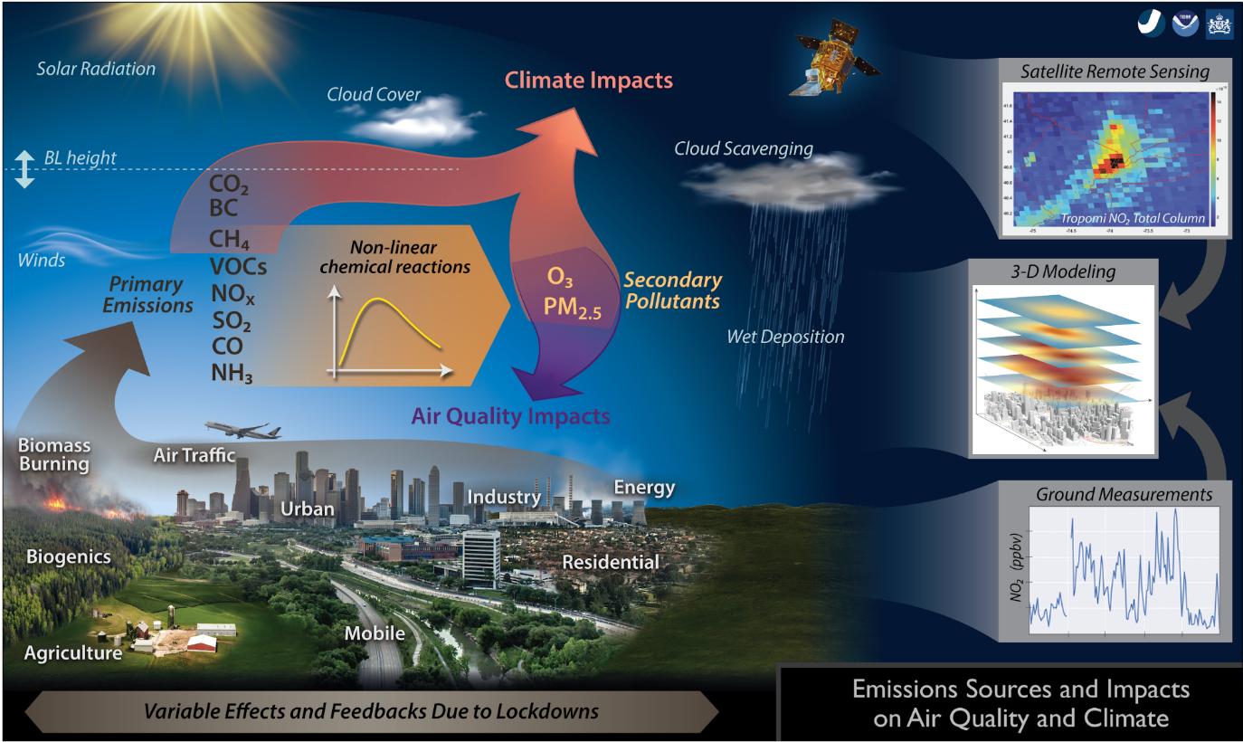

Slide 4
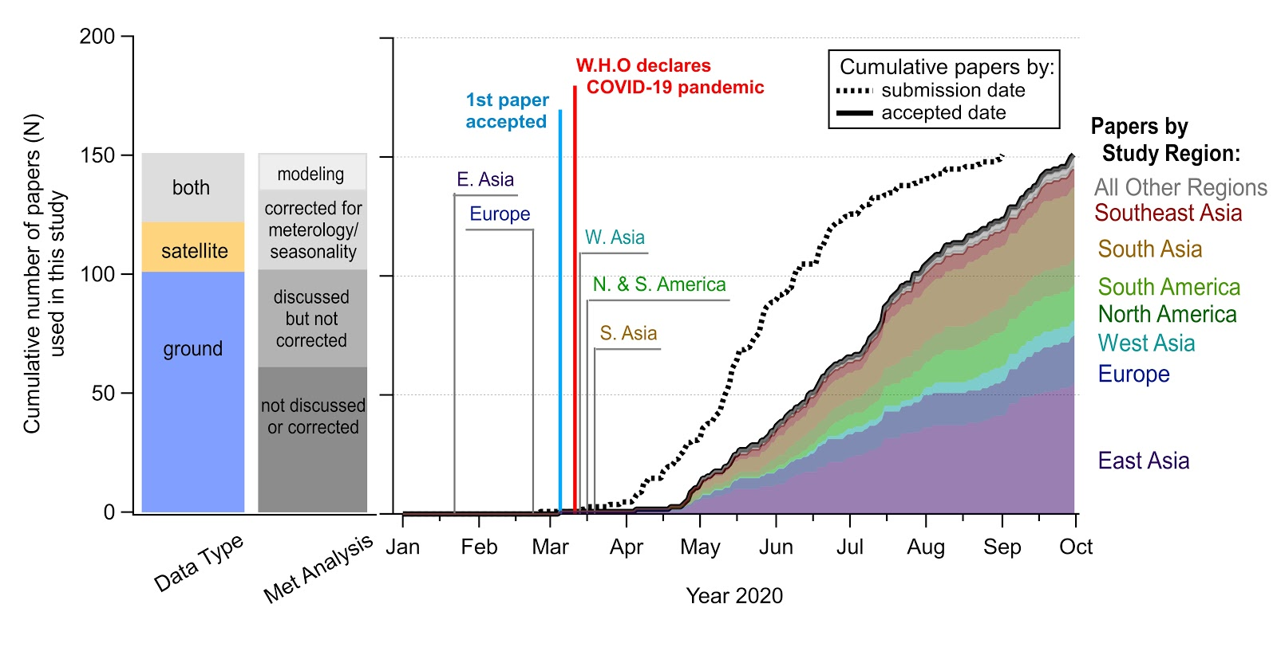
Literature review process: Response to the pandemic
Information per publication
manually catalogued
Percent change of pollutant concentrations
Absolute pollutant concentrations
the region and periods studied,
Methods to measure
  Ground-based
  Satellites
First author
Journal name
Dates of submission, acceptance,
How authors may or may not have accounted for the effects of seasonality/meteorology.
… and more
4

Slide 5
Literature review process: Response to the pandemic
Meteo Analysis
5

Slide 6
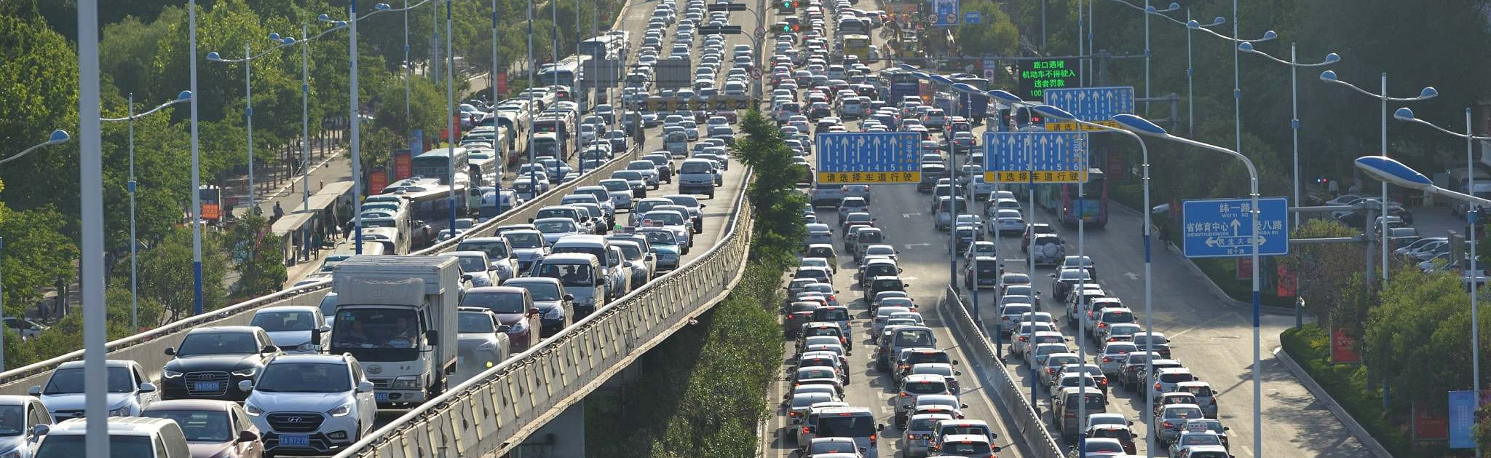
How drastic changes do we expect?
BEFORE
Before Lockdown
Reference period
How much are we expecting transportation to contribute to the overall emissions?
LOCKDOWN
During Lockdown
Lockdown period
6

Slide 7
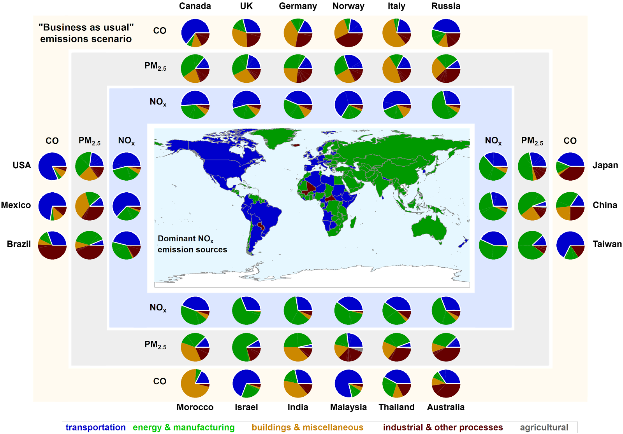
Inventory-based business as usual emission scenario
The global EDGAR inventory provides context for expected changes in air pollutant species in the atmosphere due to the COVID-19 pandemic.
Transportation contributed
NO_{x}: 36% (15–51%)
7

Slide 8
Inventory-based business as usual emission scenario
The global EDGAR inventory provides context for expected changes in air pollutant species in the atmosphere due to the COVID-19 pandemic.
Transportation contributed
NO_{x}: 36% (15–51%),
PM_{2.5}: 8% (3–19%),
7

Slide 9
Inventory-based business as usual emission scenario
The global EDGAR inventory provides context for expected changes in air pollutant species in the atmosphere due to the COVID-19 pandemic.
Transportation contributed
NO_{x}: 36% (15–51%),
PM_{2.5}: 8% (3–19%),
CO: 30% (5–70%)
NO₂ > CO > PM_{2.5}
7

Slide 10
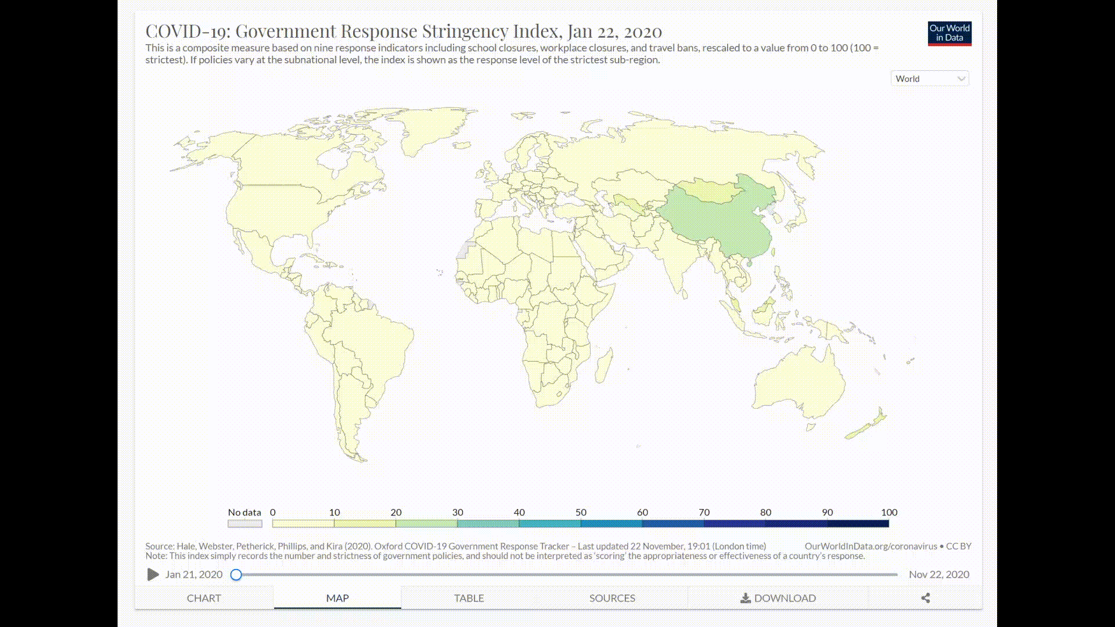
Stringency index as a metric for lockdown measures
Categories included are:
the implementation and extent of school closures
implementation and extent of workplace closures
restrictions on public events
Gatherings
closure of public transport
degree of public information campaigns
extent of measures to enforce stay-at-home
restrictions on internal movement,
international travel
testing policy, and
contact tracing.
As such the index includes both measures that impact emissions and measures with no obvious consequence for emissions.
https://ourworldindata.org/grapher/covid-stringency-index
8

Slide 11
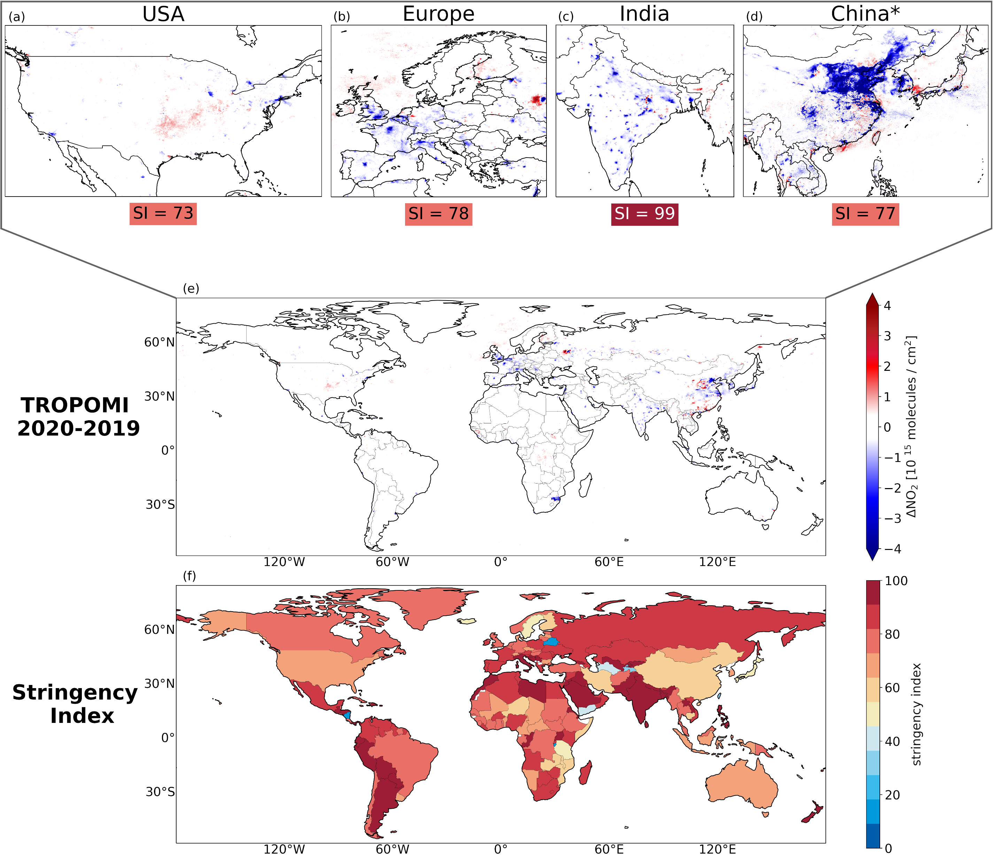
Anne
Lange
Henk Eskes
We did our own bit of analysis first
Difference in NO₂ column concentrations based on the TROPOMI measurements for 2020 compared to 2019.
Stringency index is used for April as a representative month for the most stringent conditions globally. China is an exception where lockdown measures were implemented in February-March and relaxed in April.
9

Slide 12
Data included in the upcoming analysis
ground-based only
PLATFORM
USED
both
satellite only
meteo & long-term trends not discussed
METHOD
USED
discussed,
not quantified
modeling
quantified
10

Slide 13
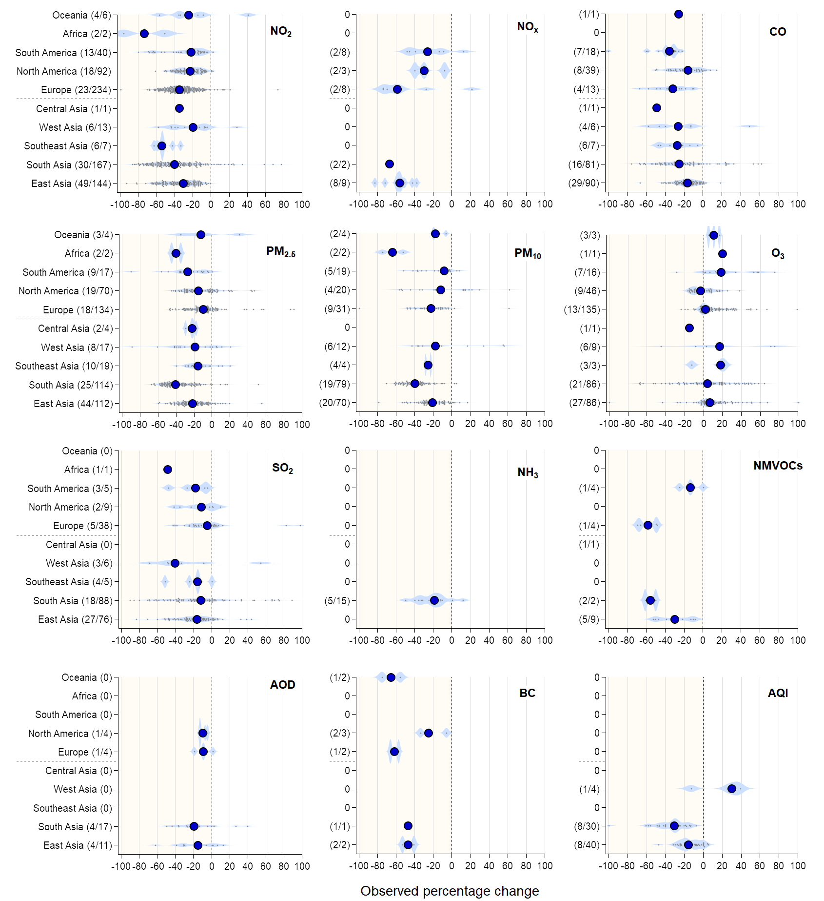
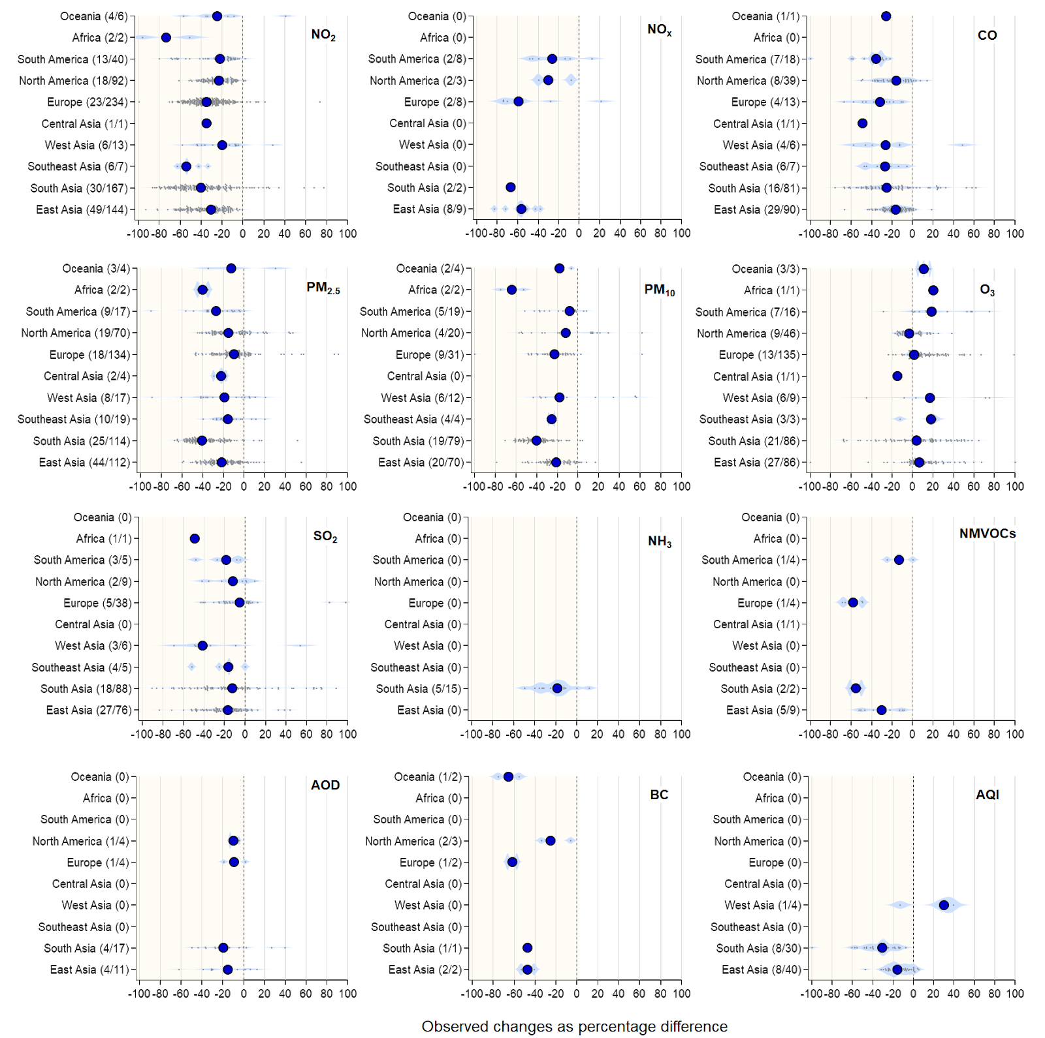
Observed changes as percentage difference
(N/N) = (number of publications / number of datasets)
NO₂, NO_{x}, and CO have the largest expected contribution from transportation
PM_{2.5}, and O₃ as the most relevant pollutants for health impacts that are also secondary;
11

Slide 14
Observed changes as percentage difference
(N/N) = (number of publications / number of datasets)
SO₂, NH₃, and non-methane volatile organic compounds (NMVOCs) mostly related to primary gas-phase emissions,
PM₁₀, aerosol optical depth (AOD), black carbon (BC), and air quality index (AQI).
12

Slide 15
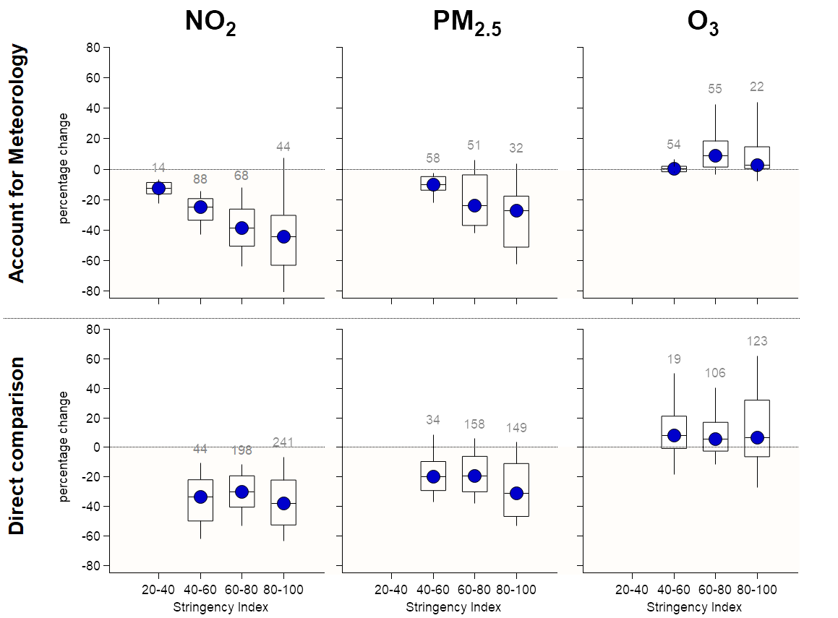
Percent changes vs. stringency index
Emission of primary pollutants are expected to decrease as the lockdown measures become stricter
It is essential to account and quantify the effects of meteorology to quantitatively link changes in atmospheric abundance with changes in emissions
13

Slide 16
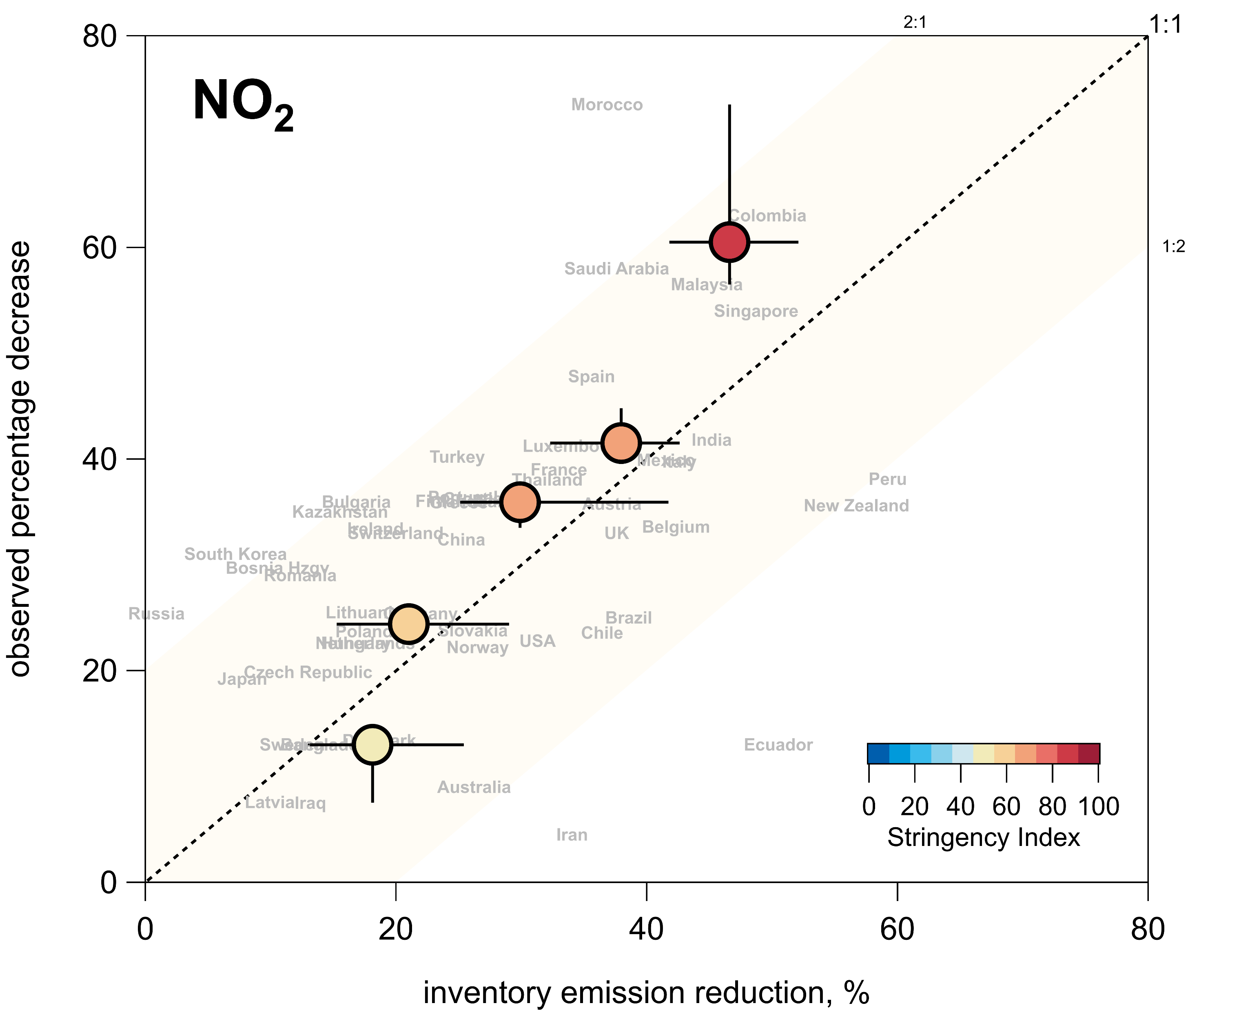
Comparison of observations to the Forster inventory
Agreement within a factor of 2, within the associated uncertainties.
The stringency of lockdown measures has a strong relationship with levels of traffic
The similarity between changes in the emissions inventory and atmospheric observations due to COVID-19 lockdown measures suggests the importance of traffic as a source of NOx in cities around the world.
Forster et al. (2020), Nature
14

Slide 17
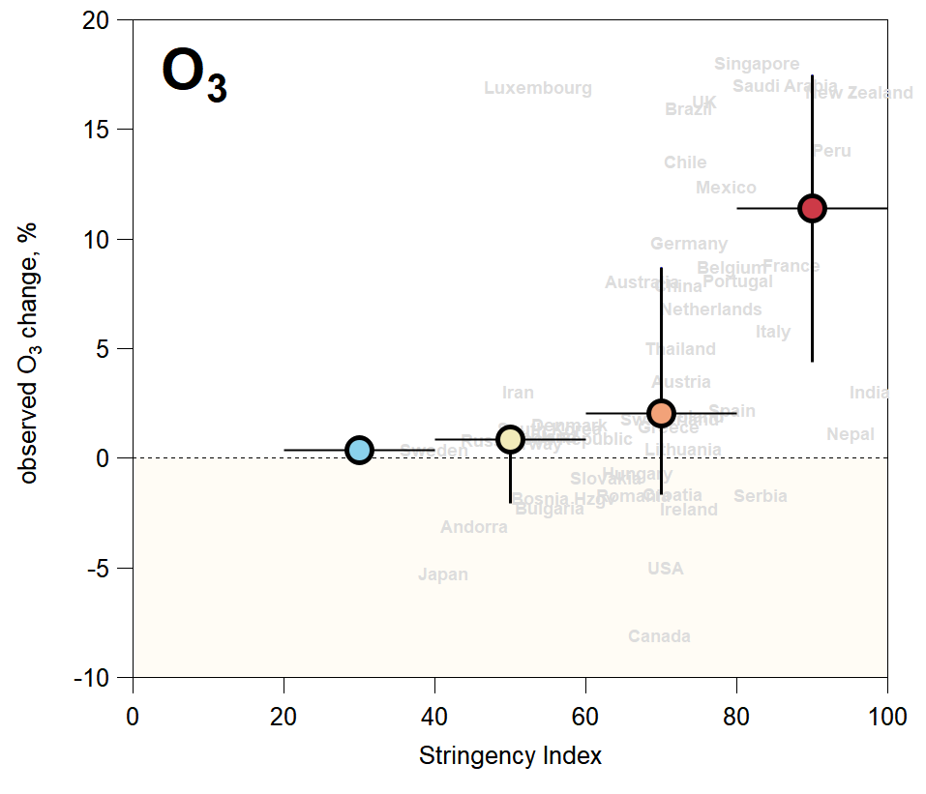
O₃ percent changes and correlation to stringency index
Forster et al. (2020), Nature
15

Slide 18
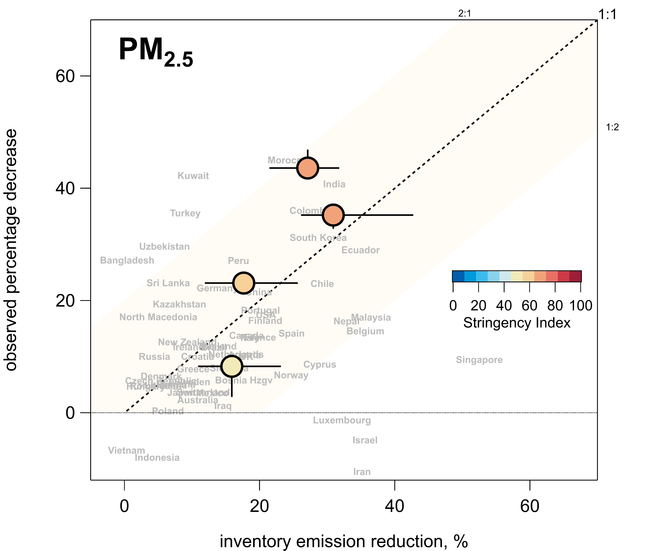
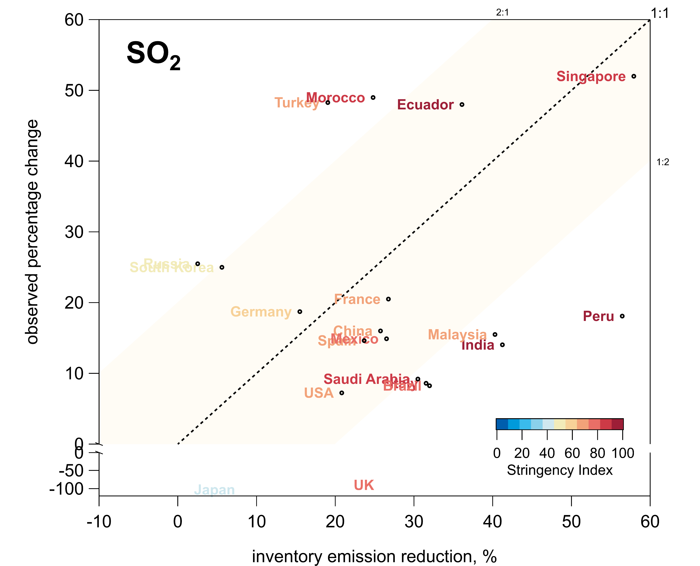
PM_{2.5} and SO₂ observations compared to the Forster inventory
Forster et al. (2020), Nature
Forster et al. (2020), Nature
16

Slide 19
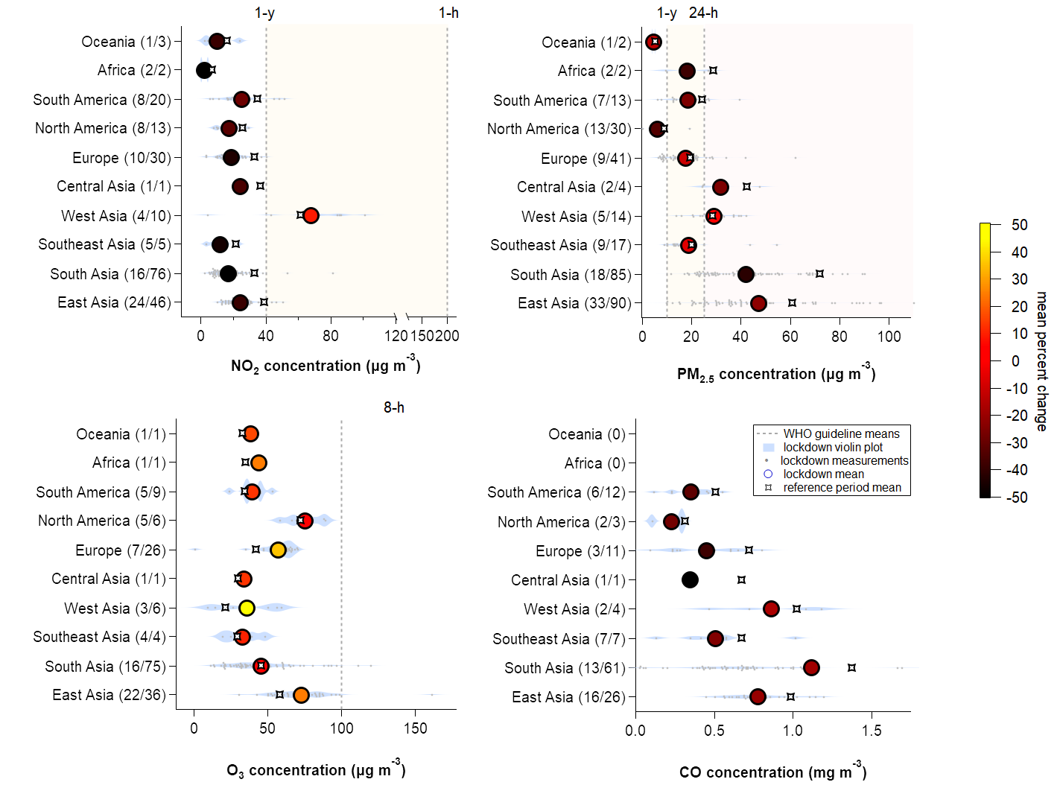
Absolute concentrations: Lockdown vs. Reference periods
(N/N) = (number of publications / number of datasets)
WHO guideline values
WHO guideline values
WHO guideline values
NO₂ concentration (µg m⁻³)
PM_{2.5} concentration (µg m⁻³)
O₃ concentration (µg m⁻³)
-40 ± 26% - 21 ± 13% + 21 ± 19%
17

Slide 20
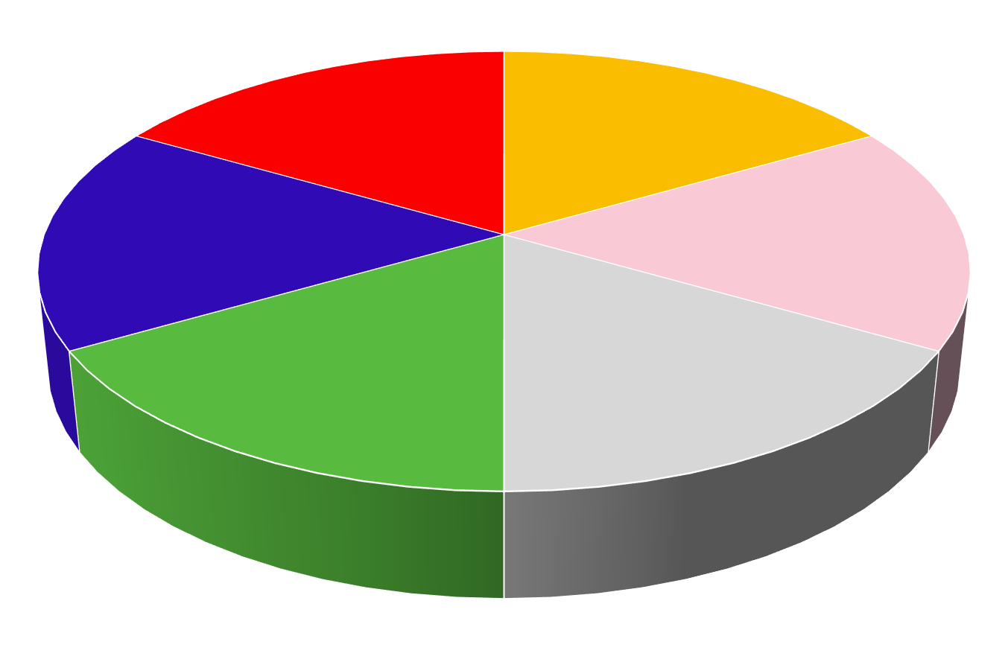
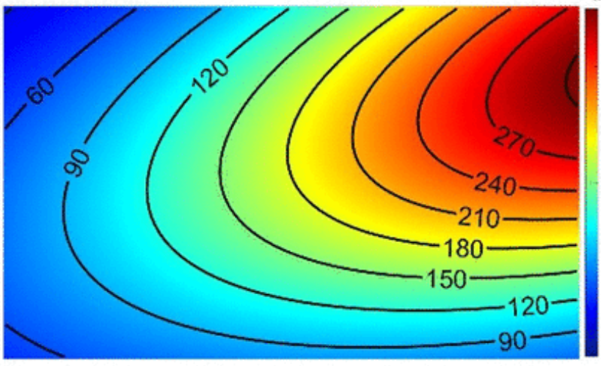
How well do we understand PM_{2.5} and O₃?
O₃ isopleth
secondary
primary
SO₄
NH₄⁺
NO₃⁻
chloride
NO_{X}
O₃
SOA
POA
VOCs
What is the
chemical composition
of PM_{2.5}?
What happens in chemically active seasons?
18

Slide 21
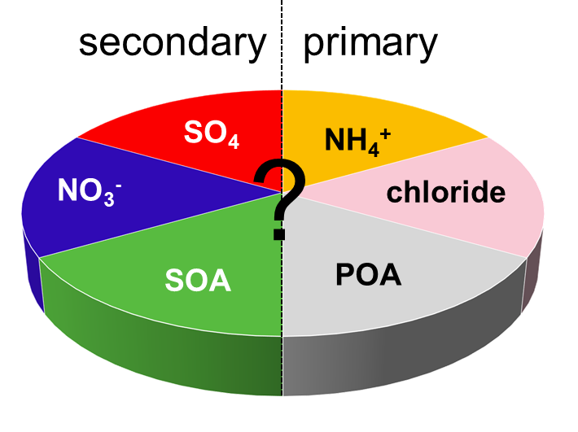
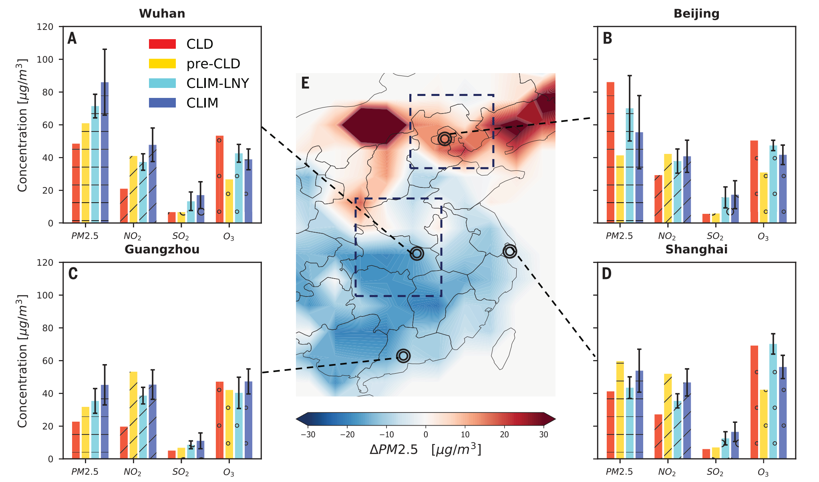
What is the role of secondary PM_{2.5} on air quality?
In China during lockdowns PM_{2.5} % even increased
Le et al., Science, (2020)
19

Slide 22
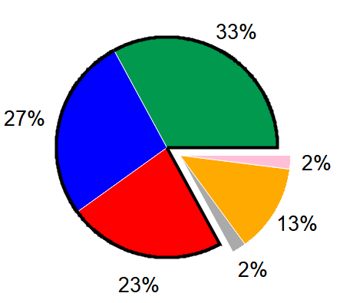
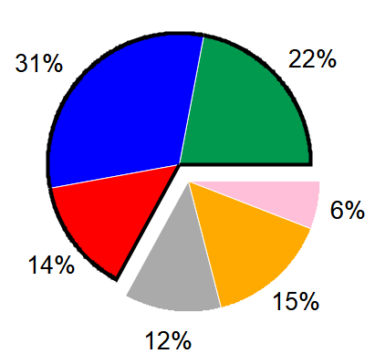
What is the role of secondary PM_{2.5} on air quality?
In China during lockdowns PM_{2.5} % even increased
Le et al., Science, (2020)
Guo et al., PNAS, 2014
Gkatzelis et al., GRL, 2021
POA SOA nitrate sulphate ammonium chloride
19

Slide 23
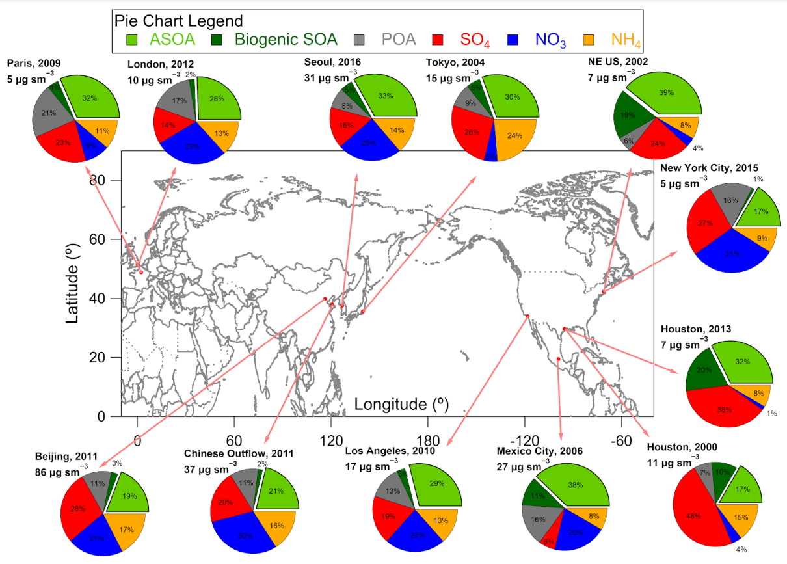
What is the role of secondary PM_{2.5} on air quality?
In China during lockdowns PM_{2.5} % even increased
Le et al., Science, (2020)
Guo et al., PNAS, 2014
Gkatzelis et al., GRL, 2021
Nault et al., ACP, (2021)
Secondary PM represent the dominant fraction of the mass
POA SOA nitrate sulphate ammonium chloride
19

Slide 24
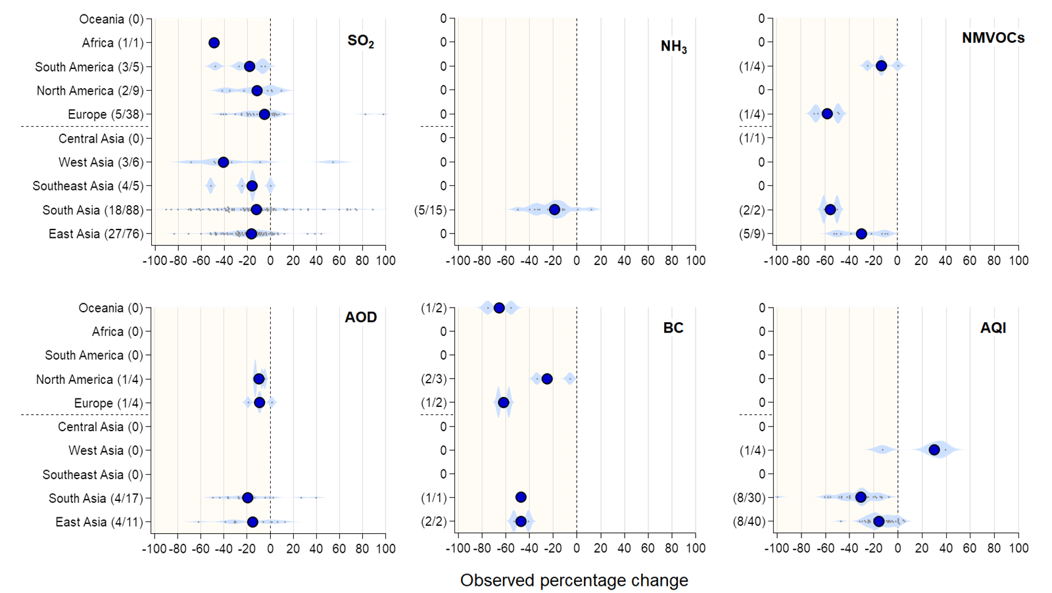
PM_{2.5} concentrations and precursor compound reductions
PM guideline values are still exceeded
WHO guideline values
Understudied PM
precursors
PM_{2.5} concentration (µg m⁻³)
Observed percentage change
20

Slide 25
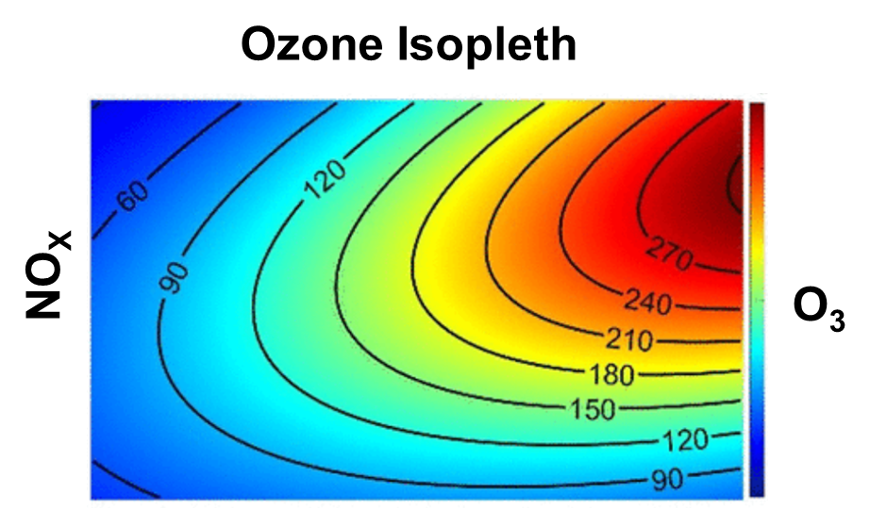

How do VOC emissions change during lockdowns?
To get O₃ right you need both NO_{X} and VOC emission reductions
NOx emission reductions can be quantified relatively well
But which VOC emission sectors are expected to change though?
VOCs?
Expectation
reductions
unknown
21

Slide 26
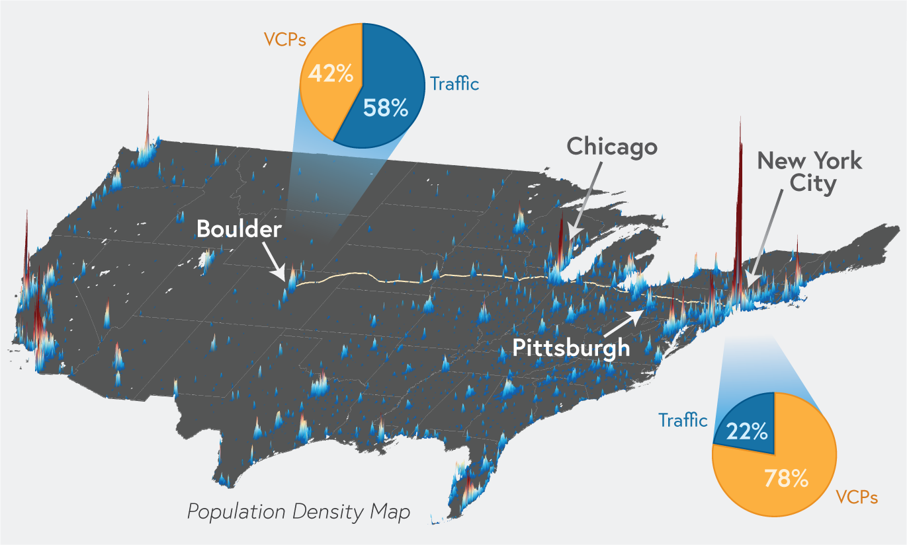
Importance of residential emissions in urban environments
Volatile chemical products (VCPs) contribute significantly to urban VOC emissions in the US
Places with drastically different population densities show high fraction of VCPs
Do these emissions contibute to O₃ production?
Gkatzelis et al., ES&T, 2021
22

Slide 27

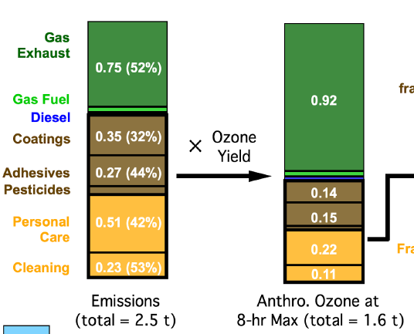

O₃ formation in New York City during a heatwave
July, 2018
Total AVOC Emissions
Produced O₃
Quantifying changes in residential VOC emissions will be essential in accurately determining O₃ during the lockdown periods
NOAA Instrumented Mobile Laboratory in NYC
Coggon et al., (2021), in press
23

Slide 28
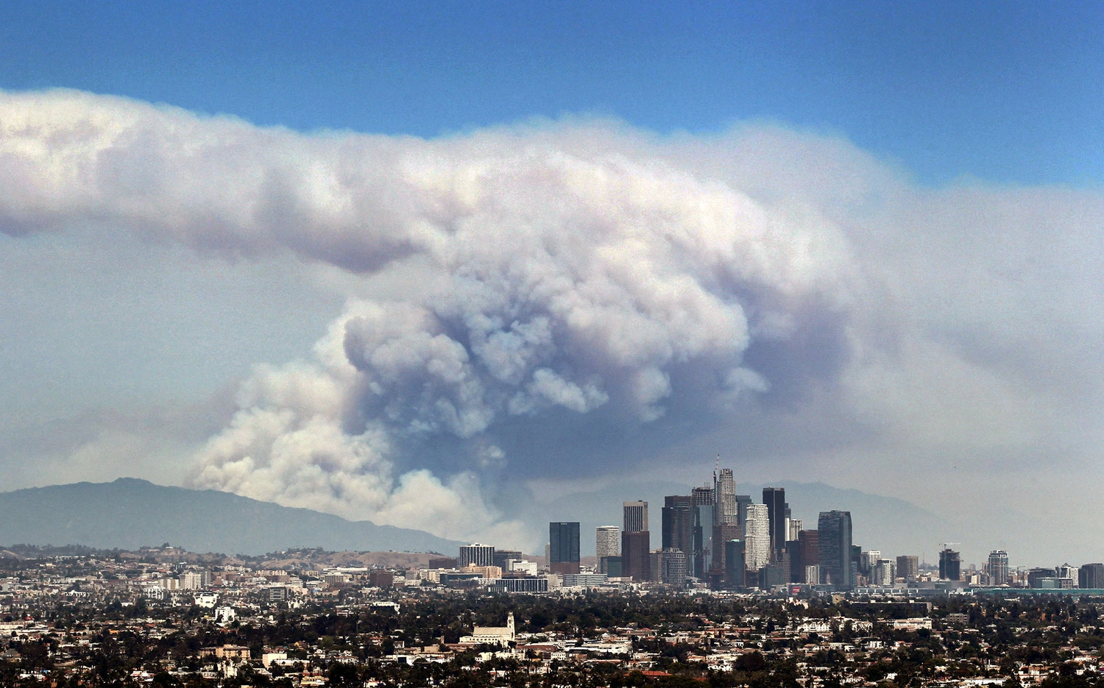

How could wildfire season affect O₃ formation in lockdowns
Radical production & termination balance
O₃ ↑
Fast transition to a NO_{X} sensitive regime
O₃ production expected to increase moving over an urban environment
Periods influenced by biomass burning will be challenging to compared to previous years
Robinson et al., (2021), in review
24

Slide 29
Concluding Remarks
1. Importance of Accounting for the Effects of Meteorology and Long-term Trends
2. Statistics for certain pollutants is good but for other not.
3. Comparisons to emission inventories is good for NO₂ but for other pollutants more work is required
4. A logarithmic O₃ increase with increasing stringency index is evident
25

Slide 30
Future Recommendations
Changes in O₃ associated with COVID-19 emissions reductions, particularly O₃ during photochemically active seasons.
Changes in PM_{2.5} may enable similar sensitivity analyses to primary emissions. A larger analysis of chemically speciated PM_{2.5} data, where available, will be especially informative.
Expansion of the available analyses to include a larger number of short-lived species would help to constrain and inform emissions inventories
Analysis of the radiative forcing associated with short-lived climate forcers is a priority.
This review has been limited in scope to short-lived air pollutants that are relevant to air quality and climate, but not to longer lived species such as CH₄, CO­_{­2}, N₂O and halogenated short lived climate forcers.
26

Slide 31
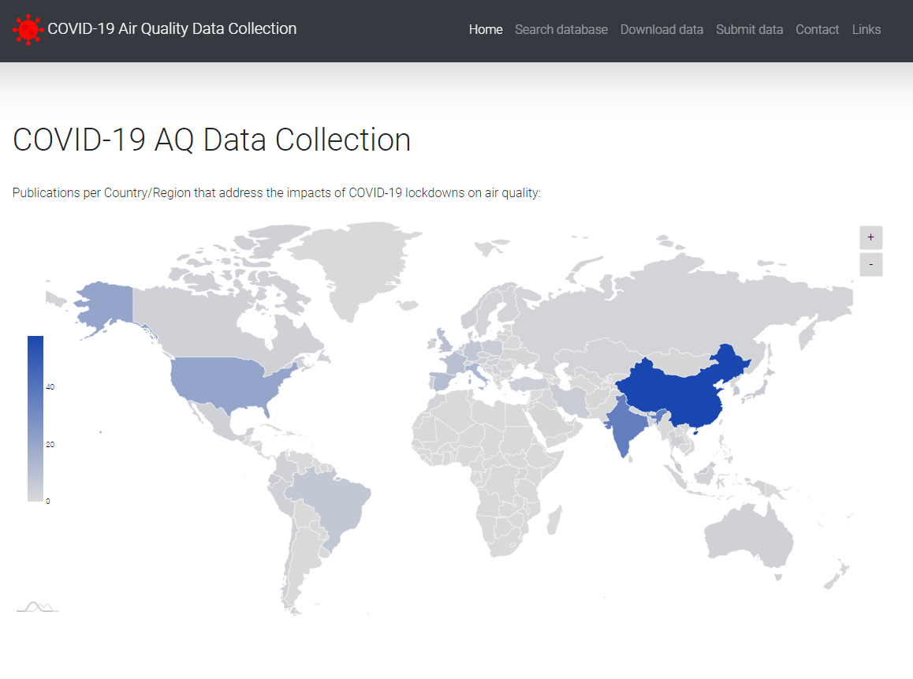


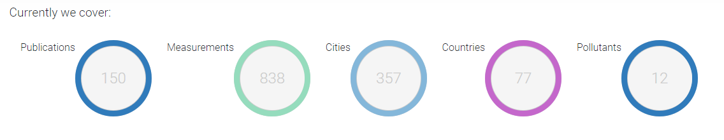
Online Database Available Now!
Rita
Gomes
Michael
Decker
Download data but also submit your own
https://covid-aqs.fz-juelich.de/
Georgios Gkatzelis, g.gkatzelis@fz-juelich.de
27

