Slide 1
SIT-TW
2024
AFOLU Roadmap Actions and Status
Lola Fatoyinbo, NASA
Agenda Item #
SIT Technical Workshop 2024
Sydney, Australia
18th - 19th September 2024

Slide 2
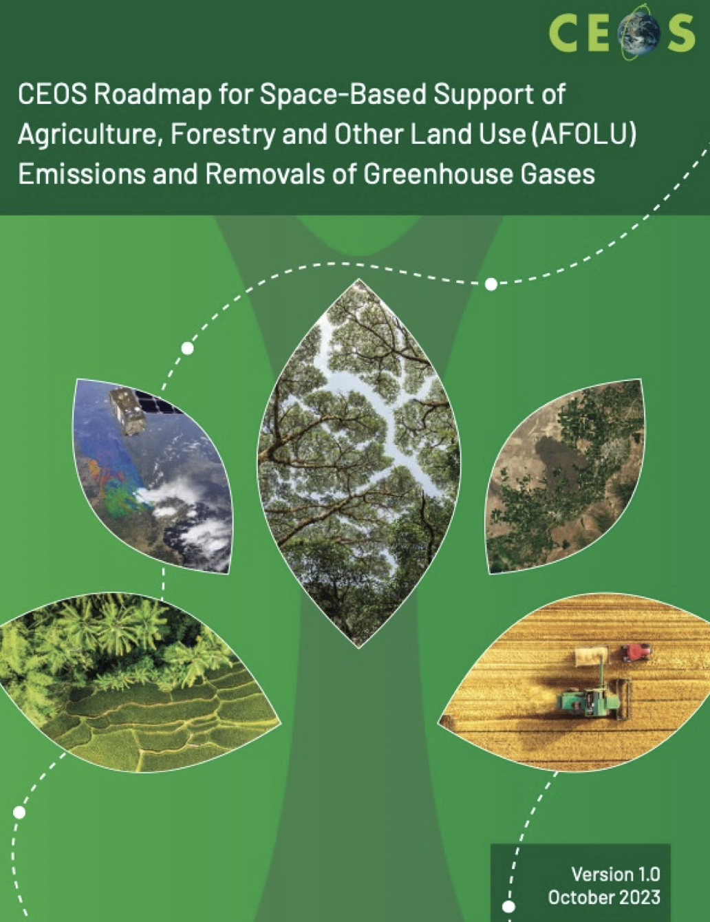
AFOLU Roadmap
A framework for long-term coordination of agency programmes in support of the needs of society for Agriculture, Forestry and Other Land Use (AFOLU)-related information, with a particular focus on the needs and ambition cycle of the Global Stocktake of the 2015 Paris Climate Agreement.
A guiding vision for long-term space agency coordination around AFOLU.
An effective means for communicating the intentions of CEOS
Addresses basic observation continuity and necessary agency coordination to achieve goals of sustained land-imaging of land-use and land cover change and biomass estimation.

Slide 3
Classes of actions
Actions across all Recommendations broadly fall into three categories:
  Those pertaining to presently available data to support AFOLU procedures, as in the 2006 IPCC Guidelines for National GHG Inventories Vol.4 and their 2019 Refinement.
  Actions to develop new or improved products that would allow more accurate and/or easier implementation of the Guidelines
  Actions to facilitate greater interaction with the GHG Roadmap and hence improve characterisation of land management emissions through MVS based on satellite-based atmospheric inversions.
    - At this stage, the focus is on the two action classes above due to technical reasons related to MVS integration
Notes:
- focus at this stage on two action classes above for technical reasons on MVS integration)

Slide 4
Recommendations & actions
Universal access to satellite (sensor) data needed for national reporting
Continuity and backward compatibility for missions providing activity data and emission factors
Improve data use in UNFCCC reporting and IPCC Guidelines
Enable dialogue between inventory practitioners and the CEOS community
Reconcile bottom-up, top-down and inventory estimates of GHG emissions and removals
Systematically target activities to support IPCC Land Cover classes
Work with New Space to provide comprehensive coverage for national GHG inventories
Ensure consistency of AFOLU and GHG Roadmaps for integrated national GHG inventory system, GHG+.
Notes:
- focus at this stage on two action classes above for technical reasons on MVS integration)

Slide 5

Actions
2.5: Biomass harmonisation group to work with GEO-TREES to implement validation of CEOS biomass products with GEO-TREES data.
Notes:
- focus at this stage on two action classes above for technical reasons on MVS integration)

Slide 6

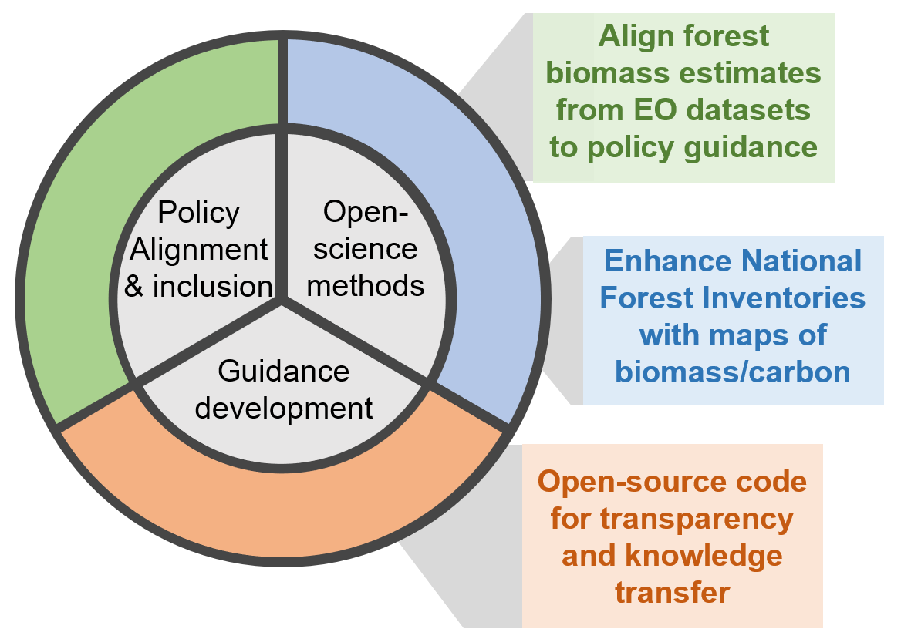


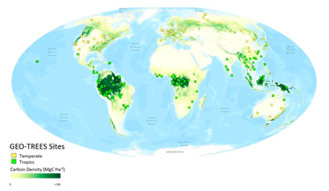
Biomass Harmonization
Under CEOS Biomass Harmonization, there are ongoing country case-studies on the improvement of GEDI biomass estimates and integration with NFIs
Generally, there is an increasing interest of NFI and EO integration techniques from countries
GEO-TREES will provide a global biomass reference network - this an action toward biomass product validation
CEOS Biomass Harmonization planning a submission of forest biomass estimates to IPCC Emission Factors Database (EFDB)
Notes:
This submission to Emissions factors database is hpp

Slide 7
Actions
2.2: Coordination with IPCC TFI through meetings, workshops, regular COP/SBSTA participation and side events for engagement. Establish agreed IPCC-consistent land cover definitions based on satellite data with other actors. Explore the possibility of a systematic and comprehensive approach to submission of CEOS agency datasets to the IPCC Emission Factors Database
Notes:
- focus at this stage on two action classes above for technical reasons on MVS integration)

Slide 8
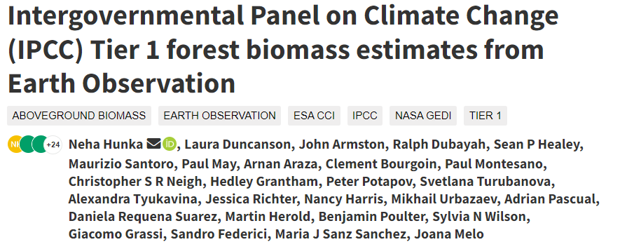
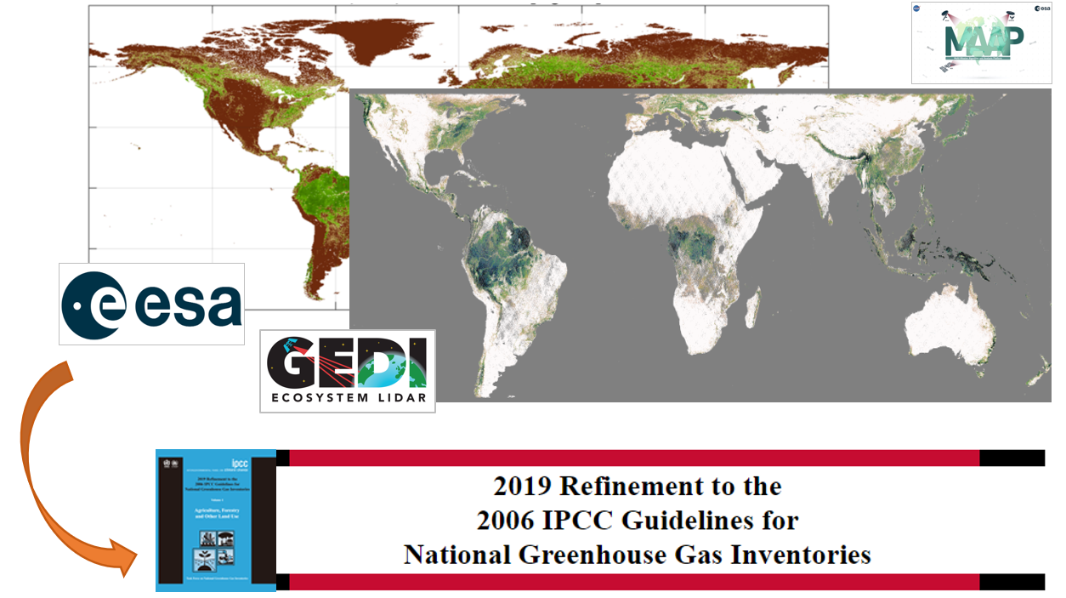
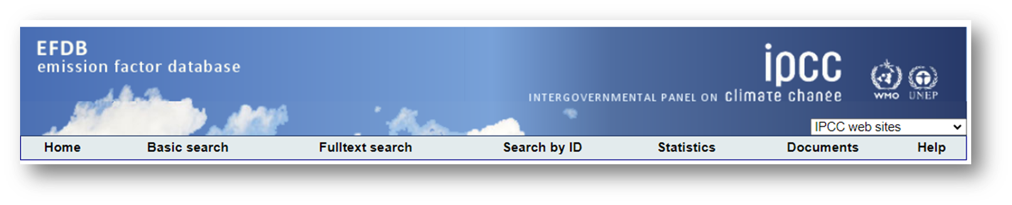
Biomass Harmonization: IPCC EFDB
The research generates natural forests biomass estimates in the format of Intergovernmental Panel on Climate Change (IPCC) Tier 1 values
The approaches leverage strengths of various EO-derived datasets, compiled in a transparent, open-science framework
The dataset will be regularly updated as biomass maps improve in accuracy
Request for this to be a CEOS submission to the IPCC EFDB
Pre-print available
Notes:
This submission to Emissions factors database is hpp

Slide 9
Actions
5.3: Review and consolidate current approaches to characterising, mapping and monitoring Blue Carbon Ecosystems (BCEs) and establish approaches that are consistent globally and across scales. Facilitate detection and description of change and links between terrestrial and aquatic environments.
5.4: Support the development of new CEOS initiatives on wetlands mapping and monitoring. Ensure new CEOS missions consider wetlands amongst mission goals, recognising the heterogeneity of wetlands and the need for multi-sensor approaches.
Notes:
- focus at this stage on two action classes above for technical reasons on MVS integration)

Slide 10
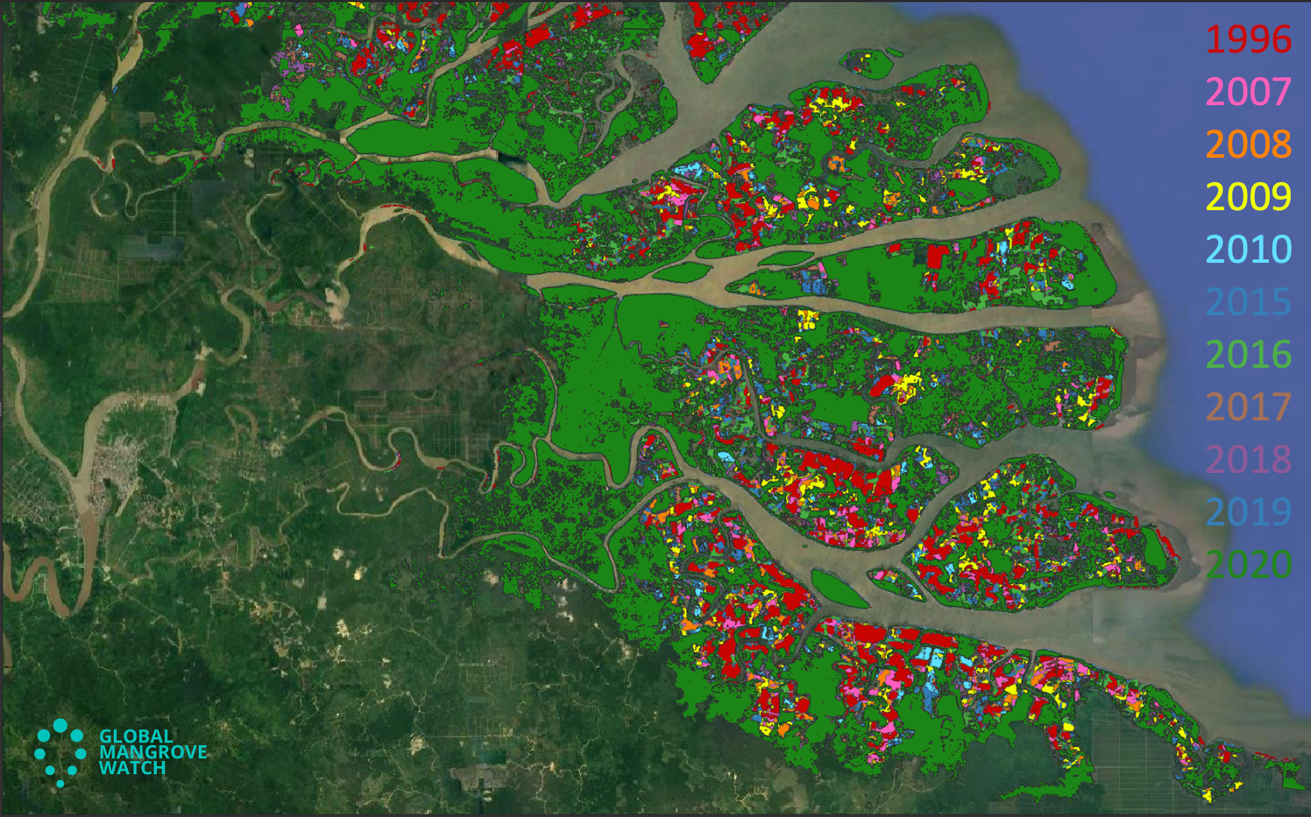
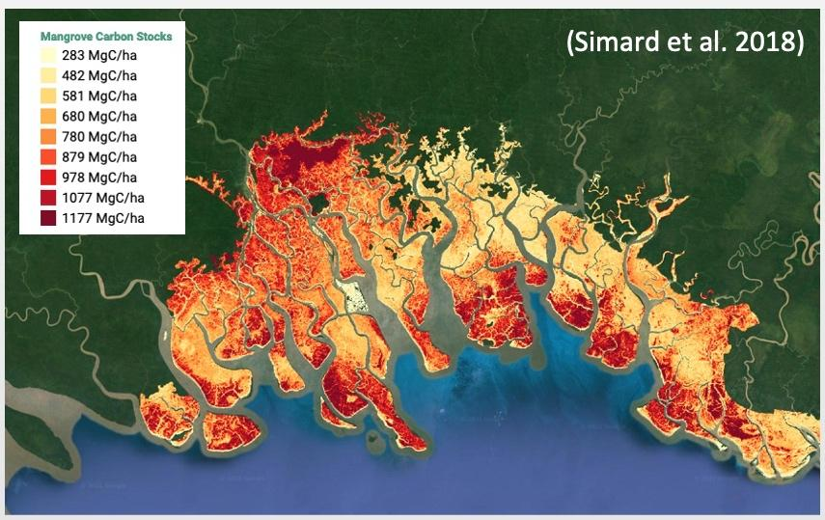
Other Land Use – Wetlands & Blue Carbon
(Bunting et al. 2022)
MANGROVES (Forest / OLU-Wetlands)
Activity Data – Global Mangrove Watch (JAXA Kyoto & Carbon (K&C))
Global maps of mangrove area and annual changes at 25 m derived from L-band SAR and optical data 1996 - 2020.
New baseline map for 2020 at 10 m developed. Open access in public domain.
1996–2023 change maps available by Q1/2025
Emission Factors – LCLUC Global Mangrove Mapping (NASA JPL/GSFC)
Global maps of mangrove Height, AGB and Total Biomass.
New 2015 baseline at 12 m from TanDEM-X DEM and GEDI finalized, Methods paper in review and data publicly available on NASA ORNL Data Archive
Notes:
- focus at this stage on two action classes above for technical reasons on MVS integration)

Slide 11
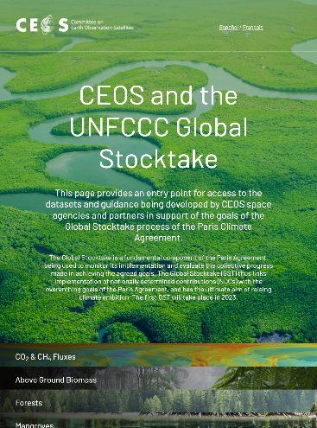

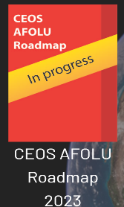
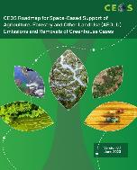

Support Carbon monitoring in all domains
CEOS Global Stocktake Strategy Paper and Global Stocktake Portal
CEOS Aquatic Carbon Roadmap
Under development!
Demonstrate the value of Earth Observation satellite datasets to support the Global Stocktake process
Summary of CEOS thematic observing strategies:
https://ceos.org/observations/
<< www.ceos.org/gst
Notes:
CEOS has been formalising its strategies for various aspects of carbon and climate in all three domains:
In 2020: Greenhouse Gas Roadmap has been agreed.
In 2021: Strategy to Support the Global Stocktake.
In 2023: Agriculture, Forestry and Other Land Use (AFOLU) Roadmap in 2023.
In 2024: Aquatic Carbon Roadmap is under development. Also an AFOLU Roadmap actions supplement.
WMO regularly engages with the implementation of the CEOS Greenhouse Gas Roadmap, through the CEOS-CGMS Working Group on Climate Greenhouse Gas Task Team. This is a key area for CEOS and WMO collaboration.

Slide 12
Aquatic Carbon Roadmap Focus
Deliverable VC-23-01
Pools and processes of the ocean biological and solubility carbon pumps
Both the GHG and AFOLU roadmap have a strong focus on the major milestones of GST1 (2023) and subsequently for GST2 (2028) and how remote sensing data can effectively support these by providing means to monitor carbon emissions and removals, based either on a top-down approach (GHG roadmap) or a bottom-up approach (AFOLU roadmap).
Why should we care about the Aquatic realm?
The ocean acts as a significant carbon sink, by absorbing large amounts of carbon dioxide from the atmosphere through the ocean biological, solubility and injection pumps.
The coastal ocean also host crucial blue carbon ecosystems (mangroves, seagrass, salt marshes)
The inland waters also play crucial roles in the global carbon cycle by storing, sequestering, and transporting carbon, as well as influencing regional and global climate dynamics.
Brewin et al, 2001:Sensing the ocean biological carbon pump from space: A review of capabilities, concepts, research gaps and future developments, Earth-Science Reviews 217 (2021) 103604.
An improved understanding and monitoring of the aquatic carbon components will enhance the accuracy and reliability of global carbon stocktake assessments by providing insights into the role of the aquatic/oceans as a carbon sink and the factors influencing carbon storage dynamics.

Slide 13
Aquatic Carbon Roadmap Objectives
Deliverable VC-23-01
To provide a framework and serve as a guiding vision for long term (~ 15+ years) coordination of CEOS agency observing programmes in support of the science and policy needs for Aquatic carbon related information in the context of the CEOS carbon strategy.
To contribute to support the needs and ambition cycle of the Global Stocktake of the Paris Climate Agreement, by
        driving the inclusion of inorganic and organic carbon in the ocean within global and regional carbon assessments constraining the global carbon budget
        supporting countries reporting on their NDC by improving the estimation and monitoring the changes in CO2 fluxes from/to the inland waters/Oceans at country level (within each country’s exclusive economic zone (EEZ))
        improving the monitoring of major Blue Carbon coastal ecosystem’s extent and carbon stock around the world.
To characterize the needs, gaps and challenges, regarding the required data and products to support science, services and applications and the observing systems that can support their developments, including the needs to plan for ground and space segments. This includes addressing basic observation continuity and the necessary agency coordination to achieve it.
To clarify the importance and elevate the profile and complexity of remote sensing and satellite Earth observation that are already routinely used within carbon assessments, highlighting how Earth observation has much more to offer beyond its current use and serve as an effective means for communicating our intentions to society, UNFCCC, national inventory community.

Slide 14
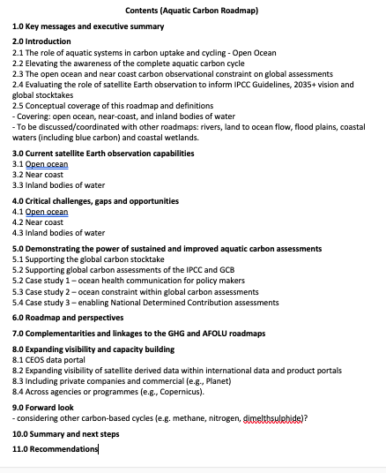
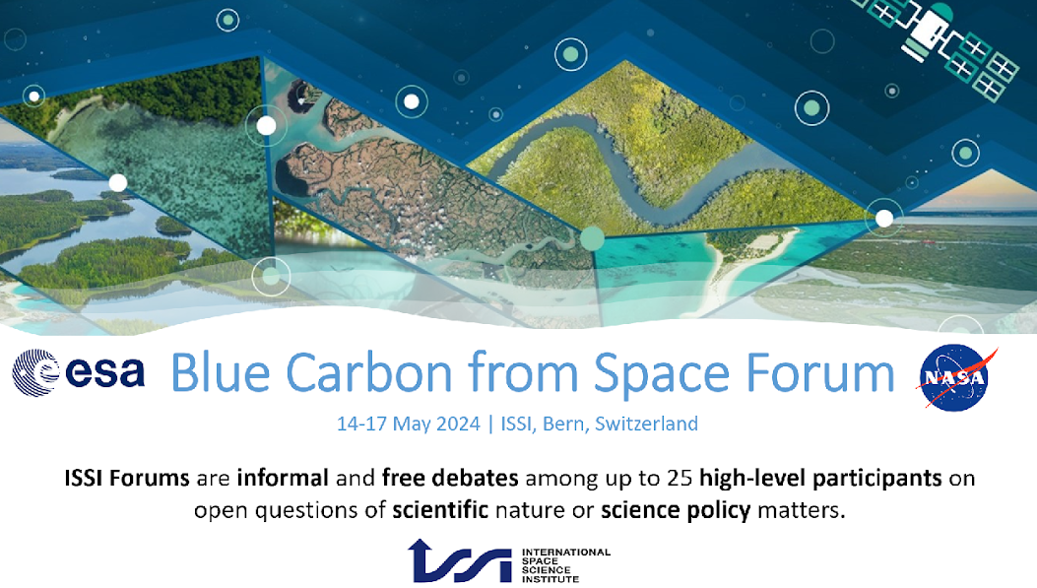
Toward an Aquatic Carbon Roadmap – Status
Coordinators
Marie-Helene Rio (ESA)
Laura Lorenzoni (NASA)
Hiroshi Murakami (JAXA)
Scientific leaders
Jamie Shutler (University of Exeter)
Bob Brewin (University of Exeter)
Cecile Rousseaux (GSFC-NASA)
Kelsey Bisson (NASA)
Notes:
We would welcome feedback from the GHG and the AFOLU roadmap; we have been working on the synthesis of the Coastal Blue Carbon Forum, and the perspective paper, which both will contribute to the roadmap. Leveraging existing projects and PIs to author chapters.

