Slide 1
CEOS GST Roadmaps Discussion CEOS Update| Oct 18, 2024 Ben Poulter
CEOS AC VC| 18 Oct 2024 |NOAA

Slide 2
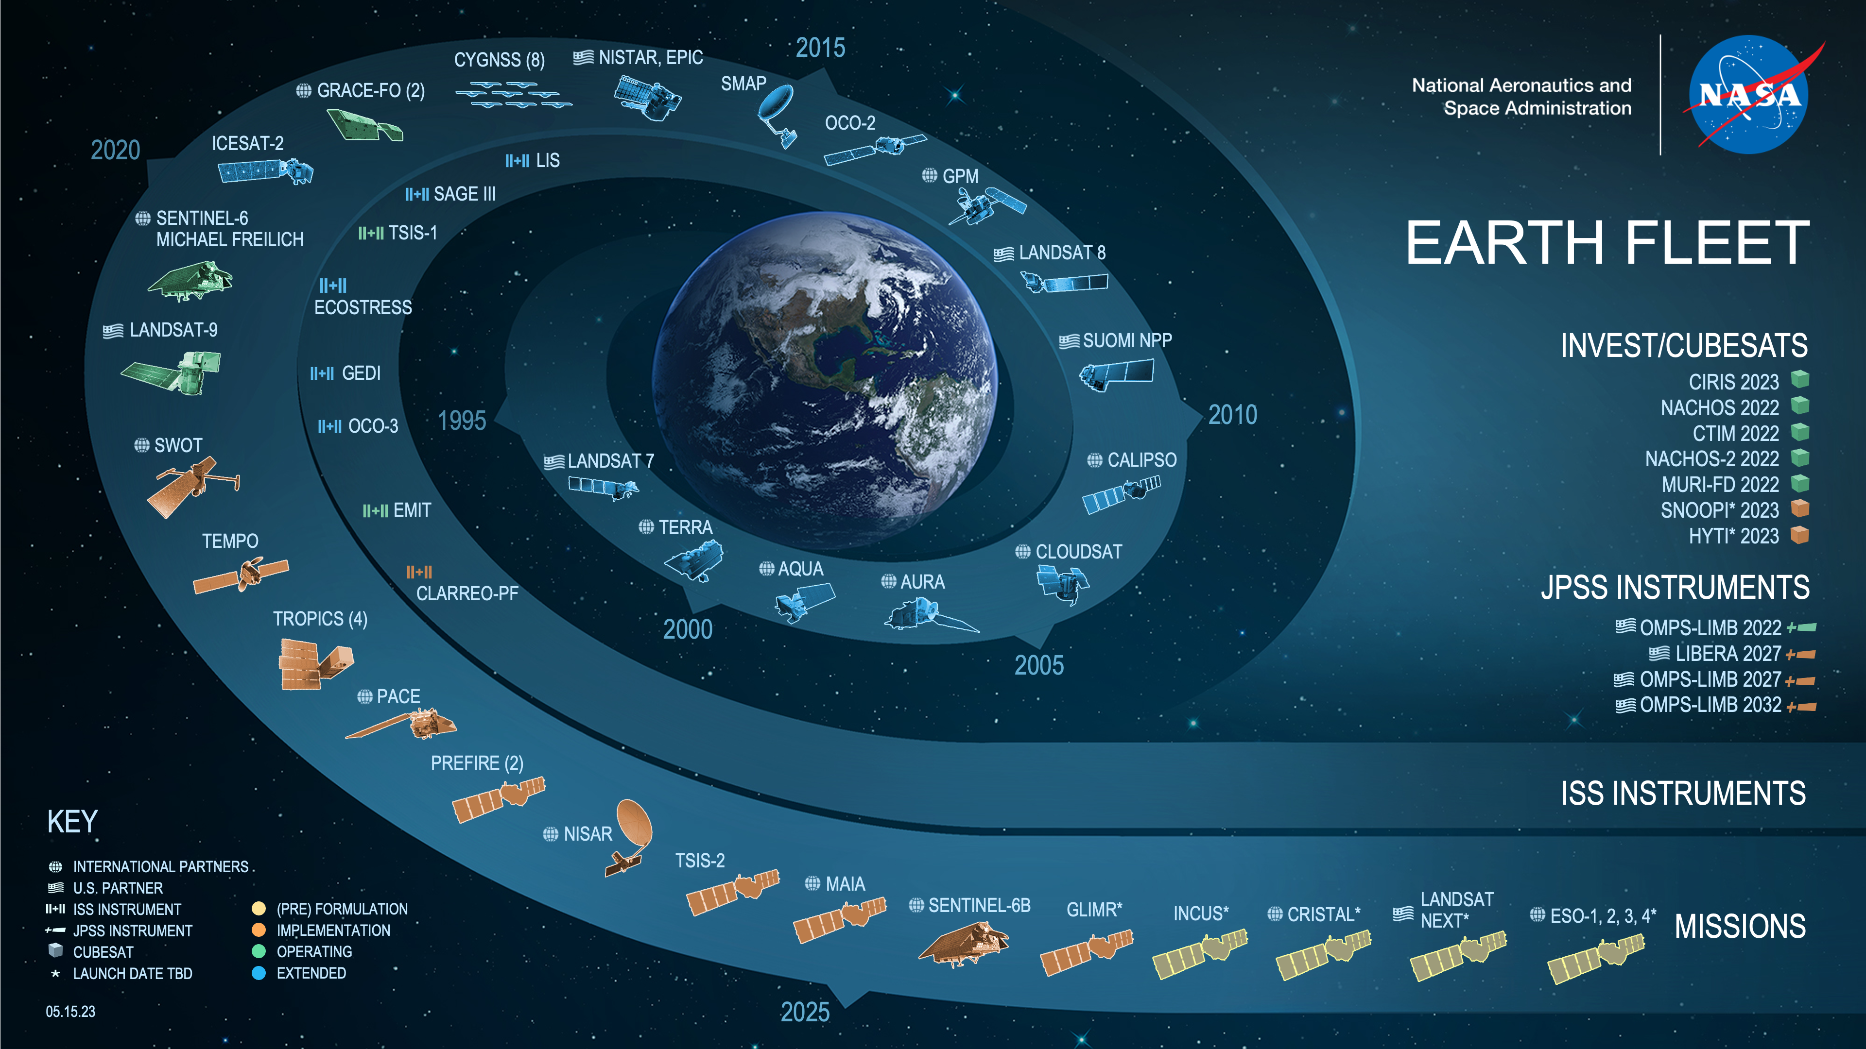
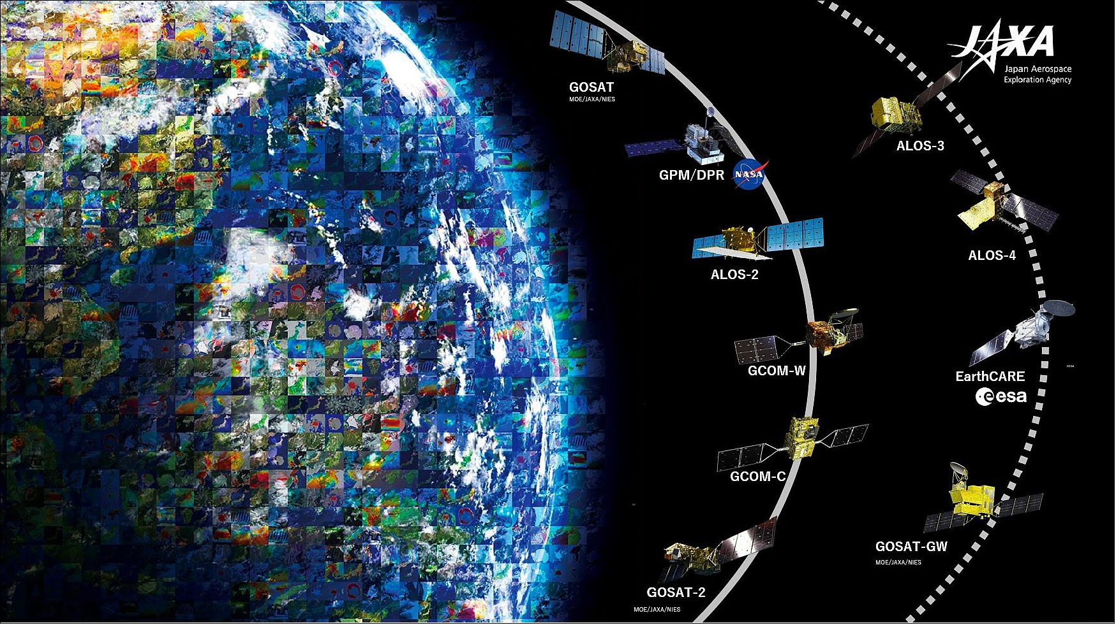
CEOS Strategy to Support the Global Stocktake
2021 strategy directs CEOS to support Global Stocktake by:
Identifying Earth Observations to support Greenhouse Gas measurements and AFOLU activity data and emissions factors
Coordinate with UNFCCC and IPCC Taskforce on Inventories
Support engagement w practitioners via SilvaCarbon & SERVIR
Implement a airborne field campaign demonstrator project
Work toward operational monitoring, verification & support system

Slide 3
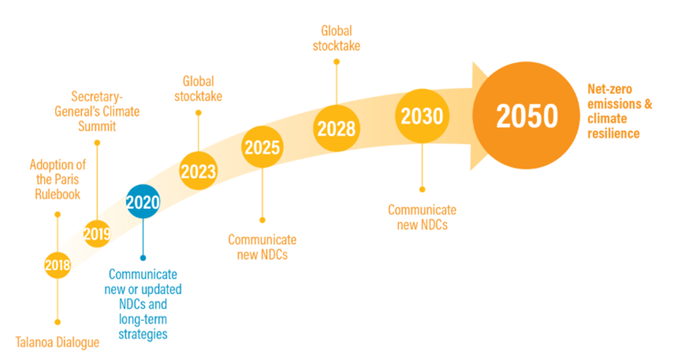
CEOS AFOLU submission to Technical Dialogue
https://www.climate-chance.org/en/comprehend/blog-observatory-global-africa/cop28-first-global-stocktake-what-to-expect-paris-agreement/

Slide 4
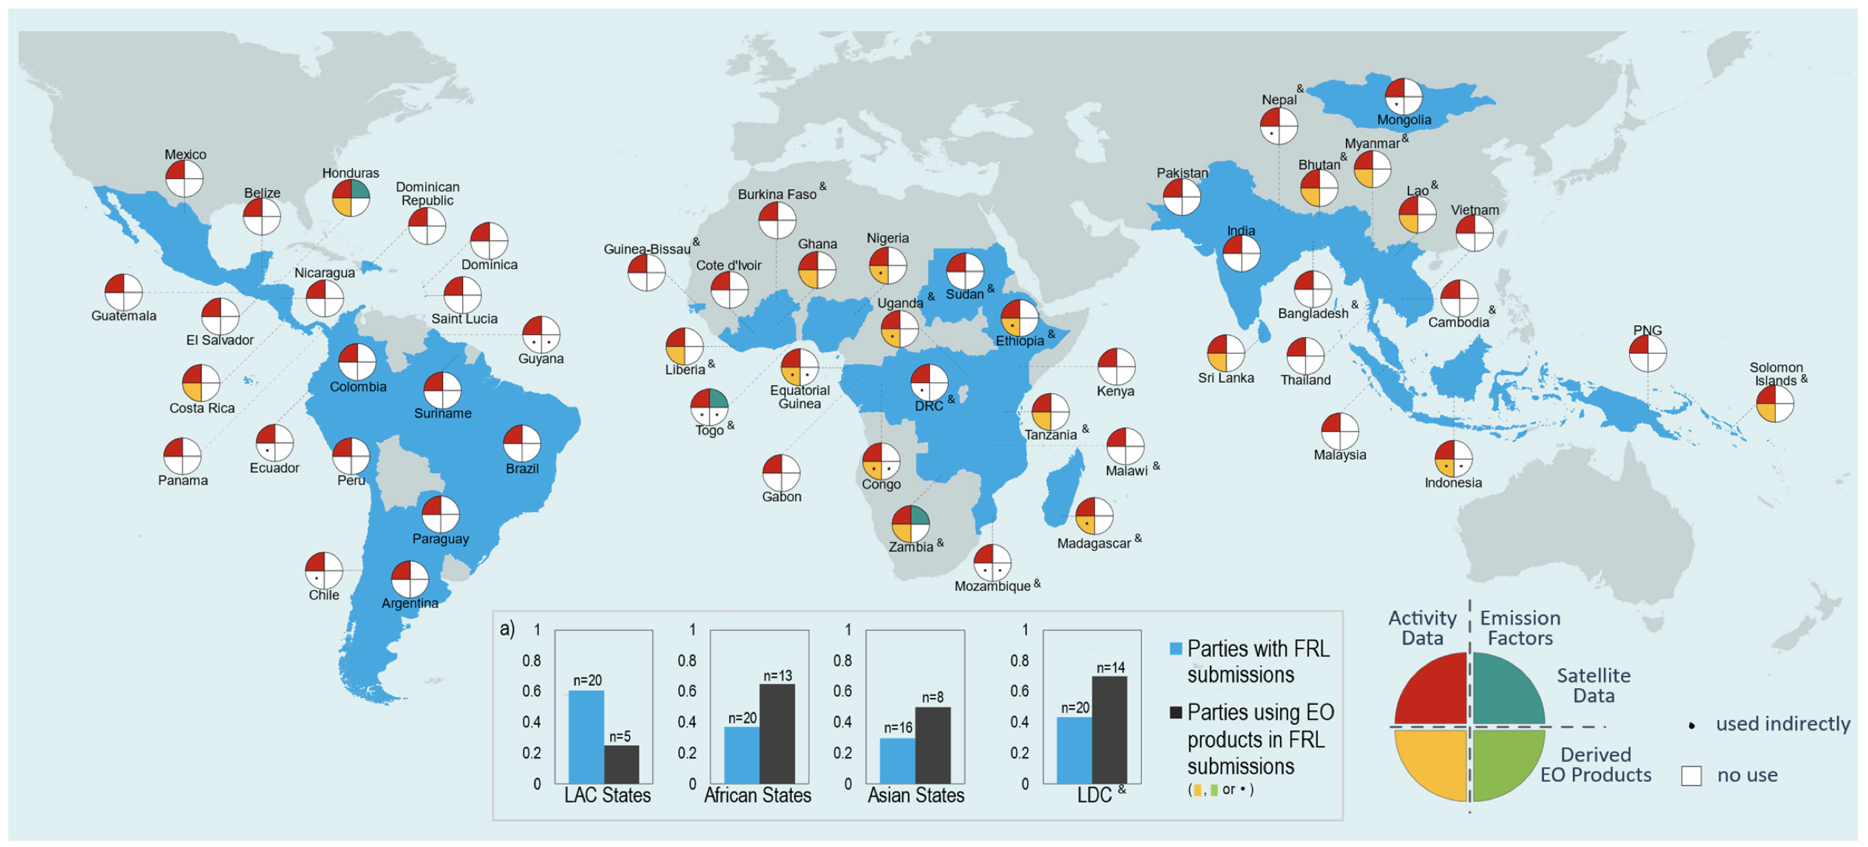
Opportunity for Earth Observations & National GHG Inventories
Melo et al., 2023, ERL

Slide 5
CEOS AFOLU Roadmap, Oct 2023
Benjamin Poulter (NASA Goddard Space Flight Center), Osamu Ochiai (JAXA), Frank-Martin Siefert (ESA), Clement Albergel (ESA), Stephen Briggs (ESA), Mark Dowell (EC-JRC), Laura Duncanson (University of Maryland), Sven Gilliams (VITO), Nancy Harris (WRI), Martin Herold (GFZ), Neha Hunka (University of Maryland), Heather Friendship-Kay (Aberystwyth University), Ian Jarvis (GeoGlam), Richard Lucas (Aberystwyth University), Yasjka Meijer (ESA), Joana Melo (EC-JRC), Shaun Quegan (University of Sheffield), Ake Rosenquist (JAXA), Frank-Martin Seifert (ESA), Lindsey Sloat (WRI), Terry Sohl (USGS), Daniela Requena Suarez (GFZ/WUR/GFOI), Stephen Ward (JAXA), Alyssa Whitcraft (University of Maryland), Silvia Wilson (USGS)

Slide 6
CEOS AFOLU Roadmap, Oct 2023
Contents
Overview of IPCC methodologies
Stock change
Gain loss
EO for Activity Data
Land cover change working group
EO for Emissions Factors
Biomass harmonization working group
Capacity Building and Stakeholder Engagement
Integrated Monitoring and Verification System
Recommendations

Slide 7
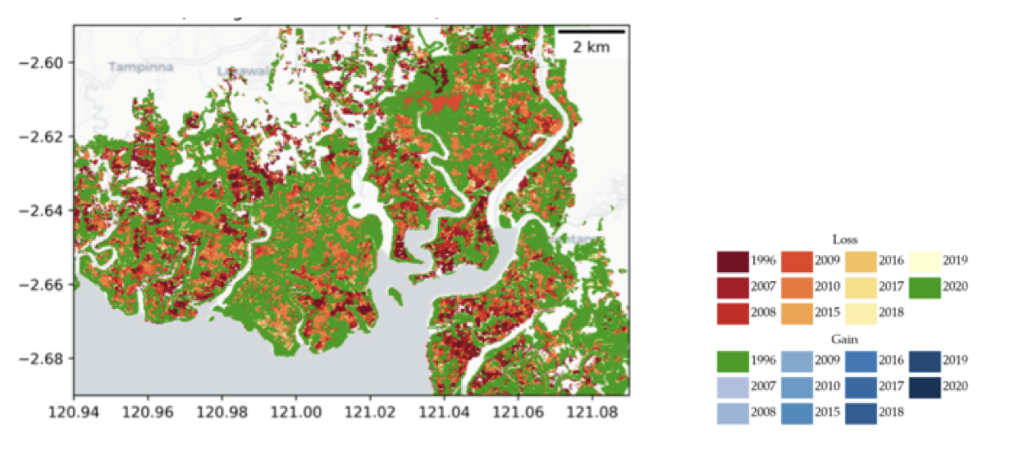
CEOS AFOLU Roadmap, Oct 2023
Global Mangrove Watch v3.0
Global Peatlands Database (2021)
Several SilvaCarbon workshops (Gabon, Thailand, …)

Slide 8
Recommendations broadly fall into three categories:
Those pertaining to presently available data to support AFOLU procedures as in the 2006 IPCC Guidelines for National GHG Inventories vol.4, and their 2019 Refinement.
Actions to develop new or improved products that would allow more accurate and/or easier implementation of the Guidelines
Actions to facilitate greater interaction with the GHG Roadmap and hence improve characterisation of land management emissions through MVS based on satellite-based atmospheric inversions.

Slide 9
CEOS AFOLU: Recommendation 1
Recommendation 1: long term continuity of data…
Recommendation 1.a: Provide information and feedback on new missions for LUC and biomass e.g. BIOMASS, ALOS-4, NISAR< Landsat Next, Sentinel 1&2 NG. Support ongoing update of CEOS MIM database
Action: All CEOS Members to maintain information flow on new mission characteristics through CEOS MIM database.
Recommendation 1.b harmonise efforts of to improve consistent long-term activity data, and biomass estimates in relation to emission factors
Action: CEOS members to support ongoing research areas such as NASA GEDI/CMS, ESA CCI Biomass, JAXA Biomass mapping project

Slide 10
CEOS AFOLU: Recommendation 2
Recommendation 2: ensure communications of use of EO data in UNFCCC reporting….
Recommendation 2.0: Support UNFCCC actions and lessons learned throughout GST process…
Action: Ensure lessons learned from GST1 – SIT Chair
Recommendation 2.a: Ensure dialogue with TSU on use of EO data in inventory guidelines…
Action: report on status of progress with IPCC TFI, TSU and RSO/SBSTA (with WGClimate) – SIT Chair
Recommendation 2.b: Best practice guidance on use of EO…
Action: Develop demonstration studies with individual country GHG and forest Inventory agencies, jointly with GFOI workshops – GFOI leads, CEOS LPV biomass co-leads, Silvacarbon – report at SIT
Recommendation 2.c: establish international cooperation on Forest Biomass Reference Measurement program
Action: work with GFOI, GEO-TREES, MAAP and FRM4BIOMASS – AGB team., SIT Chair
Recommendation 2.d: align consistent terminology for forest biomass estimates and uncertainty
Action: Implement expert meetings to improve country guidance on NFI and forest regrowth emissions and removals – GFOI team & AGB team
Recommendation 2.e: improve traceability and consistency in land activity definitions
Action: undertake a concrete study on intercomparison of land activity definitions with those used in GHG inventories – LSI-VC, LC team. New initiative proposed at SIT

Slide 11
CEOS AFOLU: Recommendations 3-4
Recommendation 3.a: national inventory team training
Action: invest in local training of inventory agencies, aligned between CEOS and GFOI Capacity Building – GFOI CB team, LSI-VC Forest and Biomass(F&B) SG Leads
Recommendation 4.a: develop guidance and datasets to compare bottom-up and top-down methods of emission estimates in cooperation with GHG TF, including through Amazonas 2024 campaign (ESA, INPE, NASA…)
Action: work with GHG-TT, WMO G3W, EU CO2MVS, US-CMS, NIES (Japan) and others to ensure consistency - GHG TT Chair, LSI-VC F&B SG Leads.
Action: support ongoing discussions with WMO on design and implementation of G3W – GHG-TT Chair, LSI-VC F&B SG leads

Slide 12
CEOS AFOLU: Recommendations 5-7
Recommendation 5.a: Support activities to compare IPCC and FAO/LCCS land cover classes
Action: demonstration studies locally and globally to intercompare broad IPCC land classes and more detailed FAO/LCCS satellite -based classification – LSI-VC, LSI-VC F&B SG
Recommendation 5.d: improve mapping of wetlands including managed/unmanaged stratification
Action: support new wetlands mapping work (including Global Mangrove Watch) and ensure future missions take this into account - JAXA, ESA lead
Recommendation 6.a/6.b/6.c: consider how New Space Missions can support GHG inventories through improved AFOLU information:
Action: take outputs of NSTT report to understand how best to cooperate in relevant areas – LSI-VC
Recommendation 7 (see also Action 4.1): Ensure consistency of AFOLU and GHG RMs to support an integrated GHG+ inventory system
Action: support ongoing discussions with WMO on design and implementation of G3W – GHG-TT Chair, LSI-VC F&B SG leads

Slide 13
Lessons Learned
Success is from building community support through engaging with contributing authors, presenting at conferences, supporting workshops, and circulating drafts for comments
While the writing process was slow, the process was also adaptive to new data and new insights coming from the implementation of the first Global Stocktake
During the writing phase, many of the recommendations took on a life of their own and the roadmap is already seeing improved coordination with EO community and UNFCCC and IPCC
The 2025-2026 Amazonia field campaign will help advance and integrate science and GHG accounting while training current and new generation of scientists

