Slide 1
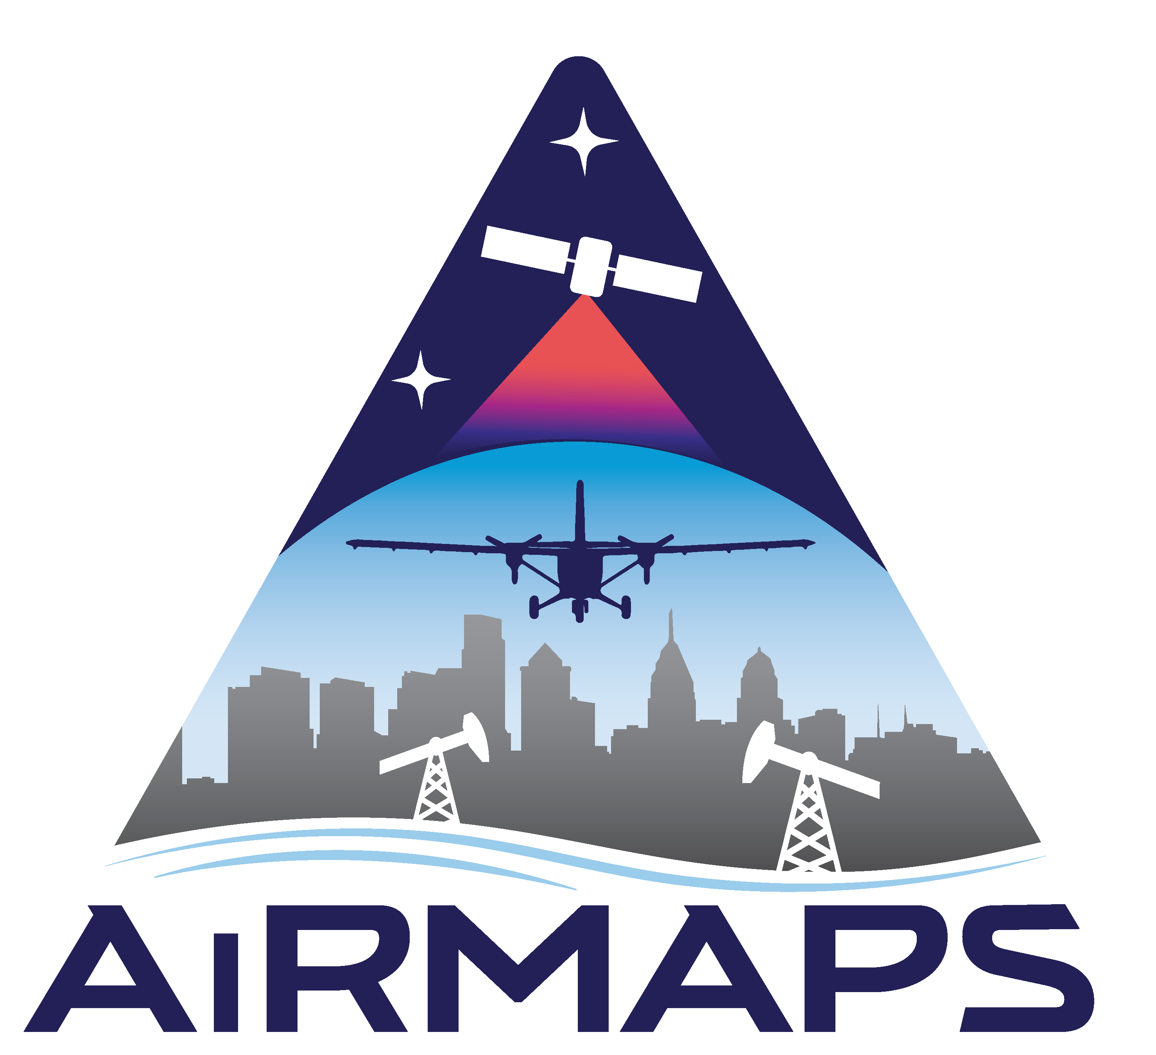
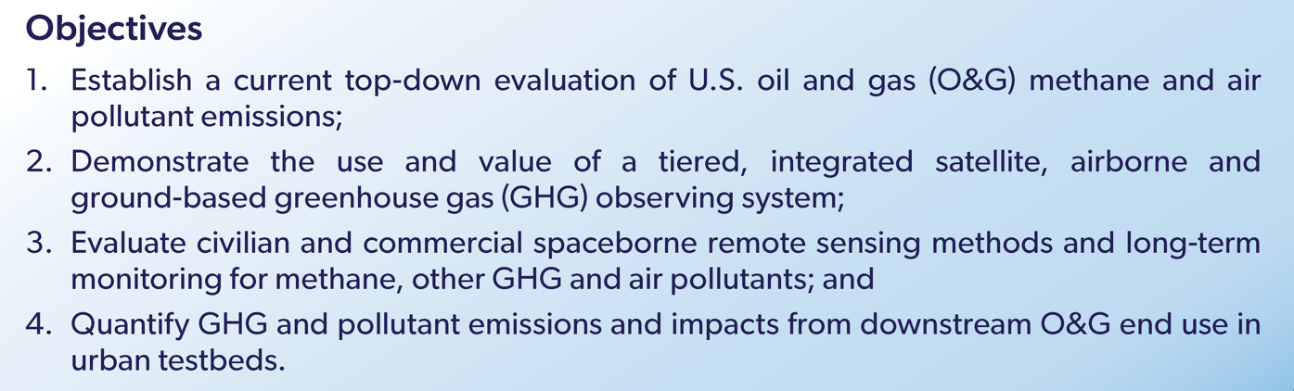


AiRMAPS
Airborne and Remote Sensing Methane and Air Pollutant Surveys
https://csl.noaa.gov/projects/airmaps/
NOAA Office of Atmospheric Research (OAR)
  Chemical Sciences Laboratory (CSL): Steven Brown, Brian McDonald, Carsten Warneke, Sunil Baidar
  Air Resources Laboratory (ARL): Xinrong Ren, Winston Luke
  Global Monitoring Laboratory (GML): Colm Sweeney, Arlyn Andrews, Jeff Peischl
  Climate Program Office (CPO): Monika Kopacz, Annarita Mariotti
NOAA National Environmental Satellite, Data and Information Service (NESDIS)
  Center for Satellite Applications and Research (STAR): Shobha Kondragunta
  National Centers for Environmental Invormation (NCEI): Jeff Privette

Slide 2
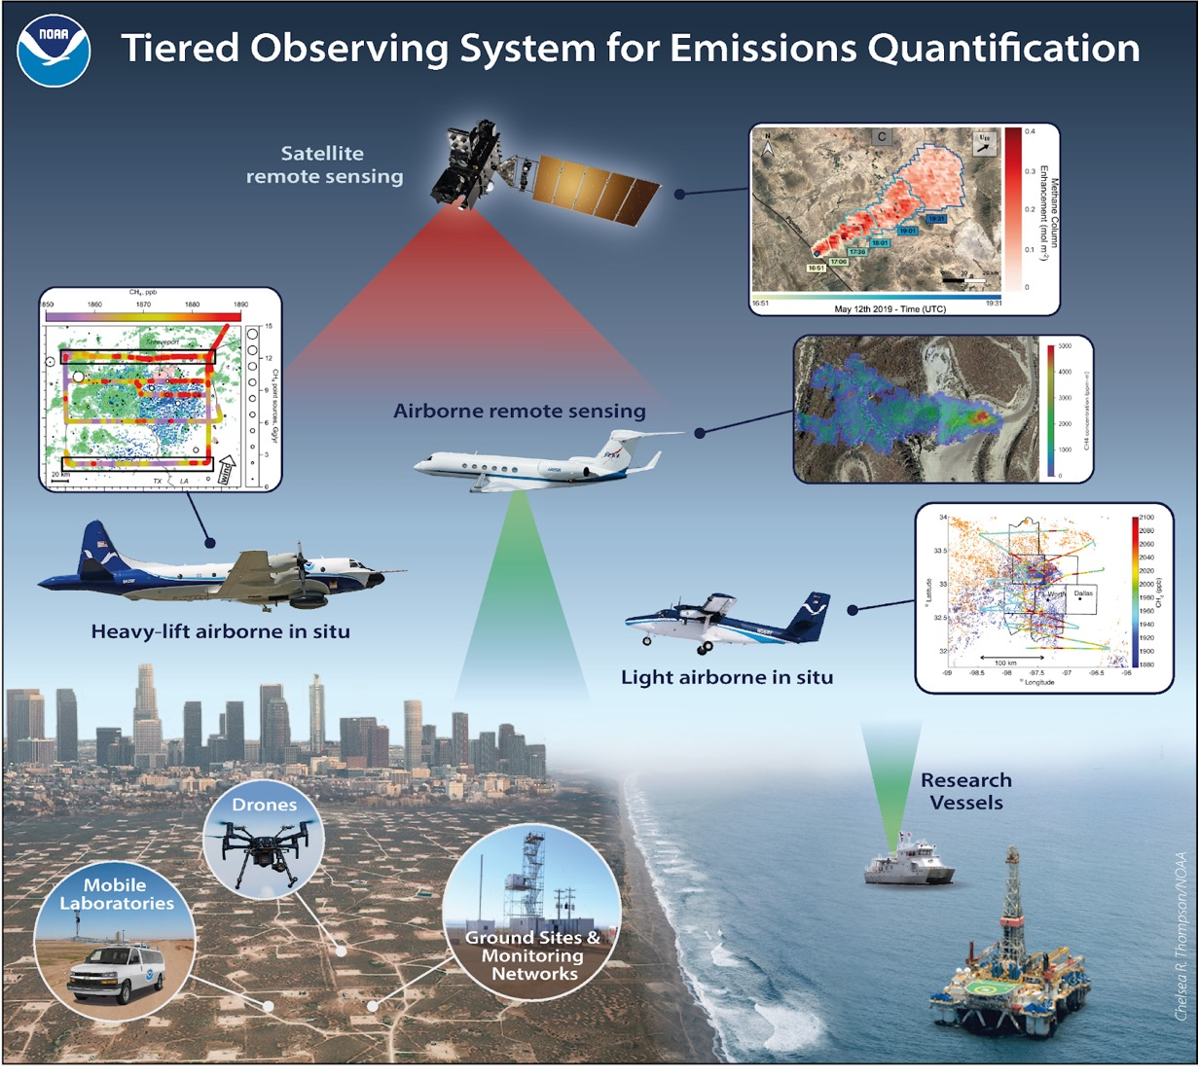
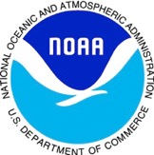


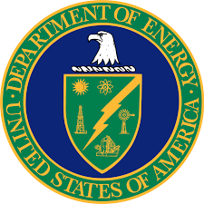


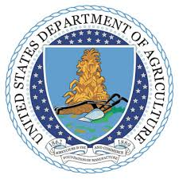


NOAA OAR (CSL, ARL, GML, CPO): 3-5 year deployments of Twin Otter and P-3 aircraft
NOAA NESDIS: Partner with airborne observations to augment and validate satellite based air quality (UV-VIS) and GHG (SWIR) instruments
Partners: NOAA intends to execute this strategy in collaboration with other agencies and stakeholders
State agencies
Academic partners
Industry

Slide 3
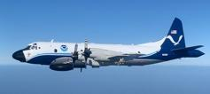
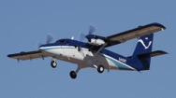
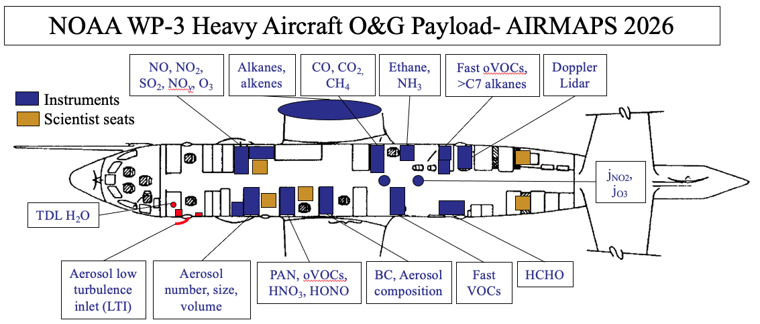
NOAA Airborne Platforms
NOAA Twin Otter
NOAA P-3
NOAA P3 heavy aircraft: full payload for complete measurements of GHG and other pollutants
NOAA Twin Otter light aircraft: smaller payload for GHG, NO_{x}, O₃ and other tracers
Both aircraft: Doppler wind lidar for dynamics & transport

Slide 4
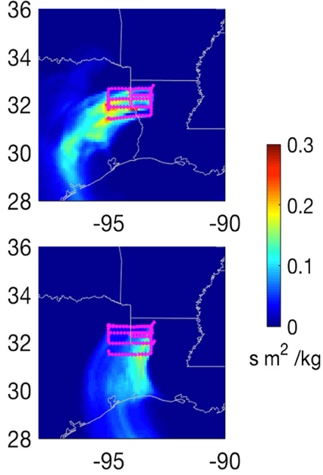
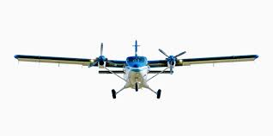
Airborne Methods for Quantifying Emissions
Mass Balance
Tracer Relationship
Eddy Covariance
Inverse Modeling
Airborne Doppler lidar
NOAA CSL has used all four methods for emissions quantification using airborne, multi-species measurements
Incorporation of Doppler lidar for wind fields and boundary layer depth improves mass balance

Slide 5
Airborne Surveys & Schedule
2024
Oil & Gas: Denver Julesburg Basin, CO; Uinta Basin, UT
Urban: Denver, CO; Salt Lake City, UT
2025
Oil & Gas: Marcellus
Urban: Baltimore – DC
2026
Oil & Gas: TX, OK, LA, AR, Gulf of Mexico
Urban: Dallas, Houston

Slide 6
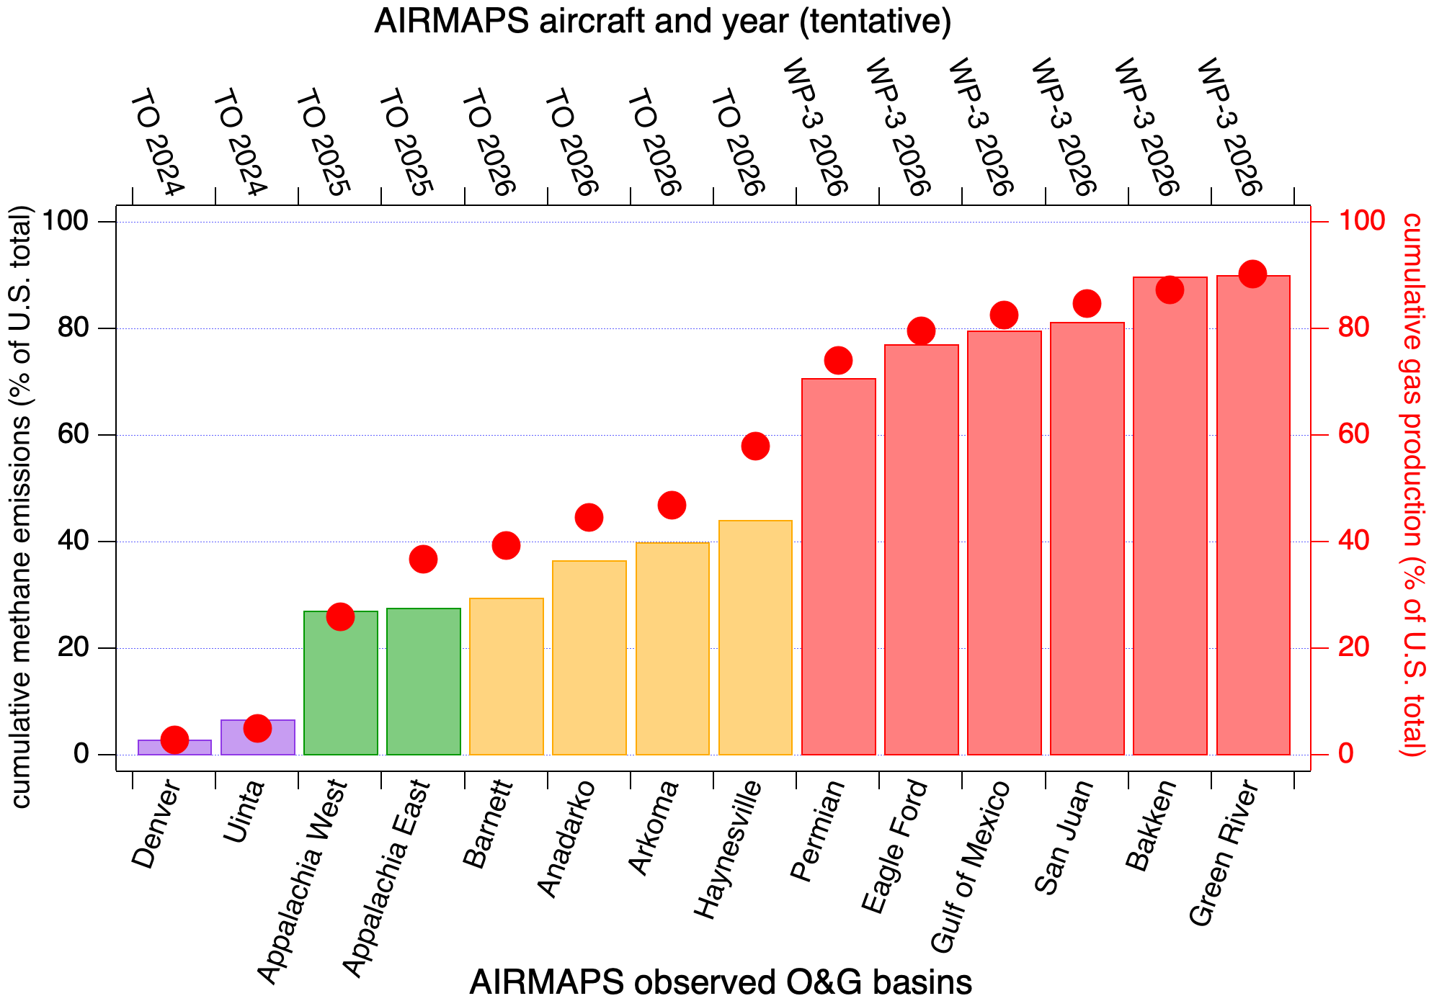
Airborne Surveys & Schedule
Two aircraft platforms (Twin Otter and P-3) plan to survey ~ 90% of U.S. O&G methane emissions

Slide 7
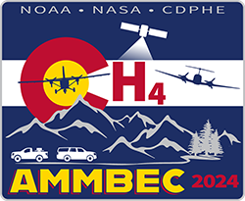
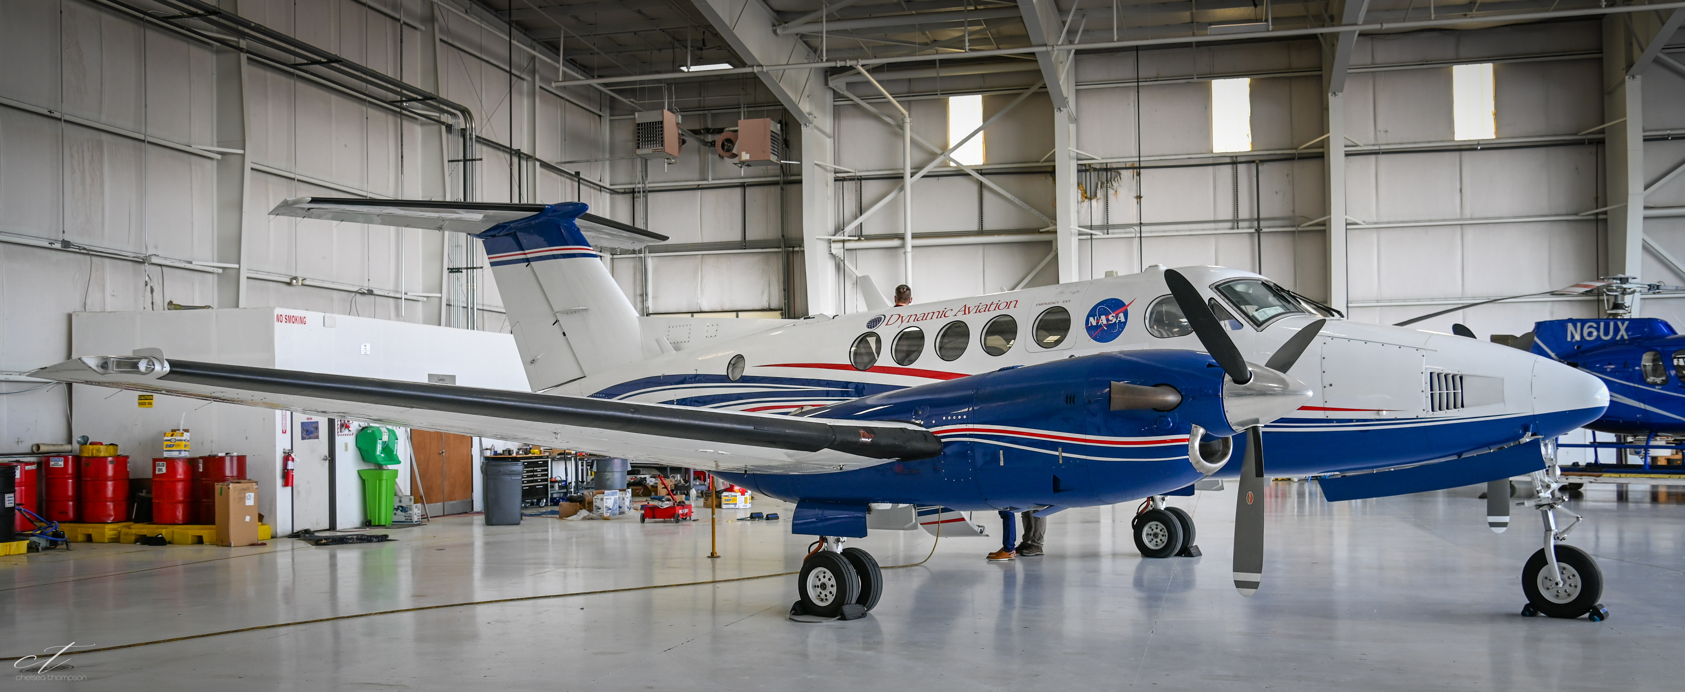
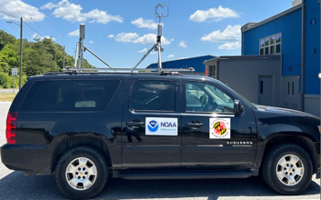
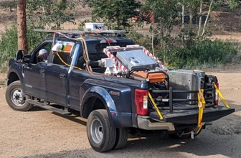
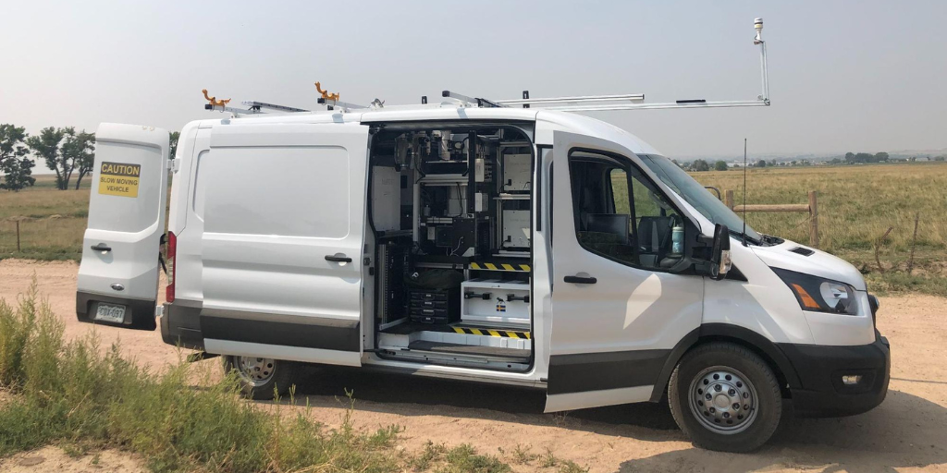
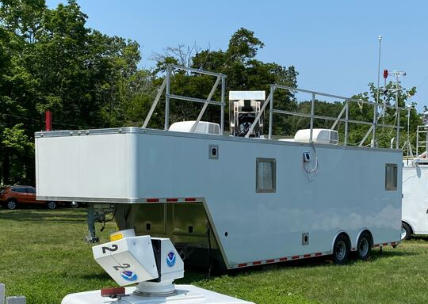
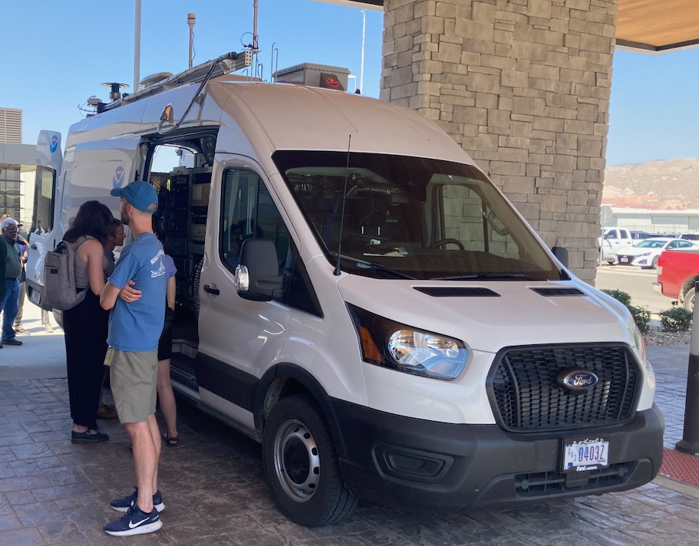
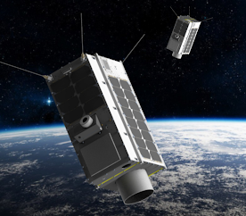
AiRMAPS 2024 Colorado: AMMBEC
Airborne Methane Mass Balance Experiment in Colorado, July 1 – 14 2024
NOAA Twin Otter (In-situ CH₄, NO_{x}, column NO₂, Doppler lidar): 22 individual flights, 12 flight days, ~75 flight hours
NASA King Air (AVIRIS-3 CH₄ imaging spectrometer): 9 individual flights /flight days, ~45 flight hours
NOAA Air Resources Car (NOAA’s ARC) (In-sit CH₄, NO_{x}, other trace gases): 11 drive days
PickUp Mobile Atmospheric Sounder (PUMAS): Doppler lidar at Platteville, CO
CDPHE Mobile Optical Oil and gas Sensor of Emissions (MOOSE)
Penn State DJ Tower Network
GHGSat data from NESDIS
TOPAZ Ozone Lidar: Boulder, CO
CSL Mobile Laboratory: Detailed GHG, VOC, NO_{x}

Slide 8
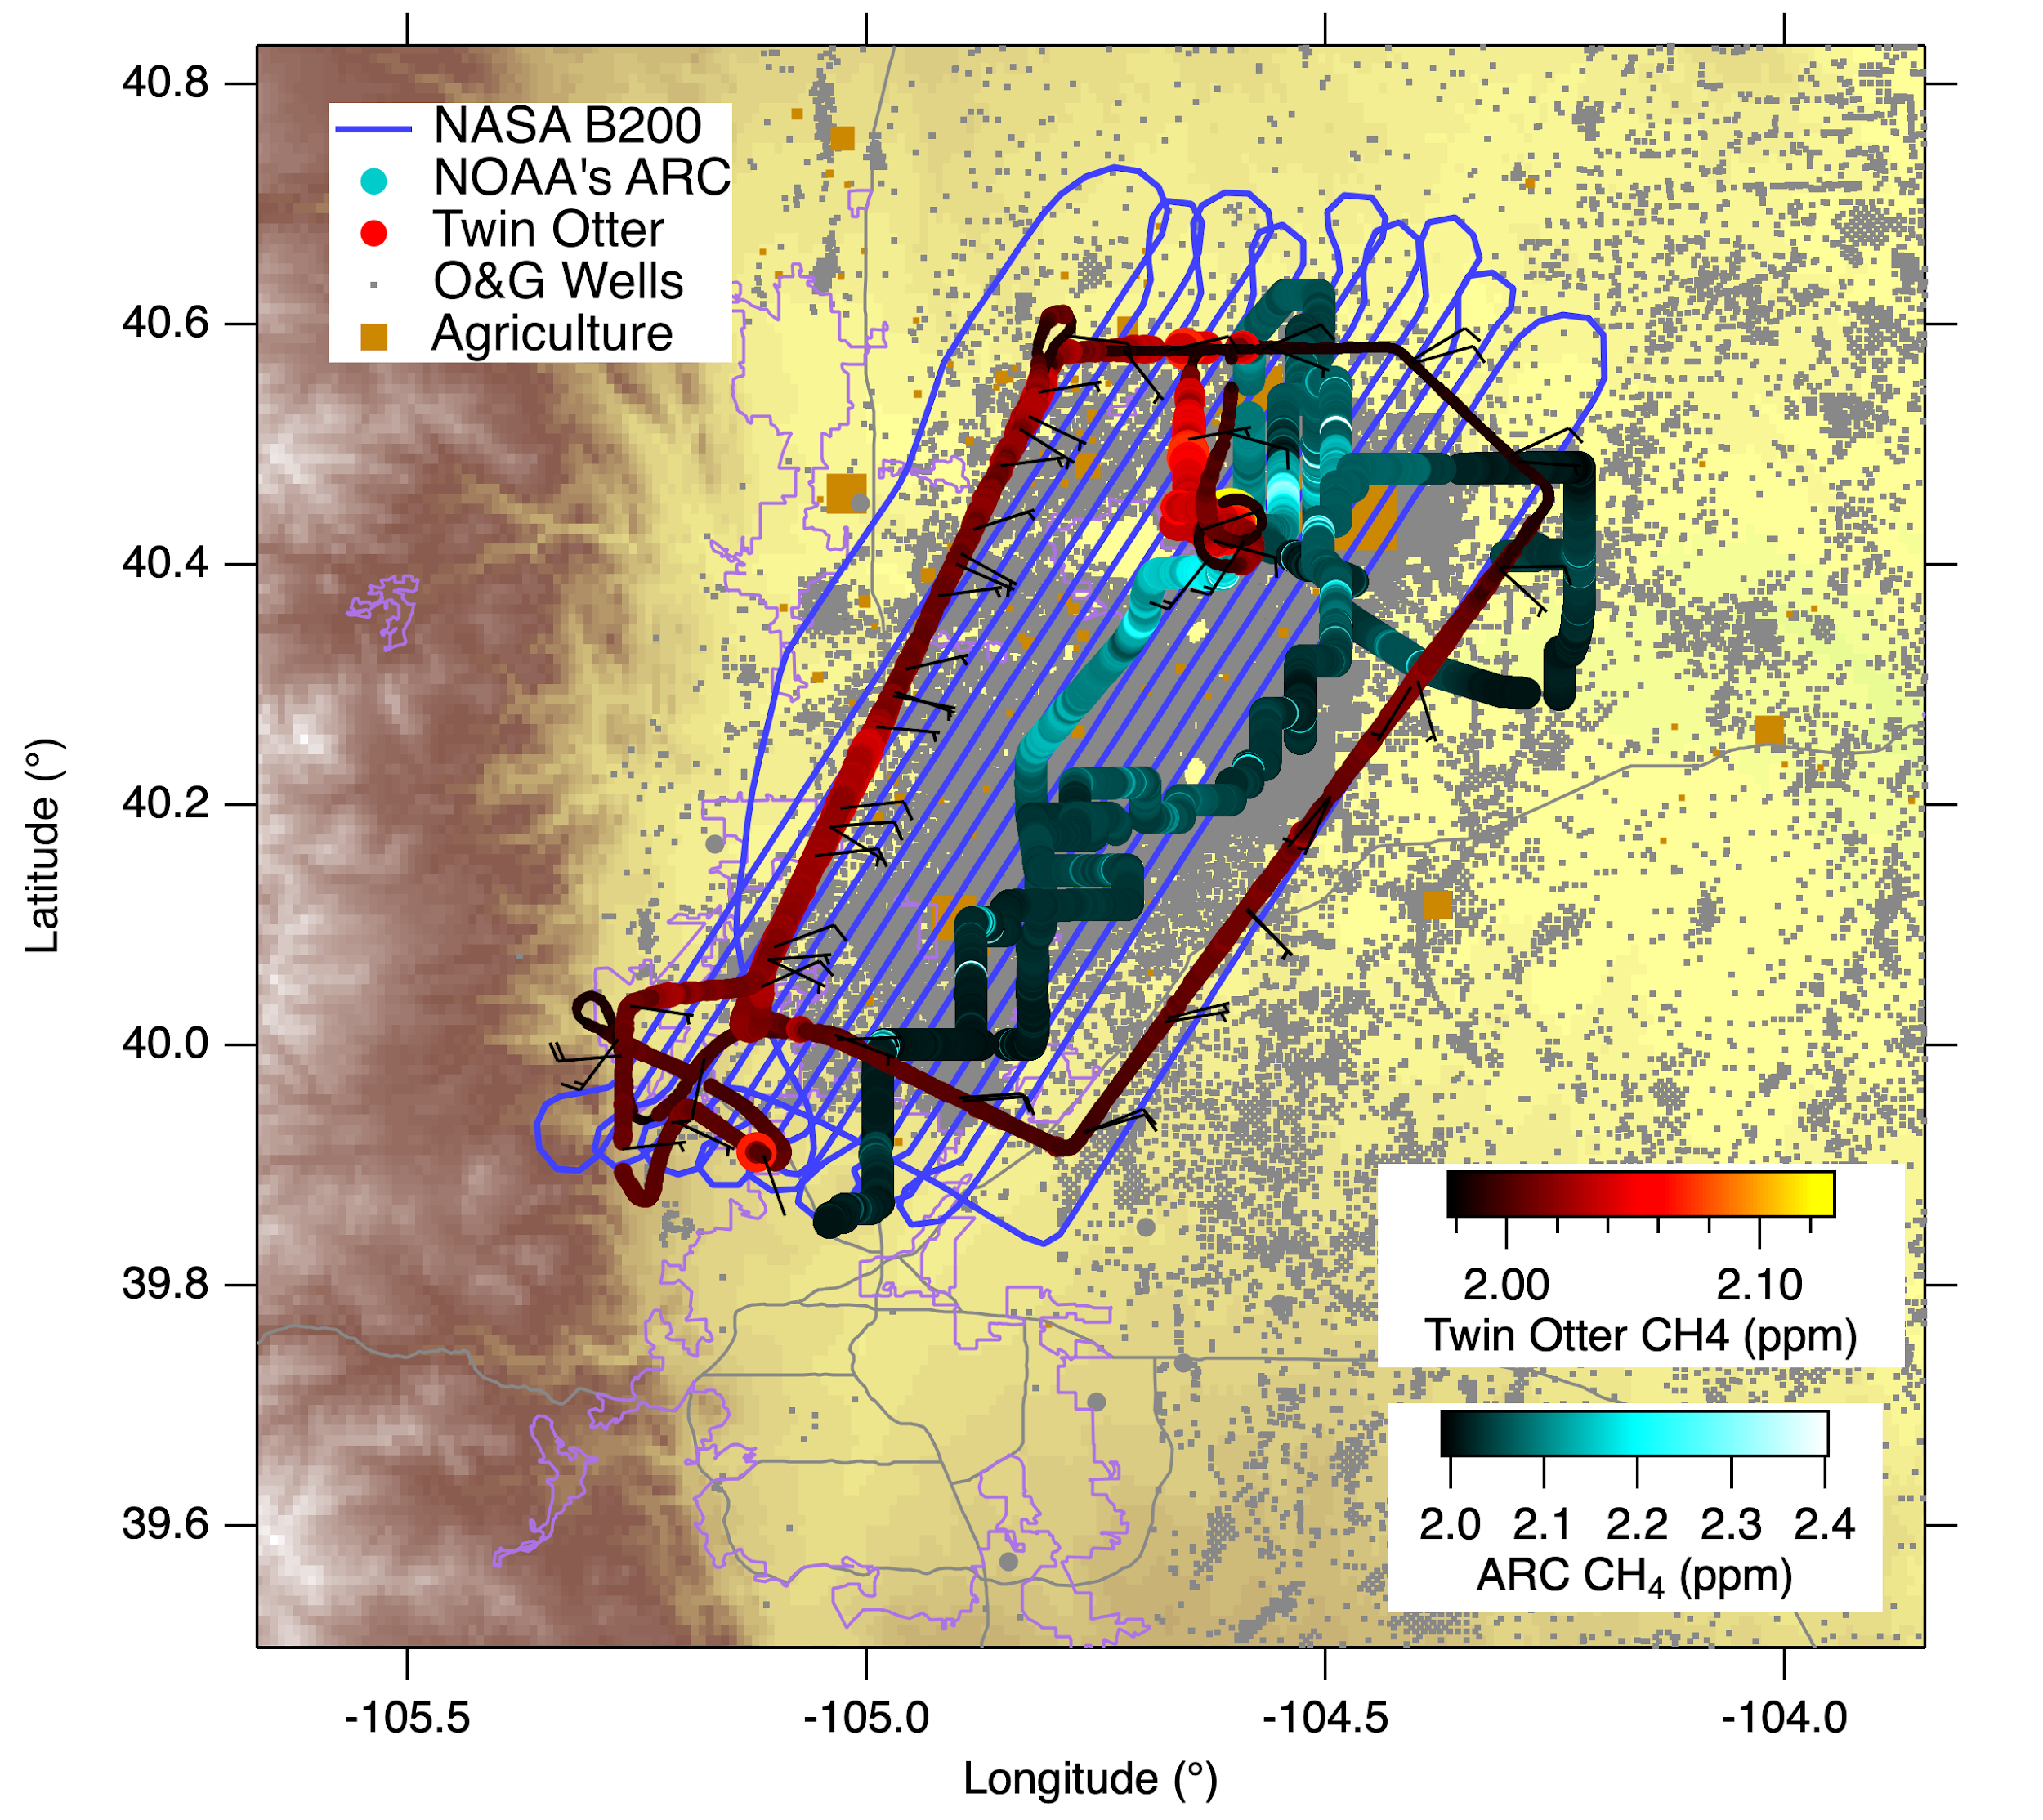

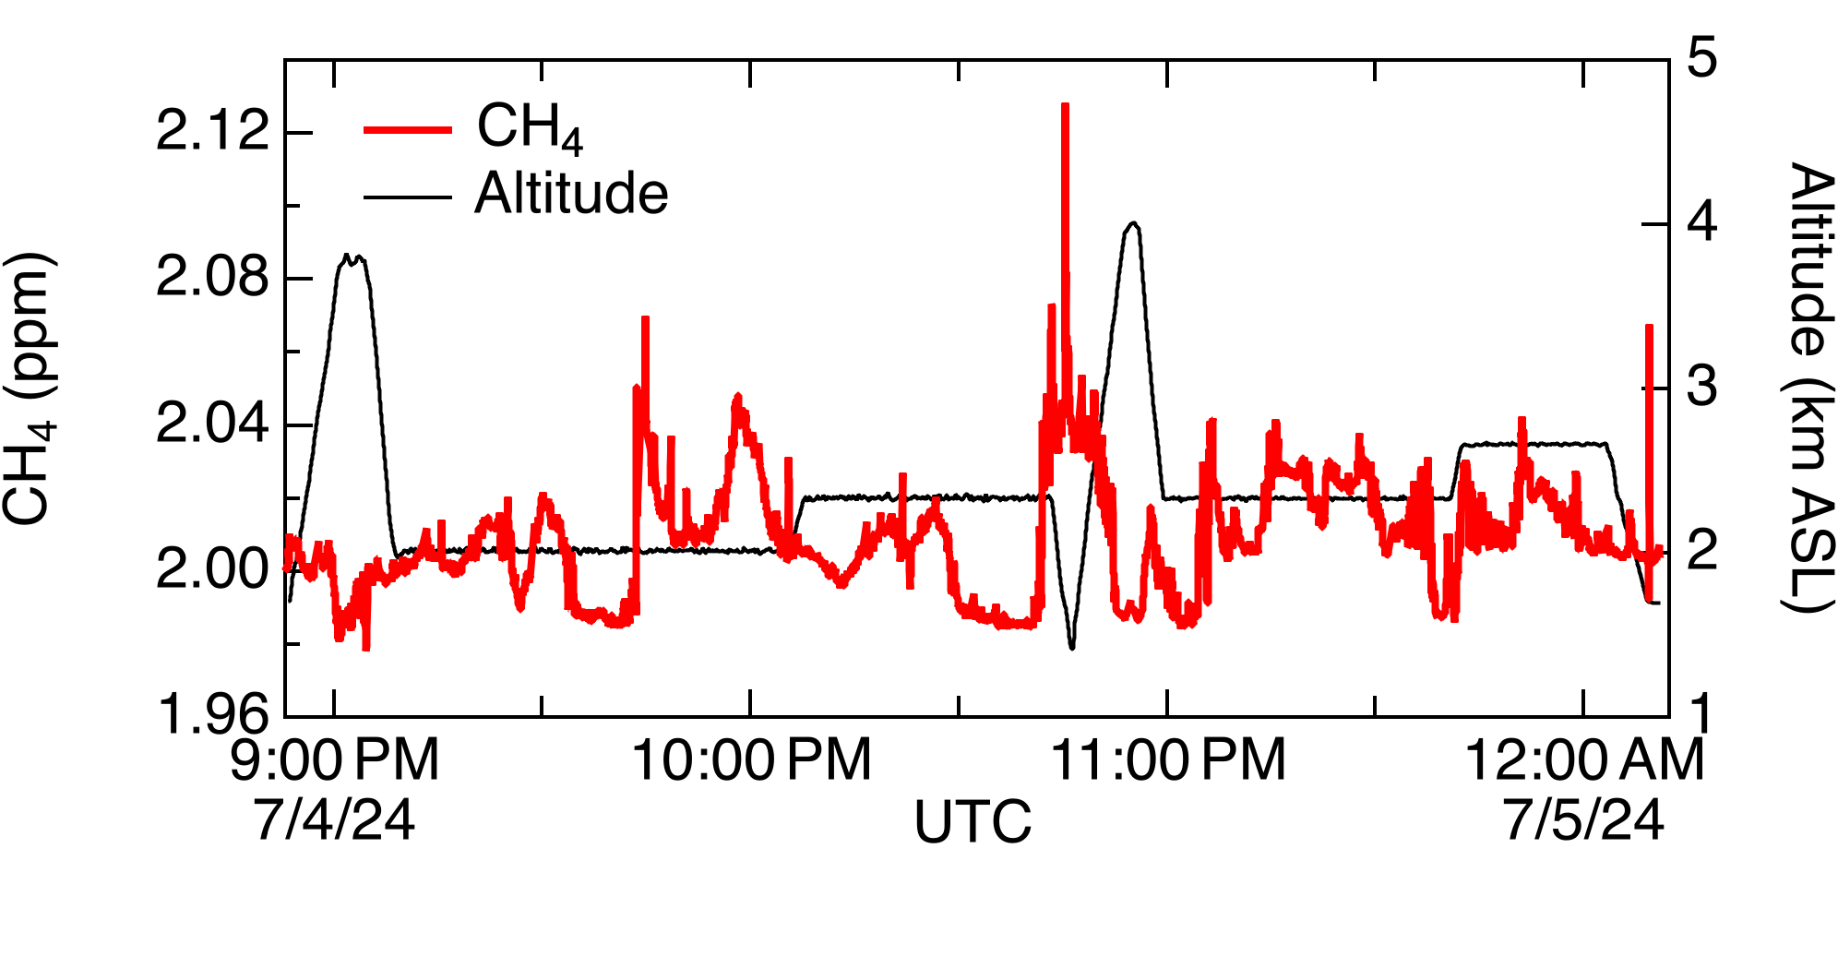
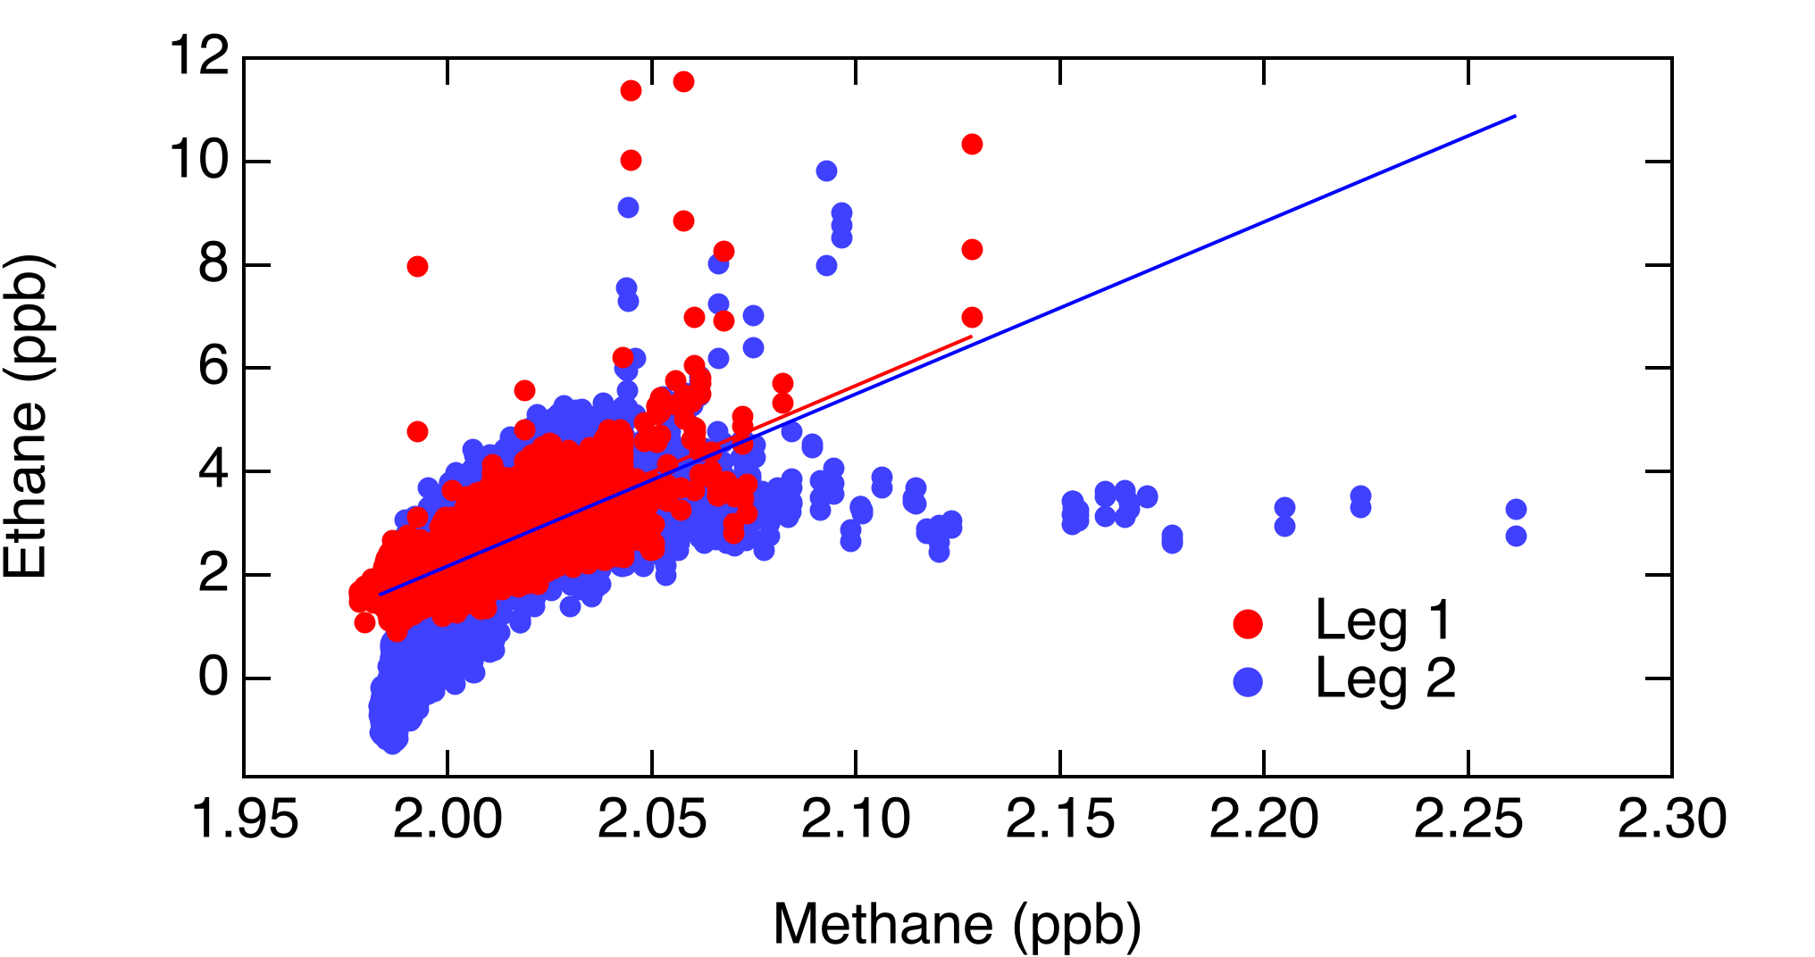
Coordinated Aircraft & Mobile Lab Methane
Wind Direction
Ft Collins
Twin Otter Methane
Boulder
Denver
July 4, 2024

Slide 9
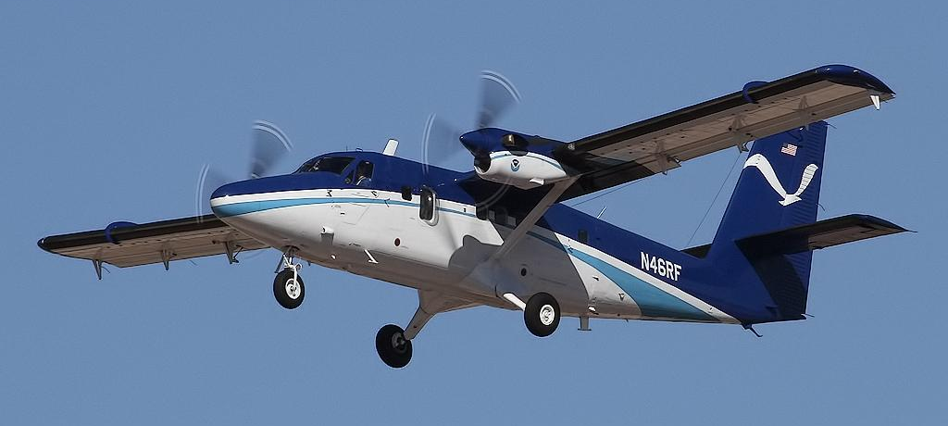
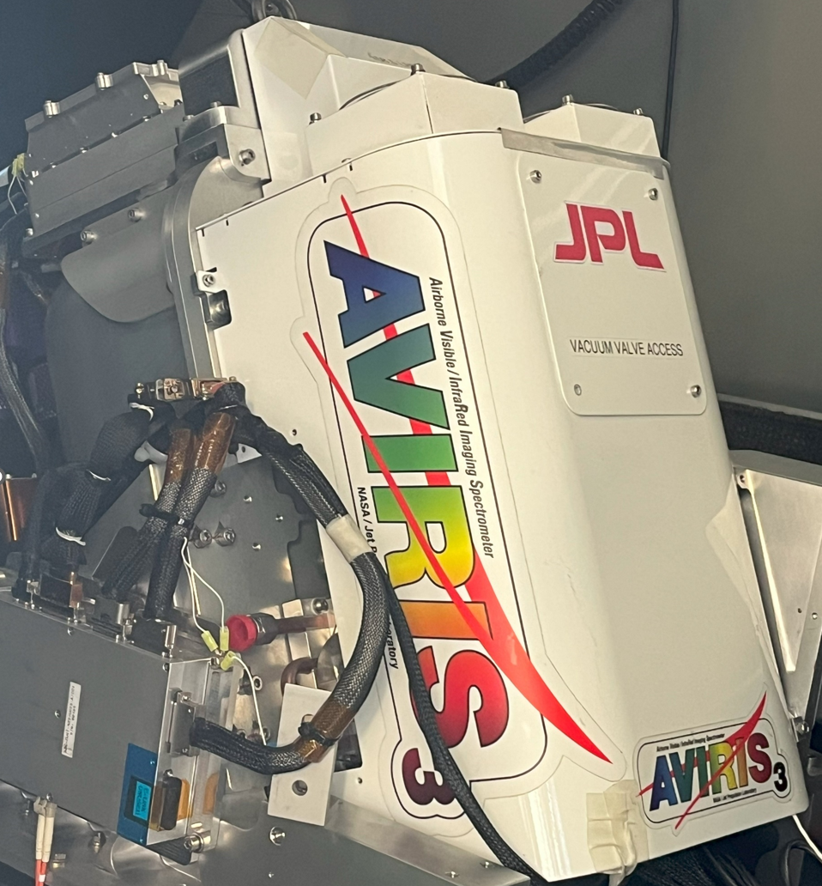
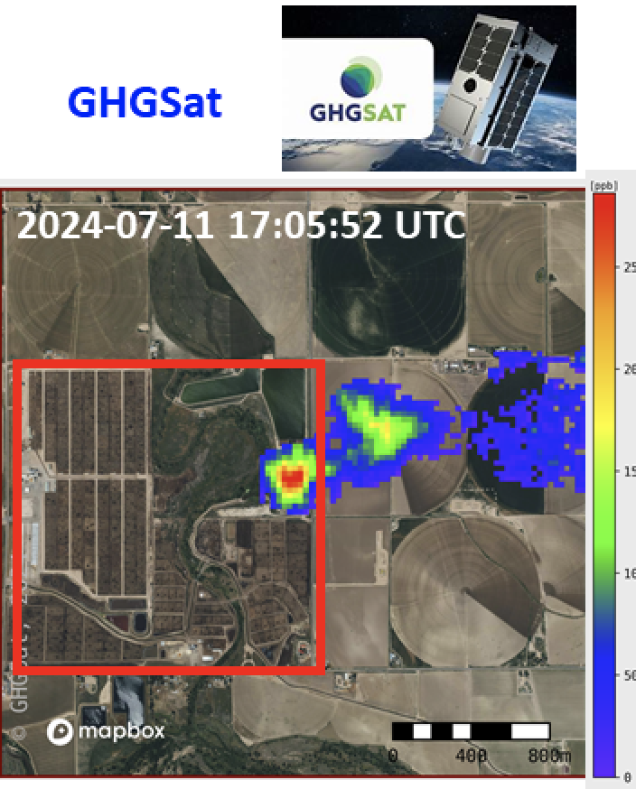
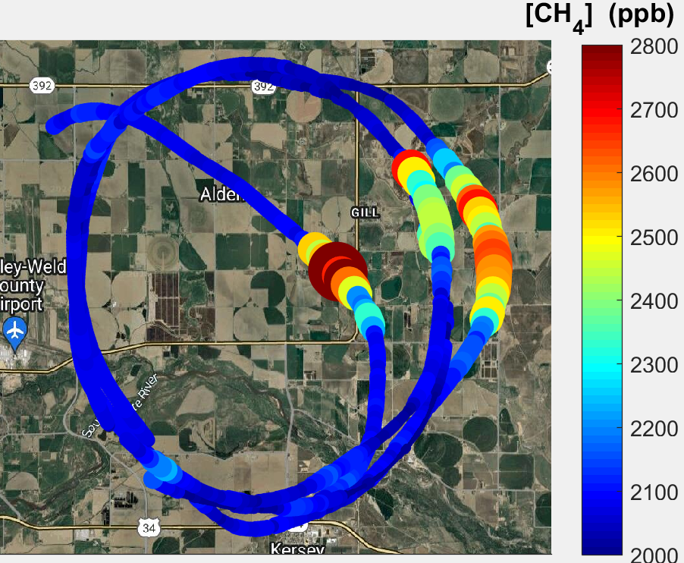
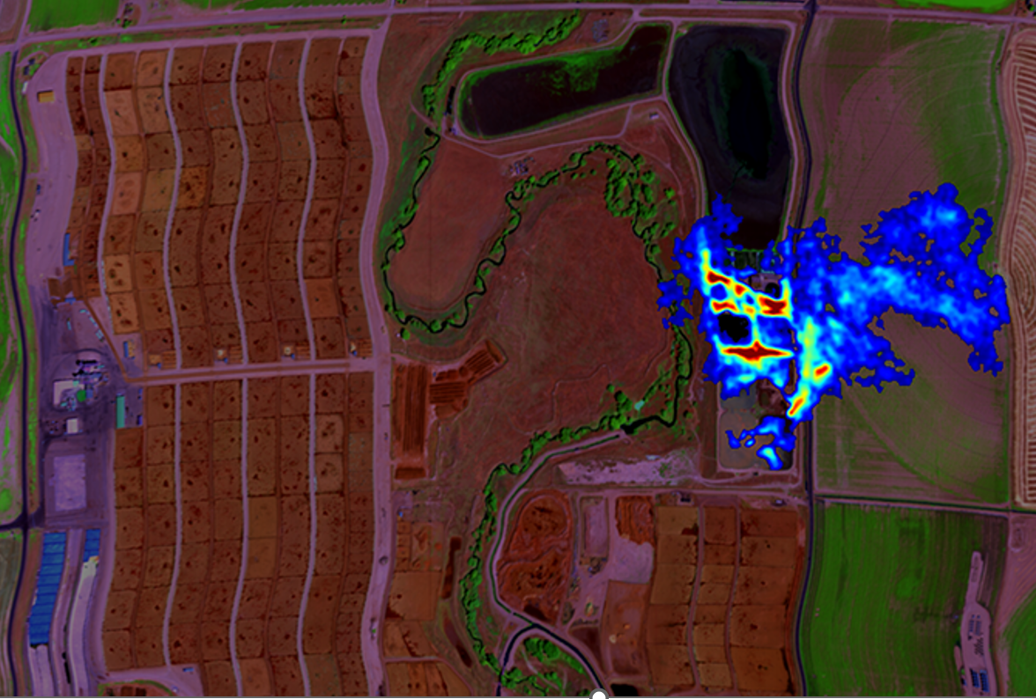
Coincident Measurements of Agricultural Methane
Boundary layer mass balance
Remote sensing plus inverse modeling
Tasking of commercial satellite
In-situ methane from NOAA
Twin Otter
Remote sensed methane from NASA JPL
King Air
Remote sensed methane
2024-07-11 17:00 – 17:27 UTC
2024-07-11 17:06:28 UTC
wind
wind
Red boxes represent similar areas
1,821 kg CH₄ / hr
1,135 kg CH₄ / hr
AVIRIS-3 Image from Andrew Thorpe

Slide 10
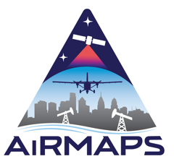
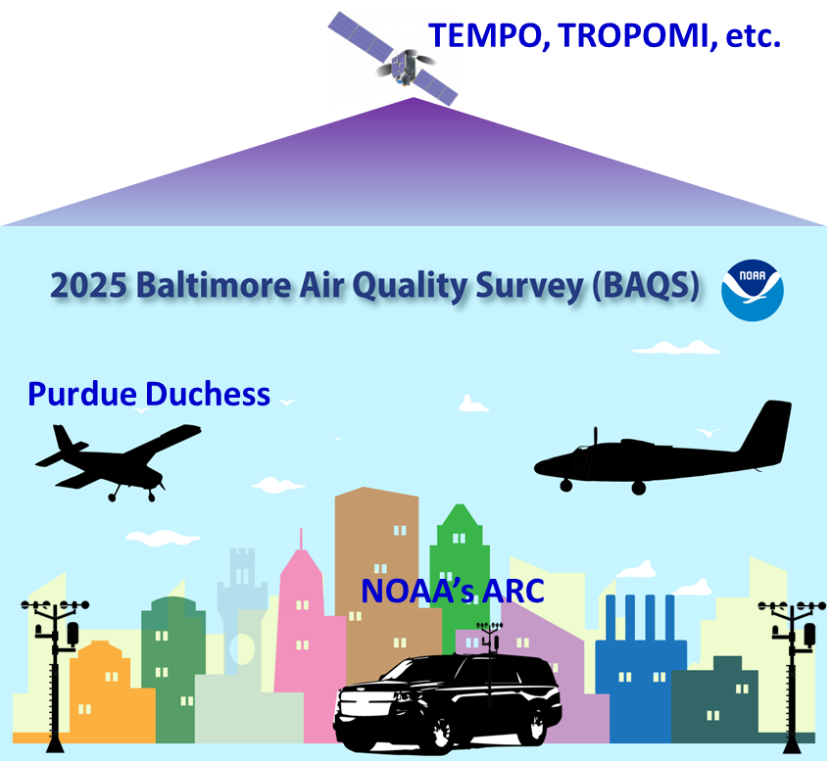
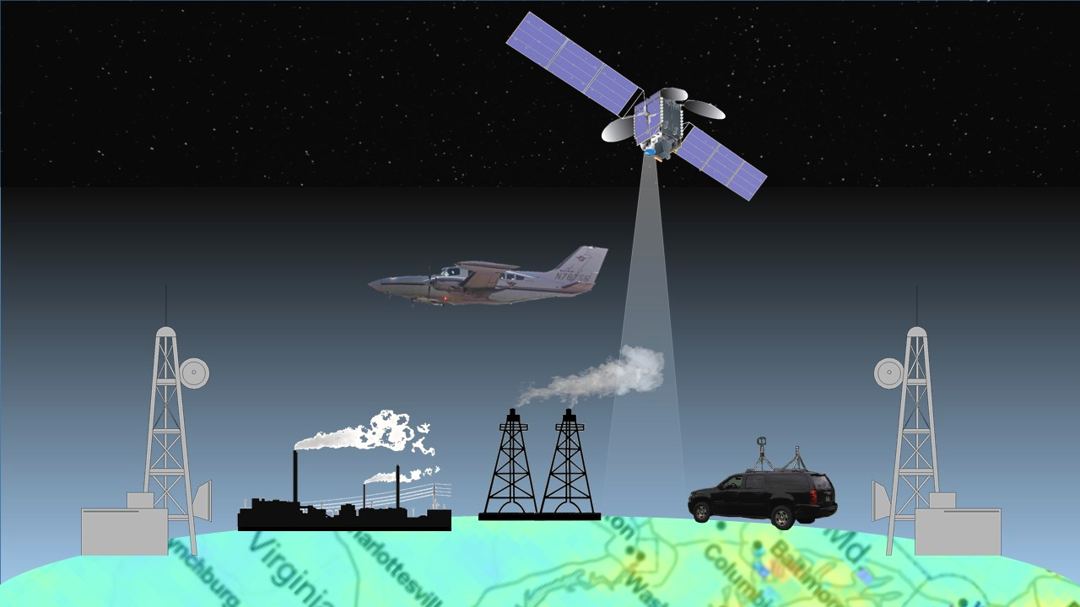
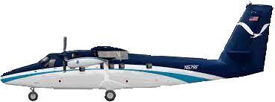
AiRMAPS 2025: Baltimore Maryland & Marcellus Shale
BAQMMS: Baltimore Air Quality and Marcellus Methane Surveys
ARL/CSL led mission on Twin Otter, Duchess & NOAA’s ARC
  Airborne Doppler wind lidar, In-situ & remote sensing measurements of air pollutants and greenhouse gases (GHGs) to characterize emissions and chemistry in Washington, DC-Baltimore and Marcellus
2025 Marcellus Methane Survey
NOAA Twin Otter

Slide 11
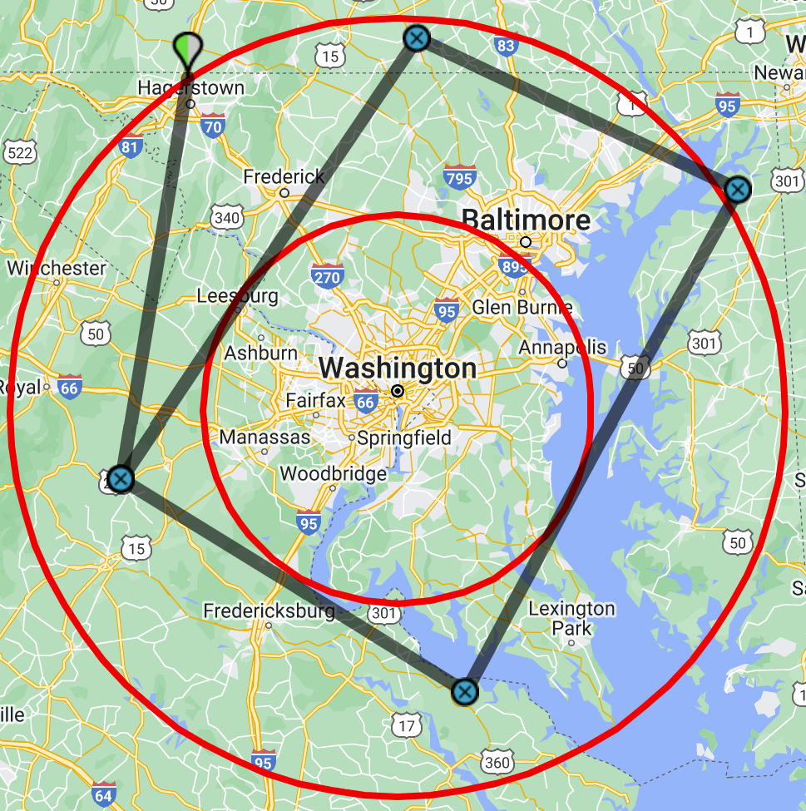
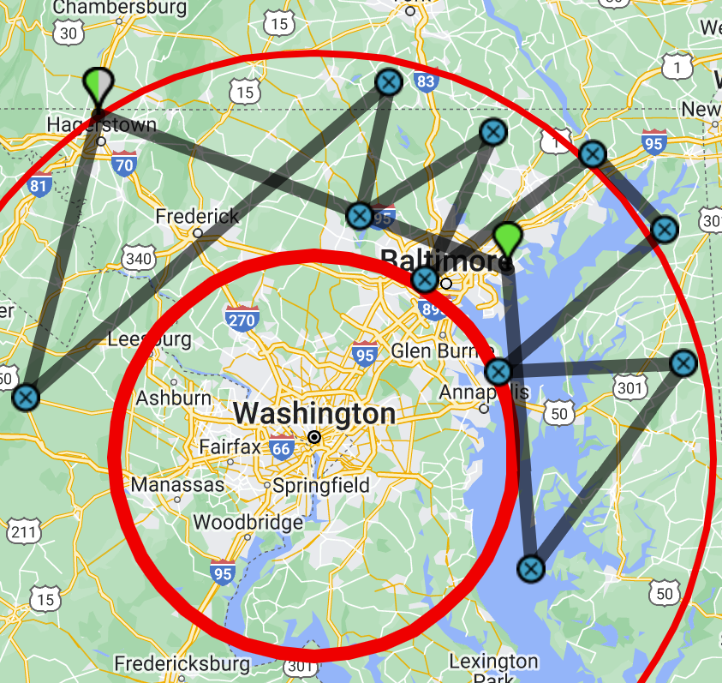
NOAA Twin Otter Survey Areas for AiRMAPS 2025
Duration: June 15 – August 15, 2025
  1 week of integration, 7-8 weeks of science flights
Flight hours: 180 Total
  50-60 hours each in SW, NE Marcellus, DC-Baltimore
  ~15 research flights / 7-8 flight days in each region
Twin Otter Base: TBD, possibly Martin State or Hagerstown
Flight Plans: Mass Balance or Air Quality Flights
DC-Baltimore Mass Balance
DC-Baltimore Air Quality
Marcellus Mass Balance

Slide 12

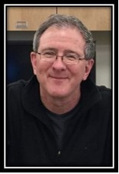

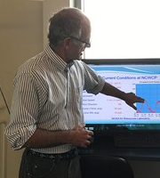


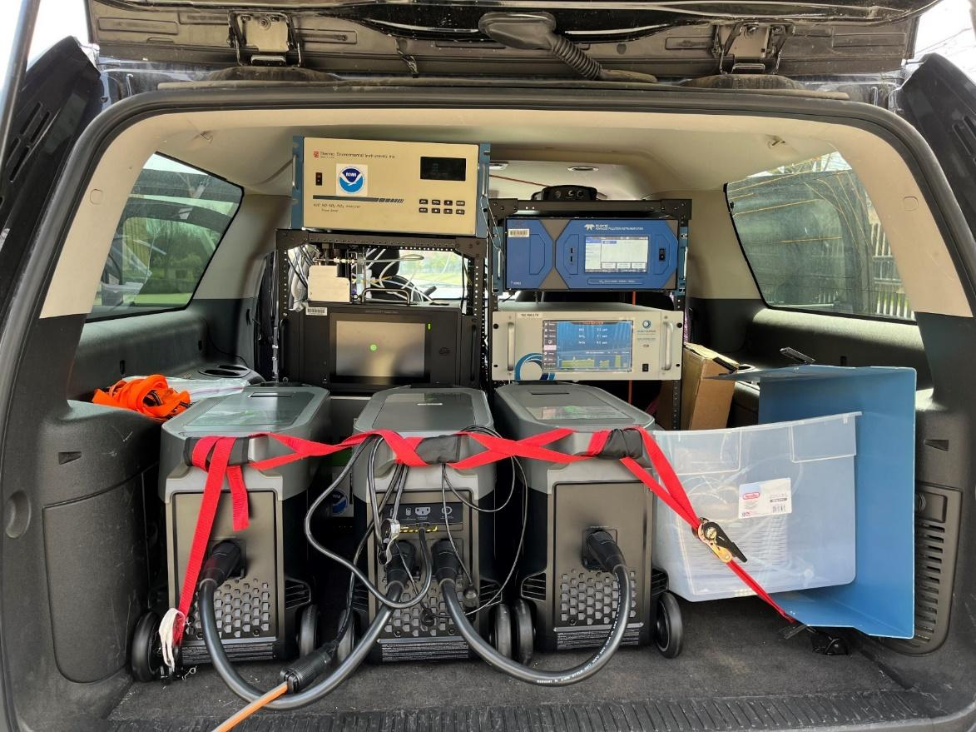
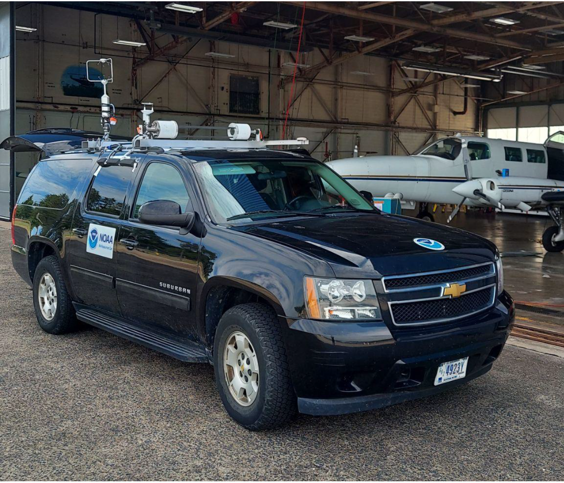
NOAA Air Resources Car (NOAA’s ARC)
Xinrong Ren - NOAA ARL
Winston Luke - NOAA ARL
Phil Stratton - NOAA ARL
Paul Kelley - NOAA ARL
Jiayang Sun - U. of MD
Hannah Daley - U. of MD
GHG, Air Quality, and Meteorology Measurements
Instrument | Platform | Species
Picarro G2401(-m) | ARC / TO (m) | CO₂/CH₄/CO/H₂O
Picarro G2201-i | ARC | CH₄/CO₂/δ¹³C-CH₄/δ¹³C-CO₂/H₂O
Aeris Ultra MIRA | Both | CH₄/C₂H₆/H₂O
TECO 49C/2B Tech | Both | O₃
Global Analytics G60 | Both | NO/NO₂/NO_{x}
Teledyne N500 CAPS | TO | NO_{y}
AE43 Aethalometer | ARC | Black Carbon
Particle Plus | ARC | PM2.5/PM10
Vaisala/RM Young | ARC | T/P/RH/2D wind with differential GPS
Chevy Suburban
3 ECOFLOW battery generators with a capacity of 10.8 KWh
8-10 hours of measurement
Two inlets, one for gases, the other for aerosols

Slide 13
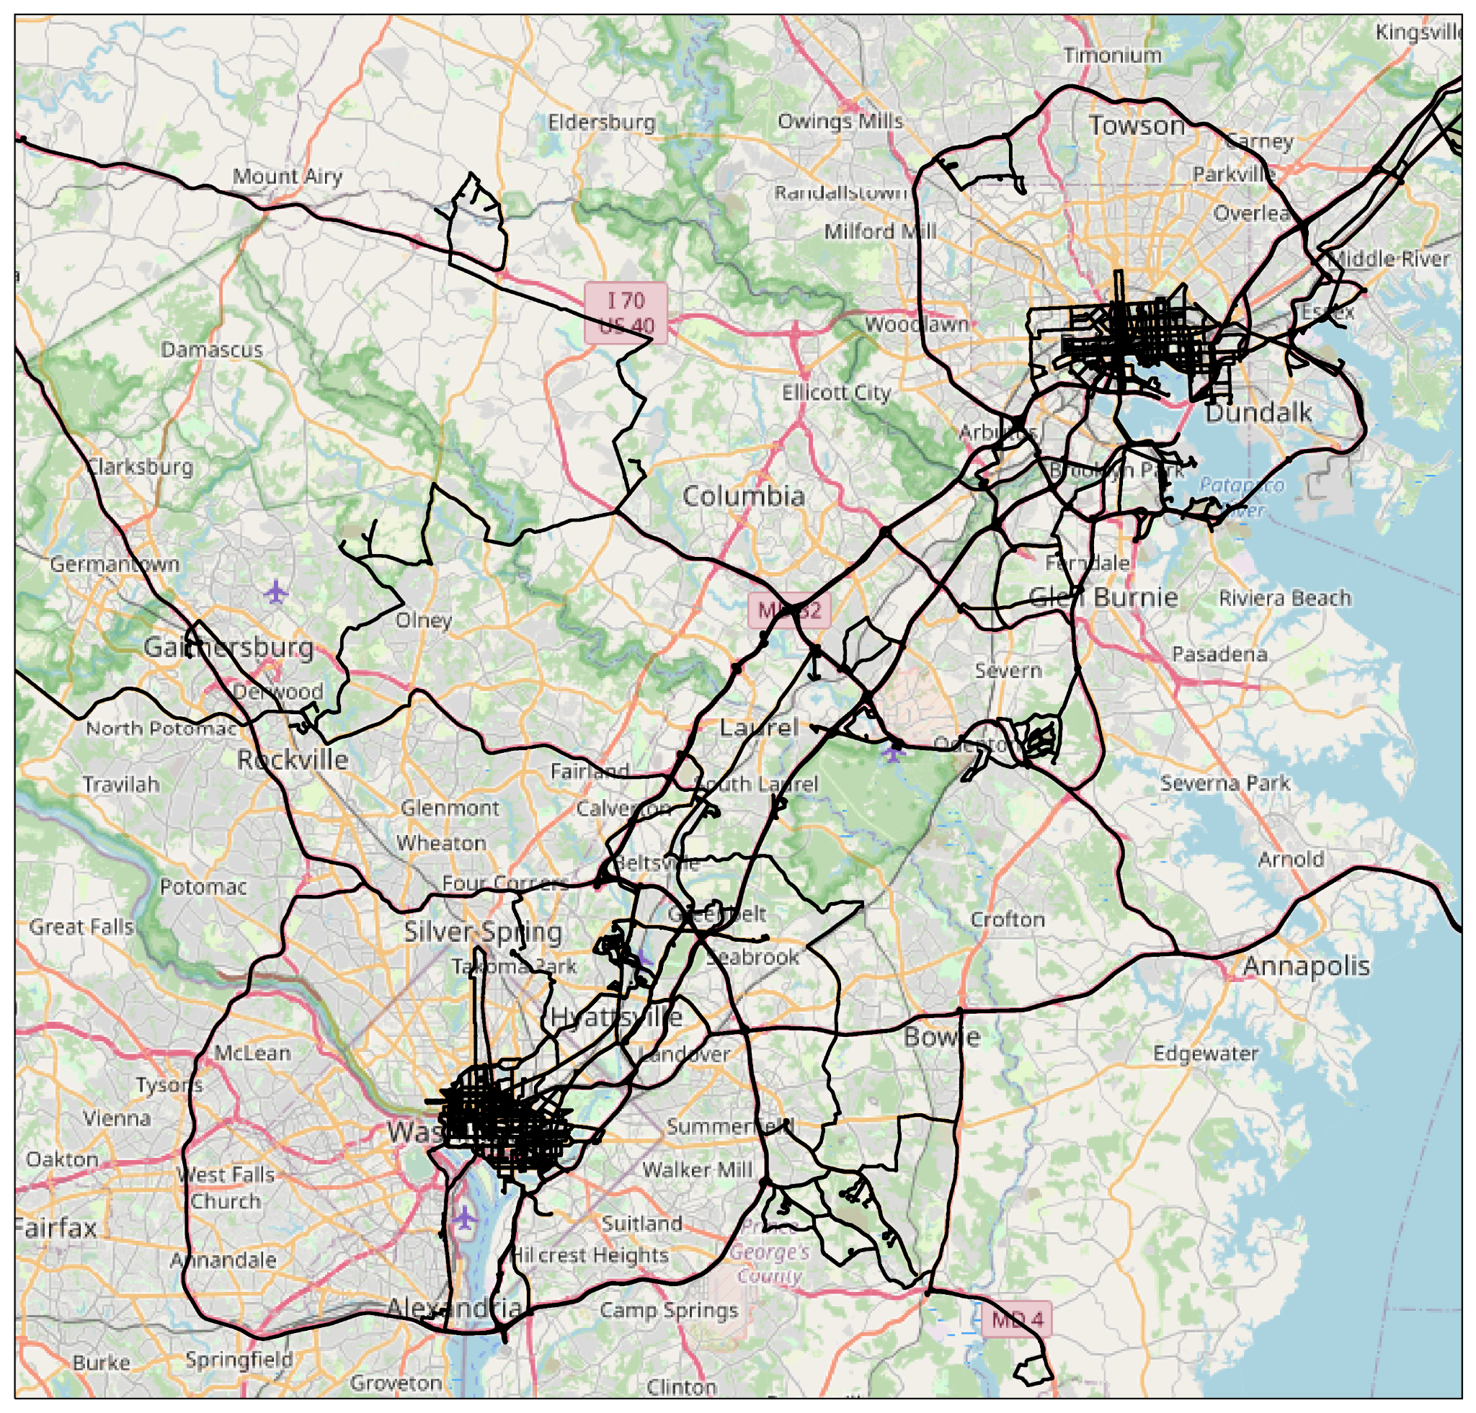
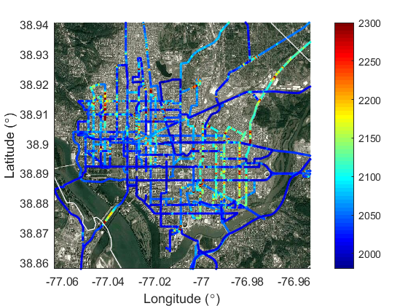
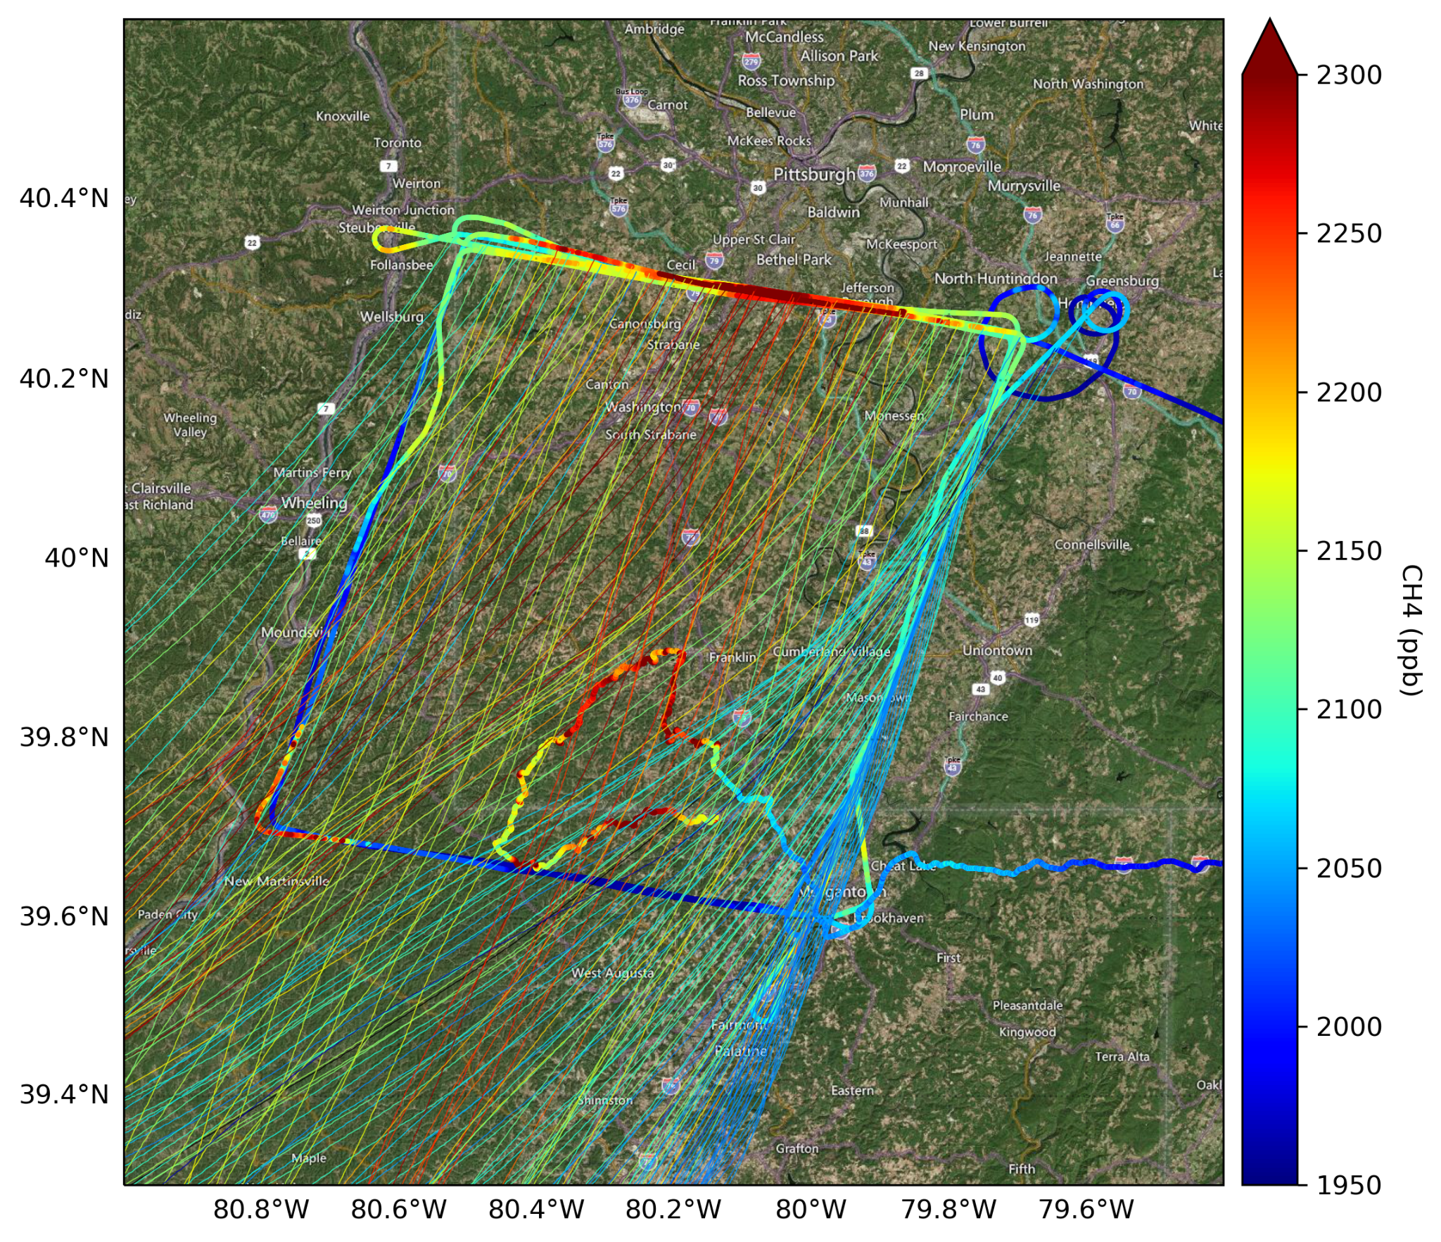
AiRMAPS 2025 Builds on 3 Years in DC-Baltimore & Marcellus
Methane in Washington, DC
Martin State
UMD Cessna Mass Balance + NOAA’s ARC in Southwest Marcellus, 2022
College Park

Slide 14
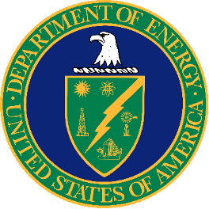
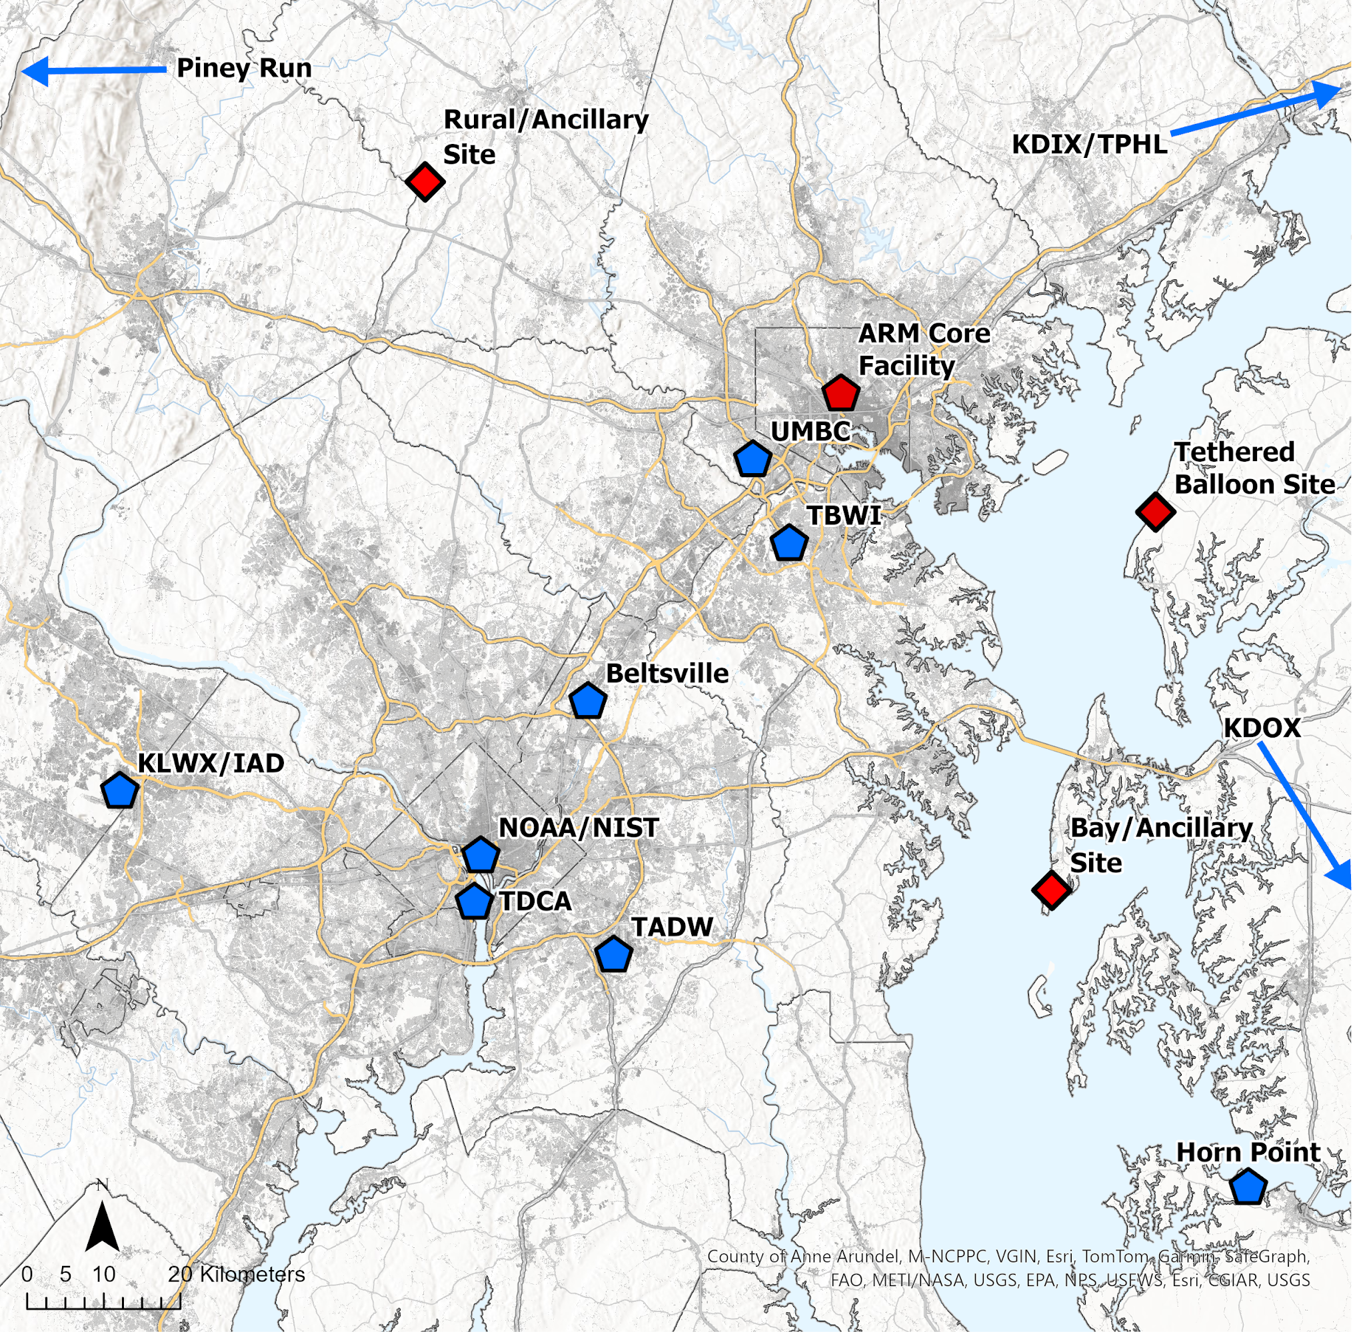

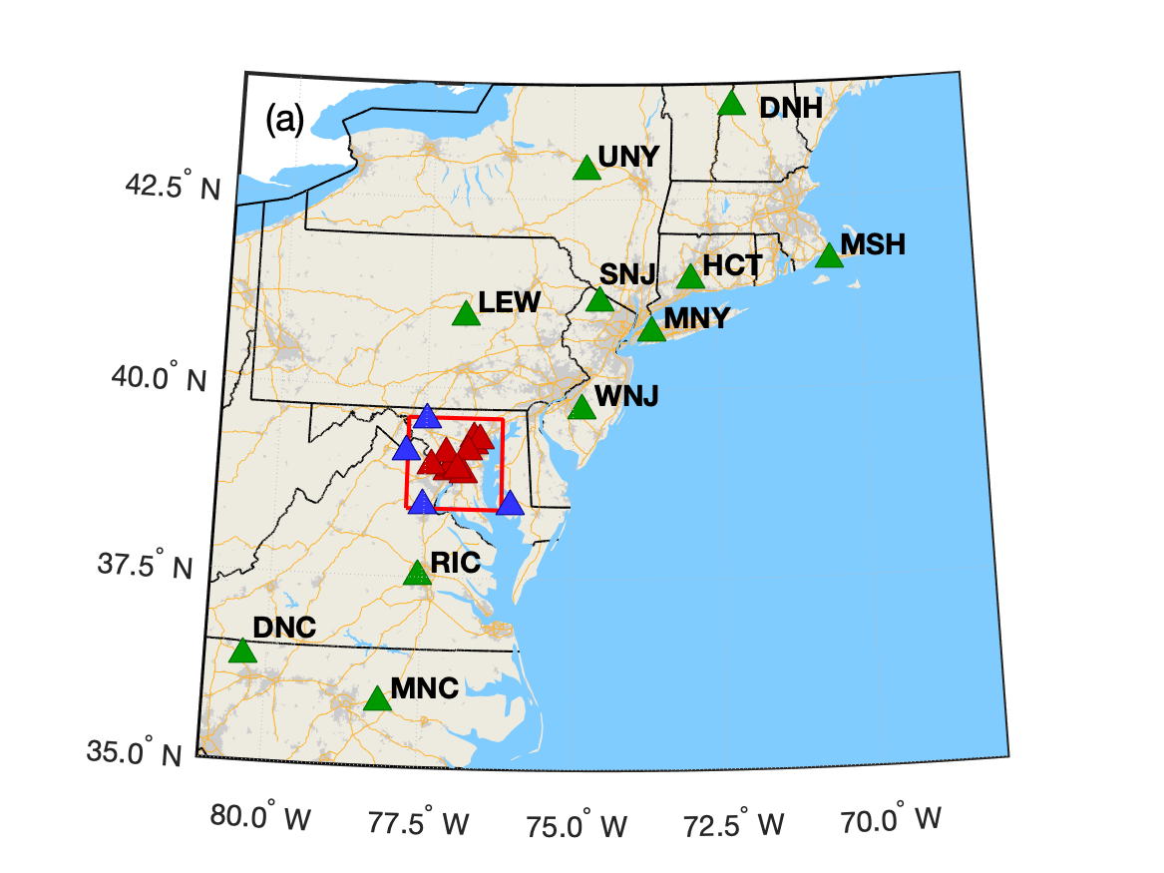

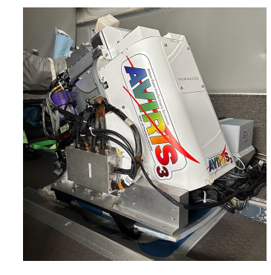
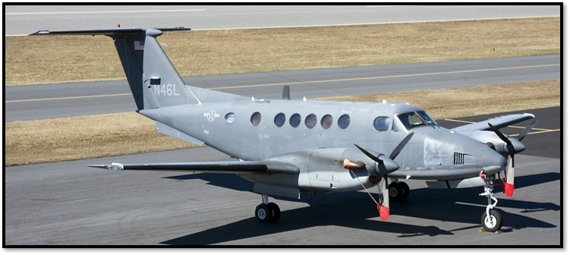
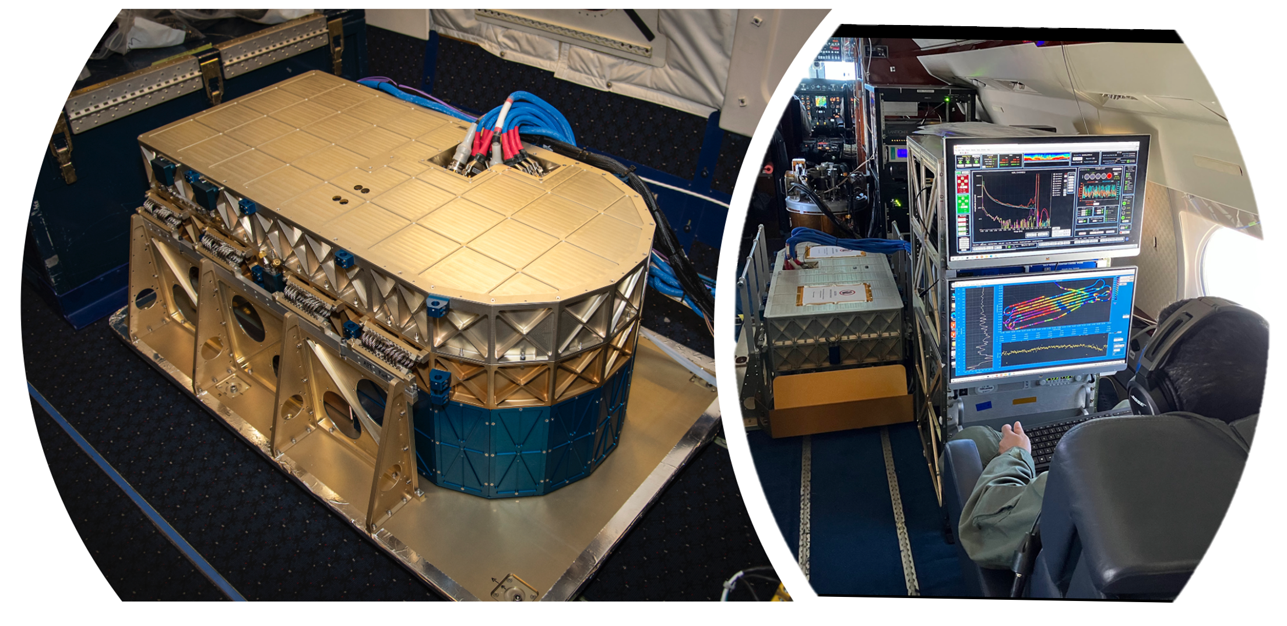
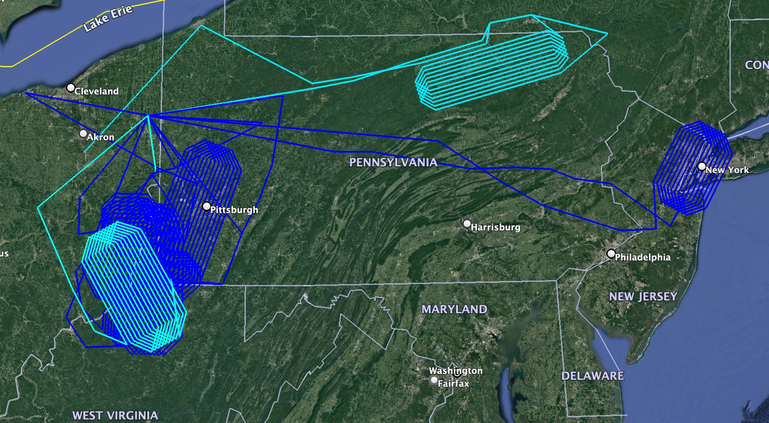
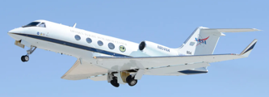
AiRMAPS 2025: Coordinating Activities
DOE BSEC and CoURAGE
  Baltimore Social-Environmental Collaborative Urban Integrated Field Lab
  Coast-Urban-Rural Atmospheric Gradient Experiment
NIST Northeast Corridor Urban Testbed
  Advancing Urban GHG Monitoring and Modeling
NASA Airborne Platforms
  AVIRIS Methane Imaging Spectrometer on B-200
  SARP Flights on B-200 (GHG, NOx, VOC)
NASA Gulfstream 3 (Tentative)
  Methane Air – Harvard University / EDF
  NASA High Altitude Lidar Observatory

