Slide 1
Studying Atmospheric Composition on the Global South with Geostationary Satellites: South American Perspective
Arlindo da Silva¹ and Barry Lefer²
¹NASA Goddard Space Flight Center
²NASA Headquarters
With contributions from the Geostationary Global South Community:
Pieternel F. Levelt, Eloise A. Marais, Wenfu Tang, Sara Martinez-Alonso,
David Edwards, Helen Worden, Henk Eskes, Pepijn Veefkind, Steve Brown,
Collins Gameli Hodoli, Allison Felix Hughes, Joanna Joiner, Sheldon Drobot , Dan Westerfelt.

Slide 2
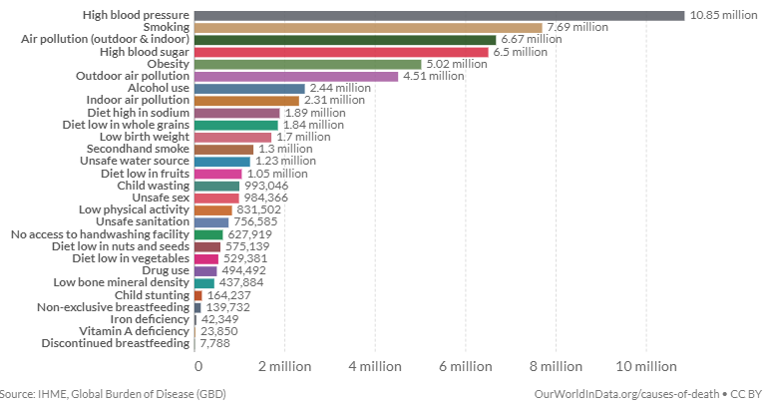
Air-quality & Human Health
4 million premature deaths attributed to outdoor air pollution
Poor air quality is leading cause of premature fatalities
World Bank estimates air pollution costs global economy $8.1 Trillion dollars in losses
Slide Courtesy: BAE Systems

Slide 3
100 Largest Megacities in 2025
Slide Courtesy: Steve Brown, NOAA

Slide 4
100 Largest Megacities in 2100
Unlike Africa, population growth
is not the main driver for
increased air pollution in the rest
of the world
Slide Courtesy: Steve Brown, NOAA

Slide 5
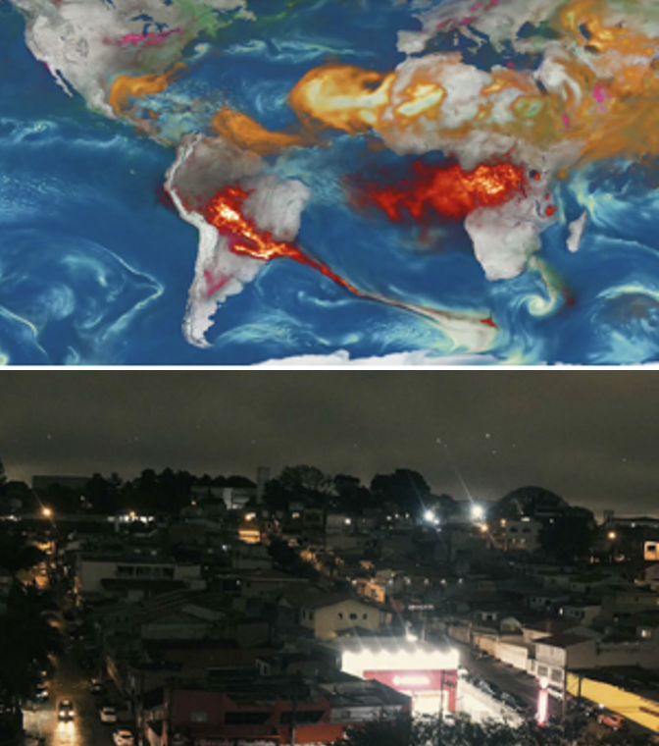
Increased Wildfire Threat
Smoke AOD from the GEOS-FP Aerosol Data Assimilation System
São Paulo in the middle of the day
Source: The Washington Post
August 19, 2019

Slide 6
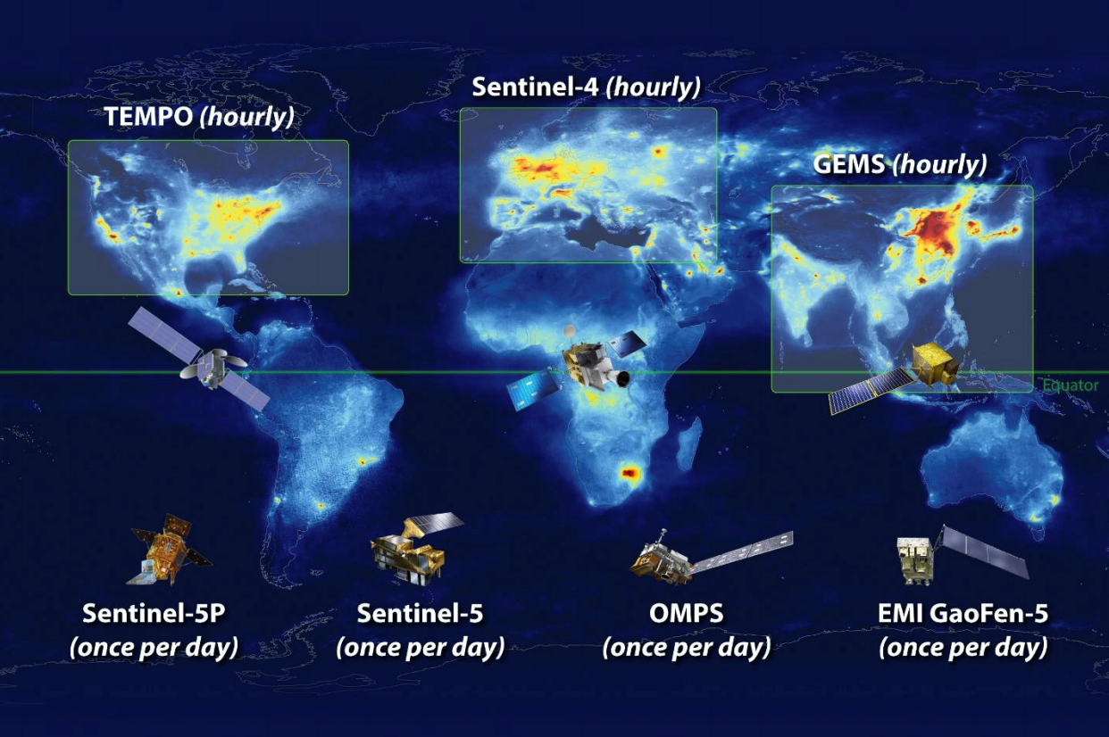
The Atmospheric Composition PoR: TEMPO, GEMS & Sentinel 4
The Low-Earth Orbit (LEO) satellites, while offering global coverage, provide only once per day measurements
The geostationary satellites TEMPO, GEMS and Sentinel-4 are offering revolutionary approaches for high spatial and temporal air quality monitoring, especially over North America, Europe, and Southern & Eastern Asia
However, significant coverage gaps remain across the southern hemisphere.
MEASMA-North
(hourly)
GeoSA
(hourly)
MEASMA-South
(hourly)
GeoAUS
(hourly)

Slide 7
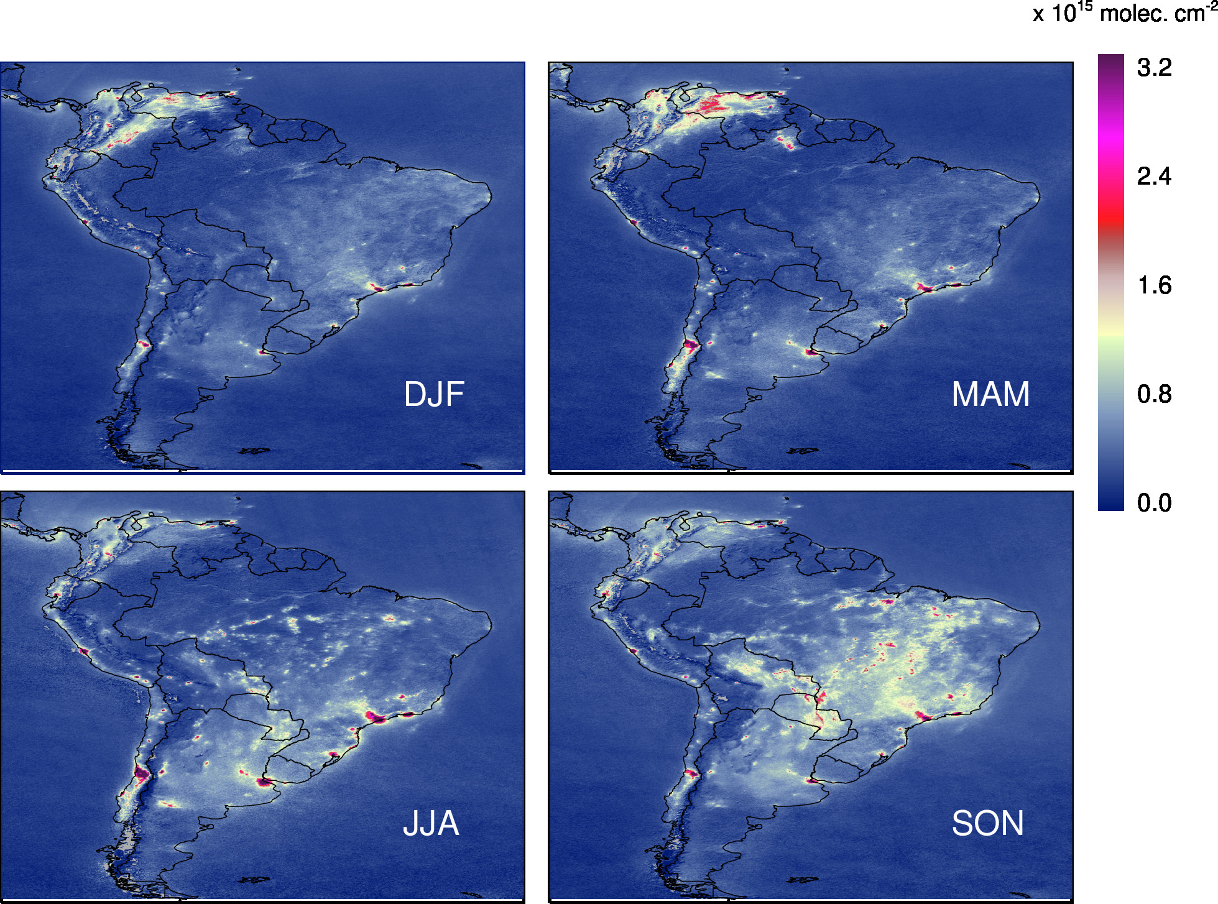
South America
All pollution sources are present in South America:
Smoke – biomass burning
O3 – anthropogenic emissions
NO₂ – fossil fuel combustion
HCHO – Biogenic Emissions
There are limitted ground-based measurements
There is a lack of emission estimates over South America
There is an urgent need for new capability for air quality management for health and environment
Image Credit: Lok Lamasal (NASA/GSFC)

Slide 8
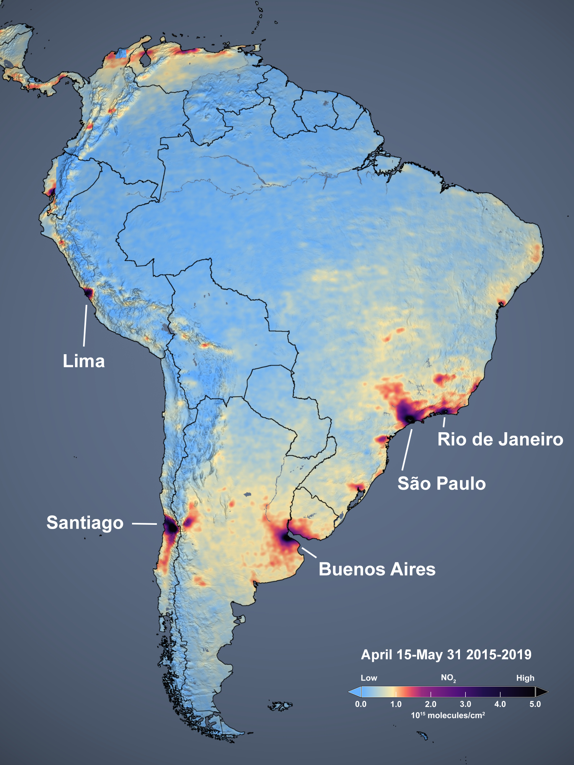
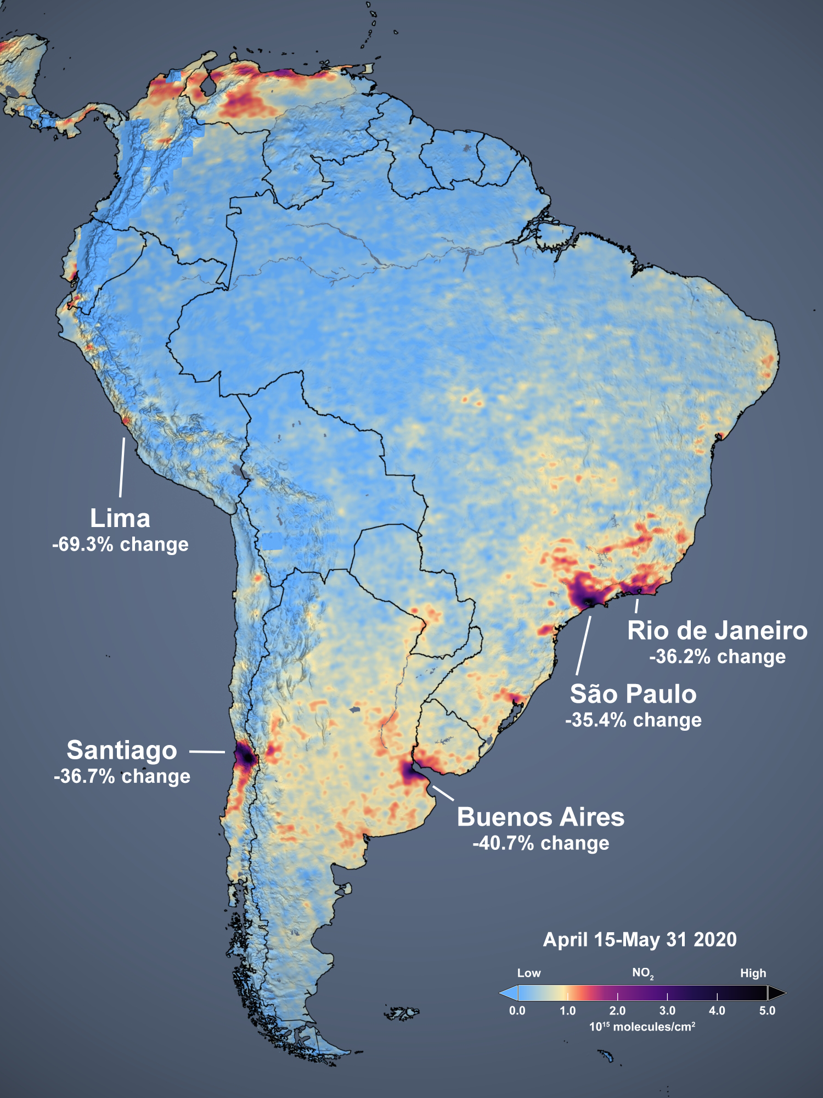
OMI NO₂ Measurements over South America: COVID Lockdown
Image Credit:
NASA GSFC
Scientific
Visualization
Studio
Slide Courtesy:
A. da Silva
(NASA/GSFC)

Slide 9
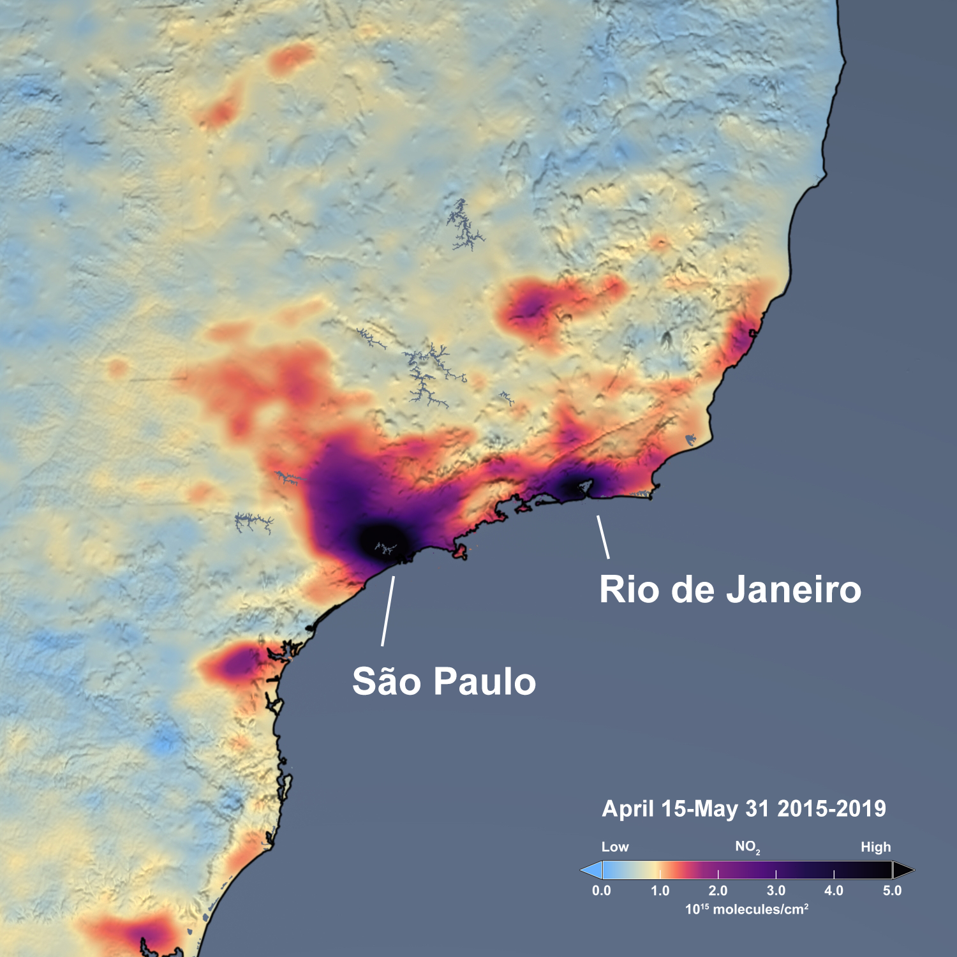
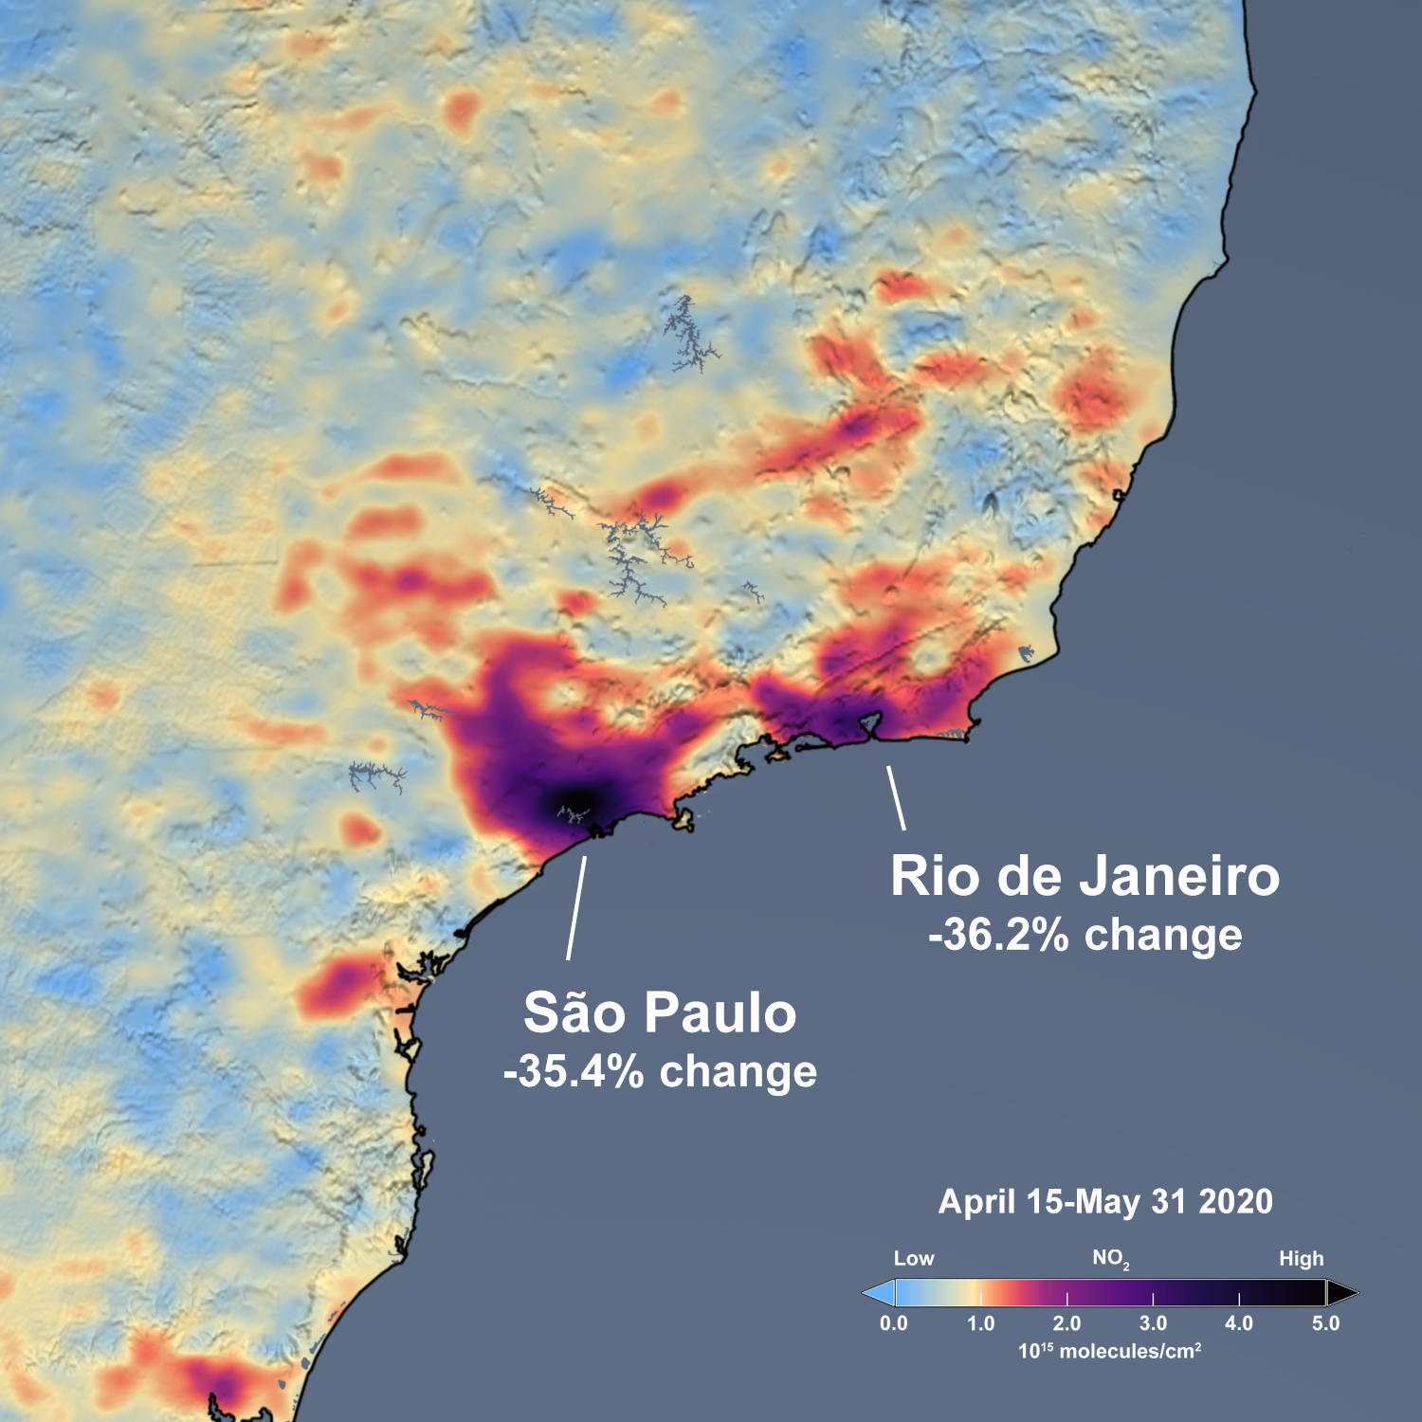
OMI NO₂ Measurements over South America: COVID Lockdown
Image Credit:
NASA GSFC
Scientific
Visualization
Studio
Slide Courtesy:
A. da Silva
(NASA/GSFC)

Slide 10
Gross Primary Production of Vegetation
MODIS generated GPP using AI/ML algorithm trained on Flux Tower Data
With MODIS, a 16-day time window is required to produce these images
With hyperspectral GEO data similar maps can potentially be created in near real-time, even under moderate cloudiness.
Slide Credit: Joanna Joiner (NASA/GSFC)

Slide 11
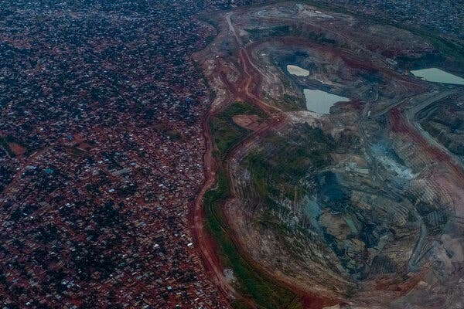
Emissions from Metal Mining
Source: New York Times 2021
NOx Emissions follow Production
Martinez-Alonso et al., JGR 2023, NCAR ACOM
Slide Courtesy: Pieternel Levelt (NCAR)

Slide 12
A Global Air-quality Network
Vision
An integrated observing, modeling and warning system
Approach
Integrate LEO, GEO, airborne and ground-based measurements into physical and AI/ML based modeling and data assimilation systems
Measurements
Ozone, aerosols (such as PM2.5), NOx, SOx, and numerous other gases
Image Courtesy: BAE Systems

Slide 13
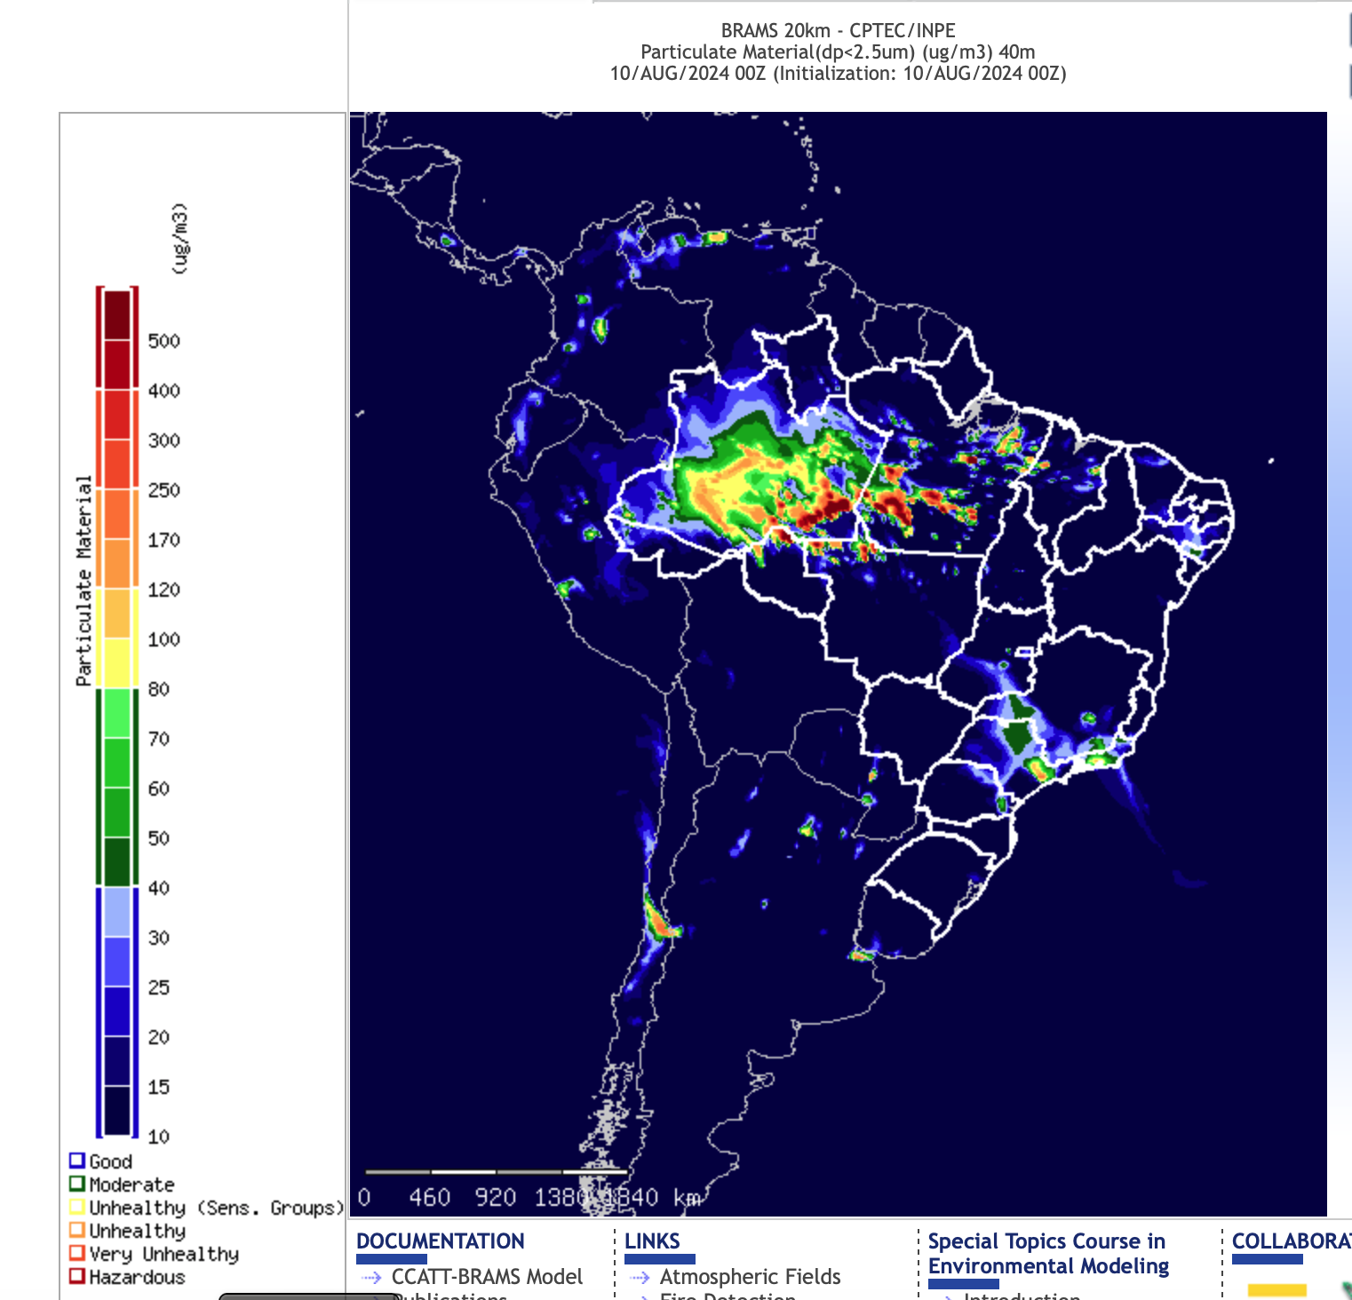
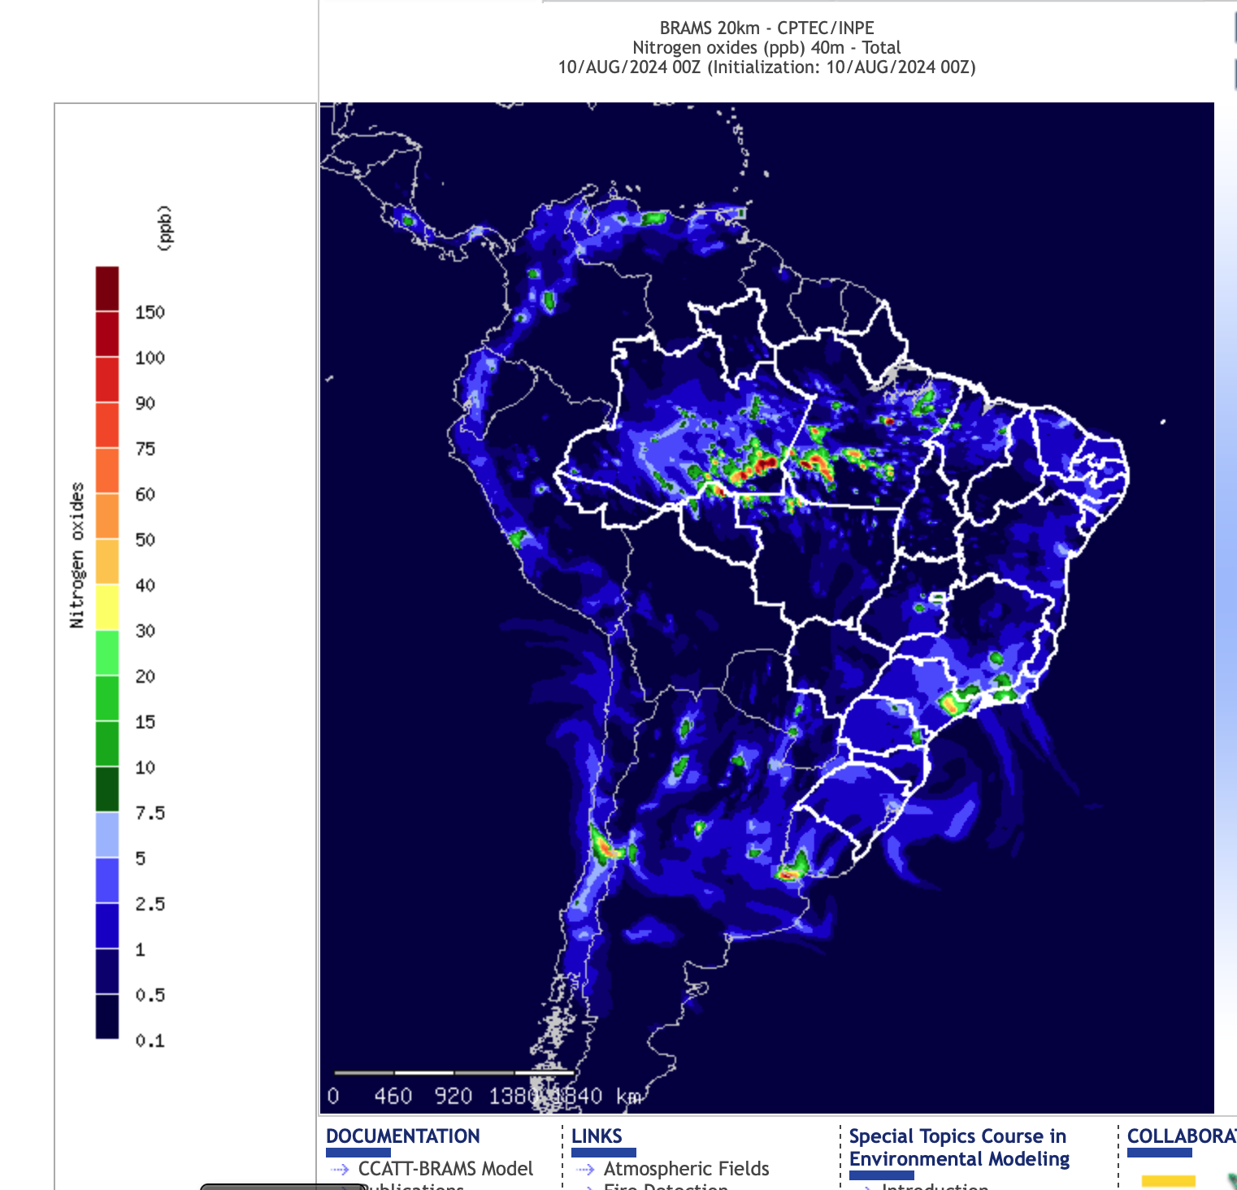
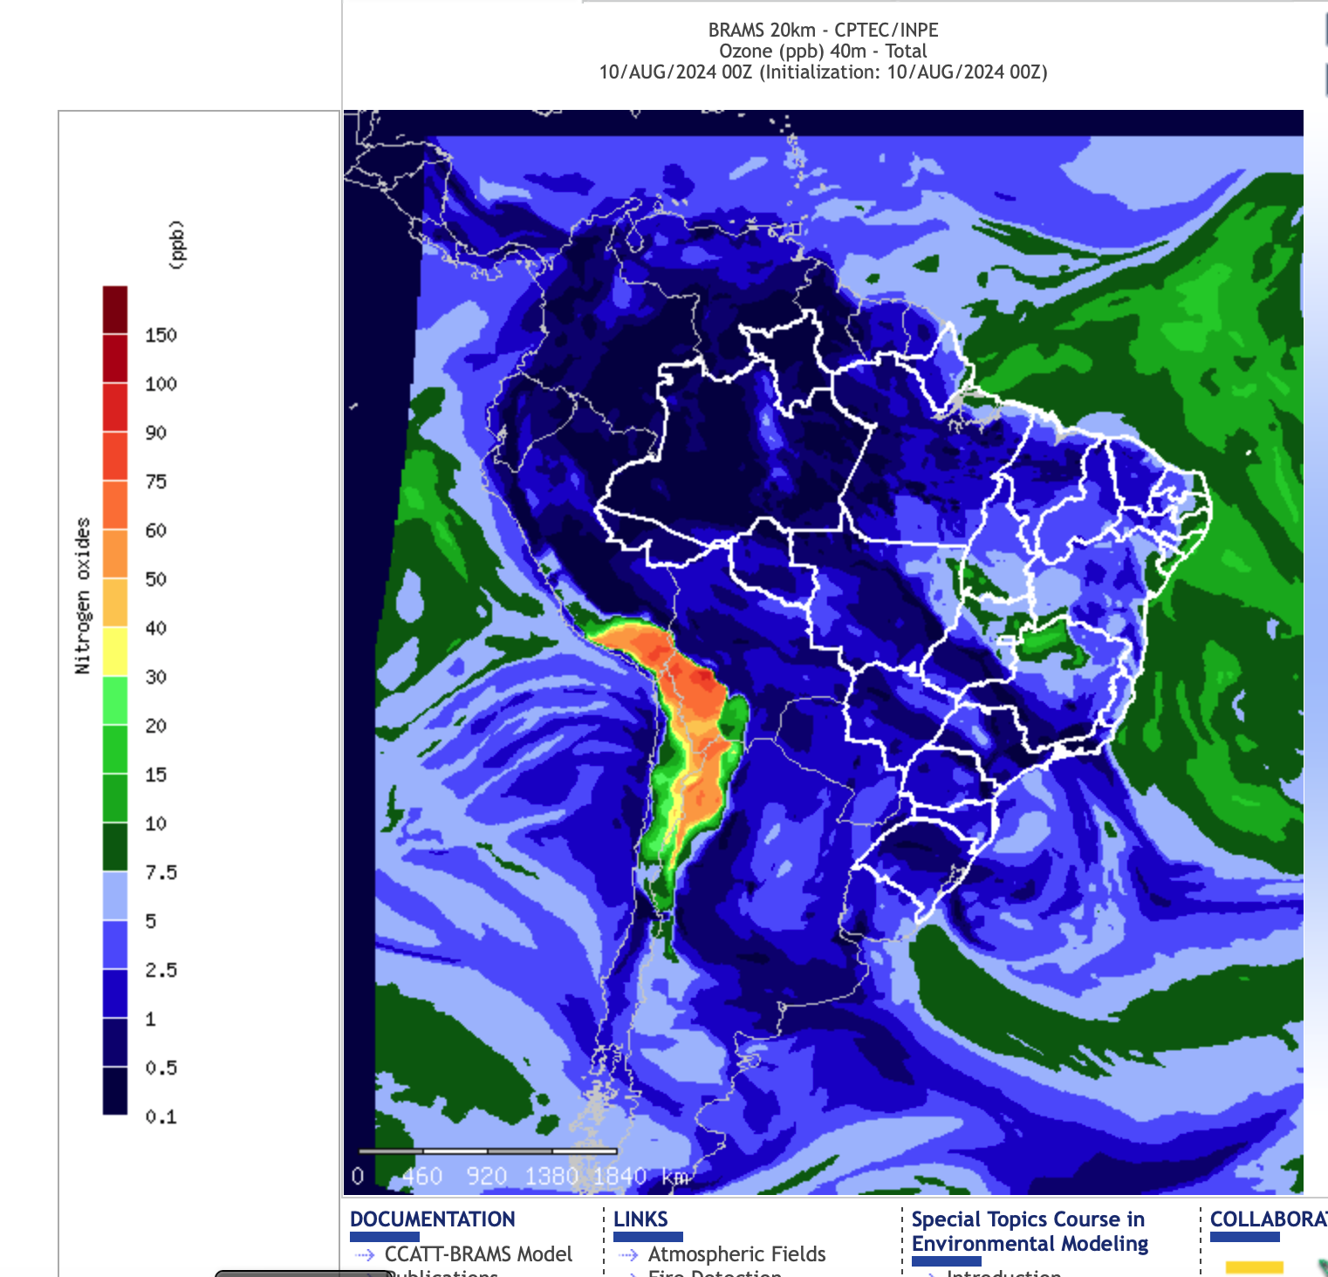
Air-quality Modeling at INPE
Image Credit: http://meioambiente.cptec.inpe.br
Slide courtesy: A. da Silva (NASA/GSFC)

Slide 14
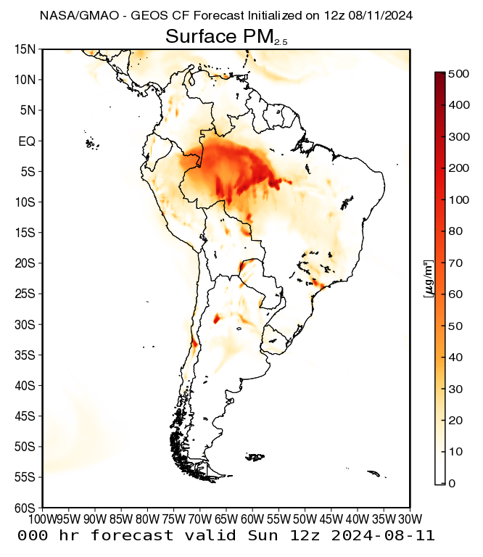
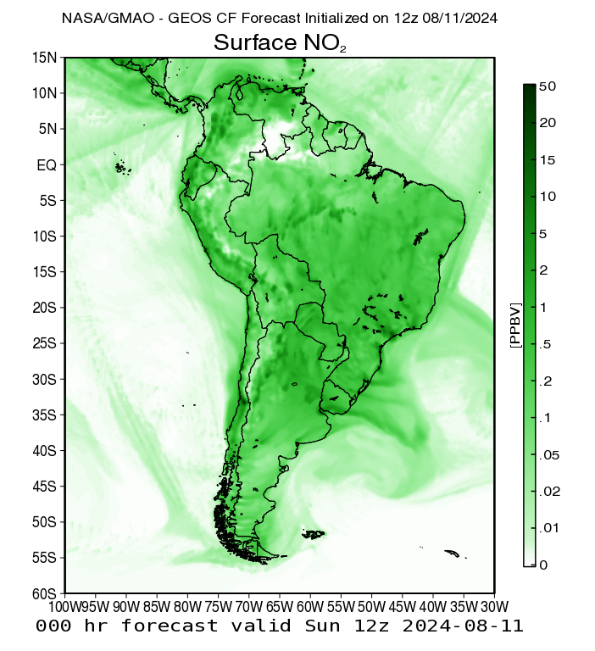
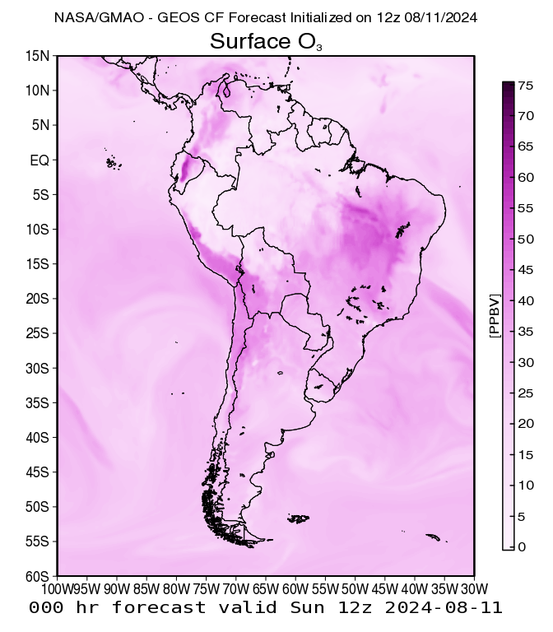
Air-quality Modeling at NASA GEOS-CF Composition Forecasts at GMAO
Image Credit: https://fluid.nccs.nasa.gov/cf/
Slide courtesy: A. da Silva (NASA/GSFC)

Slide 15
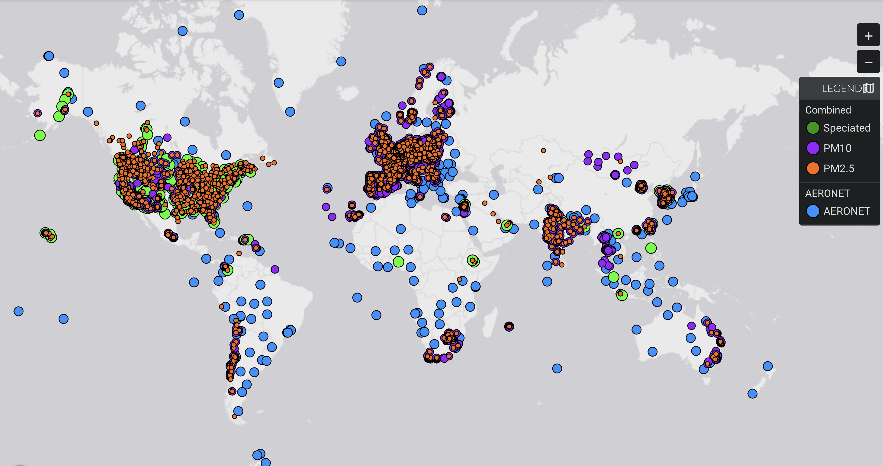
Limited Ground-based Atmospheric Composition Observations in the Global South
Ozone Monitoring sites
(TOAR and Open AQ)
Aerosol Surface Monitoring sites
(MAIA Data Visualization Tool)
Slide Courtesy: Pieternel Levelt, NCAR ACOM

Slide 16
TEMPO First Images
Tropospheric Emissions: Monitoring of Pollution (TEMPO)
Geostationary scanning ultraviolet/visible spectrometer
Enables accurate air quality forecasting by providing hourly measurements of major pollutants
First funded NASA Earth Venture Instrument
Launched in 2023
Geostationary Environment Monitoring Spectrometer (GEMS)
Developed in tandem with TEMPO, capturing efficiencies
Launched in 2020, monitoring air pollution over Asia
Funded by Korea Aerospace Research Institute
Nitrogen dioxide (NO₂) is a byproduct of fossil fuel combustion, lightning, and wildfires. NO₂ contributes to the formation of ground-level ozone and particulate matter pollution and is itself a toxic gas (EPA criteria pollutant).
Credit: NASA's Scientific Visualization Studio. Data provided by the Smithsonian Astrophysical Observatory at the Center for Astrophysics | Harvard & Smithsonian.
Image Credit: TEMPO Team

Slide 17
Hourly ocean color from TEMPO
NASA’s Tropospheric Emissions: Monitoring of Pollution (TEMPO) demonstrates hourly ocean color
Machine learning with TEMPO’s hyperspectral data produces parameters like chlorophyll even in glint and moderately cloudy conditions
TEMPO provides hourly ocean color over N. America with coverage comparable to daily average of 3 multi-spectral LEO sensors
Dynamic movement of the gulf stream is seen with TEMPO hourly data
Presented at: European Geophysical Union, Vienna, Austria, April, 2024 (Z. Fasnacht et al.)
Slide Courtesy: Zach Fasnacht (NASA/GSFC)
Notes:
17
17
17
17
17
17

Slide 18
Night Lights from TEMPO
Hyperspectral Atmospheric Composition instruments can sense low clouds under moonlight
Thermal IR on imager/sounder has difficulty distinguishing low clouds from surface at night).
Demonstration of nigh light measurements with TEMPO was possible from Autumn to Spring equinox when sun is not shining on the instrument
With 12 second exposures, observations of clouds in moonlight as well as spectrally-resolved measurement of night lights can be achieved
Slide Courtesy: TEMPO Team

Slide 19
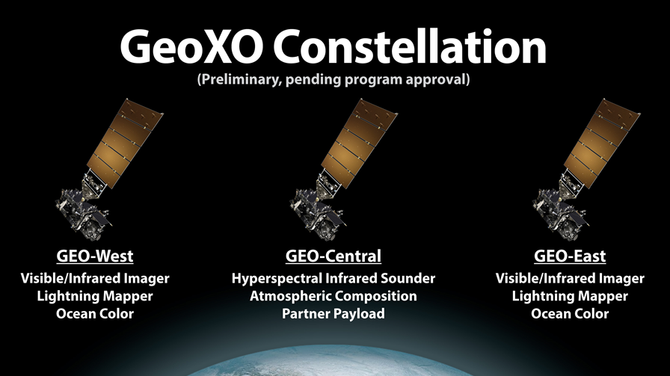
GeoXO atmospheric composition will be a multi-instrument strategy for various NOAA applications
Applications
Near real time emissions | Air quality forecasting
Air quality monitoring | Fire weather forecasting
Fire emissions monitoring | Ozone monitoring
Hazards forecasting | Greenhouse gas monitoring
Climate modeling and Earth system science research
Fire detection
Fire radiative power
Aerosol type
Aerosol optical depth
Aerosol concentration
Large methane leaks
Sulfur Dioxide (night)
Ozone
Carbon monoxide
Carbon dioxide
Ammonia
Isoprene
Ozone
Nitrogen dioxide
Sulfur dioxide
Formaldehyde
Aerosol layer height
UV aerosol index
UV aerosol optical depth
VIS-IR IMAGER
GXI
IR SOUNDER
GXS
UV-VIS SPECTROMETER ACX
Slide Credit: GeoXO Team

Slide 20
Atmospheric Composition Virtual Constellation: Toward the Global South
GEO AC Program of Record:
TEMPO
GEMS
Sentinel-4
MEASMA-North
(hourly)
Initiatives:
MESMA-North
MEASMA-South
GeoSA
(hourly)
MEASMA-South
(hourly)
GeoAUS
(hourly)
Seeking Interest:
Geo South America
Geo Australia

Slide 21
Current Activities by the International Community
Existing Initiatives
Meetings
There are 2 initiatives lead by BAE Systems (formerly Ball Aerospace) and members of the scientific community at large:
MEASMA-North – focused on Northern Africa and the Middle East
MEASMA-South– focused on Southern Hemisphere Africa
Meeting with INPE leadership in Brazil (August 2024) to discuss the GeoSA concept.
In the process of requesting the formation of a CEOS AC-VC committee focused on geostationary AQ for the Global South
This committee will write a scientific concept paper for the need of geostationary Atmospheric Composition measurements over the Global South
BAE Corporate, INTOPASS in talks with private funders and foundations
AGU 2023
Townhall Meet at AGU with leaders in the field and cross disciplinary
Papers at AGU, one from Levelt, one from BAE Systems, in different sessions
EGU 2024
Oral presentation in the AQ constellation session (Levelt)
GeoXO meeting May 6-8, 2024 in Washington DC
OMI-TROPOMI Science Team Meeting June 3-6 2024 at NCAR-ACOM (also TEMPO, GEMS, GEO over the Global South)
TEMPO-GEMS Science Team Meeting in August 2024 in Hawaii

Slide 22
Summary
Increase in air pollution, particularly from enhanced biomass burning, is expected to increase on the coming years
The ability to measure trace gases, vegetation parameters and ocean color from space on an hourly frequency calls for spaceborne hyperspectral geostationary measurements
GeoAQ sensors such as those on TEMPO, GEMS and Sentinel-4 have the ability to provide such measurements in near real-time
These measurements greatly complement other geostationary meteorological sensors (imagers and sounders)
Great synergisms enabled by hyperspectral capability
While GeoAQ sensors have been deployed for the Northern Hemisphere, a great gap exists in the Global South
Existing initiatives such as MEASMA addresses this gap for Africa and the Middle-east
We are seeking the leadership from INPE and other Brazilian and South American institutions to develop a Geo South American capability.
Engagement of other South American countries very desirable
Great opportunity for integrating the South American science community
Image Credit: NASA GSFC Scientific Visualization Studio
Slide Courtesy: A. da Silva (NASA/GSFC)

