Slide 1
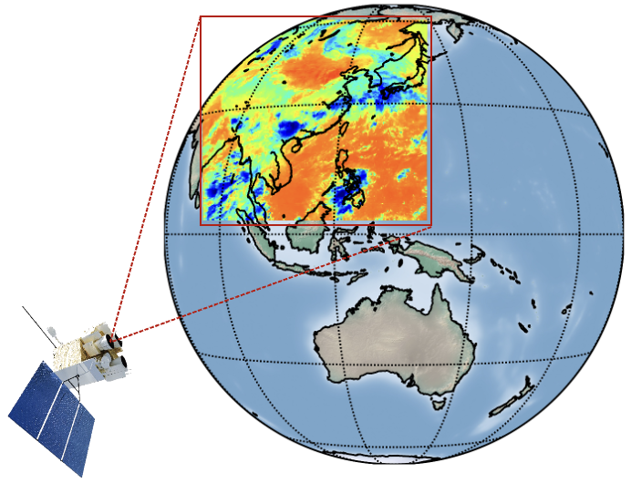

CEOS AC-VC Meeting #20, October 2024
Observing the Total Ozone Column Observed from the Geostationary Interferometric Infrared Sounder (GIIRS) over East Asia
Zhao-Cheng Zeng (zczeng@pku.edu.cn)
School of Earth and Space Sciences, Peking University, Beijing, China
Lu Lee, Chengli Qi, Feng Lu, Xiuqing Hu (National Satellite Meteorological Center, China Meteorological Administration)
Cathy Clerbaux (LATMOS/Sorbonne U.), Yangcheng Luo (LMD/Sorbonne U)
Shangyi Liu, Jiancong Hua, Mengya Sheng, Huidong Wang, Hao Song,
Shan Han (School of Earth and Space Sciences, Peking University)
GIIRS on board FengYun-4B satellite

Slide 2
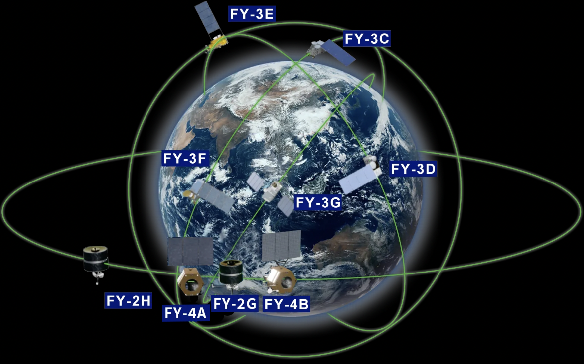
China’s FengYun meteorological satellites
风
雲
FY3E: dawn-dusk polar orbit (5:30 am/pm)
Wind
Clouds
The FengYun meteorological satellites:
Odd number series (FY-1, FY-3) polar-orbiting
Even number series (FY-2, FY-4) geostationary
Alphabet table is used, e.g., the ‘FY-4B’ means the second satellite in the FY-4 geostationary series.
Primary goal: Numerical Weather Prediction (water vapor; temperature; wind, clouds et al.)
Other goals: Monitoring atmospheric radiation, air pollutants and GHGs
All L1 (spectra) and higher level data products are publicly available through the National Satellite Meteorological Center (https://nsmc.org.cn/)
FY-4A/B: geostationary orbit
In operation FengYun satellites by Sept 2024
Source: http://www.nsmc.org.cn/

Slide 3
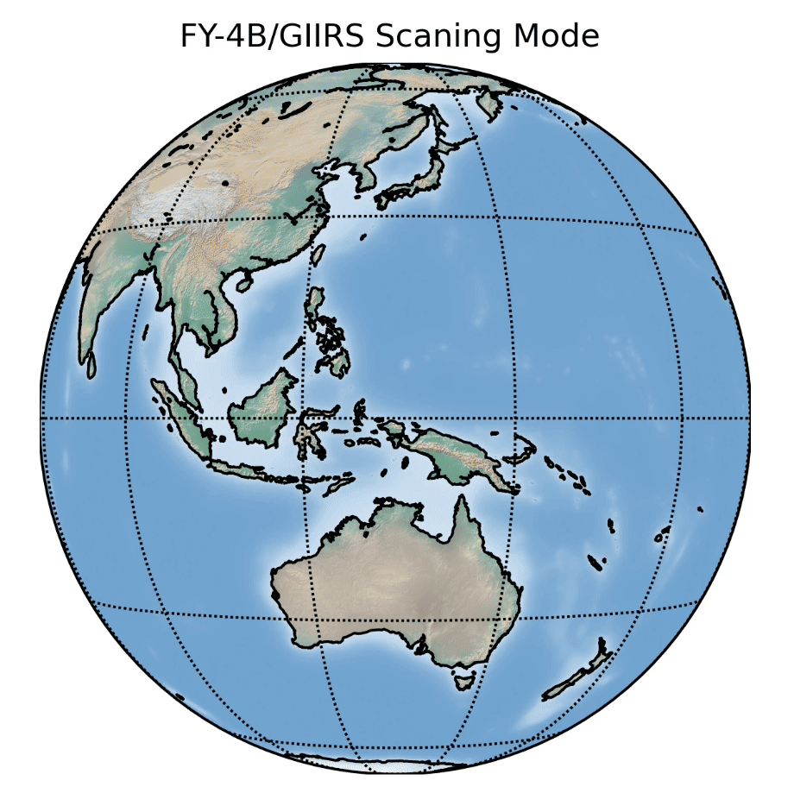
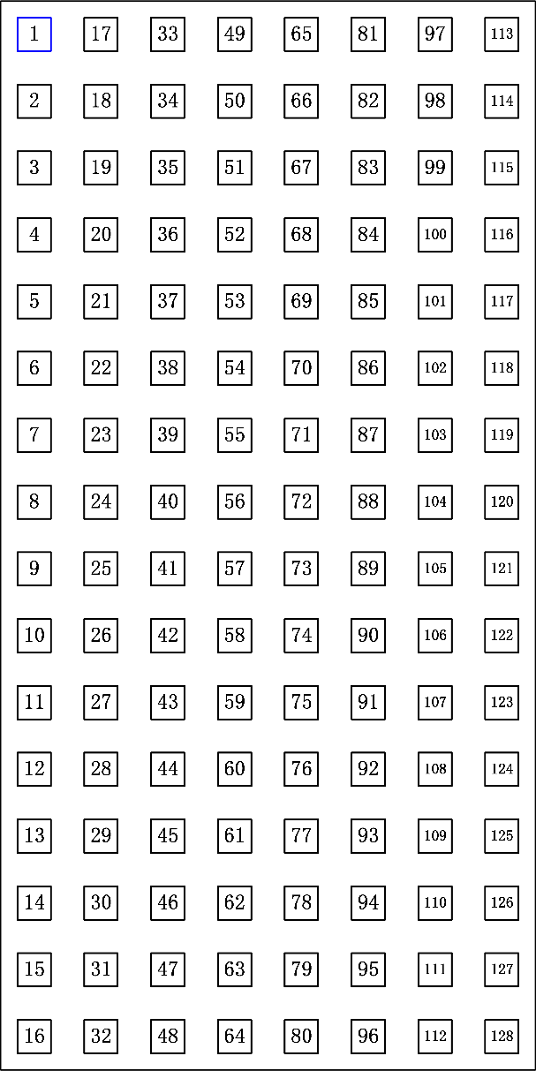
The Geostationary Interferometric Infrared Sounder (GIIRS)
GIIRS: the first geostationary hyperspectral infrared sounder, launched in mid-2021, data available from July 2022.
GIIRS scans the Earth in a “step-stare” mode: Each field of view collects16×8 interferograms
A typical GIIRS scan: 27 fields-of-regard (FORs)
The observation region comprises 27 FORs×12 Scans.
One coverage takes about 2.0 hours. 12 maps in a day covers day and night.
Footprint size at Nadir: about 12 by 12 km.
27 FORs
Detector layout
(16×8 interferograms)
12 Scans
By courtesy of Dr. Lee Lu (NSMC)

Slide 4
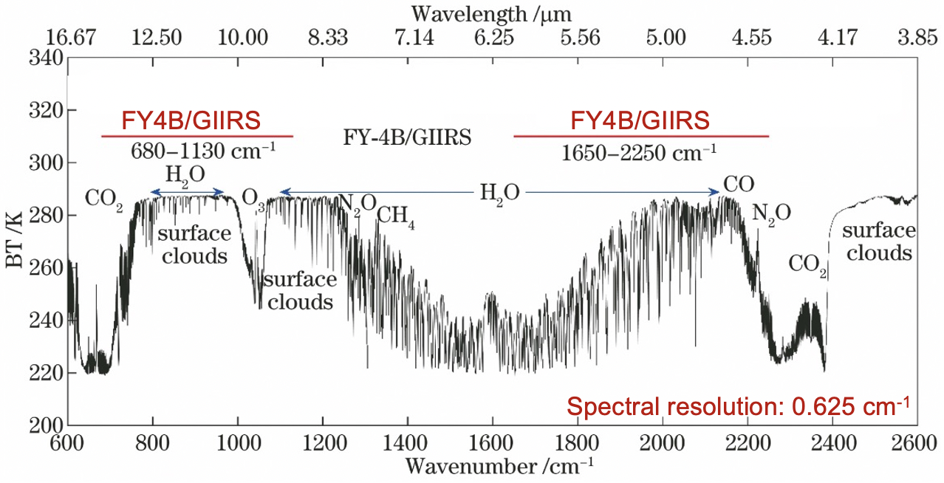
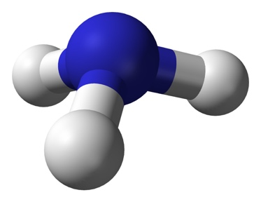
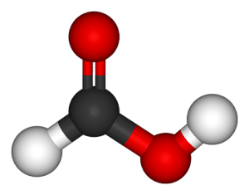
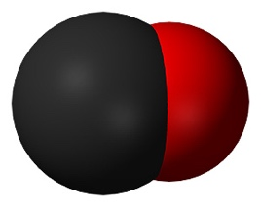
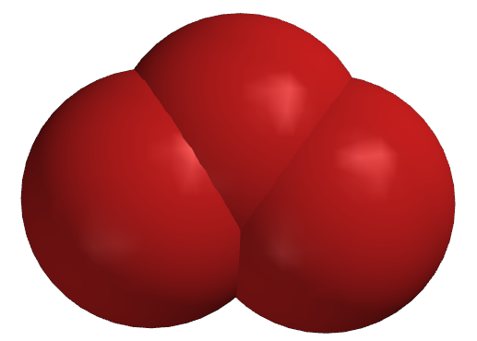
Spectral coverage of FY-4B/GIIRS
For NWP, CO₂ and H₂O absorption channels are used for retrieving atmospheric temperature and water vapor profiles.
Absorption features of trace gases, including air pollutants (CO, NH₃, O_{3,} VOCs) and GHGs (CO₂, CH₄, N₂O).
Pioneering naidr looking hyperspectral IR sounders include MOPITT, AIRS, TES, IASI, CrIS, et al.
NH₃
HCOOH
CO
O₃
955-975 cm⁻¹
1090-1120 cm⁻¹
2140-2180 cm⁻¹
1000-1080 cm⁻¹
Zeng et al. 2023a, AMT
Zeng et al. 2024, JGR
Zeng et al. 2023b, AMT
Liu et al. 2024, under review

Slide 5
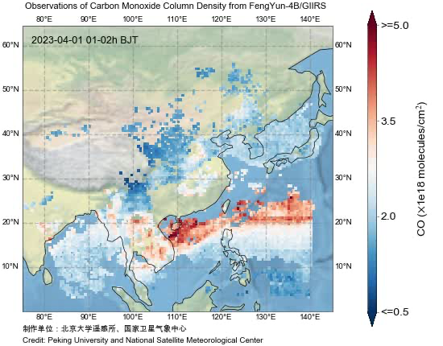
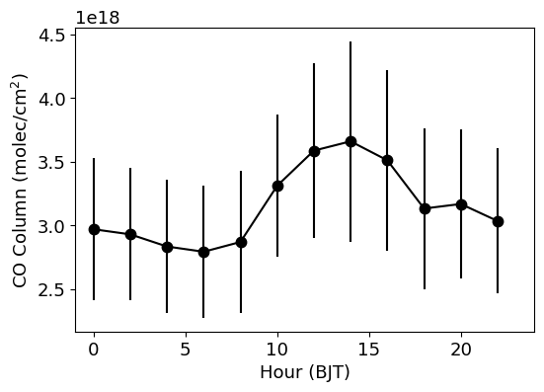
Diel cycle of wildfire CO enhancement from Southeast Asia
Maps of CO columns every 2-hour in Apr 2023
2-hour averages over the SE Asia land
LT: 13 pm
Strong CO emissions transported toward the South China Sea and the Pacific;
The diel cycle represents typical fire emissions caused by changes in temperature/humidity/agricultural activities
The observational sensitivity also changes from daytime to nighttime (averaging kernel)

Slide 6
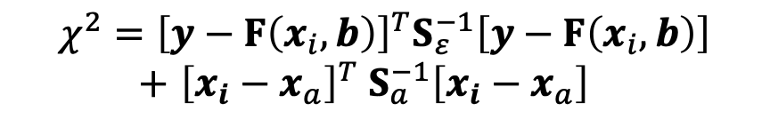
Ozone retrieval algorithm using FY-4B/GIIRS spectra
Optimal Estimation
Variables | Number of variables | A priori values | A priori uncertainty | Descriptions
O₃ | 26 | fixed |  | derived from ERA5 reanalysis
H₂O | 26 | ECMWF ERA5 reanalysis | 20%
CO₂ | 1 | ECMWF CAMS | 5% | only proﬁle scaling factors are retrieved
Surface skin temperature | 1 | ECMWF ERA5 | 5K
Air temperature proﬁle | 1 | ECMWF ERA5 | 0.05% | only a proﬁle scaling factor is retrieved
Surface emissivity slope and curvature | 4 | [0.0, 0.0, 0.0, 0.0] | [0.1%, 0.01%, 0.001%, 0.0001%] | the a priori surface emissivity data come from the University of Wisconsin-Madison
The solution from the retrieval algorithm is the state vector which minimizes the following cost function:
Forward Model
Observation error covariance
$${χ^{2}=\left[y−F\left(x_{i},b\right)\right]}^{T}S_{ε}^{−1}\left[y−F\left(x_{i},b\right)\right]$$
$+$ ${\left[x_{i}−x_{a}\right]}^{T} S_{a}^{−1}\left[x_{i}−x_{a}\right]$
State Vector
Priori Covariance
The Levenberg-Marquardt modification of the Gauss-Newton method is used to search the solution. The averaging kernel (AK) matrix is used to characterized the DOFS and observational sensitivity.
Table. Parameters in the state vector to be retrieved in the ozone retrieval algorithm
The a priori O₃ profile in the retrieval algorithm is fixed.
Notes:
Here is the inverse model
The solution from the retrieval algorithm is the state vector that minimizes this cost function. The lm method is used to search the solution.
State vector: target gas, interfering gases, surface temperature, temperature profile (scale factor), surface emissivity (polynomial scale factor)

Slide 7
Diurnal cycle of ozone maps from FY-4B/GIIRS
Diurnal ozone retrievals in September 2023 (1)
x10¹⁸
12 times whole coverage per day (every two hours).
A typical total ozone columns (TOC) distribution: high values at high latitudes, decreasing at mid-latitudes and towards the equator.
DOFS ranges from 0.8 to 1.4 with latitudes. The diurnal variation of DOFS in ocean and land is different.
Overview of GIIRS O₃ retrieval performances for hours 1–2, 5–6, and 9–10 UTC averaged for the month of September 2023. All the results are monthly averaged in 0.5°×0.5° grids.
Notes:
Next is the ozone retrievals from GIIRS. GIIRS can provide 12 times whole coverage per day.
This figure is the monthly mean retrievals in different time period of a day, including the total ozone columns and the associated DOFS.

Slide 8
Diurnal cycle of ozone maps from FY-4B/GIIRS
Diurnal ozone retrievals in September 2023 (2)
x10¹⁸
12 times whole coverage per day (every two hours).
A typical total ozone columns (TOC) distribution: high values at high latitudes, decreasing at mid-latitudes and towards the equator.
DOFS ranges from 0.8 to 1.4 with latitudes. The diurnal variation of DOFS in ocean and land is different.
Overview of GIIRS O₃ retrieval performances for hours 1–2, 5–6, and 9–10 UTC averaged for the month of September 2023. All the results are monthly averaged in 0.5°×0.5° grids.
Notes:
Next is the ozone retrievals from GIIRS. GIIRS can provide 12 times whole coverage per day.
This figure is the monthly mean retrievals in different time period of a day, including the total ozone columns and the associated DOFS.

Slide 9
Inter-comparison with IASI ozone data
Comparison with IASI retrievals
IASI/Metop-B, overpasses equator at 09:30 and 21:30 each day, with a 12 km footprint at nadir.
Two examples of comparison on December 02, 2022, and June 15, 2023, using daytime (upper panel, 1 h~8 h UTC) and nighttime (lower panel, (11 h~18 h UTC)) retrievals.
A good agreement in the mean TOCs between GIIRS and IASI, with r of 0.94 and slopes from linear regression ranging from 0.98 to 1.
Intercomparison of gridded O₃ column retrievals between GIIRS (first column) and IASI (second column) on two representative times: daytime on 01 December 2022 (upper panel, a) and nighttime on 15 June 2023 (lower panel, b).
Notes:
we carry out data evaluation of GIIRS O3 retrievals by cross-comparison with ERA5 reanalysis data, collocated IASI satellite retrievals and ozonesonde data.
It shows two examples of comparison between GIIRS and IASI. One is daytime on December, the other is nighttime on June
The result shows a good agreement

Slide 10
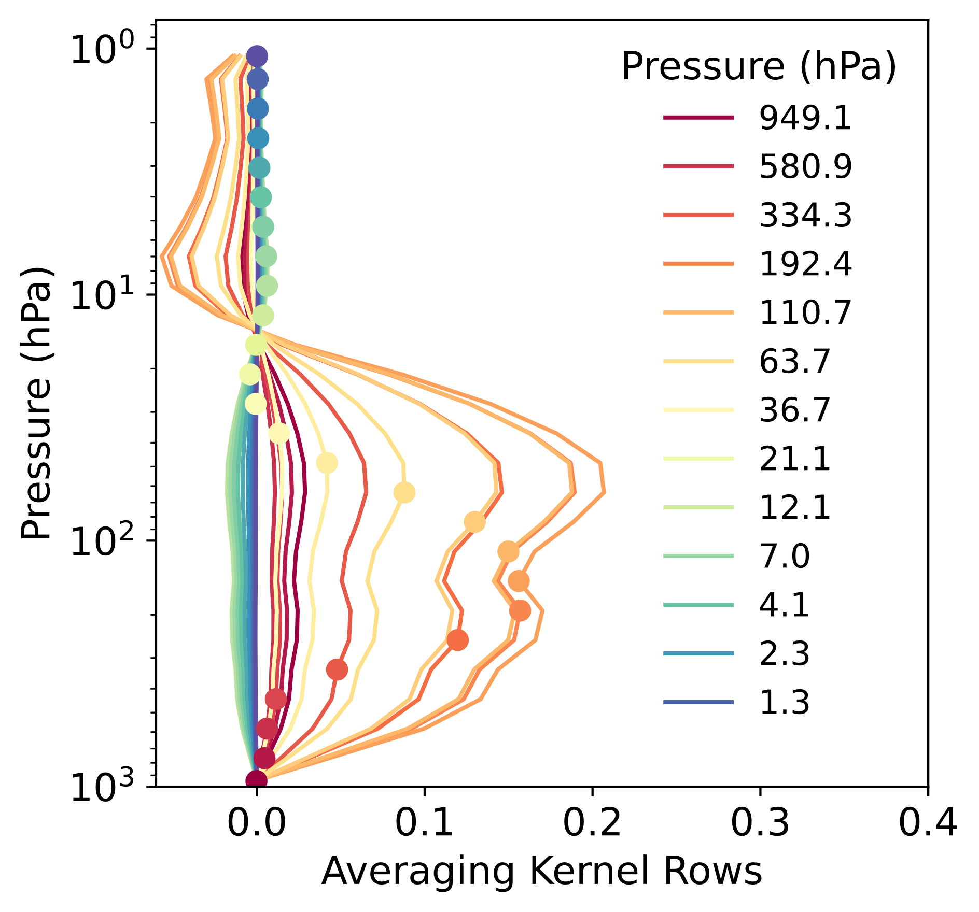
Inter-comparison with ECMWF ozone reanalysis data
A point-by-point collocation comparison between GIIRS and ERA5 is performed:
Interpolate the ERA5 data to the locations and times of the GIIRS retrievals;
Smooth the ERA5 ozone profile using the corresponding AK matrix from GIIRS retrievals:
Results show good agreement: r ranging from 0.96 to 0.99; The mean bias is –3.1×10¹⁷ molec/cm² (~ –3.9%).
Example of AK matrix rows

Slide 11
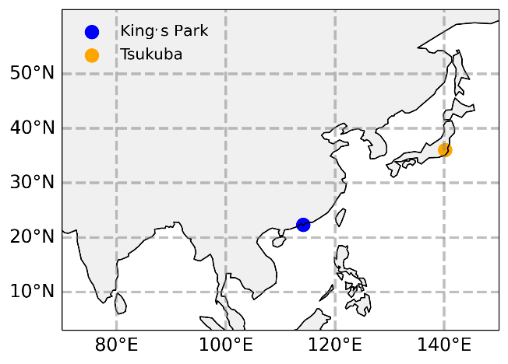
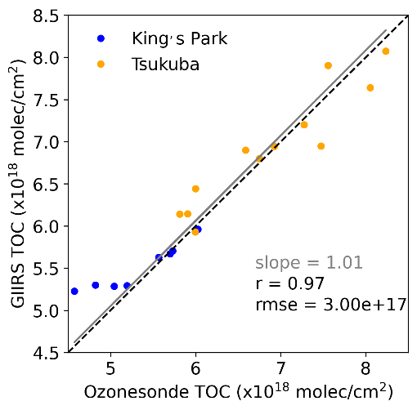
Inter-comparison with ozonesonde data
Ozonesonde data are obtained from the World Ozone and Ultraviolet Radiation Data Centre (WOUDC) archive.
The coincidence criteria for the comparison are of a 100km search radius and ±2h, resulting in a total of 20 data points (in 4 months).
The two datasets are of good agreement, with r of 0.97, slope of 1.01 and RMSE of 3.0×10¹⁷ mole/cm².
Notes:
Here is the Comparison with Ozonesonde measurements. The data are
only two stations have complete data during the study period and can be used in the comparison,
a total of 20 validations are conducted

Slide 12
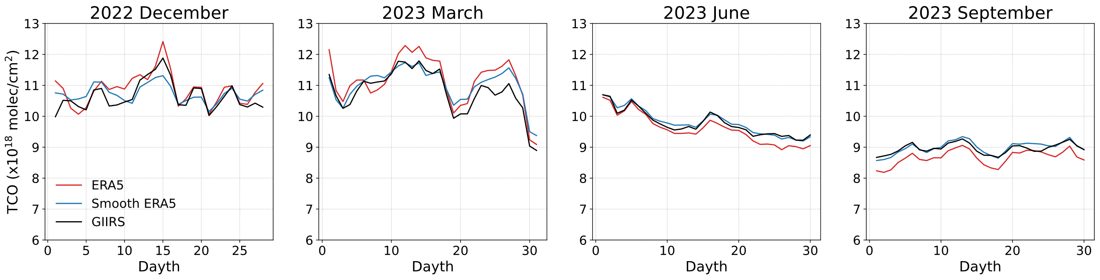
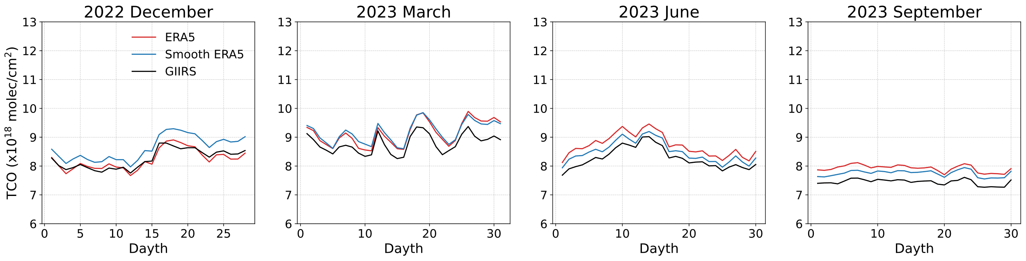
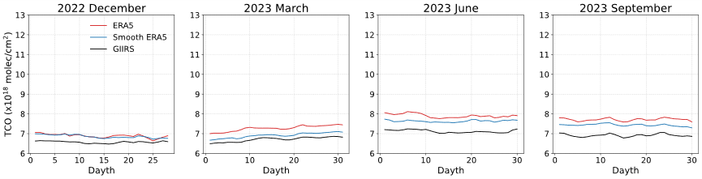
Daily mean TOC as a function of days in different months and latitude zones
Daily to seasonal variation of ozone columns
50°N
–60°N
FY4B/GIIRS captures the daily dynamics of total ozone.
High latitude regions experience significant seasonal variations in solar radiation and ozone transport, while tropical regions are relatively stable with smaller seasonal variations.
30°N
–40°N
10°N
–20°N
Notes:
This figure shows the daily mean TOC as a function of days in different months and latitude zones, from top to the bottom are the high latitudes to low latitudes
We can see the strong fluctuations in TOC at high latitude, especially in march. high latitude regions experience significant seasonal variations in solar
Besides the chemical production and loss, some other process can also influence the TOC

Slide 13
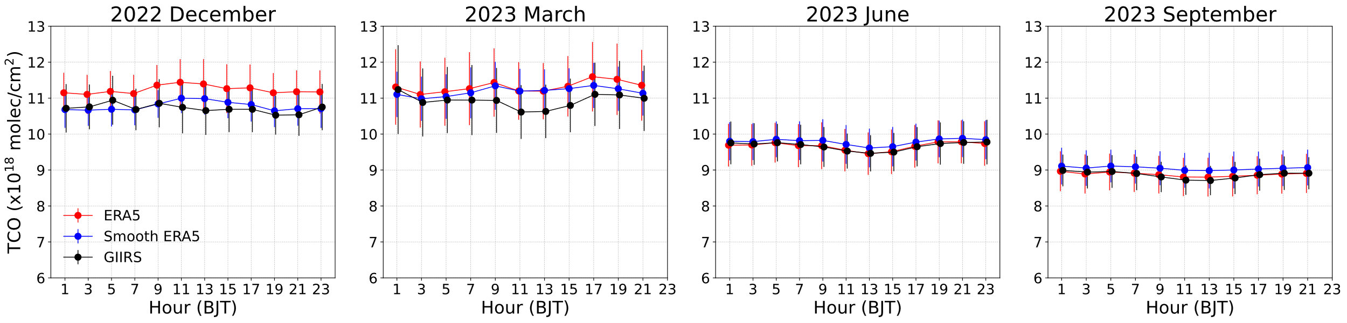
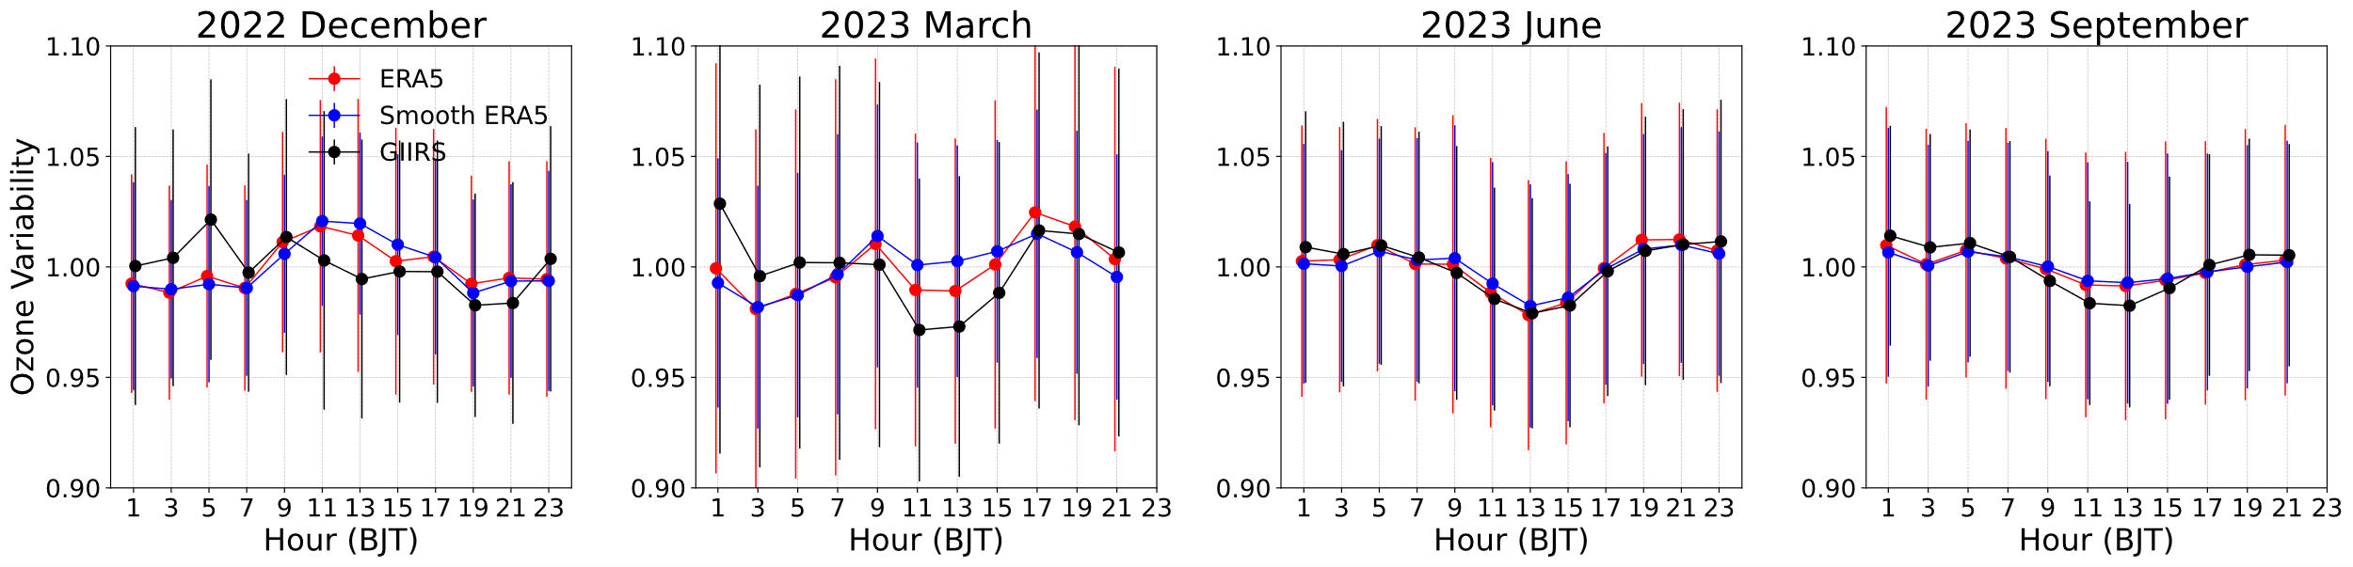
Diurnal variation of ozone column from FY-4B/GIIRS
(a) 2-hour averages over a 5°×5° region centered at 130°E, 50°N (high latitude)
The most significant diurnal variation in ozone occurs in spring (March): TOC increases from 5:00 to 9:00 local time, decreases then and reaches the minimum at around 13:00 BJT. It gradually rises again and peaks at 17:00 BJT and follows by a slow decline thereafter.
This diel change maybe attributed to the time-varying ultraviolet radiation levels which play a crucial role in both ozone production and depletion.
The balance between chemical production and loss processes together determines the overall outcome of ozone variations.
(b) the ratio of 2-hourly TOC to the daily mean TOC for illustrating the relative changes
Errorbar: data variability
Notes:
Let us see the result in this region.
To better quantify the diel cycle of TOC, we calculate the ratio of the 2-hourly TOC values to the daily mean
In march, TOC increase in the morning and decrease in the noon and rise again in the afternoon. This diel change is attributed to the time-varying ultraviolet radiation levels.
The balance between chemical production and loss processes together determines the overall outcome of ozone variations.

Slide 14
Conclusions
Related GIIRS Publications
(1) CO: Zeng, Z.-C., et al., 2023a, Diurnal carbon monoxide observed from a geostationary infrared hyperspectral sounder: first result from GIIRS on board FengYun-4B, Atmos. Meas. Tech., AMT Highlight paper
(2) NH3: Zeng, Z.-C., et al., 2023b, Optimal estimation retrieval of tropospheric ammonia from the Geostationary Interferometric Infrared Sounder on board FengYun-4B, Atmos. Meas. Tech.
(3) HCOOH: Zeng, Z.-C., et al., 2024, Observing a Volatile Organic Compound from a Geostationary Infrared Sounder: HCOOH from FengYun-4B/GIIRS, JGR, accepted.
(4) O3: Liu et al. 2024, under review by JGR, preprint available at ESSOA.
We show the ozone retrieval algorithm for FY-4B/GIIRS observations over East Asia for every two hours (12 observations in a day).
The total column data have good agreement with IASI, ECMWF reanalysis, and ozonesonde data.
More validation is needed, especially for high latitude winter retrievals.
Combining with data from other sources, in the coming future, we will try to understand what drives the diurnal variability and ita anamalies, and if GIIRS is sensitive to detect the impacts on O3 from the volcano eruptions in the tropics and the lofted pollution from Asian moonsoon, and many more.
Data availability:
The GIIRS L1 spectra are publicly available from the National Satellite Meteorological Center (quota: 30-100G/day/account): http://satellite.nsmc.org.cn/portalsite/.
Acknowledgement: National Science Foundation of China; National Satellite Meteorological Center (https://nsmc.org.cn/); IASI data portal (https://iasi.aeris-data.fr/)
Thank you!

