Slide 1
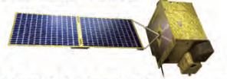
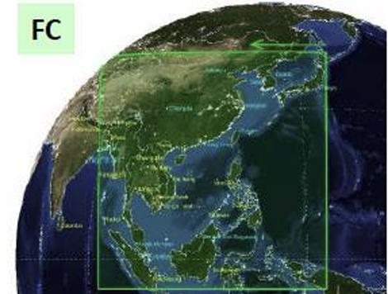
Introduction to the upcoming version 3 of GEMS ozone profile product
Juseon (Sunny) Bak
Institute of Environmental Studies,
Pusan National Univ.,
Busan, South Korea

Slide 2
GEMS O3Profile algorithm
Inverse method is an optimal estimation, which iteratively estimates the geophysical variables until the simulated spectrum closely matches the measured spectrum, within the retrieval constraints of the a priori information.
GEMS (310-330 nm) + on-line radiative transfer (VLIDORT) + A priori constraints (climatology)
O3 partial columns (DU) for 24 layers from surface to 65 km (2.5 km thickness)
+ integrated column amounts up to the tropopause
$$\hat{X}=F^{−1}\left(y\right) ⇔X_{ap}$$
Heritage
 | GEMS v2-OMI C3 | GEMS v3-OMI C4
RTM | VLIDORT 2.4 | PCA-VLIDORT v2.7
Xap | LLM climatology | Tropopause-based O3P climatology
Slit | Gaussian | Super Gaussian + Slit function linearization
spectroscopy | SAO solar ref. BDM (1995) | TSIS solar ref. Birk And Wagner (2018)
SAO PROFOZ ozone profile algorithm
developed for OMI collection 3 @ Aura validation center
(Liu et al. 2020)
adopted for the GEMS v2.0 (current) ozone profile
enhanced for OMI collection 4 data processing
(Bak et al. 2024)
adopted for GEMS v3.0 (upcoming) ozone profile &
TEMPO

Slide 3
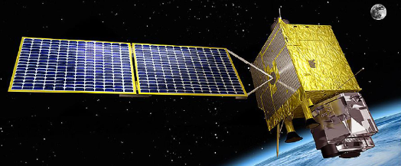
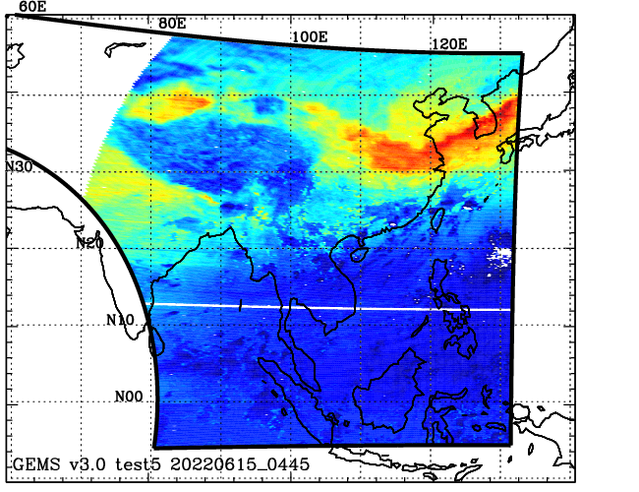
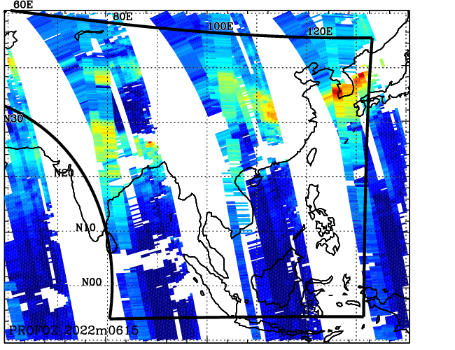
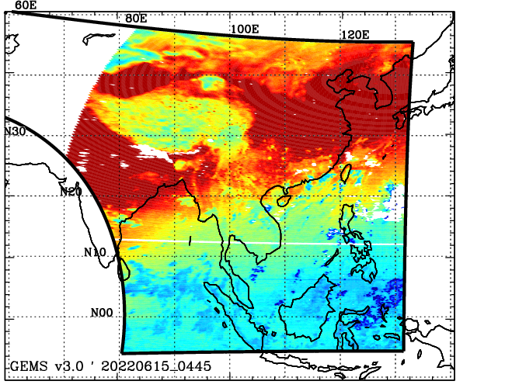
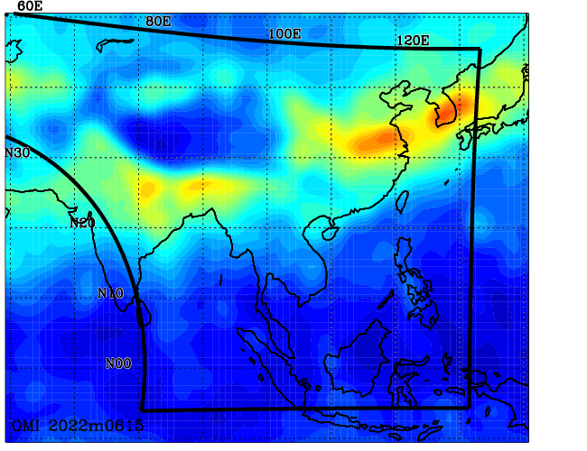
Example of OMI vs GEMS TCO without re-calibration
270-330 nm
310-330 nm
OMI
GEMS
Inverse (OE) model
Forward (RT)model
$$\hat{X}=F^{−1}(Y)$$
Inverse-forward process is exactly same. The O3 retrieval results are dependent on the instrument calibration errors.
OMI collection 4 l1b data is extensively calibrated, but the remaining uncertainty cause stripes along with the left edge pixels
GEMS illustrate significant overestimation over the entire domain due to 30 % irradiance offset,.

Slide 4
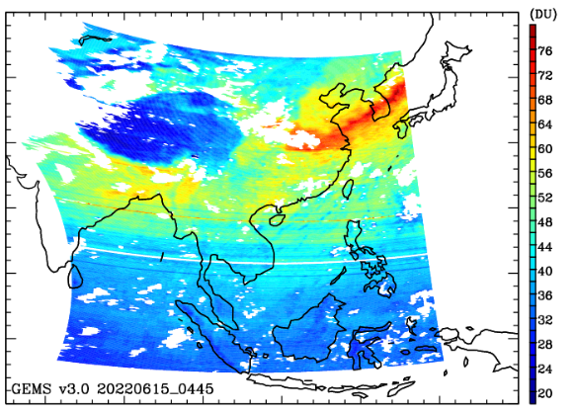
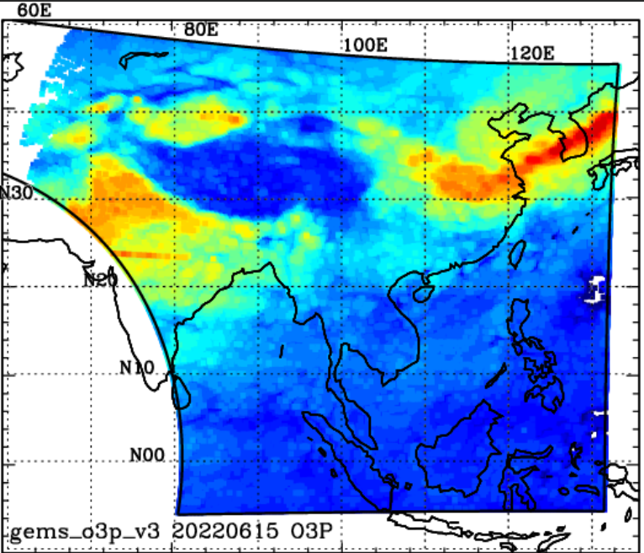
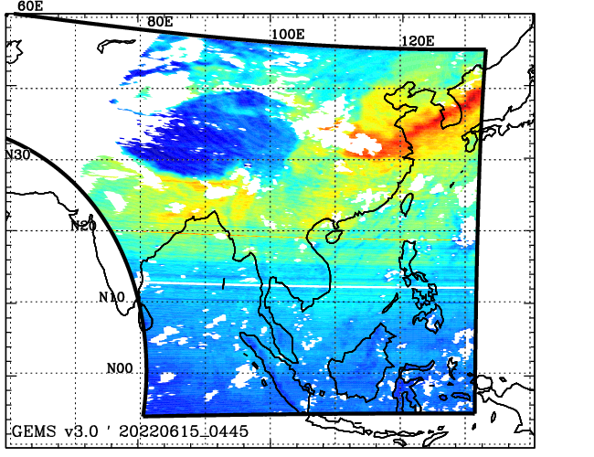
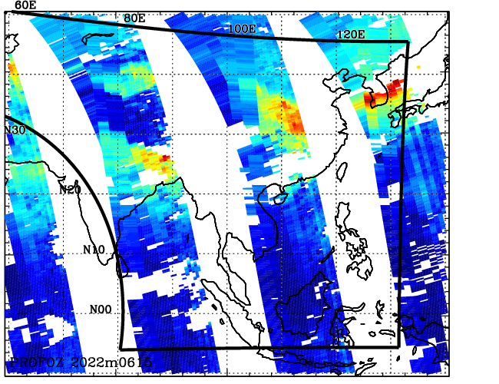
Example of OMI vs GEMS TCO with re-calibration
irradiance offset
+
Soft calibration
soft calibration
OMI
GEMS
Inverse (OE) model
Forward (RT)model
$$\hat{X}=F^{−1}(Y)$$
Soft calibration is a well known empirical method to remove the systematic measurement bias dependent on CCD dimension. The soft spectrum is derived as the systematic residuals between measurement and simulation over clear-sky tropical pixels where forward calculation error can be assumed to be free.
Irradiance offset correction is implemented to account for the BTDF uncertainties in GEMS irradiance calibration. The offset spectrum is derived with polynomial terms by fitting GEMS irradiance to the high-resolution solar reference spectrum.

Slide 5
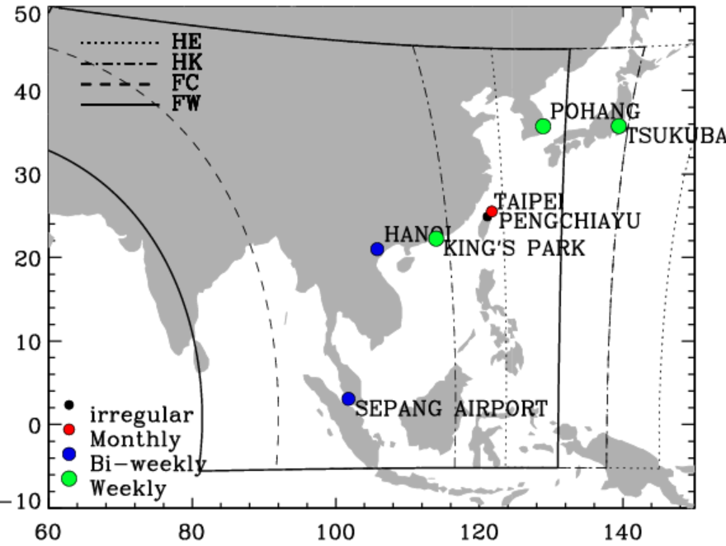
Validation for GEMS 2021.01-2023.12 for 0445 UTC
Global international network
station | source | frequency | Latest update
Pohang | Woudc | Weekly | 2023.07.10
Taipei | Woudc | Monthly | 2023.12.27
King’s park | Woudc | Weekly | 2022.02.24
Hanoi | Shadoz | Bi-weekly | 2021.11.26
Sepang Airport | shadoz | Bi-weekly | 2022.12.22
Campaign archive
Asia-AQ 2024.Feb-Mar : # 26 sonde profiles
ACCLIP 2022.Jul-Aug : daily sonde in Anmyendo island, 6 sondes in Taipei
Satellite ozone profile product
1. OMI collection 4 ozone profile product (same algorithm) 2. S5P re-processed ozone profile product (KNMI)

Slide 6
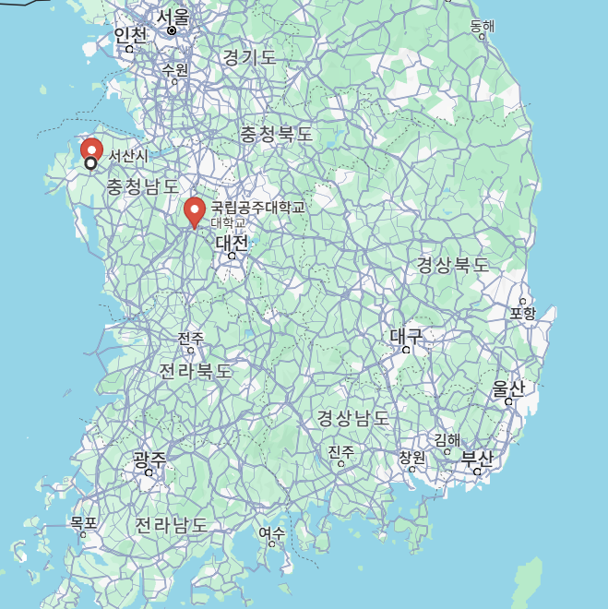
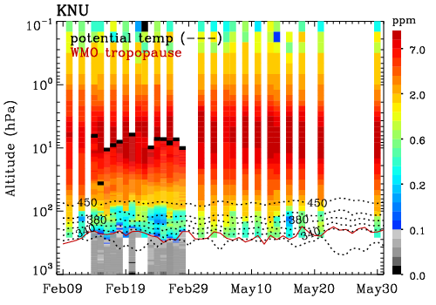
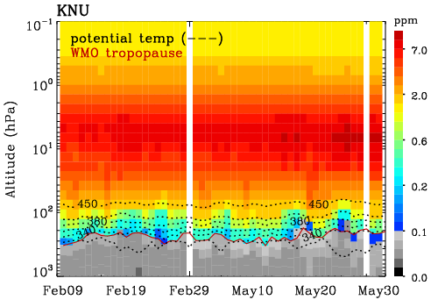
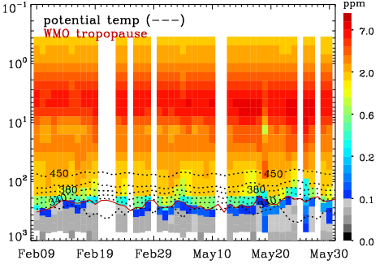
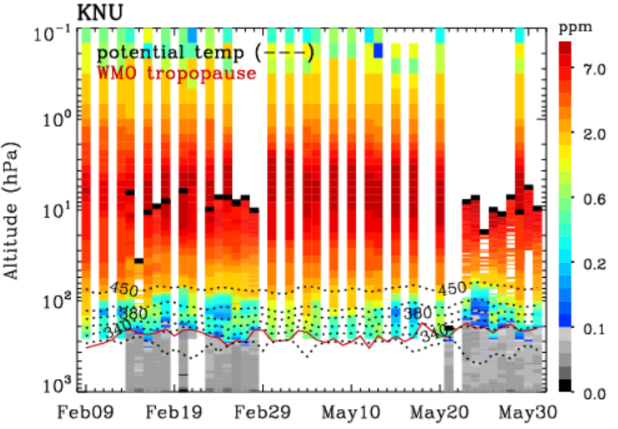
Comparison btw GEMS v2.0 and V3.0 in 2024 Asian-AQ campaign
The ASIA-AQ mission is an international cooperative field study designed to address local air quality challenges (2024 Feb-Mar). Specifically, ASIA-AQ will contribute to improving the integration of satellite observations with existing air quality ground monitoring and modeling efforts across Asia.
SeoSan
30 km
KongJu
Ozone sonde observations in South Korea
SeoSan : Feb 14-28 (#13) @ 36.92 N 126.37 E
KongJu : Mar 21-31 (#10) @ 36.47 N 127.74 E
MLS (5ºx5º, 3-day)
+ ozonesonde
GEMS v3.0
GEMS v2.0

Slide 7
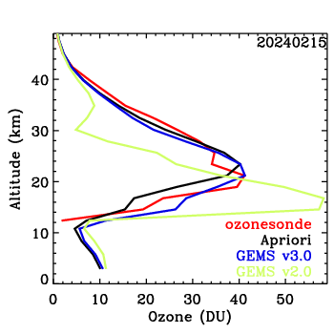
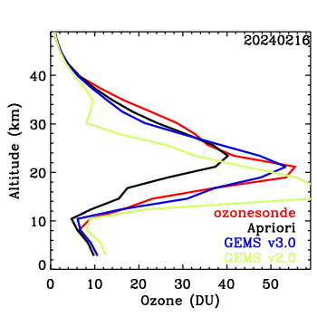
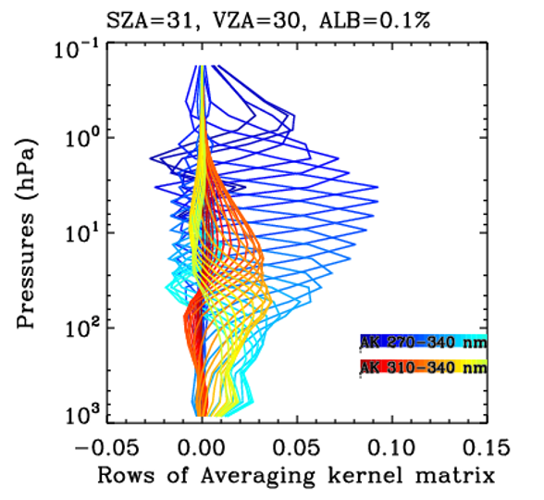
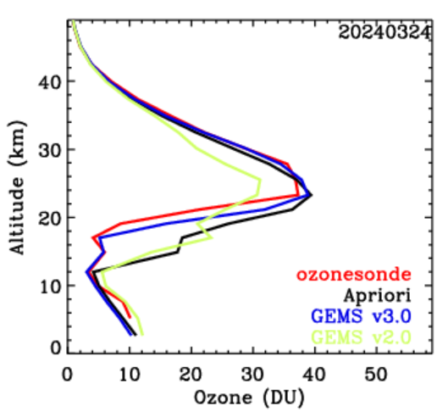
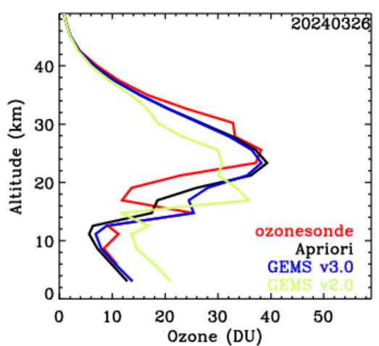
2024 Feb 15
2024 Feb 16
48 km
GEMS 3.0
A priori
32 km
sonde
GEMS 2.0
GEMS
310-330 nm
OMI
270-330 nm
2024 Mar 24
2024 Mar 26
GEMS use the limited spectral information
from 310 to 330 nm, in hence, we have the reduced information content in the stratosphere
In spite of that, GEMS have somewhat
independent piece of information capturing the dynamically varying profile shape

Slide 8
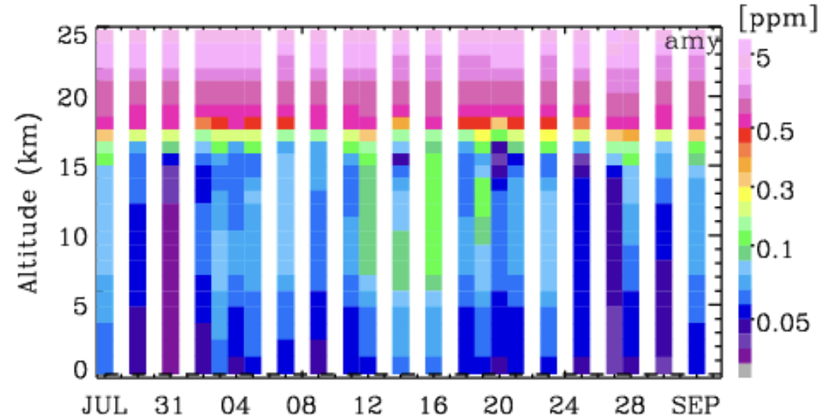
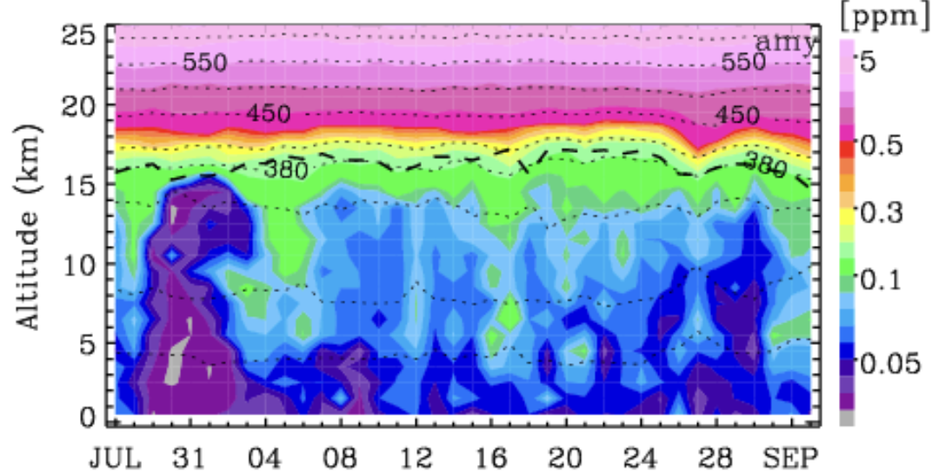
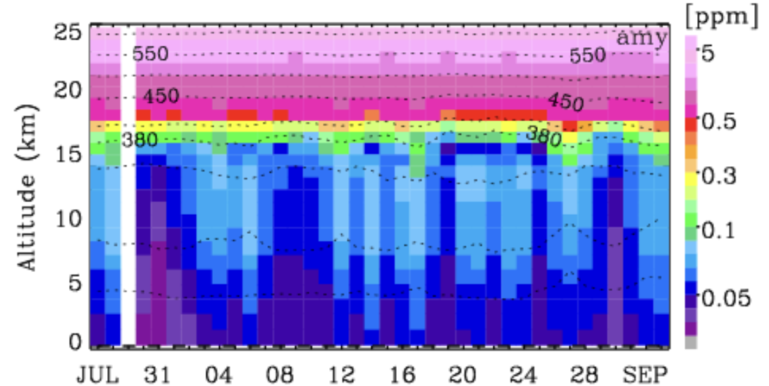
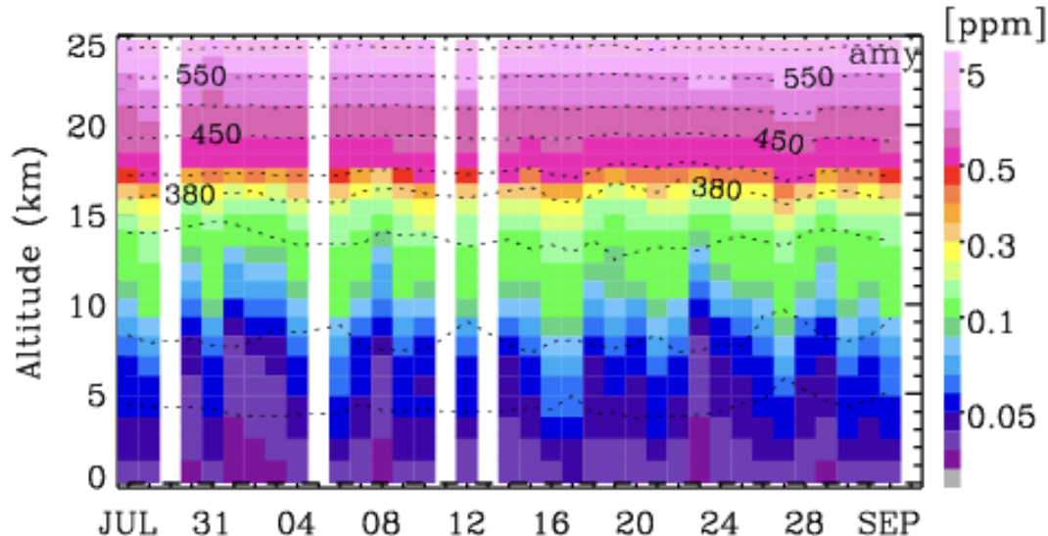
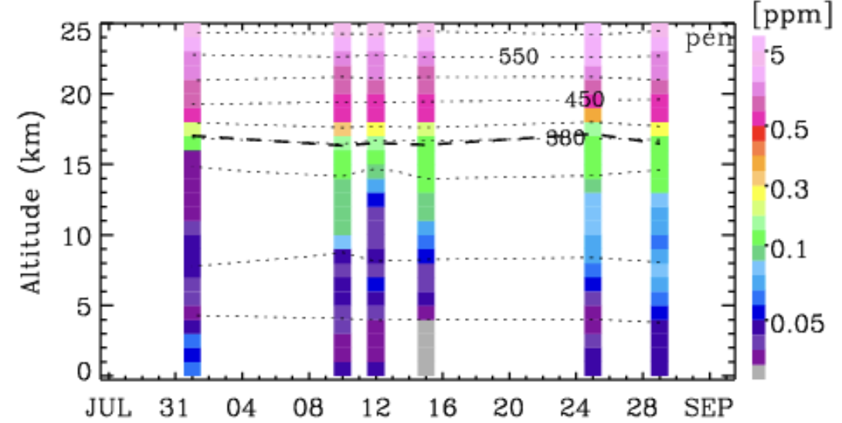
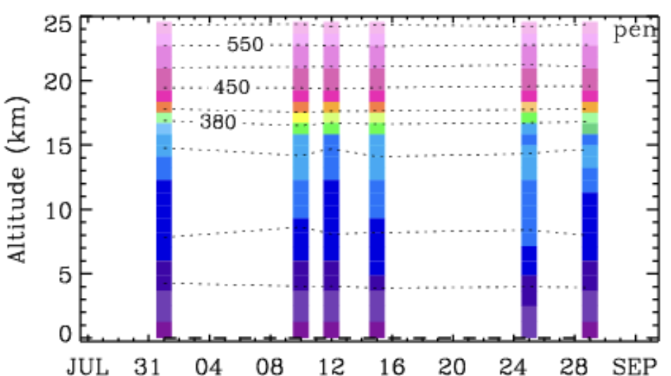
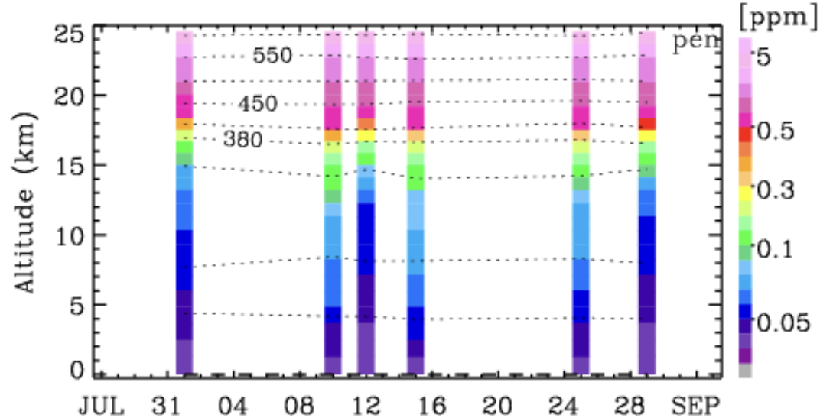
Comparison btw GEMS v2.0 and V3.0 in 2022 ACCLIP summer campaign
Ozonesonde
GEMS/V3.0
S5P/KNMI
South Korea
Taiwan
Airborne filed campaign in summer of 2022 (July15-Augst 31) in south Korea To investigate the impacts of Asian gas and aerosol emissions on global chemistry and climate via the linkage of Asian Summer Monsoon (ASM) convection and associated large-scale dynamics.
1. 38 ozonesondes launched from Anmyeondo Island, South Korea, from 27 July to 2 September
2. 8 ozonesondes launched from Pengjia Islet, Taiwan (August 2022, 10:00−12:00 LT)

Slide 9
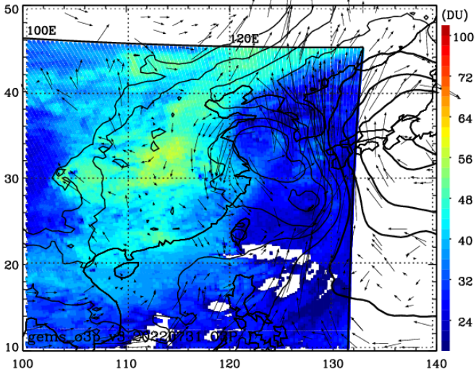
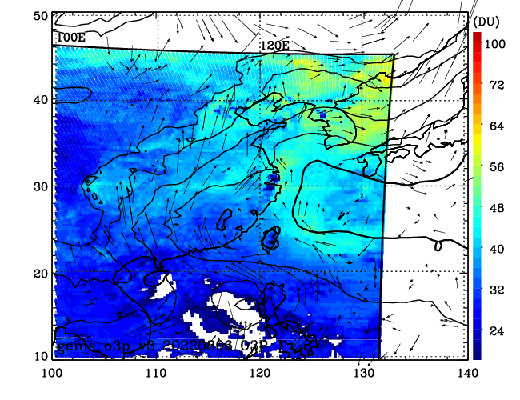
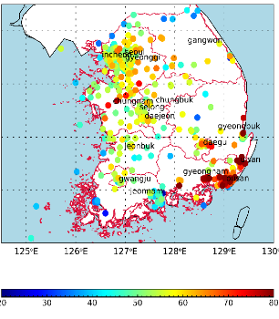
Spatial distribution of tropospheric column ozone (GEMS v3.0)
July 31 2022
AUG 06 2022
L
H
Dirty air
Westerlies
H
Tropical storm
Clean air
Capture the impact of transboundary transport from tropical region (clean) and China (polluted) over Korean peninsular and western pacific

Slide 10
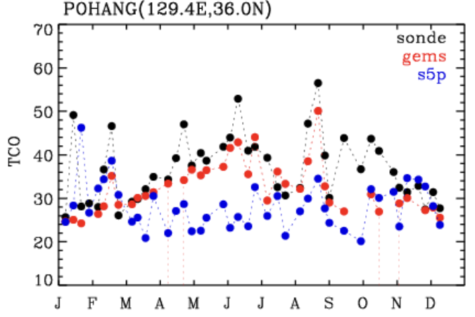
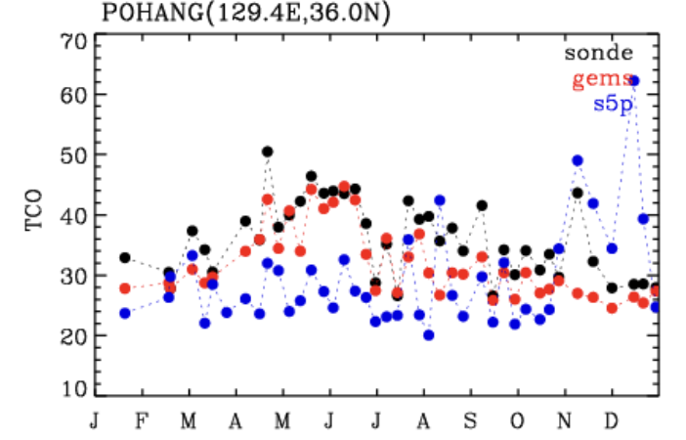
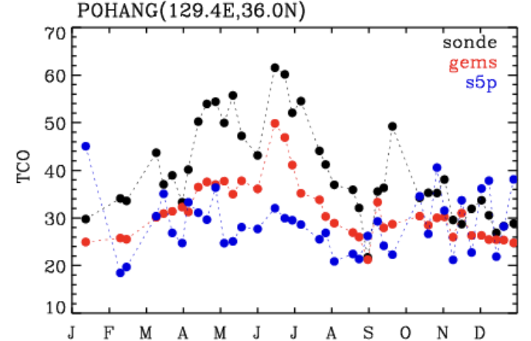
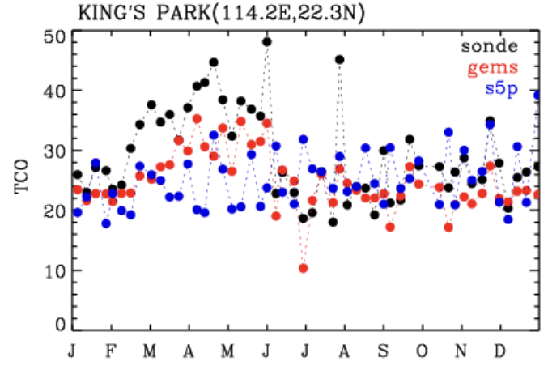
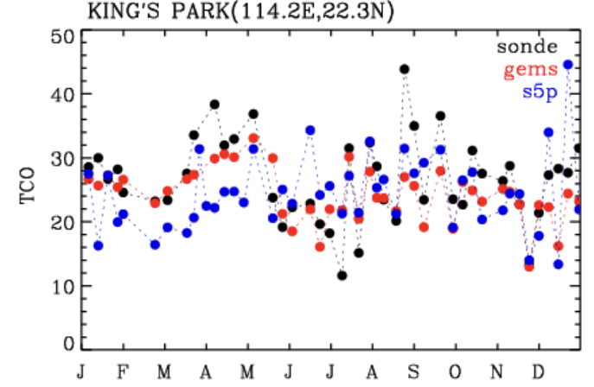
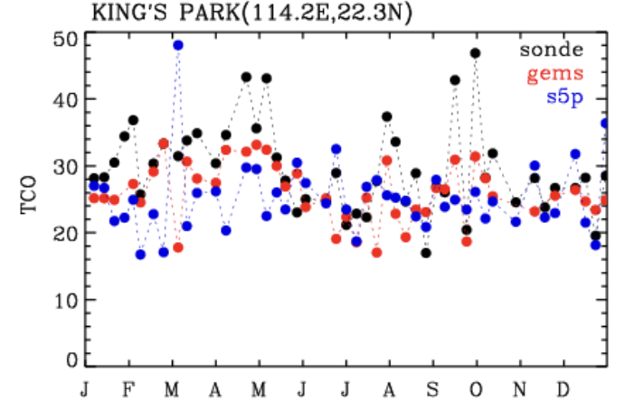
Cross-evaluation with S5P: TCO 1000-400 hPa
Pohang in South Korea
2021
2022
2023
King’s park in HongKong
2021
2022
2023

Slide 11
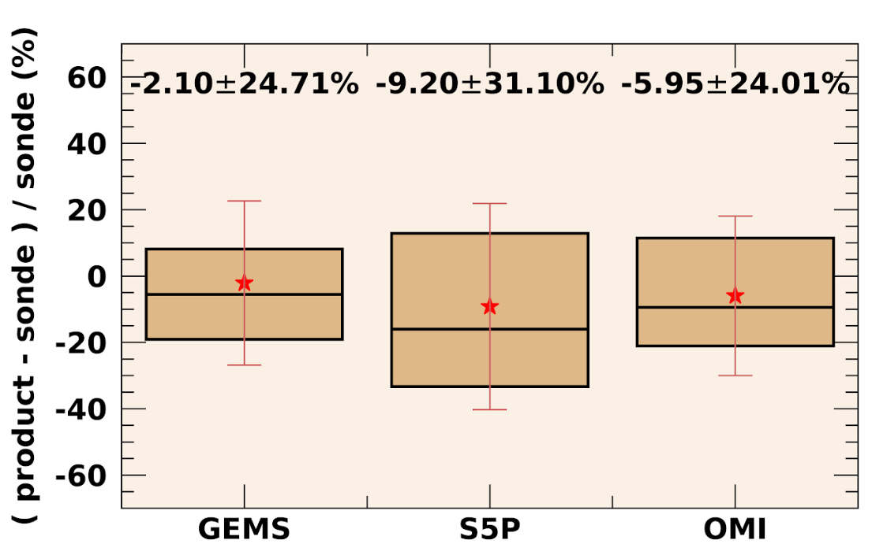
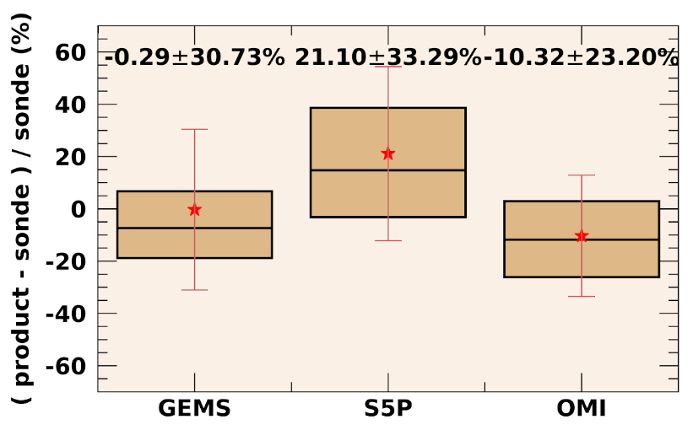
Comparison statistics
Lower TCO (1000-300 hPa)
Upper TCO (300-100 hPa)

Slide 12
Summary
GEMS wavelength and radiometric calibration processes have been implemented for both radiances and irradiances, leading to significant improvements in ozone profile retrievals for GEMS v3.0
We demonstrate that GEMS is able to capture the dynamics-induced ozone variability in the lower stratosphere and the photochemical-induced ozone variability in the troposphere.
In comparison with ozonesondes, GEMS show the similar quality with OMI
The enhanced GEMS v3.0 product is planned for public release in early 2025
Thanks you for your attention !!
Feel free to contact me (juseonbak@pusan.ac.kr)
Notes:
To conclude,
This is the summer for this talk, we introduced the updates for OMI collection 4 ozone profile research product and demonstrate that OMI is still working in 2022 for ACCLIP and in 2024 for Asia-AQ application.
The version 2 retrieval algorithm has been installed and made available on NASA’s SIPE and we are currently working on adjusting the output format

Slide 13
