Slide 1
Southern Hemisphere Additional Ozonesondes (SHADOZ) Network: The Standard for Satellite Validation and Trends
Debra Kollonige, NASA/GSFC and SSAI
Ryan Stauffer (GSFC; SHADOZ PI), Anne Thompson (GSFC and UMBC; SHADOZ Founding PI), Bryan Johnson, Gary Morris, Patrick Cullis (all NOAA), and dozens of SHADOZ colleagues
CEOS AC-VC-20
College Park, MD, USA
18 October 2024, 1020-1035

Slide 2
Roadmap: High-Quality Profiles for Validation & Trends
SHADOZ Network Status and Archive Updates
Ozonesonde Data Quality Assurance Activities – How we know our data are of excellent quality
Global Perspective: ±2% Total Column Ozone Agreement w/Satellites!
Setting the Standing for Ozone Trends
SHADOZ tropical trends from surface to UT/LS: Climate signal at the tropopause (update of Thompson et al., 2021; JGR “T21”)
Tropics show overall modest trends except SE Asia where dynamics are a factor (Stauffer et al., 2024; ACP TOAR-II Special Issue)

Slide 3
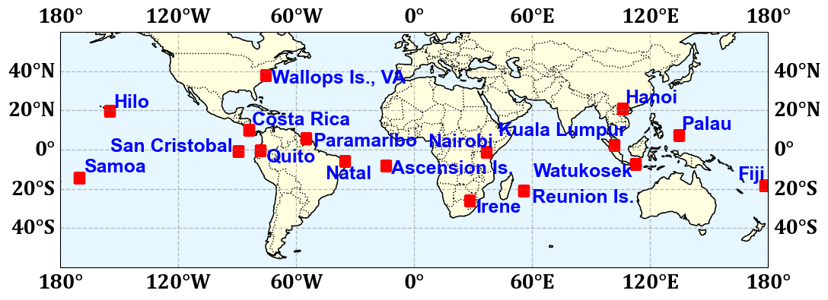
SHADOZ: >25 Years and >10,000 Profiles
SHADOZ Data Collection & Archive
Now 16 stations and >20 sponsoring organizations. 2-4 profiles per month at individual stations
Data Archive Statistics: >10,000 profiles. Complete post-COVID rebound in yearly data collection
NASA/GSFC also oversees NASA/Wallops Is. (WFF) >50-year record
SHADOZ: https://tropo.gsfc.nasa.gov/shadoz

Slide 4
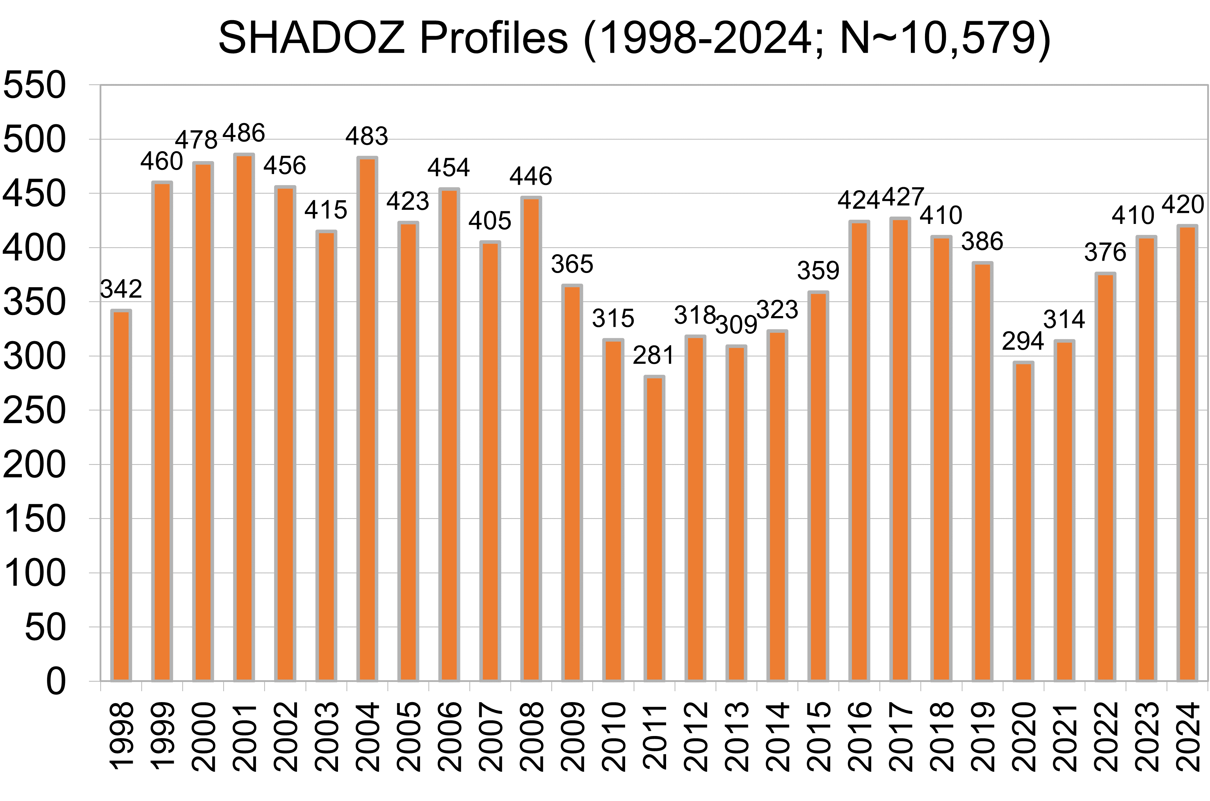
SHADOZ Data Archive Status
14 stations with >10-year records
2024: Palau and Quito joining SHADOZ – V06 data coming to the archive soon!
>10,000 O₃-PTU profiles archived on SHADOZ website
SHADOZ v6 data DOI: https://doi.org/10.57721/SHADOZ-V06
NOAA station/logistical support

Slide 5
SHADOZ Data Archive Status
14 stations with >10-year records
2024: Palau and Quito joining SHADOZ – V06 data coming to the archive soon!
>10,000 O₃-PTU profiles archived on SHADOZ website
SHADOZ v6 data DOI: https://doi.org/10.57721/SHADOZ-V06
SHADOZ covers a latitudinal band equal to ~40% of Earth’s surface
NOAA station/logistical support

Slide 6
SHADOZ Data Quality Assurance and Recent Science

Slide 7
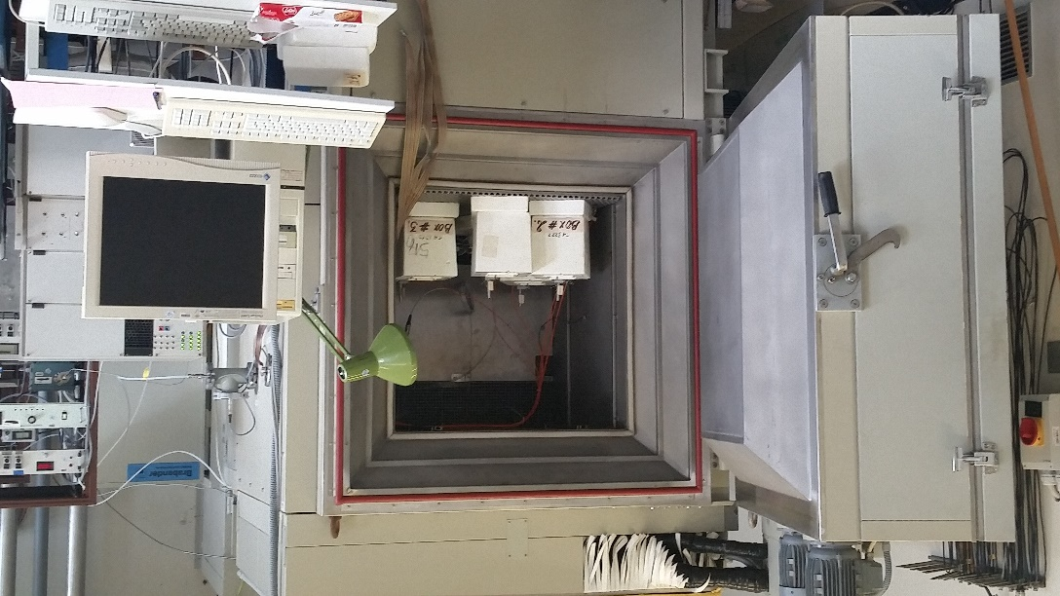
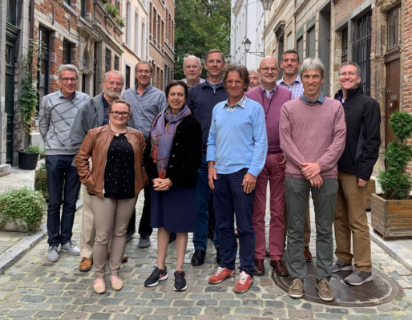
Data Quality Assurance: ASOPOS Panel
Assessment of Standard Operating Procedures for OzoneSondes v2.0 (ASOPOS 2.0) prescribes SOPs for global network
Field and WCCOS chamber tests at FZJ, Germany, inform guidelines and steps to reprocess or “homogenize” data → 5% uncertainty goal for satellite validation
WMO/GAW Report #268
World Calibration Centre for OzoneSondes (WCCOS) environmental chamber
Four Ozonesondes Compared to WCCOS UV Photometer
ASOPOS 2.0, Brussels, Sep 2019

Slide 8
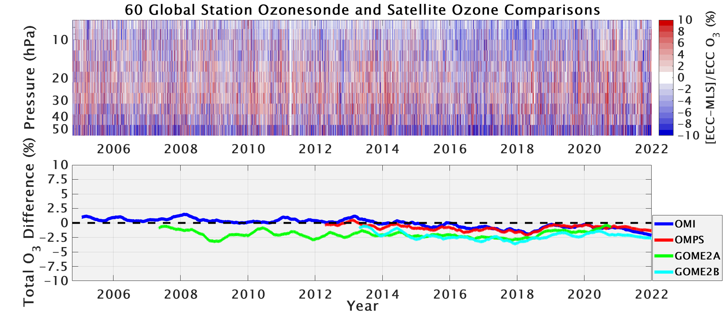
The Fruits of Our Labor: ±2% Agreement!
Global survey of 60 stations in Stauffer et al., (2022) showed total column ozone stability with satellites of ±2%. Agreement with Aura MLS profiles is ±5%
Data reprocessing has been highly successful!
Uncertainties reduced from ~20% in the 1990s to near 5% today
Global ozonesonde data are accurate enough to detect a drift in OMI v8.5 total column ozone (see above), which has since been corrected.
Now we can compute ozonesonde profile trends with confidence

Slide 9
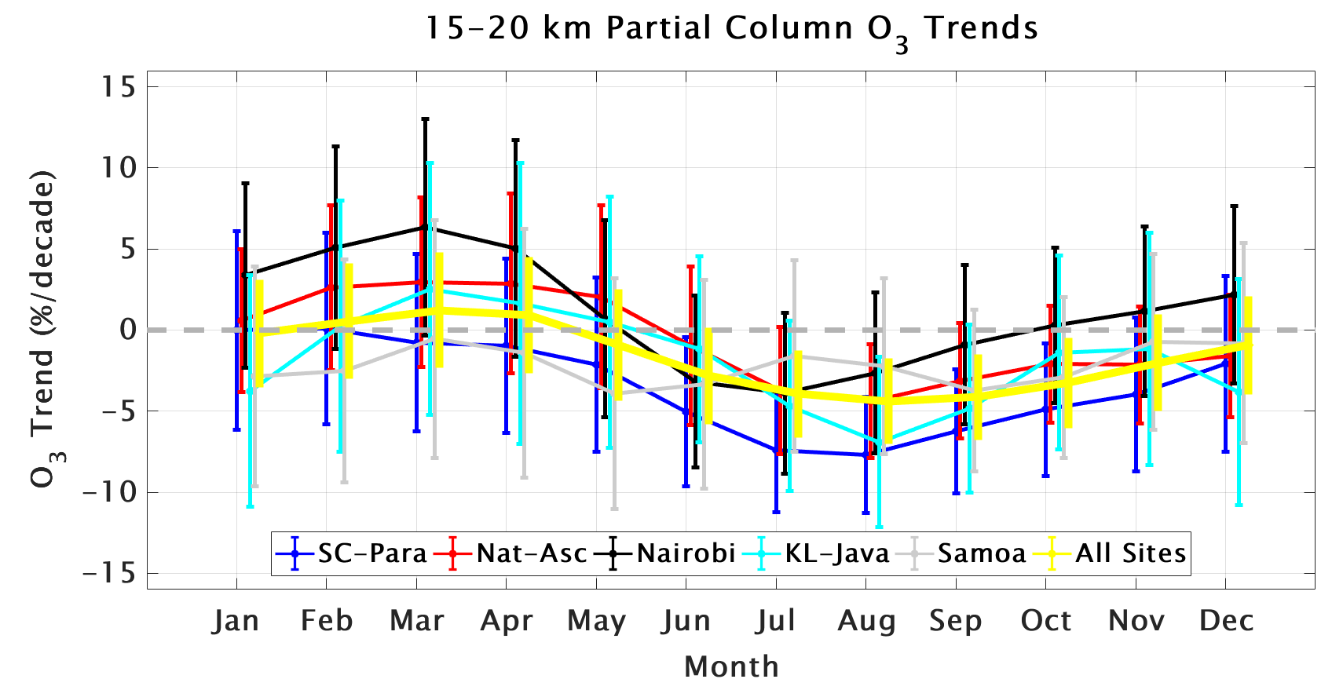
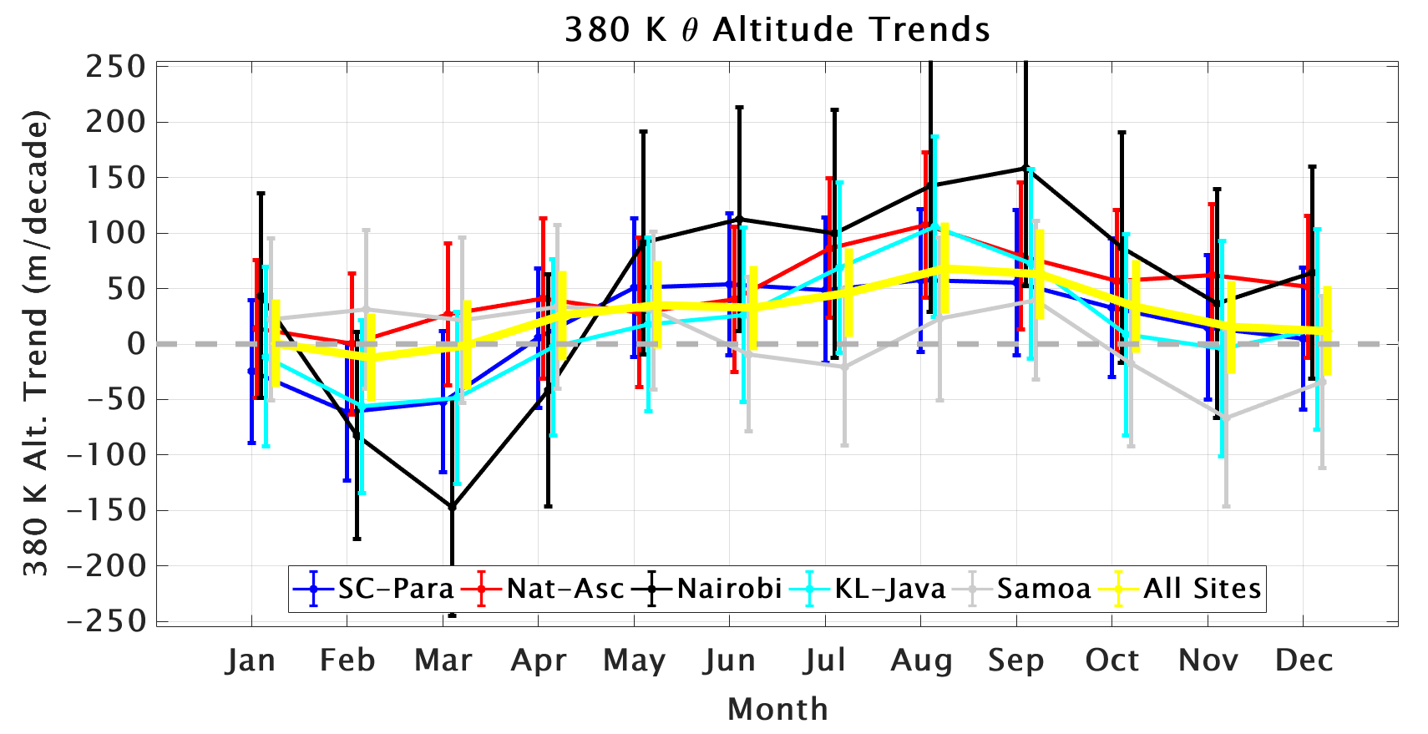
SHADOZ Science: O₃ Profile Trends
SHADOZ ozonesonde profile trends updated from Thompson et al., 2021 (“T21”). 1998-2023 trends calculated with a multiple linear regression model at five stations (8 total individual sites *and* all sites combined in yellow)
In the 15-20 km layer, significant negative trends of -5 to -7 %/decade occur in several months during the second half of the year (top)
This is coincident with significant positive trends in the tropopause height at the stations (bottom)
Are the SHADOZ lower stratospheric ozone trends an artifact of tropopause height changes?
Update from Thompson et al. (2021)

Slide 10
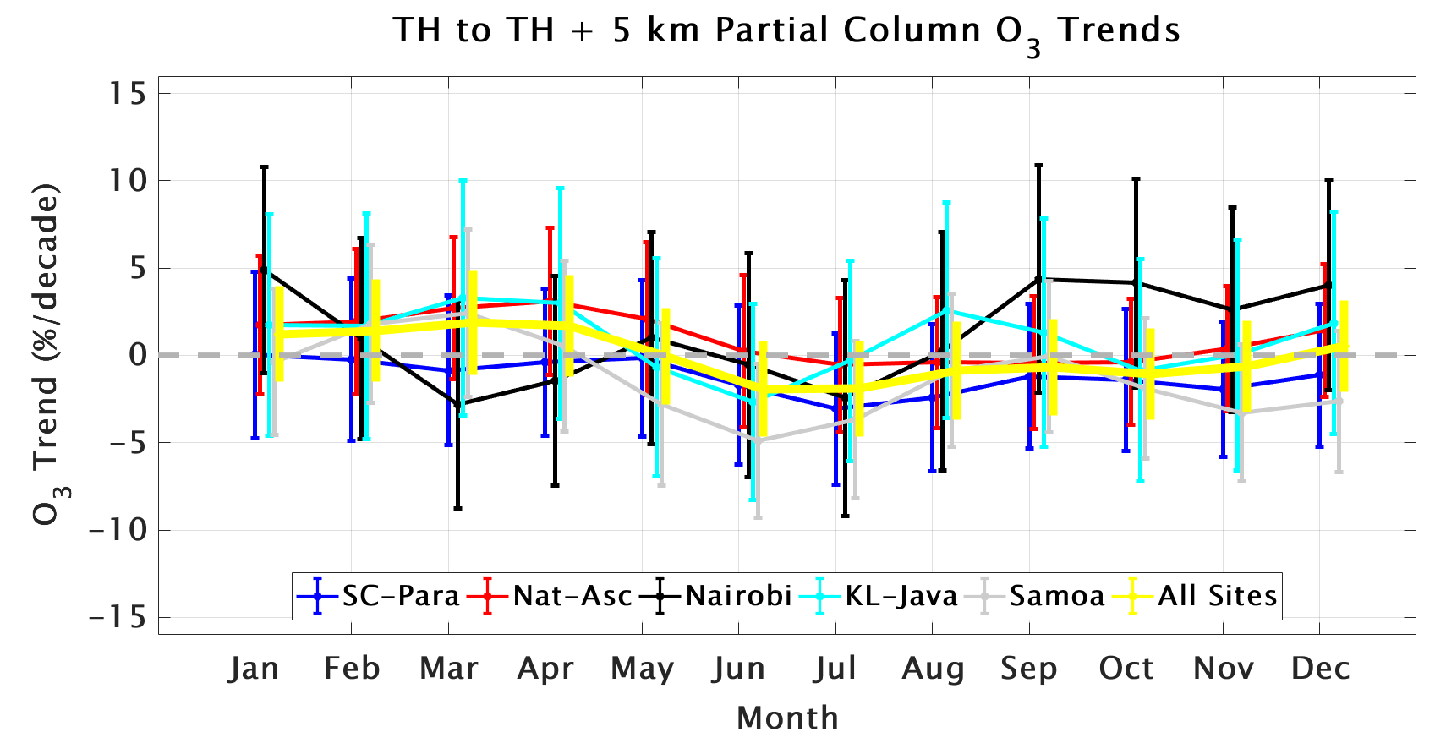
SHADOZ Science: O₃ Profile Trends
Referencing the ozonesonde profiles to the tropopause height and re-calculating trends shows that the trends largely “disappear”! (bottom)
Climate signal in tropopause height increases are leading to negative ozone trends in the lower stratosphere
Trends output from Thompson et al., (2021; JGR) are found at: https://tropo.gsfc.nasa.gov/shadoz/SHADOZ_PubsList.html.
Use the output to evaluate satellite and model-based trends calculations!
Update from Thompson et al. (2021)

Slide 11
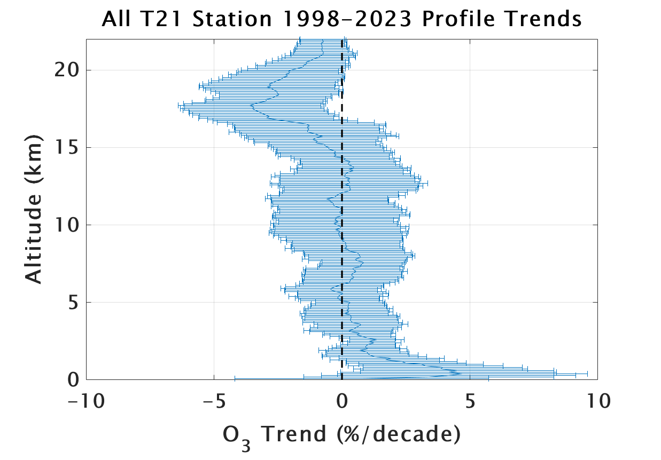
SHADOZ Science: O₃ Profile Trends
New profile trends 1998-2023 from all 8 tropical SHADOZ stations used in T21 combined →
UT/LS trends of up to -4 %/decade (significant with 95% confidence) on average across the 8 tropical stations
Seasonal/monthly trends contain important information. Not always uniform.
Note: No trend in troposphere above ~2 km altitude! Boundary layer positive trends are driven by Kuala Lumpur and Watukosek Equatorial SE Asia stations (next slides…)

Slide 12
SHADOZ Science: O₃ Profile Trends
Tropospheric column (surface to 300 hPa) trends calculated using Quantile Regression (QR) show overall modest increases across the tropics
The largest (~5%/decade) positive trends over 2000-2022 are found in SE Asia (Hanoi, KL, Watukosek)
Are increases driven entirely by anthropogenic emissions, or is there also a dynamics story to the tropospheric trends in SE Asia?

Slide 13
SHADOZ Science: O₃ Profile Trends
Stauffer et al., (2024; ACP TOAR-II SI) shows that Feb-Apr large positive ozone trends over Southeast Asia (top; KL and Java SHADOZ stations) are associated with a significant decrease in convection (bottom) 1998-2022
Decrease in convection reduces the lofting and redistribution of near-surface ozone poor air, and tropospheric ozone accumulates
This is a dynamics signal only identified using monthly-resolved trends in ozone and meteorological parameters

Slide 14
Summary
Thanks to our partners, collaborators, and NASA HQ Program Manager K. Jucks for support
SHADOZ fills an otherwise huge gap in ozone profile data in the tropics. More than 10,000 profiles archived.
How do we know our data are of high-quality? Lab and field tests inform reprocessing efforts that have helped us achieve high accuracy and close to a ~5% uncertainty goal for ozonesonde data
SHADOZ ozone measurements and trends set the standard for satellite product evaluation and activities like TOAR-II.

