Slide 1




Tropospheric ozone:
Satellite data harmonization and TOAR assessment
CEOS AC-VC-20
Oct. 15-18, 2024
College Park, MD, USA
Arno Keppens, Daan Hubert, Oindrila Nath, and Jean-Christopher Lambert*
+ many satellite data providers + TOAR HEGIFTOM WG
*BIRA-IASB, Belgium

Slide 2
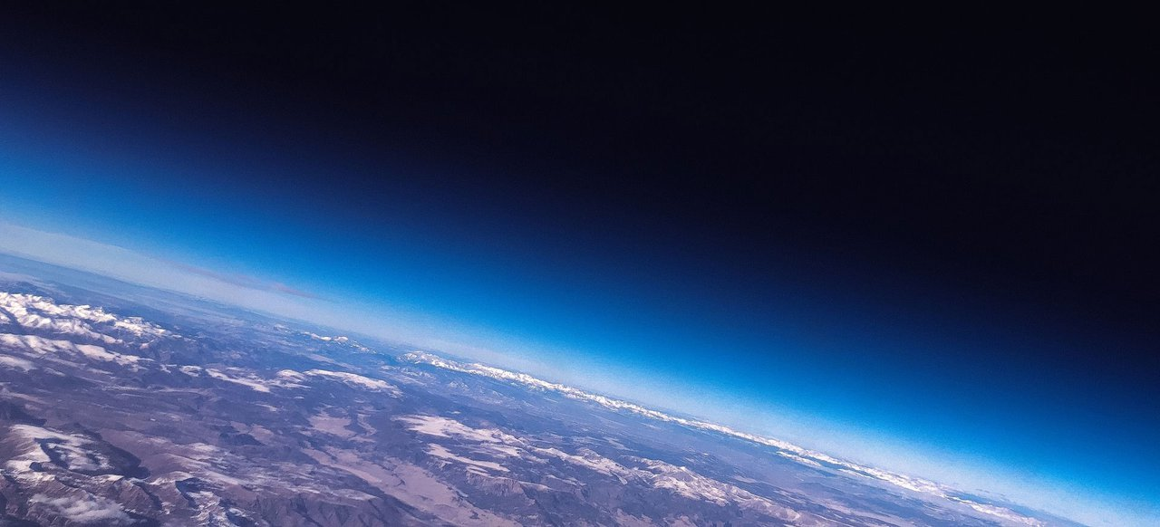
Measuring tropospheric ozone from space
Total columns
(clear-sky & cloudy)
Total column
Limb /
reanalysis
profile
Free troposphere
Nadir profile

Slide 3
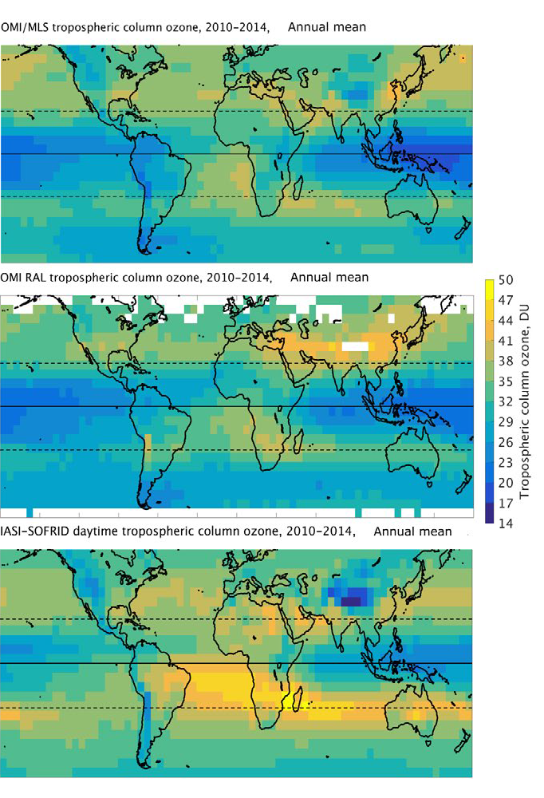
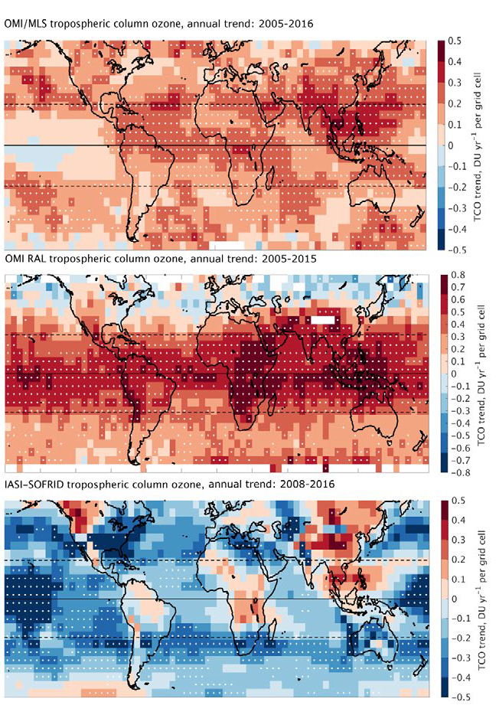


Tropospheric Ozone Assessment Report (2018)
Gaudel et al (2018)
“Despite potentially large differences for different satellite observations at a local level, the global mean tropospheric ozone burden estimates are remarkably consistent.”
“… we are unable to provide a definitive statement regarding the change in tropospheric ozone burden over the past decade and future work is required to reconcile the different satellite products.“
“[caused by] … time-varying instrument biases, differences in vertical sensitivity and sampling, differences in tropopause definitions…”
Response: CEOS VC-20-01 Activity in support to TOAR II Satellite WG
decadal trend
2010-2014 mean

Slide 4
Transfer standard: CAMS Reanalysis EAC4
CAMSRA (Inness et al., 2019)
  60 levels (1012-0.1 hPa) → lat-lon dependent, fixed in time
  0.7° x 0.7° (global) → regridded to 1° x 1°
  6 hours (2003-2021) → UTC interpolated to LST satellite overpass time
  assimilated ozone: TC (SCIA, OMI, GOME-2A/B), PROF (MIPAS, Aura-MLS, SBUV/2)
Used for
  tropospheric column extension
  new prior info
  auxiliary data source for quantity matching
  (assessment of horizontal and temporal sampling differences)
Complementary choice to TCR-2 reanalysis (Miyazaki et al., 2020)
transfer standard used by TOAR-II SOWG

Slide 5

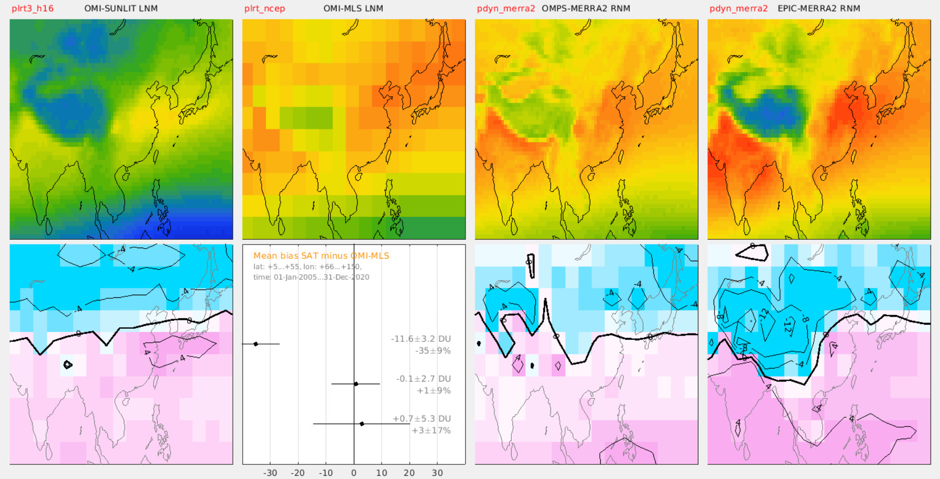
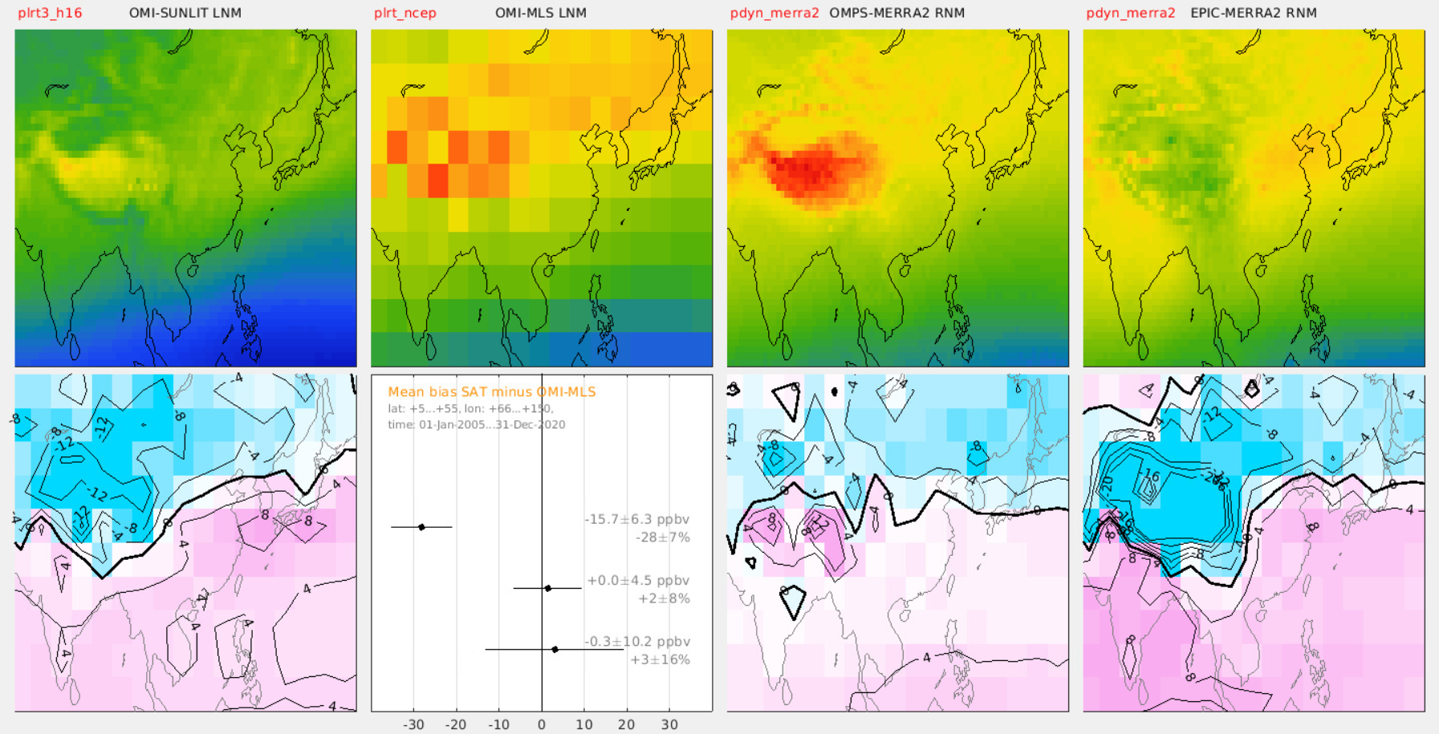
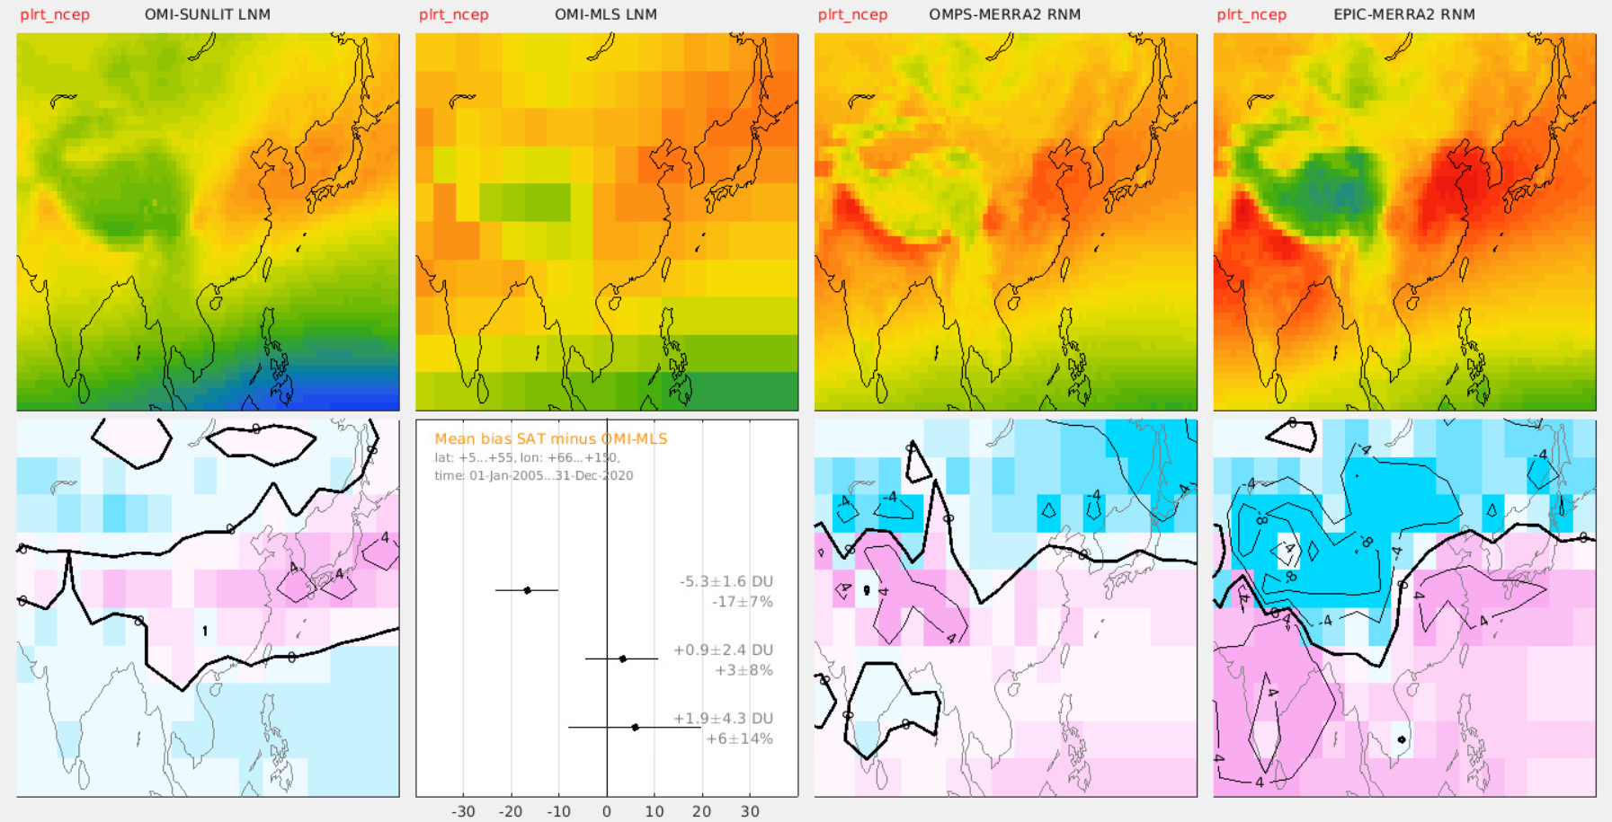



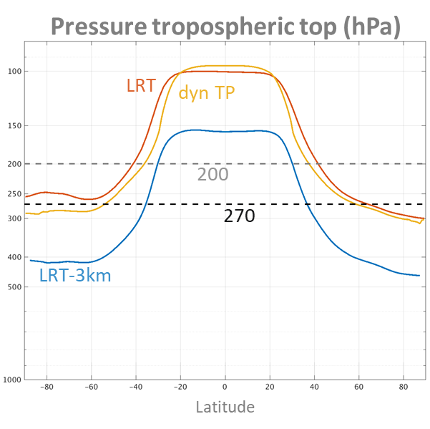
Harmonisation column products
OMI-SUNLIT
OMI-MLS
OMPS-MERRA2
EPIC-MERRA2
v
v
No harmonisation
Method A : XO3
α TrOC / (p_{sfc}-p_{top})
OMI-SUNLIT
LRT - 3 km
Method B : fill-in
TrOC + ΔTrOC_{CAMSRA}
OMPS-MERRA2
dyn TP
EPIC-MERRA2
dyn TP

Slide 6
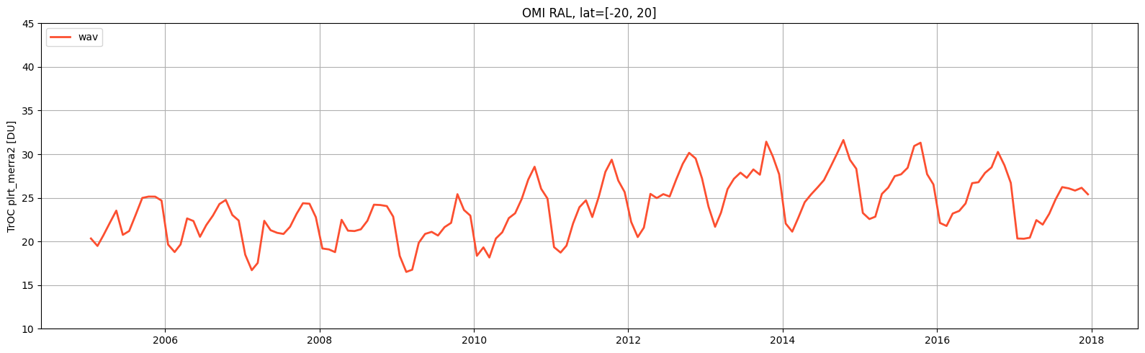
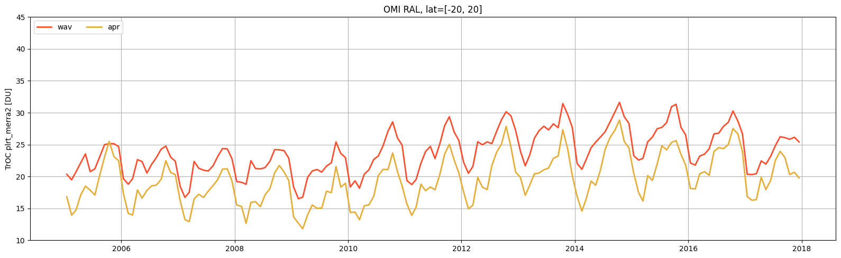
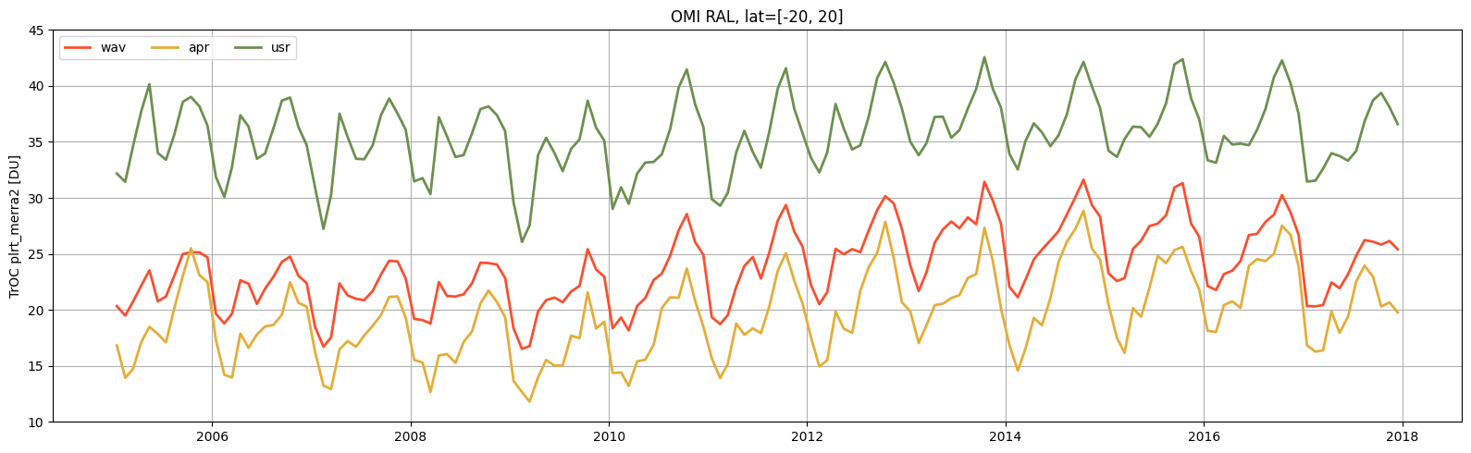
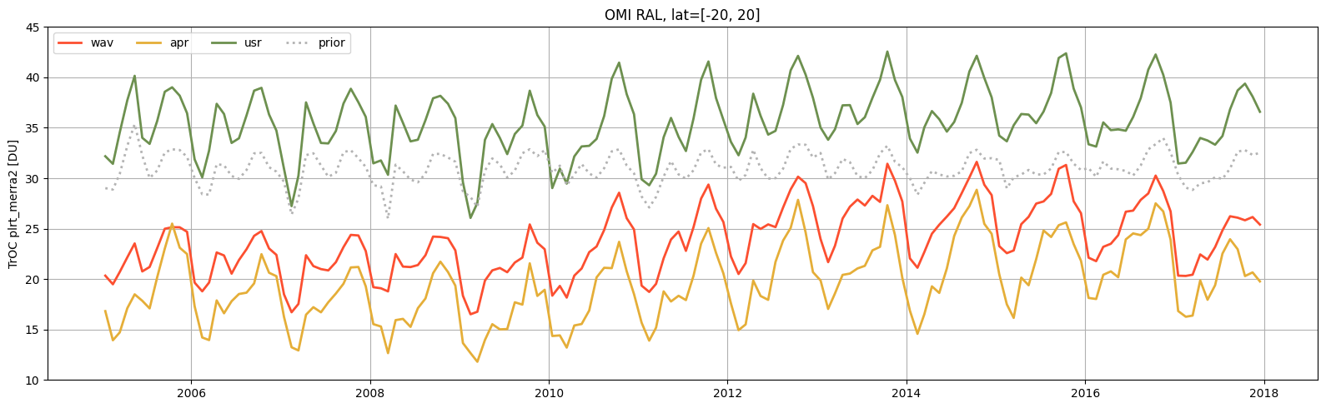
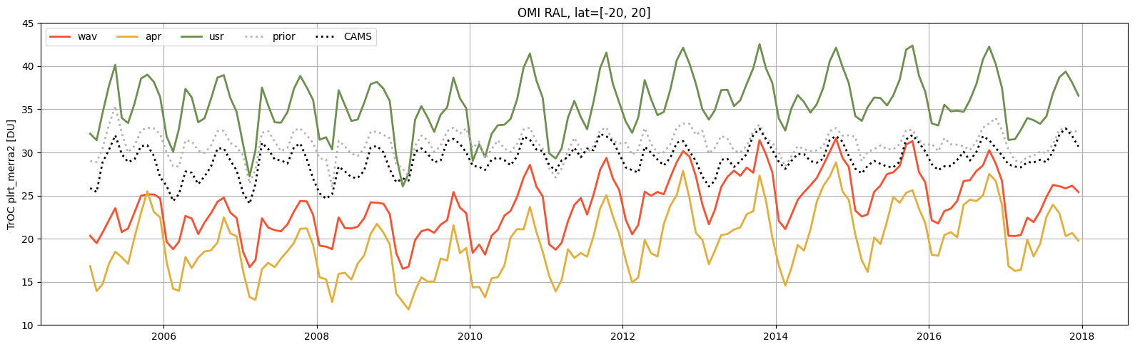
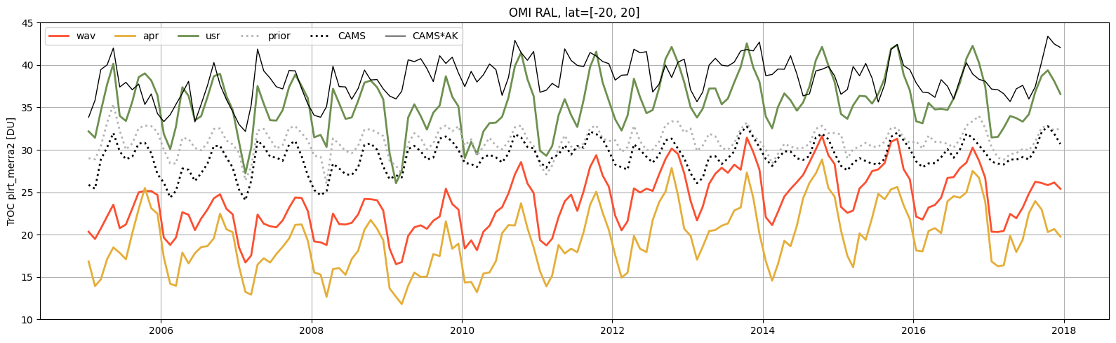
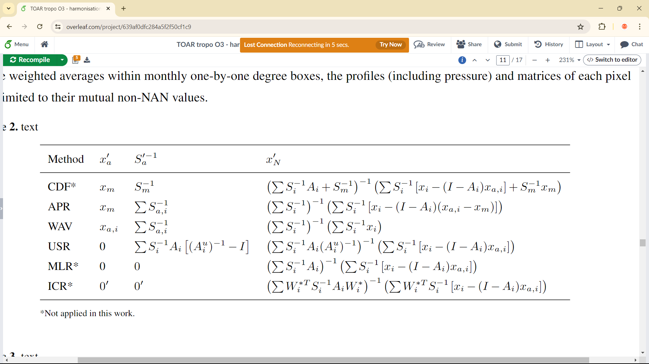
Harmonisation nadir profile products

Slide 7
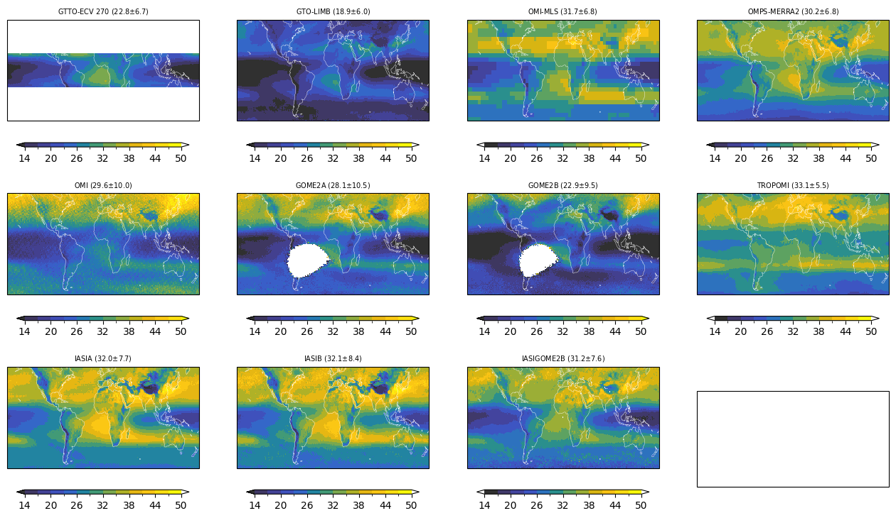
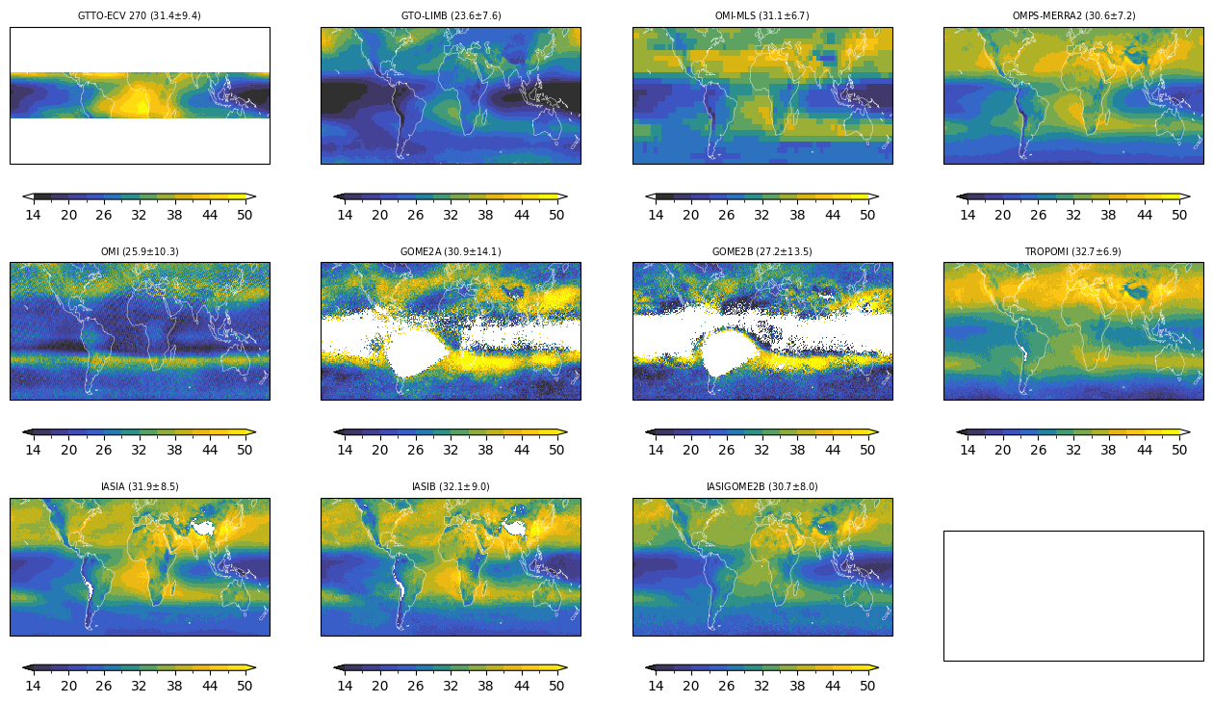
2014-2019 mean
Native
Harmonised (LRT MERRA2)
*preliminary*

Slide 8
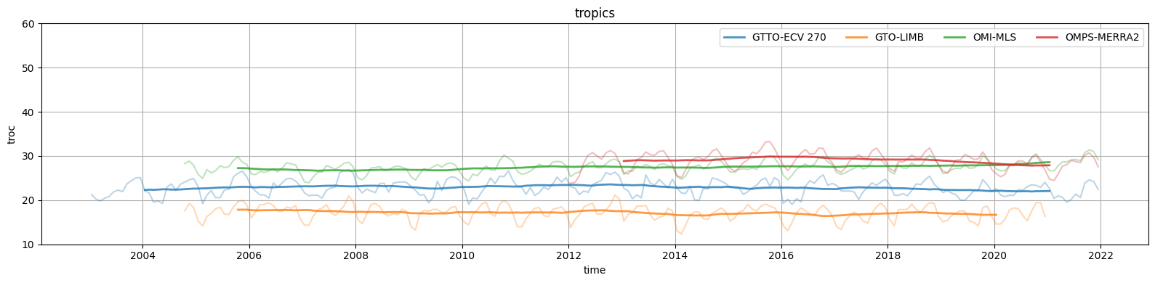
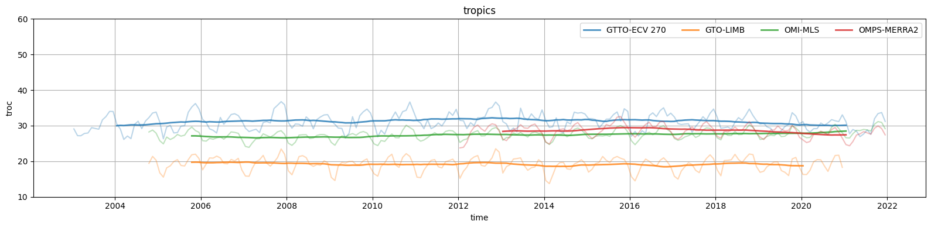
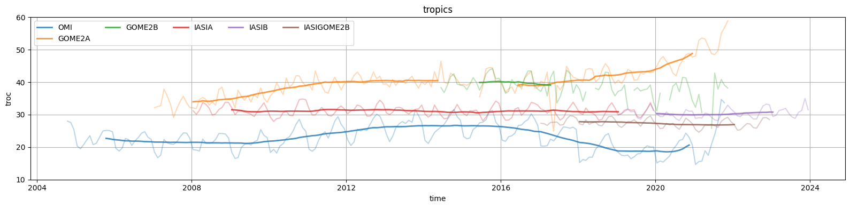
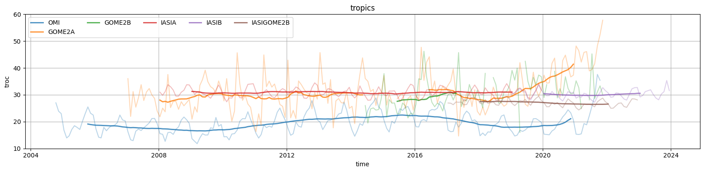
Tropics
*preliminary*
Native
Harmonised (LRT MERRA2)
TrOC [DU]
Native
Harmonised (APR, LRT MERRA2)
TrOC [DU]

Slide 9
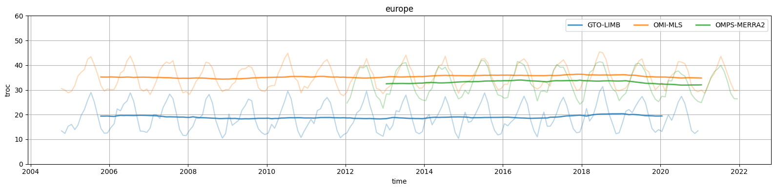
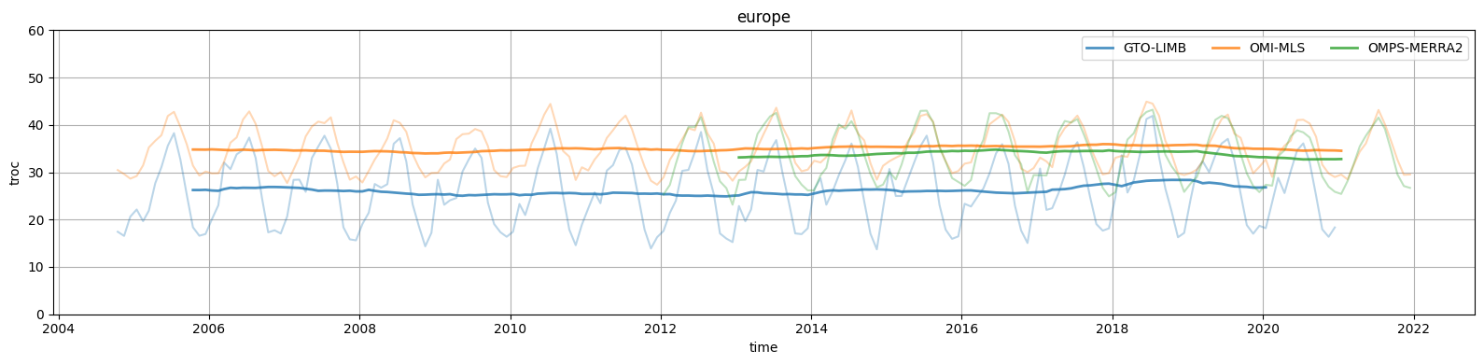
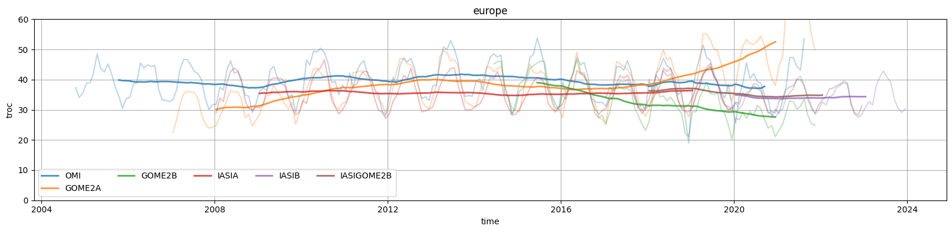
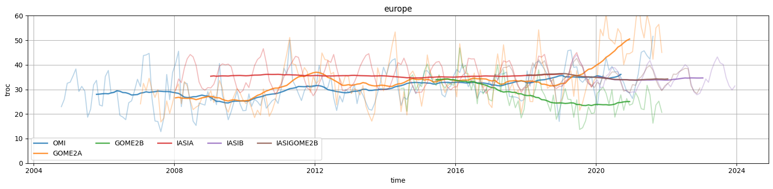
Europe
*preliminary*
Native
Harmonised (LRT MERRA2)
TrOC [DU]
Native
Harmonised (APR, LRT MERRA2)
TrOC [DU]

Slide 10
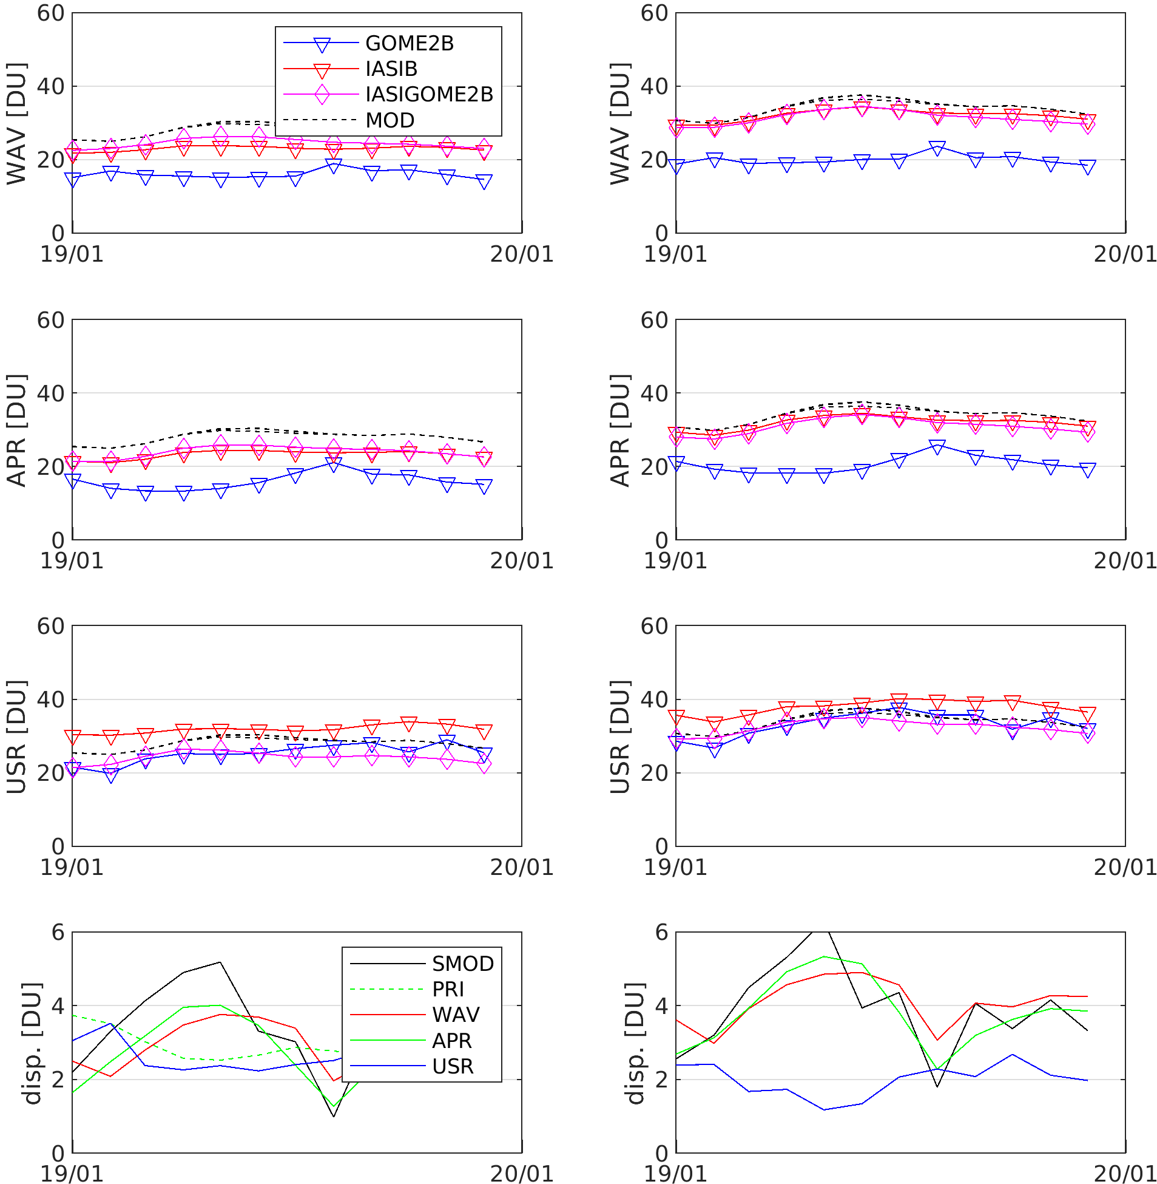
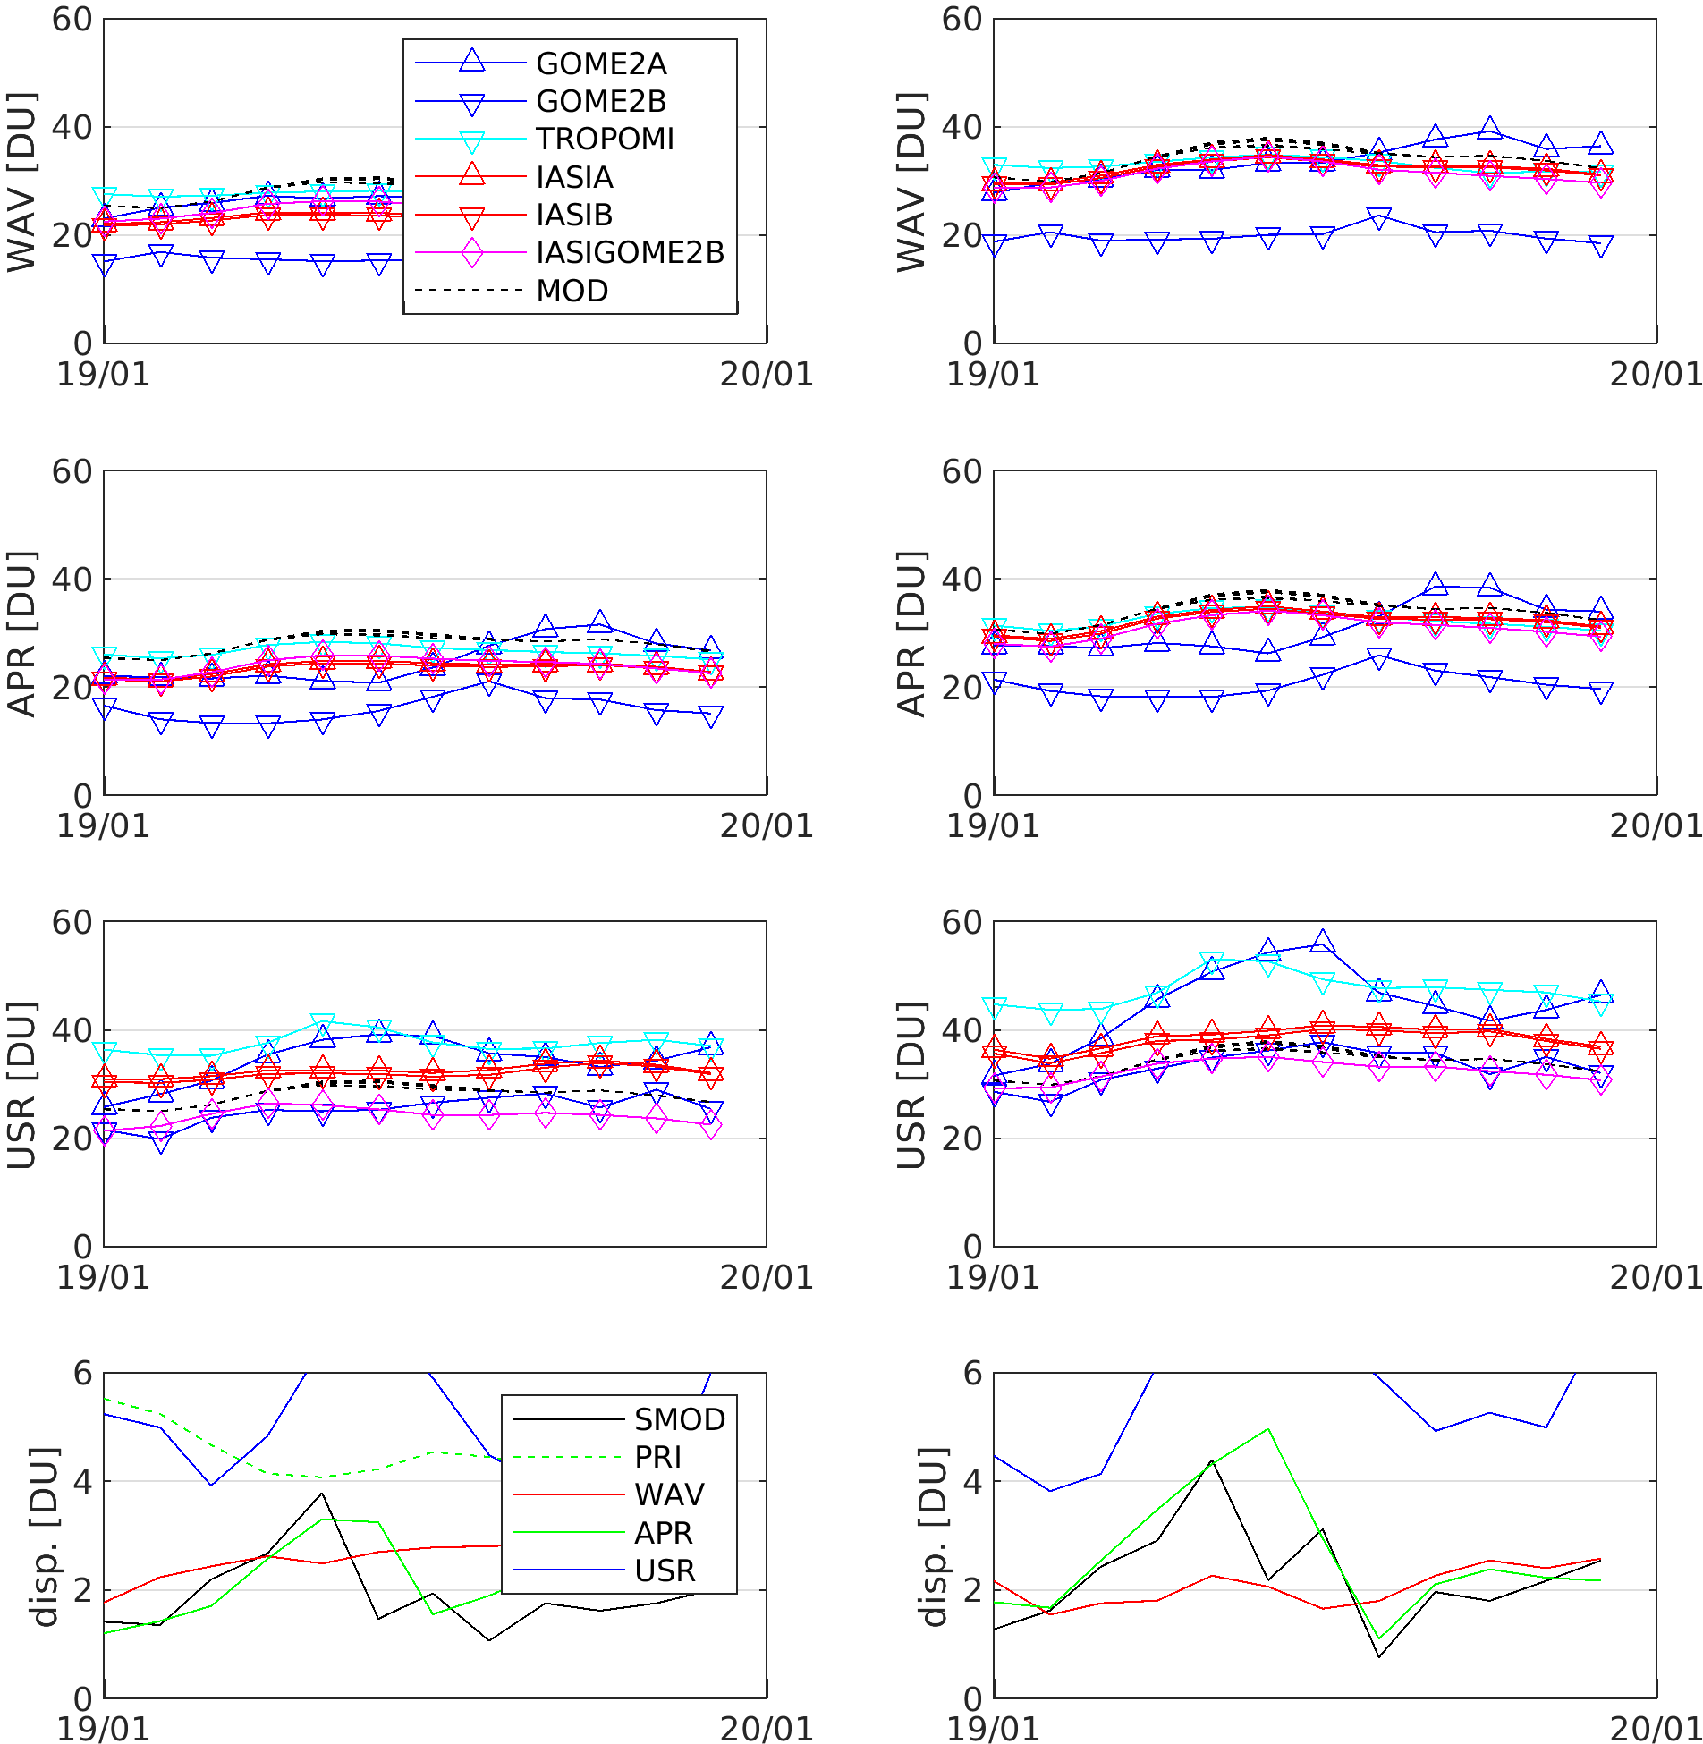
Dispersion reduction?
*preliminary*
Ideal case (Metop-B only for 2019 global mean):
‘failing’ USR (all NP sensors for 2019 global mean):

Slide 11

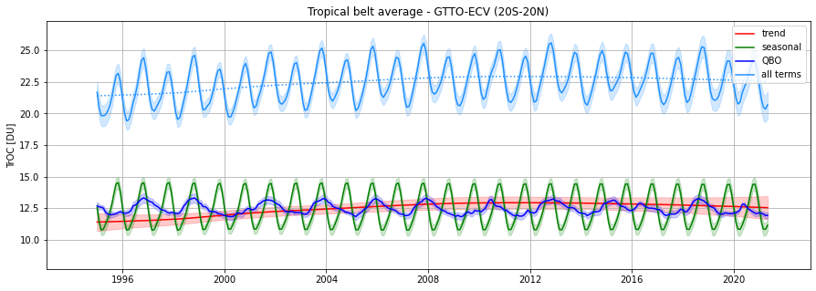
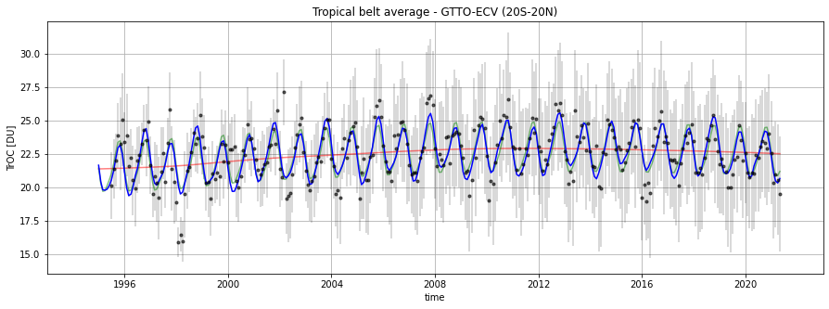
Time series analysis : DLM
preliminary

Slide 12

Conclusions & outlook
Initial findings
  Column-based products: fill-in harmonisation is more successful than XO3 harmonisation
  Profile-based products: APR as expected, but USR challenging in case of insufficient vertical sampling or quality of averaging kernels
For most satellite data sets we will able to exclude that differences in multi-annual means/trends are due to differences in top level, sampling & smoothing
Final steps
  Consistent (re)processing of all harmonized data
  Comparison to L3-like ozonesonde data from TOAR HEGIFTOM WG (43 stations)
  Analyse distribution of multi-annual mean and long-term changes in harmonised data

Slide 14
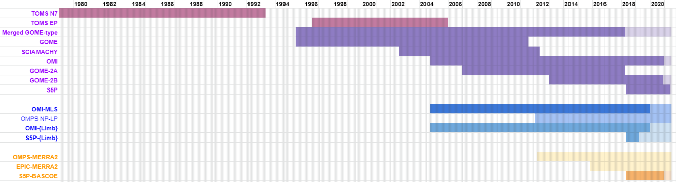
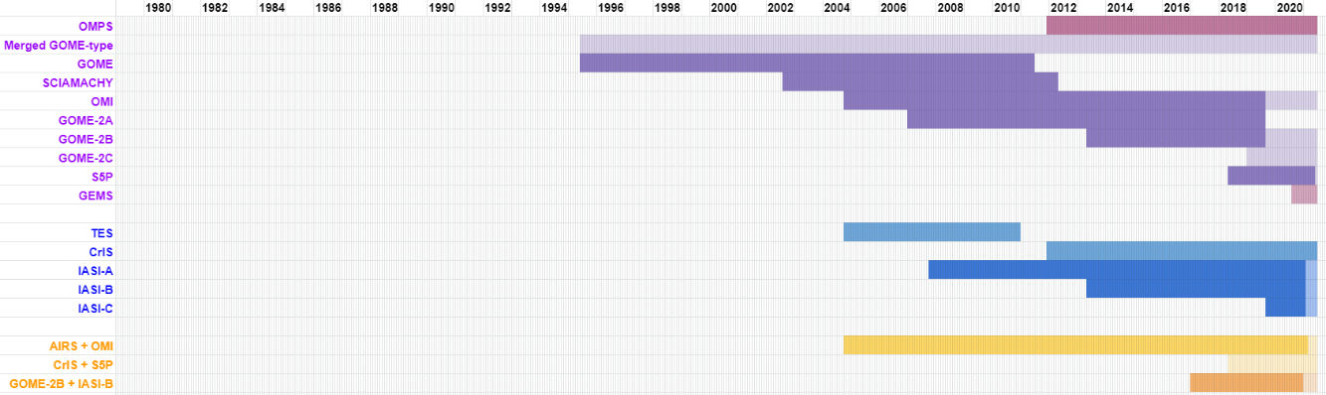
VC-20-01 tropospheric ozone datasets
Residual technique (UV-VIS sensors)
Convective Cloud Differential
Nadir minus Limb
Nadir minus Reanalysis
Optimal Estimation profile retrieval
UV-VIS
IR
VIS+IR synergy

Slide 15
VC-20-01 tropospheric ozone datasets
Residual technique (UV-VIS sensors)
Convective Cloud Differential
Nadir minus Limb
Nadir minus Reanalysis
Optimal Estimation profile retrieval
UV-VIS
IR
VIS+IR synergy

Slide 16
Harmonization of TOAR-II profile datasets
L2 profiles → monthly-gridded (1°x1°) & harmonized (prior info) satellite L3 data
Illustration: 1° x 1° box containing Brussels,
for January 2020
Comparison with both CAMSRA and Uccle ozonesondes
Sampling example: March 24, 2021
(courtesy of N. Zoppetti, IFAC)

Slide 17
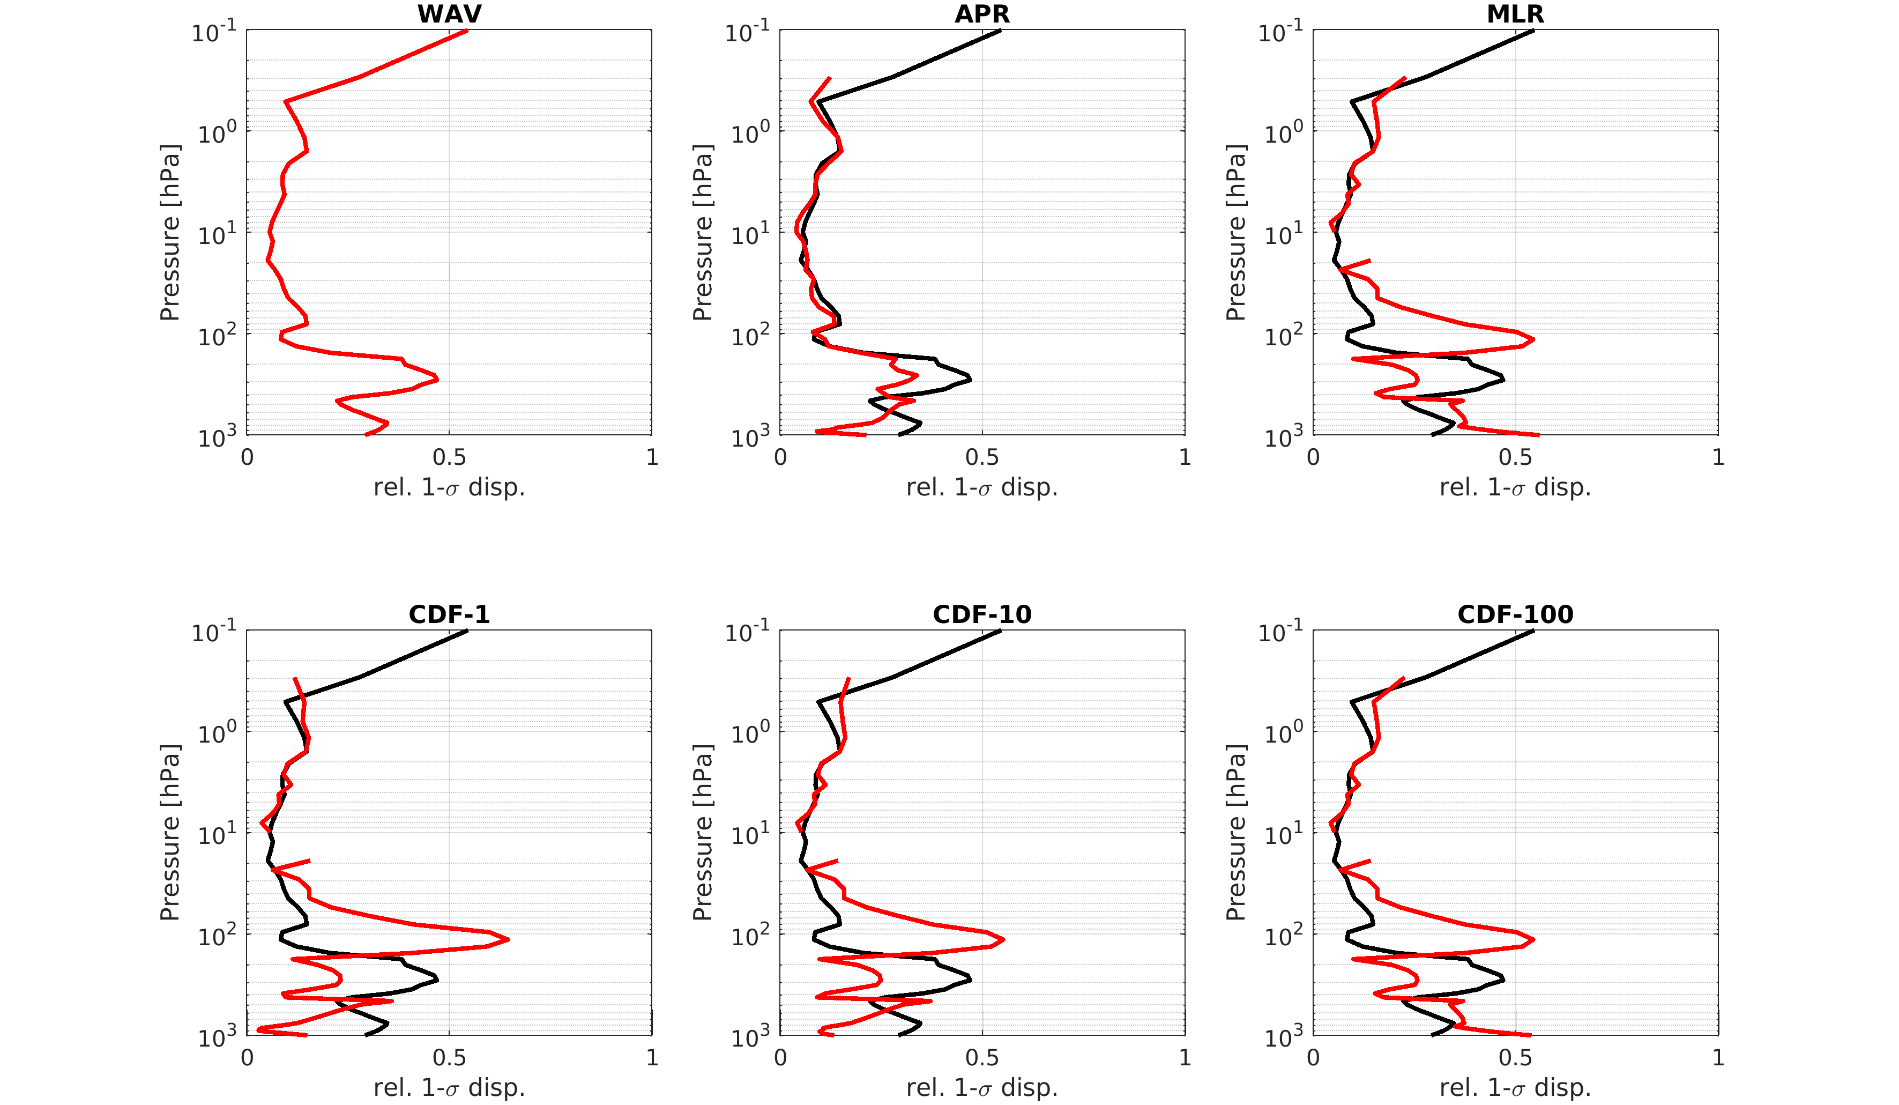
Profile dispersion reduction? (9 sats)

Slide 18
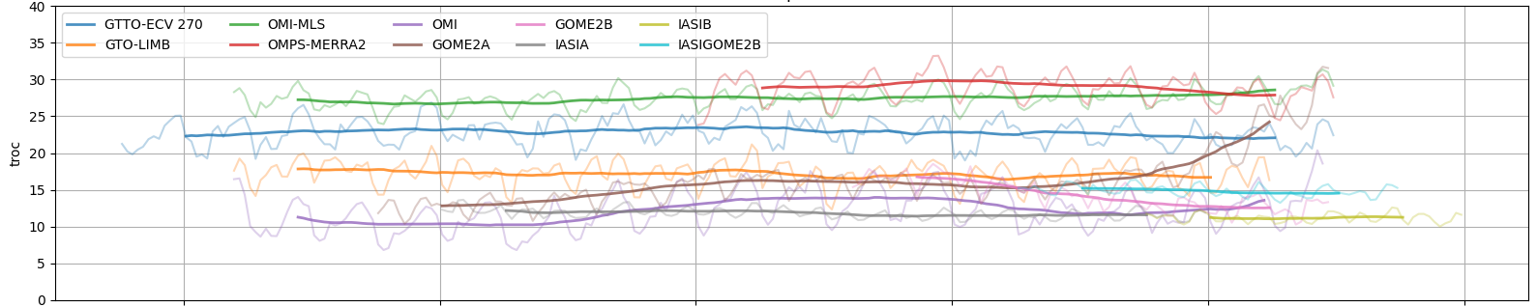
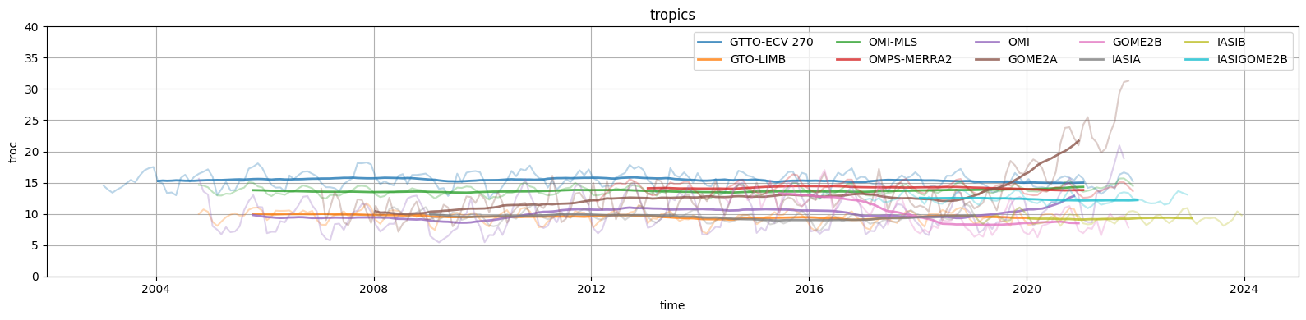
Tropics 450 hPa

Slide 19
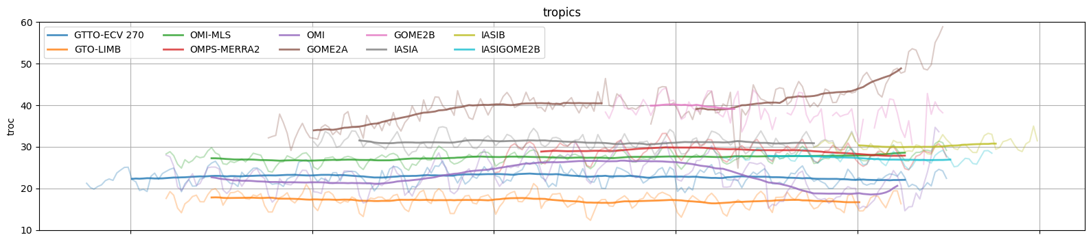
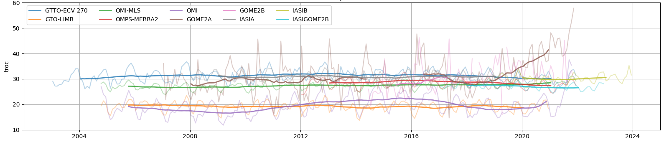
Tropics LRT MERRA2

Slide 20

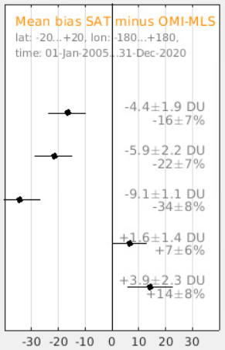
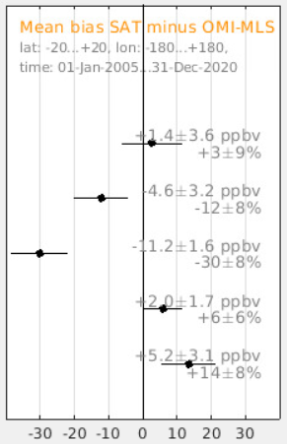
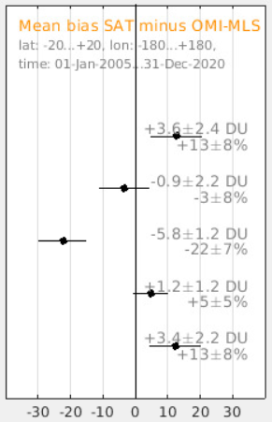
Bias before/after harmonisation (20°S-20°N)
No harmonisation
Method A : XO3 = α TrOC / (p_{sfc}-p_{top})
Method B : fill-in = TrOC + ΔTrOC_{CAMSRA}
GTTO-ECV
270 hPa
GOME-SCIA-GOME2A
200 hPa
OMI-SUNLIT
LRT - 3 km
OMPS-MERRA2
dyn TP
EPIC-MERRA2
dyn TP

Slide 21
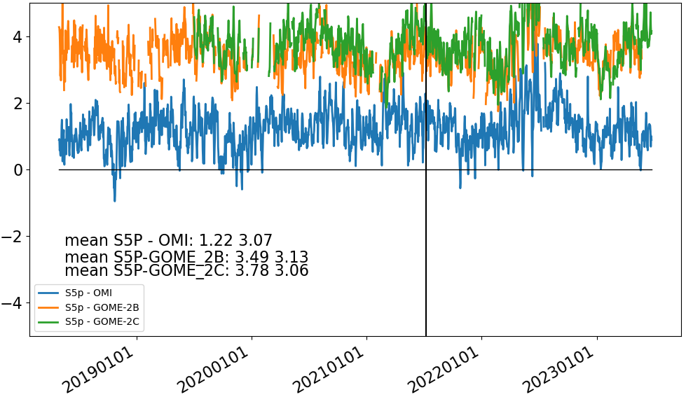
Satellite bias : due to mismatch in diurnal sampling?
Petetin et al (2016) Frankfurt, aircraft
Afternoon TrOC is ~1 DU larger than nighttime TrOC
Hubert, Heue et al (2021, …) Tropics, UV-vis nadir, sfc-270 hPa
Afternoon TrOC is ~2-3 DU larger than morning TrOC

