Slide 1

An update on long-term (1990-2023) tropospheric ozone trends
Owen R. Cooper
NOAA Chemical Sciences Laboratory
CEOS AC-VC-20 Meeting
College Park, Maryland, USA
October 15-18, 2024

Slide 2
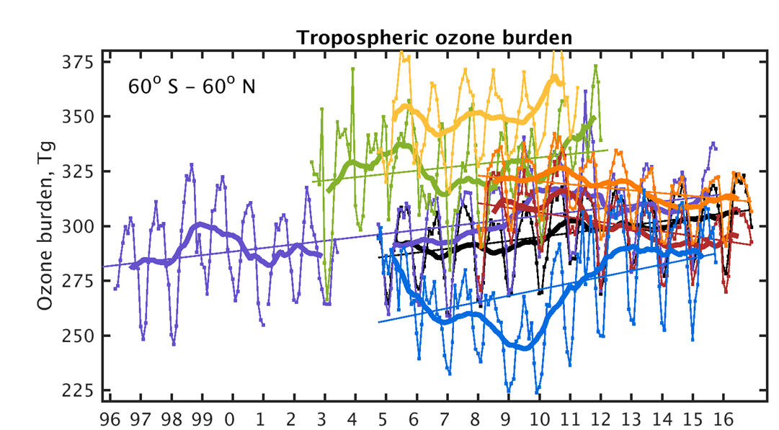
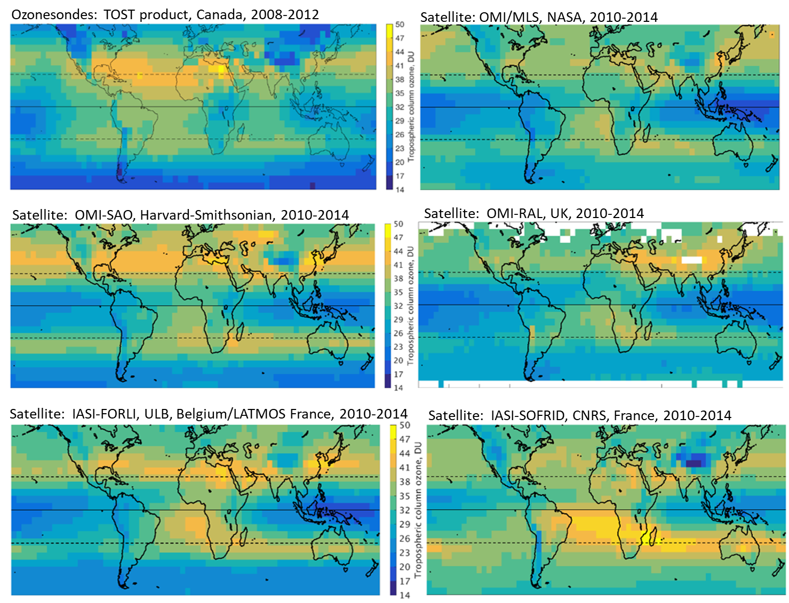
TOAR-I key results
The first intercomparison of satellite ozone products
Satellite products generally agree regarding global ozone hotspots.
Satellites and IPCC models report similar values for the tropospheric ozone burden.
However, the satellites disagree regarding trends over the past decade (2008-2016).
See TOAR-Climate for further details:
Gaudel, A., et al. (2018), Tropospheric Ozone Assessment Report: Present-day distribution and trends of tropospheric ozone relevant to climate and global atmospheric chemistry model evaluation, Elem Sci Anth, 6(1):39, DOI: https://doi.org/10.1525/elementa.291

Slide 3
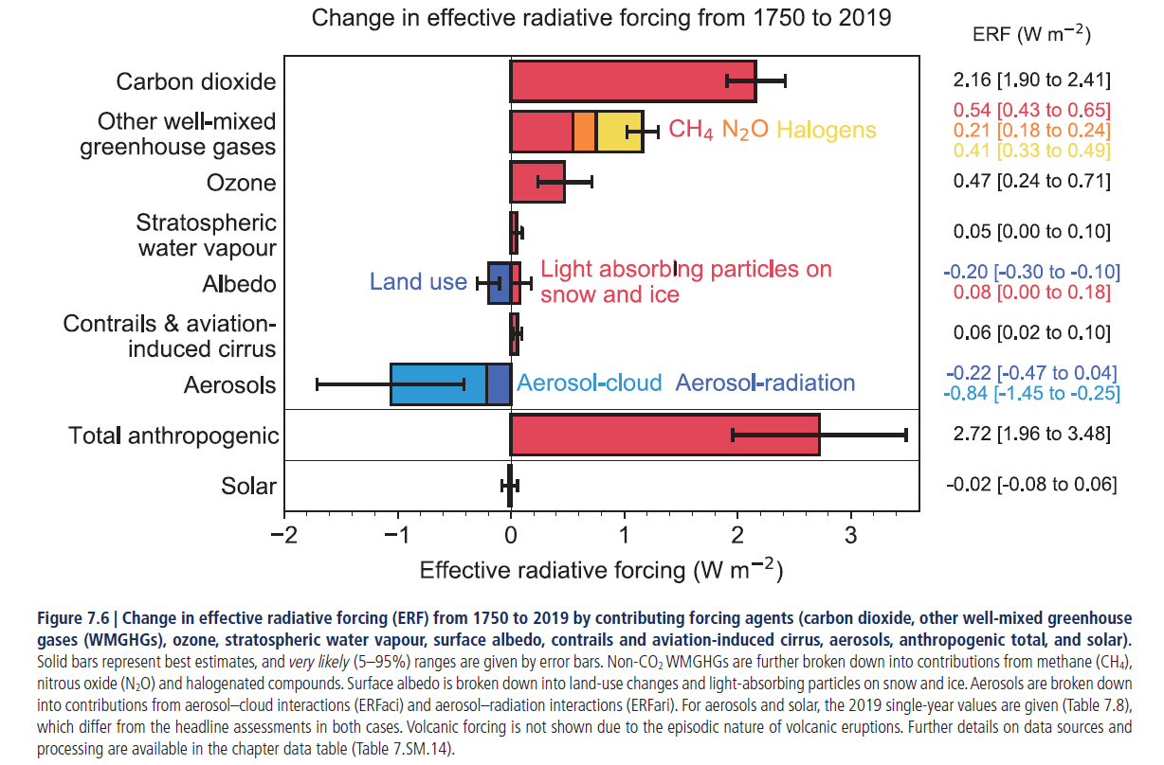

Slide 4
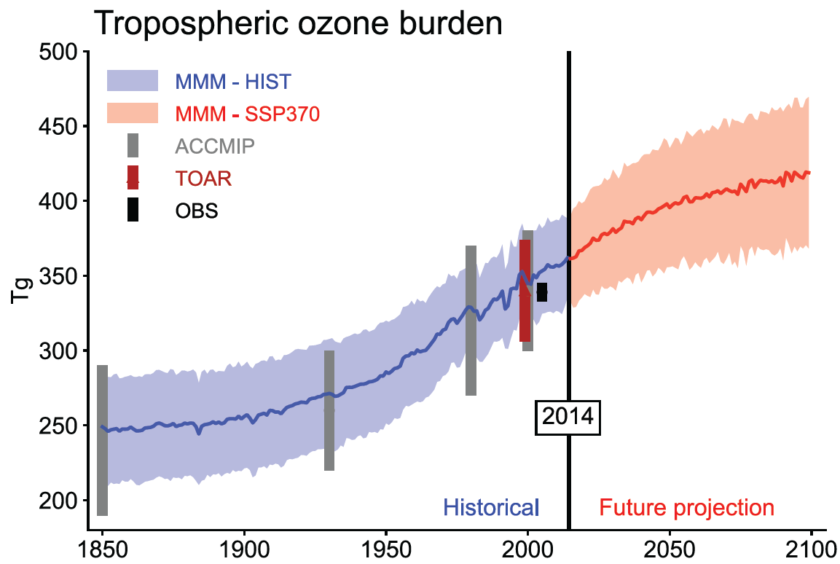
IPCC AR6 key findings on tropospheric ozone
Assessed the tropospheric ozone burden to be 347±28 Tg for 2010
Ozone’s effective radiative forcing (ERF) is +0.47 [0.24 to 0.70] W m⁻² (1750-2019, tropospheric + stratospheric ozone), 17% of total ERF (2.72 W m⁻² since 1750)
The tropospheric ozone burden increased by 45% from 1850 to the present-day, and has continued to increase since the 1990s
Ozone burden is expected to increase in the near future if emissions and methane continue to increase
Trends at the surface do not necessarily match trends in the free troposphere
Figure 6.4 from IPCC AR6 shows the historical and future projection (SSP3-7.0) of the global tropospheric ozone burden. The observed ozone burden of 338 ± 6 Tg for 2010-2014 is from the TOST ozonesonde and IASI satellite products reported by TOAR-Climate [Gaudel et al. 2018].

Slide 5
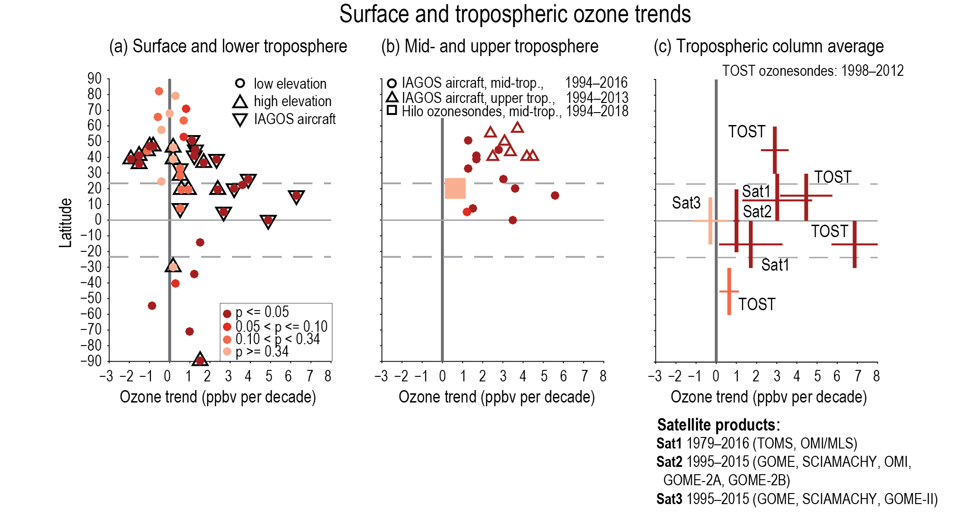
IPCC AR6 assessment of tropospheric ozone trends since the 1990s (Chapter 2)
Surface/low altitude ozone trends since the mid-1990s are variable at northern mid-latitudes, but positive in the tropics [2 to 17% per decade] (high confidence).
Since the mid-1990s, free tropospheric ozone has increased by 2–7% per decade in most regions of the northern mid-latitudes, and 2–12% per decade in the sampled regions of the northern and southern tropics (high confidence).
Limited coverage by surface observations precludes identification of zonal trends in the SH, while observations of tropospheric column ozone indicate increases of less than 5% per decade at southern mid-latitudes (medium confidence).
Figure 2.8 | Surface and tropospheric ozone trends. (a) Decadal ozone trends by latitude at 28 remote surface sites and in the lower free troposphere (650 hPa, about 3.5 km) as measured by IAGOS aircraft above 11 regions. All trends are estimated for the time series up to the most recently available year, but begin in 1995 or 1994. Colours indicate significance (p-value) as denoted in the in-line key. See Figure 6.5 for a depiction of these trends globally. (b) Trends of ozone since 1994 as measured by IAGOS aircraft in 11 regions in the mid-troposphere (700–300 hPa; about 3–9 km) and upper troposphere (about 10–12 km), as measured by IAGOS aircraft and ozonesondes. (c) Trends of average tropospheric column ozone mixing ratios from the TOST composite ozonesonde product and three composite satellite products based on TOMS, OMI/MLS (Sat1), GOME, SCIAMACHY, OMI, GOME-2A, GOME-2B (Sat2), and GOME, SCIAMACHY, GOME-II (Sat3). Vertical bars indicate the latitude range of each product, while horizontal lines indicate the very likely uncertainty range. Further details on data sources and processing are available in the chapter data table (Table 2.SM.1).
Figure citation: Chapter 2. In: Climate Change 2021: The Physical Science Basis. Contribution of Working Group I to the Sixth Assessment Report of the Intergovernmental Panel on Climate Change [Gulev, S.K., et al., 2021: Changing State of the Climate System. In Climate Change 2021: The Physical Science Basis. Contribution of Working Group I to the Sixth Assessment Report of the Intergovernmental Panel on Climate Change. Cambridge University Press, pp. 287–422, doi: 10.1017/9781009157896.004 .]

Slide 6
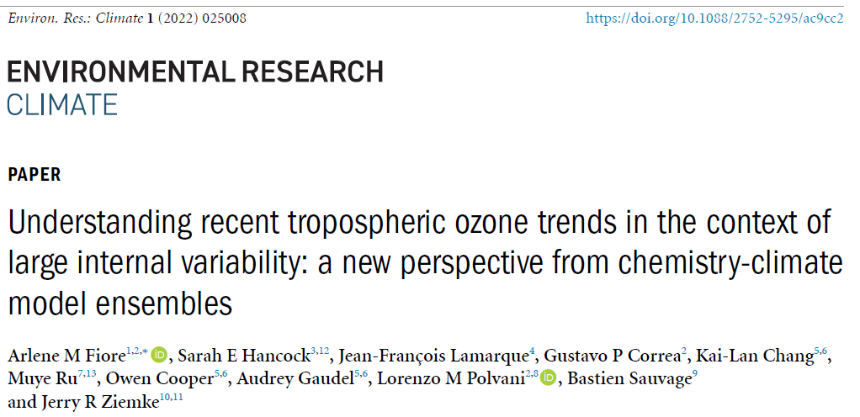
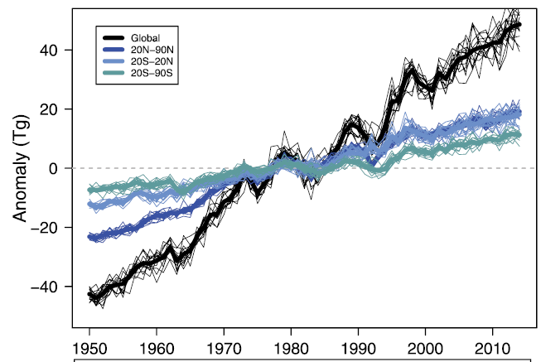
NCAR’s new CESM2-WACCM6 chemistry climate model shows that the global tropospheric ozone burden increased from 1950 to 2014, based on a 15-member ensemble (Fiore et al., 2022).

Slide 7
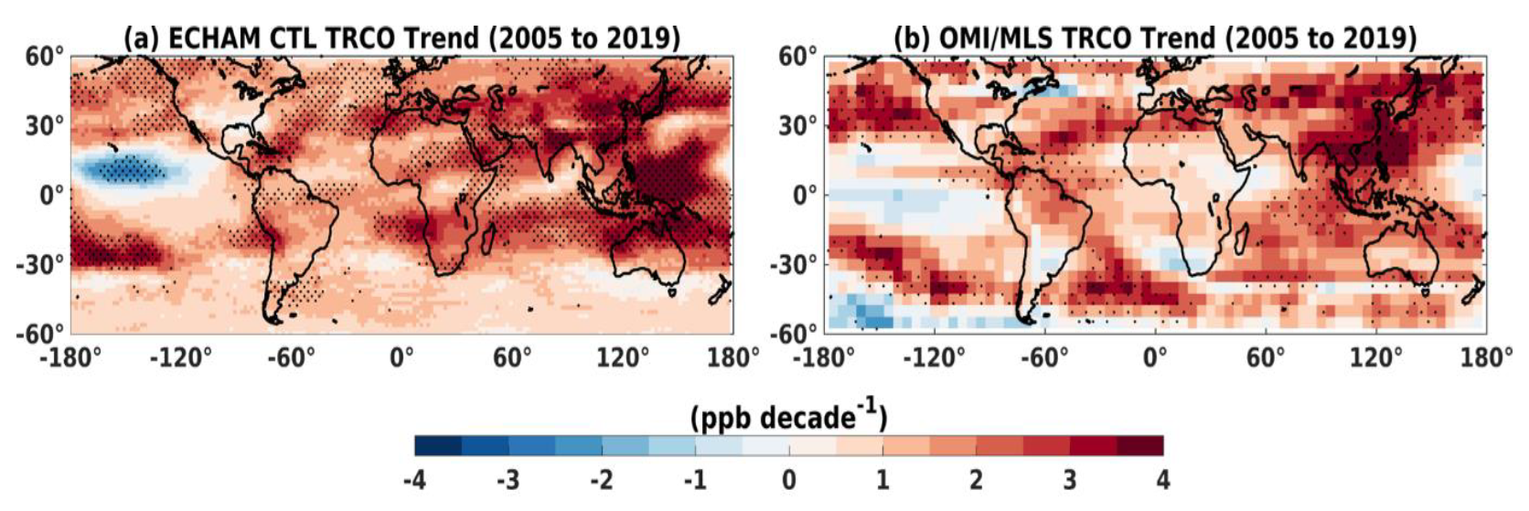
Junhua Liu and colleagues (NASA Goddard) used the NASA GEOS-CCM to estimate tropospheric ozone increases (2005-2018)
Liu, J., Strode, S. A., Liang, Q., Oman, L. D., Colarco, P. R., Fleming, E. L., et al. (2022). Change in tropospheric ozone in the recent decades and its contribution to global total ozone. Journal of Geophysical Research: Atmospheres, 127, https://doi.org/10.1029/2022JD037170
Fadnavis, S., Elshorbany, Y., Ziemke, J., Barret, B., Rap, A., Chandran, P. R. S., Pope, R., Sagar, V., Taraborrelli, D., Le Flochmoen, E., Cuesta, J., Wespes, C., Boersma, F., Glissenaar, I., De Smedt, I., Van Roozendael, M., Petetin, H., and Anglou, I. (2024), Influence of nitrogen oxides and volatile organic compounds emission changes on tropospheric ozone variability, trends and radiative effect, EGUsphere, https://doi.org/10.5194/egusphere-2024-3050

Slide 8
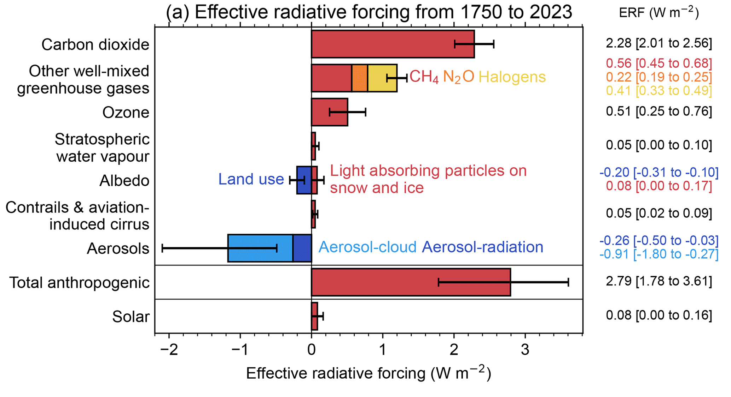
IPCC AR6 (2021) Forster et al. (2024)
Ozone’s effective radiative forcing increased by ~9 % from 2019 to 2024, most likely due to increases in biomass burning emissions
Forster, Piers M., et al. (2024), Indicators of Global Climate Change 2023: annual update of key indicators of the state of the climate system and human influence, Earth Syst. Sci. Data, 16, 2625–2658, https://doi.org/10.5194/essd-16-2625-2024

Slide 9
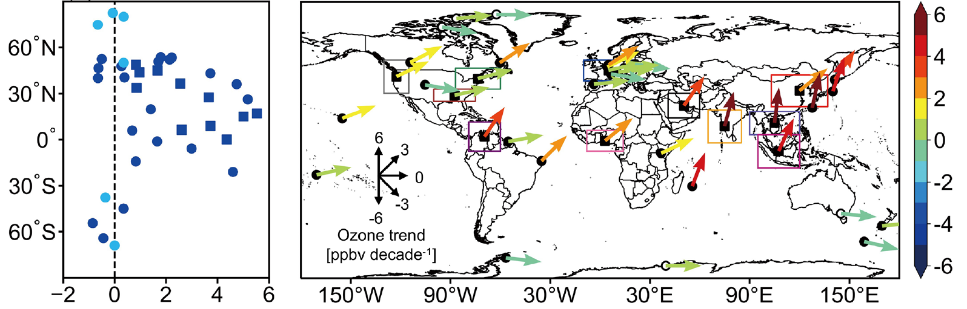
Updated trends, 1995-2017
Wang et al. reported long-term (1995-2017) ozone trends for at 27 ozonesonde sites and 11 IAGOS sampling regions.
All trends were calculated using the same method.
The latitudinal distribution of the trends, and their magnitude, is similar to the IPCC AR6 findings.
Wang, H., et al. (2022), Global tropospheric ozone trends, attributions, and radiative impacts in 1995–2017: an integrated analysis using aircraft (IAGOS) observations, ozonesonde, and multi-decadal chemical model simulations, Atmos. Chem. Phys., 22, 13753–13782, https://doi.org/10.5194/acp-22-13753-2022

Slide 10
Implications of the post-COVID-19 period
Steinbrecht, W. et al. (2021), COVID‐19 Crisis Reduces Free Tropospheric Ozone Across the Northern Hemisphere, GRL, 48, https://doi.org/10.1029/2020GL091987
Bouarar, I., et al. (2021), Ozone Anomalies in the Free Troposphere During the COVID-19 Pandemic, Geophys. Res. Lett., 48, e2021GL094204, https://doi.org/10.1029/2021GL094204
Clark, H., et al. (2021), The effects of the COVID-19 lockdowns on the composition of the troposphere as seen by In-service Aircraft for a Global Observing System (IAGOS) at Frankfurt, Atmos. Chem. Phys., 21, 16237–16256, https://doi.org/10.5194/acp-21-16237-2021
Miyazaki, K., et al. (2021), Global tropospheric ozone responses to reduced NOx emissions linked to the COVID-19 worldwide lockdowns, Sci. Adv., 7, eabf7460, https://doi.org/10.1126/sciadv.abf7460, 2021.
Ziemke, J. R., et al. (2022), NASA satellite measurements show global‐scale reductions in free tropospheric ozone in 2020 and again in 2021 during COVID‐19, GRL 49, no. 15: e2022GL098712.
Chang, K.-L., et al. (2022), Impact of the COVID-19 economic downturn on tropospheric ozone trends: an uncertainty weighted data synthesis for quantifying regional anomalies above western North America and Europe, AGU Advances, https://doi.org/10.1029/2021AV000542
Chang, K.-L., et al. (2023). Diverging ozone trends above western North America: Boundary layer decreases versus free tropospheric increases. Journal of Geophysical Research: Atmospheres, 128, e2022JD038090. https://doi.org/10.1029/2022JD038090
Putero, D., et al. (2023), Fingerprints of the COVID-19 economic downturn and recovery on ozone anomalies at high-elevation sites in North America and western Europe, Atmos. Chem. Phys., 23, 15693–15709, https://doi.org/10.5194/acp-23-15693-2023
Many recent studies have shown a clear decrease of ozone (approximately 5%) in the free troposphere and at high elevation surface sites of northern mid-latitudes during 2020.
Satellite data indicate no recovery of ozone levels in the years after 2020.

Slide 11
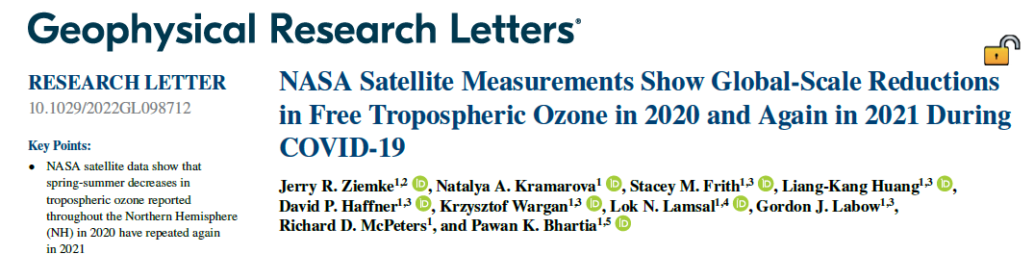
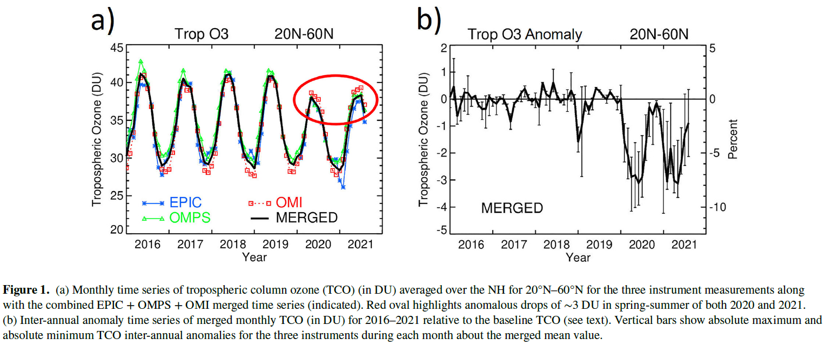
Impact of the Covid-19 pandemic
Satellite instruments also detected ozone decreases at northern mid-latitudes.

Slide 12
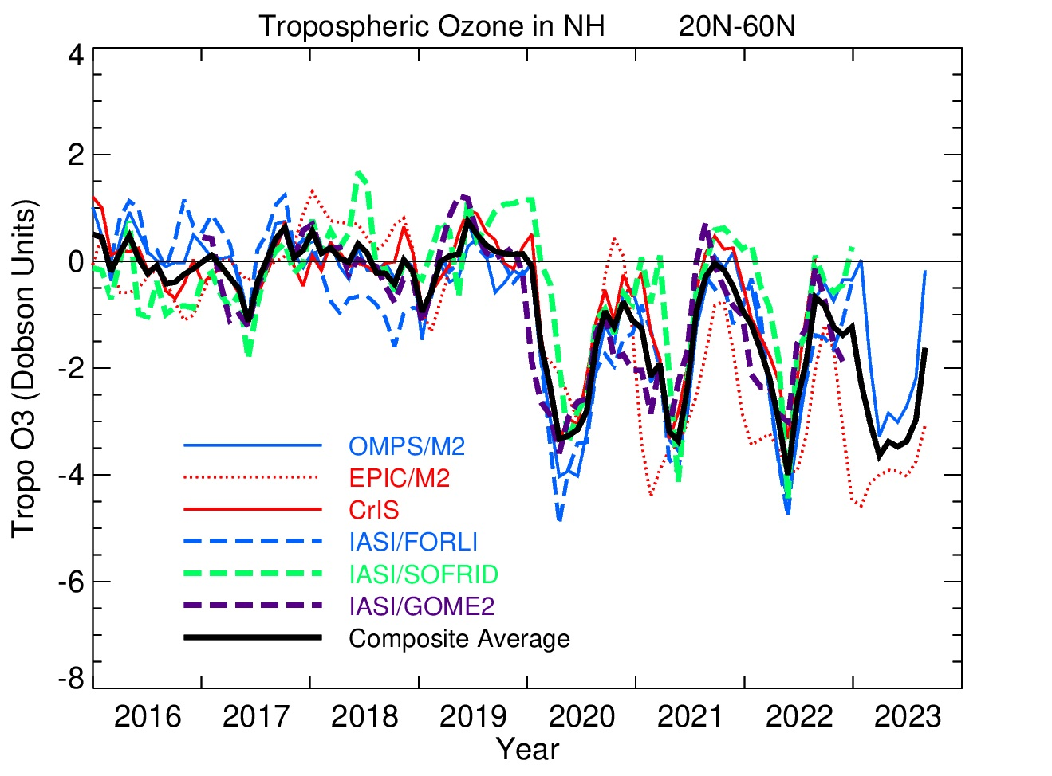
The information below was presented by J. Ziemke at the Quadrennial Ozone Symposium, Boulder, 2024.
Updated analysis shows diminished ozone at northern mid-latitudes for 4 consecutive years, 2020-2023.
Tropospheric Ozone Satellite Products from TOARII: 20ºN-60ºN Hemispheric Averages
Deseasonalilzed
data:
2016-2019
seasonal cycles
removed from
entire record
~3 Dobson Unit drop four years in a row starting in 2020
(Data source: TOARII:
Tropospheric Ozone
Assessment Report II)

Slide 13
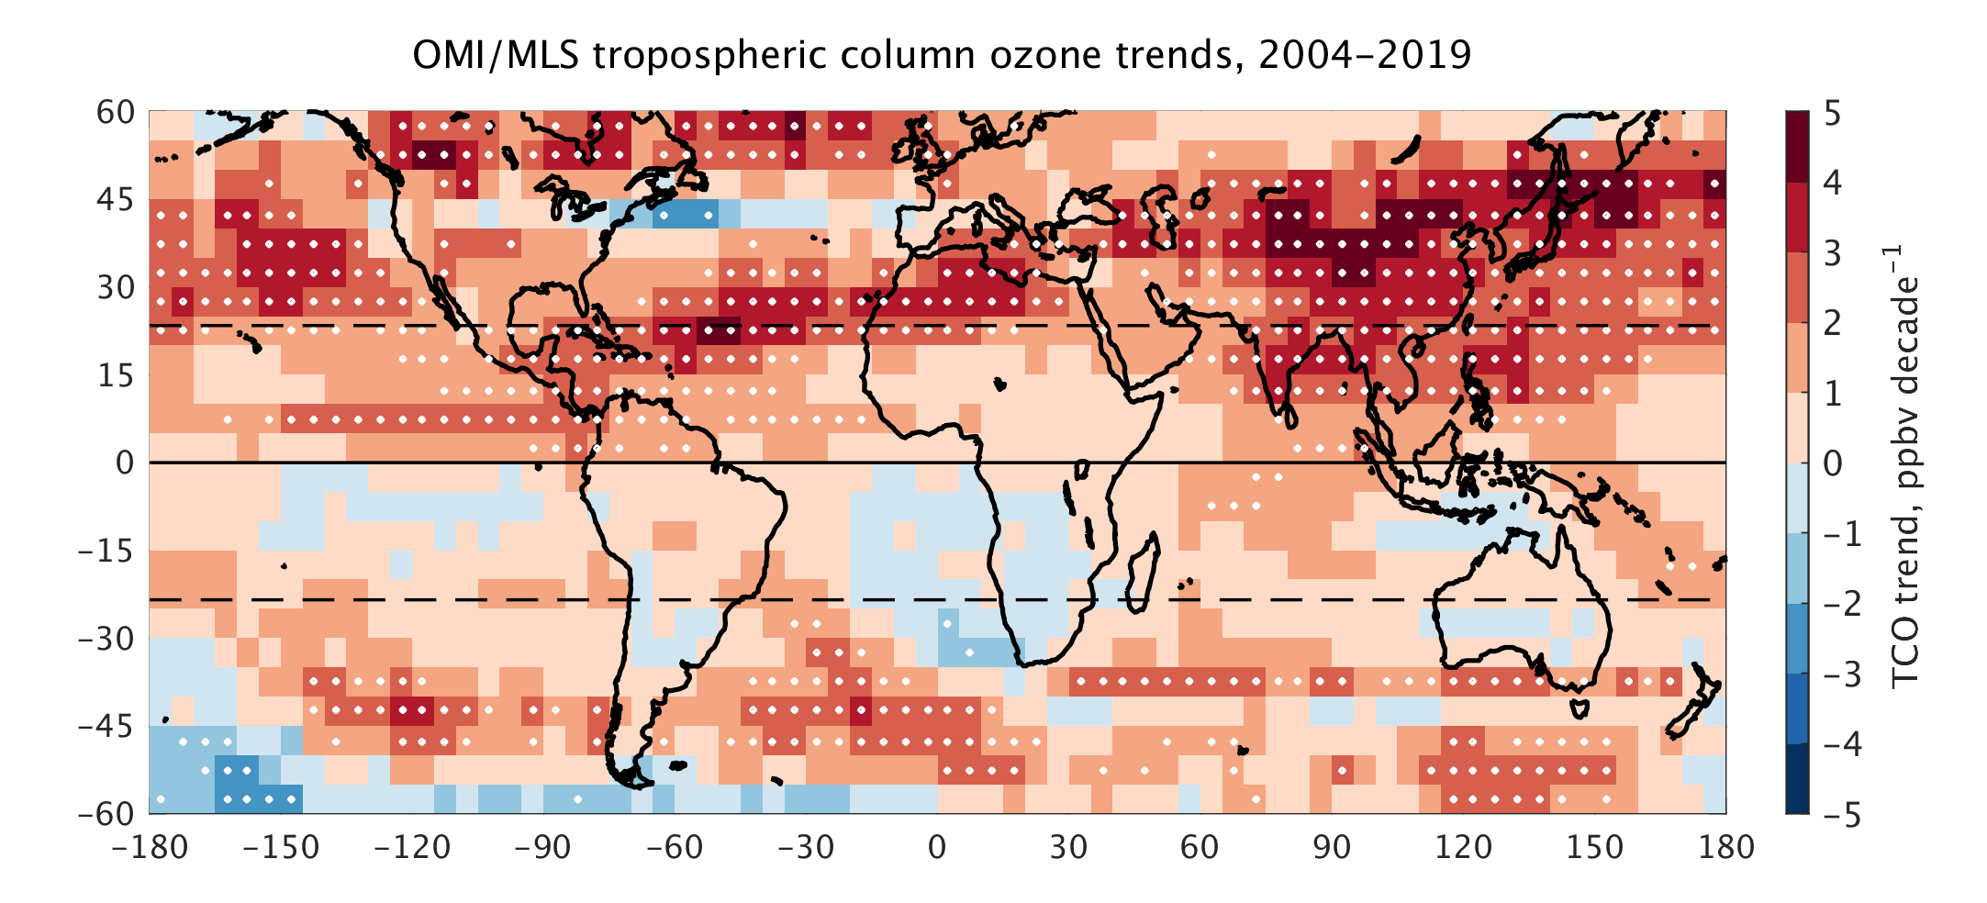
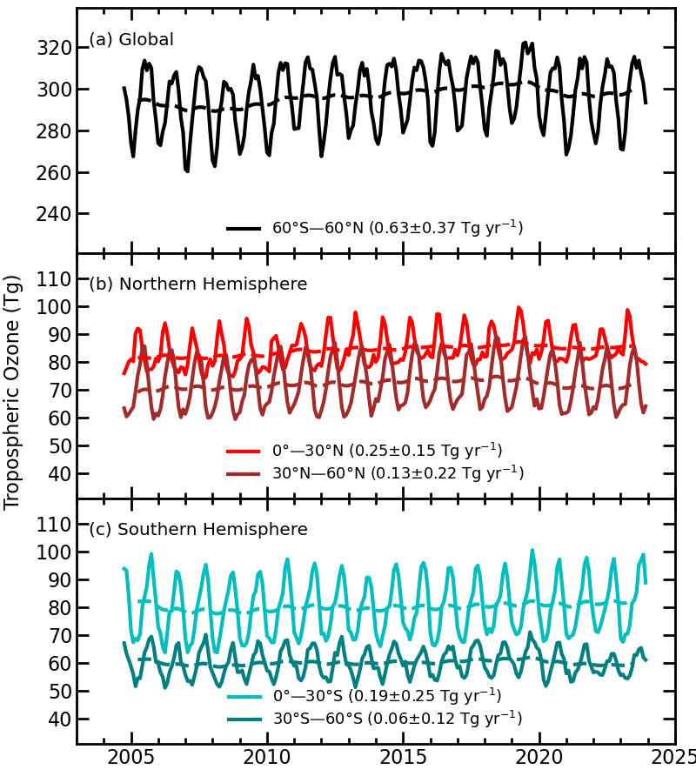
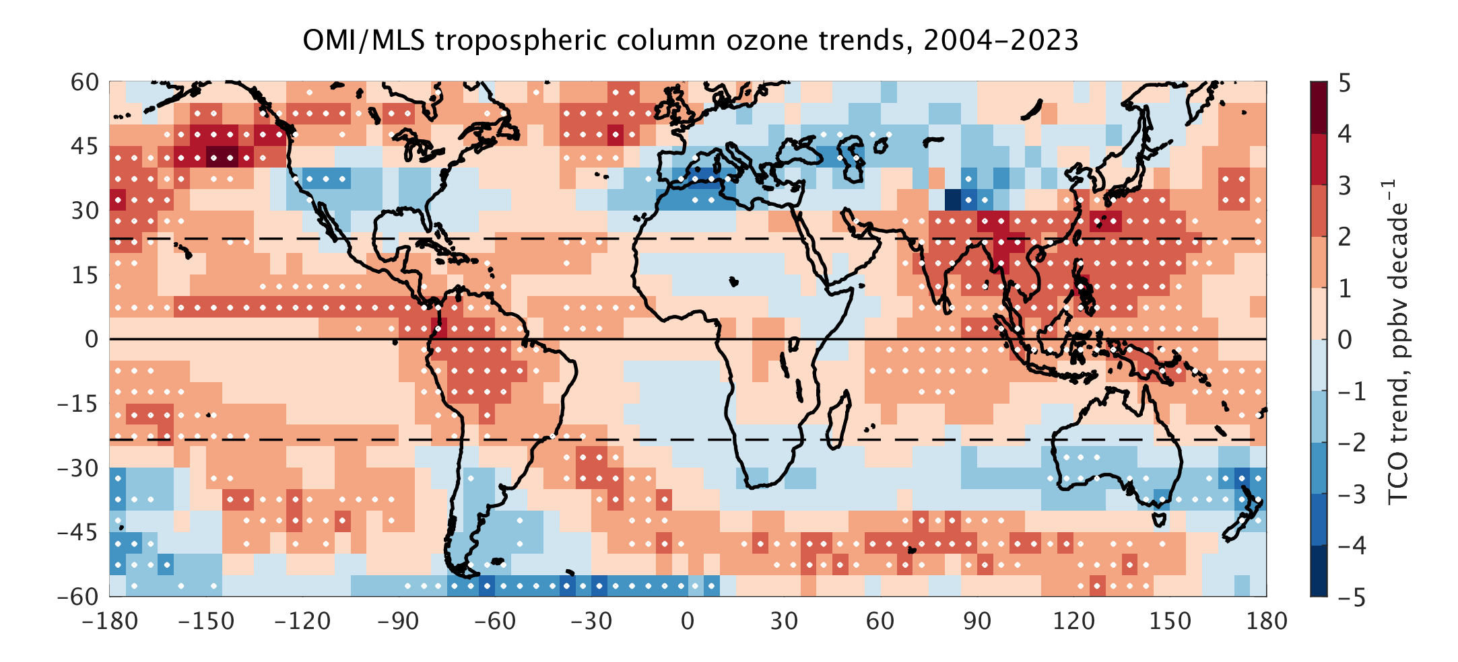
From: “State of the Climate in 2023”, published, August 2024, https://doi.org/10.1175/BAMS-D-24-0116.1

Slide 14
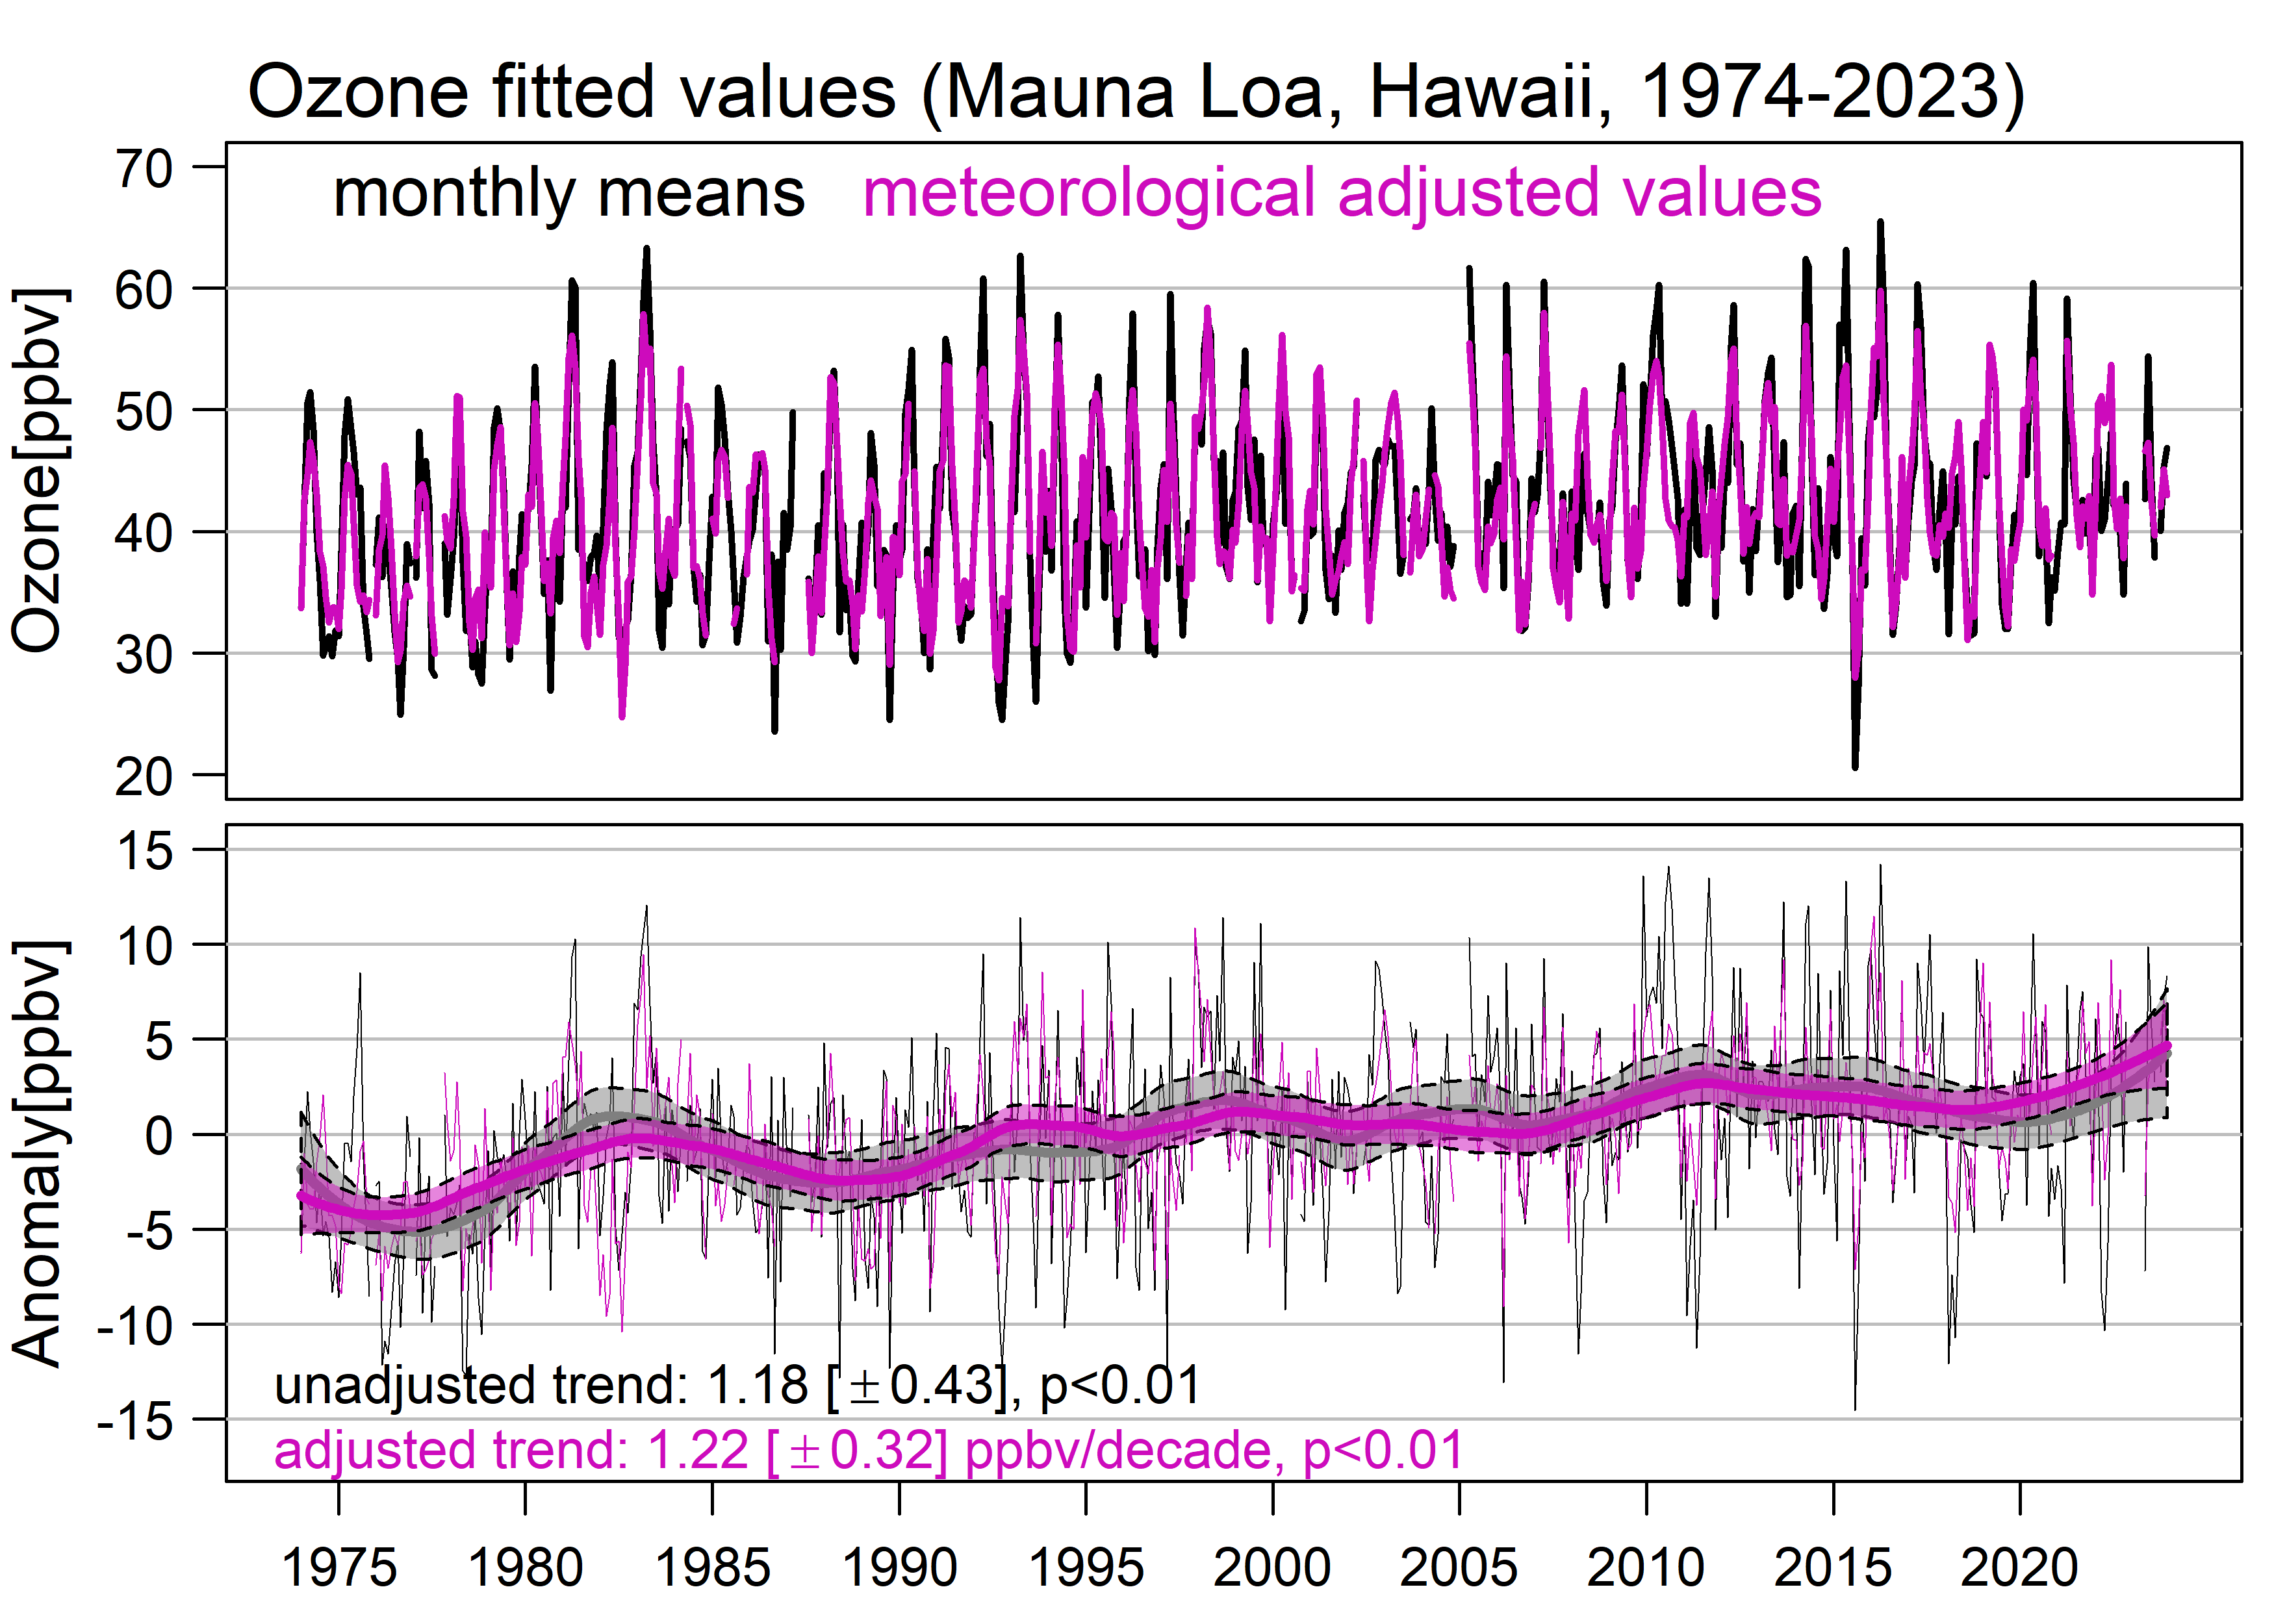
50-year ozone trends at Mauna Loa Observatory (3.4 km above sea level) based on nighttime (downslope flow) observations.
Mauna Loa did not see a drop in ozone during the post-COVD-19 period. Rather, 2023 had the highest ozone levels on record.
When adjusted for meteorological variability the trends are:
1974-2023: 1.22 ± 0.32 ppbv decade⁻¹ p<0.01
1990-2023: 0.94 ± 0.51 ppbv decade⁻¹ p<0.01
2000-2023: 1.09 ± 0.68 ppbv decade⁻¹ p<0.01
Analysis by Kai-Lan Chang, U. of Colorado Boulder/NOAA CSL

Slide 15
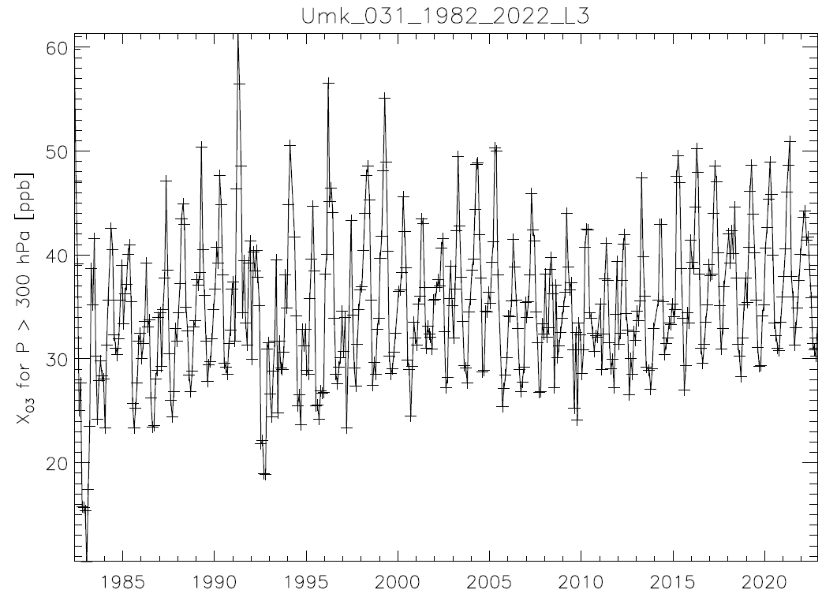
The Umkehr record at Mauna Loa shows an ozone increase in the mid-troposphere (680-300 hPa), 1982-2022, ~ 1 ppbv per decade
The Hilo, Hawaii ozonesonde record shows a similar increase in the 600-300 hPa range, 1991-2021 (Chang et al., 2024)
Umkehr data provided by Irina Petropavlovskikh (U. of Colorado/NOAA GML) to the HEGIFTOM database; data plotted by R. van Malderen (RMI, Belgium)
Umkehr monthly mean values

Slide 16
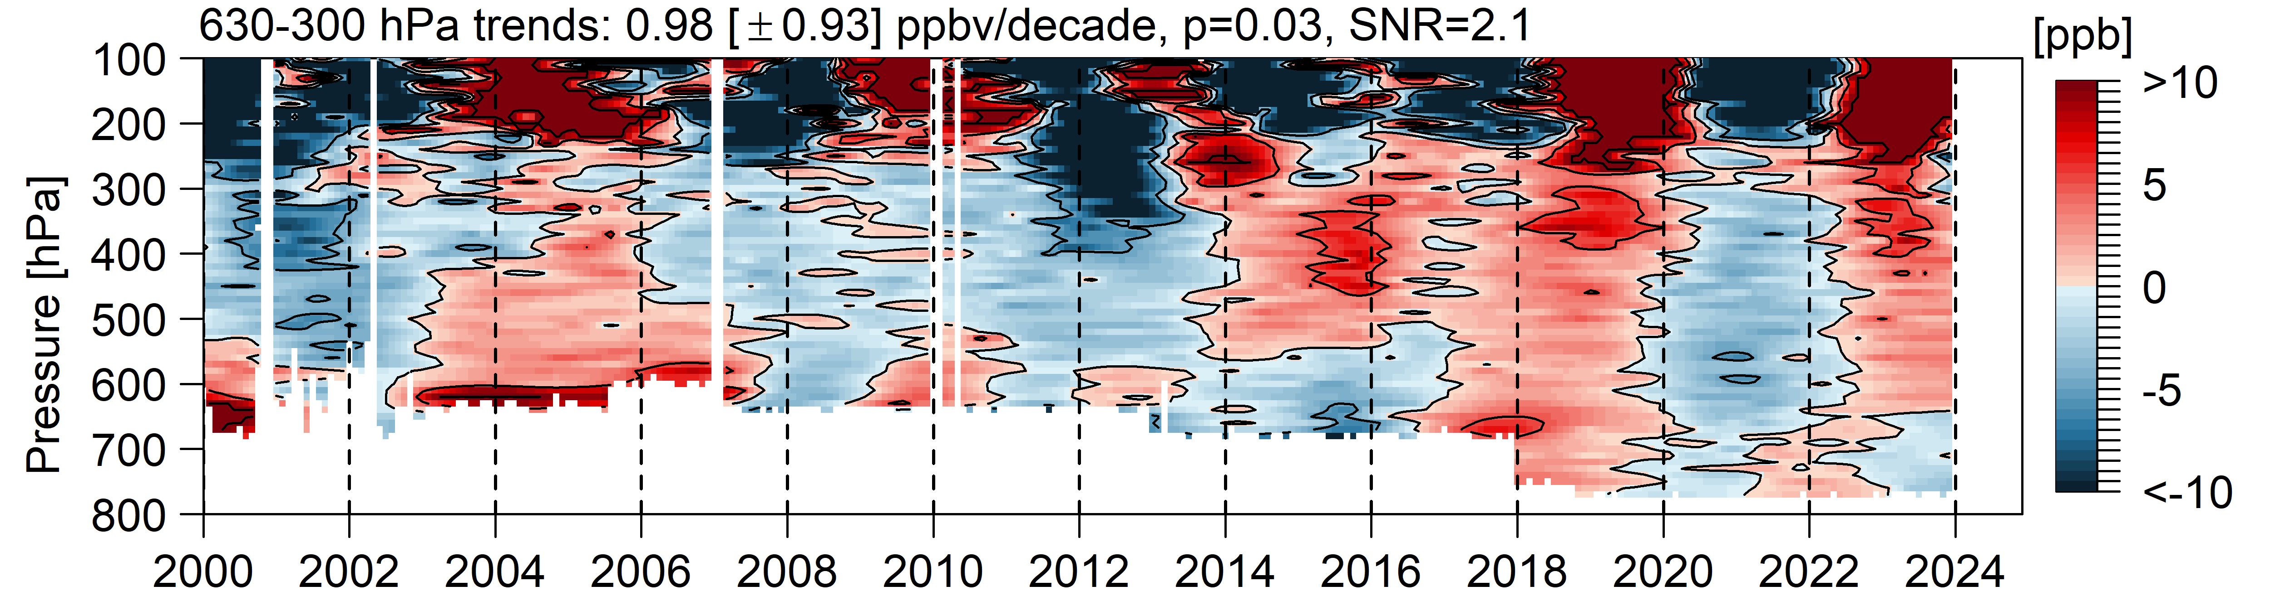
Free tropospheric ozone decreased by approximately 5% above Western Europe and western North America in 2020 (Chang et al., 2023).
The JPL lidar at Table Mountain, CA shows a negative ozone anomaly in the free troposphere in 2020 and 2021.
Data provided by Thierry Leblanc, JPL.

Slide 17
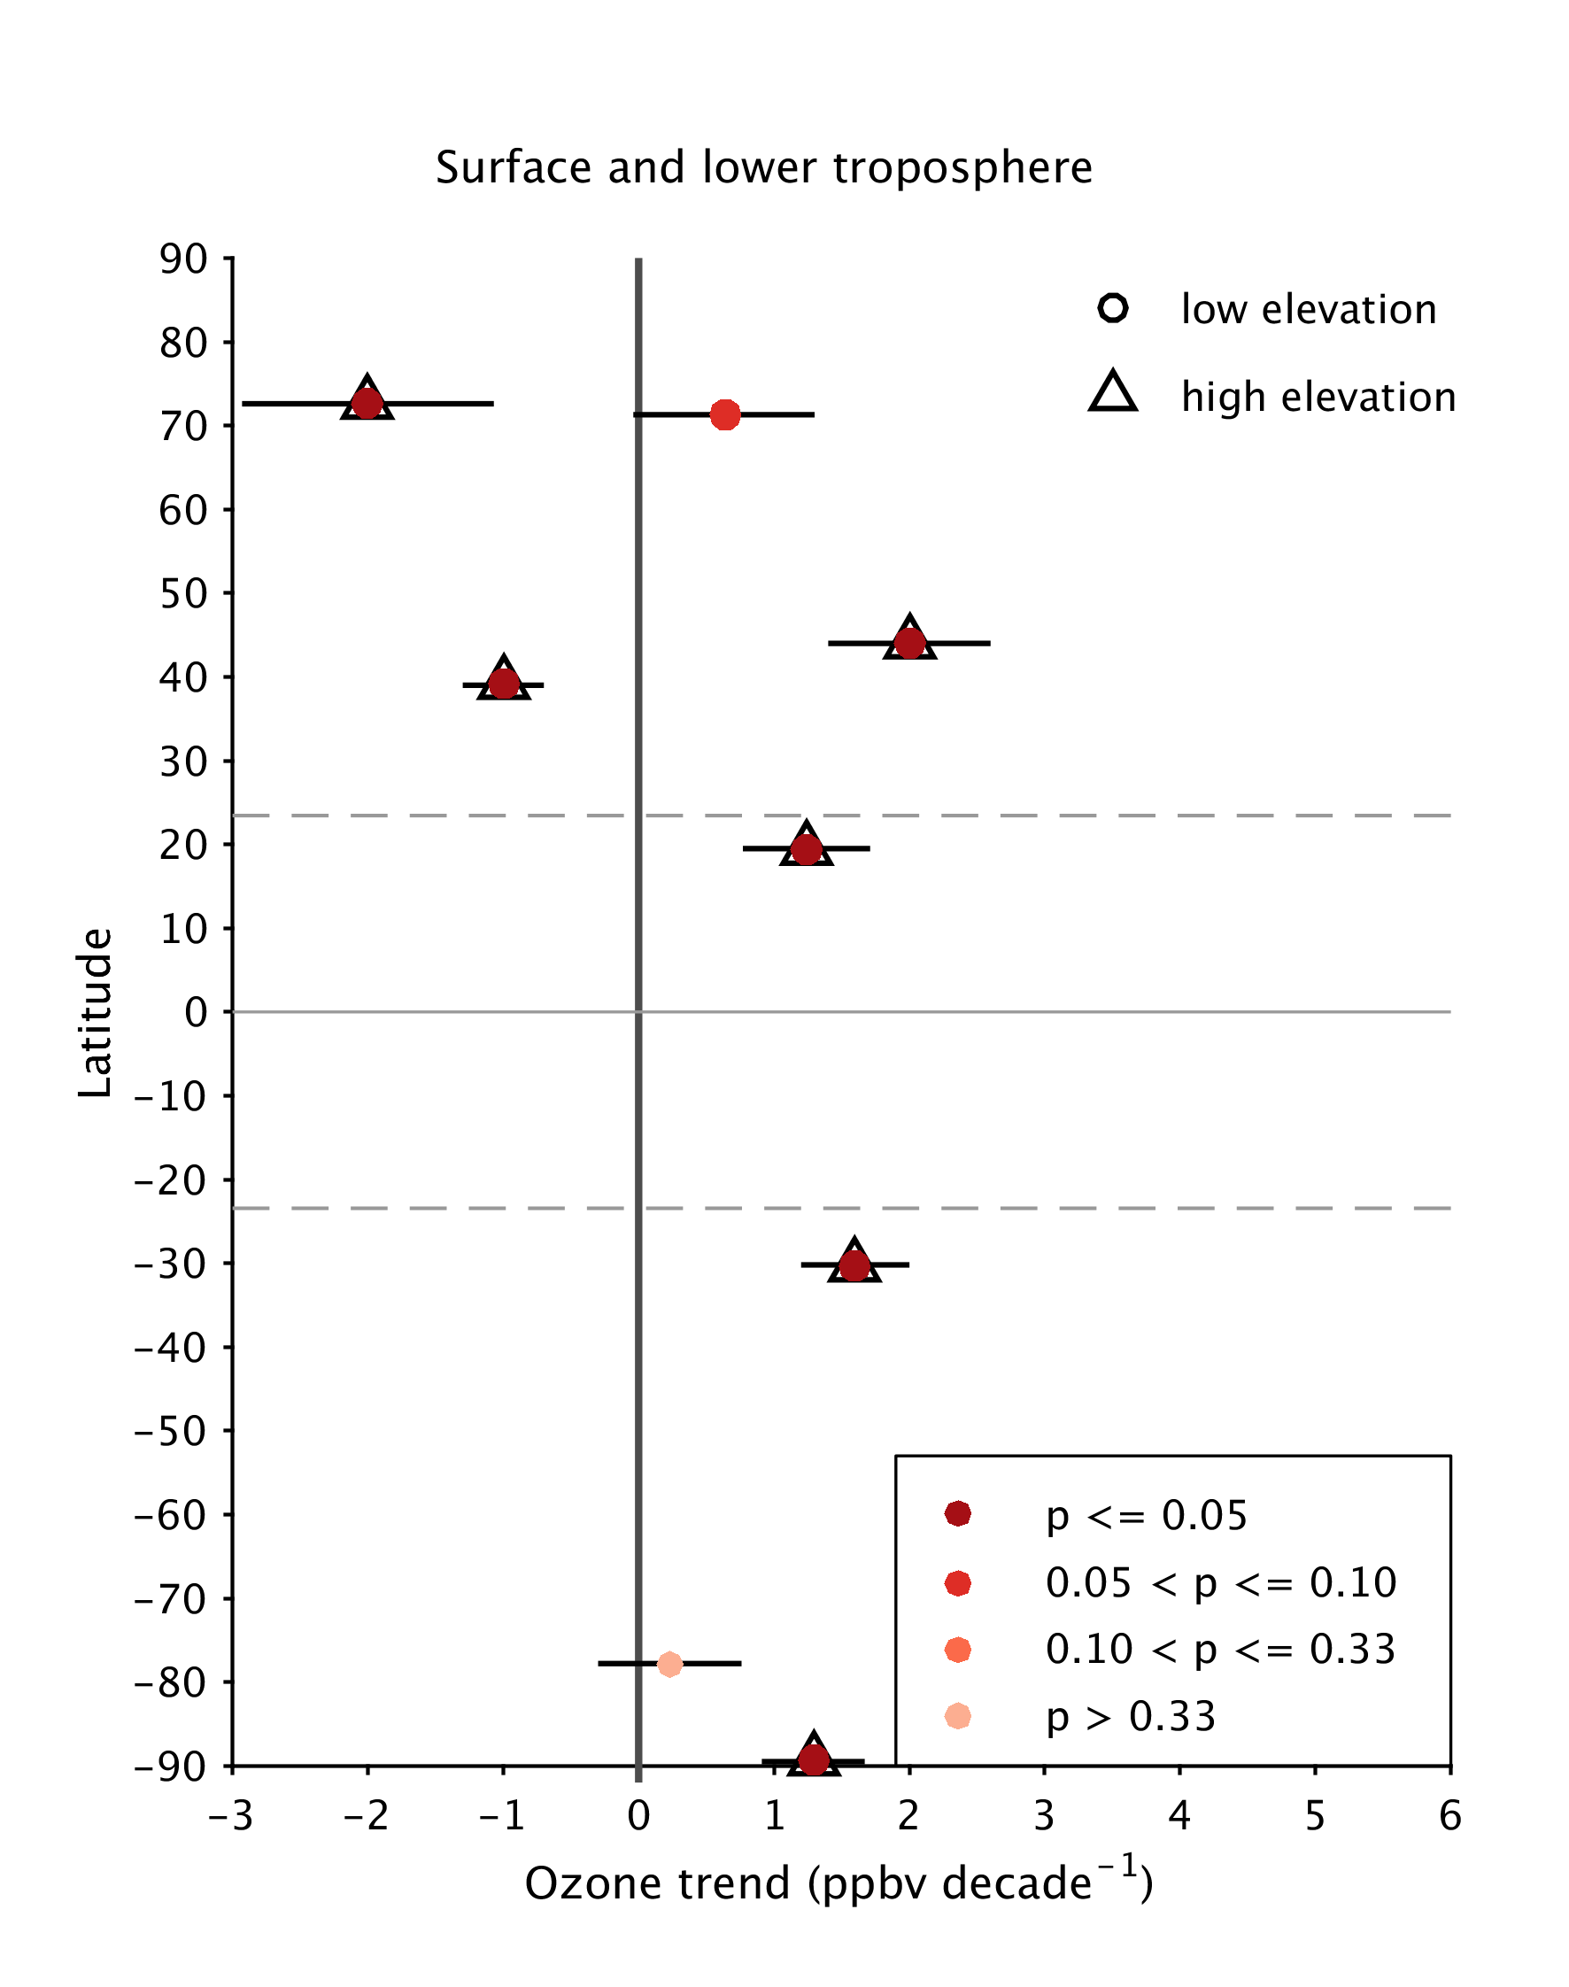
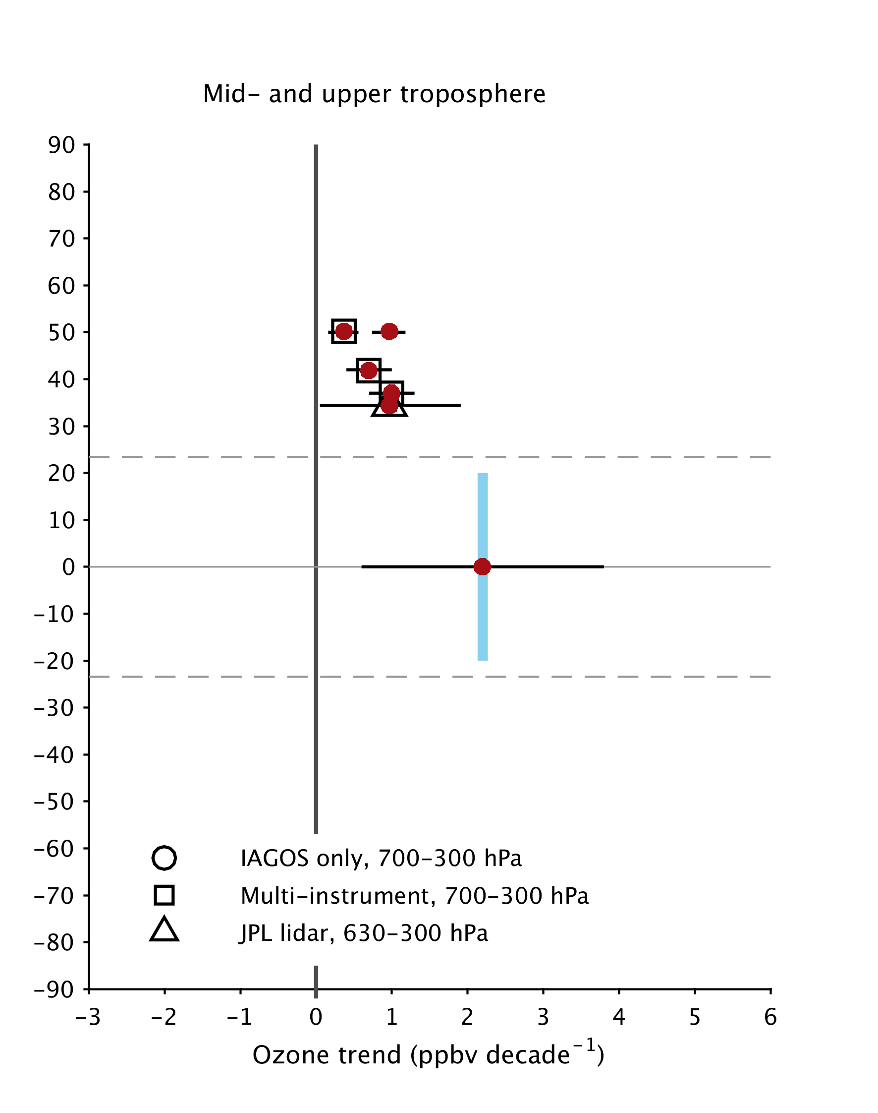
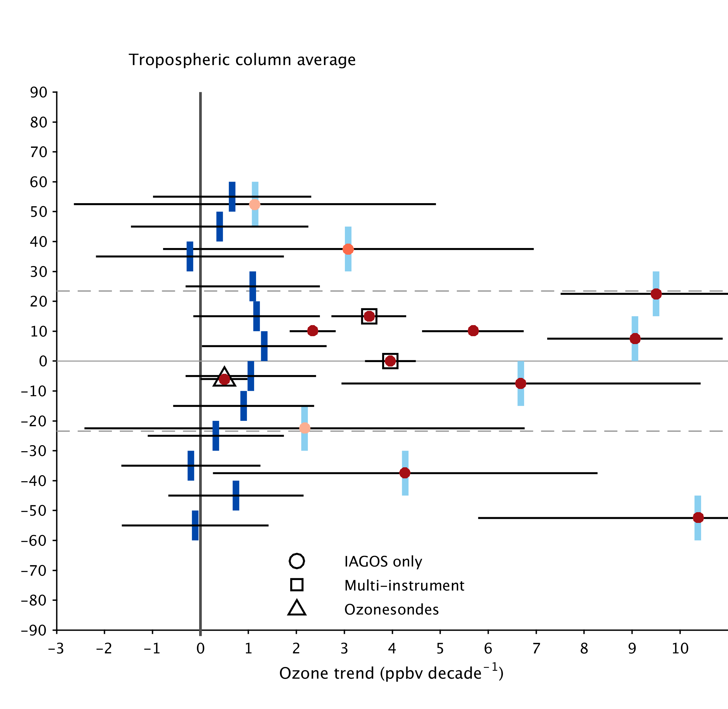
Updated ozone trends
OMI/MLS 2004-2023
GOME-SCIAMACHY-OMI 1996-2017
Summit, Greenland
2000-2023
Barrow, AK
1990-2023
Western Europe 1994-2020
Western N. America 1995-2021
SE Asia
1994-2019
Mt Bachelor
2004-2021 nighttime
California 1995-2021
western USA
26 rural sites
1995-2021
JPL lidar, 2000-2023
Mauna Loa, 1990-2021
meteorologically adjusted
Western Africa
1994-2019
India
1994-2019
Malaysia/Indonesia
1994-2019
MLS upper troposphere
2005-2020
South
Atlantic
1998-2019
El Tololo, Chile
1995-2021
Arrival Heights
1996-2023
South Pole 1990-2023
(NASA SHADOZ)
Chang et al., 2023, JGR, https://doi.org/10.1029/2022JD038090
Chang et al., 2024, ACP, https://doi.org/10.5194/acp-24-6197-2024
Cooper et al. 2024, State of the Climate in 2023, https://doi.org/10.1175/BAMS-D-24-0116.1
Seguel et al. (2024), ACP
https://doi.org/10.5194/acp-24-8225-2024
Chang et al., 2022, AGU Advances, https://doi.org/10.1029/2021AV000542
Chang et al., 2023, JGR, https://doi.org/10.1029/2022JD038090
Froidevaux et al., 2024, ACP (in review), https://doi.org/10.5194/egusphere-2024-525
Pope et al., 2024, ACP, https://doi.org/10.5194/acp-23-14933-2023, Merged product of GOME-I, SCIAMACHY and OMI, surface to 450 hPa
OMI/MLS analysis by J. Ziemke, data available at: https://acd-ext.gsfc.nasa.gov/Data_services/cloud_slice/#nd
Gaudel, et al., 2024, ACP, in press, https://doi.org/10.5194/egusphere-2023-3095

Slide 18
Conclusions
Independent model studies published (or submitted) since the release of IPCC AR6 (2021) indicate the global tropospheric ozone burden has continued to increase through 2019
A recent update to ozone’s effective radiative forcing (ERF), based on IPCC methods, suggests a ~9% increase in ERF from 2019 to 2023, likely driven by biomass burning
Model and observation-based studies show a ~5% drop in ozone at northern mid-latitudes in 2020 in response to the COVID-19 pandemic.
Multiple satellite records indicate that ozone has levelled off since 2020 at northern mid-latitudes
Recently published studies of observed ozone trends indicate a general increase of tropospheric ozone from 1990 through 2023, but some locations show decreases (North America boundary layer, Summit Greenland), and positive trends have been diminished by the post COVID period.
More work is needed to understand changes in ozone ERF since 2019

