Slide 1




Upcoming reduction in space-based observations of ozone atmospheric composition at high vertical resolution: implications for data products and long-term studies
CEOS AC-VC #20
15-18 October 2024
Daan Hubert¹, J.-C. Lambert¹, R. Salawitch², K. Wargan^{3,4},
S. Davis⁵, V. Sofieva⁶, M. I. Hegglin^{7,8}, E. Castelli⁹, P. Thorne¹⁰
¹BIRA-IASB, ²UMD, ³NASA-GSFC, ⁴SSAI, ⁵NOAA-CSL,
⁶FMI, ⁷FZ Jülich, ⁸U Reading, ⁹CNR/ISAC, ¹⁰Maynooth U

Slide 2
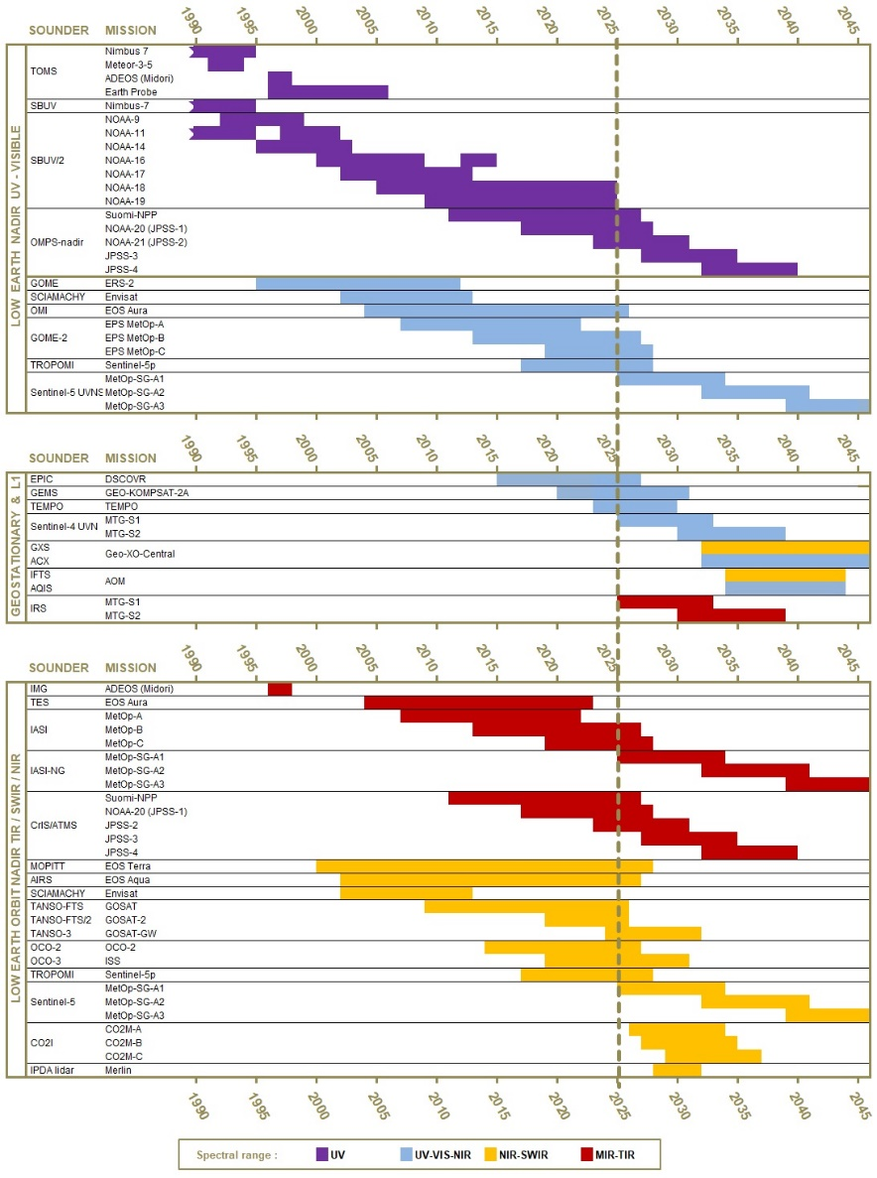
Nadir observing system : continuity up to 2040+
Fig. by J.-C. Lambert (BIRA-IASB)

Slide 3
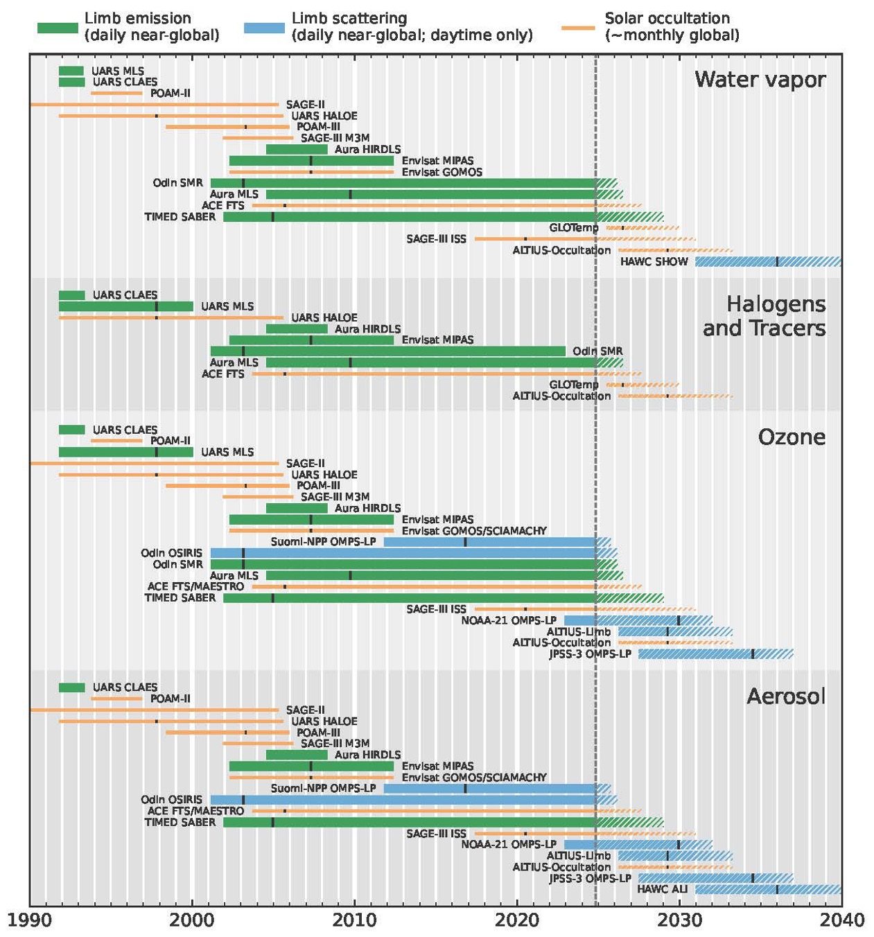
Limb / occultation observing system
Fig. by N. Livesey (NASA-JPL), Salawitch et al., "The Imminent Data Desert: The Future of Stratospheric Monitoring in a Rapidly Changing World“, BAMS, submitted.
N. Livesey (NASA-JPL)

Slide 4
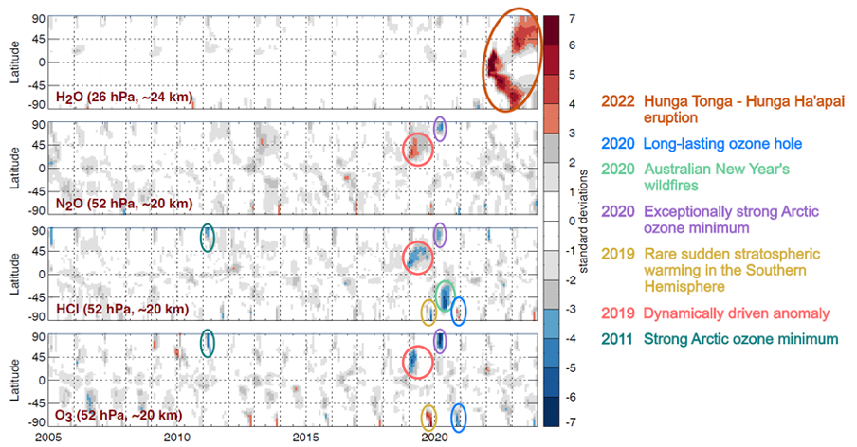
Large observed perturbations in recent years
M2-SCREAM (Wargan et al., 2023)
Fig. by K. Wargan (NASA-GSFC, SSAI),
Salawitch et al., BAMS, submitted

Slide 5
Limb / occultation observing system
Fig. by N. Livesey (NASA-JPL), Salawitch et al., BAMS, submitted
N. Livesey (NASA-JPL)

Slide 6
GCOS Action since 2010…
2010
2016
2022

Slide 7
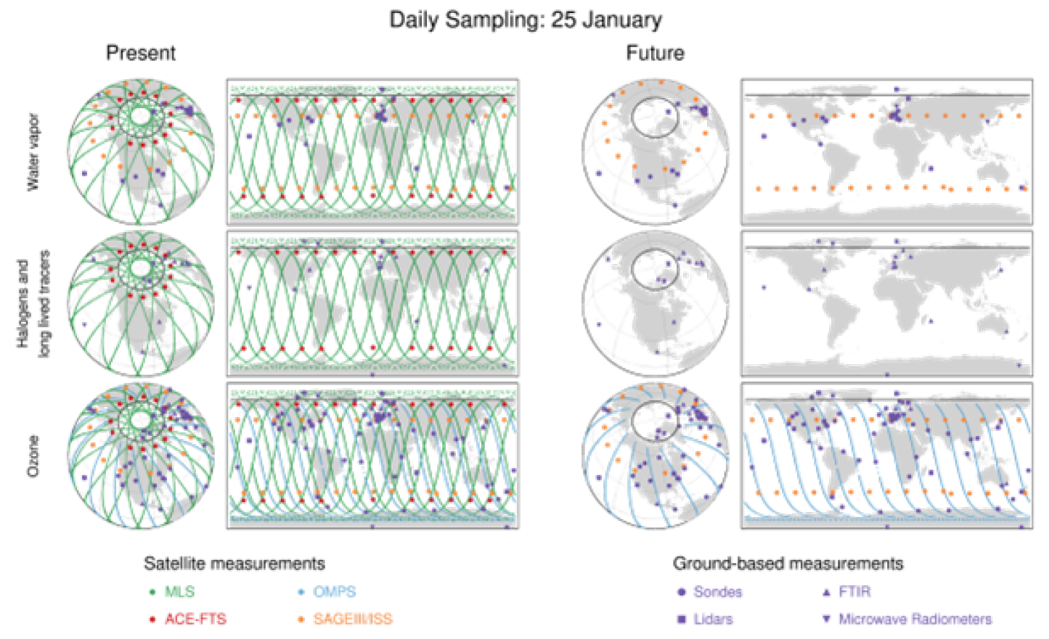
Fewer observations, fewer gases
Fig. by N. Livesey (NASA-JPL), Salawitch et al., BAMS, submitted

Slide 8
No detection, nor complete view on perturbations in future
M2-SCREAM (Wargan et al., 2023)
Fig. by K. Wargan (NASA-GSFC, SSAI),
Salawitch et al., BAMS, submitted

Slide 9
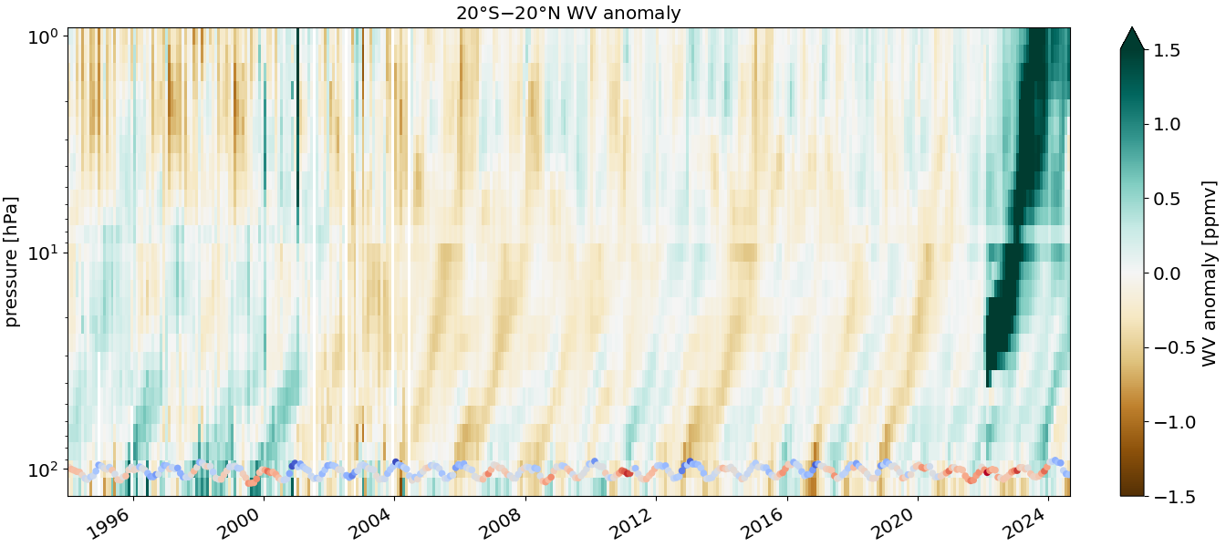
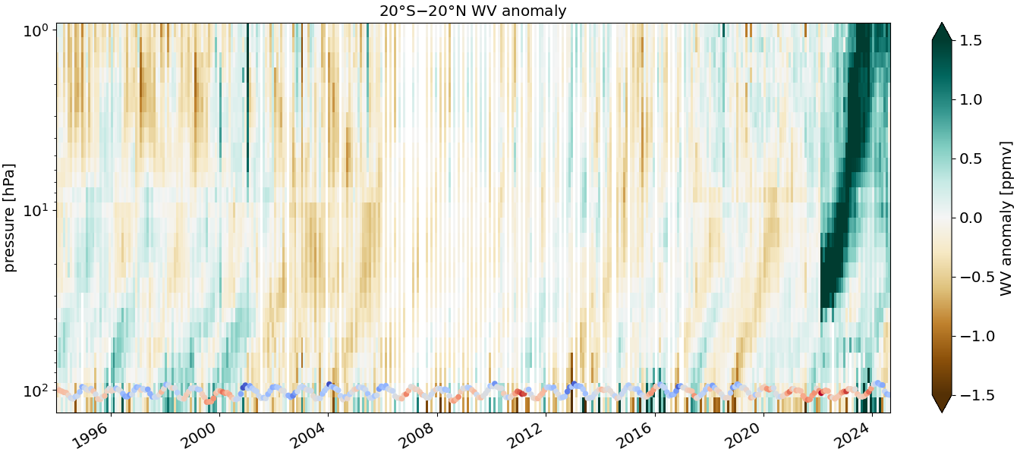
The tape recorder with/out Aura MLS
SWOOSH with Aura MLS
SWOOSH without Aura MLS
Fig. by Sean Davis (NOAA-CSL)

Slide 10
Increased uncertainty over few years → impacts nadir trends during many years
Frith et al (2017)
WMO/UNEP 2018
WMO/UNEP 2022

Slide 11
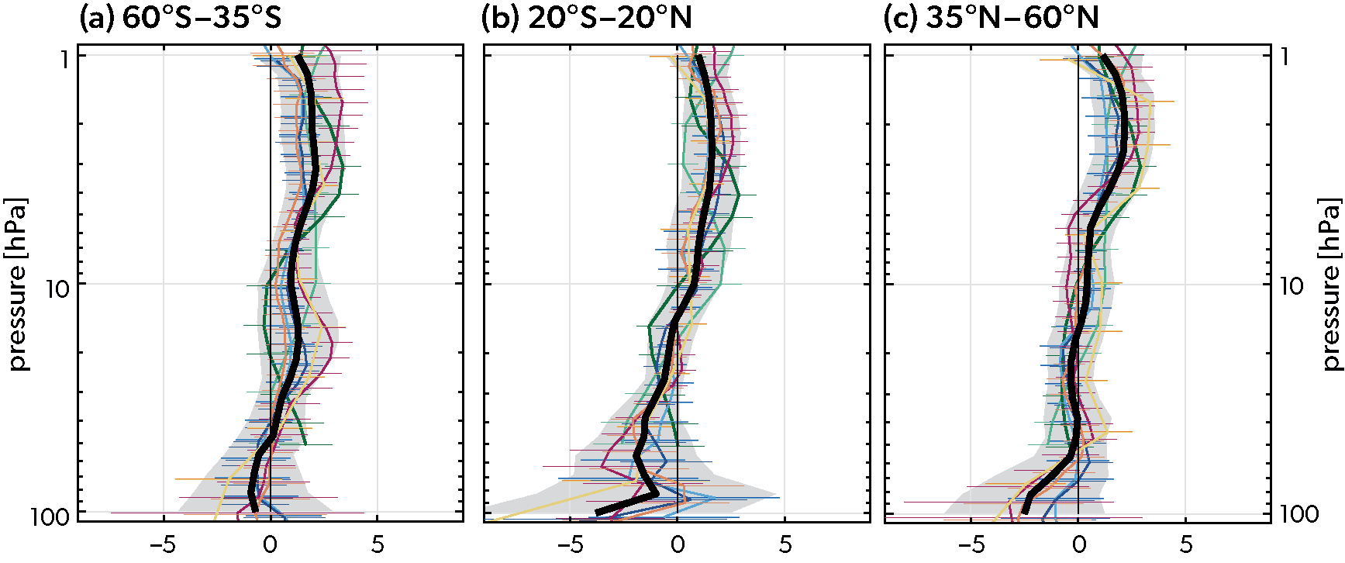
Future WMO O3 assessments : larger uncertainty?
WMO/UNEP 2022

Slide 12
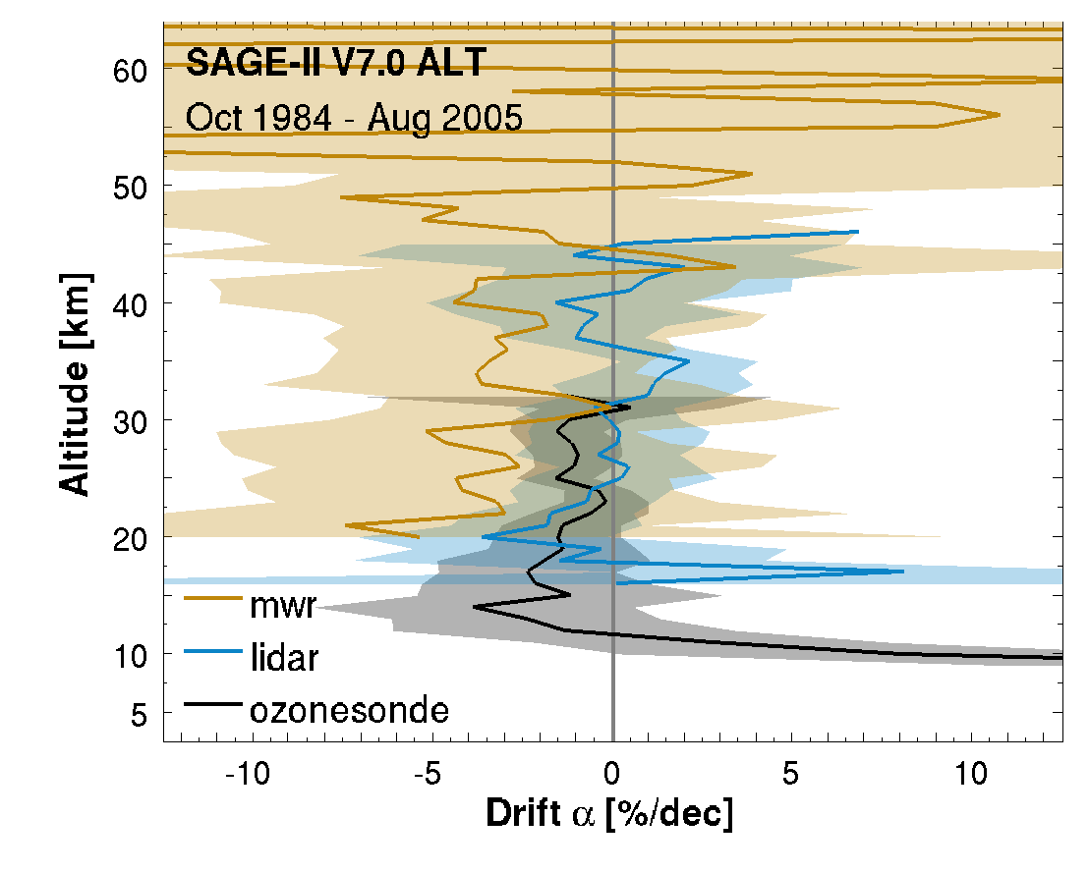
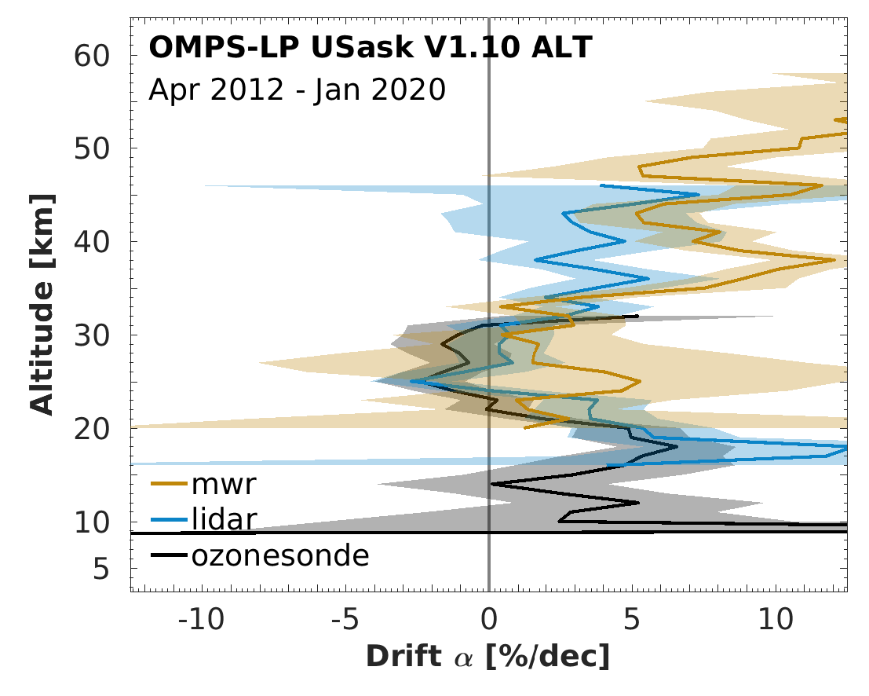
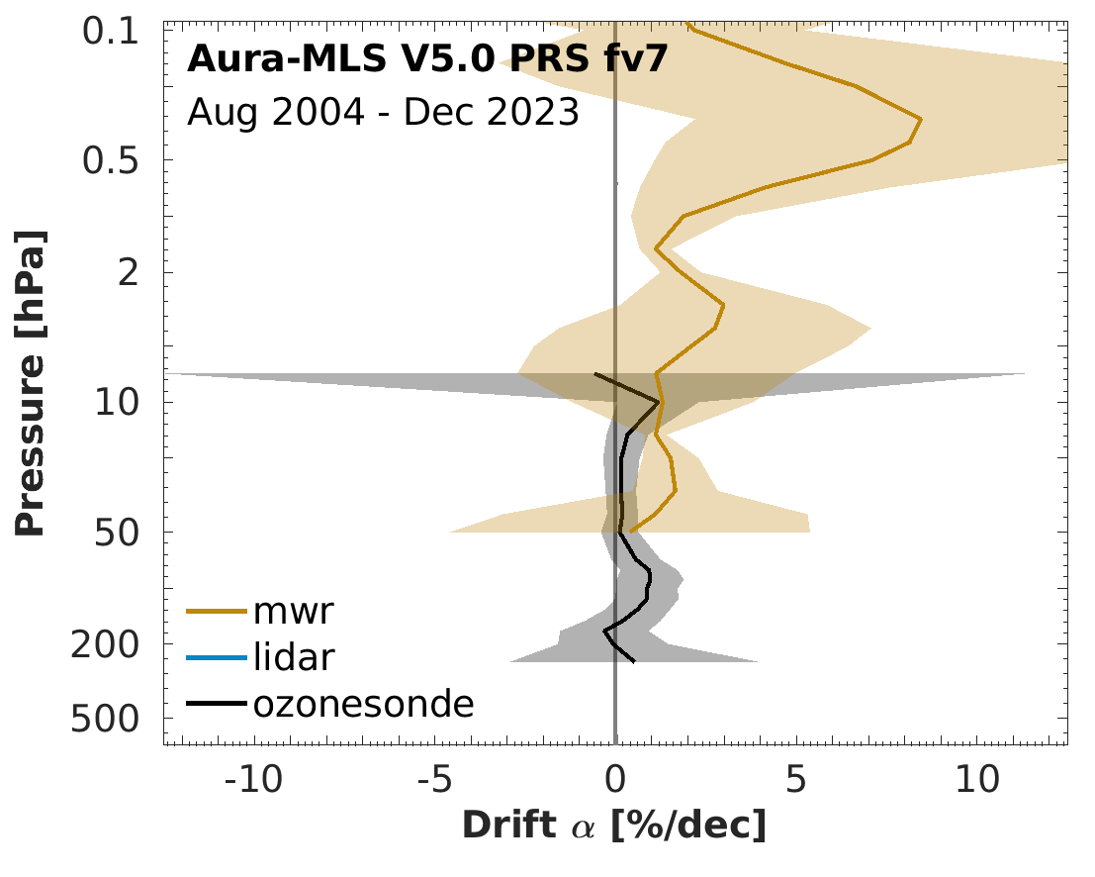
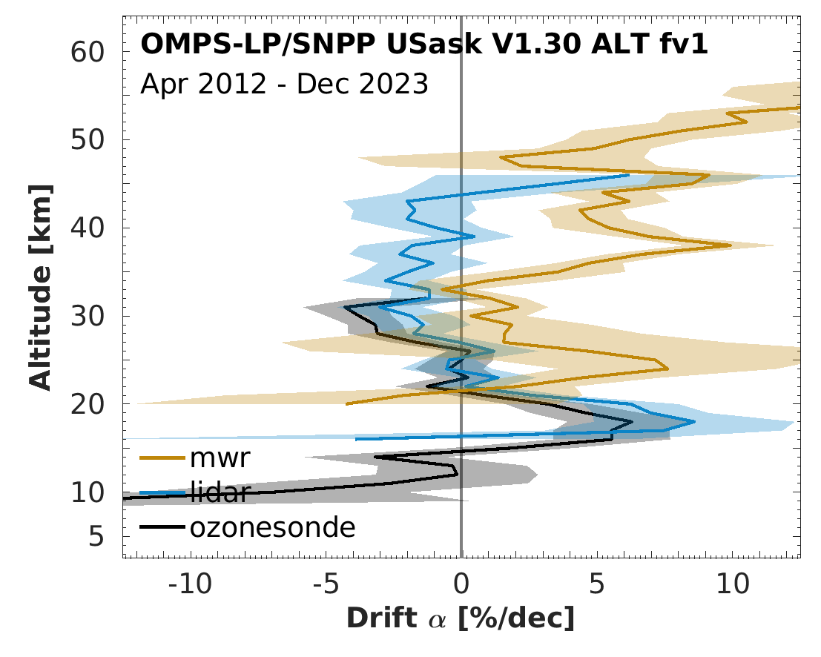
Pointing stability is a challenge for limb UV-vis scattering
SAGE II
Aura MLS
OMPS-LP/SNPP
Update of Hubert et al (2016)
Limb IR/MW emission sensor data should be more stable
Solar occultation data as well, but …

Slide 13
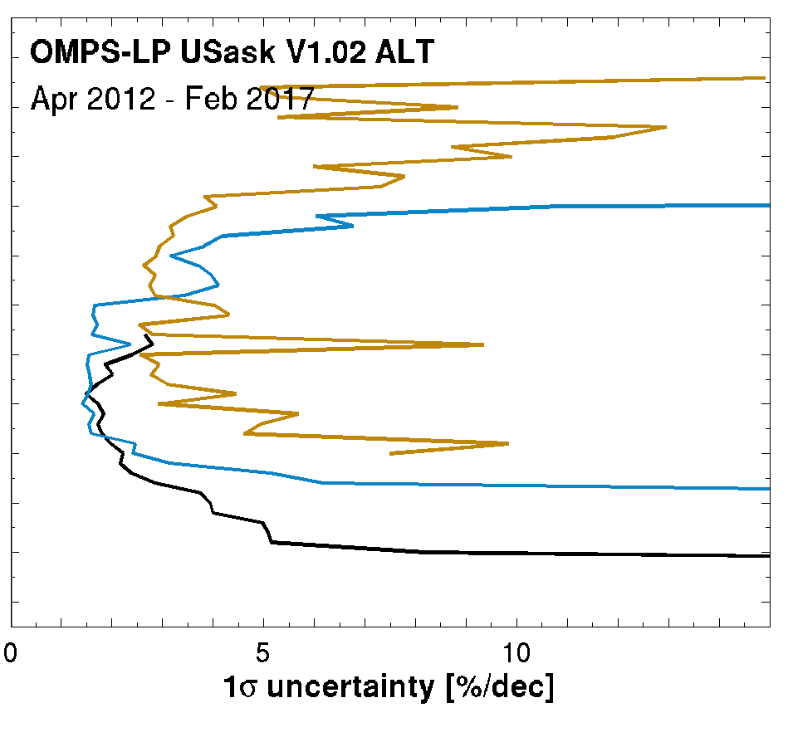
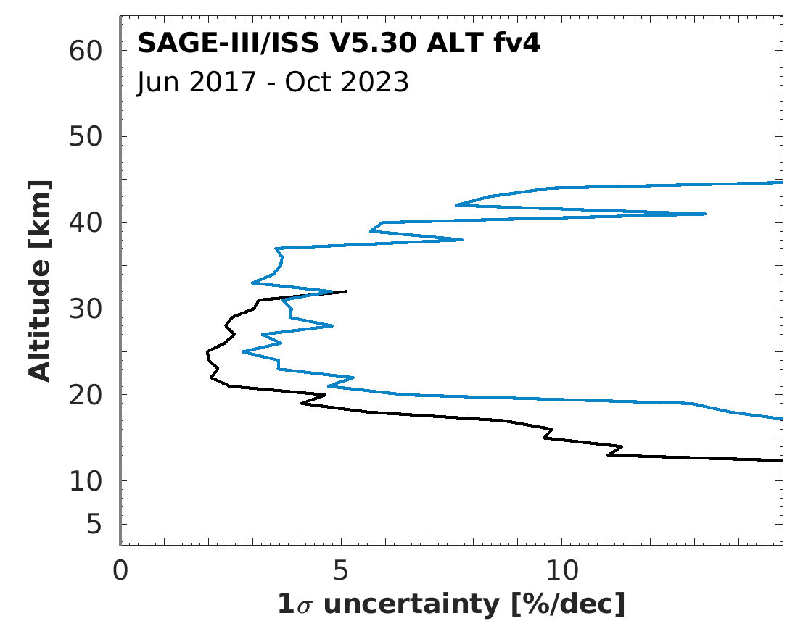
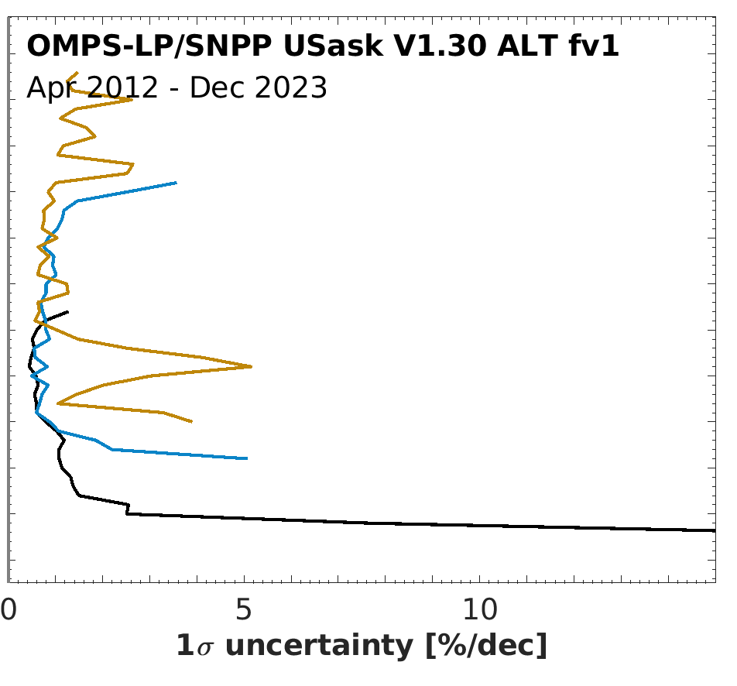
It takes a lot of time to confirm stability of occultation data
Update of Hubert et al (2016)
6 years
5 years
11 years
GCOS Breakthrough
GCOS Goal
GCOS Threshold
GCOS Breakthrough
GCOS Threshold
GCOS Goal

Slide 14
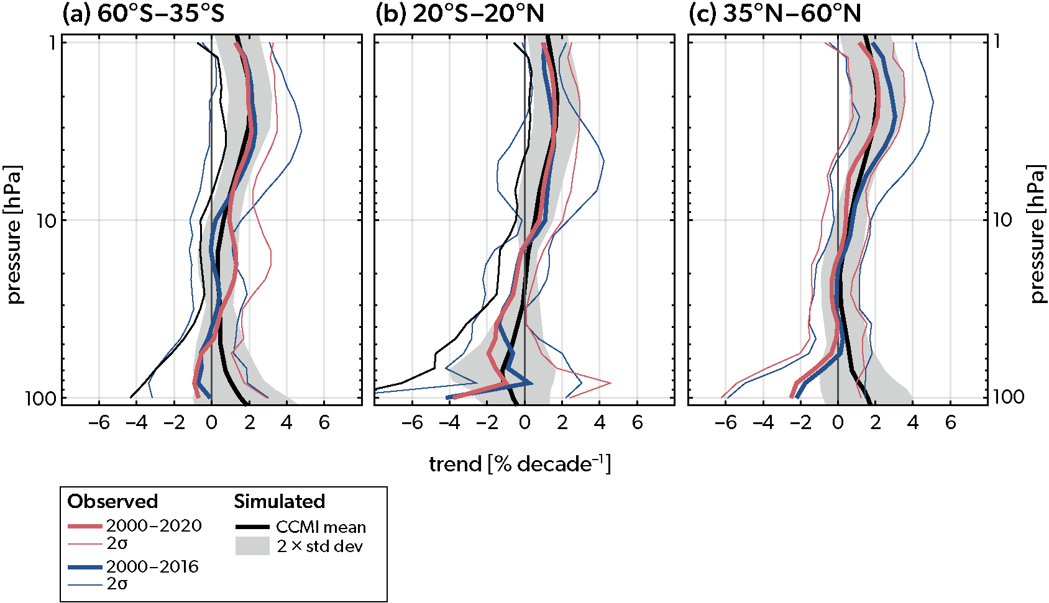
Tracer observations needed to understand → resolve tension in observed/simulated LS trends
WMO/UNEP 2022
Ball et al. (2020)

Slide 15
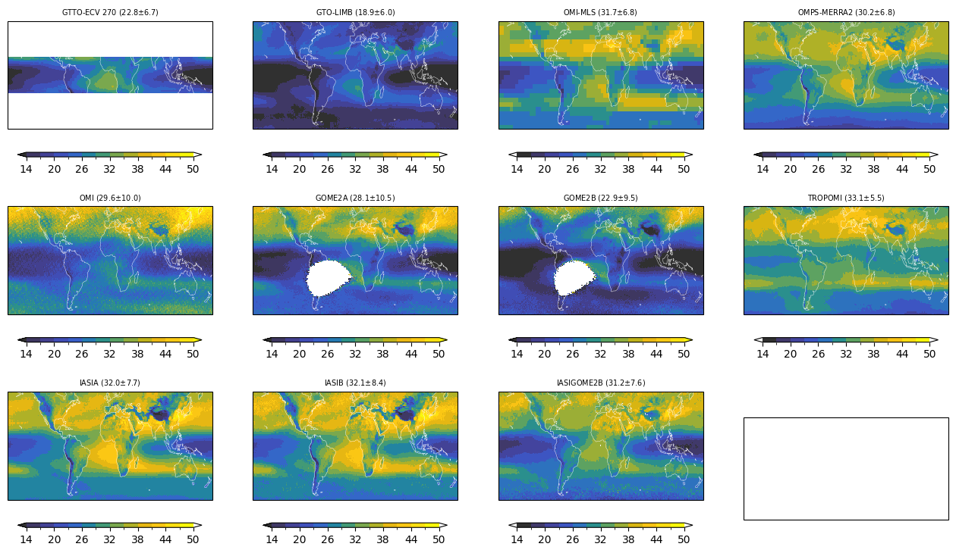
One tropospheric ozone technique relies on stable limb data
Keppens, Hubert et al. (in prep)

Slide 16
Recommendations
Various communities are in urgent need of limb observations
  Requested since more than a decade (GCOS 2010+)
  Detect and study impact of special events (volcanic eruptions, wildfires, …)
  Improve process understanding and modelling at different scales
  Preserve ability to estimate long-term changes and their attribution (BDC, ODS, GHG, …)
  Diversity & quality of products : strato/troposphere, L2/L3, observations/reanalyses
  Validation : chemistry-climate models, satellite and ground-based measurements
What is needed in addition to what planned sensors?
  Limb IR/MW emission : dense sampling; H2O, tracers, halogens, O3
  Solar occultation IR : stable pointing (but sparse): H2O, tracers, halogens, O3
  2x limb IR/MW emission : “ensure” a new golden standard

