Slide 1




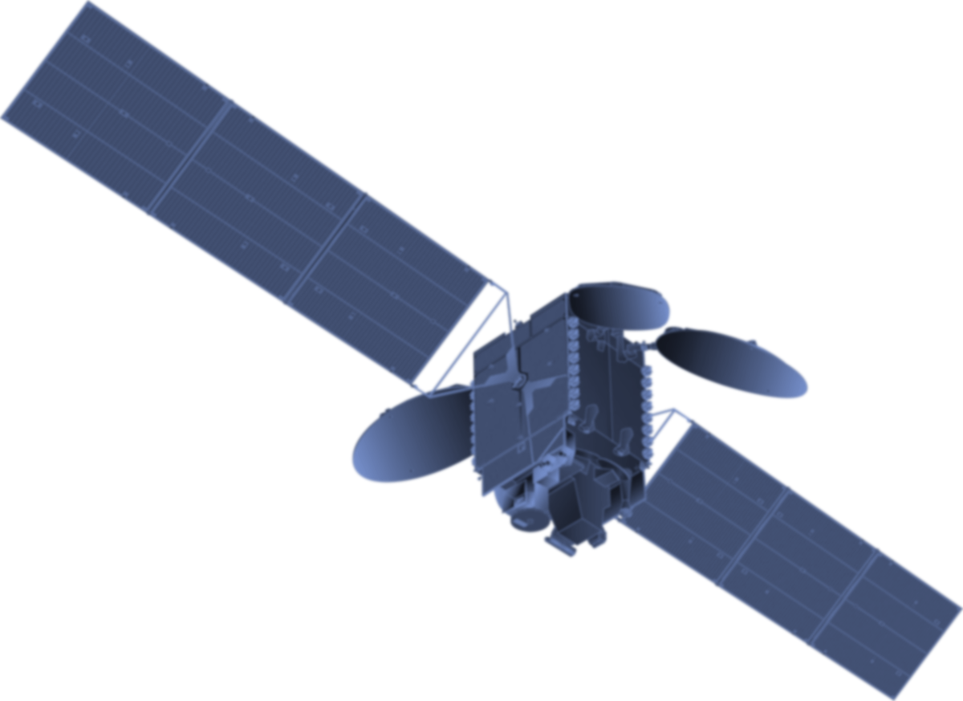
The U.S. GHG Center: Stakeholder-Driven Design
Lesley Ott
U.S. Greenhouse Gas Center Project Scientist
NASA Goddard Space Flight Center
On behalf of the large (and growing!) Interagency GHG Center team
October 17, 2024
Notes:
Background Image:
NASA's Scientific Visualization Studioz: https://svs.gsfc.nasa.gov/5110
Atmospheric Carbon Dioxide
This visualization is based on the following papers:Weir, B., Ott, L. E., Collatz, G. J., Kawa, S. R., Poulter, B., Chatterjee, A., Oda, T., and Pawson, S.: Bias-correcting carbon fluxes derived from land-surface satellite data for retrospective and near-real-time assimilation systems, Atmos. Chem. Phys., 21, 9609–9628, https://doi.org/10.5194/acp-21-9609-2021, 2021.

Slide 2
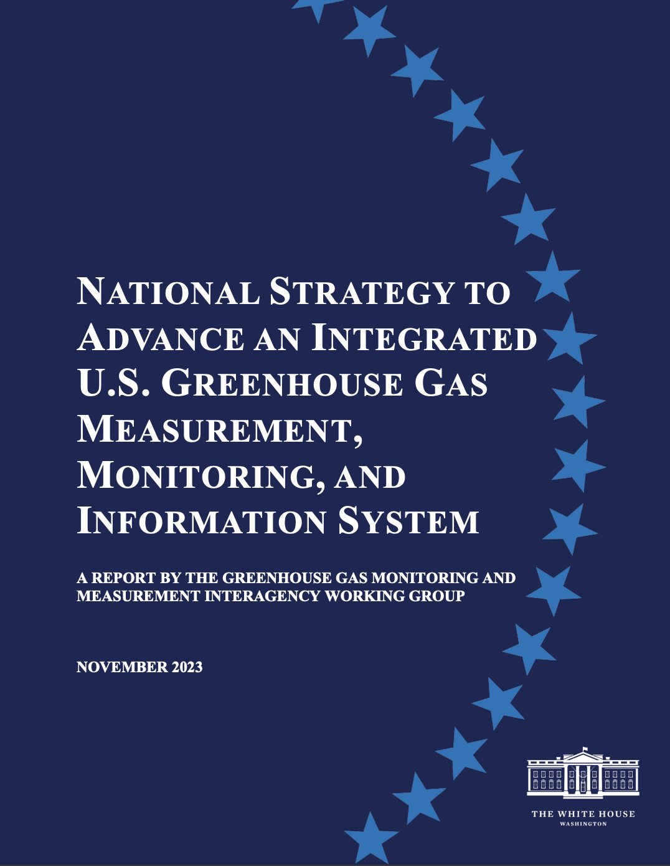
What is the U.S. Greenhouse Gas Center?
From the National Strategy to Advance an Integrated U.S. Greenhouse Gas Measurement, Monitoring, and Information System:
The U.S. GHG Center, initially led by NASA, EPA, NIST, and NOAA, will facilitate coordination across federal and non-federal, domestic, and international entities to integrate and enhance GHG data and modeling capabilities from the USG and non-USG sources for scalable impact.
Notes:
Gridded Anthropogenic Greenhouse Gas Emissions (10 min) [Erin McDuffie]
UC1 EPA CH4 Demo (5 min) [Deb/Manil]
Top-down description and application (2 min) [Bowman]
Potential products for GHG Center
TBD (2 min) [NOAA Miller]
TBD (2 min) [NIST Mueller / NOAA McDonald]
Top-down CH4 (2 min) [NASA Bowman]
Q&A/Discussion (25 min)

Slide 3
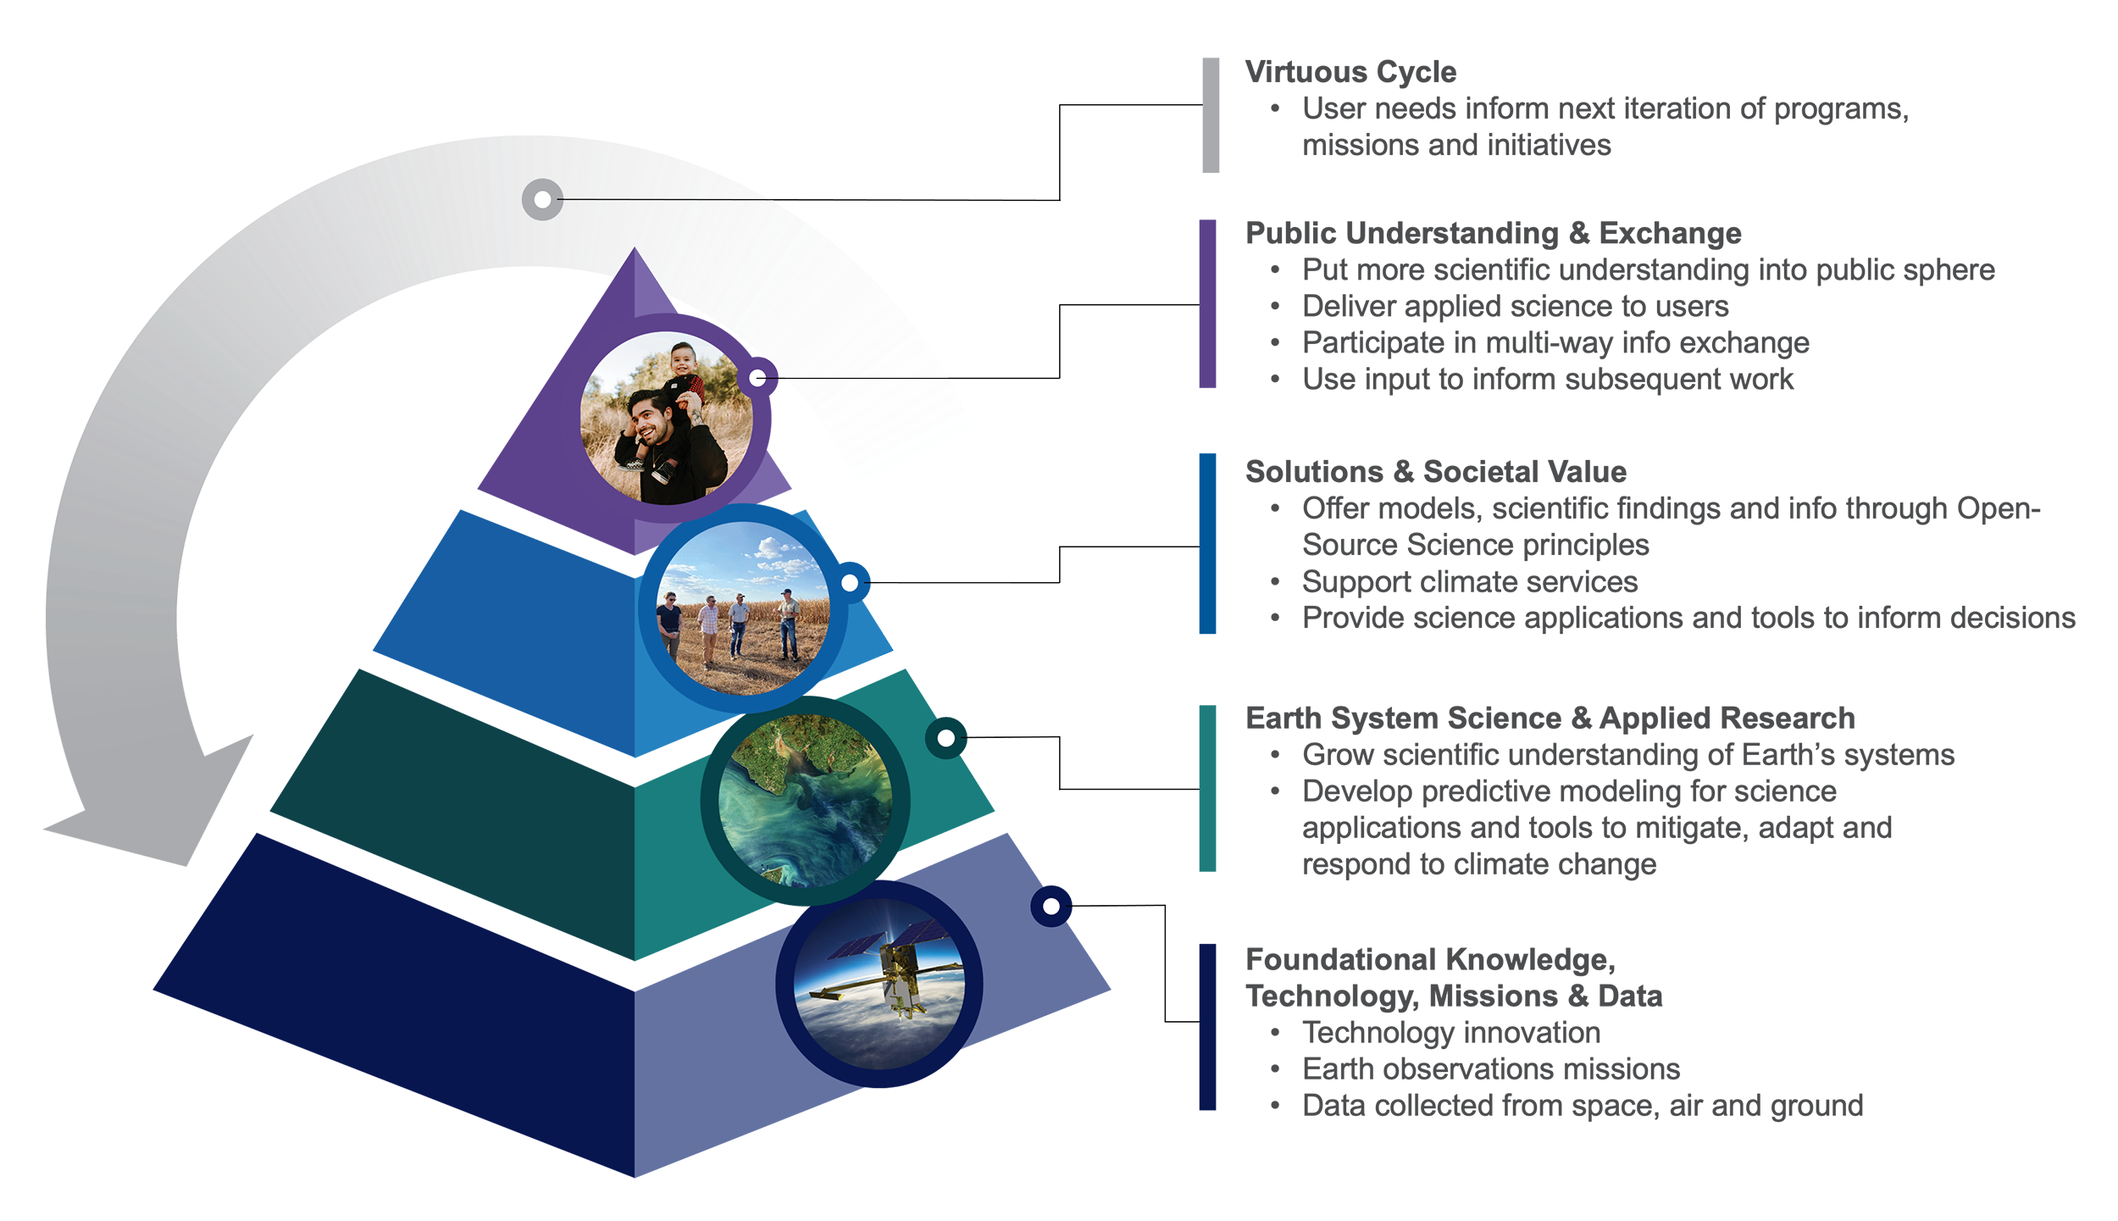
Earth Action Strategy
Notes:
GHGI background
- Highlight that updated a published every year

Slide 4



The U.S. Greenhouse Gas Center
Strategy
Outreach
Education
Tools
OCO portal
EMIT portal
GMAO site
WorldView
DAACs
...
Models
GMAO
CMS-Flux
GISS Model-E
Land, ocean
...
Observations
OCO-2, 3
EMIT
...
Ground-based remote sensing
Airborne
Outreach
Education
Tools
GHGRP (facility scale)
GHGI data and reports
...
Models
CMAQ
Activity models
Exposure models
...
Observations
Stack monitoring
Ground stations (AQ)
Research measurements
Outreach
Education
Tools
GHG website
Urban testbed website
...
Models
WRF-STILT inversions
VPRM
Hestia* (NAU)
...
Observations
Urban Testbeds
Low cost sensors
Airborne campaigns
Outreach
Education
Tools
OCOMIP site
CarbonTracker site
GGGRN site
Data centers
...
Models
CarbonTracker
CT-Lagrange
HYSPLIT
Land, ocean
...
Observations
GGGRN
Airborne (research) monitoring,
CrIS
...
Ultimate goal – Provide consensus, stakeholder-driven GHG information to enable climate change mitigation
Notes:
GHGI background
- Highlight that updated a published every year

Slide 5
The U.S. Greenhouse Gas Center
Scalable Impact (examples - designed to align with EOP priorities):
User needs inform refinement of tools, products
Coordinated communications, outreach
Workforce, educational initiatives
Earth Information Center – interactive events
Stakeholder engagement
Development of user-driven GHG tools/data portal
Trust through open science principles
Foundational Science Integration Activities (examples – designed to align with federal strategy)
Quasi-operational GHG modeling
Standardized model evaluation, methods for providing consensus estimates
Interagency modeling strategy and coordination
Coordination and evaluation of satellite data
Ground network coordination and standards
Expanded airborne measurements and coordination
NASA Earth Action Strategy
Cross-cutting: Alignment with stakeholder needs, interagency coordination, open science, and inclusivity
Notes:
GHGI background
- Highlight that updated a published every year

Slide 6
Summary of findings from stakeholder engagement efforts (through 7/31)
Datasets, portal:
Datasets with higher spatial resolution, lower uncertainty
Context and background on data products aimed at non-technical audiences
Tutorials and training material on how to use, interpret data
Tools to support BU/TD reconciliation
Additional information on key sectors – land use, transportation, aquatic systems
Additional information on air quality
Additional coordination needs:
Platform for data sharing
Collaborative workforce development
Opportunities for interaction with scientists, other stakeholders
Stakeholders to date: Broad cross section of U.S. federal, state agencies, tribal organizations, NGOs, academia, international science organizations
Near term priorities: Building deeper relationships with states, cities, land management organizations, private sector, and federal agencies

Slide 7
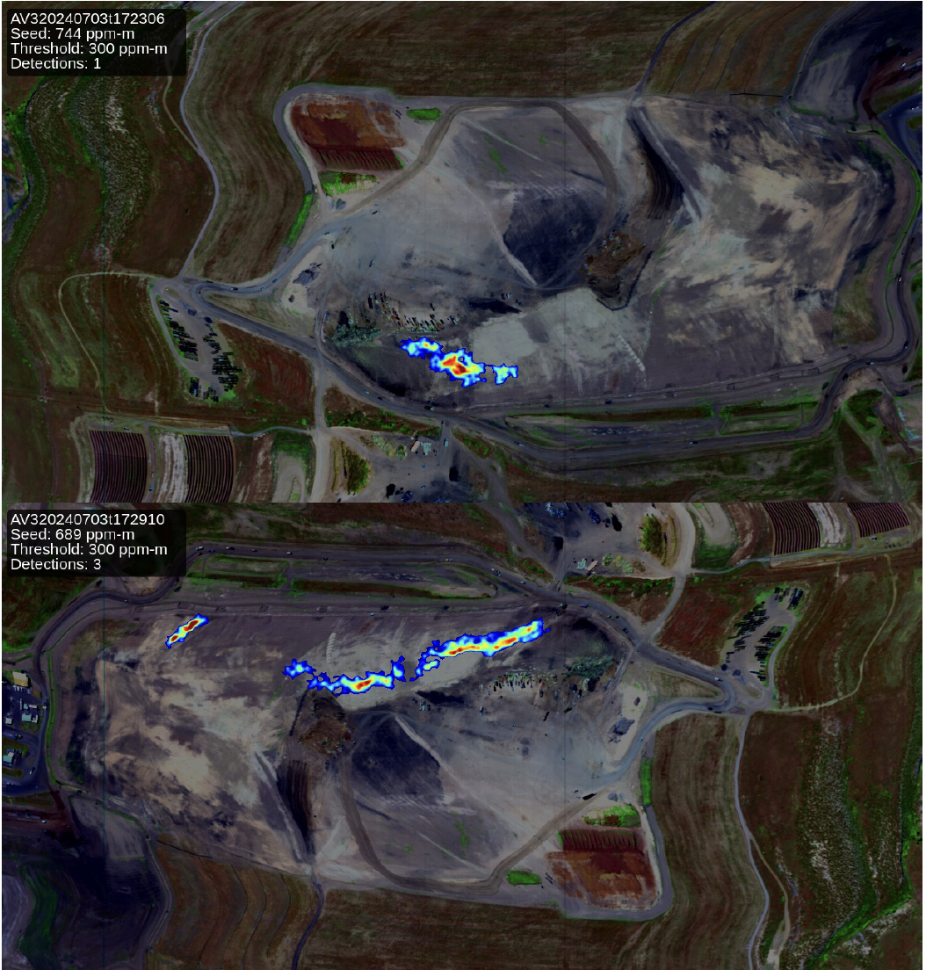

Enabling action through collaboration on airborne observations of ONG emissions (June-July 2024)
Example of observed plumes –NASA/AVIRIS
NOAA flight planning - AiRMAPS
NRT plume detections shared with state agency
For persistent plumes or those near populated areas, state inspectors dispatched or facility operators notified
Example: Tank venting remediated within a few days of notification

Slide 8


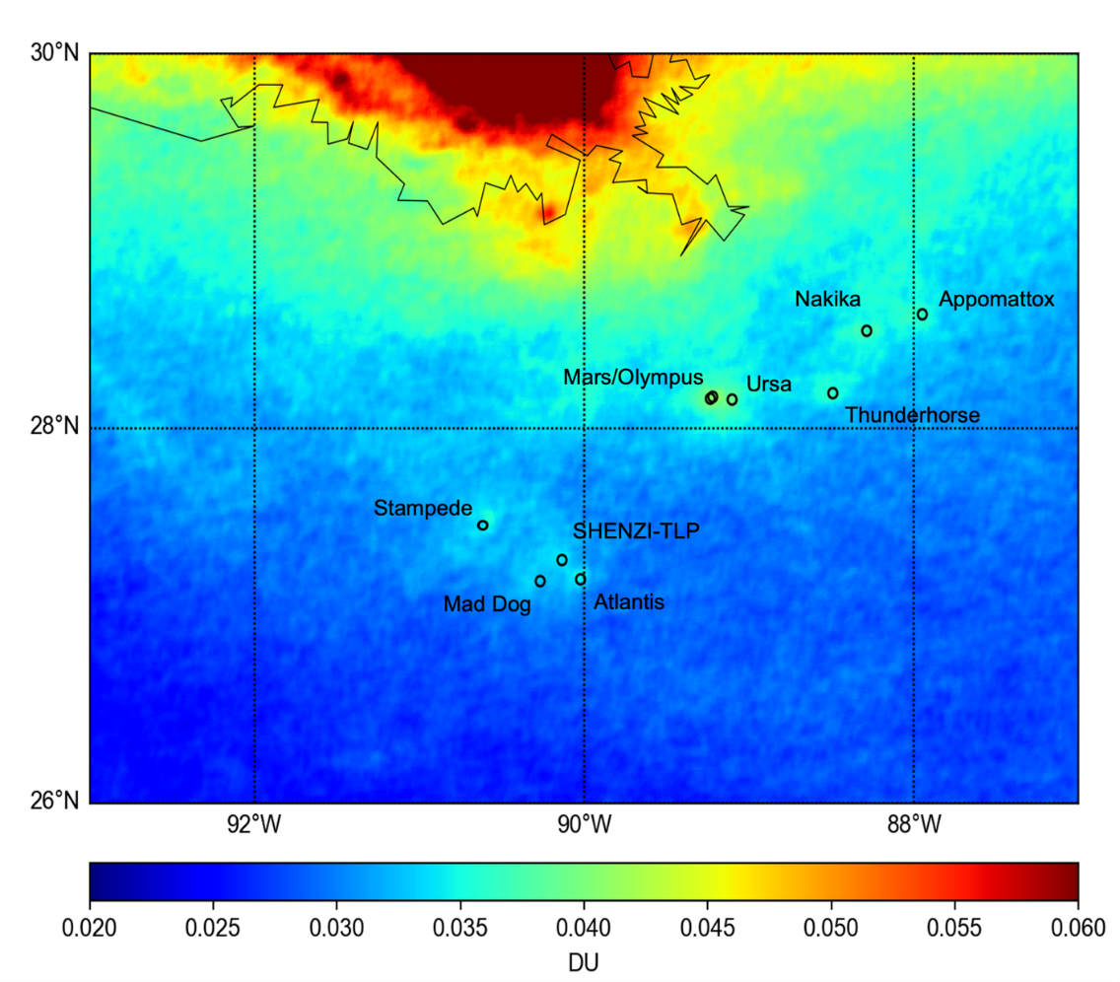
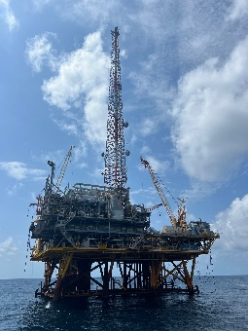
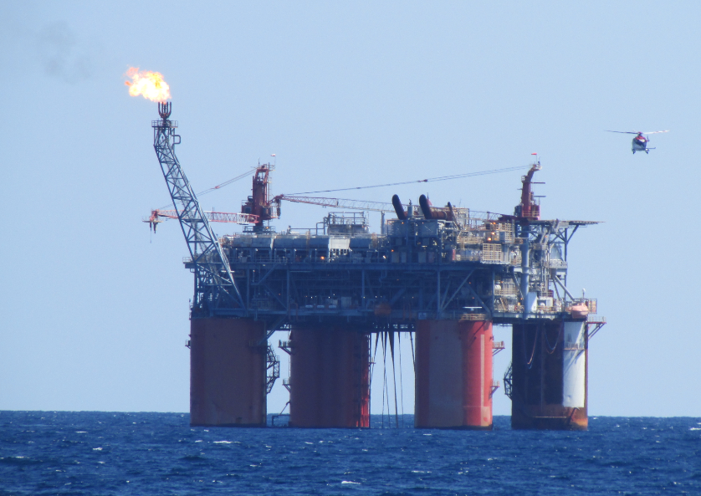
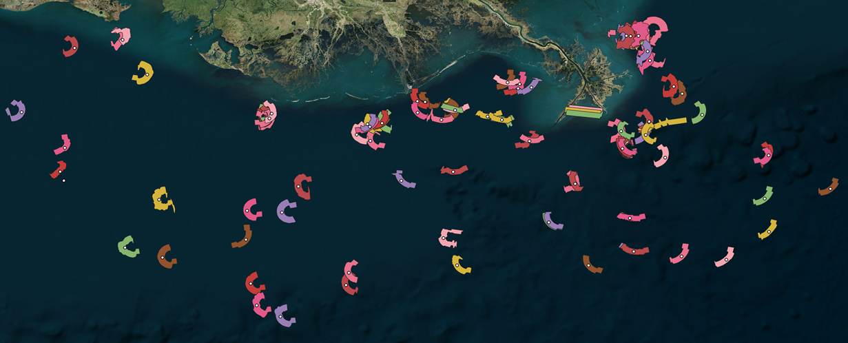
Measuring Gulf of Mexico Oil and Gas Emissions from Ship, Air, and Space
NASA Data: Measurements of air quality and greenhouse gases near Gulf of Mexico (GOM) oil and gas platforms with the Satellite Coastal and Oceanic Atmospheric Pollution Experiment (SCOAPE; May 2019) and SCOAPE-II (June 2024)
Who uses it? BOEM uses SCOAPE, NASA satellite data analysis to evaluate ~3-yearly GOM emissions inventory and identify platforms emitting the highest amounts of CH₄, NO₂. SCOAPE-II is coordinated with satellite measurements from TEMPO, OMI, TROPOMI (see image), GHGSat, and EnMAP. Each satellite team will use SCOAPE-II to evaluate their data accuracy and retrieval algorithms.
Impact: SCOAPE-II CH₄ measurements 4x above background in June 2024 triggered on-site inspections by the Bureau of Safety and Environmental Enforcement (BSEE). Improved GOM satellite measurements enable mitigation of fugitive emissions, monitoring of AQ from Space.
TROPOMI NO₂ hotspots (2018-2023)
AVIRIS-3 measurements (June 3, 7, 8, 9)
Credit: Ryan Stauffer, NASA

Slide 9
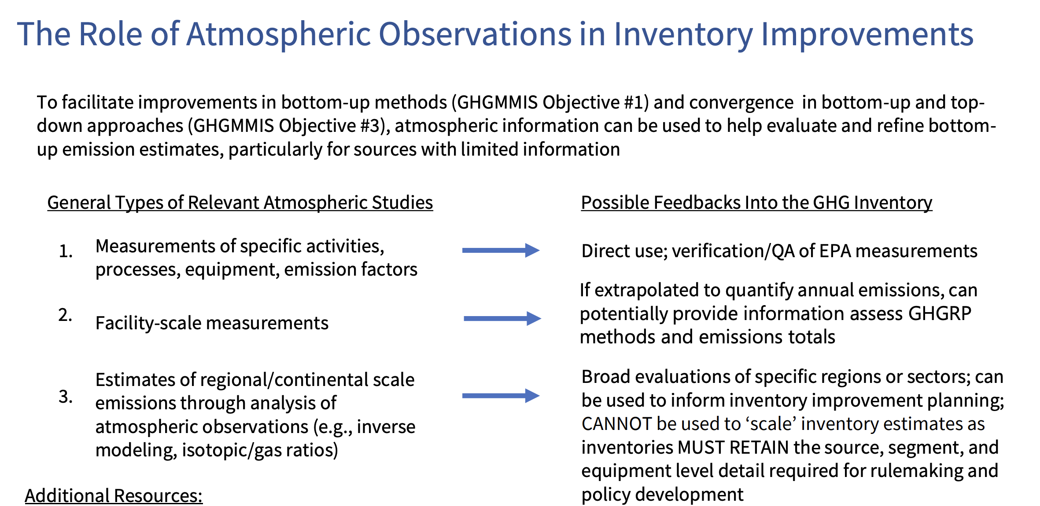
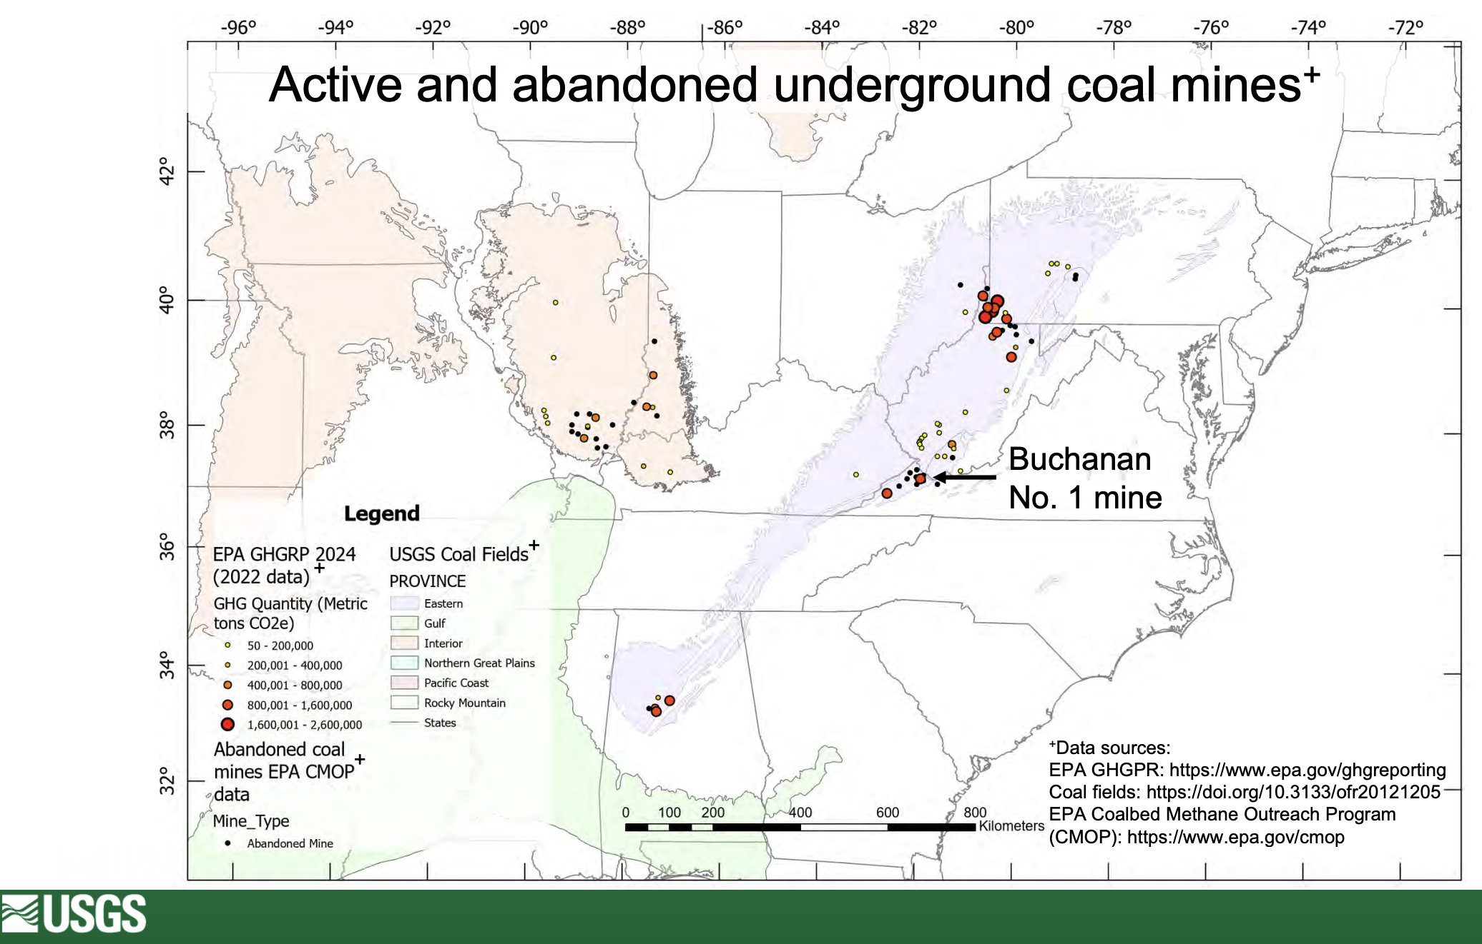
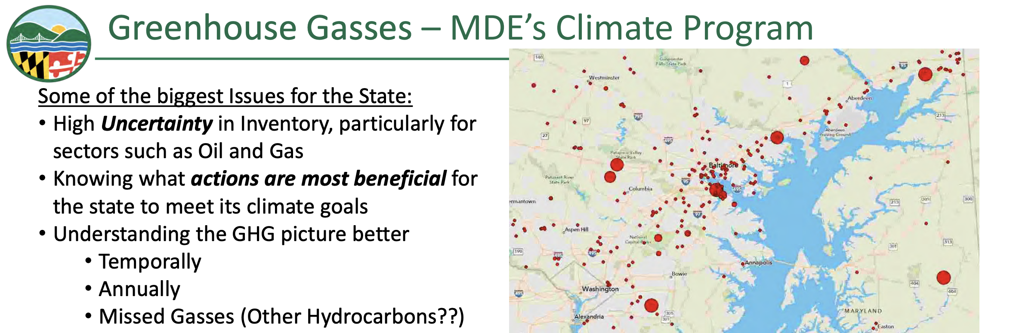
Stakeholder feedback motivates coordination of airborne measurements in summer 2025
Organized by GHG Center Airborne Coordination Working Group
Examples of stakeholder feedback from EPA, MDE, USGS
Will inform GHG Center coordination of observations in mid-Atlantic in spring, summer 2025
Credit: Erin McDuffie (EPA), Joel Dreessen (MDE), Peter Warwick (USGS)

Slide 10
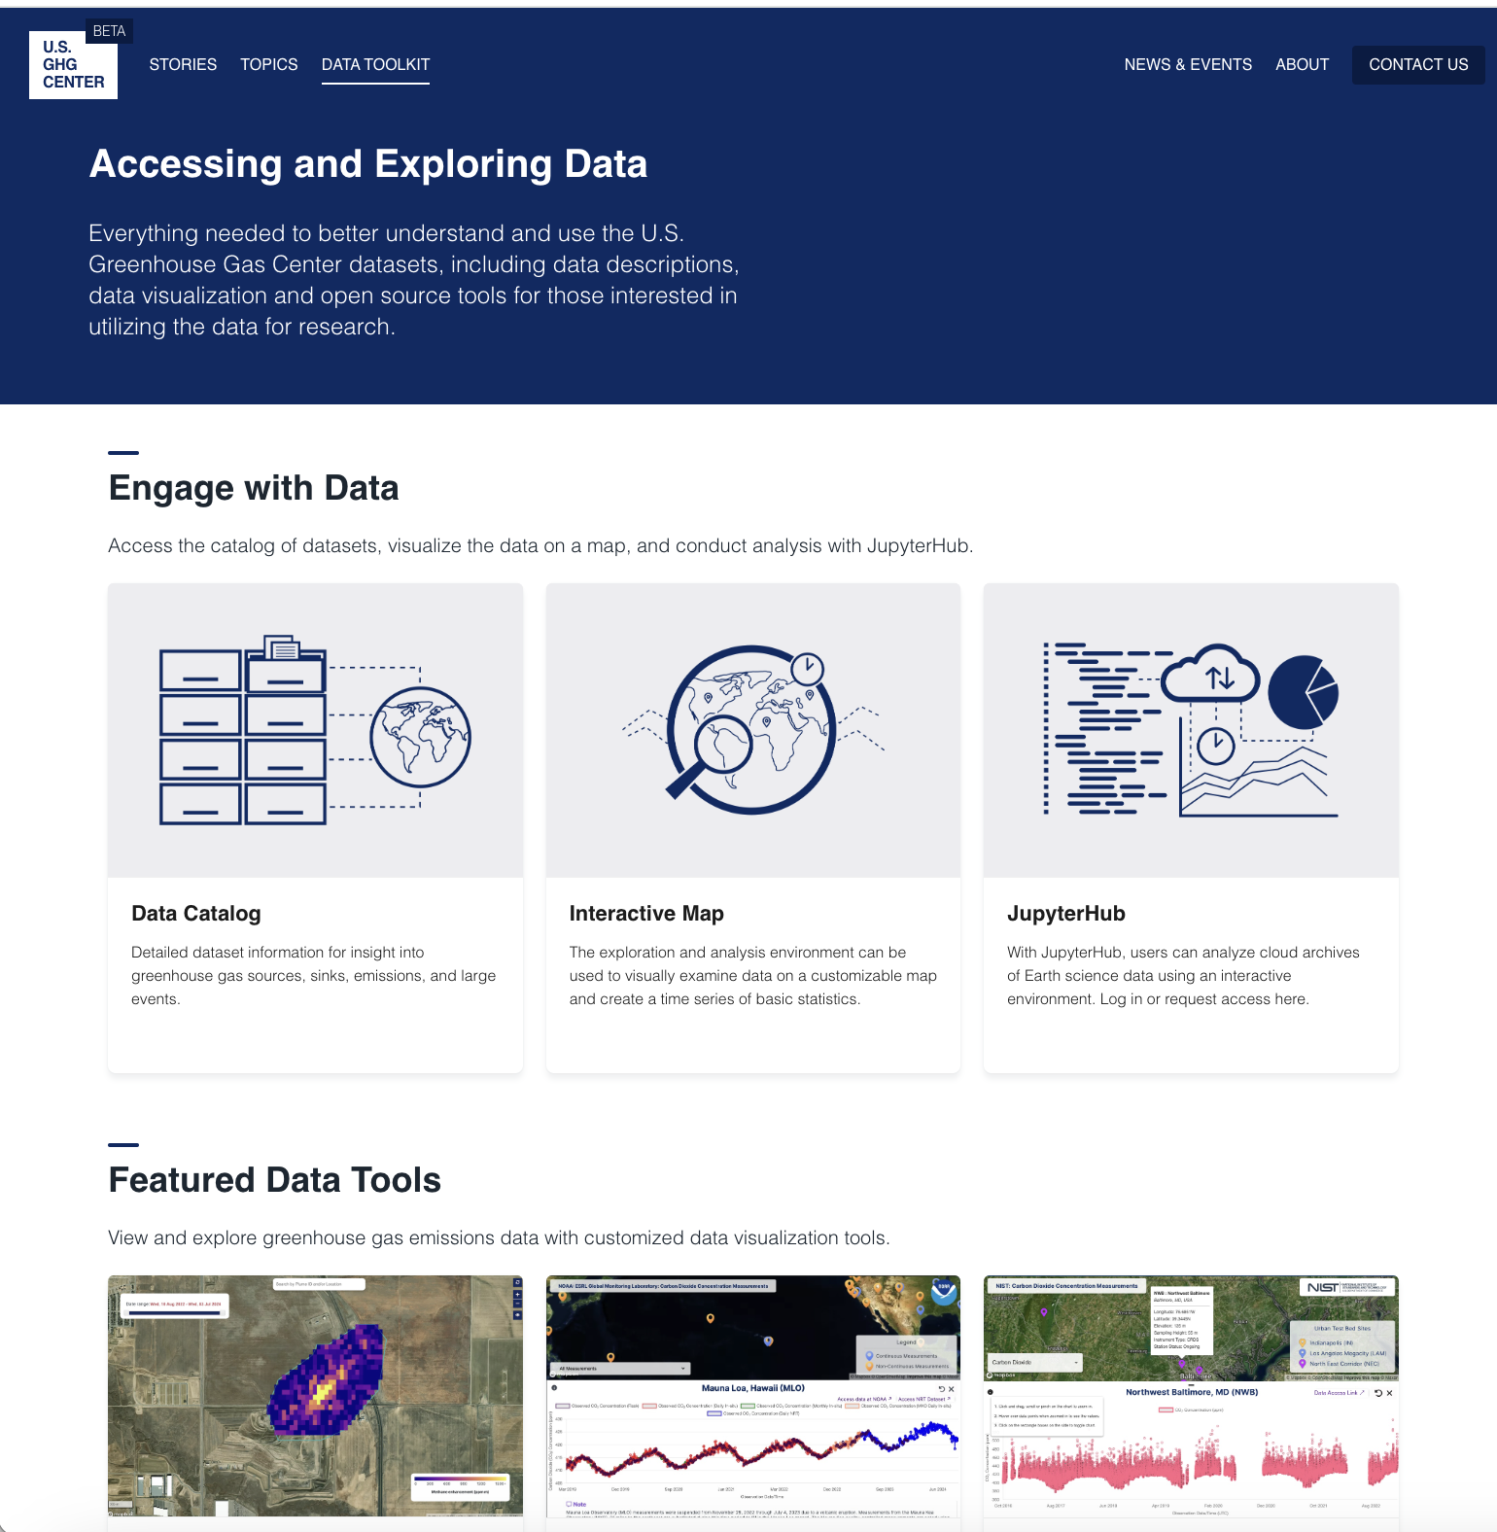

Growing data catalog and tools earth.gov/ghgcenter
Curated set of products and interactive tools
Website evolving into dual literacy platform with major update planned for May 2025

Slide 11
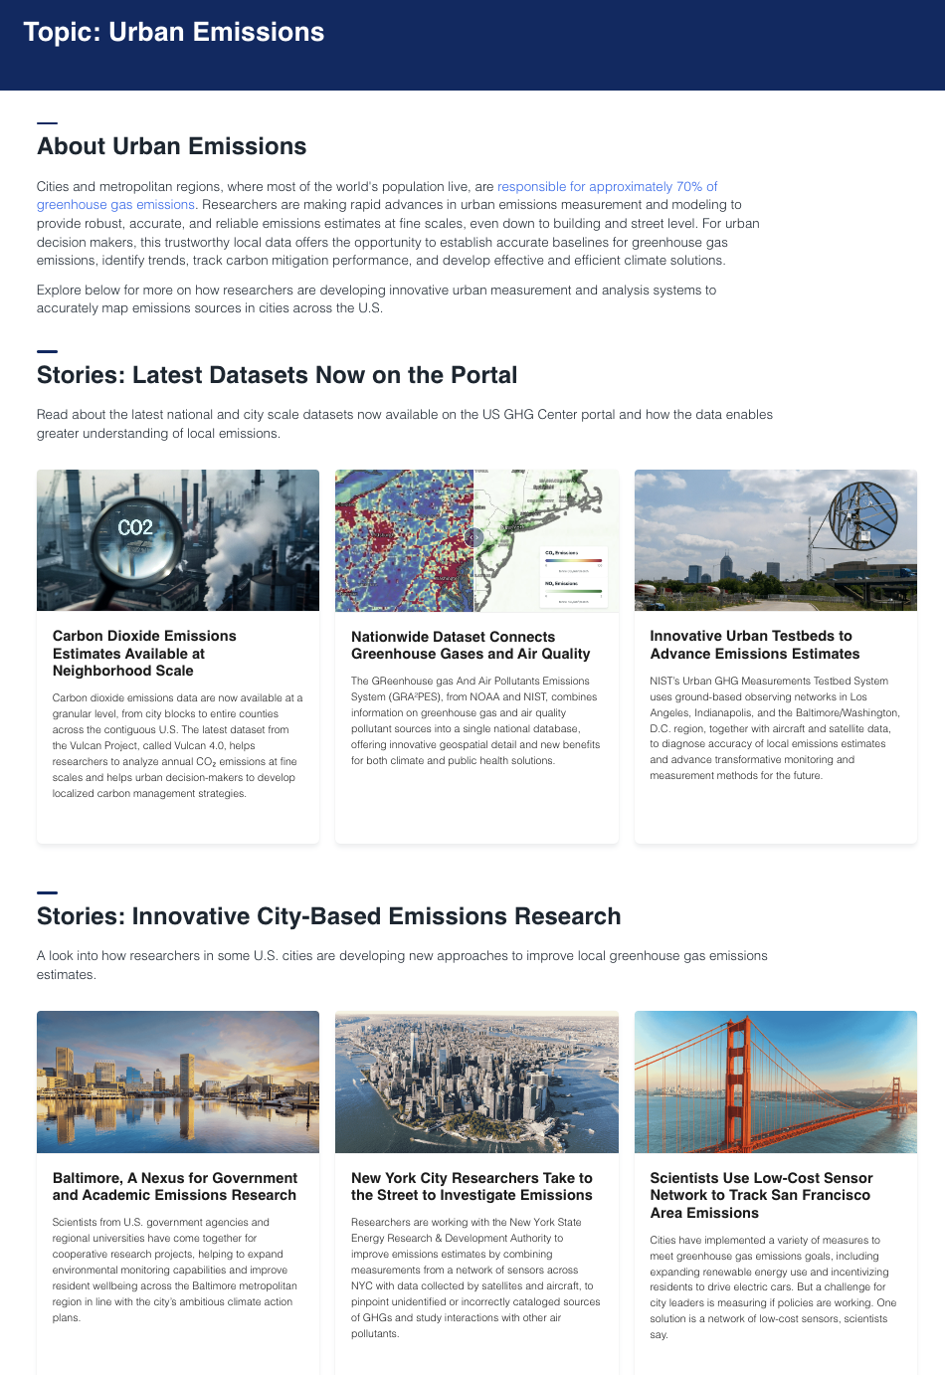
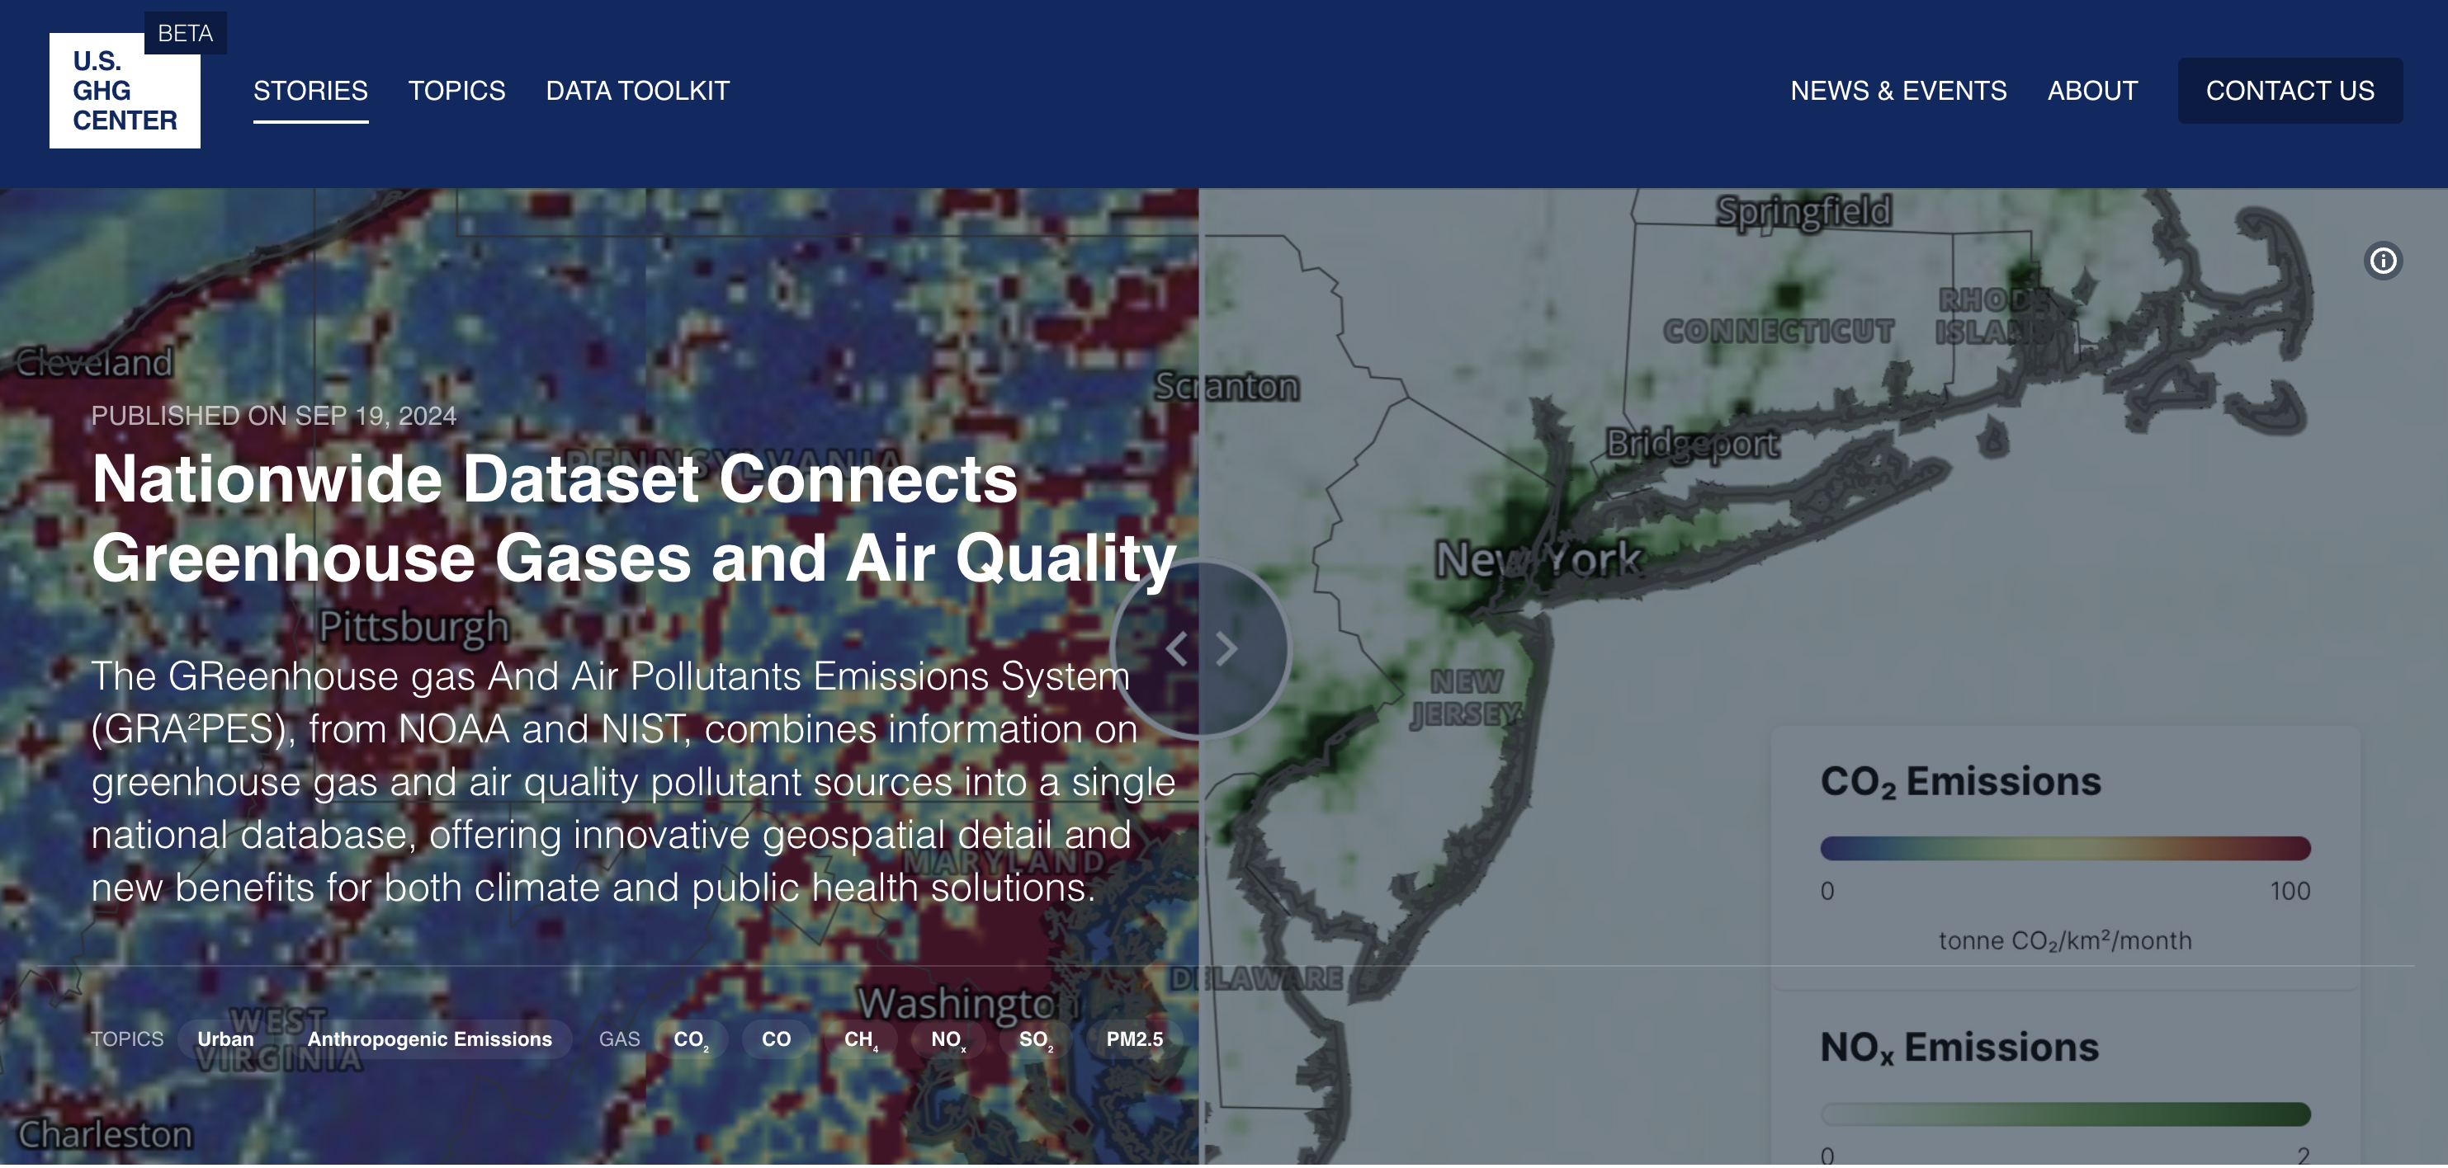
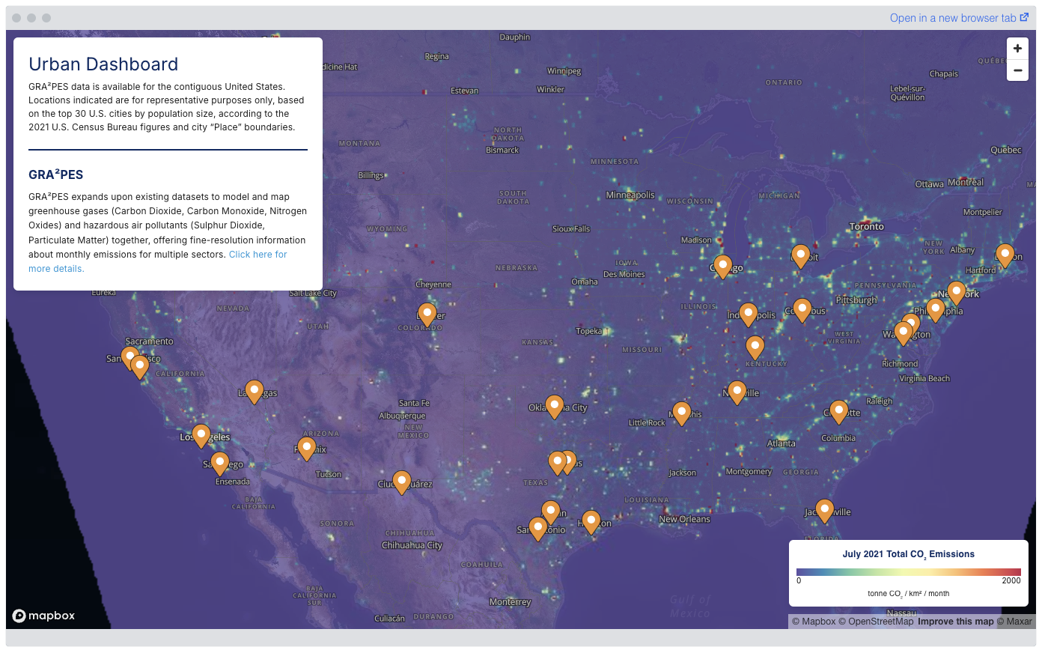
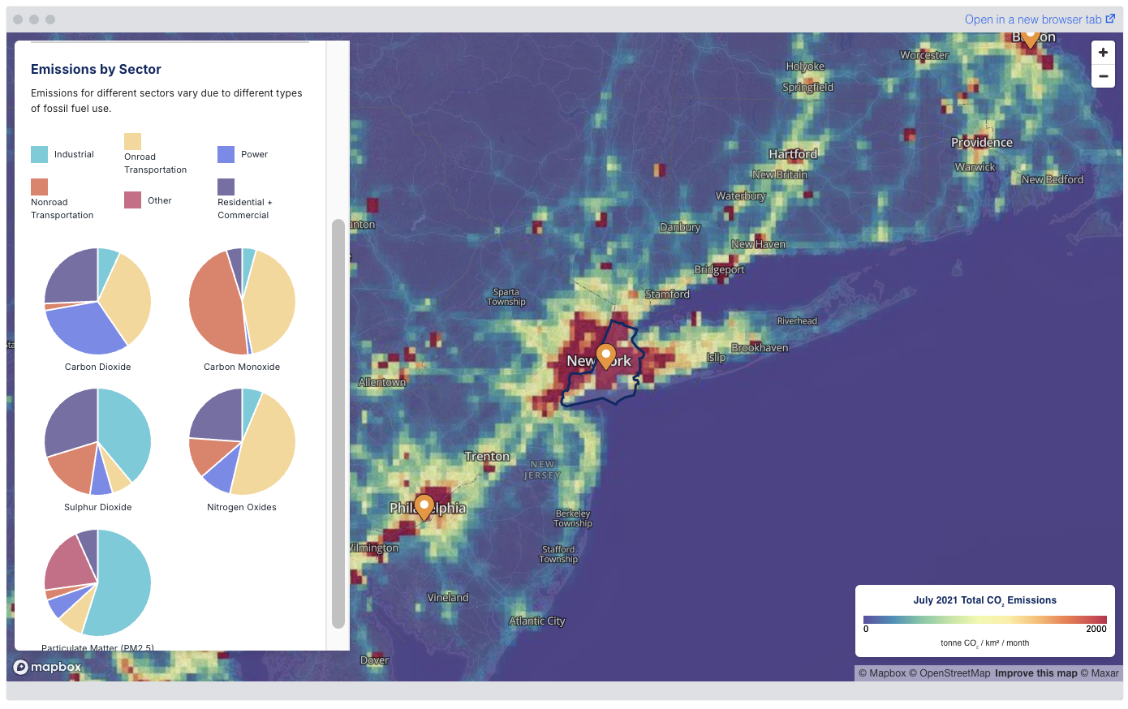
Dedicated urban GHG focus earth.gov/ghgcenter
Urban dashboard tool – AQ and GHG connections
Highlights urban-relevant datasets, relevance for planning and decision-making, and interactive tools

Slide 12


Urban data portal release, Climate Week NYC
9/24/24
Portal release accompanied by GHGs for Cities Climate Week event, including NOAA, NIST, NASA, OSTP, NY State, NYC, Washington D.C. participation
  Strong interest in GRAAPES data on portal, greater availability of combined air quality + GHG information
  Additional needs: emission factors, information on co-benefits of mitigation, future emission projections, coordination and data sharing, upscaling from building-level information
Additional feedback on data portal implementation to be gathered from engagement with cities and boundary organizations, including C40. Builds on analysis by GHG Center interns

Slide 13
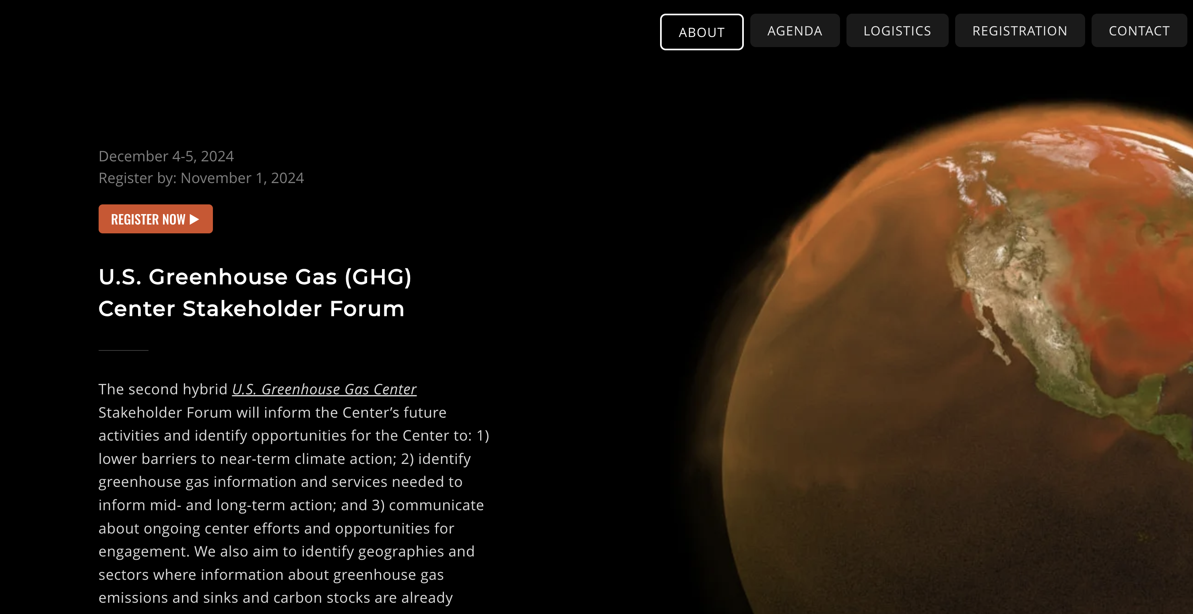
Upcoming GHG Center Stakeholder Forum
https://emg-wd.wixsite.com/us-ghg-2024

Slide 14
The U.S. Greenhouse Gas Center
earth.gov/ghgcenter
Thank you!
Lesley Ott
lesley.ott@nasa.gov
Notes:
Background Image:
NASA's Scientific Visualization Studioz: https://svs.gsfc.nasa.gov/5110
Atmospheric Carbon Dioxide
This visualization is based on the following papers:Weir, B., Ott, L. E., Collatz, G. J., Kawa, S. R., Poulter, B., Chatterjee, A., Oda, T., and Pawson, S.: Bias-correcting carbon fluxes derived from land-surface satellite data for retrospective and near-real-time assimilation systems, Atmos. Chem. Phys., 21, 9609–9628, https://doi.org/10.5194/acp-21-9609-2021, 2021.

