Slide 1
Discussion: Retrieval Intercomparison Project
Chris O’Dell (CSU),
Dave Crisp (Spectra LLC),
John Worden (JPL)

Slide 2
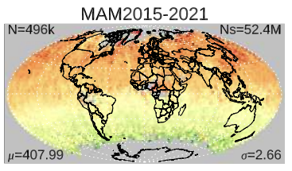
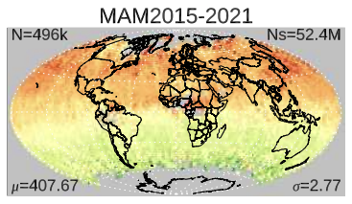
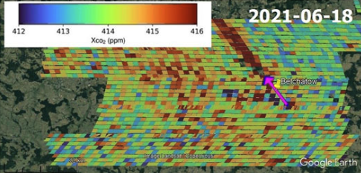
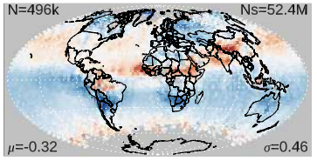
XCO₂ : Two Major Applications
The Original Goal:
Regional-to-Global Scale Fluxes
The Hot New Goal:
Local/Urban Scale sources
Applications:
Regional biospheric fluxes
Country-level emissions
Ocean fluxes
Changes in these fluxes over time.
Needs:
Absolute XCO2 accuracy
Ocean as well as Land observations.
Applications:
Power Plant FF Emissions
City-scale FF Emissions
Needs:
Relative XCO2 accuracy (difference w.r.t background)
Ocean data not needed.
Many systematic biases cancel out
Wind information often dominates flux uncertainty
Mean XCO2, MAM, 2015-2021
XCO2 plume from Bełchatόw Power Plant, seen by OCO-3
Mean of 6 Models
OCO-2 v11
417 ppm
XCO2
396 ppm
+2 ppm
$Δ$XCO2
-2 ppm

Slide 3
The XCO₂ Goal for Regional-to-Global Fluxes
We have a goal (my own interpretation):
To deduce accurate, science- and policy-relevant surface fluxes of CO2 at nation-state (or better) & monthly scales using top-down inversion systems driven by in-situ and satellite CO2 data.
To achieve this goal, we require:
Extremely well-calibrated reflected sunlight spectra
Highly accurate retrieved XCO2 from those spectra
Robust top-down carbon source/sink inversion systems (with accurate transport and well-specified priors)
OCO-2 Has Largely Achieved this!
Gold standard for future sensors!
< 0.5 ppm (0.12%)
(CO2M MRD)
< 0.2 ppm (0.05%)
(MicroCarb Target;
Common Opinion)
Notes:
Relevant to this audience - 0.2ppm is the MicroCarb target (the goal is 0.1 ppm)

Slide 4
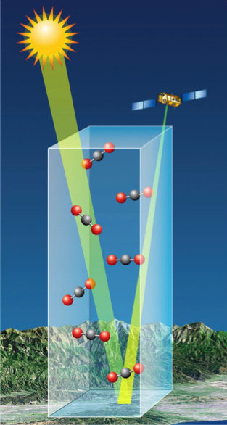
How do current XCO2 retrievals work?
Solar Induced Fluorescence (SIF),
O₂, Clouds, Aerosol
$$X_{CO2}= \frac{Column {CO}_{2}}{Column Dry Air}$$
$$Column Dry Air ≈ \frac{1}{M_{dry}}\left(\frac{P_{s}}{g}−TCWV\right)$$
CO₂, H₂O, Clouds, Aerosol
We require good spectroscopy & meteorology to model the column gas absorption:
$$I\left(λ\right)={\frac{F_{sun}\left(λ\right)A\left(λ\right)μ_{0}}{π}e}^{−m τ_{gas}\left(λ\right)}$$
Aerosols & clouds modify the light path, thereby affecting the apparent columns of dry air & CO2.
CO₂, H₂O, Clouds, Aerosol

Slide 5
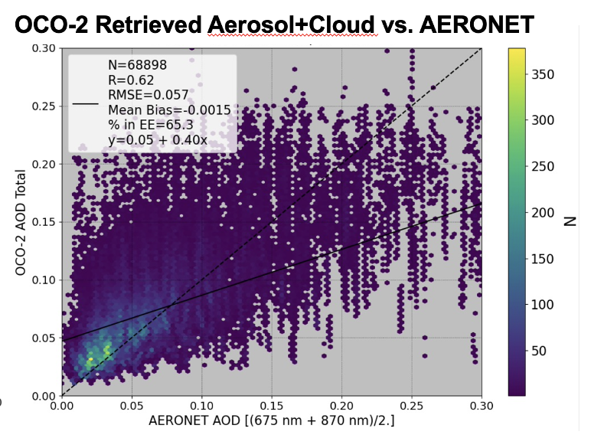
The fly in the ointment: Aerosols & Clouds
We screen out most aerosol & cloud cases with our pre-screeners (~70%)
We screen out scenes with minor aerosol & cloud contamination with post—screeners (~15%)
The remaining “good quality” retrievals still have some aerosol & cloud contamination.
These lead to lots of open questions about the reliability of XCO2 from space.
2016
2023
Source of Bias | OCO2 Land Errors [ppm] | GeoCarb Land errors [ppm] | OCO2 Ocean errors [ppm]
Instrument Calibration | 0.38 | 0.15 | 0.14
Spectroscopy | 0.23 | 0.53 | 0.05
Meteorology |  | 0.33
Aerosols | 0.55 | 0.66 | 0.50
Theoretical Total | 0.71 | 0.92 | 0.52
OCO-2 measured total | 0.8 | 0.8 | 0.6
Actual OCO-retrieved AODs are not great
Aerosols are the single largest source of systematic error in SWIR-based XCO2

Slide 6
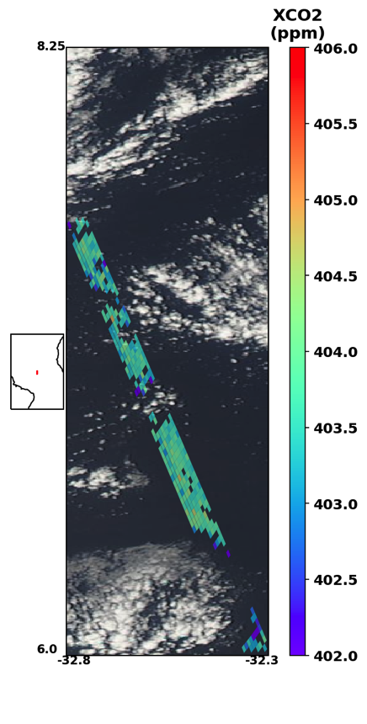
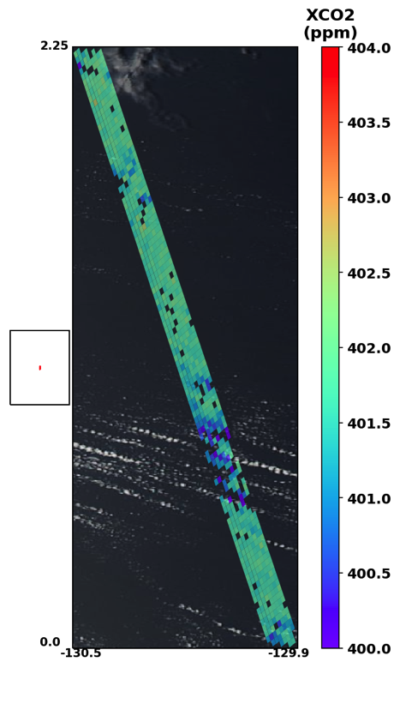
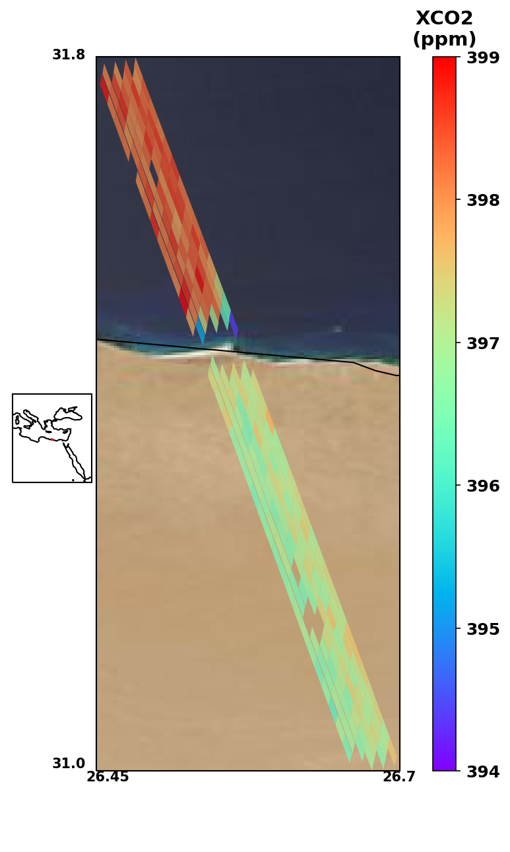
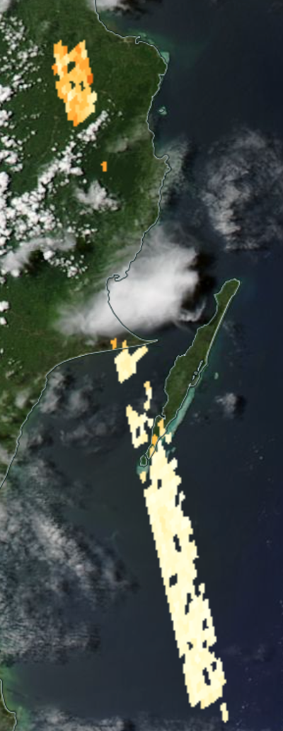
Early indicators of aerosol/cloud biases
Cloud-induced biases over water
Aerosol-induced land/water biases

Slide 7
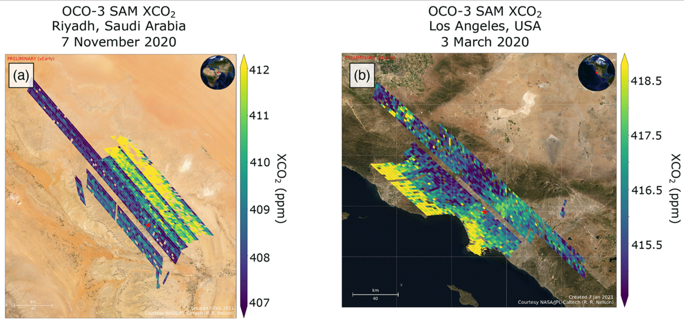
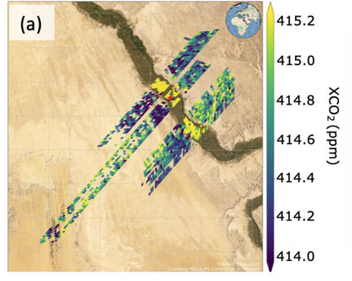
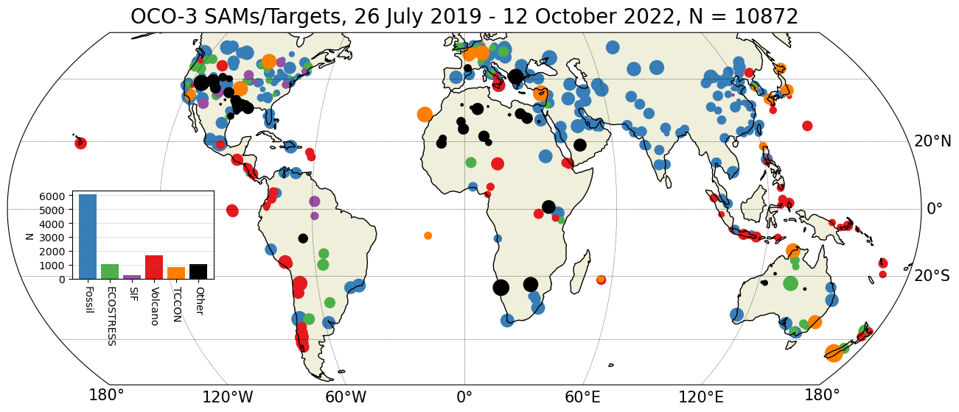
Geometry-correlated biases in early OCO3 SAMs
OCO-3 SAM XCO₂
Sohag, Egypt
31 January 2021

Slide 8
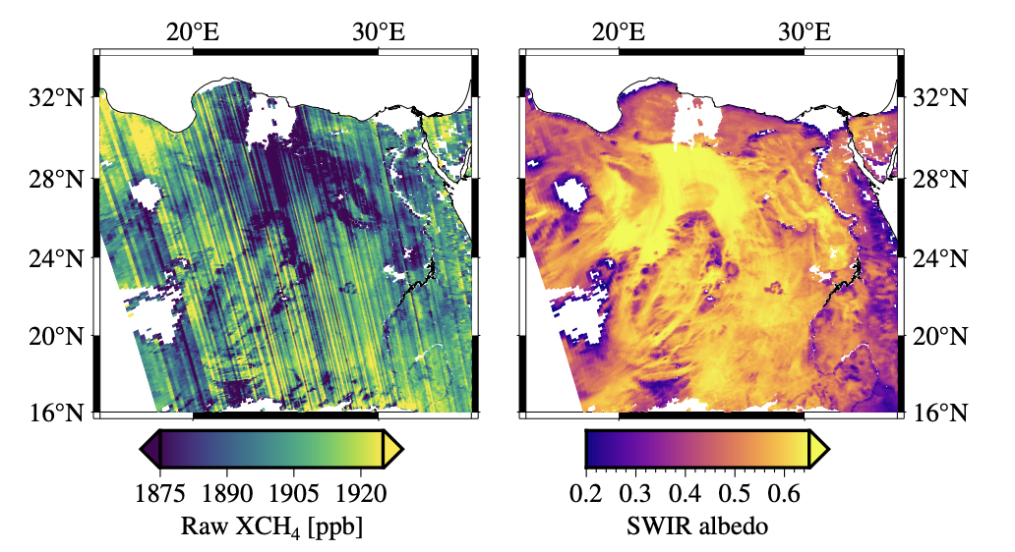
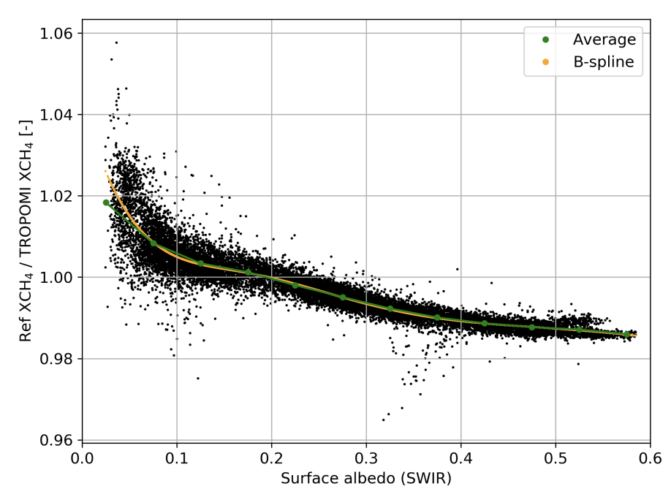
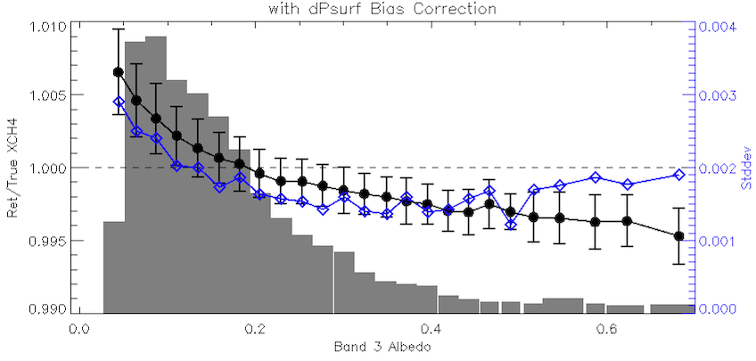
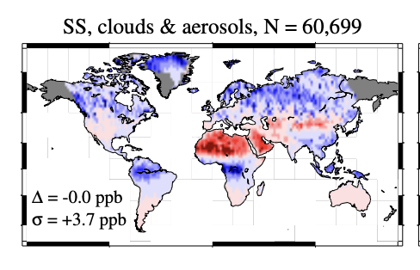
An Aside: Aerosol-Induced Biases in TROPOMI CH₄
Synthetic Retrieval Experiments
Full-physics Retrievals
Lorente et al., AMT 2021
TROPOMI Raw XCH₄ (no bias correction) and SWIR Albedo for TROPOMI orbit 27865, data version 2.4.0.
Simulated Aerosol-induced XCH₄ errors from 2.3 micron obs.
Well-known “albedo-bias” in TROPOMI CH4 retrievals
This bias emerges naturally in sim-retrieval experiments!
Source primarily related to surface albedo/aerosol interaction.
Somkuti et al, 2024, submitted to AMT:
“Surface reflectance biases in XCH₄ retrievals from the 2.3 µm band are enhanced in the presence of aerosols”
Notes:
remind everyone that both the sign and amplitude of the aerosol bias depends on surface albedo.

Slide 9
Pick your Poison: The Choice of Aerosol Scheme
X_{CO2} Retrieval | Satellite(s) applied to | Aerosol Scheme | # of aer params | Reference
ACOS | GOSAT, OCO-2, OCO-3 | 5 fixed types, AODs+heights | 9 | O’Dell et al., 2018
UoL-FP | GOSAT, OCO-2, CO2M | 2 Aerosols + Cirrus: full profiles | 60 | Cogan et al., 2012
RemoTeC | GOSAT, OCO-2, CO2M | 1 variable type: AOD, Height, Size | 3 | Butz et al., 2011
NIES | GOSAT, GOSAT-2, GOSAT-GW | 2 Aerosols: profiles; Cirrus: AOD+Height | 14 | Yoshida et al., 2013; Someya et al., 2023
4ARCTIC | OCO-2, MicroCarb | 1 variable type: AOD, ALH, Angstrom Exponent | 3 | Bertaux et al., 2020
FOCAL | OCO-2, GOSAT, CO2M | 1 type: AOD, Height, Angstrom Exponent | 3 | Reuter et al. (2017), Noel et al. (2021)
There are many schemes to account for aerosols in “Full Physics” retrievals
They have generally not been well-studied in terms of aerosol efficacy, because there are so many confounding factors in real data! (Prior Met, DEM, Spectroscopy, Filtering, Bias Correction, etc.)
Which is best? Let’s do a "Full-Physics Aerosol Scheme Intercomparison Project”
Notes:
Modify with Rob’s latest Figure?

Slide 10
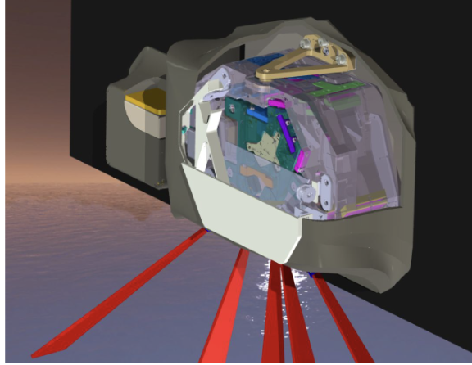
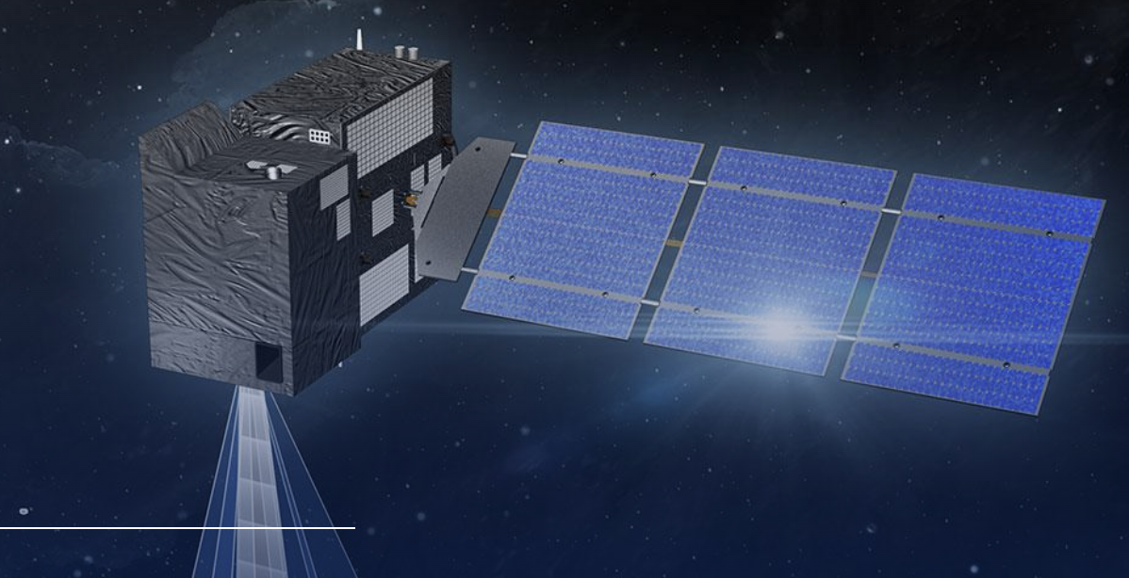
The alternative: The CO2M Plan for Aerosols
SpexONE Multi-Angle Polarimeter on PACE. Multiple dual-pol channels measure at multiple angles to derive a wealth of aerosol information.
CO2M will consist of:
GHG+NO2 GHG sensor
Multi-Angle Polarimeter (MAP)
Cloud Imager (CLIM)
Must include a very advanced aerosol sensor with your GHG sensor!
Will it work well in practice?
Many (most) GHG satellite missions will lack this.
Simulated CO2M retrievals without and with a coincident multi-angle aerosol polarimeter. (a) Standard 3-parameter RemoTeC retrieval without MAP. (b) New RemoTAP retrieval with MAP. From Lu et al. (2022, AMT).

Slide 11
Motivations for a retrieval intercomparison
Previous studies have evaluated the errors in different retrievals, e.g. CH4 and CO2 from GOSAT.
GHG-CCI, EMMA (M. Reuter) papers, etc.
Only limited attempts to *understand* the differences in different retrieval approaches.
Retrieval inputs are relatively solid and robust:
Solar spectrum, spectroscopy [, calibration]
Some retrieval aspects are not as robust:
Aerosol / scattering parameterization
RT assumptions
Some new retrievals can skip ingredients altogether & just use machine learning methods (e.g. Reuter et al., 2024).

Slide 12
Intercomparison Goals
Learn the most with the least effort! This will be tricky to balance.
Types of retrievals that work the best, and in which situations?
CO2 vs. CH4
High latitudes, tropics
Water surfaces vs. forests vs. deserts vs. snow/ice surfaces
Air quality: clean vs. polluted environments
Full Physics vs. Proxy vs. Matched Filter vs. Machine-Learning
MAP vs No-MAP ?
Post-retrieval filtering?
Post-retrieval bias correction?

Slide 13
These issues may affect many missions!

Slide 14
Intercomparison Discussion questions
Target measurements: CO2, CH4 ? Include plume studies?
Simulation-based or real-data based?
Simulations: truth is known, everything is highly controlled.
Real data: includes all un-included and unknown error sources.
For simulations or real data, testing database?
Want high realism: aerosols, clouds, surfaces, gas profiles, surfaces.
For simulations, create a new one, or use an existing one?
For which sensor / type of sensor?
Just hyperspectral NIR+SWIR? Include aerosol sensor?
Retrieval types? Full-physics, proxy, ML?
How deal with filtering & bias correction?

Slide 15
Discussion Notes

Slide 16
Back-up Slides

Slide 17
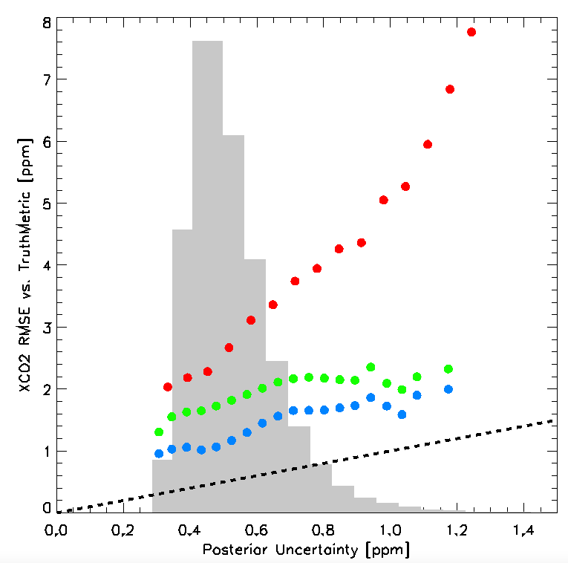
Filtering & Bias Correction is very important!
OCO2 v11 Single Sounding XCO2 errors vs. TCCON (ggg2014)
Raw: RMSE=2.83 ppm
Filtered (70% Good):
RMSE=1.75 ppm
XCO2 Actual Error , RMS [ppm]
Filtered + Bias Corrected:
RMSE=1.18 ppm
XCO2 Posterior Uncertainty [ppm]

Slide 18
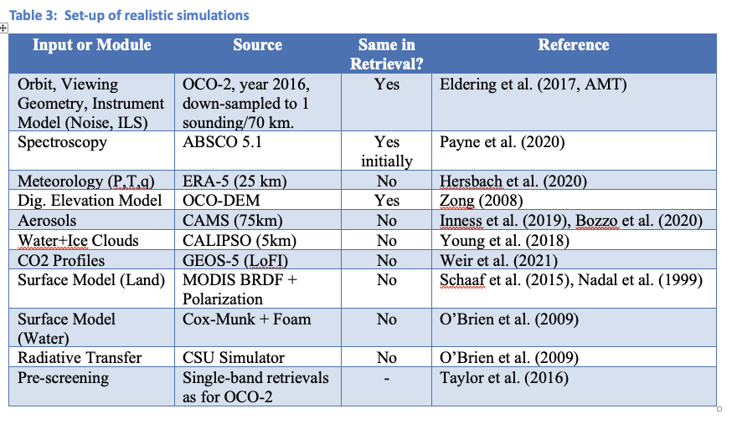
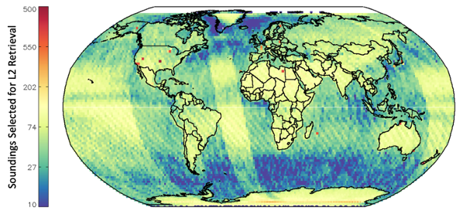
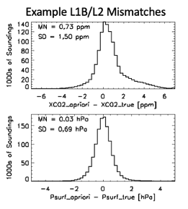
One possibility: Proposed CSU Simulations
Already doing for another project
Top: Location of real OCO-2 soundings, after pre-screening in 2016 in our synthetic dataset. There are ~ 1.2M total soundings, and 600,000 soundings selected for X_{CO2} retrieval.
Left: Mismatches in XCO2 and Surface Pressure between the simulations (truth) and the retrievals (prior).
Will (likely) not include:
3D RT Effects
Subscene Effects (i.e., partial clouds)
Realistic in-band spectral variability?

