Slide 1
Best Practices for Reporting Satellite Based Facility Scale Emissions
J Worden (JPL)
Paul Green (NPL)
Annmarie Eldering (NIST)
Evan Sherwin (LBL)
Adam Brandt (Stanford)
GHG TT & other contributors
Agenda item #2.2
SIT TW 2024, Sydney, Australia
18th - 19th September 2024

Slide 2
Background
The Global Stocktake (GST) is a comprehensive assessment of the world’s progress on climate action. Anchored in Article 14﻿ of the Paris Agreement, it is intended to inform Parties to the Agreement on their progress against its goals, including but not limited to limiting global temperature rise to 1.5°C.
Drastically reduce greenhouse gas emissions to keep global temperature rise below 2°C and ideally 1.5°C (Article 2.1.a)
The Global Methane Pledge (GMP) was launched at COP26 by the European Union and the United States.
Now Composed of 152 countries it aims to reduce methane emissions by 30% between 2020 and 2030: methane is a much stronger GHG (per 20 years) than CO2 but may also be easier to reduce as well known remediation efforts can be applied to managed sources such as landfills and fossil emissions

Slide 3
From the IPCC: atmospheric measurements can now be used to inform inventories
“… comparisons with atmospheric measurements are not established as a standard tool for verification to be applied by an inventory compiler. Still, considerable scientific progress in this area needs to be noted and inventory compilers may wish to take advantage of the potential of this approach, as it gives independent data for verification.”
IPCC Expert Meeting on Use of Atmospheric Observation Data in Emission Inventories

Slide 4
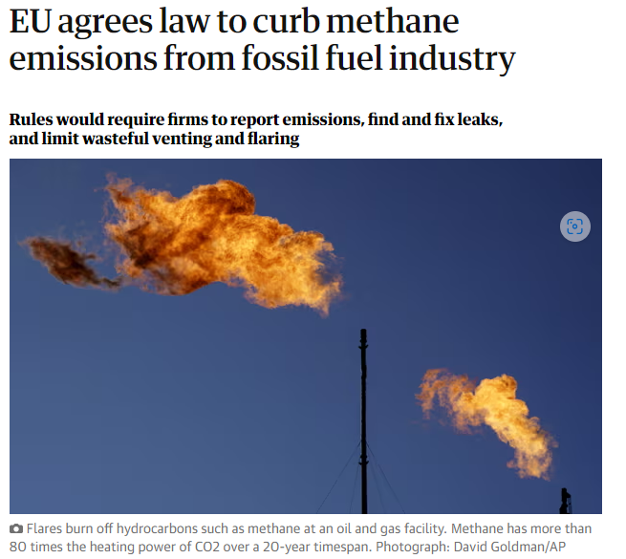
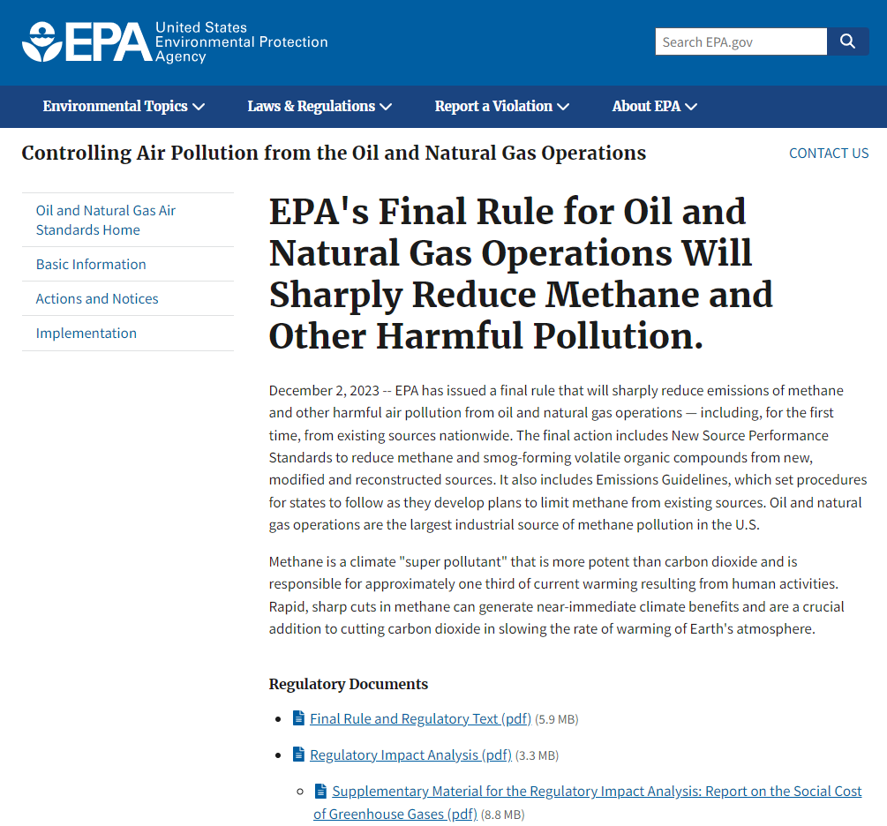
New rules on Energy sector
https://www.epa.gov/controlling-air-pollution-oil-and-natural-gas-operations/epas-final-rule-oil-and-natural-gas
https://oeil.secure.europarl.europa.eu/oeil/popups/ficheprocedure.do?reference=2021/0423(COD)&l=en

Slide 5

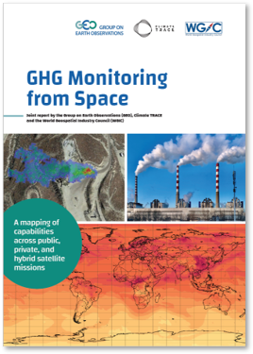
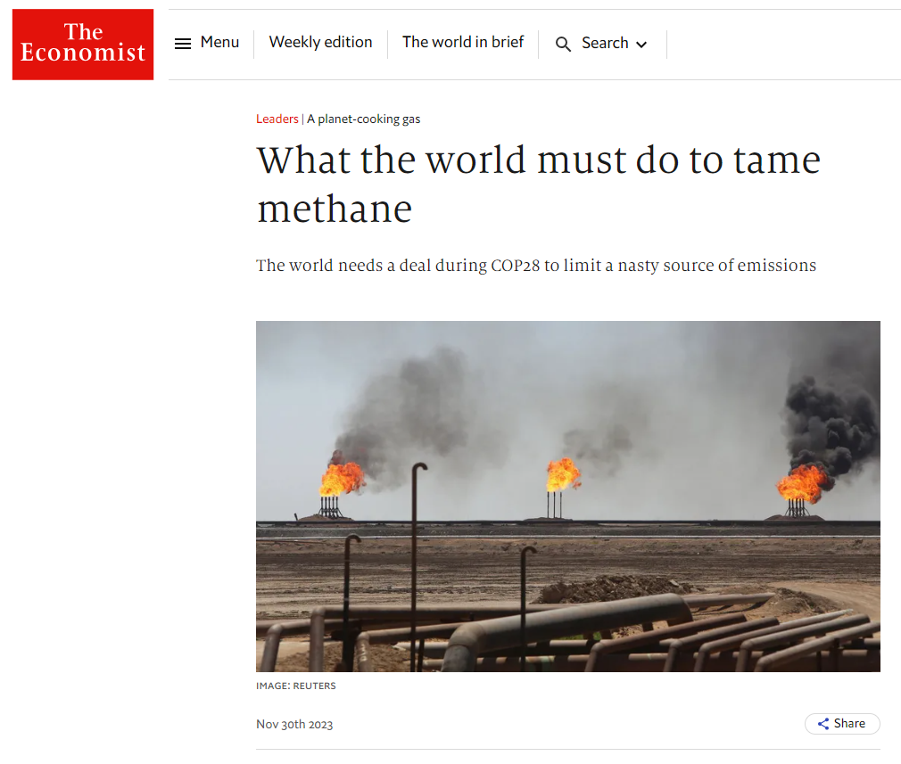
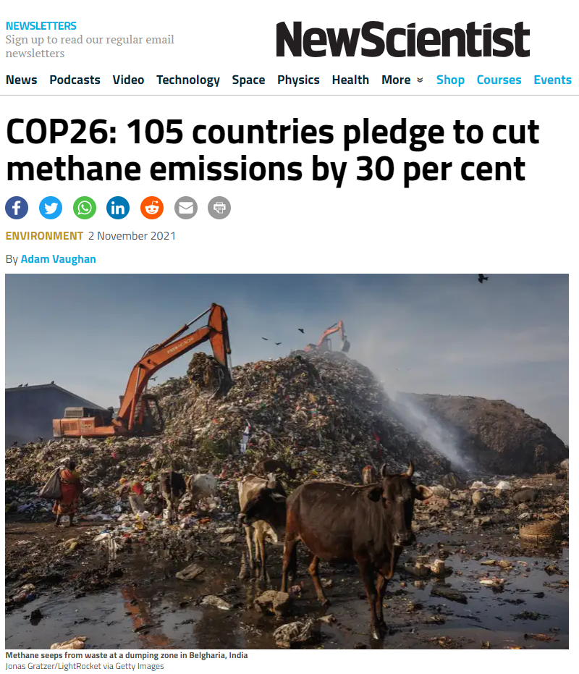

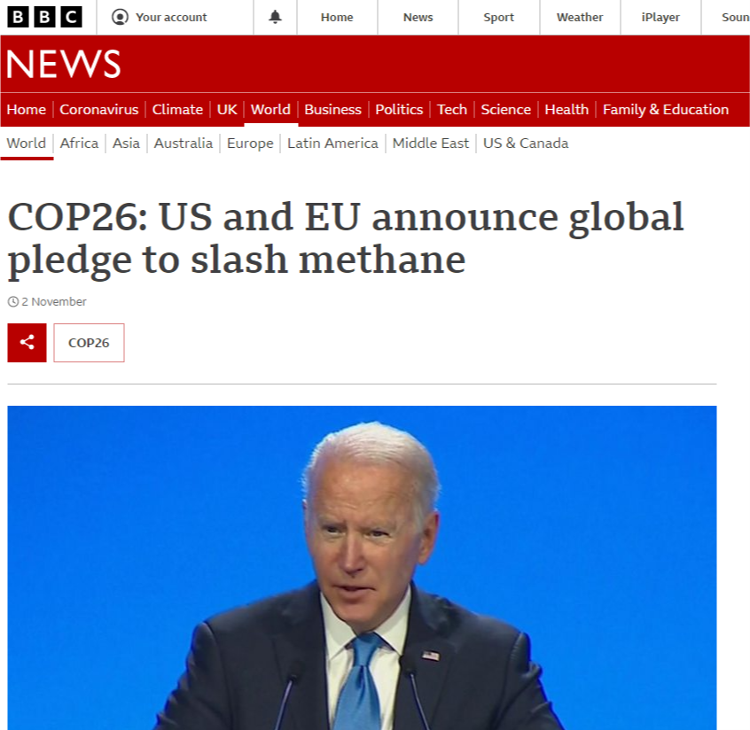

Corporate emissions and climate risk reporting
TCFD
Compulsory emissions & climate risk reporting for listed companies in US and UK, together with voluntary schemes to maintain market competitiveness aligned with customer climate expectations

Slide 6
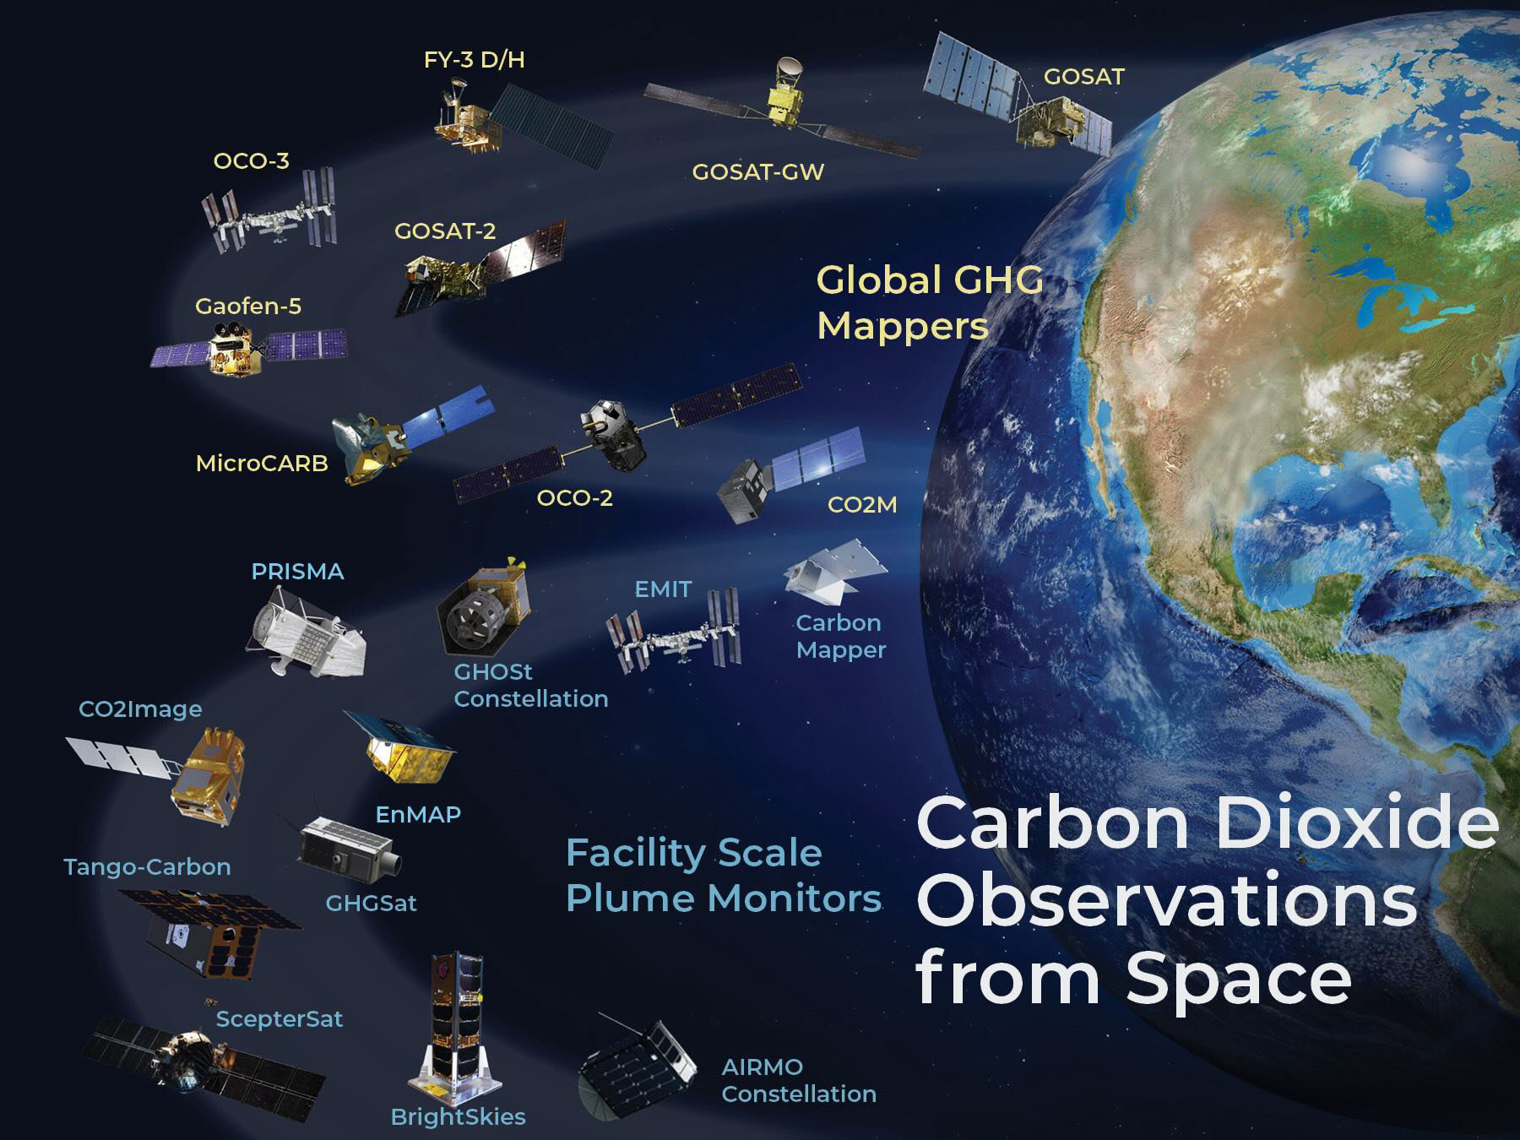
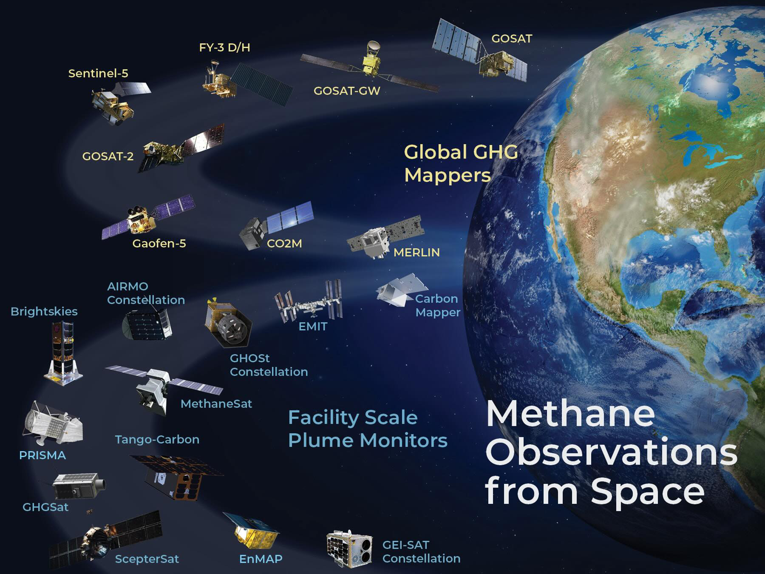
Growing constellation of observations are observing GHG concentrations from the global to the facility scale
These observations are now being used to derive methane emission (flux) estimates on a range of spatial and temporal scales for science and decision making

Slide 7
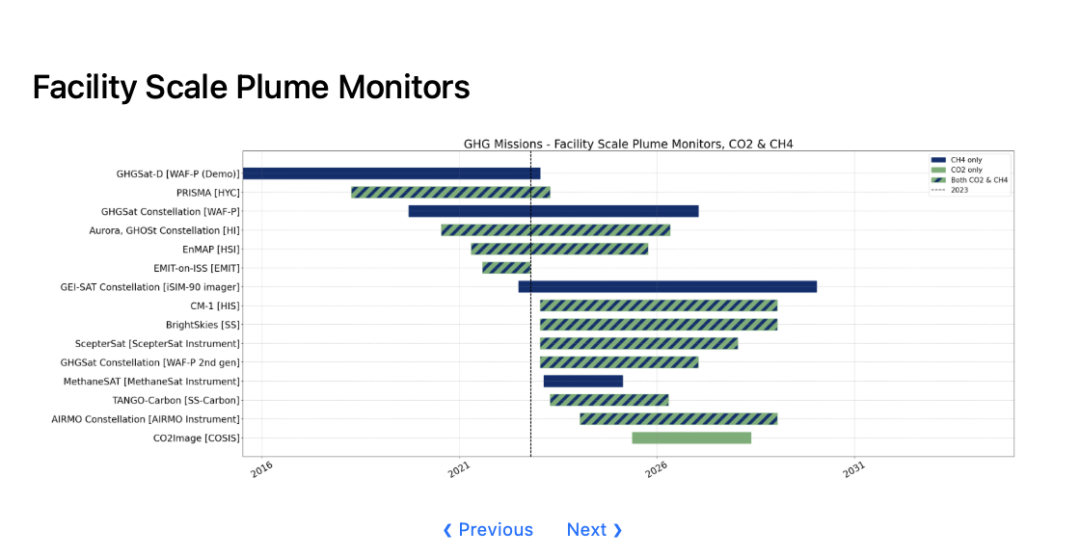
Growing Fleet of Missions are Measuring Emissions
at the Facility Scale
10 of these 15 missions are from New Space
(for profit or funded by philanthropy)
Intellectual Property concerns play a role in transparency of data provenance and processing from New Space Observations
We need to define common practices for generating, validating, and reporting data, as well as a quality assessment framework, so that 1) emerging companies that report methane emissions know what the community expects before their data is considered reliable and 2) potential users of these data can assess if the provided data is fit for purpose.

Slide 8
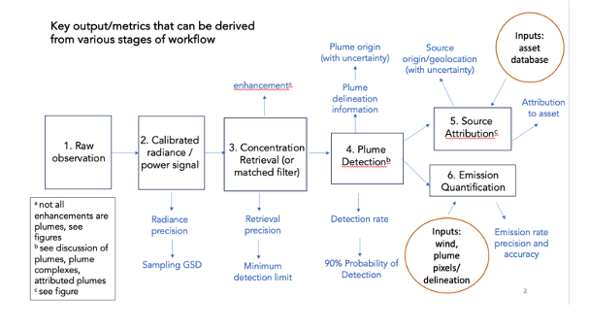
Workflow Common Practise
At a high level, all practitioners use the same sequence of steps in their workflows
The details of implementation vary, increasingly later in the process (from concentration/enhancement to emissions estimates)
Later plume detection, delineation and emission quantification steps require a human in the loop

Slide 9
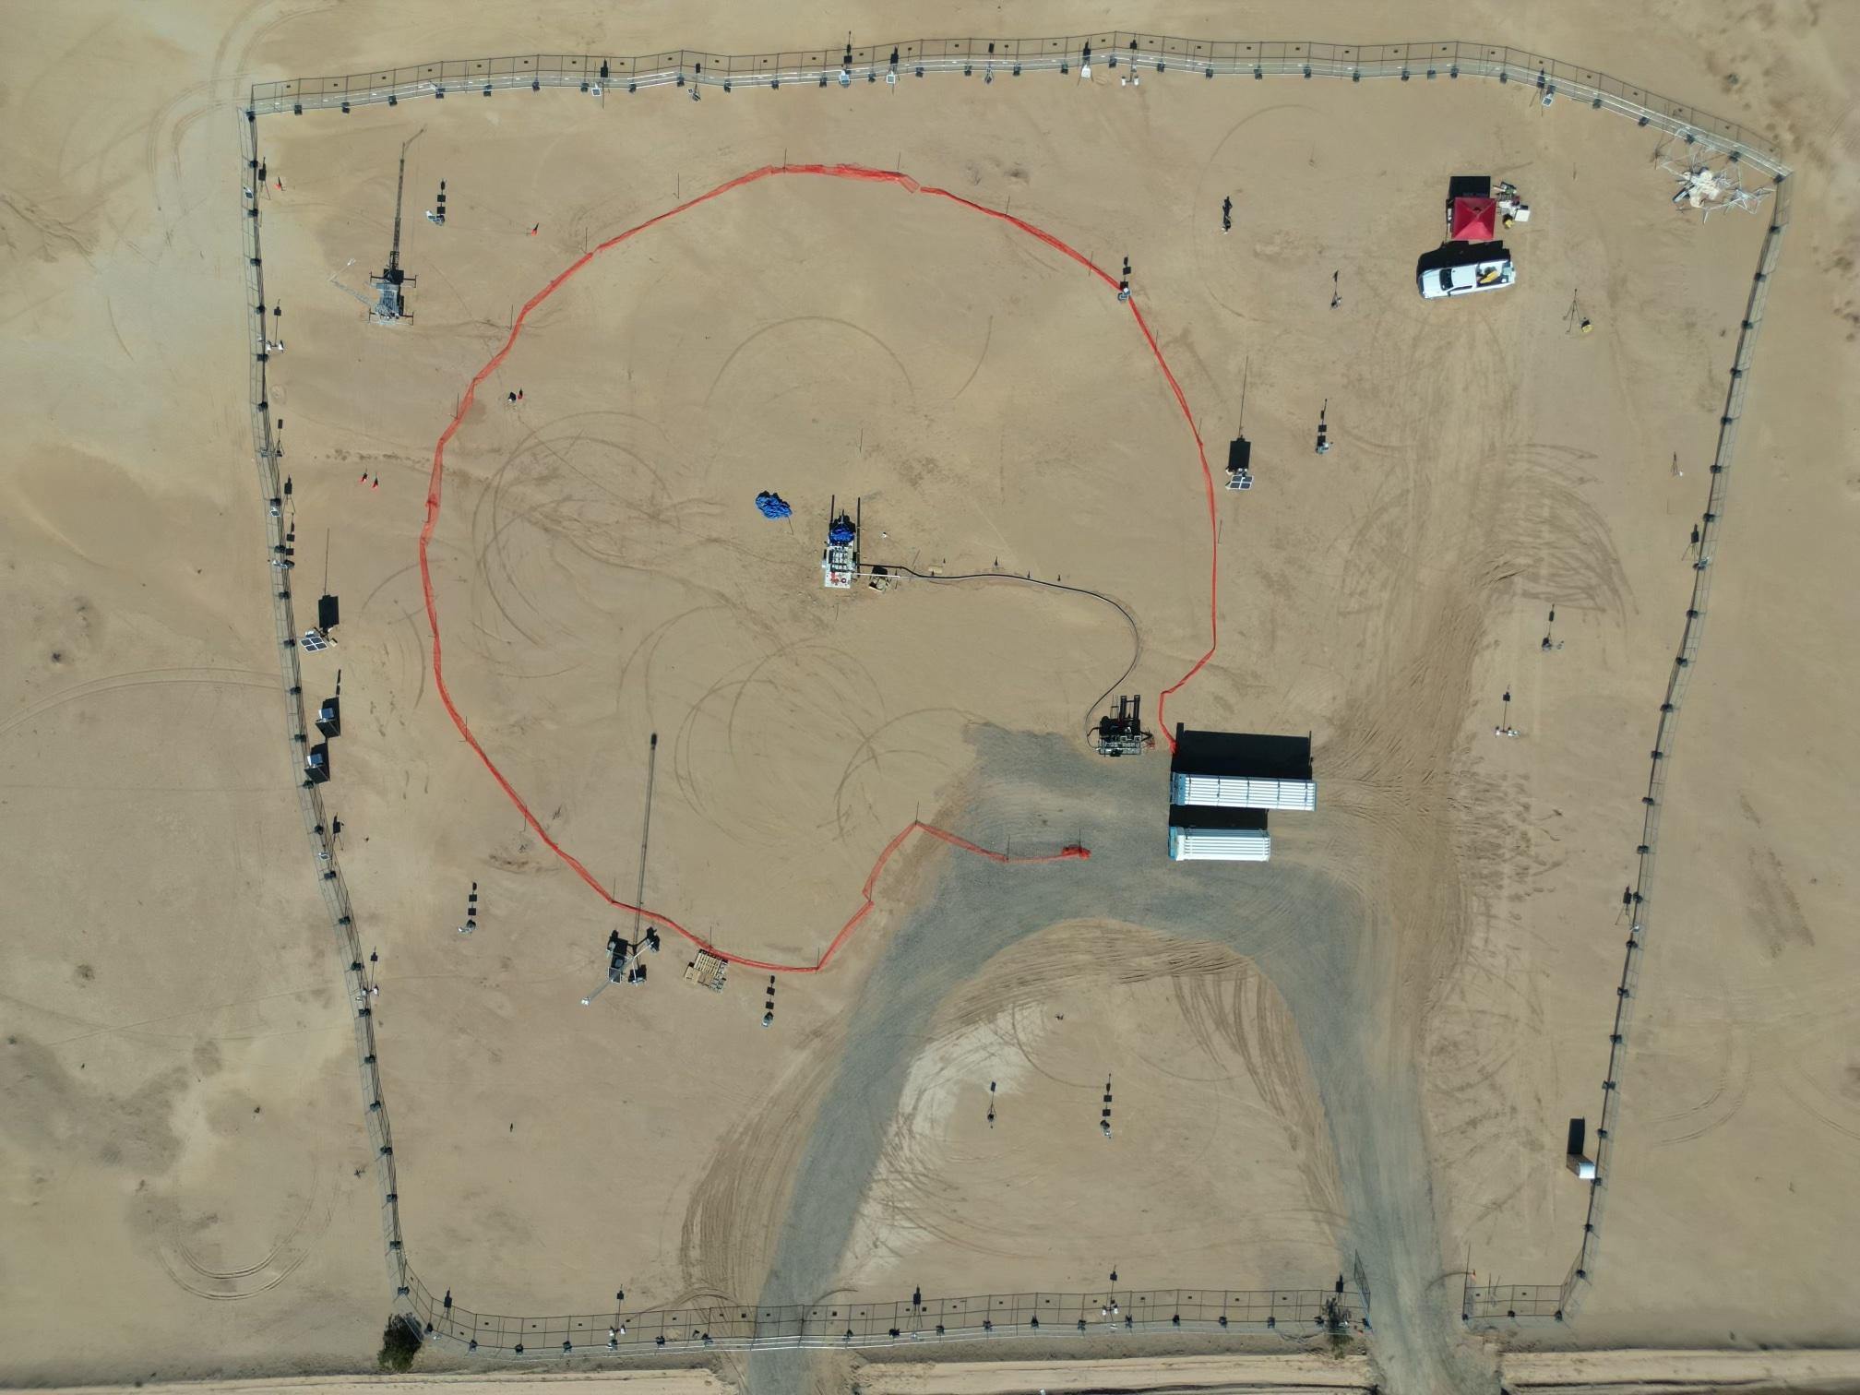
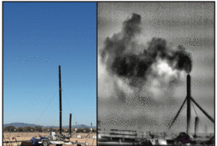
Validation – controlled release
First-of-a-kind controlled and blind* testing of super emitter quantification and satellite detection
  Tests teams’ detection and quantification ability
10 m ultrasonic winds
and meteorological station
Work station
?
Metering and
release point
Gas trailers and
pressure reg
Credit: A Brandt Stanford tinyurl.com/stanford-methane
*Participants know location but not [on/off] or volume flow rate. Coriolis flow metering for leaks between 3 kg/h and 1500 kg/h

Slide 10
Quality Assessment framework
Quality Assessment framework aligned with that developed within EDAP / CSDA for consistency across GHGs and other ECVs
Column Enhancement
Emissions

Slide 11
Progress and timeline
Commercial mission drivers demand a relatively short timescale for a working first version of documentary standards.
2024 – outline development & peer review
2025 – detailed development, peer review & v1 finalisation for end 2025

Slide 12
Summary and Requests
Summary:
Emissions based on Public and New Space observations of CO₂ and CH₄ are increasingly being used for regulation (in addition to science) and are likely needed for a functioning reporting obligations and carbon market
We need a set of best practices for facility scale emissions so that producers of these data know what is expected by the community and (new) users know how the data should be generated and reported so that it can be trusted
Emissions estimates at both scales ideally are traceable to a calibration standard, are reproducible, and are well validated with ground truthing

Slide 13
Thank you

Slide 14
Slide for GHG task team: What we need
Background of effort and general description of document
Where we are and general Caveats on document
Input that we need
General structure and are the missing elements?
Introduction + exec summary, Validation section, and quality assessment documents are good enough to review.
Feel free to look at L0 to L4 Best practices but only look for missing content... we are going to pull in a wider group to help edit (Annamrie to organize, Dylan Jervis, Jochen Landgraf, Andrew Thorpe, and Dan Cusworth)

Slide 15
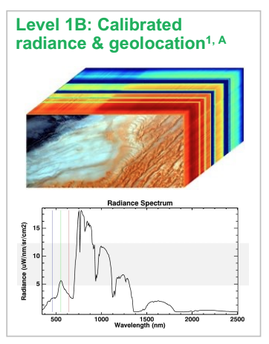
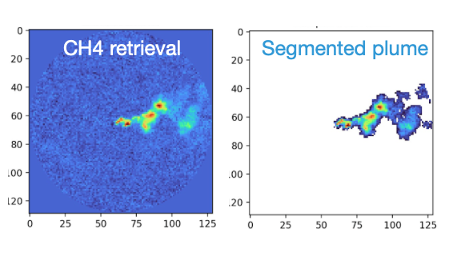
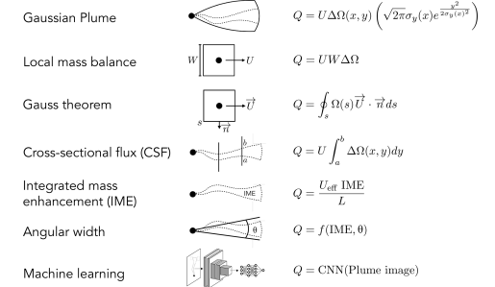
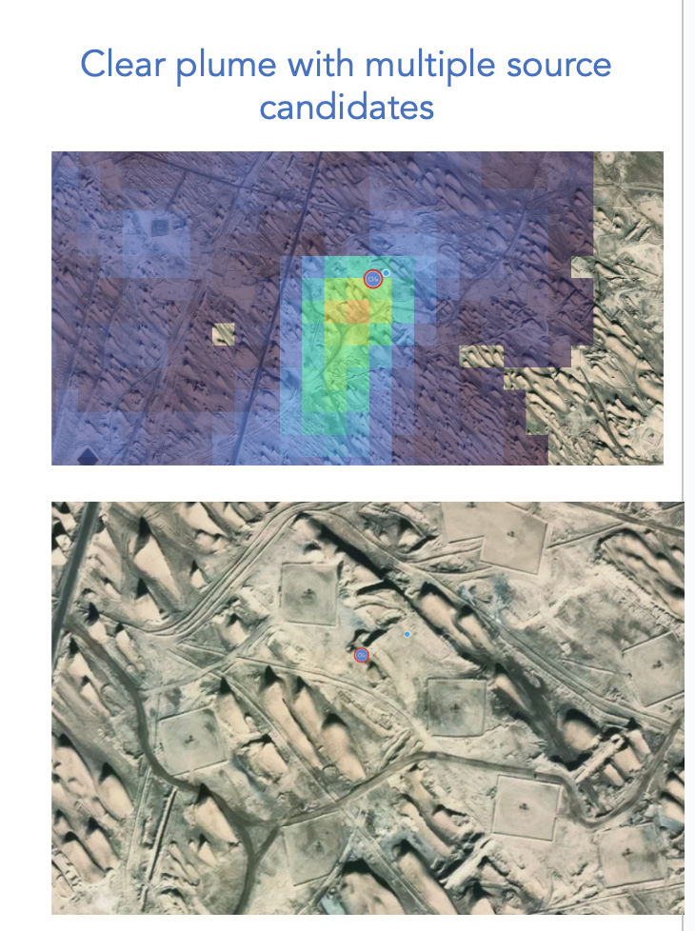
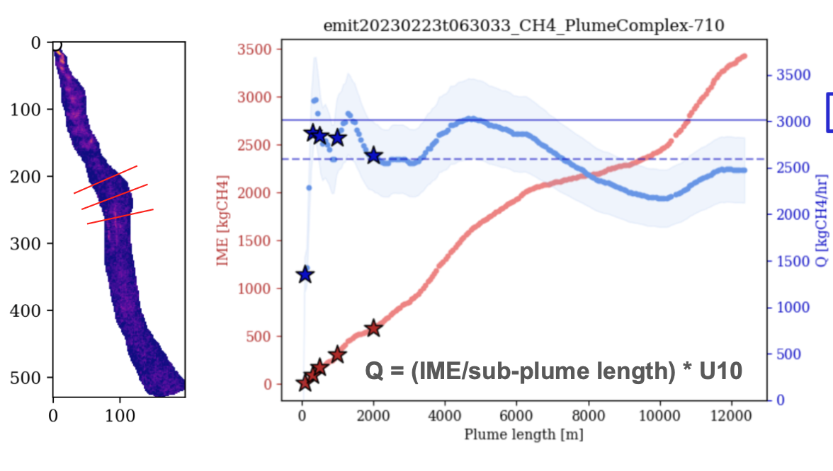
Current workflows
Source Rate Quantification Methods
Figures from Dan Cusworth (CM) and Andrew Thorpe (EMIT/JPL)
Figures just for illustration -
The details of implementation and ancillary data vary at pretty much every step

Slide 16
Use Case 2: Other factors affecting how plume mapping based emissions are reported from New Space
Intellectual property concerns mean that provenance of data in different levels of data products (L1 radiances, L2 concentration enhancements, and L4 emissions) are not necessarily traceable
Need to develop evaluation metrics for how well these products are reported and evaluated (in process with ESA / NASA evaluation team)
Public missions (e.g. EMIT, CO2Image) can be used as benchmarks for data products and transparency
May need to move away from “no false positive” for public missions and instead provide gradation of data quality flags

Slide 17
Best Practice for Facility Scale: Intercomparison of emissions complicated by inconsistent definition of plume

Slide 18
Best Practices Challenge:
Validation of Emissions Estimates from Facility to Area Scales
Developing best practices is facilitated by a robust network for validation as it allows testing of top-down methodologies.
(Left Figure) Ground validation is possible for facility scale emissions estimates but this capability is still in its nascent phase and only provides validation under optimal conditions.
Can CEOS support validation of facility scale emissions?
Use of aircraft and ground campaigns to support emissions quantification, intercomparison, and validation
Coordination of satellite measurements to measure over same site
Figure courtesy of GHGSat

