Slide 1


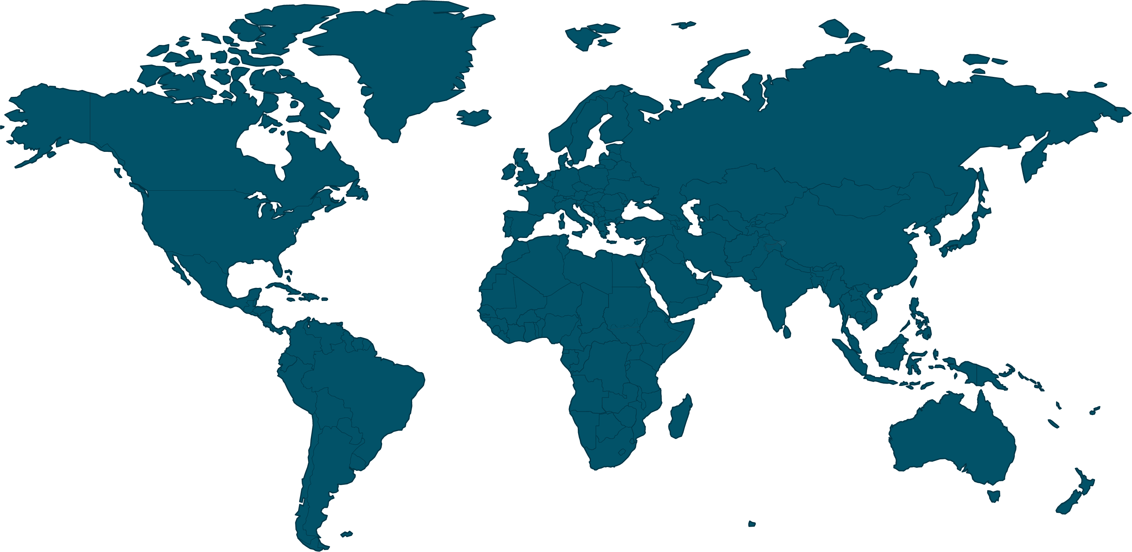


The International Methane Emissions Observatory
Discussion on Characterizing POD for Facility Scale
Emissions Estimates
Itziar Irakulis-Loitxate, Javier Gorroño, Manuel Montesino, Gonzalo Mateo-García, Luis Guanter
October 2024

Slide 2
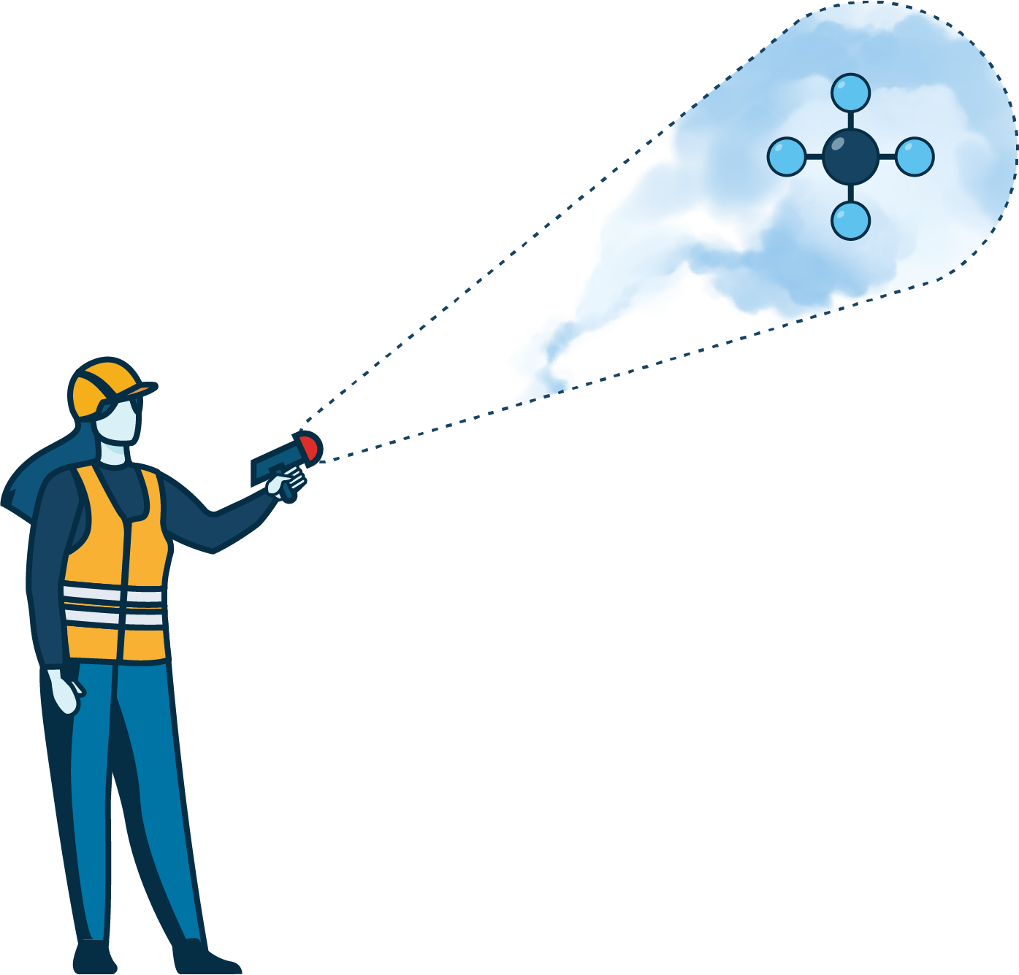

UNEP’s IMEO
interconnects better data with targeted action
Actionable Data
The International Methane Emissions Observatory exists to provide open, reliable, and actionable data to those that can act to reduce methane emissions
MARS
Methane Science
OGMP 2.0

Slide 3
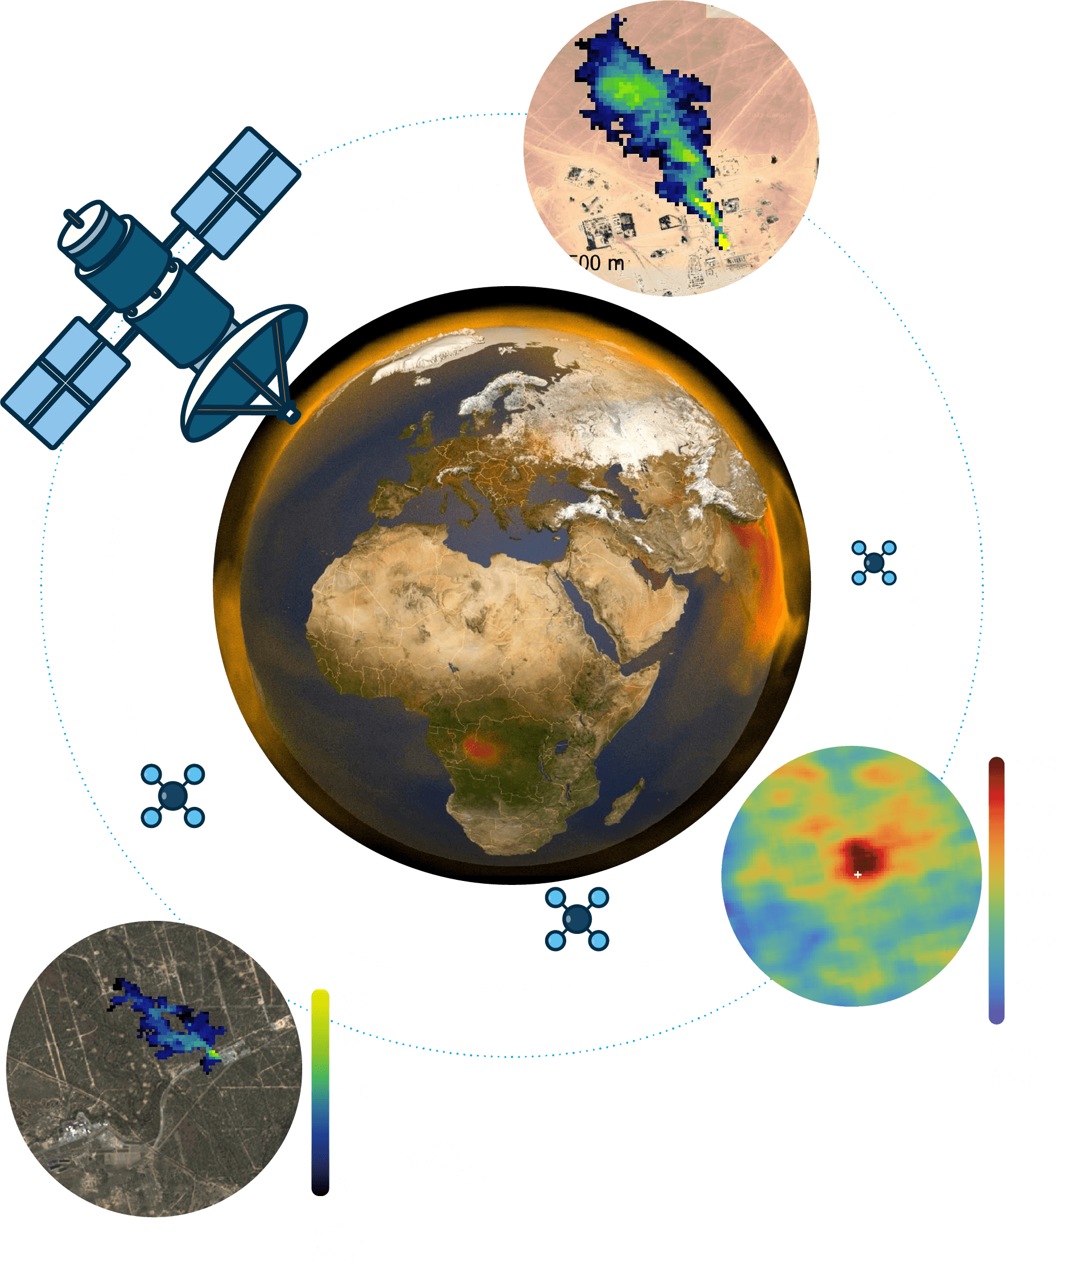
IMEO’s MARS uses satellites to provide rapid, actionable data to stakeholders
METHANE
Detect and Attribute
ALERT
Notify and Engage Stakeholders
RESPONSE
Stakeholders Take Action
SYSTEM
Track, Learn, Collaborate, Improve
Requirements for notification:
High-resolution plume
Recent plume
O&G emission (coal emissions soon)

Slide 4
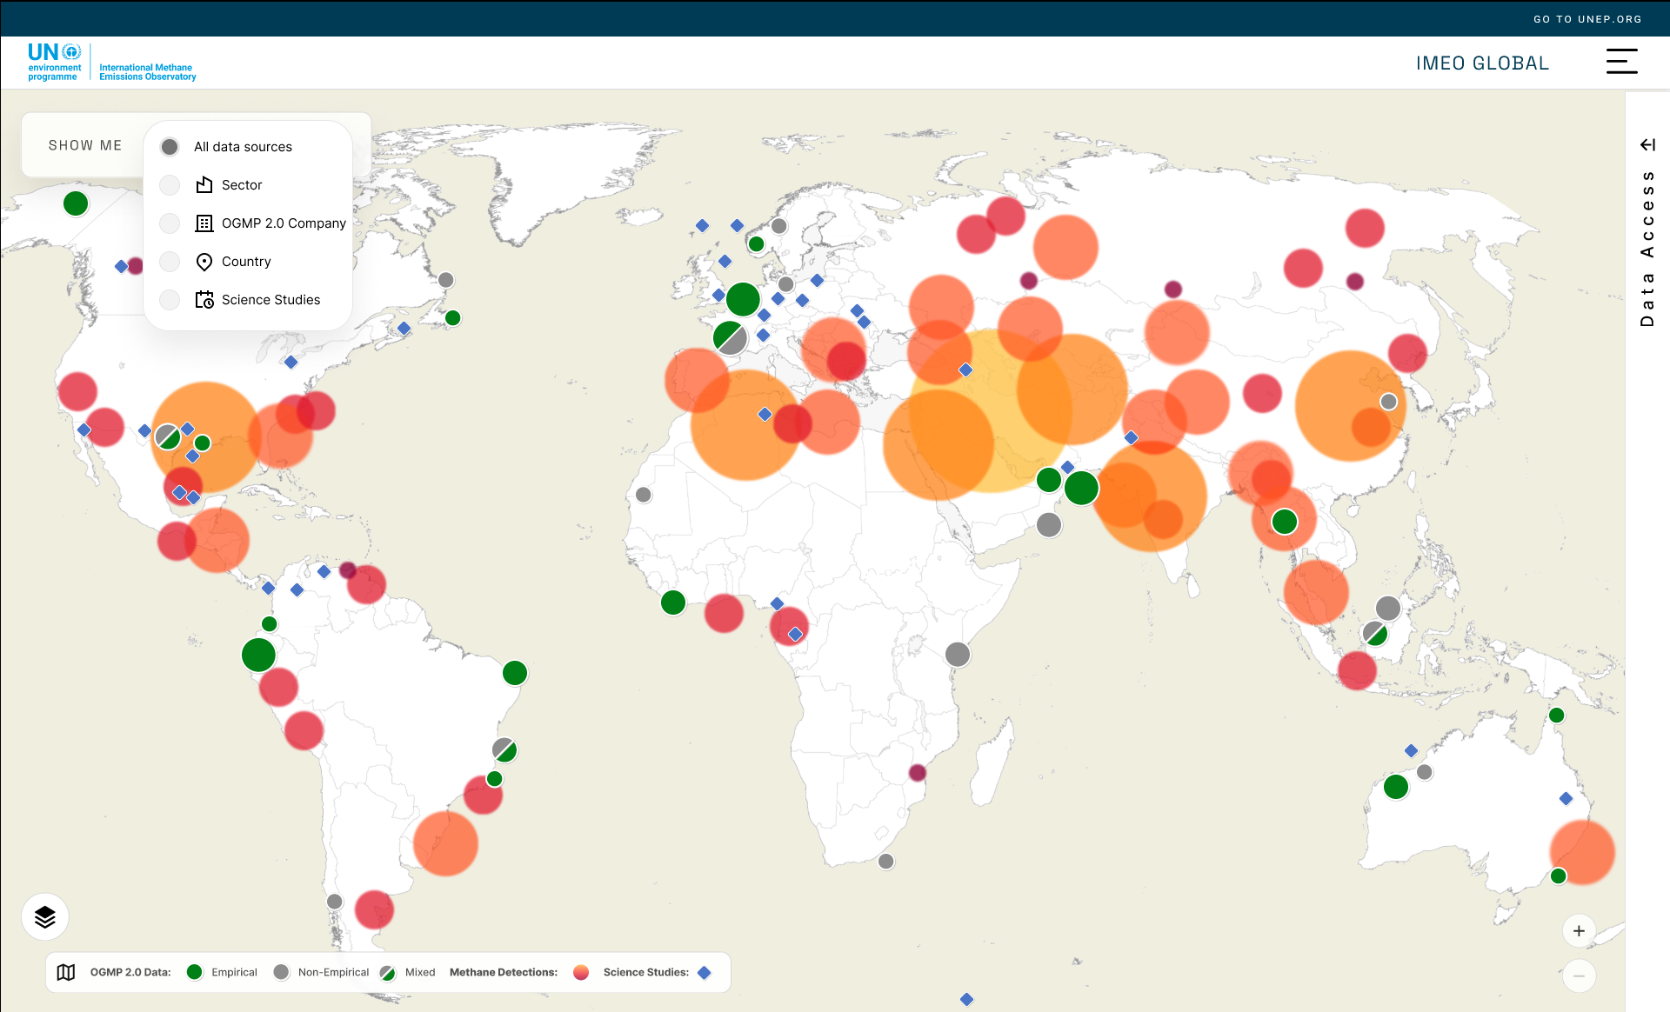
Data to Action
Tapping into the methane data revolution
Actionable Data
MARS
MSI
Methane Science
Beta Version
OGMP 2.0

Slide 5
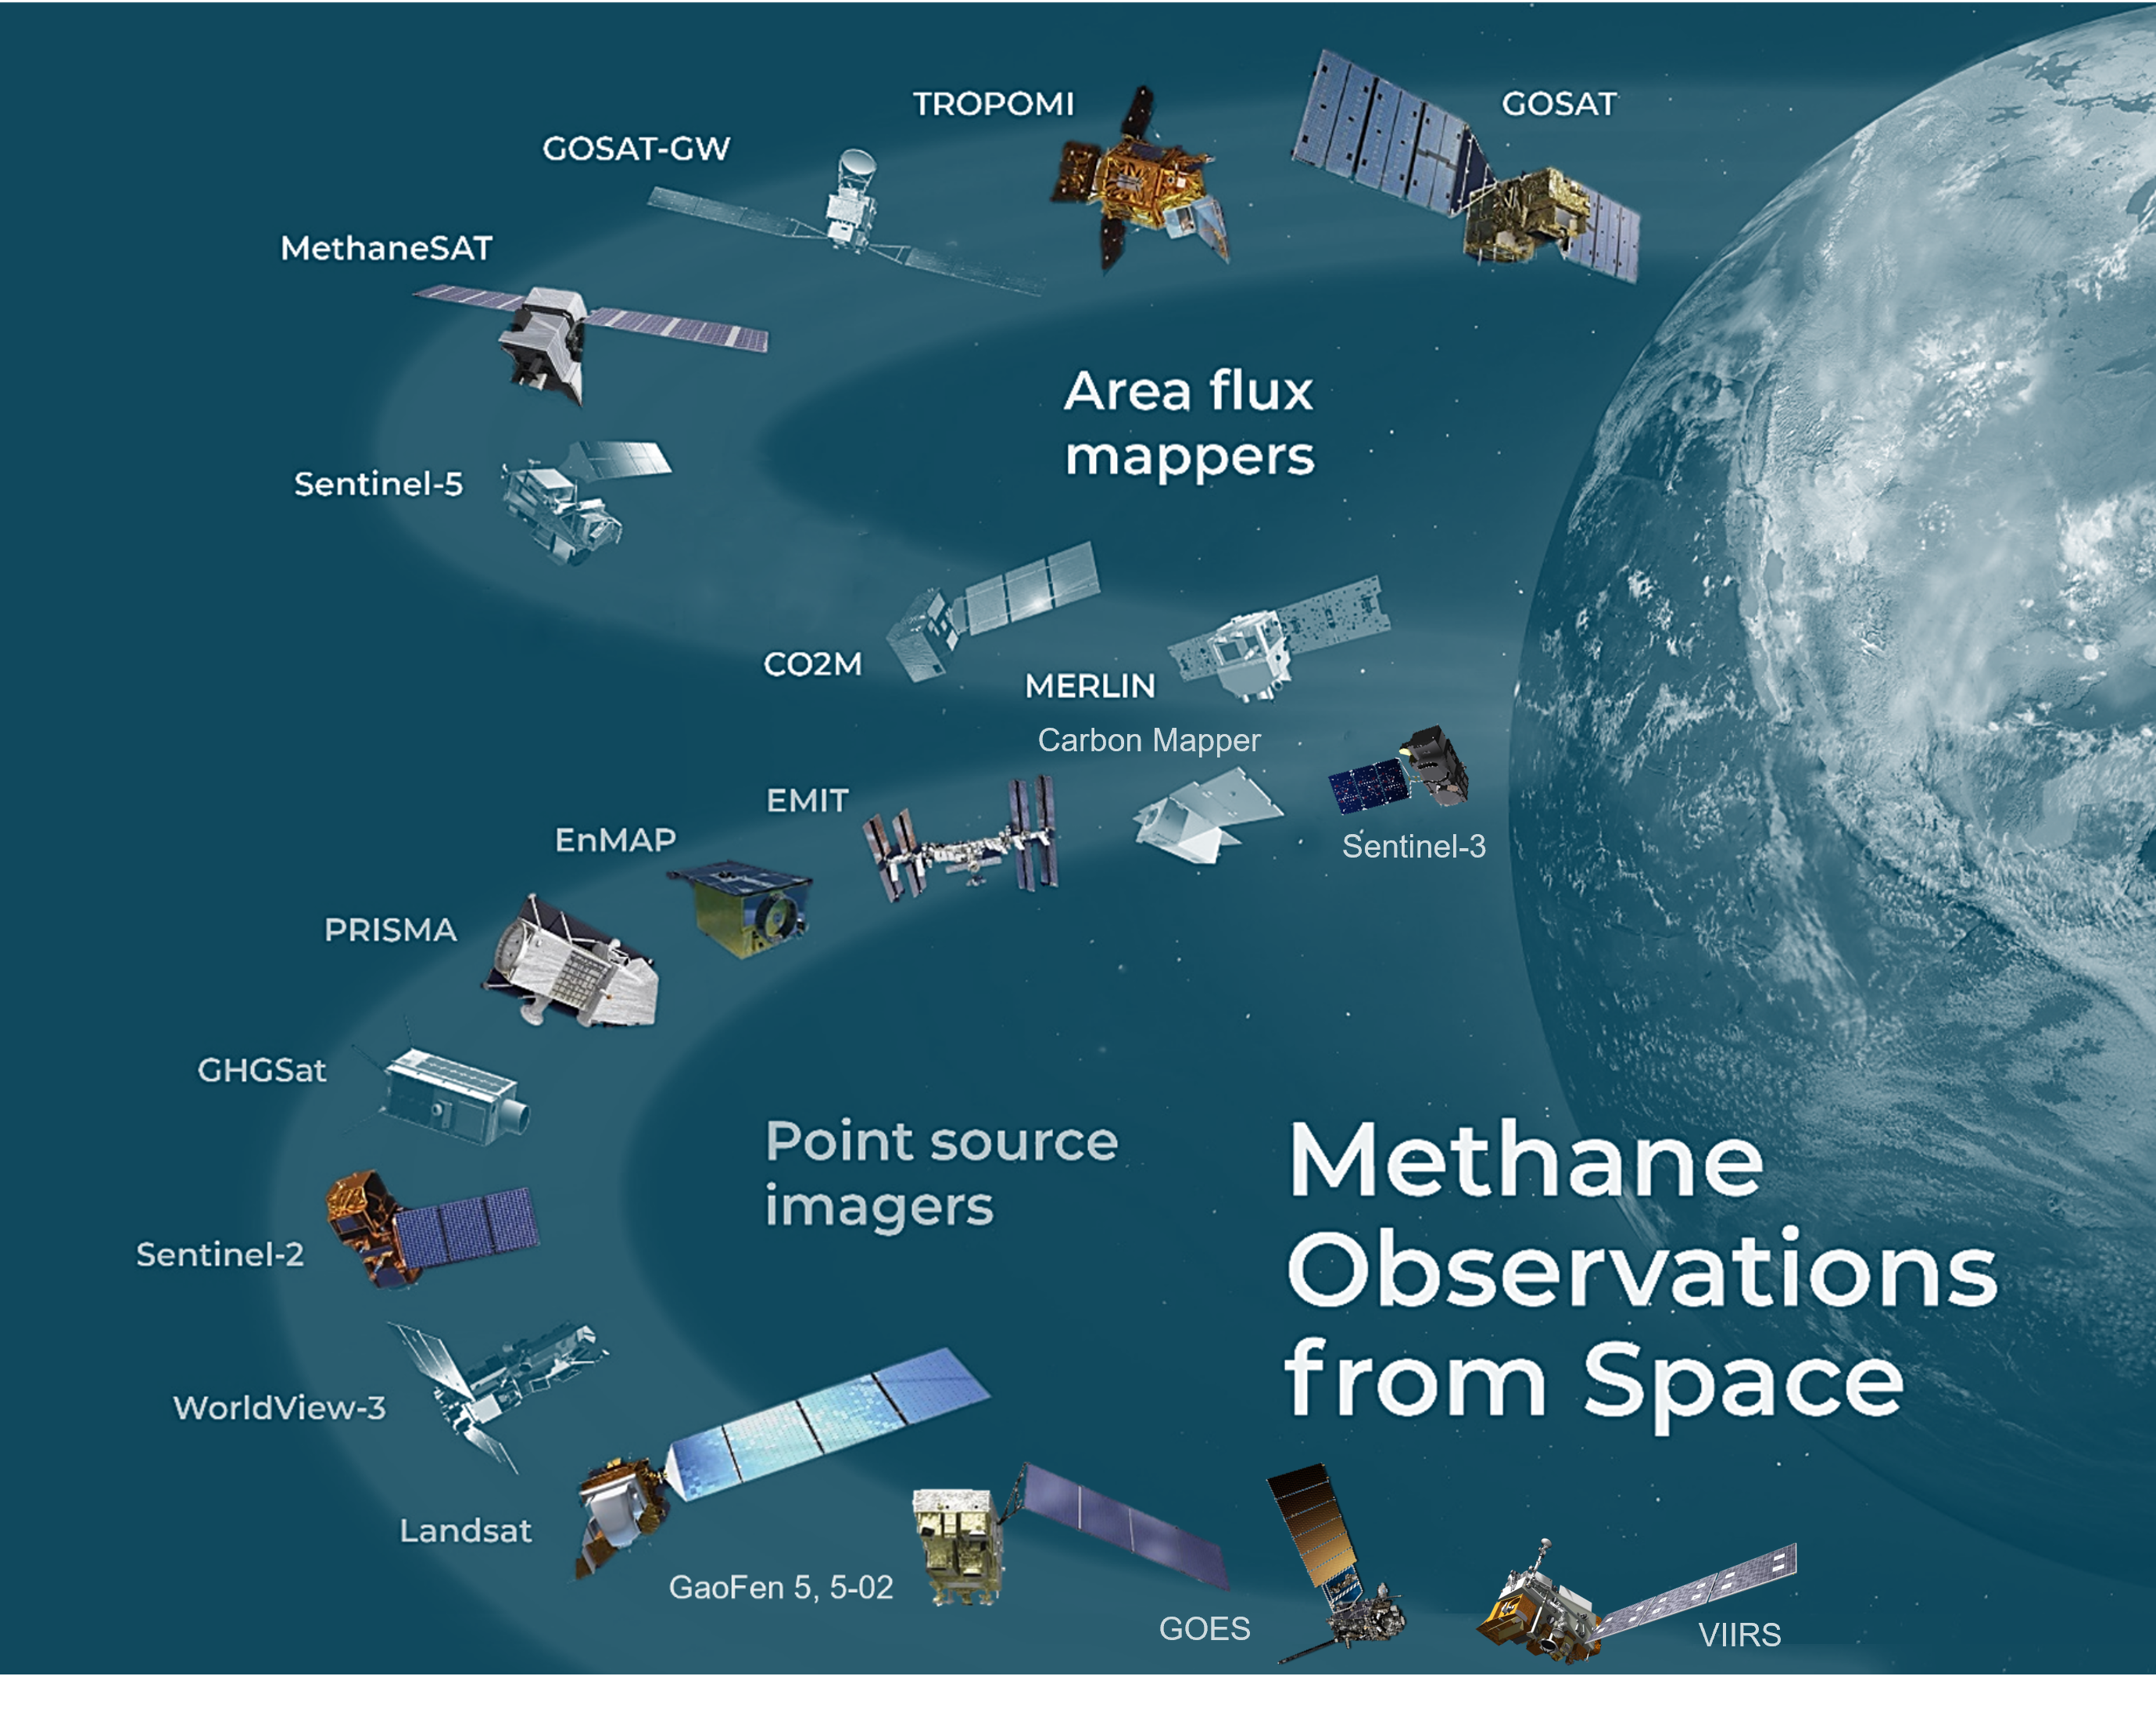


The diverse ecosystem of methane-sensitive missions
Area flux mappers:
  Spatial sampling ~1-10 km
  TROPOMI: 7 km/pixel, global daily coverage, >10 t/h emissions, difficult attribution to sources
  A number of other missions coming up soon
  Point source imagers:
  Spatial sampling ~30 m
  Allow attribution to sources and lower detection limits (300-10,000 kg/h)
  Two classes of satellite missions
    Spectrometers (PRISMA, EnMAP, EMIT): medium sensitivity, sporadic acquisitions, require tasking/limited to some latitudes
    Multispectral imagers (S-2/Landsat): low sensitivity, but “monitoring” with frequent and global coverage
Jacob et al., ACP, 2022 (edited)

Slide 6
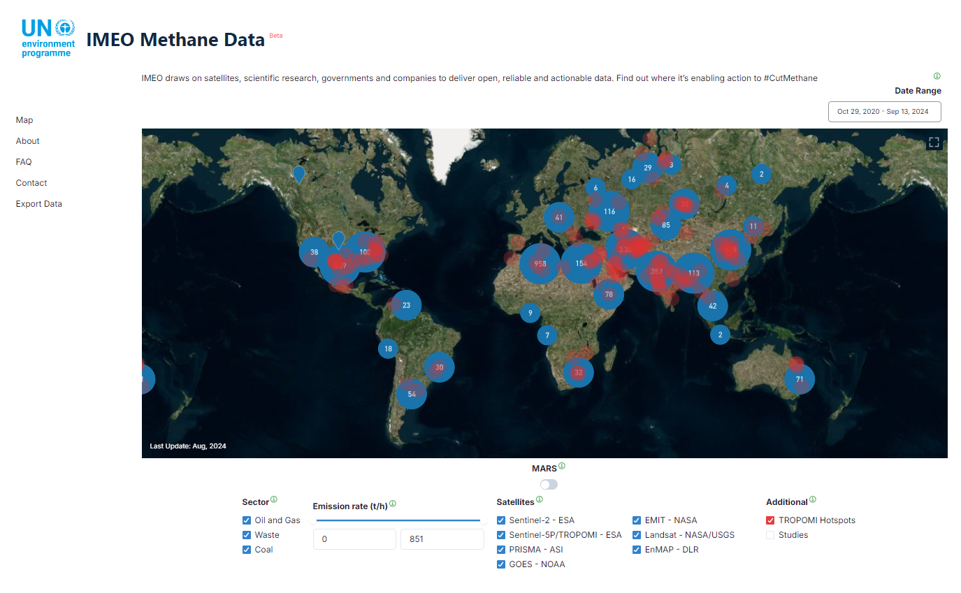

IMEO public portal with all detected plumes and hot spots
In the portal we show the plumes but not the days without plumes
Users: both experts and non-experts (journalists, NGO, governments, industry,...) in satellites and/or methane.
Requests for:
  No-plume days
  Frequency of emission/persistence of a leak
  Estimate of the total amount of methane emitted (requires knowing the duration of the emission)
  Detection limit of the satellites

Slide 7

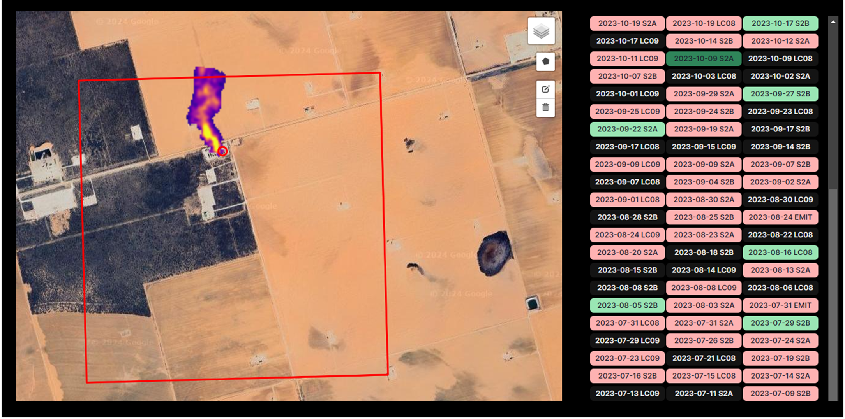
The danger of giving non-plume data
  No plume No emission
Internally we keep with the “no plume observed” data
Without the proper expertise, the data can be easily misinterpreted.

Slide 8
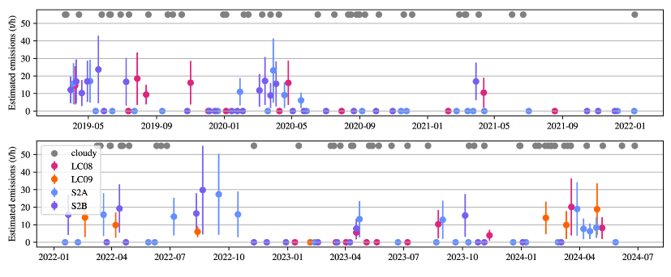
Proposed solution
In order to give a more comprehensive understanding of the emission frequency we would like to provide the emission time series per source
The days without plume need further context
Vaughan et al., 2024 (in preprint) https://arxiv.org/html/2408.04745v1
Minimum Detection Limit (MDL): Lowest emission flux rate for a set of conditions to provide a correct quantification at a given level of probability

Slide 9
DEFINITION
Minimum Detection Limit (MDL) – Lowest emission flux rate for a set of conditions to provide a correct quantification at a given level of probability
Emission flux rate (Q):
kg/h – combines CH4 sensitivity and spatial resolution
Conditions:
Observation conditions – illumination, wind speeds and turbulence, landscape
Instrument capabilities – spectral and spatial resolutions, Signal-to-Noise ratio
Algorithm performance – transmission artefacts and detection algorithms
Based in simulations
Correct quantification – when the true Q is within the confidence interval (tied to quantification)
  $$\hat{Q }−σ<Q<\hat{Q }+σ$$
Frequency at which the system provided the right quantification:
Q₅₀ – flux rate at which the system provides the right quantification 50% of the times
Q₉₀ – flux rate at which the system provides the right quantification 90% of the times

Slide 10
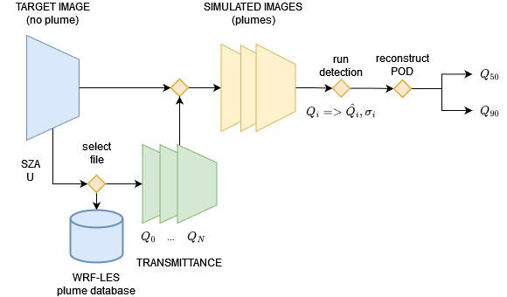
ALGORITHM

Slide 11
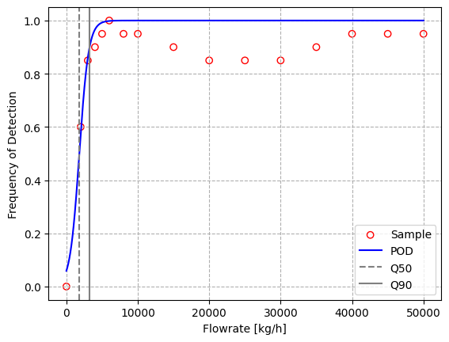
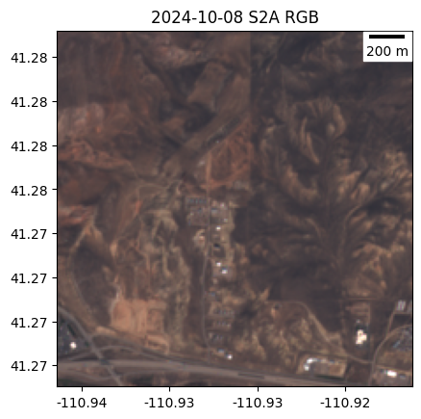
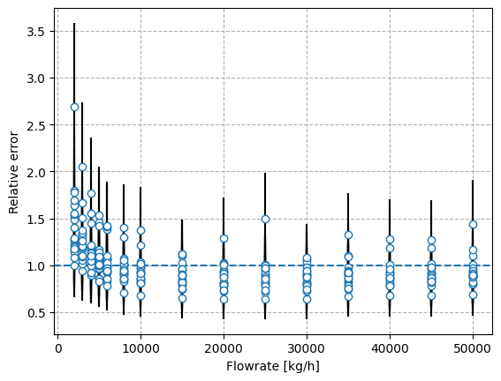
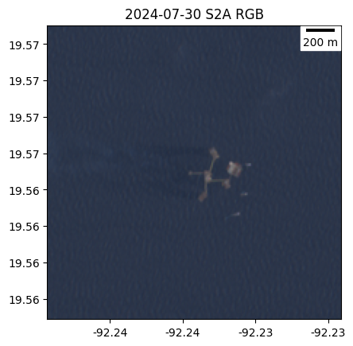
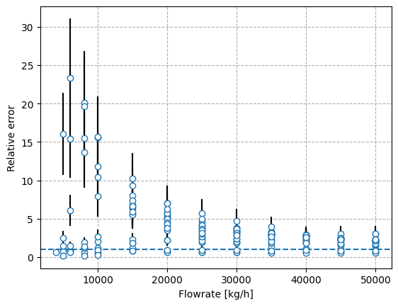
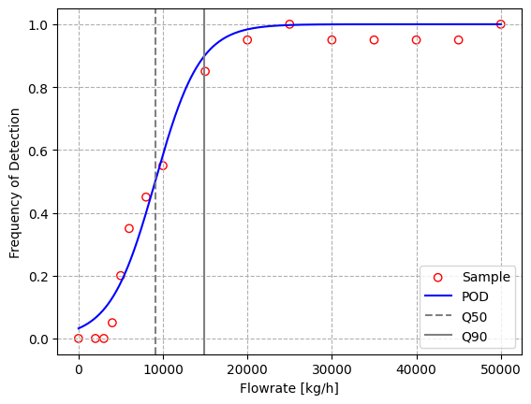
PRELIMINARY RESULTS
PoD
Target image
Detections and quantifications
Q50 – 1812 kg/h
Q90 – 3249 kg/h
Q50 – 9081 kg/h
Q90 – 14933 kg/h
Q₅₀ – flowrate at which the system provides the right quantification 50% of the times
Q₉₀ – flowrate at which the system provides the right quantification 90% of the times

Slide 12
Implementation
Goal: provide the time series and the data for each non-plume day with an estimated MDL
The first tests are already running
First tests:
  With multispectral data
  Using standard wind
  Simulate the plume in the centre of the image
  Processing time 3-6 minutes
There is a trade-off between processing time and scope of validation: more simulations with more flux rates and plume variability, more processing time.
Next versions adapted to other satellites and with different winds

Slide 13
Thank you !
Itziar Irakulis Loitxate
MARS Remote Sensing Lead
itziar.irakulisloitxate@un.org

