Slide 1
Consensus Standards for Methane Measurements: Facility scale emissions intercomparison
A. Eldering
For Oct 2024 CEOS AC/VC
October 17, 2024

Slide 2
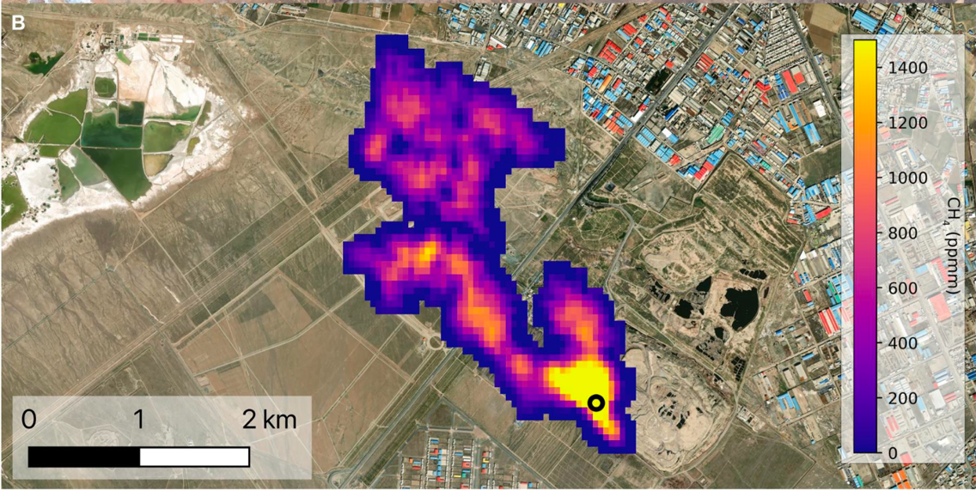
Methane plume detection and quantification from remote sensing data is a rapidly developing
New instruments are added often, from civil space agencies, non-profits, and private companies. This figure is showing only some of them.
EMIT, from Thorpe et al 2023
Space-borne instruments are able to detect and quantify methane emissions. Plumes from oil and gas, landfills, feedlots and more have been detected.
Courtesy of CEOS

Slide 3
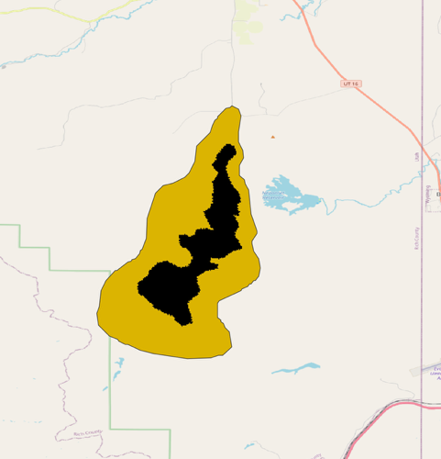
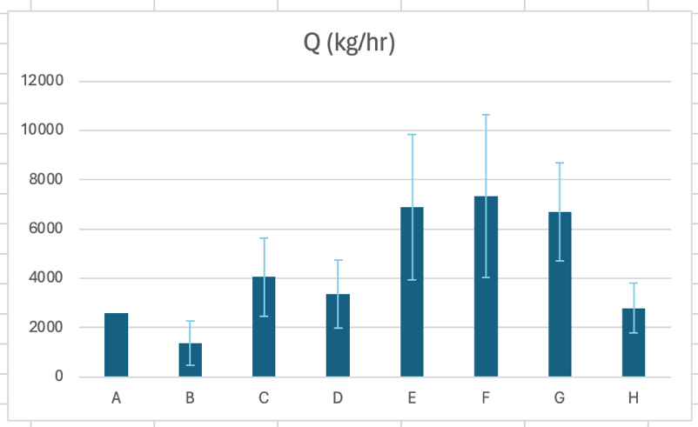
Spectrometer measurements to quantification is in the midst of research to operations transition
There is a lot of variation in the answers
What is the extent of the plume?
Location of the source of the plume
Estimate of total emissions
Limited controlled release experiments to date, but they are key!
Estimated emissions
A clear case for engagement from a standard setting organization!
Analysis team

Slide 4
Overview of NIST activities: Methane plumes
Jan ’24 kickoff workshop with industry, Fed agencies, and researchers
Develop definitions and terminology
Explore expansion of group to other measurement technologies
Collaboratively document current practices
Develop transparency portal at US GHG Center
Stage 1: Brainstorm and community building
Stage 2: Advance in a few specific areas
Stage 3: Future directions
Begin intercomparison activities
Guidance on validation practices and data specifications
Facilitate info flow for controlled release activities
Strengthen connections to other organizations
Notes:
Say something more explicitly about objectives
Not prescribing a method – documenting, developing consensus and commonality where it makes sense. Some technical work to understand source of difference. Supporting community in developing validation approach and ‘requirements’

Slide 5
Context of NIST activities
Stage 1
Cooperative activities with technical focus and limited scope
Respect limited staff and resources available
Stage 2
Expanding group of technical participants
Formalize ground rules for participation
Stage 3
Strengthen connections to external programs and projects
Take action where contribution is most impactful

Slide 6
Intercomparison Objectives
Begin to gain insight into the reasons for variation in plume origins and plume quantification
Use this information to see if there are preferred methods
Have framework in place to better understand controlled release results
Document and share our findings, so community and end users have a better understanding of the reasons for variations (and that is isn’t because people don’t know what they are doing…)

Slide 7
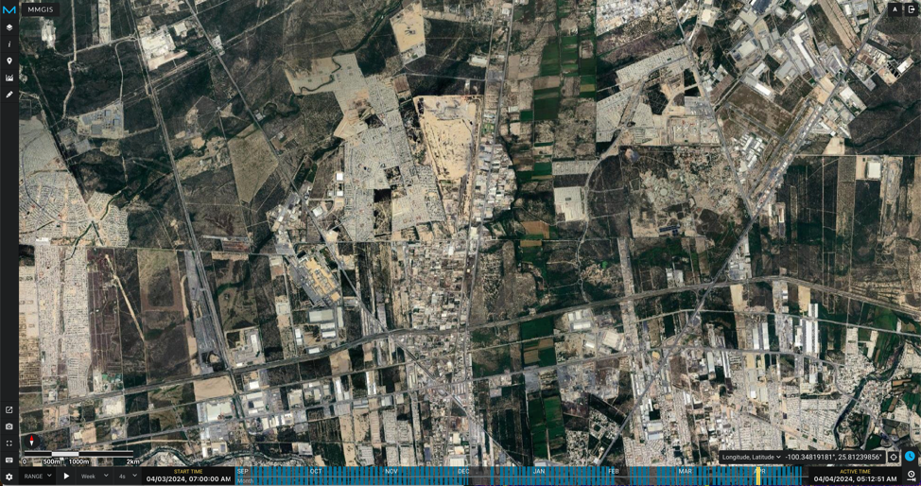
Intercomparison Exercise: Phase 1
For the May 2024 meeting we asked teams to participate in an intercomparison
Four different EMIT scenes, some with multiple plumes per scene
Eight analysis teams
Comparison includes plume masks, wind fields, length of plume, emissions estimate, plume origin
Surface reflectance and complexity varied

Slide 8
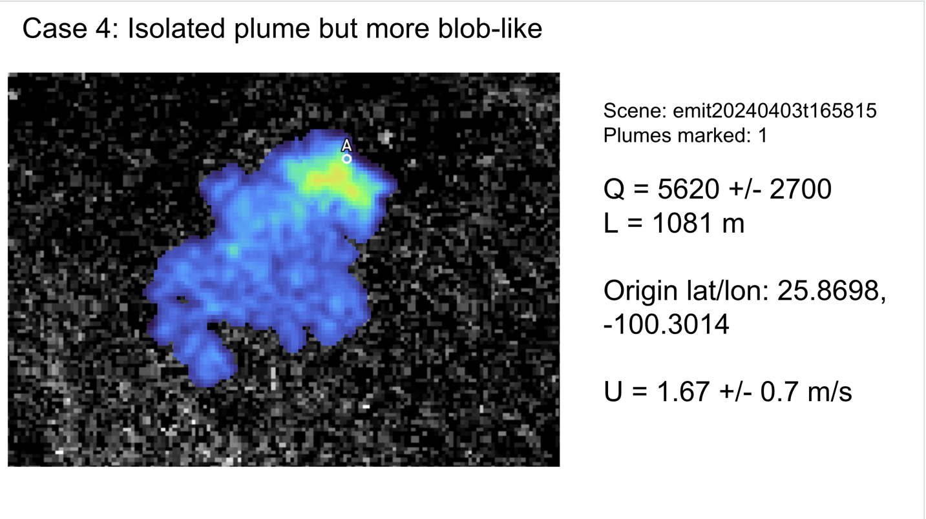
Results overview
Rich dataset submitted for the intercomparison
Scenes had between 1 and 16 plumes
Added variations to experiment, where teams used JPL L2 field instead their own
Needed to be careful to match results and compare the right results

Slide 9
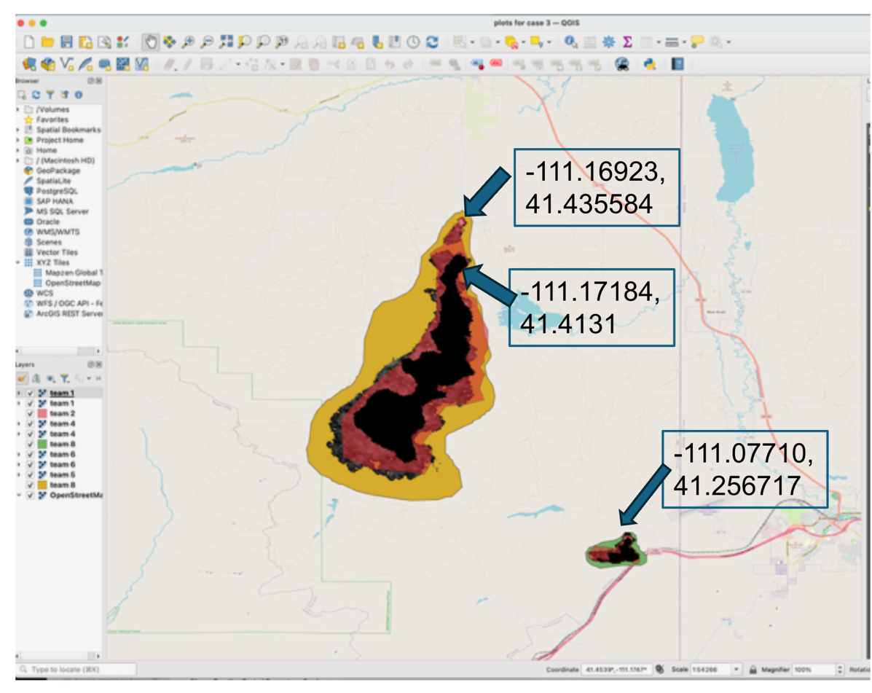
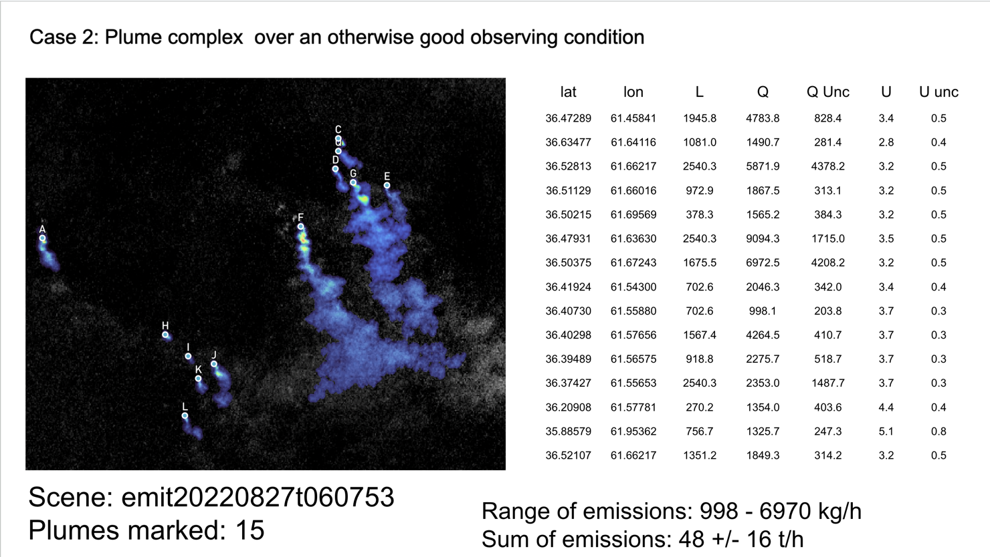
But results were not always that simple…

Slide 10
Plume detection and quantification analysis
Plume detection and location
Compared the plume masks submitted by each team
Analyzed lat/lon data submitted as the plume origin from each team
Plume quantification comparisons
Compared emission rates provided by each team
Assess what quantification would be if all team used same wind speed
assessed quantification if same L2 retrieval was used by teams
Overall assessment of variation
How do the three steps contribute to variation

Slide 11
General description of the cases
Case number | Number of plumes | Size of emissions | Wind speeds
1 | One long plume | large | 3.4 m/s
2 | Many (12 to 16 marked) | Small to medium | ~4 m/s
3 | One large, one small | Very large | 1.5 to 2 m/s
4 | One blobby plume | large | 1.6 to 2 m/s

Slide 12
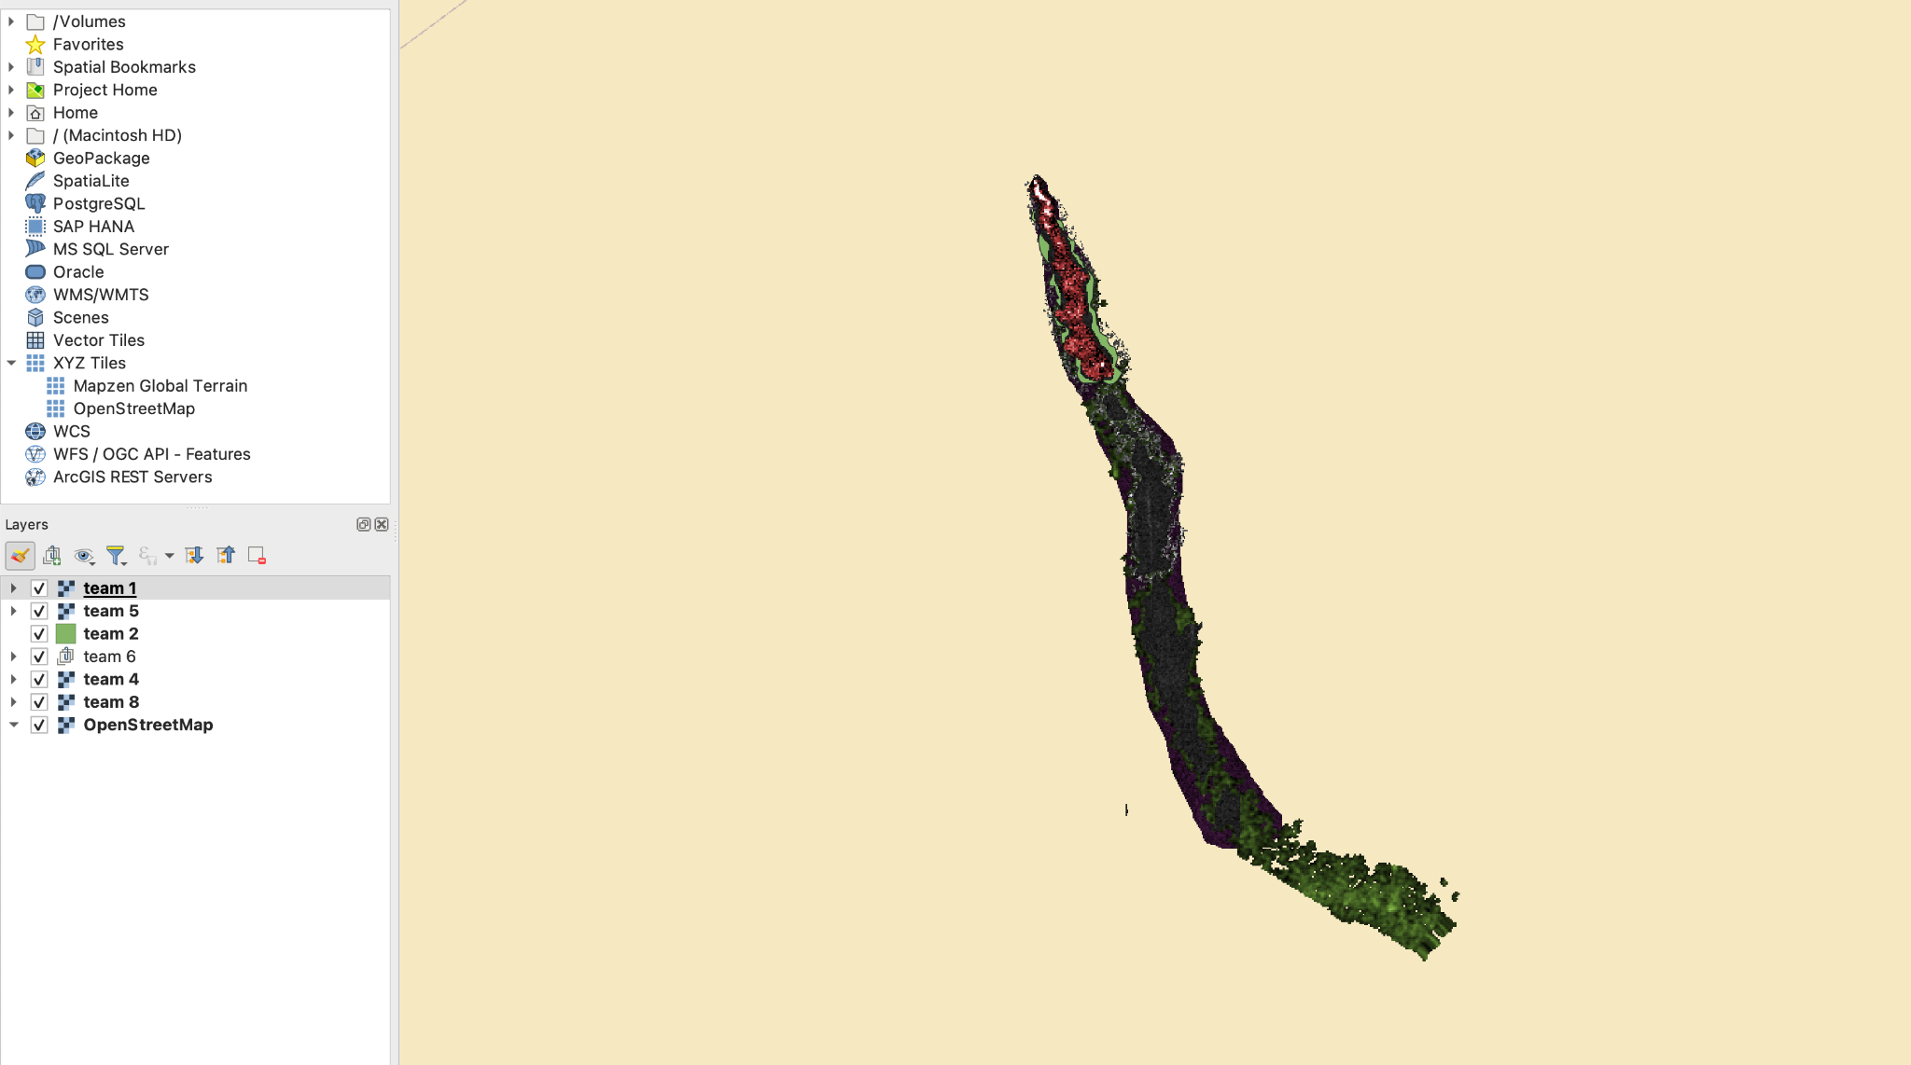
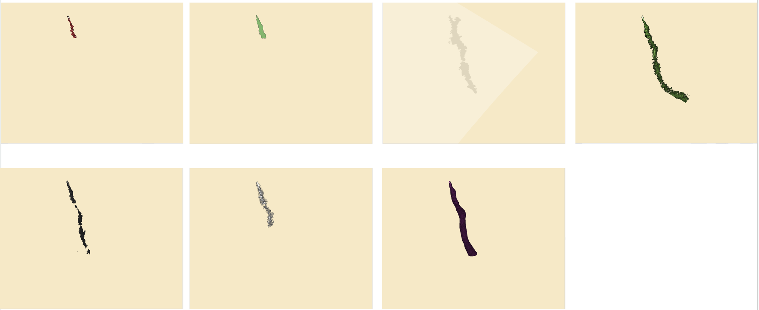
Plume detection and location
Different locations for start of plume
Different extent
Number of plumes in a scene

Slide 13
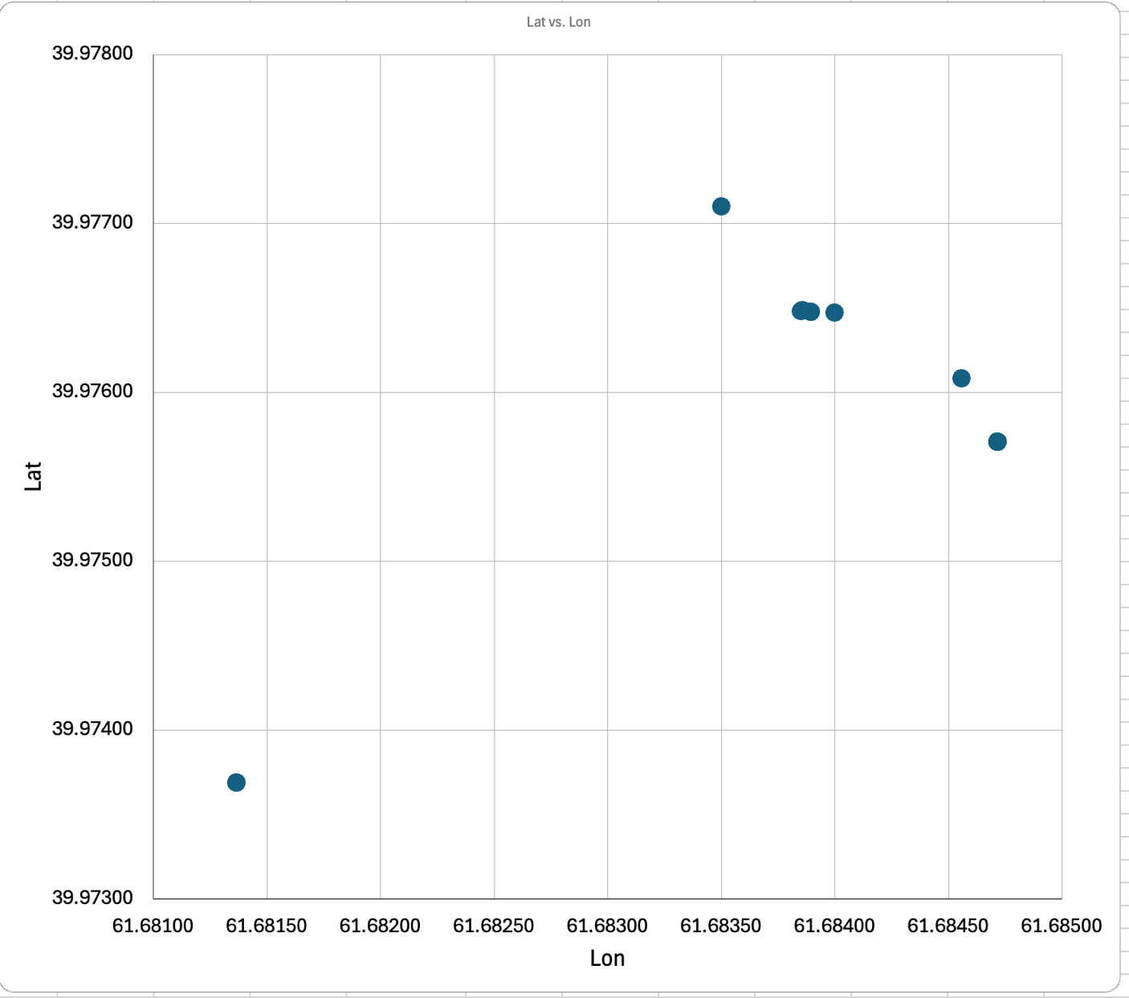
Plume origin
Factors
Instrument spatial resolution
Methodology of team
Currently assessing lat/lon spread
Need to rotate and examine error along wind direction and perpendicular to wind direction
For this case latitude is roughly in wind direction
Uncertainty not reported, but should be!
Pixel size is about 60m ~ 0.0006 degrees for EMIT
~pixel

Slide 14
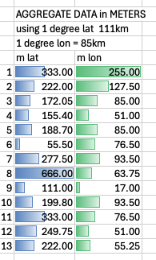
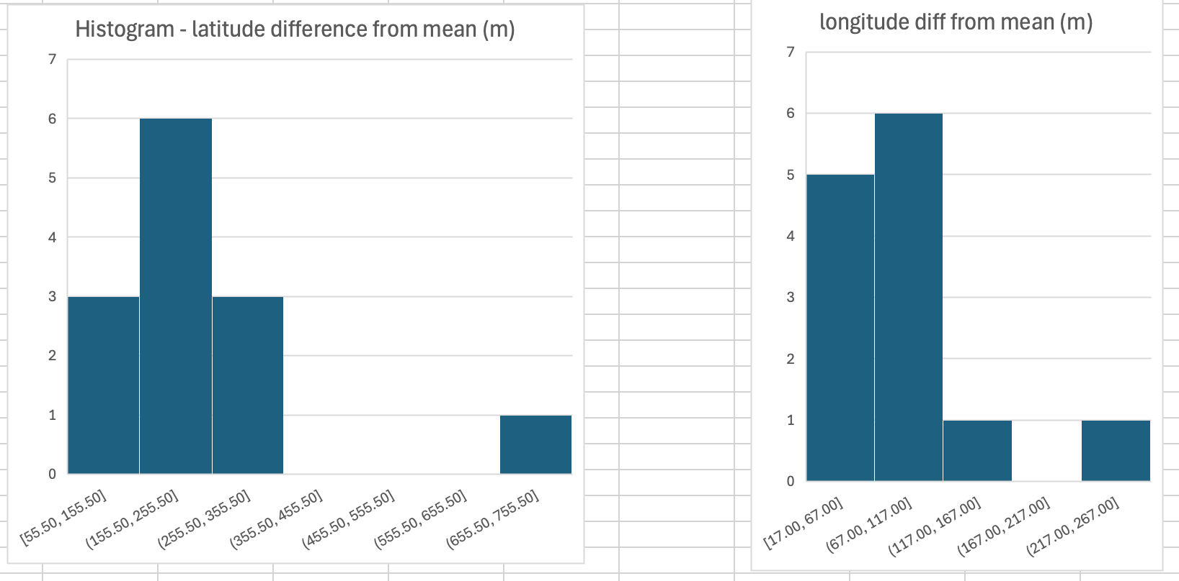
Plume origin statistics from larger number of plumes
Differences typically 50 to 350m in latitude and 0-120m in longitude
This is 3-5 pixels in latitude, 1 to 2 pixels in longitude
Notes:
Wind was primarily north south for this case, so more uncertain in latitude

Slide 15
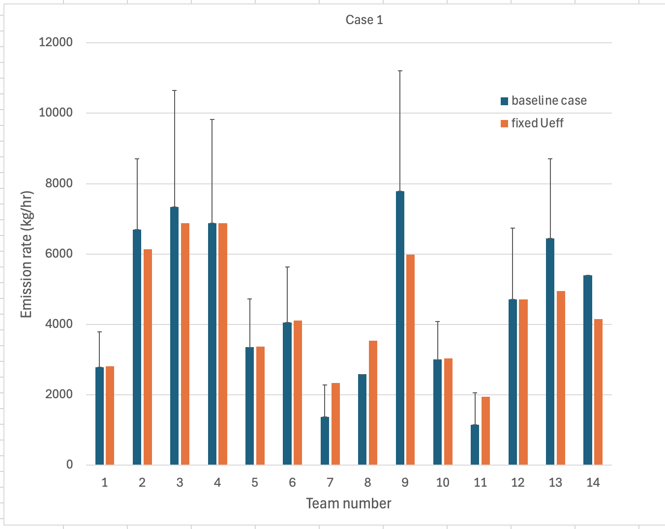
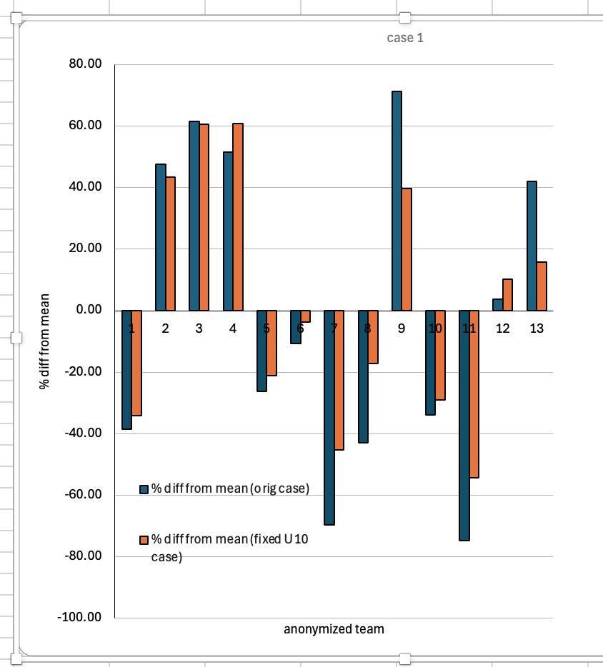
Example comparison of emission rates

Slide 16
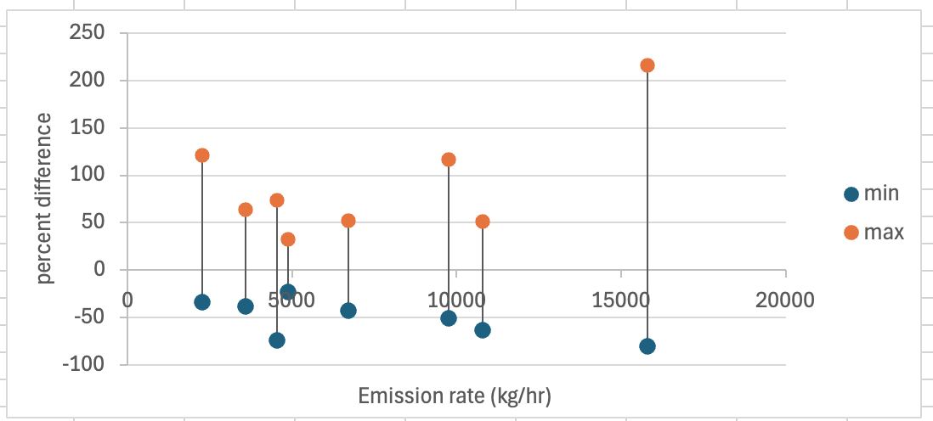
Emissions Differences across a number of cases
Difference from mean typically range from -50% to 50-100%
Not clearly driven by any one factor

Slide 17
Retrieval
Quantification method (mask, Ueff, and Quantification)
Emission Rate
wind speed (U10)
Motivation: Understand drivers of variability (precision) across emission rates from the retrieval (MF), from the wind speed, and the different quantification methods. Is there one variable that has a larger impact on variability than the other?
Methods: Fix all the values then individually vary the retrieval, the wind speed, and the quantification method and compare the relative variability (std/mean) across emission rates.
Results: All variables contribute equally to emission rate precision. In some cases, they counteract one another increasing overall precision. In other cases, these variables compound decreasing precision.
(this contains case 4, case 1, and many plumes from case 2)

Slide 18
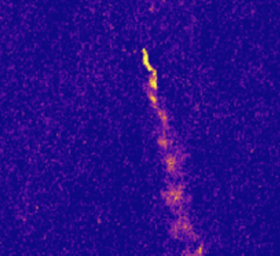
Total Variability
Case 1 – all teams
Case 4- 6 teams
Total Var: 55%
Total Var: 29%
Preliminary conclusion: given the limited analysis, no one factor can explain all or the majority of the total variability. But each individual variable contributes similar variability (so far).

Slide 19
Quantification Algorithm Variability
8 plume
5-4 teams per plume
22.85% variability +/- 13.5 %
Preliminary conclusion: fixing the retrieval and wind speed can decrease the variability but the quantification algorithm alone can cause ~20% variability across emission estimates

Slide 20
Wind Variability
8 plume
6-4 teams per plume
19.7% variability +/- 7.6 %
Preliminary conclusion: wind speed alone can cause ~20% variability across emission estimates.

Slide 21
Retrieval Variability
19 plume
4-3 teams per plume
19.98% variability +/- 13.76 %
Preliminary conclusion: L2 alone is responsible for ~20% variability in emission estimates.

Slide 22
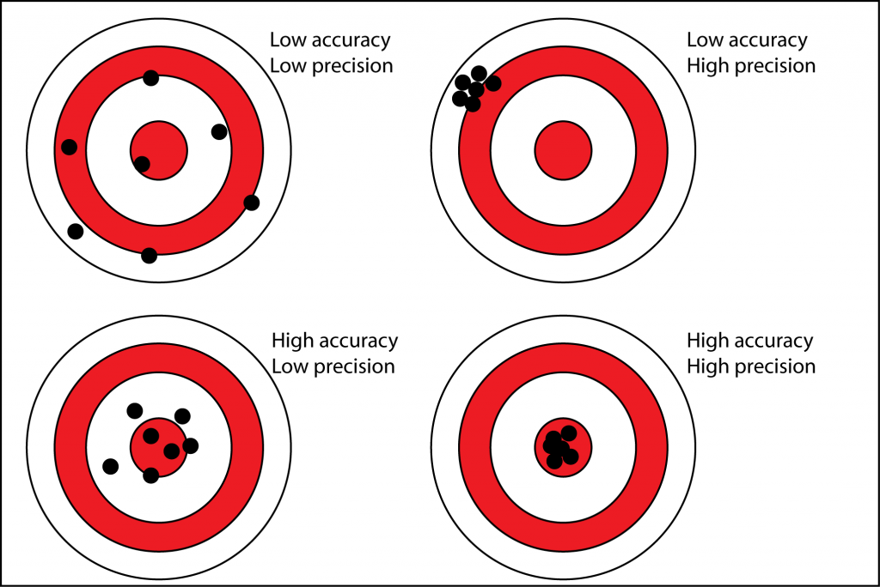
What we are learning and what we are missing
Current analysis is a good analysis to assess driver of precision in emission quantification.
Controlled release are necessary to assess accuracy in emission quantification.
Next Step: Converge on plume definition!
Next Step: Once a controlled release has been collected repeat process on controlled release plume and compare to ‘truth’ value.

Slide 23
Next steps
EnMap (& EMIT) controlled release analysis – use existing data
Perhaps analyze larger sets of EMIT data for improved stats with a subset of teams
Moving ahead more broadly
Publish documents, document validation strategies, support controlled release data centralization and coordination
Develop a consortium and get more teams engaged
What about other measurement technology (aircraft, drone, fenceline, lidar, long wavelength)
Stronger ties to other activities – CEOS, GHG Center, IMEO, academic + industrial groups (EEMDL @UT Austin, CSU Energy Institute), DOE FECM MMRV work, EPA

Slide 24
Summary
NIST is part of the ecosystem of groups working on remote sensing emissions estimate for methane
We are developing documentary standards
Current focus is to gain insights through an intercomparison exercise
This effort will get a boost from controlled release measurements
Plume origins known to within a few pixels, emissions vary by +/- 50-100% across teams

Slide 25
Backup

