Slide 1




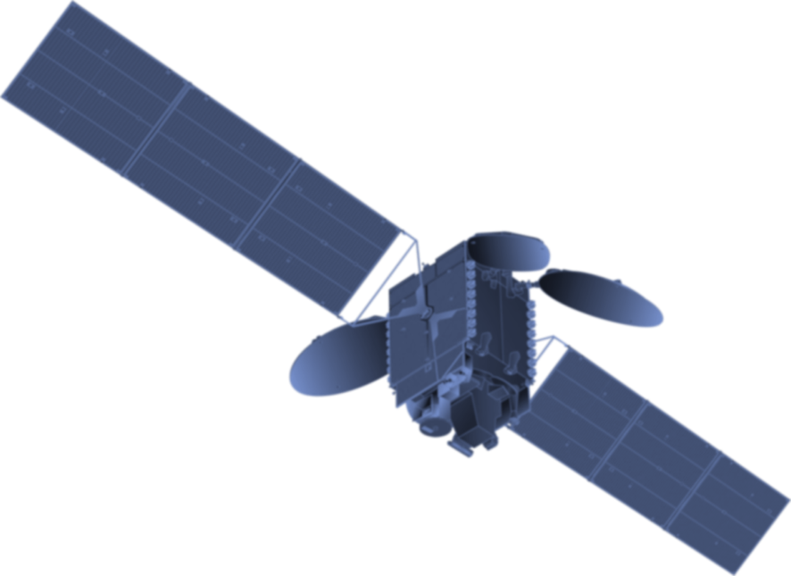
The U.S. GHG Center: Improving Trust in GHG Observations
Argyro Kavvada, Ph.D.
Program Manager, U.S. Greenhouse Gas Center
With contributions from Lesley Ott, Andrew Thorpe, Rob Green,
Annmarie Eldering, the project office and GHG Center team!
CEOS AC VC Meeting | October 17, 2024
Notes:
Background Image:
NASA's Scientific Visualization Studioz: https://svs.gsfc.nasa.gov/5110
Atmospheric Carbon Dioxide
This visualization is based on the following papers:Weir, B., Ott, L. E., Collatz, G. J., Kawa, S. R., Poulter, B., Chatterjee, A., Oda, T., and Pawson, S.: Bias-correcting carbon fluxes derived from land-surface satellite data for retrospective and near-real-time assimilation systems, Atmos. Chem. Phys., 21, 9609–9628, https://doi.org/10.5194/acp-21-9609-2021, 2021.

Slide 2
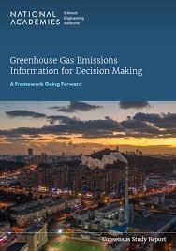
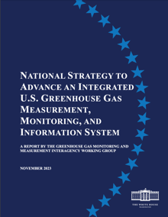
Motivation for the U.S. Greenhouse Gas Center
The NASEM Report on GHG Emissions Information for Decision Making (2022) calls for:
  “a mechanism that brings different types of information together could facilitate the integration of multiple types of data at various spatial scales and make the information accessible to decision makers and users in ways that meet their needs.”
The US GHG Center supports implementation of the national GHG Strategy (2023):
  “The U.S. Greenhouse Gas Center: Initially led by NASA, EPA, NIST and NOAA, this center will facilitate coordination across federal and non-federal, domestic, and international entities to integrate and distribute actionable GHG data.”
Notes:
The GHG Center coordinates implementation of GHG measurements, modeling, and data integration across partner agencies.

Slide 3
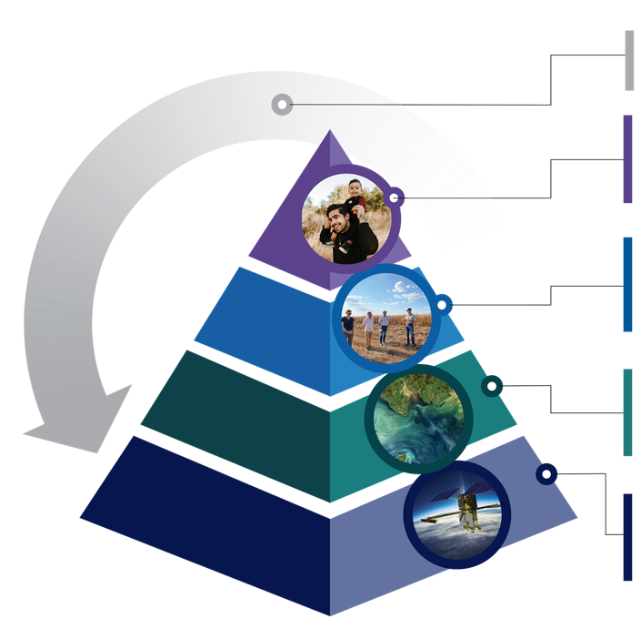
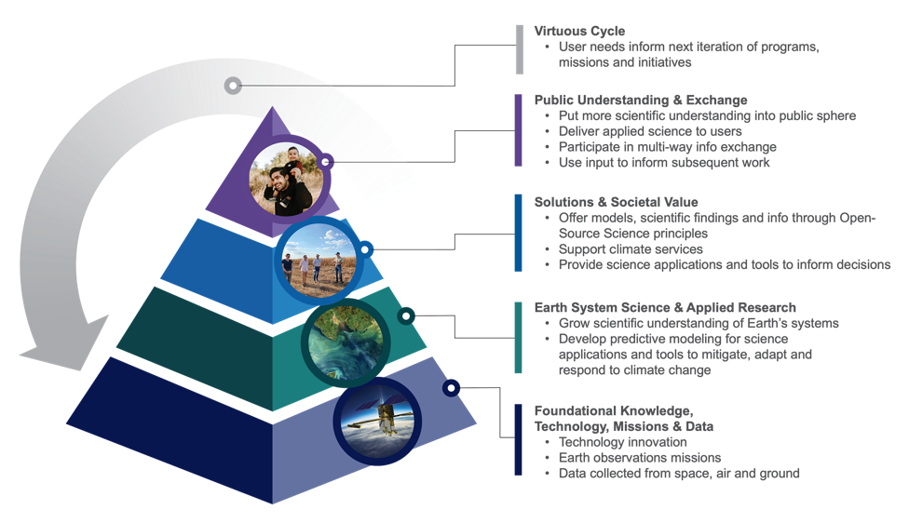
The U.S. Greenhouse Gas Center
Scalable Impact (alignment with GHGMMIS)
User needs inform refinement of tools, products
Coordinated communications, outreach
Workforce, educational initiatives
Earth Information Center – interactive events
Integrated Data portal
  Technical Analysis, Intercomparisons
  Thematic releases, coordinated storytelling
  Forward facing end-user interface
Stakeholder Engagement
Foundational Science Integration Activities (alignment with GHGMMIS)
Quasi-operational GHG modeling
Standardized model evaluation, methods for providing consensus estimates
Interagency modeling strategy and coordination
Coordination and evaluation of satellite data
Ground network coordination and standard
Expanded airborne measurements and coordination
NASA Earth Action Strategy
Cross-cutting: Alignment with stakeholder needs, interagency coordination, open science, and inclusivity
Notes:
GHGI background
- Highlight that updated a published every year

Slide 4
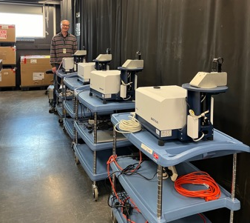
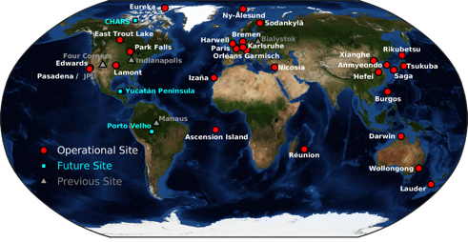
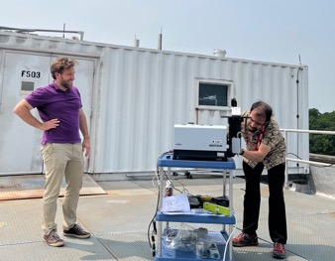
Expanding ground-based measurement networks and IPMSI participation
Coordinated deployment of lower cost, portable ground-based measurements
Current TCCON network for GHG cal/val
GHG measurements, GSFC
Image Credit: TCCON
  GHG Center supported expansion of EM27 capabilities from 4 → 18 instruments
  8 NASA –owned instruments supporting co-deployments with partner agencies – including CO (NOAA), NC (EPA), DC/Baltimore (NIST/NASA)
  10 additional NASA –owned instruments support MSI-based network – NASA ROSES FY24 – Expect announcements in Nov 2024
Before GHG Center investments: cal/val network is sparse, lacks coverage in key areas including U.S. East Coast

Slide 5


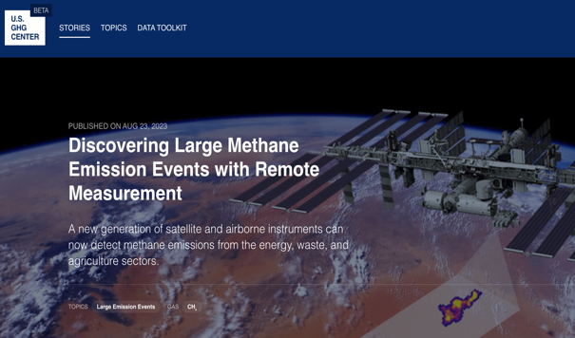
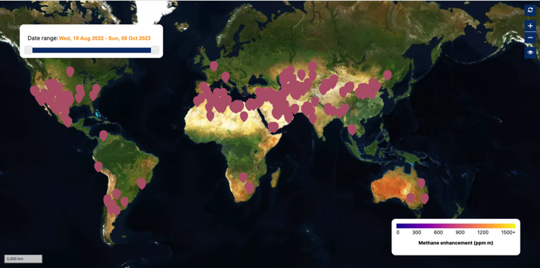

EMIT CH₄ data available through U.S. GHG Center
Planned:
EMIT CO₂ results
AVIRIS-3 CH₄ and CO₂ results

Slide 6
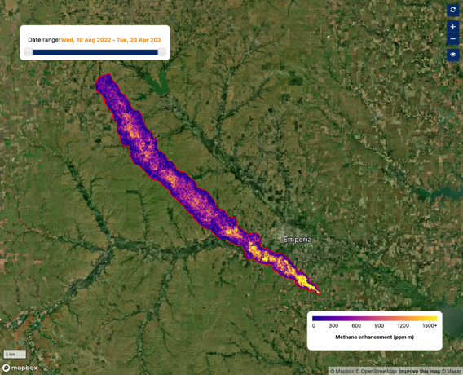
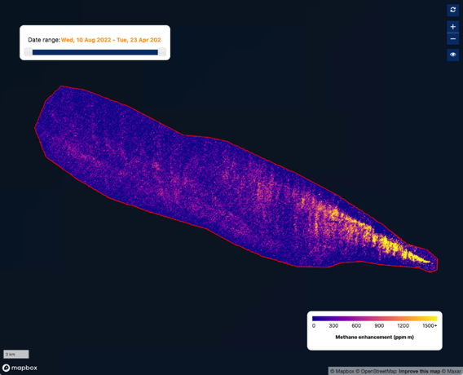



EMIT CH₄ results can discover unexpected emissions
EMIT CH₄ near Olpe, Kansas
EMIT CH₄ offshore Mexico
Sources verified by:
Notes:
Kansas: reached out to our EPA colleagues and they were able to verify this emission given it was eventually reported. It was confirmed to be a leak from a pipeline (i.e. unexpected) that necessitated a repair.
Shared the result with NOAA and they confirmed that at this location there was an offshore platform that was historically known to release methane. This example was unexpected for EMIT because we were able to see the plume without optimizing for sunglint (i.e. the EMIT instrument can’t be pointed).

Slide 7

US GHG Center: Coordination of Airborne Measurements Across Federal and Non-Federal Partners
First Airborne Coordination Workshop on September 3-4, 2024, hosted by NOAA.
Focused on improving coordination of air and ground-based measurements in the mid-Atlantic during summer 2025.
Included state (MDE) and federal stakeholders (EPA, DOE, USGS), who provided input on priority targets for observations and preliminary flight plans.
NASA and NOAA are coordinating planned NOAA GHG data purchases that support NOAA airborne teams and their efforts to evaluate commercial data quality
GHG Center is working with NOAA to coordinate four NASA-funded aircraft flights, targeting urban areas in Baltimore and regions in Pennsylvania associated with oil and gas production
Notes:
These efforts aim to bolster trust in remote sensing observations, refine state and federal inventories, and enhance understanding of the relationship between greenhouse gases, air quality, and urban heat that states.

Slide 8

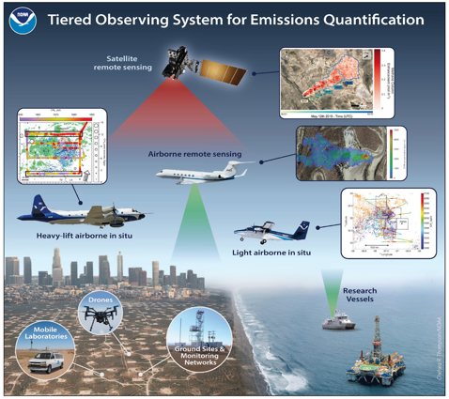




AIrborne and Remote sensing Methane, Air Pollutant Surveys
2024: CO & UT
2025: PA & MD
Early outreach for future years:
CA, NV, AZ, NM, TX
Courtesy: Steve Brown
Notes:
Airborne and Remote sensing Methane and Air Pollutant Surveys (AiRMAPS) is a series of studies led by NOAA Oceanic and Atmospheric Research (OAR) and NOAA National Environmental Satellite, Data, and Information Service (NESDIS) to investigate greenhouse gas and air pollutant emissions and impacts.

Slide 9
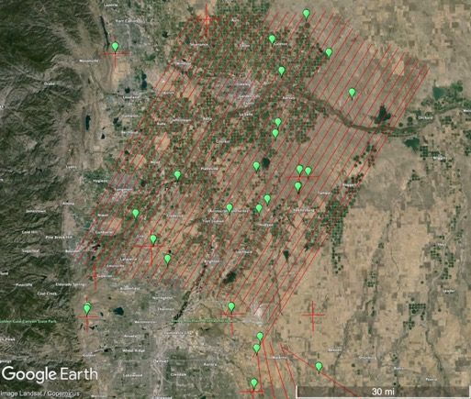
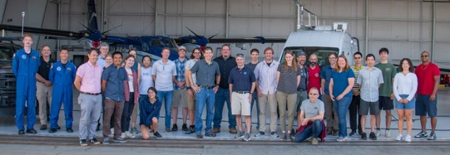
AIrborne and Remote sensing Methane, Air Pollutant Surveys – Recent Campaigns
Denver Julesburg Basin, July 2024
Led by Steven Brown (NOAA), supported by Colorado Department of Public Health and Environment
NASA AVIRIS-3 flights funded by US GHG Center in coordination with NOAA Twin Otter Mass Balance flights
>40 CH₄ plumes identified with AVIRIS-3
AVIRIS-3 CH₄ plumes

Slide 10
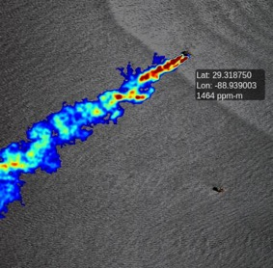
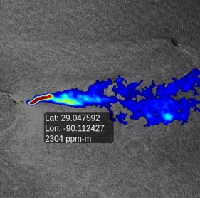
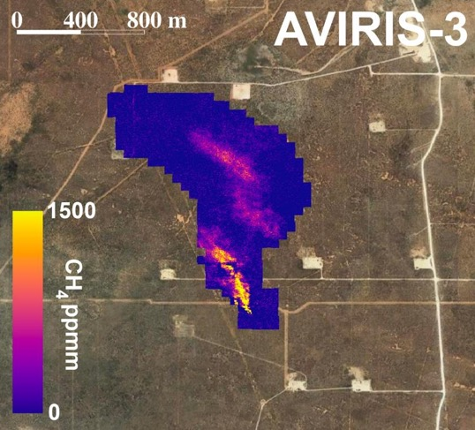
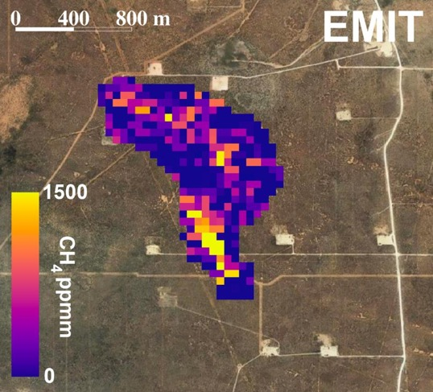

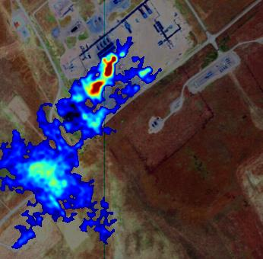
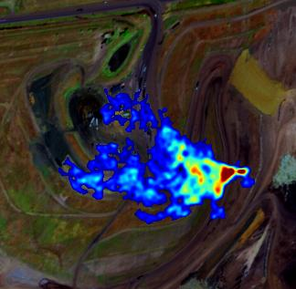

AVIRIS 3 Activities Supporting EMIT Cal/Val & Agency Initiatives
NASA SCOAPE-II mission
Coincident AVIRIS-3/ EMIT observations in Permian Basin (NM, TX)
Offshore platform (LA)
Offshore platform (LA)
NOAA AiRMAPS mission
Compressor station (CO)
Landfill (CO)
10
Notes:
AVIRIS-3, the airborne version of EMIT, has been heavily utilized for activities such as underflying EMIT for cal/val activities, supporting BOEM in examining offshore methane emissions from oil rigs, and supporting the NOAA AIRMAPS activity exploring emissions and air quality in the Denver-Julesburg basin

Slide 11
Consensus Standards for Methane Measurements:
Facility Scale Emissions Intercomparison
Jan ’24 kickoff workshop with industry, Fed agencies, and researchers
Develop definitions and terminology
Explore expansion of group to other measurement technologies
Collaboratively document current practices
Develop transparency portal at US GHG Center
Stage 1: Brainstorm and community building
Stage 2: Advance in a few specific areas
Stage 3: Future directions
Begin intercomparison activities
Guidance on validation practices and data specifications
Facilitate info flow for controlled release activities
Strengthen connections to other organizations
Courtesy - Annmarie Eldering, NIST

Slide 12
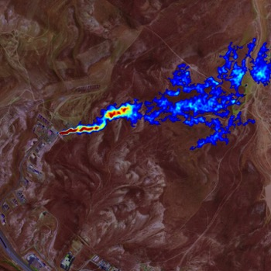
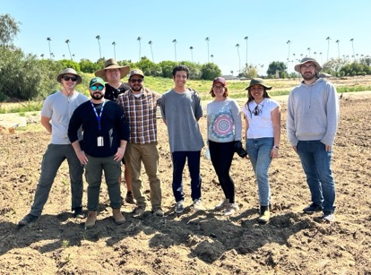
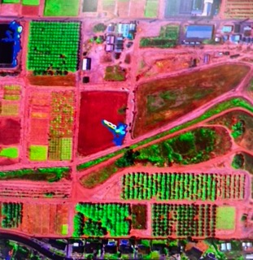
Methane Controlled Releases
NASA AVIRIS-3 controlled release datasets will be made available through the ORNL DAAC
US GHG Center portal to serve as centralized location for airborne/satellite datasets
Mar. 2024, JPL & U.C. Berkleey, US GHG Center funded
Sep. 2024, JPL & Stanford, Carbon Mapper funded

Slide 13
Ongoing/ Future Collaborations
US GHG Center is working to support EPA’s Super Emitters Program remote sensing technology reviews
Improving access to and quality of NGO data on large methane emissions
  Incorporate NGO, publicly available data into GHG Center portal following internal review (e.g., MethaneSat, Carbon Mapper; Sept release featured Vulcan 4.0 inventory from Crosswalk Labs)
  Work with agency, industry partners to co-develop enhanced transparency portal to share methods, algorithms, calibration/validation data, and/or exemplar/benchmark data sets
Ongoing discussions with existing US GHG Center partners, DOE and other interested parties on coordination of controlled release experiments, expanding data sharing efforts related to Agency initiatives, such as the Methane Emissions Reduction Program, and facilitating ground-based and airborne measurements across natural and urban systems.
Training Opportunities (e.g., ARSET Training on Methane Observations for Large Emission Event Detection and Monitoring)

Slide 14
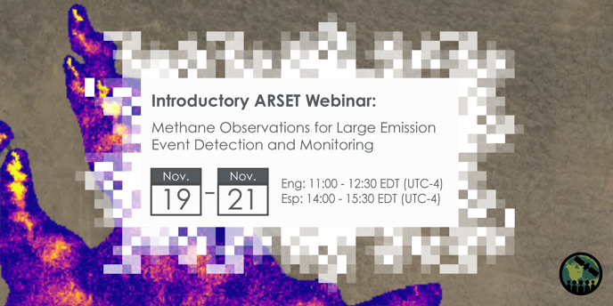


Upcoming ARSET Training: Methane Observations for Large Emission Event Detection and Monitoring
Identify the goals and objectives of the U.S. Greenhouse Gas Center
Define the roles of methane and large emission events in climate change
Identify the sensors used to measure methane
Recognize the strengths and limitations of satellite observations used to measure methane for large emission event tracking
Navigate the U.S. Greenhouse Gas Center Portal and the EMIT Open Data Portal to access and visualize data for large emission event tracking
English webpage:
Spanish webpage:

Slide 15
The U.S. Greenhouse Gas Center
earth.gov/ghgcenter
Thank you!
Argyro.Kavvada@nasa.gov
Notes:
Background Image:
NASA's Scientific Visualization Studioz: https://svs.gsfc.nasa.gov/5110
Atmospheric Carbon Dioxide
This visualization is based on the following papers:Weir, B., Ott, L. E., Collatz, G. J., Kawa, S. R., Poulter, B., Chatterjee, A., Oda, T., and Pawson, S.: Bias-correcting carbon fluxes derived from land-surface satellite data for retrospective and near-real-time assimilation systems, Atmos. Chem. Phys., 21, 9609–9628, https://doi.org/10.5194/acp-21-9609-2021, 2021.

