Slide 1
Validation of Facility Scale Measurements
Dr. Evan Sherwin
Climate Sciences Dept.
Sustainable Energy & Environmental Systems Dept.
Lawrence Berkeley National Laboratory
Founder & Chair, Methane Emissions Technology Alliance
evansherwin@lbl.gov

Slide 2
How well does methane remote sensing work?
Can Technology X:
Detect methane point sources?
Quantify methane point sources?
How reliably?
With what accuracy?

Slide 3
Ways to answer these questions
Engineering calculations/simulations
Collaborative controlled release testing
Blind controlled release testing
Statistical analysis of field measurements

Slide 4
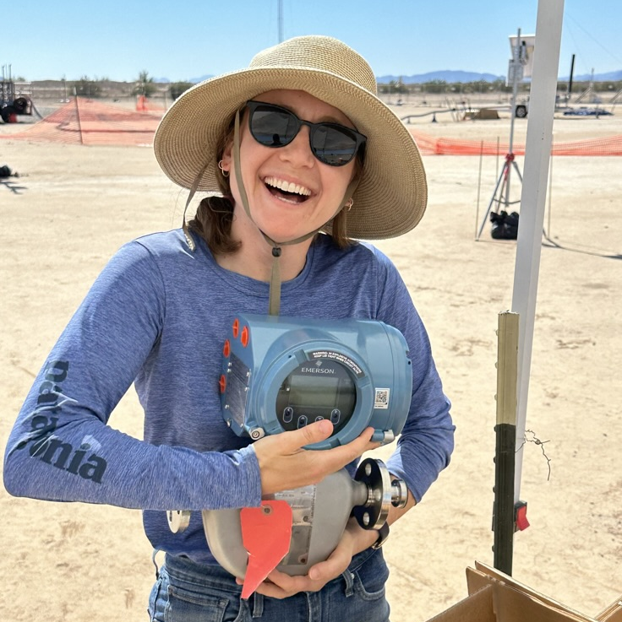
Principles of single-blind testing
Creative Commons:
OpenClipArt.org
PinClipArt.com
PublicDomainVectors.com
Pixabay.com
FreeSVG.org
Jeff Rutherford
Sahar El Abbadi

Slide 5
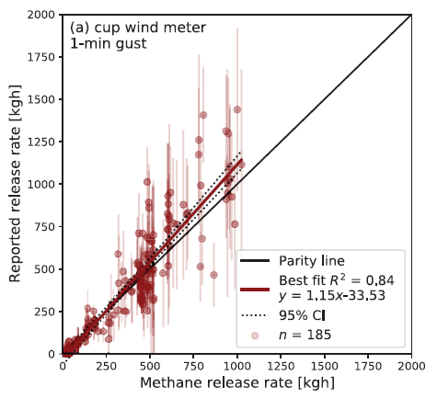
Promising results from aerial testing
Source: Sherwin, Chen et al. 2021

Slide 6
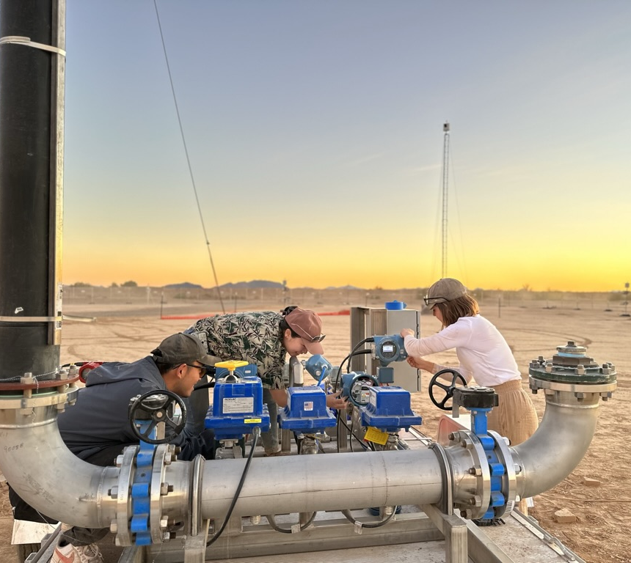
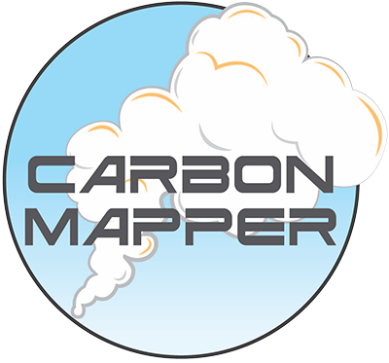
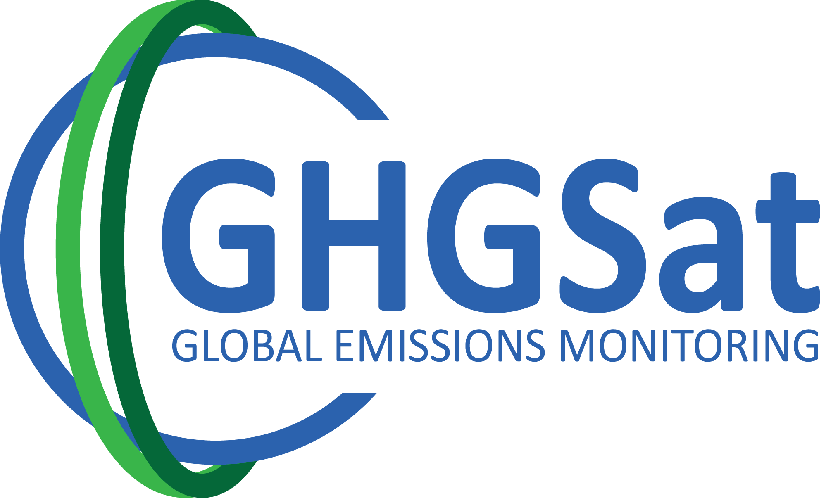
We have basically tested them all
ORBIO
MethaneAIR
Adam Brandt
Airplanes
Satellite Analysis
Sahar El Abbadi

Slide 7
Takeaways from aerial testing
Methane remote sensing works
Uncertain, but unbiased quantification
(95% confidence intervals of +-80%)
Important to test at field-realistic rates
It takes at least ~100 data points to
thoroughly characterize performance

Slide 8
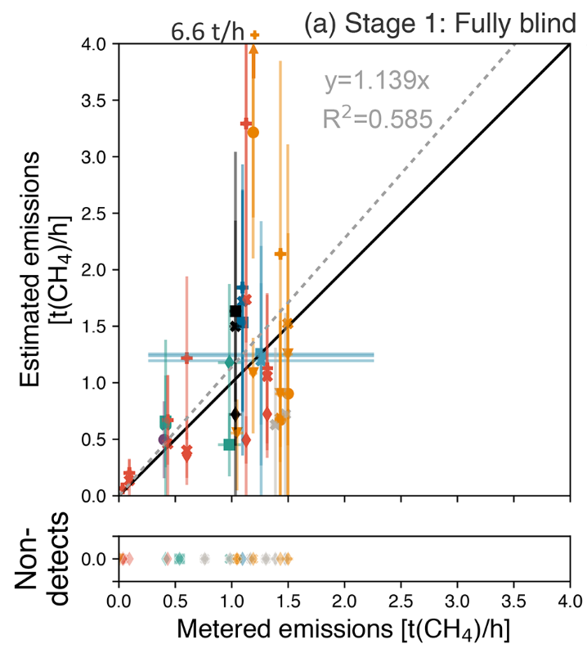
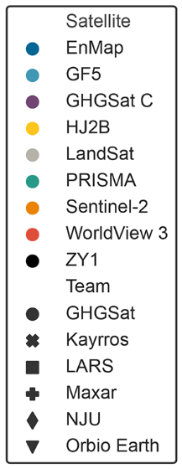
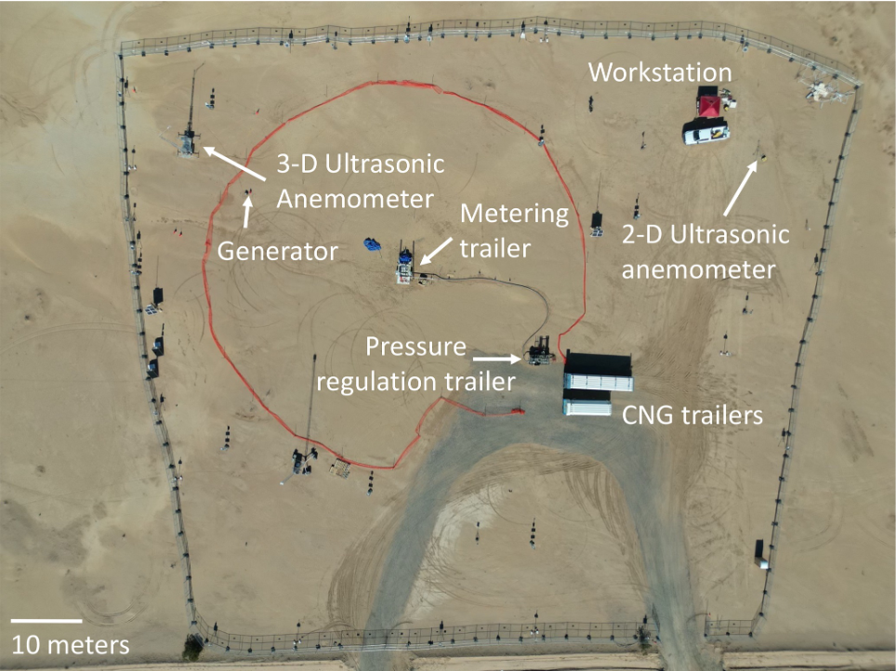
Promising initial results from satellite testing
Similar uncertainty to aircraft
Sherwin et al. 2024

Slide 9
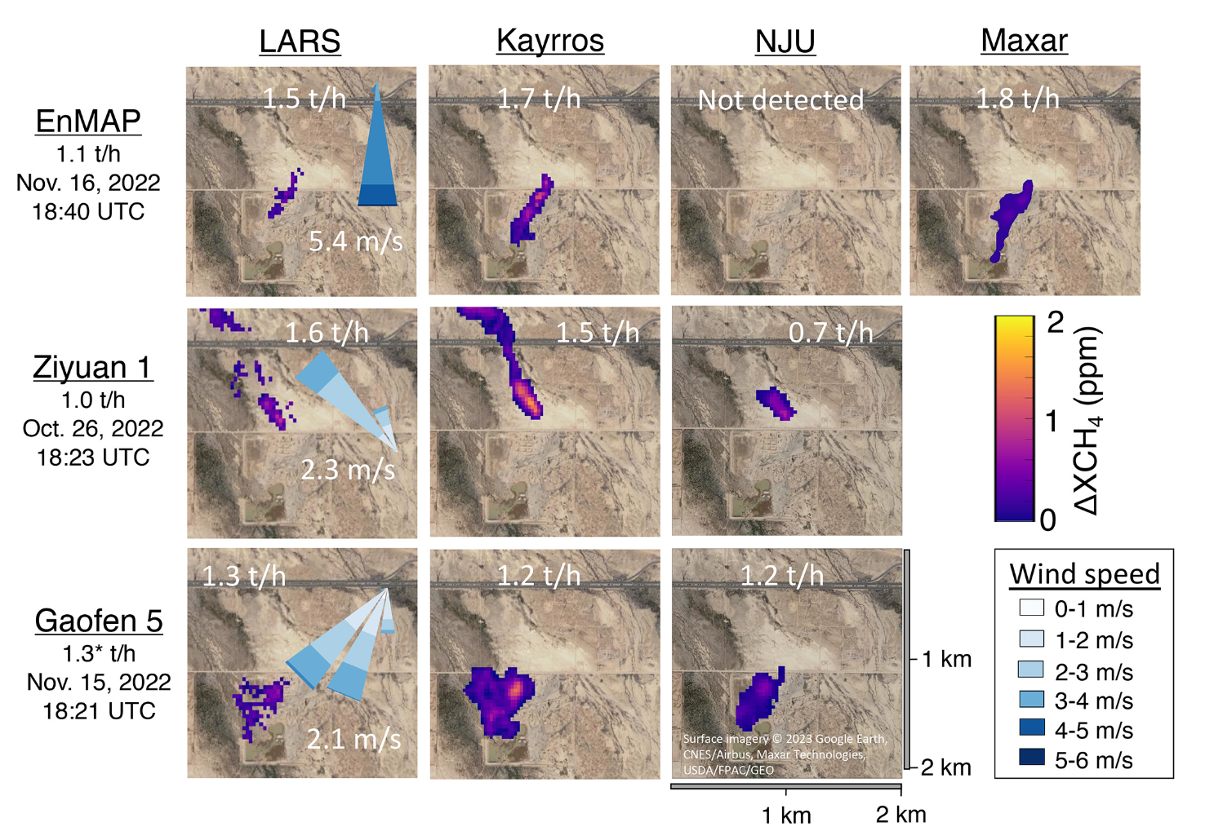
Same spectra, different results
Sherwin et al. 2024

Slide 10
Shortcomings of satellite testing so far
Small sample size
Favorable environmental conditions
Short duration
Known location

Slide 11
With known location testing, you know where to look
Would they have found this in the wild?

Slide 12
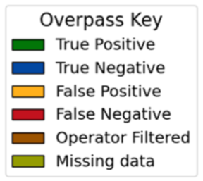
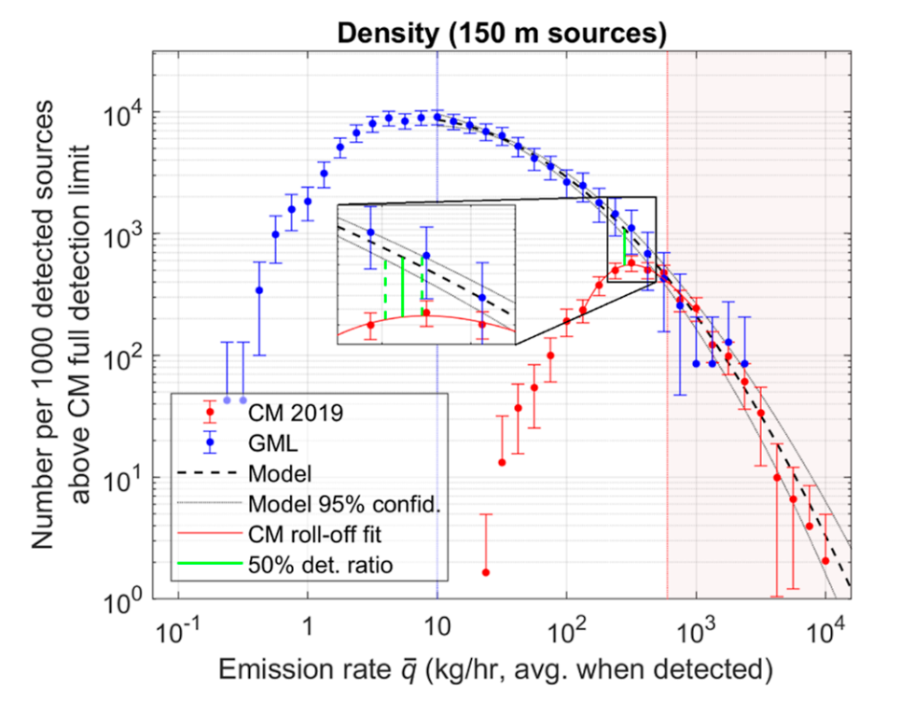
Can leverage field statistics to assess detection abilities
# of releases
Release rate [kg/h]
Can compare field statistics with a more sensitive instrument to estimate detection capabilities
Sources: El Abbadi et al. 2023,
Kunkel et al. 2023

Slide 13
Single-blind testing is critical, but probably not enough
We have learned a lot from testing so far
We need much more testing to rigorously understand capabilities
Field statistics can tell us a lot about detection capabilities in the wild
Stanford & Colorado State University set to begin next generation of satellite testing

Slide 14
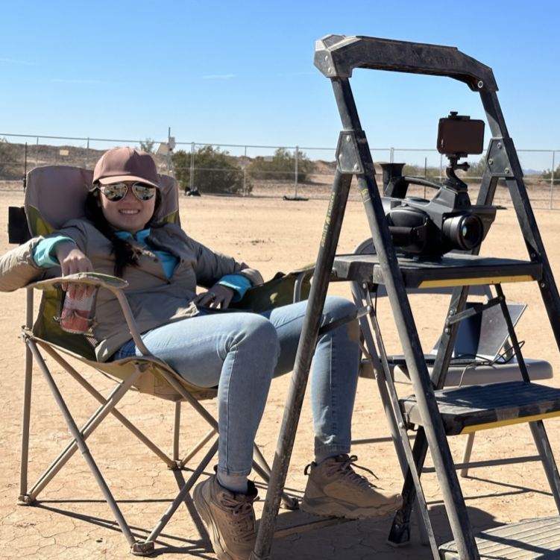
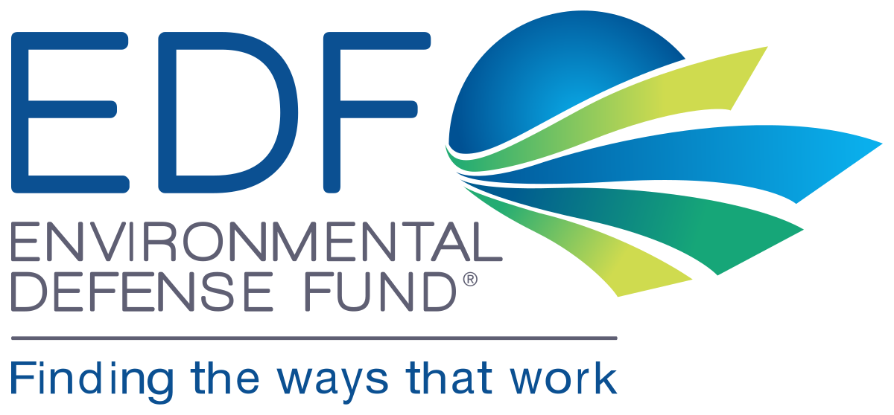
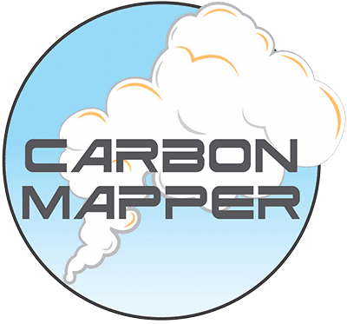
Acknowledgments
Funders
Philippine Burdeau
Richard Chen
Yulia Chen
Jeff Rutherford
Zhan Zhang
Sahar El Abbadi
Evan Sherwin
Adam Brandt
Partners
Volta Fabrication
14

Slide 15
Works cited
1. Omara, M. et al. Methane Emissions from Natural Gas Production Sites in the United States: Data Synthesis and National Estimate. Environ. Sci. Technol. 52, 12915–12925 (2018).
2. Alvarez, R. A. et al. Assessment of methane emissions from the U.S. oil and gas supply chain. Science eaar7204 (2018) doi:10.1126/science.aar7204.
3. Rella, C. W., Tsai, T. R., Botkin, C. G., Crosson, E. R. & Steele, D. Measuring Emissions from Oil and Natural Gas Well Pads Using the Mobile Flux Plane Technique. Environ. Sci. Technol. 49, 4742–4748 (2015).
4. Cusworth, D. H. et al. Intermittency of Large Methane Emitters in the Permian Basin. Environ. Sci. Technol. Lett. 8, 567–573 (2021).
5. Sherwin, E. D. et al. Single-blind validation of space-based point-source methane emissions detection and quantification. Preprint at https://doi.org/10.31223/X5DH09 (2022).
6. Sherwin, E. et al. Single-blind test of nine methane-sensing satellite systems from three continents. Atmospheric Meas. Tech. 70, 765–782 (2024).

Slide 16
Works cited
7. Rutherford, J., Sherwin, E., Chen, Y., Aminfard, S. & Brandt, A. R. Evaluating methane emission quantification performance and uncertainty of aerial technologies via high-volume single-blind controlled releases. Preprint at https://doi.org/10.31223/X5KQ0X (2023).
8. El Abbadi, S. et al. Comprehensive Evaluation of Aircraft-Based Methane Sensing for Greenhouse Gas Mitigation. https://eartharxiv.org/repository/view/5569/ (2023) doi:10.31223/X51D4C.
9. Sherwin, E. D. et al. US oil and gas system emissions from nearly one million aerial site measurements. Nature 627, 328–334 (2024b).
10. Rutherford, J. S. et al. Closing the methane gap in US oil and natural gas production emissions inventories. Nat. Commun. 12, 4715 (2021).
11. Omara, M. et al. Methane emissions from US low production oil and natural gas well sites. Nat. Commun. 13, 2085 (2022).
12. MethaneSAT. Go Bold on Reducing Methane. https://www.methanesat.org/ (2022).
13. Sherwin, Chen et al. Single-blind test of airplane-based hyperspectral
methane detection via controlled releases. Elementa. 9:1 (2021)
.

