Slide 1
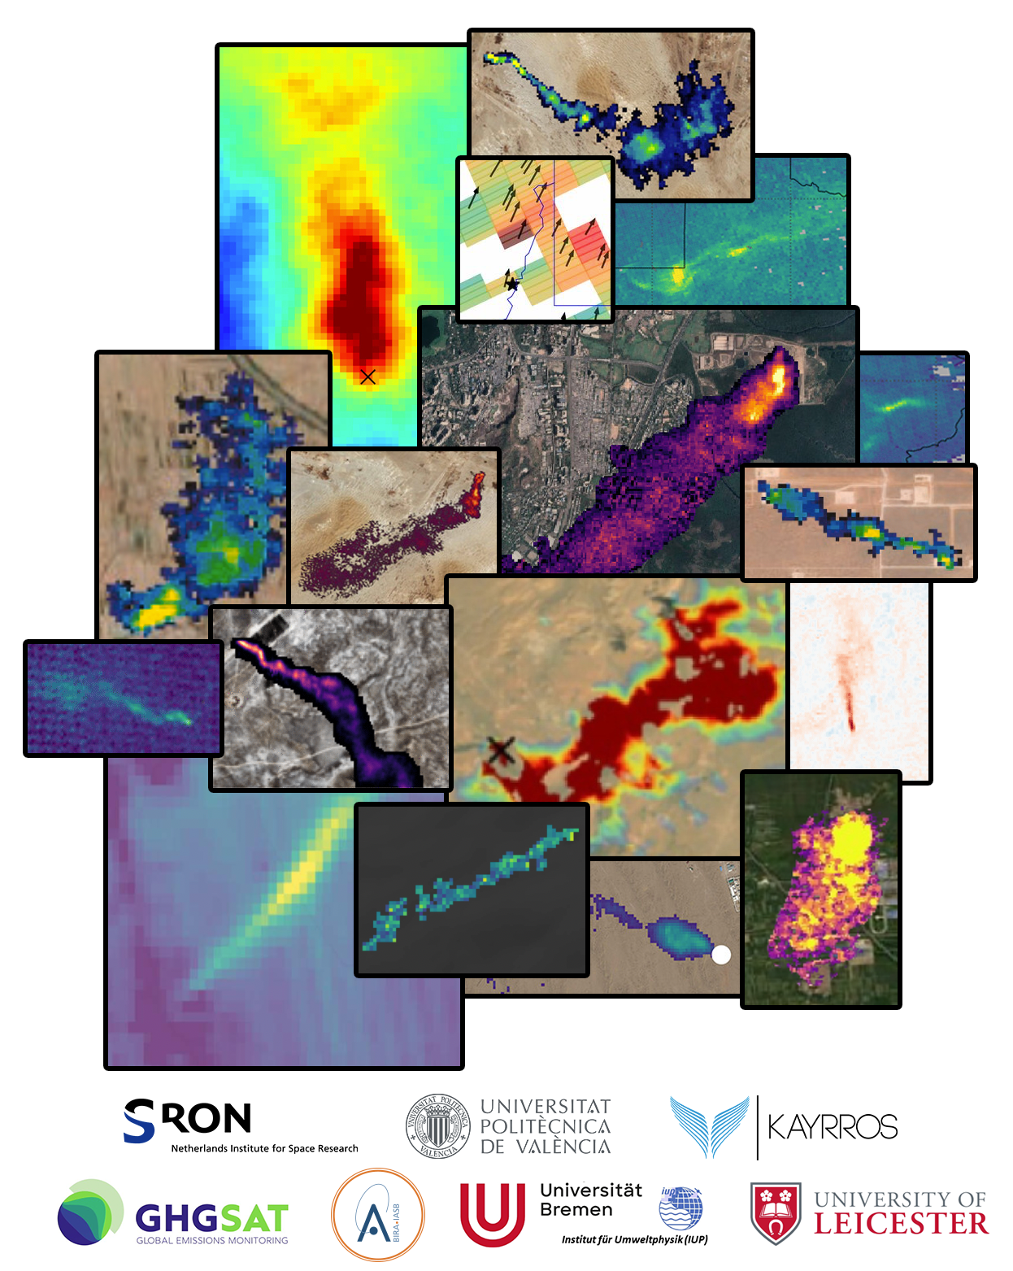
Methane
Emissions
Detection
Using
Satellites
Assessment
Project lead: SRON
Duration: 3 years (2024-27)
October 17th, 2024
Notes:
SRON-led

Slide 2
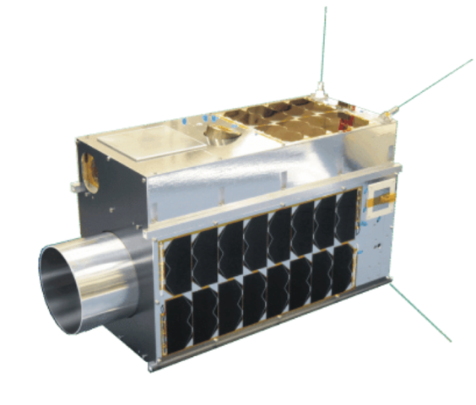
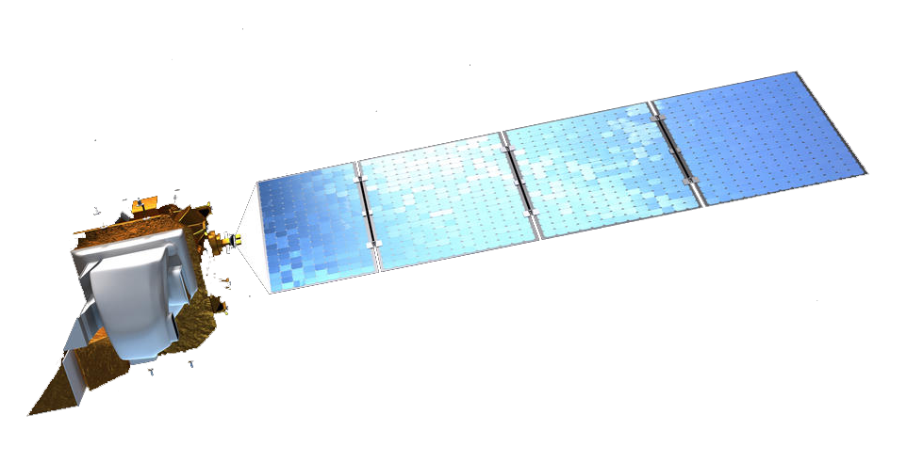
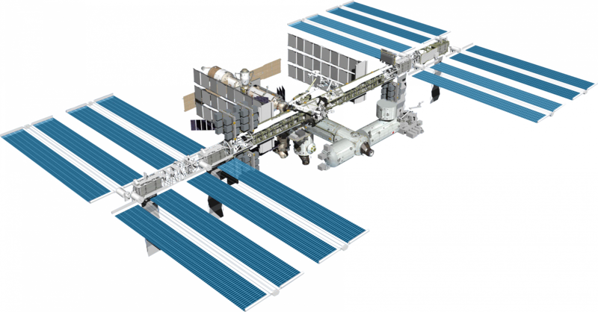
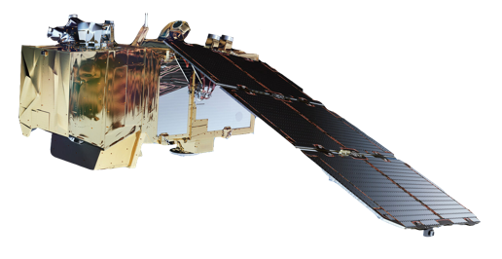
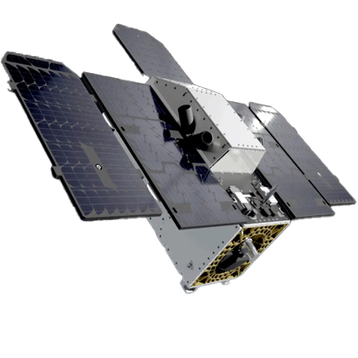
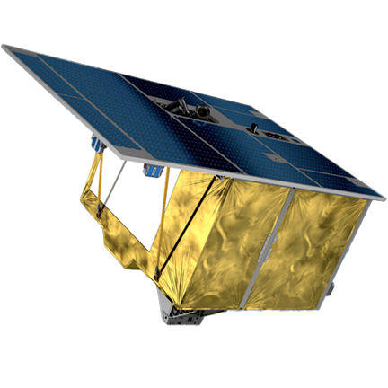
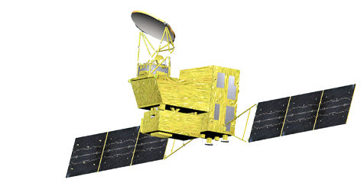
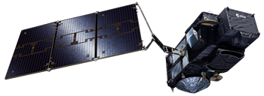
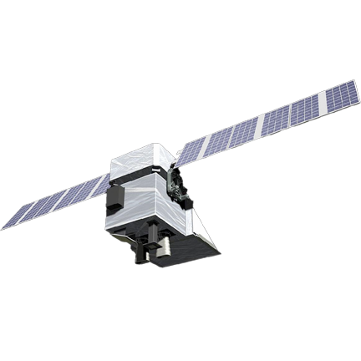
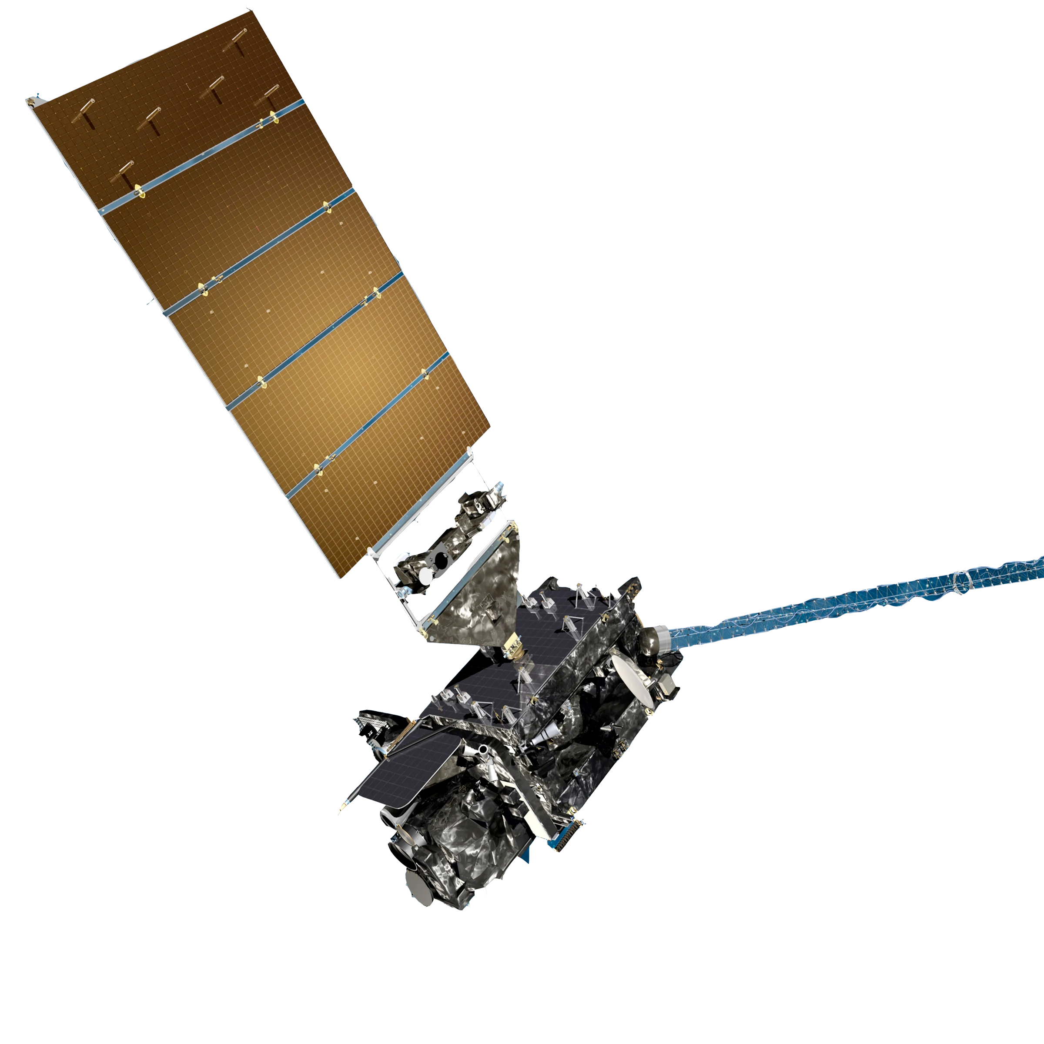
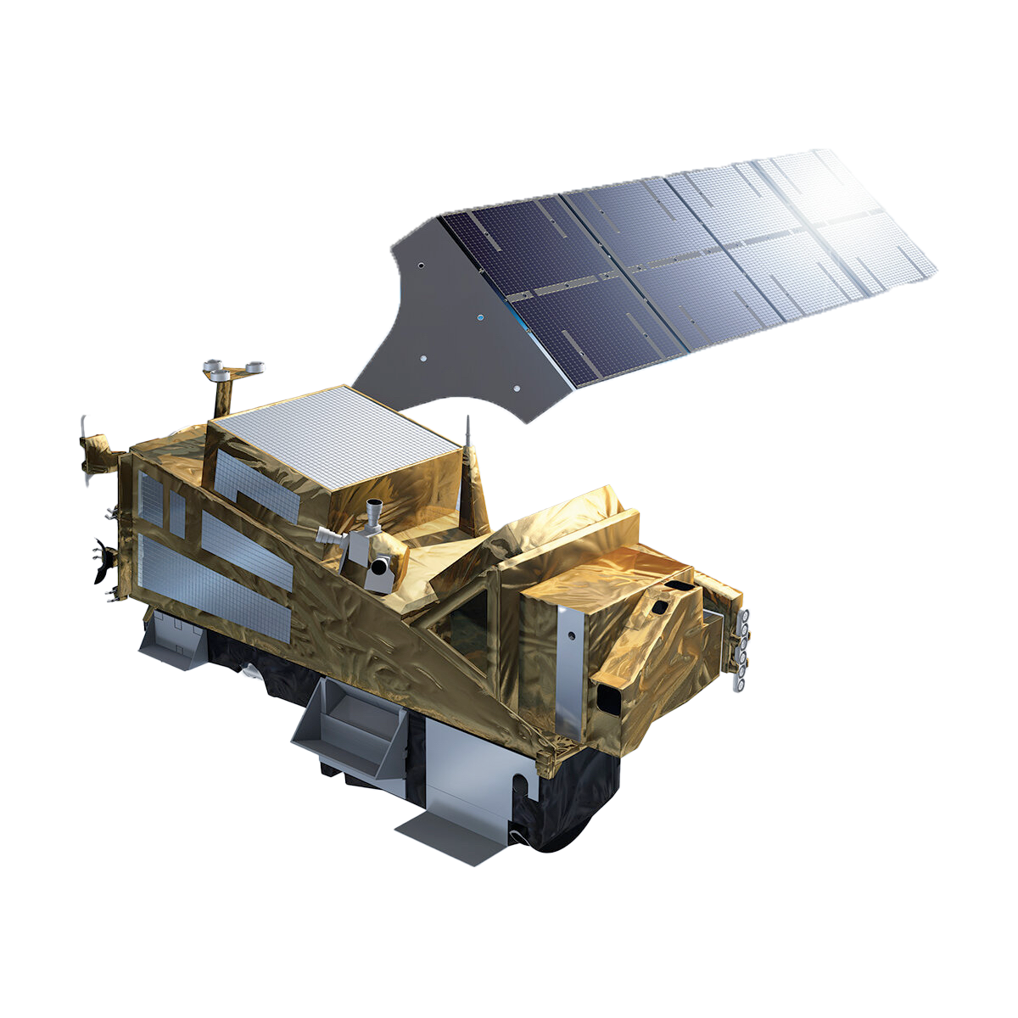
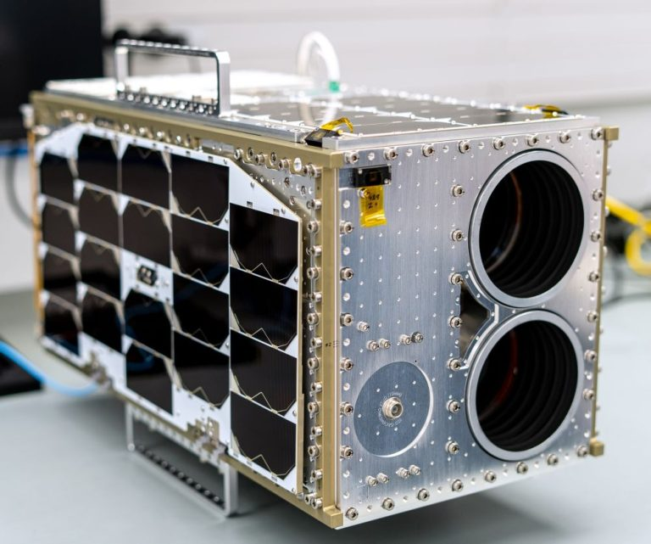
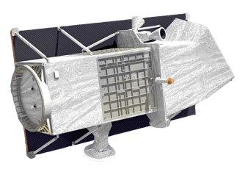
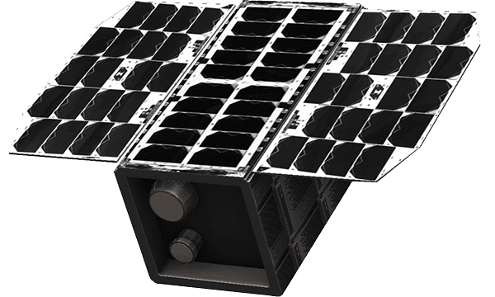
Overview of satellites observing methane hot spots/plumes
Global flux mappers
Point source imagers
Designed for methane Hyperspectral Band Imagers
Daily global, city-scale res.
Targeting, facility-scale
scientific products
Part of the data
private company
Landsat
Sentinel-5P (TROPOMI)
GHGSat
EMIT/ISS
Sentinel-2
Sentinel-3
Carbon Mapper
EnMAP
GOSAT-GW
GEISAT, Satlantis
GOES
MethaneSAT
private companies
Sentinel-5
PRISMA
VIIRS
Animation Credit: ESA/ATG
GESat, Absolut sensing
Notes:
Very different characteristics, spatial resolution, coverage, sensitivity methane
Public vs private, open data
Targeting vs global coverage

Slide 3
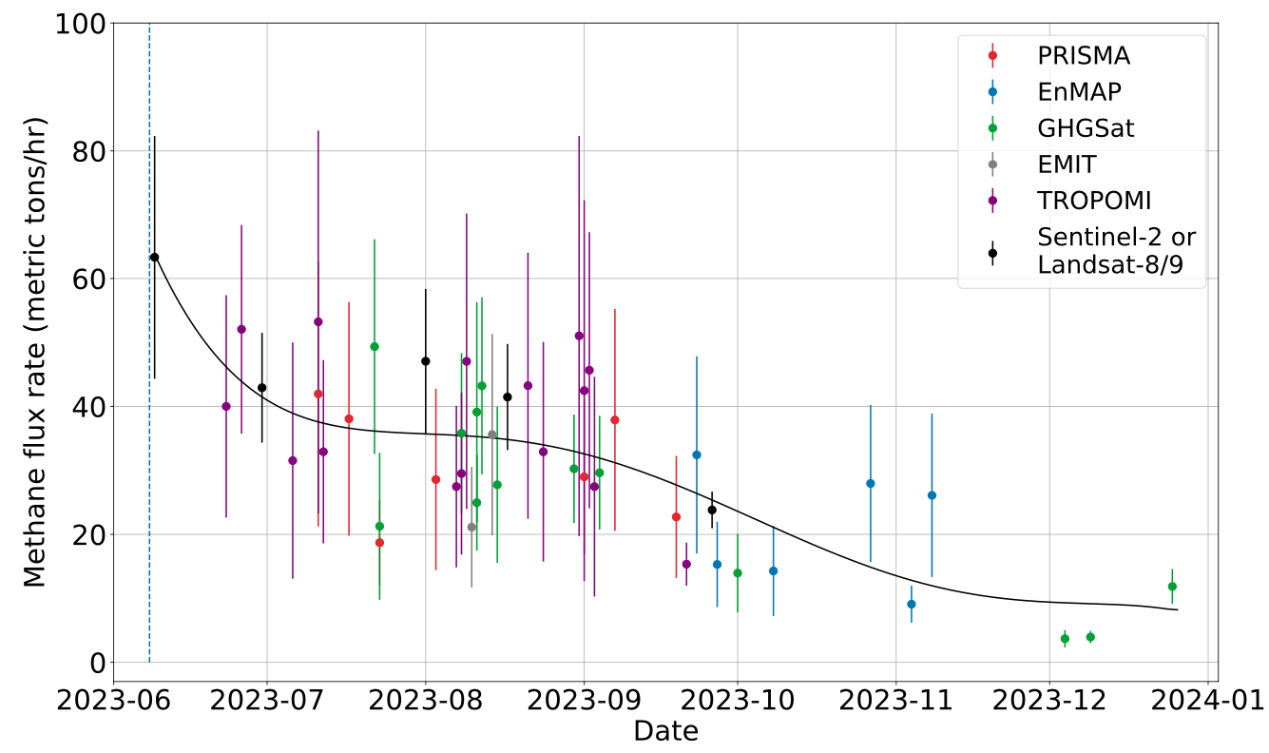
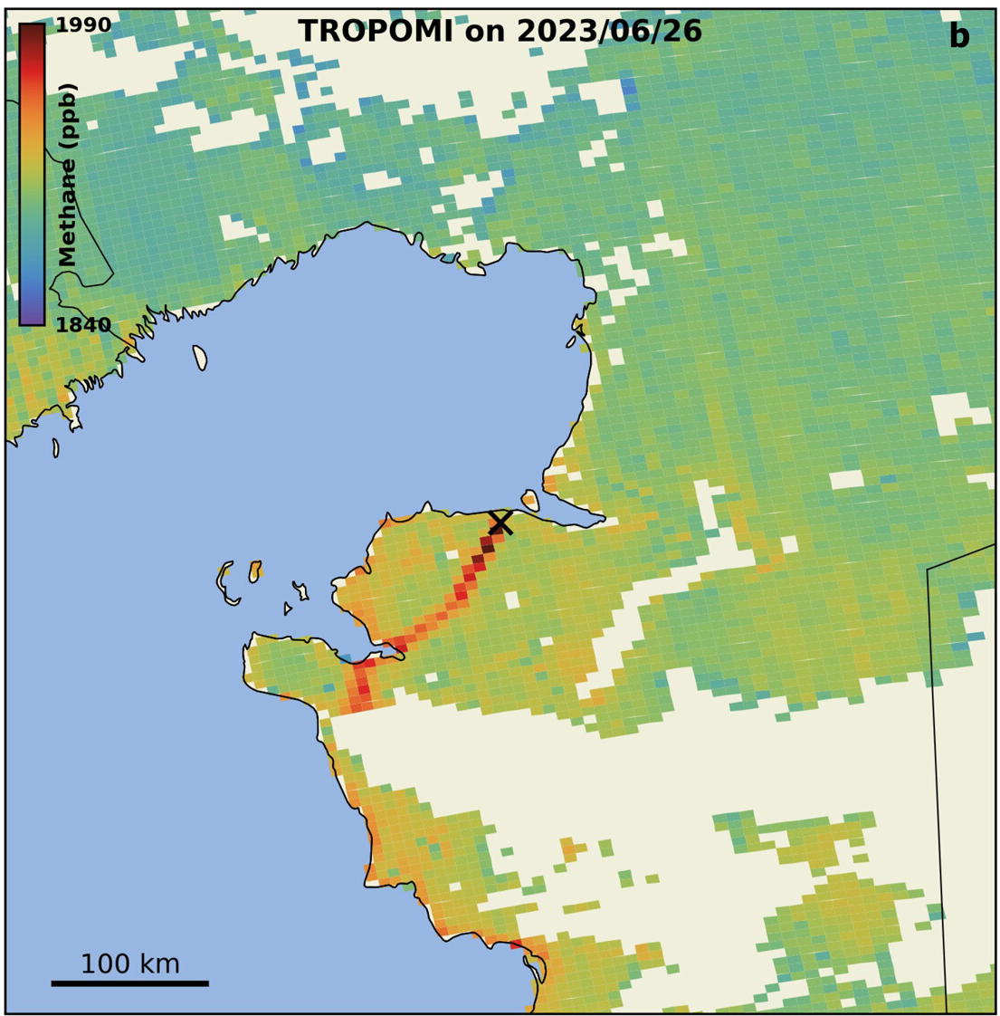
MEDUSA – Objective
‘To develop the techniques and a pre-operational system to harmonize and integrate global information on subnational (urban, hot spot) to facility scale anthropogenic methane emissions derived using diverse satellite instruments and algorithms.’
TROPOMI 26 June’23
Guanter et al. (2024)
Notes:
Well blow out in an oil field

Slide 4
MEDUSA – Objective
‘To develop the techniques and a pre-operational system to harmonize and integrate global information on subnational (urban, hot spot) to facility scale anthropogenic methane emissions derived using diverse satellite instruments and algorithms.’
Guanter et al. (2024)

Slide 5
MEDUSA – Setup
High resolution instruments
Validation of high-resolution imagers against controlled releases
(gold standard)

Slide 6
MEDUSA – Setup
High resolution instruments
Coarse resolution instruments
1
Validation of emission estimates
Validation of high-resolution imagers against controlled releases
(gold standard)
Linking coarse resolution mapper observations on relevant cases
.......................

Slide 7
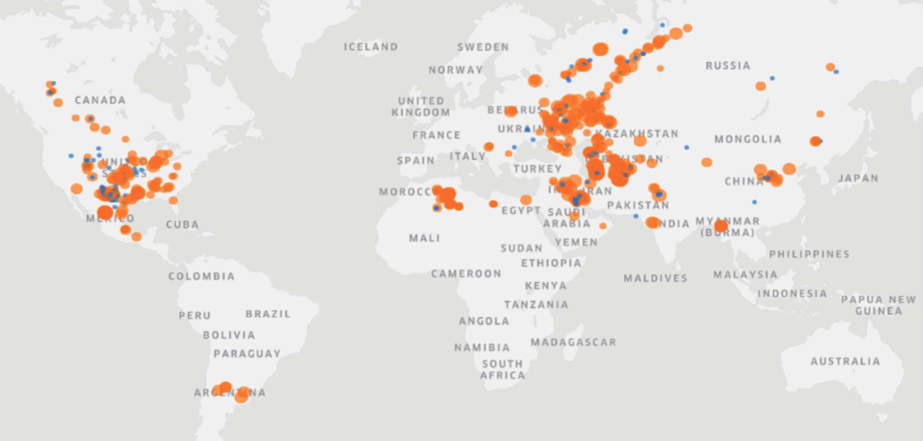
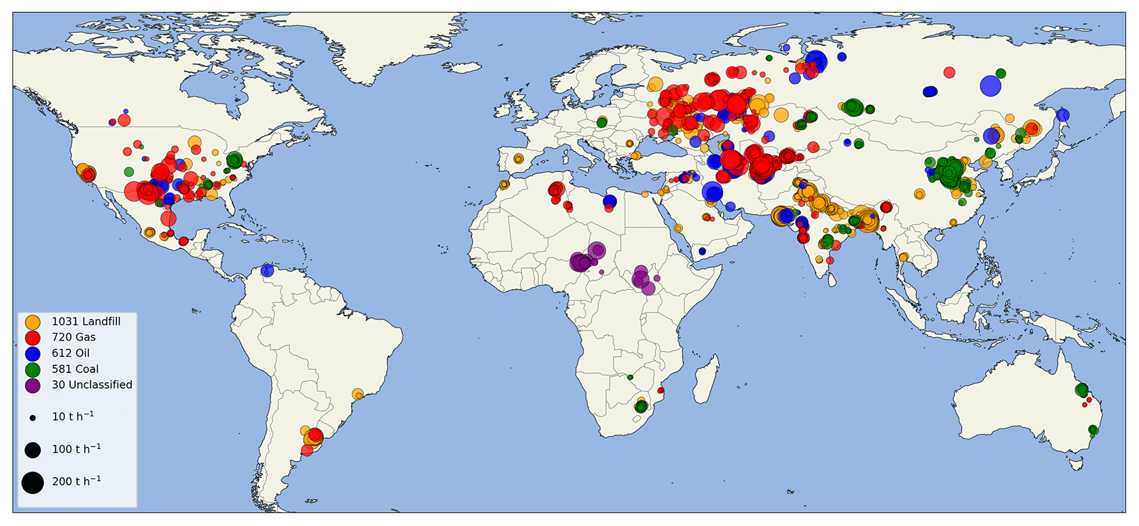
MEDUSA – Setup
2
Intercomparison of different results from similar satellites
E.g.
Kayrros
High resolution instruments
Coarse resolution instruments
SRON
1
Validation of emission estimates
Validation of high-resolution imagers against controlled releases
(gold standard)
Linking coarse resolution mapper observations on relevant cases
.......................

Slide 8
MEDUSA – Setup
2
Intercomparison of different results from similar satellites
E.g.
Kayrros
High resolution instruments
Coarse resolution instruments
SRON
3
Uncertainty calculation
Develop common approach/guidelines
4
Integration and case studies
1
Validation of emission estimates
Validation of high-resolution imagers against controlled releases
(gold standard)
Linking coarse resolution mapper observations on relevant cases
.......................
5
High-resolution satellite CO₂ observations
Notes:
..guidleines that can be readily applied to estimate prognostic uncertainty for different instruments and retrieval algorithms (community concensus)

Slide 9
MEDUSA – Covered instruments
Covered instruments
Instrument type | Instrument / Satellite
Flux Mappers | TROPOMI/S5P
 | Sentinel-5
 | GOSAT-GW
Hyperspectral Imagers | PRISMA
 | EnMAP
 | EMIT
Band Imagers | Landsat 8
 | Sentinel-2
 | GOES
 | Sentinel-3
 | MTG
Methane-specific | GHGSat
 | Potentially: Absolute Sensing & Satlantis
Methane-specific instruments (Publicly available L4) | Carbon Mapper
 | MethaneSAT
Parallel activity lead by NIST
comparing EMIT CH4 plume emissions
Future data products in gray

Slide 10
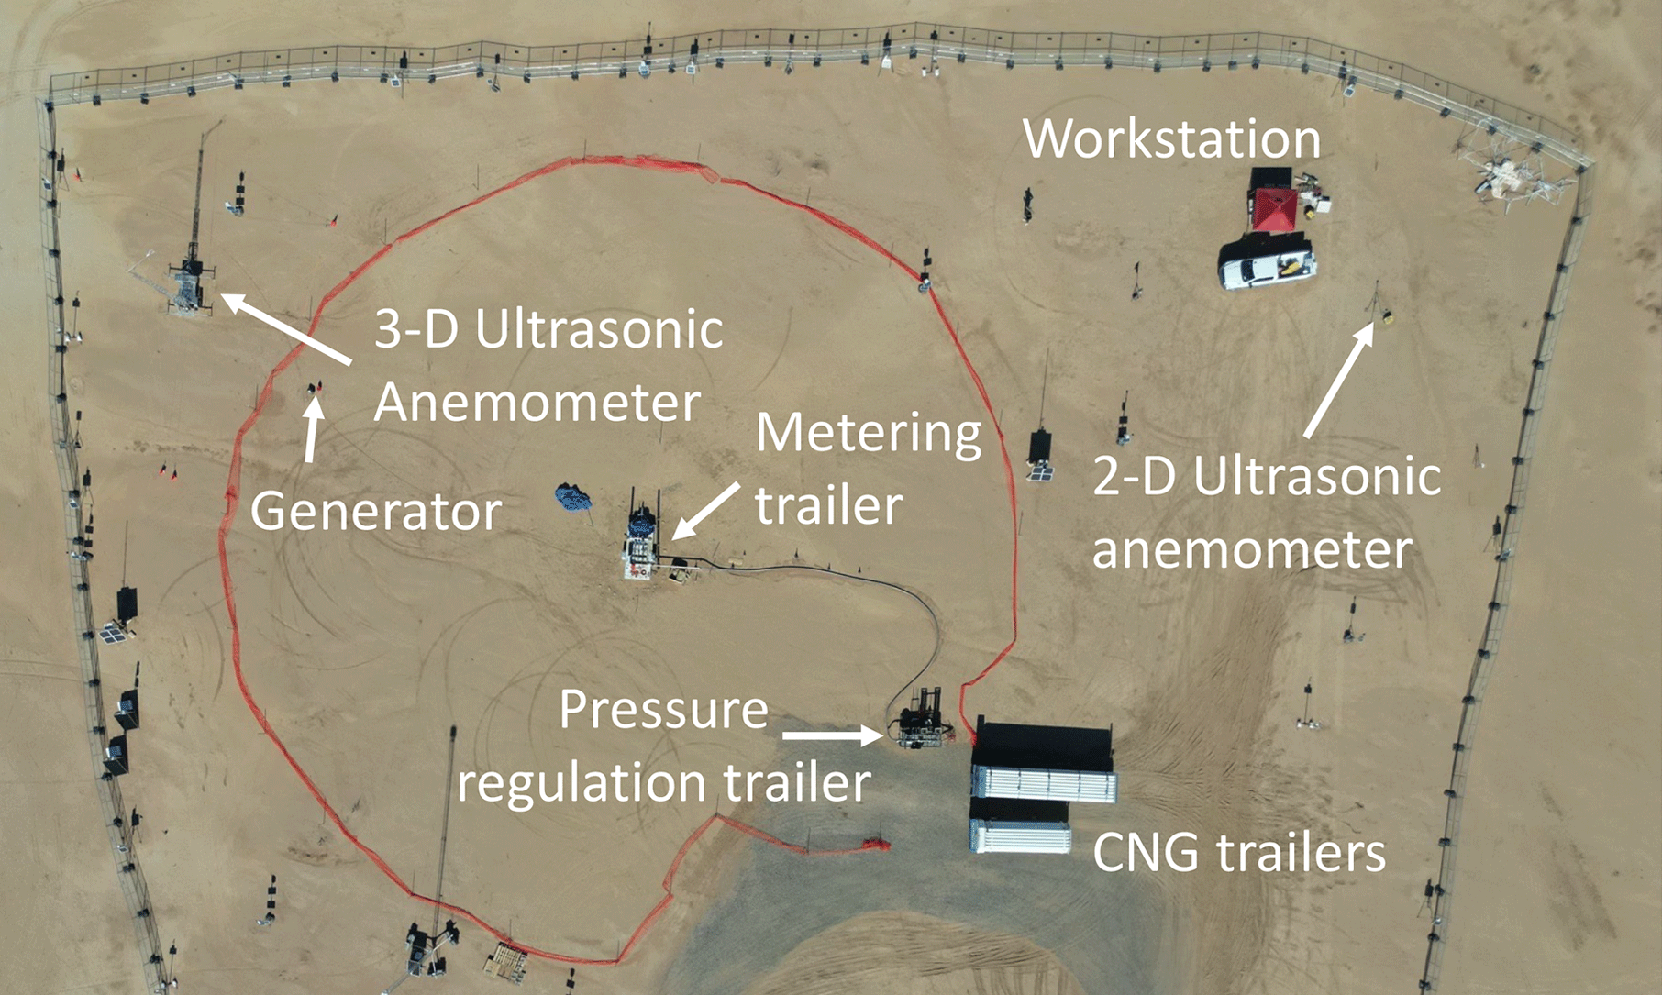
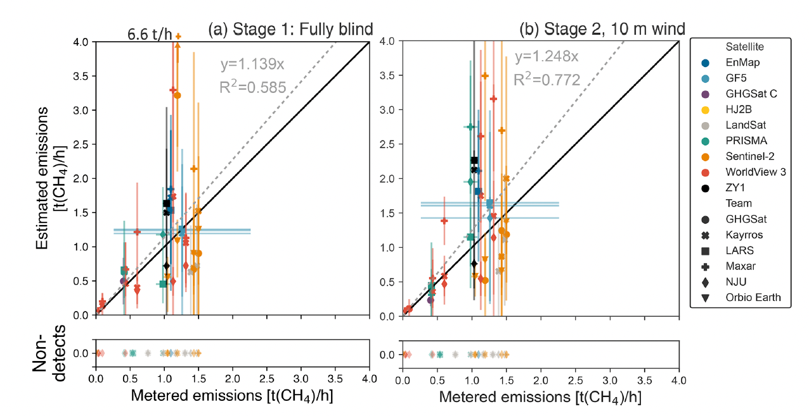
MEDUSA – Covered instruments
Systematic Product intercomparison and validation
Define a framework for the systematic validation of satellite-based methane emission hotspot information.
Only two controlled release campaigns for satellites reported in public domain so far : Stanford campaign in 2021
(desert site) and Stanford campaign in 2022 (Sherwin et al., 2023, 2024)
Controlled releases are the only true validation we have
Limited so far (number of releases, release rates, surface albedo, point source, ...)
Currently Stanford/Michi. campaign 2024-2025 started
Anchored to controlled releases (by others).
Expanded using:
Simulations adding plumes to L1 data.
Observations of the same emissions.
Comparison to ground-based observations where possible.
Sherwin et al. (2024)

Slide 11
What do we need ?
Need for many more controlled releases (Stanford univ/univ Michigan 2024-2025; METEC – all semi-arid sandy terrain for now)
Covering all observations conditions (e.g. surface albedo, …)
Including ‘landfill’-type controlled releases (Dave Risk/FLUXlab, NPL ?, …)
Other gr.based/’in-situ’ measurements emission rates at facility level (e.g. coal mine vent-shafts, …) ?
Increase efforts for large scale intercomparisons plume emission rates (e.g. EMIT NIST initiative; MEDUSA) – often best effort basis – this should be a long term effort (as we do for L2 [CH4])
Ideally all of the above internationally coordinated (benefit the most from controlled releases, intercomparisons)
Notes:
Middleton, Idaho Oct12, 2023, company 900 ton

