Slide 1


Carbon Mapper Overview
Dan Cusworth +
Carbon Mapper Team
Science Director
Carbon Mapper

Slide 2
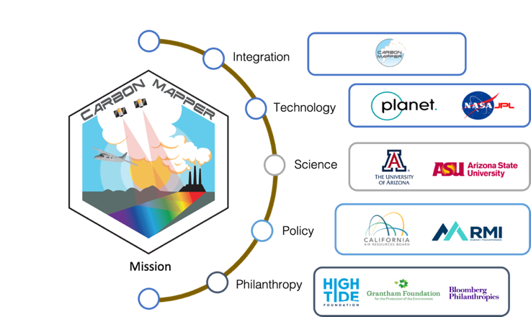
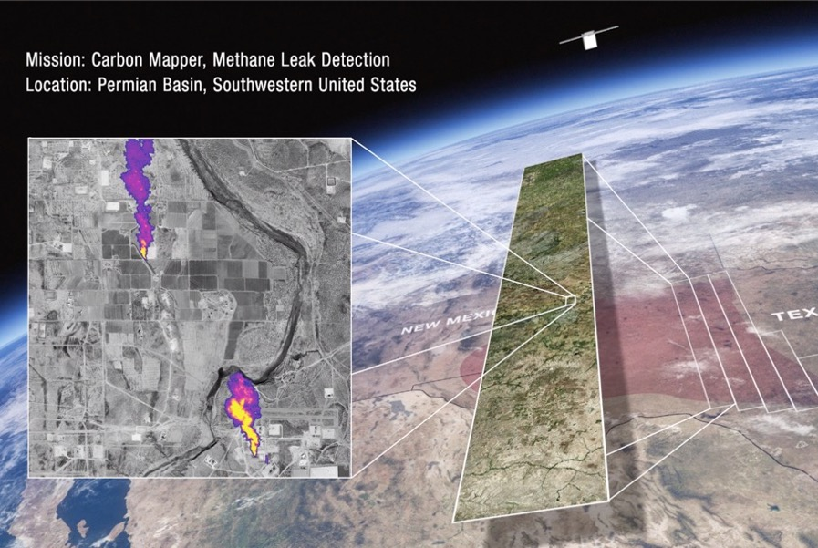

What is Carbon Mapper?
Carbon Mapper is a non-profit working to deliver actionable, localized CH₄ and CO₂ data
Carbon Mapper leads a public-private partnership to develop and deploy emissions detecting satellites.
Tanager-1 launched Aug 16, 2024: plan to complete commissioning Jan 2025
Long-term goal: Scale to a full constellation to track 90% of high emitting CH₄ & CO₂ point sources globally
Work with industry, governments, and other stakeholders to translate data into action
All CH₄ & CO₂ data publicly available
Notes:
Carbon Mapper – we’re a nonprofit focused on making methane data actionable and accessible. And we are primarily focused on that second bucket of monitoring – providing localized methane data to help support direct mitigation action on the ground.
We use aerial and satellite remote sensing observations – and also lead a public-private partnership focused on developing and deploying two satellites with this capability – we are targeting launch this year. All data is publicly available on our website

Slide 3
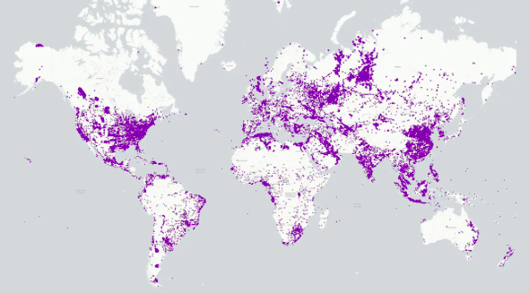
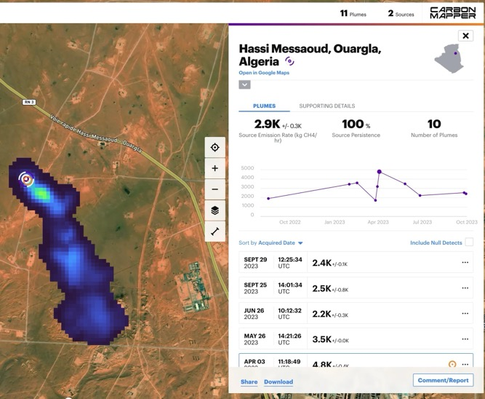
Carbon Mapper planned tasking deck
Mean time to access (MTTA) < 7 days for isolated areas of interest (AOIs) in mid-latitudes,
Regional mapping with 1 Tanager monthly to quarterly.
Can work to develop custom AOIs for tasking related on impact, stakeholder, and coordinated observations
As the constellation grows, we will be able to increase the rate of monitoring
All CH4/CO2 data made publicly available on Carbon Mapper’s data portal
Super-emitters &
Disadvantaged Communities

Slide 4
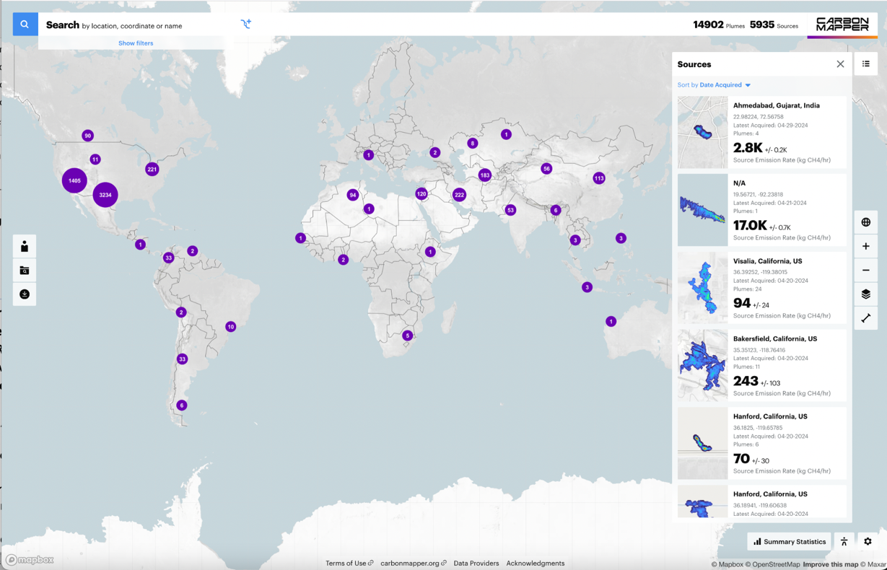
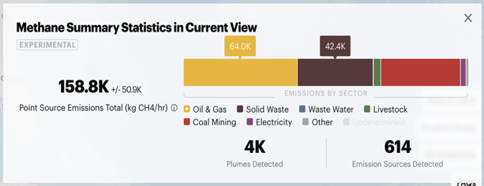
Global Data Portal: Enhanced Access and Insights
Now over 14,000 methane plumes and over 800 CO₂ plumes published - Airborne and EMIT
Improved plume visualizations
Trend emission rates over time - and verify leak repairs
Summary statistics for regional and sector-specific insights
User-specified areas of interest
Public API access
Portal: data.carbonmapper.org
API: api.carbonmapper.org
Notes:
Currently we have been analyzing data from aerial surveys as well as NASA’s EMIT instruments – which is on the international space station – this data is accessible on our public data portal at data.carbonmapper.org.
We have over 13000 methane plume detections around the world. Our data comes from aerial surveys and space-based observations from the NASA EMIT instrument on the International Space Station.

Slide 5
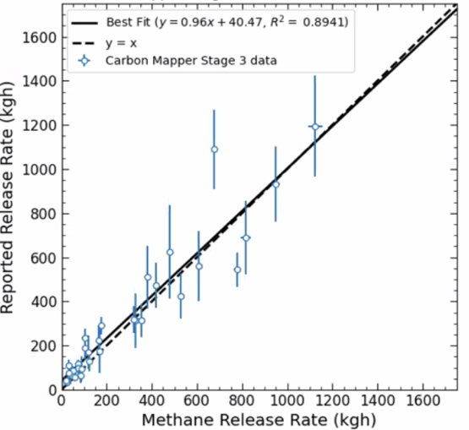
Carbon Mapper’s methods for detection and quantification are published in the scientific literature and supported by in-field tests
We produce an emission estimate for each methane plume and use plume imagery to attribute the emission to a source to within 10 to 50 meters
In single-blind controlled experiments with Stanford, Carbon Mapper’s measured emission rates are well correlated with actual emissions
1. Methane detection
2. Methane plume delineation
3. Emission rate quantification
4. Source attribution

Slide 6
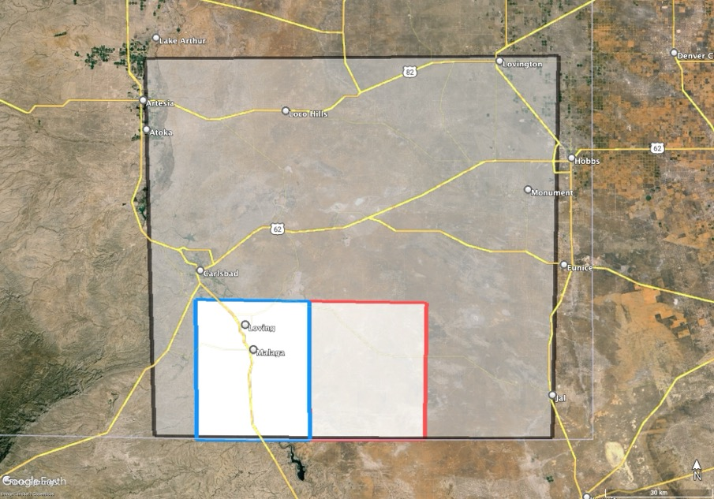
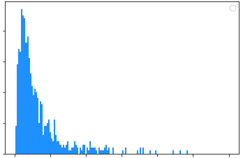
Important of detection limit and spatial coverage in assessing contribution from super-emitters on basin-level emissions
2024 Airborne campaign in Permian Basin
Distribution of Quantified Emissions
40
30
20
10
0
Wide Area
12,000 sq km
77,000 wells
83% of NM Permian Oil Prod
86% of NM Permian Gas Prod
Most of detections fall within 100-500 kg/h range:
At least half of “super-emitter” budget comes from this bin
Detection Count
West Box
1,200 sq km
7,000 wells
13% of NM Permian Oil Prod
21% of NM Permian Gas Prod
East Box
1,200 sq km
7,000 wells
36% of NM Permian Oil Prod
42% of NM Permian Gas Prod
0
500
1000
1500
2000
2500
3000
Emission Rate (kg/h)
Need for wide area surveying at sufficiently low detection limit to appropriately understand impact of super-emitters

Slide 7
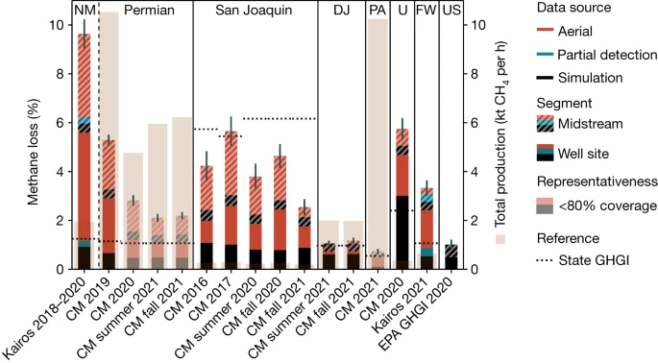
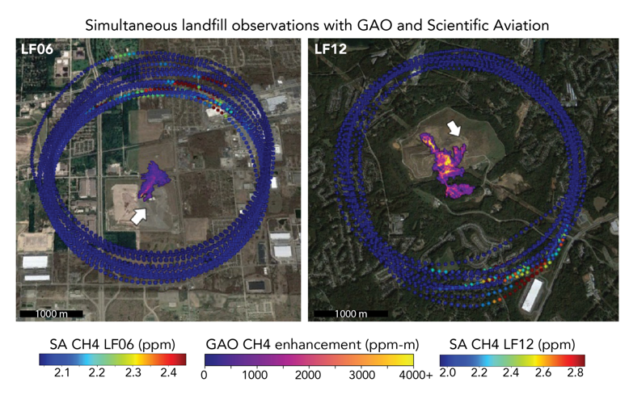
Research collaborations with academics and agencies to provide stakeholder and policy-relevant context to satellite observations
Oil & Gas. Carbon Mapper, Stanford, Insight M: Combine Carbon Mapper data with process-model to estimate basin-level and super-emitter intensities for major oil&gas basins (Sherwin et al., Nature, 2024)
Waste. Carbon Mapper, EPA Office of Research and Development: Coordinate observations and attribution emissions to activities across wide array of U.S. landfills. (Cusworth et al., Science 2024; Scarpelli et al., submitted)

Slide 8
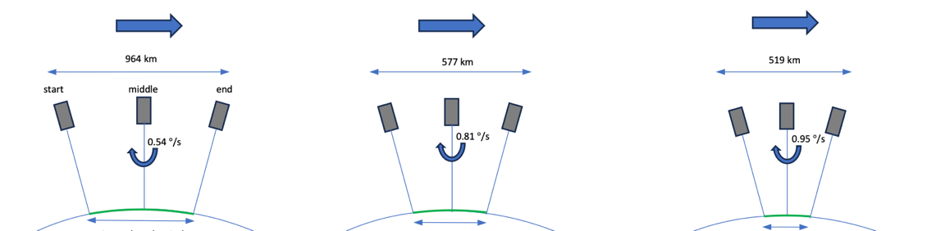
Tanager-1 employs several imaging modes that trade spatial coverage for SNR / detection limit.
Back-nodding to increase SNR
1x8 mode
Predicted detection capability for imaging modes
3 m/s wind, 30 m GSD, 25% albedo, 35 deg SZA

Slide 9
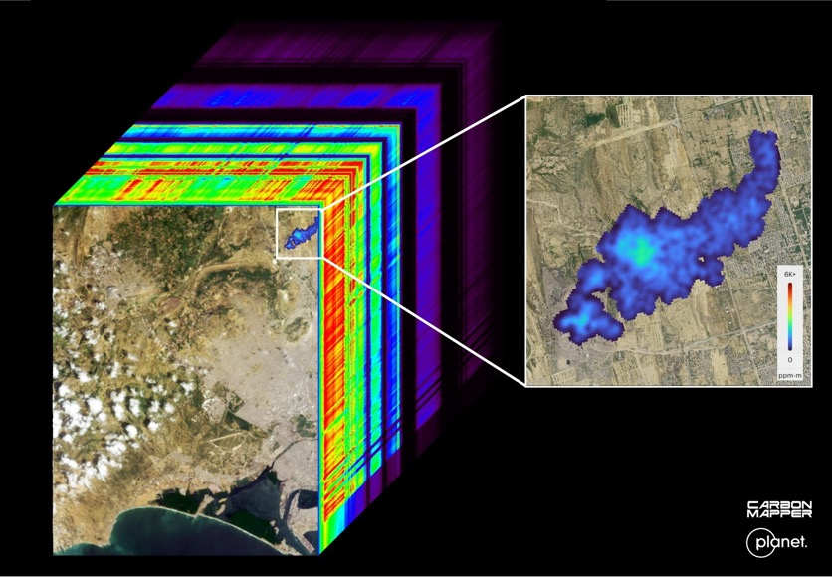
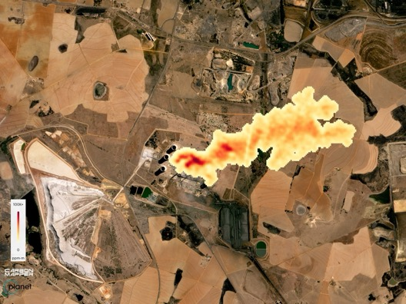
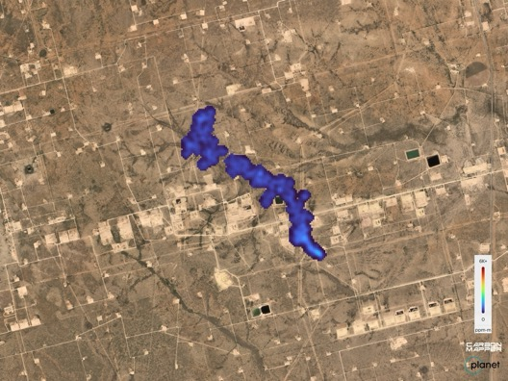
Tanager-1 has acquired first light imagery!
Tanager image cube showing 400+ wavelengths it observes
CO2 plume at power plant in South Africa
Upstream oil&gas in Permian Basin, Texas
We’ve currently mapped over 200 plumes globally in 1 month of active imaging
Methane plume at dumpsite in Karachi

Slide 10
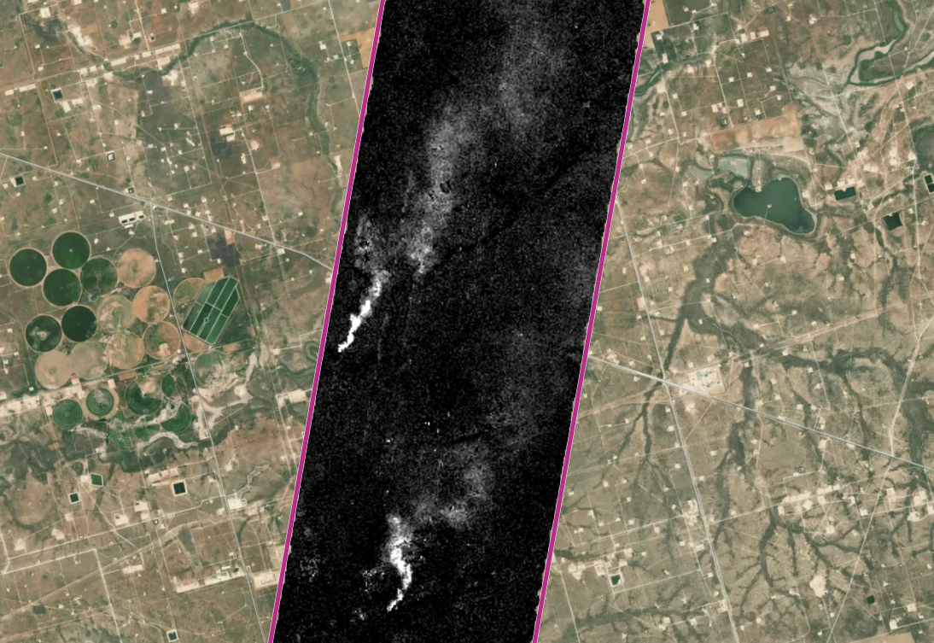
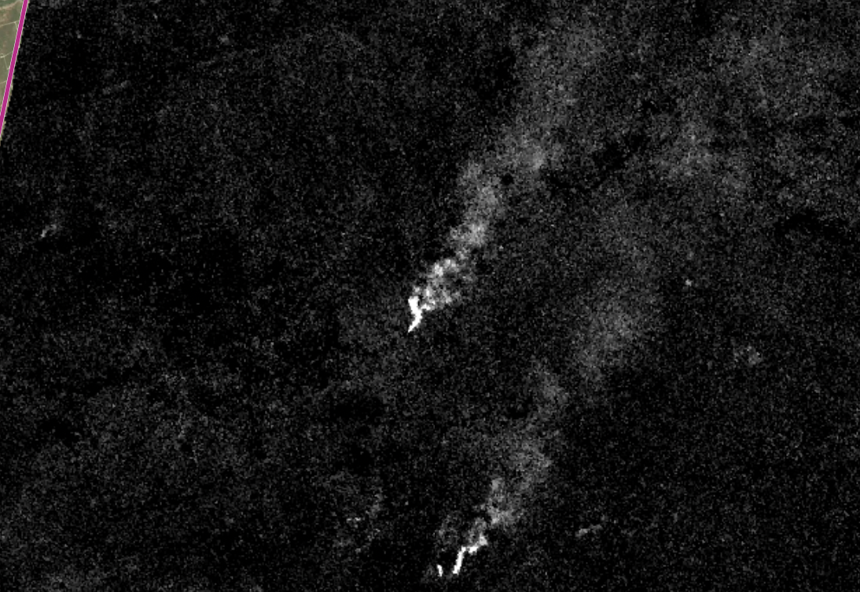
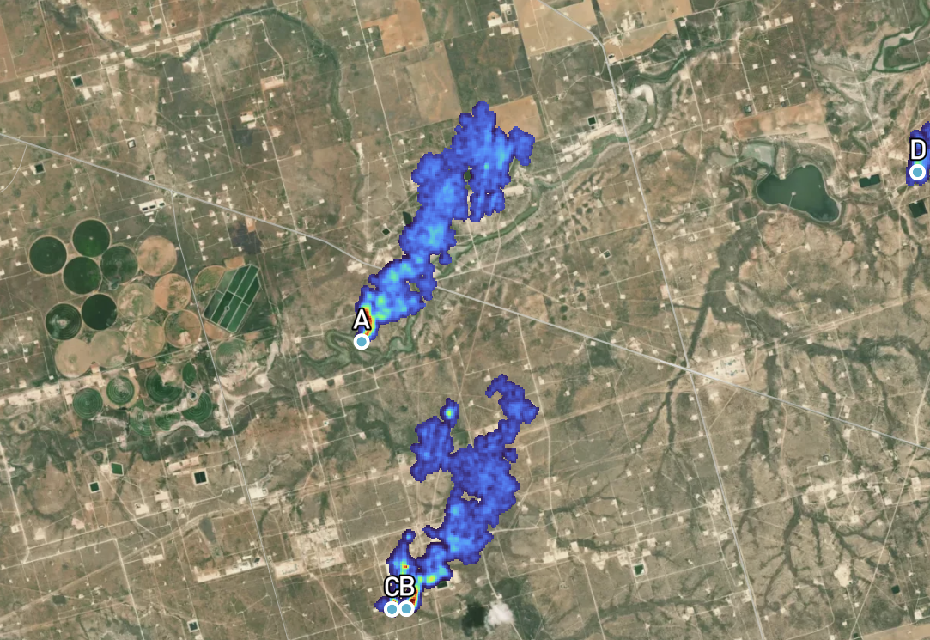
Validation is underway with controlled releases and coordinated observations
Near simultaneously collected imagery in the Permian Basin with Tanager-1 and AVIRIS-3
NASA AVIRIS-3 aircraft, altitude 9 km, 17:44:34 UTC
Tanager-1 satellite, altitude 510 km, 17:46:56 UTC
Tanager-1 segmented plumes
Preliminary data – NO SCREENSHOTS

Slide 11
Summary
Carbon Mapper Coalition launched Tanager-1 in Aug 2024. Currently commissioning satellite including calibration and validation experiments and orbit lowering.
Tanager-1 data planned to begin public rollout early 2025
In Y1 of the satellite mission, we plan to task the majority of oil&gas infrastructure in major global basins (goal quarterly revisit), as well as perform the largest global survey of waste disposal sites. Plan to also task and quantify emissions from coal, wastewater, livestock, and power generation sectors as possible.
Plan to continue to processing EMIT and airborne datasets to build upon our open data portal.

Slide 12
Thank You

