Slide 1

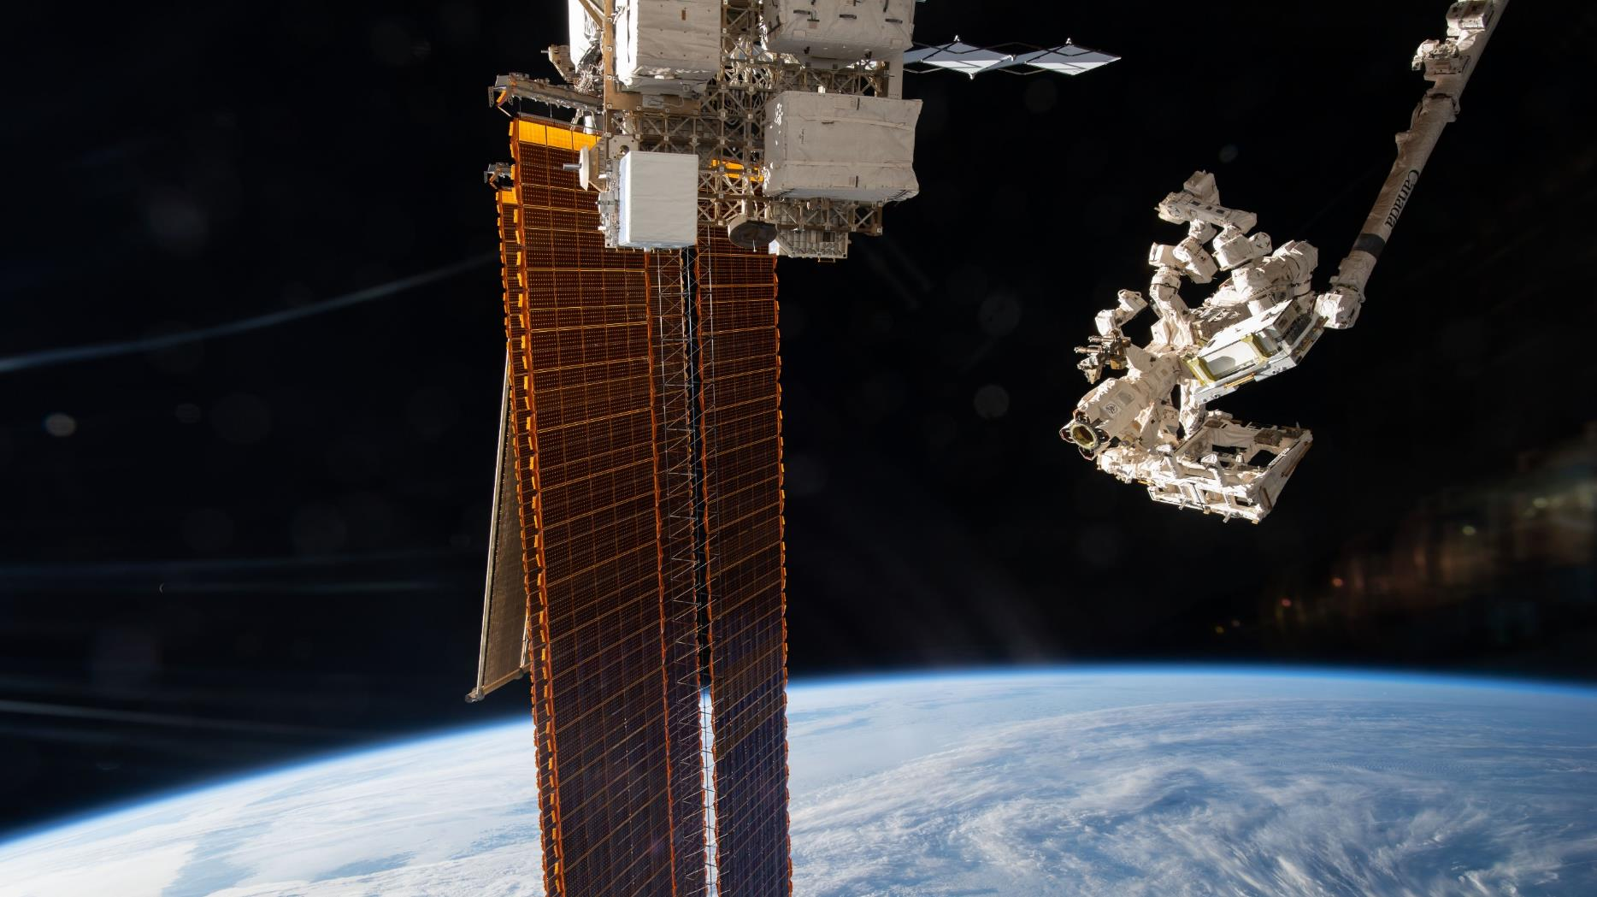

Identifying large methane and CO₂ emissions from space with EMIT
Andrew K. Thorpe¹, K. Dana Chadwick¹, Philip G. Brodrick¹, Robert O. Green¹, David R. Thompson¹, Jay E. Fahlen¹, Chuchu Xiang¹, Red Willow Coleman¹, Claire Villanueva-Weeks¹, Amanda M. Lopez¹, Daniel J. Jensen¹, Holly A. Bender¹, Quentin P. Vinckier¹ , John R. Worden¹, Lesley E. Ott², Kevin W. Bowman¹
¹Jet Propulsion Laboratory, California Institute of Technology
²Goddard Space Flight Center
*Andrew.K.Thorpe@jpl.nasa.gov

Slide 2

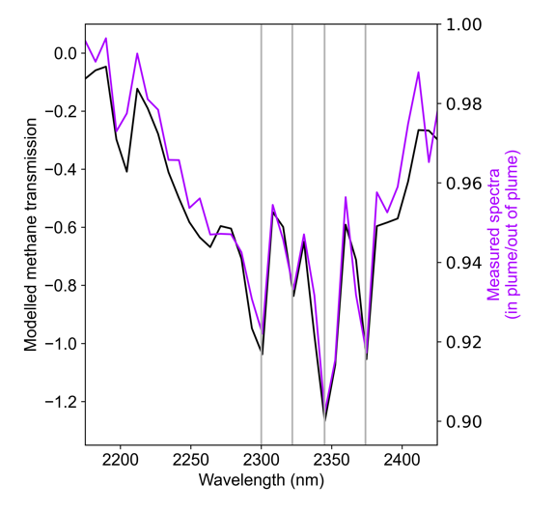
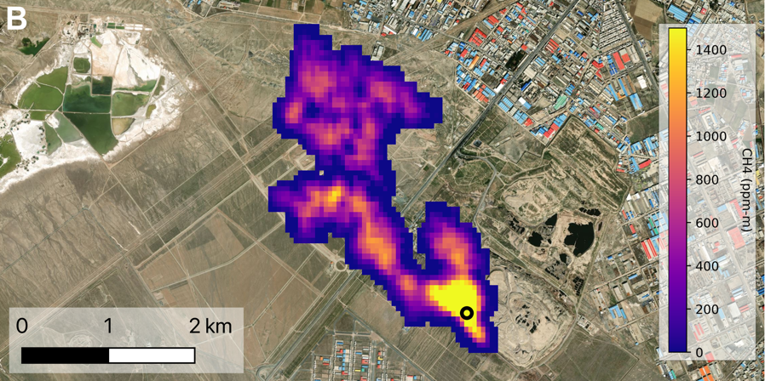
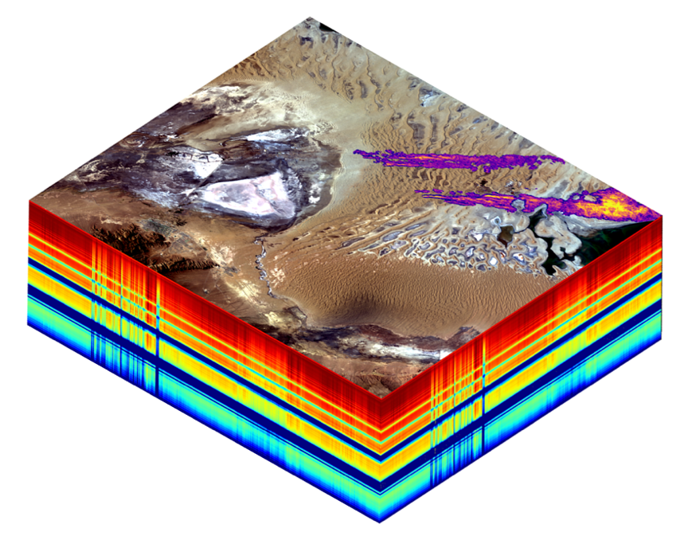
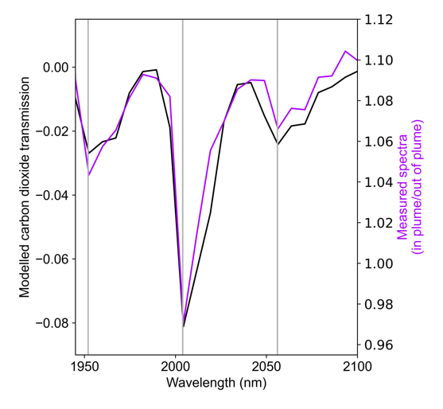
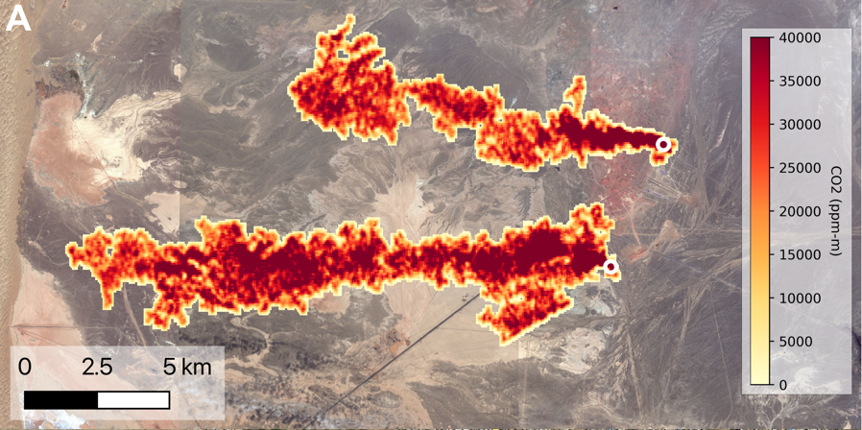
CH₄ and CO₂ spectral fingerprints
CH₄ spectral fingerprint from EMIT radiance data
EMIT CH₄ from landfill (Iran)
Detector array
Spectrometer
Slit
Telescope
CO₂ spectral fingerprint
EMIT CO₂ from power plants (China)
Observation direction
Thorpe et al., 2023
2

Slide 3
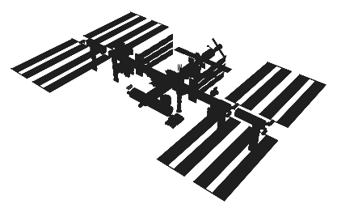

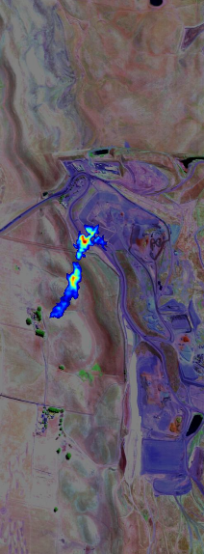
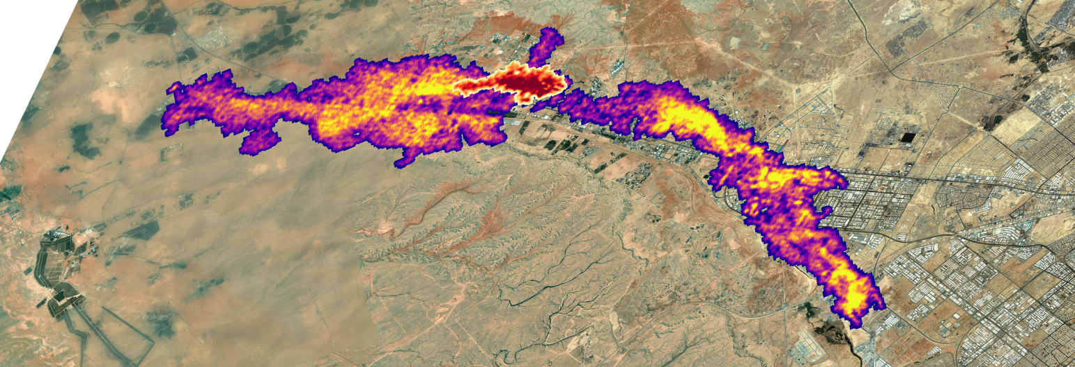
NASA imaging spectrometers deliver new understanding of GHG emissions
AVIRIS-3 2023
AVIRIS-NG* 2013
AVIRIS 2008
CH₄, CO₂ point source imager (energy, waste, & agriculture emissions)
Improved sensitivity relative to EMIT (10s of kg CH₄ hr⁻¹)
EMIT** on ISS 2022
CH₄, CO₂ point source imager (energy, waste, & agriculture emissions)
Less sensitive relative to airborne (100s of kg CH₄ hr⁻¹)
Wider coverage
*Global Airborne Observatory (GAO) was built at JPL
**Carbon Mapper Coalition Tanager Satellite utilizes JPL technology
AVIRIS-3
EMIT
Power plant (CH₄, CO₂)
Wastewater (CH₄)
NGL pipeline (CH₄)
Landfill (CH₄)
3

Slide 4
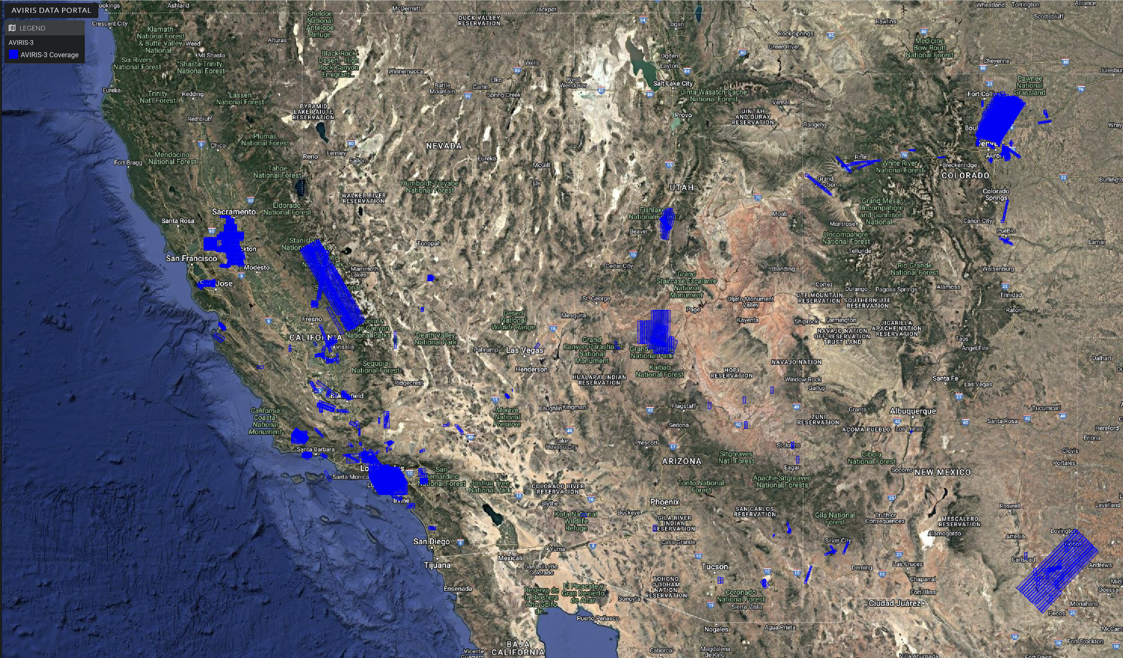
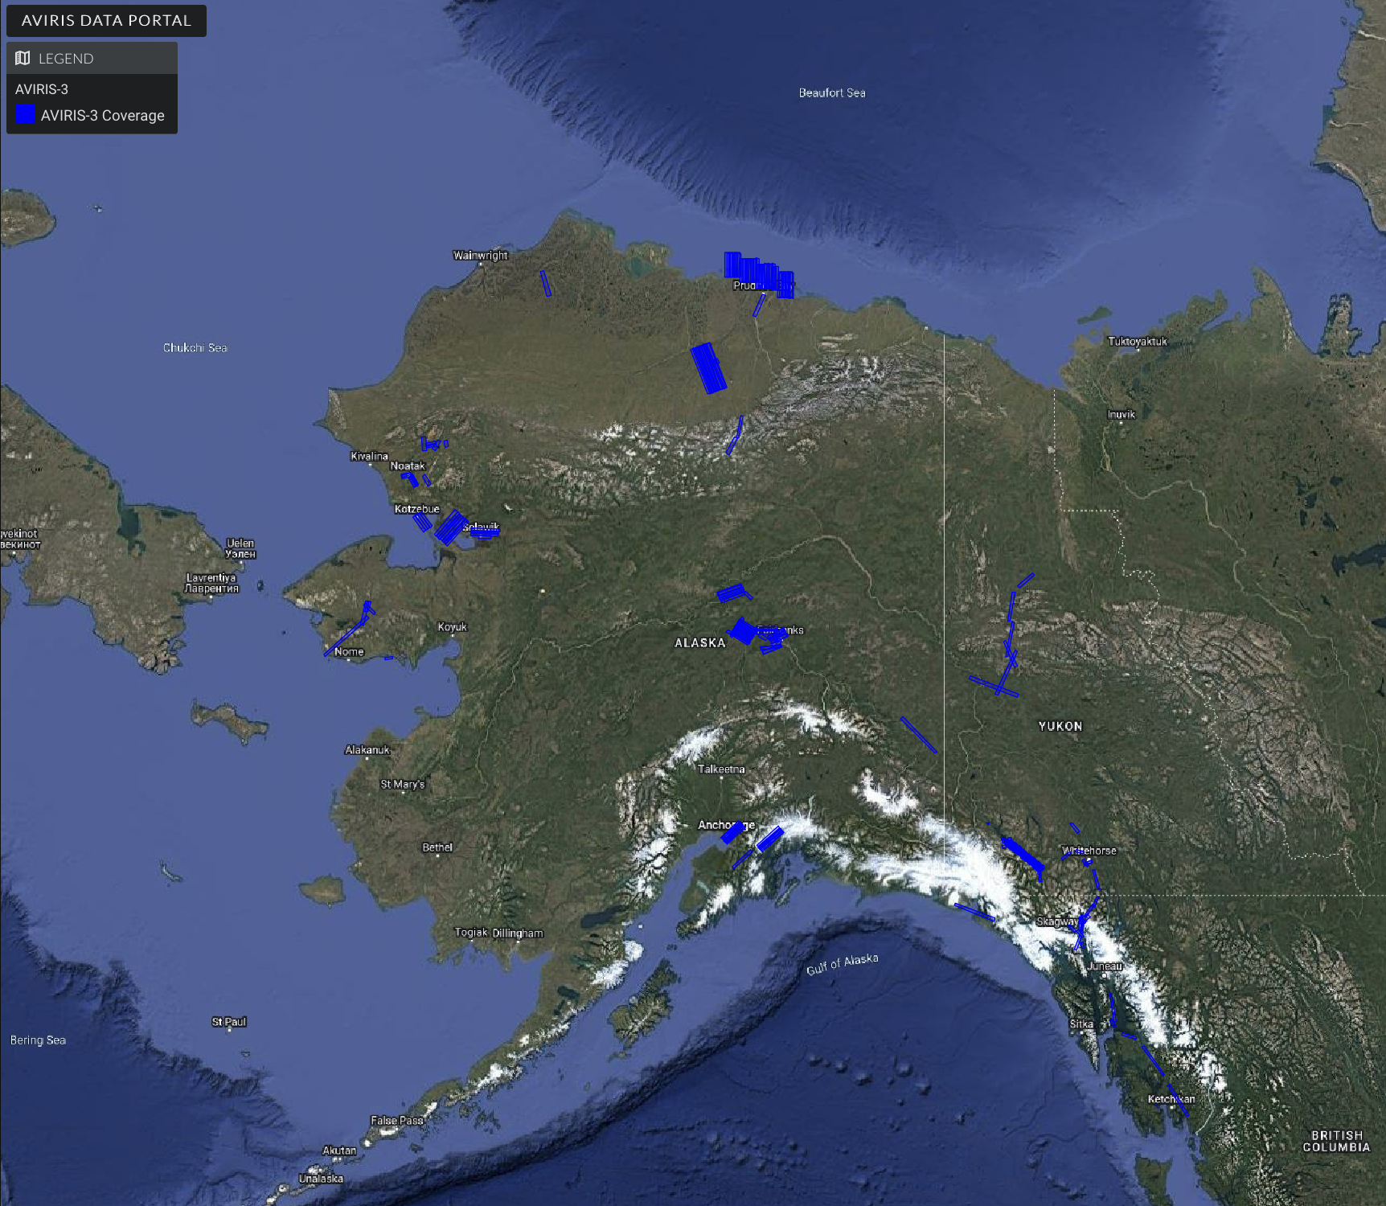

AVIRIS-3 operating since 2023
Airborne flight campaigns in support of the US GHG Center and others like Carbon Mapper
4

Slide 5
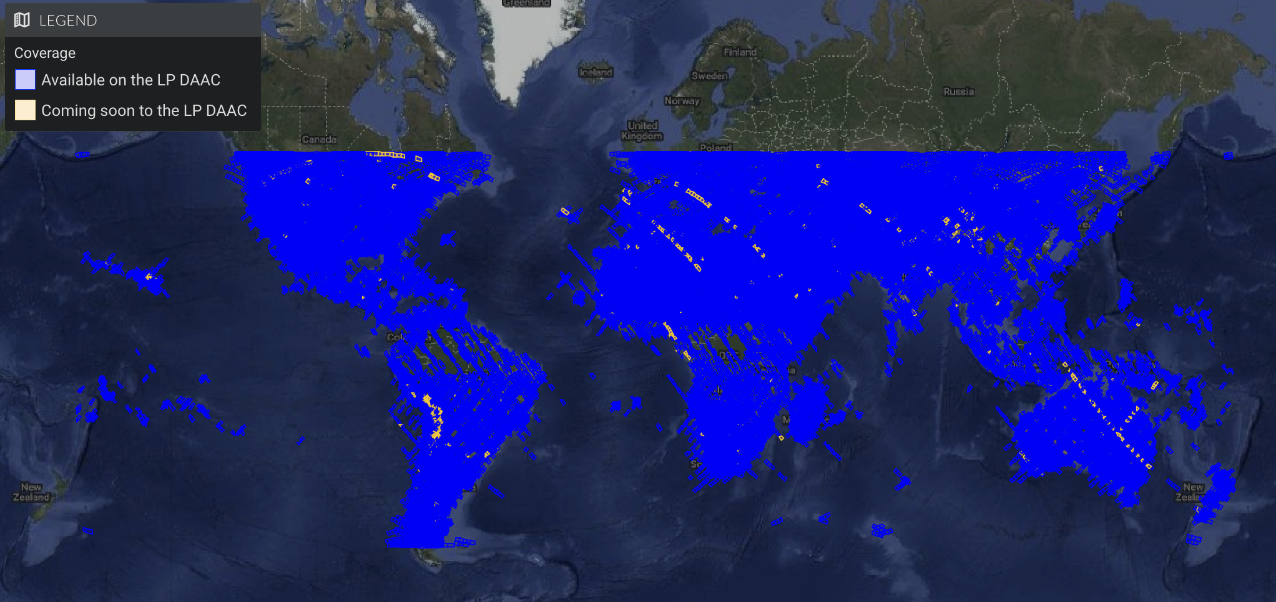
EMIT is in an extended mission
5

Slide 6
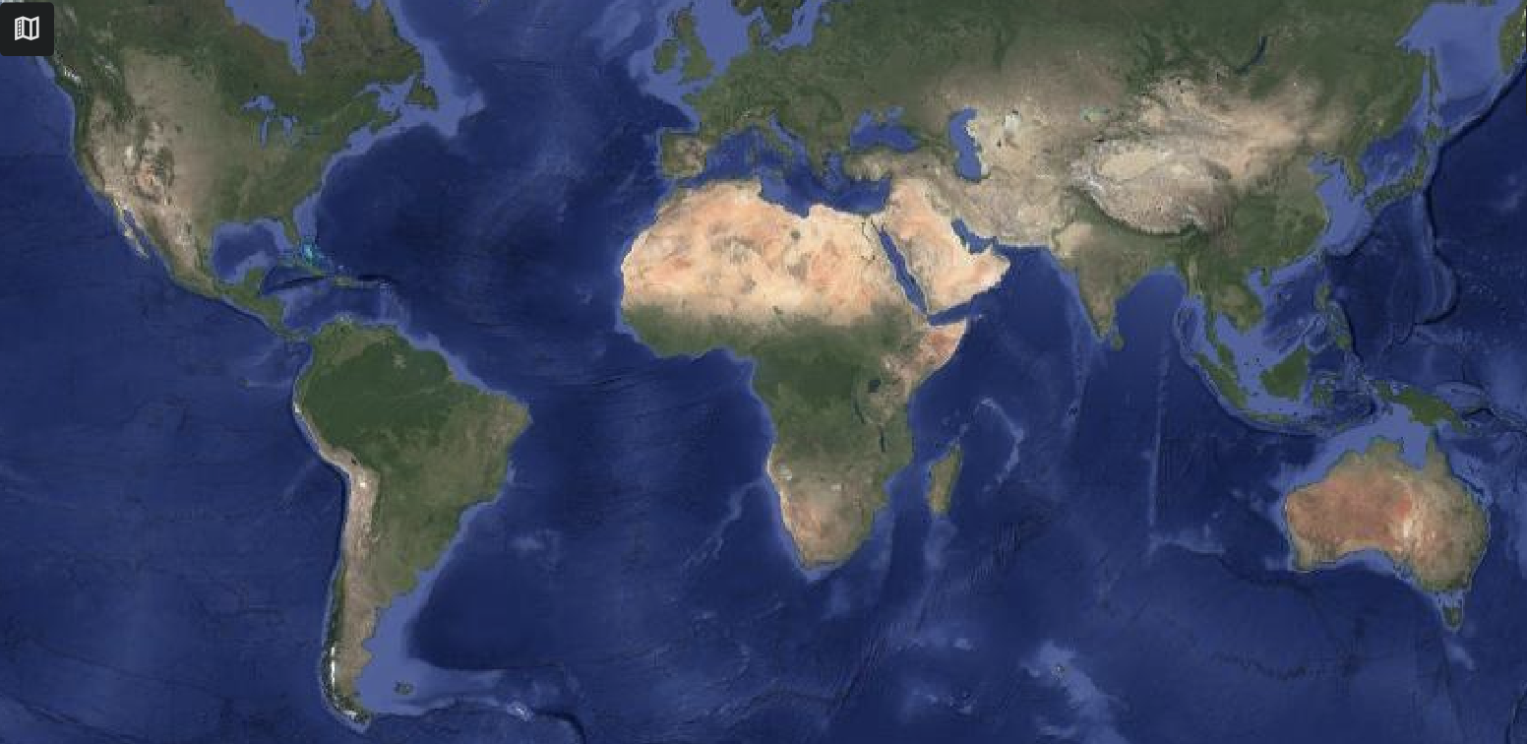
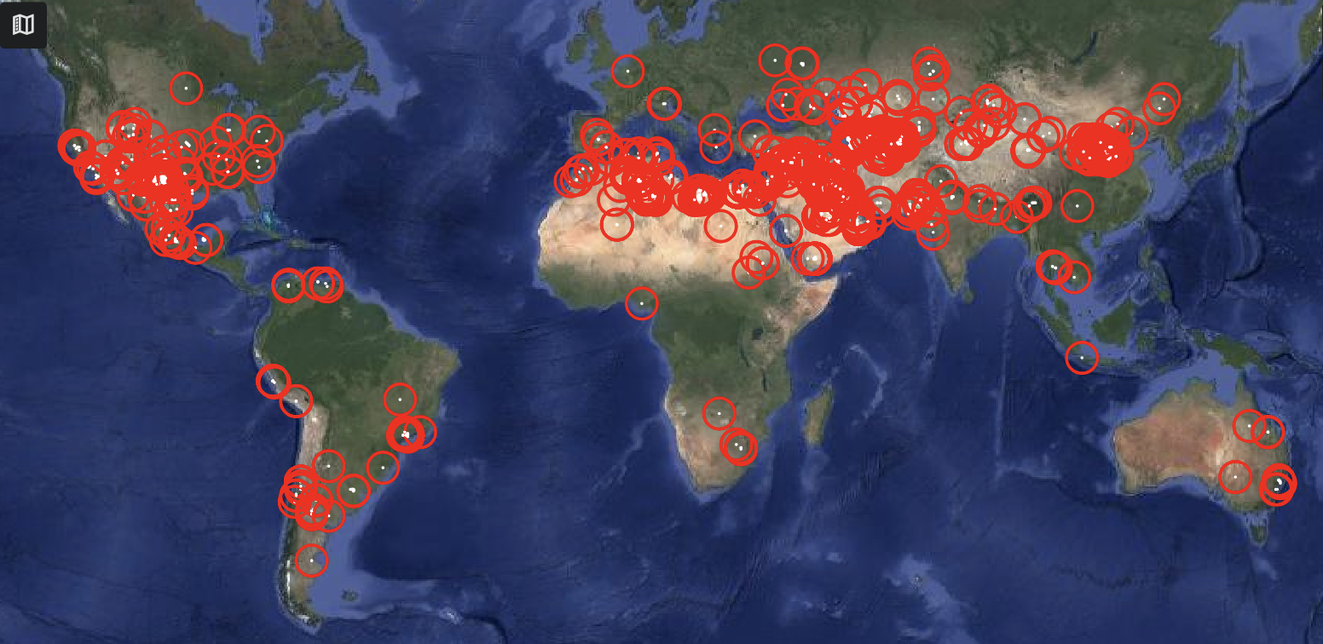
EMIT has identified >1,400 CH₄ plumes at the facility scale
6

Slide 7
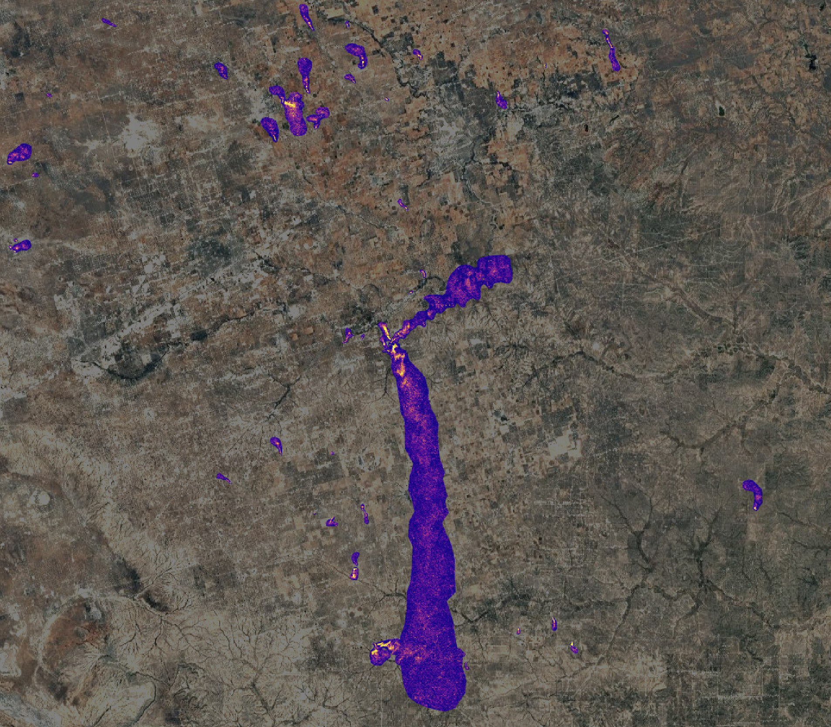
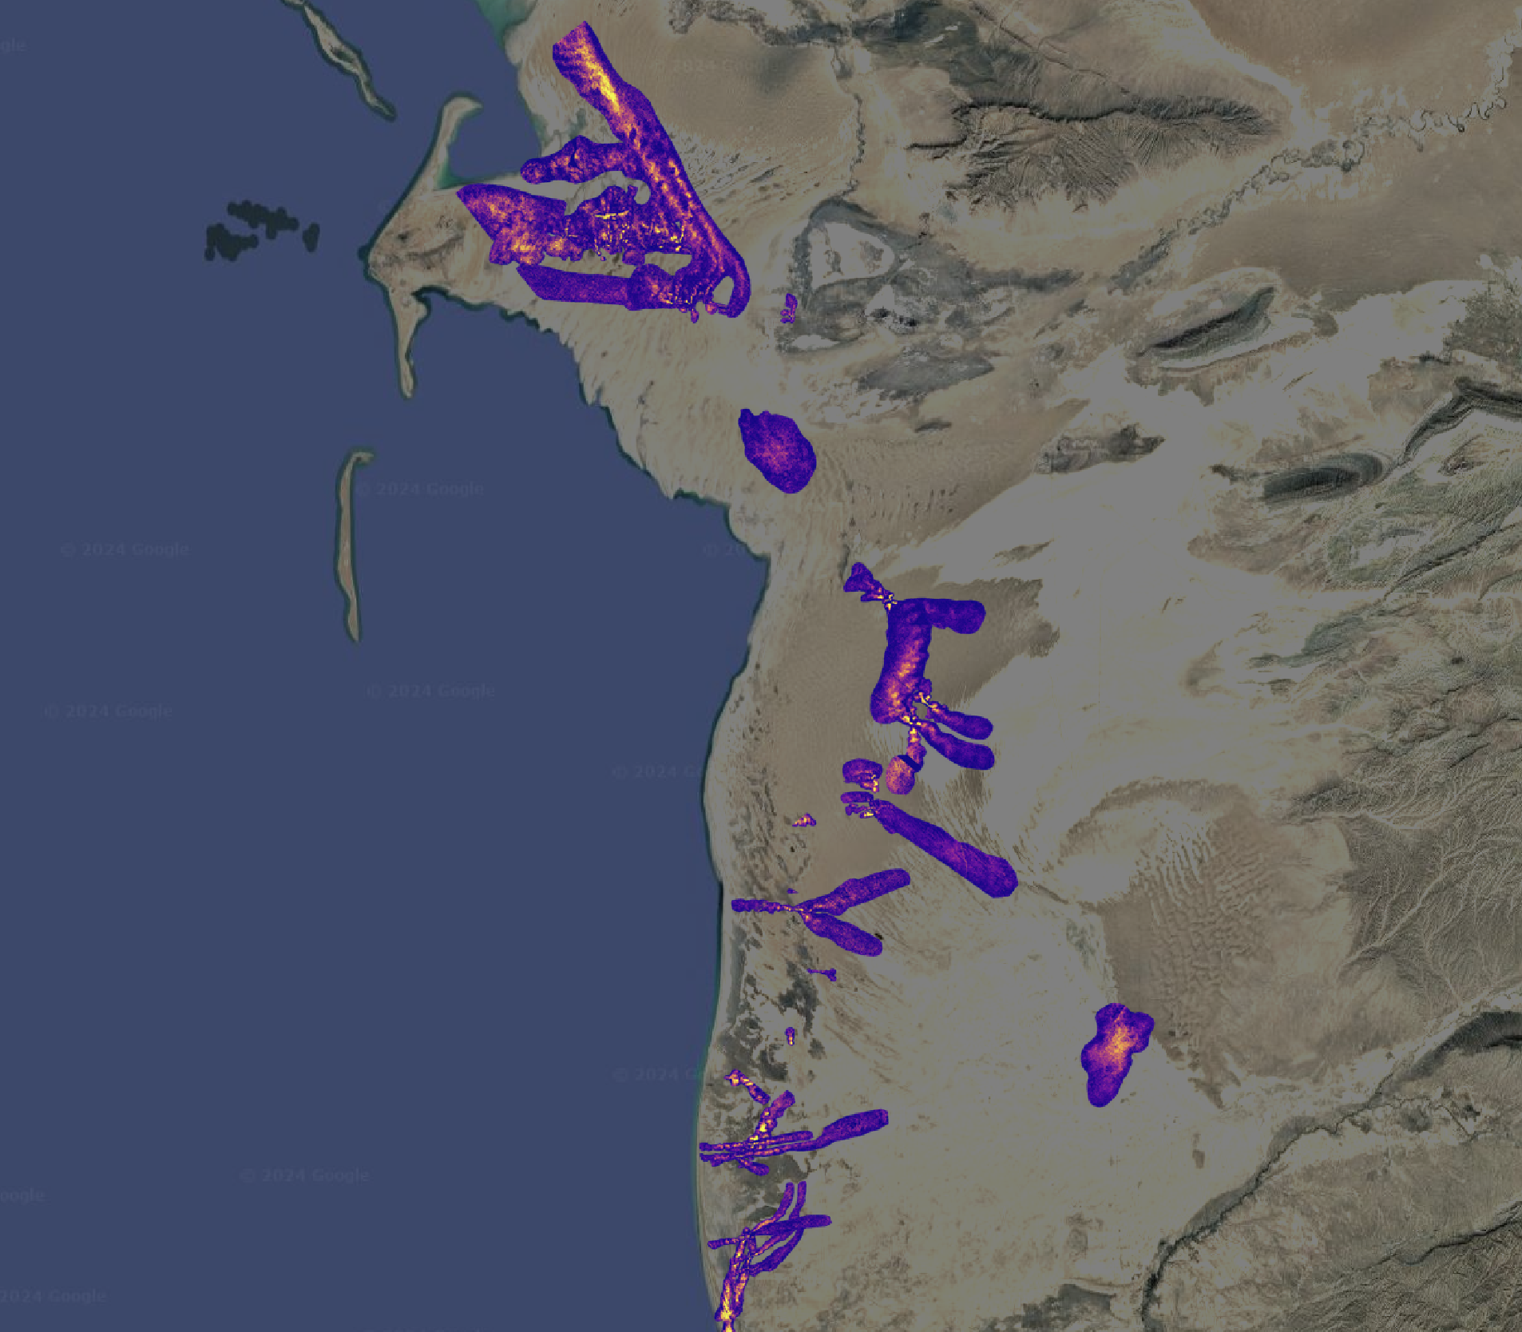
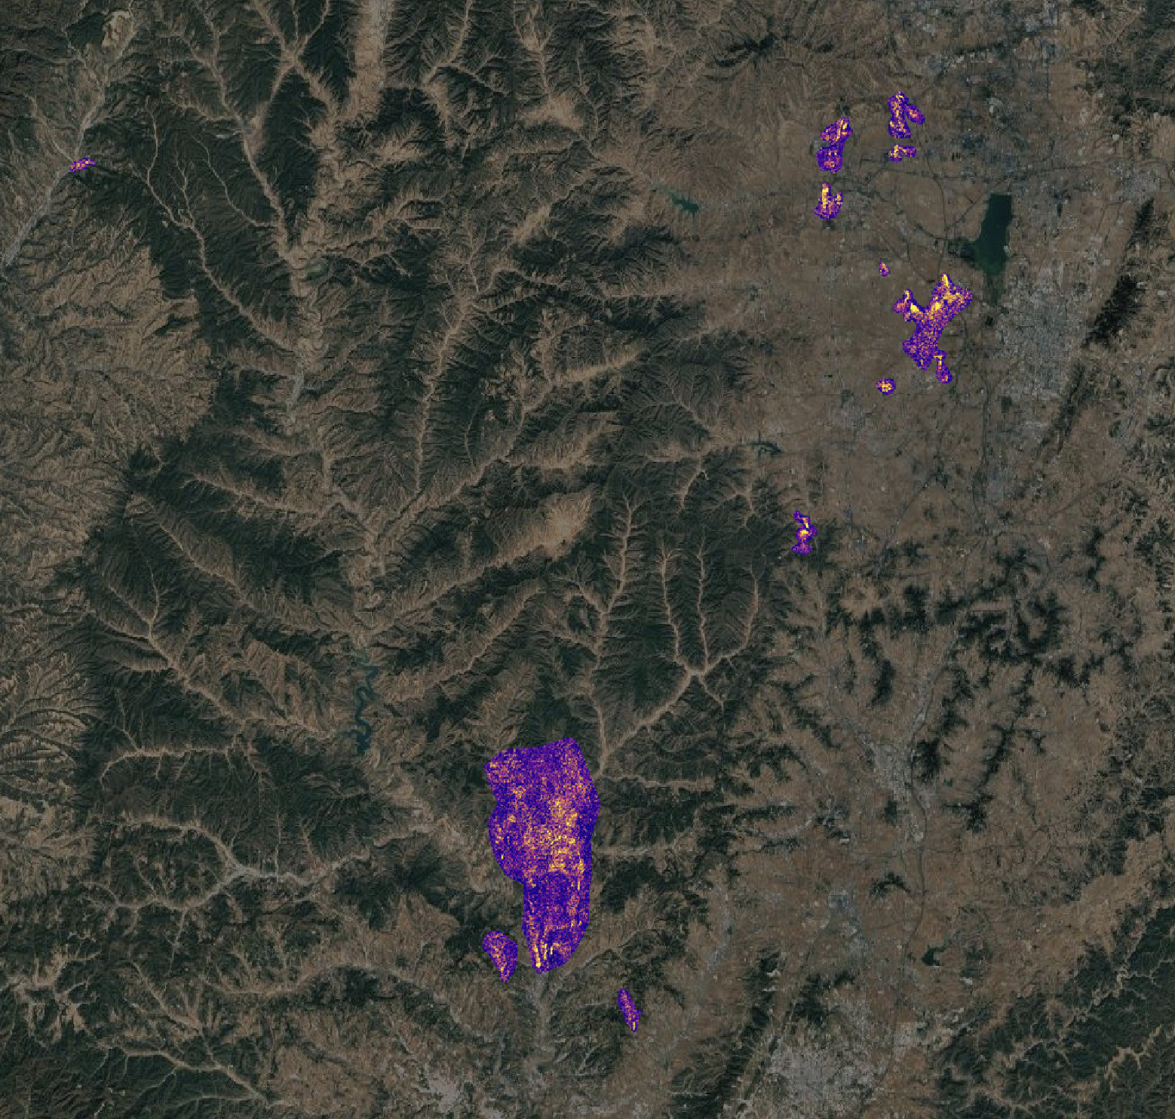
EMIT CH₄ from oil & gas
United States (oil & gas)
Turkmenistan (oil & gas)
China (coal)
~100 km x ~100 km
~200 km x ~200 km
~80 km x ~80 km
7

Slide 8
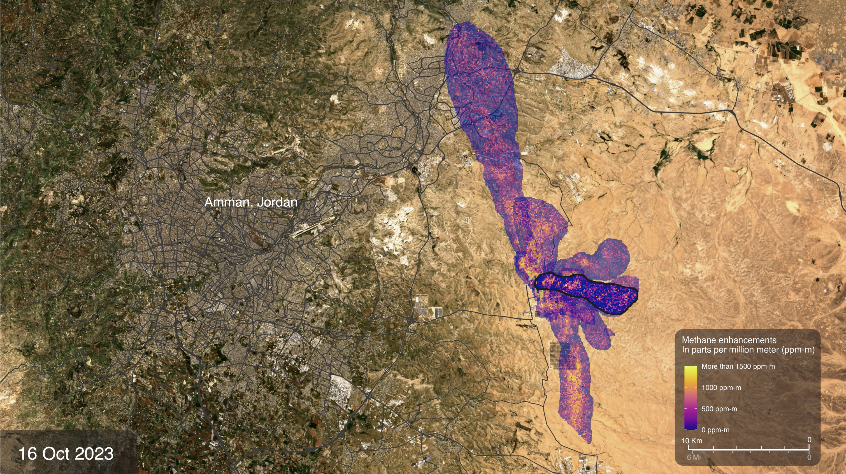
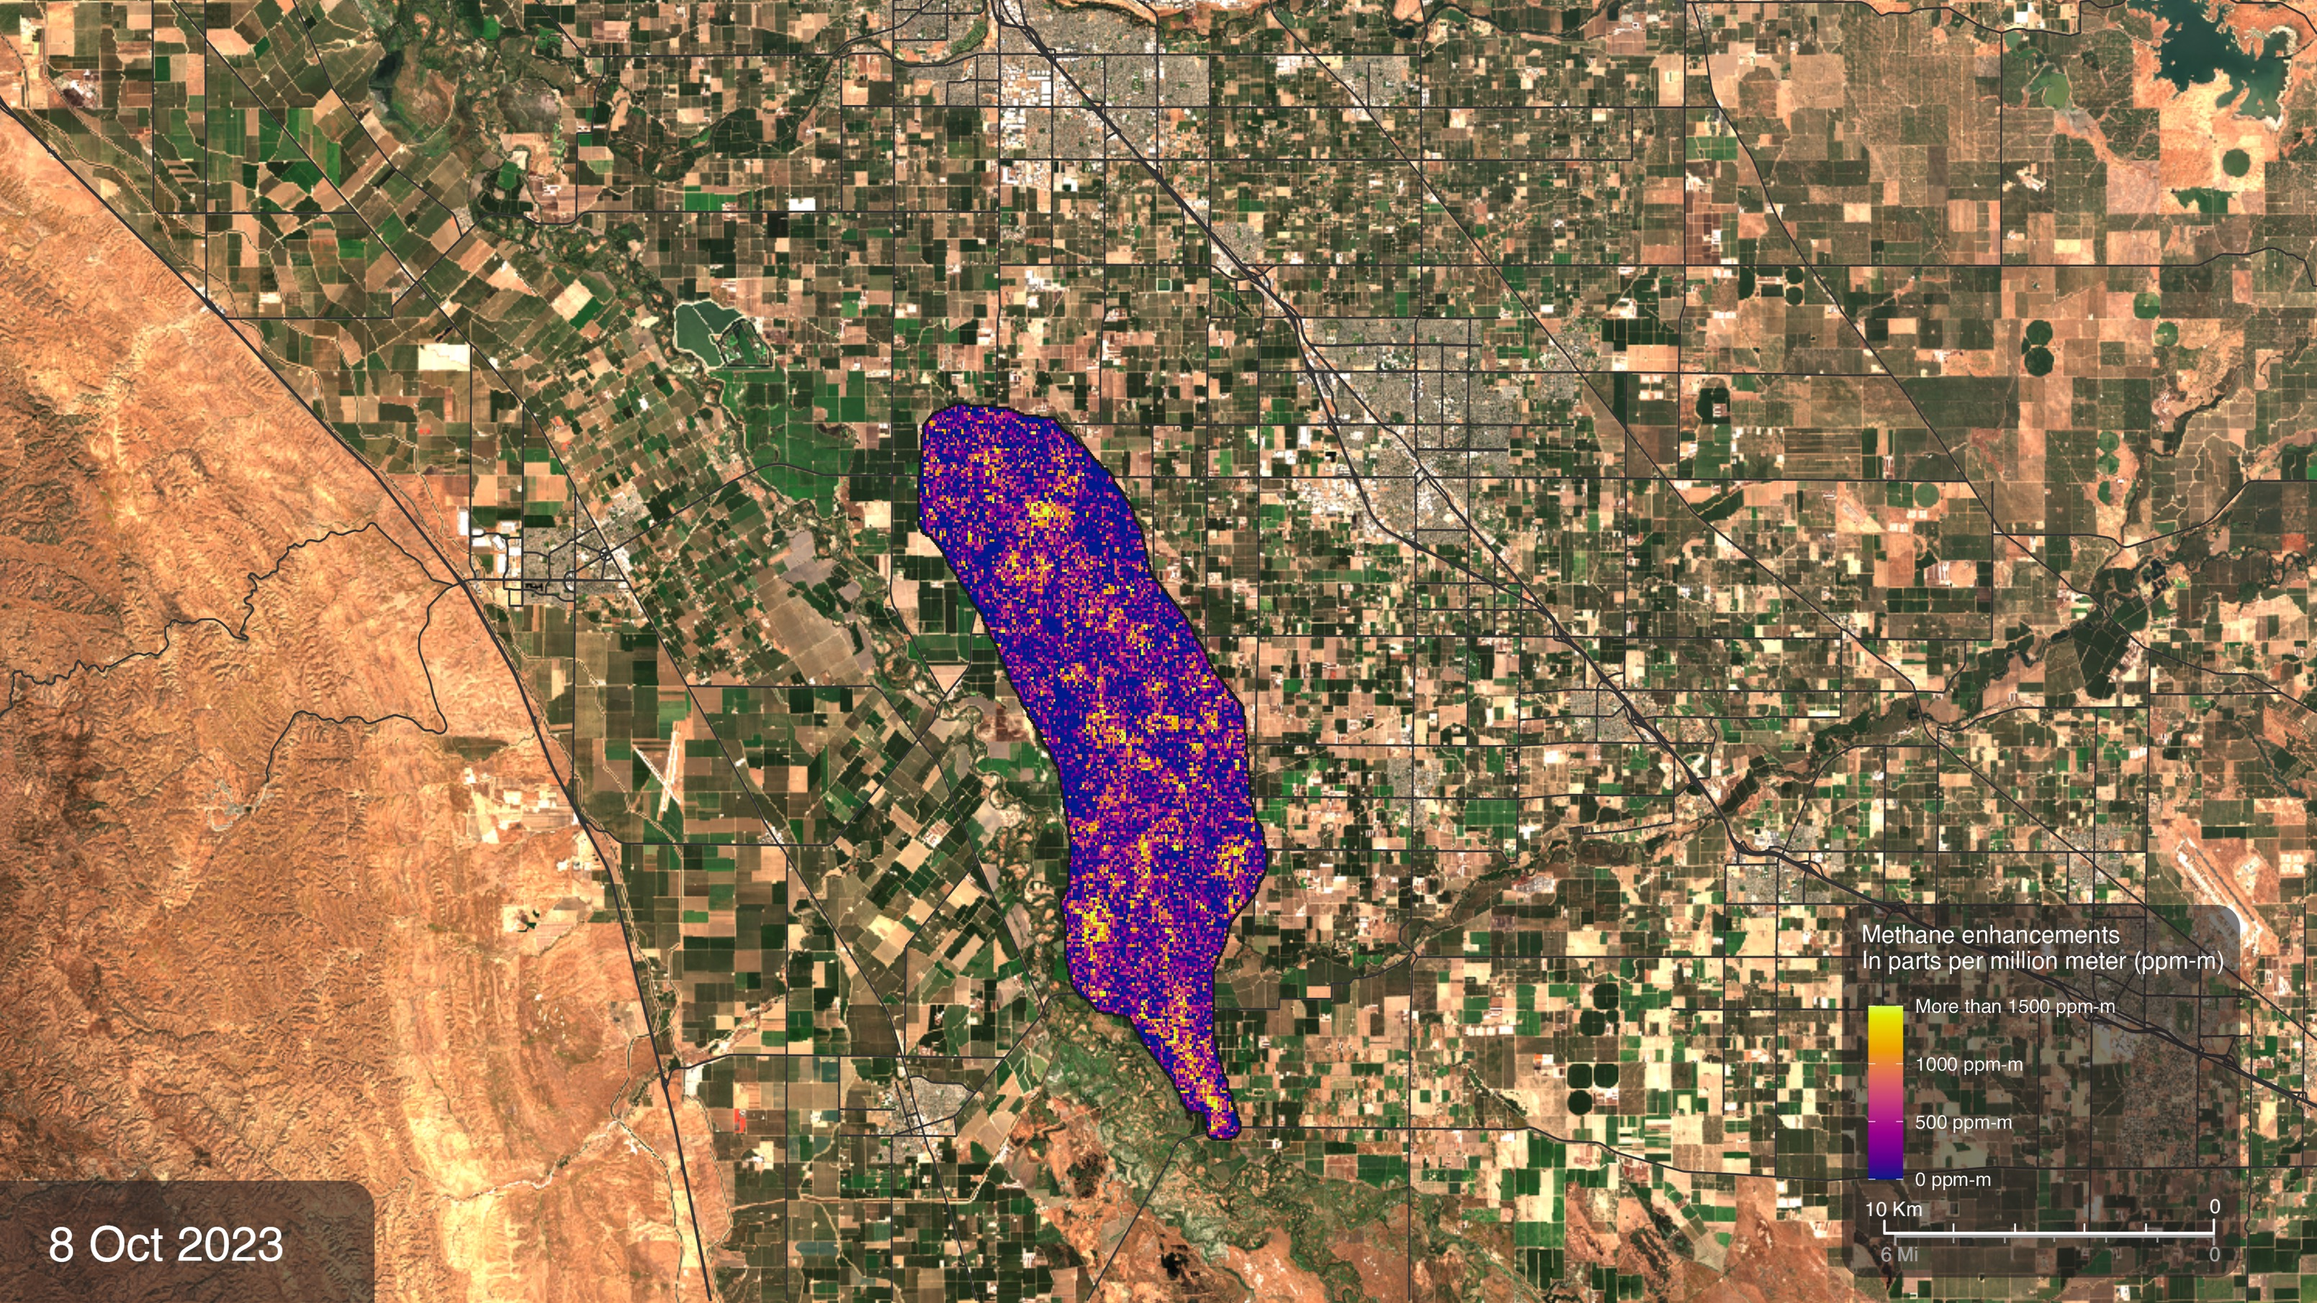
EMIT CH₄ from waste and agriculture
Agricultural emissions San Joaquin Valley, California
Landfill near Anman, Jordan
8

Slide 9
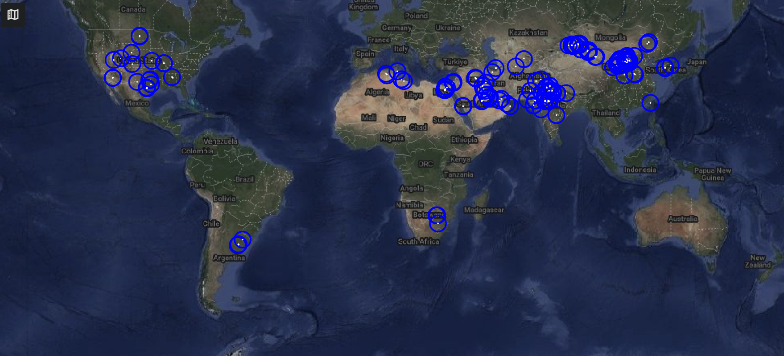
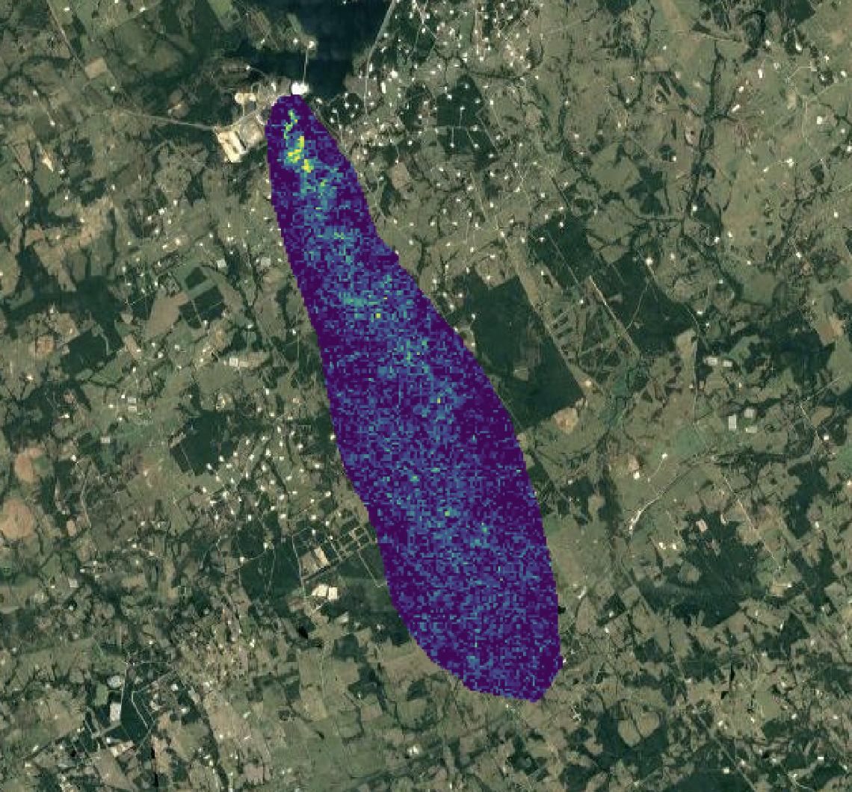
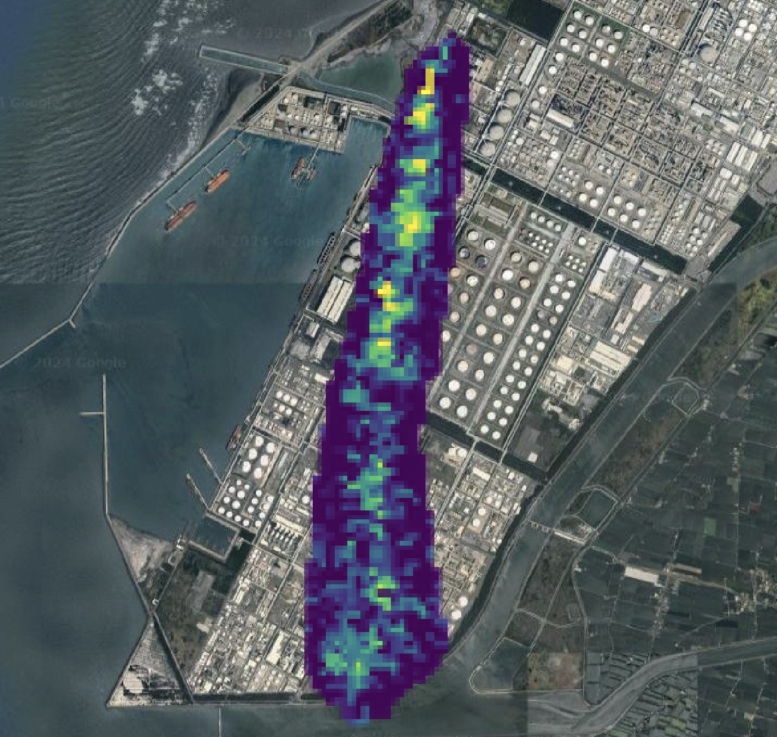
EMIT CO₂ from stationary point sources
9

Slide 10

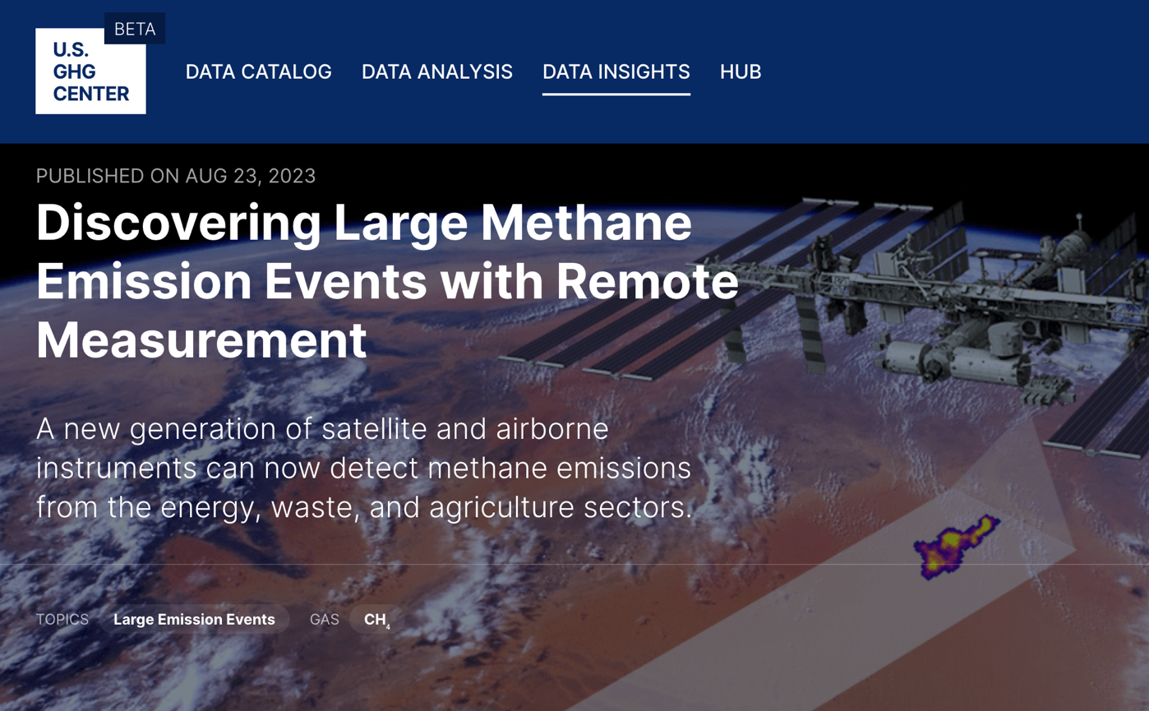
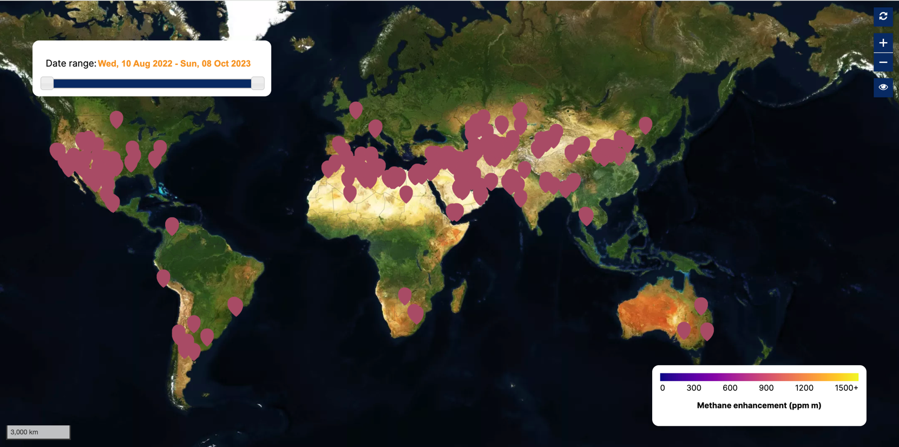

EMIT CH₄ data available through U.S. GHG Center
>1,400 EMIT CH₄ plumes
10

Slide 11


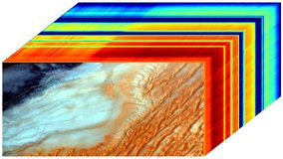
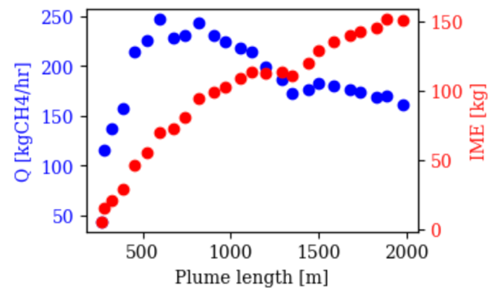
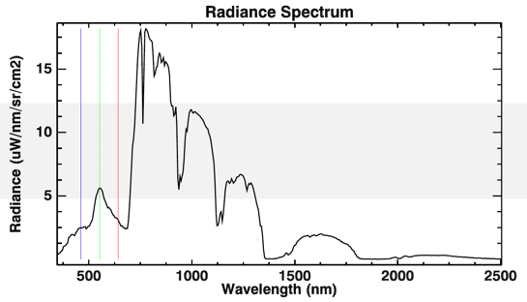
GHG data products
EMIT Level 1B: Calibrated radiance & geolocation
LP DAAC
Level 2B: Methane enhancement maps
Level 2B: Methane plumes
Level 3: Methane emission rates with uncertainties (planned)
Level 2B: CO2 enhancement maps
Level 2B: CO2 plumes
Level 3: CO2 emission rates with uncertainties (planned)
AVIRIS-3 Level 1B: Calibrated radiance & geolocation
ORNL DAAC
Level 2B: Methane enhancement maps
Level 2B: Methane plumes
(planned)
Level 3: Methane emission rates with uncertainties (planned)
Level 2B: CO2 enhancement maps
Level 2B: CO2 plumes
(planned)
Level 3: CO2 emission rates with uncertainties (planned)
Open science repositories:
https://github.co/emit-sds https://github.com/emit-sds/emit-ghg
11

Slide 12
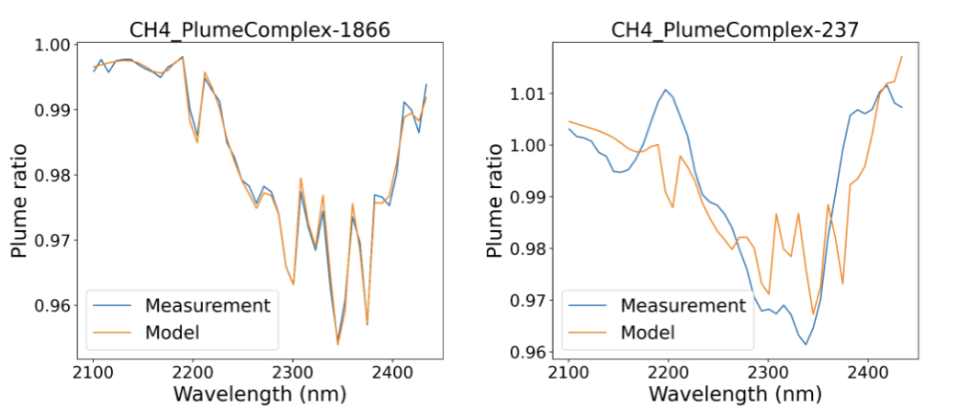
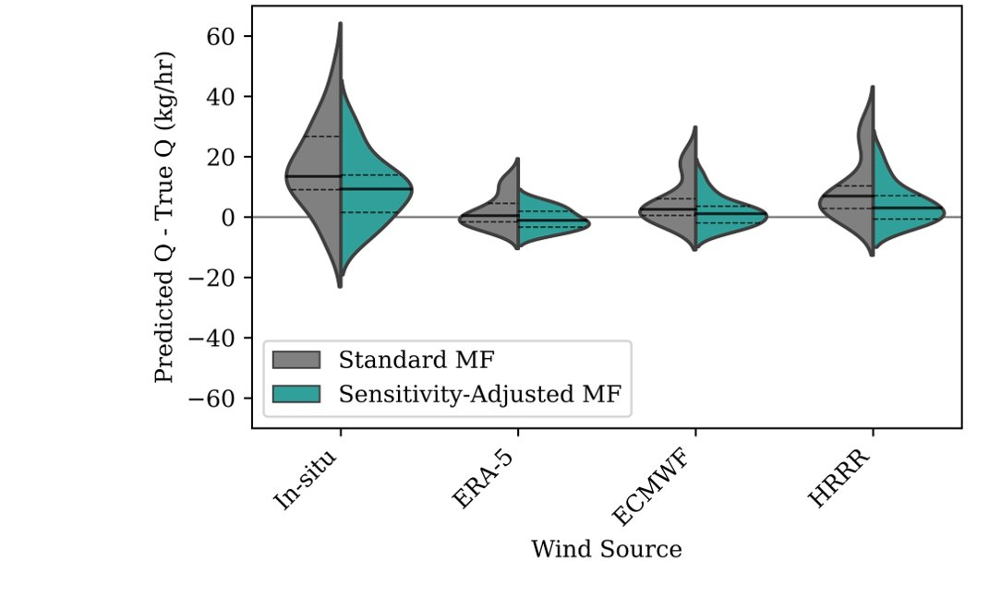
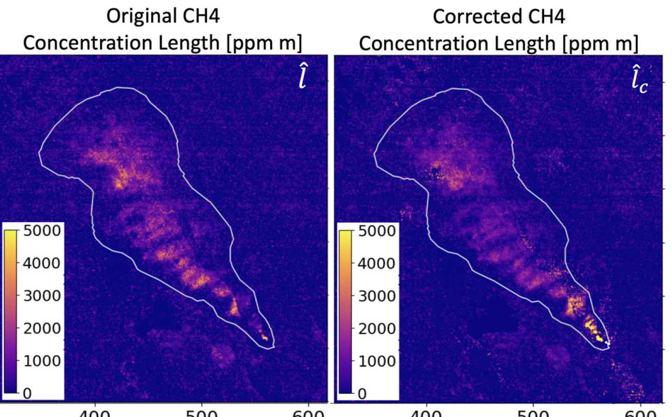
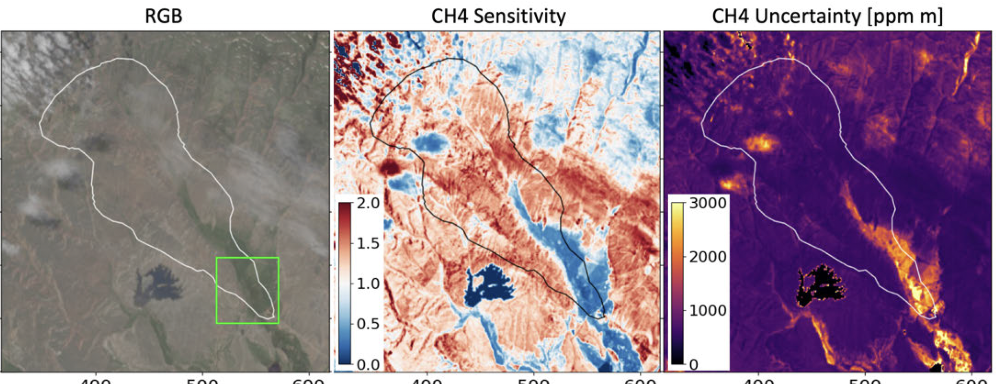
Develop next generation algorithms for the science community
False positive screening
Emission quantification
Xiang et al., in prep.
Coleman et al., in prep.
Greenhouse gas retrieval error and sensitivity metrics
Fahlen et al., 2024
12

Slide 13
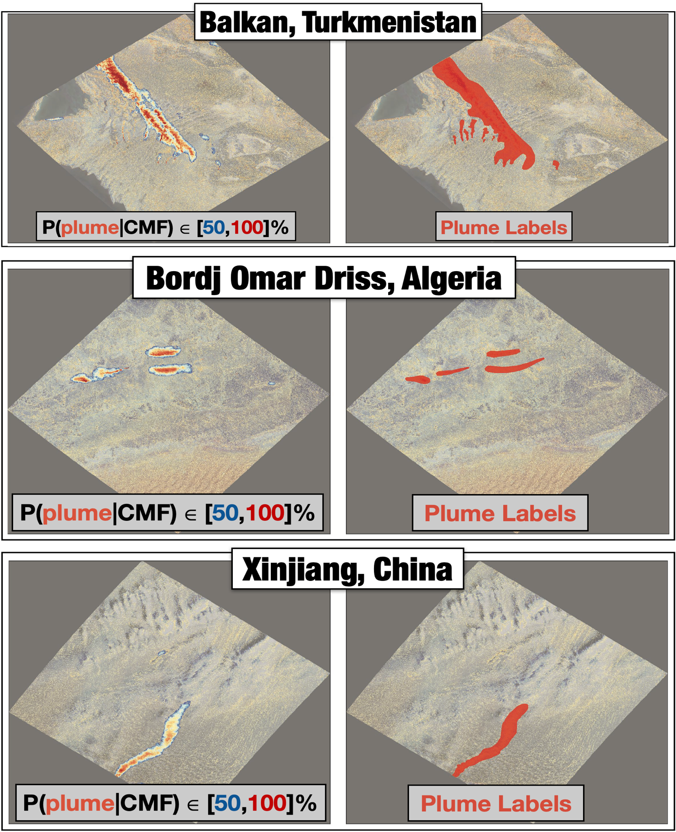
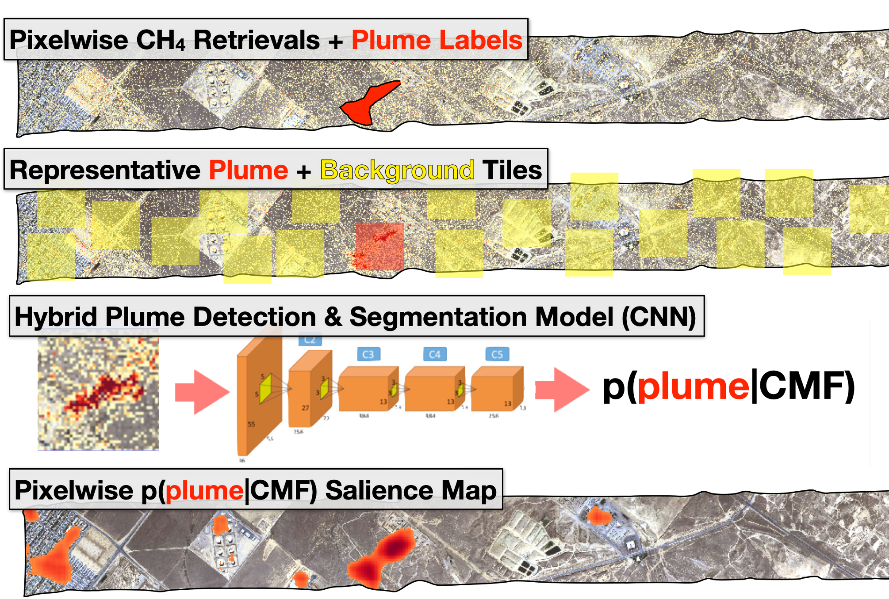
Machine learning for automated plume detection
Previously funded by Carbon Mapper, currently funded by US GHG Center
EMIT Plume Segmentation Results
Plume Detection & Segmentation Training/Validation Pipeline
Bue et al., in prep.
13

Slide 14
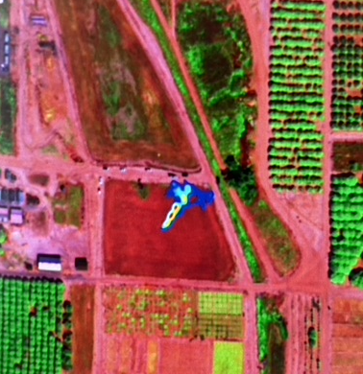
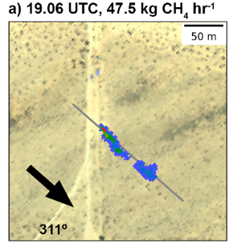
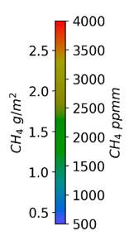
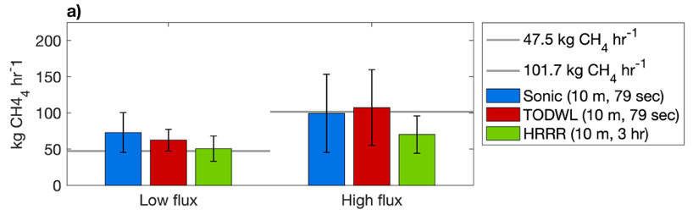
Validation
Methane controlled release experiments
  AVIRIS-3
    Nov. 2023 & Mar. 2024, U.C. Riverside, US GHG Center funded
    Sep. 2024, Stanford, Carbon Mapper funded
  EMIT
    Looking for opportunities in 2024 and beyond, Stanford, US GHG Center funded
Coincident observations with EMIT and AVIRIS-3
AVIRIS-3, 2024, 10 kg/hr
AVIRIS-NG, 2020
Thorpe et al., 2021
Coleman et al., in prep.
14

Slide 15











NASA’s Open Source Science Initiative expands use of EMIT data​
Stakeholders who are, have indicated intent to, or are exploring, incorporating EMIT observations into their platforms or operations
National Enforcement
Investigation Center
Methane Alert and
Response System (MARS)
15

Slide 16
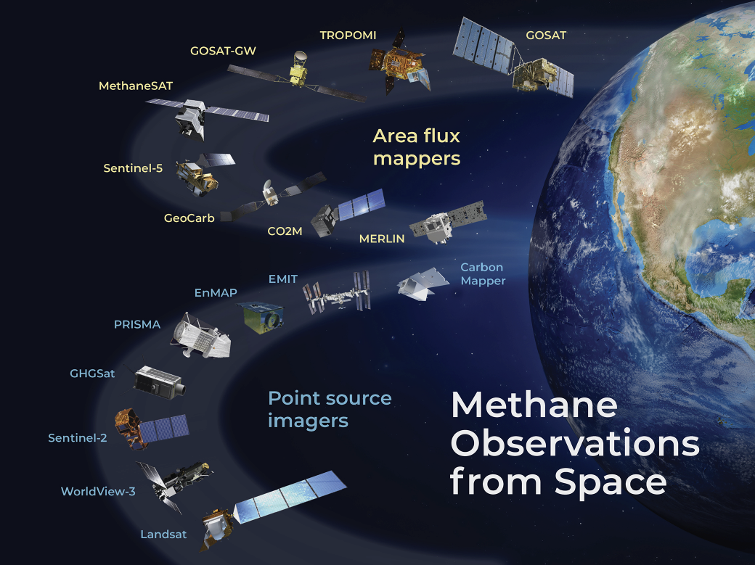









Space and airborne datasets for CH₄ are expanding rapidly
Airborne observations
Jacob et al., 2022
16

Slide 17

NASA imaging spectrometers deliver new understanding of GHG emissions
Surface Biology and Geology (SBG) VSWIR
CH₄, CO₂ point source imager
>10x coverage of EMIT
EMIT on ISS 2022
CH₄, CO₂ point source imager
Wider coverage
Carbon-I: First GHG optimized imaging spectrometer
CH₄, CO₂, CO, N₂O, HDO, C₂H₆ area flux and point source mapper
>10x improvement in precision, accuracy, sensitivity
AVIRIS-3 2023
AVIRIS-NG 2013
AVIRIS 2008
CH₄, CO₂ point source imager
Improved sensitivity relative to EMIT
AVIRIS-3
EMIT/SBG VSWIR
Power plant (CH₄, CO₂)
Carbon-I
Area flux mapper:
Large-scale variations (10-100 km scale) of GHGs
Provides 2-3 order of magnitude more data in the tropics than the POR to inform global GHG budgets
Point source imager:
10x smaller point sources
Energy, waste, agriculture, dams, wetlands, permafrost
Wastewater (CH₄)
NGL pipeline (CH₄)
Point source imager:
Large anthropogenic CH₄ & CO₂ emissions
Energy & waste emissions
Landfill (CH₄)
17
17

