Slide 1
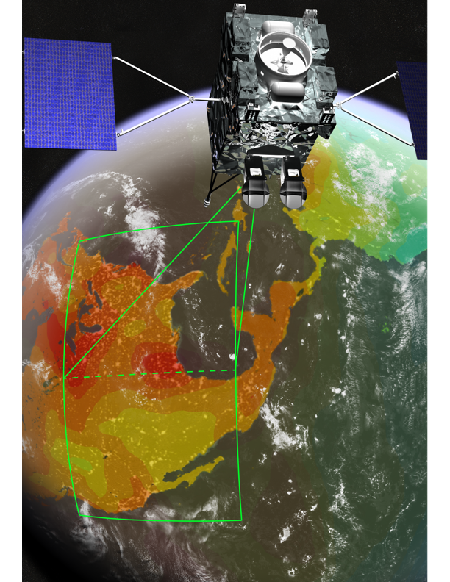
GeoCarb
Mission Status & Opportunities
Berrien Moore, Principal Investigator
Sean Crowell, Deputy PI/Project Scientist

Slide 2
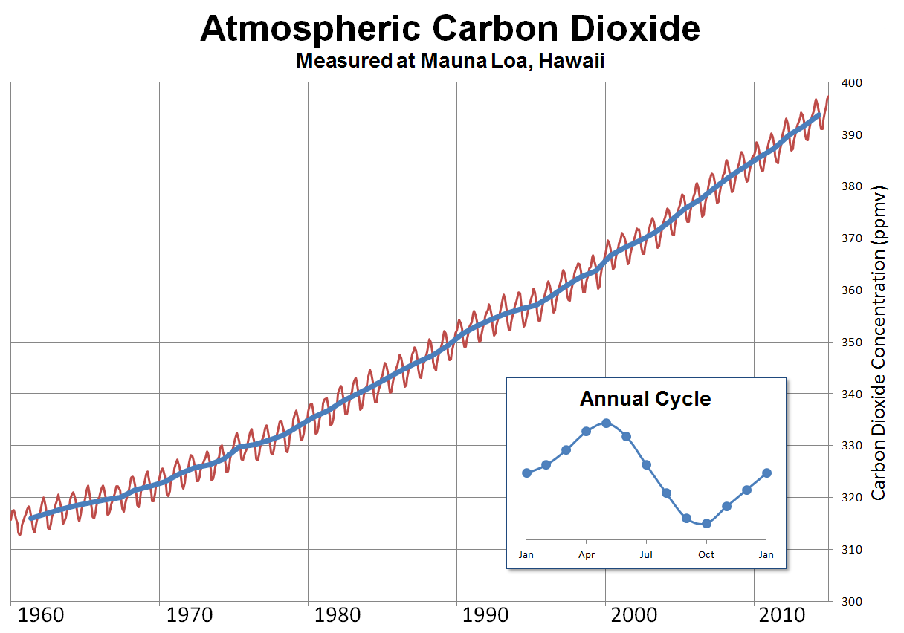
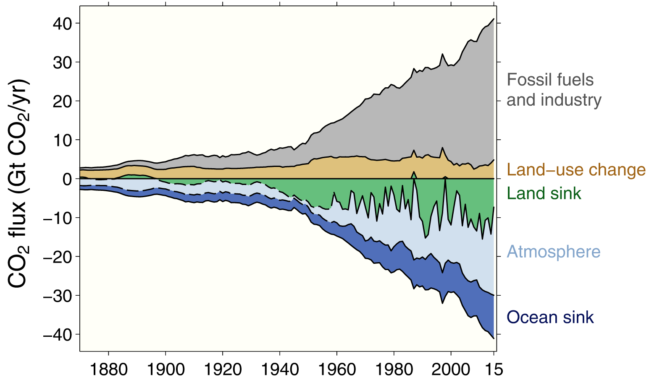
GeoCarb Motivating Science: Drivers of the Carbon Cycle
Atmospheric Growth Rate is
about half of global fossil fuel emissions
highly variable from year to year, but
the global ocean flux variability is small – land must be the cause
Outside of CONUS and Europe, observations are extremely sparse
Keeling Curve is the Fundamental Carbon Cycle Measurement
Seasonal Cycle of Biosphere
Upward trend – Anthropogenic Forcing
Inter-annual Variability
Atm Growth rate (time rate of change of Keeling curve) = fossil source + LUC – (land + ocean)

Slide 3
Mission Science Questions
What is the balance of net biosphere exchange to the anthropogenic source on regional scales?
Which spatiotemporal variations of net biosphere exchange are driven by ecosystem respiration versus photosynthesis?
How do weather and climate variability drive variability in carbon fluxes?
Are more densely populated cities more carbon efficient than less densely populated ones?
What controls the spatiotemporal variation of the Amazonian CH₄ source?
What is the distribution and magnitude of CH4 sources over CONUS?

Slide 4
GeoCarb’s Unique Capability
Persistence: At least daily coverage of cloud free regions; ability to adjust scan strategies daily. Observing strategy examples:
  CONUS and Central and South America; Twice Daily
  CONUS and Brazil; 6 Times Daily
  I-35 Scan (1000km east and west of I-35); 16 Times Daily
High Precision
  X_{CO2} (0.3%), X_{CH4} (0.6%), X_{CO} (10%)
  High precision necessary to determine large, diffuse sources of CH₄ & CO₂ (extensive wetlands or changes in net primary production in the tropical forests) and strong but highly localized point sources.

Slide 5
Why GeoCarb? Proactive & Wall-to-Wall
Proactive
  Addressing Missing Measurements of Methane.
  By mapping the Brazilian forest early in the “day” one increases the ability to see between clouds that challenge midday overpasses from Low Earth Orbiting satellites.
  Highly flexible to take advantage of Targets of opportunity
Wall-to-Wall
  Allows the use of inverse methods with the important added advantage of having the observations close to any land sources and sinks of CO₂ and CH₄ - mass balance approaches may be feasible
  Boundary conditions for higher resolution inversions can come from the data itself
GEO & LEO are highly complementary, as evidenced in the weather and air quality community!

Slide 6
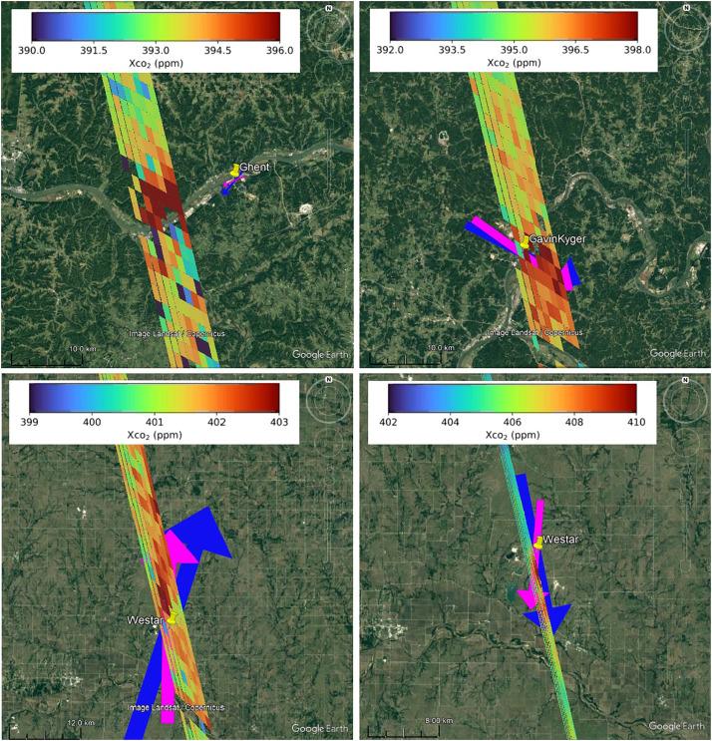
Anthropogenic Emissions from Space
Ray Nassar and others have shown that we can retrieve emission rates for point sources of CO2 using opportunistic OCO-2 observations
With GeoCarb, we will assess
  All sites in our FoV
  Changes in emissions throughout the day, over seasons, and across years
  Uncertainties in these rates arising from background assumptions and meteorology
  Sources that are not accounted for in global and national inventories
From Nassar et al (2021)
Rayner et al (2014), O’Brien et al (2016)

Slide 7
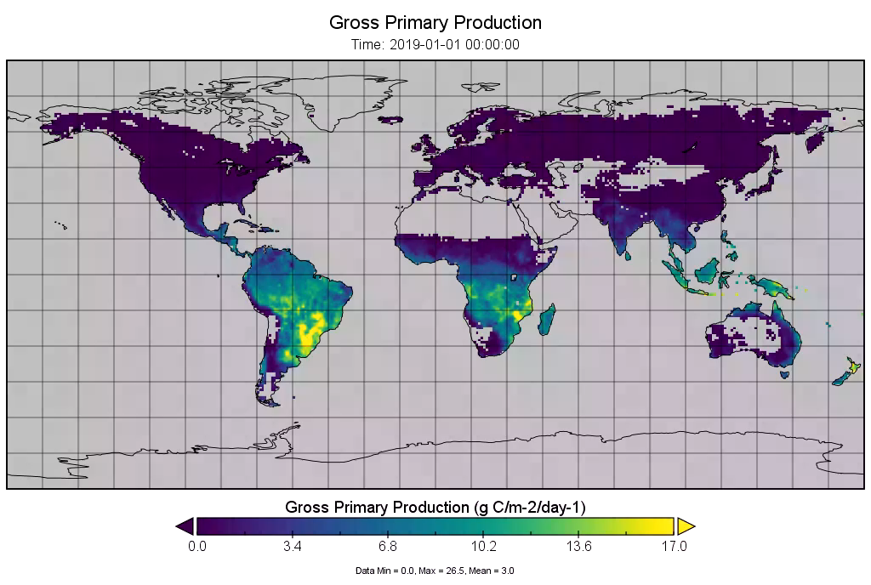
Photosynthetic Capacity and SIF
With dense data we can estimate GPP at high resolution in space and time using more fundamental approaches
ChluoFluo model: GPP = APARchl = SIF/SIF_yield
  By modeling SIF yield with a process based model like CLiMA, we can derive estimates of GPP directly from SIF with no linear assumption
Credit: Russell Doughty

Slide 8
Photosynthetic Capacity and SIF
Credit: Jen Johnson and Peter Somkuti
By understanding the local canopy-level SIF response to light, we can back out more general descriptions of local canopy-level photosynthetic capacity using work by Johnson et al (2021) that extends the classical Farquhar photosynthesis model.
This has the potential to bridge the leaf-level to canopy-level gap that has been so challenging for inferring GPP from SIF.

Slide 9
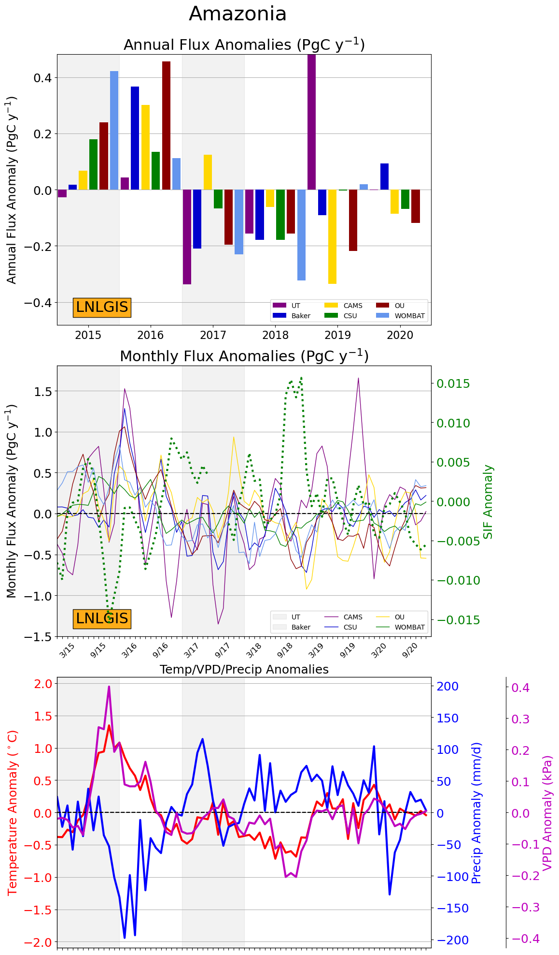
Amazonian NBE variations from OCO-2v10
Inversion models are starting to see signals that tease apart ecosystem dependence on climate variations

Slide 10
Moving to higher spatiotemporal fluxes
In the OCO-2/GOSAT era, the flux constraint seems to be limited to a few large regions per continent
Sarvesh Kumar Singh and Gregoire Broquet have shown that individual overpasses of GeoCarb with sufficiently clear scenes are able to constrain fluxes at the sub-basin scales
  Shorter time windows might be useful in avoiding the worst effects of transport error
CATS, ISCCP, Aeronet, and MODIS MAIAC cloud cover products suggest that we can get these data if we scan early in the day (before 10am)
Transport and Prior Uncertainty are Perfectly known
Prior Uncertainty is Perfectly known, Transport is not

Slide 11
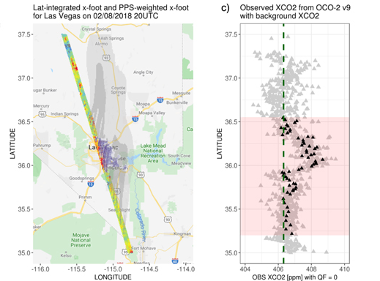
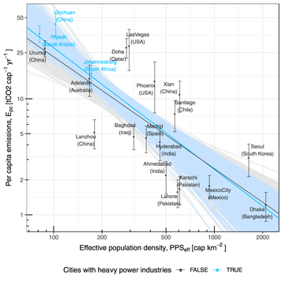
Carbon Efficiency of Cities
Wu et al (2020)
Wu et al (2020)
Uncert Reduction for Pearl River Delta
Credit: Peter Rayner
GeoCarb’s sampling density will increase the sample size of cities in the Americas and reduce errors in background estimates to enhance the robustness of these results, as well as having the ability to separate more complex multi-urban regions

Slide 12
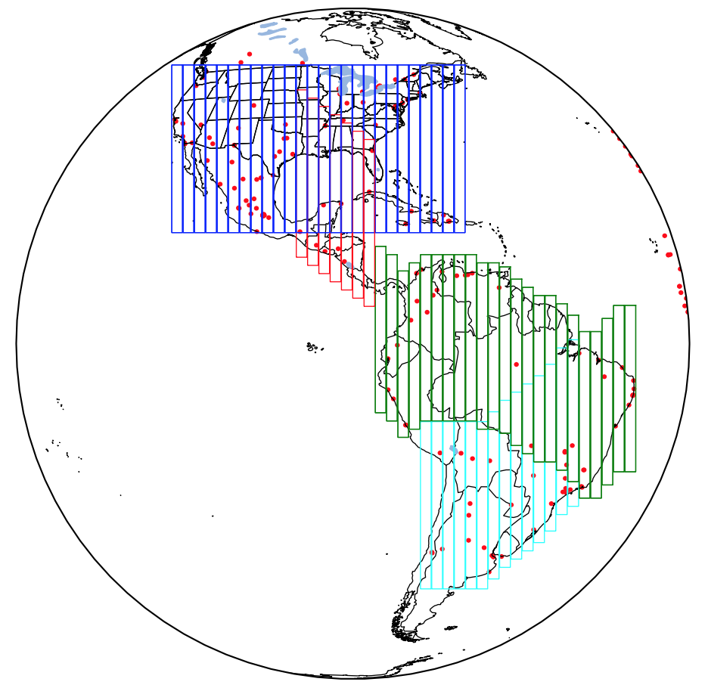
GeoCarb will Capture Urban Emissions*
Each rect. (“scan block”) contains 35 slit positions or ~35000 raw observations.
Simple strategy: Arrange scan blocks to cover as much land mass as possible
(while keeping water scenes low)
Leads to overlaps – multiple observations at those locations per day
(not necessarily bad!)
Red dots:
Cities > 500k population
*Coastal cities could remain a challenge due to footprint size, based on TROPOMI

Slide 13
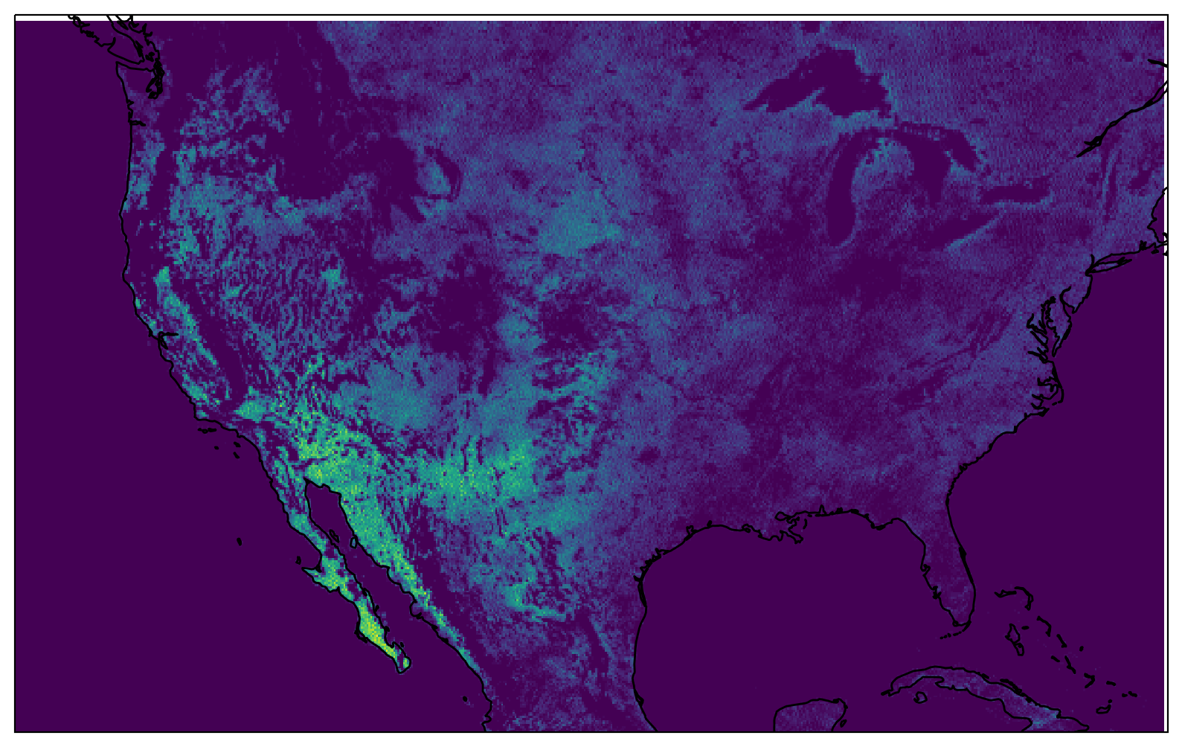
Methane from Wetlands
Signal over wet surfaces is extremely low due to low albedo in the NIR and SWIR bands
Only sampling repeatedly upwind and downwind of wetland regions will provide sufficient data to elucidate the drivers of wetland emissions and their variations from year to year
Monthly average number of scenes per gridbox from TROPOMI shows the difficulty of measuring methane over water affected scenes.

Slide 14
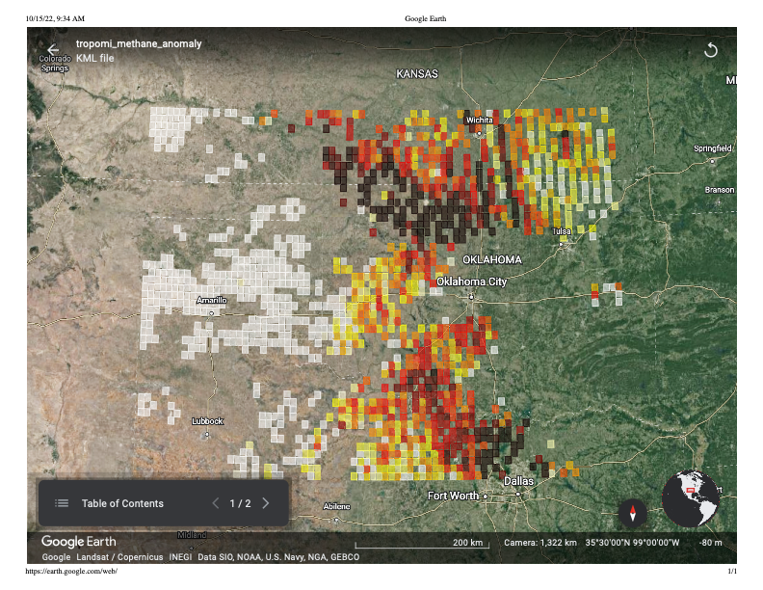
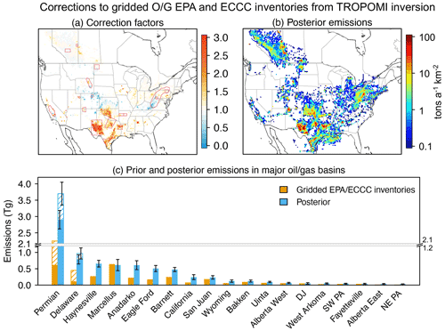
CONUS Regional Methane Emissions
TROPOMI shows us how powerful mapping-like measurements can be for measuring basin-scale measurements
Lots of work still to do to minimize footprint to footprint biases
GeoCarb will scan TCCON sites north to south regularly in order to minimize this source of uncertainty
There are open questions about diurnal variations in O&G emissions that GeoCarb will tackle as well
From Shen et al (2022, ACP)

Slide 15
A Note on Localized Sources
Early simulations showed the power of GeoCarb scanning urban regions multiple times per day as a constraint on the emissions of cities by treating them as large “plumes” - we know that even the largest cities manifest as 1-2 ppm in the column - precision is key
Intense sources of CH₄ are of interest to regulators, industry, and environmental groups and are similarly measured and quantified. GeoCarb can provide actionable information in two ways
  Satellites built for monitoring at high resolution need to be given targets: we can employ GeoCarb data to locate areas with unknown sources for further investigation (“tip and cue”) in a similar fashion to TROPOMI
  Recent work with TROPOMI has shown* that with a single overpass TROPOMI can detect signals of about 2000 kg CH₄/hour - GeoCarb should be 1.5x more precise and return daily, so we will likely do somewhat better
* https://doi.org/10.1016/j.scitotenv.2023.162222

Slide 16
A Year of Success 2023; Foundation for the Future
In November 2022
  GeoCarb was canceled due to cost and schedule overruns with no hope of completion
Since then:
  November 2022 - June 2023: completed dev & test of subassemblies
  June-July 2023: Spectrograph, telescope, scan box, and baffle/door successfully integrated onto the main bench and co-aligned - we have an integrated, aligned optics package.
  August 2023: Instrument optics package and electronics functionally tested.
  September – October 2023: Engineering Performance Test (EPT) in T-VAC demonstrated that we have an instrument with the potential for game changing science
  November 2023 Completed GeoCarb instrument was delivered to NASA LaRC and Ready for Calibration and Characterization
  December 2023 - Today: Analysis of EPT data, OSSEs, Instrument Performance Report

Slide 17
Mission Science Summary
The key performance metrics of GeoCarb are excellent: spectral and spatial resolution, SNR, polarization, etc
The instrument noise is lower than OCO-2, which gives us hope that we can find and correct systematic retrieval errors
The effects of scene inhomogeneity appear to be smaller than we previously thought due to blurring by the PSF
The residual image appears to be mitigatable with the forward bias, though FPA-0 was not properly configured
The stray light is significant, but appears to be characterizable
The keystone correction remains the tallest pole, but we have more avenues to explore
The instrument is exquisitely made and there are no showstoppers.

Slide 18
GeoCarb SNR is Spectacular
The GeoCarb instrument SNR is as good or better relative to OCO-2 (with slightly lower resolving power)
GeoCarb SNR is significantly better than was assumed in the most recent algorithm paper
Significance
  SIF data quality is strongly driven by SNR
  Systematic errors in retrievals are much easier to correct

Slide 19
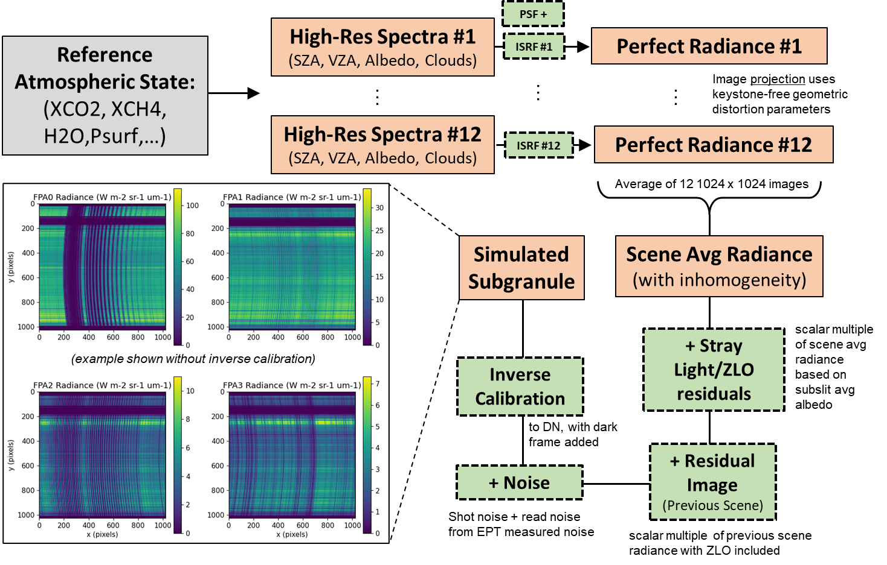
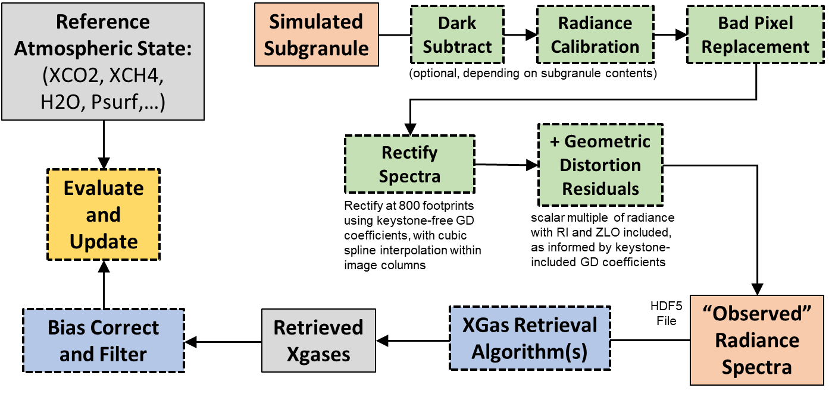
“Kitchen Sink” Simple OSSE Results
XCO2
0.75
ppm
5.5
ppb
2.4
ppb
XCH4
XCO

Slide 20
Evolution of Team’s Level of Concern
8/2023
9/2024
SNR
Alignment/Focus
Co-alignment of channels
Scene inhomogeneity
Residual Image
Stray light
Geometric Distortion
Data analysis by a small team has made significant progress in resolving perceived issues in the GeoCarb performance

Slide 21
Programmatic Challenges
Getting to GEO on a dedicated platform is hard
  NASA previously issued an RFP to get dedicated mission within 24 months - cost would have been approximately $300M-$400M (estimated from the cancelation press release)
  We have a ROM from a commercial partner that would get GeoCarb to space with 4 years of operations: NASA would have open access to this data for < 20% of the press release cost under a proposed cost sharing agreement
    Orbital slot near 90W
    Launch vehicle
    Spacecraft bus
NASA has many competing priorities from the Decadal Survey

Slide 22
Perceptual Challenge
The Program of Record is chock full of GHG missions
  OCO-2/3, GOSAT/GOSAT-2 are healthy and providing a long record
  International science missions are expanding - wide-swath, aerosol measurements on board, active measurement techniques, cubesats, …
  Commercial hyperspectral missions are proliferating
  Carbon-I is the ESE GHG selection for Phase 1 in open competition with other climate-oriented missions
GeoCarb
  is completed and ready to integrate and launch after a full C&C,
  would uniquely fill a gap to complement the existing and planned Global Carbon Observing System,
  has a path that forges a public-private-university partnership to share costs among and provide value to diverse stakeholders, and
  is not in competition with missions that will launch in > 5 years - tech development for those missions must continue!

Slide 23
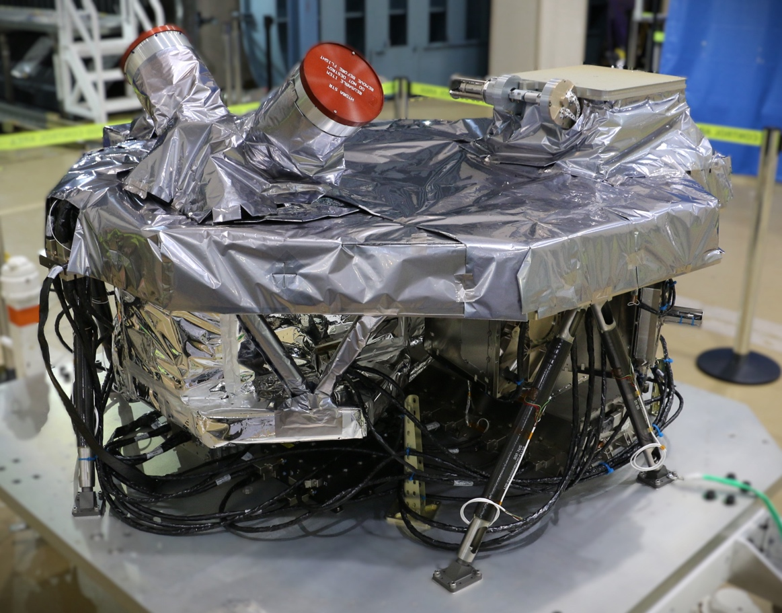
A bird in the hand…

Slide 24
Backup

Slide 25
Technical Challenges
Residual image
  The detector retains a faint image of the previous scene overlaid on the current image (0.5% magnitude)
  Can solve this with a charge injection (“forward bias”) between scenes
Scene inhomogeneity
  Varying brightness within a footprint distorts the ILSF, leading to retrieval errors
  By incorporating the along slit blurring from the telescope, we find this error to be much smaller than we previously expected - likely OK
Stray light
  Echelle gratings are known for stray light issues
  GeoCarb’s stray light is characterizable
    Grating scatter is confined to the spectral direction
    Diffuse scatter is a function of the total signal on the detector
Image Keystone Rectification
  Scene information in spatial and spectral directions are mixed
  Initial algorithm attempts were not sufficient, but there are many other paths to explore
    Construct a separate “retrieval” of the FPA image by exhaustively mapping the slit/wavelength to the detector image in testing
    Build the rectification into the L2 code directly and allow the atmospheric retrieval to optimize the detector image

Slide 26
Coverage versus Resolution
Due to the physical requirements of hardware, instrument designers must trade spatial resolution and coverage. Generally speaking,
  Extremely high spatial resolution sensors can see industrial point sources of CH4 very well, but must know where to look and be tasked to look there
  Area mappers with broad coverage measure at coarser resolution, so they see the bigger picture but may not detect moderate, but highly localized, sources

Slide 27
A Year in the Life of GeoCarb: 2023
Pictures Tell a Thousand Words

Slide 28
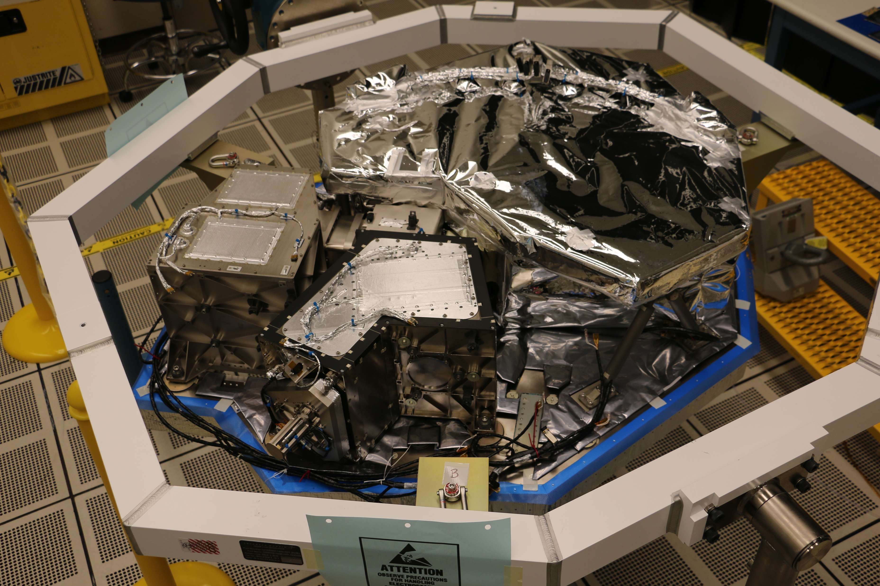
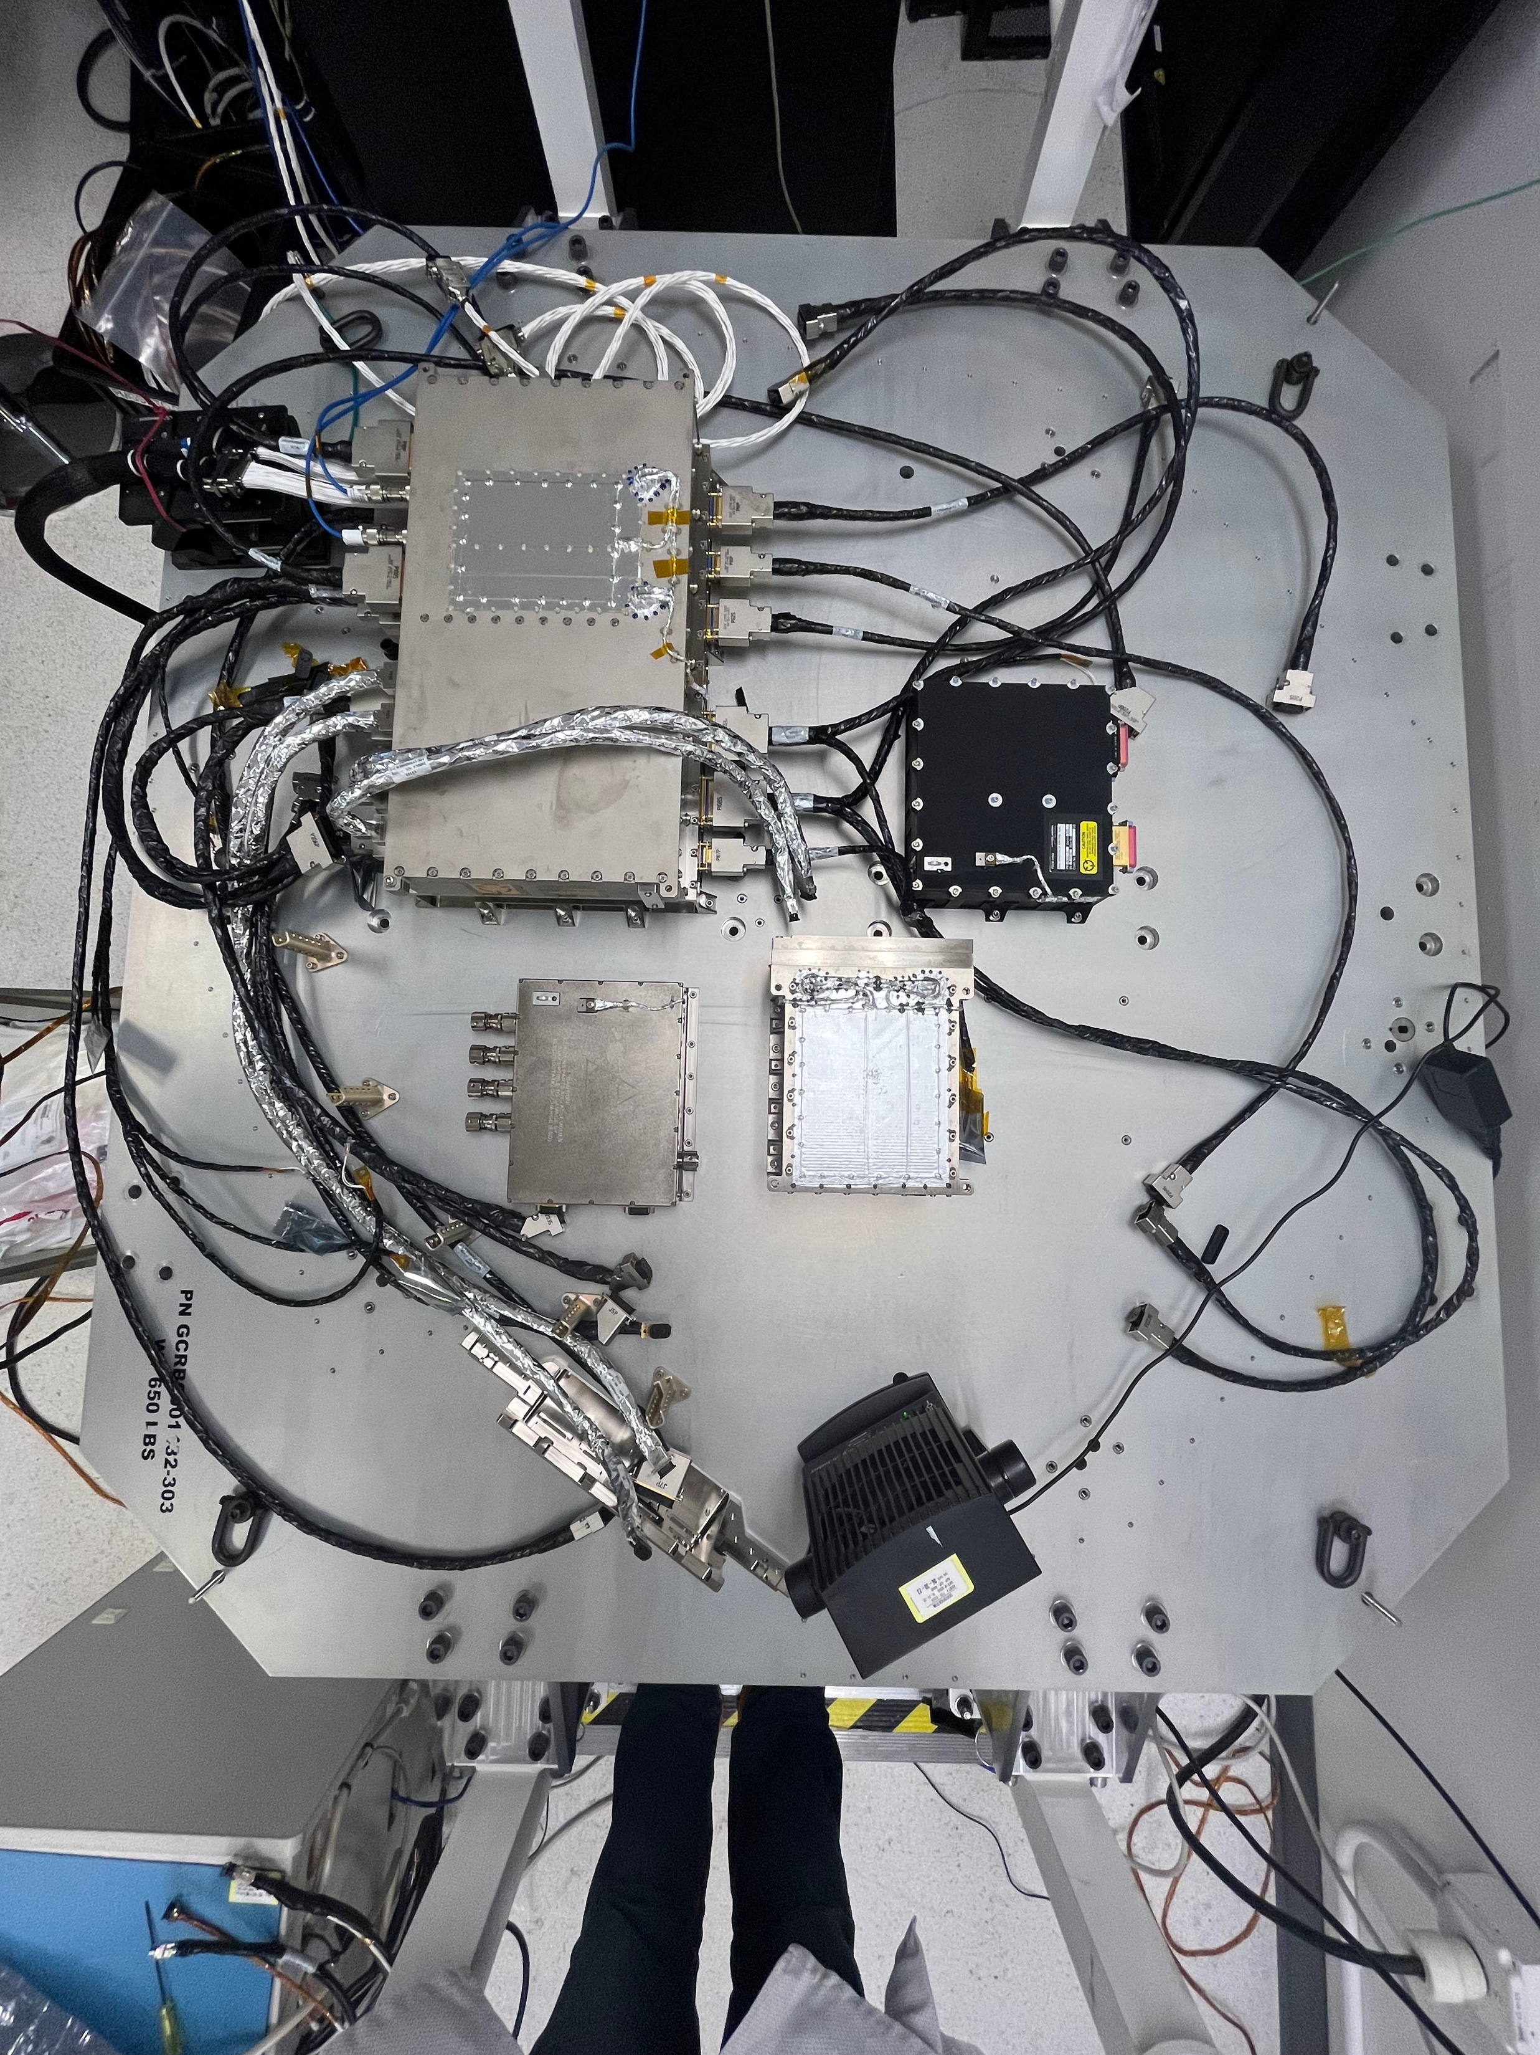
Optics Package and Electronics: May 2023
Electronics Boxes
Spectrograph
Scan Box
Telescope

Slide 29
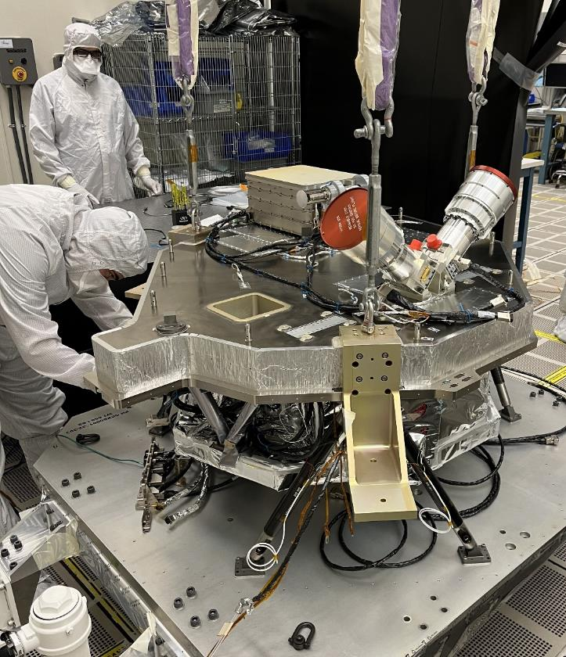
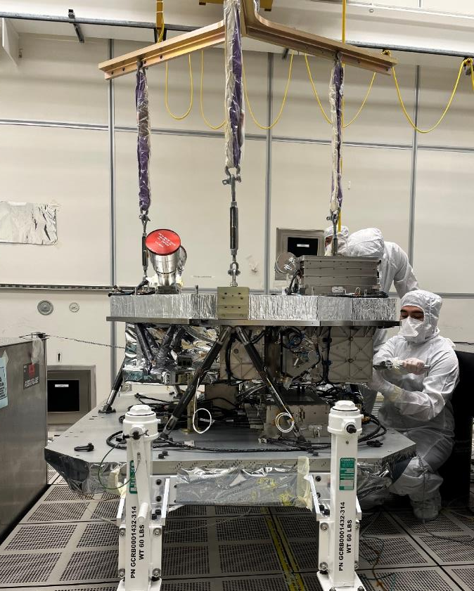
Subassemblies Integrated: July 2023
CUI//SP-EXPT
Main Bench Lift to Nadir Plate Top view
Main Bench Lift to Nadir Plate Side View
CUI//SP-EXPT

Slide 30
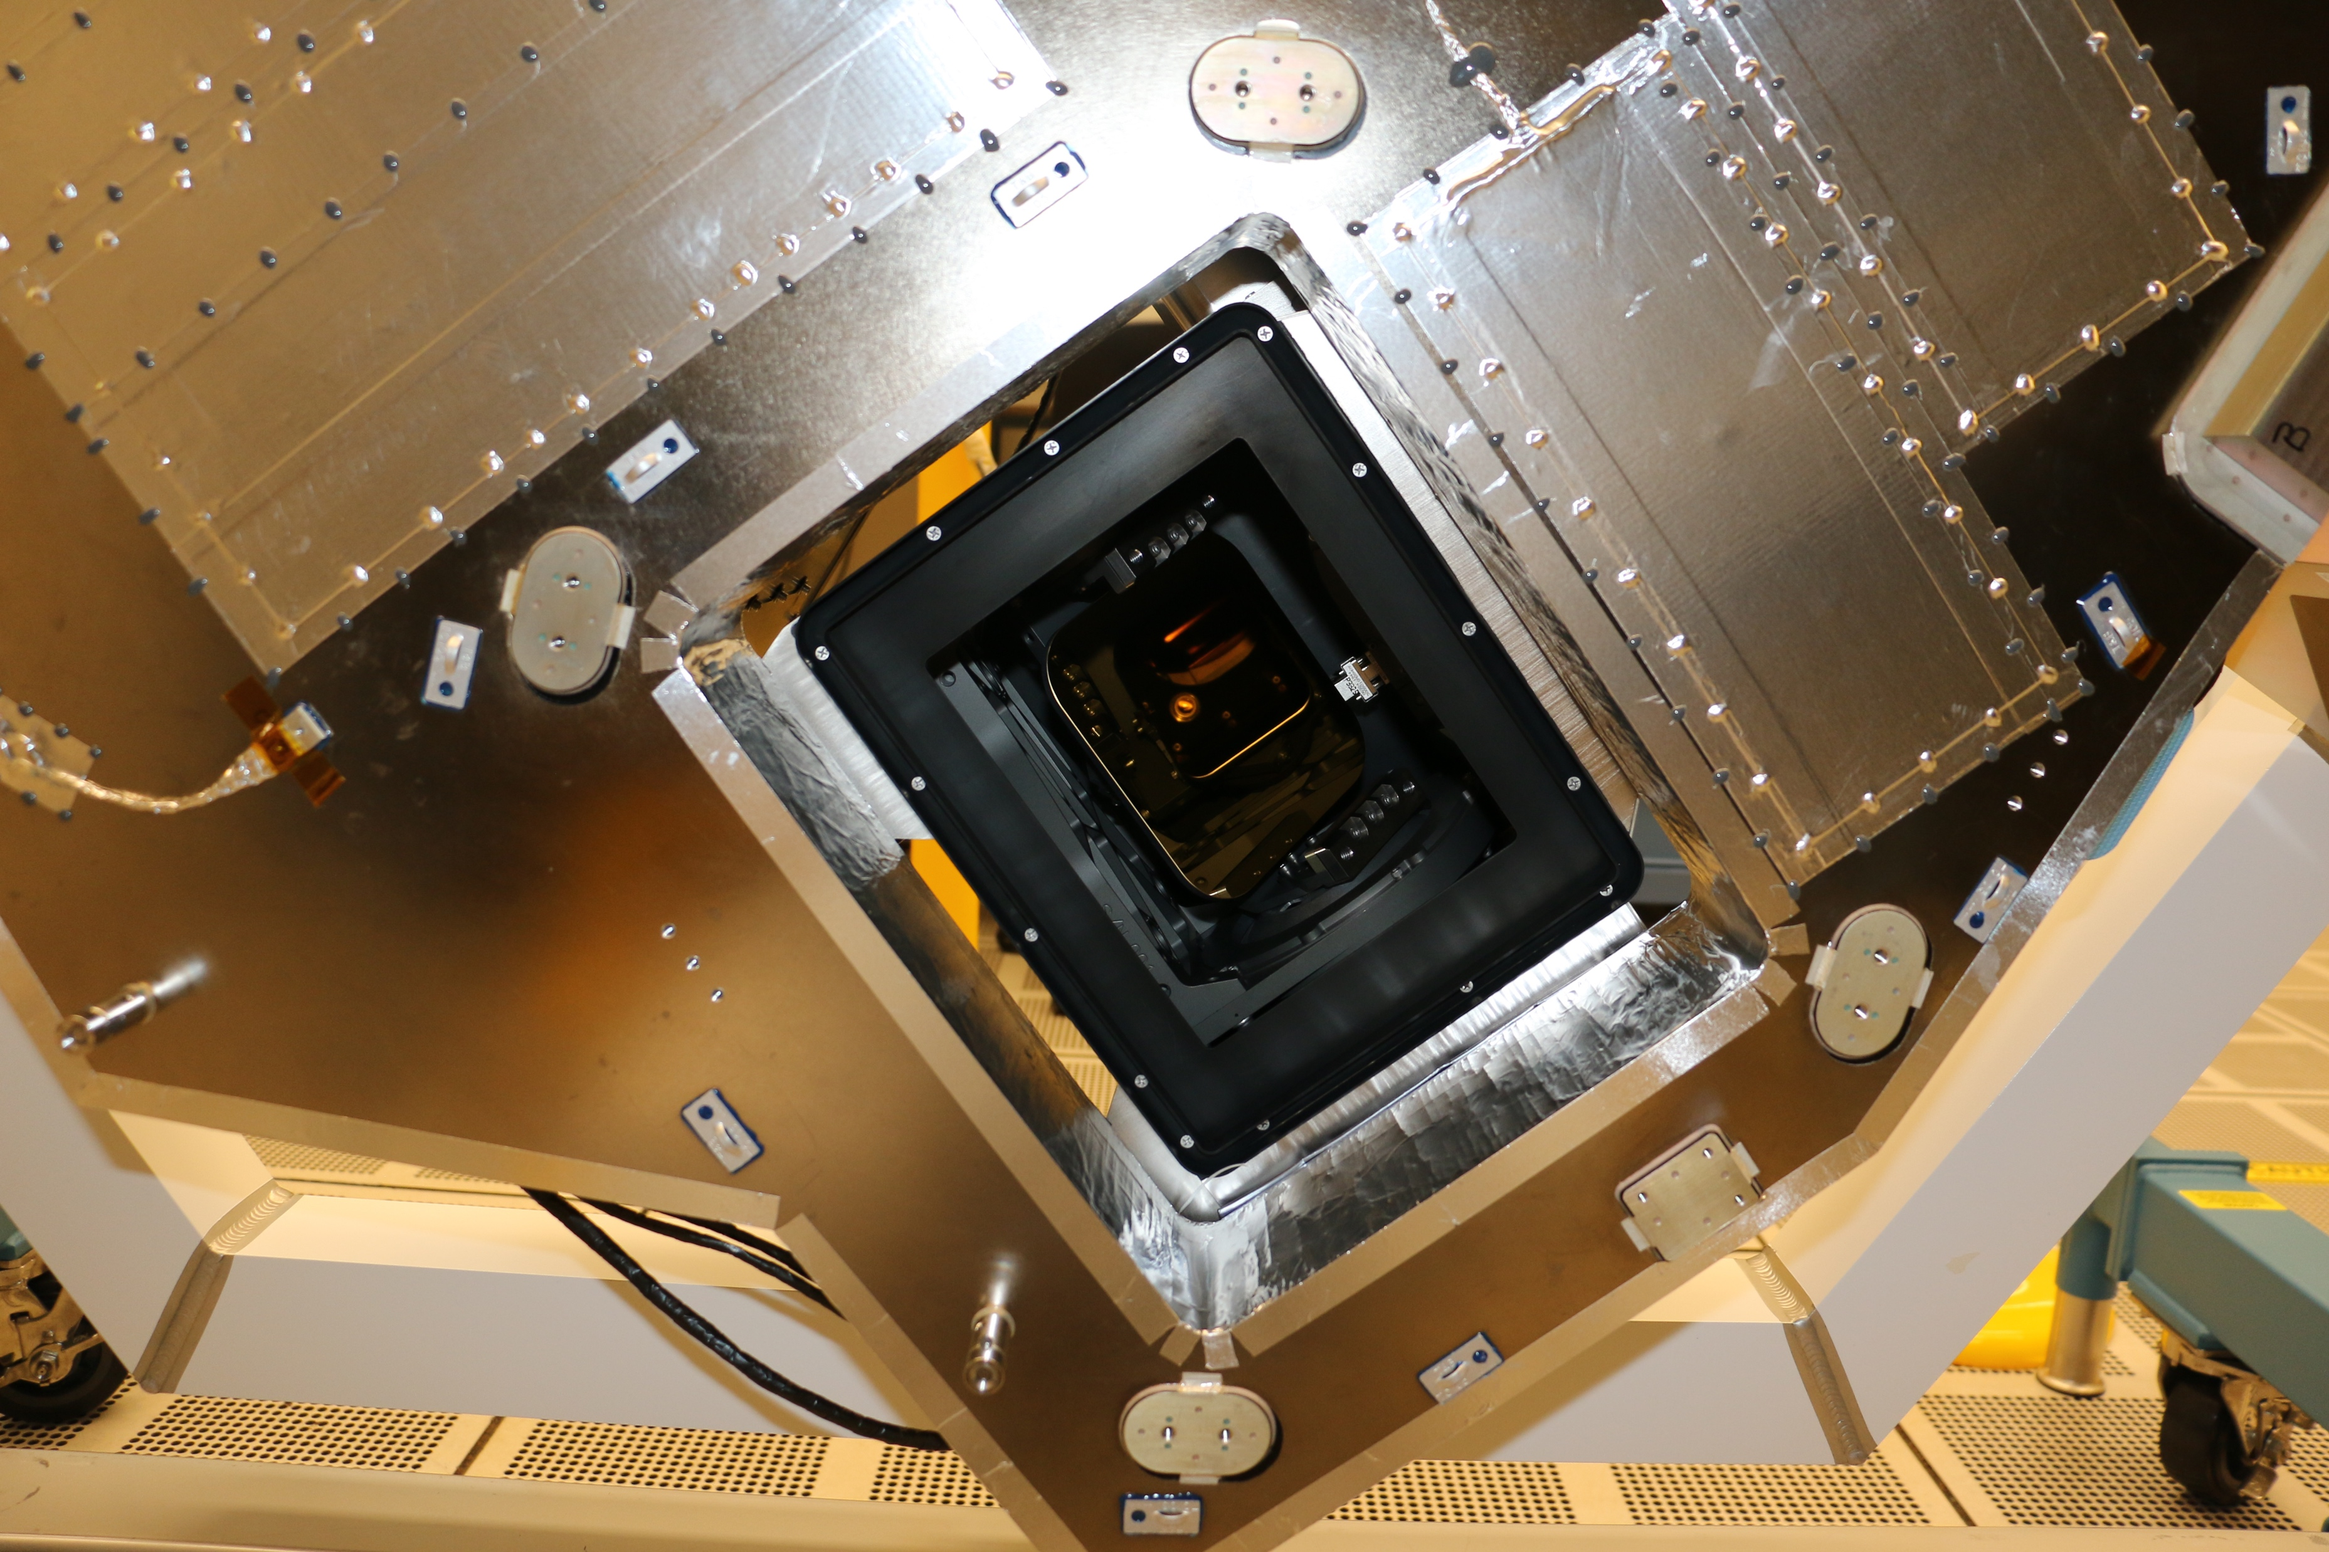
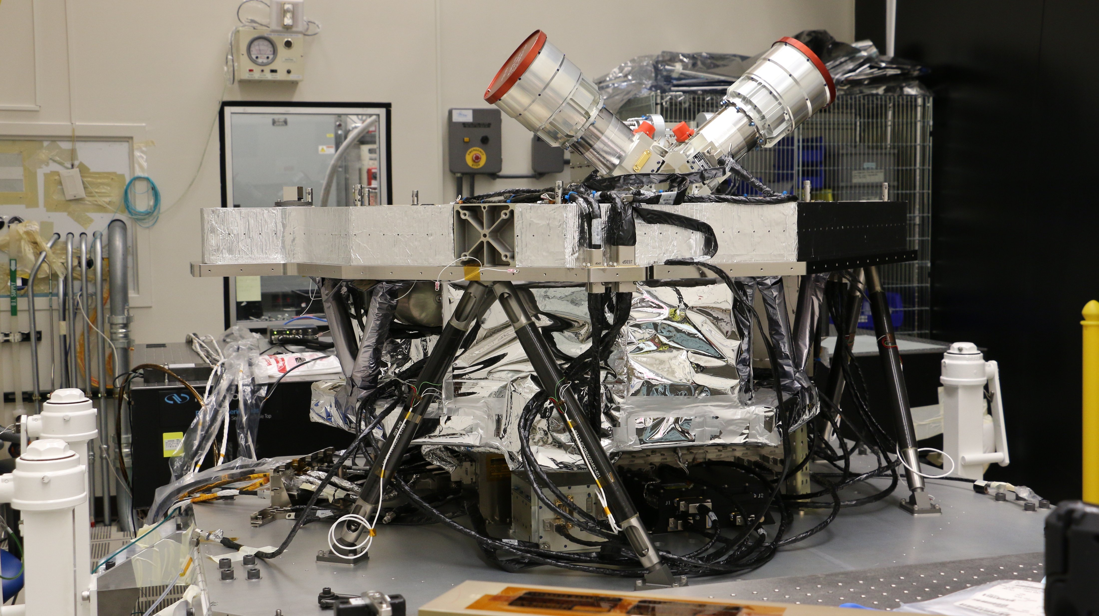
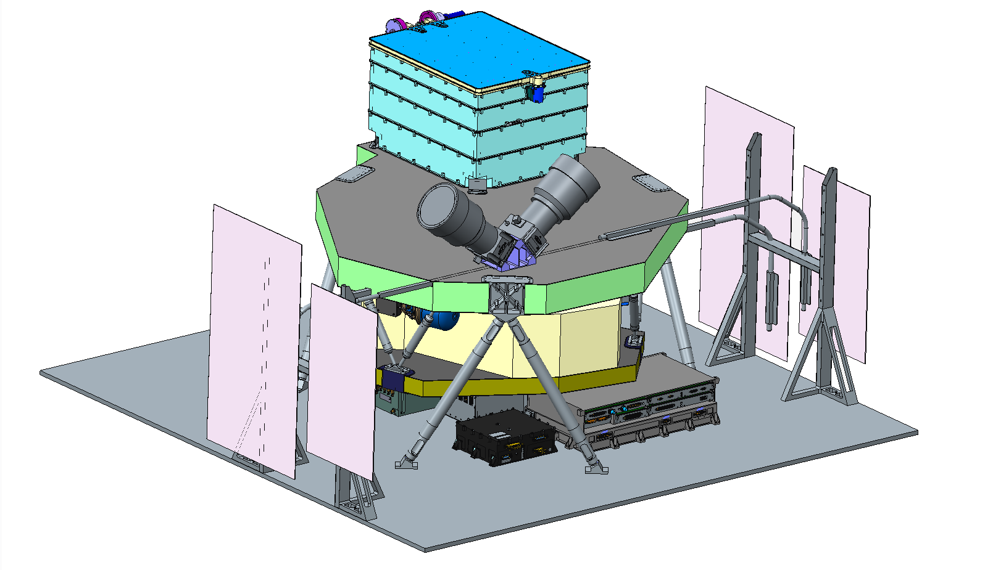
An Integrated Instrument: August 2023
Looking down into the scan mirror assembly
Nadir
S/C Deck

Slide 31
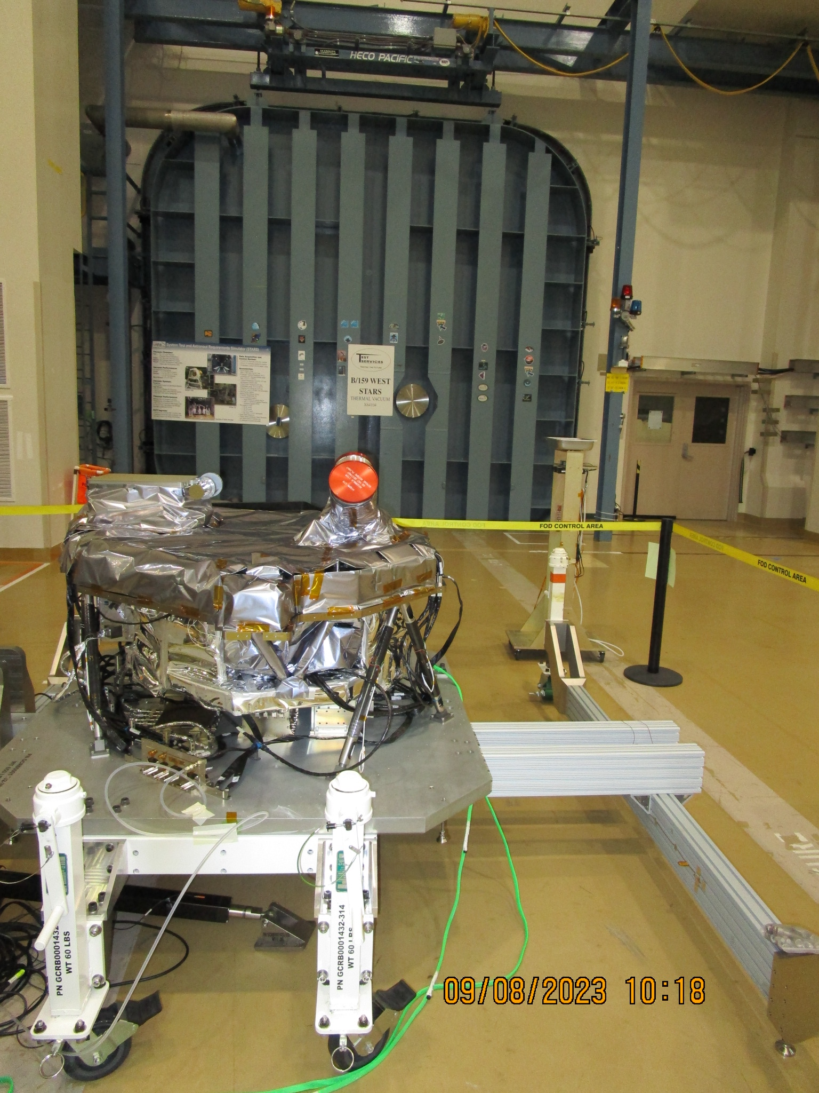
Arrived SAFELY at T-VAC

Slide 32
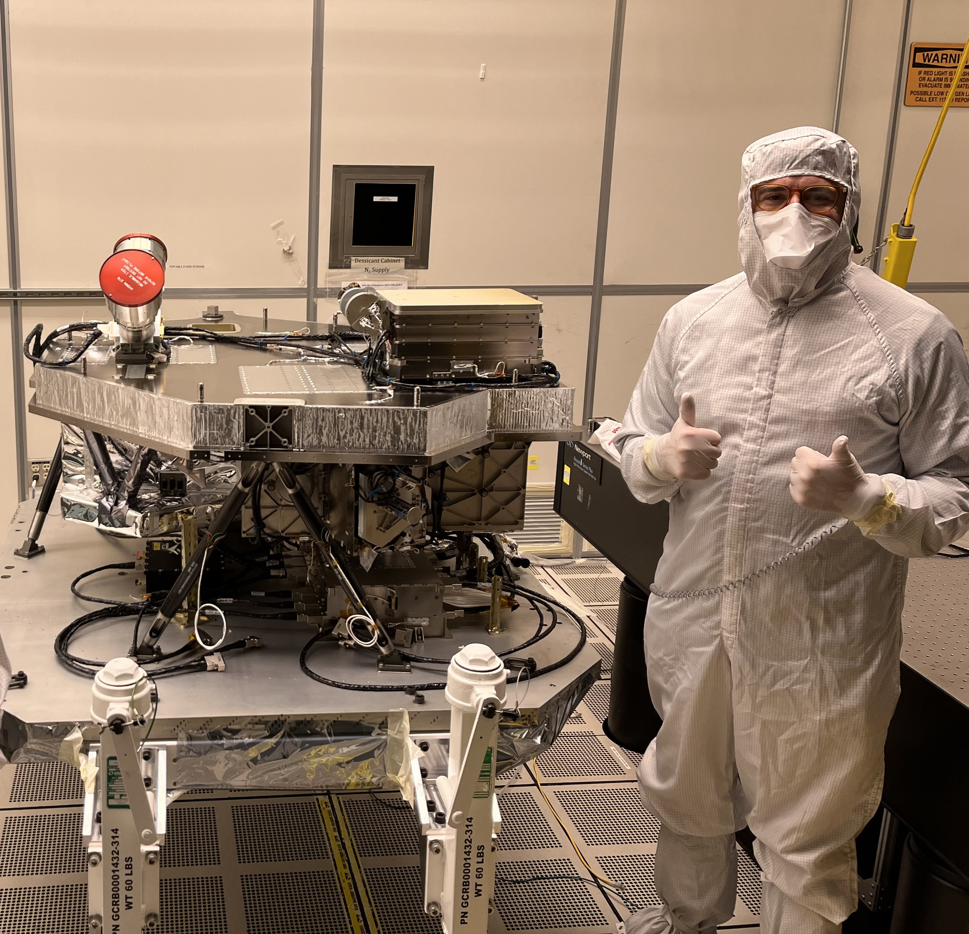
Ship to THERMOVAC: Early September

Slide 33
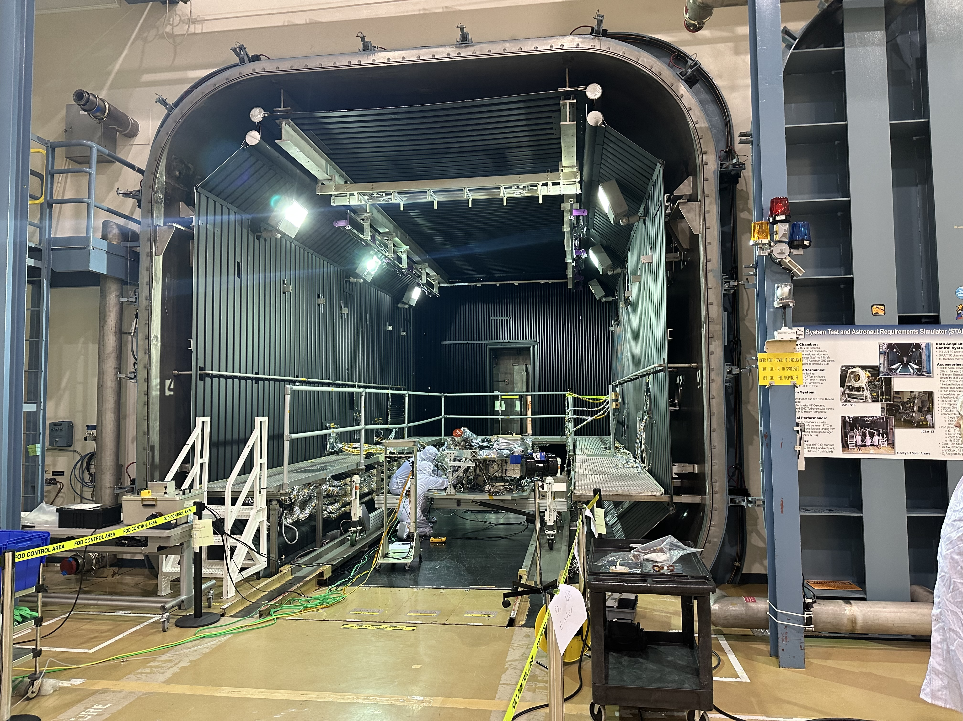
Inside T-VAC: 9/23/2023

Slide 34
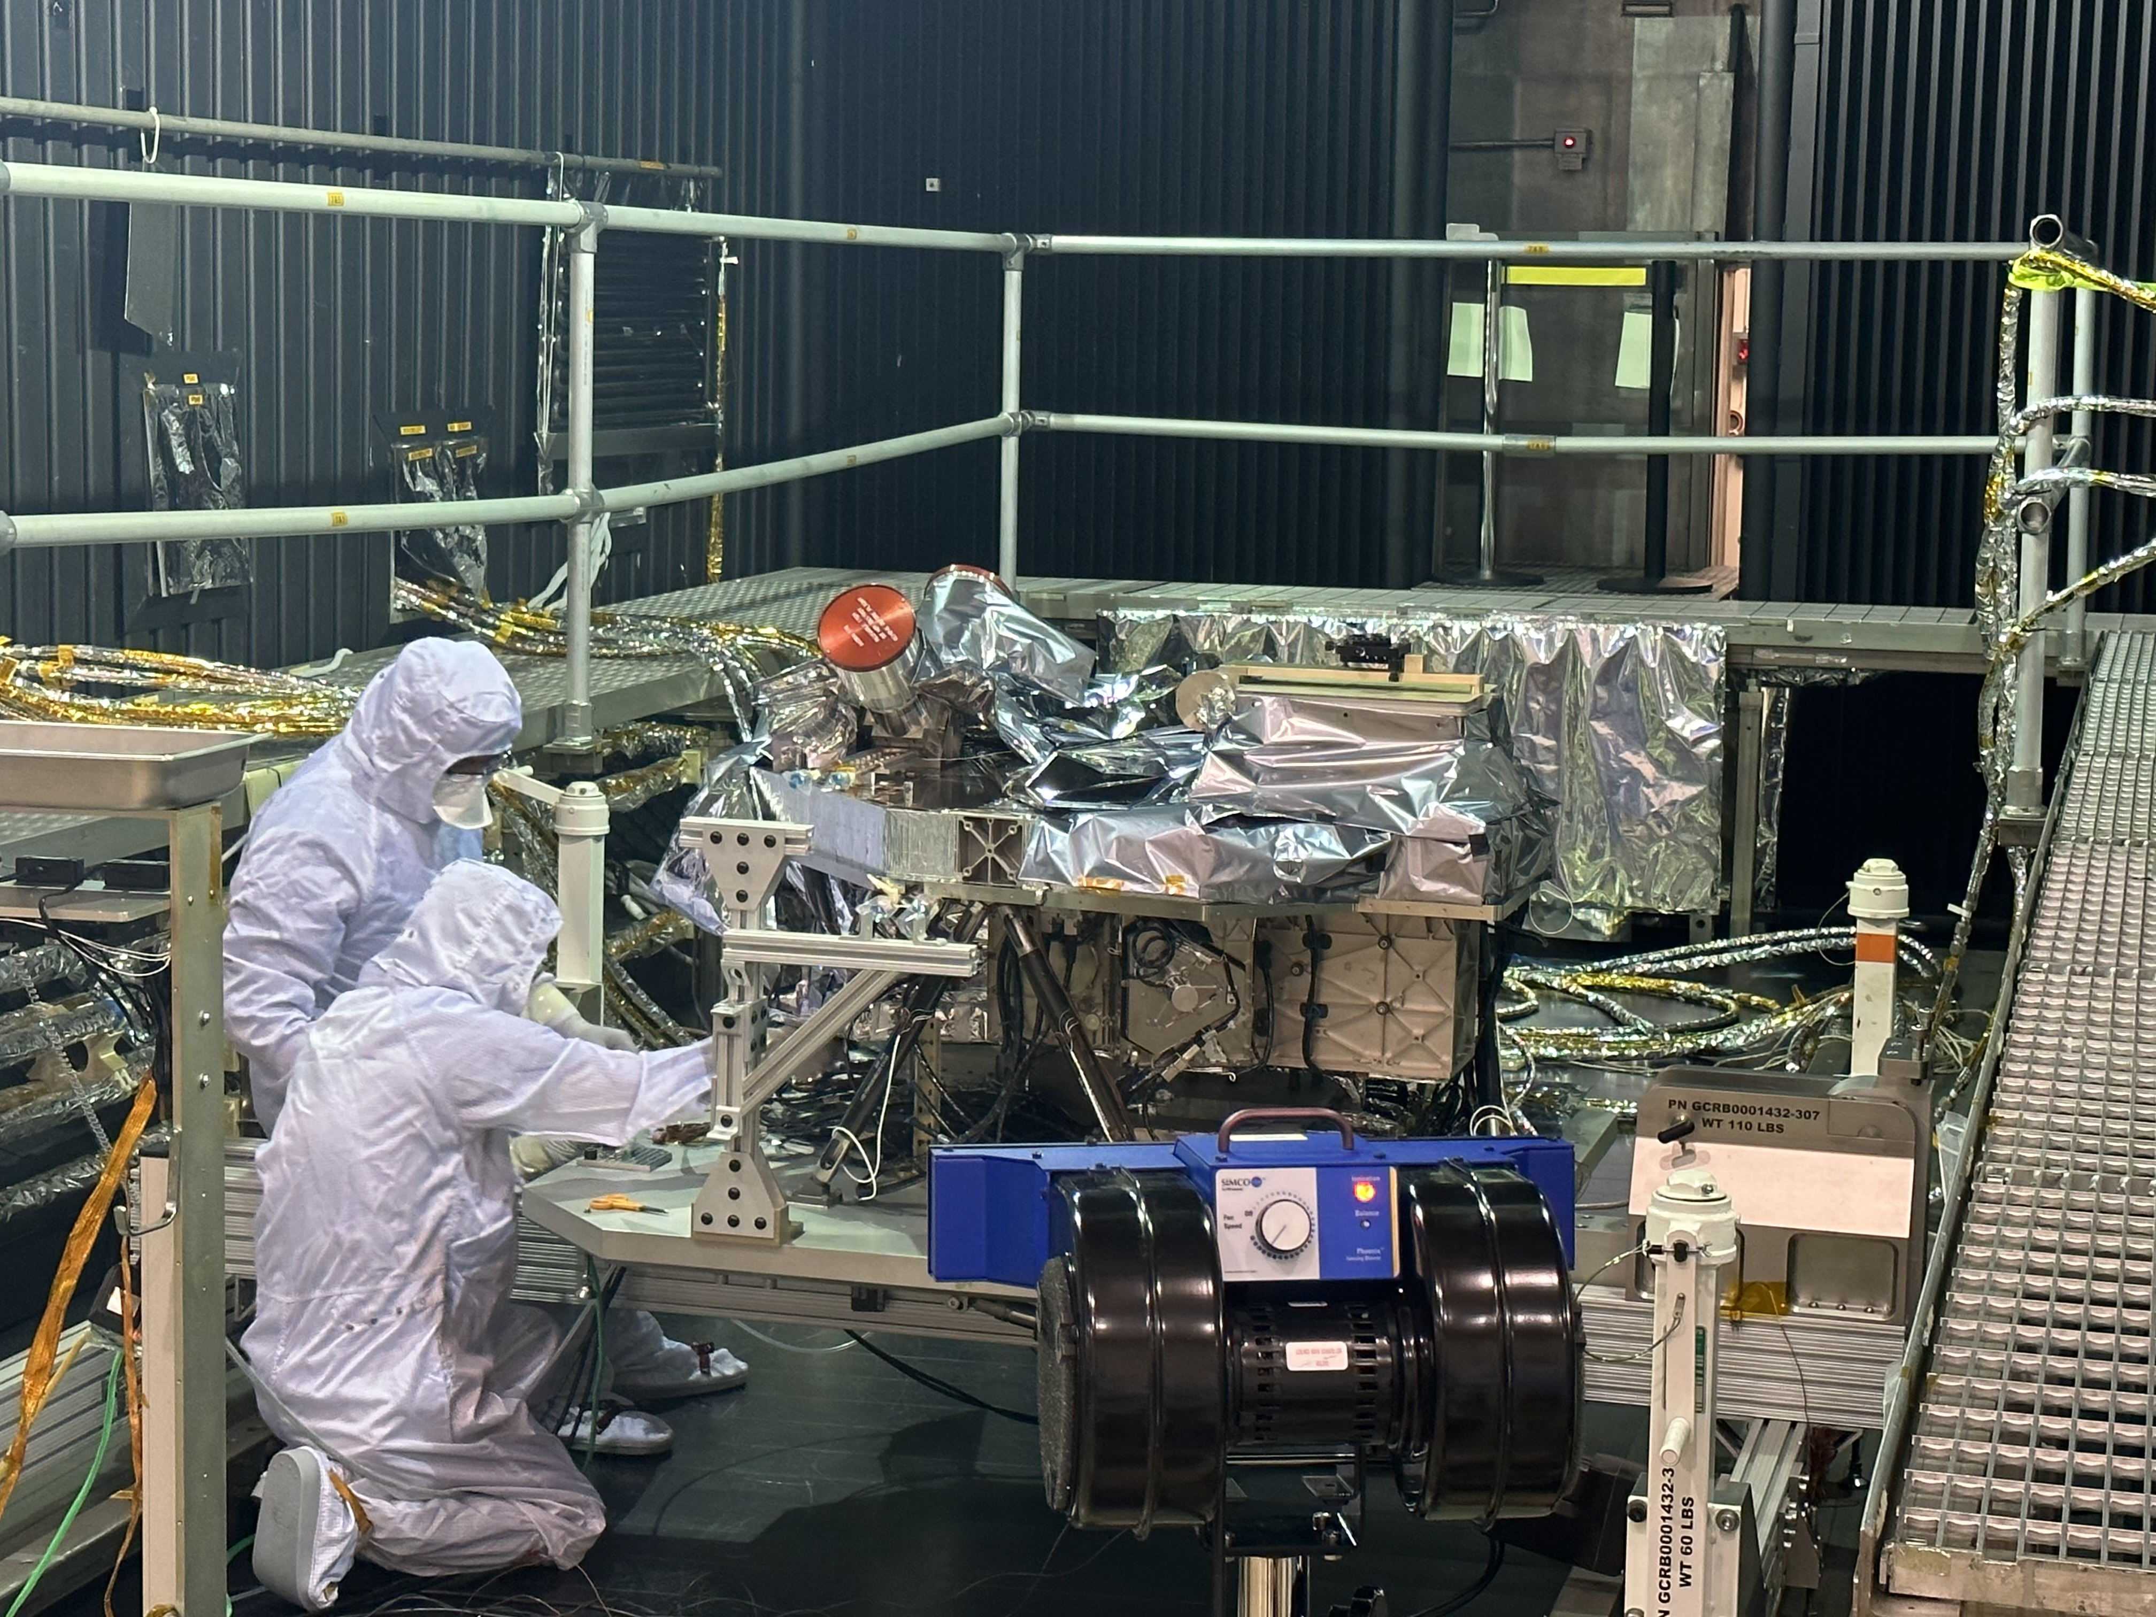
Last Minute Adjustments: 9/23/23

Slide 35
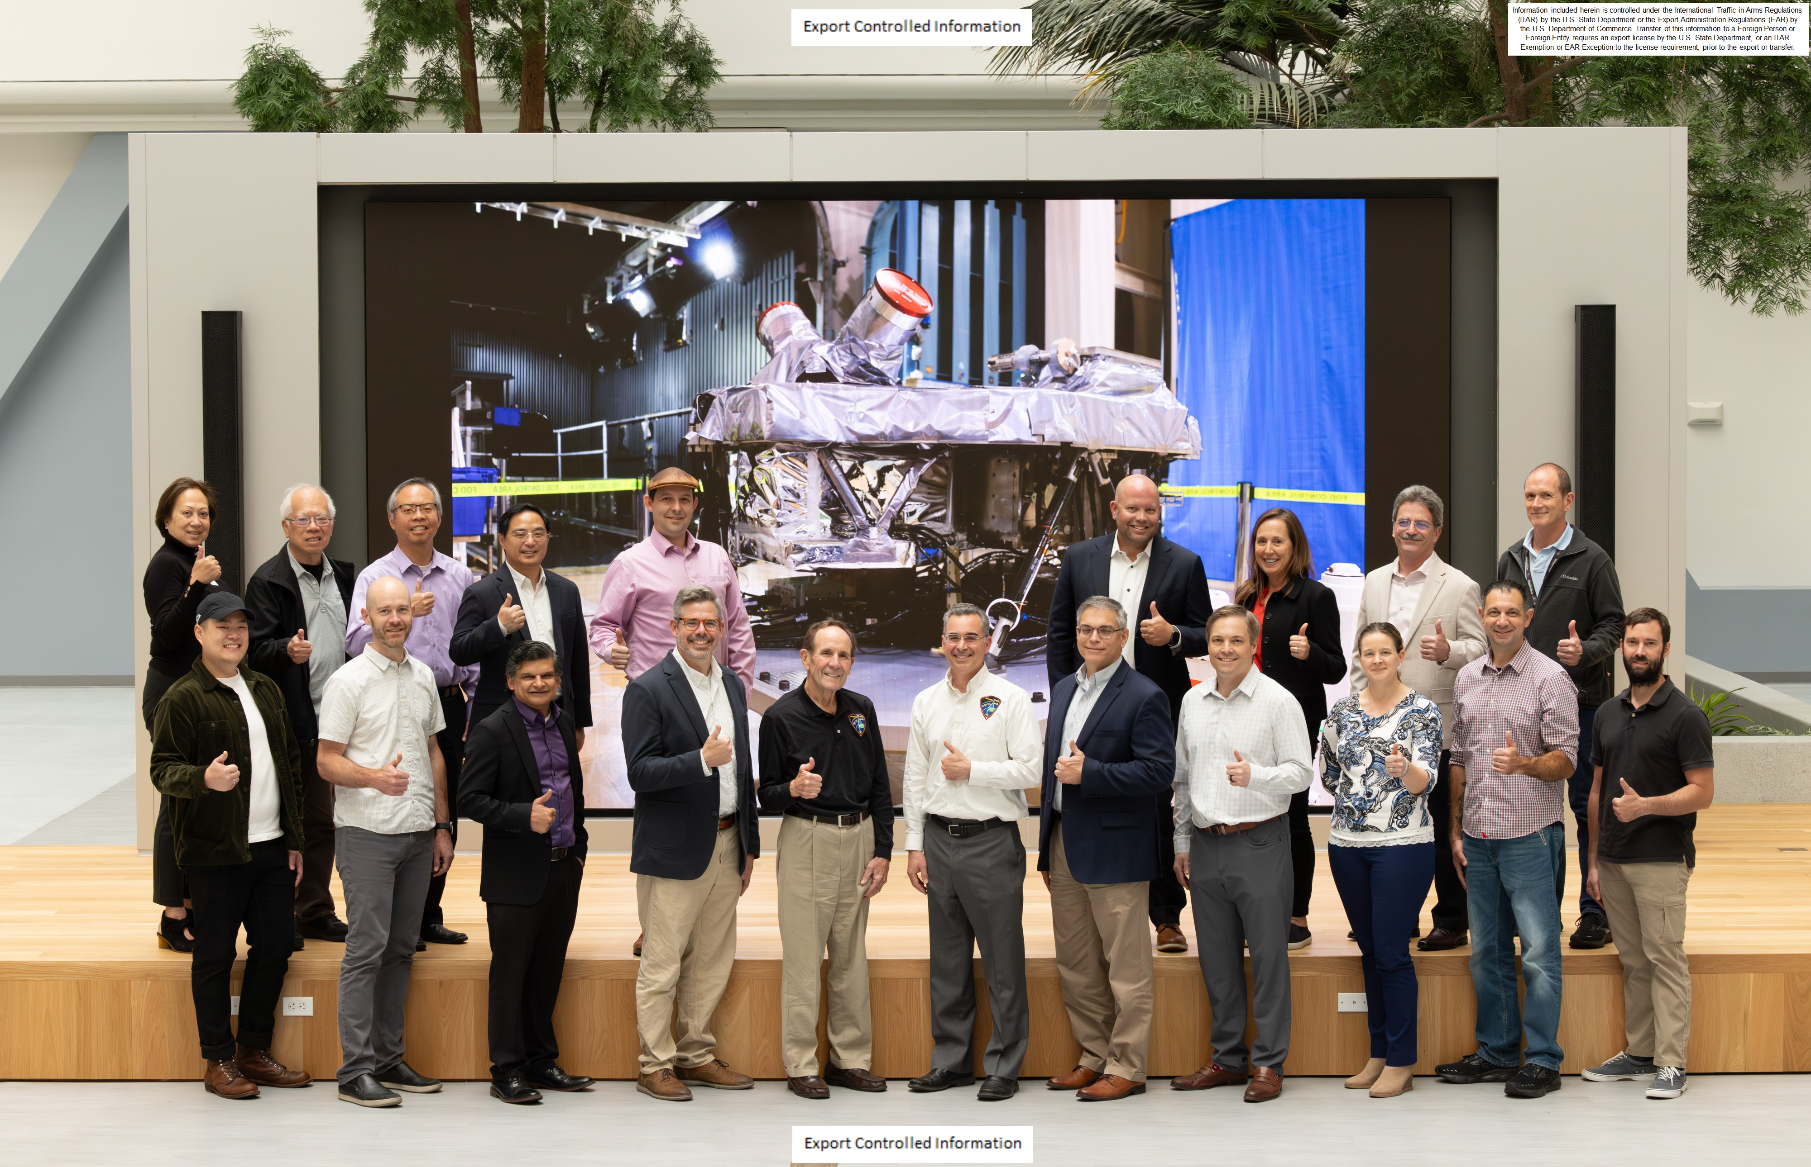
Final Review at Lockheed with NASA:
8 November 2023

Slide 36
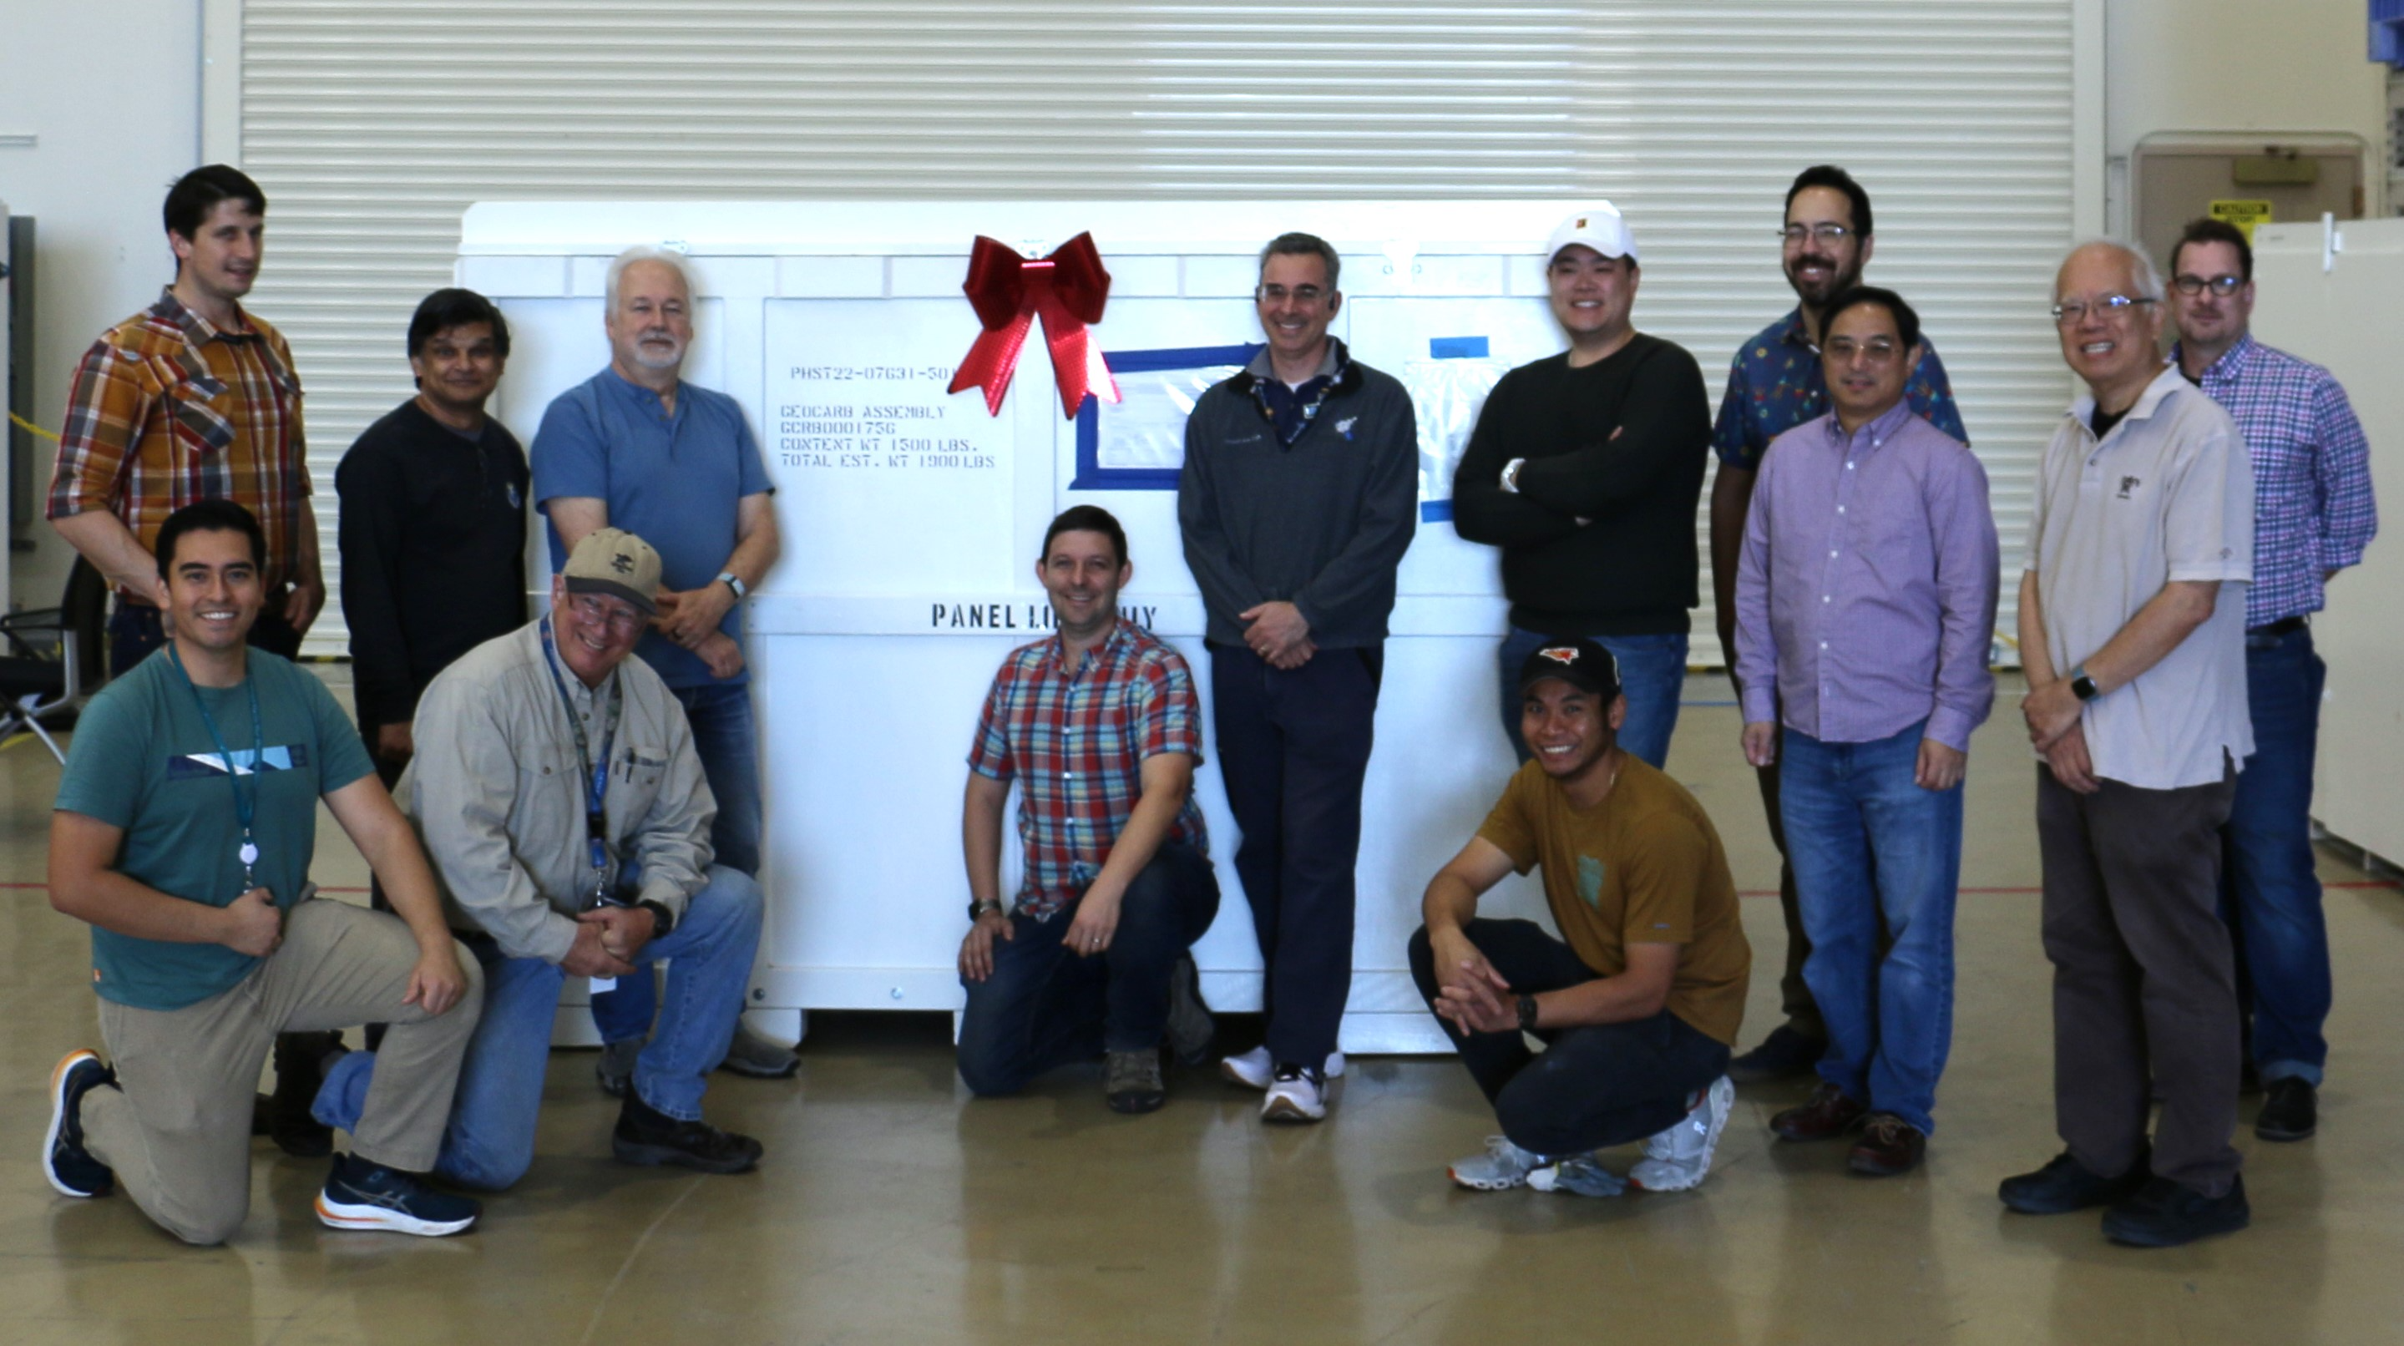
Shipped To NASA: 11/2023

Slide 37
Tip & Cue: Lessons from TROPOMI
TROPOMI and commercial satellite operators like GHGSat have worked together to attribute unexpected intense local sources of CH₄
Fig 8 from Schuit et al (2023) (https://doi.org/10.5194/acp-23-9071-2023)

Slide 38
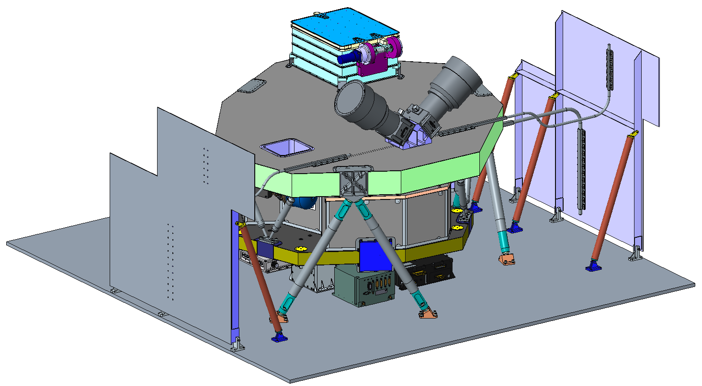
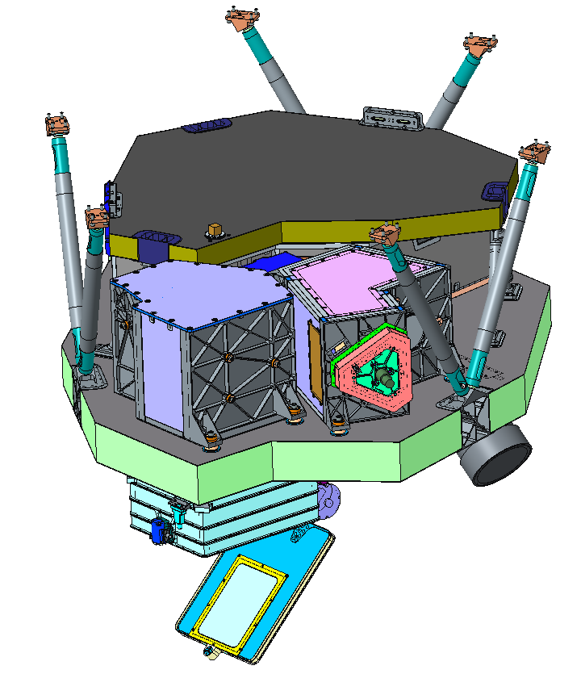
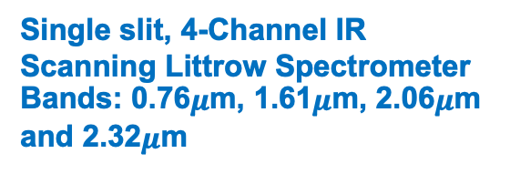
Instrument Configuration
Single slit, 4-Channel IR Scanning Littrow Spectrometer
Bands: 0.76$μ$m, 1.61$μ$m, 2.06$μ$m and 2.32$μ$m
Star Tracker
Optical Heads
Entrance Baffle & Door Assy
South
Radiator
Cryocooler Thermomechanical Unit (TMU)
Spectrograph Assy
Spectrograph
Scan Box Assy
North
Radiator
S/C Nadir Panel
+Z (nadir)
Nadir Panel Mounted Components
GeoCarb Electronics Box (GEB)
Focal Plane Electronics Box (FPE)
Star Tracker Electronics Unit (STEU)
Decoder Electronics Box (DEB)
Cryocooler Electronics (CCE)
W
S (+Y)
N
E (+X)
Main Bench
Telescope Assy
N
E (+X)
Entrance Baffle
W
S (+Y)
+Z (nadir)
Door Assembly

Slide 39
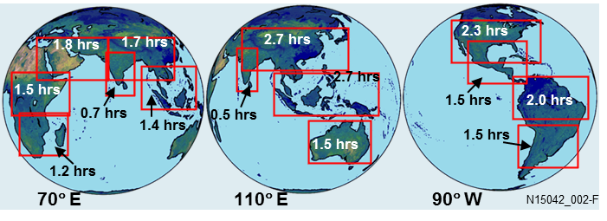
Important Views from GEO
Example GEO slots: 70°E, 110°E, and 90°W
GeoCarb is using the 90-Degree West Slot

