Slide 1

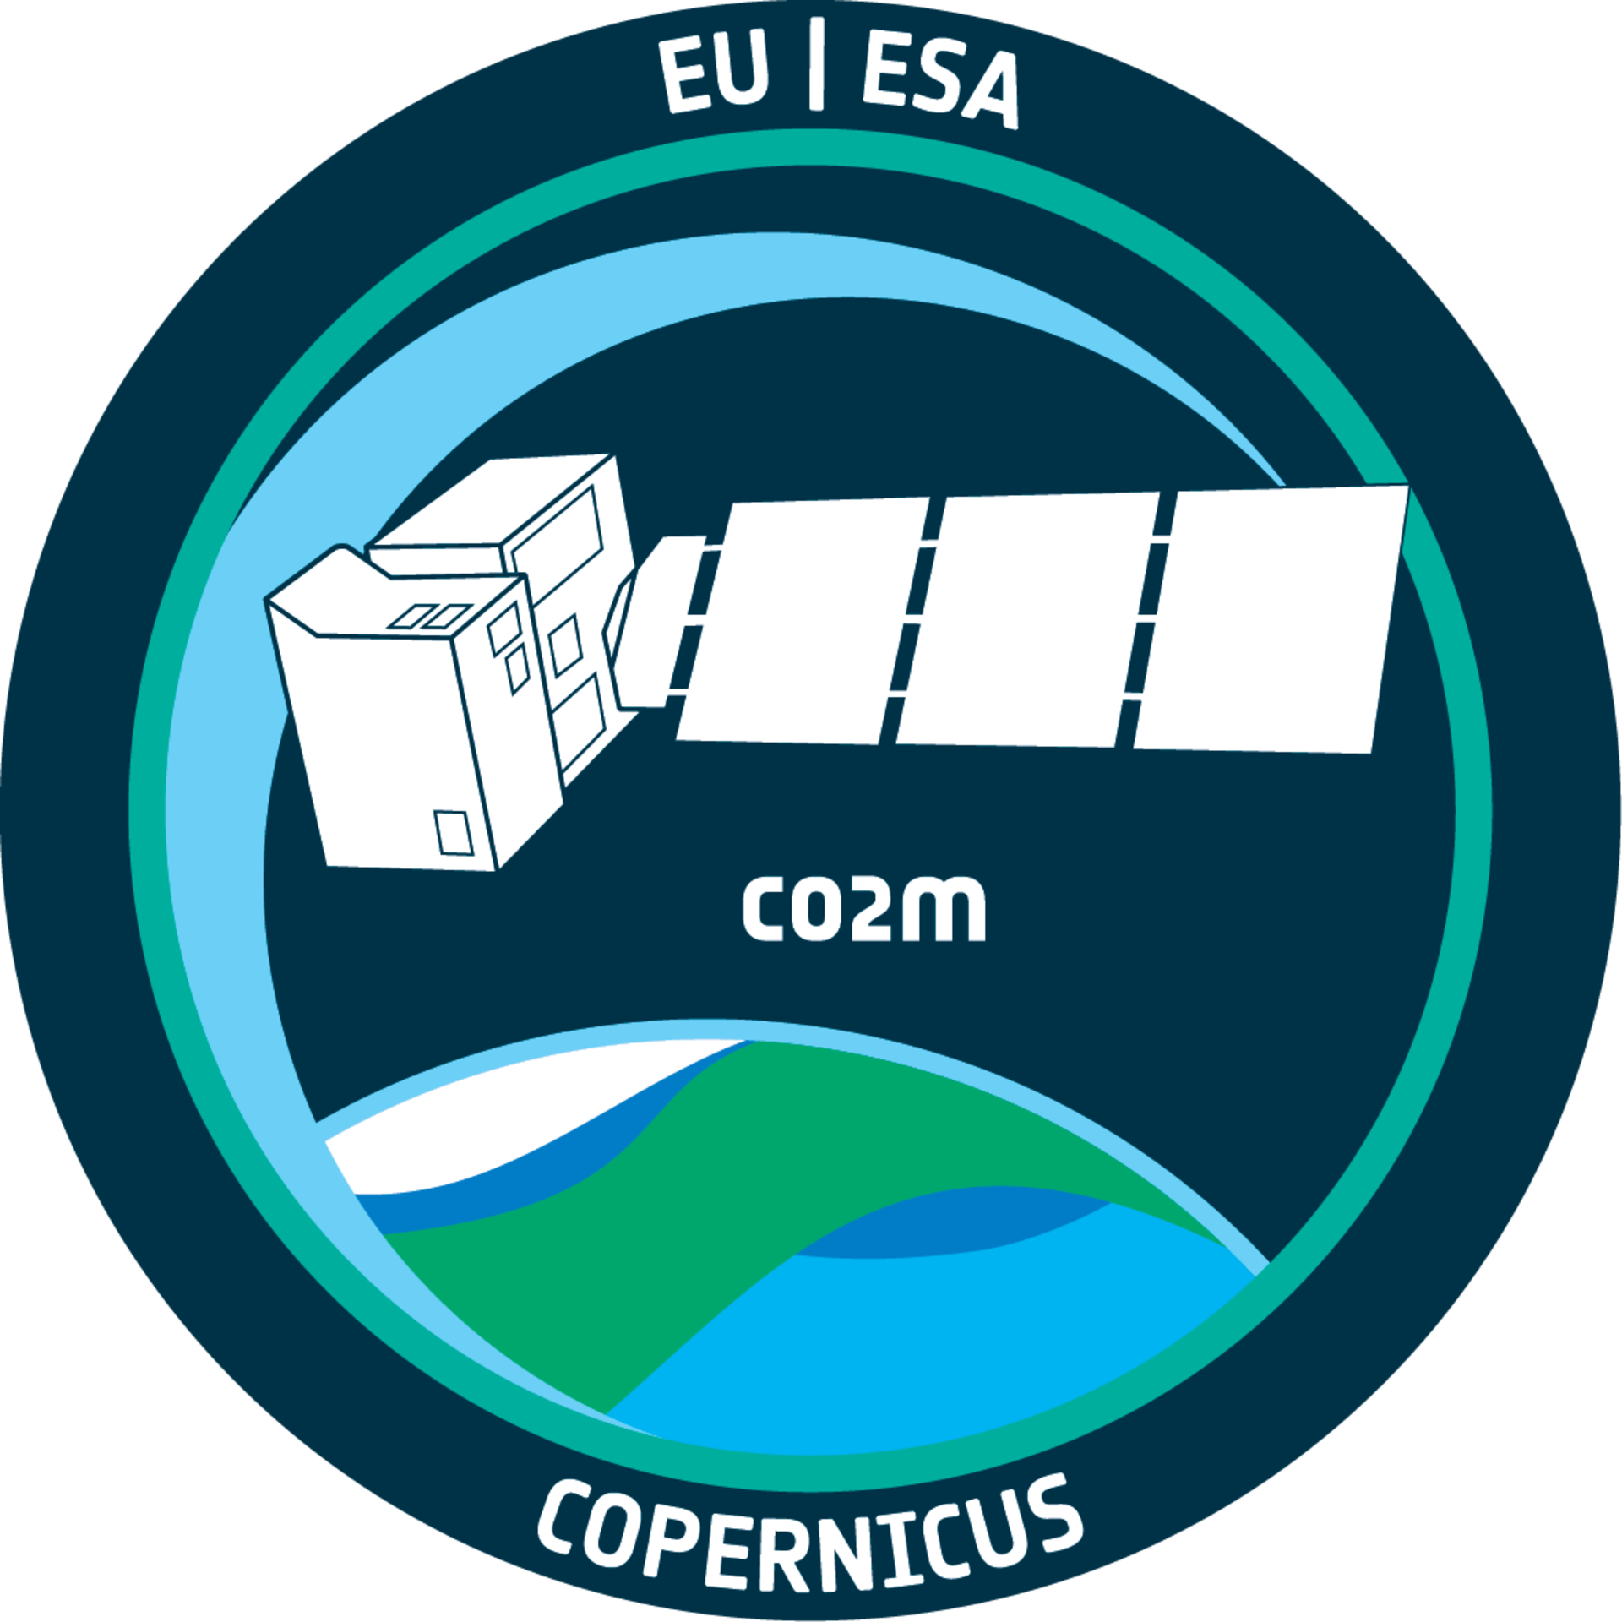
Copernicus CO2M mission
Anthropogenic greenhouse gas monitoring from space (4.07)
Dr. Yasjka Meijer
European Space Agency (ESA)
CO2M Mission Scientist
AC-VC 20, Washington, USA

Slide 2
CO₂ Monitoring (CO2M) Mission
Detection of emitting hot spots
Monitoring the hot spot emissions
Assessing emission changes against local reduction targets
Assessing the national emissions and changes
System requirements → Mission Requirements → Implementation → Performance
NB mission requirements need to be met 3-sigma & anywhere in the swath
Today implementation status & performance be will presented

Slide 3
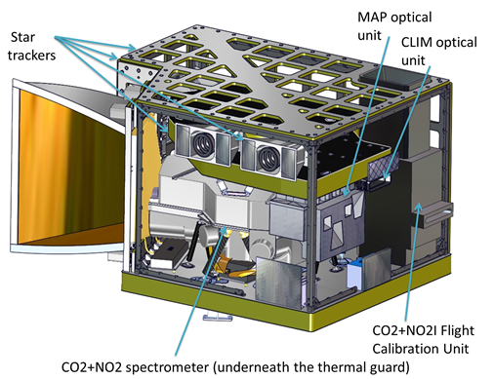
Payload Implementation
Payload Components
CO2 Imager (CO2I): 3 band (1 NIR, 2 SWIR)
co-located push-broom imaging spectrometer
NO2 Imager (NO2I): VIS band implemented as fourth band in CO2I instrument
Multi-Angle Polarimeter (MAP) for aerosol observations
CLoud IMager (CLIM) for low cloud & cirrus detection
Credits: TASiF

Slide 4
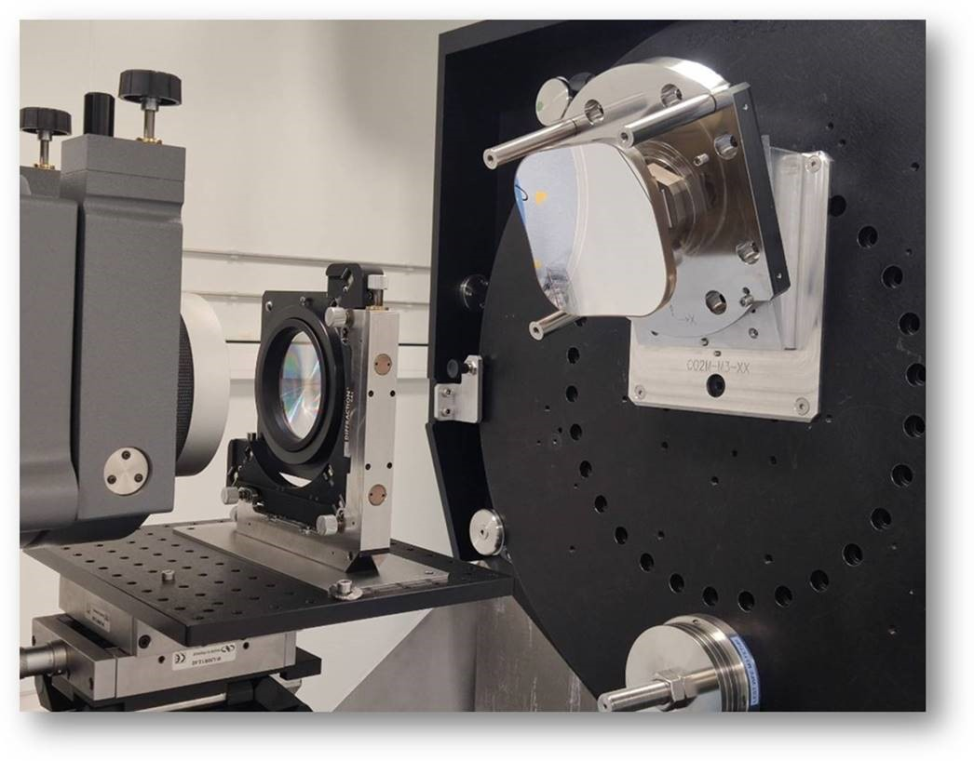
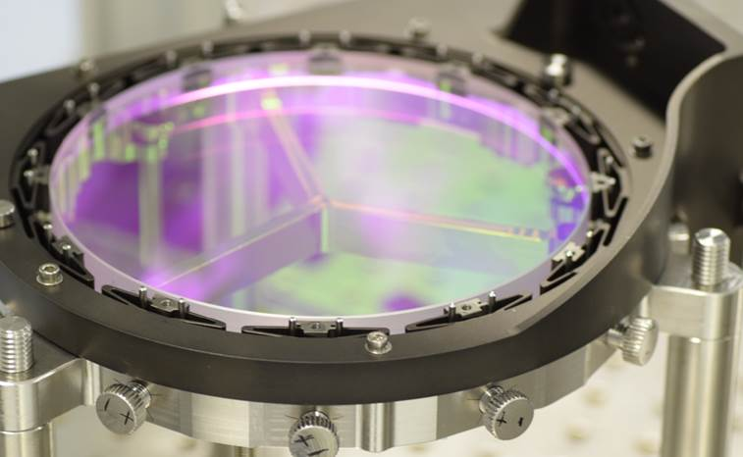
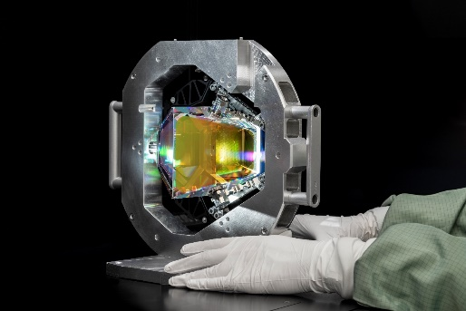
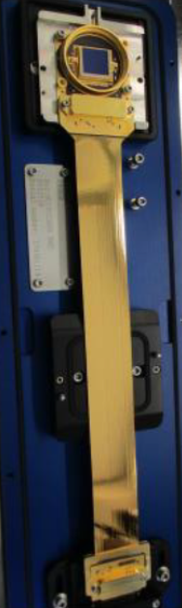
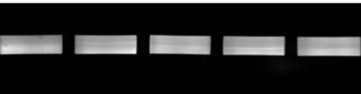
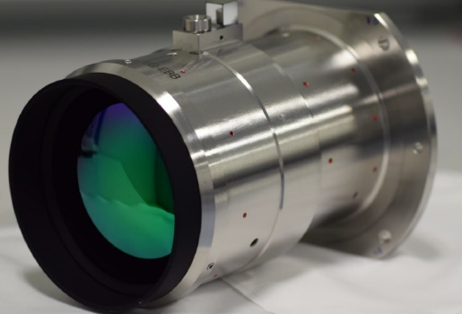
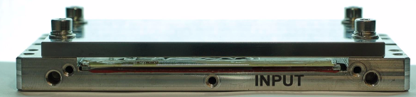
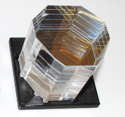
CO₂ & NO₂ Imager implementation (TAS-F)
Push-broom multi-band imaging spectrometer
Band | Spectral range
VIS | 405–490 nm
NIR | 747–773 nm
SWIR-1 | 1590–1675 nm
SWIR-2 | 1990–2095 nm
Credits: IOF
Credits: LYNRED
Credits: TASiF
Credits: TASiF / TSESO
Credits: Optec
Credits: TSESO
Telescope | Common telescope with polarisation scrambler
Slit | 110 Fibres are used to homogenise the scene; one per sample
Collimator | One reflective collimator, common for all bands
Band separation | 3 Dichroic plates used in collimated beam
Diffraction grating | 4 Prism-Grating-Prism assemblies
Imagers | Glass (VIS/NIR) and silicon (SWIR-1/SWIR-2); band-pass filters
Detectors | MCT CMOS detectors in SWIR; Si CMOS in VIS-NIR
Credits:
Bernhard Halle
Credits: Media Lario

Slide 5

CO2I & NO2I performance
Critical design review (CDR) is nearly passed & integration has started
Performances are met with some minor points, but also with good exceptions:
Swath width 266–276 km (orbit variation)
Spatial co-registration bands +++
Spectral ch. position variation very low
ISRF shape well-known
Polarisation sensitivity very low
Absolute radiometric accuracy +++
Residual offset very low
CDR

Slide 6
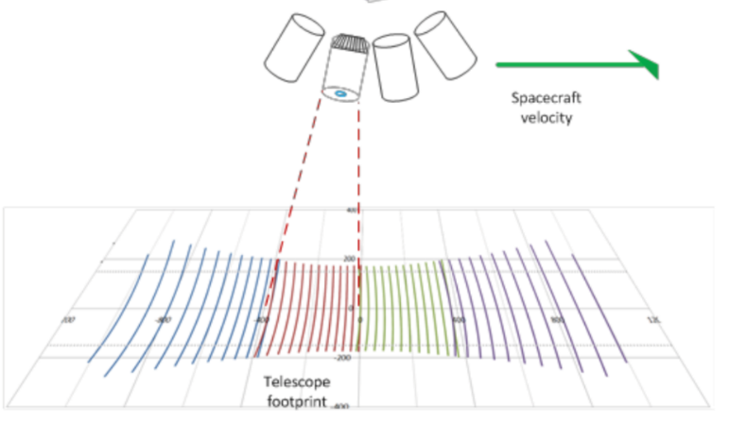
Multi Angle Polarimeter (TASiUK)
Multi-angle polarimeter (MAP) implementation:
Compact push broom imager:
40 viewing angles (+/- 60º), plus 8 more @larger angles
Spatial resolution: 4x4 km2 and sampling < 1x1 km2
One focal plane assembly combining polarization & spectral filtering
6 spectral bands in VIS and NIR (+1 for co-reg with CO2I)
3 polarisations (0º, 60º, 120º) sampled by µ-polarizers at detector pixel-level
CDR
MAP Band | Wavelength
VNIR-1 | 410 nm
VNIR-2 | 443 nm
VNIR-3 | 490 nm
VNIR-4 | 555 nm
VNIR-5 | 670 nm
VNIR-6* | 753 nm
VNIR-7 | 865 nm
MAP OU STM in mechanical testing
Credit © TAS-UK

Slide 7
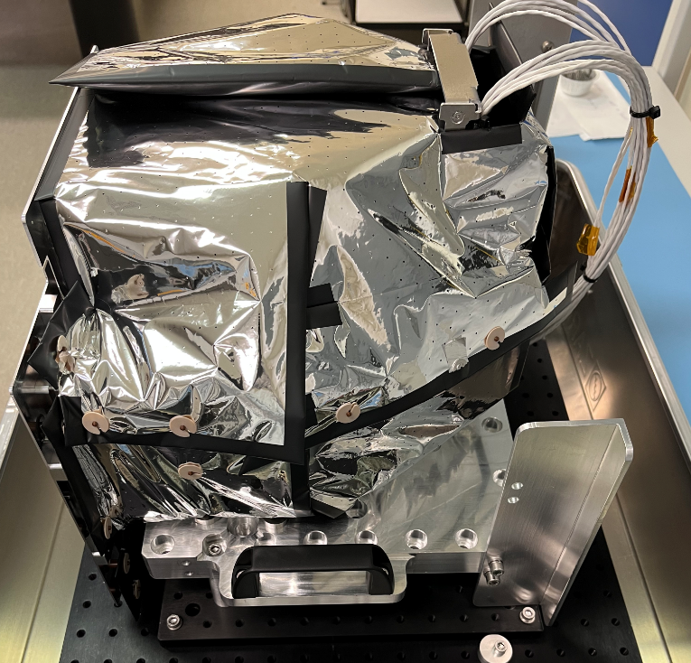
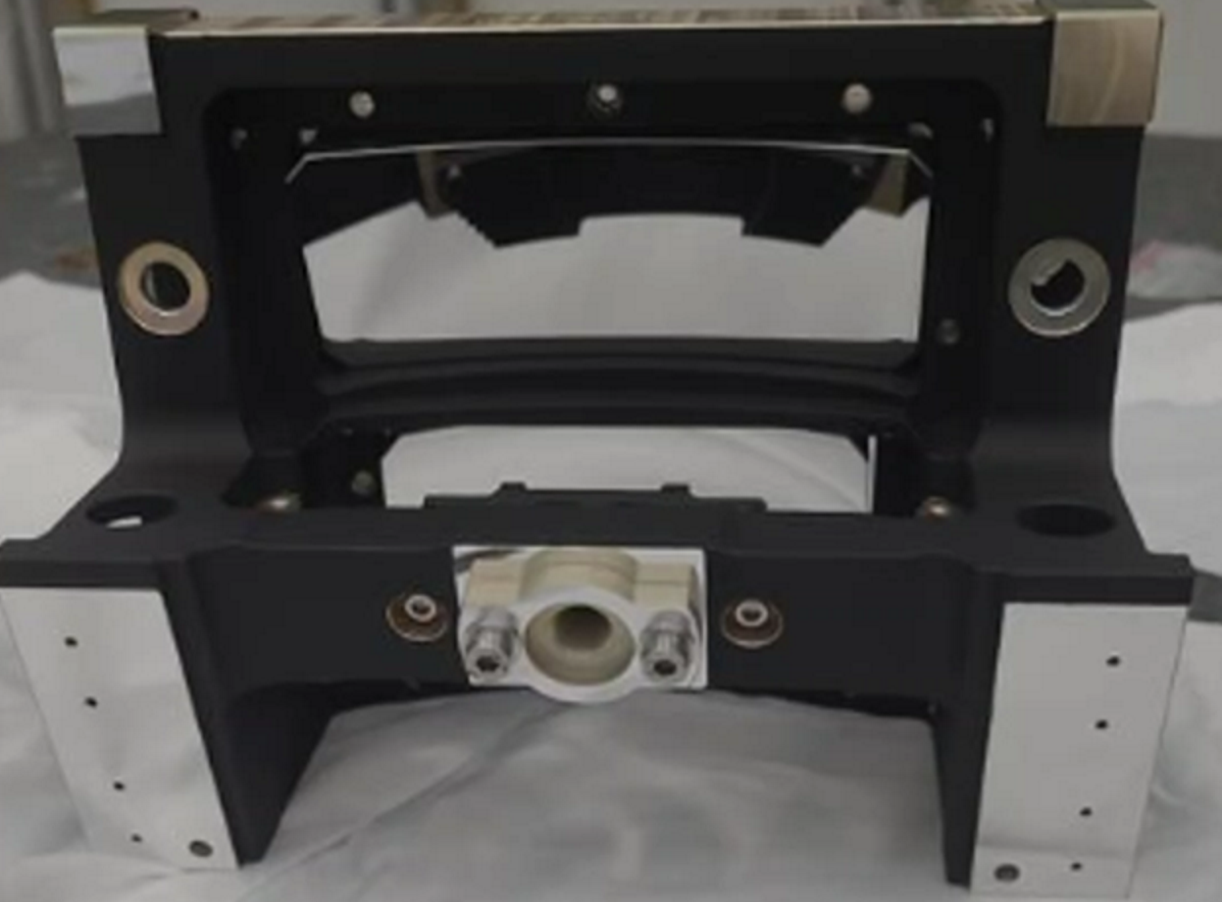
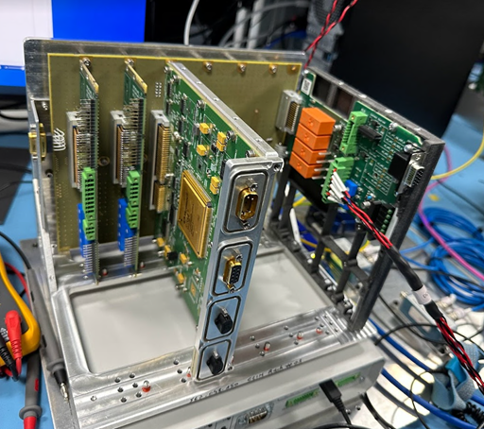
CO2M: Cloud Imager: CLIM (OIP Belgium)
Cloud Imager based on Proba-V
Binning on-ground, specs @400m
Three mirror telescope with Aluminium mirrors
InGaAs Xenics (CLIM-3) & Si CCD Teledyne E2V (CLIM-1 & CLIM-2)
Band | Band center | Band width | Native sampling (ALTxACT)
CLIM-1 | 670 nm | 20 nm | 94m x 87m
CLIM-2 | 753 nm | 9 nm | 94m x 87m
CLIM-3 | 1378 nm | 15 nm | 376m x 163m
SSRD | Required | Compliance status
SNR @Lref | SNR>200 | CLIM-1 >542 (3sigma) CLIM-2 >533 (3sigma) CLIM-3 >240 (3sigma)
CDR
Credits: OIP
Credits: OIP
Credits: AMOS
CLIM OU PFM Telescope
CLIM EU EM1 boards Testing
CLIM OU wrapped in MLI for thermal test
Notes:
SPDT: single point diamond Turning

Slide 8
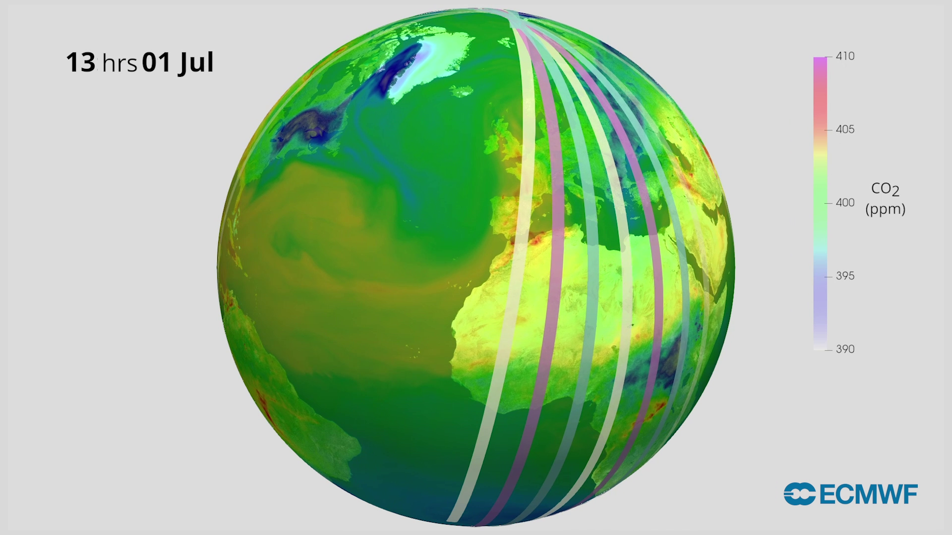
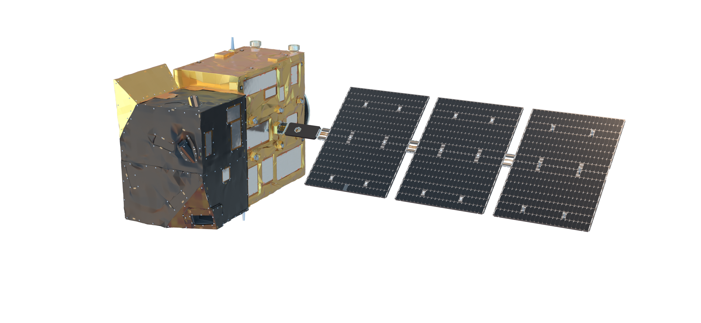
Copernicus CO2M Mission – Status
Project status:
Constellation of satellites
Each satellite >266 km swath
First and second satellite will have their
Flight Acceptance expected mid 2026
Third satellite → APPROVED!!
Product | Spatial | Precision
CO₂ | 4 km² | 0.7 ppm
CH₄ | 4 km² | 10 ppb
NO₂ | 4 km² | 1.5 10¹⁵ molecules cm⁻²
Vegetation SIF | 4 km² | 0.7 mW m⁻² sr⁻¹ nm⁻¹
Aerosol params | 16 km² | 0.05 AOD, 500 m LH
Cloud fraction | 1% | Water clouds & cirrus
Copernicus data is made freely available
to any person and organisation around the world
EUMETSAT performs operational data processing
Credits: EMPA

Slide 9
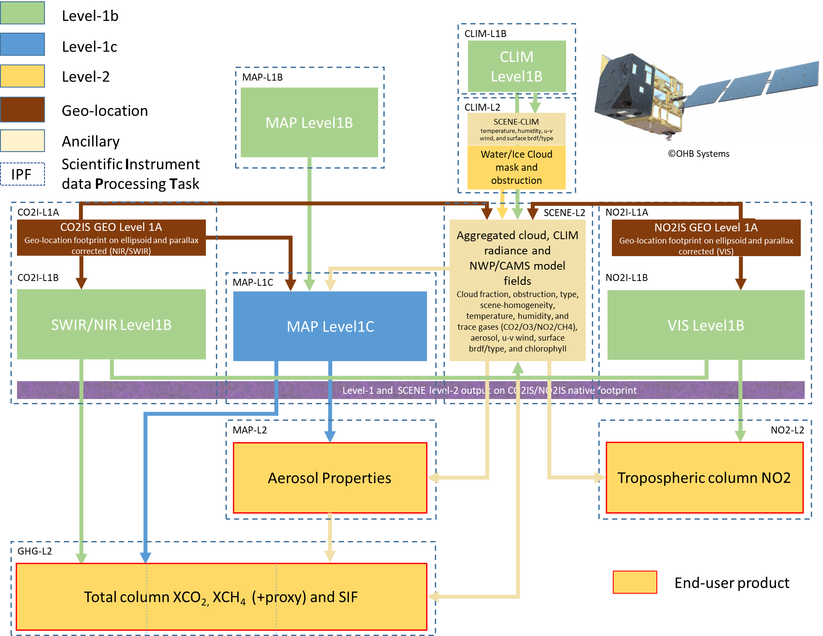
EUMETSAT CO2M MDPS scientific processing tasks
CO2M
Mission Data Processing System
Make one
“hyper-GHG/NO₂-instrument”
out of three!
Below this level: everything is co-registered or provided at the CO2I/NO2I spectrometer footprint

Slide 10

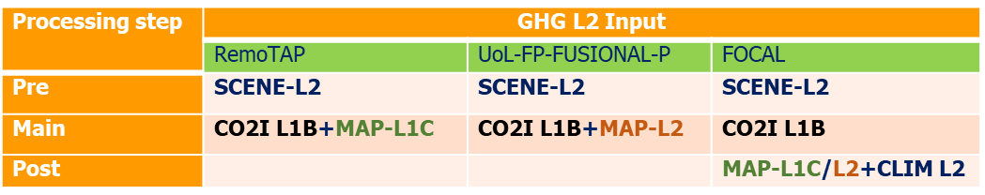
Early results from synthetic data (GHG level-2 XCO₂)
Three GHG algorithms for CO2M
ATBDs v2L, 2024
FOCAL
RemoTAP
FUSIONAL-P

Slide 11
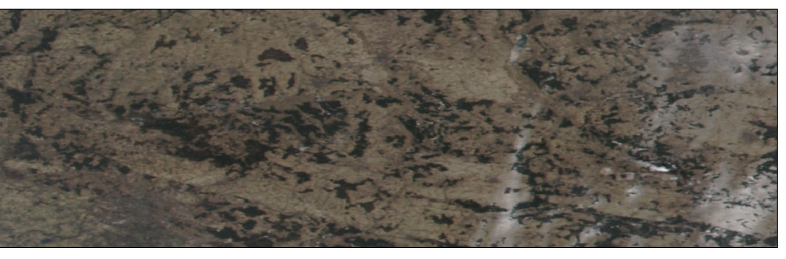
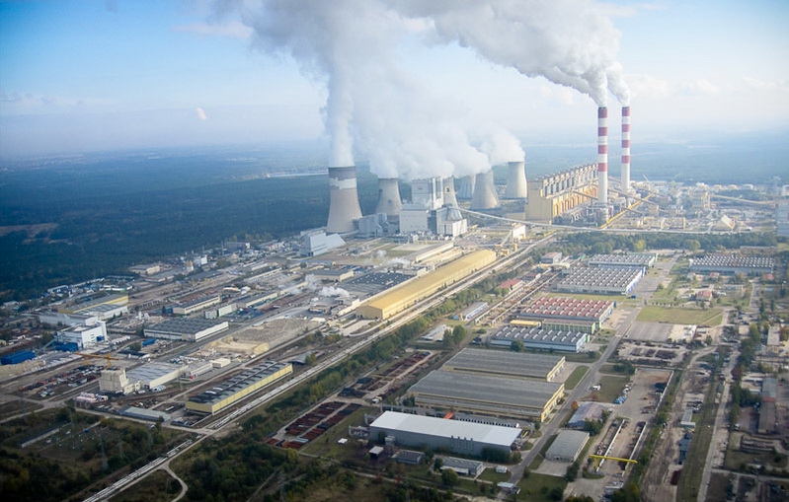
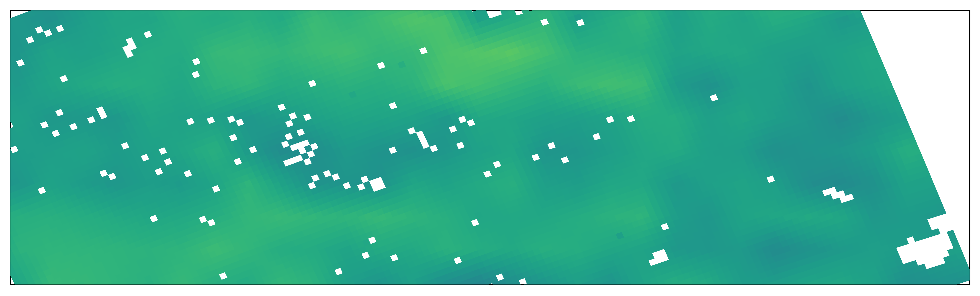
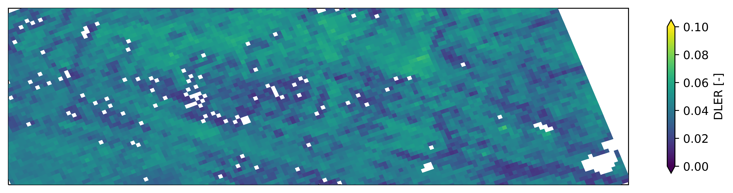
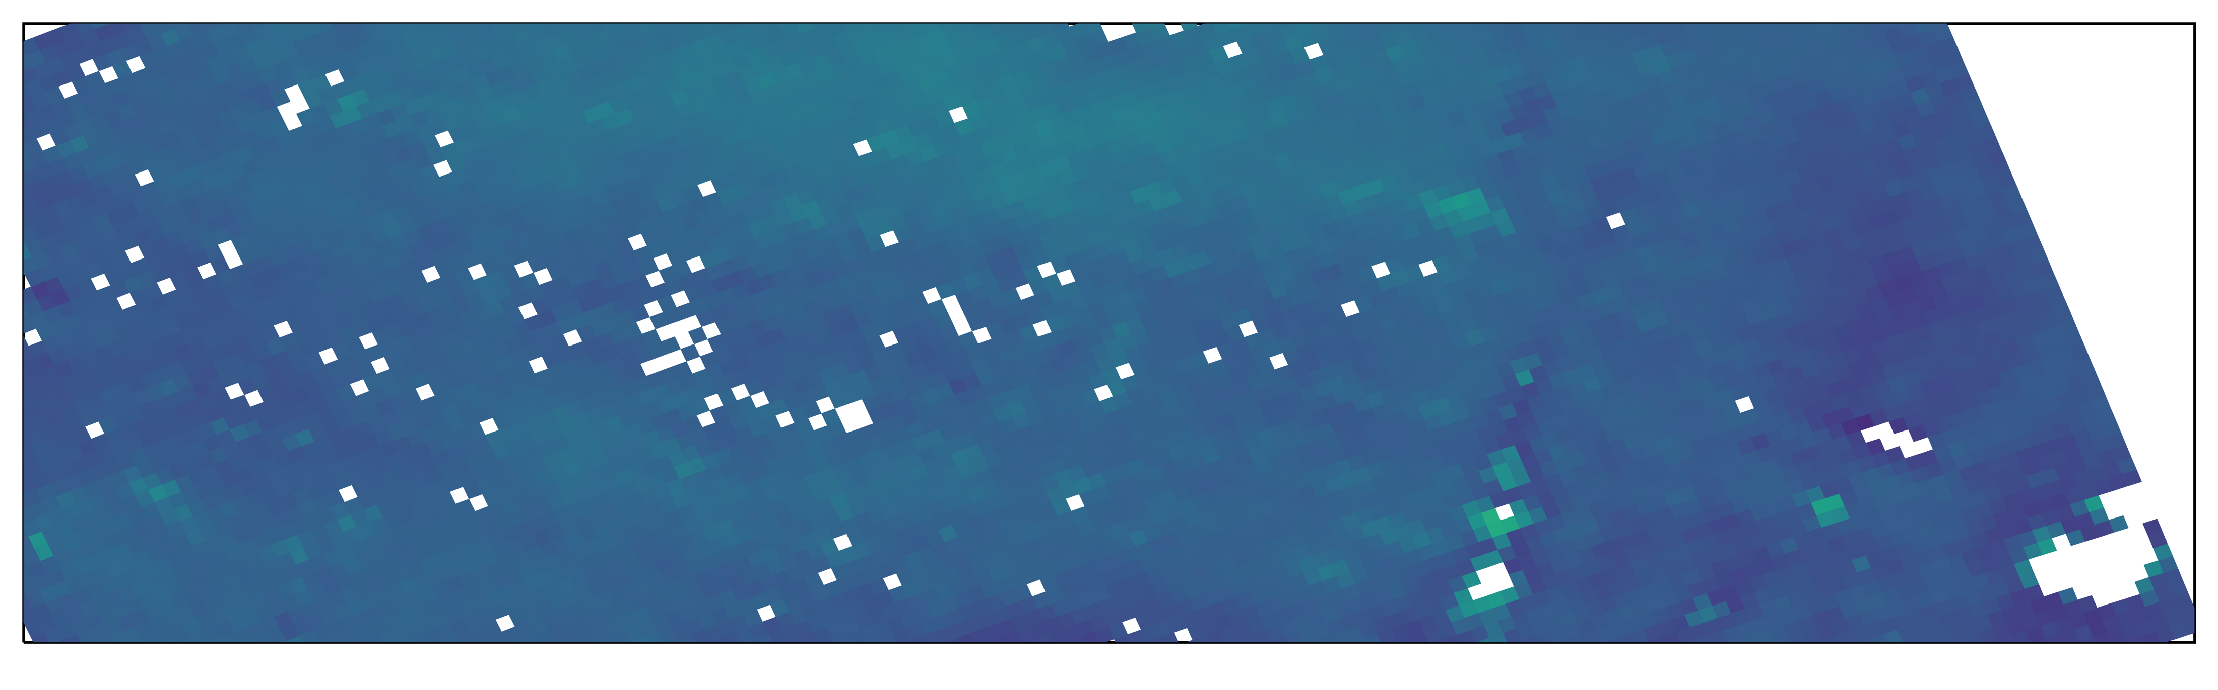
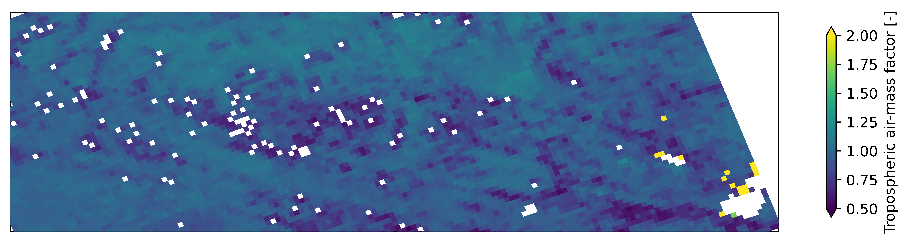
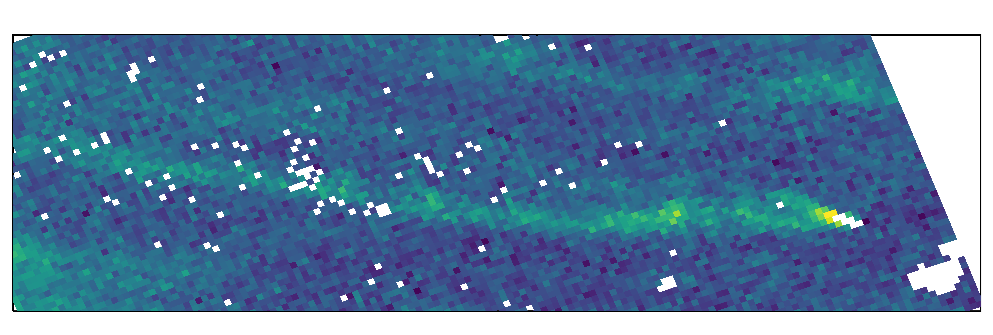
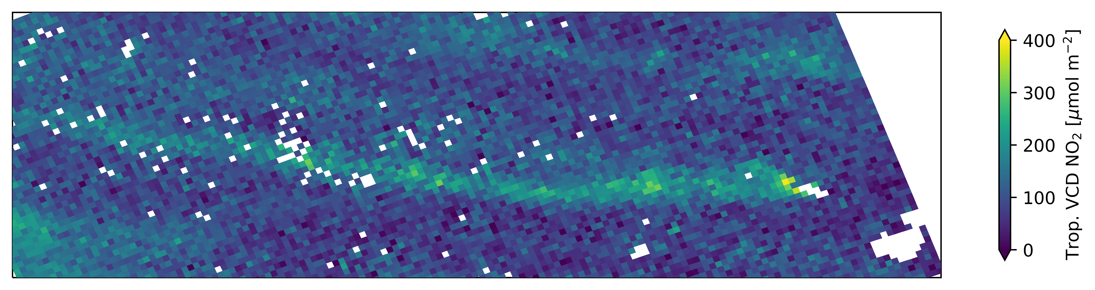
Early results from synthetic data (NO₂ level-2)
NO2 algorithms or CO2M
Bełchatów coal power plant
Albedo effects, ATBD 2024
S5P algorithm
CO2M algorithm
Source: Wikipedia
Surface reflectance
(DLER)
Tropospheric
air-mass factor
Tropospheric
NO₂ vertical column
Notes:
Effect of albedo on NO2 retrieval

Slide 12
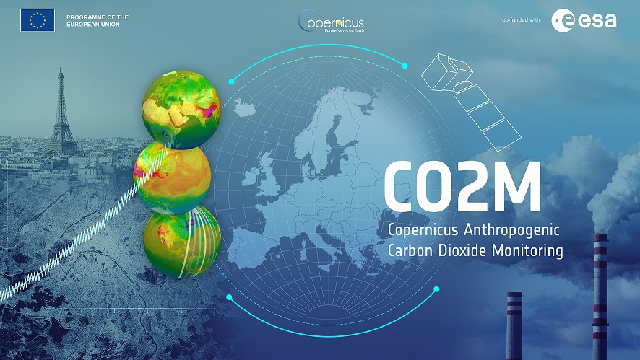
THANK YOU

