Slide 1
The OCO-2 and OCO-3 missions: Status, results and plans
Vivienne Payne, Abhishek Chatterjee and Junjie Liu
Jet Propulsion Laboratory, California Institute of Technology
+ OCO-2/OCO-3 Project and Science Teams!
© 2024 California Institute of Technology. US Government sponsorship acknowledged

Slide 2
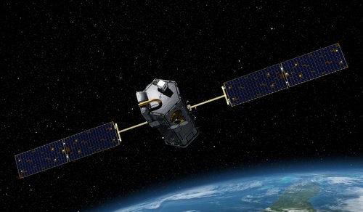
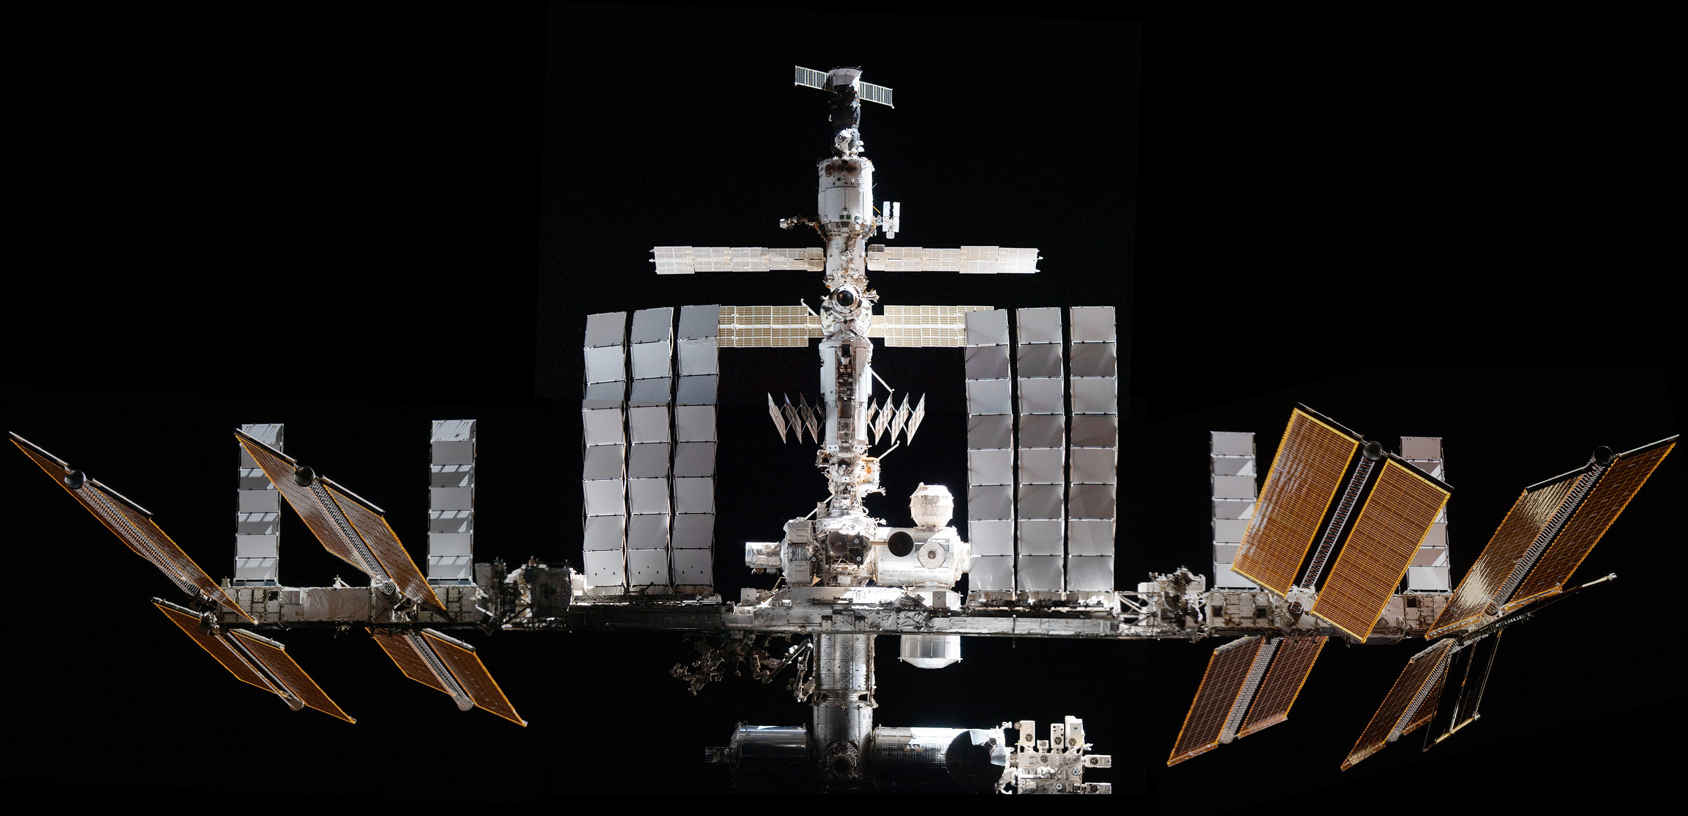
OCO-2 and OCO-3 Overview
Orbiting Carbon Observatory-2 (OCO-2)
Orbiting Carbon Observatory-3 (OCO-3)
Launched July 2, 2014
Free flying spacecraft
Sun-synchronous polar orbit
Launched May 4, 2019
International Space Station (ISS)
± 52° inclined orbit
OCO-2 and OCO-3 data products are archived and made publicly available through the GES-DISC
“Forward” processing stream, typically delivered within one week of acquisition
“Retrospective” stream (refined calibration, process all cloud-free soundings) delivered at monthly intervals.
Notes:
OCO-2, which launched in 2014 and flies solo ~700 km above the earth in low earth orbit. OCO-3 was launched 5 years later and is installed on the JEM-EF Port 3.

Slide 3
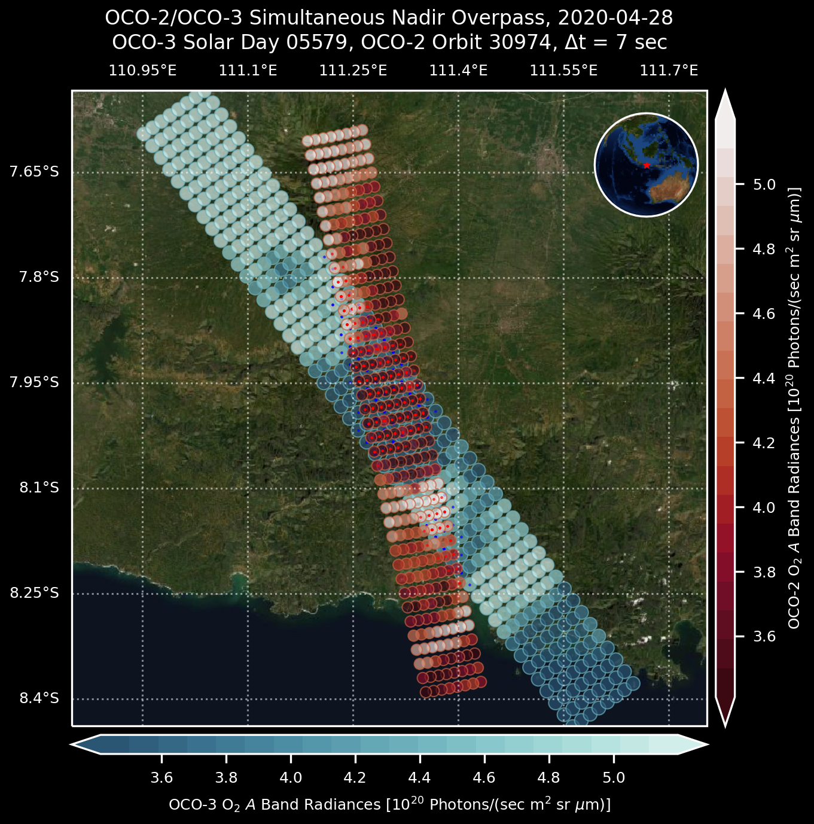
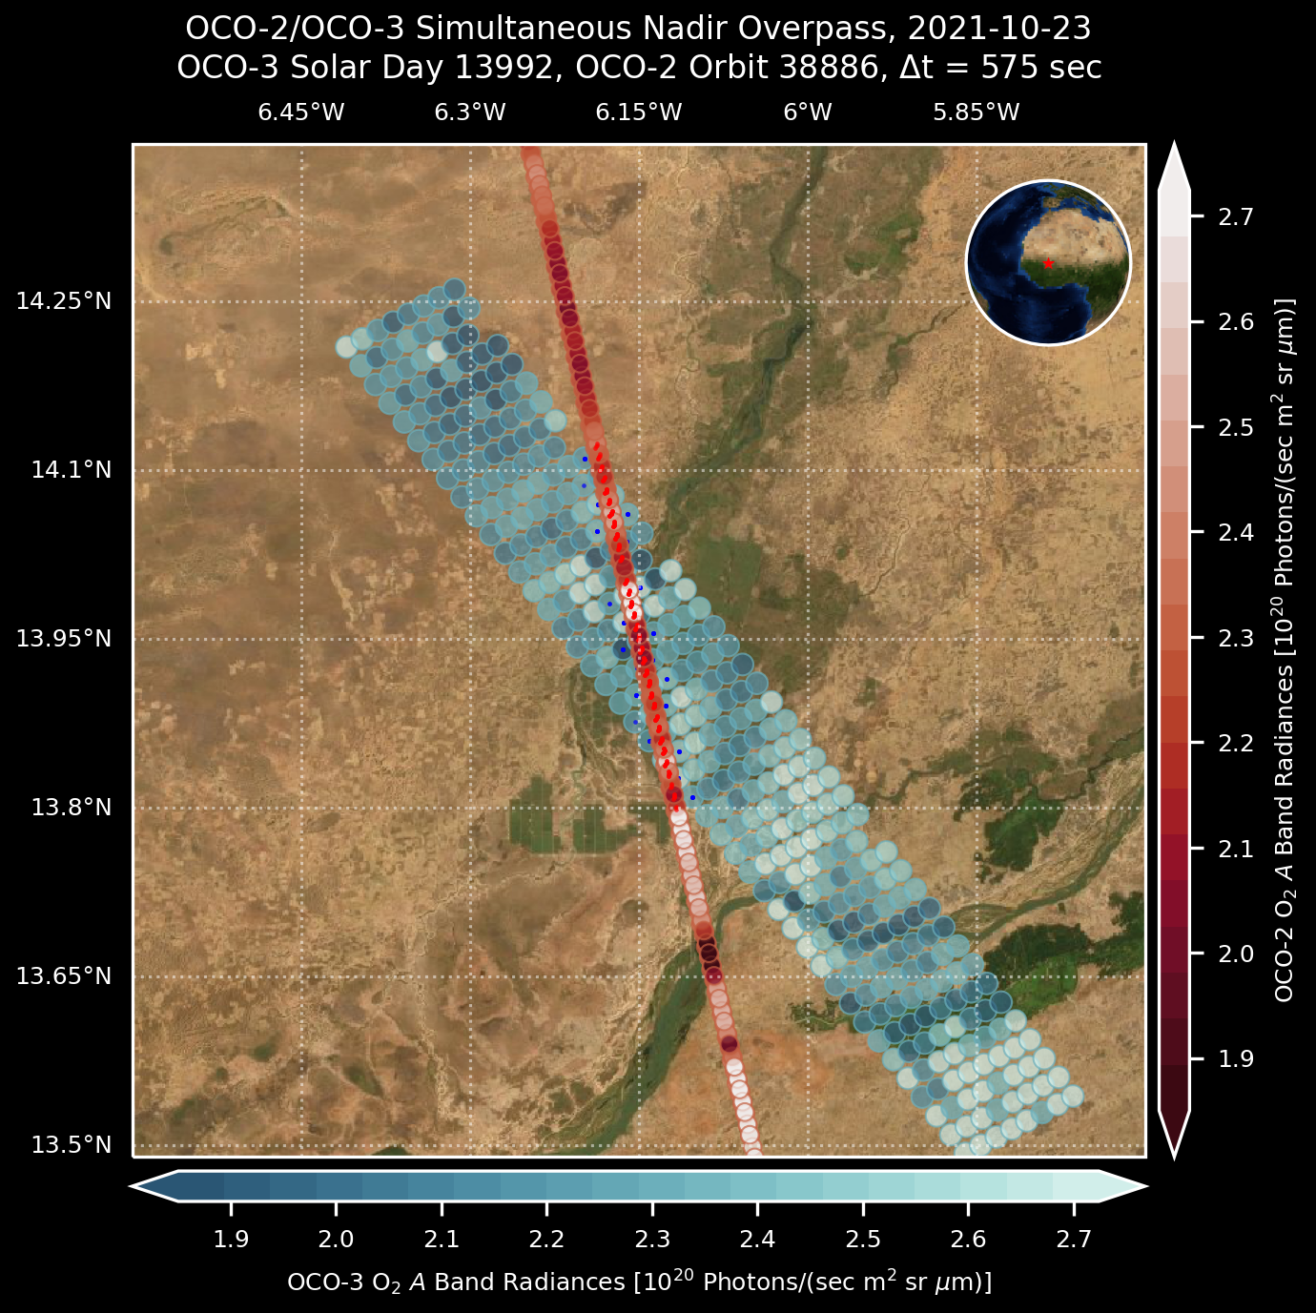
OCO-2 vs. OCO-3 Instrument Overview
 | OCO-2 | OCO-3
launch | 02 July 2014 | 04 May 2019
orbit | sun-synchronous, A-Train | precessing, ISS, 51.6º inclination
coverage | pole-to-pole, 1330h ect | 52ºS – 52ºN, variable
Swath width | ~10 km (swath width varies along orbit) | ~10 km
spectrometer | 3 bands: 0.765 µm, 1.61 µm, 2.06 µm, 20,000 resolving power (OCO-3 was built as the OCO-2 spare)
observed species | CO₂ dry-air column (XCO₂), total column H₂O solar-induced fluorescence (SIF)
observation modes | nadir, glint, target | nadir, glint, target, SAM
off-nadir viewing | move spacecraft | pointing mirror assembly two mirrors: azimuth and elevation, moving independently
repeatability of observations | same local time every orbit; 16 days repeat (233 orbits) | none! local time a little earlier each day; day-by-day change in latitude coverage
Nadir
☀️
🛰
Land
Glint
Java (tropical)
☀️
🛰
Ocean
+Land
Target, SAM
☀️
🛰
Mali
(sub-Saharan)
Land
The OCO-2 swath width changes along the orbit as the spacecraft rotates to mitigate polarization effects. The OCO-3 instrument, with its pointing capability, maintains a uniform swath width. Figures: T. Kurosu

Slide 4
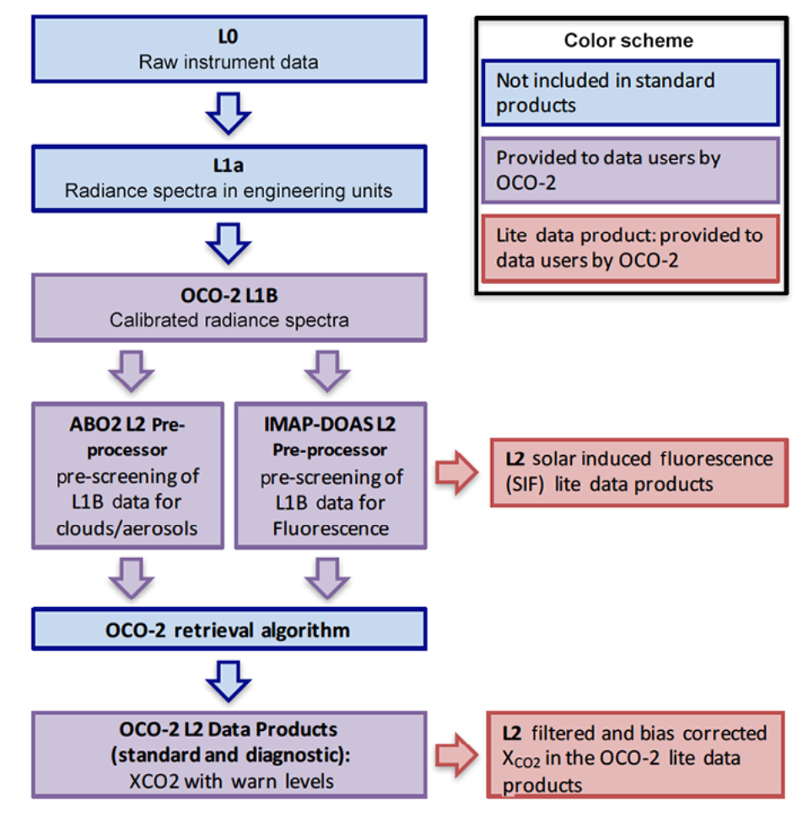
Data processing
OCO-2 and OCO-3 data are processed through the same ACOS L2 algorithm
O’Dell et al. (2018)
Taylor et al. (2023)
Jacobs et al. (2024)
Flowchart from
Eldering et al. (2017)

Slide 5
OCO-2 and OCO-3 each offer unique & complementary coverage, sampling
OCO-2
”Pole-to-pole” coverage, depending on season;
Fixed 1330h equator crossing time (and local overpass time)
XCO₂
OCO-3
Coverage limited to ±52º latitude, changing with season;
Observations span all times of day
Edmonton
Calgary
Amsterdam
Rotterdam
London
Rio Gallegos
Punta Arenas
Videos from Thomas Kurosu/JPL
Notes:
OCO-2 and OCO-3 each offer unique and complementary coverage and sampling during the years of overlap.
Each frame here shows 16 days of data.
Under the CEOS definitions these are in the “Global mappers” category, although you can see with these narrow swaths ”Global sampler” might be more of an appropriate descriptor.
Also have the solar induced fluorescence measurements.

Slide 6
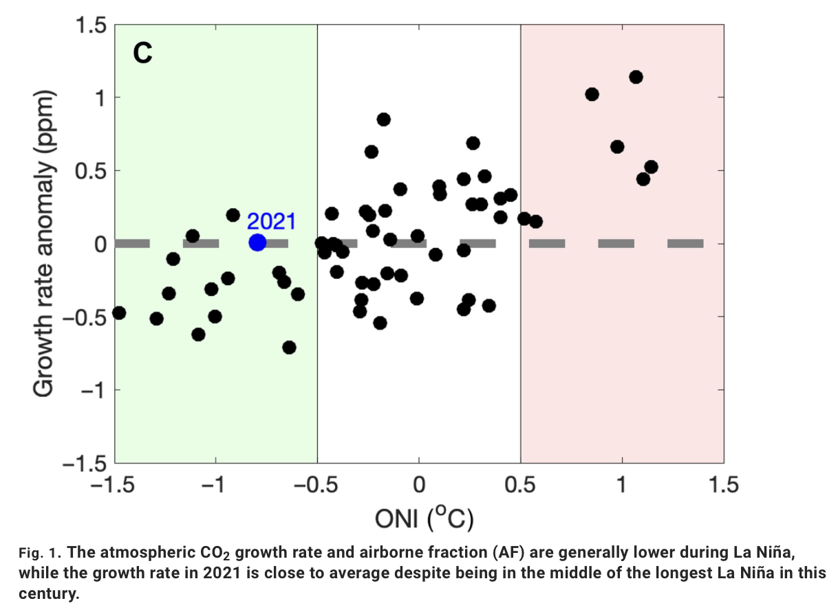
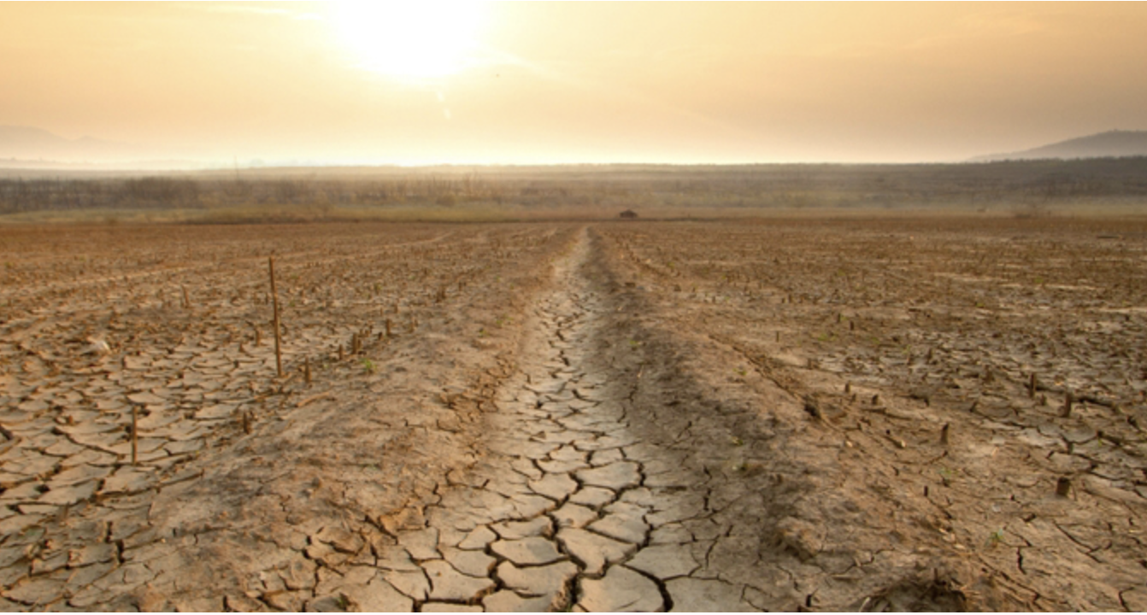
OCO-2: Heatwaves, drought and carbon storage
La Niña historically associated with substantial reductions in the atmospheric CO₂ growth rate. However, the 2021 La Niña exhibited a near-neutral impact on the CO₂ growth rate. Why?
Liu et al. (2024) used OCO-2 MIP results to show that extreme drought and warm anomalies in Europe and Asia reduced the net carbon uptake and offset 72% of the increased net carbon uptake over the tropics in 2021.
https://www.science.org/doi/10.1126/sciadv.adl2201
https://www.pnas.org/post/journal-club/heatwaves-and-drought-quelled-la-nina-s-carbon-storage-benefits-2021
Annual mean Oceanic Nino Index (ONI) against CO₂ growth rate anomaly between 1959 and 2021 (excluding 1991 and 1992 when Pinatubo impacts were dominant).
Notes:
The long record from OCO-2 is starting to enable meaningful studies of carbon/climate interactions

Slide 7
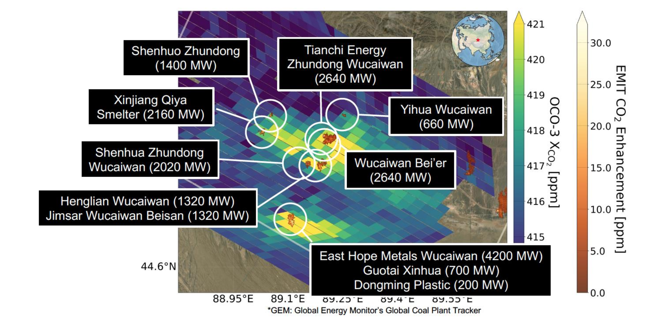
OCO-3 + EMIT synergy
Joint observations can better constrain emission rates and disentangle contributions from individual facilities.
Nelson et al., in review
Notes:
At least 11 power plants within this OCO-3 SAM

Slide 8
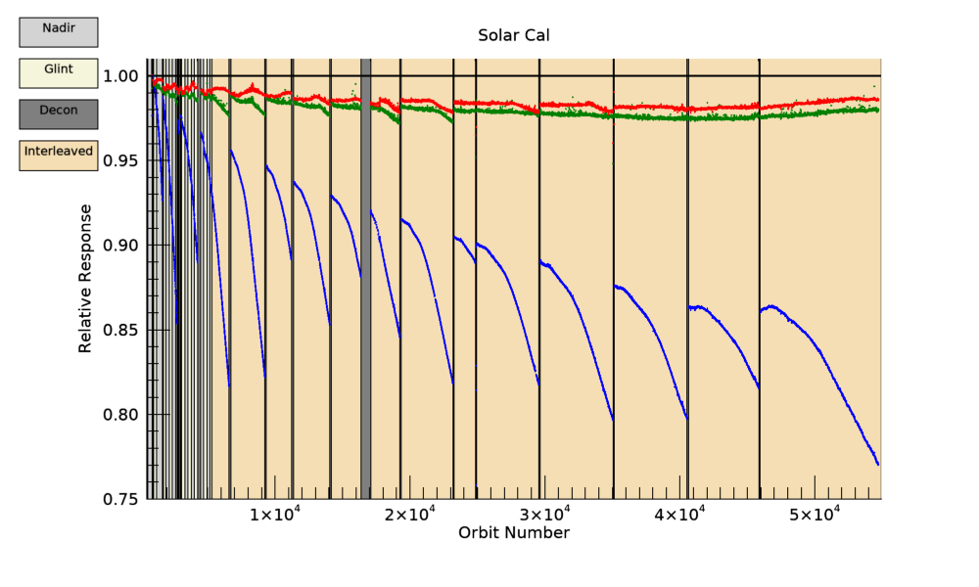
Status of the two missions
OCO-2: “Aging like a fine wine”
OCO-3: “The youngest child syndrome”
10+ years of global XCO₂ and SIF measurements
Instrument and spacecraft are in excellent health!
Outgassing/icing impacts diminishing as the mission extends in time
Latest data version (v11.2) is publicly available; comparison to TCCON show accuracy and precision <0.8 ppm
Das et al [2024], submitted to AGU Earth and Space Science
5+ years of XCO₂ and SIF measurements, 52°N - 52 °N (Aug. 2019 – Nov. 2023 and July 2024 – present!)
ISS is a busy and dynamic environment with LOTS of interruptions that our ops need to account for
Storage 11/2023, Reinstalled July 4 2024
Resumed science measurements July 16 2024
IOC2 completed Oct 6 2024, resumed nominal ops
Data collection underway and will continue for the “lifetime of ISS”
v11 data publicly available, accuracy & precision <1 ppm
Notes:
OCO-2 launched in 2014 and had a nominal 2 year mission lifetime, so now well into our extended operations phase.
All NASA missions in extended operations go through a process of review every 3 years, we are now a year into our latest cycle
Effects related to icing are diminishing with time, things are more stable
For both instruments, calibration team keep a close eye on the instrument, make sure that the quality of our L1B is maintained.
Mention upcoming summer campaign at Railroad Valley.
Point to Graziela’s poster, Rob R’s talk

Slide 9
Algorithm needs: Some thoughts
Well-calibrated L1B radiances
OCO-2 v11 calibration in relatively good shape, continue to monitor/adjust as mission progresses
OCO-3 v11 calibration is much-improved over previous versions, still some challenges
Forward model accuracy
E.g. Spectroscopy advances, Rotational Raman Scattering
3D cloud effects
Meteorological fields
Surface pressure, temperature, water vapor, aerosol
Recent OCO-2 experience with transition from GEOS-FPIT to GEOS-IT input. (OCO-3 v11 all processed with GEOS-IT.)
CO₂ prior for OCO-2/OCO-3/TCCON
Laughner et al. GGG2020 priors: NOAA GML in-situ data utilized as input
Surface characterization
Surface albedo
Global database of spectral albedo for the SWIR? Equivalent of TIR surface emissivity databases (e.g. CAMEL)?
BRDF (particularly over snow)
Bias correction
Reference XCO₂ measurements over a range of surface, atmospheric conditions
Algorithm speed
Notes:
OCO-2 and OCO-3 use a common L2 algorithm
We are on v11 of the algorithm. (OCO-2 at launch was v7.) OCO teams have learned a huge amount over the years, from the early days with simulations, to the work with real data from the GOSAT instrument and then with OCO-2 and OCO-3.
New line shape model in the works: Accounting for the breakdown of the impact approximation
RadCalnet (run by U. Arizona): Wideband, not spectrally resolved. Assume relative intensity of the bands remains constant, according to one set of measurements taken a long time ago – doesn’t account for soil moisture. Errors order 7%. Doesn’t go far into blue. Stops at 450 nm. Dependent on assumptions about the solar model. Only takes measurements in nadir.
No use of spectralon panels.

Slide 10
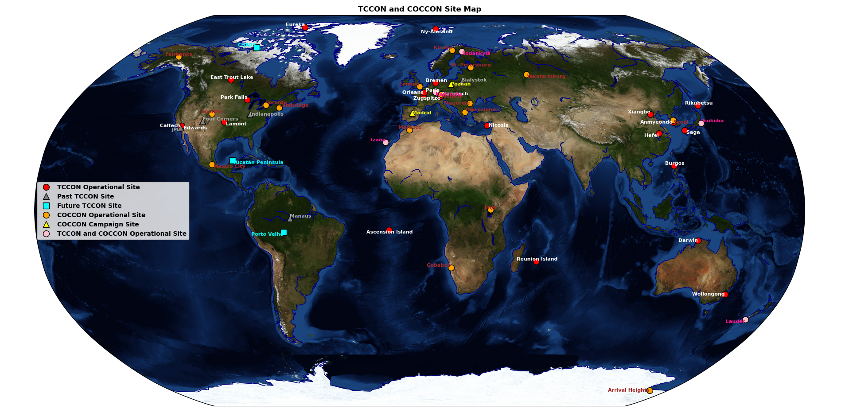
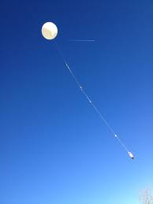
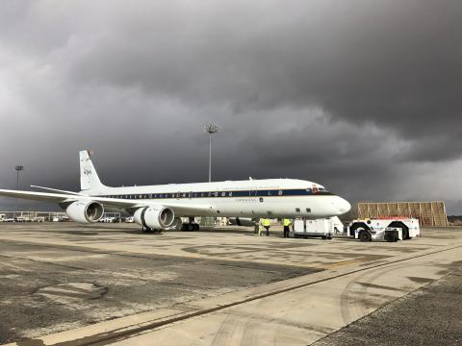
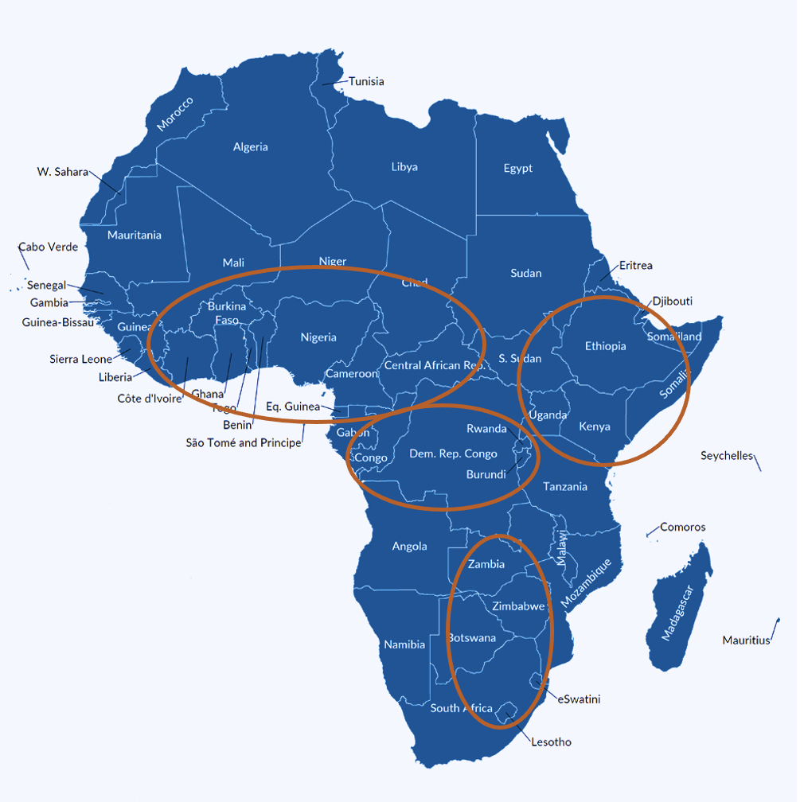
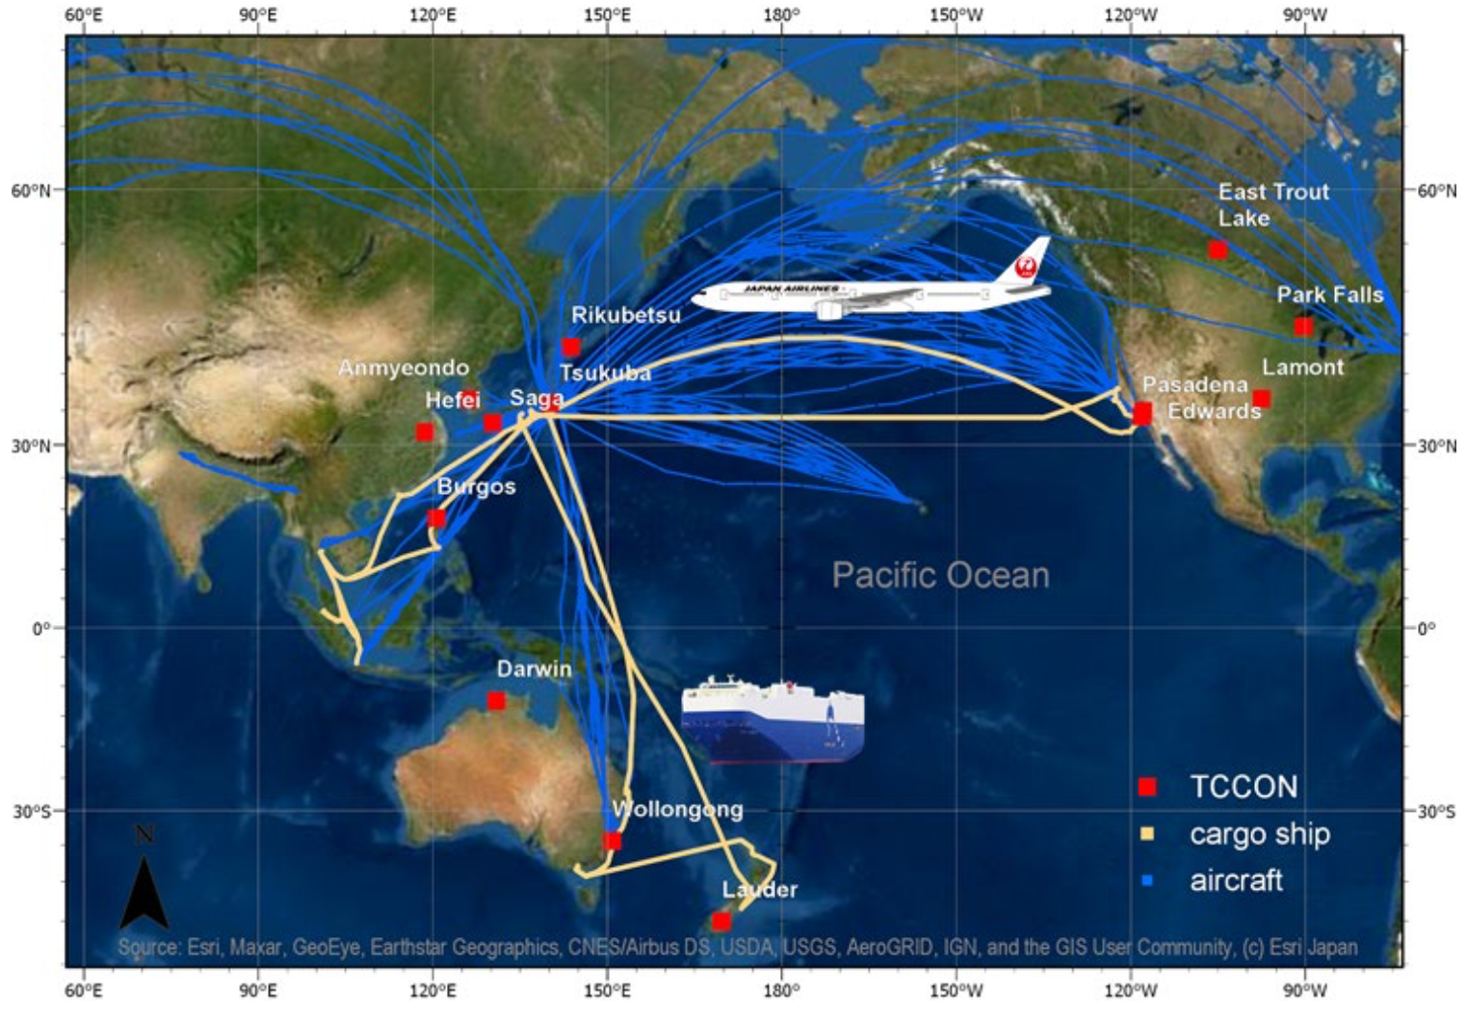
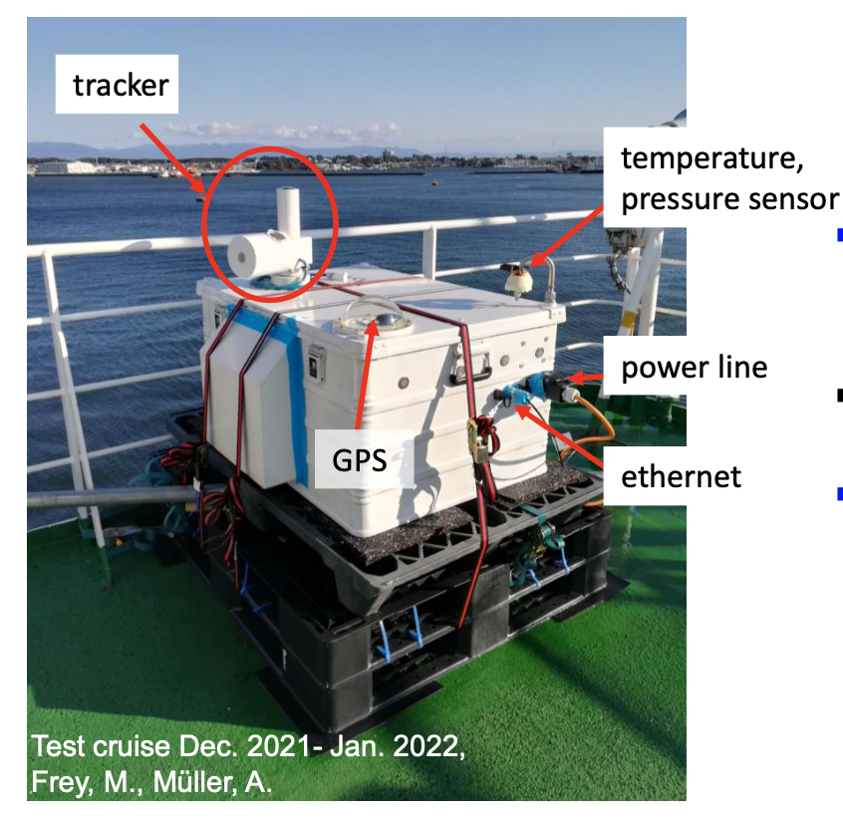
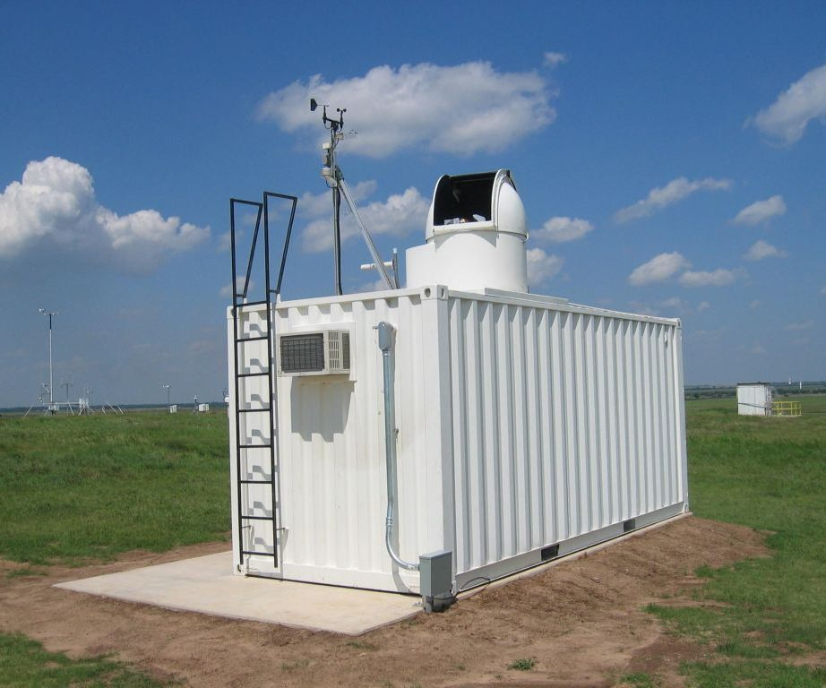
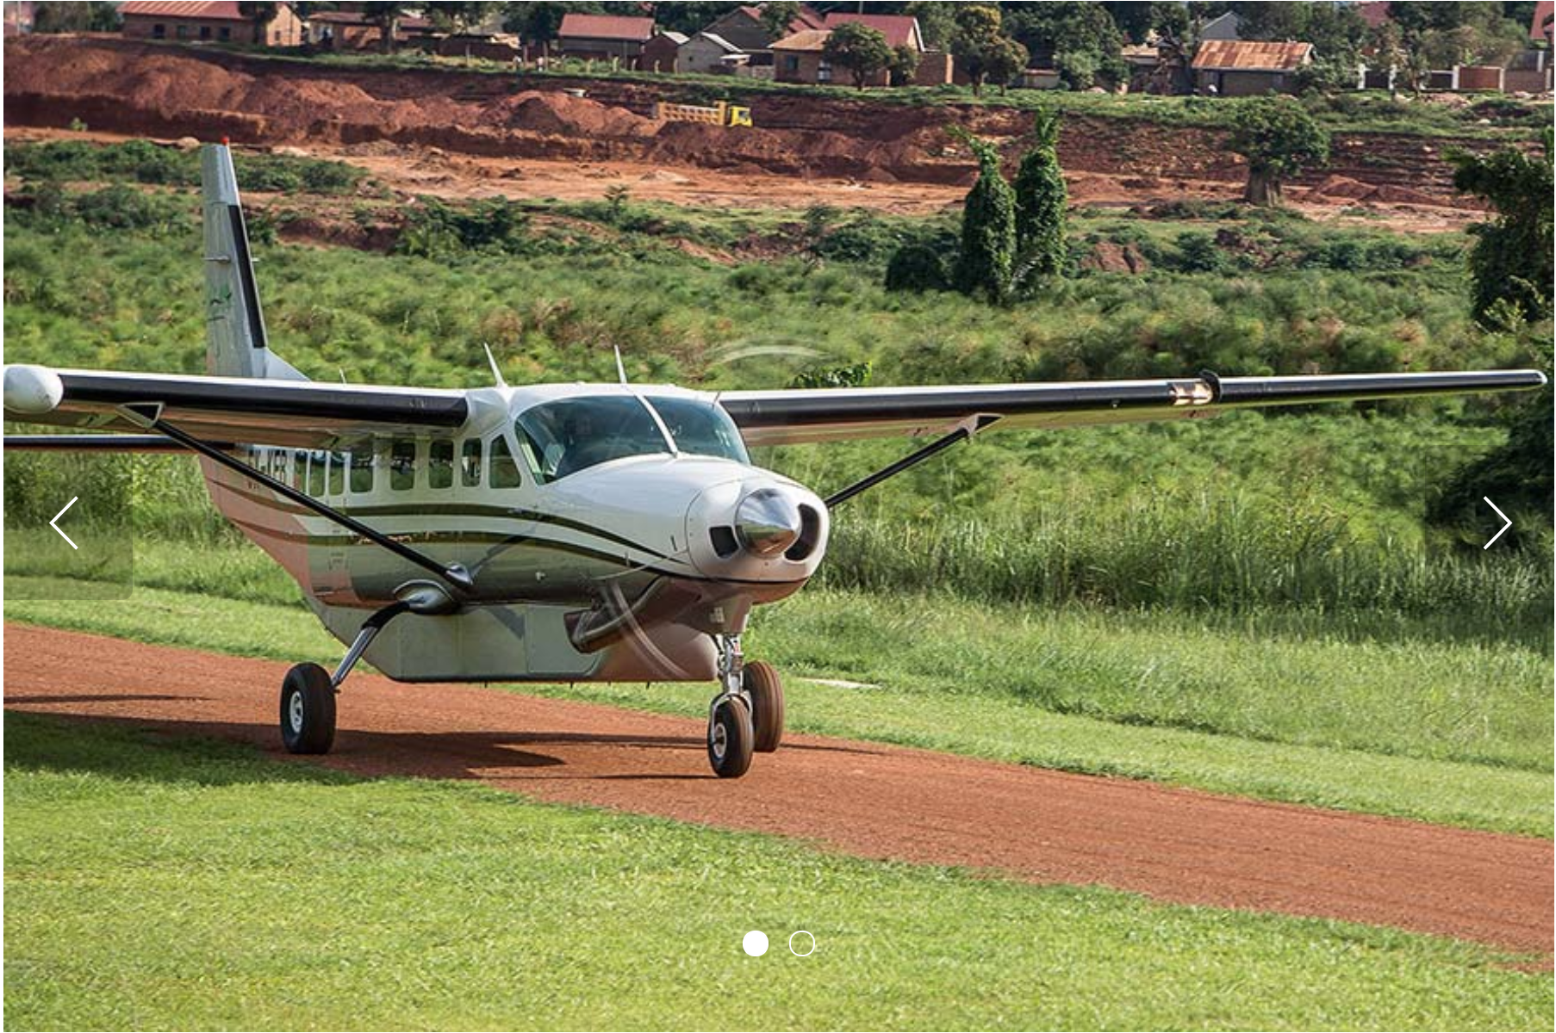
Validation
Stephens et al.
Gaubert et al.
Baier et al.
McKain et al.
Müller et al.
Notes:
SCATTER PLOT, SEASONAL CYCLES, SPATIAL GRADIENTS
Spatial gradients: Rissman et al. OCO-2 over Munich, Chen et al (2024): OCO-3 and urban/rural gradients over Mexico City
TCCON remains the cornerstone of OCO-2 and OCO-3 validation (and for other satellite missions). This group are aware how critical it is to support the TCCON network.
Expanding opportunities from deployment of EM-27/SUNs and COCCON.
Small-scale spatial gradients
Mahesh Sha’s work, new Vertex 70 instrumentation, MK trip out to India under PESEP
On datasets: Consistent processing is key – there are an ever-growing number of EM27/SUNs out there – not trivial to get XCO2 at “validation”accuracy
Ken’s point from earlier in the week: For these sensors, we are using reference measurements not only for validation but also for bias correction
AirCore measurements provide a means to tie the TCCON and COCCON measurements to the WMO standards as well as providing a reference for direct comparisons with satellite overpasses.
People in this community are acutely aware of the gaps in coverage from ground-based networks.

Slide 11
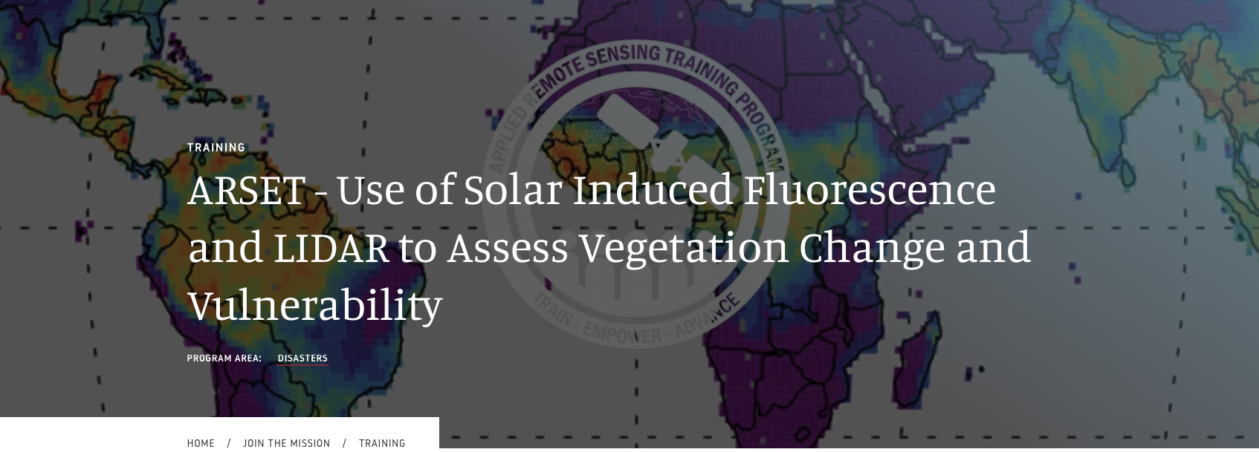
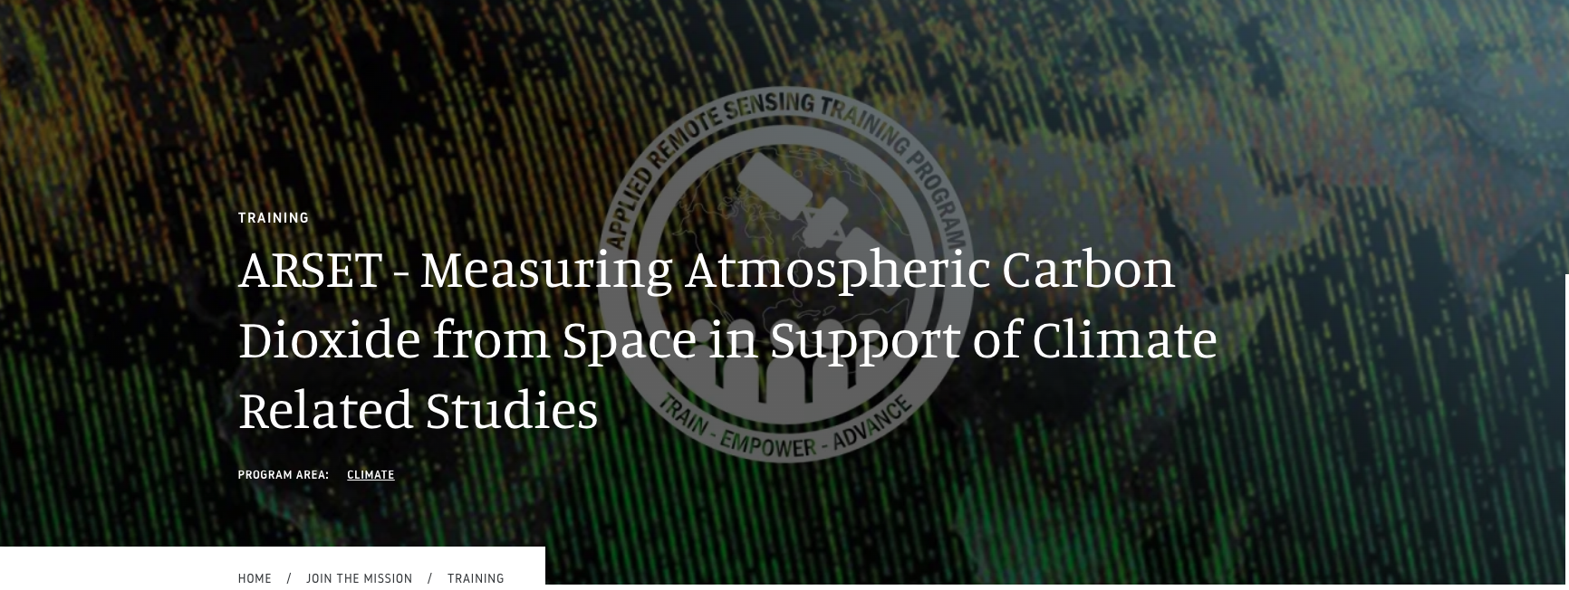
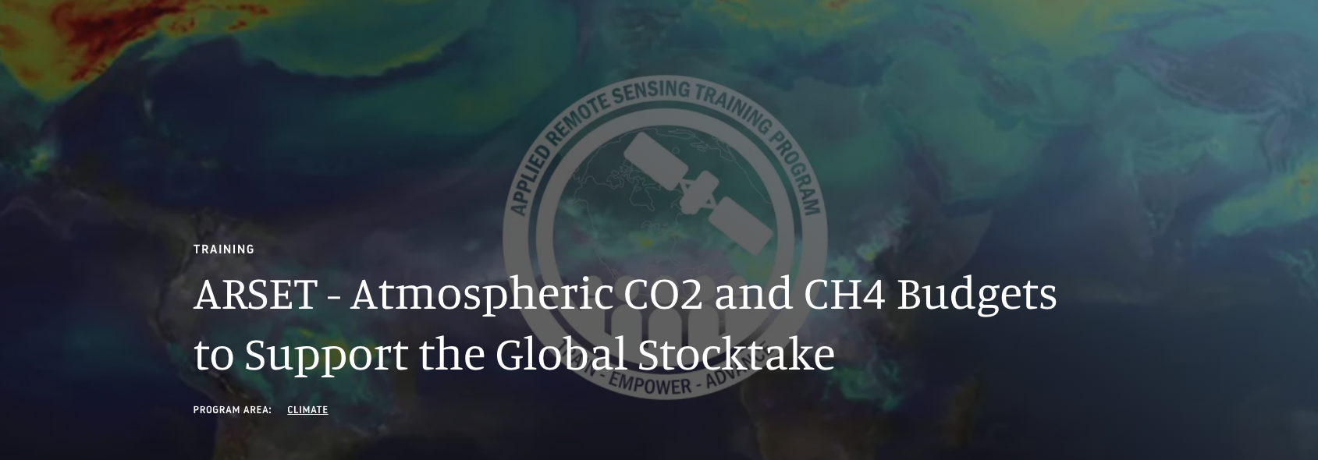
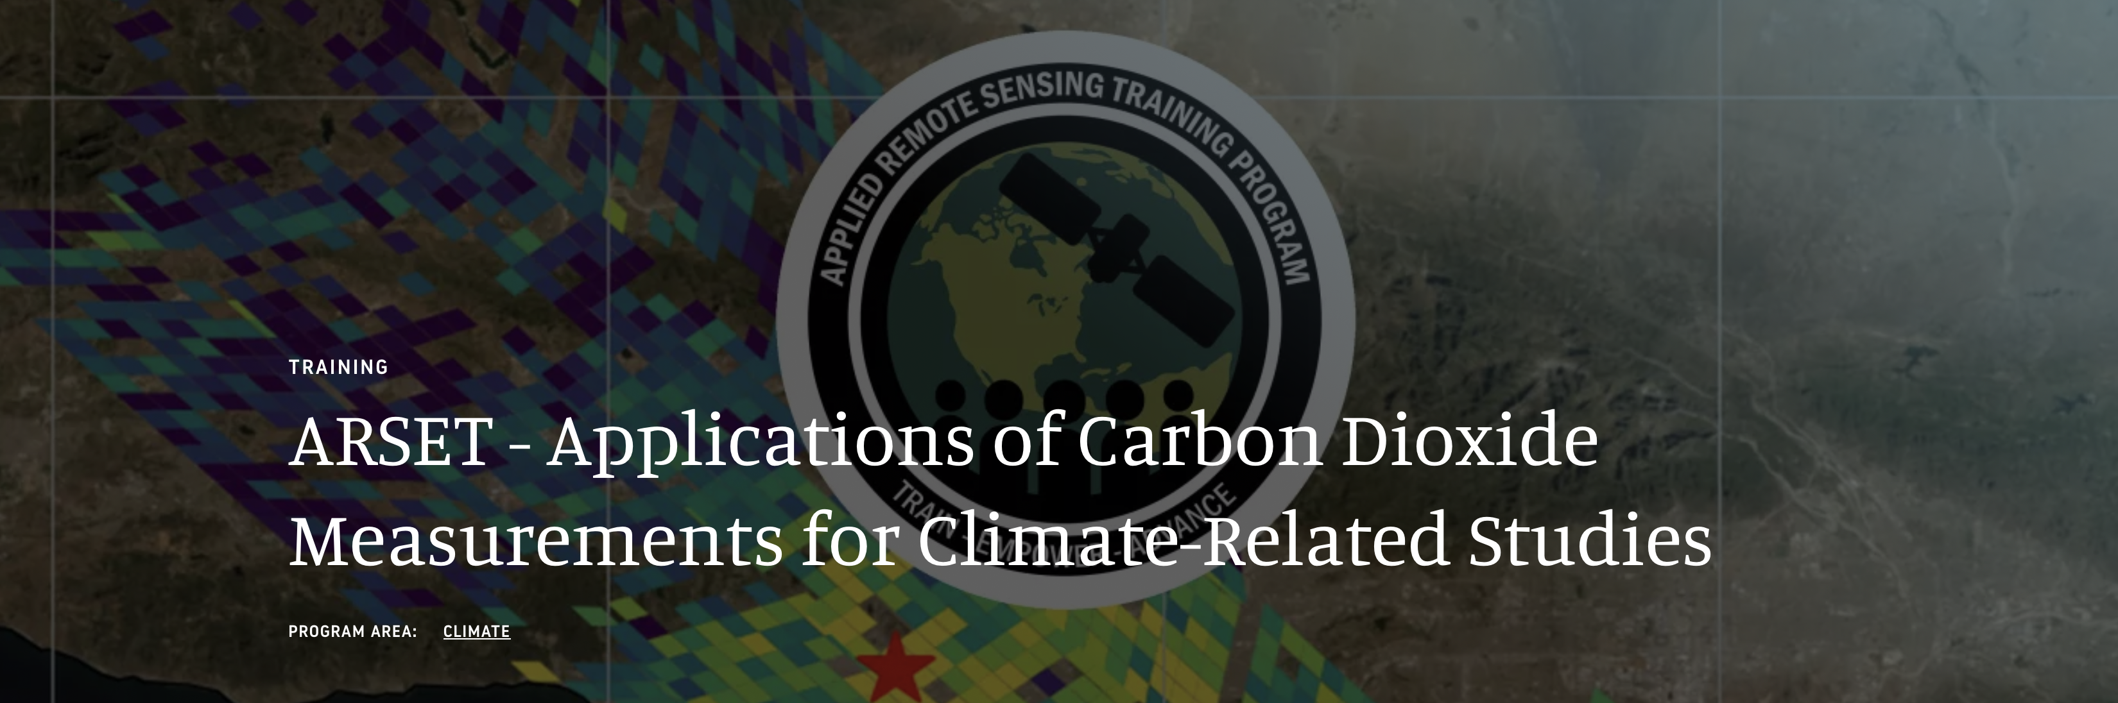
Capacity-building efforts
Capacity-building efforts to foster the use of space-based GHG products to support the policy and national inventory communities. Development of four NASA Applied Remote Sensing Training (ARSET) Programs:
2021: Use of Solar Induced Fluorescence and LIDAR to Assess Vegetation Change and Vulnerability. https://appliedsciences.nasa.gov/join-mission/training/english/arset-use-solar-induced-fluorescence-and-lidar-assess-vegetation
2022: Measuring Atmospheric Carbon Dioxide from Space in Support of Climate Related Studies . http://appliedsciences.nasa.gov/join-mission/training/english/arset-measuring-atmospheric-carbon-dioxide-space-support-climate
2022: Atmospheric CO2 and CH4 Budgets to Support the Global Stocktake. http://appliedsciences.nasa.gov/join-mission/training/english/arset-atmospheric-co2-and-ch4-budgets-support-global-stocktake
2024: Applications of Carbon Dioxide Measurements for Climate-Related Studies. https://appliedsciences.nasa.gov/get-involved/training/english/arset-applications-carbon-dioxide-measurements-climate-related
Notes:
We were able to run two of these in both English and Spanish. We got really impressive level of participation.

Slide 12
Mission status summary
OCO-2: 10+ years in space and still going strong!
Instrument and spacecraft are in excellent health
OCO-3: 5+ years in space, re-installed on the ISS and working beautifully!
Successfully reinstalled on the ISS July 4 2024
Started taking science measurements July 16 2024
Completed IOC2 Oct 6 2024, has resumed nominal operations
Potential to continue to end of lifetime of ISS
OCO-2 and OCO-3 data products now both produced using v11 L2 algorithm
OCO-2 v11.2, OCO-3 v11 now available at GES DISC
Notes:
Joint use of OCO-2 and OCO-3: constellation in simplest form

Slide 13
Backup

Slide 14
Validation needs/gaps
Spatial coverage on a global scale
Tropics
High latitudes
Oceans
Coverage of conditions for bias correction
Surface type
Aerosol conditions
Other?

Slide 15
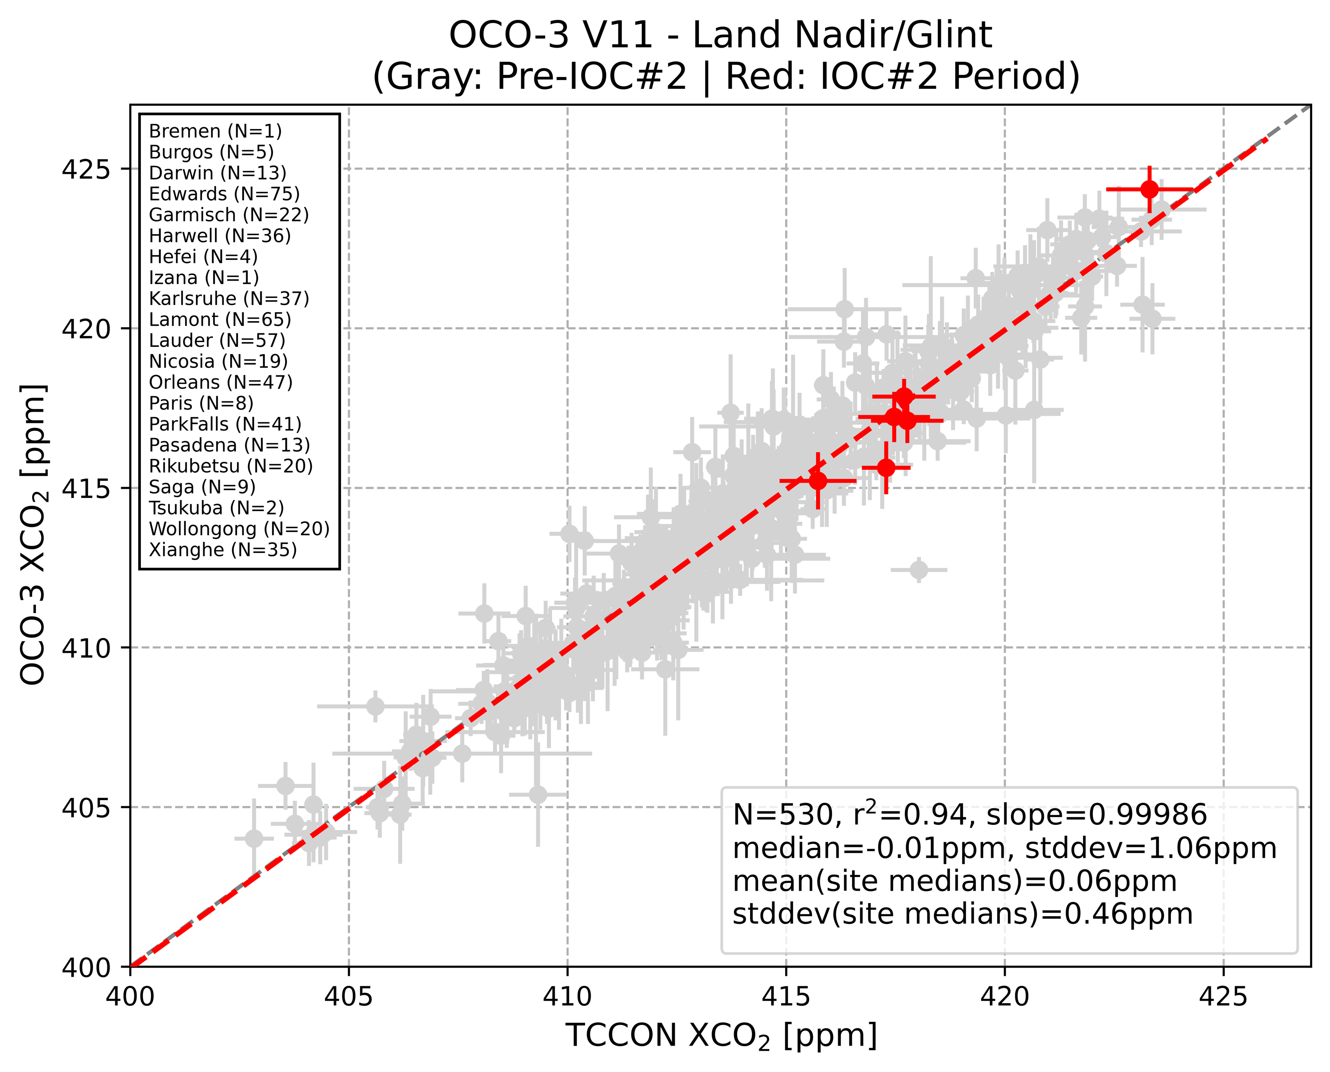
OCO-3/TCCON comparisons since reinstall
M. Kiel, JPL
Notes:
B11 IOC#2 Validation
Chris O’Dell (CSU) generated OCO-3 V11 Lite Files from July 2024 – September 2024 using forward stream data
TCCON data available for Park Falls and Caltech/Pasadena, Edwards and Lamont data still in QA/QC but expected to be available soon
Preliminary Land/Nadir Analysis:
11 overpasses analyzed (10 for Park Falls, 1 for Caltech)
6 overpasses met the spatiotemporal colocation criteria with a minimum of 25 good-quality OCO-3 soundings (5 Park Falls, 1 Caltech)
Data for Park Falls and Caltech appears consistent with pre-IOC#2 data (stddev = 0.9ppm, bias=-0.2ppm)
Additional data needed; continued monitoring is ongoing
Preliminary Target Analysis: ongoing, waiting for additional TCCON data

