Slide 1
GOSAT and GOSAT-2 mission update
Kei SHIOMI, Hiroshi SUTO, Akihiko KUZE, Nobuhiro KIKUCHI,
and GOSAT Team (JAXA)
CEOS AC-VC-20, NOAA Center for Weather and Climate Prediction, College Park, MD, US, October 17, 2024

Slide 2
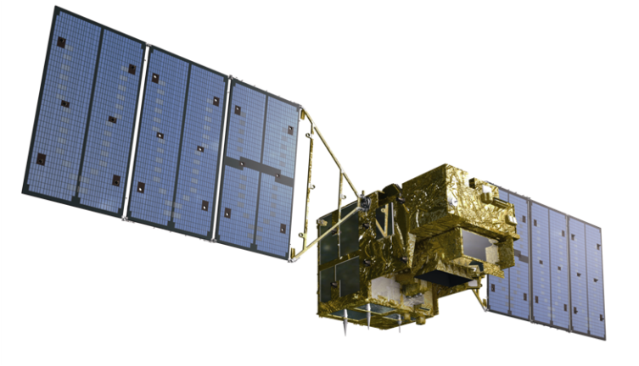
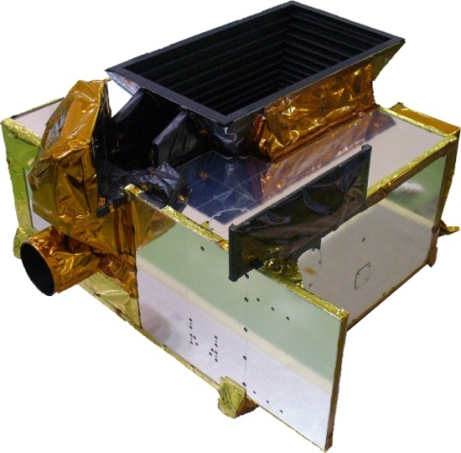
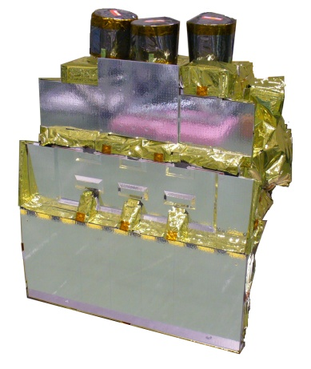
GOSAT and GOSAT-2 satellites
GOSAT and GOSAT-2 missions are promoted by JAXA, NIES and MOE.
GOSAT (2009~)
GOSAT-2 (2018~)
FTS-2
CAI-2
FTS-2
O₂A(0.76μm)
WCO₂,CH₄(1.6μm)
SCO₂, CO (2μm)
2 TIR bands (5-15μm)
High spectral resolution 0.2cm⁻¹
Enhanced pointing mechanisms
FTS
O₂A(0.76μm)
WCO₂,CH₄(1.6μm)
SCO₂(2μm)
TIR (5-15μm)
High spectral resolution 0.2cm⁻¹
Pointing mechanism
CAI
UV-SWIR
4 bands linear array
Nadir view
CAI-2
UV-SWIR
10 bands linear array
5 forward view bands, 5 backward view bands

Slide 3
GOSAT and GOSAT-2 status
Long term (15-year Jan. 2024)
calibrated and validated dataset
Satellite Condition
Enough fuel to operate for at least another 10-year
All four batteries are healthy
Since Jan. 2024, the monthly-used back-side solar diffuser has not been available due to rotation anomaly, but the front-side is in normal operation every orbit.
Level 1 V300.300 (released in March 2023)
Best-estimate radiance spectra using TSIS-HSRS and long-term vicarious-calibration data.
NIES Level 2 standard products V03.05
Intense target observations using
flexible and wide angle pointing
Oct30,2023, 5-year operation review.
The operation has been extended.
Feb. 2021, anomaly occurred in the solar diffuser plate mechanism. The solar irradiance calibration has been suspended since then, Lunar calibration is normal.
Level 1 V220.221 (released in March 2024)
TIR calibration updated in large-AT angles (V220.220)
SWIR radiometric degradation update (V220.221)
Next update is scheduled in March 2025.
NIES Level 2 standard products V02.00
JAXA Level 2 Partial Column product V3
GOSAT (15-year) and GOSAT-2 (5-year) Lite (csv format) and HDF with averaging kernels.
3

Slide 4
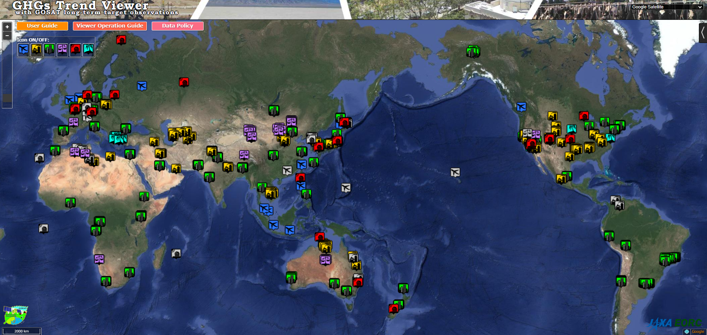
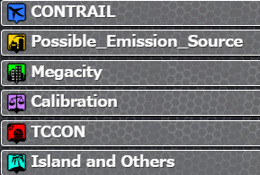
GOSAT and GOSAT-2 target observations
Over 60 Megacities optimized by local user communications
Cal/Val sites (Railroad Valley, TCCON, COCCON, airport)
CO₂ and CH₄ emission sources (energy, dairy sectors)
GOSAT-2 has capability to operate more enhanced target observations.
https://www.eorc.jaxa.jp/GOSAT/CO2_monitor/index_Ver.K.html

Slide 5
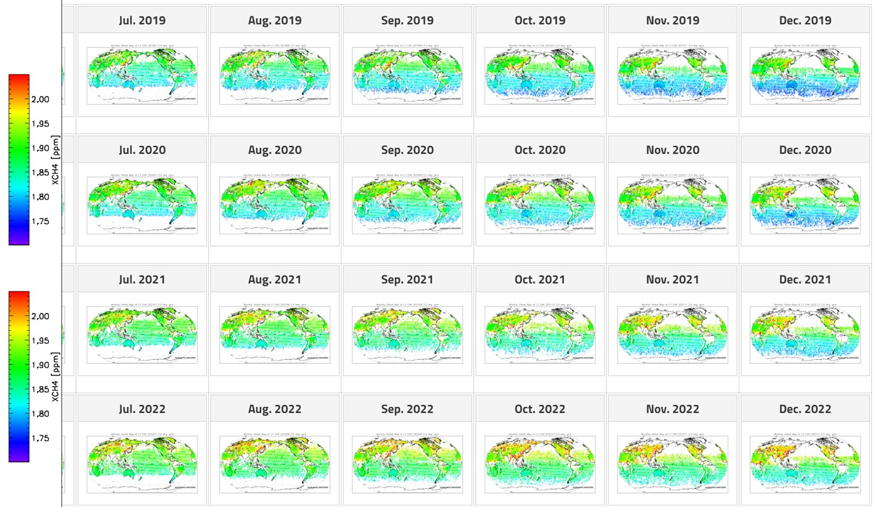
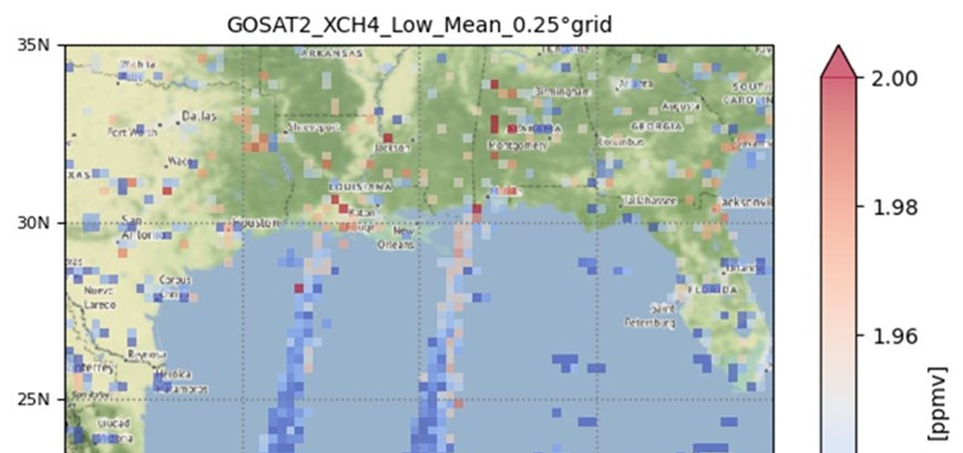
JAXA GHG product Partial Column Density of Upper and Lower Troposphere
©MOE/JAXA/NIES
12km
4km
GOSAT-2
XCH₄ (LT)
Delta CO₂ = XCO2 (LT) –CO2(UT)
(1) SWIR constrains column density
(2) Two orthogonal linear polarization data remove aerosol contamination.
(3) TIR provides difference in partial column density between lower and upper troposphere.
Post screening of cloud contamination using onboard camera
(1) 15-year GOSAT and 5-year GOSAT-2 products One file per month with clear sky data, CSV format and AK
(2) Contents XCO₂, XCH₄, XCO₂ (LT, UT), XCH₄ (LT, UT), XCO (GOSAT-2 only), H₂O (11 layers) aerosol optical thickness (AOT),
Retrieved surface pressure (P), solar-induced chlorophyll fluorescence (SIF) time, geometry
(3) https://www.eorc.jaxa.jp/GOSAT/GPCG/download_v3/ ID：gosat、PW：***** (please contact)
Gulf of Mexico
5
Notes:
Close to the coast of Texas

Slide 6
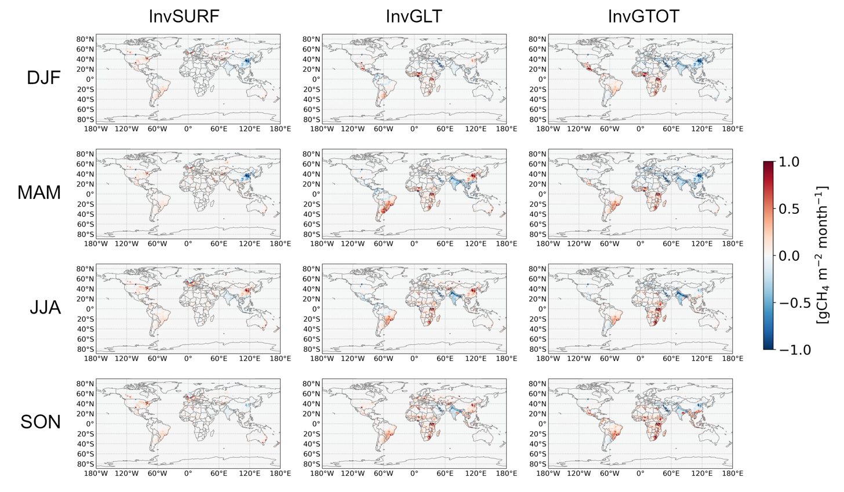
Application of JAXA GHG products
Assimilation of LT_CH4, some local areas, such as Amazon, China, presents interesting (anomalous) feature.
These are positive feedback for our products, because, LT_CH4 have sensitivity near surface emission changes.
To understand these feature, the further analysis will be conducted.
In-situ based
LT_CH4 based
XCH4 based
Tsuruta (FMI) in prep.
Anthropogenic Emission increments = post-prior, 2016-2019 multi year averaged
Notes:
Inversion method posterior result minus prior 4 year average

Slide 7
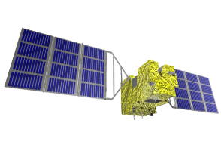
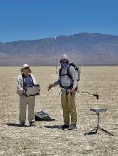
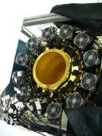
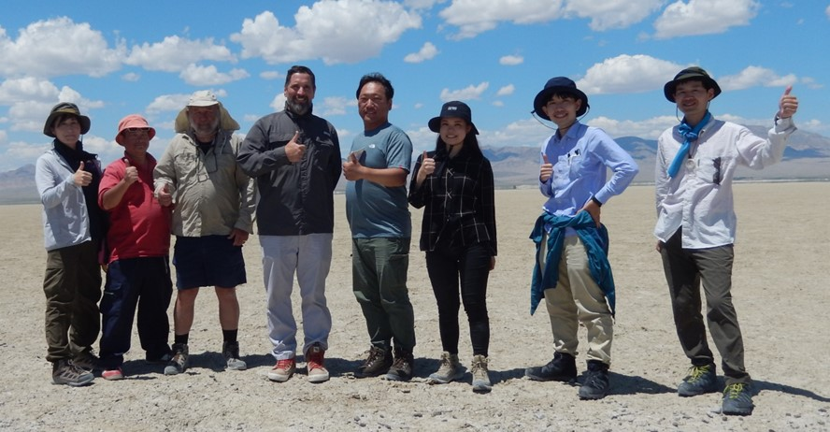
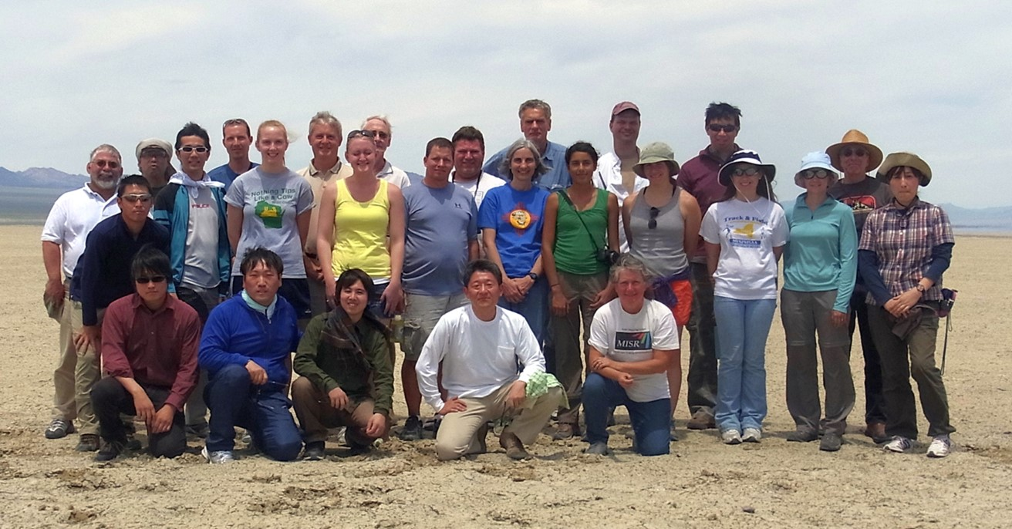
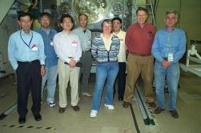
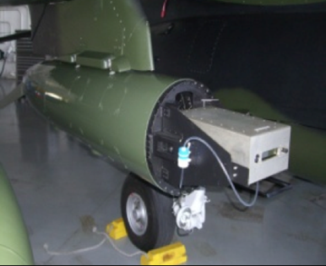
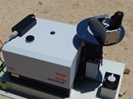
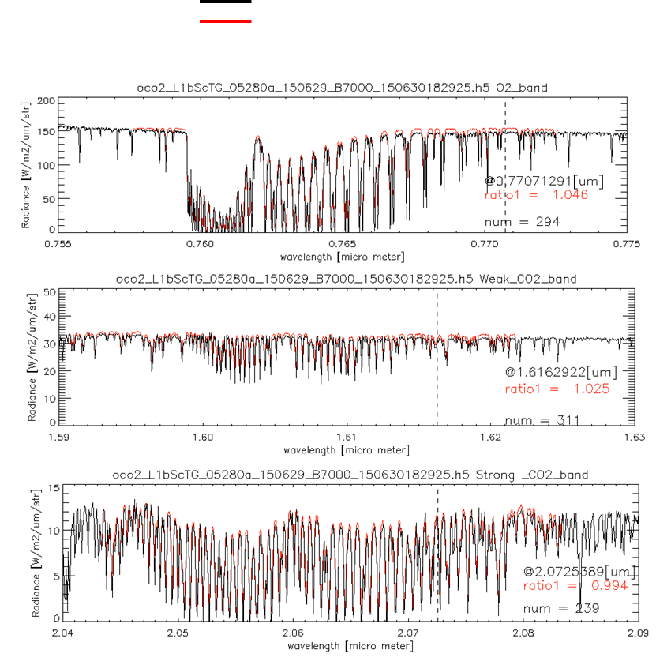
International collaboration for GHG sensors calibration
2008 09 10 11 12 13 14 15 16 17 18 19 20 21 22 23 24
Radiometric calibration
Prelaunch
X-CAL
Annual Vicarious Calibration at the desert playa in Nevada
CO₂ & CH₄ profile
In situ CO₂ and CH₄ on AJAX
XCO₂ & XCH₄
Column with EM-27 FTS
GOSAT OCO-2
Coincident Target
Calibrated GOSAT and OCO-2 radiance spectra agrees within 5% for all bands.
Notes:
We started the OCO-GOSAT collaboration in pre-launch radiometric cross-calibration of the laboratory standard lamp integrating sphere.
After the GOSAT launch, we conducted the annual vicarious calibration campaign at Railroad Nevada for radiometric calibration on orbit.
NASA AMES team take CO2 CH4 profile by AJAX airplane experiment.
JAXA deploys the portable FTS for total column averaged CO2 and CH4.
After the OCO-2 launch 2014, we have coincident target measuemrents RRV, and then TROPOMI 2017, GOSAT-2 2018, OCO-3 2019 joined.
GHG is strongly related to the air pollution such as NO2, which is originated from the same combustion process of industry activity, transportation.
We cover the UV-VIS measurement. TEMPO the US geostationary air pollution mission have joined the RRV campaign by making special target 2024.

Slide 8
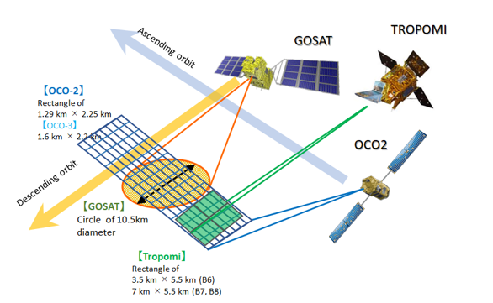
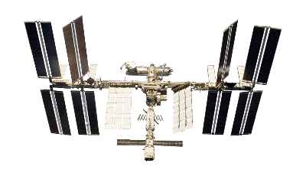
Railroad Valley target by 5 GHG sensors
GOSAT-2
RRV 2022 Summer Campaign schedule
Date | DoW | OCO-2 path | GOSAT path | GOSAT-2 path | TROPOMI InstZA [deg]
8-Jun-22 | Wed |  | no | no | 53.6 | RRV
9-Jun-22 | Thu | 138 | 36 | 72 | 8.1 | RRV
10-Jun-22 | Fri |  | 37 | 73 | 6.9 | RRV
11-Jun-22 | Sat | 136 | no | 74 | 46.3 | RRV
12-Jun-22 | Sun |  | 36 | no | 31.7 | RRV
13-Jun-22 | Mon |  | 37 | no | 46.6 | RRV
Good conditions for all sensors come every 48 days.
 | Nadir footprint size
GOSAT | Circle of 10.5km diameter
GOSAT-2 | Circle of 9.6km diameter
OCO-2 | Rectangle of 1.3 km * 2.3 km
OCO-3 | Rectangle of 1.6 km * 2.2 km
TROPOMI | Rectangle of 3.5 km * 5.5 km (B6) 7 km * 5.5 km (B7, B8)
OCO-3
8

Slide 9
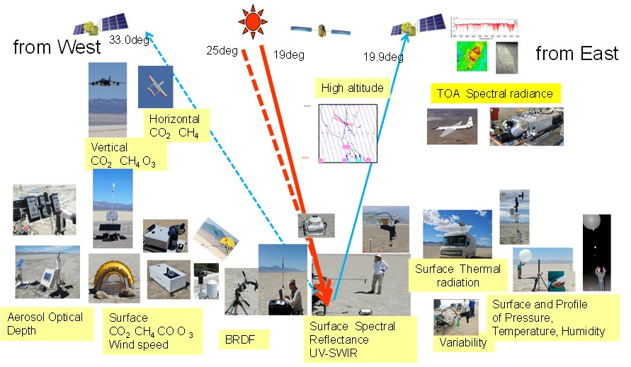
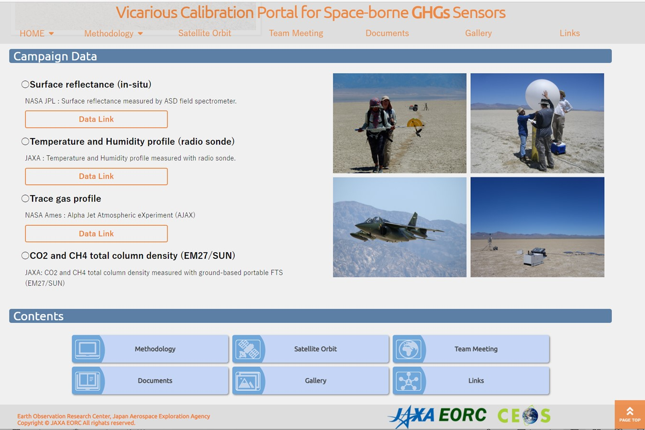
VCAL Portal site for field data access
https://www.eorc.jaxa.jp/GOSAT/GHGs_Vical/index.html
The Railroad Valley field data are available from VCAL portal site.
VCAL team meeting is held every 3-4 months. Next meeting: 6-7UTC, January 17, 2024.
This year: TEMPO first special target at RRV. In future: MethaneSAT, CO2M, …
9

Slide 10
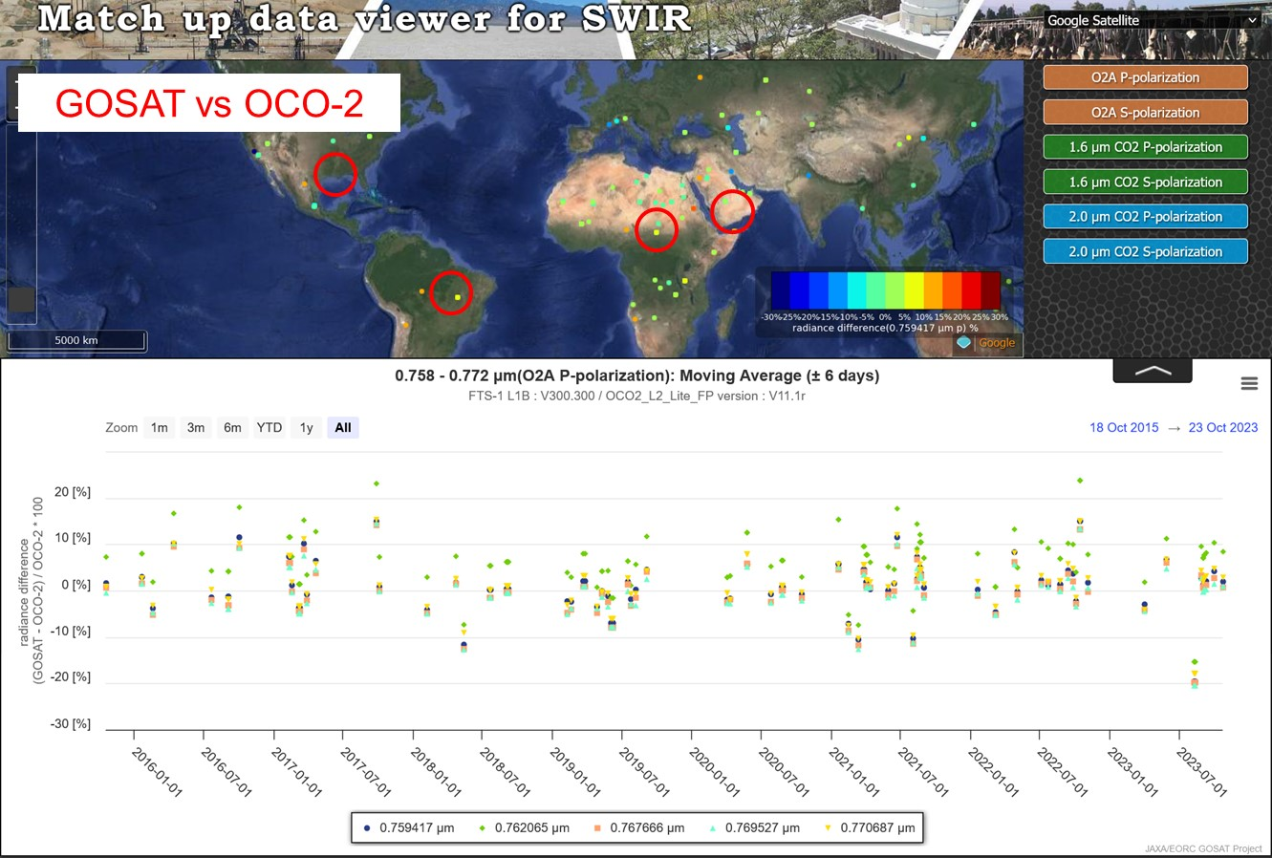
Match-up data viewer of GHG sensors L1 and L2
GOSAT vs OCO-2 O2A radiance spectra
Degradation corrected
Cloud screened (successful L2)
Most of the data agree within 10% for all three bands except for over forest.
SWIR
Calibrated radiance
XCO2, XCH4, SIF, AOT
TIR
Calibrated radiance
Brightness temperature
This page will be released in the next month.
10
Notes:
To harmonize the GHG data, inter-comparisons of the sensor radiances or gas densities are important to confirm the biases in spatial and temporal variations.

Slide 11
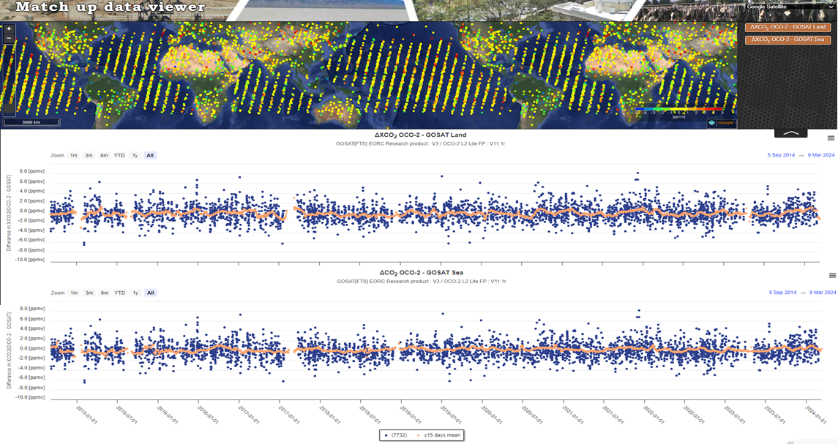
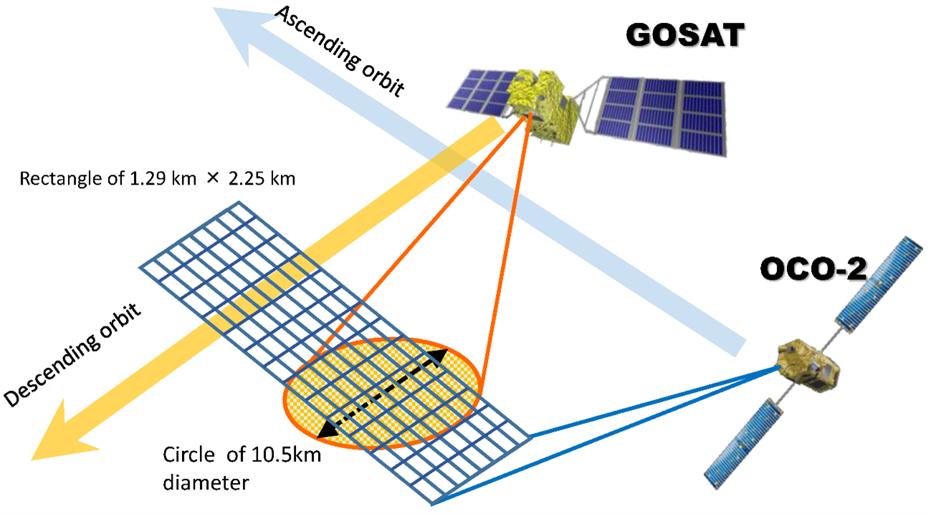
L2 XCO₂ inter-comparison (OCO2-GOSAT)
OCO2-GOSAT XCO₂
-5ppm
0
+5ppm
Land
Match up data
+/-15days moving average
ΔXCO₂ (OCO2-GOSAT)
Ocean
GOSAT: JAXA GHG product V3
OCO2: OCO2_L2_Lite_FP V11.1r
Retrieved parameters are different between the L2 algorithms over Land and Ocean. Ocean glint measurement methods are slightly different between GOSAT and OCO-2. Bias might be also different.
OCO-2 and GOSAT XCO₂ are in good agreement < 0.5ppm. OCO-2 has low bias than GOSAT over forest area of Amazon and Africa.
11

Slide 12
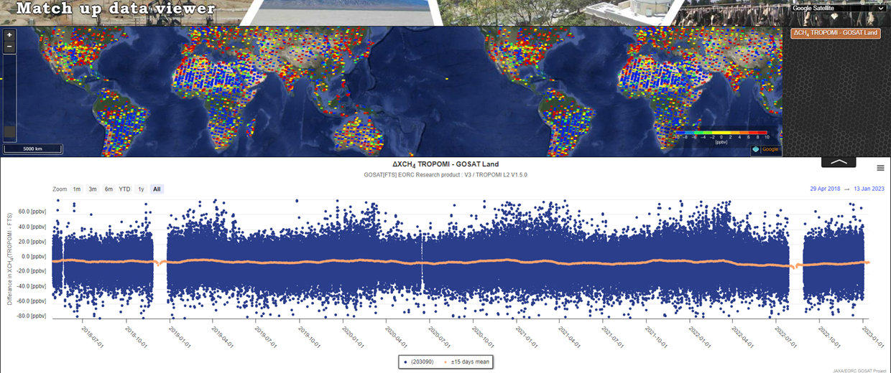
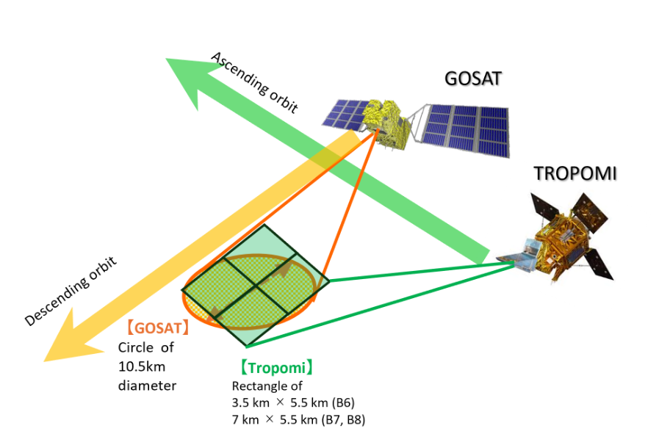
L2 XCH₄ inter-comparison (TROPOMI-GOSAT)
TROPOMI-GOSAT XCH₄
-10ppb
0
+10ppb
ΔXCH₄ (TROPOMI-GOSAT)
Match up data
+/-15days moving average
GOSAT: JAXA GHG product V3
TROPOMI: Processor Version 02.04.00
XCH₄ bias shows spatial features. These areas are less or lacking validation data.
Inter-comparisons of multiple sensors are useful for feedback to the retrieval algorithm.
12

Slide 13
Summary
GOSAT and GOSAT-2 conditions are very healthy.
GOSAT total and partial column are provided over 15 years, GOSAT-2 over 5 years.
GOSAT and GOSAT-2 target over megacities and emission sources.
VCAL campaign at Railroad Valley has conducted since 2009 over 16 years.
5 GHG sensors (GOSAT, OCO-2, TROPOMI, GOSAT-2, OCO-3) + AQ (TEMPO)
VCAL portal site (https://www.eorc.jaxa.jp/GOSAT/GHGs_Vical/index.html)
Inter-comparison between GHG sensors
L1 radiance and L2 XCO₂, XCH₄, AOD
Matchup data viewer site will be open soon.

