Slide 1

Satellite Observations for Quantifying the Global Carbon Budget
Junjie Liu
Jet Propulsion Laboratory, California Institute of Technology, US
Oct 17th, 2024
With input from Dan Cusworth, Hannah Nesser, and John Worden

Slide 2
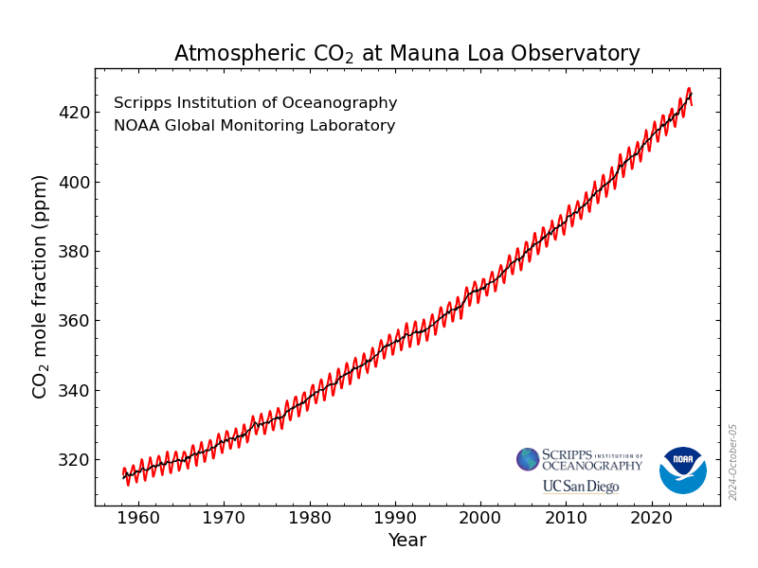
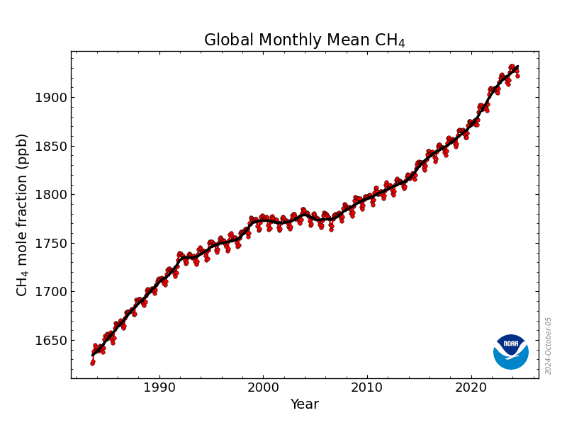
Dramatic Increase in Atmospheric CO₂ and CH₄ Concentration
CO2 has increased about 30% since 1958;
CH4 has increased more than 20% since 1980s.

Slide 3


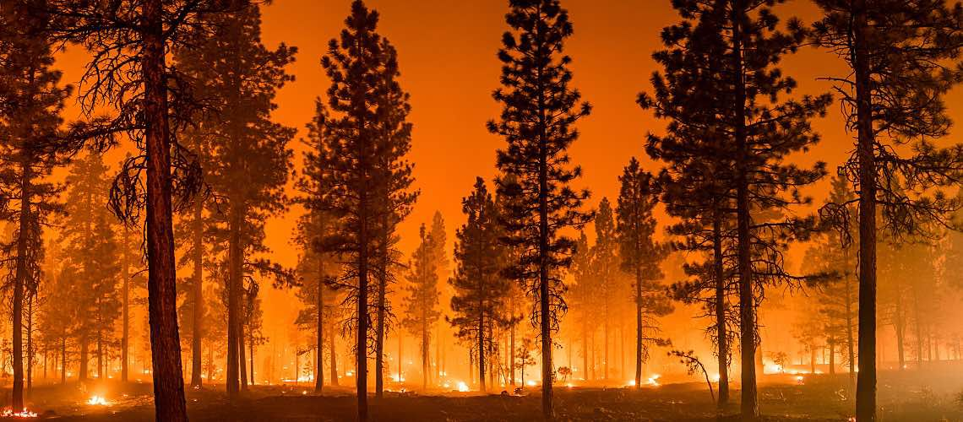



Large Ranges in Spatial Scales and Magnitudes among Major Sources and Sinks of CO₂
Unit: gC/m²/day
The observations need to be close to the sources and footprint size needs to be small to capture emission signals from large point sources
Power plants and heavy industry (~30%)
10³
The observations need to have a global coverage and high accuracy and precision to capture the signals from natural carbon fluxes.
10²
Fires and land use
Cities (70%)
Extreme climate events
Intensity
10
10⁰
Terrestrial biosphere
10⁻¹
Air-sea carbon fluxes
10⁻¹
1
10¹
10²
10³
10⁴
Unit: km²
Manage emissions and enhance carbon uptakes
Spatial Scales
Notes:
Power plants (scale, intensity), cities (emissions), fires, forest (emissions), drought (intensity)

Slide 4
Large Ranges in Spatial Scales and Magnitudes among Major Sources and Sinks of CH4
Unit: kg /hr
The observations need to be close to the sources and footprint size needs to be small to capture emission signals from power plants and cities.
10³
Oil and gas (~20%)
10²
Livestock and landfill (~40%)
Intensity
Biomass and Biofuel burning (5%)
The observations need to have a global coverage and high accuracy and precision to capture the signals from diffused sources
10
10⁰
Combined wetlands and inland waters (climate change, extreme events) (28~37%)
10⁻¹
OH sink
10⁻¹
1
10¹
10²
10³
10⁴
Unit: km²
Spatial Scales
Notes:
Power plants (scale, intensity), cities (emissions), fires, forest (emissions), drought (intensity)

Slide 5
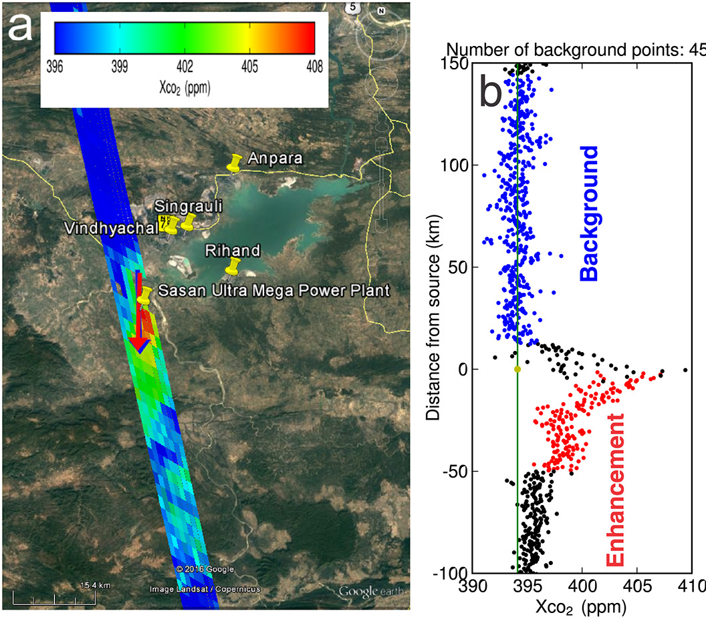
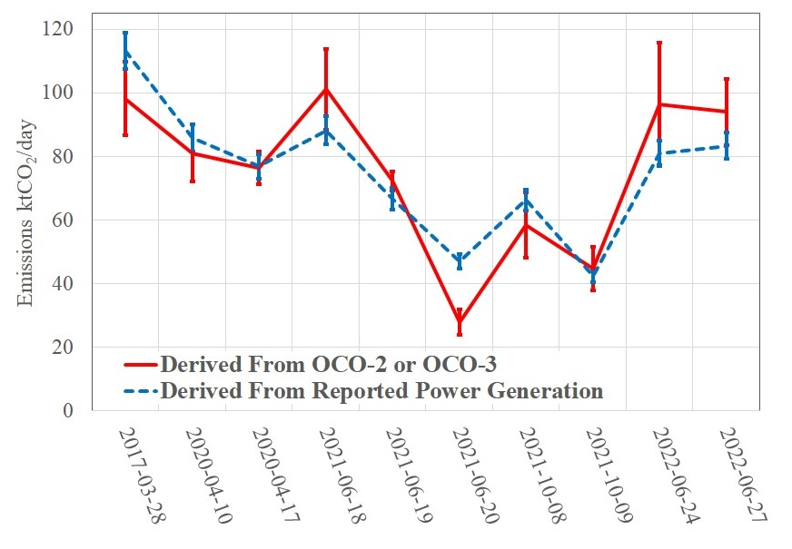
Area Mappers can Detect the Emissions from Large Power Stations
OCO-2
Nassar et al., 2017, 2023
The OCO-2/3 observations capture a factor of two temporal variations of emissions from power stations .
The uncertainty can be up to about 20% of emissions.

Slide 6
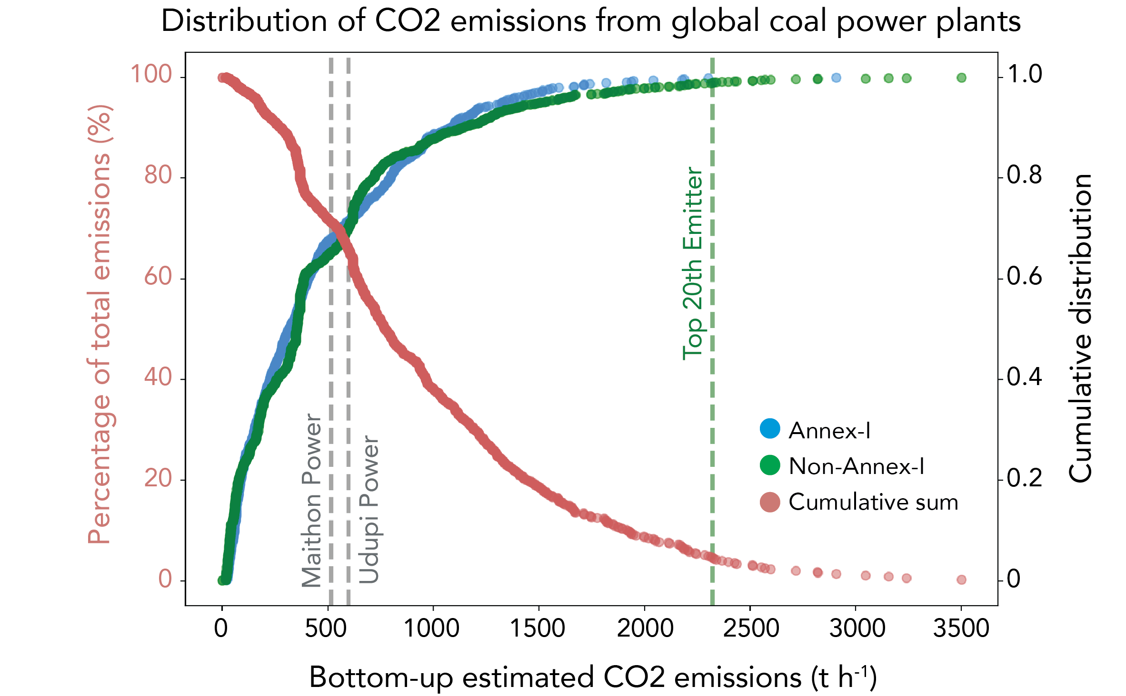
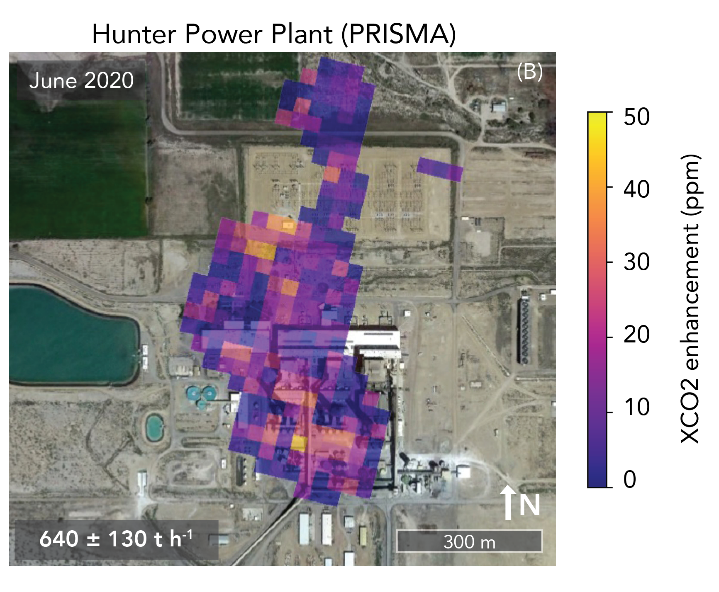
60-80% of Emissions from Power Stations can be Detected with Plume Imagers
Instrument with PRISMA type of detection limit (680 t CO2 h⁻¹ )~60%of global coal power plant CO2 emissions
Instrument with 350 t CO2 h⁻¹ detection limit ~80% of emissions
Cusworth et al., 2021

Slide 7
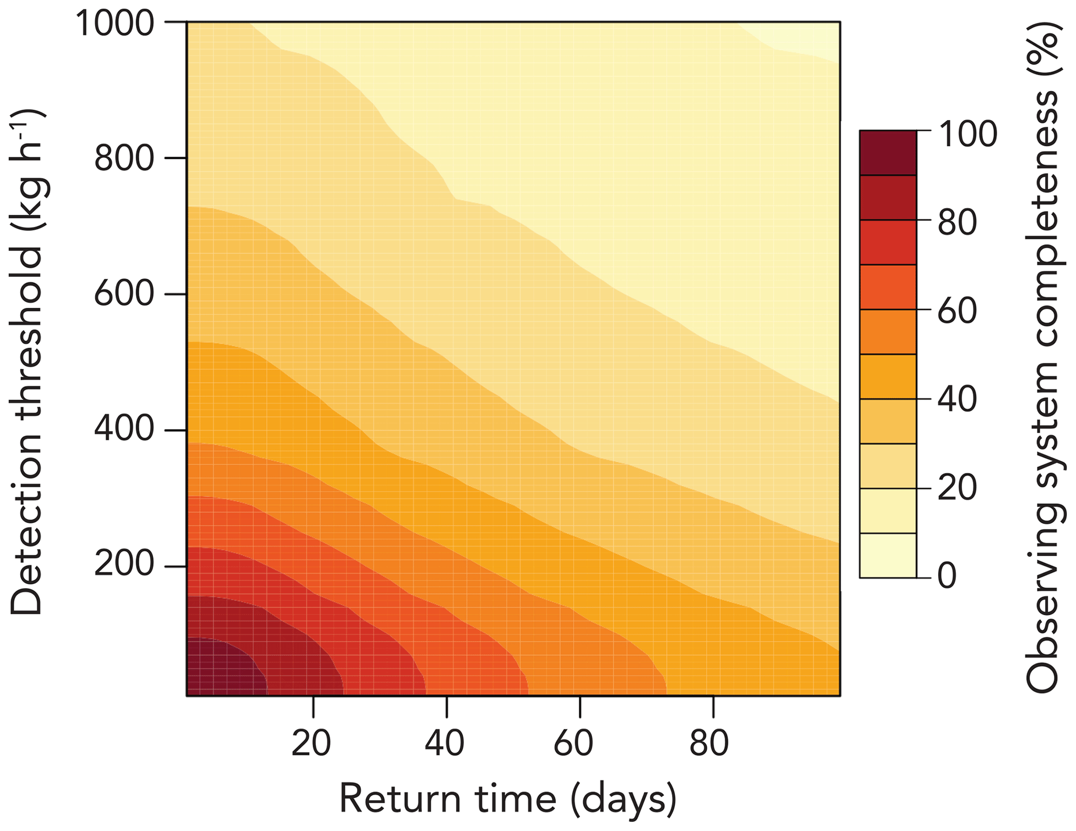
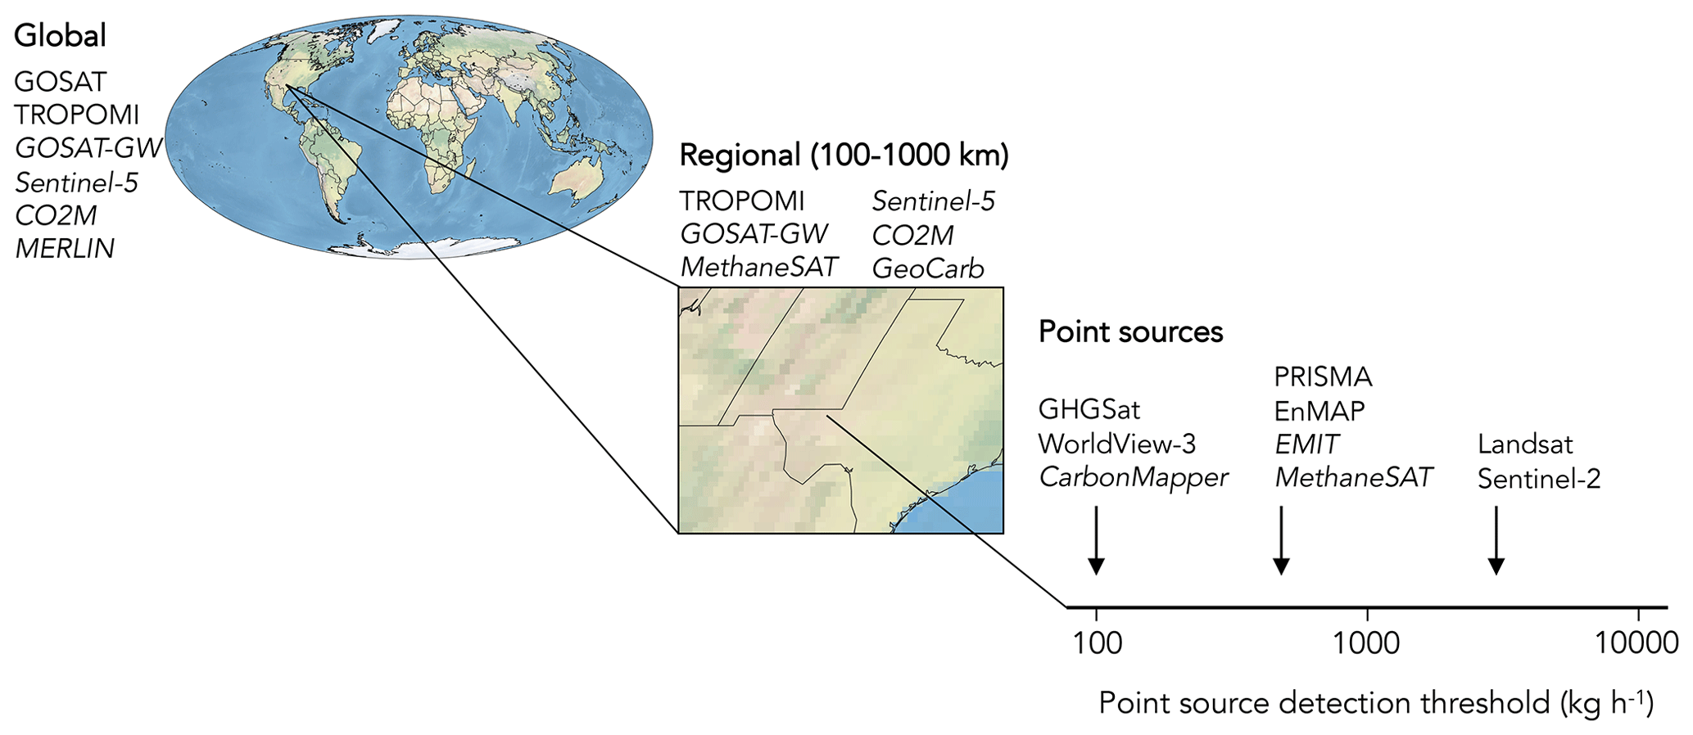
CH4 Emissions from Point Sources with Tiered Observing System
The observing system completeness for point sources is defined as the fraction of total point source emissions larger than 10 kg h⁻¹ within a domain and time window that can be detected by a given instrument (or constellation of instruments).
Detection limit is a function of environmental factors
Jacob et al., 2022

Slide 8
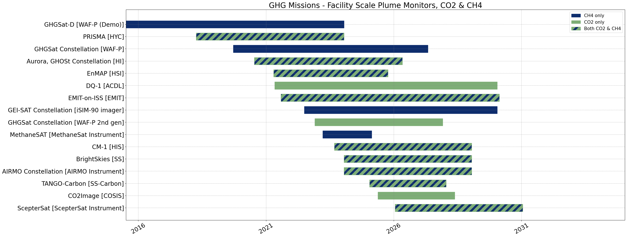
Plume Mappers
300kg/hr for CH4
100-500 kt/hr for CO2
7-14 days revisit, 500kg/hr
1-7 days revisit, 100kg/hr for CH4
200-600 kt /hr for CO2
https://database.eohandbook.com/ghg/
With the current and planned missions, 60-80% of large point source can be detected for both CO2 and CH4.

Slide 9
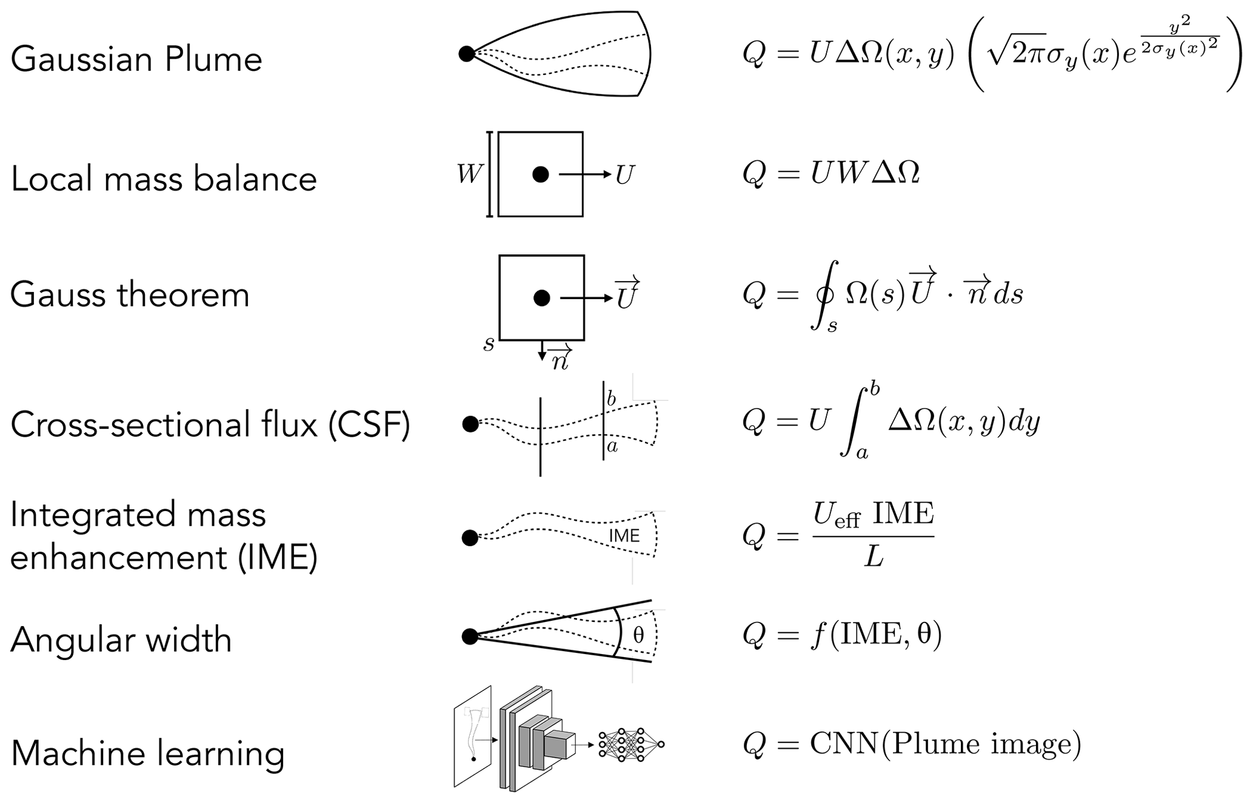
Future Directions
Huge progress in methane large point source detection, especially methane (e.g., MARS program)
Uncertainties in winds and models to infer fluxes remain to be the major sources of uncertainties.
Combination of data from multiple sources to increase the completeness in detecting emissions;
  Standardize data format and variables among different data products
  Coordinated validation of emission estimations and cross-validation.
Jacob et al., 2022

Slide 10
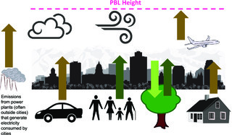
Complexities of Urban Emissions
Lin et al., 2018
Emission sources: transportation, residential, industrial, aviation; a combination of large point source and diffused sources
Urban biosphere
Cloud and aerosols reduce observation throughput
Area mappers with small footprint size (OCO-2, OCO-3, GOSAT-GW, CO2M, )

Slide 11
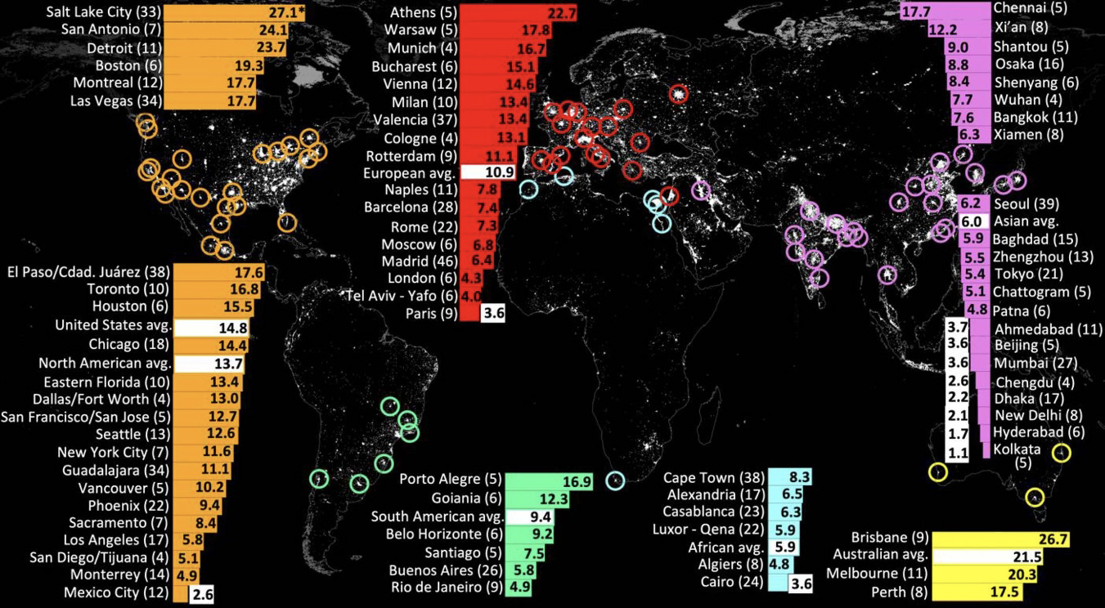
Urban Emission Characteristics and Quantification with Observations from OCO-2
77 cities (2015-2022)
Wilmot e t al.,ERL, 2024
OCO-2, 16-day revisit time; OCO-3: Snapshot Area Mode (SAM)
Captures ∼16% of global carbon dioxide emissions, similar in magnitude to the total direct emissions of the United States or Europe.

Slide 12
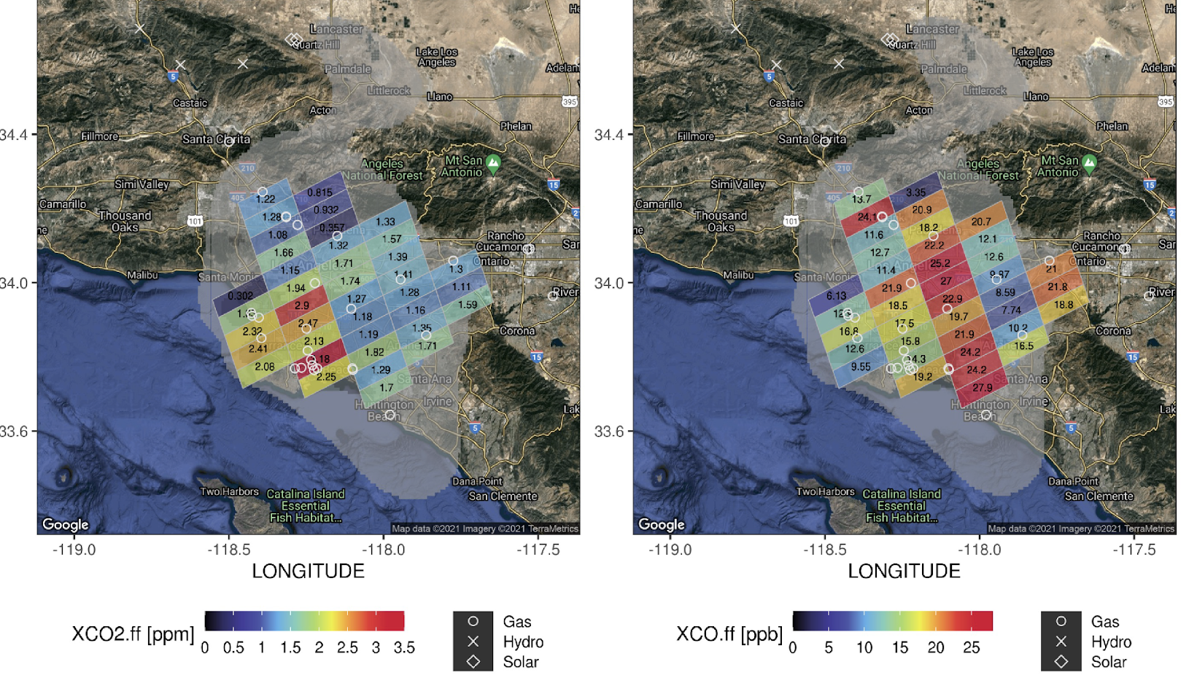
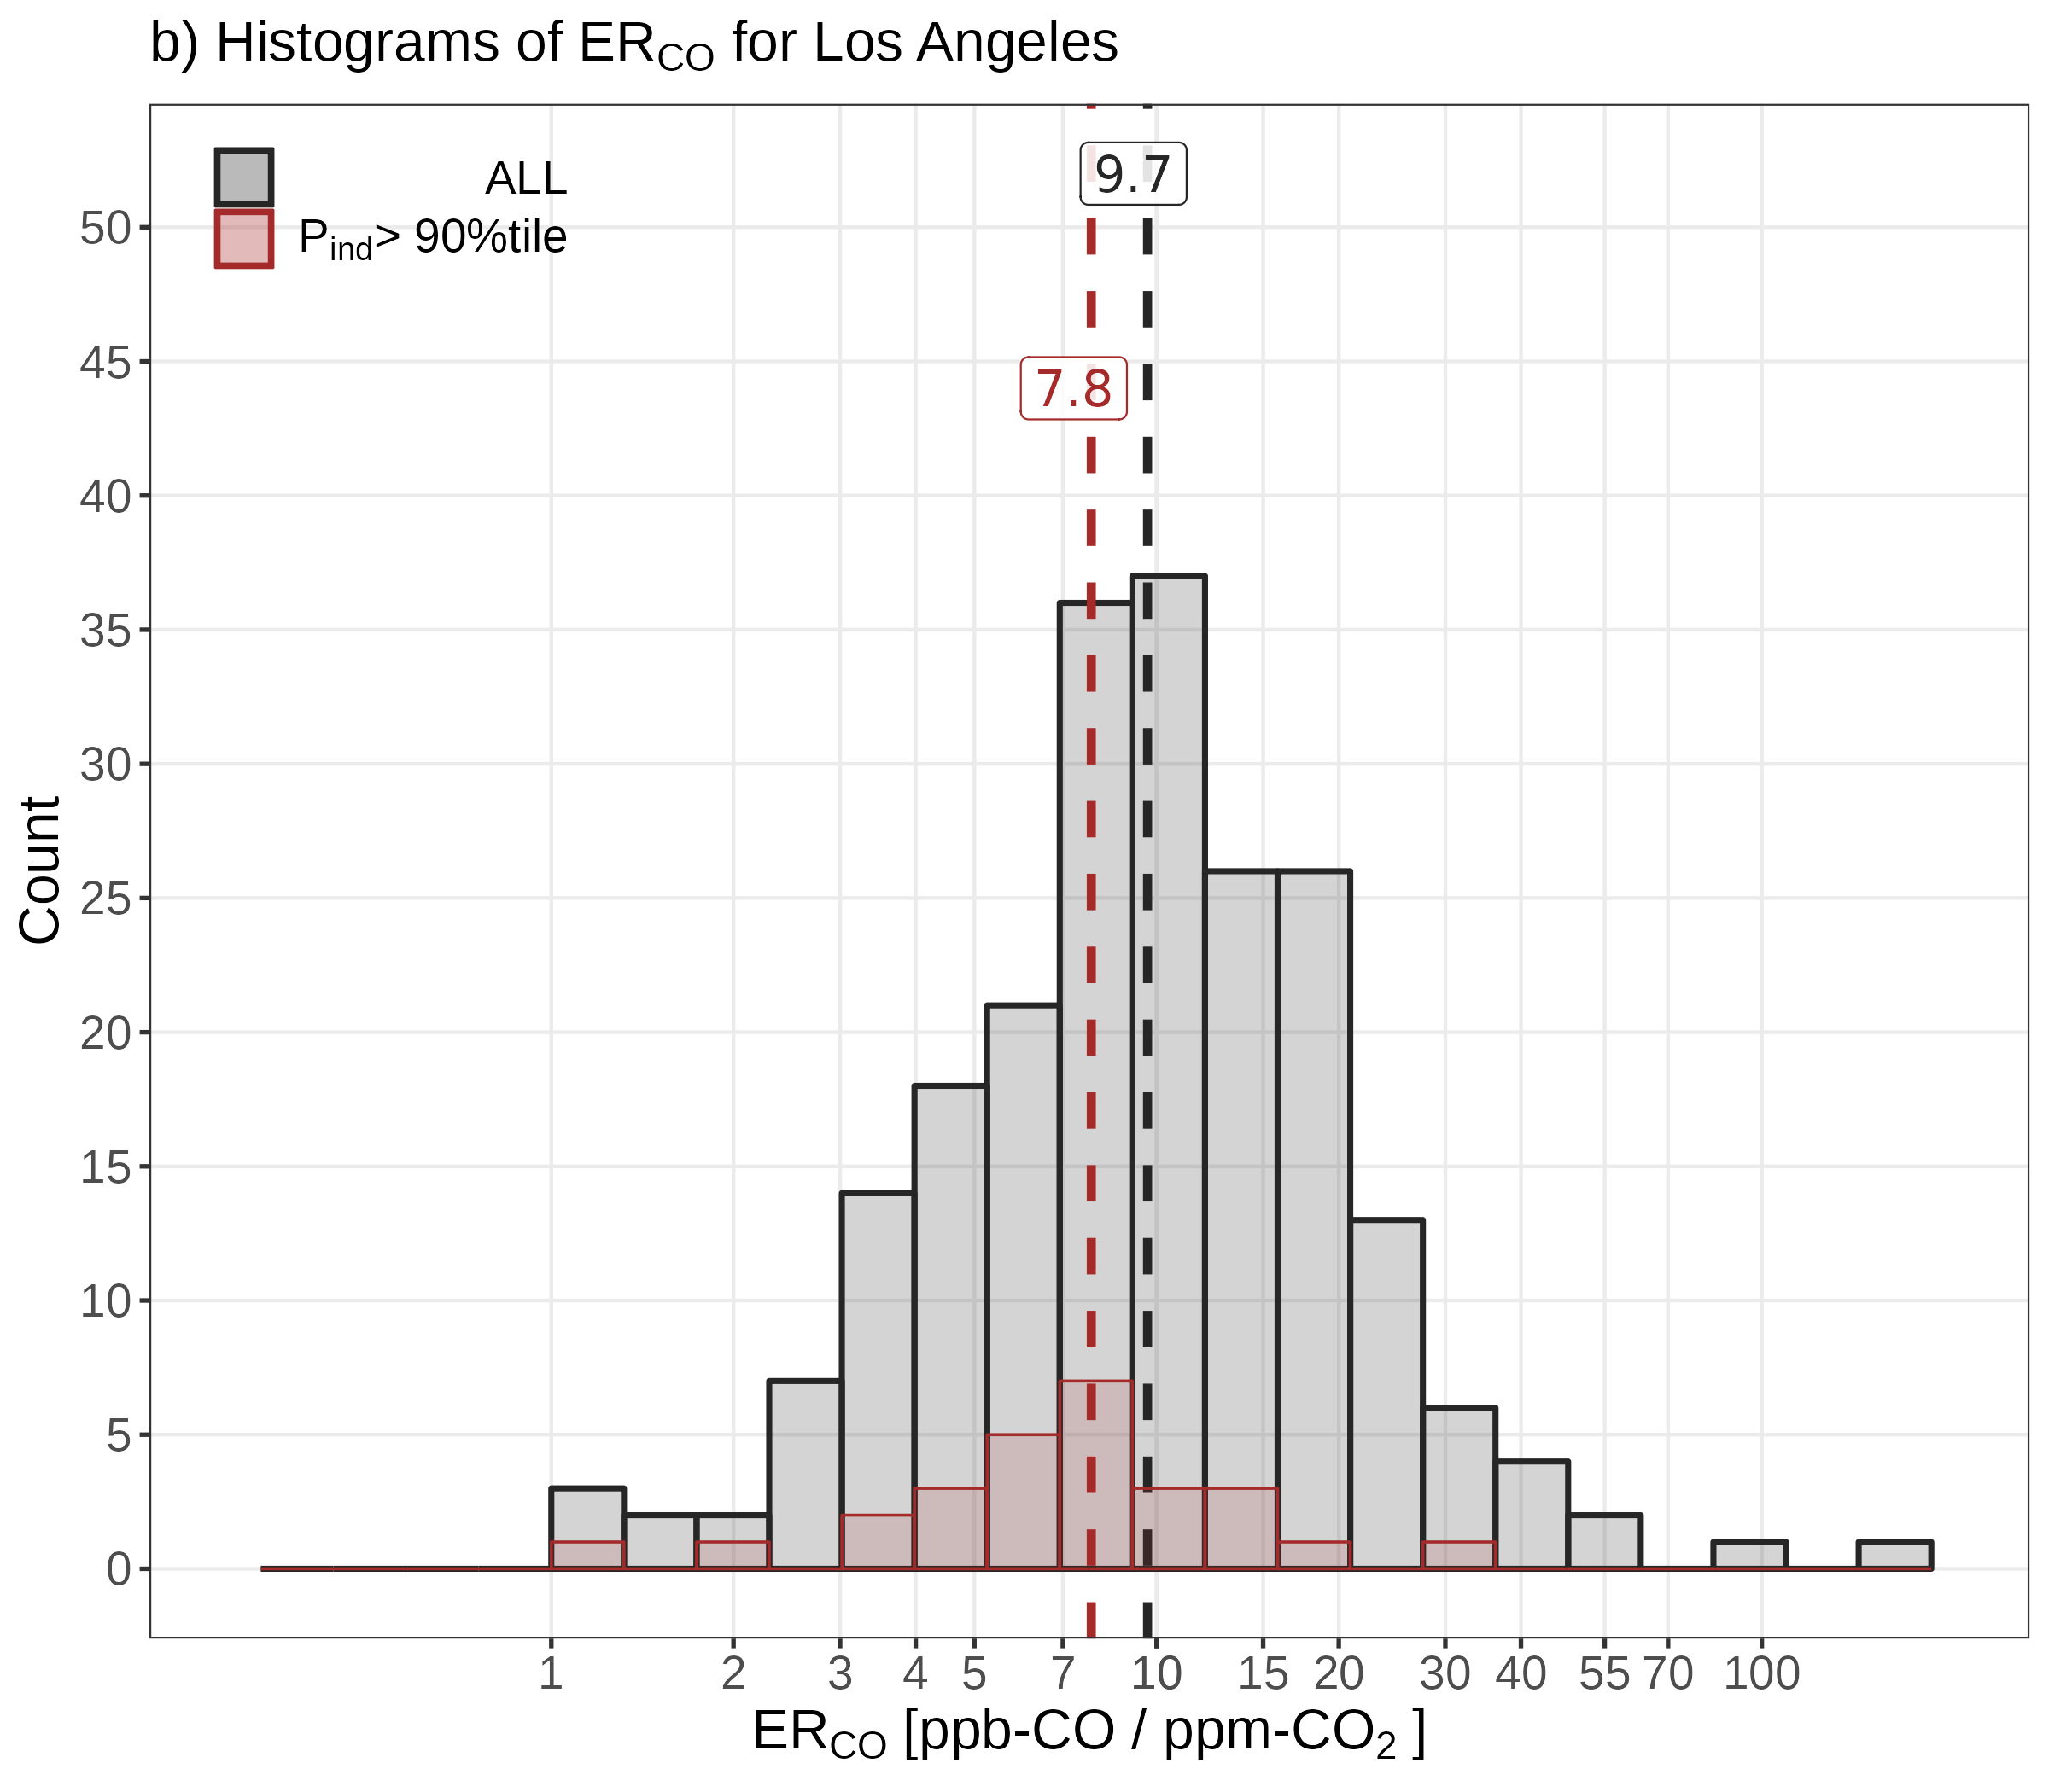
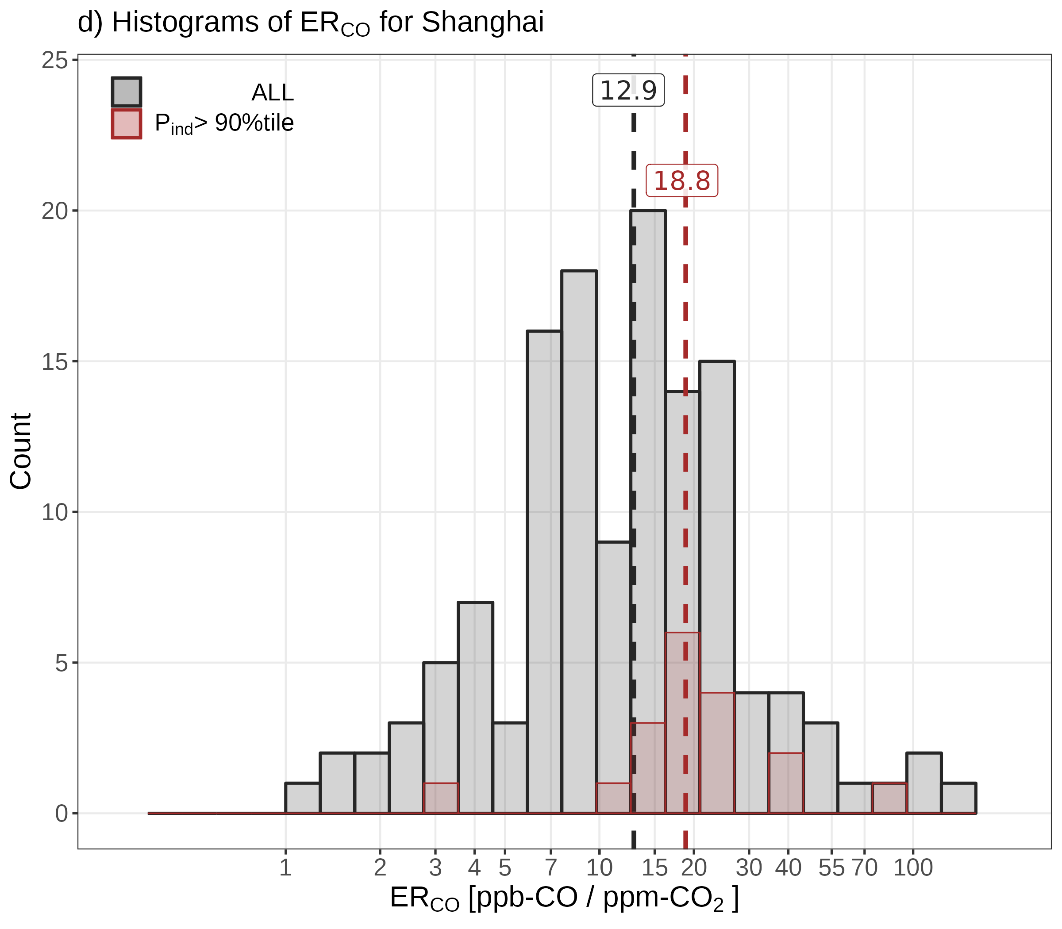
Sector-based Attribution Using intra-city Variations in Space-based Emission Ratios
CO2 from OCO-3
CO from TROPOMI
9.6
12.9
Wu et al., 2022
Histogram of emission ratio of CO:CO2 for all soundings in LA and Shanghai (gray bars) and for only soundings that are strongly affected by heavy industries in cities (blue/red bars).
Emission ratios dominated by heavy industry in Shanghai (e.g., iron & steel productions) are much higher than the city mean.
Dense observation coverage is critical to capture the CO2 gradients within the city.
Notes:
12
You may add comments here to clarify the work or the results.

Slide 13
Challenges and Future Directions
Limited observational coverage due to cloud and aerosol
Validation of urban emissions
  Urban testbed (e.g., Northeast Corridor, INFLUX)
  Multiple EM27s across urban domes
Sectorial attributions (e.g., AQ and GHG, inventory information)
Atmospheric transport at regional scale
Use data from multiple satellites (GOSAT-GW, CO2M, OCO-2/3 )
  Standardize data format
  Cross validation and calibration

Slide 14
Large-scale Natural Carbon Fluxes
Unit: gC/m²/day
CO2 sinks offset 50% of emissions;
The observations need to have a global coverage and high accuracy and precision to capture the signals from natural carbon fluxes. (area mappers)
Long time scales of carbon-climate feedbacks
10³
10²
Fires and land use
Extreme climate events
Intensity
10
10⁰
Terrestrial biosphere
10⁻¹
Air-sea carbon fluxes
10⁻¹
1
10¹
10²
10³
10⁴
Unit: km²
Spatial Scales

Slide 15
Large Ranges in Spatial Scales and Magnitudes among Major Sources and Sinks of CH4
Unit: kg /hr
The observations need to have a global coverage and high accuracy and precision to capture the signals from diffused sources
Long time scale, respond and feedback to climate
10³
10²
Intensity
Biomass and Biofuel burning (5%)
10
10⁰
Combined wetlands and inland waters (climate change, extreme events) (28~37%)
10⁻¹
OH sink
10⁻¹
1
10¹
10²
10³
10⁴
Unit: km²
Spatial Scales
Notes:
Power plants (scale, intensity), cities (emissions), fires, forest (emissions), drought (intensity)

Slide 16
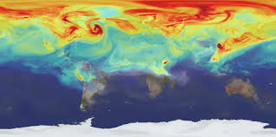
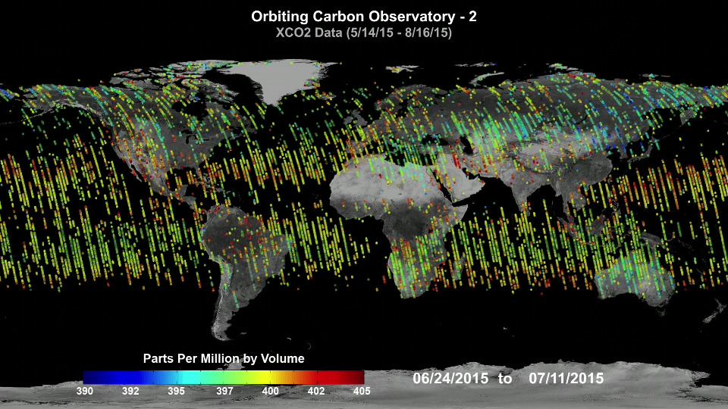
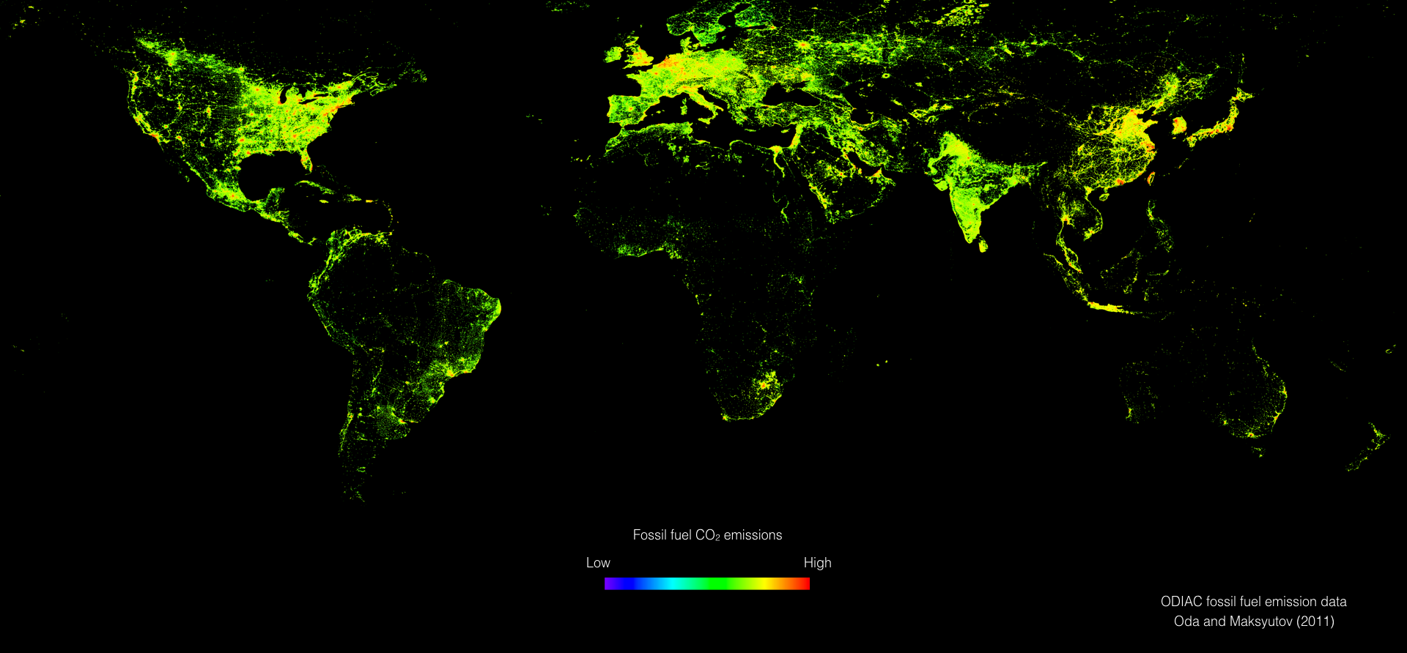
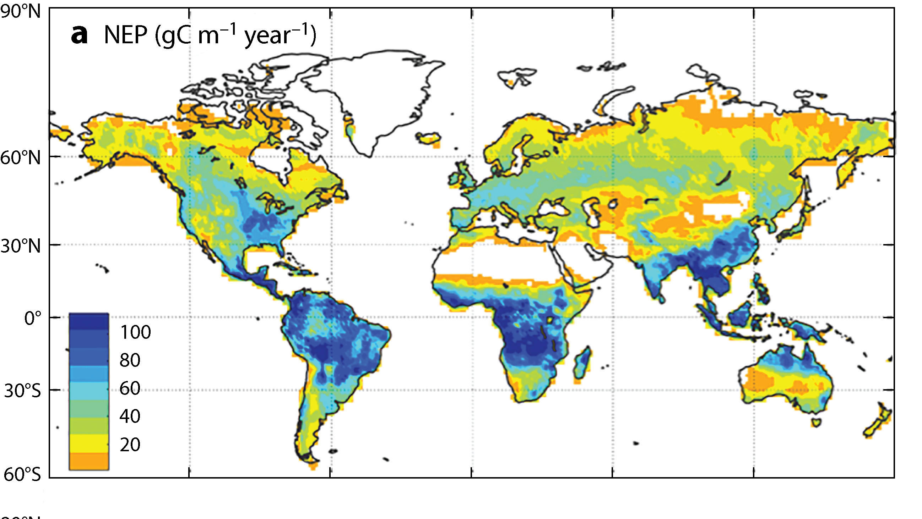
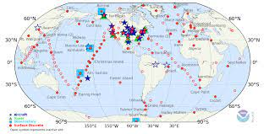
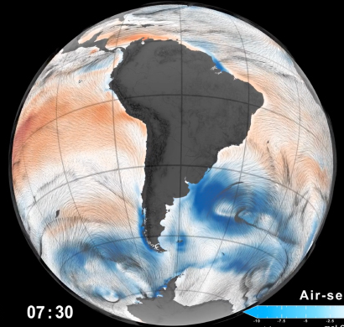
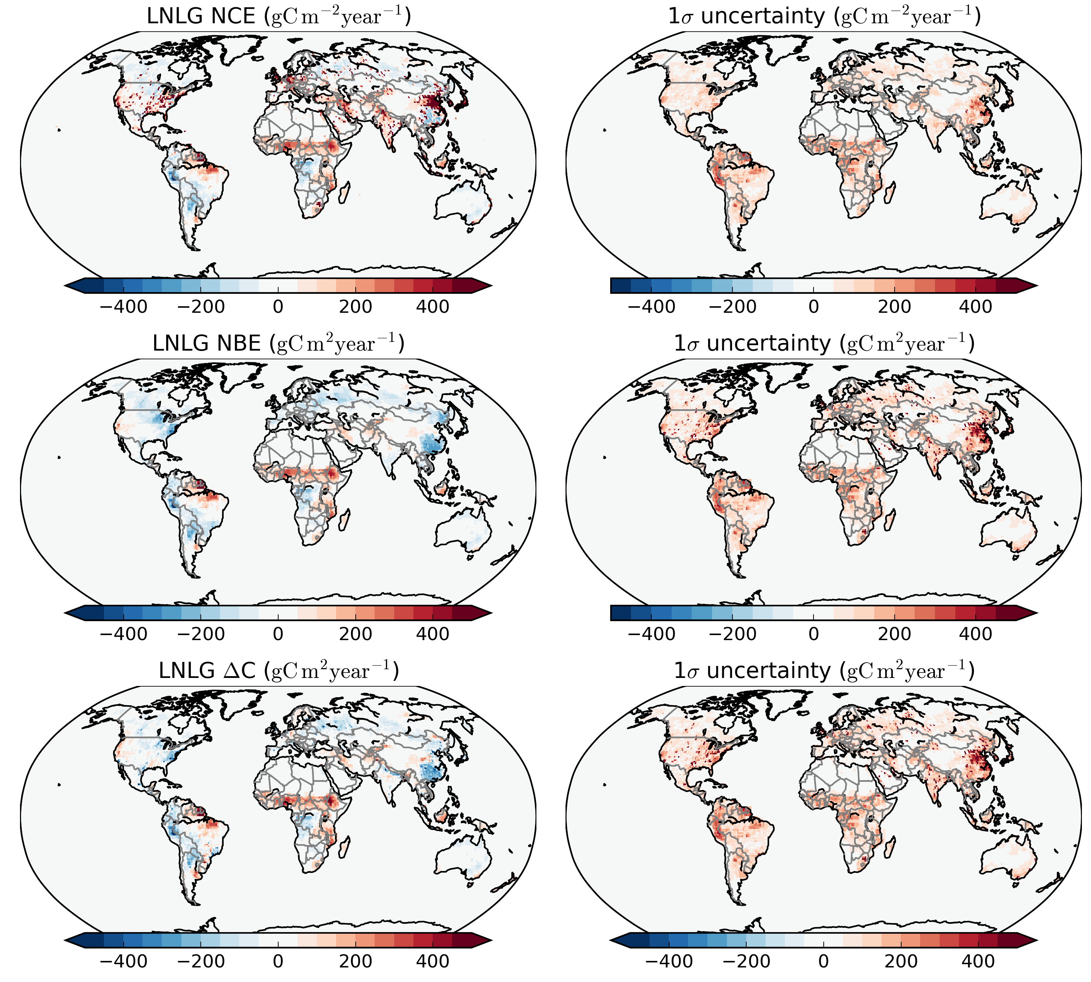
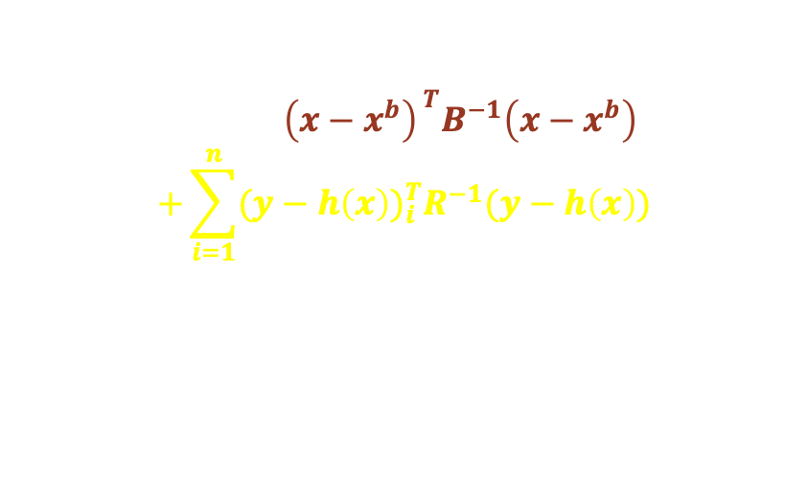
Inferring Natural Carbon Fluxes with Atmospheric CO2/CH4 Observations
Atmosphere Transport Model
Bottom-up models and uncertainties
GHG observations
(e.g., flask, OCO-2)
CO₂ frm OCO-2 and GOSAT
Simulated CO2 concentration
Atmospheric inverse model
$$J\left(x\right)={\left(x−x^{b}\right)}^{ T}B^{−1}\left(x−x^{b}\right)$$
$$+\sum_{i=1}^{n}{{{(y−h\left(x\right))}_{i}^{T}R}^{−1}(y−h\left(x\right))}$$
Science and decision support
Posterior fluxes (CO2, CO, CH4) and uncertainties
Notes:
Where has carbon been absorbed?
B: prior flux uncertainties
R: observation uncertainties,
H: atmospheric transport model

Slide 17
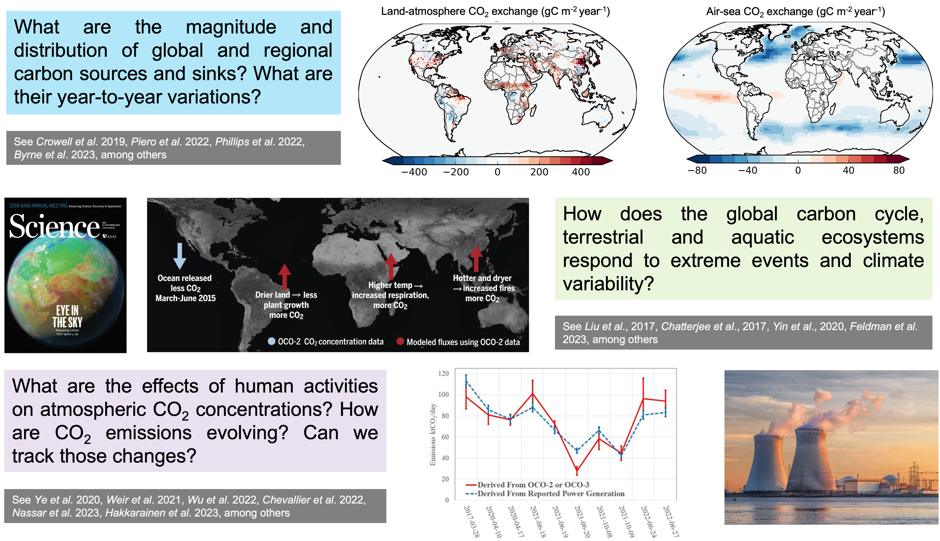
The Spatial Distributions of CO₂ Sources and Sinks over Land and Ocean
Fossil Fuel + Terrestrial biosphere fluxes
Ocean fluxes
gC/m²/year
gC/m²/year
Annual mean fluxes averaged over 2015-2020;
It is the average over 13 top-down inversion models that have different assumptions of prior fluxes, prior flux uncertainties. These models use different transport models and inversion methodologies.
Byrne et al., ESSD 2022,

Slide 18
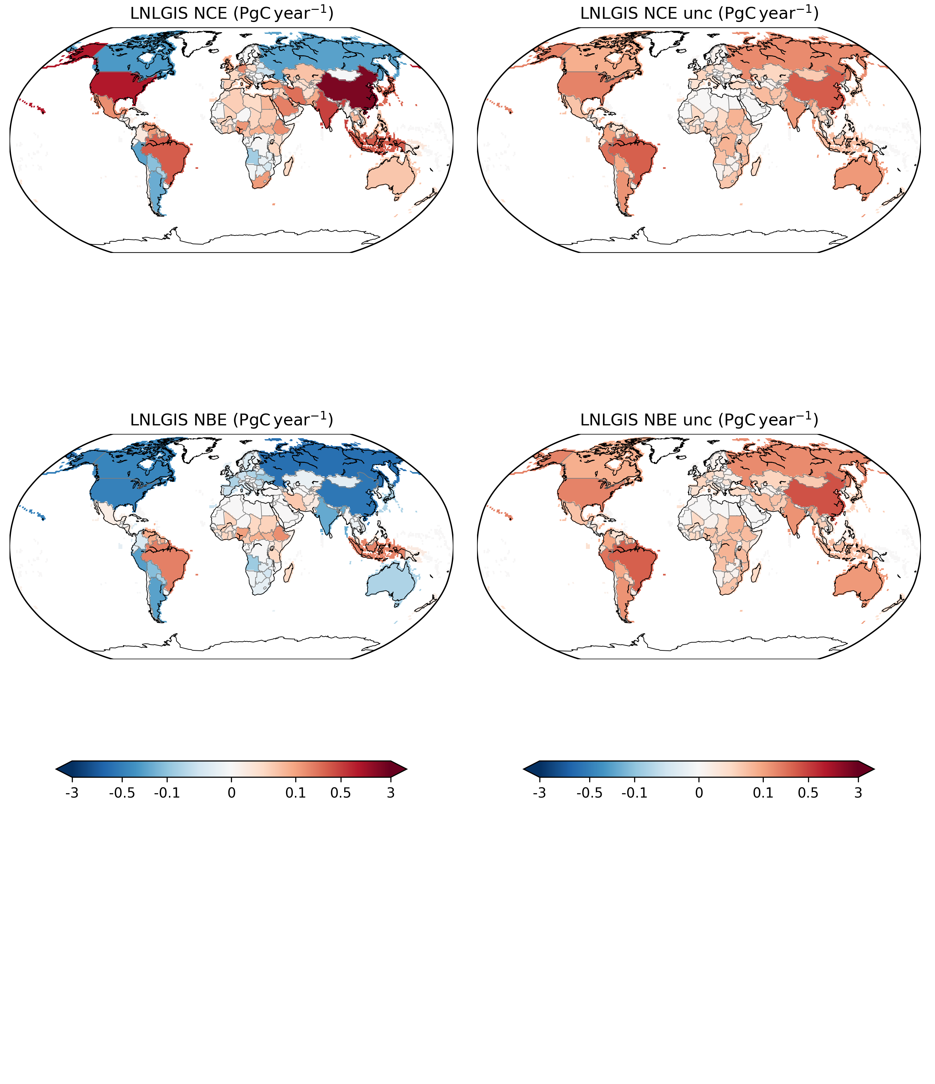
Country-scale Carbon Budget
Fossil + natural land carbon flux (GtC/year)
Uncertainties (GtC/year)
Negative: sink;
Positive: source.
Uncertainties of net carbon exchange at country scale are dominated by the uncertainty in natural carbon fluxes;
Uncertainties are large over small tropical countries and the tropics;
Uncertainties are the spread among 13 models, so it includes uncertainties from transport, priors, observations, inversion methodology, fossil fuel, etc.
Byrne et al., ESSD 2022,

Slide 19
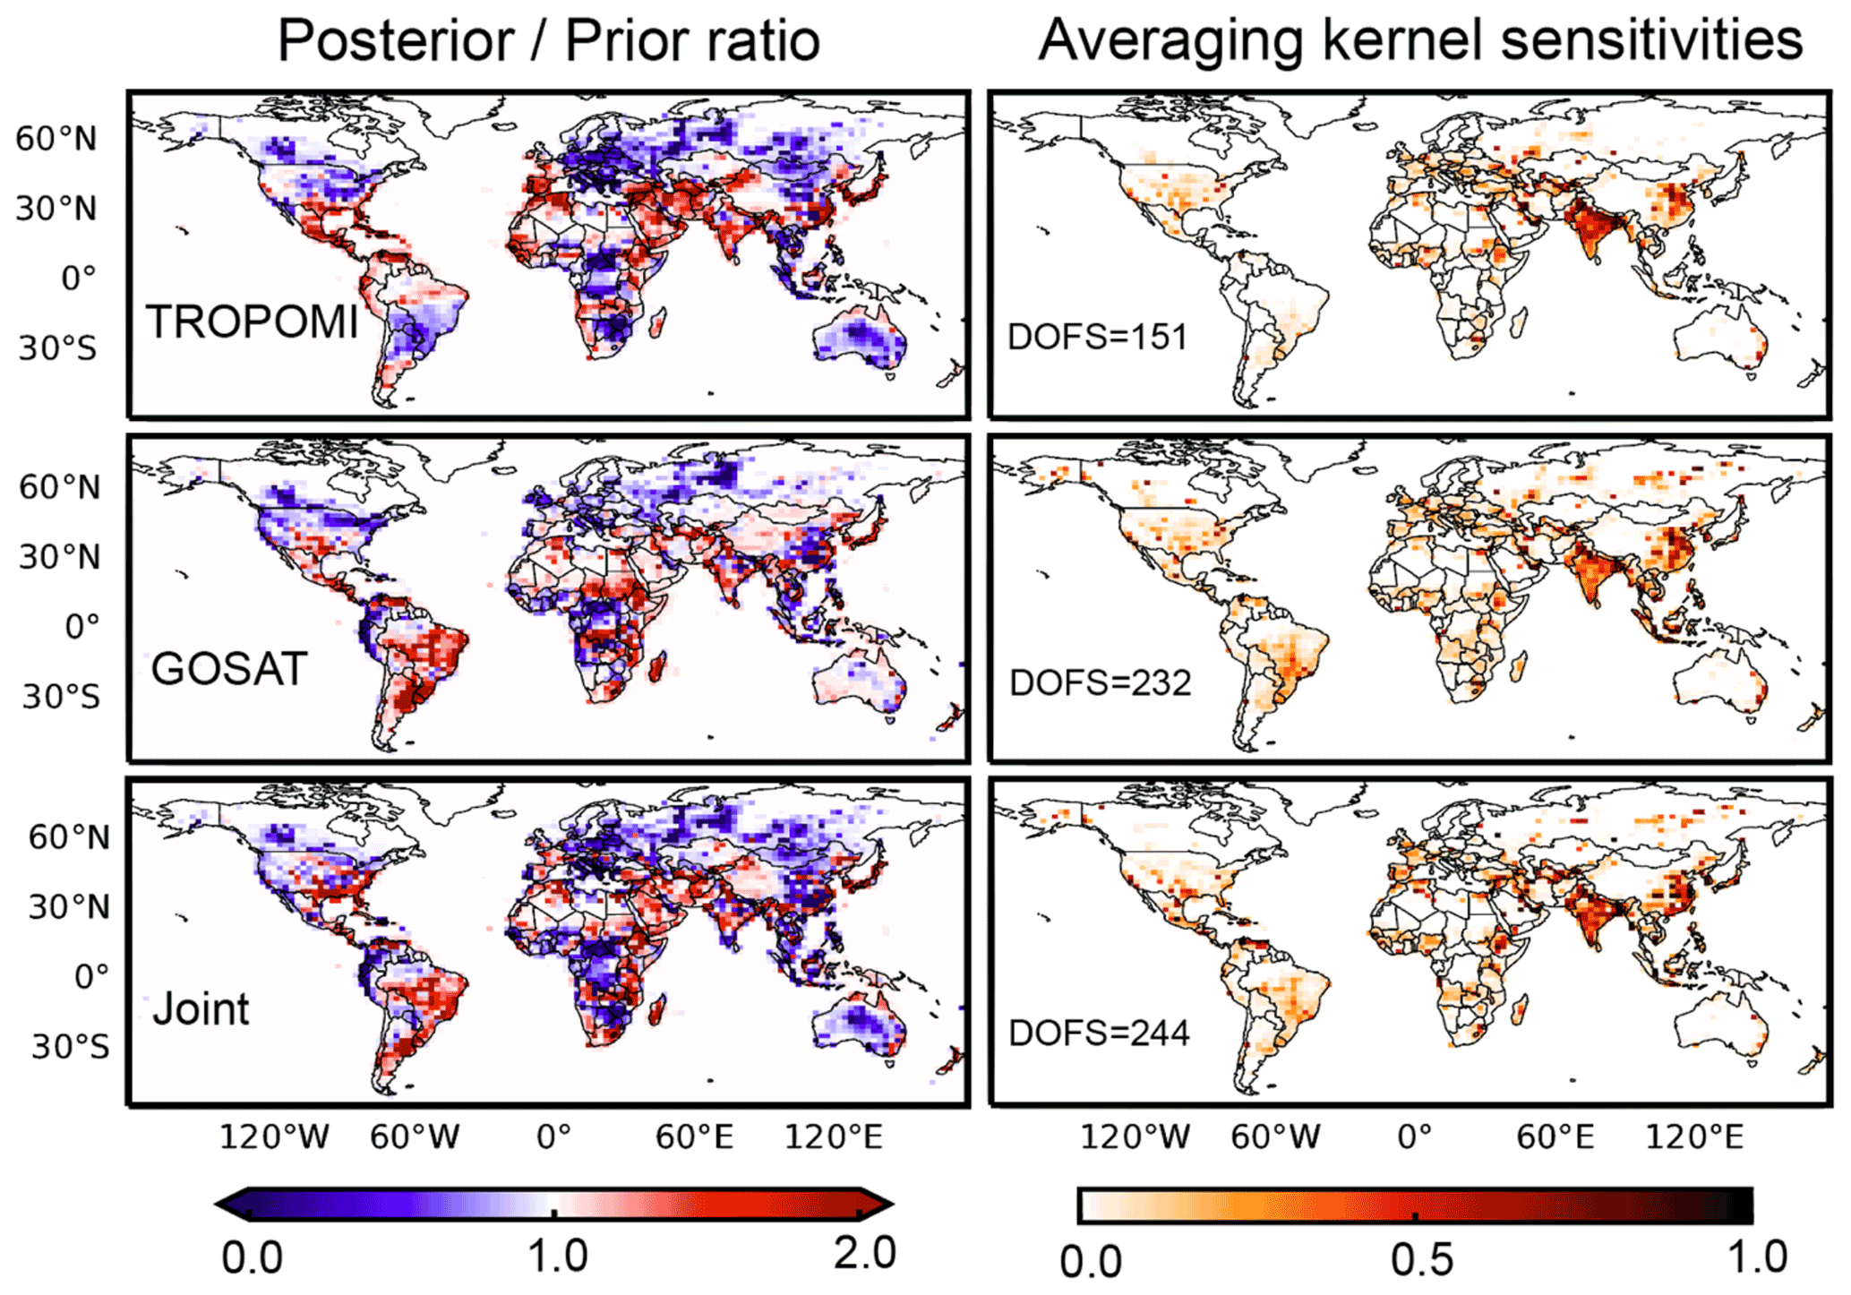
Global CH4 Emission Estimation with GOSAT and TROPOMI
The averaging kernel (AK) sensitivities measure the ability of the observations to constrain the emissions (1=fully; 0=not et al).
Satellite observations have less constraint over the tropics.
Qu et al., 2021

Slide 20
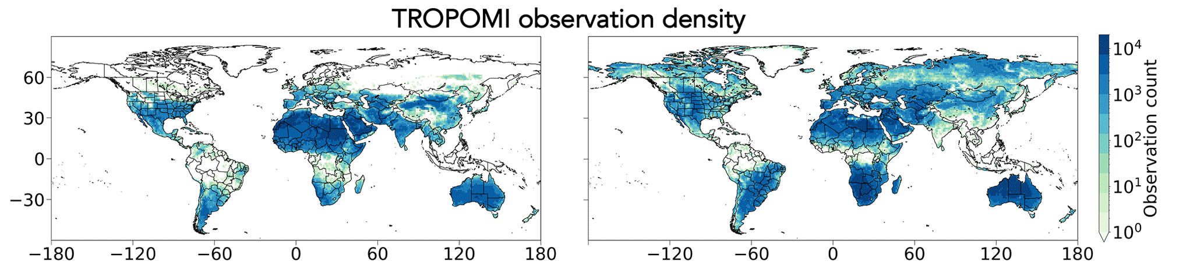
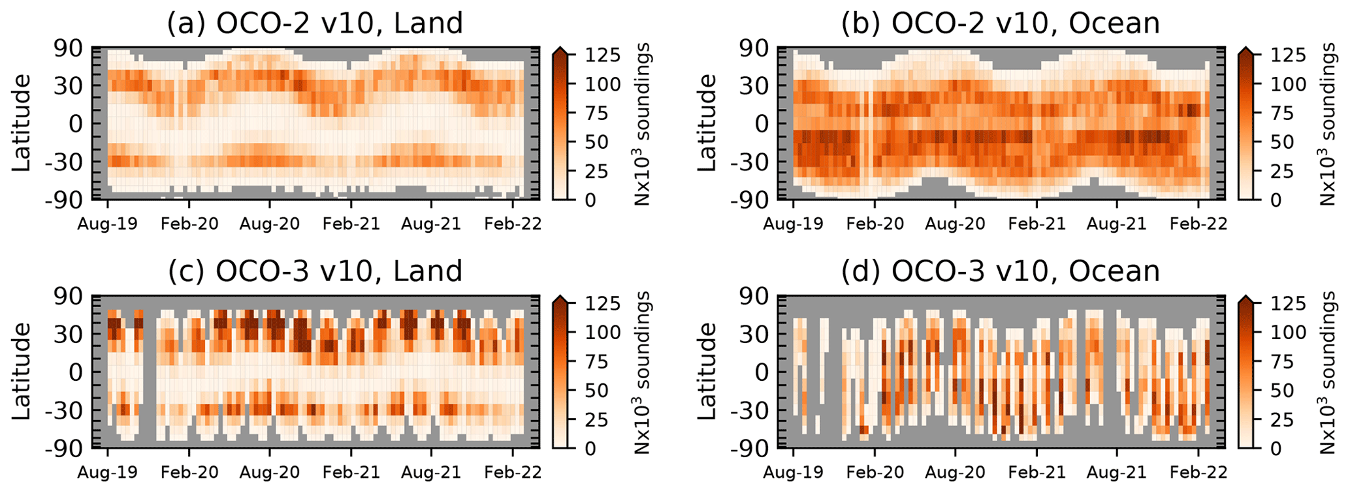
Observational Gaps from Passive Sensors
The numbers of CH4 observations from TROPOMI
DJF (2019-2020)
JJA (2020)
Jacob et al., 2022
The number of OCO-2/3 observations
Taylor et al., 2023
Worden et al., 2021

Slide 21
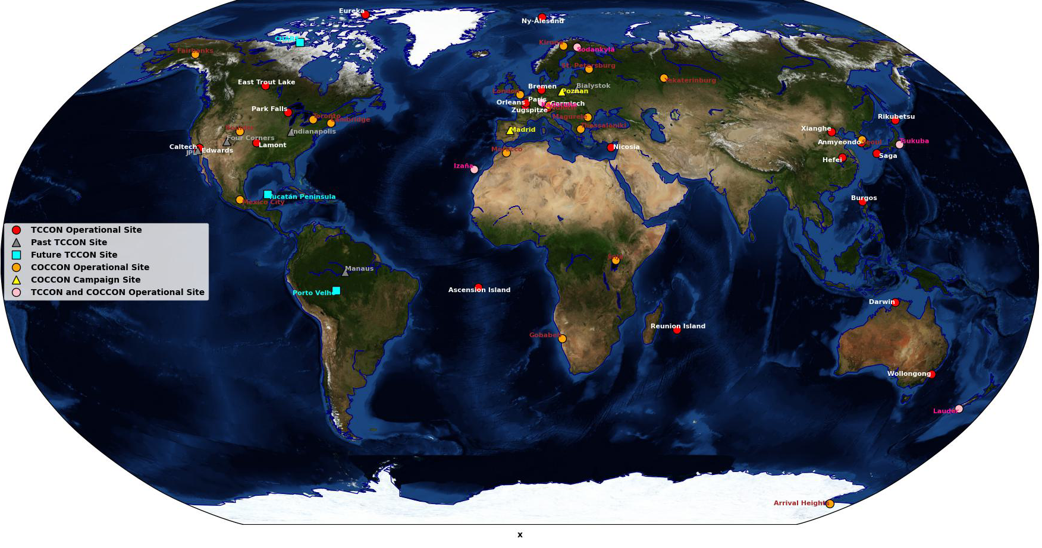
Limited Validation Sites over the Tropics and Ocean
Spatial distributions of TCCON and COCCON network
Fill the validation gaps over the tropics and ocean;
The uncertainty of TCCON is 0.5 ppm; increase the accuracy of the validation dataset.
How to validate the natural carbon fluxes?

Slide 22
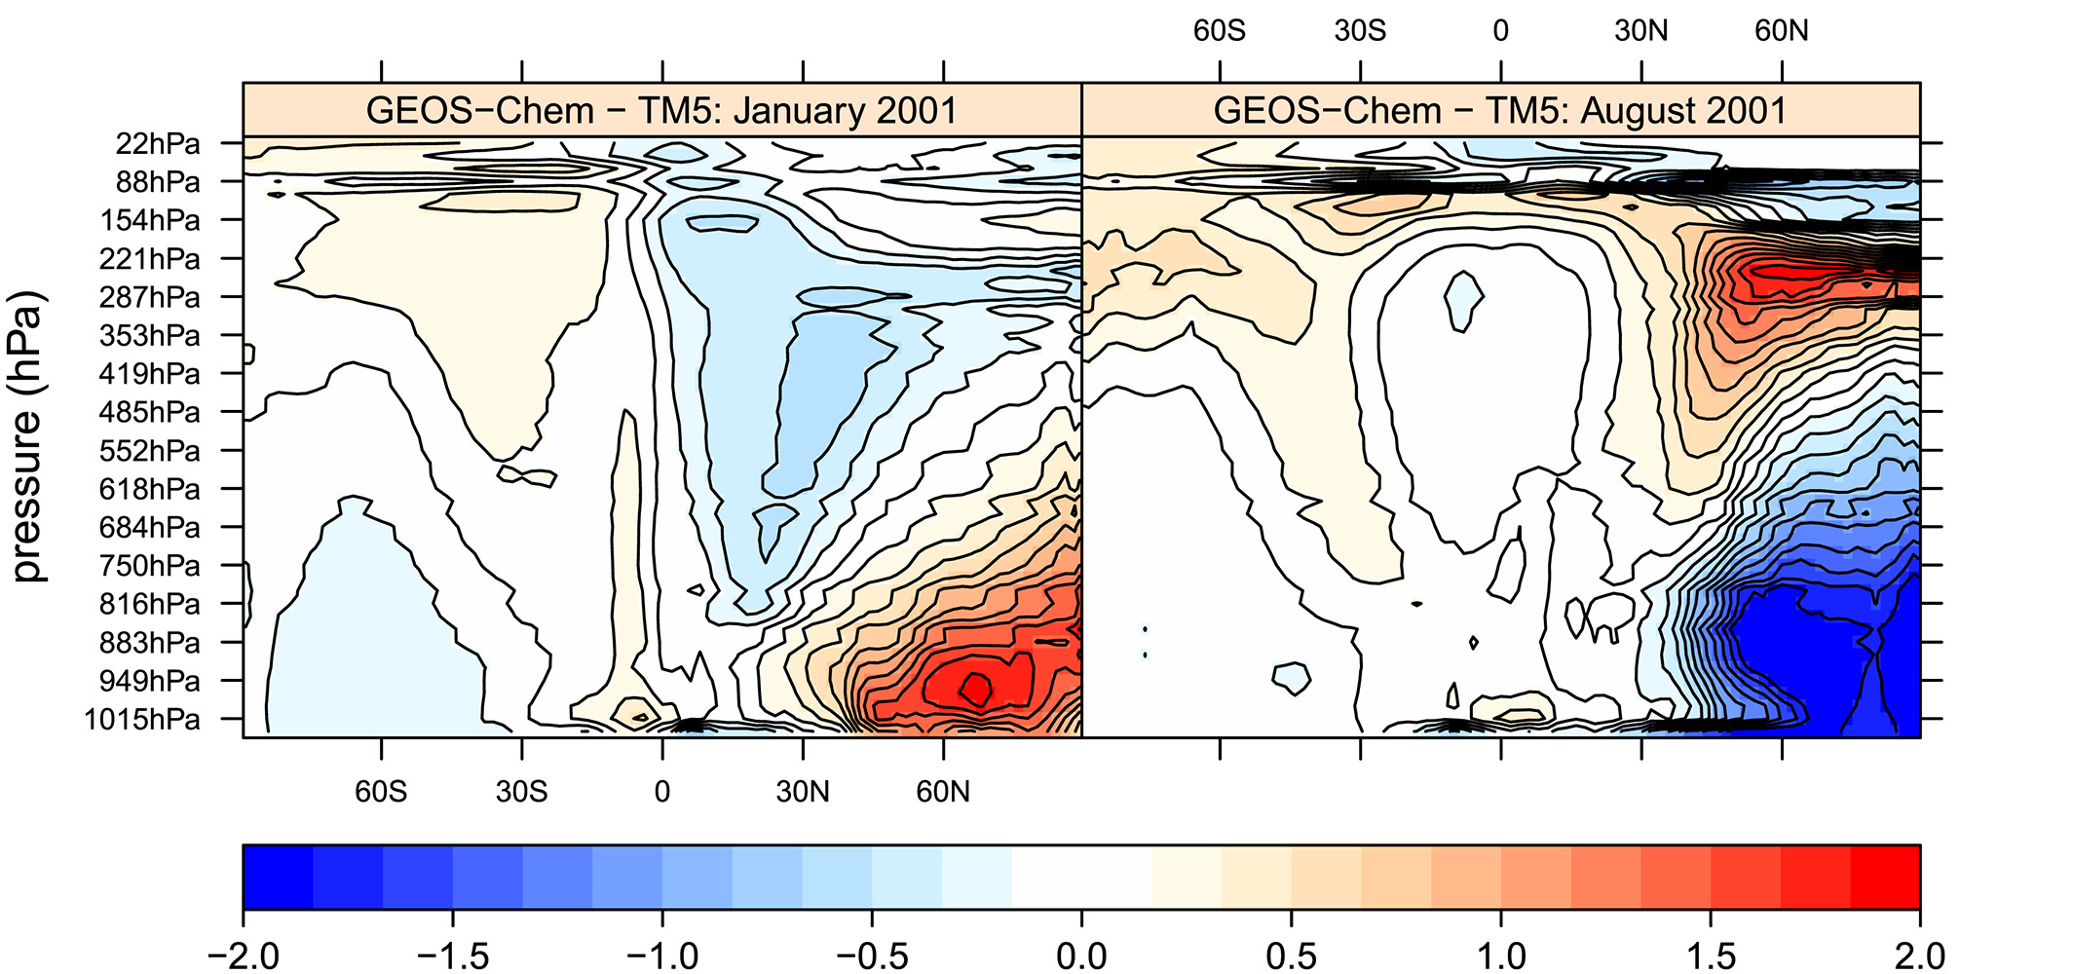
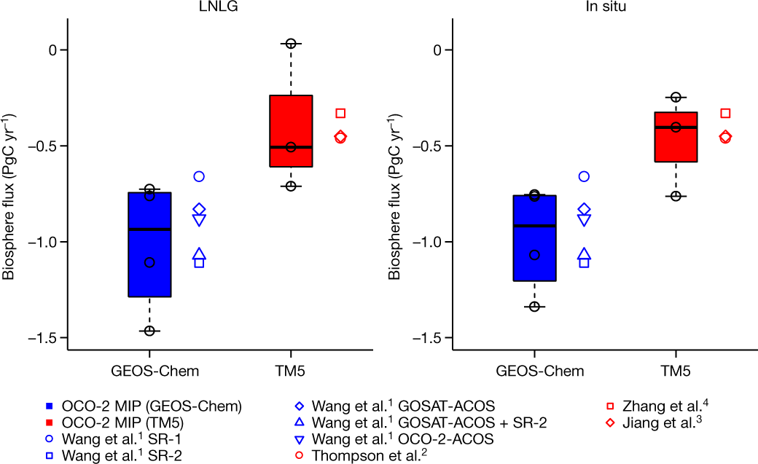
Regional and Large-Scale Transport Errors Remain to be one of the Leading Uncertainties for Natural Carbon Flux Estimation
The differences between GEOS-Chem and TM5 simulated CO2
Chinese Natural Carbon Sink
Satellite
Surface
ppm
Same surface flux forcing for both TM5 and GEOS-Chem model.
The vertical transport of GEOS-Chem is more sluggish.
Schuh et al., 2019, 2022

Slide 23
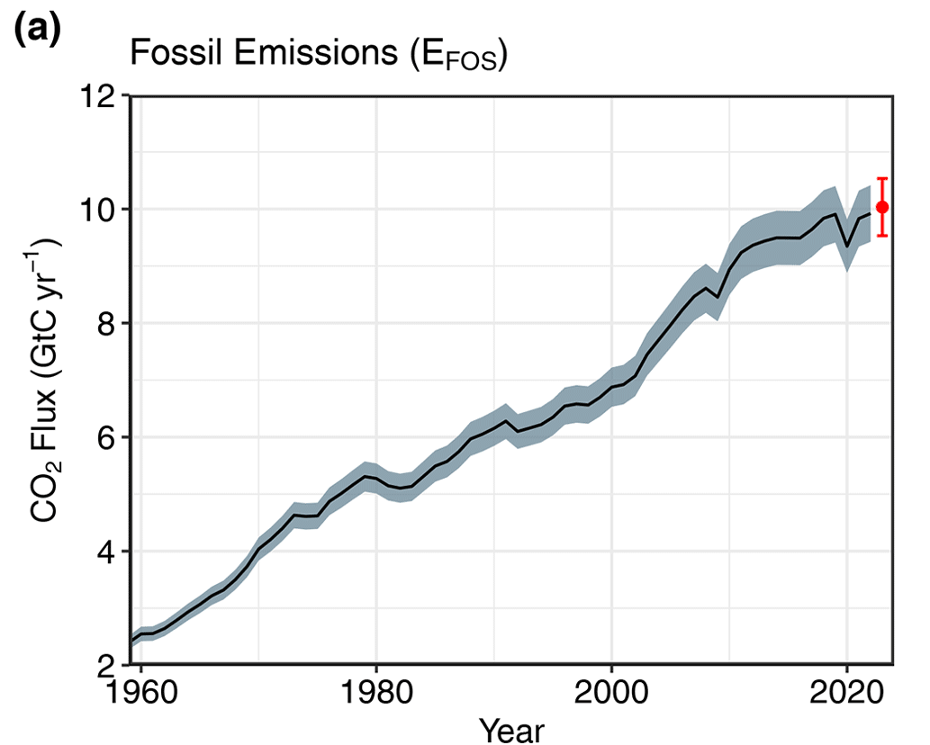
Fossil Fuel Emission Uncertainties
Hogue et al., 2016
Increasing the magnitude of uncertainties in fossil fuel emissions in recent years
Friedlingstein et al., ESSD, 2024

Slide 24
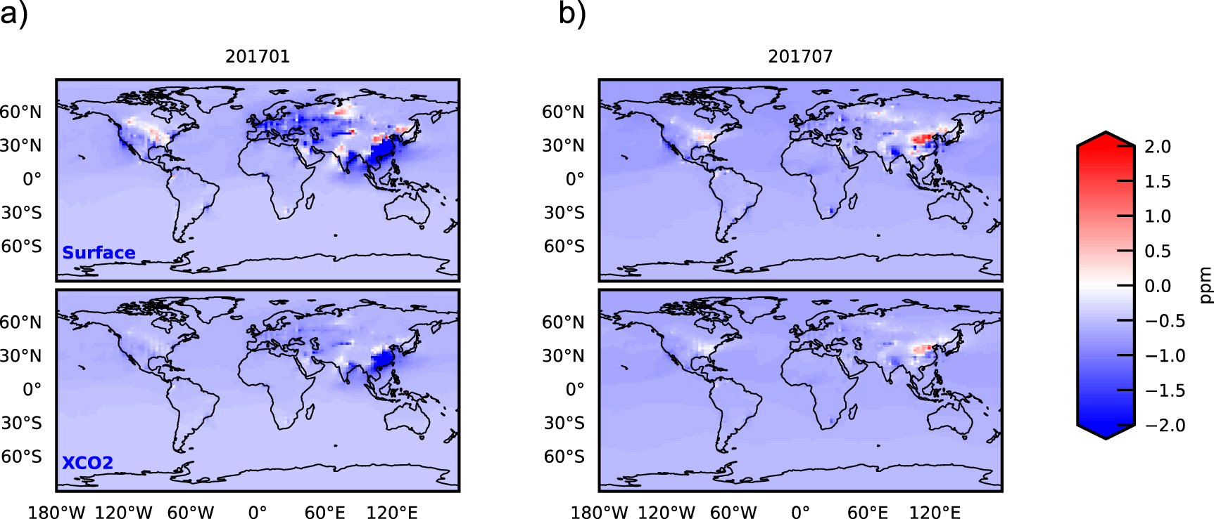
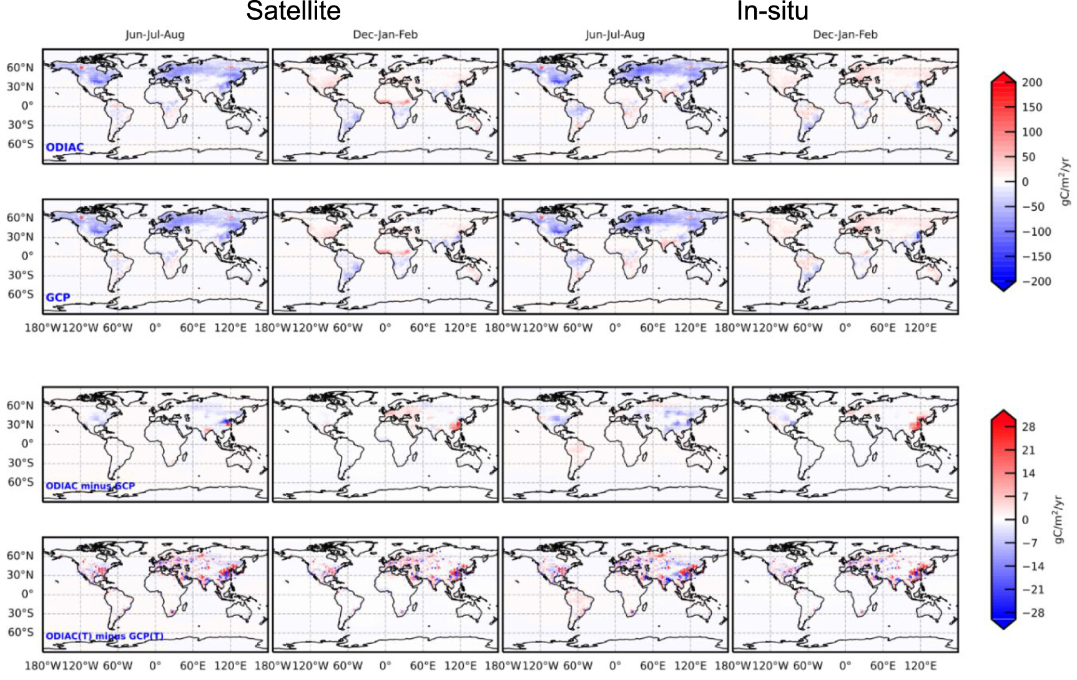
Attribution of Total Fluxes to Fossil and Natural Components
Column CO2 signal in July due to the difference between ODIAC and GCP
Fossil fuel emissions and natural carbon fluxes offset each other.
Biosphere flux estimation differences between ODIAC and GCP
Oda et al., ERL, 2023

Slide 25
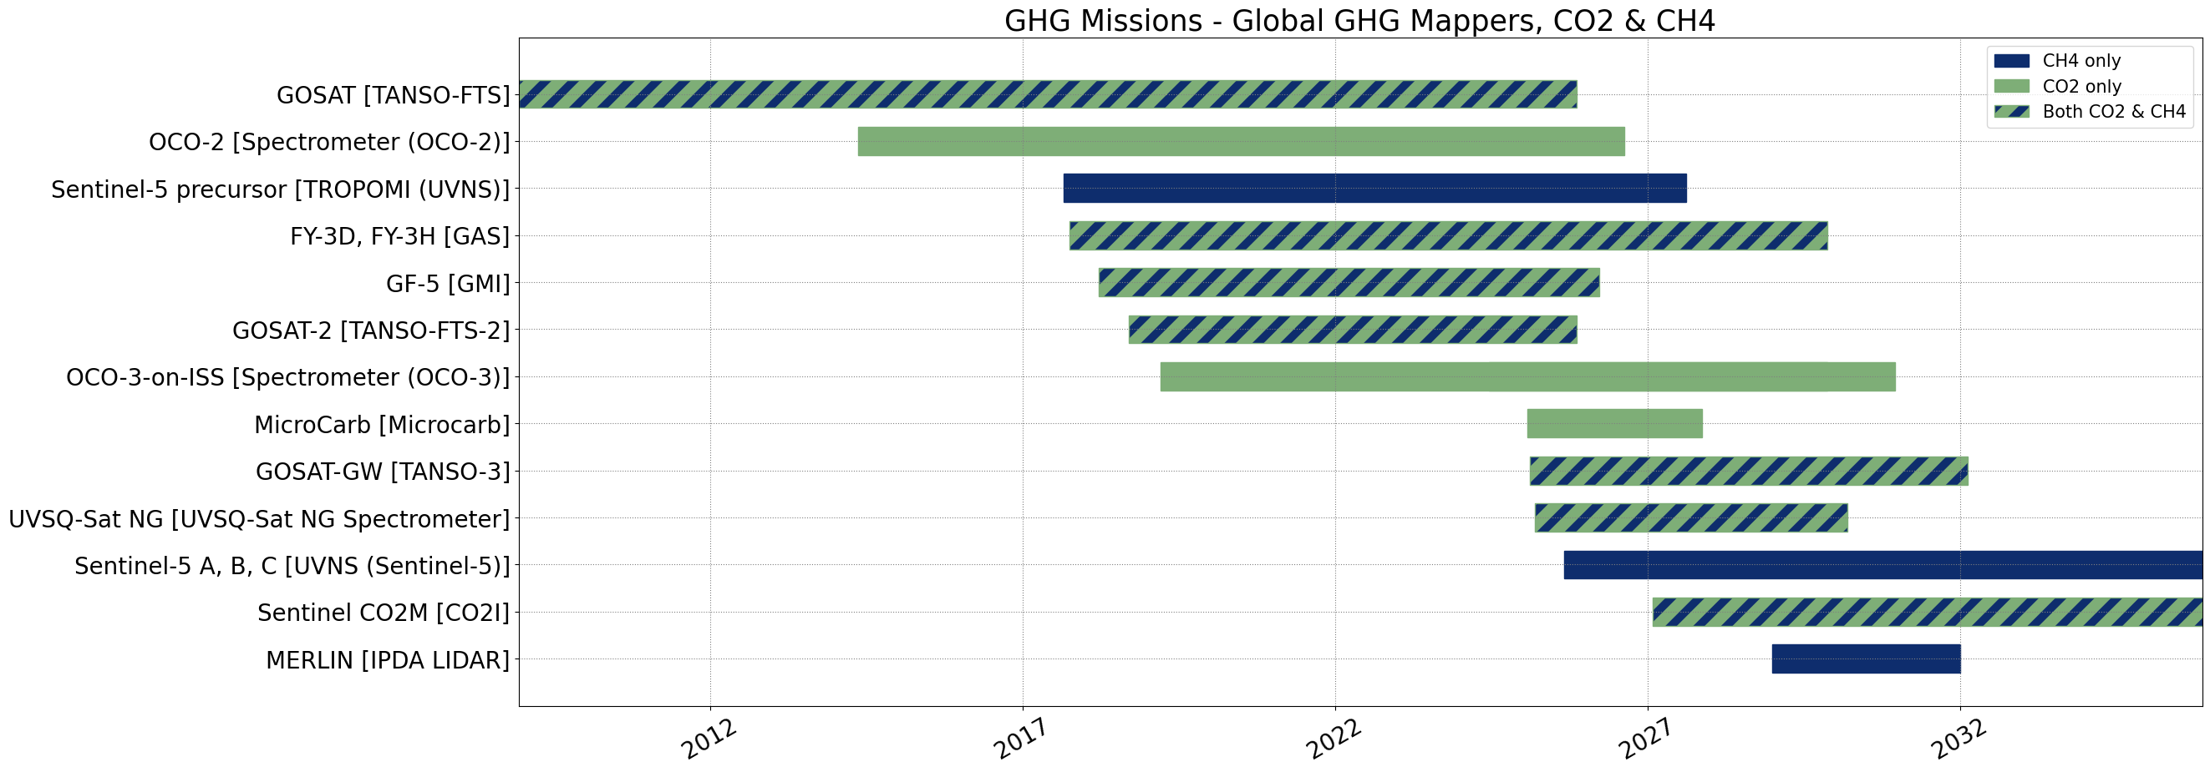
How to Use Observations from Multiple GHG Satellites?
Multiple satellites cover the same time period.
Using data sets from multiple satellites make it possible to investigate long-term trend.
Standardize data format and variables available across agencies;
Validation against the same standard and cross validation;
Dedicated programs to support using observations from multiple space agencies

Slide 26
Challenges Future Directions for Large Scale Natural Carbon Fluxes
Observational gaps over the tropics and high latitudes;
Needs validation data over critical regions(e.g., tropics and ocean)
Long-term observing strategy to quantify trend and interannual variabilities;
Atmospheric transport at regional and global scale
Attribution of net carbon fluxes to natural and anthropogenic components
Use data from multiple satellites (GOSAT/GOSAT2, GOSAT-GW, CO2M, OCO-2/3 )
  Standardize data format
  Cross validation and calibration
  Dedicate program to use observations from multiple space agencies

Slide 27
Summary of current and future satellite observations for balancing the global carbon budget: Large Point Sources
Large point source, super emitters (>100kt/hr for CO2; 100kg/hr for CH4) (30% of CO2 emissions; ~20% of CH4 emissions)
  Carbon Mapper, EMIT, MethaneSAT
  60-80% of emissions can be detected.
  Validation (e.g., control release) and cross validation among different satellites.
  Winds are the major source of uncertainties

Slide 28
Summary of current and future satellite observations for balancing the global carbon budget: Urban Emissions
Urban emissions (~70% of CO2 fossil fuel emissions)
  Large urban domes: OCO-2, OCO-3, GOSAT, GOSAT-2, TROPOMI CO2M, GOSAT-GW
  Aerosols and clouds are the major factors affecting the throughput and major sources of uncertainties for CO2 retrievals.
  Targeted validation strategy (e.g., multi EM27s, aircraft flights, and urban testbeds)
  Atmosphere transport error is one of the major sources of uncertainties
  Smaller footprint area mappers may be needed to quantify smaller-size cities

Slide 29
Summary of current and future satellite observations for balancing the global carbon budget: Natural Carbon Fluxes
Natural carbon sources and sinks
  Smaller intensity and diffused signal, requires measurements of high accuracy and precision.
  OCO-2, OCO-3, TROPOMI, GOSAT, GOSAT-2, GOSAT-GW, CO2M
  Long-term observations to detect trend and interannual variability
  Aerosols and clouds are the major factors affecting the throughput and major sources of uncertainties for CO2 retrievals.
  Lack of observations over the tropics, especially during wet season, and high latitudes.
  Needs validation data over critical regions, such as the tropics and ocean.
  Limited use of satellite observations in ocean carbon flux estimation.
  Atmospheric transport error is one of the major source of uncertainties.
  Better attribution of total fluxes to fossil and natural component.
  Detecting the impact of extreme climate anomalies.
Use data from multiple satellites and observing platforms

Slide 30
Backup

Slide 31
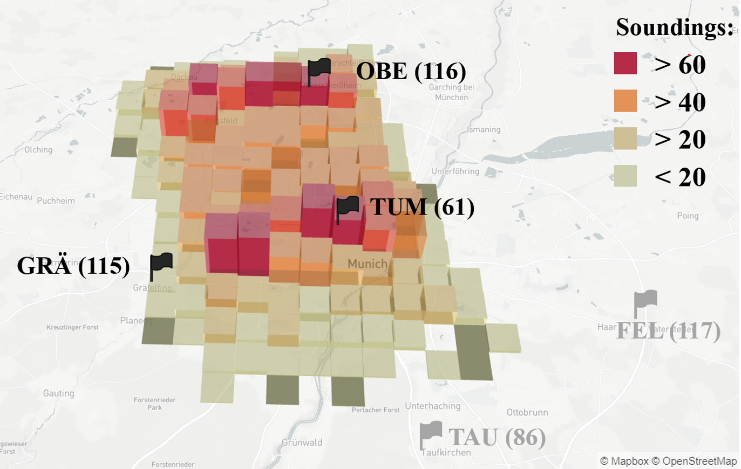
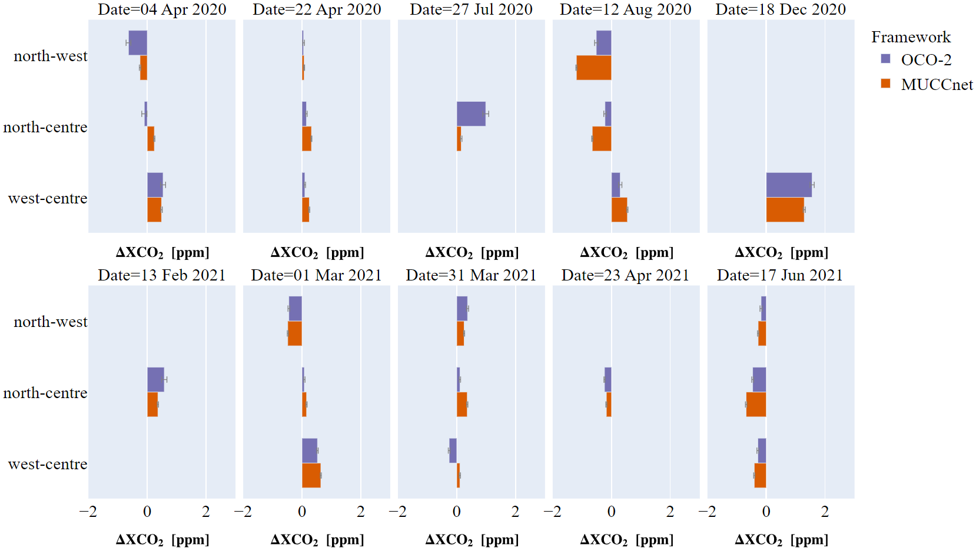
How to Validate Urban Emissions?
Validation of Urban XCO2 Gradient over an Urban Dome with MUCCnet
OCO-2 target observations capture the XCO2 spatial differences observed by MUCCnet.
Urban testbeds to directly validate emission (e.g., INFLUX testbed, Northeast corridor )
Rißmann et al., 2022

