Slide 1
GHG Roadmap
Issue 2
Yasjka Meijer, ESA GHG Task Team Lead
Agenda item 4.02
AC-VC, Washington 17th October 2024

Slide 2
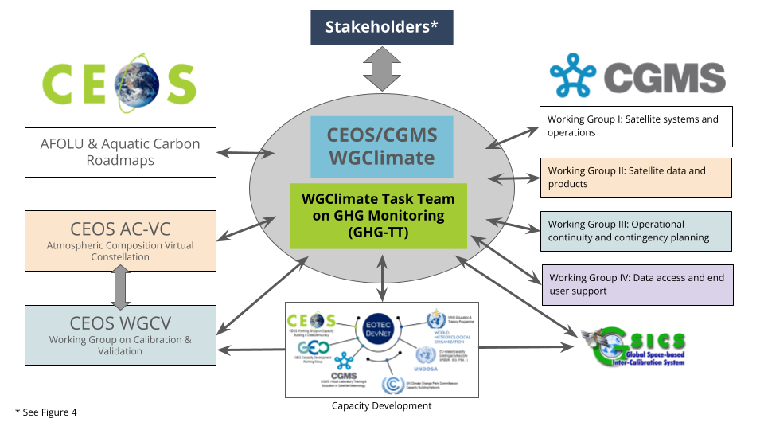
GHG Task Team - Recall
Greenhouse Gas Task Team (GHG TT) is part of joint CEOS-CGMS WGClimate
Responsible for maintaining and implementation of the GHG Roadmap
Coordinates GHG related activities across various (CGMS &) CEOS WGs: WGClimate, WG-CalVal, AC-VC, WGCapD, NewSpace Task Team, etc
GHG Roadmap issue 1 is from March 2020 and followed from recommendations in GHG White Paper

Slide 3
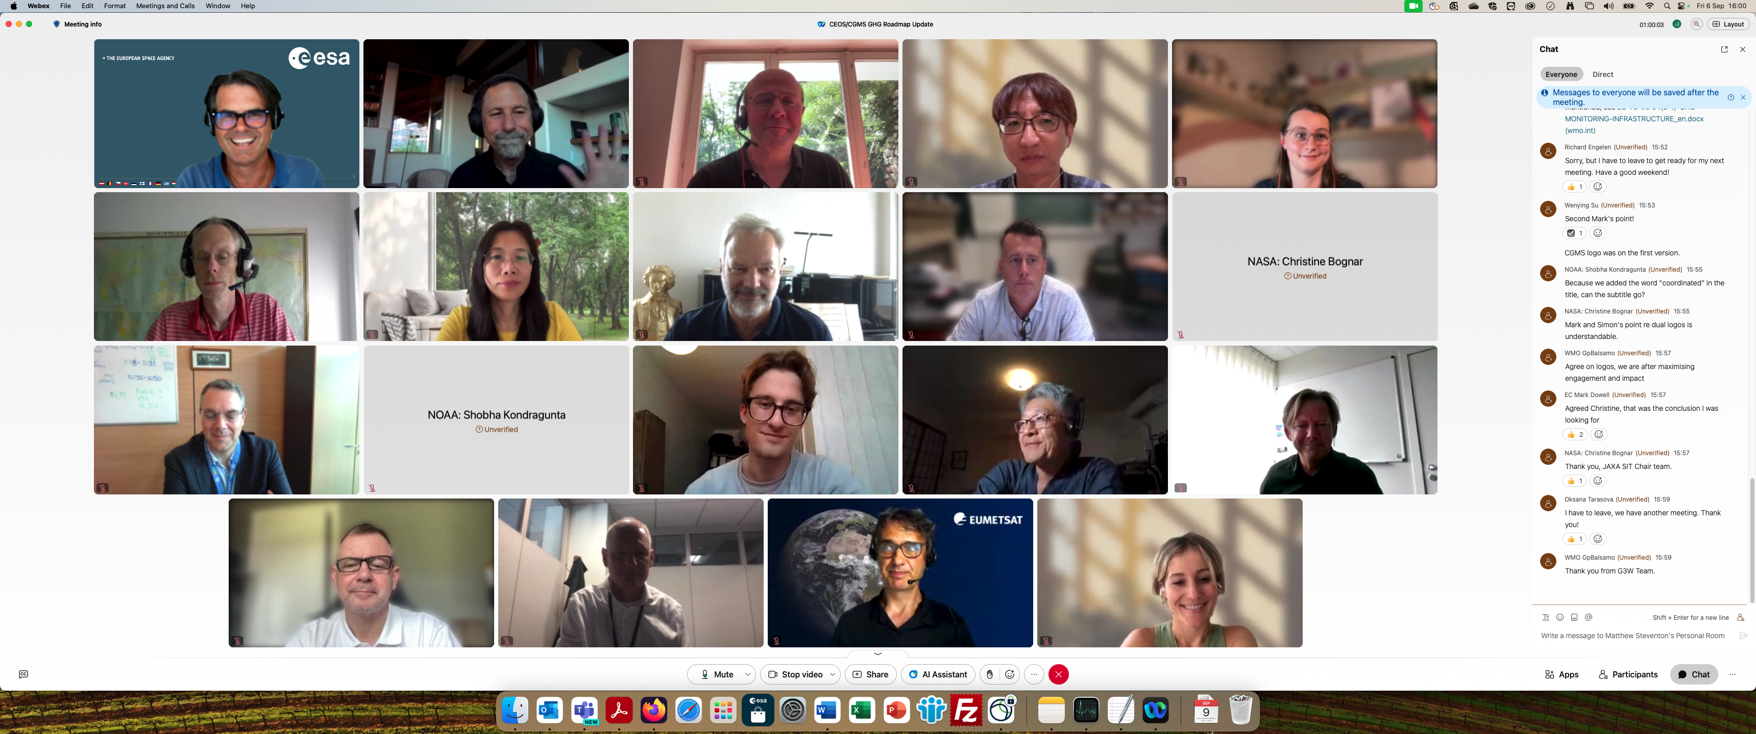
GHG Roadmap – Issue 2 – drafting
Decision at SIT-39 to update GHG Roadmap
Since Tokyo, an outline was drafted and followed by biweekly GHG TT meetings
In June, we coordinated with CGMS WGs
At CGMS-52, Simon Elliott was appointed as PoC to coordinate CGMS’ input
A real team effort and until the last telecon well attended →
Special thanks to Dave Crisp & Libby Rose for drafting issue 2
CEOS SIT-39 DECISION 03 | SIT-39 agreed that an update of the CEOS GHG Roadmap should be completed for discussion at the SIT Technical Workshop in preparation for potential endorsement at 2024 CEOS Plenary. Note that the document will need to be made available in advance for CEOS Agency review.

Slide 4
GHG Roadmap – Issue 2 – final
Draft issue 2 circulated on 9 Sep (CEOS & CGMS)
Feedback received at SIT-TW, Sydney
Final version delivered on 8th October
Wenying Su will present at CEOS plenary
Endorsement of issue 2 due at CEOS Plenary
Endorsement of issue 2 requested to CGMS
Once fully endorsed issue 2 will be distributed

Slide 5
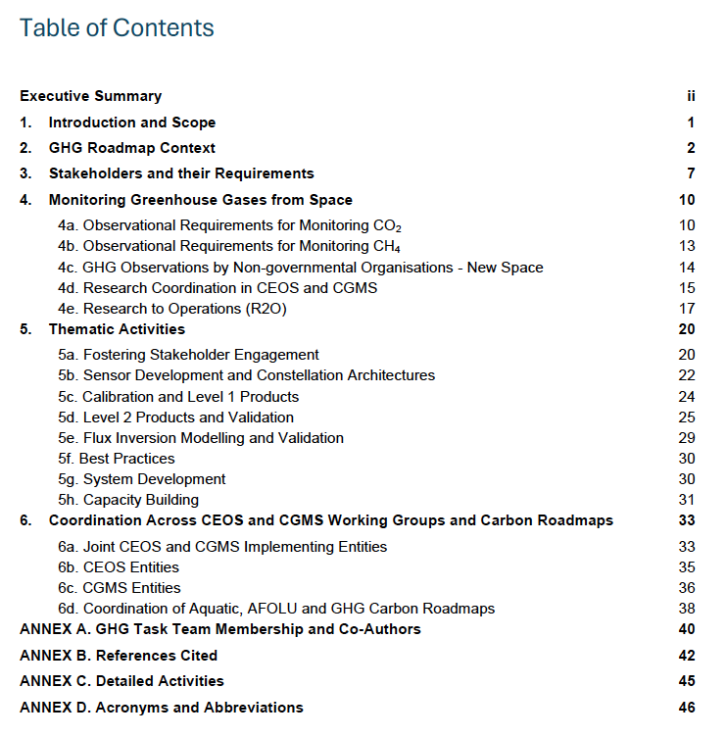
GHG Roadmap – Issue 2
Includes (1-page) executive summary
This version has been expanded in its scope to support the rapid evolution of the international GHG science, policy and regulatory communities. The updated Roadmap describes specific thematic areas where CEOS and CGMS are working with (new) stakeholders and partners to develop improved, fit-for-purpose space-based GHG products. As in issue 1, detailed activities and action items which are continuously evolving, are described in an Annex. With these changes, the GHG Roadmap should foster the coordination of space-based GHG products that better address the needs of an increasingly diverse stakeholder community and be more resilient to the future evolution of this rapidly evolving field.
Table of contents →
Specific detailed actions tracked in Annex C and maintained online (living document)

Slide 6
GHG Roadmap – Stakeholder
Issue 2 has specific focus on co-developing activities with stakeholders
Section 3 covers “Stakeholders and their Requirements”, which explicitly includes WMO G3W and UNEP’s IMEO
Section 5a describes the thematic activity for “Fostering Stakeholder Engagement”
Issue 2 has been established in coordination with G3W and IMEO
John Worden (NASA) is the GHG TT PoC vis-à-vis IMEO
Vincent-Henri Peuch (ECMWF) is the GHG TT PoC vis-à-vis G3W
Collaboration with IMEO is part of planned activities
Intention to have a follow-up meeting of the joint CEOS-IMEO Harvard meeting “International Coordination Workshop on Detection of Anthropogenic Methane Emissions from High-resolution Satellites”, which was held in June 2023

Slide 7
GHG TT – Next steps
Thematic activities (long-term goals) described in section 5 with leads (plus deputies):
Fostering Stakeholder Engagement - Mark Dowell (John, Wenying)
Sensor Development and Constellation Architectures – John (AC-VC) (Yasjka)
Calibration and Level 1 Products – Hiroshi (Kuze)
Level 2 Products and Validation – Ruediger & Dave
Flux Inversion Modellin g and Validation – Kevin (Frederic)
Best Practises – John (Paul Green)
System Development – Richard (John, Kevin)
Capacity Building – TT
Focus is now on updating short-term actions (to be) described in online GHG Roadmap Annex C
Meeting with area leads scheduled on 22 November (online)
GHG Task Team meeting scheduled 11–13 Feb. ‘25 in Harwell, UK, coincident with WGClimate

Slide 8
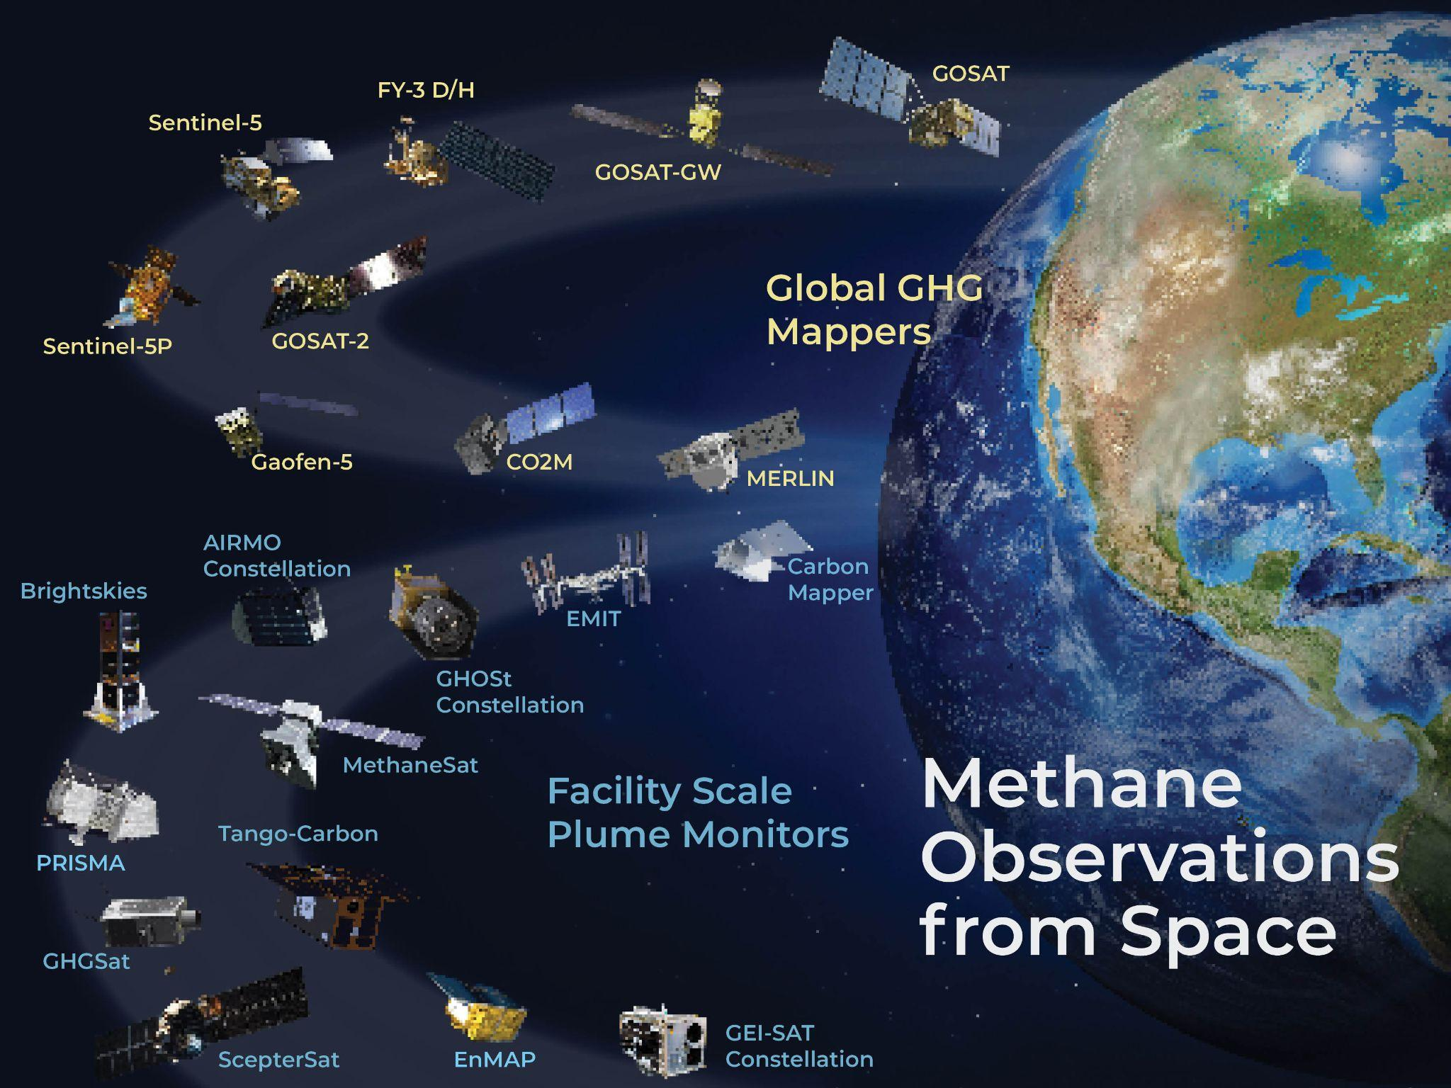
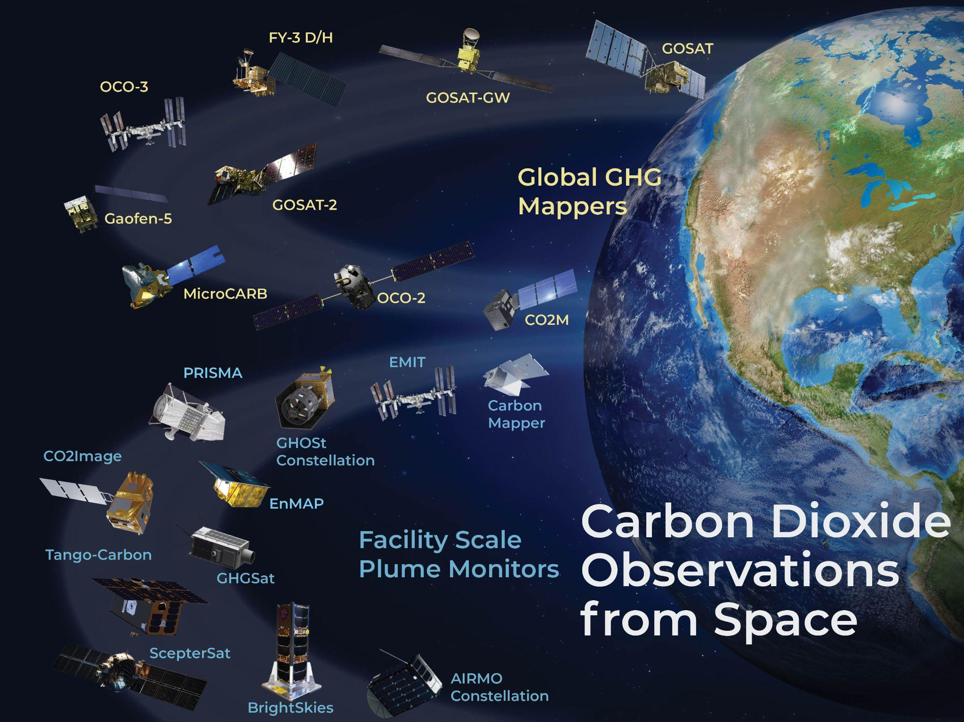
GHG TT – AC-VC
Some highlights in relation to AC-VC:
John Worden is GHG TT PoC in AC-VC
GHG Mission portal keeps evolving – ceos.org/ghg
GHG Constellation Builder as spreadsheet is now available, which allows to select requirement filter to build a constellation of satellites suiting specific needs
Best practise → see presentation 4.20
NASA has an activity, and ESA has allocated resources to support, for a L2 algo intercomparison activity → your input is required!
CO2M Mission Advisory Group benefits from international participation; JAXA, NASA, CNES
Lessons learned from heritage mission on calibration (mainly on-ground) have been discussed with CO2M Project in a dedicated meeting

Slide 9
Time for questions
and discussion
THANKS!

