Slide 1
TEMPO Aerosol Retrieval and Application to PM2.5 Estimation
Hai Zhang¹, Shobha Kondragunta², Pubu Ciren¹
¹IMSG at NOAA; ²NOAA
CEOS AC-VC #20 2024
College Park, MD, Oct 15-18,2024
Disclaimer: The scientific results and conclusions, as well as any views or opinions expressed
herein, are those of the author(s) and do not necessarily reflect those of NOAA or
the Department of Commerce.

Slide 2
Aerosol Retrieval Algorithm Development
The algorithm retrieves AOD and ALH
Adapt AOD retrieval algorithm from VIIRS and ABI
Adapt ALH retrieval algorithm using O₂ bands by Chen et al. 2021
Spectral selection
Hyperspectral measurements are convolved to the bands 354, 388, 416, 440, 494, 670, 687.75 nm using a triangle function
Look-up Table (LUT) generation
TOA reflectance of the bands for different AOD, ALH, surface reflectance, surface pressure, and Sun-satellite geometry
Smoke, dust, generic aerosol models
UNL-VRTM (VLIDORT)
TEMPO Directional Lambertian Equivalent Reflectivity (DLER) Database
Regridded into fixed 0.05 degree lat-lon grid
Atmospheric correction using 0.025 background AOD (from AERONET analysis)
Generate lower bound using historical data
Build hourly DLER

Slide 3
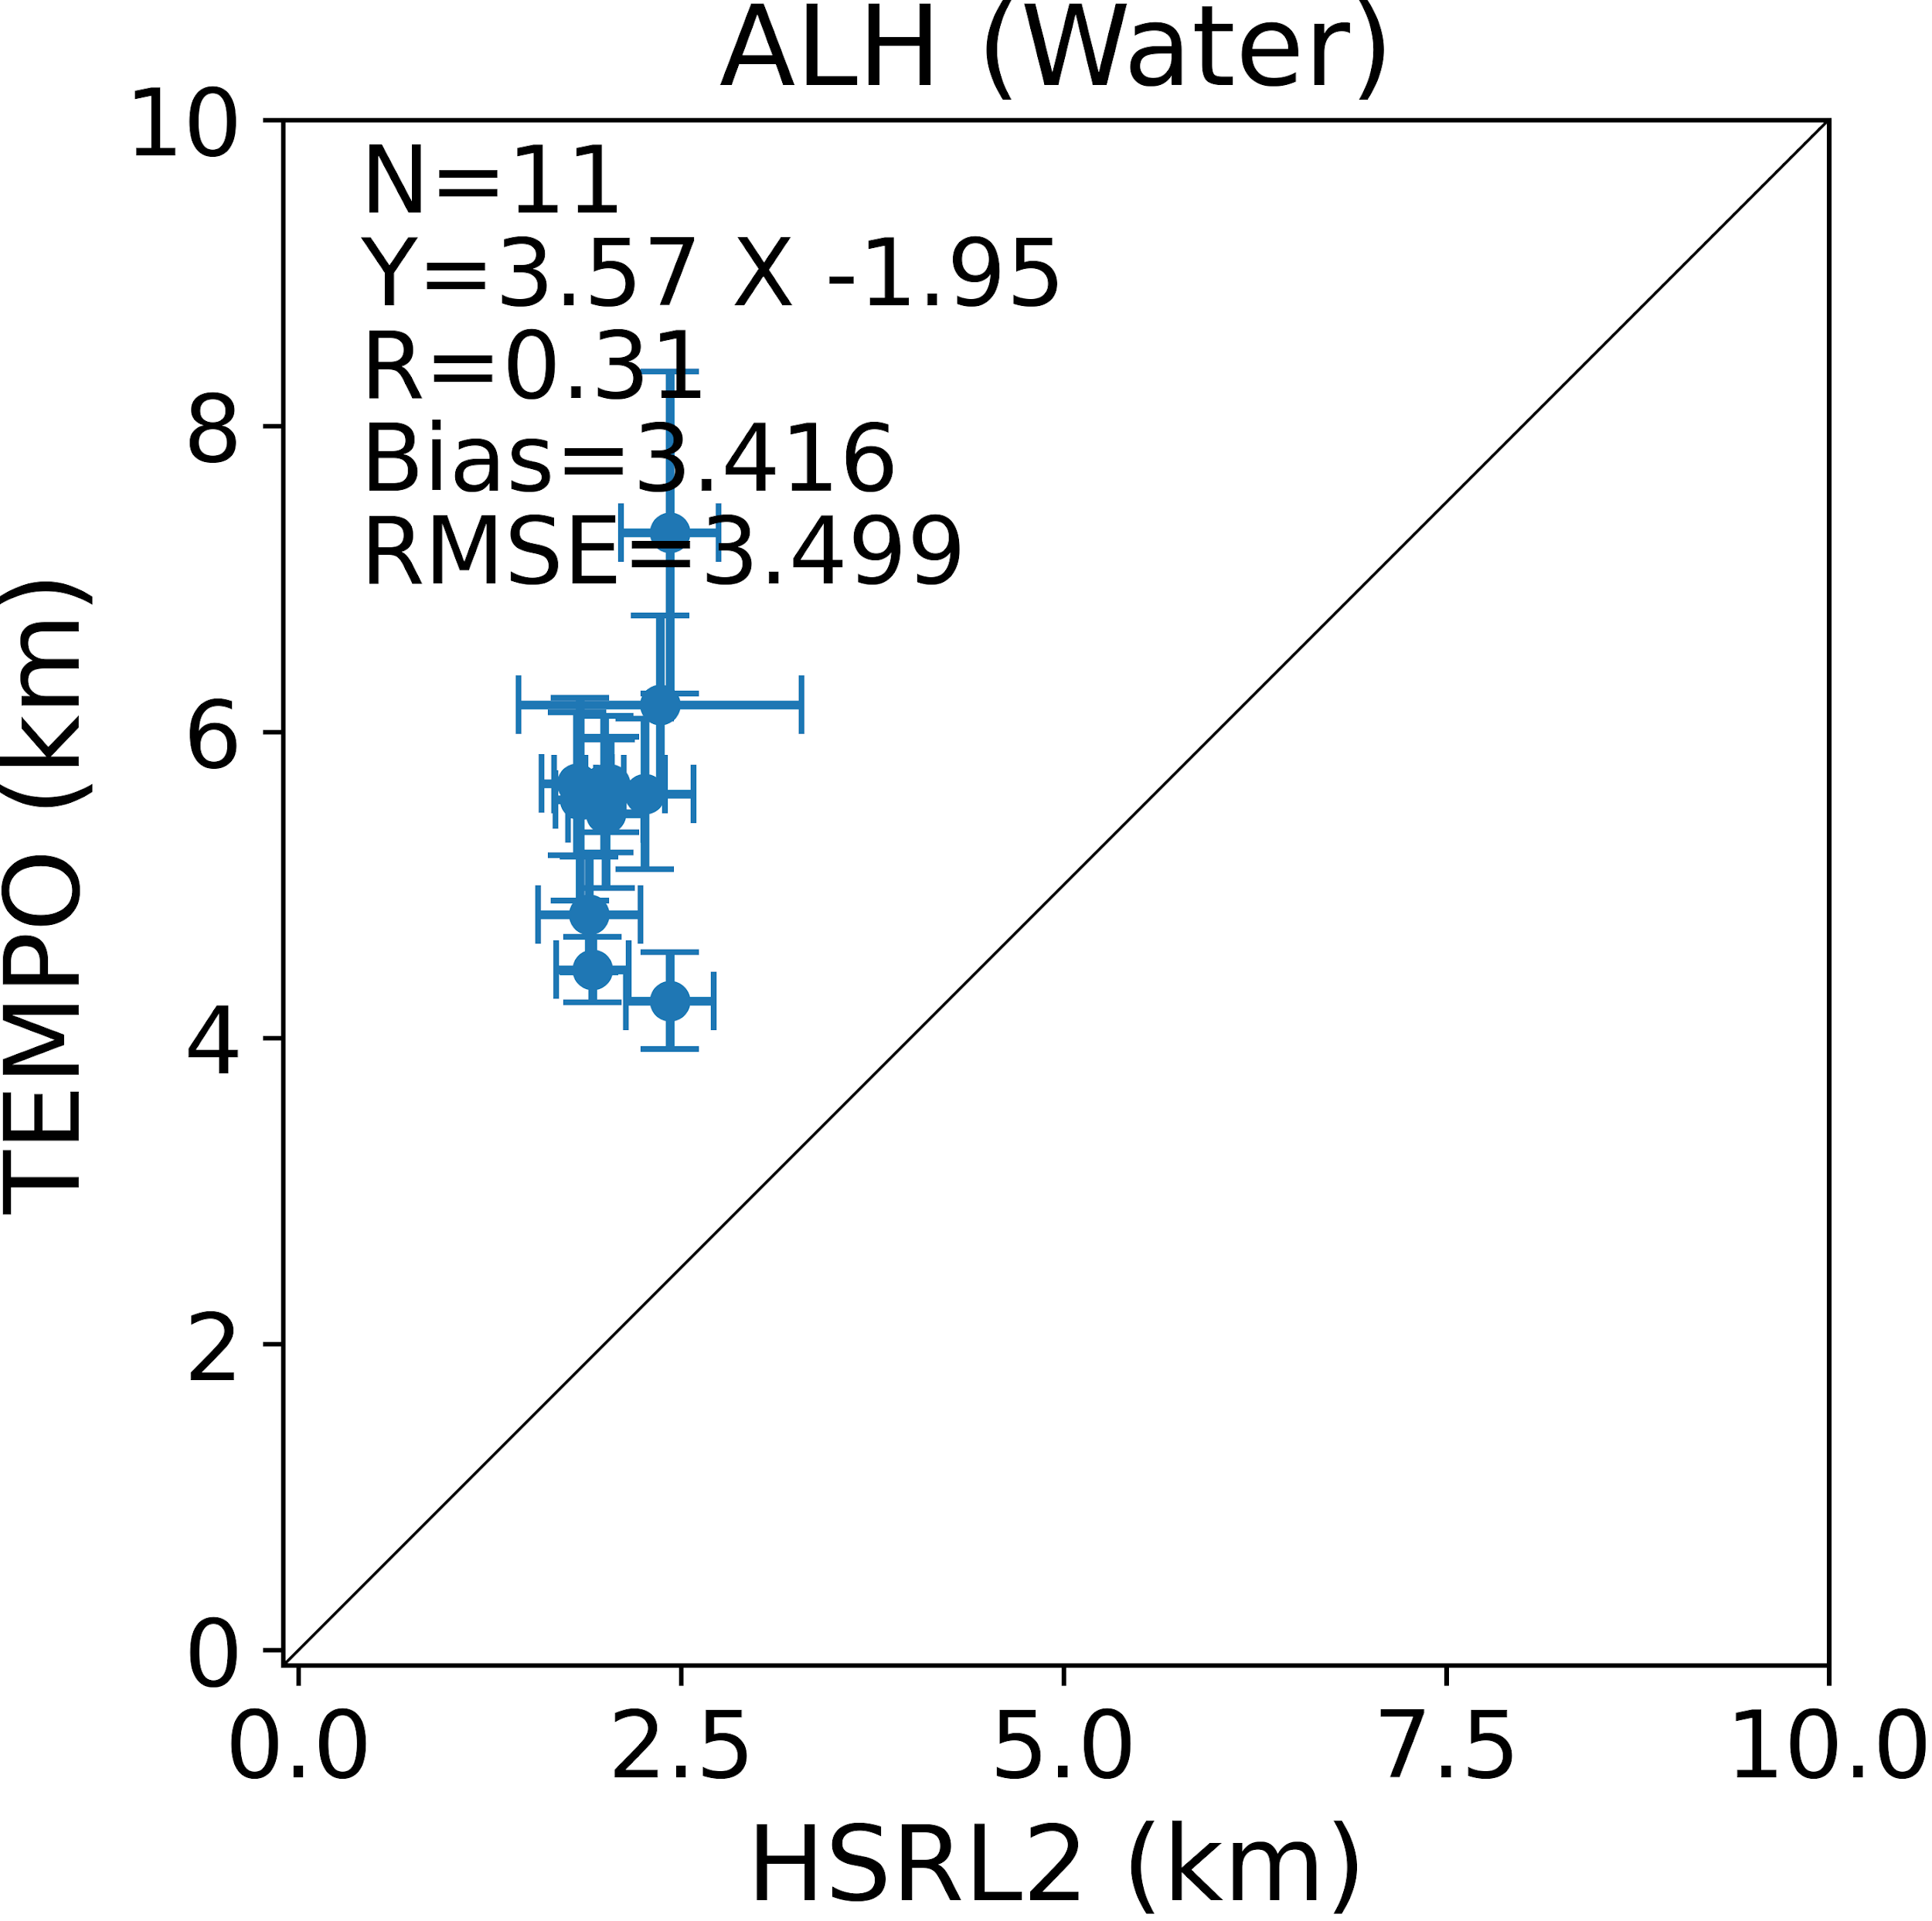
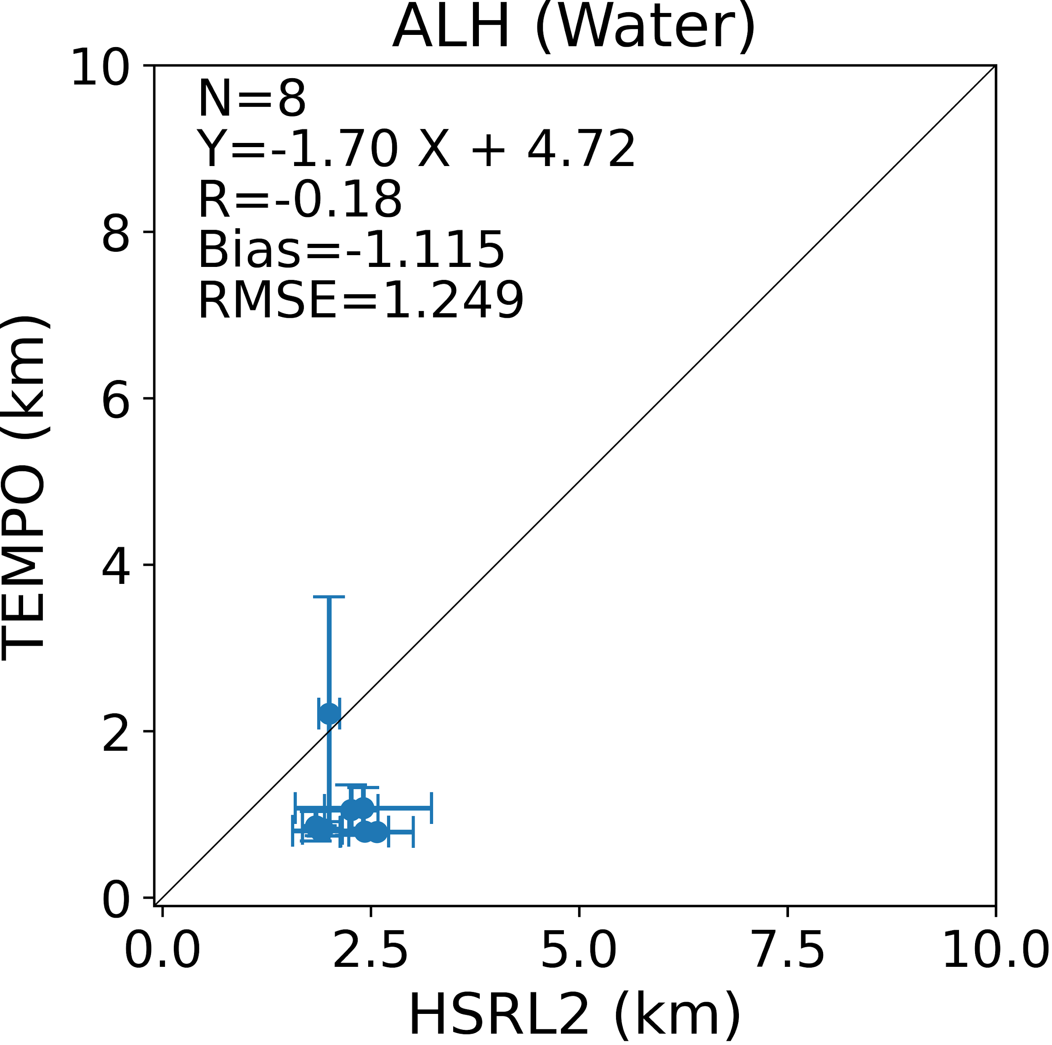
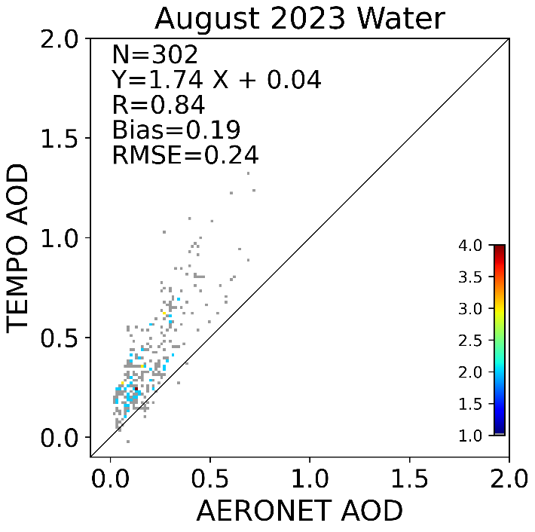
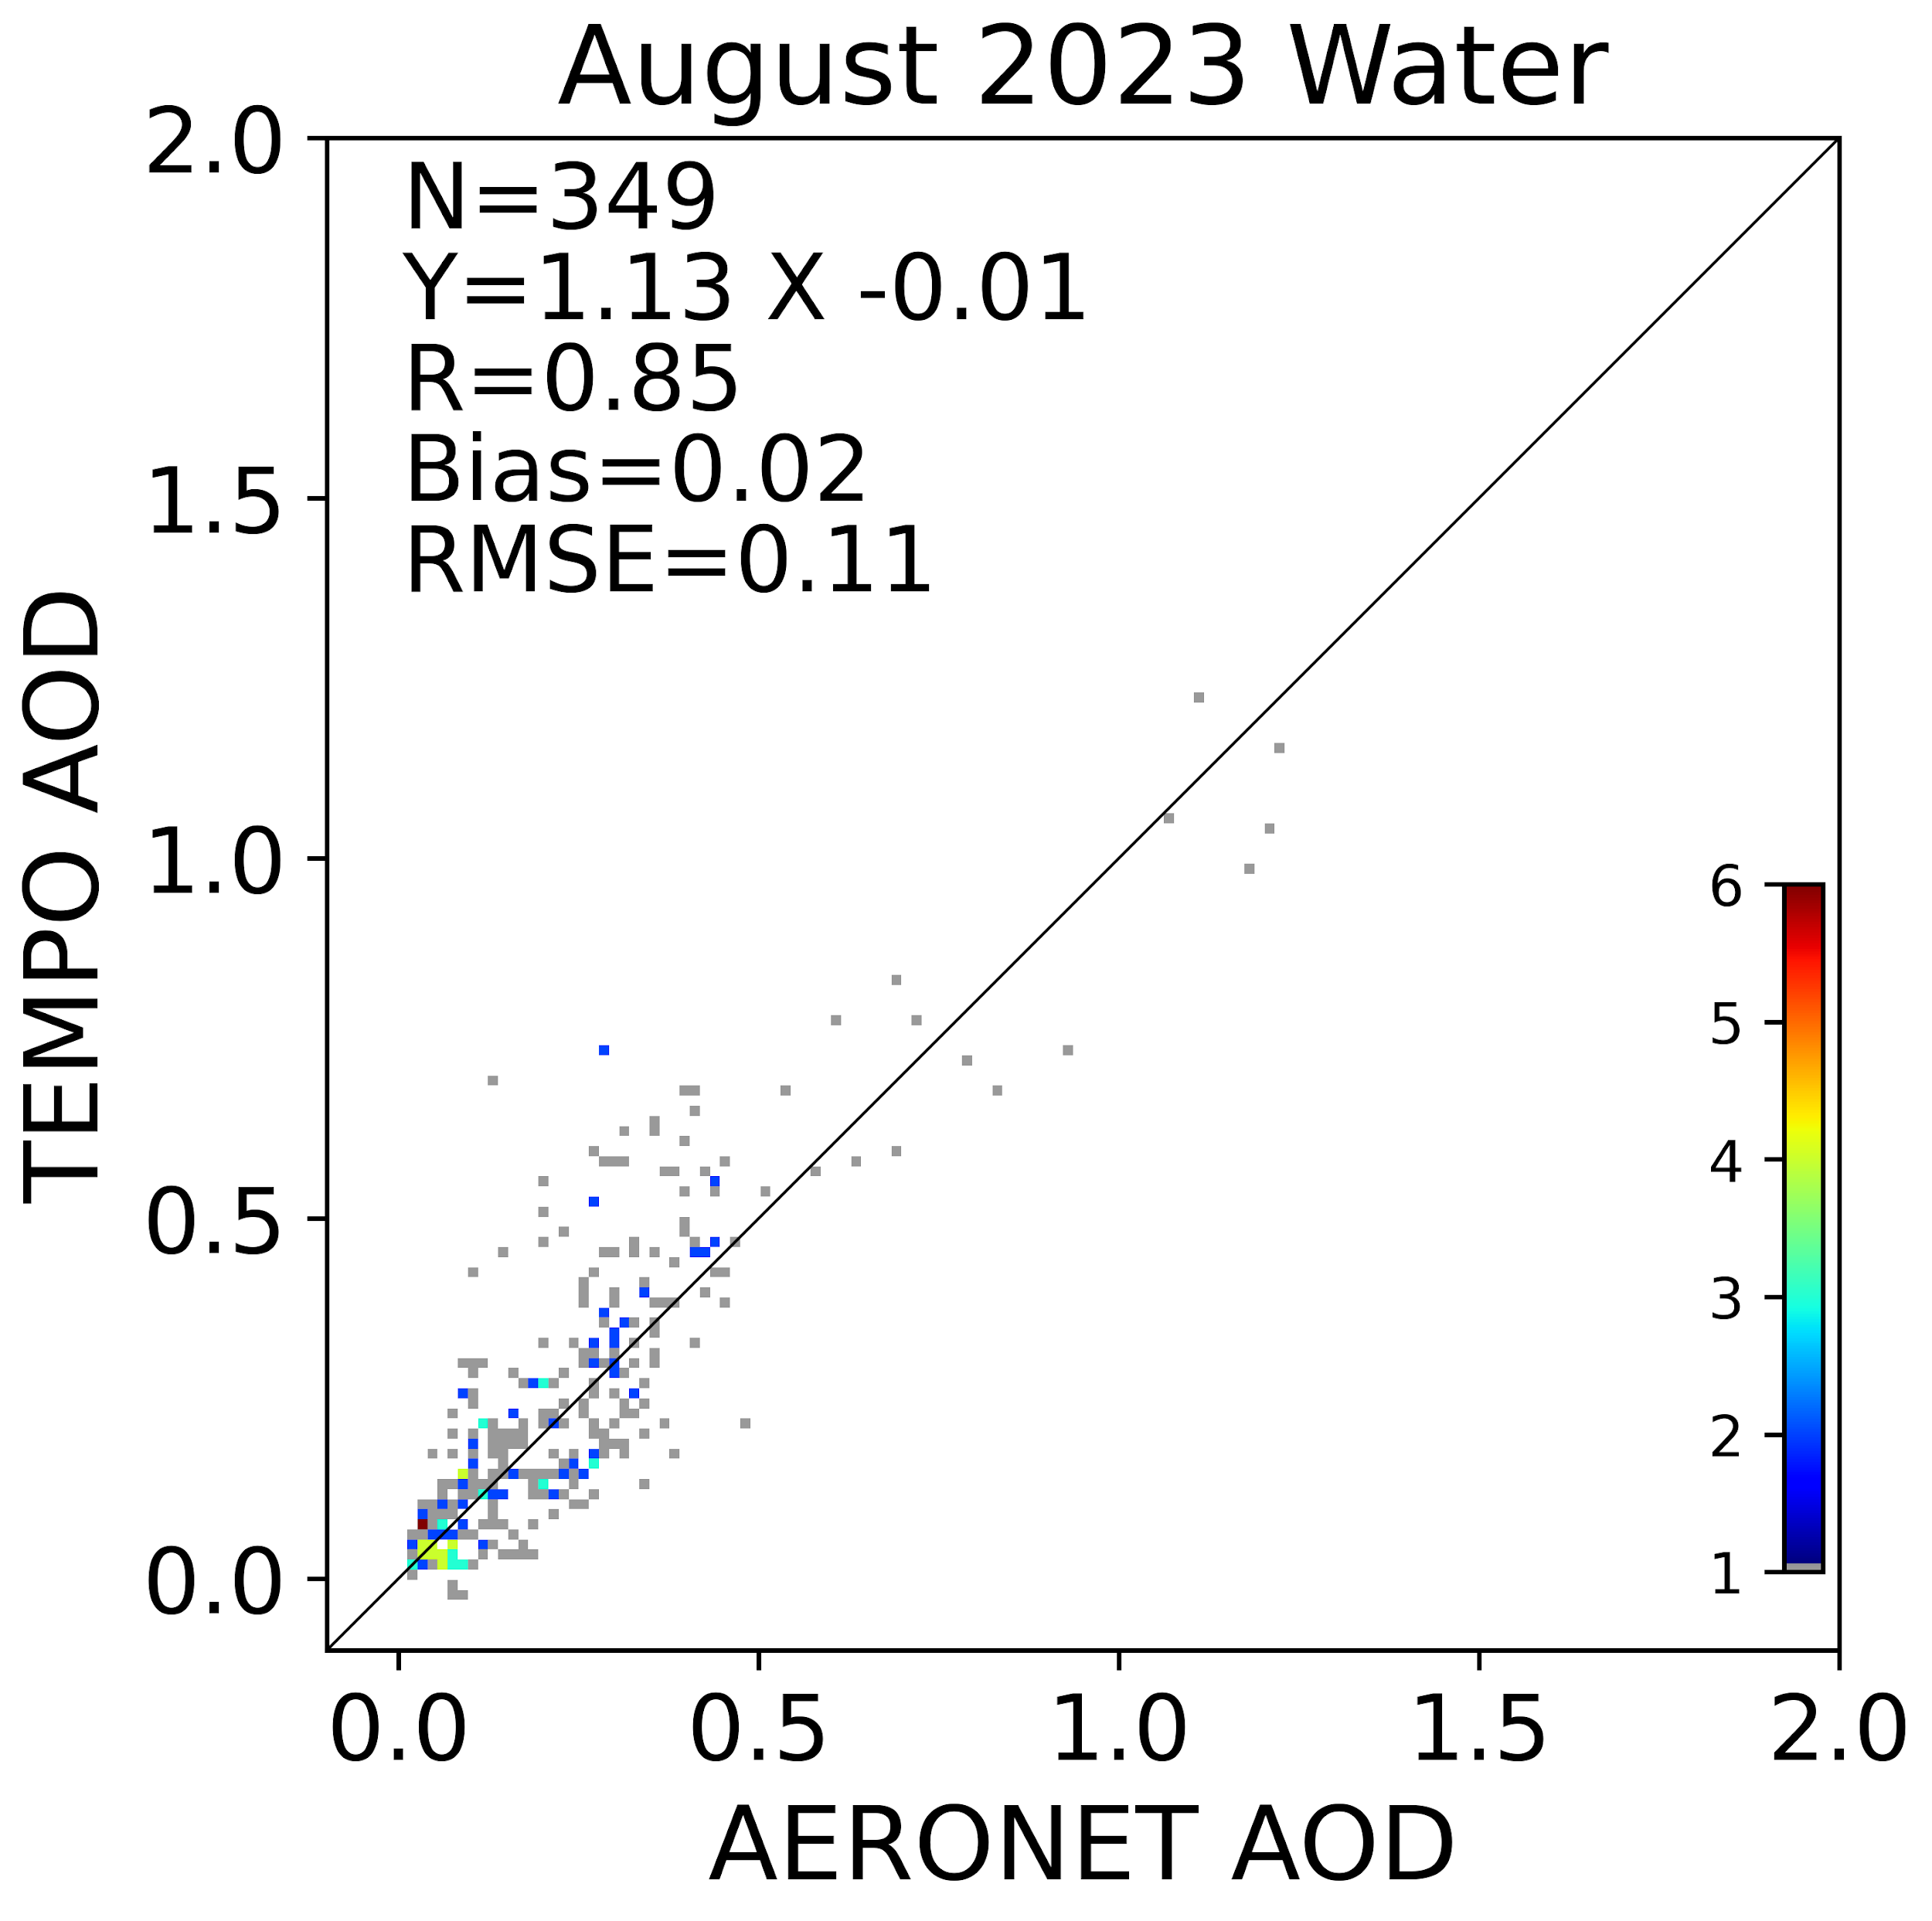
Calibration correction for retrieval
TEMPO L1b reflectance was found to have positive bias.
Used ABI AOD over ocean and TEMPO geometry to derive empirical corrections to L1B reflectances
Used the corrected TOA reflectances to derive surface reflectance database (DLER) and retrieved AOD and ALH.
With soft calibration
With soft calibration
Original
Original

Slide 4
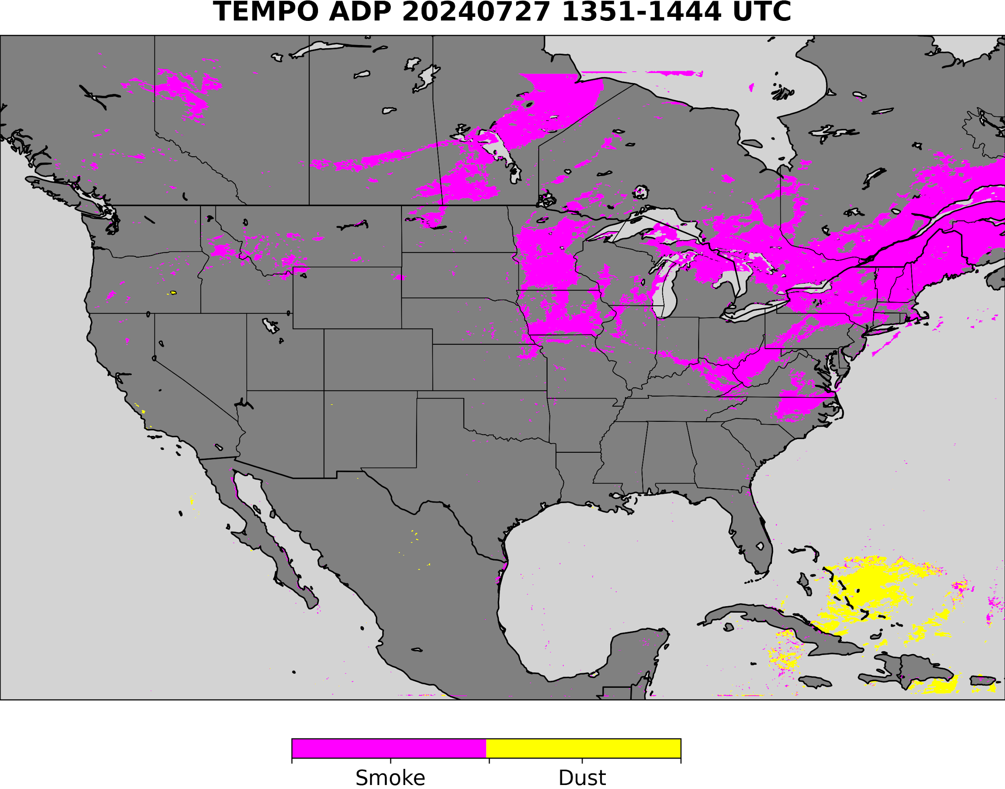
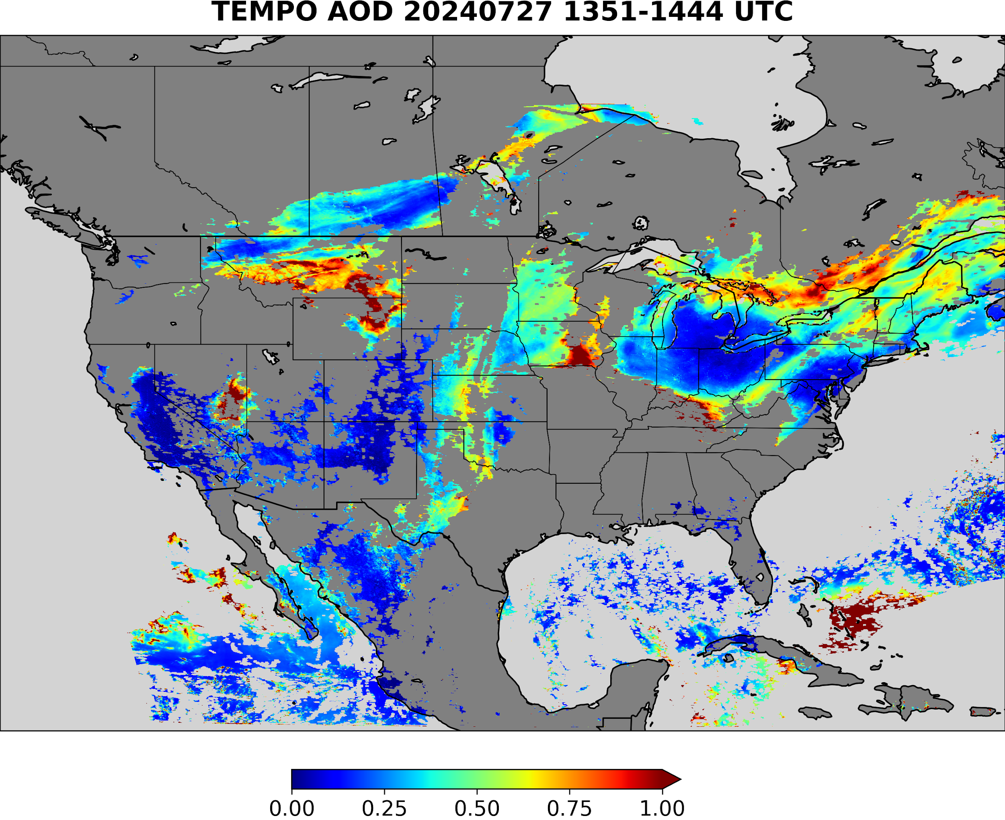
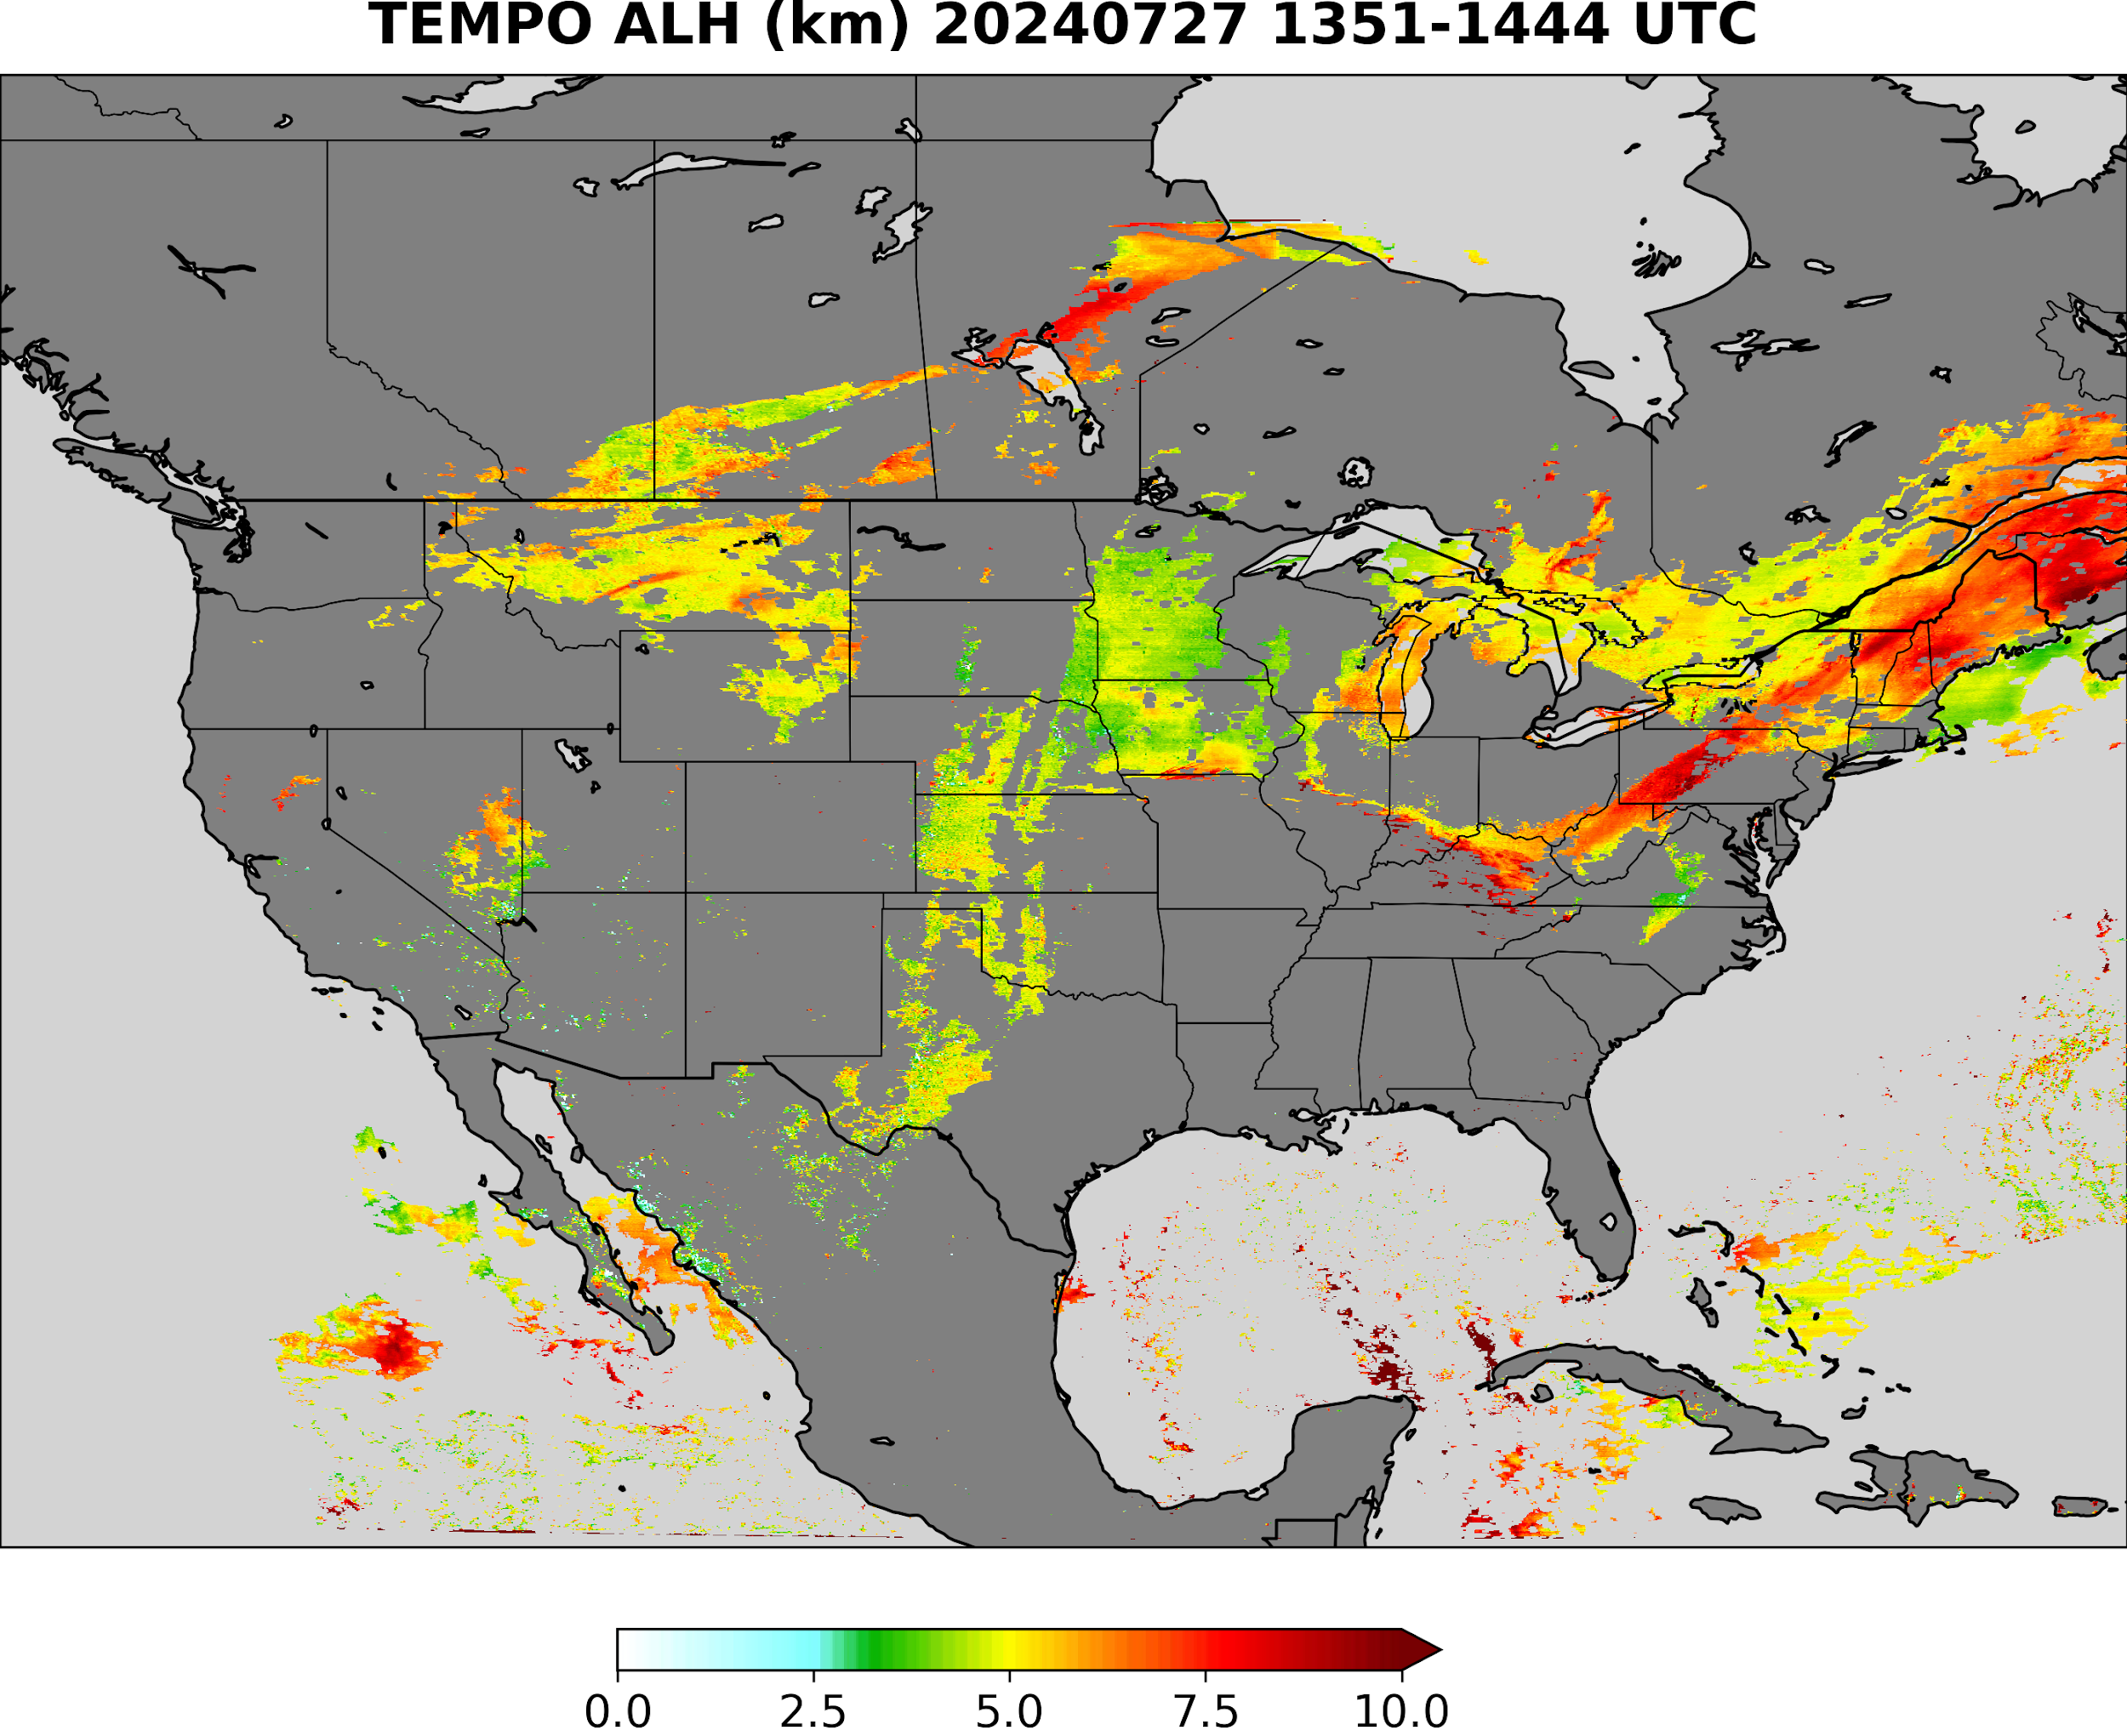
TEMPO AOD ALH retrieval uses ADP to differentiate aerosol type
Smoke
TEMPO ADP Smoke Dust Mask Input
smoke
Smoke or dust ?
dust
No detection
Use smoke model
Use generic model
Use dust model
With UV bands available from TEMPO, the combined TEMPO and ABI detection can better detect the dust and smoke and can help AOD retrieval, because dust plumes usually are missing in ABI AOD retrievals

Slide 5
TEMPO AOD and ALH aerosol type selection using ADP
Dust
TEMPO ADP Smoke Dust Mask Input
smoke
Smoke or dust ?
dust
No detection
Use smoke model
Use generic model
Use dust model
With UV bands available from TEMPO, the combined TEMPO and ABI detection can better detect the dust and smoke and can help AOD retrieval, because dust plumes usually are missing in ABI AOD retrievals

Slide 6
TEMPO AOD and ALH aerosol type selection using ADP
Generic
TEMPO ADP Smoke Dust Mask Input
smoke
Smoke or dust ?
dust
No detection
Use smoke model
Use generic model
Use dust model
With UV bands available from TEMPO, the combined TEMPO and ABI detection can better detect the dust and smoke and can help AOD retrieval, because dust plumes usually are missing in ABI AOD retrievals

Slide 7
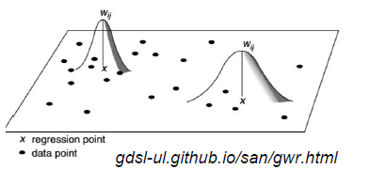
Geographically Weighted Regression (GWR) to estimate PM_{2.5} from AOD and ALH
GWR becomes simple linear regression if the weight is set to 1
Regression coefficients are updated dynamically for each time step using the satellite surface matchup data: Every hour for hourly PM2.5 estimates
The dynamic adjustment of the regression relation can catch the temporal and spatial variation of the PM2.5 and AOD relationship

Slide 8
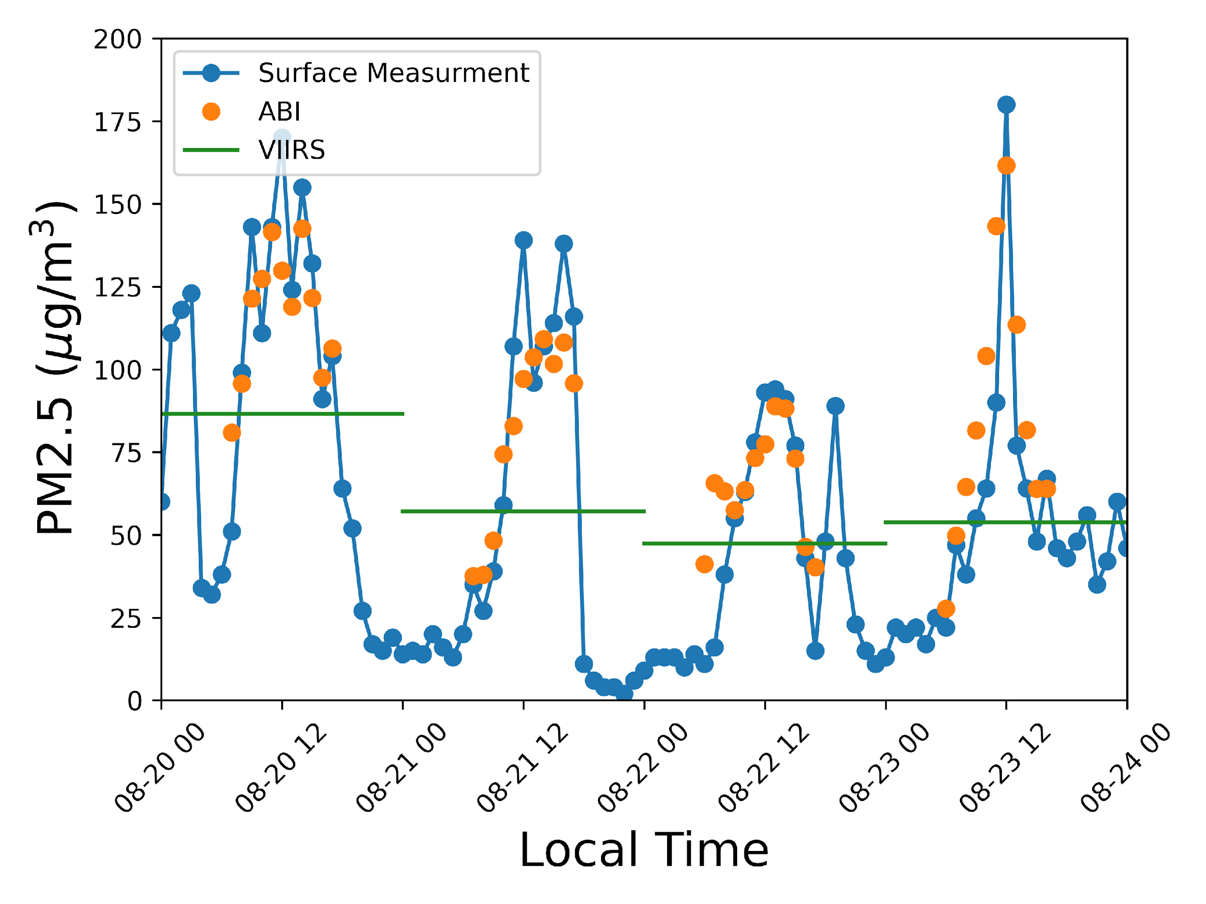
ABI AOD for PM2.5 estimates
Hourly PM2.5 has been estimated from combined GOES-East and GOES-West AOD;
The product is running near-real-time and the data are provided to EPA;
High temporal resolution of geostationary observation can help with tracking pollution transport;
Better spatial coverage compared to the polar-orbiting satellites
38.53°N; 121.77°W

Slide 9
Combining ABI and TEMPO aerosol retrievals to estimate PM2.5
ABI AOD
TEMPO AOD
TEMPO ALH
Merged AOD
GWR
AIRNOW PM2.5
PM2.5 estimates

Slide 10
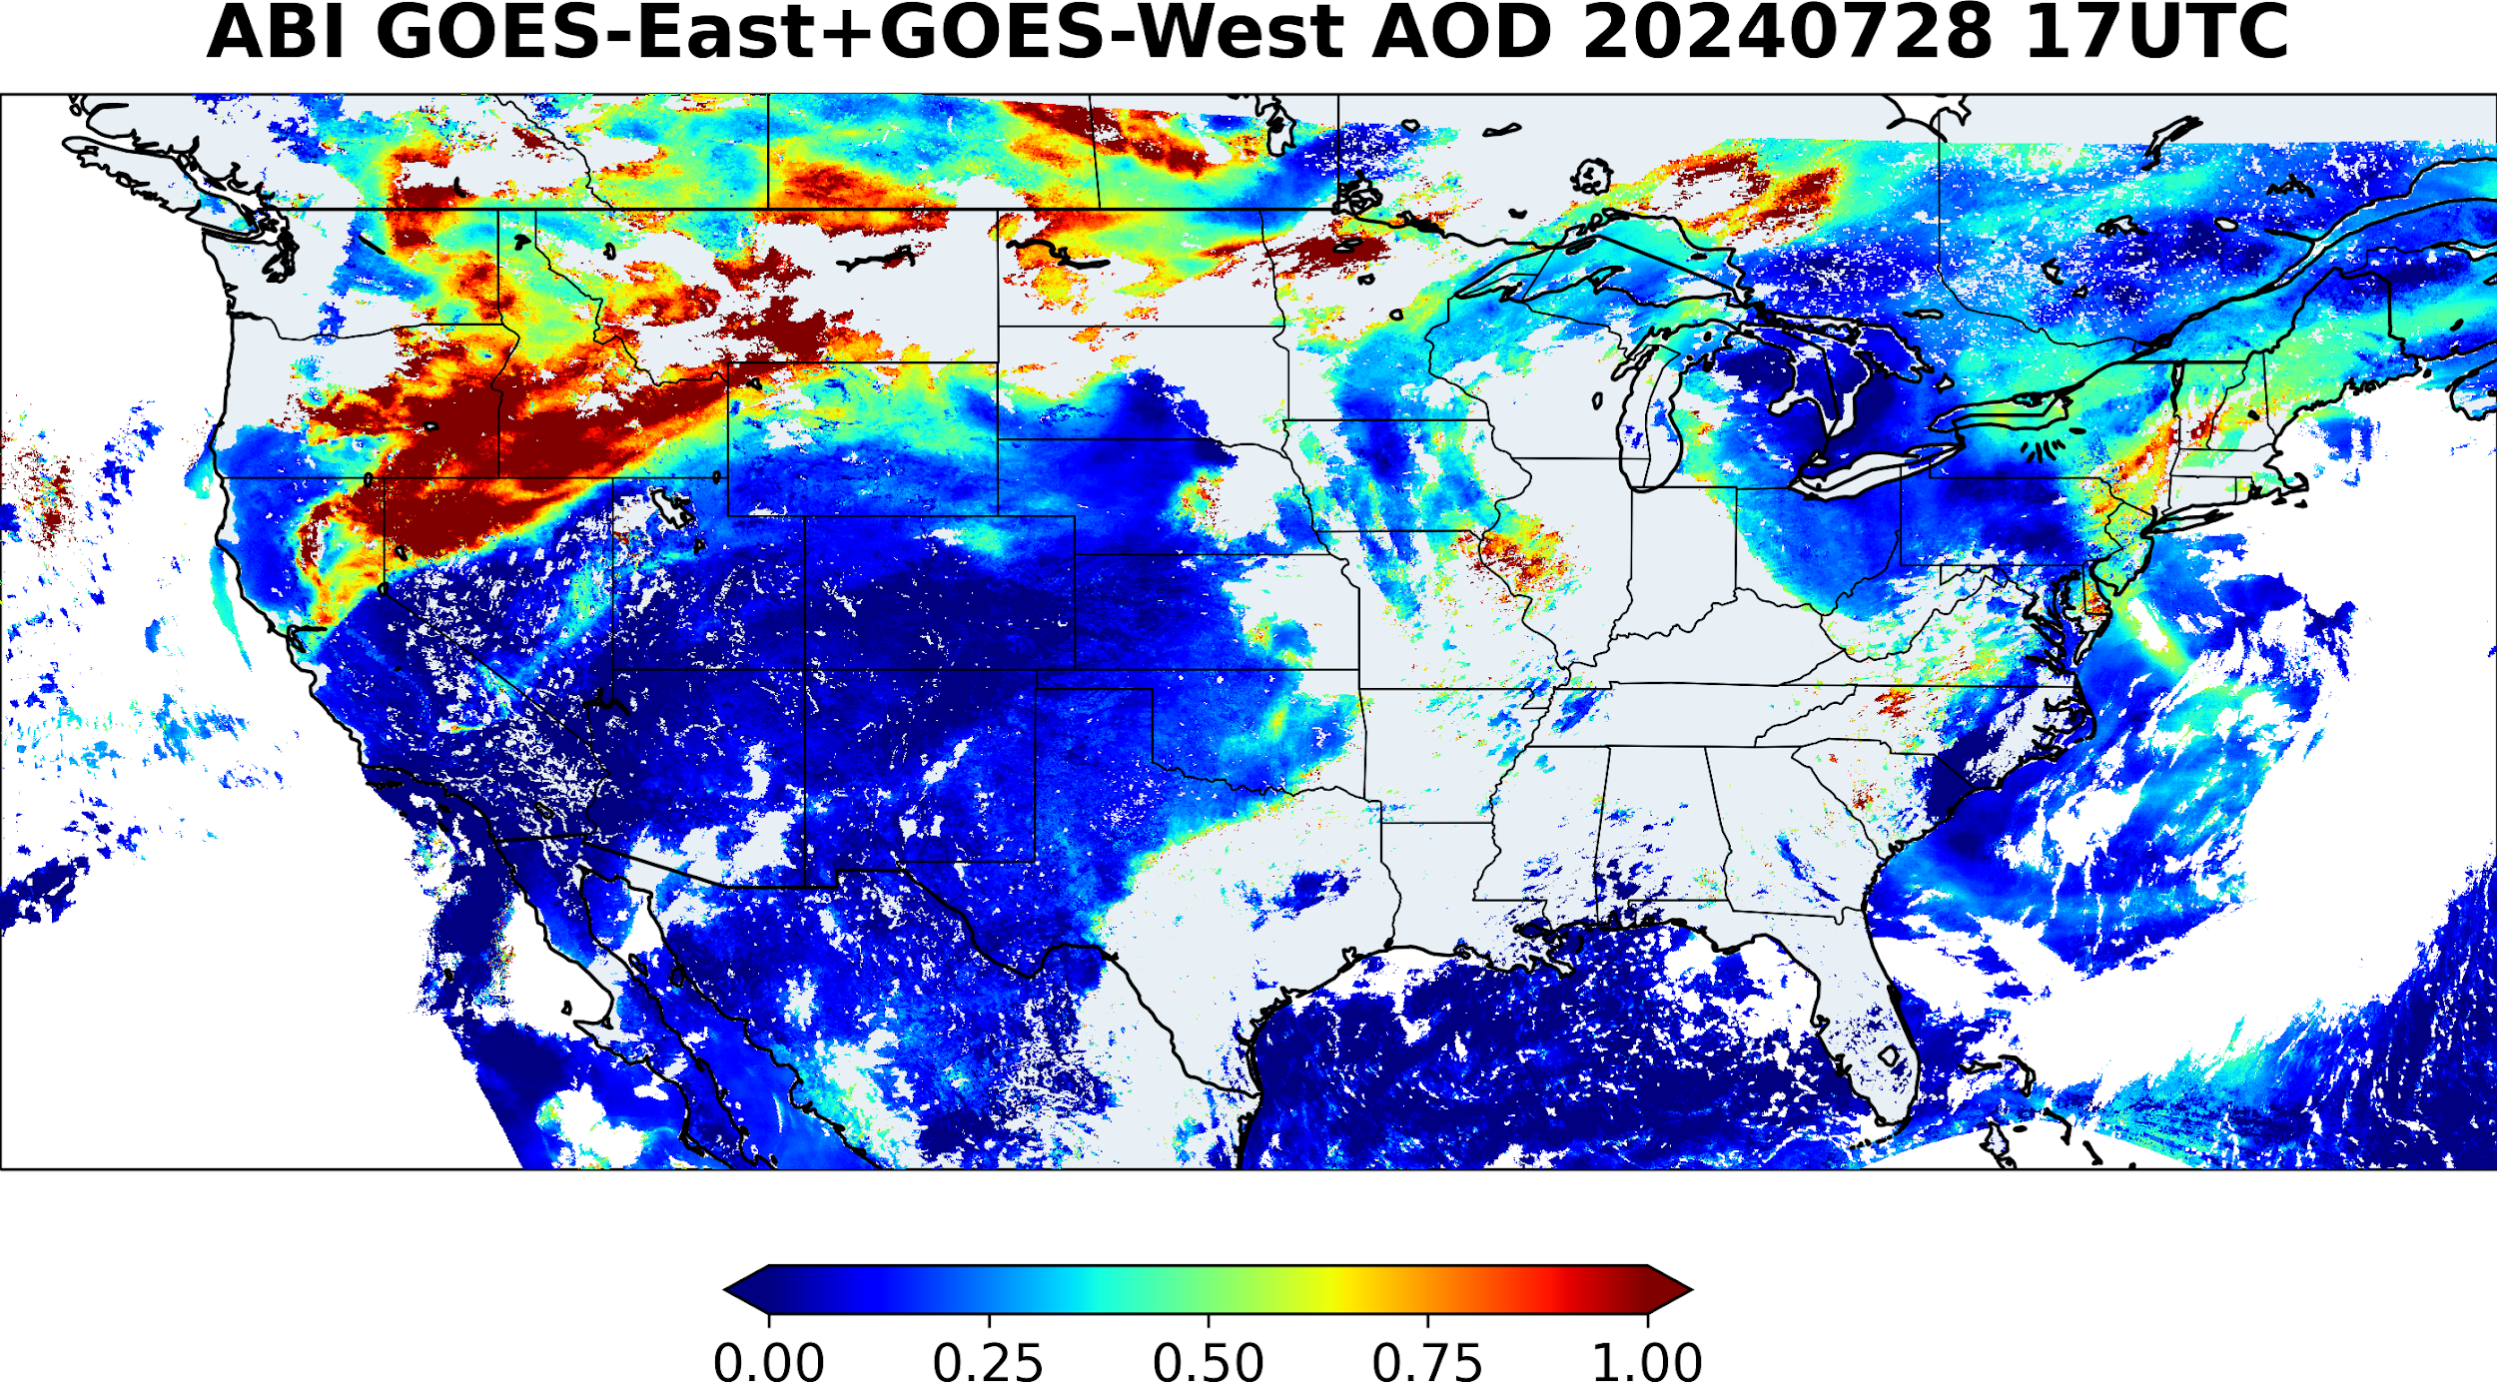
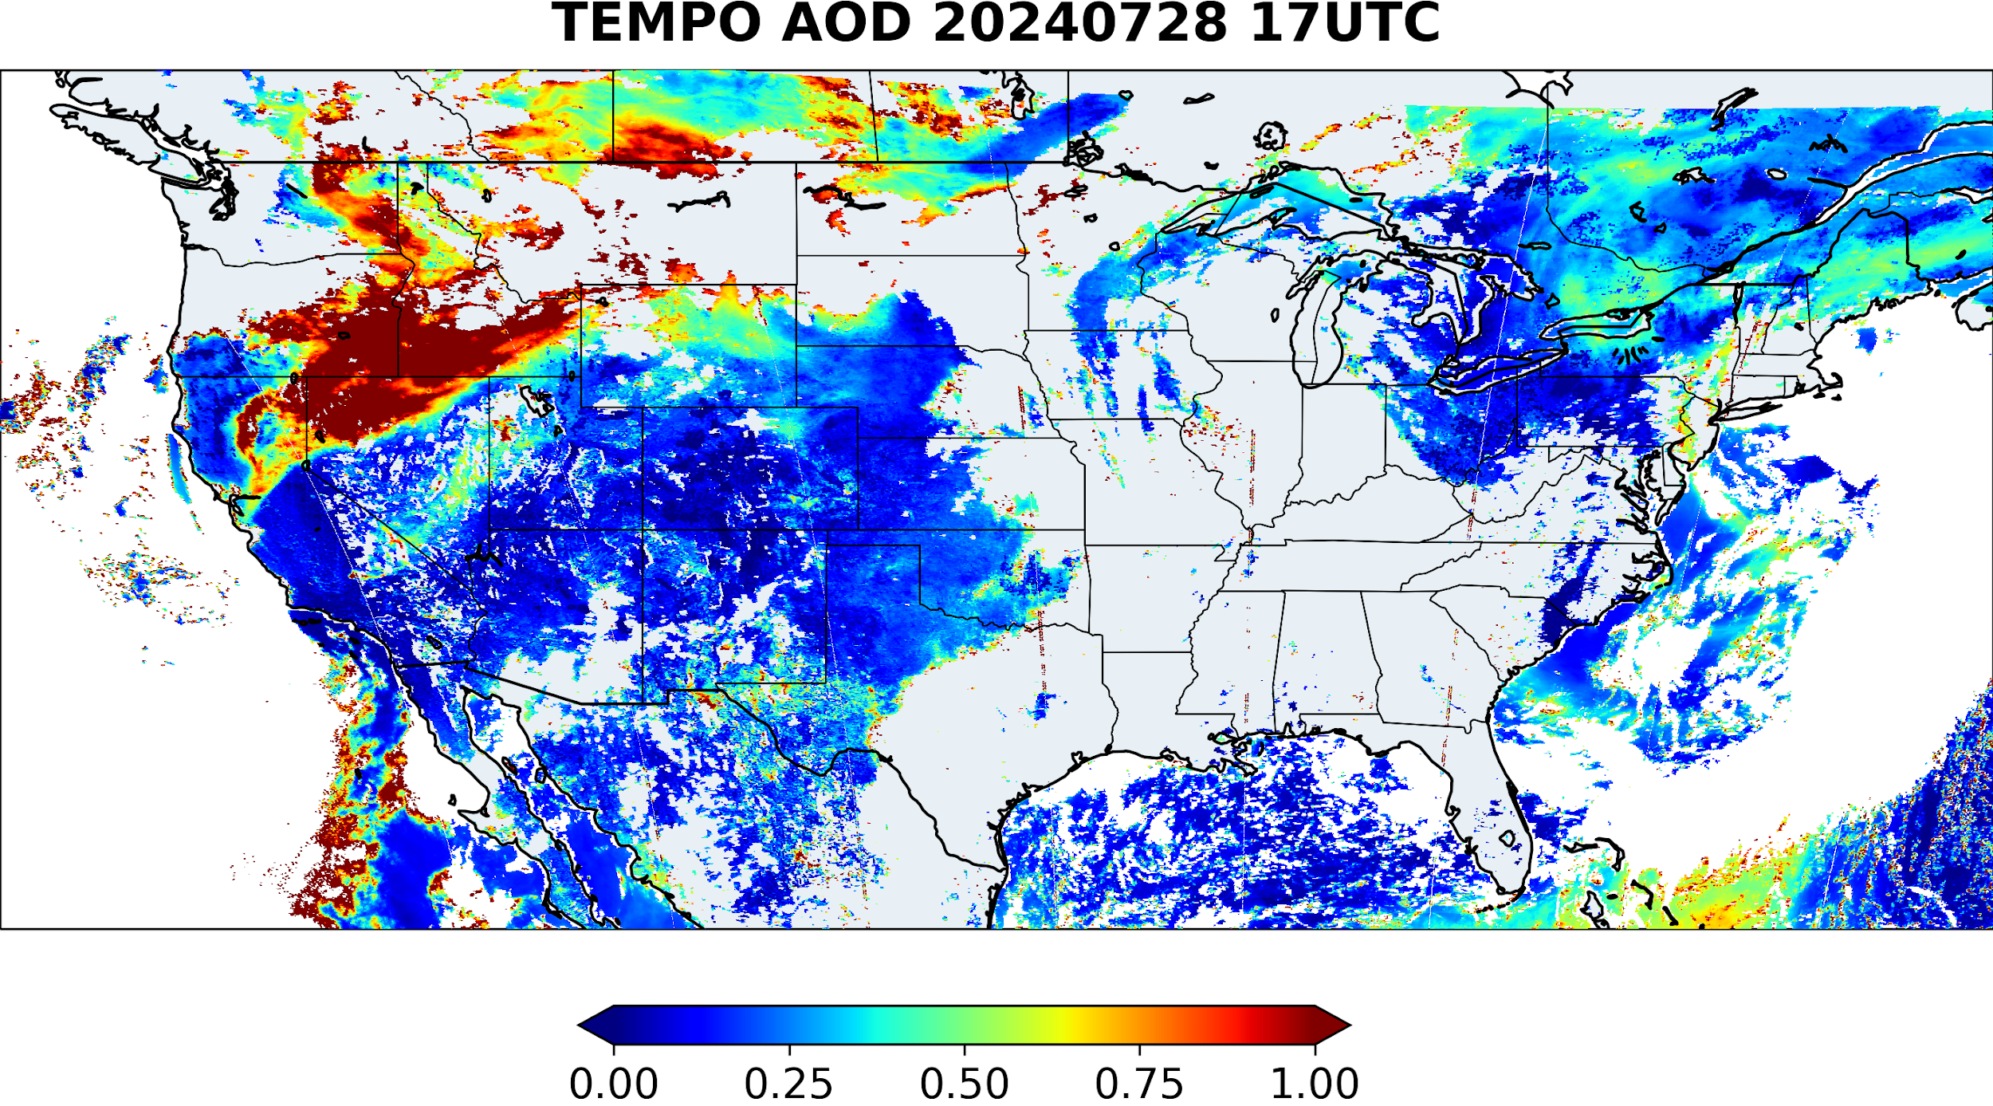
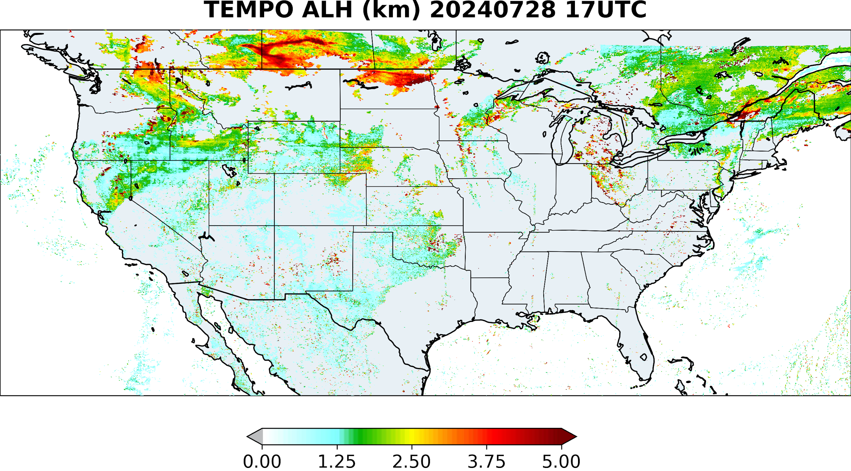
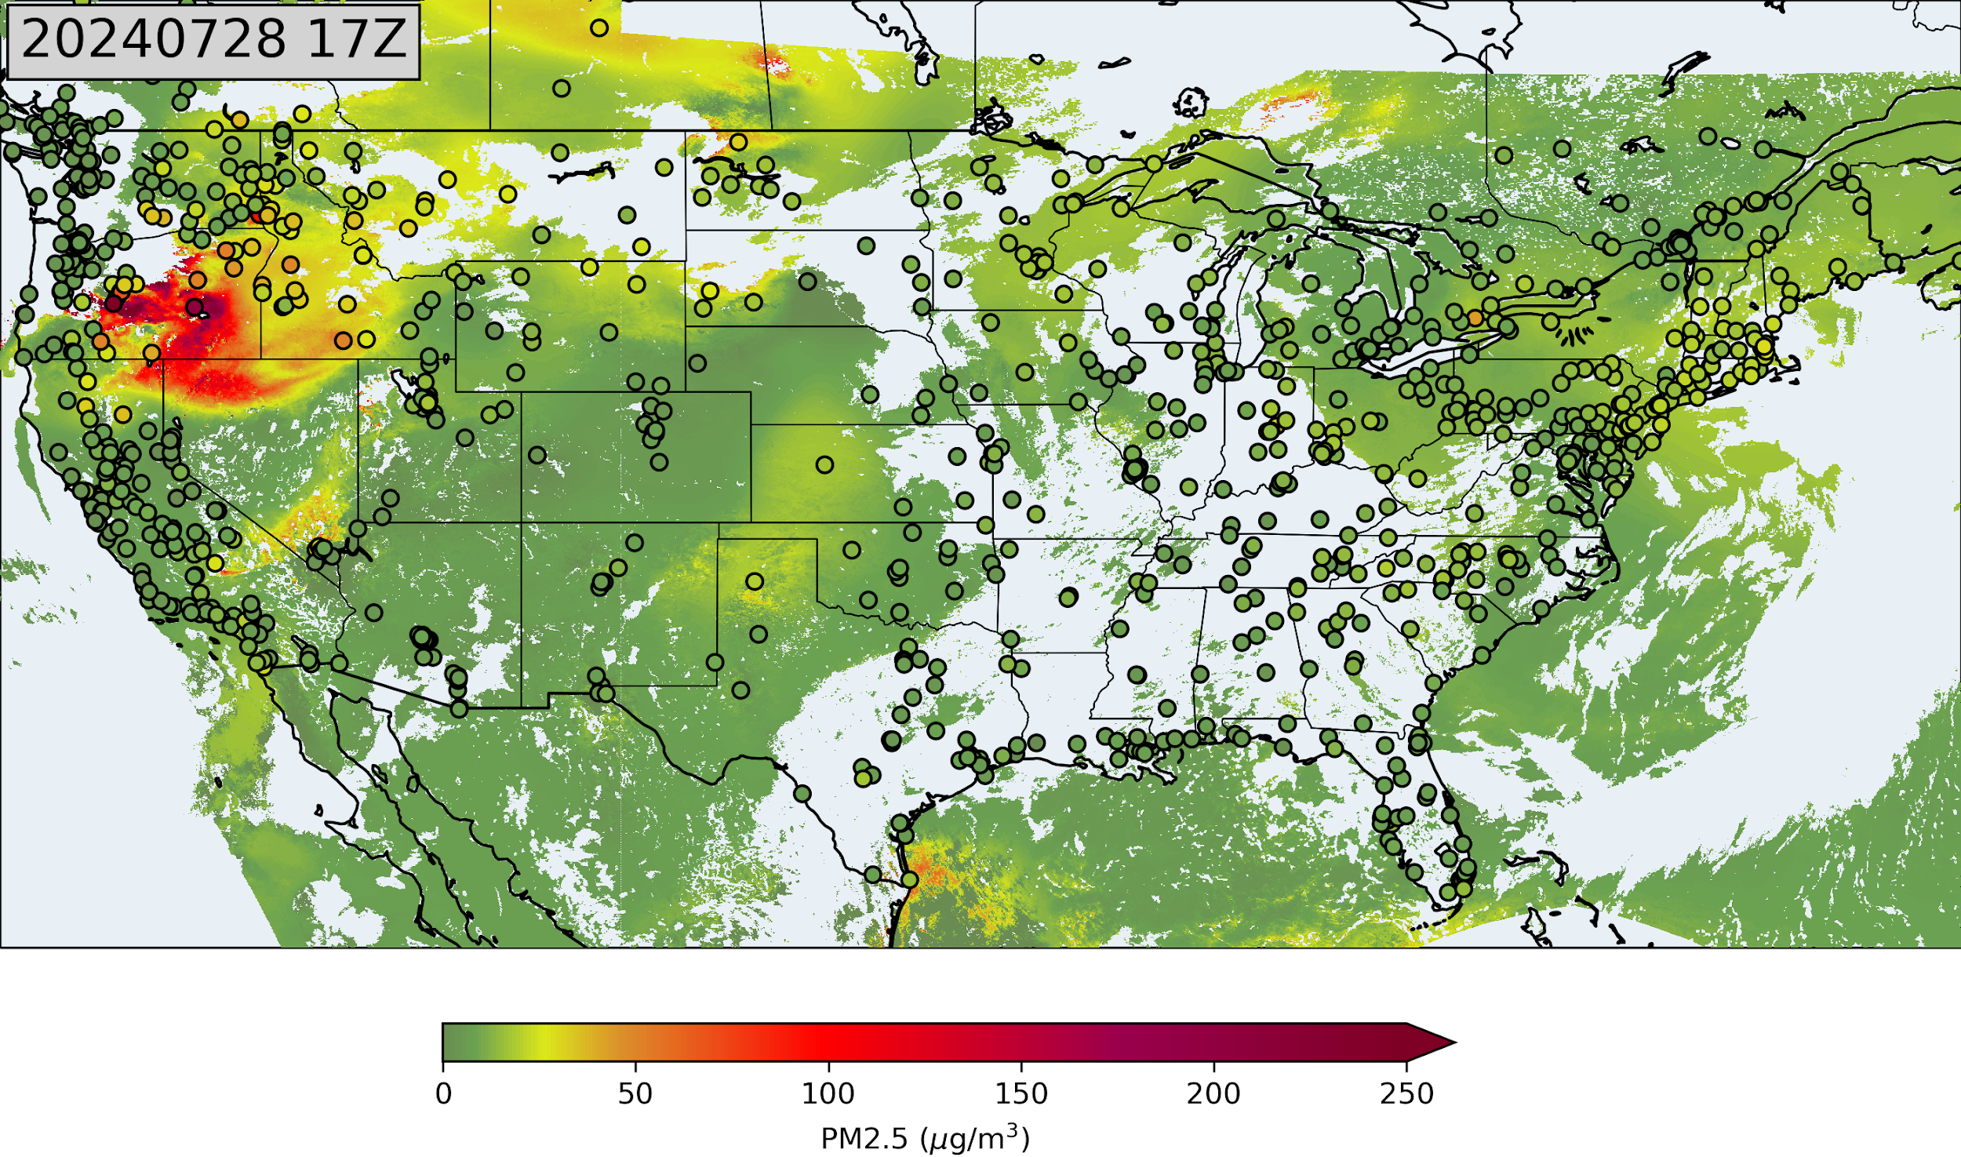
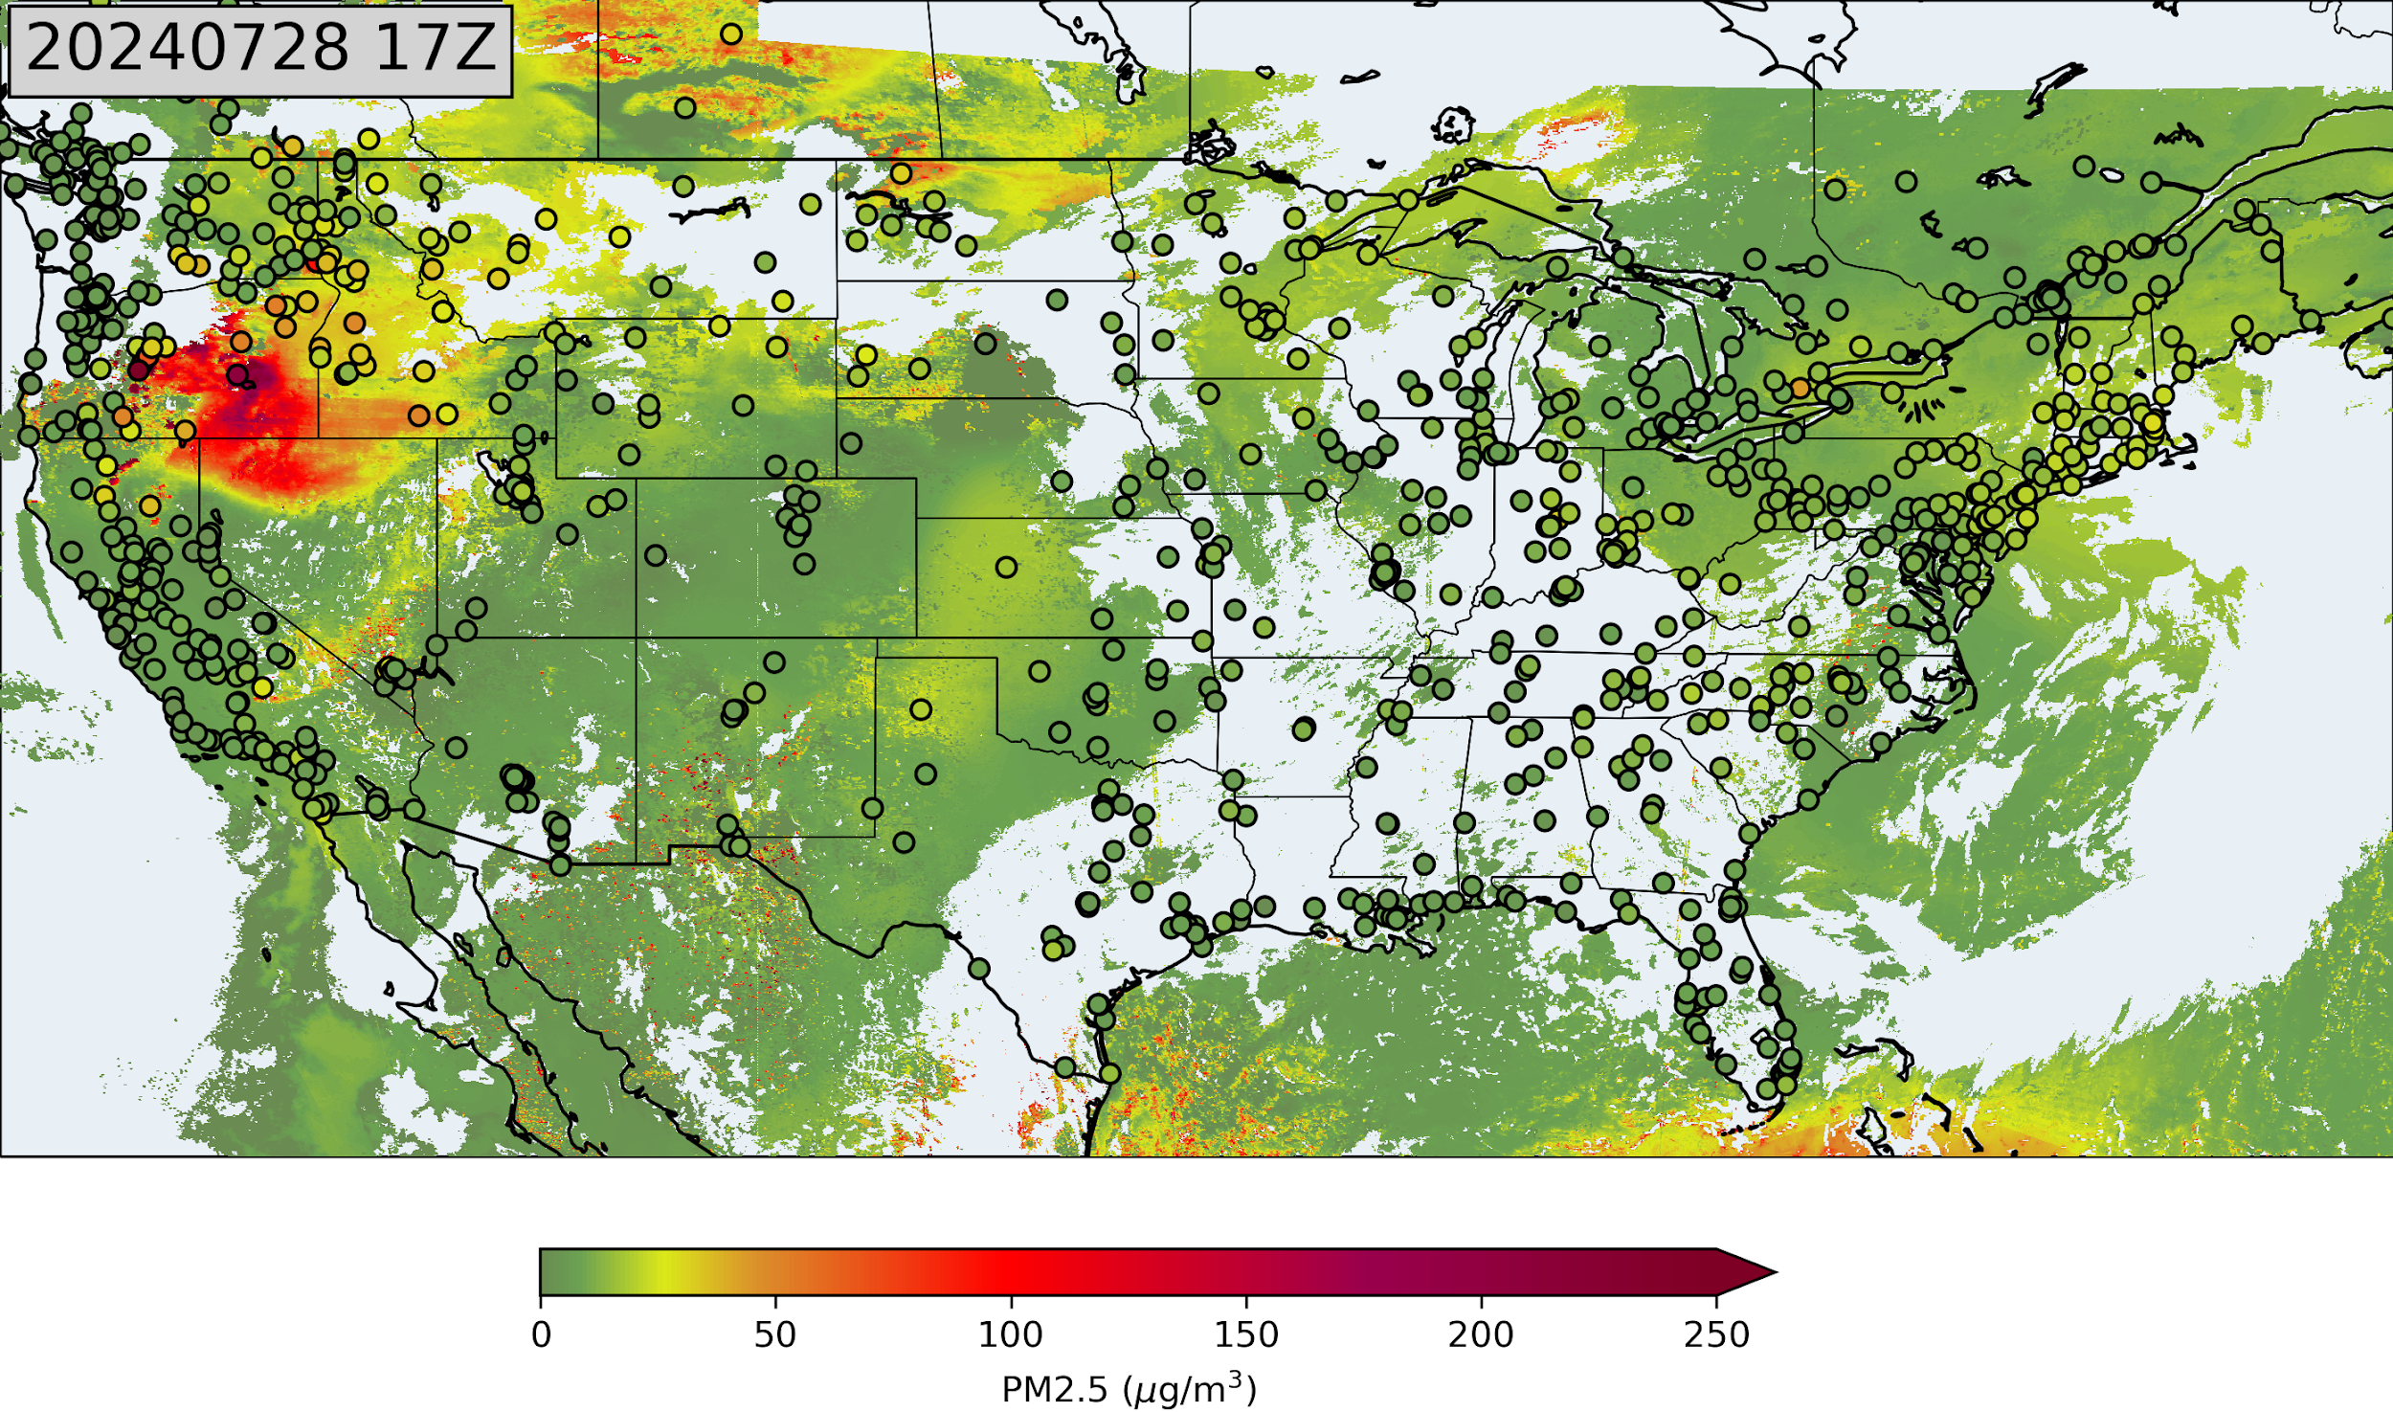
An example PM2.5 estimates
PM2.5 from ABI AOD only
PM2.5 from ABI AOD and TEMPO AOD ALH

Slide 11
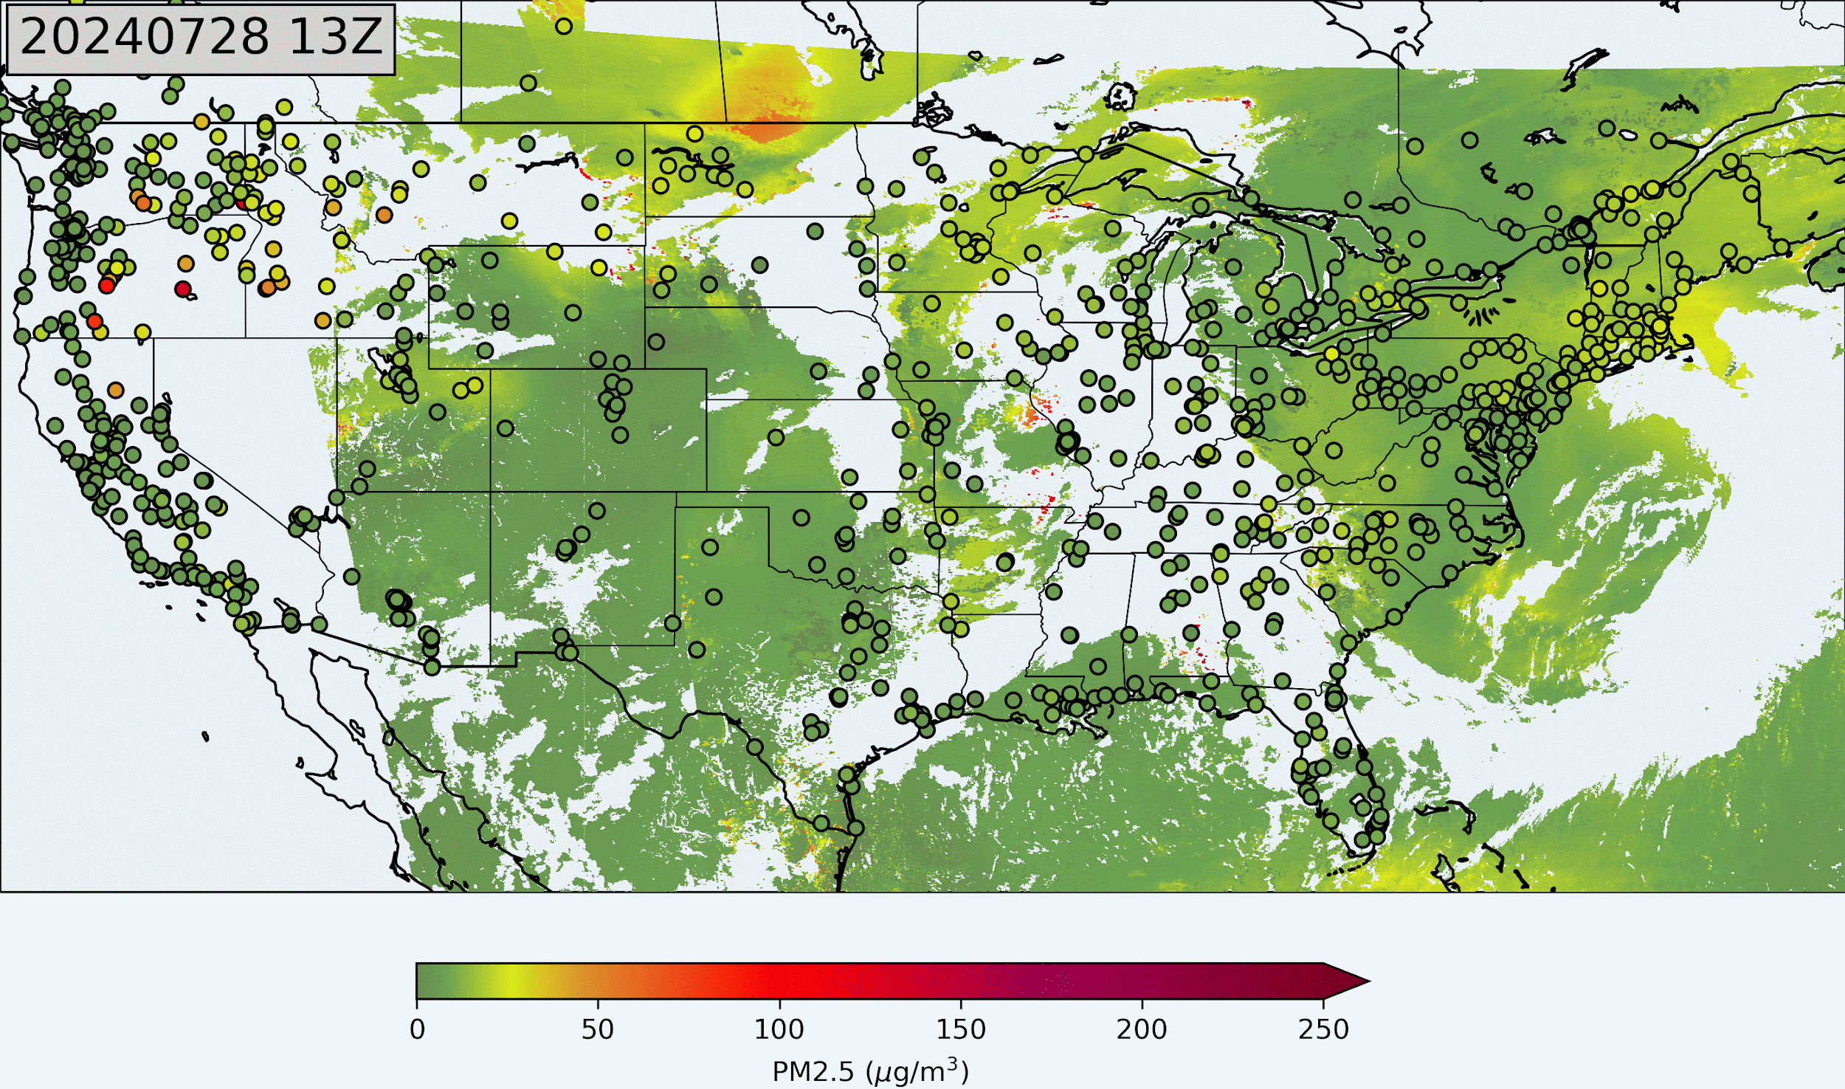
Hourly PM2.5 estimates from ABI AOD, TEMPO AOD and ALH for July 28, 2024

Slide 12
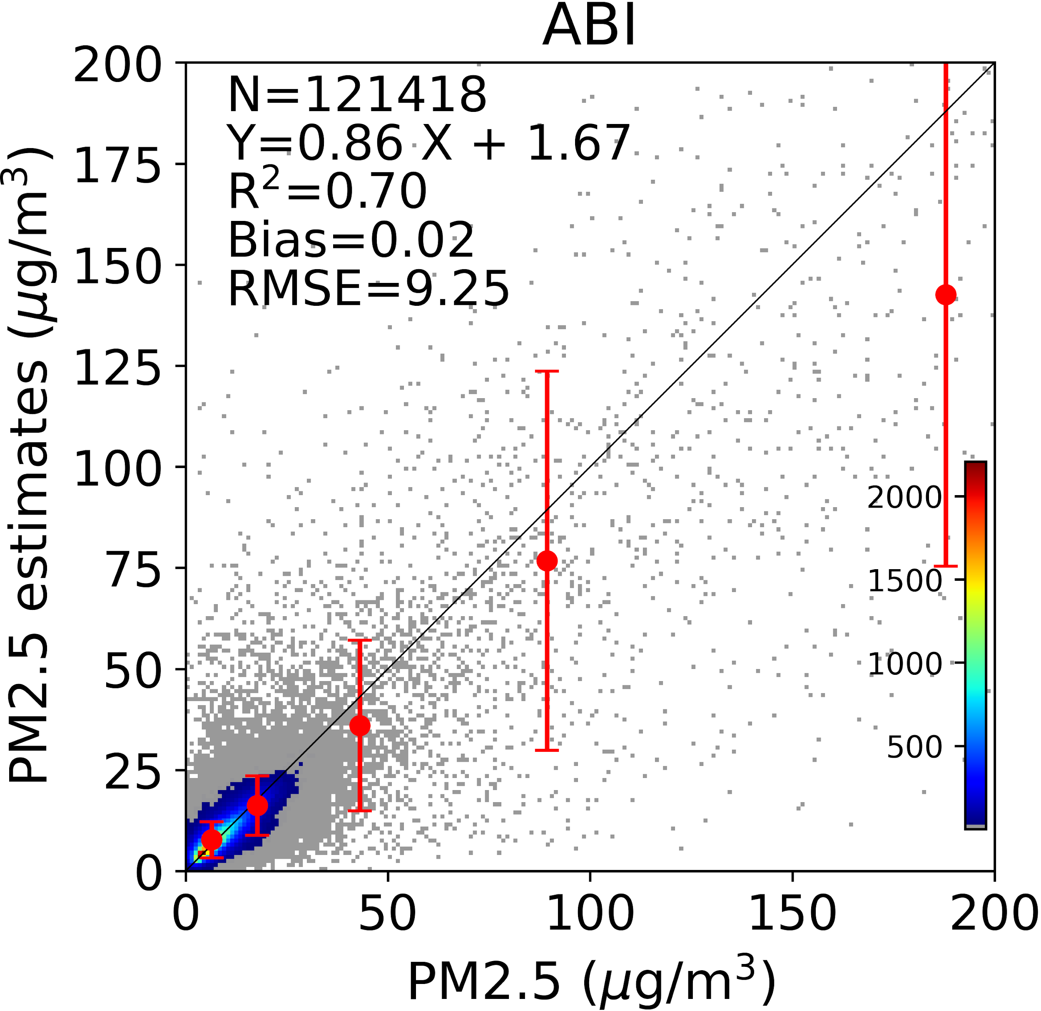
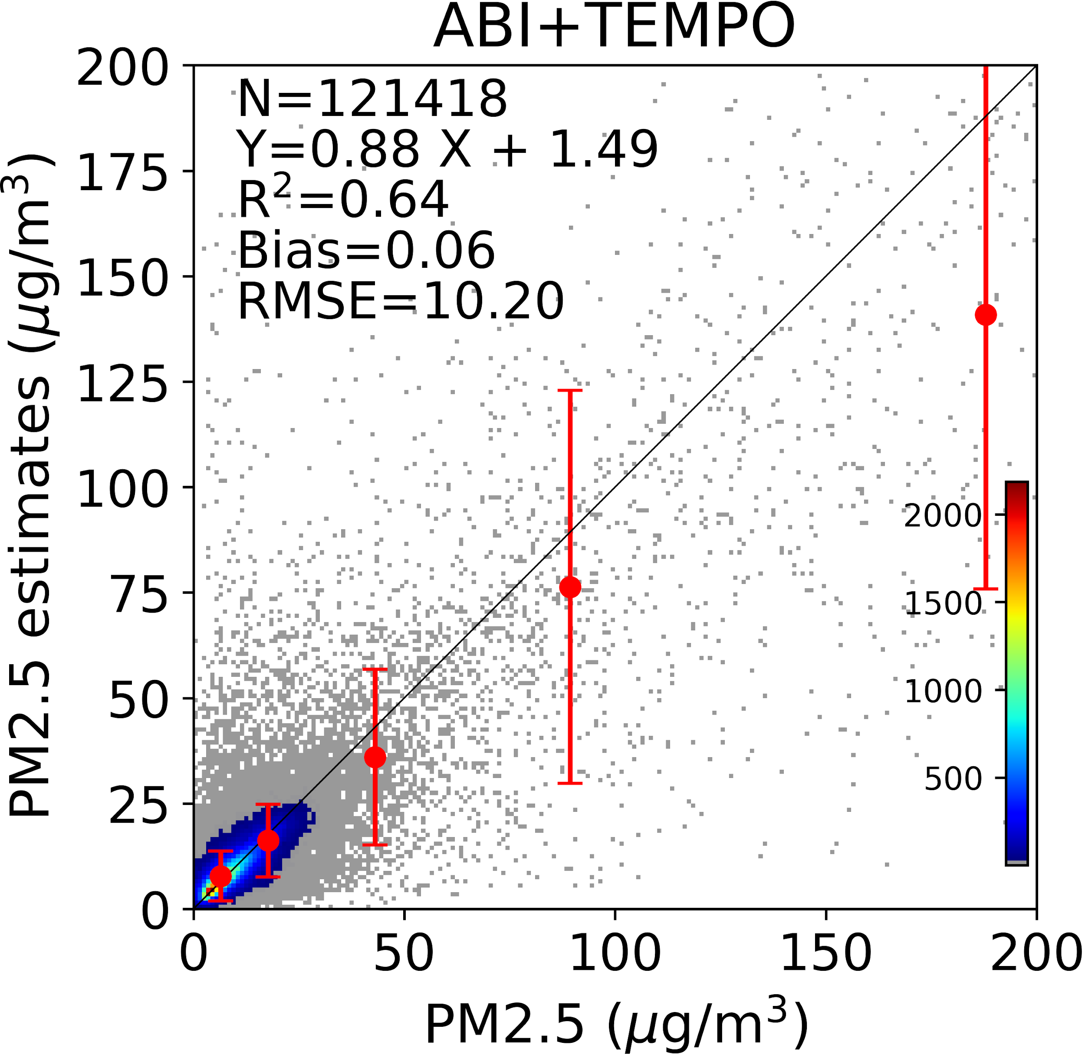
10-fold cross validation (August 2023)
TEMPO AOD and ALH have more cloud contamination, which may be the reason of lowered performance
ALH is not retrieved for AOD < 0.2, which will have many missing values in ALH. A default 1.0 km ALH is assumed for the missing value

Slide 13
Further improvements for TEMPO aerosol retrieval
More accurate retrieval is important for PM2.5 estimates
Cloud mask improvement
Bring applicable internal tests from ABI and VIIRS AOD retrieval algorithm
Tune the thresholds for the internal tests
Reduce cloud contamination
Callback of the smoke/dust plumes that misclassified as clouds
Calibration correction refinement
The ALH retrieval is very sensitive to the calibration
More examination of the calibration is necessary to get better correction coefficients

Slide 14
Summary
The aerosol optical depth and aerosol layer height retrieval algorithm was developed for TEMPO
Soft calibration was applied to improve the AOD and ALH retrieval
The GWR algorithm was applied to estimate PM2.5 from combined ABI AOD, TEMPO AOD and ALH.
Further improvement will be applied for the TEMPO AOD and ALH retrieval algorithm

