Slide 1
Satellite perspectives to changing Federal standards for PM_{2.5}
Michael Cheeseman, Shobha Kondragunta,
Hai Zhang, Pubu Ciren
Disclaimer: The scientific results and conclusions, as well as any views or opinions expressed
herein, are those of the author(s) and do not necessarily reflect those of NOAA or
the Department of Commerce.

Slide 2
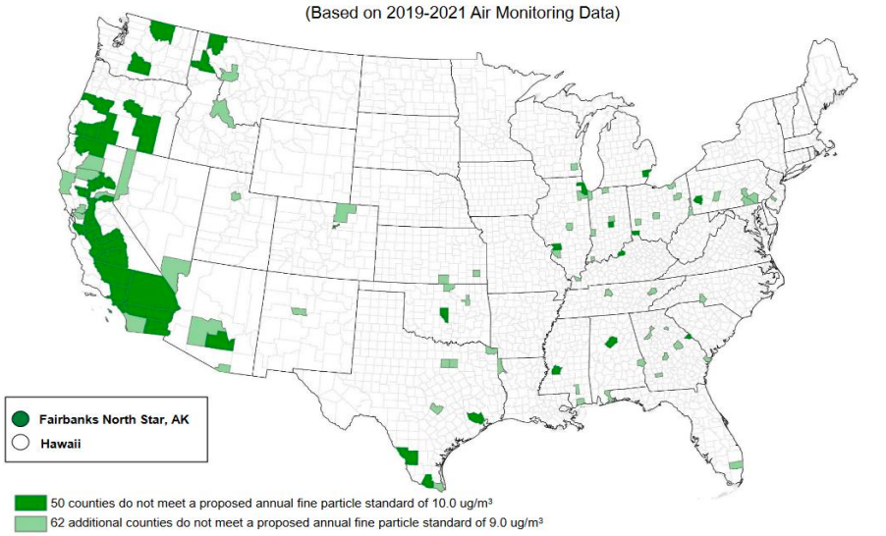
EPA amended federal standards for PM_{2.5}
In 2024, the US EPA updated the National Ambient Air Quality Standards (NAAQS) for annual average PM_{2.5} from
12 µg m⁻³ to 9 µg m⁻³
The EPA estimates that 99% of counties will be in attainment by 2032
Source: U.S. Environmental Protection Agency (EPA), Proposed Decision for the Reconsideration of the National Ambient Air Quality Standards for Particulate Matter (PM)

Slide 3
The Exceptional Events Rule (EER)
Pollution levels can often exceed the NAAQS due to unusual and naturally occurring events (exceptional events) that cannot reasonably be controlled by state regulations:

Slide 4
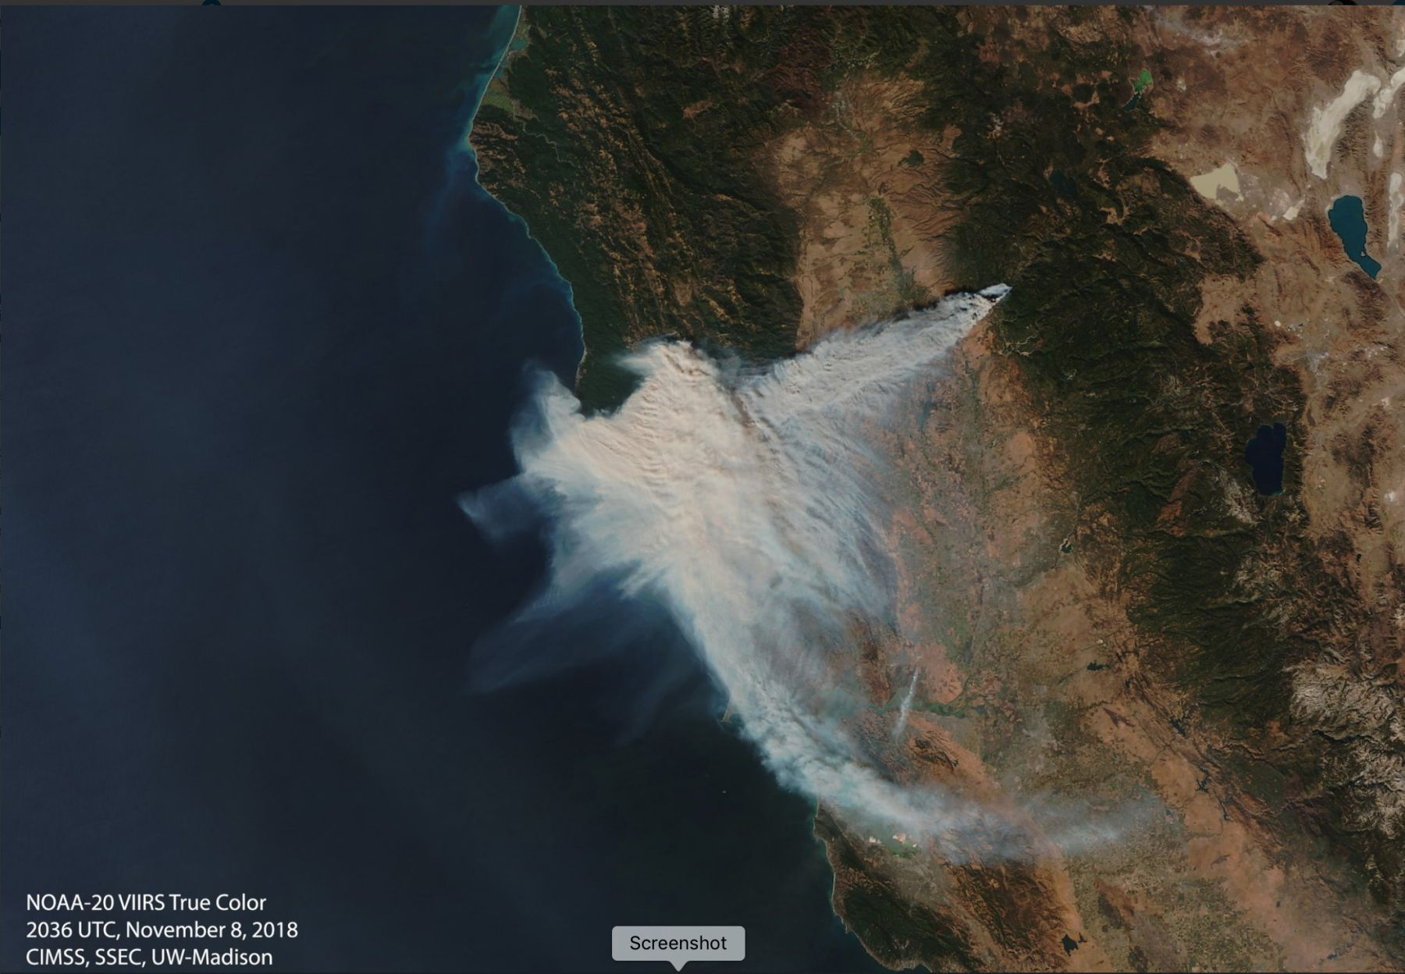
The Exceptional Events Rule (EER)
Pollution levels can often exceed the NAAQS due to unusual and naturally occurring events (exceptional events) that cannot reasonably be controlled by state regulations:
  Wildfires
  Dust storms
  Volcanic emissions
(Image credit: EUMeTrain)

Slide 5
The Exceptional Events Rule (EER)
Pollution levels can often exceed the NAAQS due to unusual and naturally occurring events (exceptional events) that cannot reasonably be controlled by state regulations:
  Wildfires
  Dust storms
  Volcanic emissions
In these cases, states can take advantage of the Exceptional Events Rule (EER) and avoid being classified as nonattainment.

Slide 6
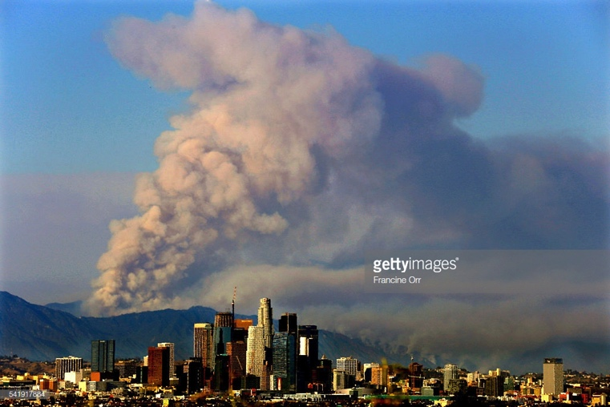
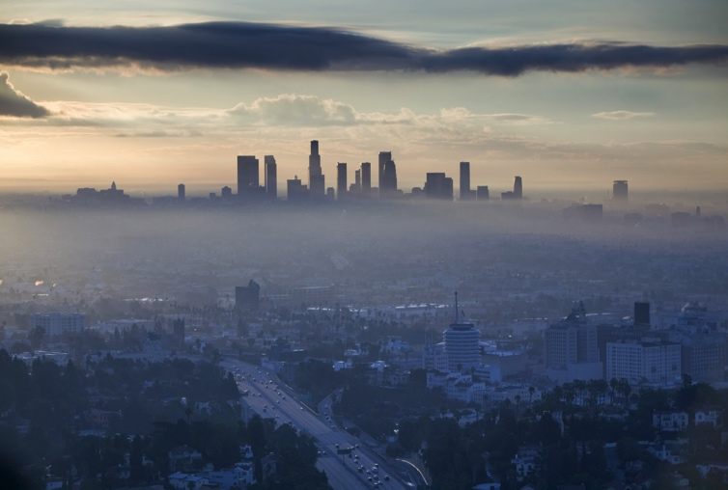
Landscape fires are becoming an increasingly important source of PM_{2.5} in the US
See Ford et al. (2018), slide courtesy of Bonne Ford

Slide 7
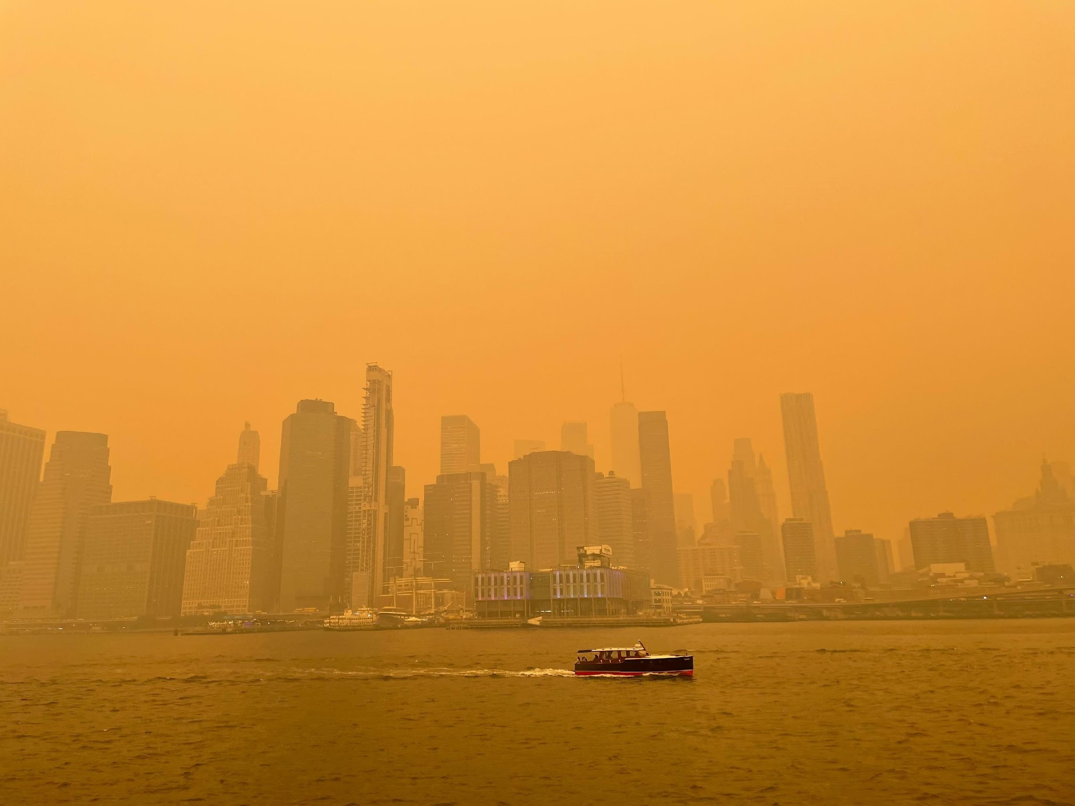
Exceptional Events Reports (EERs) have significant resource costs
A single EER for a wildfire can require tens of thousands of dollars and hundreds of working hours for local agencies.
Reducing the NAAQs will likely lead to an increase in EERs and some agencies argue those resources would be better spent on reducing local air pollution.
New York city smoke from Canadian fire in June 2023
https://www.nbcnewyork.com/local/wildfire-smoke-photos-in-nyc-show-apocalyptic-sepia-landscape/4405485/

Slide 8
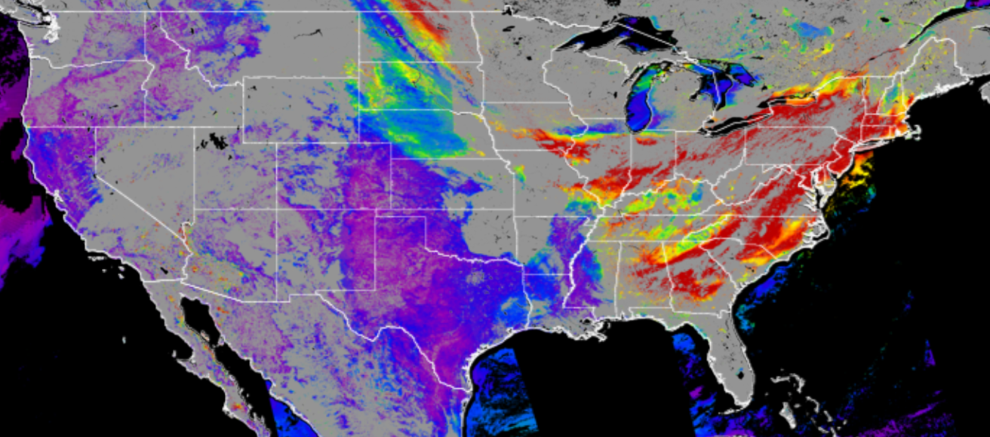
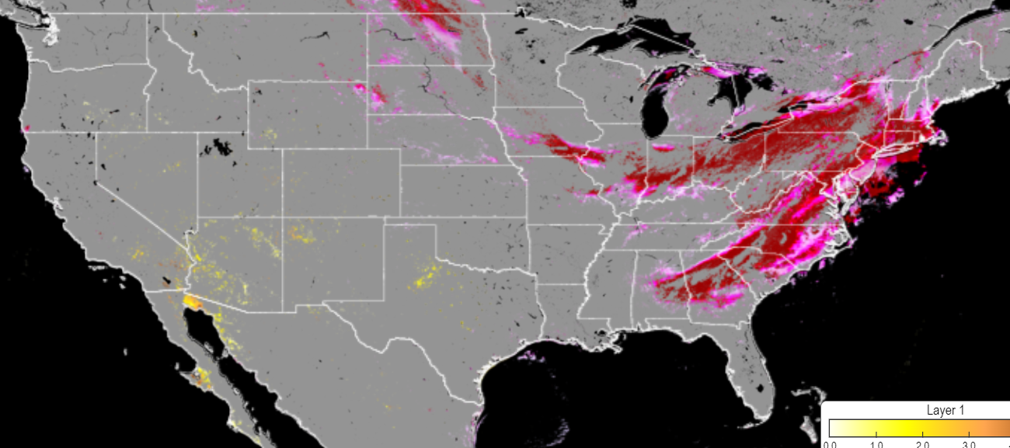
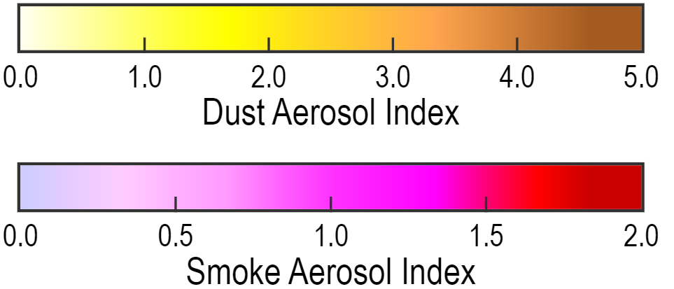
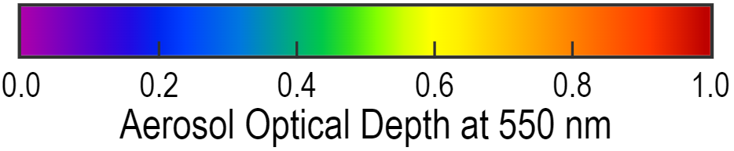
Visible Infrared Imaging Radiometer Suite (VIIRS) Aerosol Products from JPSS series

Slide 9
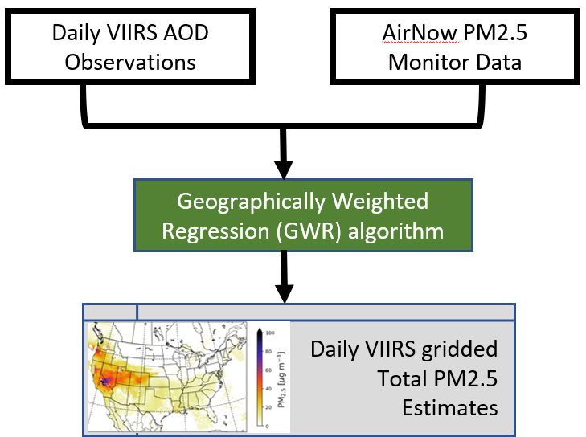
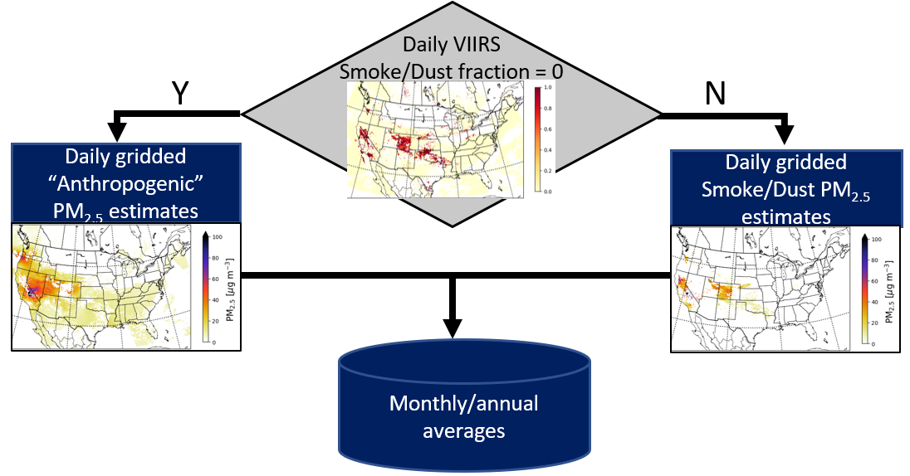
Translating satellite AOD, smoke, and dust retrievals to PM_{2.5}

Slide 10
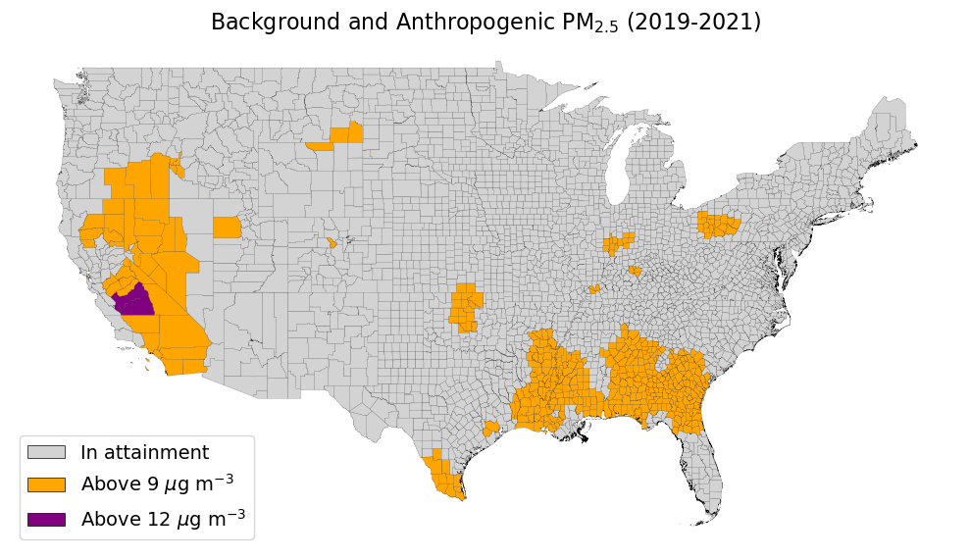
VIIRs smoke/dust-free PM_{2.5} shows many counties in excess of the new NAAQs during the 2019-2021 period
Notes:
Southeastern US exceedances may be driven by combination of local sources and optically thin transported smoke/dust that isn’t captured

Slide 11
VIIRs smoke/dust-free PM_{2.5} shows many counties in excess of the new NAAQs during the 2019-2021 period
Increase from 1.6 million people to 65 million people above the NAAQs during 2019-2021
Notes:
Southeastern US exceedances may be driven by combination of local sources and optically thin transported smoke/dust that isn’t captured

Slide 12
VIIRs smoke/dust-free PM_{2.5} shows many counties in excess of the new NAAQs during the 2019-2021 period
Southeastern exceedances may be driven by combination of smoke/dust transport, sulfate aerosols, and secondary organic aerosol (SOAs) formation.
Notes:
Southeastern US exceedances may be driven by combination of local sources and optically thin transported smoke/dust that isn’t captured

Slide 13
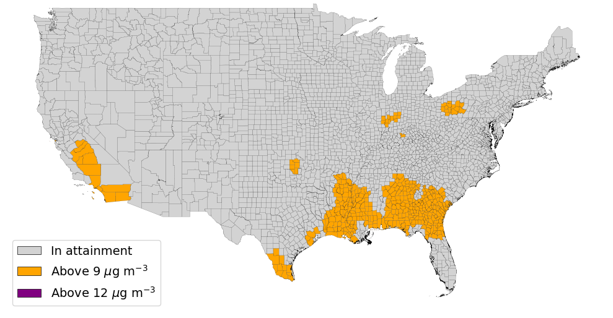
Using HMS smoke information leads to similar results in southeastern US but a decrease in the West

Slide 14
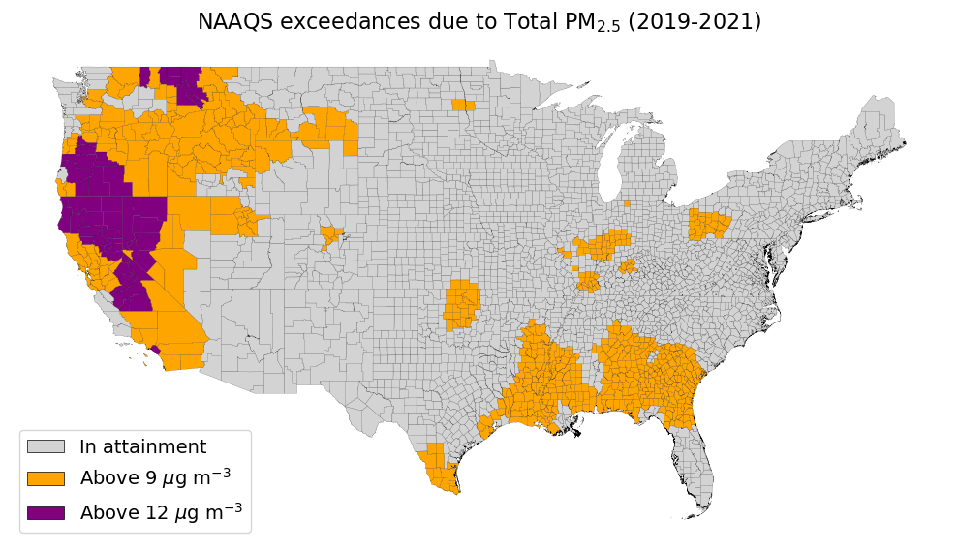
Including smoke/dust events indicates a significant increase in NAAQs exceedances
Notes:
Southeastern US exceedances may be driven by combination of local sources and optically thin transported smoke/dust that isn’t captured

Slide 15
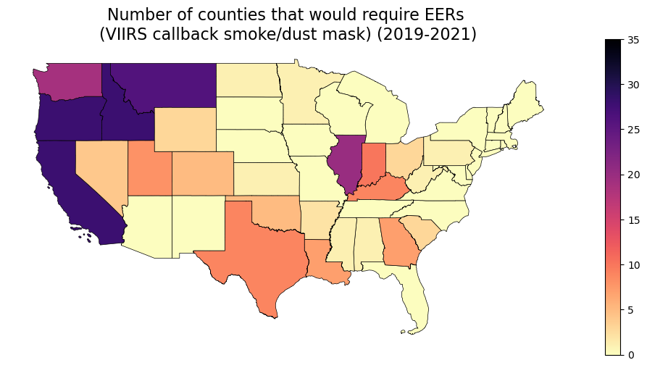
Thus, smoke/dust events will likely drive increased demand for counties to produce EERs, especially in Western US
Number of counties that would require EERs (VIIRS smoke + dust mask, 2019-2021)

Slide 16
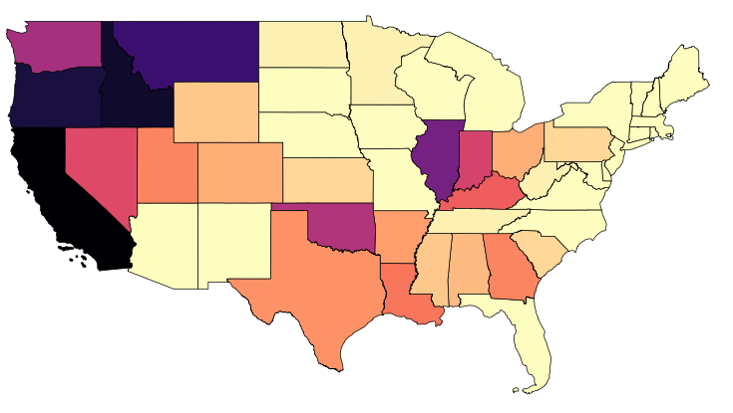
HMS indicates an even greater number of EERs during the 2019-2021 period
Number of counties that would require EERs (HMS smoke + VIIRS dust mask, 2019-2021)

Slide 17
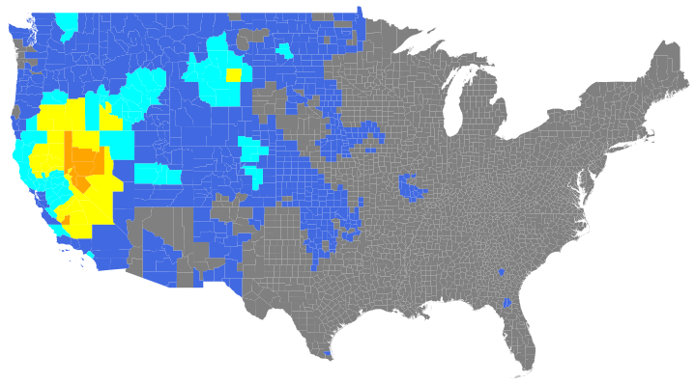
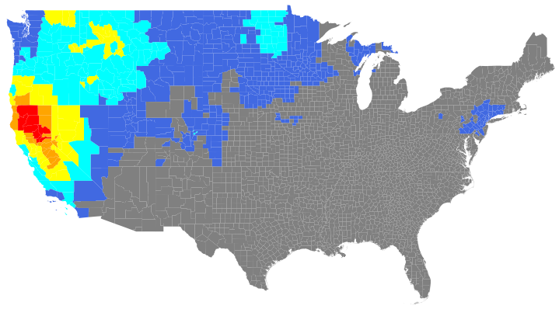
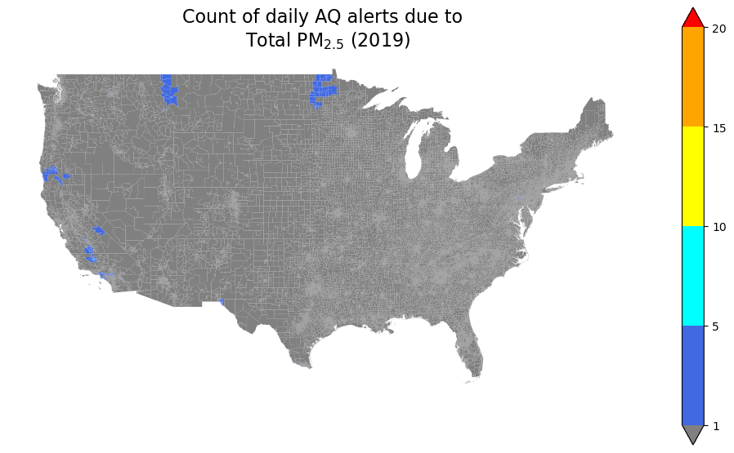
VIIRS aids in identifying areas most impacted by acute PM_{2.5} concentrations
Background/Anthropogenic PM_{2.5}
VIIRS-identified Smoke PM_{2.5}
<1
5
10
20
> 30
Number of days with hazardous PM_{2.5}

Slide 18
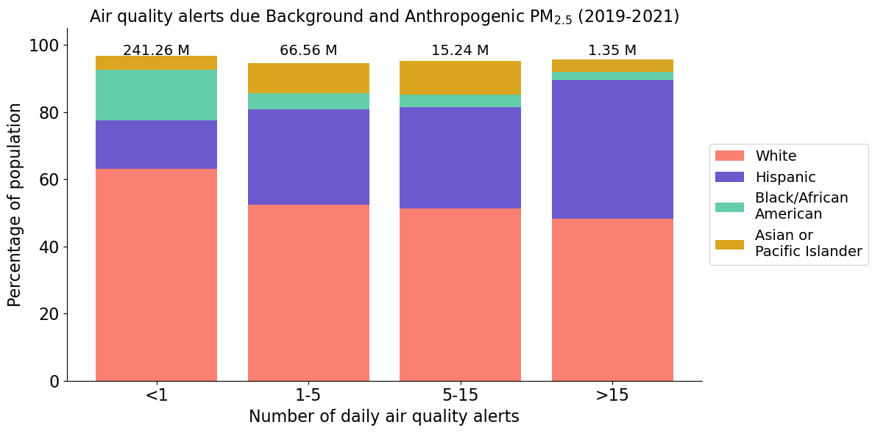
Racial/ethnic data indicates that there is some disparity in acute episodes of smoke/dust-free PM_{2.5}

Slide 19
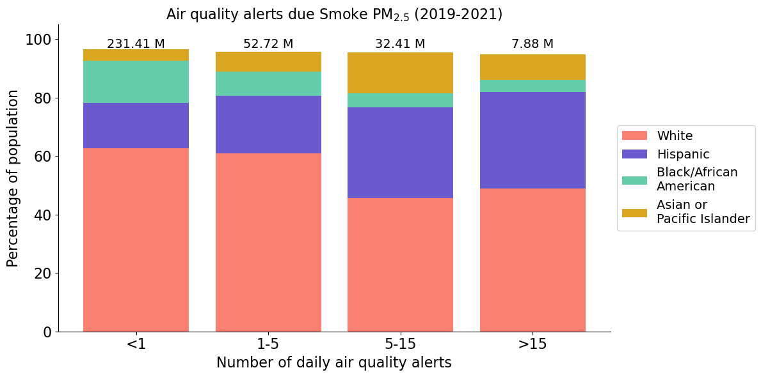
Racial/ethnic data indicates that there is some disparity in acute episodes of smoke/dust-free PM_{2.5}

Slide 20
Conclusions
VIIRS observations indicate a large population increase across many counties that will exceed the new annual PM_{2.5} NAAQS, even in the absence of smoke/dust.
  The Southeastern US may be driven by anthropogenic emissions of SO₂ and NOx that will be diminished by 2032 due to regulations.
  However, if biogenic emissions and transported smoke/dust also play a major role, this region may continue to be in exceedance of the new NAAQs.
The increasing number landscape fires and reduced annual NAAQS may lead to a large increase in Exceptional Events Reports, which require significant man-hours and analysis to complete.
VIIRS-derived PM indicates disparities in acute exposure for both anthropogenic and smoke/dust sources.

Slide 21
Supplemental Slides

Slide 22
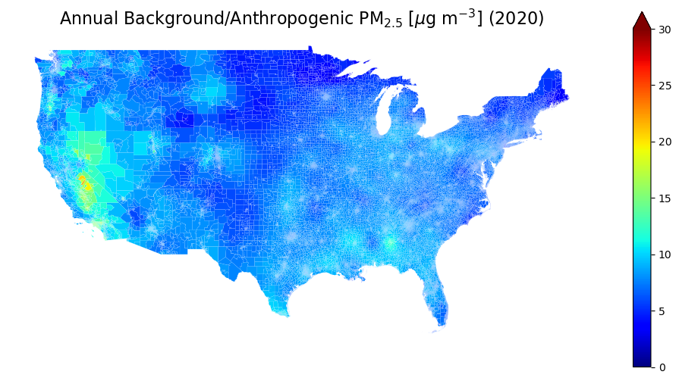
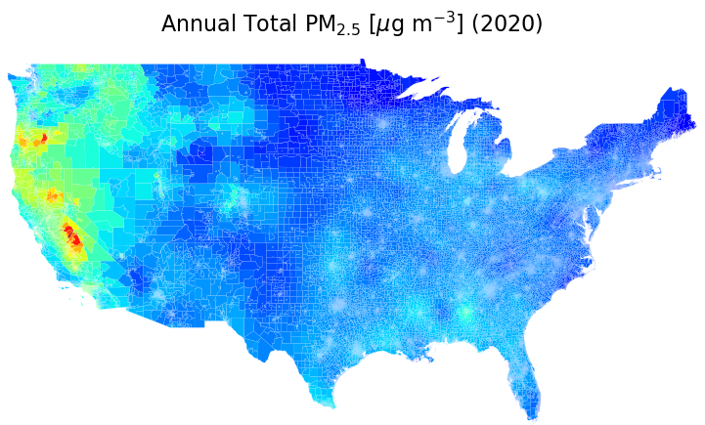
VIIRS smoke/dust retrievals are especially useful for thicker smoke plumes in the West

Slide 23
What happens when PM_{2.5} concentrations exceed the NAAQS?
If a county is in nonattainment, the state must create a
State Implementation Plan (SIP):
New York city smoke from Canadian fire in June 2023
https://www.nbcnewyork.com/local/wildfire-smoke-photos-in-nyc-show-apocalyptic-sepia-landscape/4405485/

Slide 24
What happens when PM_{2.5} concentrations exceed the NAAQS?
If a county is in nonattainment, the state must create a
State Implementation Plan (SIP):
  Show that the state has adequate air quality management program to implement NAAQS
New York city smoke from Canadian fire in June 2023
https://www.nbcnewyork.com/local/wildfire-smoke-photos-in-nyc-show-apocalyptic-sepia-landscape/4405485/

Slide 25
What happens when PM_{2.5} concentrations exceed the NAAQS?
If a county is in nonattainment, the state must create a
State Implementation Plan (SIP):
  Show that the state has adequate air quality management program to implement NAAQS
  Provides state-adopted control measures in order to reach and maintain air pollutant concentrations below the NAAQS
New York city smoke from Canadian fire in June 2023
https://www.nbcnewyork.com/local/wildfire-smoke-photos-in-nyc-show-apocalyptic-sepia-landscape/4405485/

Slide 26
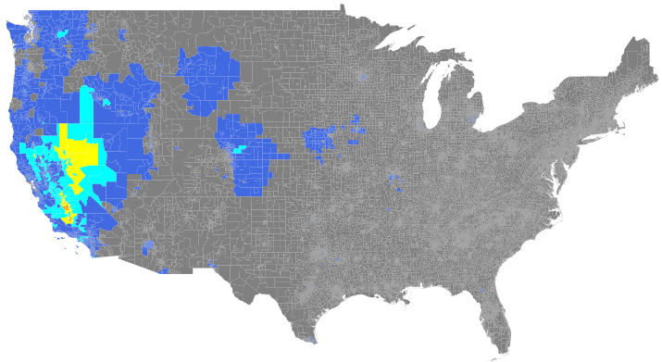
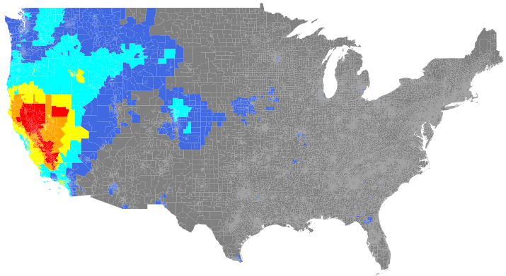
How does smoke/dust impact daily air quality disparities across the US?
Number of daily air quality alerts due to
Background/Anthropogenic PM_{2.5} (2020)
Number of daily air quality alerts due to
Total PM_{2.5} (2020)
Air quality alert:
daily PM_{2.5} > 35 μg m⁻³
<1
1-5
5-10
10-15
15-20
> 20

Slide 27
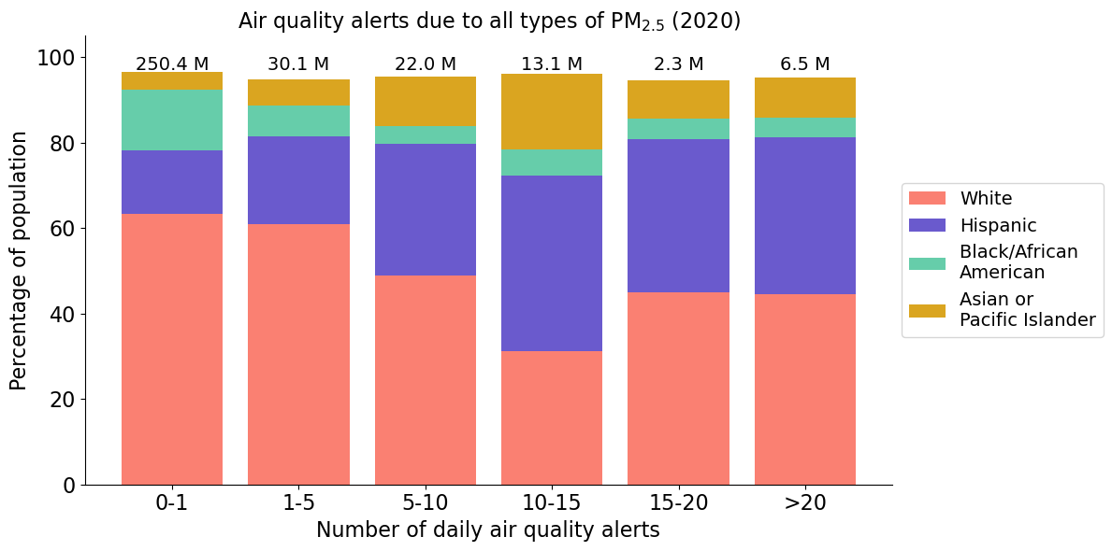
Racial/ethnic data indicates that there is some disparity in daily air quality alerts from Total PM_{2.5}

Slide 28
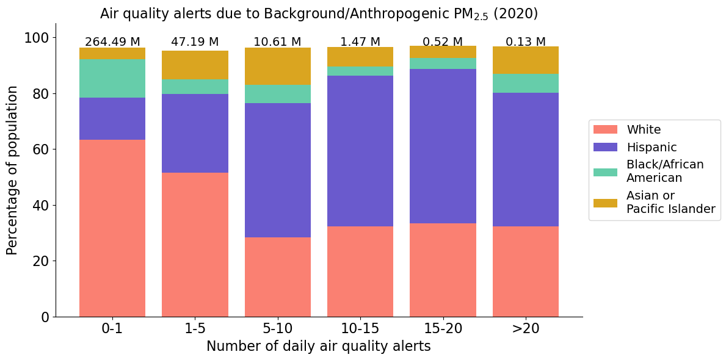
Background/anthropogenic PM_{2.5} shows even larger disparities

Slide 29
Low-fire year (2019) shows very few daily PM_{2.5} air quality alerts
Number of daily air quality alerts due to Total PM_{2.5}
<1
1-5
5-10
10-15
15-20
> 20

Slide 30
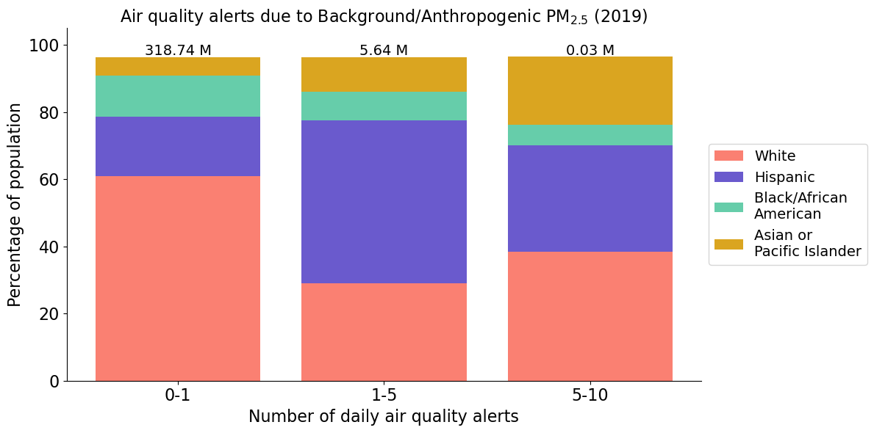
Hispanics still have proportionally higher number of daily air quality alerts

Slide 31
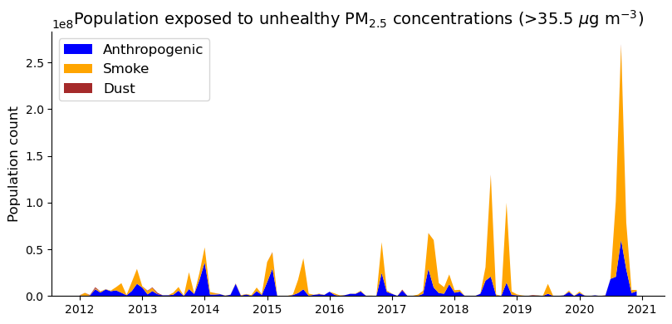
VIIRS captures acute smoke contributions to daily hazardous PM_{2.5}

