Slide 1
Evaluating TEMPO Aerosol Layer Height Product using Airborne and Ground-Based Observations
Siyuan Wang,^{1,2} Hai Zhang,³ Shobha Kondragunta,³ Brian McDonald.²
¹ Cooperative Institute for Research in Environmental Sciences (CIRES), University of Colorado, Boulder
² National Oceanic and Atmospheric Administration (NOAA), Chemical Sciences Laboratory (CSL)
³ National Oceanic and Atmospheric Administration (NOAA), National Environmental Satellite, Data, and Information Service (NESDIS)
CEOS AC-VC 2024
Notes:
2:40-2:52

Slide 2
AOCH: Aerosol Optical Centroid Height
2
TEMPO AOCH algorithm was originally developed by Jun Wang’s group (University of Iowa) and has been previously tested on TROPOMI (Chen et al. 2021) and EPIC (Lu et al. 2021).
NOAA/NESDIS (Shobha Kondragunta, Hai Zhang) is producing/maintaining the TEMPO AOCH product.
NOAA/CSL (Siyuan Wang, Brian McDonald) is evaluating the preliminary TEMPO AOCH product & iterating with the NESDIS team.

Slide 3
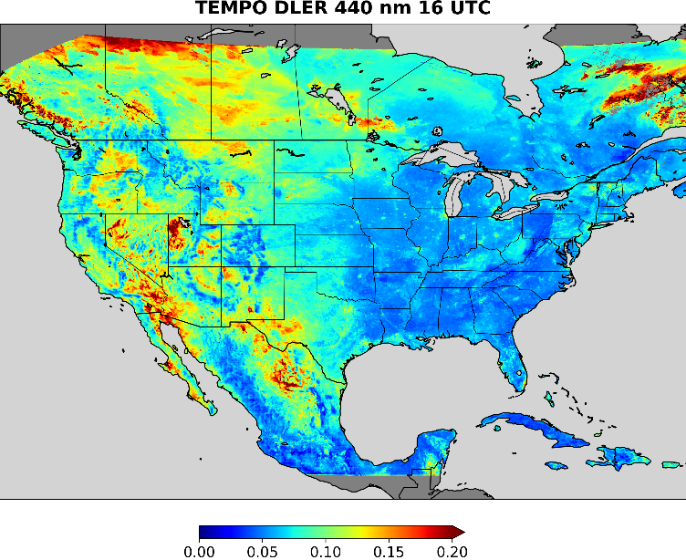
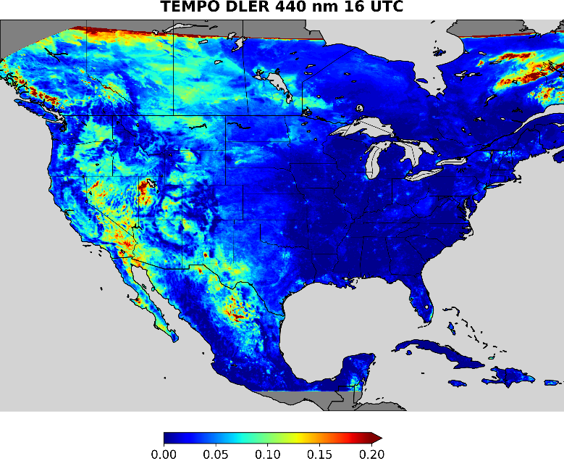
Current Status
3
Initial evaluation identified several issues, including a major high bias over water. This issue is largely fixed by re-calibrating the TEMPO TOA reflectance (Hai Zhang/NESDIS).
Plots below demonstrate the 440 nm surface reflectance before and after the L1b calibration correction.
Currently recalibrated TEMPO AOCH data available for August 2023.
BEFORE AFTER

Slide 4
TEMPO AOCH Evaluation
4
Airborne campaign: NOAA/NASA AEROMMA/STAQS (summer 2023). NASA GV/HSRL2.
Ground-based network: NASA MPLNET (summer 2023). MPL.
Airborne campaign: NOAA USUS (summer 2024). NOAA Twin Otter/Doppler Lidar.
AEROMMA/STAQS: summer 2023
20230802 ← Chicago flight (first TEMPO day)
20230804 ← Toronto flight
20230805 ← NYC flight
20230808 ← Chicago flight
20230809 ← NYC flight
20230812 ← Chicago flight
20230815 ← Chicago flight (last GV flight)
USOS: summer 2024, special case study: Park Fire (California)
20240725 ← NEXRAD radar near-field detection: Park Fire (California)
20240726 ← NEXRAD radar near-field detection: Park Fire (California)
20240728 ← Twin Otter: SLC urban pollution + transported smoke
20240730 ← Twin Otter: SLC urban pollution + transported smoke
20240801 ← Twin Otter: SLC urban pollution + transported smoke
(working in progress)
MPLNET: summer 2023
GSFC (MD): 20230802-20230831
Appalachian State (NC): 20230802-20230831
UH-Liberty (TX): 20230826-20230831
London-CDR (Canada): 20230804-20230829

Slide 5
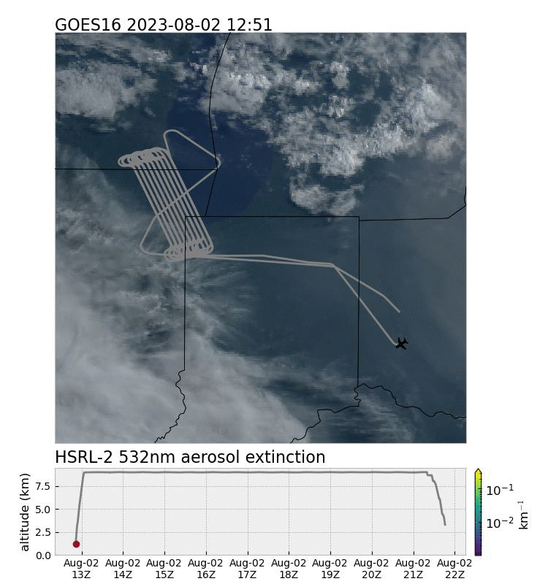
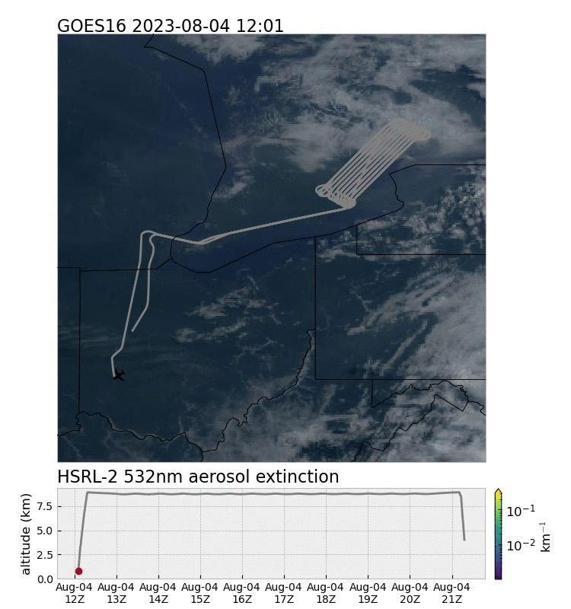
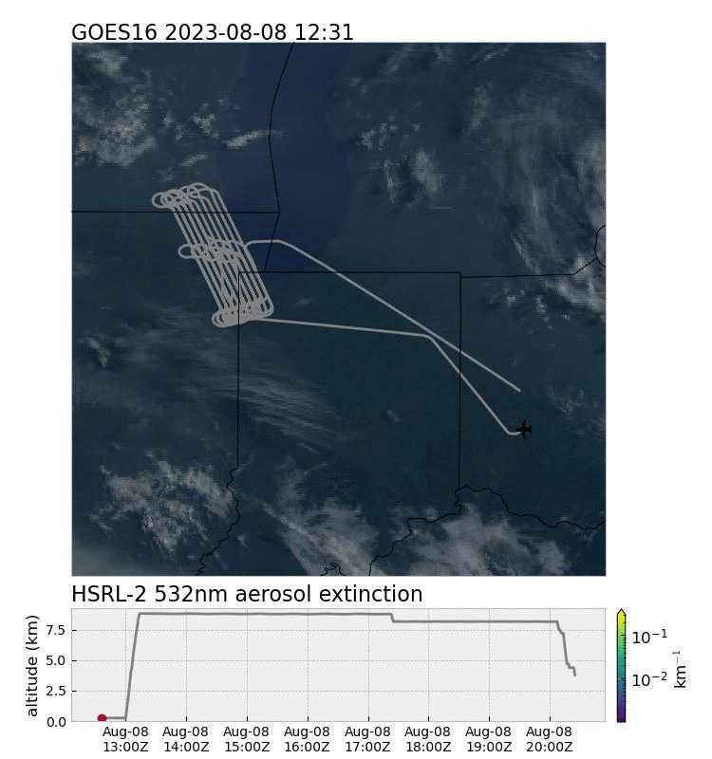
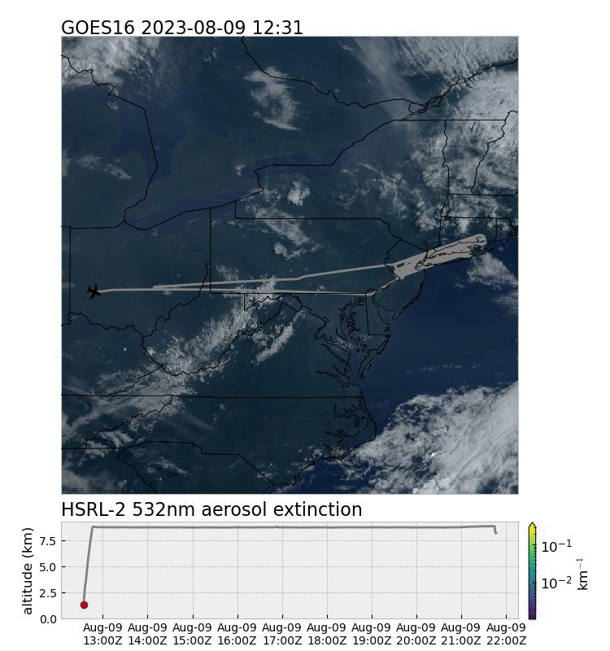
AEROMMA/STAQS: HSRL2
5
Coordinated airborne mission (DC-8, GV, …) sampling urban air pollution in multiple regions (Chicago, NYC, etc); encountered transported Canadian wildfire smoke.
↑ 0802 (Chicago): Cloudy. Lofted smoke (up to ~4km) in the morning & boundary layer aerosols.
↑ 0804 (Toronto) cloudy. Aerosols confined below 3 km, with some lofted reaching 5-7 km.
↑ 0808 (Chicago) mostly clear. Lofted smoke layer at 4-5 km decoupled from the surface aerosol layer (<3 km).
↑ 0809 (NYC): a lofted layer (up to 5km); another closer to the surface later extends deeper (also 4-5km).

Slide 6
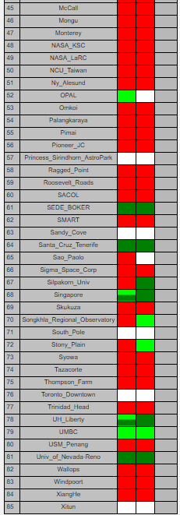
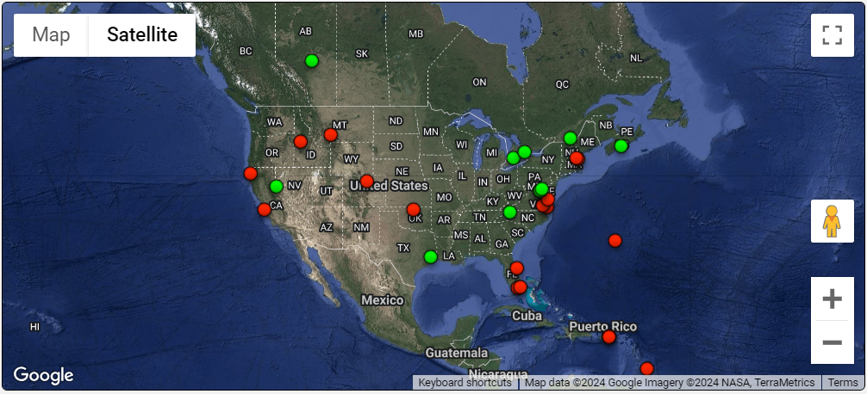
MPLNET: Micro-Pulse Lidar (MPL)
6
Multiple locations in North America, long-term operation.
For the evaluation period (Aug 2023), only 4 sites reported data: GSFC (MD), Appalachian State (NC), UH-Liberty (TX), London-CDR (Canada).

Slide 7
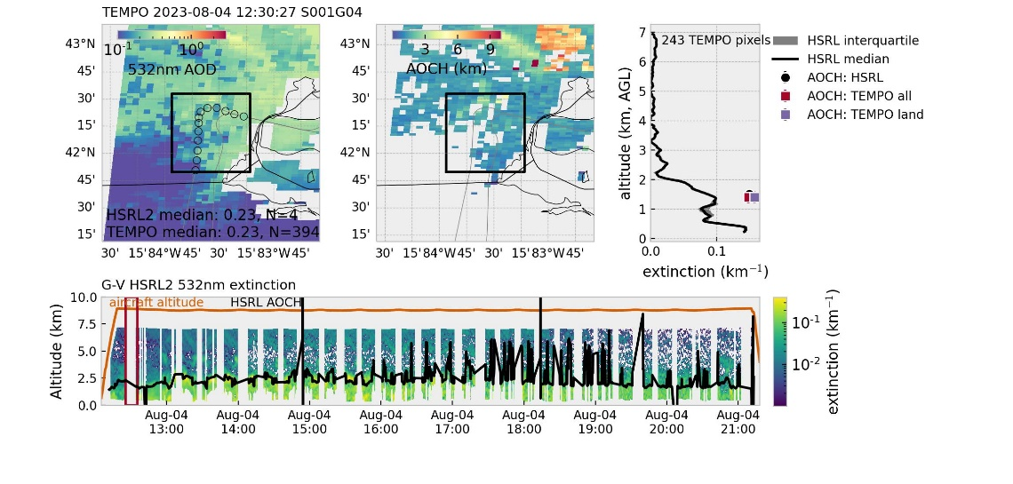
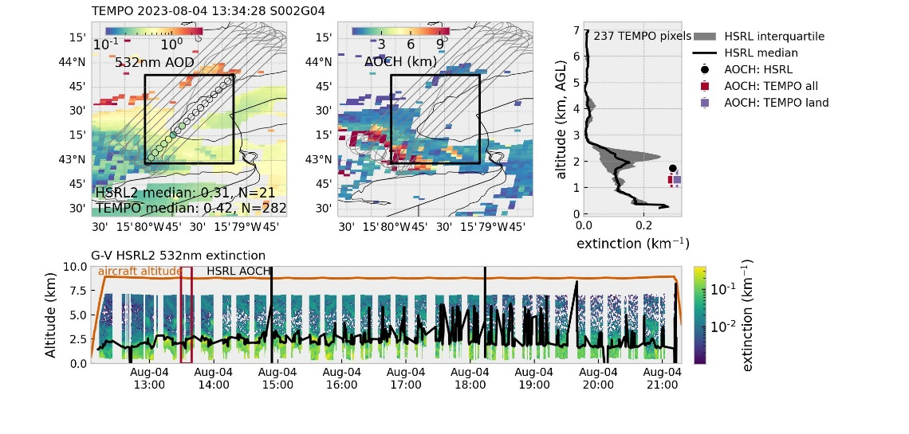
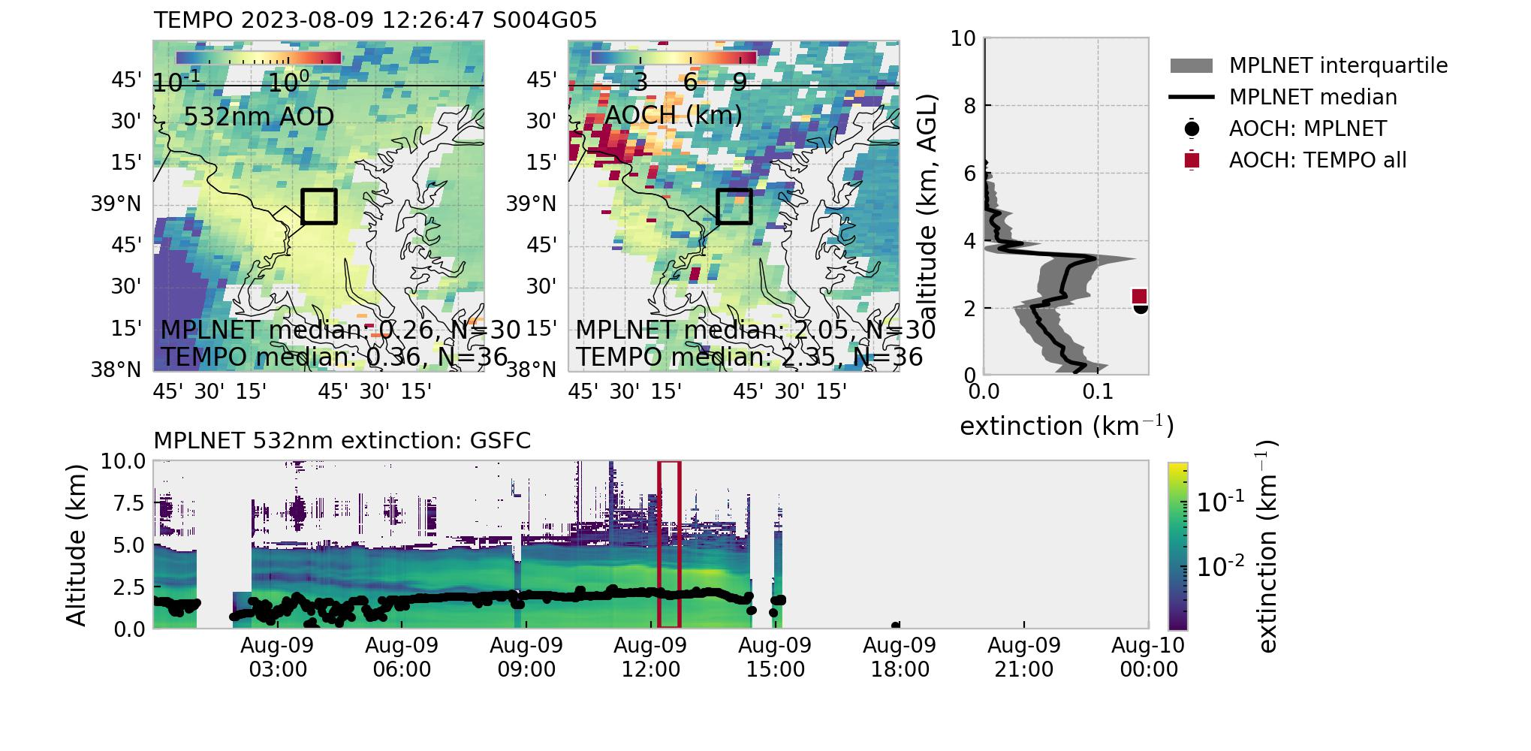
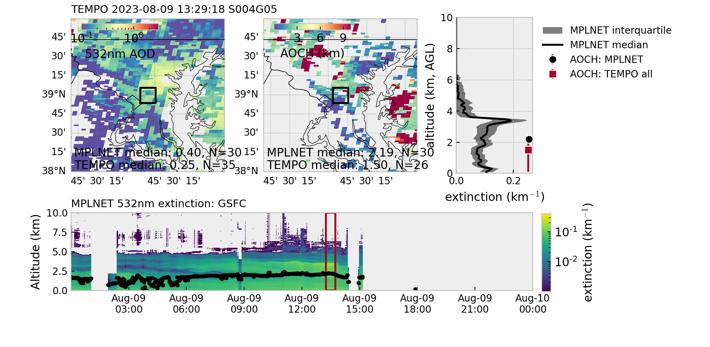
Works Well in Moderate AOD Range (>0.2)
7
← Two examples using GV/HSRL2 data during AEROMMA/STAQS
← Two examples using MPL data at GSFC
Lidar window: TEMPO overpass ± 10 min.
Geographic footprint: MPLNET within 0.1 deg; airborne: dynamically determined but no bigger than 0.5 deg.

Slide 8
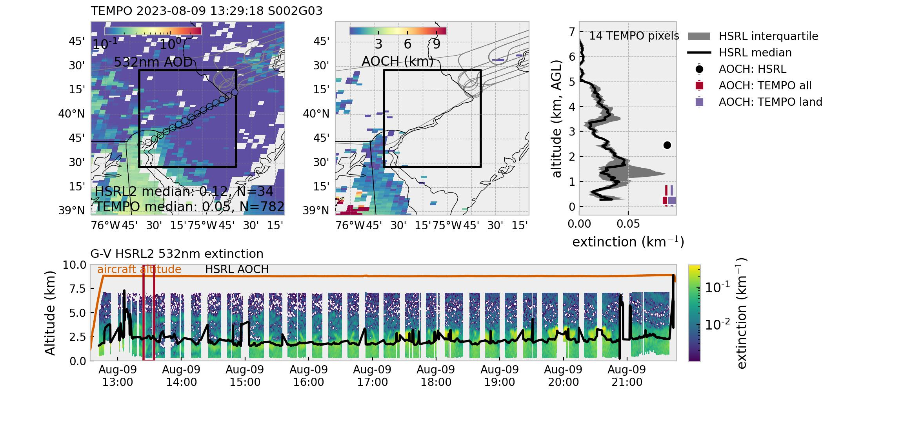
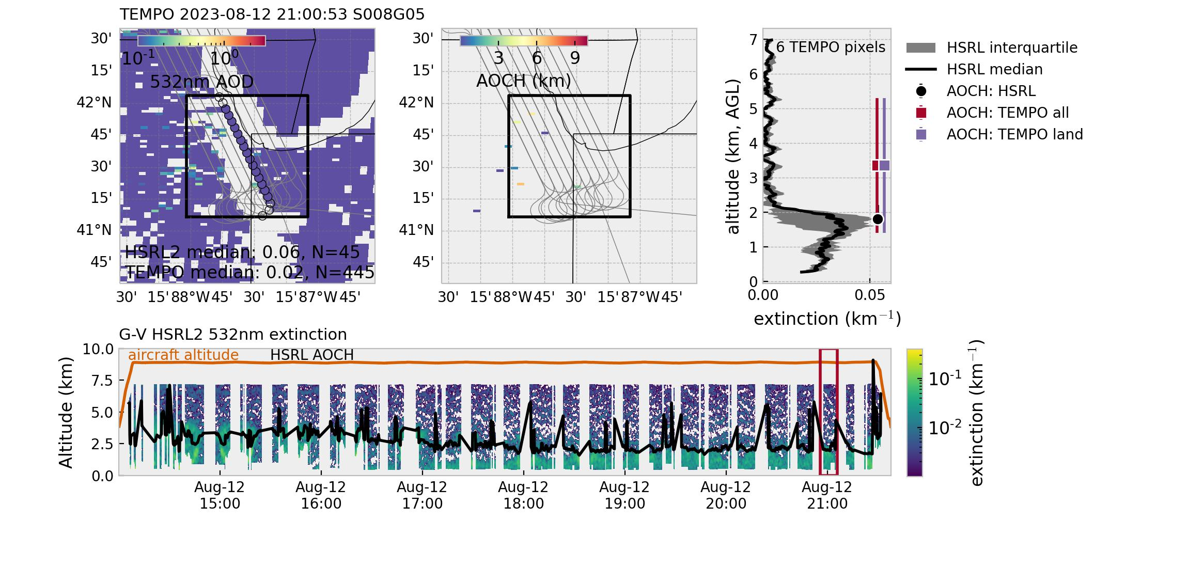
Low AOD is Challenging
8
TEMPO AOCH algorithm struggles in the low AOD range (<0.2 or so).
Of course not sufficient high quality pixels can affect the results as well.
↑ Two more examples using GV/HSRL2 during AEROMMA/STAQS. TEMPO AOCH retrievals with low AOD (<0.2) should be discarded.

Slide 9
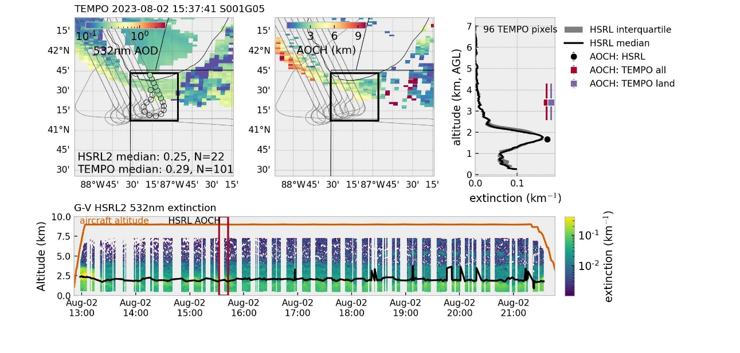
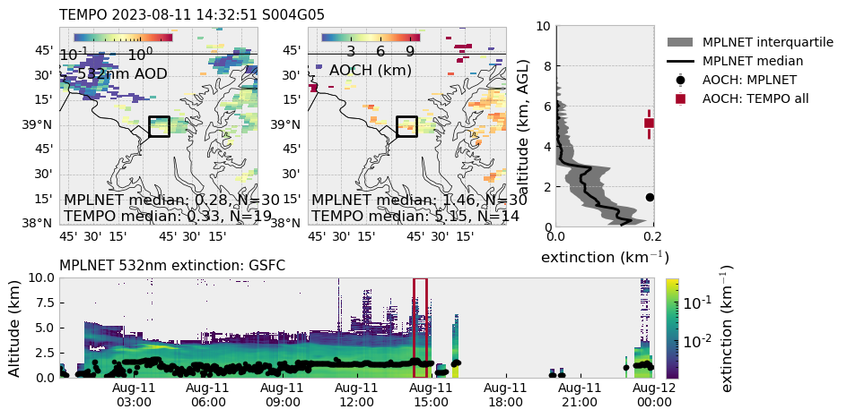
Sometimes High Biases: Not Sure Why
9
2 representations examples with moderate AOD (>0.2) and sufficient high quality pixels.
For lidar profiles, weighted extinction height is compared to AOCH (Chen et al. 2021 and refs there in), introducing some systematic bias. But the discrepancies shown in these cases are likely beyond that.
Weighted extinction height: $AOCH_{lidar}=\frac{\sum{β_{ext}Z_{i}}}{\sum{β_{ext}}}$
↑ AEROMMA/STAQS Chicago flight (GV/HSRL2). Well defined aerosol layer decoupled from surface. TEMPO AOD 0.29 (>100 good pixels).
↑ MPLNET GSFC. Surface-bound aerosols extending to ~3 km. TEMPO AOD 0.33 (19 high quality pixels).

Slide 10
Summary: MPLNET + AEROMMA
10
MPLNET
(GSFC, Appalachian State, UH-Liberty, London-CDN)
AEROMMA/STAQS
GV/HSRL2
Based on August 2023: 4 sites in MPLNET and 7 research flights during AEROMMA/STAQS. Need more observations, especially MPLNET (or similar ground-based networks).

Slide 11
Summary: MPLNET + AEROMMA
10
MPLNET
(GSFC, Appalachian State, UH-Liberty, London-CDN)
AEROMMA/STAQS
GV/HSRL2
TEMPO AOCH often shows a high bias. Number of high quality pixels? Need at least 10, but more not always better.

Slide 12
Summary: MPLNET + AEROMMA
10
MPLNET
(GSFC, Appalachian State, UH-Liberty, London-CDN)
AEROMMA/STAQS
GV/HSRL2
AOD is key: TEMPO AOD<0.2 or so should be discarded. However, in the moderate AOD range, AOD isn’t a major source of AOCH bias (<20% variability explained by AOD bias).

Slide 13
Summary: MPLNET + AEROMMA
10
MPLNET
(GSFC, Appalachian State, UH-Liberty, London-CDN)
AEROMMA/STAQS
GV/HSRL2
Solar zenith angle does not seem to affect AOCH.

Slide 14
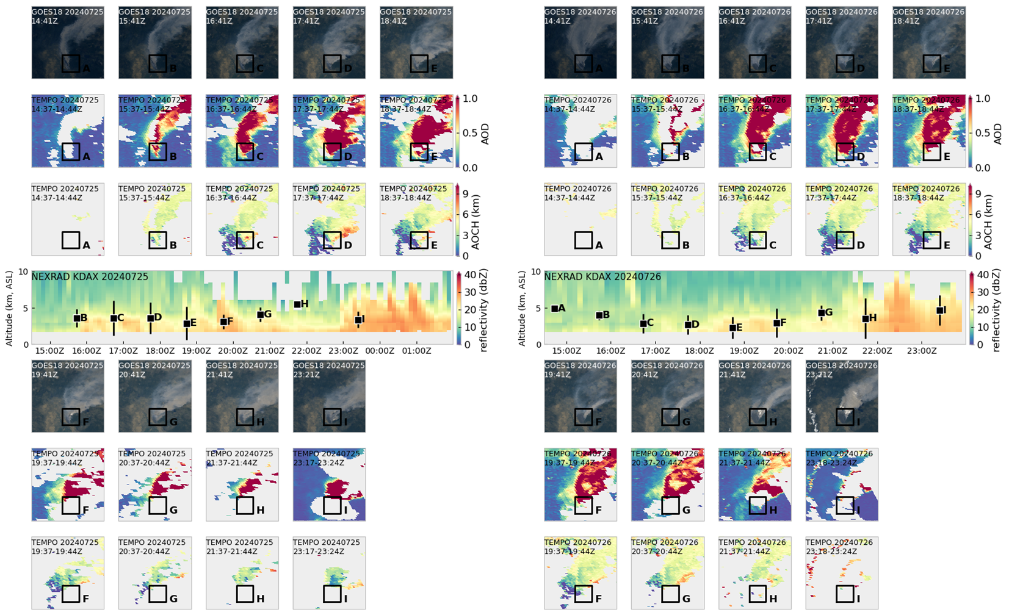
Unique Challenges with Extreme Smoke
11
Park Fire in California: ignited on 24 Jul 2024.
Plume dynamics nicely captured by NEXRAD radar.
NEXRAD radar
GOES image
TEMPO AOD
TEMPO AOCH

Slide 15
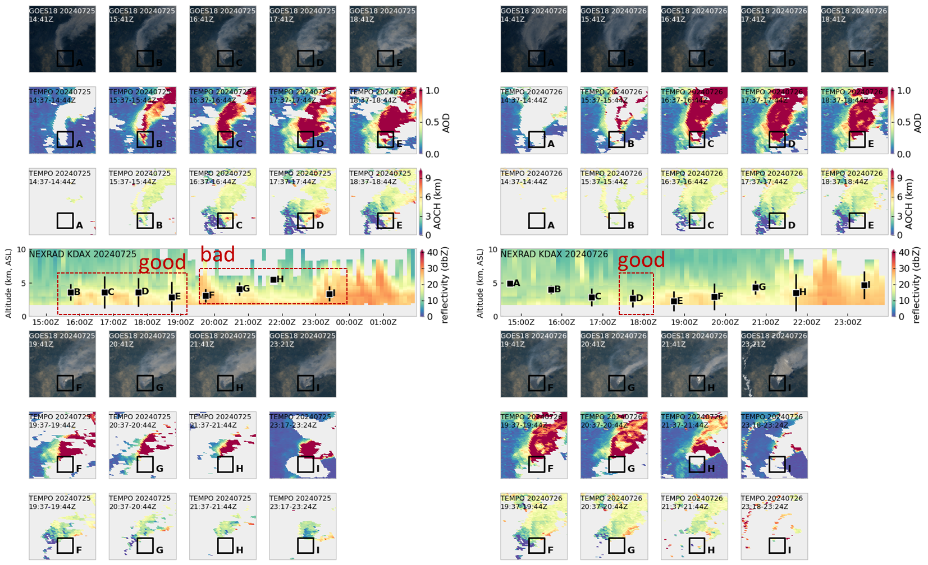
Unique Challenges with Extreme Smoke
11
Known issue: optically thick pixels misclassified as clouds with AOD retrievals. AOD is needed in AOCH retrieval.
PyroCu/PyroCb: legit fire clouds that greatly affects plume injection! AOCH is not designed for these.
Users should be careful when examining smoke injection heights near fire sources: diurnal variability may be biased by “visibility”.

Slide 16
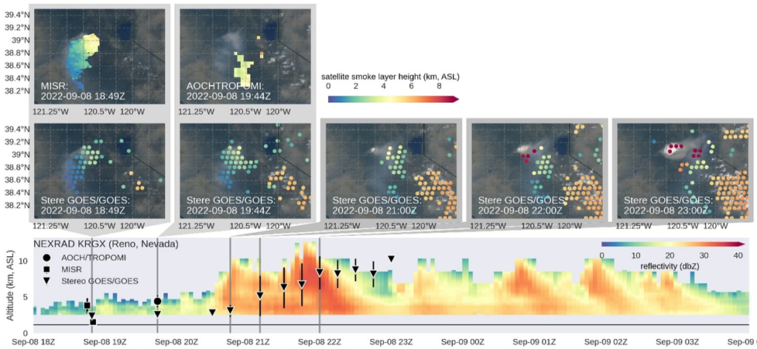
Final Remarks on Wildfire Smoke Heights
12
Optical approaches (TROPOMI AOCH, TEMPO AOCH) are sensitive to moderate AOD.
Geometry-base approaches (MISR, stereoscopic GOES/GOES) is, in theory, not affected by thick smoke, but may have reduced sensitivity for optically thin smoke/aerosols.
↓ Mosquito Fire we sampled during CALFIDE. Major pyroCb development in the afternoon captured by NEXRAD Radar and stereoscopic GEO+GEO.
MISR/Terra, AOCH/TROPOMI →
Stereoscopic GEO+GEO →
NEXRAD →
Data Courtesy: MISR: Ralph Kahn (NASA); AOCH/TROPOMI: Jun Wang (Univ. of Iowa); Stereoscopic GEO+GEO: Mariel Friberg (UMD/NASA).

Slide 17
Final Remarks on Wildfire Smoke Heights
13
Geometry-based approaches retrieve the smoke top, while optical approaches retrieve the height with max extinction (depends on smoke structure).
Be careful with the physics behind the retrievals when comparing different satellite-derived aerosol layer height products!
From the modeling perspective, optical approaches may be more useful for plume injection. But optical approaches can’t see very dense smoke or pyroCu/pyroCb, and geometry-based approaches are, in theory, not affected.
Both struggle with layered structures.
Data Courtesy: MISR: Ralph Kahn (NASA); AOCH/TROPOMI: Jun Wang (Univ. of Iowa)

Slide 18
Acknowledgements
13
HSRL2: Johnathan Hair (NASA), Taylor Shingler (NASA)
MPLNET: Judd Welton (GSFC), James Flynn (UH-Liberty), James Sherman (Appalachian-State), Robert Sica (London-CDR)
MISR: Ralph Kahn (NASA); AOCH/TROPOMI: Jun Wang (Univ. of Iowa), Xi Chem (Univ. of Iowa); Stereoscopic GEO+GEO: Mariel Friberg (UMD/NASA).

Slide 20
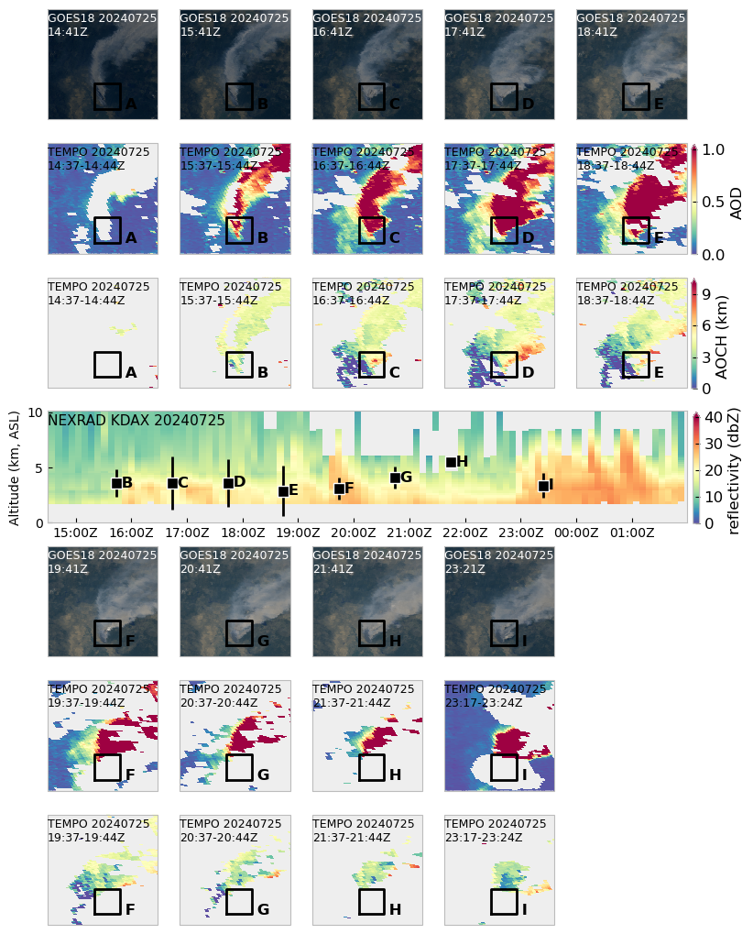
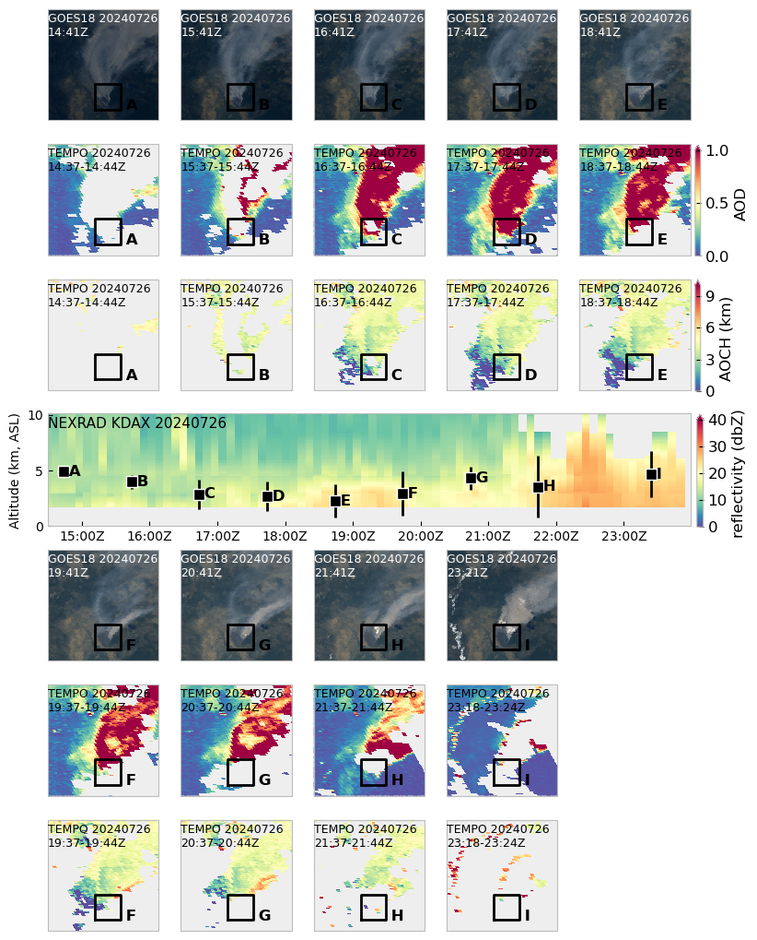
TEMPO AOCH for near-field wildfire smoke: thick smoke being misclassified as clouds and filtered out. Even more so in the early morning & late afternoon.
good
bad
good
When it works, it works nicely. But diurnal variability or statistics for plume injection may be biased. Gotta be careful.

Slide 21
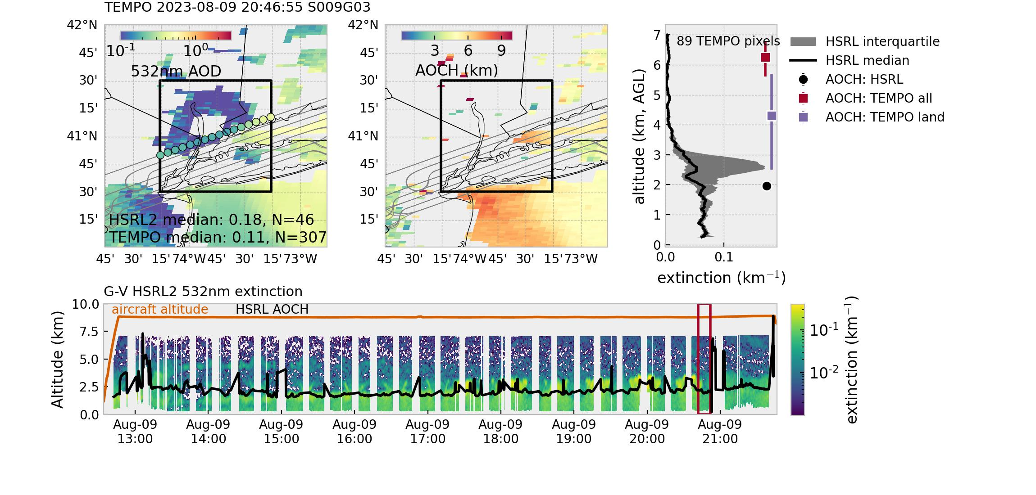
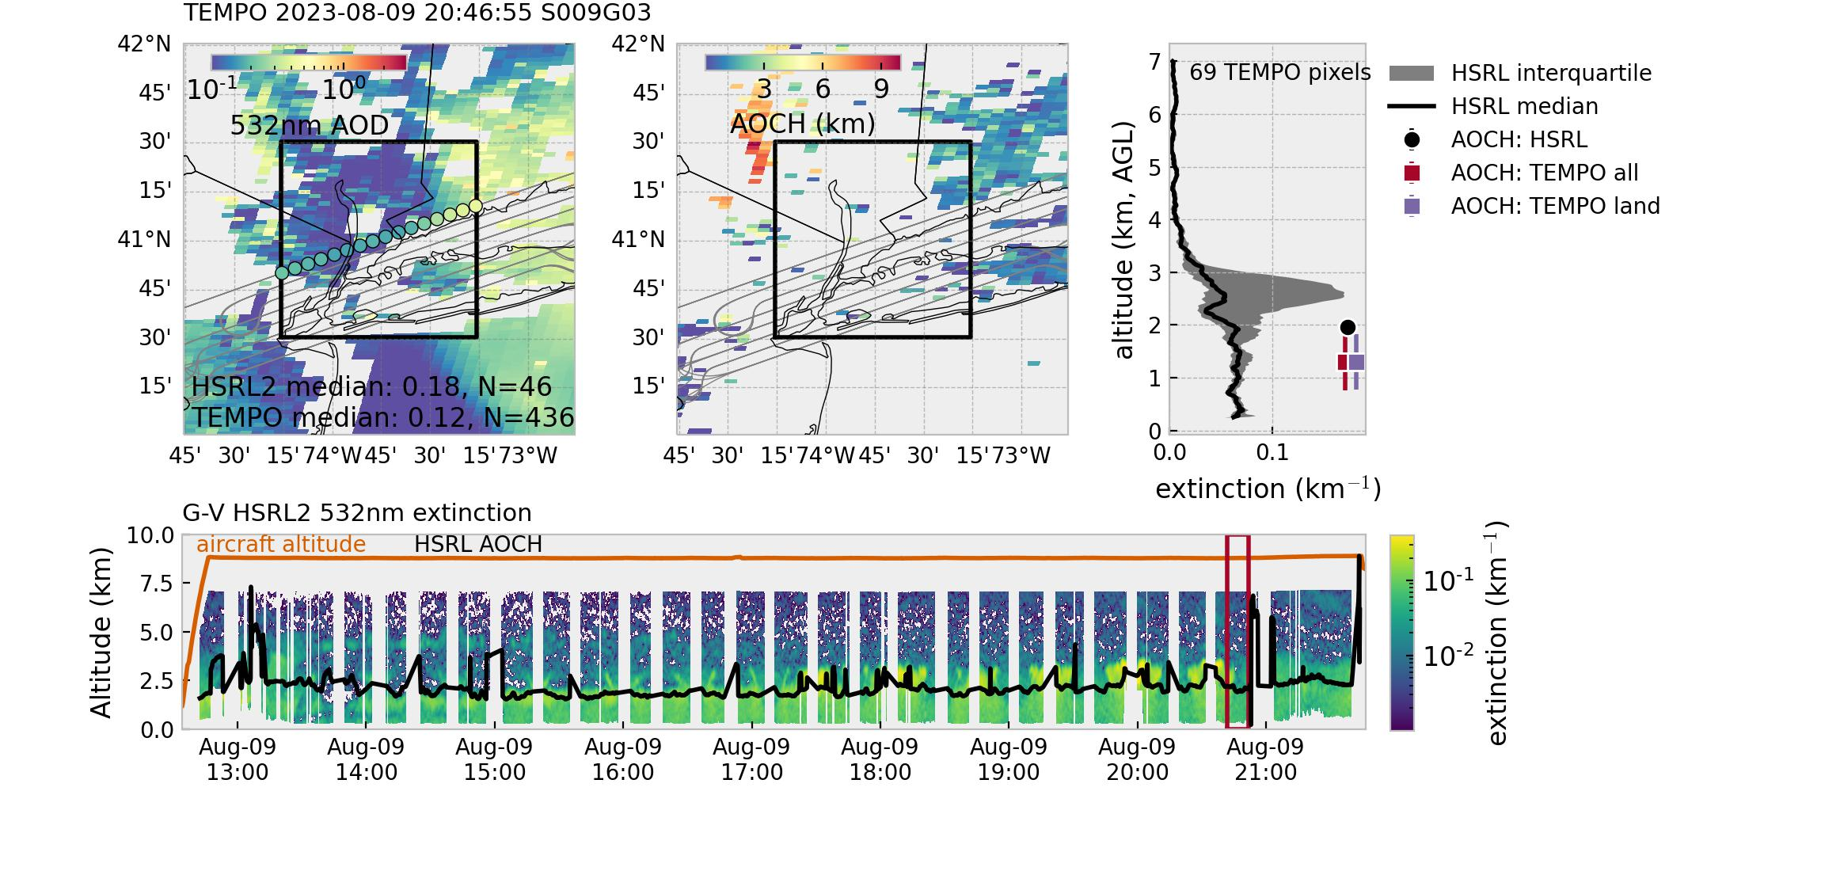
Lawn mower flight pattern over NYC.
Old batch: TEMPO AOCH is drastically overestimated, but land pixels perform better. TEMPO AOD okay.
New batch (new calibration): TEMPO AOCH is greatly improved!
Are water pixels now removed?

Slide 22
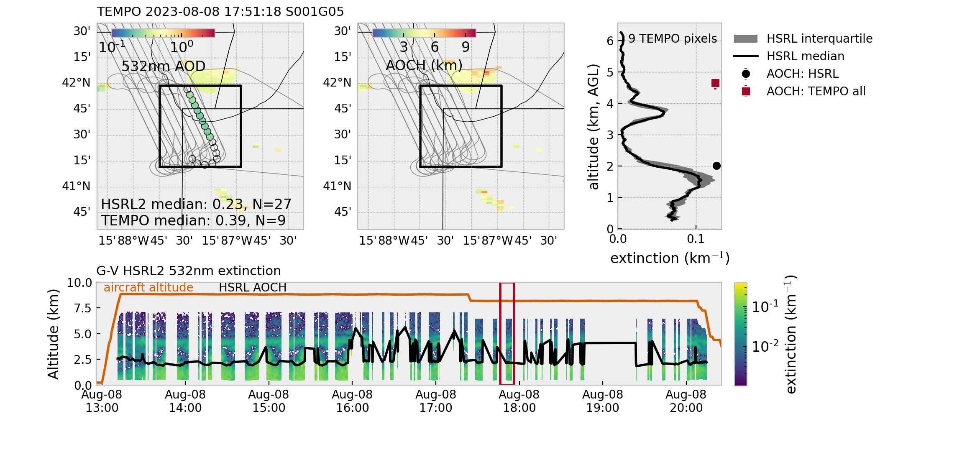
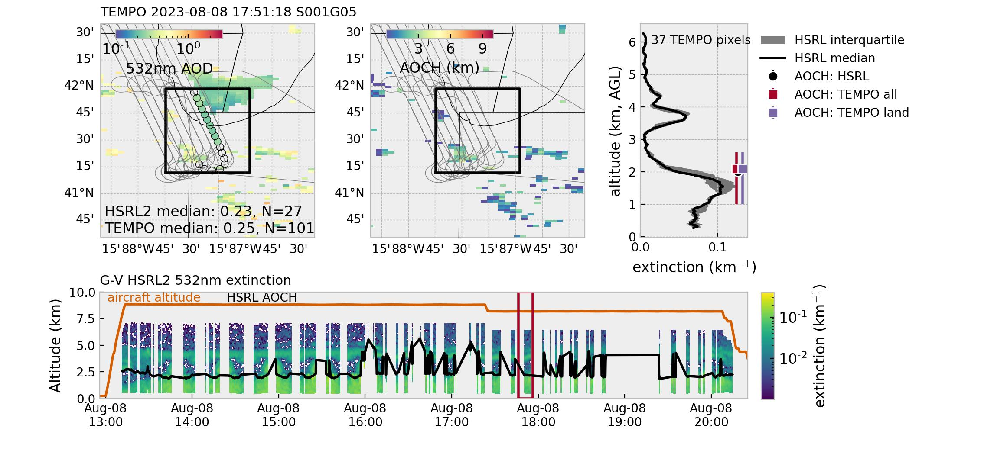
Lawn mower flight pattern over Chicago.
Old batch: TEMPO AOCH is drastically overestimated.
New batch (new calibration): TEMPO AOCH is greatly improved! AOD also improved!

Slide 23
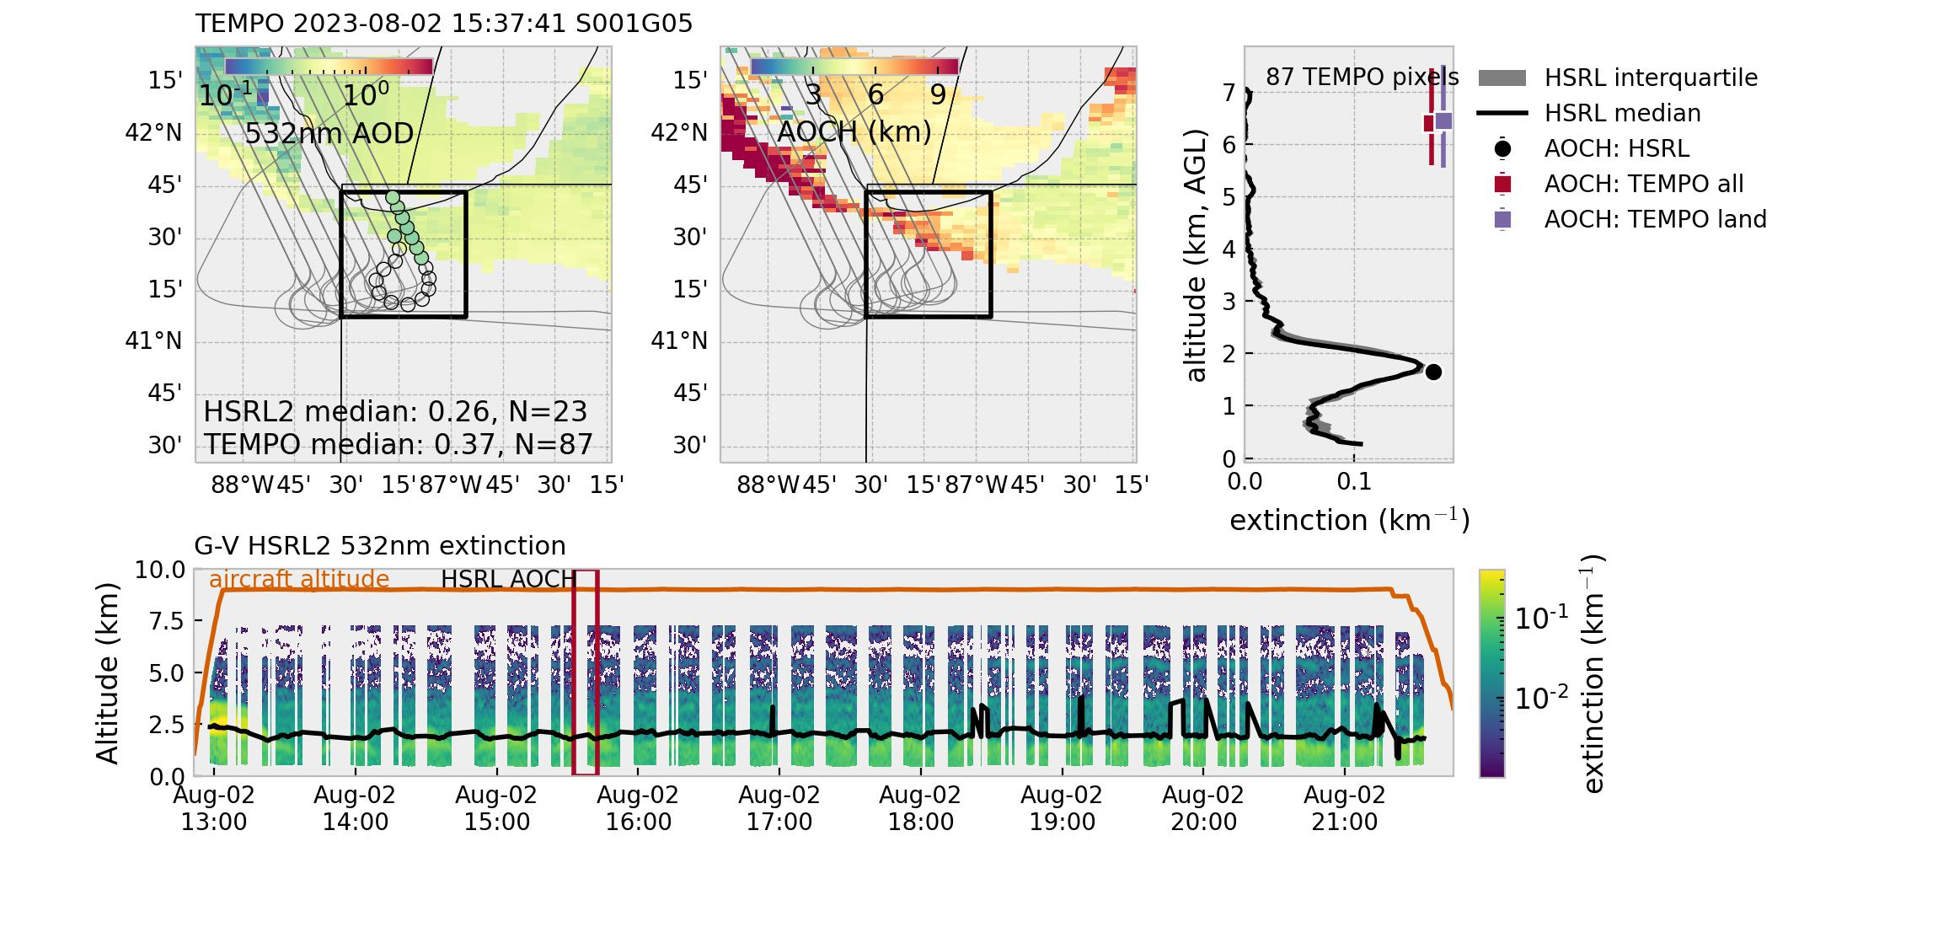
Chicago flight: mostly land grids, with a few water pixels over Lake Michigan.
Old batch: TEMPO AOD biased high (possibly beyond uncertainty); TEMPO AOCH also drastically overestimated.
New batch (new calibration): TEMPO AOD certainly improved! AOCH also greatly improved, although still shows a high bias (~1.5 km).

Slide 24
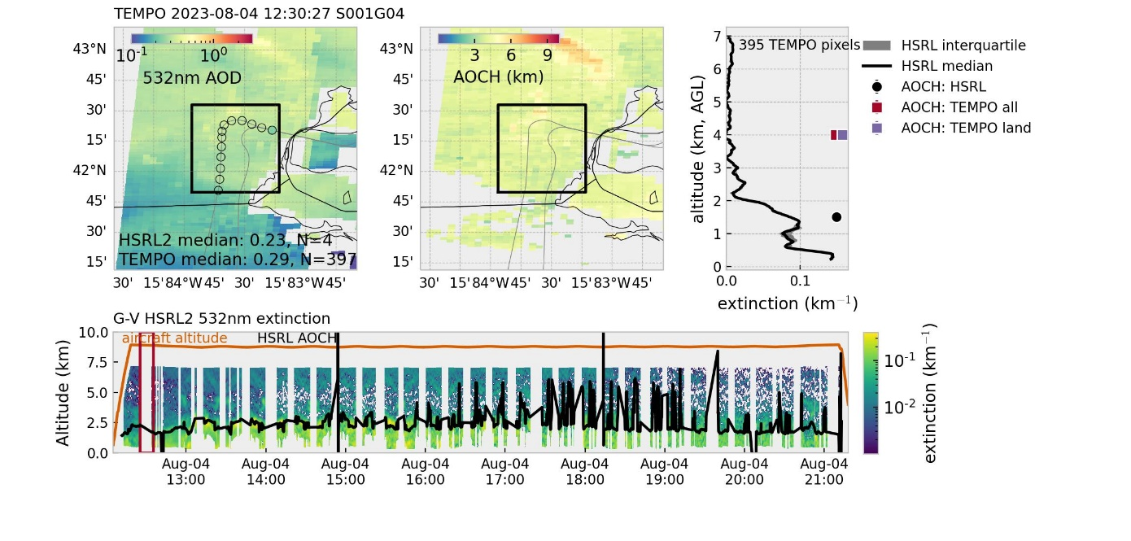
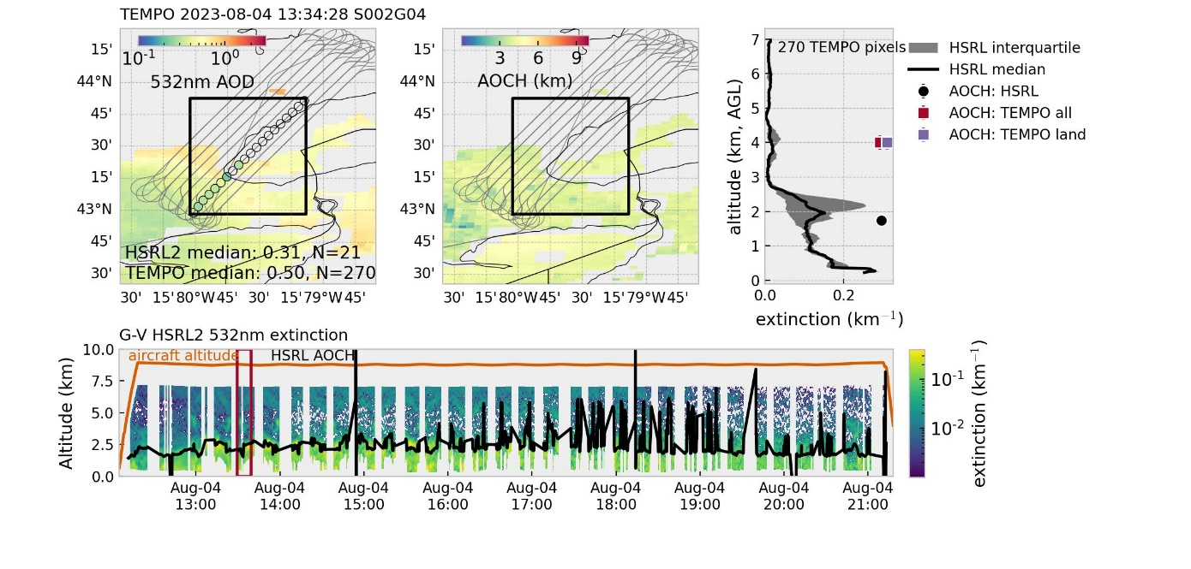
OLD
NEW
A few more examples showing drastically improved TEMPO AOCH in the moderate AOD range (0.2-0.3).
One of the previously identified issues associated with water pixels appear to be resolved.

Slide 25
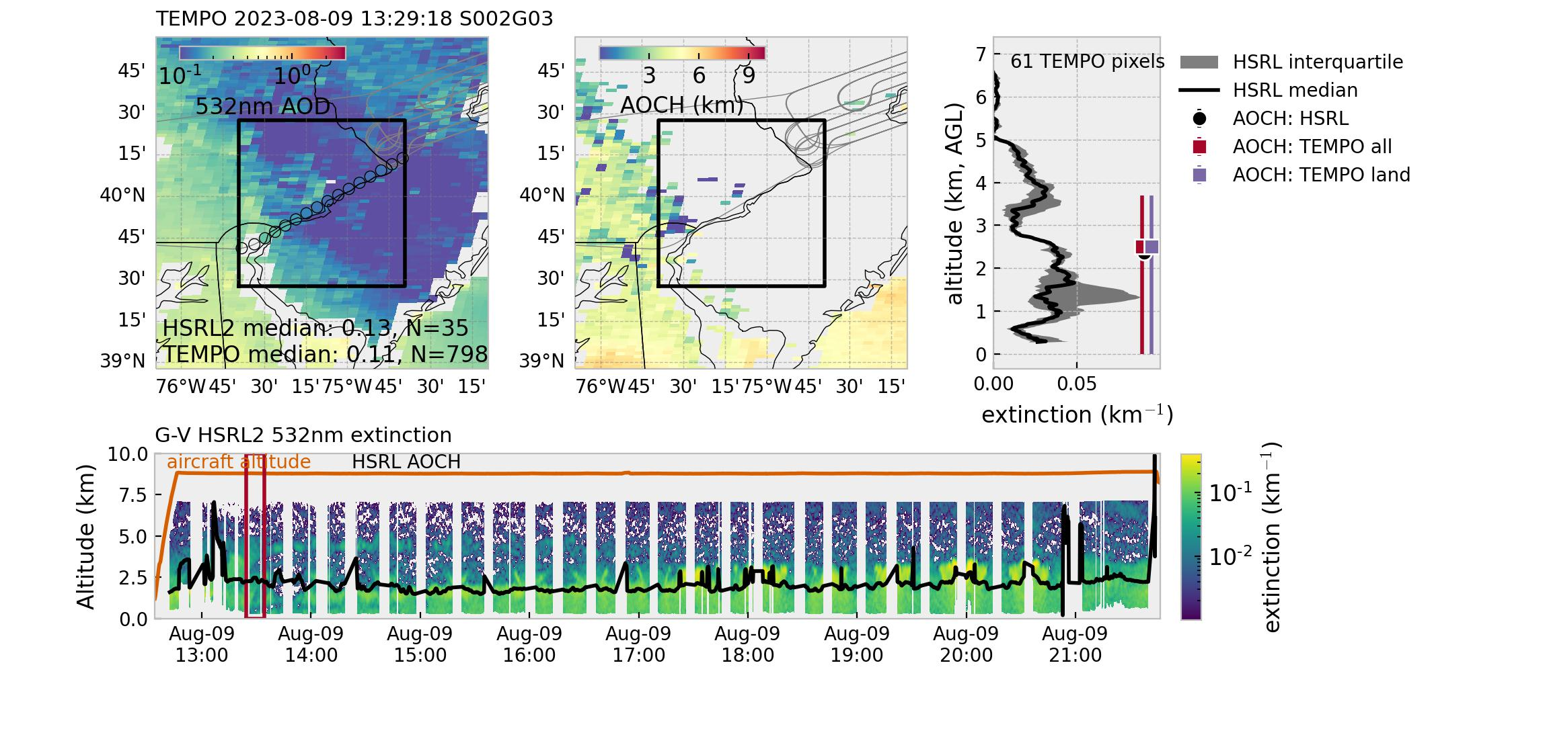
Transit to NYC: mostly land grids. Lofted smoke layer & urban pollutants near surface.
Old batch: TEMPO AOCH and AOD both in good agreement with GV HSRL2.
New batch (new calibration): TEMPO AOD now a bit lower. TEMPO AOCH very close to the surface. But this is a tricky case because AOD was pretty low.

Slide 26
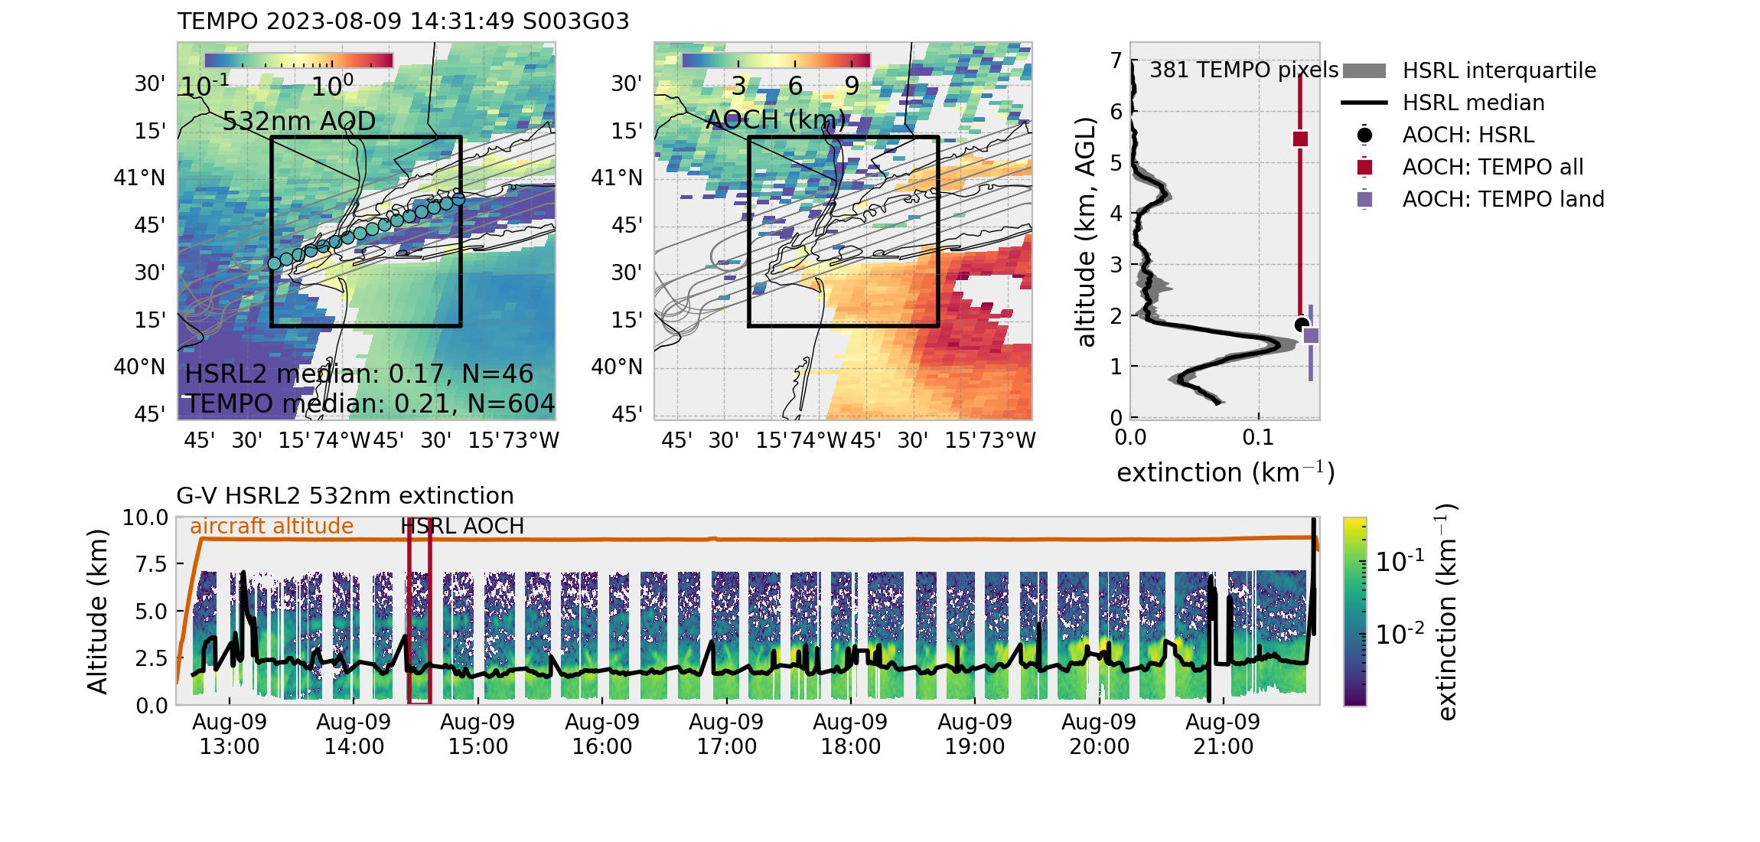
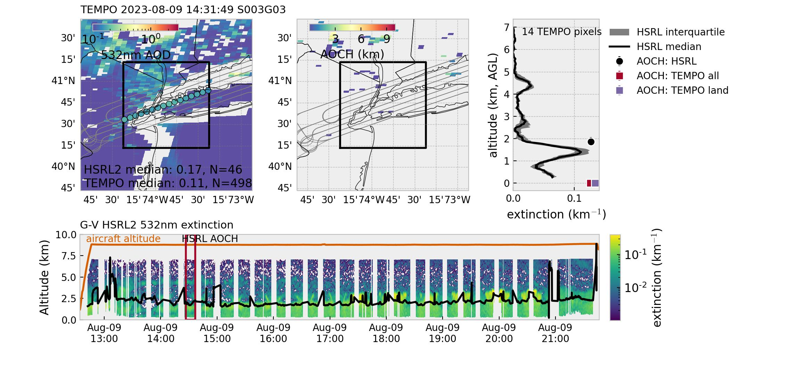
Lawn mower flight pattern over NYC: mixed land & water grids.
Old batch: TEMPO land retrievals show very good agreement with GV HSRL while water retrievals are drastically overestimated. TEMPO AOD okay.
New batch (new calibration): TEMPO AOCH again very close to the surface, although HSRL2 shows nicely defined aerosol layers (one at ~1.5km, another at ~4.5 km). Not many TEMPO pixels available.
Are water pixels now removed?

Slide 27
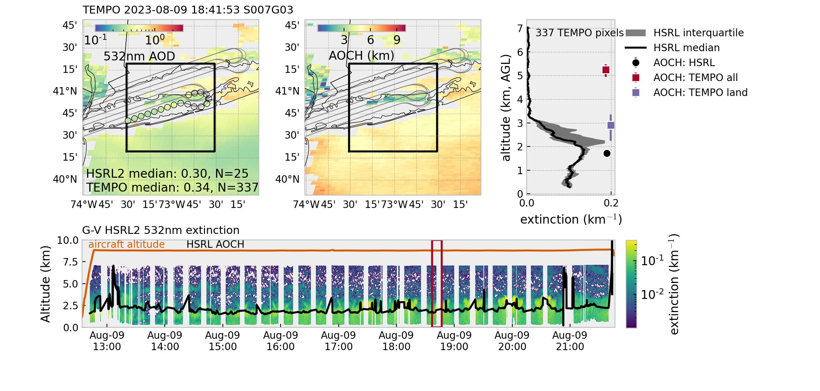
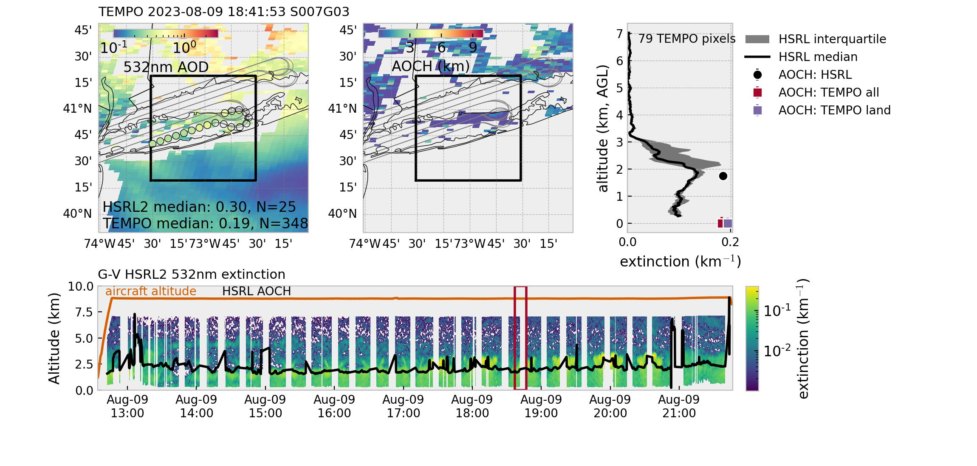
Lawn mower flight pattern over NYC: mixed land & water grids.
Old batch: TEMPO water pixels greatly overestimates AOCH; land pixels look much better! TEMPO AOD very good.
New batch (new calibration): TEMPO AOCH again very closely confined to the surface. HSRL2 shows an aerosol layer peaking at ~2km.

Slide 28
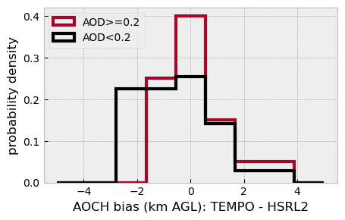
With limited flights, AEROMMA does not provide the best statistics. GV HSRL2 sampled a fairly narrow range of AOCH (mostly 1.5-2.5km).
Number of high quality pixels mostly isn’t an issue.
TEMPO AOCH shows slightly better performance in the moderate AOD range (>0.2); AOD bias explains up to 15% of AOCH bias.
In these urban settings, SZA doesn’t seem to affect TEMPO AOCH retrieval.
All pixels RMSE: 1.4 km; MAE: 1.1 km
AOD>0.2 RMSE: 1.1 km; MAE 0.7 km

Slide 29
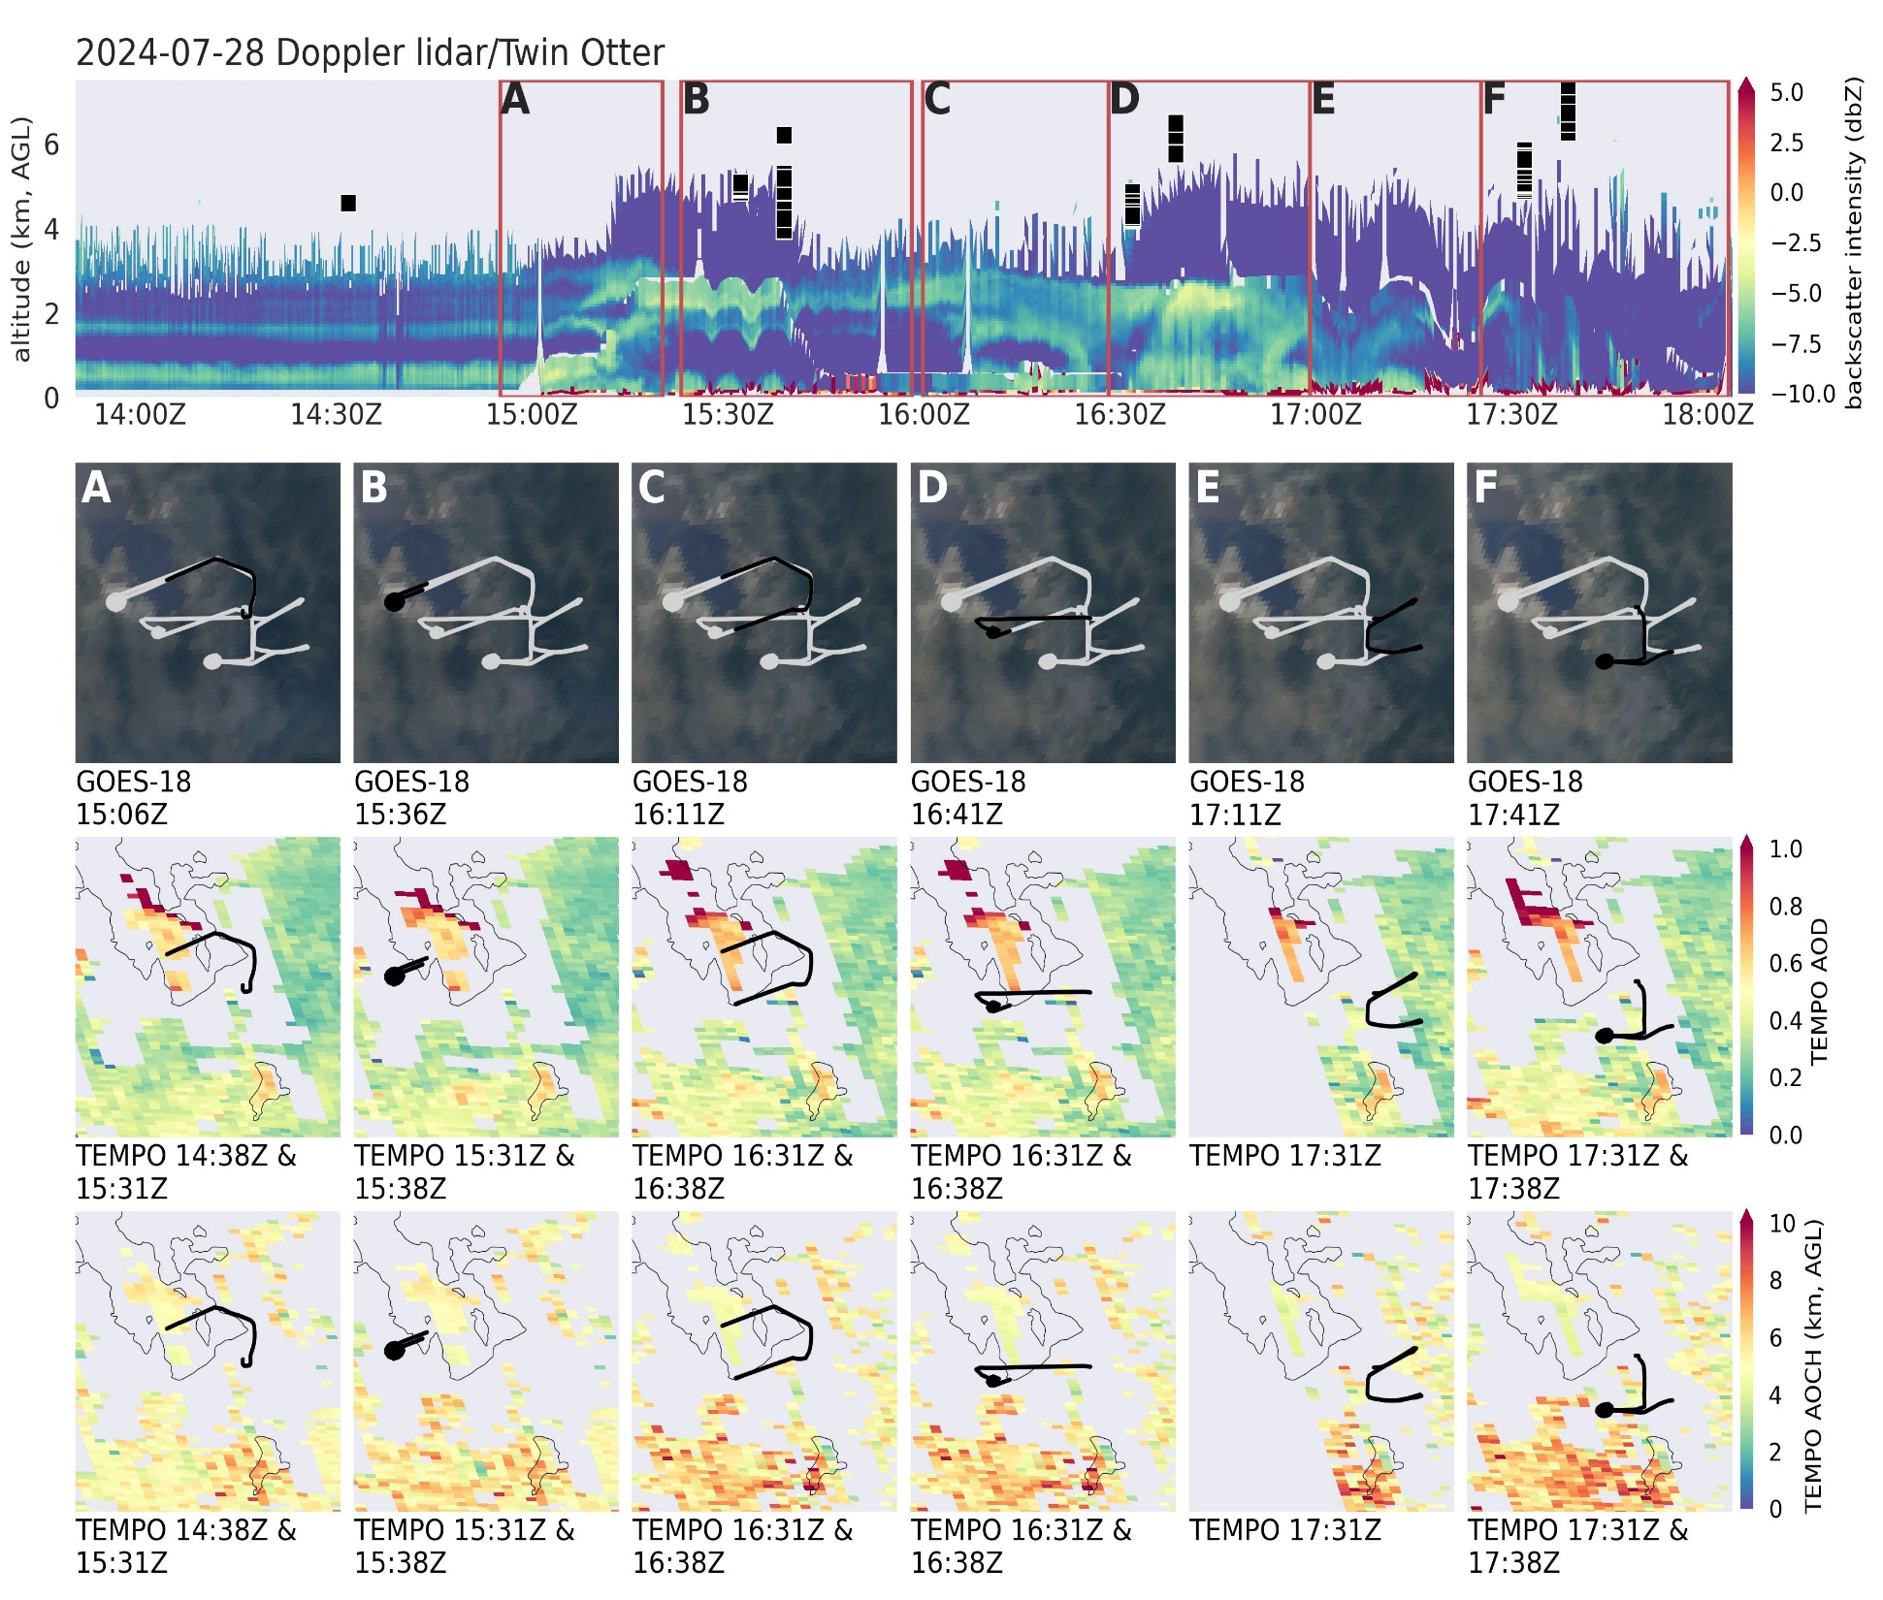
TEMPO pixels temporally & spatially matched with Twin Otter (+/-15min, within ~20 km).
A: Take off & lake shore. Lofted smoke descending to the surface.
B: Spiral west of the lake. Lofted smoke at 2-3 km AGL ^ some near surface pollutants. TEMPO overestimated aerosol layer height.
C: Lakeside. Smoke descending to the surface.
D: SLC + spiral: smoke mixing down. TEMPO overestimated aerosol layer height.
E: Canyons. Like lofted thin smoke.
F: SLC + spiral: reduced aerosols closer to the surface. TEMPO overestimated aerosol layer height.
TEMPO data to be updated!

Slide 30
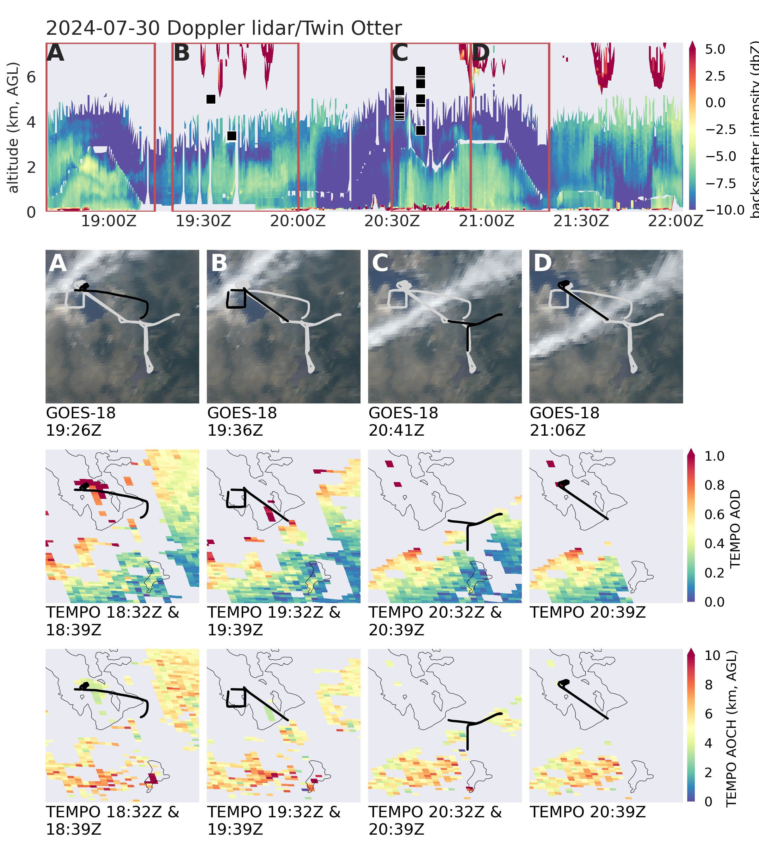
A: Take off & spiral over the lake. Cloudy. Enhanced aerosols (smoke) extending from surface to 3-4 km AGL.
B: Survey over the lake. Cloudy. Enhanced aerosols (smoke) extending to 2-4 km AGL. TEMPO showed an aerosol layer height between 3-5 km AGL, quite reasonable!
C: Survey over SLC & canyons. Aerosols confined to 2-3 km AGL. TEMPO showed aerosol layers between 3-6 km AGL, so overestimation.
D: Spiral over the lake. Aerosols confined to the lowest 2-3 km. TEMPO has no good spatial/temporal matches.
TEMPO data to be updated!

Slide 31
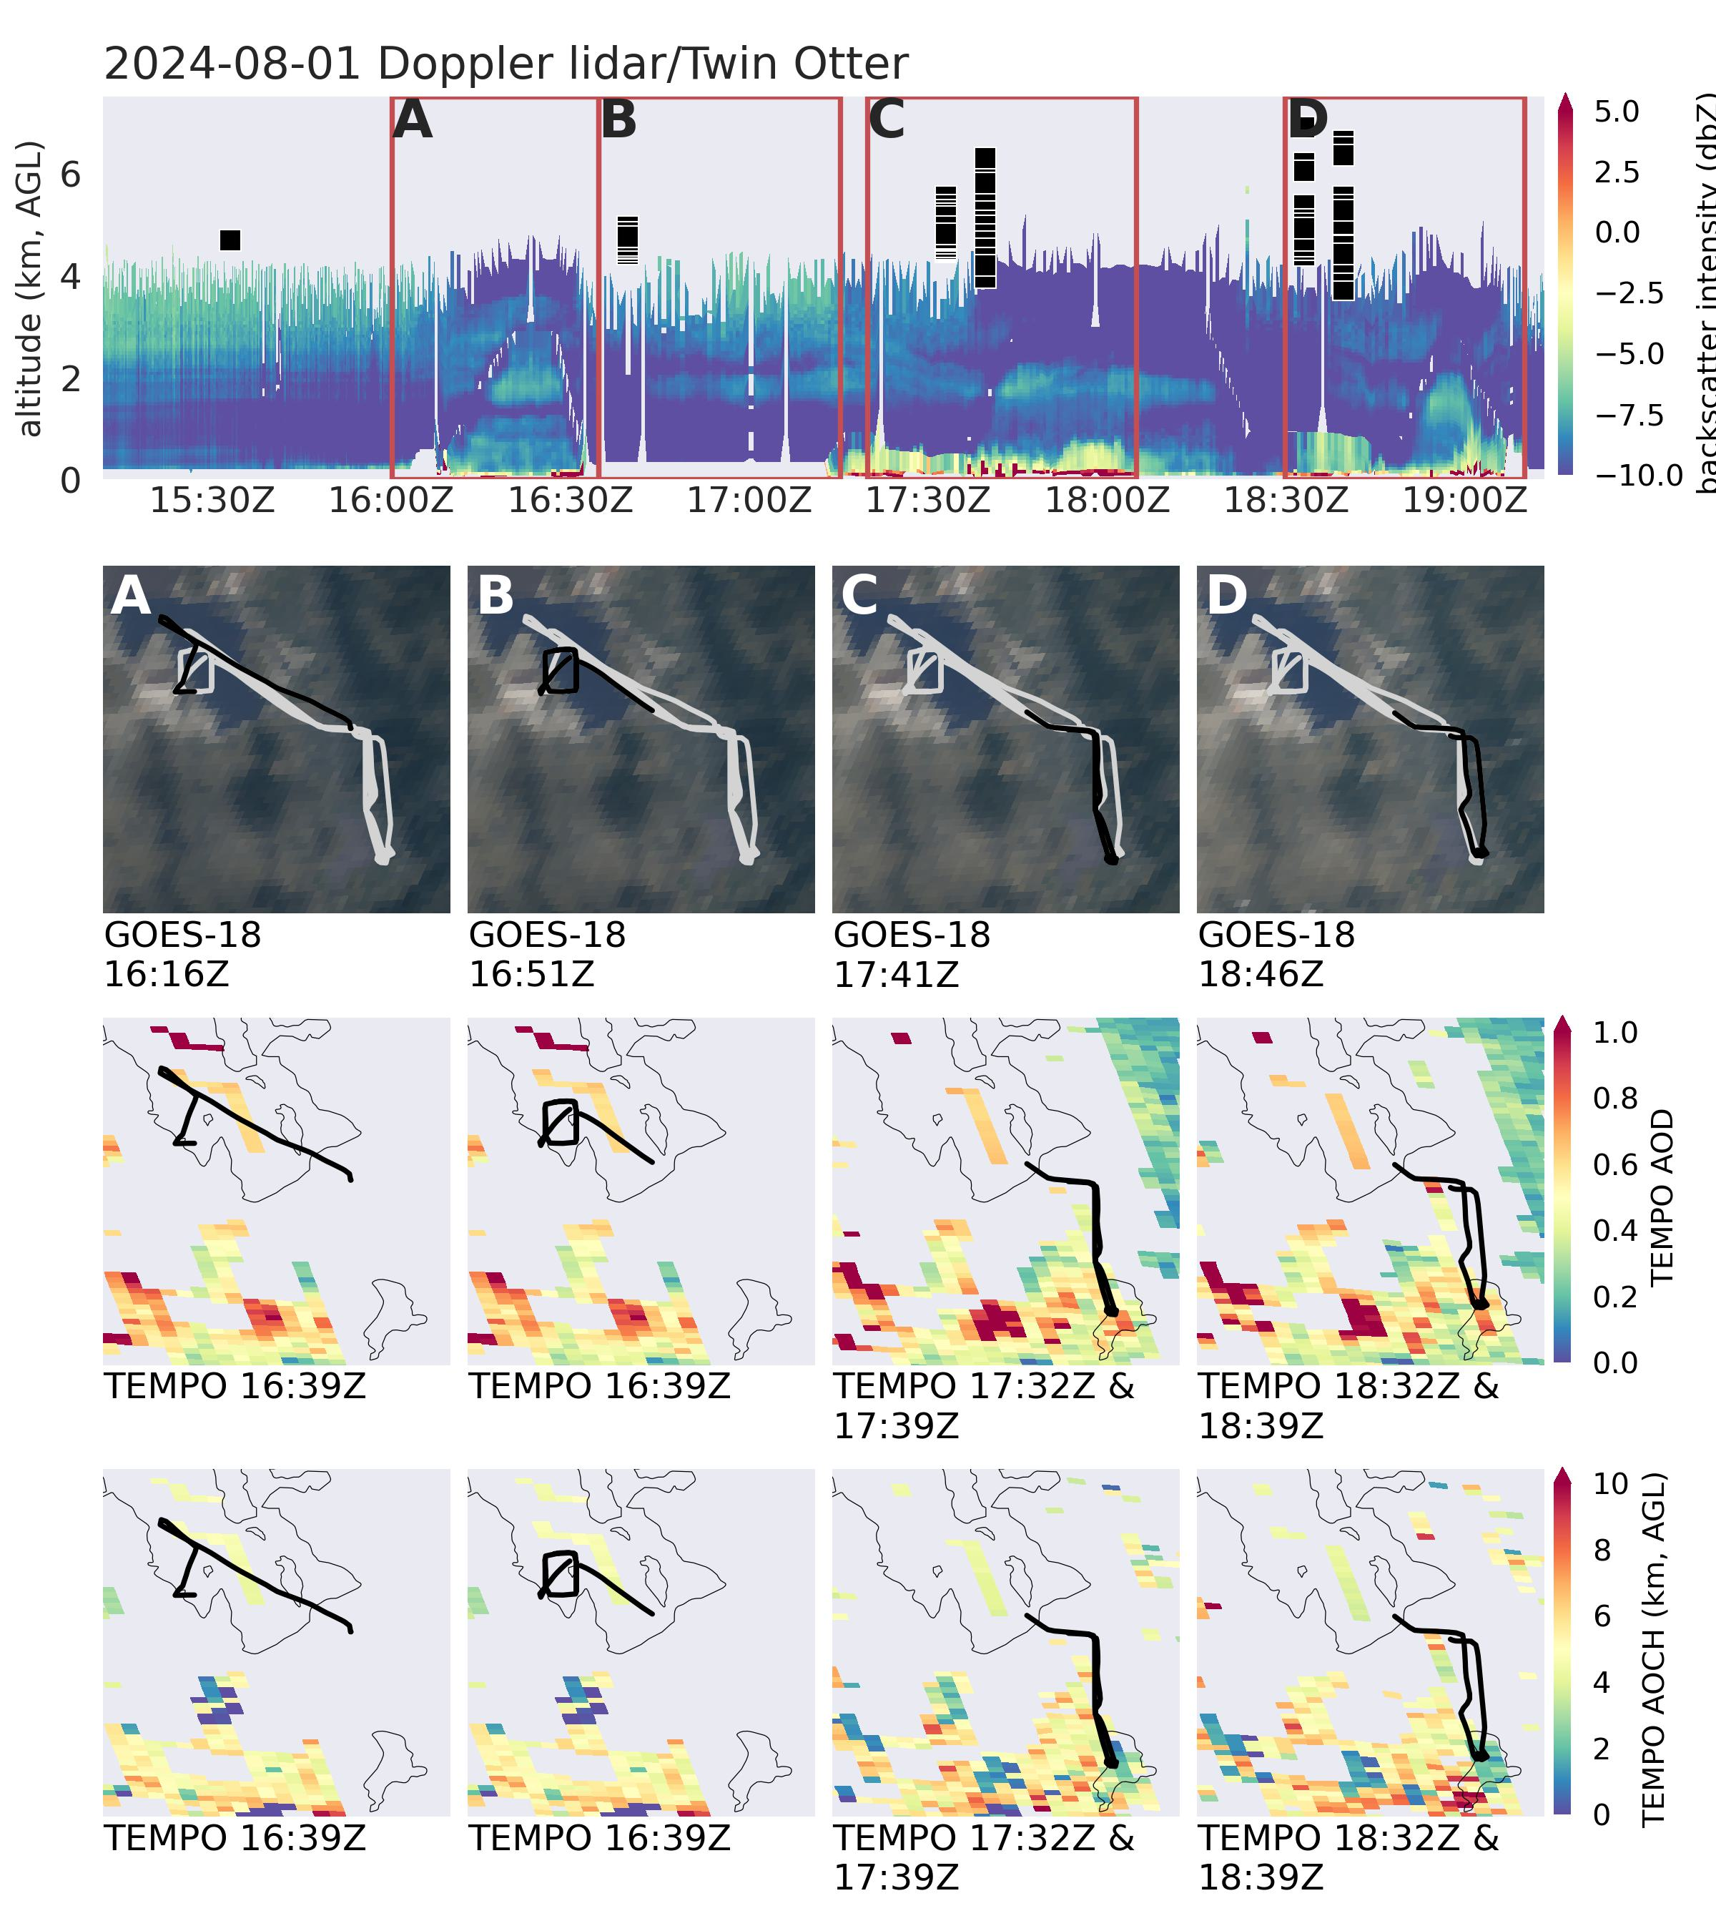
First research flight on 0801:
A: Take off & lake survey. Aerosol (smoke) confined to the lowest ~3 km AGL.
B: Lake survey. Lofted aerosol layer above 2km AGL (?) but signal cut off at ~3-4 km. TEMPO showed aerosol layer at ~4-5 km AGL.
C: SLC survey. Lofted aerosol layer at ~2 km AGL, possibly mixing with near-surface aerosols. TEMPO may be overestimating the aerosol layer height.
D: SLC survey. Mostly urban aerosols possibly mixed with smoke at ~2 km AGL. TEMPO overestimated aerosol layer height.
TEMPO data to be updated!

Slide 32
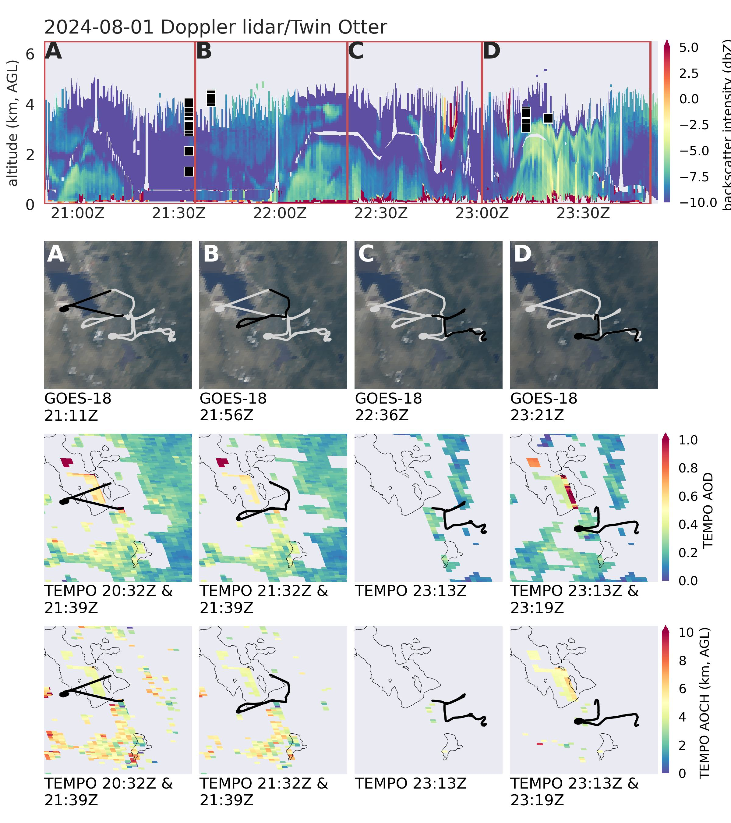
Second research flight on 0801.
A: Take off & lake survey. Some lofted aerosols over the city; over the lake aerosols confined to the lowest 1-2 km AGL. TEMPO captured the aerosol layer height over the city nicely, but tends to overestimate aerosols over the lake.
B: SLC survey. Lofted aerosols over the city, possibly mixing with the urban near-surface pollutants. TEMPO getting the lofted aerosol layer(s) nicely.
C: Survey over the canyons. Aerosols confined inside the canyons.
D: SLC survey. Again lofted aerosol layer mixing with the urban near-surface pollutants. TEMPO getting the lofted aerosol layer(s) nicely.
TEMPO data to be updated!

Slide 33
TEMPO AOCH for near-field wildfire smoke: thick smoke being misclassified as clouds and filtered out. Even more so in the early morning & late afternoon.
good
bad
good
When it works, it works nicely. But diurnal variability or statistics for plume injection may be biased. Gotta be careful.

Slide 35
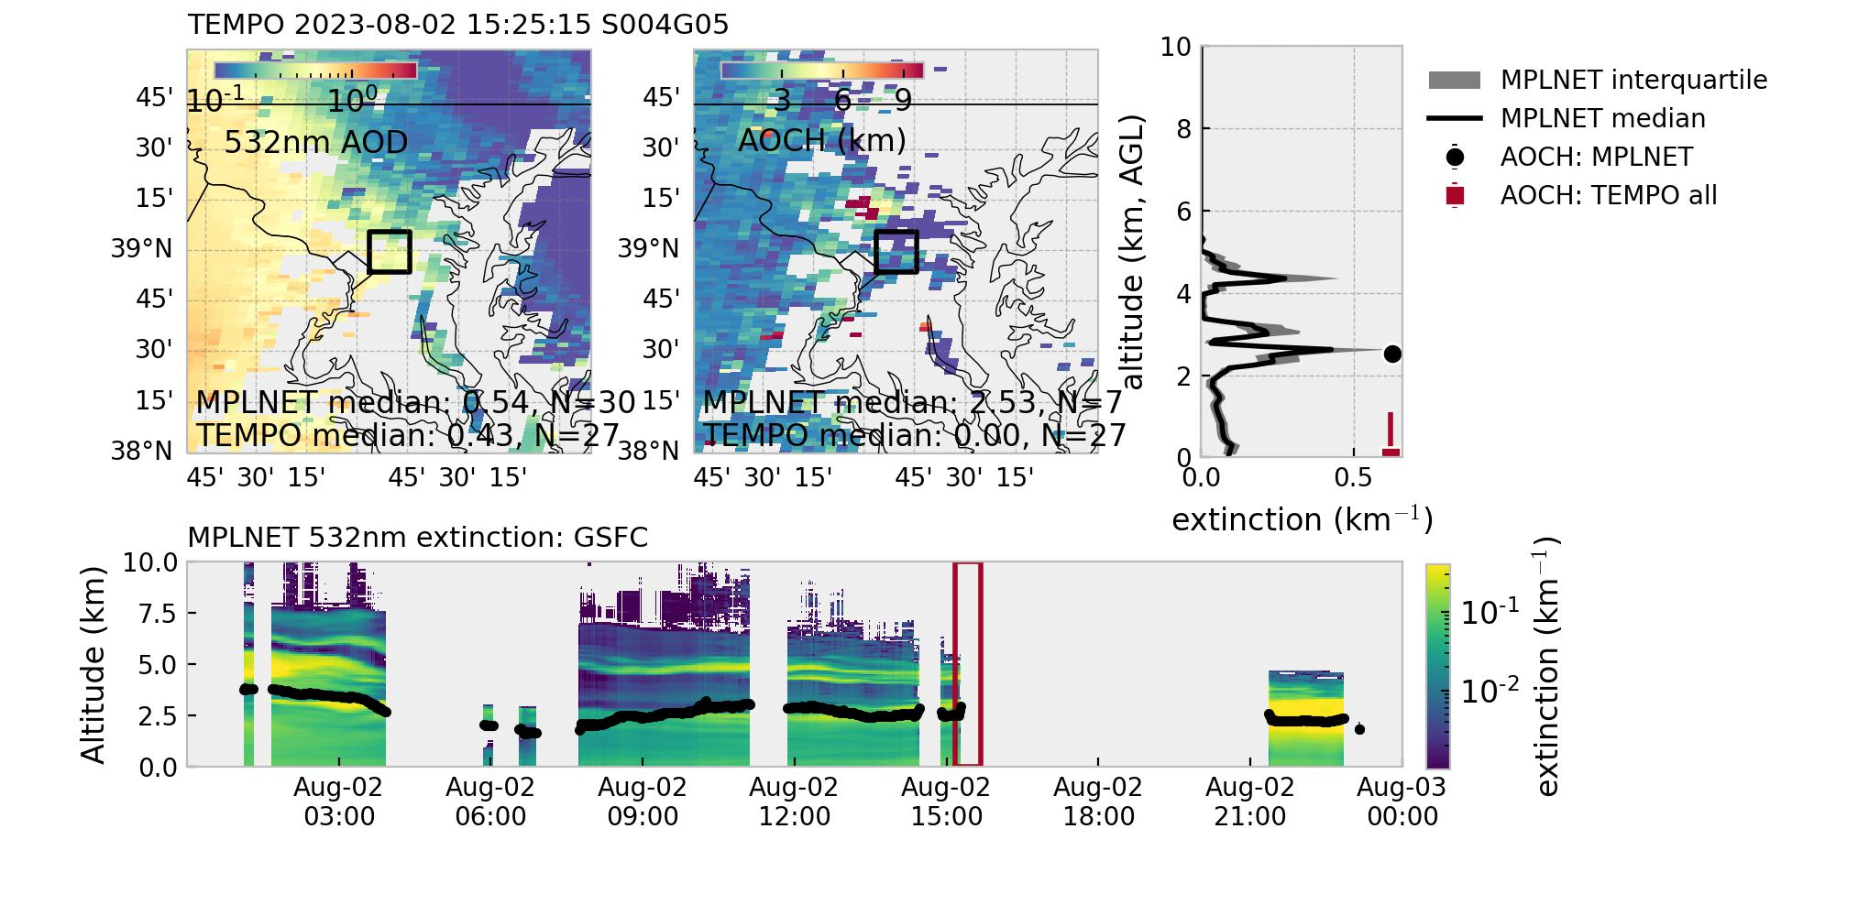
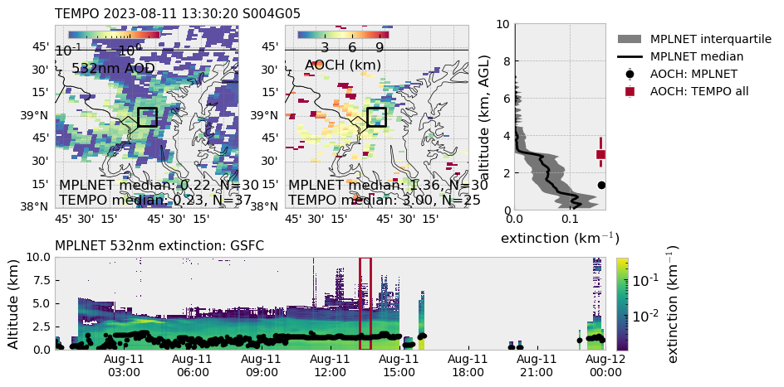
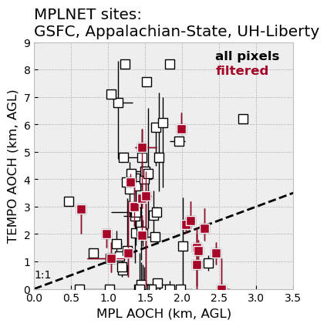
Example: aerosol vertical structures measured at GSFC (MD)
AEROMMA GV/HSRL2
MPLNET evaluation results are very similar to AEROMMA evaluation.
Filtered: TEMPO AOD>0.2.

Slide 37
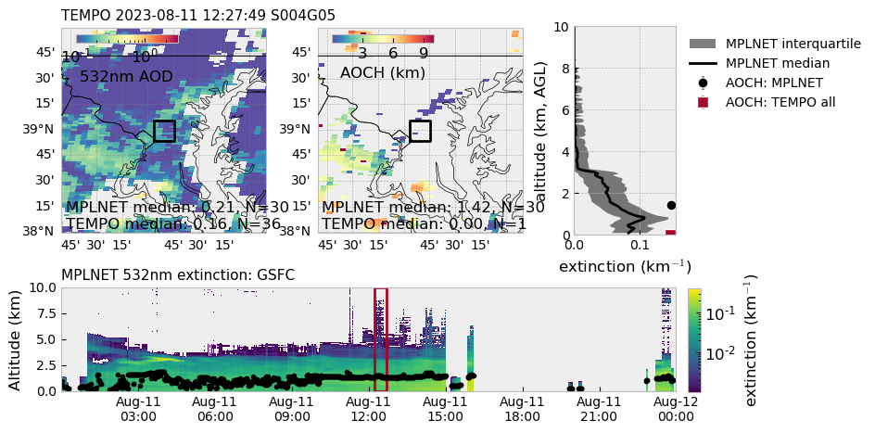

Slide 39
TEMPO AOCH pixels in the vicinity of HSRL profile location
TEMPO AOD pixels
TEMPO AOCH
GV/HSRL Flight track
HSRL AOCH
HSRL extinction profile in the “red window” (median/interquartile)
Aircraft altitude
HSRL 532nm extinction curtain
HSRL AOCH (same definition as TEMPO AOCH)
HSRL profile with the same time (+/-5 minutes) stamp as TEMPO granule

