Slide 1








Committee on Earth Observation Satellites
Atmospheric Composition Virtual Constellation (AC-VC-20)
15-18 October 2024
Potential Use of the Unified Ceilometer Network in support of TEMPO Aerosol Layer Height Validation
James Szykman, US EPA and Ruben Delgado, Hampton University
Hai Zhang* and Shobha Kondragunta
NOAA/NESDIS (ISMG*)
John McNabb, Kent Taguba, Kyle Rivera, Jia Su, and Kevin Herrera,
Hampton University
Barron Henderson, David Williams, and Corey Mocka
US EPA
Vanessa Caicedo
CIRES, NOAA/GML
Xiong Liu, Kelly Chance and entire SAO TEAM
Barry Lefer
NASA HQs
Disclaimers: The views expressed in this presentation are those of the authors and do not necessarily represent the views or the policies of the U.S. Environmental Protection Agency.
Any mention of trade names, products, or services does not imply an endorsement by the U.S. Government or the U.S. Environmental Protection Agency. The EPA does not endorse any commercial products, services, or enterprises.

Slide 2
TEMPO Aerosol Layer Height
July 2014 – Program level requirements updated to remove aerosols, SO₂, C₂H₂O2, and UV-B radiation measurement products from TEMPO Instrument Project.
Under the U.S. Group on Earth Observations (USGEO) Satellite Needs Working Group (SNWG) process the EPA and NOAA submitted needs requests to restore science data products along with near-real-time NRT) aerosols, NO₂, HCHO, and SO₂.
NASA SNWG 2020/2022 solutions - SAO/NASA to produce NTR L1B, NO2, HCHO and clouds (cycle 3) and NRT SO₂ and enhanced data products (cycle 4). NOAA NESDIS to produce NRT aerosol products in support of EPA AirFuse* project under AirNow Program
Validation of TEMPO data products have primarily relied non-TEMPO resources due to cost cap requirement of Earth Venture Instrument missions.
Can measurements from the Unified Ceilometer Network serve as a validation resource for TEMPO (satellite) Aerosol Layer Height (ALH) product?
*Barron Henderson talk next session

Slide 3
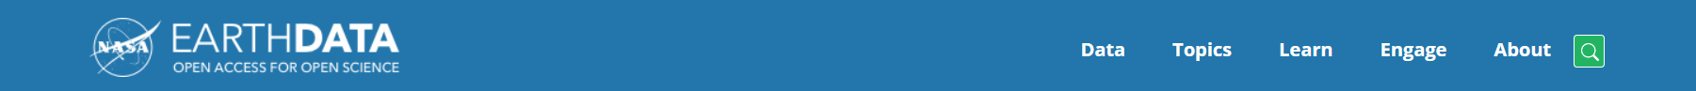
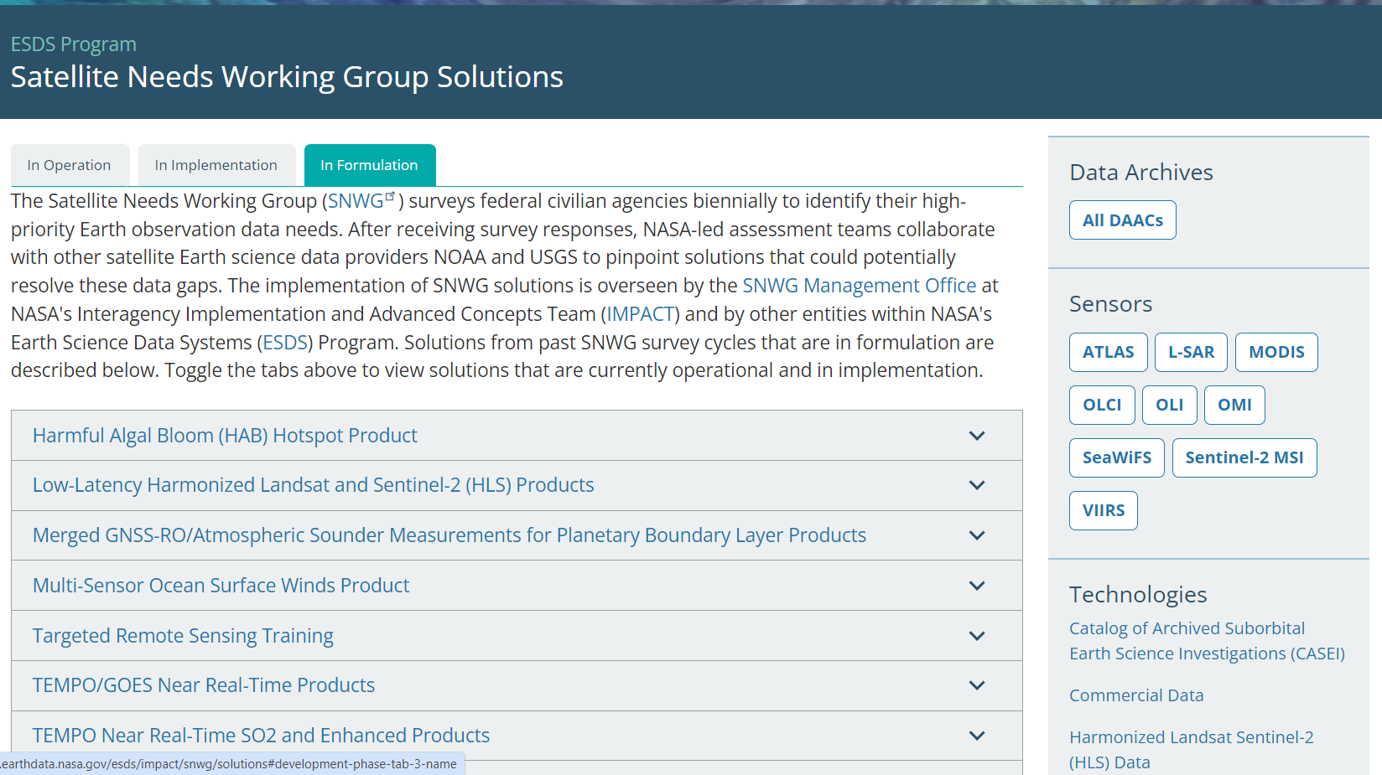
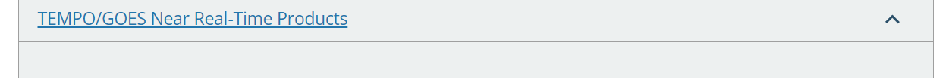
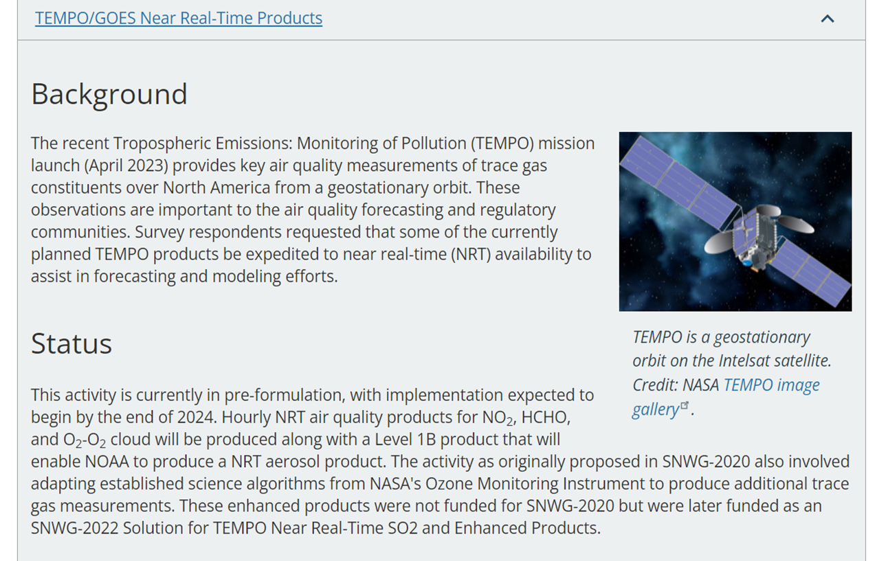

Slide 4
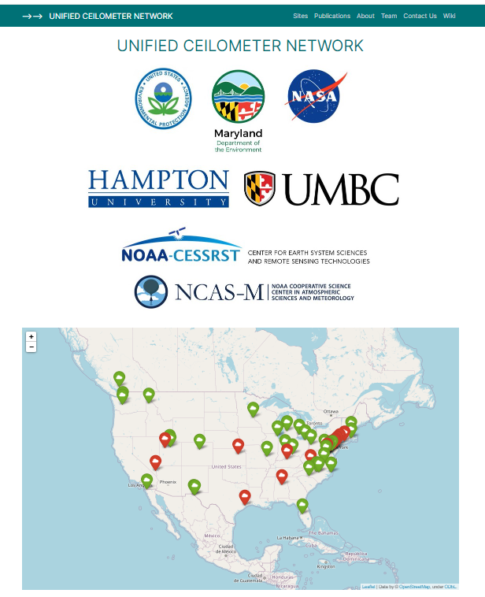
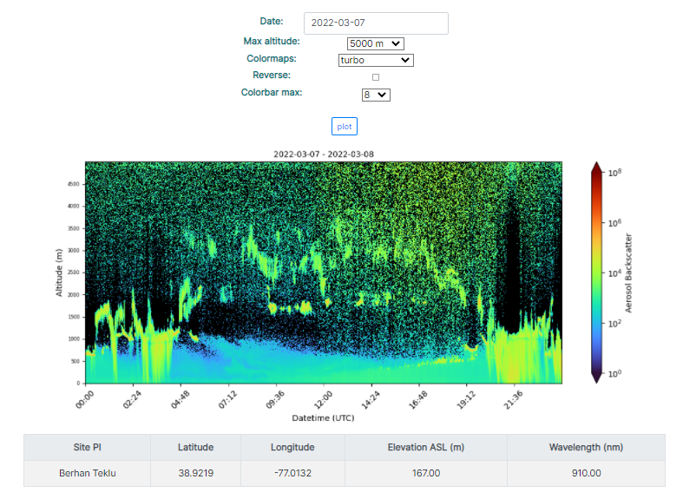

Unified Ceilometer Network (UCN)
Collaboration between Hampton University, EPA, Maryland Department of the Environment (MDE), NASA, NOAA and state and local agencies.
Development of a consolidate data archive of ceilometer attenuated backscatter coefficient profiles β(z) from U.S. Air Quality Network (~72 sites) and Academic Institutions.
Development and implementation of automated standardized retrieval Mixing Layer Heights (MLH/PBLH) algorithm for a heterogeneous network of ceilometers; correct for instrument signal quality, screen for precipitation and cloud layers, and provide PBLH uncertainties (Caicedo et al. 2020).
Currently effort focused on bringing ceilometer data for remaining EPA air quality (PAMS) sites into data archive at Hampton University; Full product generation to start winter of 2024.
Data use for EPA, state, and local agencies focused on model evaluation & development; heavy focus on non-attainment areas.
https://ucn-portal.org

Slide 5
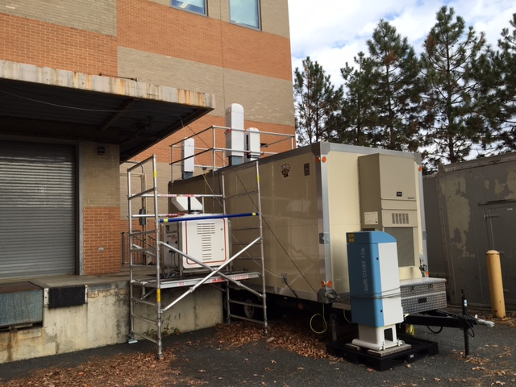
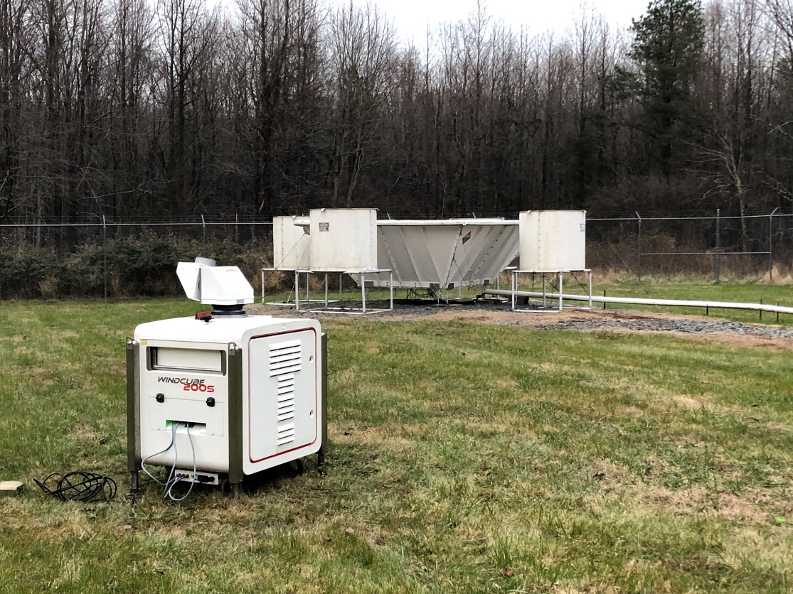
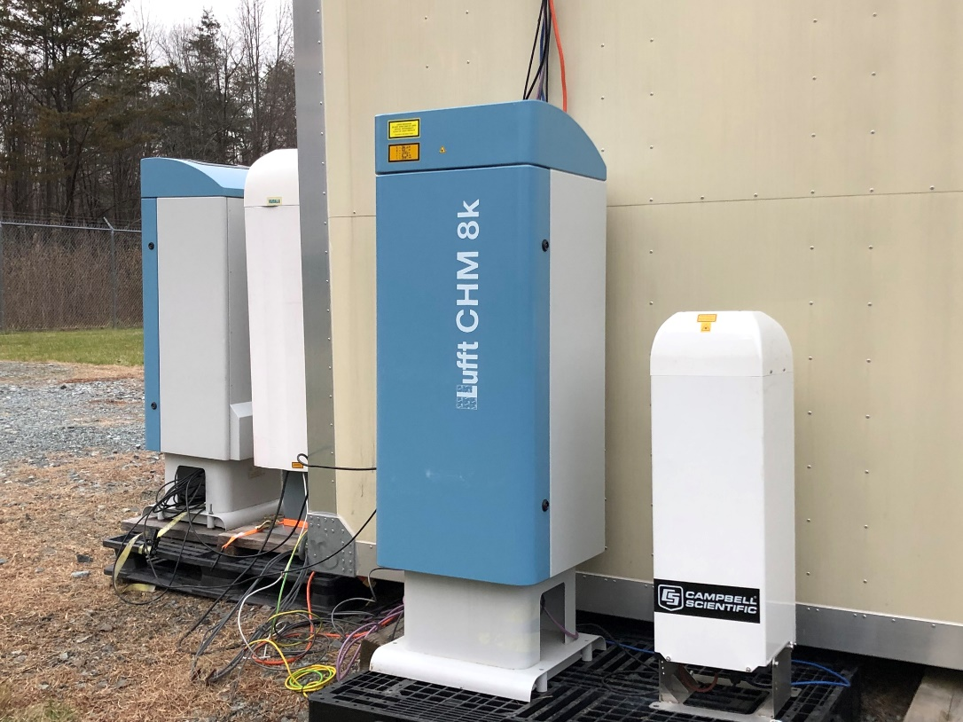
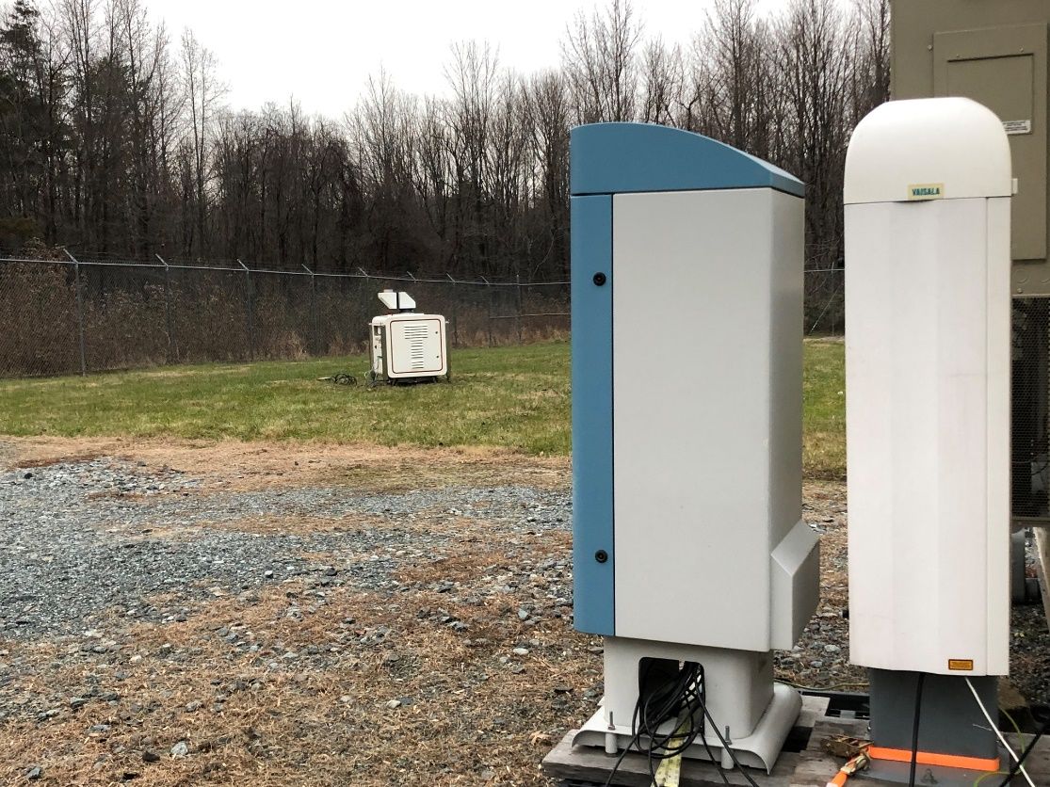
Ad-hoc Ceilometer Evaluation Study (ACES)
Joint Effort in 2016:
  UMBC/MDE/EPA/NASA/NOAA
  Academia: NOAA CESSRST and NCAS-M (CCNY and Hampton U)
Measurements to help guide EPA PAMS program implementation for new hourly MLH requirement.
Evaluation of Aerosol Backscatter and MHL retrievals from commercial ceilometer/lidars (software):
    Campbell Scientific CS135 and SkyVue Pro (Viewpoint)
    Leosphere Windcube 200S (Windforge)
    Lufft: CHM8k and CHM15k (Lufft Viewer)
    Vaisala: CL31 and CL51 (CL-View And BL-View)
Development and evaluation of common algorithm for MLH

Slide 6
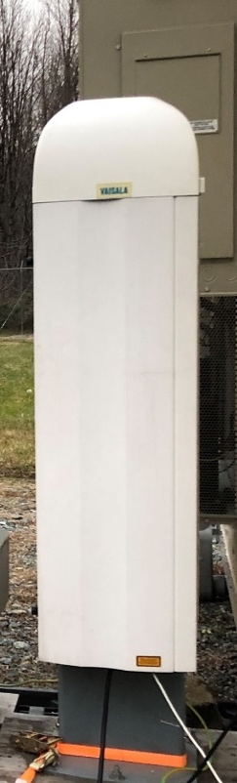
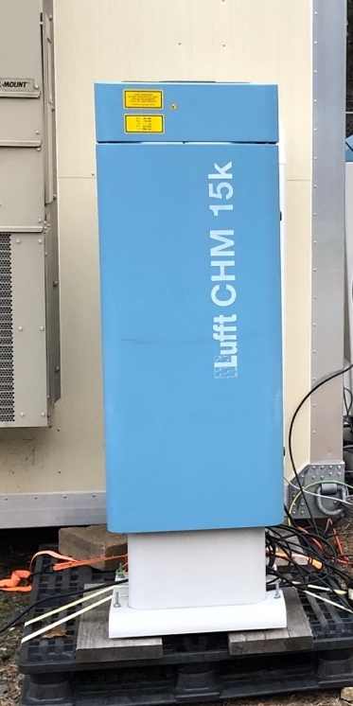
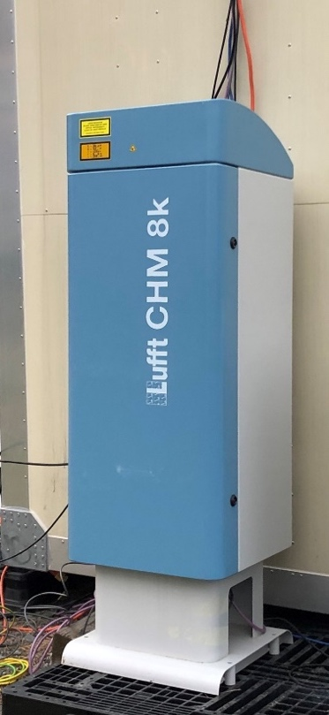
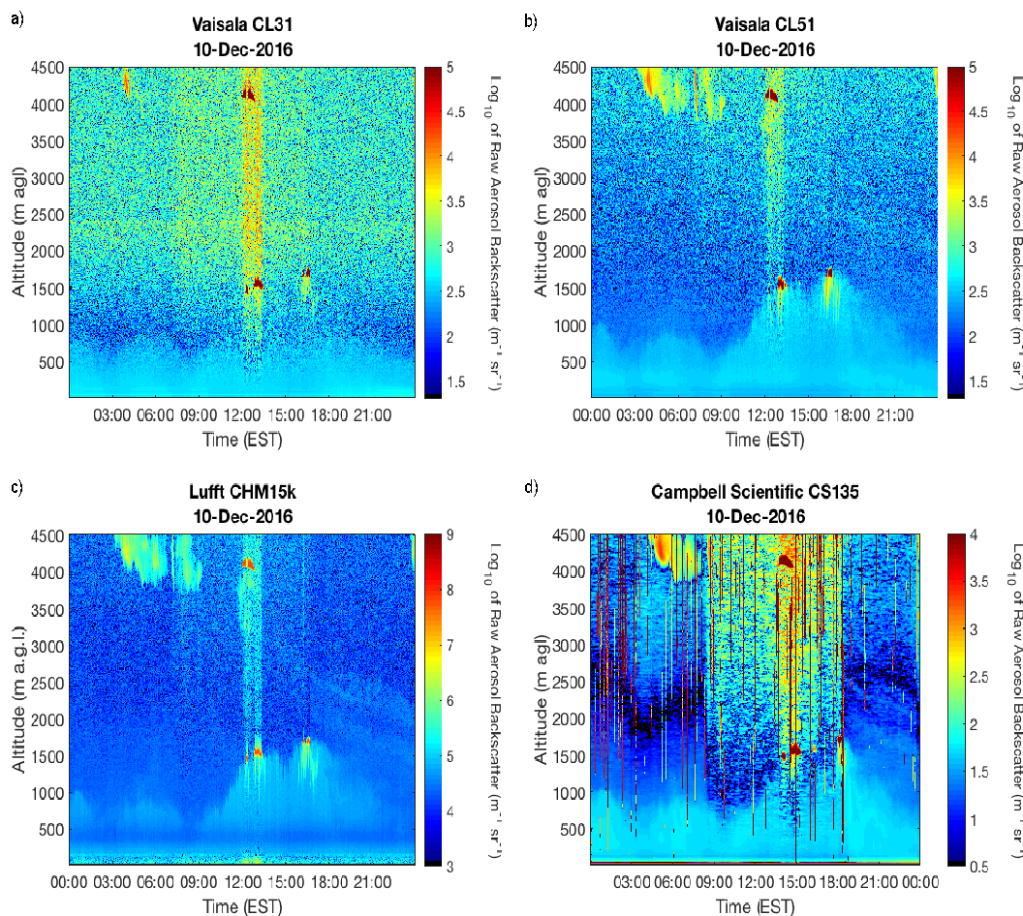
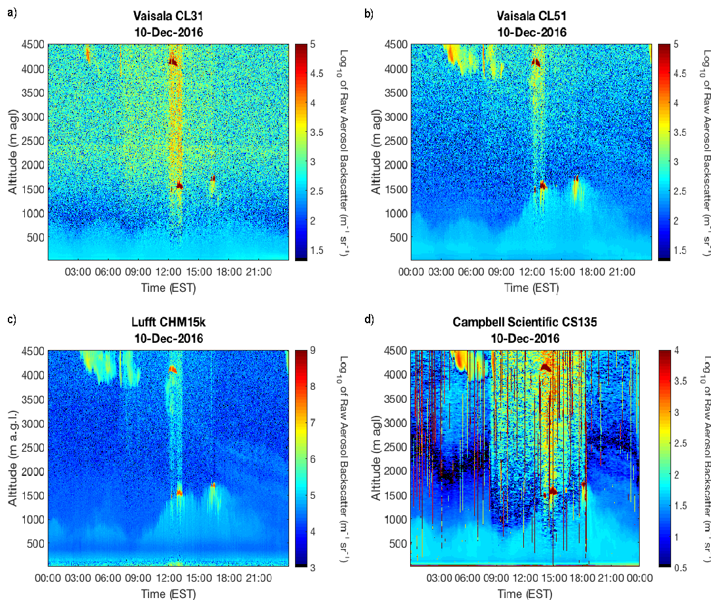
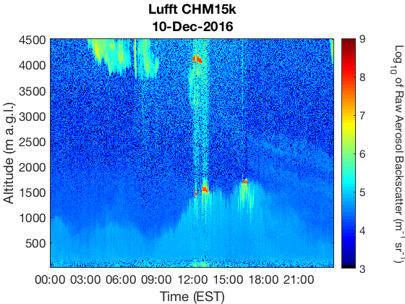
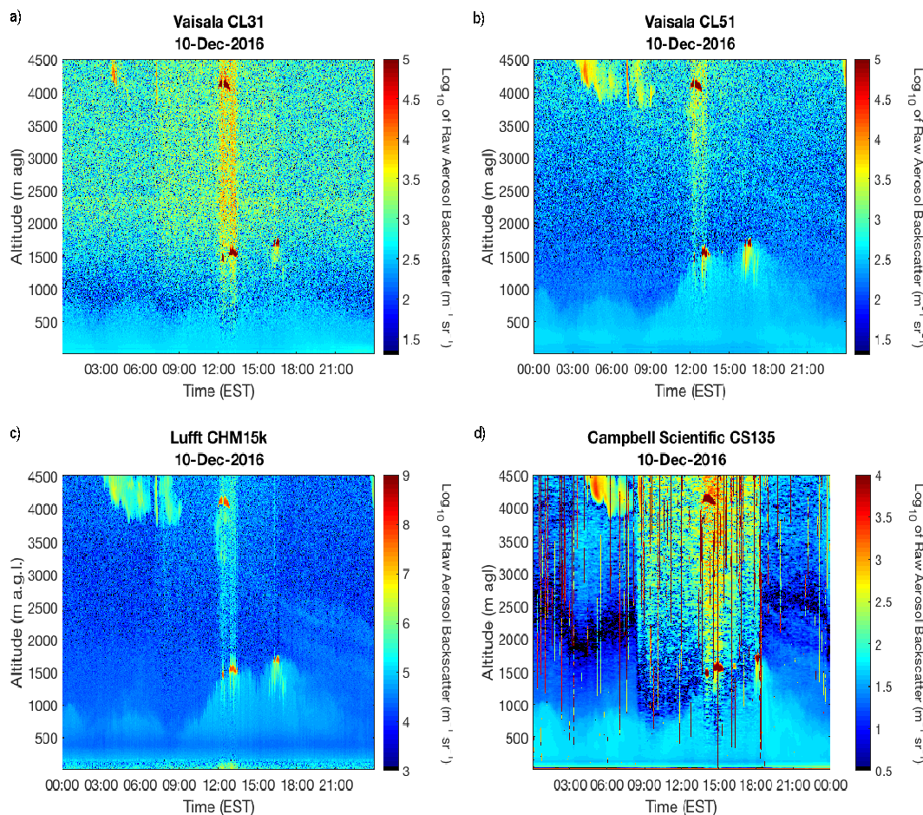
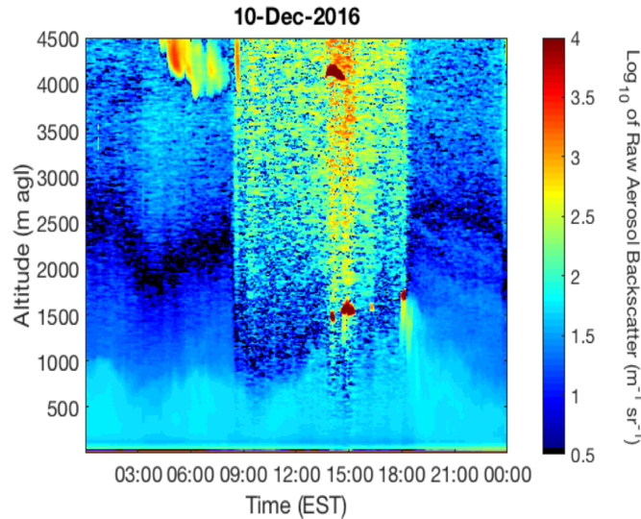
Ceilometer Signal Evaluation
Varying signal quality
  QC/QA protocols per make/model
Ceilometer signal evaluation/correction*
  Signal-to noise ratios
  Overlap corrections
  Artifacts
  Resolution
  *(O’Connor et al., 2004; Wiegner and Geiss 2012; Hervo et al. 2016; Kotthaus et al. 2016,
  among others)

Slide 7
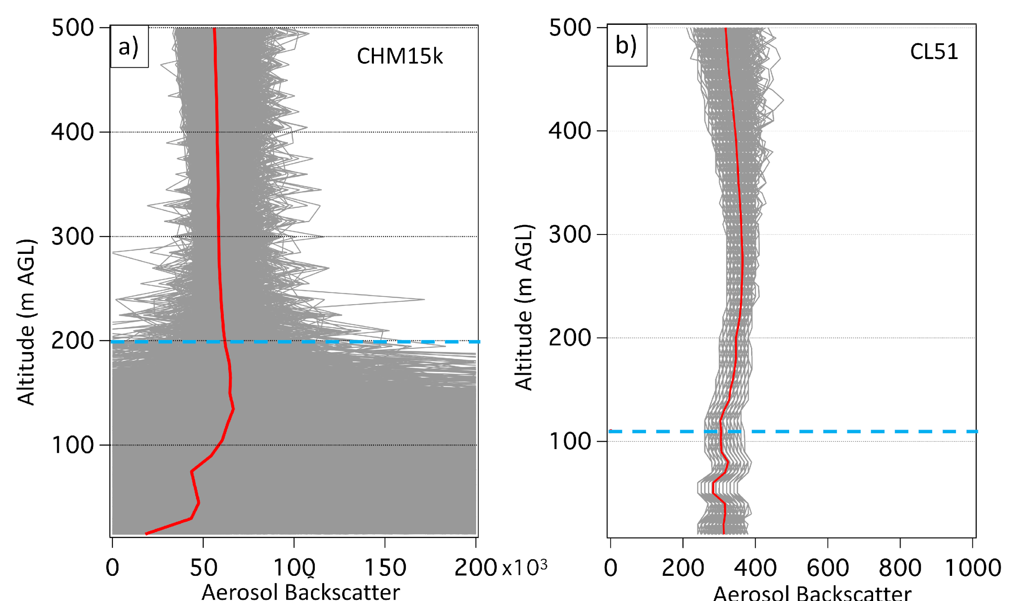
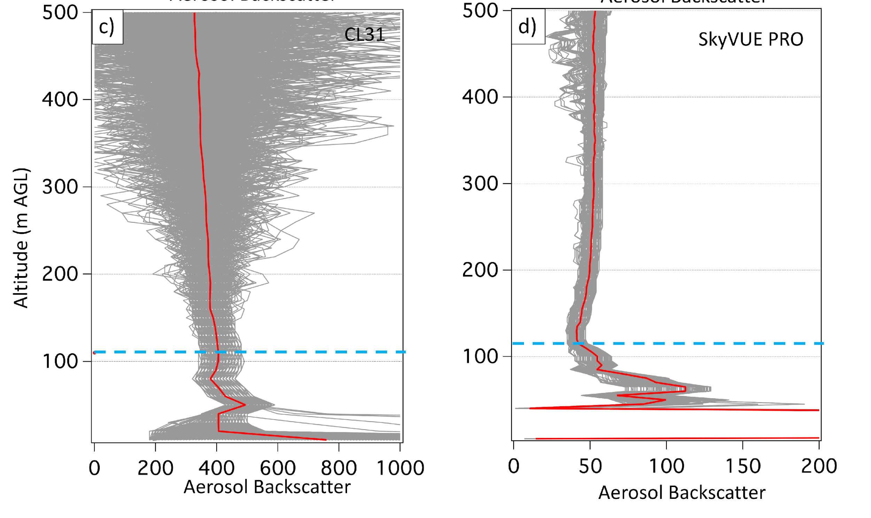
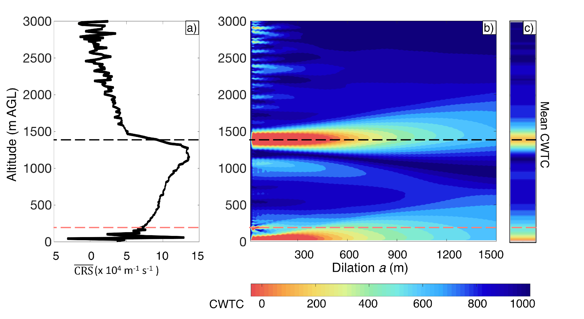
Covariance Wavelet Transform Automated Algorithm for Planetary Boundary Layer Retrievals Developed to Work Across a Heterogenous Network of Ceilometer and Using Aerosol Lidars
Includes QC/QA of Ceilometer Aerosol Backscatter Signal and Mixing Layer Height Determination
Addresses instrumental signal quality
(SNR, artifacts, overlap, etc.)
Haar step-function to detect changes in aerosol backscatter profiles using multiple dilations
Define minimum reliable signals and limitations
Automatically screens for precipitation and cloud layers with layer attribution for the planetary boundary layer height with continuation and time-tracking parameters and uncertainty calculations through automatic filtering, Caicedo at al., (2020); https://doi.org/10.1175/JTECH-D-20-0050.1

Slide 8
UCN Data Archiving and Processing at Hampton University
Processing chain
Ceilometer signals in native file format
Raw Level 0
Reformatted NetCDF for uniform data format
Raw Level 1
Quality Assessment flags: Saturation or instrument failure
Calibrations: Point Cloud/Rayleigh calibration, water vapor, overlap background
Level 2
Planetary boundary layer and
Cloud base height processing
Level 3
Level 0: Data archiving of ‘raw’ signals directly from instrumentation
Level 1: Reformatted ‘raw signals’ into uniform Network Common Data Form (NetCDF) data files
Level 2: NetCDF data files of calibrated signals
Level 3: PBL and cloud products: 10-minute to hourly retrievals (NetCDF data files and ASCII files)

Slide 9
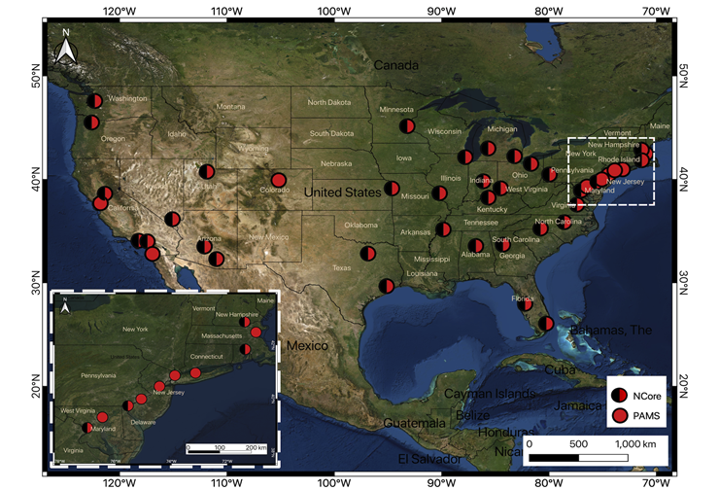
Many of the UCN sites contain complementary aerosol and trace gas surface air quality measurements
Air Quality Sites within the UCN
 | PM2.5 (FRM) | PM2.5 (continuous - FEM) | PM10/PM10-2.5 (FRM) | PM10/PM-10.2.5 (continuous FEM) | PM Speciation (CSN) | PM Speciation (IMPROVE) | PM2.5 Carbon (BC/UVC, continuous) | Utrafines (Continuous) | Particle Count continuous) | Sulfate (semi-continuous) | Ozone | SO2 | CO | Direct NO2 | NO/NOy | Ozone precursors AutoGC | Carbonyl | Toxics (NATTS) | Total Column NO2/HCHO/O3 (PGN) | Profile NO2/HCHO (PGN) | Spectral AOD (AERONET) | Continuous Mixing Height (PBLH) (UCN) | Wind Speed/Direction | Temperature | Dew Point / Rel. Humidity | Barometric Pressure | Solar Radiation
Queens College II (CUNY Queens College Campus) | 1/3 | X | 1/6 | X | 1/3 |  | X |  |  | X | X | X | X | X | X |  | 1/6 | 1/6 | X | X | X | X | X | X
New Haven – Criscuolo Park | 1/3 | X | 1/3 | X | 1/3 |  | X |  |  |  | X | X | X | X | X |  |  |  | X | X | X | X | X | X | X | X | X
New Brunswick- Rutgers | 1/3 | X | 1/6 | X | 1/3 |  | X |  |  | X | X |  |  | X | X | X | 1/6 | 1/6 | X | X | X | X | X | X | X | X | X
A select number of air quality sites also host Pandora and AERONET measurements

Slide 10
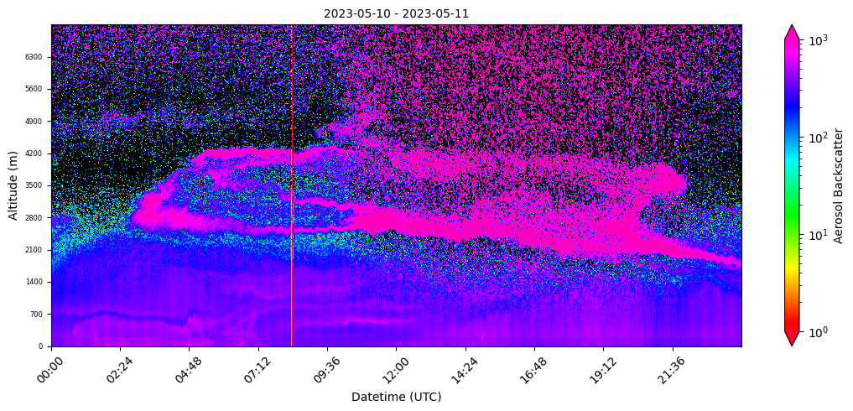
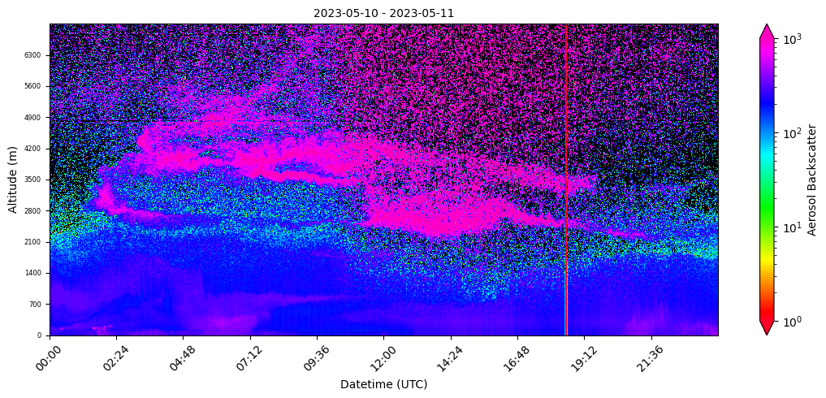
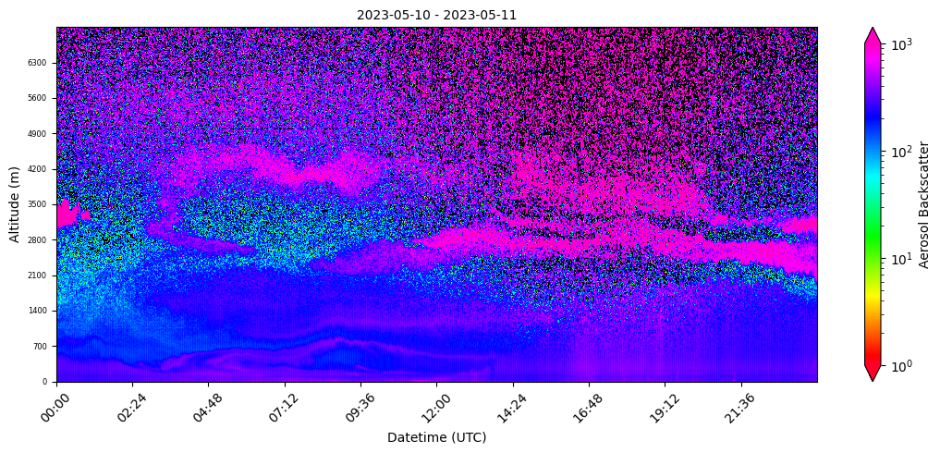
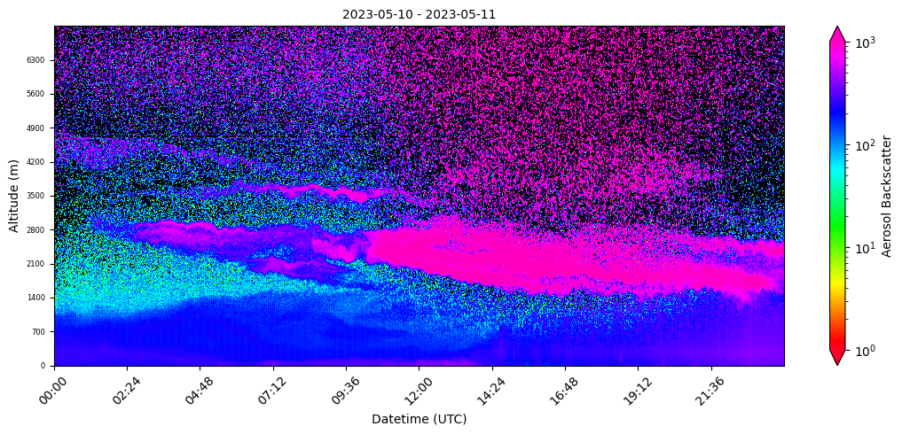
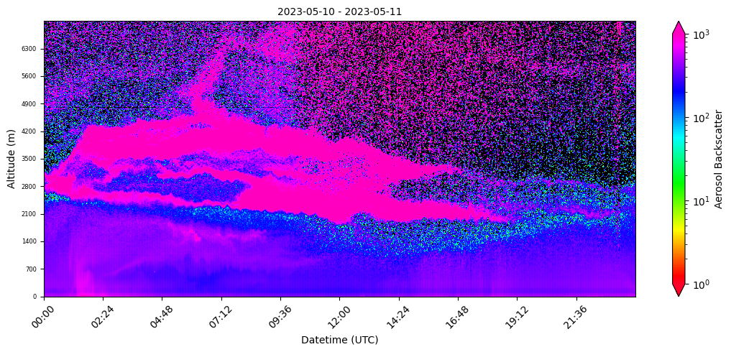
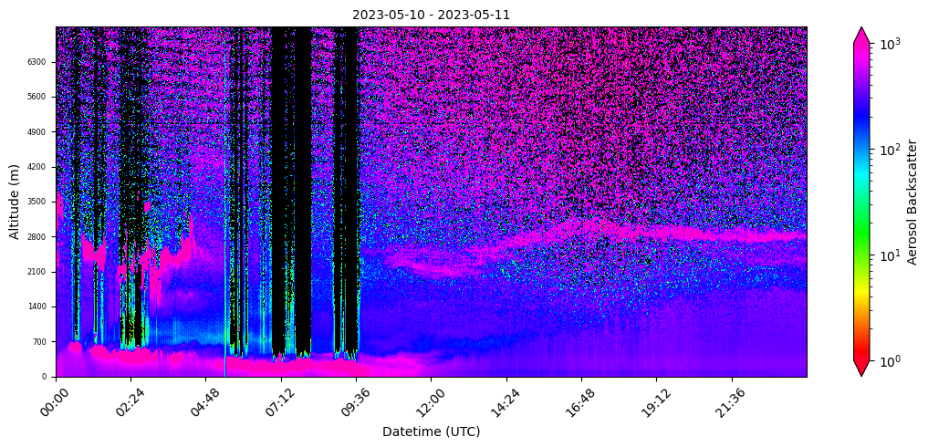
Ceilometers capture lofted aerosol layers and vertical structure
across Mid-Atlantic states on May 10, 2023: Canadian Wildfires (Alberta)
Richmond, VA
VADEQ
Essex, MD
(MDE)
Issues:
ACES evaluation for UCN was conducted in winter months (low aerosol loads) to challenge PBLH algorithm
Ceilometer SNR degrades at higher altitudes 5-7 km.
Need to determine how to deal with multiple aerosol layers and complex vertical structure versus a satellite derived ALH.
Washington, DC
DC-DOEE
Beaver, PA
(PADEP)
Arendtsville, PA
(PADEP)
Duke Forest, NC (US EPA)

Slide 11
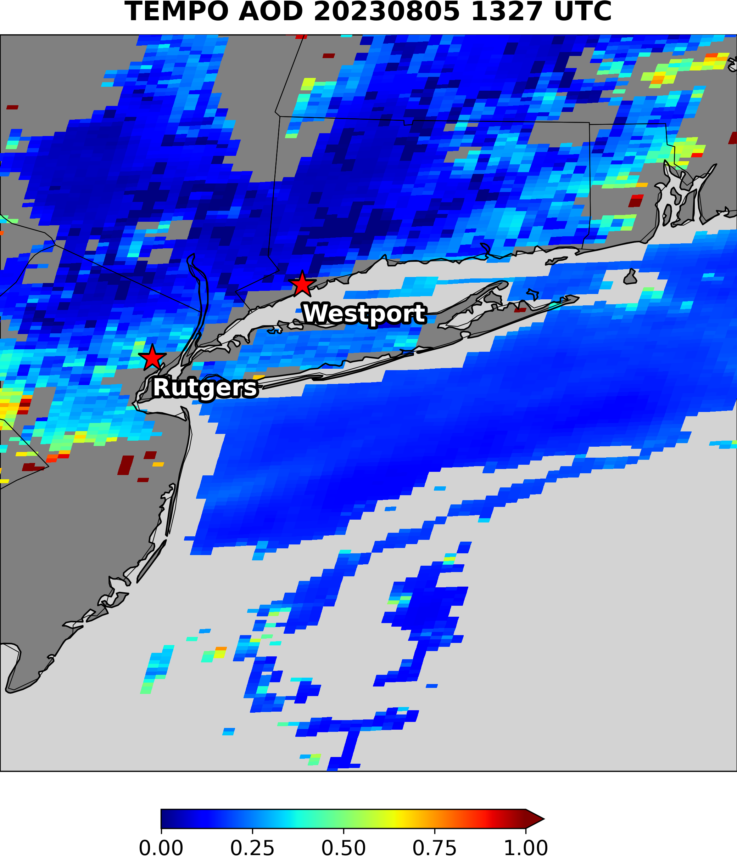
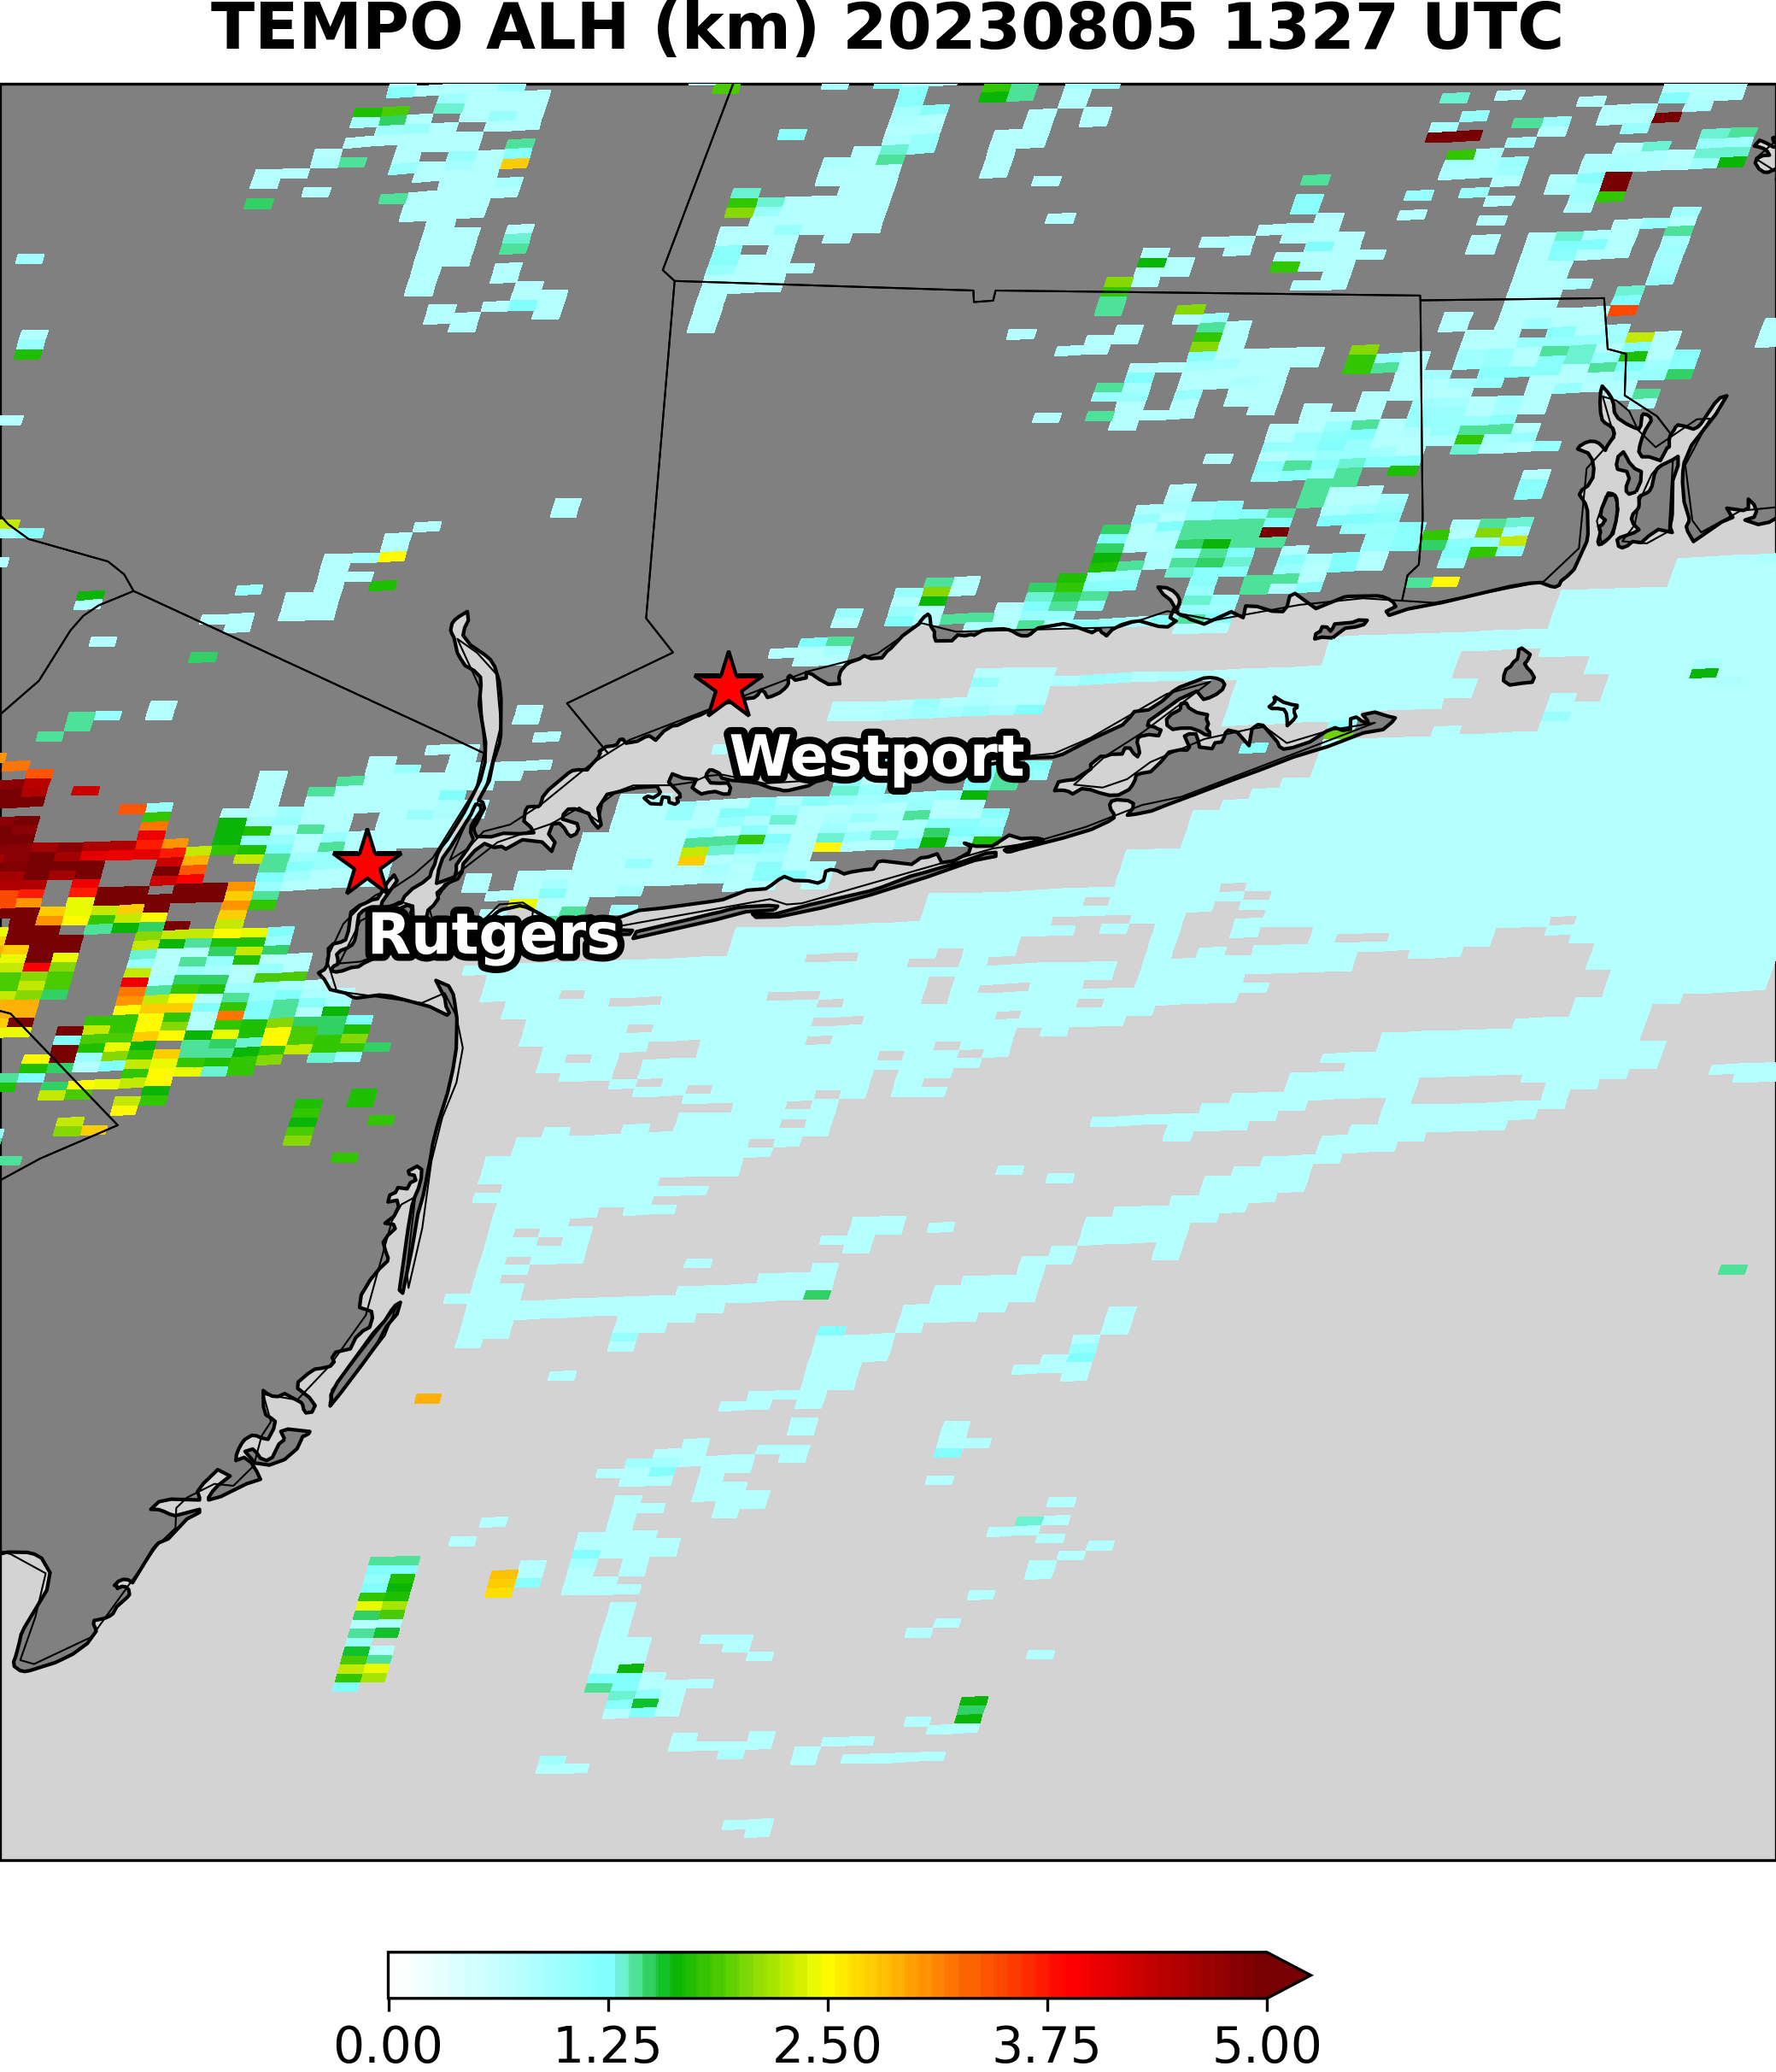
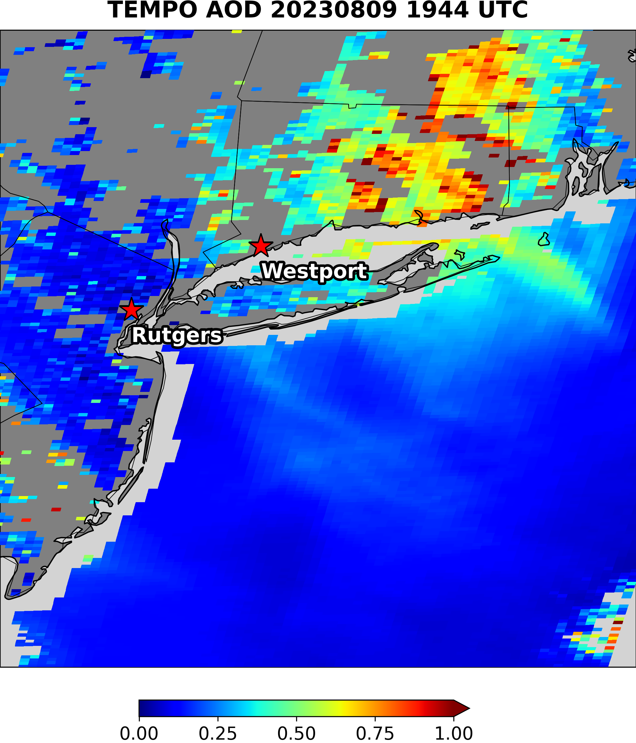
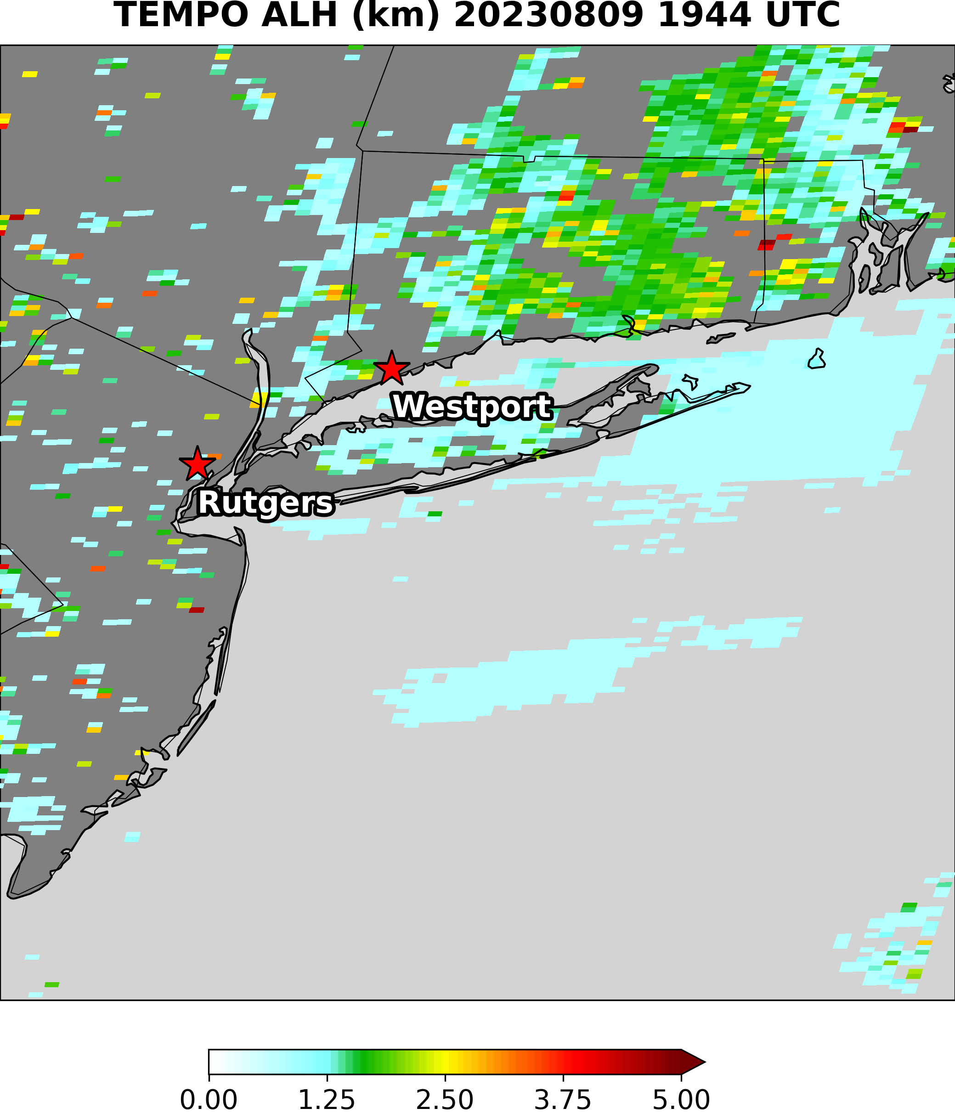
TEMPO AOD and ALH (8/5 & 9/2023)
The two granules selected have matchups available at one or both sites.
ALH is only retrieved for pixels where AOD exceeds 0.2.
TEMPO retrieval is from NOAA soft calibration of L1b data

Slide 12
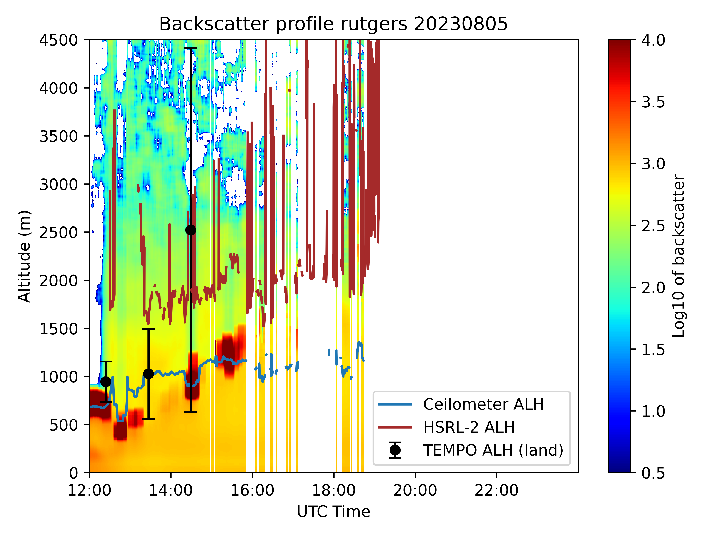
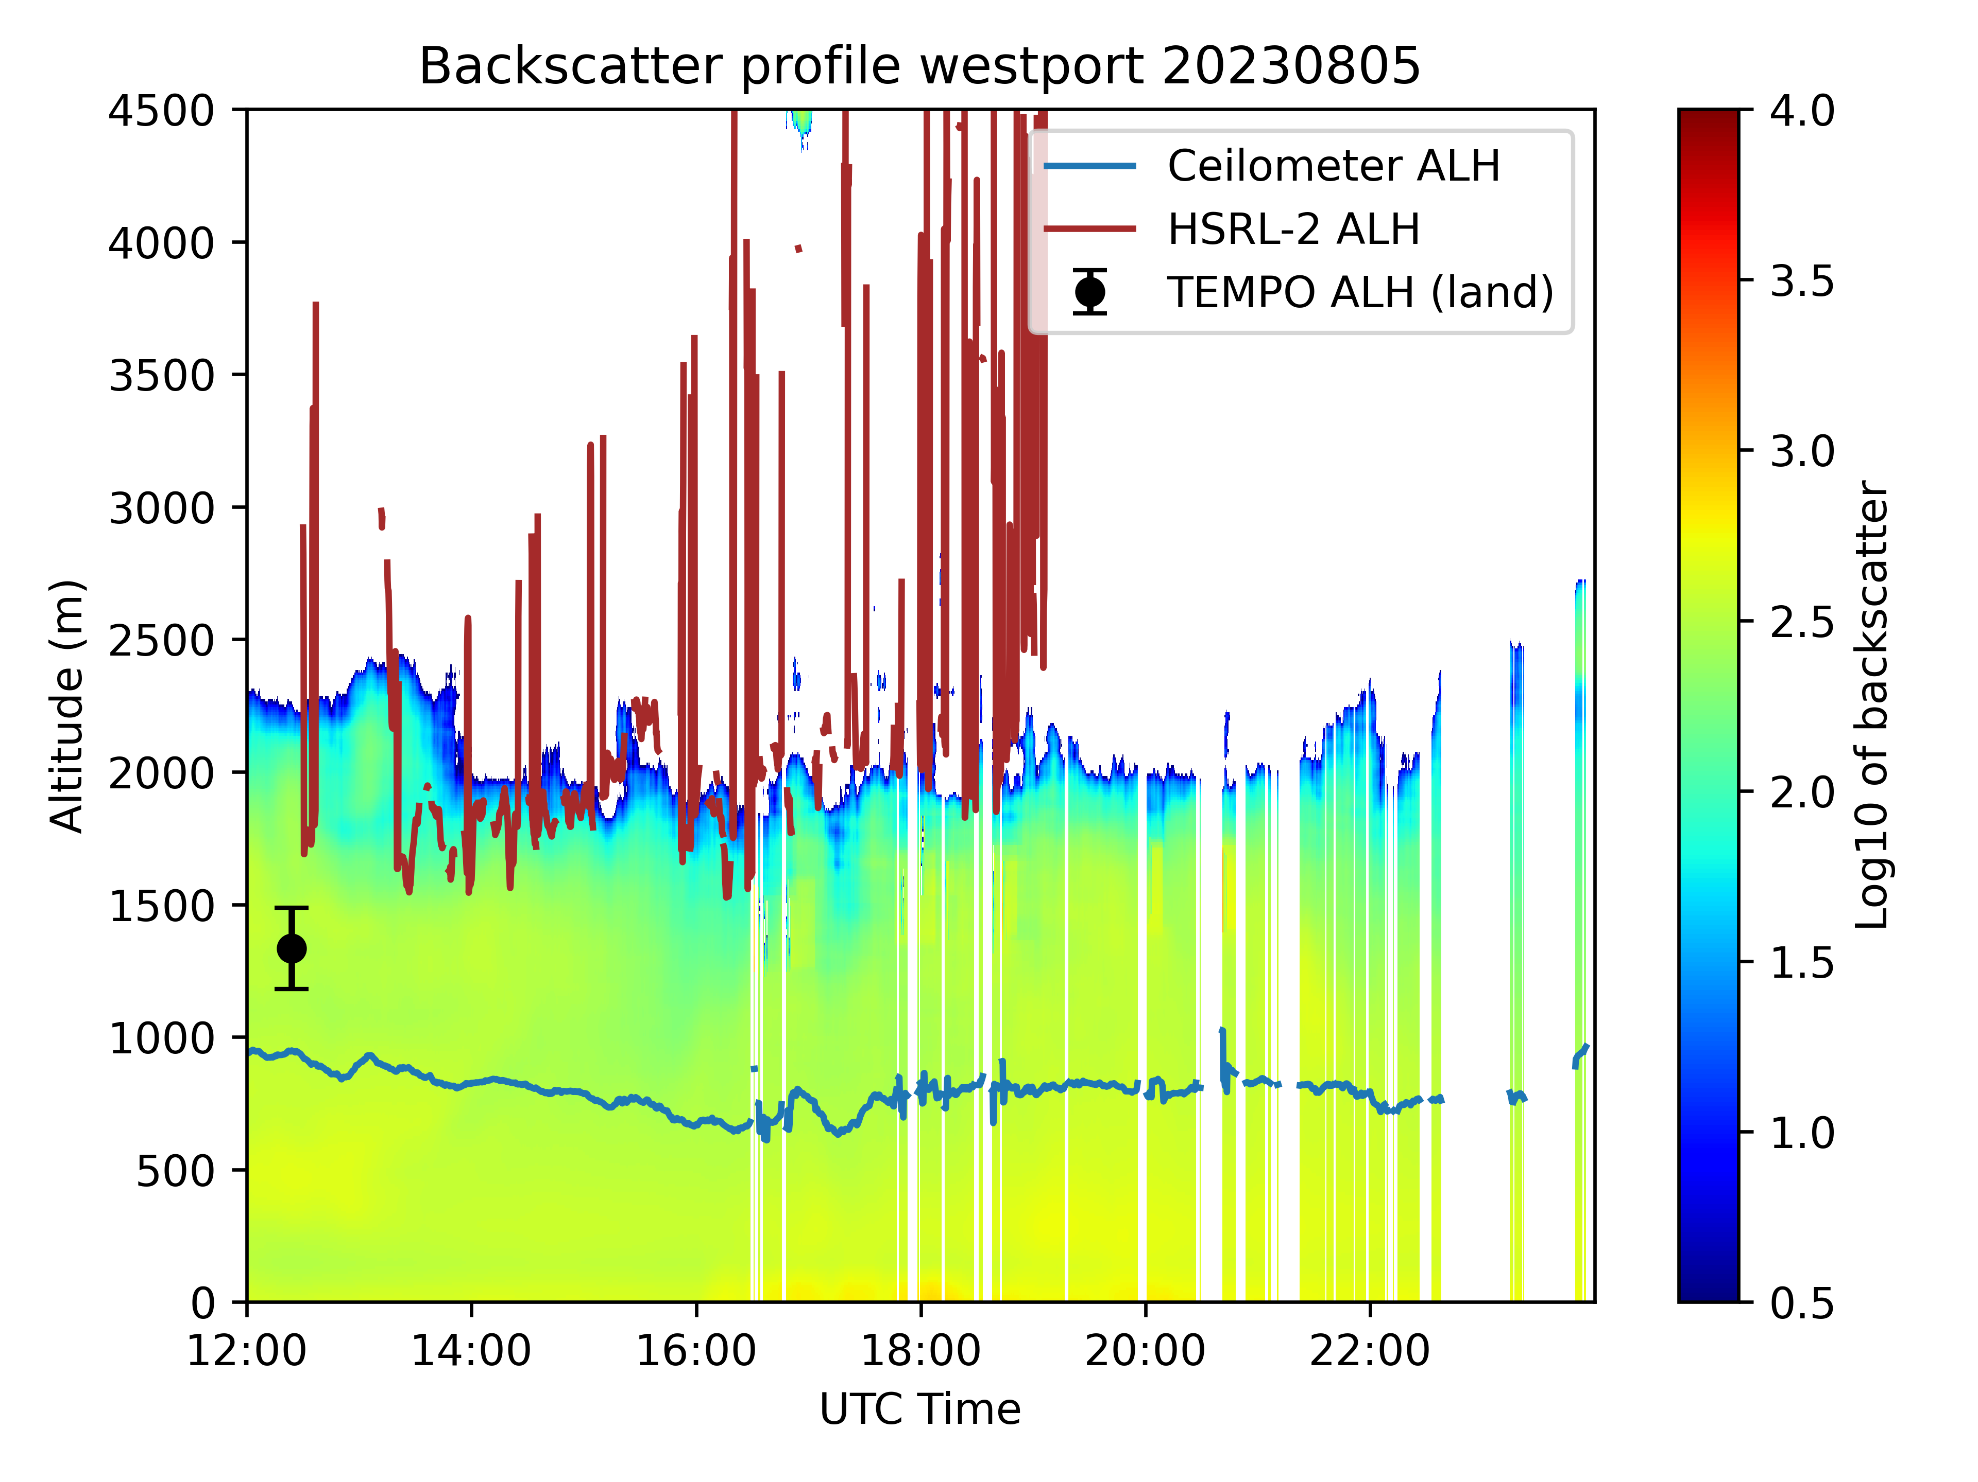
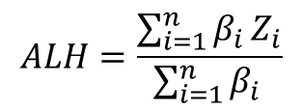
TEMPO ALH vs. NASA HSRL2 vs. Ceilometer - 8/5/23
Synergistic TEMPO Air Quality Science (STAQS) mission
New Brunswick, NJ
Westport, CT
TEMPO ALH is the mean value of retrievals within 27.5 km circle of the site, with at least 10% valid retrievals. The criteria used to be 20%. HSRL2 is the entire flight domain.
Algorithm does not retrieve for pixels with AOD <0.2 and cloudy area; no matchups over water.
Following equation is used to calculate ALH from Lidar data, where β is backscatter coefficient for ceilometer and aerosol extinction for HSRL-2
$$ALH=\frac{\sum_{i=1}^{n}{β_{i }Z_{i}}}{\sum_{i=1}^{n}{β_{i }}}$$

Slide 13
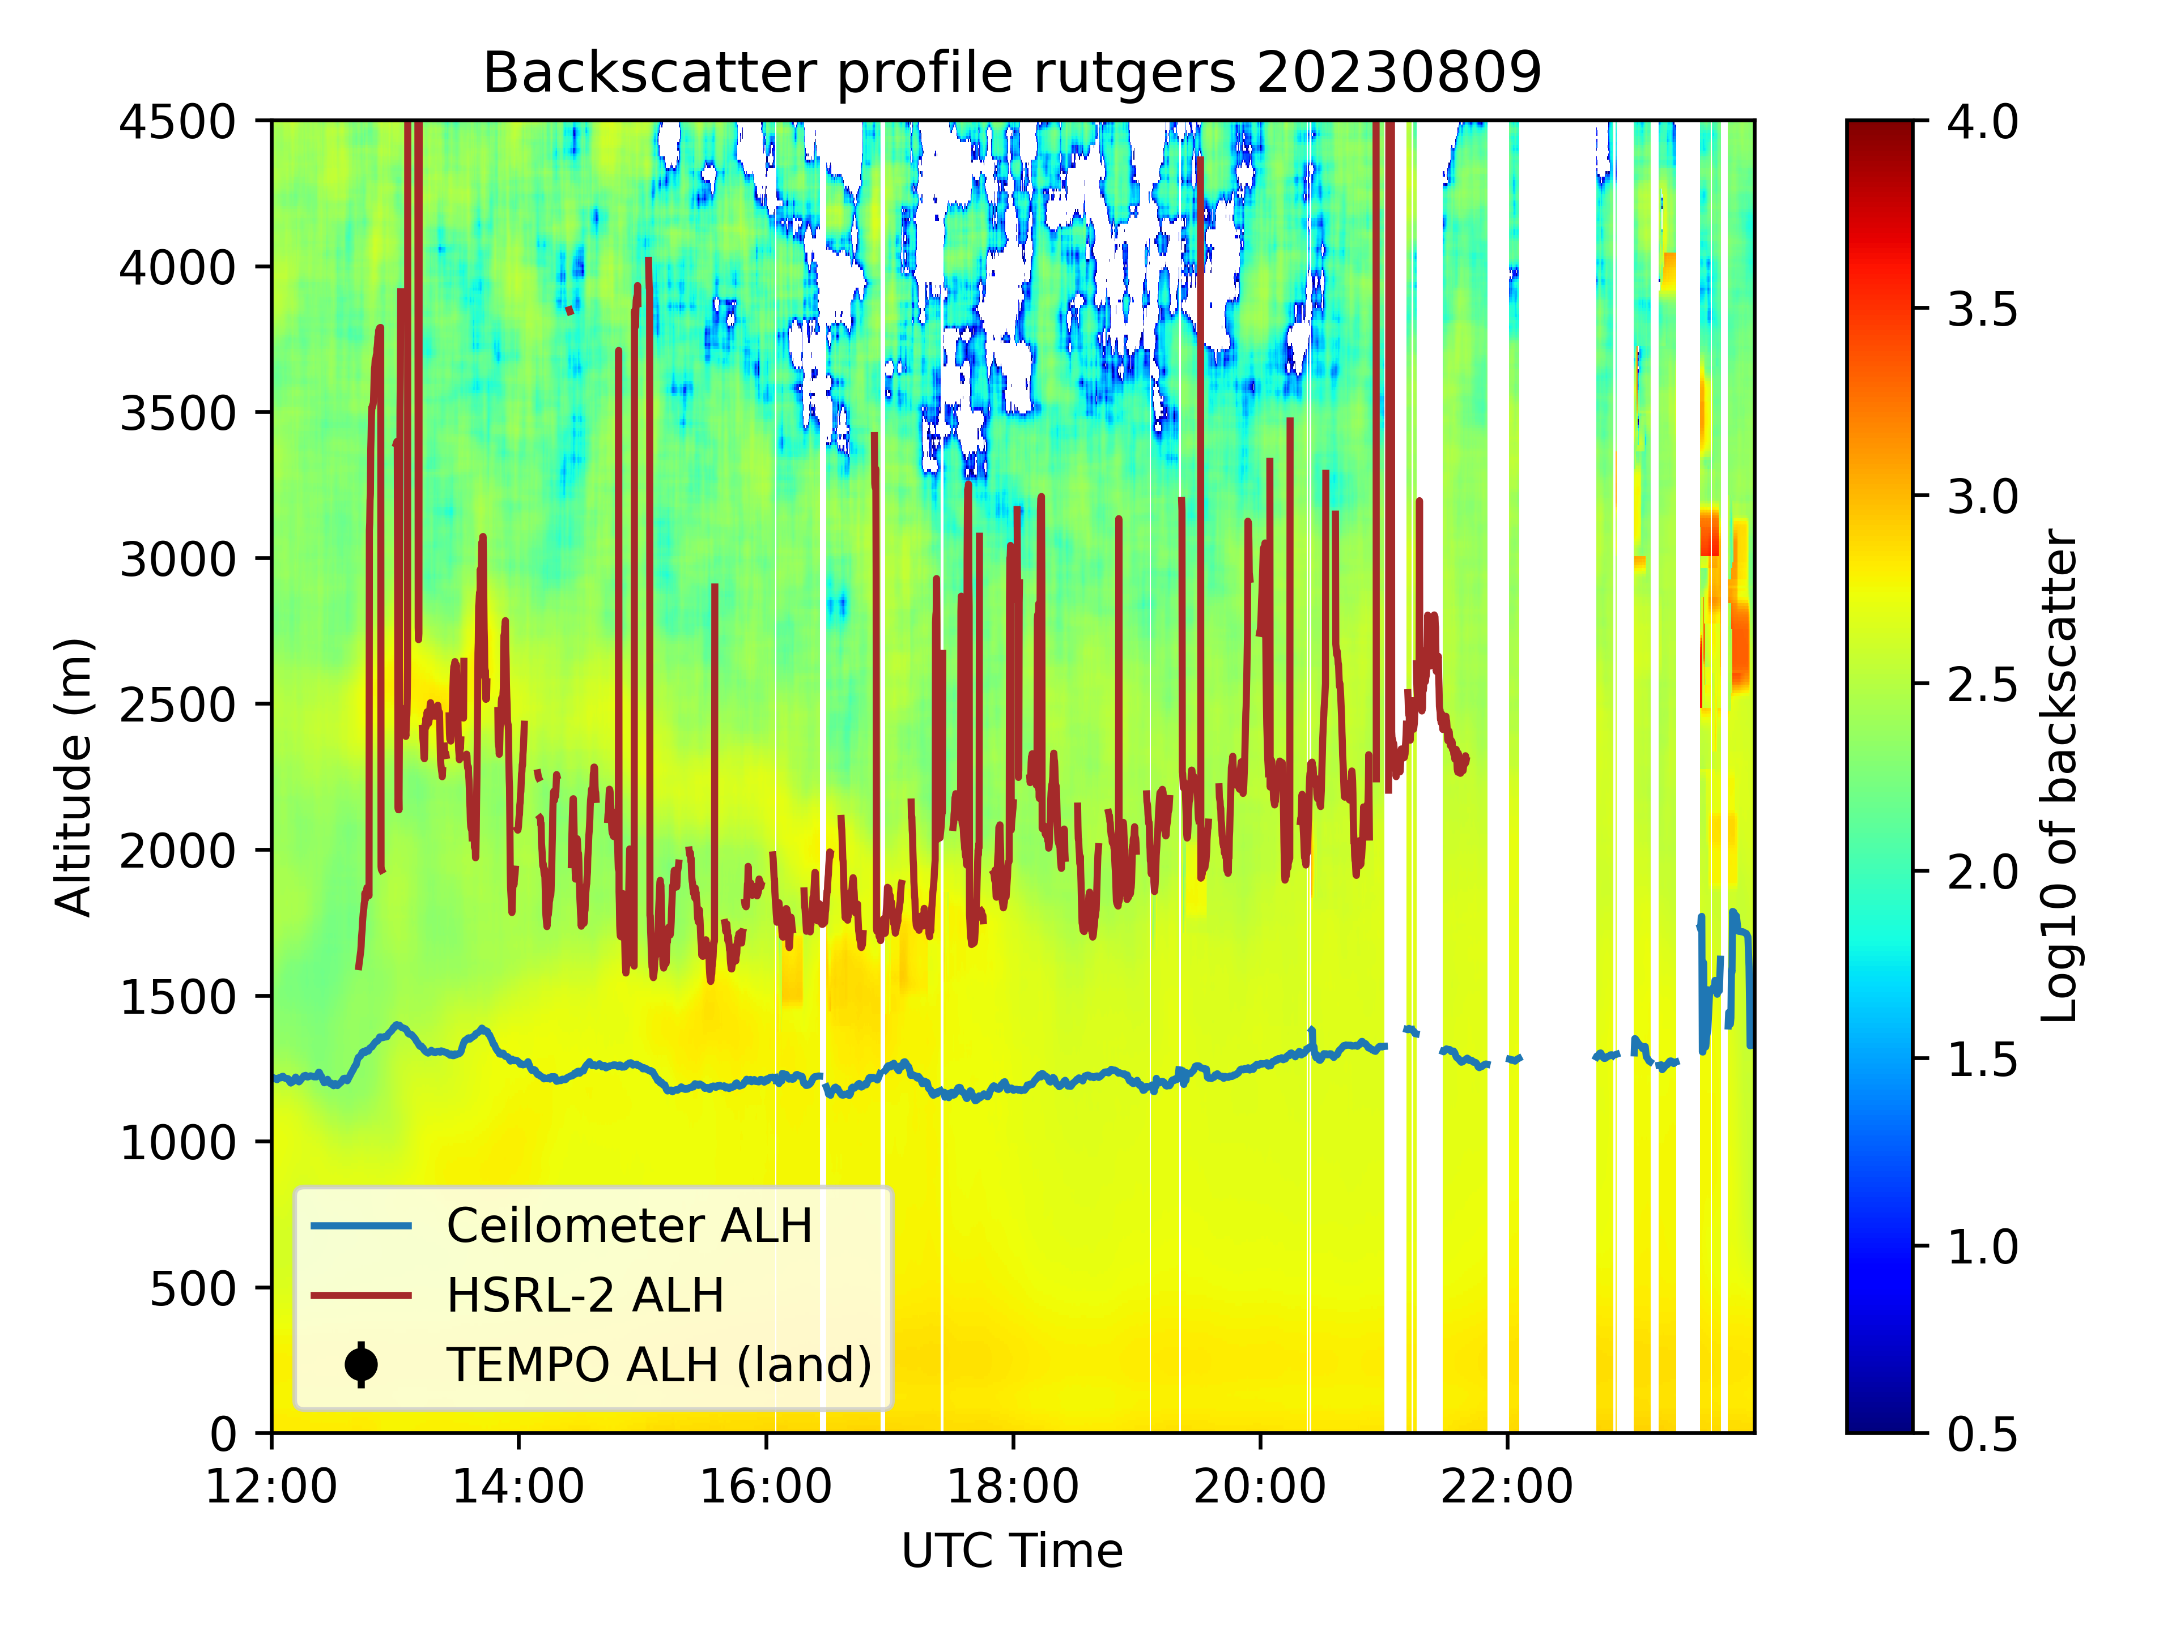
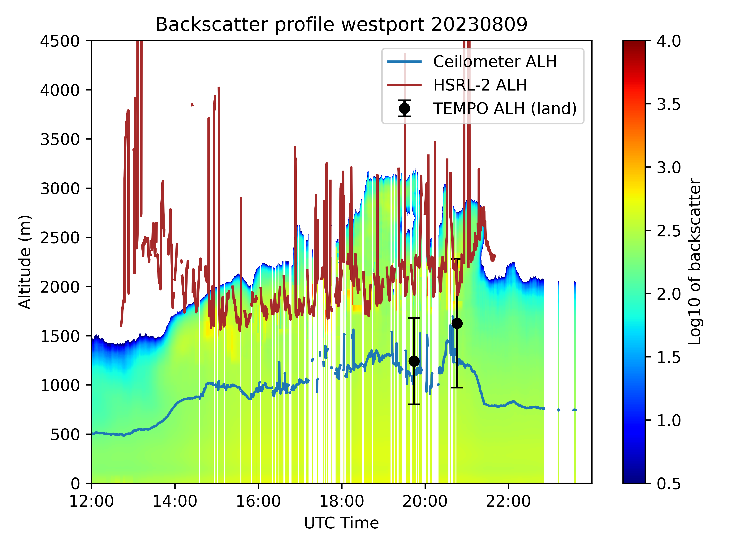
TEMPO ALH vs. NASA HSRL2 vs. Ceilometer - 8/9/23
Synergistic TEMPO Air Quality Science (STAQS) mission
New Brunswick, NJ
Westport, CT

Slide 14
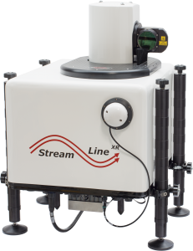
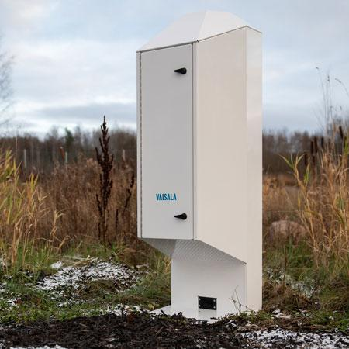
Ad-hoc Ceilometer Experiment Study (ACES II)
Summer 2025 Mid-Atlantic: Lufft CHM15k, Vaisala CL51 and CL61, Doppler Wind Lidars,and IR Sounder (LR Tech Assist-II)
Potential to add focus on development of Aerosol Layer Height algorithm
High Aerosol Loading
  Wildfire Smoke (fresh vs aged)
  Above or Below PBL: How sensitive and effective is satellite aerosol layer product to range of heights/layers?
  Saturation of photodetectors

Slide 15
Conclusions for use of UCN for ALH validation
Upfront cost for UCN (instrument, operator, and data archive) already covered largely by EPA regulatory requirement for PBLH/MLH - stable funded network
UCN archive of β(z) profiles provides broad continues coverage across the U.S. which can be leveraged to derive correlative measurements for routine ALH validation (TROPOMI, EPIC, TEMPO, etc.)
Many UCN sites collocated within U.S. air quality network providing synergistic measurements for an integrated observational system consistent with CEOS AC-VC objectives (AC-VC Validation and Monitoring PM_{2.5} White Papers)

Slide 16






























Acknowledgements
Primary Contacts
Ruben Delgado (ruben.delgado@hamptonu.edu)
John McNabb (john.mcnabb@hamptonu.edu)
James Szykman (szykman.jim@epa.gov)

Slide 17
Current UCN Timeline
Distribution of New Data Transfer Executables and Scripts (July-August 2024)
  Priority is PAMS sites which have never received an executable for data transfer
  Data Transfer to NEW Hampton University Processing Server
  Agencies should Inform via email all UCN and EPA contacts the date that you installed to assist and monitor data transfer
Migration of Data Transfer from Old to NEW Processing Server (August-September 2024)
  Transfer of Sites Displaying Data in https://ucn-portal.org
New Webpage (October-November 2024)
  Aerosol Backscatter Visualization (All Sites) and New Download* Features
Mixing Layer Height Visualizations (December 2024)
  Aerosol Backscatter with derived data products
* All Raw and Standardization Data Files are currently available for download by selecting site in
http://cas.hamptonu.edu/~mcnabb/ucn/ceilometer_data.php

Slide 18
UCN Data Products to be covered in
US EPA Quality Assurance Project Plan
Measurement /Retrieved Parameter | Analysis Method | Derived parameter | Sampling Frequency | QC Check
Mixing Layer Height | Haar wavelet algorithm | PAMS -Hourly Mixing Layer Height | 10 min average MLH generated as common sample frequency | Visual check of data and products using aerosol backscatter and MLH
Residual height layer | Haar wavelet algorithm | PAMS - Hourly residual Layer Height | 10 min average MLH generated as common sample frequency | Visual check of data and products using aerosol backscatter and MLH
Aerosol Backscatter | measured | Non-PAMS derived parameter | Varies by ceilometer 15-36 seconds | Visual check of data and instrument diagnostics monitoring
Aerosol layers | Haar wavelet algorithm | Non-PAMS derived parameter | 10 min average generated as common sample frequency | Visual check of data and uncertainty evaluations
Cloud heights | Haar wavelet algorithm | Non-PAMS derived parameter | 10 min average generated as common sample frequency | Visual check of data and products using aerosol backscatter
Precipitation | Haar wavelet algorithm (measure properties of image regions) | Non-PAMS derived parameter | 10 min average MLH generated as common sample frequency | Visual check of data and products using aerosol backscatter

Slide 19
QA/QC and Calibration/Validation
PBLH/MLH
U.S. EPA Quality Assurance Project Plan (QAPP)
  Currently being updated to reflected changes occurring from UCN move from University of Maryland Baltimore County to Hampton University
U.S. EPA Quality Assurance Handbook for Air Pollution Measurement Systems; Volume IV: Meteorological Measurements Version 3.0 (Draft)
  Updates include a subsection on ceilometers consistent with UCN QAPP
ASTM International
  Draft Standard Guide for Mixing Layer Height from Laser Based Ceilometers (Yet to receive yes vote to move out of committee)
Ad-hoc Ceilometer Experiment Study (ACES II)
Summer 2025 Mid-Altantic: Lufft CHM15k, Vaisala CL51 and CL61

Slide 20
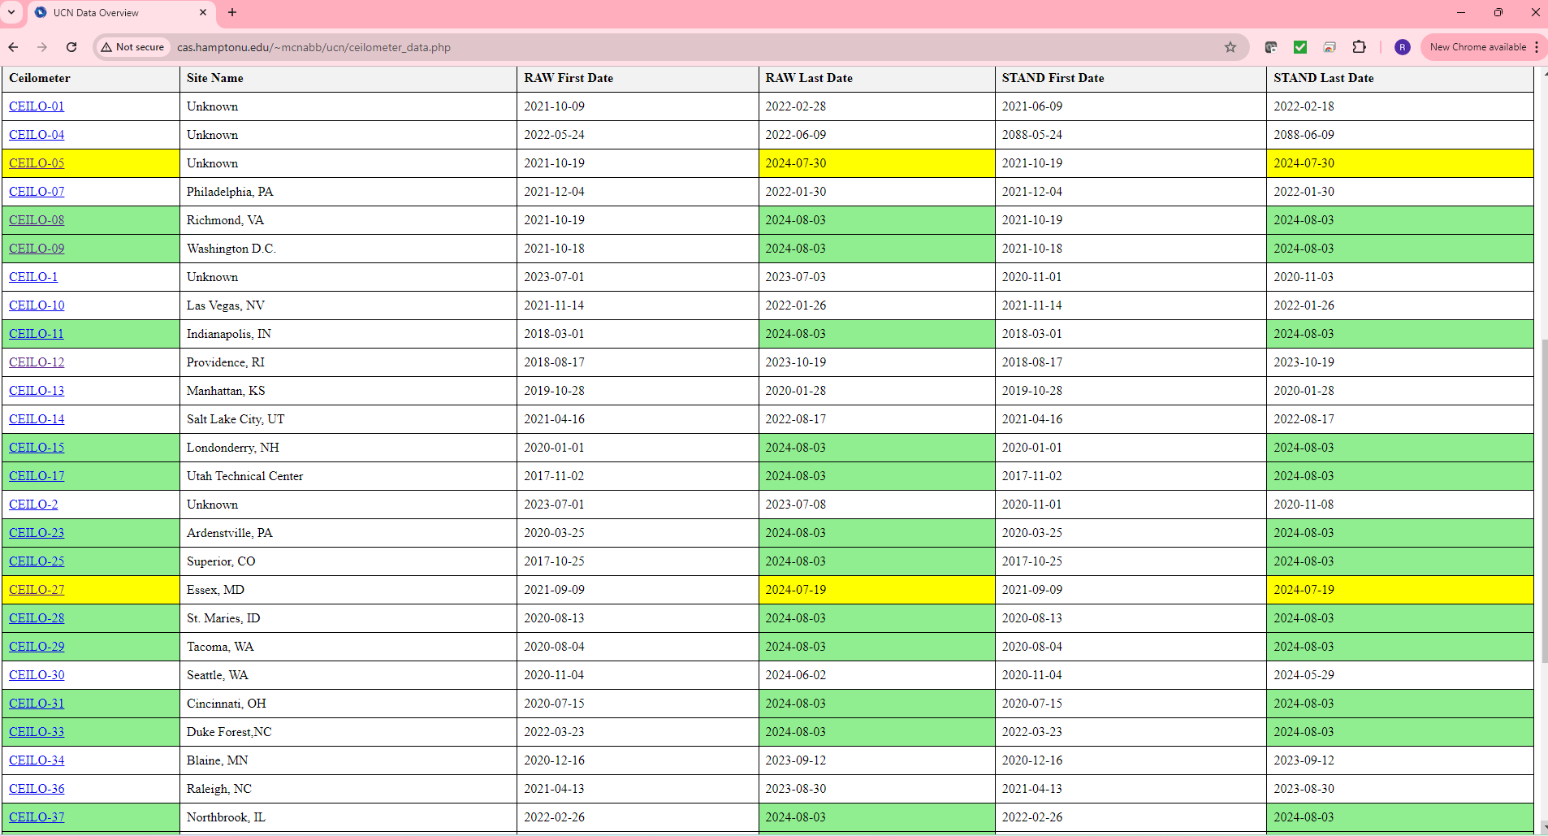
New UCN Manual Data Upload (Vaisala and Lufft)
http://cas.hamptonu.edu/~mcnabb/ucn/ceilometer_data.php
Green: Data Up to Date Yellow: Less Than Week Behind
White: Partial Data Available Red: No Data Received

