Slide 1
Review Paper: Passive Remote Sensing of Aerosol Vertical Distribution
Vijay Natraj (Jet Propulsion Laboratory, California Institute of Technology)
CEOS AC-VC Meeting #20
October 16, 2024

Slide 2
Team
Shobha Kondragunta
Martin de Graaf
Jhoon Kim
Jun Wang
Otto Hasekamp
Johannes Flemming
Mariel Friberg
Hiren Jethva
Alexei Lyapustin
Ghassan Taha
Richard Xu
Zhaocheng Zeng
Arlindo da Silva
Bertrand Fougnie
Omar Torres
Pepijn Veefkind
Ben Veihelmann

Slide 3
Genesis
CEOS AC-VC Meeting #19 in Brussels
Review of available passive techniques for remote sensing of aerosol vertical distribution
Recommendations for future satellite measurements required for more complete characterization of atmospheric aerosols

Slide 4
Importance of Aerosol Vertical Distribution
Radiative forcing: magnitude, and even sign, of aerosol radiative forcing strongly influenced by aerosol vertical distribution
Human health: Aerosol profile needed for remote sensing of particulate matter from space
Aviation: Elevated plumes can pose hazards to aviation safety
Remote sensing: Aerosols influence trace gas and surface remote sensing through their effects on the path length of radiation

Slide 5
Decadal Survey Designated Observable
QUESTION C-2. How can we reduce the uncertainty in the amount of future warming of the Earth as a function of fossil fuel emissions, improve our ability to predict local and regional climate response to natural and anthropogenic forcings, and reduce the uncertainty in global climate sensitivity that drives uncertainty in future economic impacts and mitigation/adaptation strategies?
QUESTION C-5. A. How do changes in aerosols (including their interactions with clouds which constitute the largest uncertainty in total climate forcing) affect Earth’s radiation budget and offset the warming due to greenhouse gases? B. How can we better quantify the magnitude and variability of the emissions of natural aerosols, and the anthropogenic aerosol signal that modifies the natural one, so that we can better understand the response of climate to its various forcings?
QUESTION W-6. What processes determine the long-term variations and trends in air pollution and their subsequent long-term recurring and cumulative impacts on human health, agriculture, and ecosystems?
QUESTION C-3. How large are the variations in the global carbon cycle and what are the associated climate and ecosystem impacts in the context of past and projected anthropogenic carbon emissions?

Slide 6
Paper Outline
Introduction
Occultation/Limb
Stereo Photogrammetry
UV/Vis Measurements
Oxygen Absorption Spectroscopy in the NIR
Infrared Measurements
Recommendations/Future Prospects

Slide 7
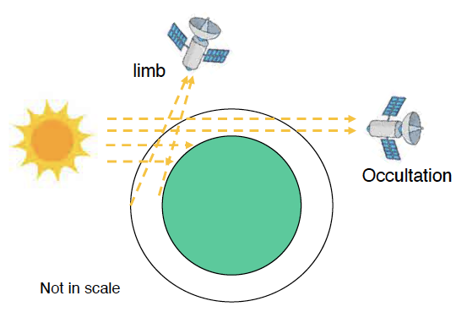
Occultation/Limb
Figure credit: Jun Wang

Slide 8
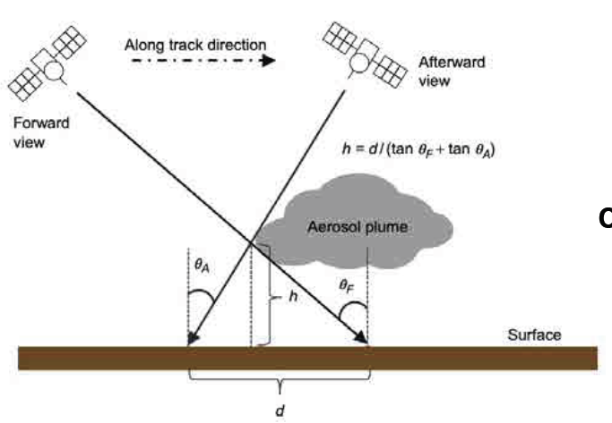
Stereo Photogrammetry
Xu et al. (2018)

Slide 9
UV/Vis Measurements
Aerosol layer shields Rayleigh scattering signal
Low surface reflectance in the UV
Less sensitivity to aerosol absorption if polarization included
Strong O₂-O₂ absorption in the Vis
Weaker Rayleigh scattering (than in the UV) and low surface albedo => 477 nm band sensitive to aerosol layer height

Slide 10
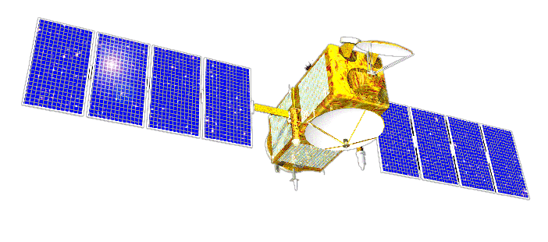
Oxygen Absorption Spectroscopy in the NIR
Column AOD
O₂ absorption

Slide 11
Oxygen Absorption Spectroscopy in the NIR
Column AOD
O₂ absorption

Slide 12
Oxygen Absorption Spectroscopy in the NIR
Column AOD
O₂ absorption

Slide 13
Oxygen Absorption Spectroscopy in the NIR
Impact of spectral resolution
Broadband measurements
Moderate and high spectral resolution measurements
Impact of polarization
Combining UV and NIR measurements

Slide 14
Infrared Measurements
Spectral signature of dust in the TIR
Negative slope in brightness temperature spectrum around 11 µm
Slope sensitive to ALH
Thermal contrast between smoke layer and surface

Slide 15
Recommendations/Future Prospects
Cross-comparison/validation of ALH products
Multisensor synergy
Measurement/model synergy
Data assimilation

Slide 16
Recommendations/Future Prospects
Day versus night remote sensing of ALH
Synergies: ALH + other aerosol products
Planned future missions
Further long-term needs

Slide 17
Acknowledgements
Richard Eckman / NASA Earth Science Atmospheric Composition Modeling and Analysis Program

