Slide 1
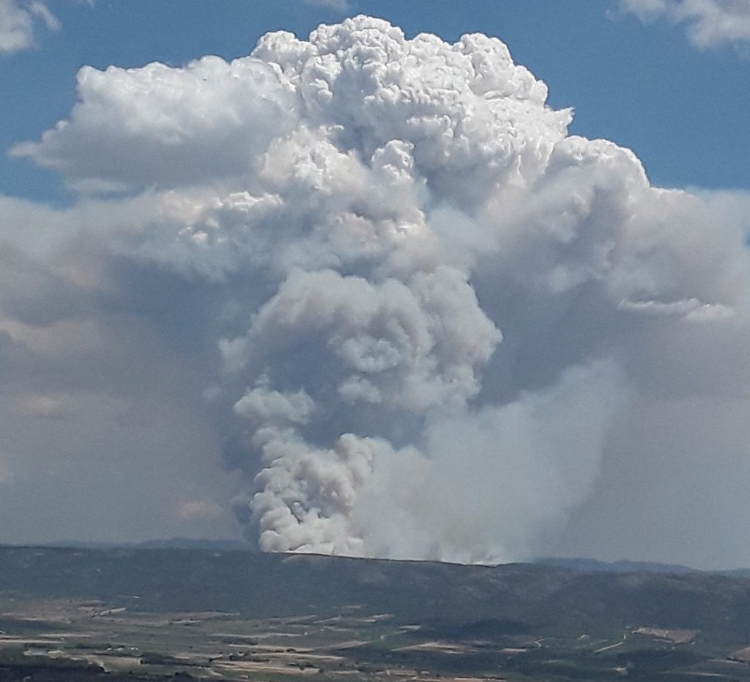
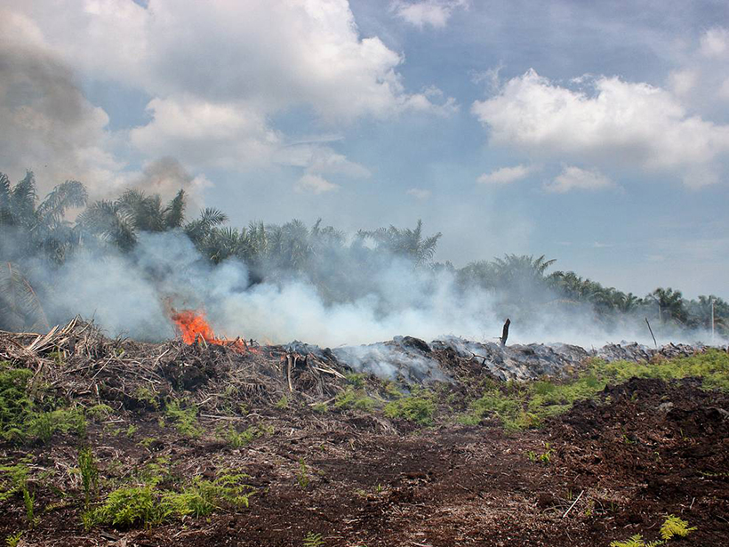
ALH Discussion
Shobha Kondragunta (NOAA)
Hai Zhang (IMSG at NOAA)

Slide 2
Are aerosols present near the surface impacting surface air quality or are they aloft?
Is the smoke plume from a fire injected into the free troposphere or into the planetary boundary layer?
On a regional scale, can we monitor the altitude at which aerosols are being transported to determine if a downwind location will be impacted?
On a hemispheric scale, at what altitude is the trans-continental dust transport occurring and how is it impacting the ocean sea surface temperature, cyclone/hurricane strength, and phytoplankton bloom?
How different is the climate forcing due to the presence of dust and smoke over clouds compared to clear-sky only or cloudy-sky only climate forcing?
What are the linkages between climate and air quality with aerosols as the drivers of climate change? Will the number, severity, and location of fires and dust storms change, and will they have adverse impacts on air quality and human health?
Can simultaneous real time assimilation of winds and aerosols improve air quality forecast models?

Slide 3
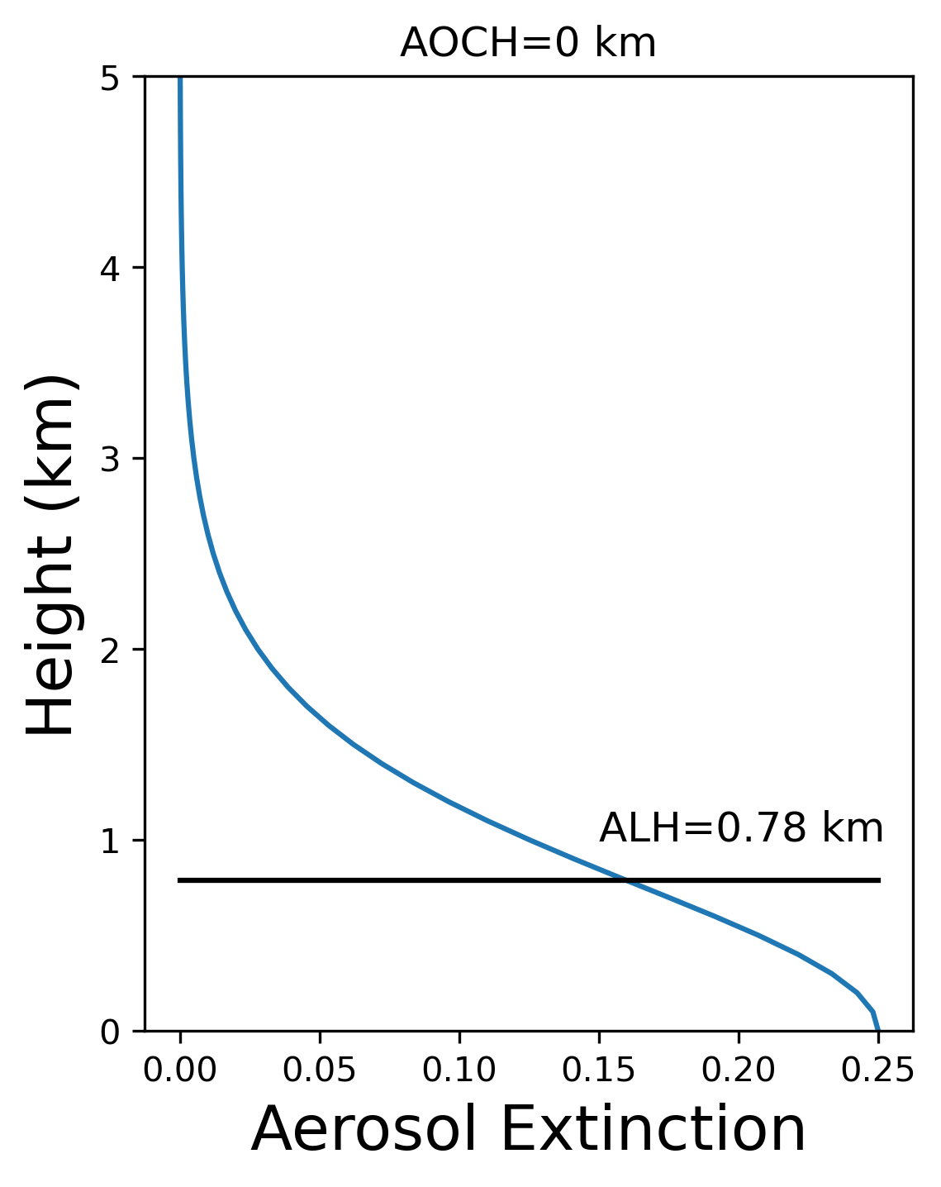
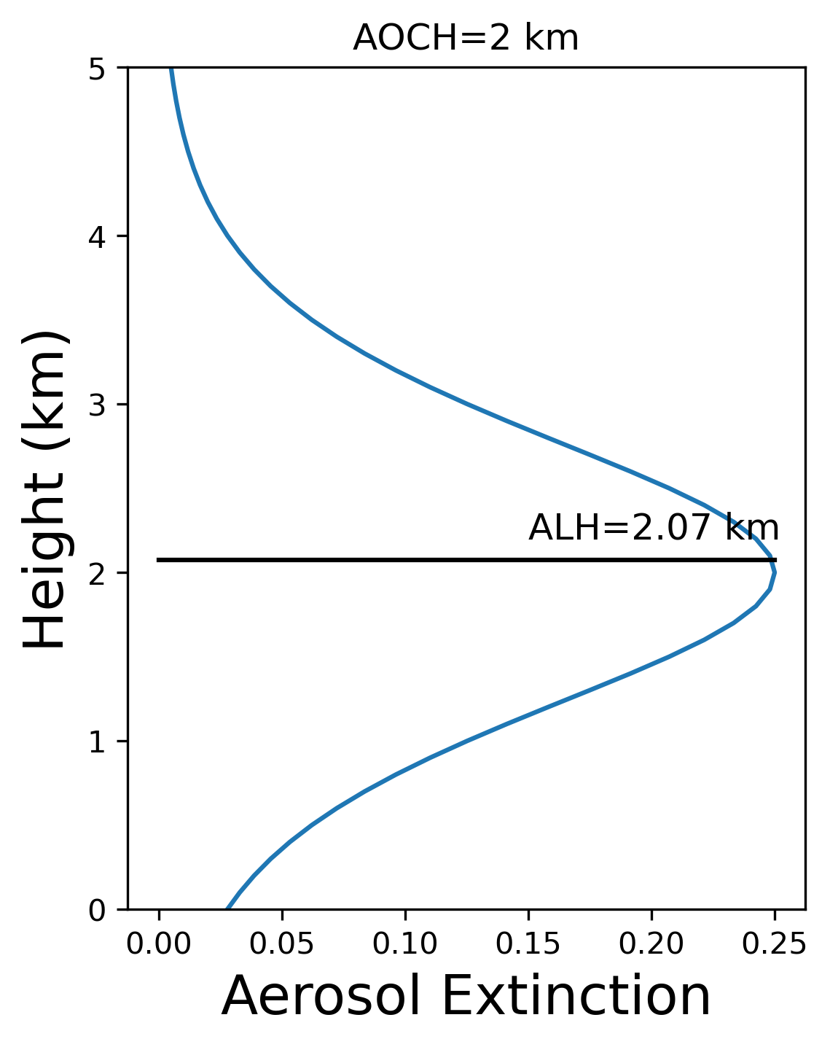
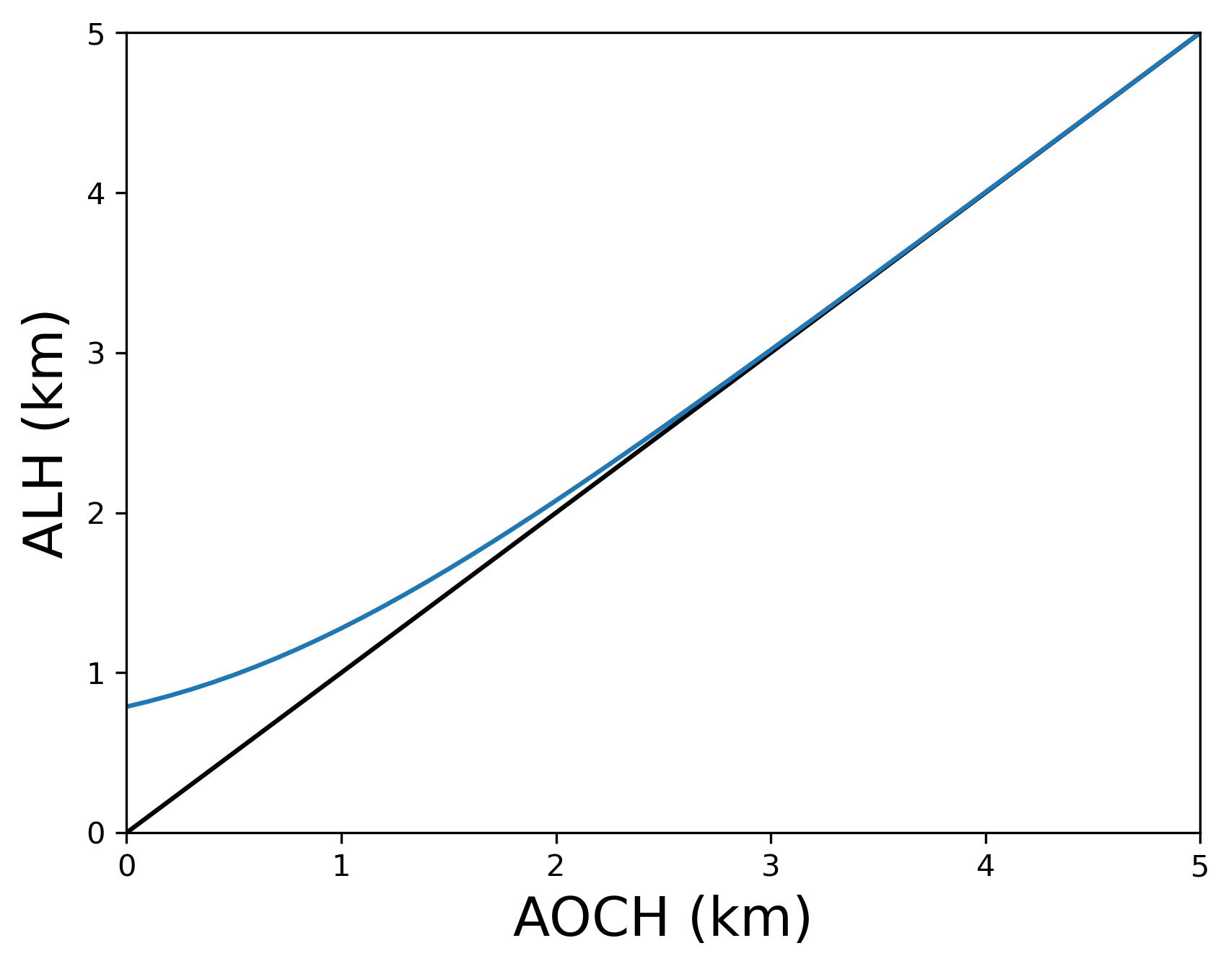
At low ALH, the retrieved AOCH is different from ALH
Obtained from Lidar data
Obtained from TEMPO retrieval
At AOCH lower than 2 km, ALH is larger than AOCH
At AOCH greater than 2km, ALH is very close to AOCH

