Slide 1
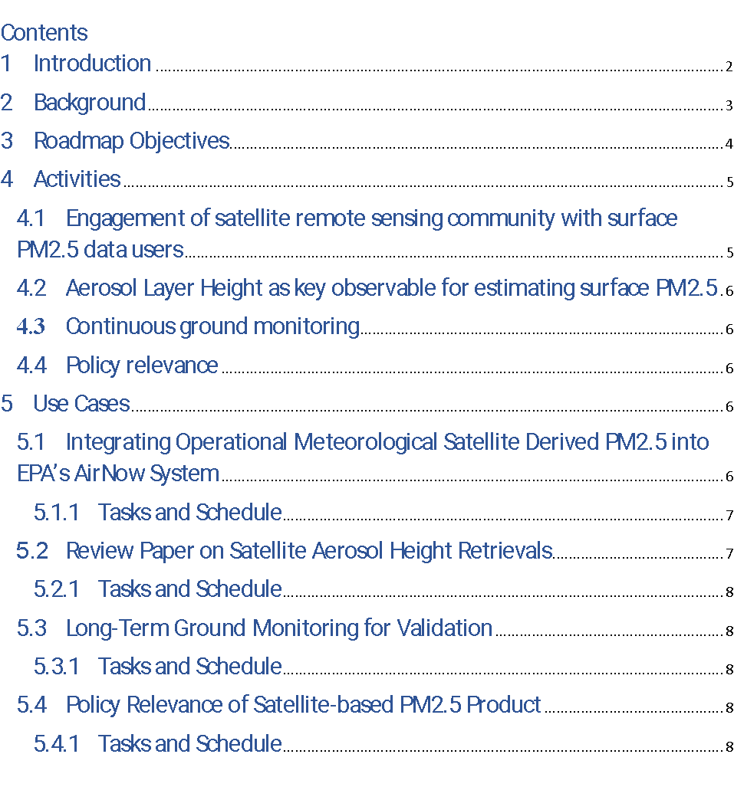
Way Forward: Roadmap for the implementation of the white paper
Satellite products
Exploit Near Real Time aerosol information from meteorological imagers
Exploit aerosol information from multi-angle polarimetric imagers
Exploit aerosol vertical information from spectrometers
Develop synergetic aerosol retrievals from multiple sensors
Enhance consistency of aerosol products
Enhance radiometric consistency of space-borne sensors
Integration with models
Develop fast forward operators for assimilation of satellite observations
Improve consistency of aerosol representation in models and satellite products
Improve uncertainty estimates in satellite aerosol products
Develop schemes for assimilation of Level-1 satellite data
Improve aerosol models and Level-2 assimilation schemes
Develop data processing tools including machine learning
Validation
Create ground-based validation supersites with comprehensive sets of sensors
Enhance ground-based observation infrastructure including low-cost PM sensors
Facilitate data access

Slide 2
Way Forward: Roadmap for the implementation of the white paper
Identify and describe activities to be carried out at CEOS and partner agencies that lead to meeting the goals of the recommendations of the whitepaper.

Slide 3
Way Forward: Roadmap for the implementation of the white paper
Inform users about the quality of the data and associated uncertainties to optimize the data use.

Slide 4
Way Forward: Roadmap for the implementation of the white paper
Assimilation of aerosol layer height to improve PM2.5 forecast is not yet a demonstrated activity.
Prior to using aerosol layer height information in models, it is important to take stock of current retrieval capabilities, their limitations and strengths and document the ways this information can be used to estimate PM2.5 in peer reviewed literature.

Slide 5
Way Forward: Roadmap for the implementation of the white paper
Space agencies should work with user agencies in establishing super sites to conduct routine long-term validation of satellite products and estimated PM2.5 by having sites measuring all needed observables.

Slide 6
Way Forward: Roadmap for the implementation of the white paper
Though regulatory agencies do not use satellite products in making regulations, they can use satellite-based information in a diagnostic way to study the impact of rule changes or the need for a rule change.

Slide 7
Way Forward: Roadmap for the implementation of the white paper
AirFuse talk by Barron Henderson (EPA)
ALH review paper discussion by Vijay Natraj (JPL)
ALH validation talks by Jim Szykman (EPA) and Siyuan Huang (NOAA)
Satellite data relevance to new PM2.5 health standard by Michael Cheeseman (NOAA)

Slide 8
Regarding Rec 2 (Exploit vertical information from spectrometers) there is progress on L2 algorithms and on assimilation approaches:
van Zadelhoff, G.-J., Donovan, D. P., and Wang, P.: Detection of aerosol and cloud features for the EarthCARE atmospheric lidar (ATLID): the ATLID FeatureMask (A-FM) product, Atmos. Meas. Tech., 16, 3631–3651, https://doi.org/10.5194/amt-16-3631-2023, 2023.
Wang, P., Donovan, D. P., van Zadelhoff, G.-J., de Kloe, J., Huber, D., and Reissig, K.: Evaluation of Aeolus feature mask and particle extinction coefficient profile products using CALIPSO data, Atmos. Meas. Tech., 17, 5935–5955, https://doi.org/10.5194/amt-17-5935-2024, 2024.
Pang, M., Jin, J., Yang, T., Chen, X., Segers, A., Lin, H. X., Liao, H., and Han, W.: The sensitivity of aerosol data assimilation to vertical profiles: case study of dust storm assimilation with LOTOS-EUROS v2.2, Geosci. Model Dev. Discuss. [preprint], https://doi.org/10.5194/gmd-2024-113, in review, 2024.
Wang, H., Yang, T., Wang, Z., Li, J., Chai, W., Tang, G., Kong, L., and Chen, X.: An aerosol vertical data assimilation system (NAQPMS-PDAF v1.0): development and application, Geosci. Model Dev., 15, 3555–3585, https://doi.org/10.5194/gmd-15-3555-2022, 2022.
Yang, T., Li, H., Wang, H., Sun, Y., Chen, X., Wang, F., Xu, L., and Wang, Z.: Vertical aerosol data assimilation technology and application based on satellite and ground lidar: A review and outlook, J. Environ. Sci., 123, 292-305, https://doi.org/10.1016/j.jes.2022.04.012, 2023.
Regarding Rec 3 (Exploit information from multi-angle polarimetric imagers) there is progress on both L2 algorithms and on assimilation approaches:
Algorithm evaluation for polarimetric remote sensing of atmospheric aerosols, AMT, https://doi.org/10.5194/amt-17-1497-2024
Gao et al.,Simultaneous retrieval of aerosol and ocean properties from PACE HARP2 […], AMT, https://doi.org/10.5194/amt-16-5863-2023
Tao et al., […] retrieval algorithm for multi-angle polarimetric measurements with physics-informed deep learning method, RSE, https://doi.org/10.1016/j.rse.2023.113763, 2023
3MI algorithm?
Wang et al., Aerosol Retrieval over Land from the Directional Polarimetric Camera Aboard on GF-5, Atmosphere 2022, https://doi.org/10.3390/atmos13111884
Tsikerdekis et al., Estimating aerosol emission from SPEXone/PACE using an ensemble Kalman smoother: OSSEs, Geosci. Model Dev., 15, 3253–3279, https://doi.org/10.5194/gmd-15-3253-2022
Tsikerdekis et al., Assimilating aerosol optical properties related to size and absorption from POLDER with ensemble data assimilation system, ACP, https://doi.org/10.5194/acp-21-2637-2021

Slide 9
Additional Activities

