Slide 1

JEDI-Based Atmospheric Composition Data Assimilation Progress at NWS/NCEP/EMC
October 16, 2024
Cory R Martin
With contributions from: Hyundeok Choi, Jianping Huang, Daryl Kleist, Jeff McQueen, Ivanka Stajner, Andrew Tangborn, Yaping Wang, Hongli Wang, Ruifang Li, Jérôme Barré, and others

Slide 2
Target Applications
GFS/GEFS
  Medium-range weather forecasting
  Global aerosols using GOCART
AQM
  N. America air quality prediction
  Full chemistry with CMAQ
SFS
  Subseasonal-to-seasonal prediction
  Global aerosols, perhaps future GHGs?

Slide 3
GFSv17 Aerosol DA Plans
Currently one of the few (only?) operational centers to not have aerosol DA initializing their aerosol prediction system
6-hourly cycles 4x a day with early and late cycles
  Early cycle to initialize the GEFS long forecasts (one aerosol analysis provided, up to the ensemble forecast group to decide if/how to perturb)
  Late cycle to initialize the high resolution GDAS forecast (without radiative feedback)
Analysis resolution C384L127 (~0.25 deg); background resolution C1152L127 (~9km)
3DVar FGAT with 3-hourly backgrounds
VIIRS EPS 550nm AOD from S-NPP, N20, N21

Slide 4
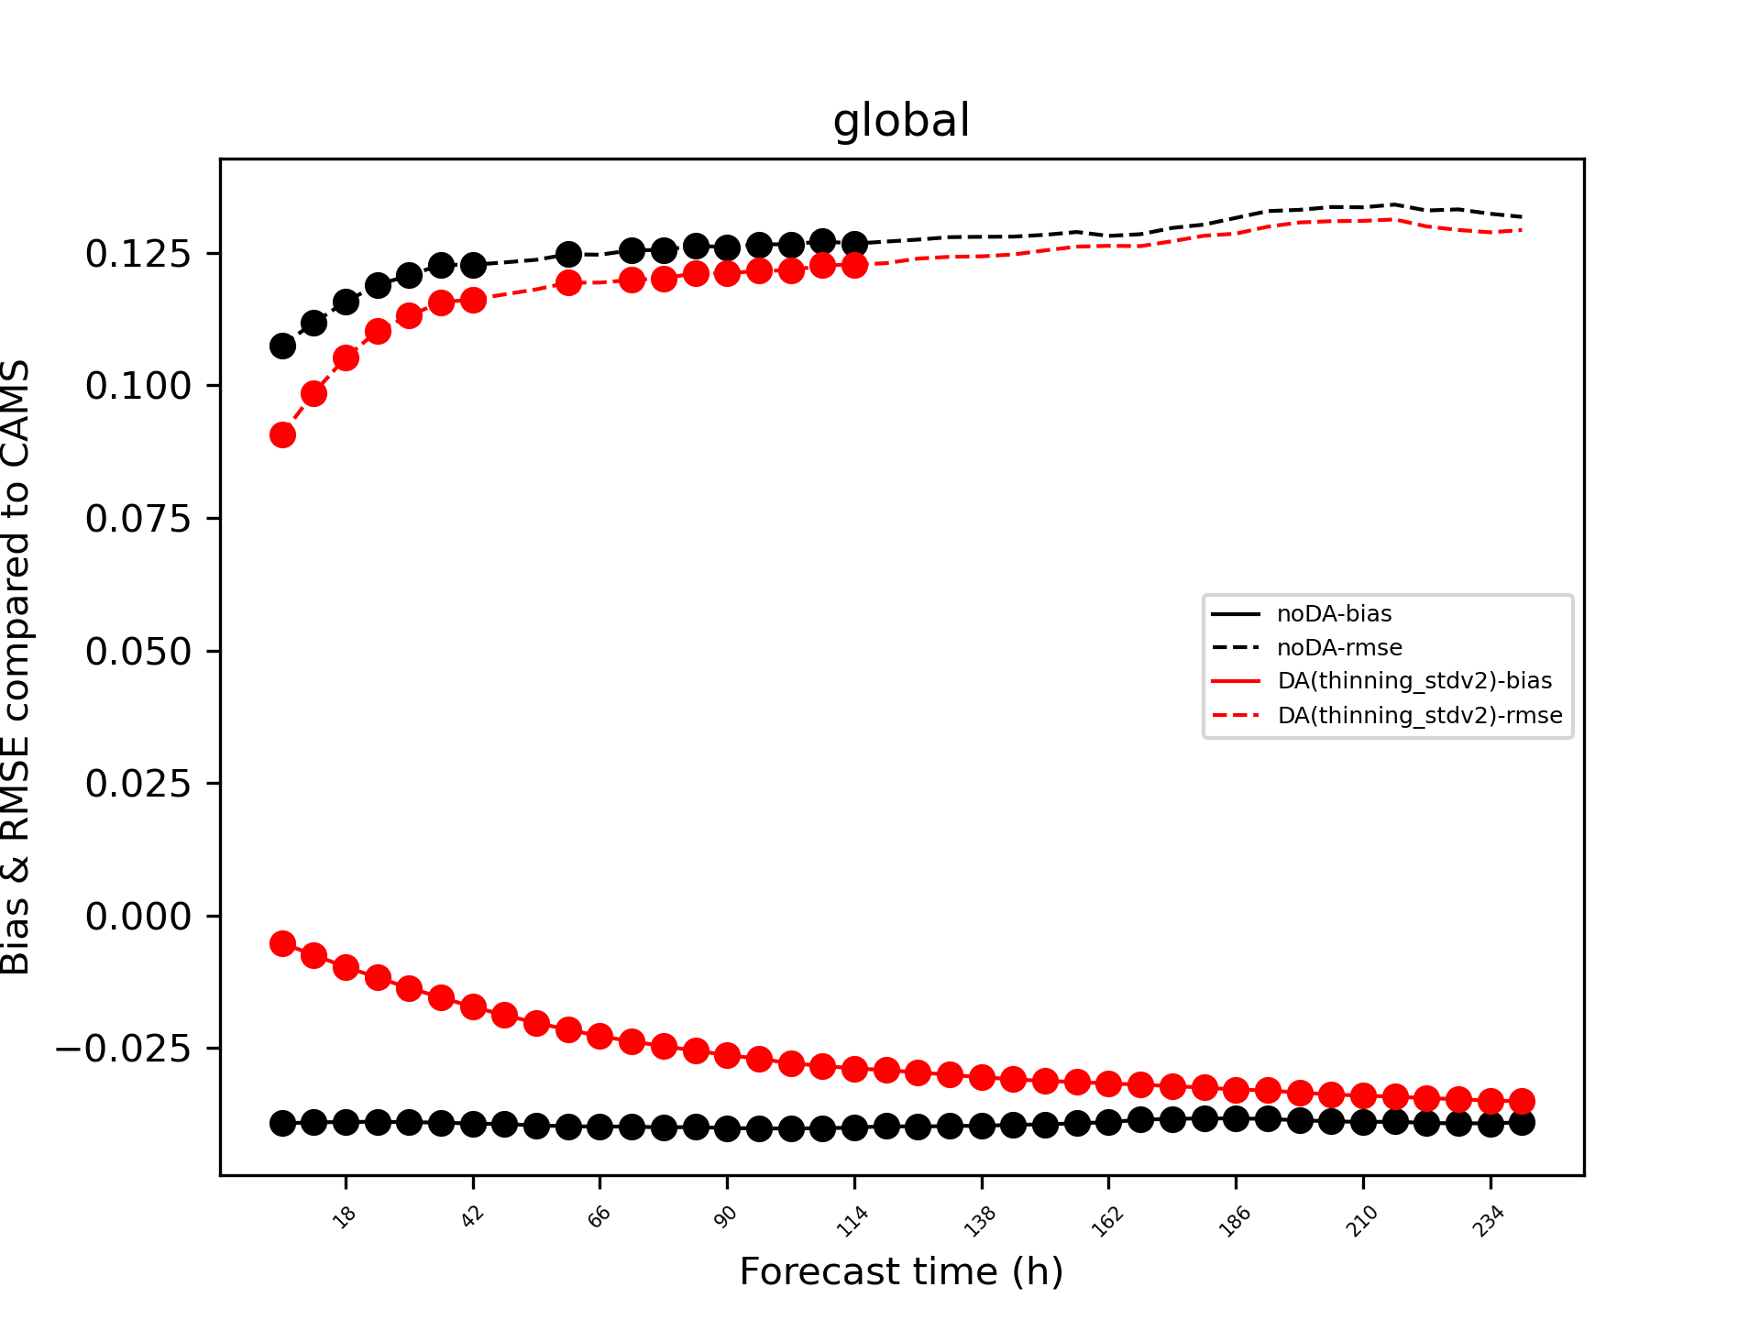
AOD Assimilation Impact
Student T-test suggests that (somewhat limited sample size) VIIRS AOD assimilation can have a significant impact on the model’s forecast of AOD.
“Significant” reduction of RMSE out to ~5 days and mean bias reduction out to 10+ days are possible.
Work/figures courtesy Yaping Wang, SAIC@EMC

Slide 5
Thinning vs Superobbing
VIIRS observations are ~750m, far too dense to assimilate all.
DA generally assumes observations are independent and not correlated, which isn’t the case here.
Two main ways to handle this:
  Thinning - select only every n-th observation, either randomly, or with some sort of space/time structure
  superobbing - averaging/binning several observations into one new observation
Aiming to have ~one observation per model grid point
Yaping Wang

Slide 6
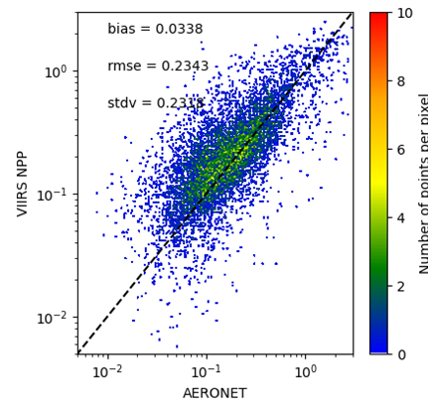
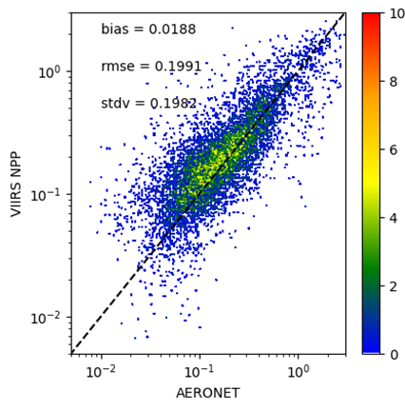
Thinning vs Superobbing
Thinned
Superobbed
Yaping Wang

Slide 7
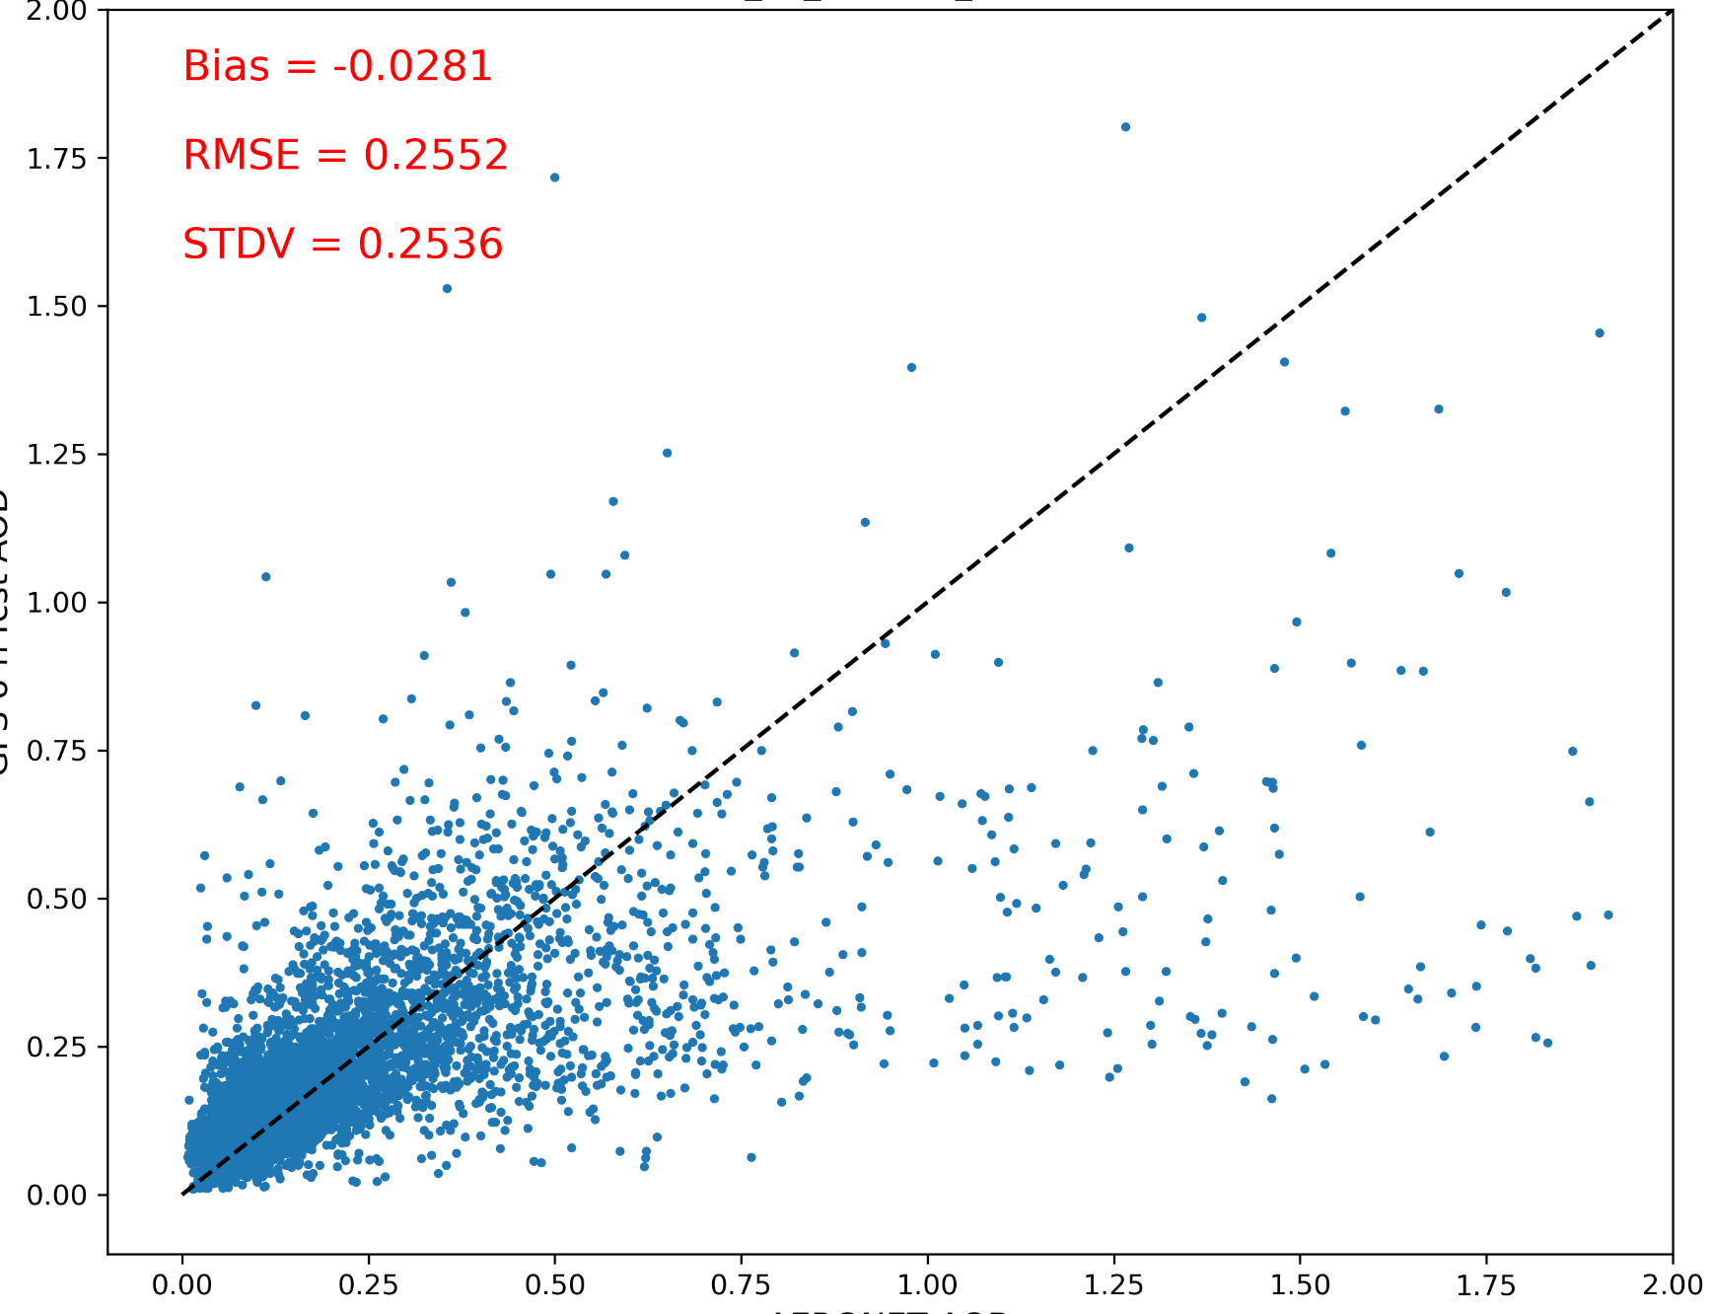
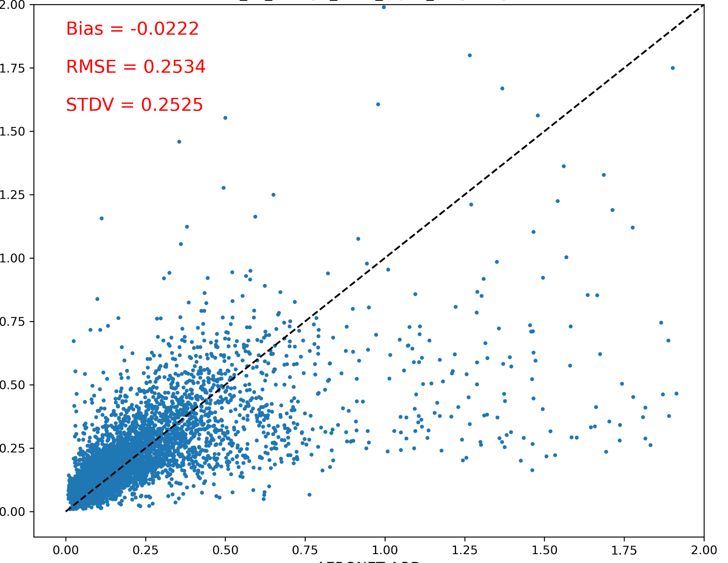
GOCART 6-h forecast verified against AERONET AOD
(01 Aug 2021 - 14 Aug 2021)
Thinning
Superobbing
global
global
On global scale, superobbing reduces the mean bias, RMSE and STDV, compared to thinning.
6-h forecasted AOD
6-h forecasted AOD
AERONET AOD
AERONET AOD
 | North America |  | Europe |  | South America |  | Africa |  | East Asia
 | Thin | Superob | Thin | Superob | Thin | Superob | Thin | Superob | Thin | Superob
BIAS | -0.0735 | -0.0669 | 0.0172 | 0.0199 | -0.0099 | -0.0043 | -0.0158 | -0.009 | 0.0027 | 0.0085
RMSE | 0.3644 | 0.3631 | 0.0904 | 0.0882 | 0.1128 | 0.1225 | 0.1275 | 0.1216 | 0.1867 | 0.1767
Yaping Wang

Slide 8
Quality Control and Error Assignment
Basic QC of the VIIRS AOD product include:
  Rejecting ‘low quality’ obs as defined by NESDIS
  Inflating errors when obs differ significantly from the forecast
  Fixing the valid ob range from 0 to 4.9 AOD
  Only using observations between 60N-60S
Exploring the use of Variational Bias Correction
  Biases between platforms that can be corrected with changes in coefficients every analysis cycle
  Normally, this uses an independent anchor but ECMWF/CAMS has used NOAA-20 to anchor other VIIRS obs

Slide 9
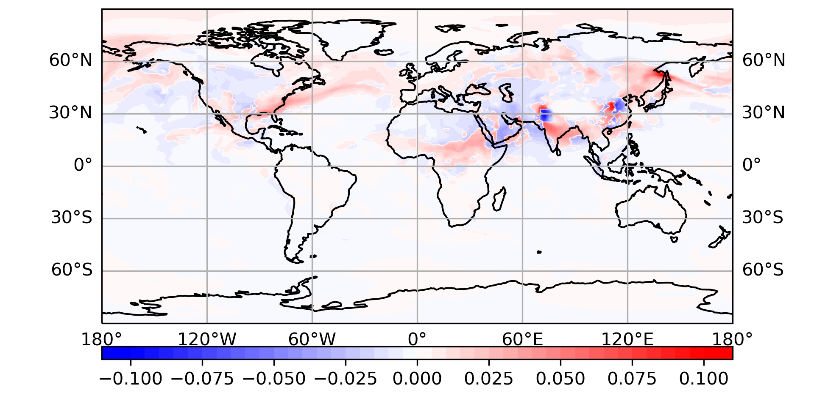
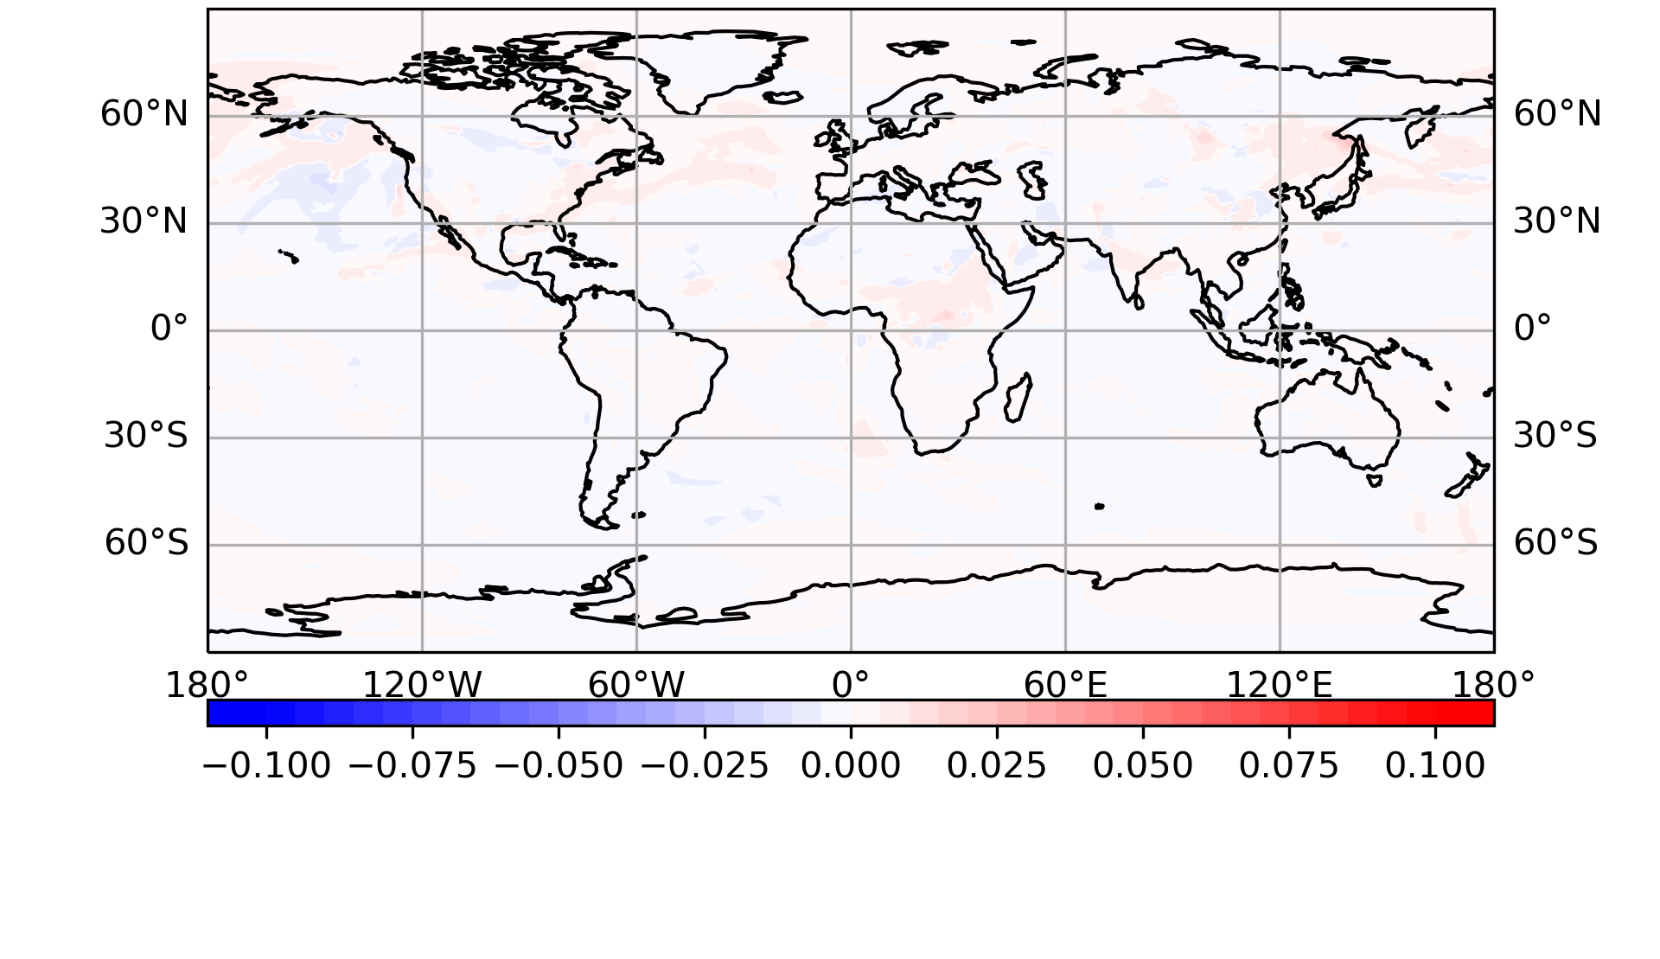
Variational Bias Correction
Exploring multiple bias predictors:
Difference of absolute error against CAMS (VarBC (sulfate) - CTRL)
Positive: VarBC has smaller error
Negative: CTRL has smaller error
Difference of absolute error against CAMS (VarBC (Constant) - CTRL)
Positive: VarBC has smaller error
Negative: CTRL has smaller error
VarBc reduces the error over east Asia, central Africa, Europe and east North America.
Not much impact
Yaping Wang

Slide 10
Error Covariance Estimation and Tuning
Because we are running a 3DVar analysis, the background error covariance matrix is essential to the performance of the system.
Multiple methods for computing B have been explored:
“NMC Method” (lagged forecast pairs)
“BUMP” estimates from an offline ensemble
Time varying covariance
  Uses background from each cycle to compute variance from neighboring gridpoints
Our plan is a hybrid of the 2nd and 3rd approaches

Slide 11
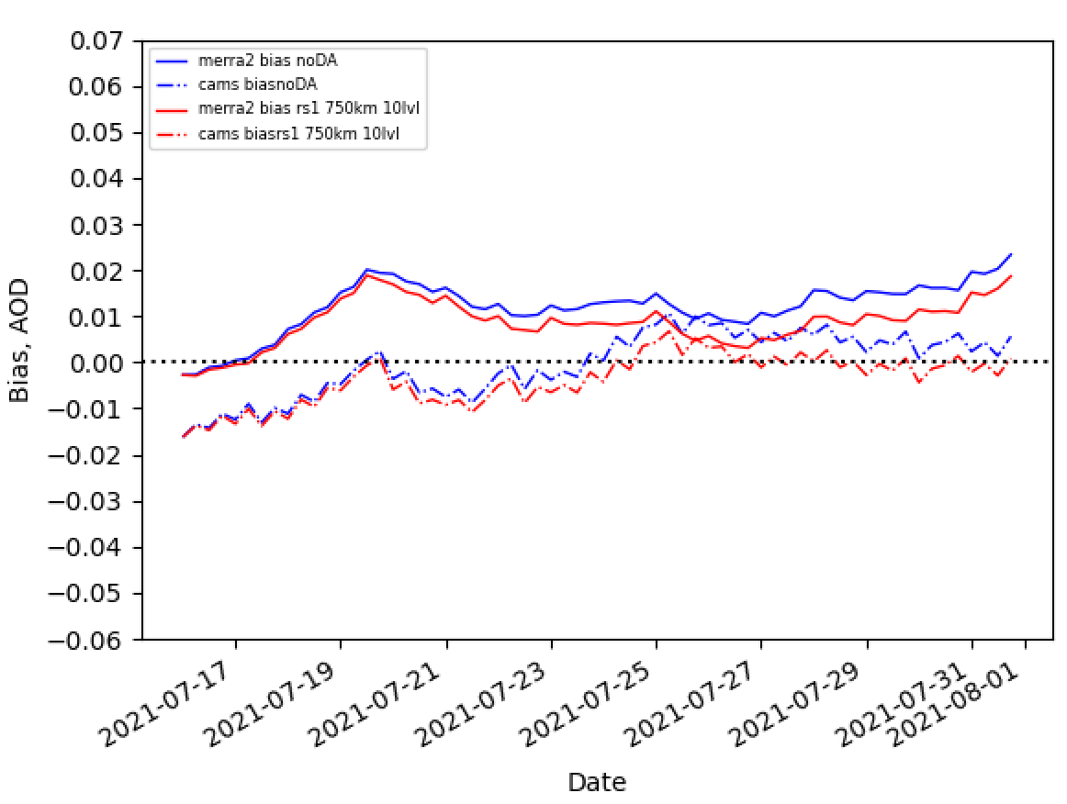
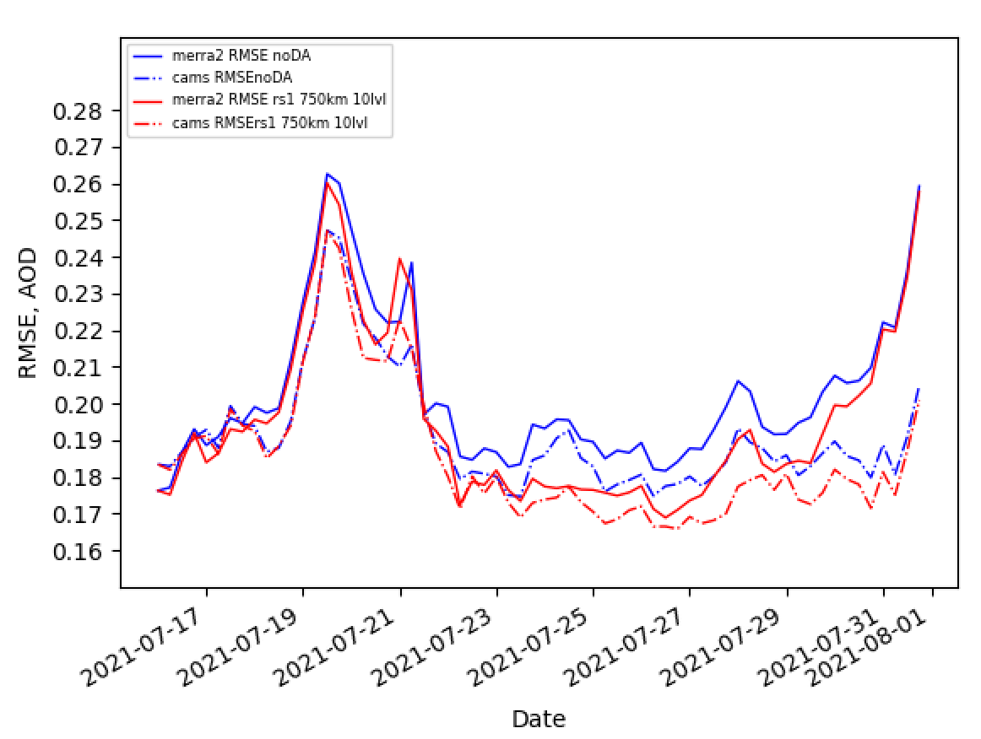
Comparisons to MERRA2 and CAMS
DA is improving the forecast, but still more tuning is needed!
Andy Tangborn

Slide 12
Regional AQ DA
AQMv7 features UFS coupled regional FV3 with CMAQ, but no DA for initialization.
Nitrogen dioxide (NO₂) from TROPOMI (EMC)
TEMPO (JCSDA + EMC)
AOD and PM (GSL)
Future: state + emissions adjustment through strongly coupled DA; GeoXO

Slide 13
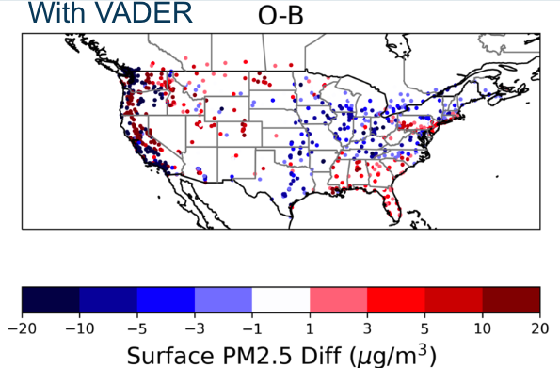
Regional AQ DA
Surface PM2.5 Assimilation
Work at GSL on generic PM2.5 variable transform in JEDI/VADER
VADER is a generic variable change tool, as part of JEDI, that can convert from different models to other fields (like CMAQ species to PM2.5)
Hongli Wang, Ruifang Li

Slide 14
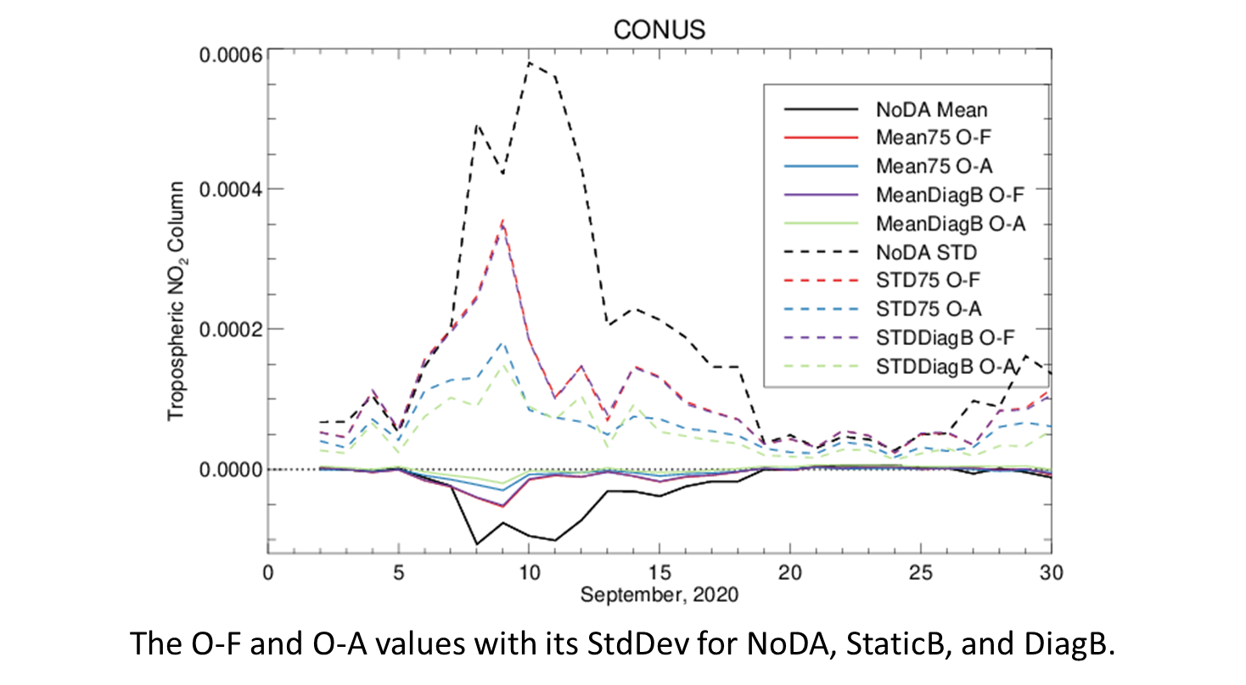
TROPOMI NO₂ DA
The JEDI DA capability was added to the regional model workflow. The Plot shows the O-F and O-A from the prototype cycling for NCEP’s air quality model with JEDI NO₂ DA.
Large departures the second week of Sept. due to wildfire NO₂ overestimated in the model, reduced by DA
Tuning of B matrix similar to that being done in the global system, leveraging lessons learned
Hyundeok Choi

Slide 15
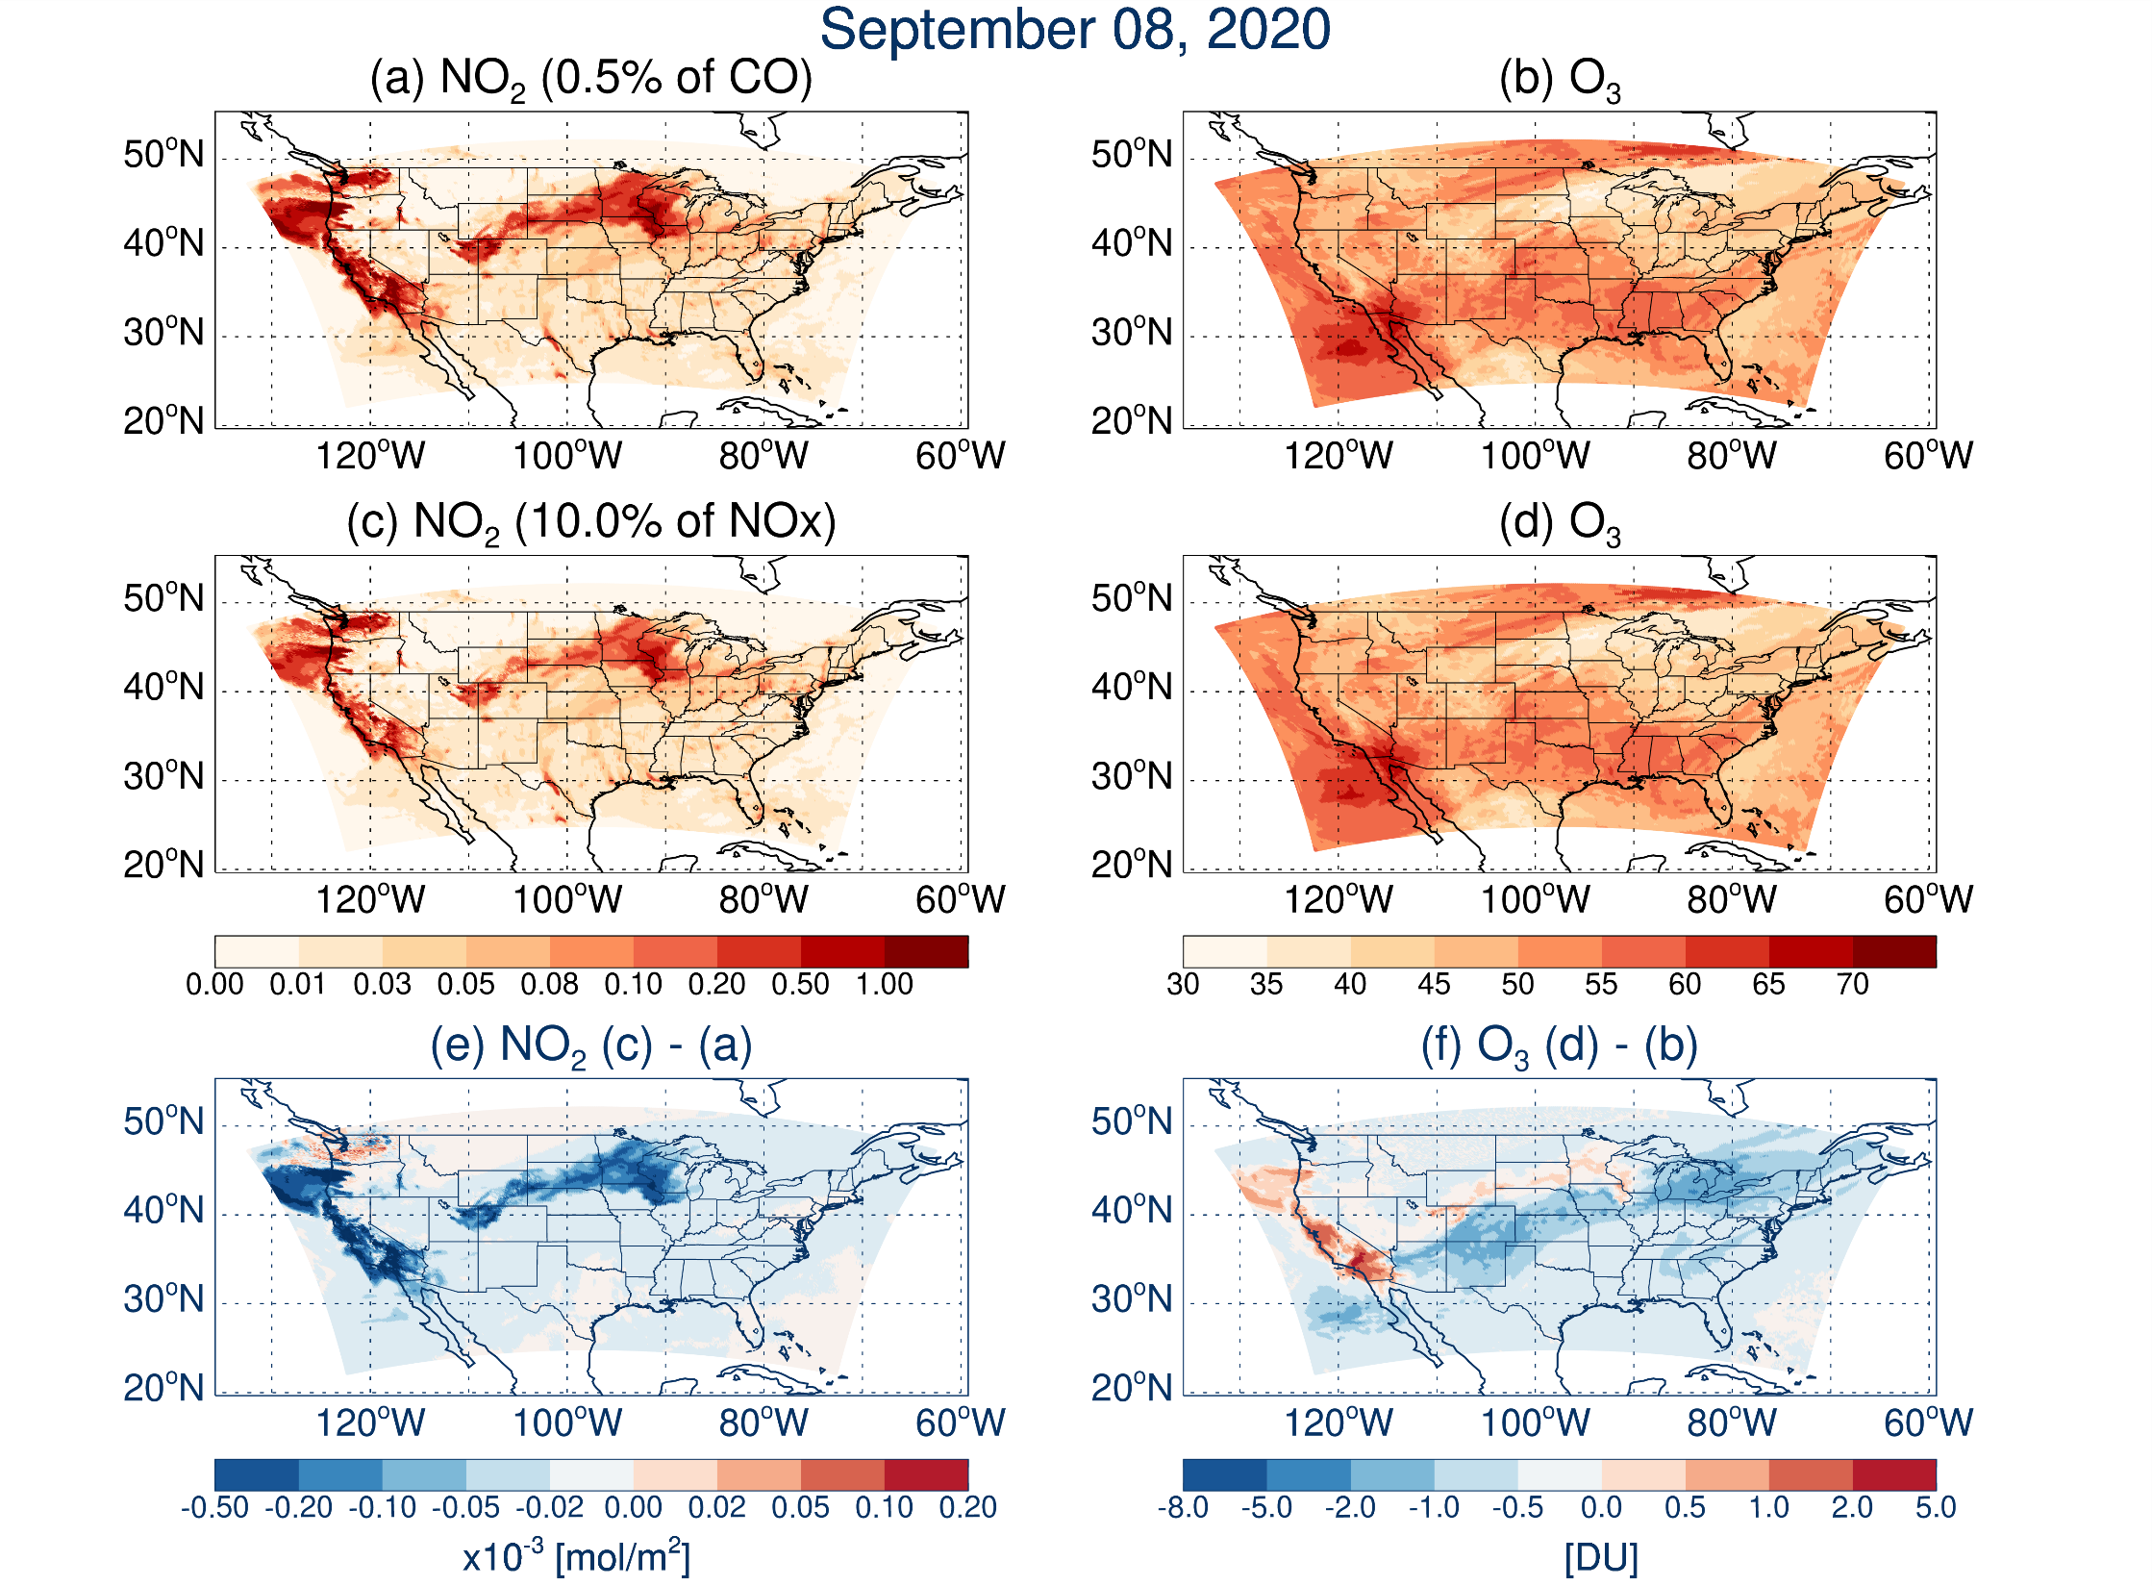
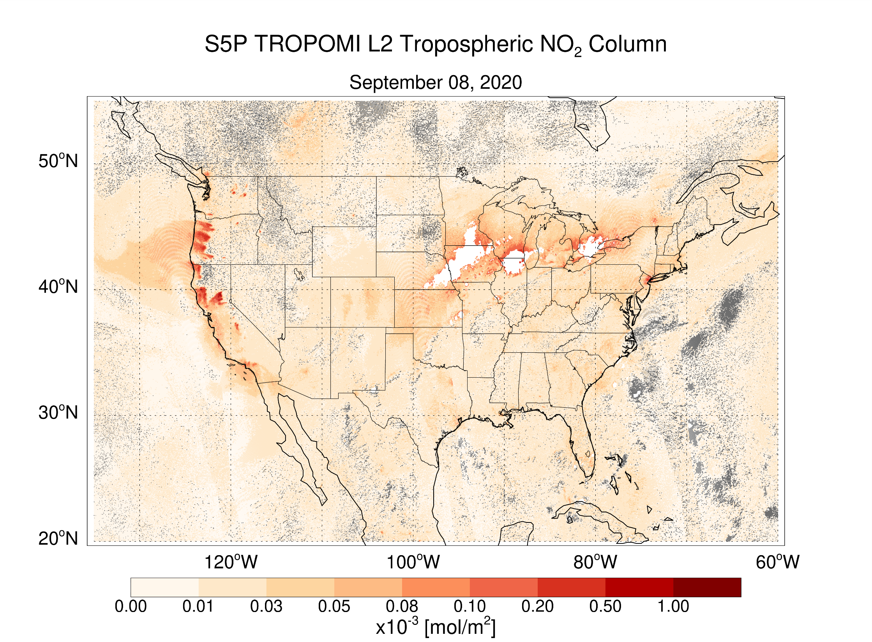
TROPOMI NO₂ DA
Testing of NOx emissions has shown that changes in how the emissions for wildfires are defined are better fitting the TROPOMI NO₂ obs, which in turn, improve O₃ prediction
This is important because DA is not great at fixing systematic biases, but can help identify them!
Hyundeok Choi

Slide 16
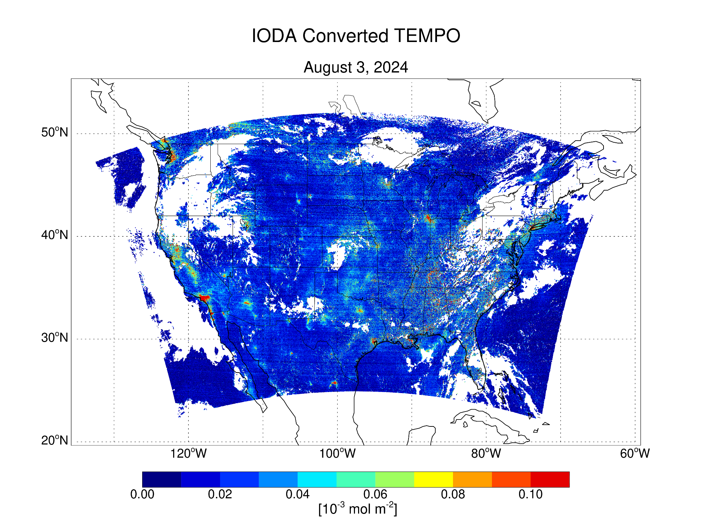
Initial TEMPO Work
TROPOMI is limited to early afternoon only, so we will need geostationary observations for best impact
JEDI’s biggest strength is the ability to quickly leverage developments from other groups
Thanks to efforts by JCSDA core staff, TEMPO is already usable in JEDI (observation preprocessing and forward operators)
Work will need to be done to properly assimilate in our AQM-based system (superobbing, errors, QC, etc.)

Slide 17
Questions
Summary
Work is progressing on NCEP’s first operational global aerosol analysis capability
  JEDI-based system
  Climatological background error covariance tuning + quality control and advanced observation usage testing is happening now
  Target to implement as part of GFSv17/GEFSv13
Regional AQ DA efforts are underway but less mature
Longer term plans to include ensemble methods, simultaneous state and emissions estimation, and strongly coupled with the atmospheric DA
?
cory.r.martin@noaa.gov

