Slide 1
Over view of the aerosol assimilation activities with the JEDI system
J. Barré¹, S.-W. Wei^{1,2}, S. Lu^{1,2}, M. Abdi-Oskouei¹, C. Martin³, Y. Wang³, B. Huang⁴, C. Dang¹, V. Buchard-Marchand⁵, A. DaSilva⁵, H. Wang³, Y. Tang⁶, S. Ha⁷, B. Ménétrier⁸ and all JCSDA
¹UCAR, Joint Center for Center for Satellite Data Assimilation
⁷State University of New York at Albany
³NOAA, NWS, NCEP, Environmental Modeling Center
⁴NOAA, OAR, Global Systems Laboratory
⁵NASA, GSFC, Global Modeling and Assimilation Office
⁶George Mason University
⁷NSF, NCAR, Microscale Mesoscale Meteorology
⁸Norwegian Meteorological Institute

Slide 2
JCSDA Atmospheric COMPOsition – Research Elements
Enhance Coupled Data assimilation with NWP:
Aerosols – Clouds - Radiation
Stratospheric Ozone
AQ - GHG
L1 DA
Facilitate high resolution data assimilation:
New sensors i.e. TEMPO, GEMS, S4, (GeoXO)
Novel geometries, stretched and refined grids
Scalability
Surface observations/ field campaigns
Coupled DA with AC
JCSDA
COMPO
Emissions
& fluxes
Air quality
& scales
Extend DA for fluxes and emission constraint:
Anthropogenic emissions
Fires
Vegetation
Chemical reactions

Slide 3
JCSDA Atmospheric COMPOsition – Core and In-Kind
NOAA NWS
Operational integration in UFS
NASA GMAO –Near Real time integration in GEOS
JCSDA COMPO core team
DA capability development and demonstration
Morgan State Univ.
GEOS-CF integration & Science
NOAA OAR –Research specific Elements for COMPO in UFS
NCAR
MPAS integration &
Science
George Mason Univ.
Regional AQ research
U. Albany
Evaluation products
Colorado State Univ.
JEDI training

Slide 4
JEDI - Design Principles and Notional Status
JEDI: moving towards coupled DA
JEDI design cleanly separates the concepts of:
DA algorithms
model specifics
observation specifics
Abstract interfaces are used by DA algorithms and implemented by specific models and observations.
Abstract Layer (OOPS)
Generic Algorithms
4DEnVar
…
4DVar
LETKF
FSOI
Uses
Abstract Interfaces
State
x
…
Covariance
B
Implements
Generic Implementations
VADER, ATLAS
Coupled State
SABER
UFO
IODA
Generic code eliminates duplication of development, testing and maintenance effort, across teams & Earth-system components.
State for FV3
BUMP
CRTM
BUFR
Specific Implementations
State for MPAS
Spectral
RTTOV
ODB
State for MOM6
Diffusion
ROPP
HDF5
Notes:
Separate (as cleanly as possible) the concepts of data assimilation algorithms from the estimated model state specifics and from the observation specifics.
Most (Gaussian) DA algorithms can be written using concepts of x, y, H, M, B, R, without knowing what grid x is distributed on, how many different channels y can contain, and whether M is atmospheric, land, or coupled model.
Key is defining ”interfaces” that are used by DA algorithms and implemented by specific models and specific observations.

Slide 5
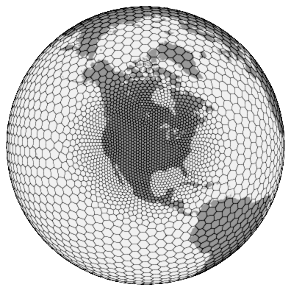
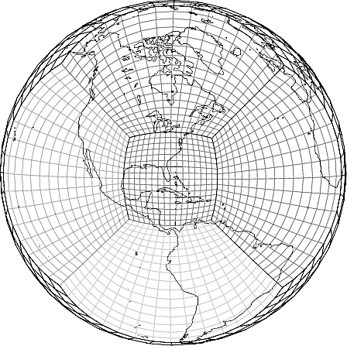
Specific: Air Quality and global Atmospheric Composition interfaces
Actively supported JEDI atmospheric composition modelling configurations for Aerosol DA
Current NOAA UFS-Chem
NASA GEOS
Future NOAA UFS-Chem
Dycore/grid: FV3 – nested domain
Dycore/grid: FV3 – stretch grid
Dycore/grid: MPAS – refined grid
Chemistry: CMAQ
Aerosol Scheme: GOCART & CMAQ
Aerosol Scheme: GOCART-2G
Aerosol Scheme: GOCART-2G in dev.
JEDI Status: Tested and used with JEDI for global and regional AQ application (pre-operational)
JEDI Status: Tested and used with JEDI for global AQ application – preliminary tests with stretch grid
JEDI Status: Tested and used with JEDI for NWP applications – ongoing activity to develop JEDI-MPAS for atmospheric composition

Slide 6
AOD observation operators in JEDI
UFO
AOD CRTM
AOD Ext
Requires mass mixing ratios in control vector
Requires aerosols extinctions at given wavelength in control vector
Computationally expensive:
Depending on aerosol scheme and univariate vs multi variate choices
More scalable:
Only one control variable per wavelength
Prognostic variables: analyses can be used as is for forecast initial condition
Not prognostic variables: require the reverse computation from extinction to mass mixing ratios
Requirement at NOAA
Requirement at NASA

Slide 7
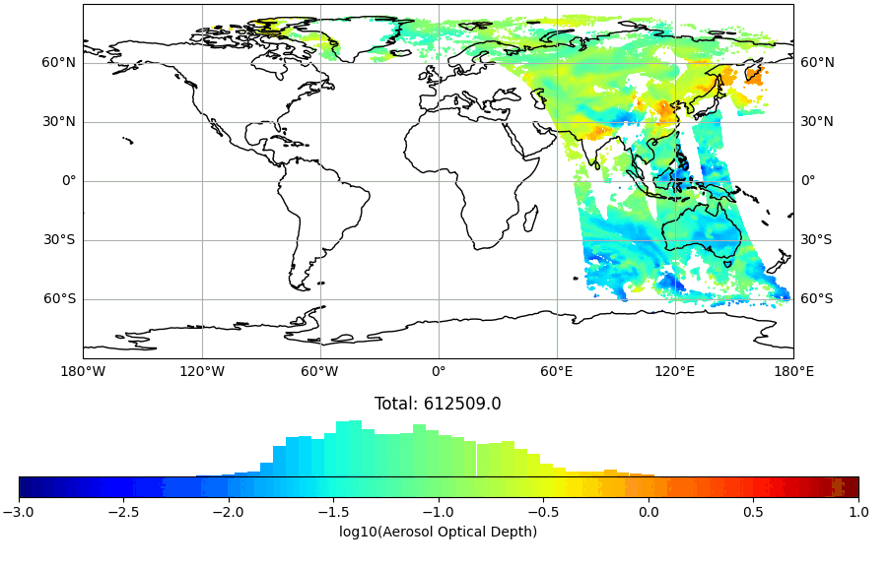
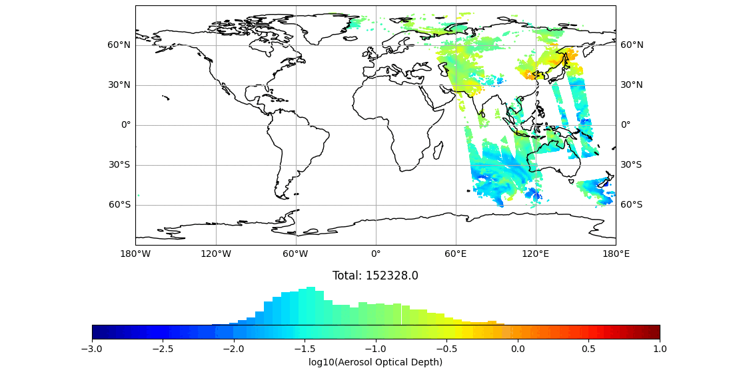
Tested and/or Assimilated aerosol observation products in JEDI
VIIRS NPP AOD
Aerosols:
VIIRS NPP AOD and L1b in development
VIIRS NOAA 20,21 AOD and L1b in development
MODIS Aqua AOD
MODIS Terra AOD
Aeronet
AirNow – PM2.5
PACE AOD in development
TEMPO AOD??
MODIS AQUA

Slide 8
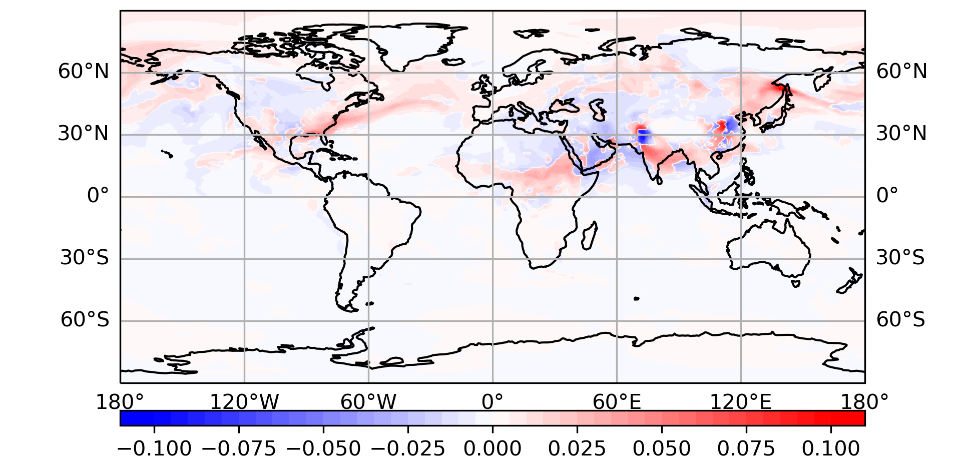
Operational Global Aerosol DA at NOAA NCEP
Lead: NOAA/NCEP/EMC – Support JCSDA
GOCART - aerosol scheme from NASA included in UFS
GEFS target: C384 (25km), prognostic aerosols in some/all members
Analysis resolution C384L127 (~0.25 deg); background resolution C1152L127 (~9km)
3DVar FGAT with 3-hourly backgrounds
VIIRS EPS 550nm AOD from S-NPP, N20, N21
Example of pre-operational fine tunning: JEDI Variational Bias Correction to correct differences between satellite platforms
Difference of absolute error against CAMS (VarBC (sulfate) - CTRL)
Positive: VarBC has smaller error
Negative: CTRL has smaller error

Slide 9
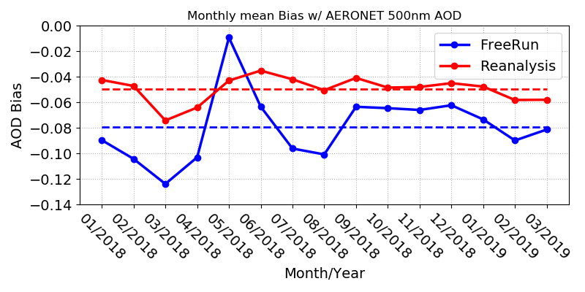
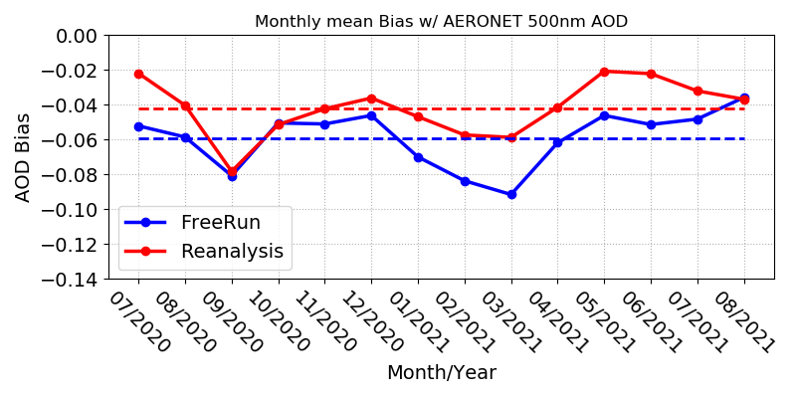
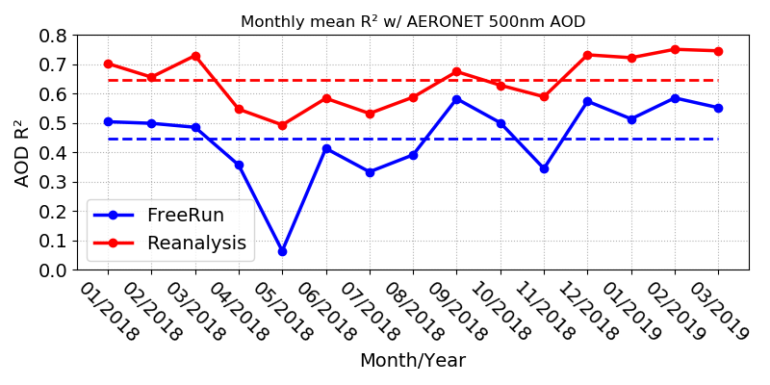
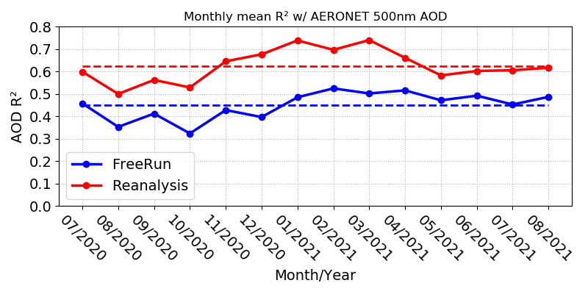
Early - NOAA global Aerosol ReAnalysis (NARA)
Lead: JCSDA - NOAA/OAR/GSL
Reanalysis shows significantly improved agreement with AERONET AOD.
MODEL: Unified Forecast System - Aerosols (UFS-Aerosols, based on NASA’s GOCART2G)
OBSERVATIONS: NOAA/NESDIS 550 nm Aerosol Optical Depth (AOD) retrievals from S-NPP VIIRS instruments
DA SYSTEM: Ensemble-Variational based with JEDI
Early Reanalysis exercise: from 2018 to 2022
Monthly mean bias and R²
Jan. 2018 – Mar. 2019
Jul. 2020 – Aug. 2021
Bias
R²
Wei et al., 2024

Slide 10
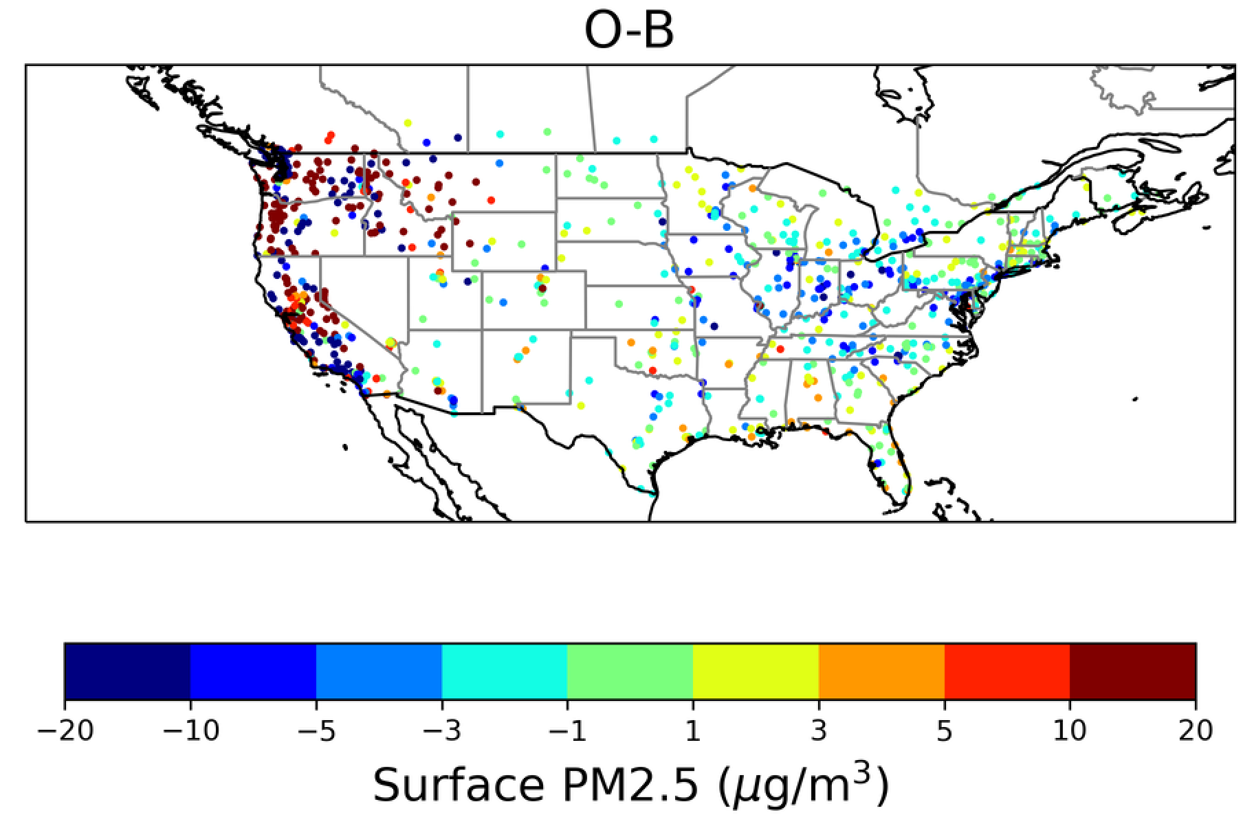
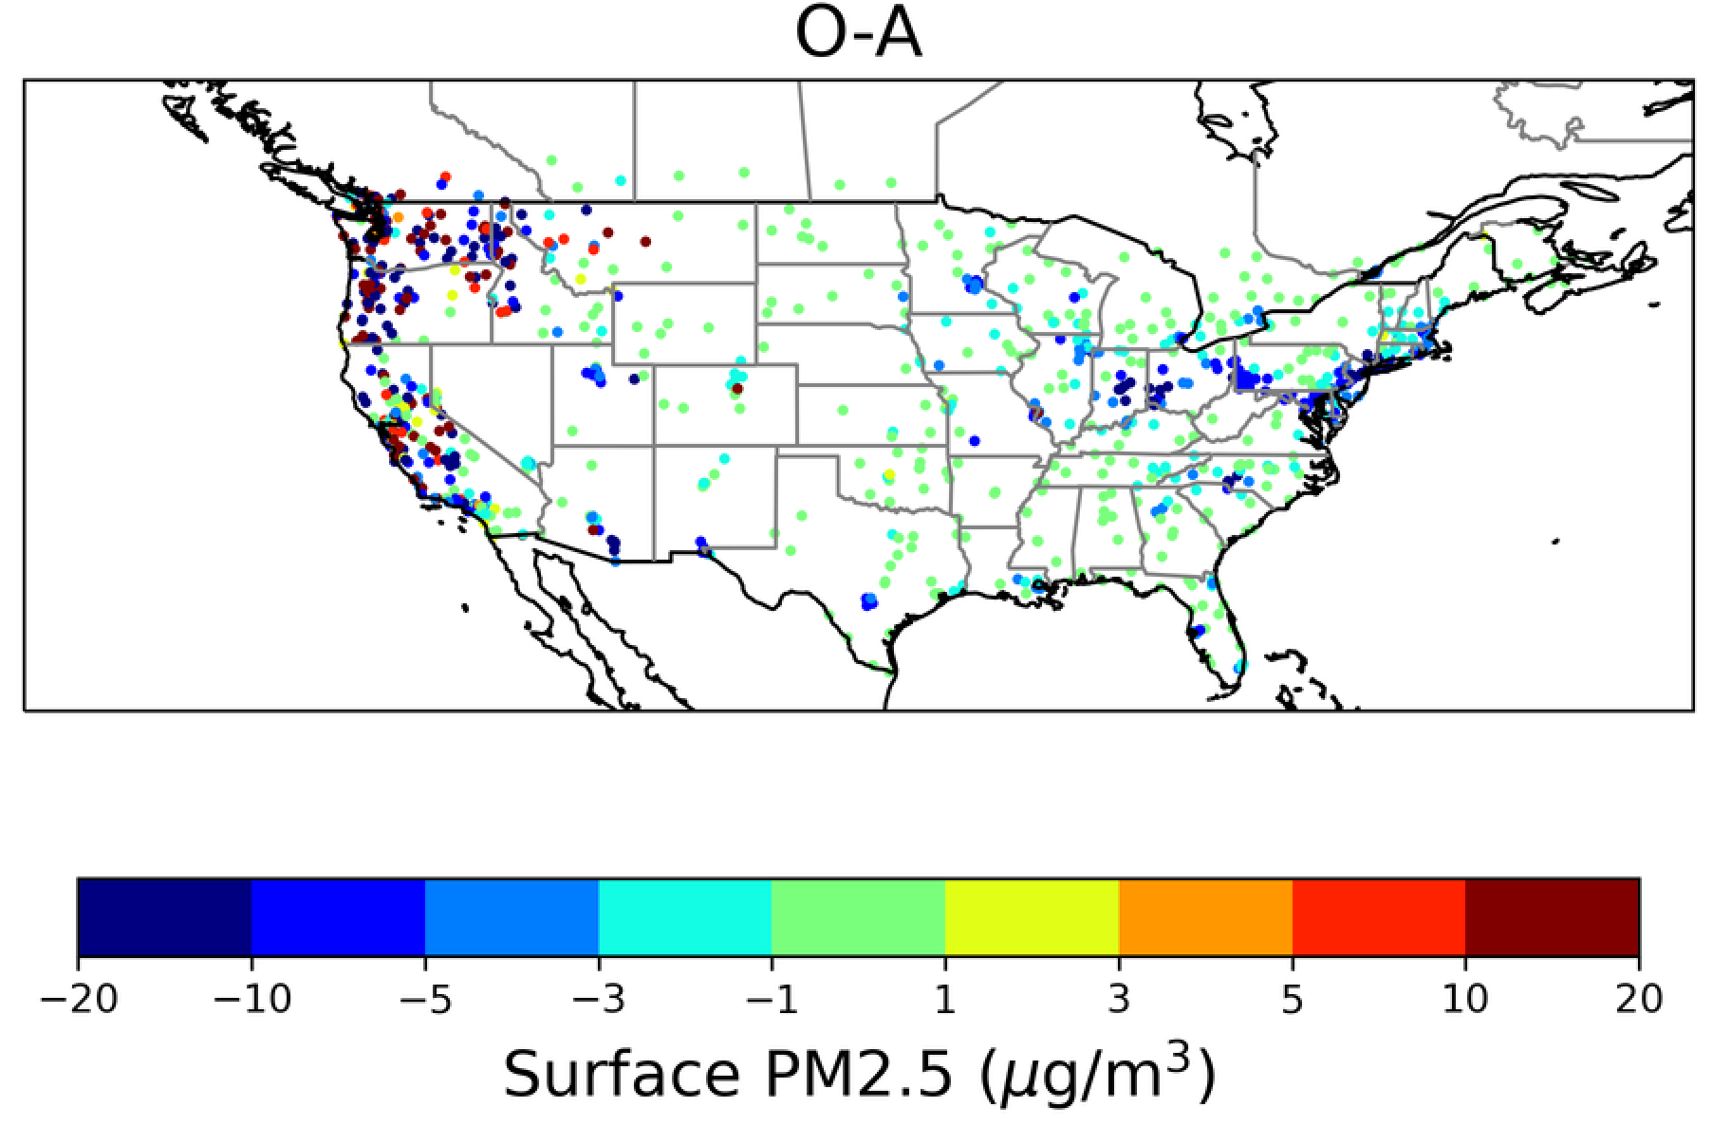
NOAA/OAR - NOAA regional air quality DA
Lead: NOAA/OAR/GSL and GMU – Support: JCSDA
Integration of PM2.5 and AOD data assimilation and forecasting cycling capabilities into the NOAA AQM workflow.
With guidance form JCSDA a set of variables transforms to compute PM2.5 and AOD (using CRTM) have been implemented in the JEDI code to perform aerosol DA with the UFS CMAQ
CMAQ has many variables we need to condense this information to make it scalable for DA
The DA works well O-A is much improved compared to the O-B.

Slide 11
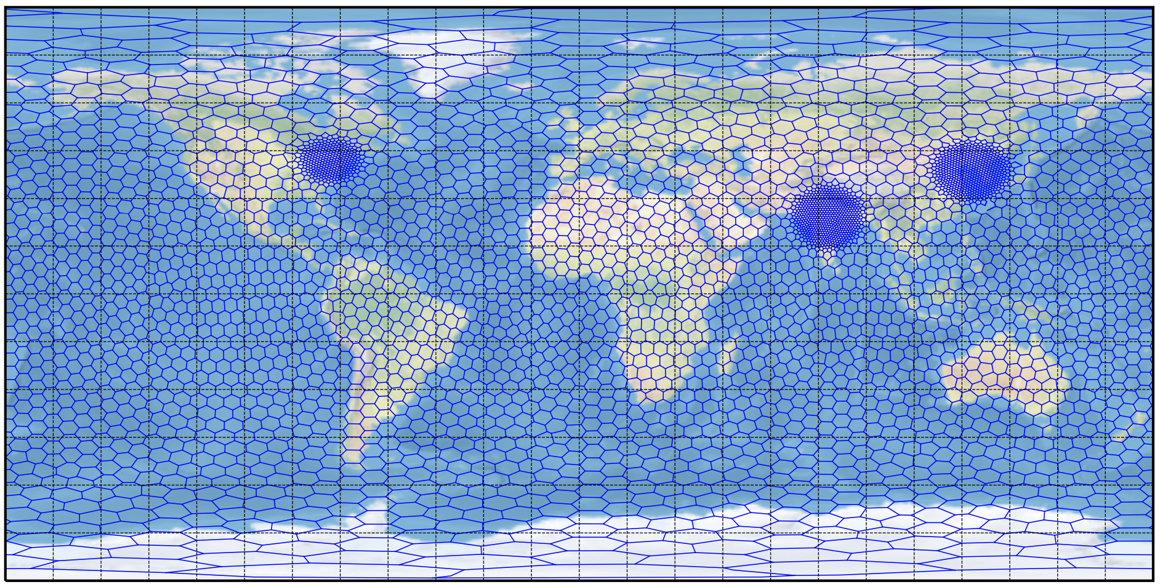
NSF NCAR MPAS for atmospheric composition using JEDI
Lead: NCAR in collaboration with JCSDA
Instrument/Source | Measurements
PACE OCI | AOD (440 and 550 nm)
MODIS | AOD (550 nm)
VIIRS | AOD (550 nm)
PACE HARP2, SPEXone | AOD (550 nm, when available)
A new system development of MPAS-GOCART2G using JEDI to assimilate NASA PACE AOD retrievals
This collaborative project between UCP-JCSDA and NCAR will leverage from previous DA efforts on AOD observations and also in weather with MPAS
Planning stage:
Add full gas-phase chemistry to MPAS-A through the Model Independent Chemistry Module (MICM)

Slide 12
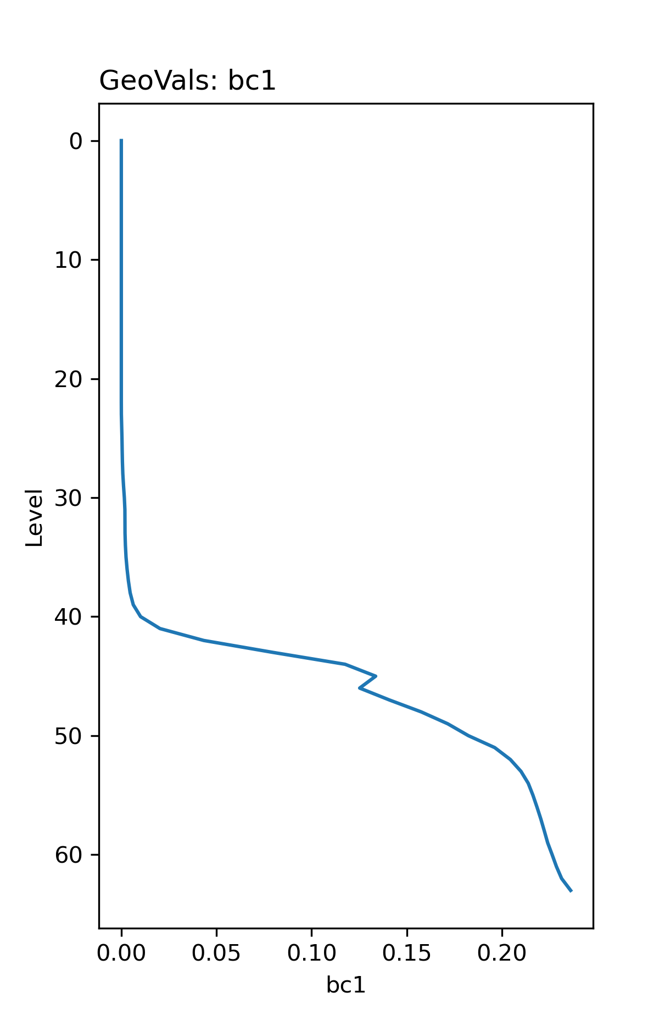
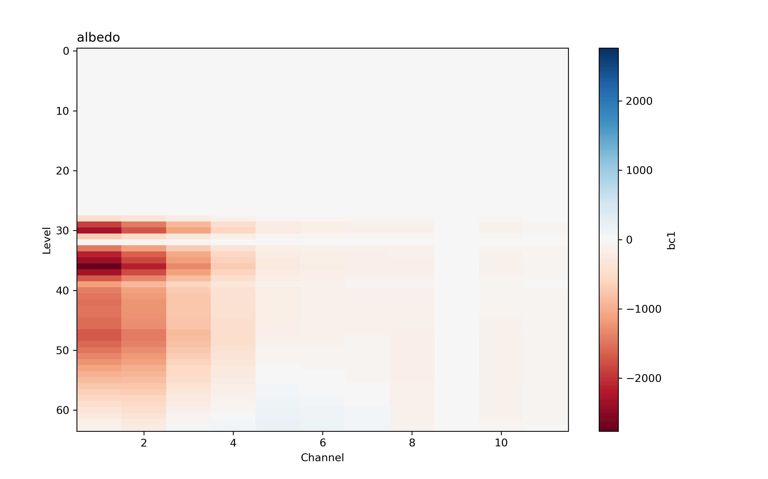
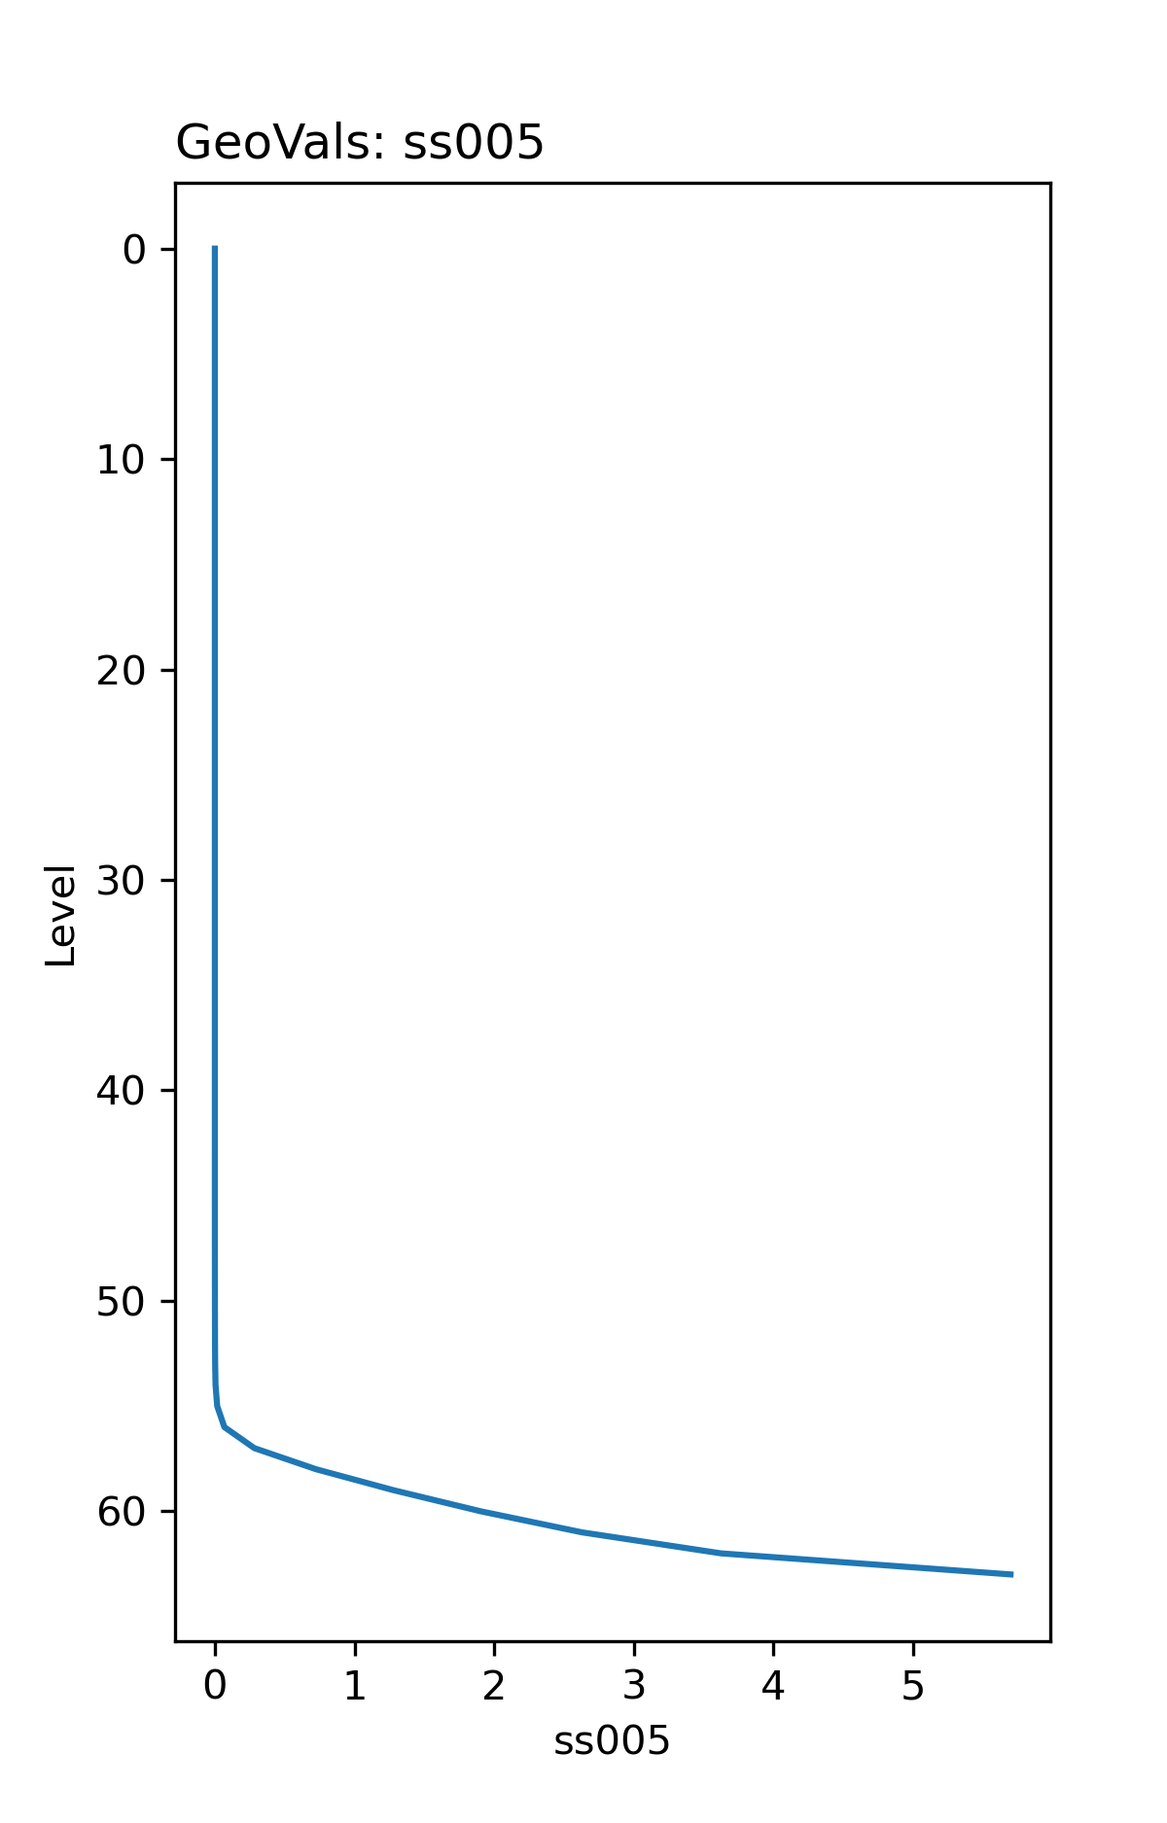
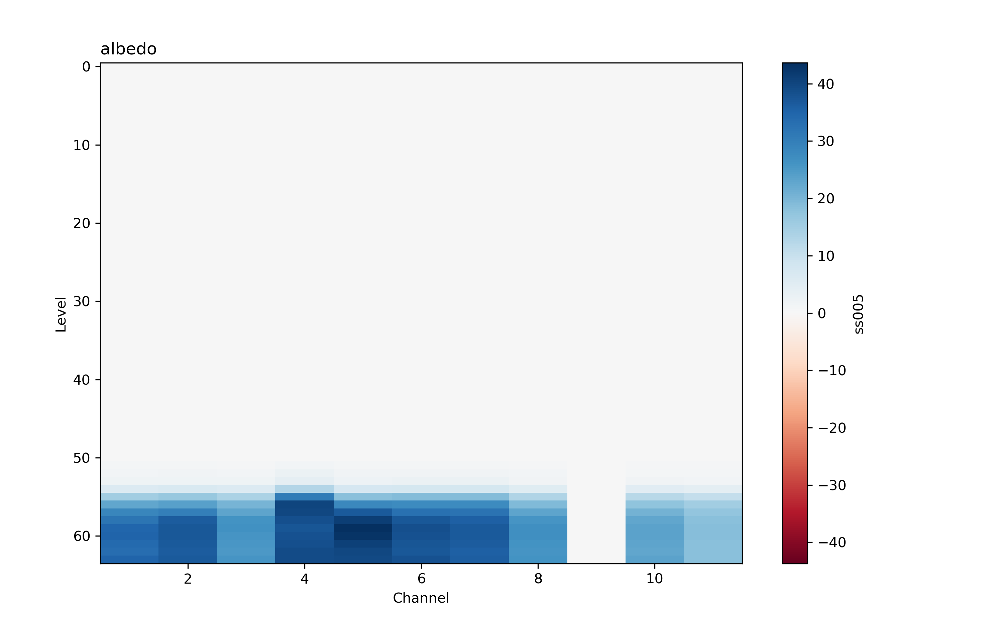
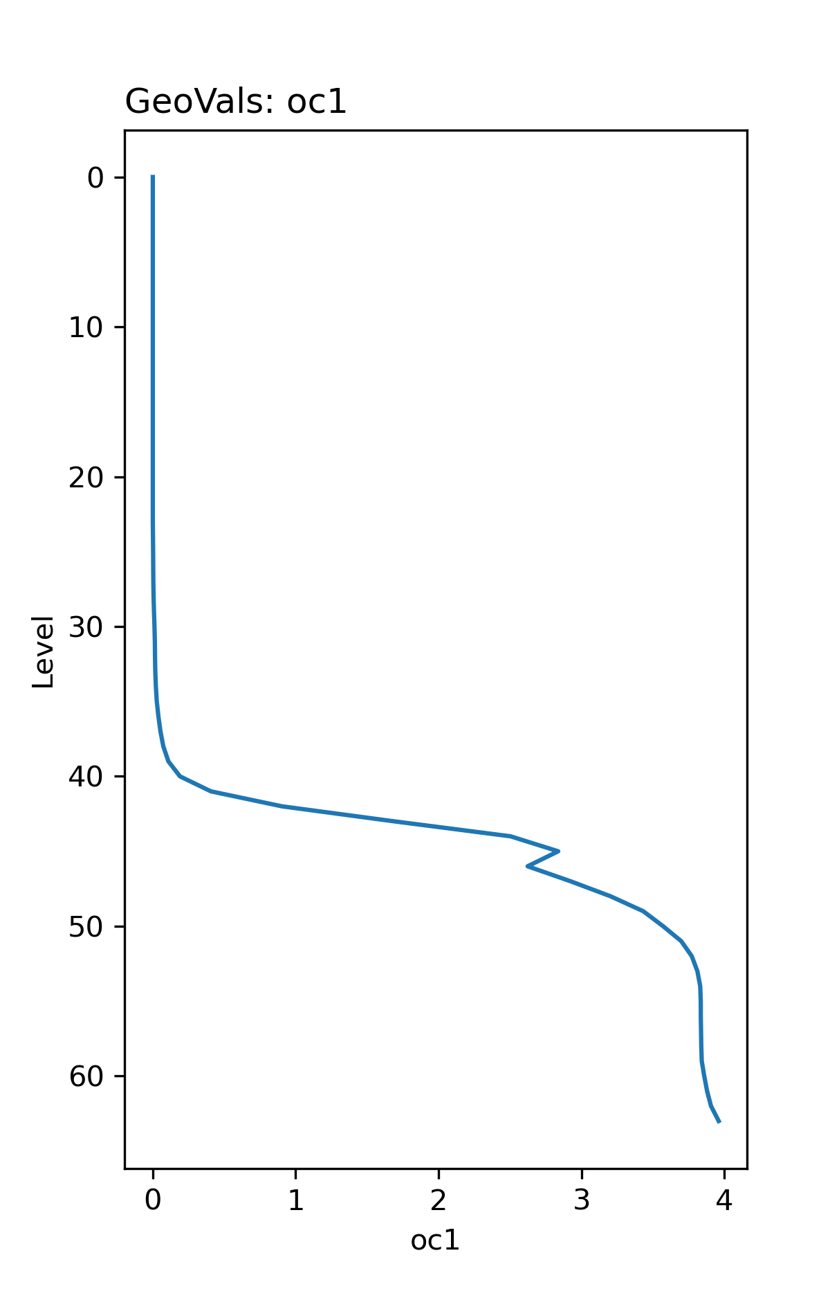
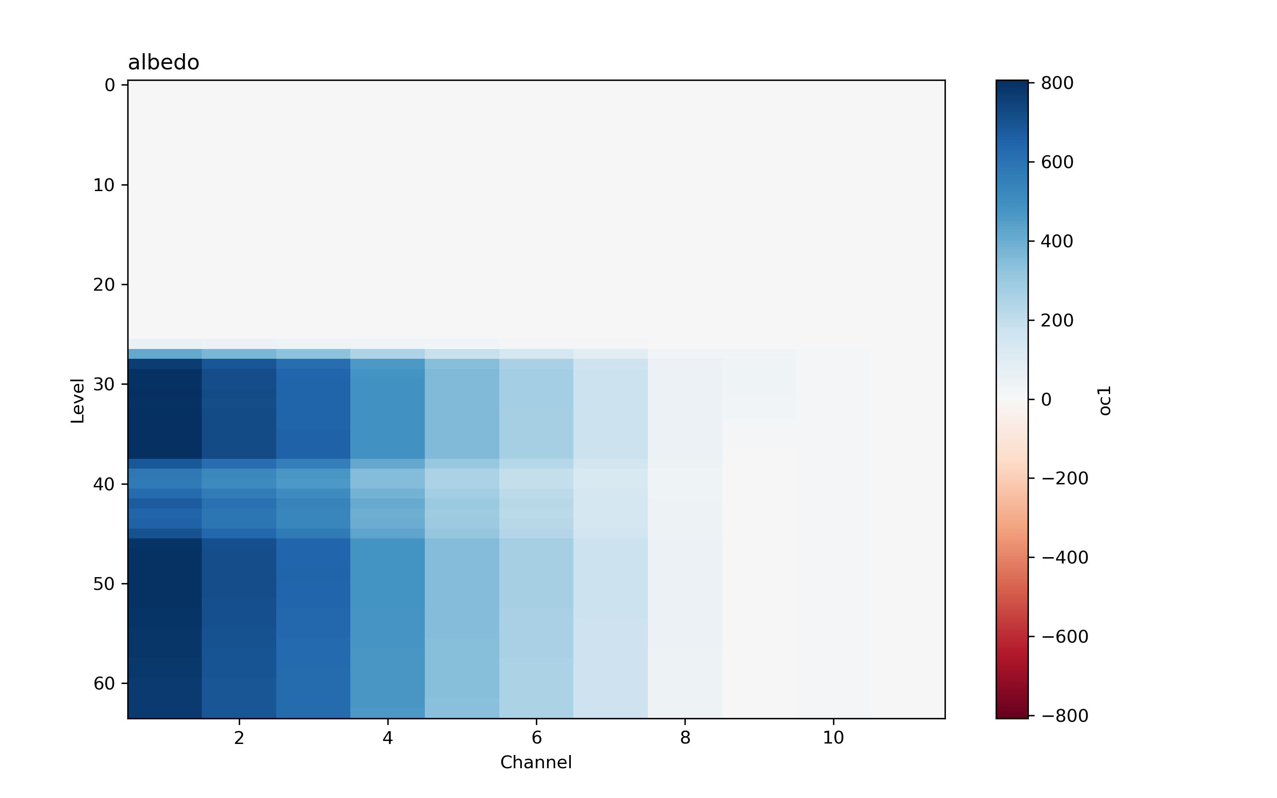
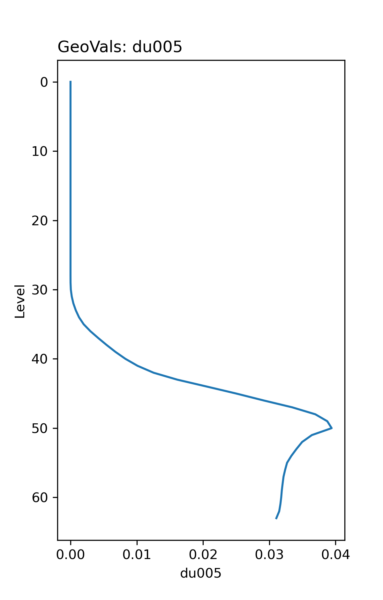
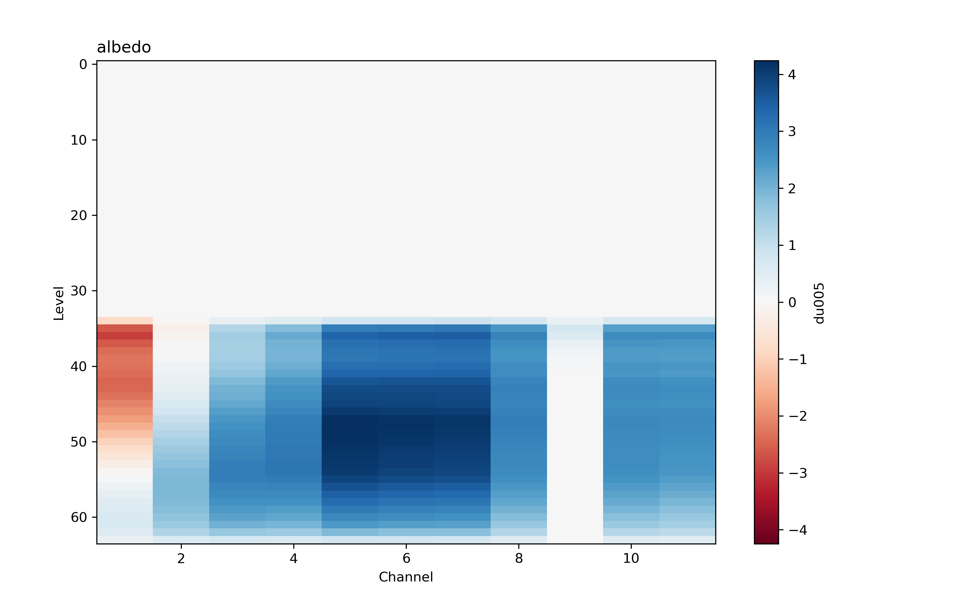
Using L1 satellite data for aerosol assimilation
Lead: JCSDA
Frontier work to 1. reduce gaps between NWP and AQ DA, 2. improve aerosol DA
First tests done with VIIRS-NPP
L1b reflectance products:
11 channels
Looking at channel vs altitude Jacobians: access to size and speciation information
BC1
SS5
OC1
DU5

Slide 13
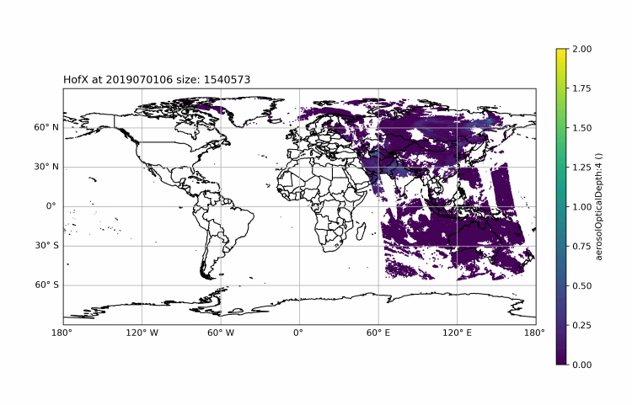
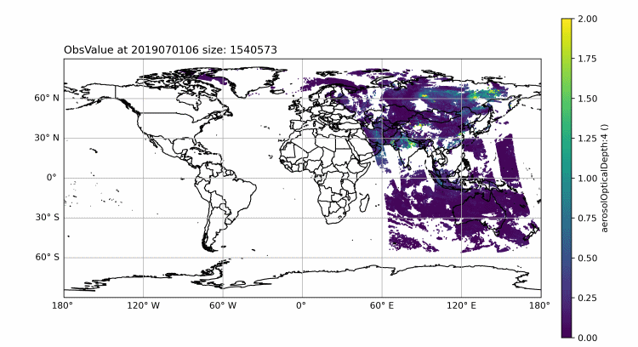
Evaluation work leveraging existing JEDI UFO capability
Lead: U. Albany and JCSDA
JEDI generic simplified interface for evaluation:
It allows users leverage existing operators in UFO to simulate observations from model states (forecasts) with any projections supported by the atlas library.
Can use all UFO functionalities: ColumnRetrieval, CRTM, RTTOV, Radar, etc.
Period: 2019 July (FIREx-AQ)
Model background: GEFS-Aerosols (6 hourly outputs in Gaussian grids, N384)
Observation: NOAA EPS VIIRS AOD (Suomi-NPP)
Operator: AOD CRTM
H(x)
Obs

