Slide 1

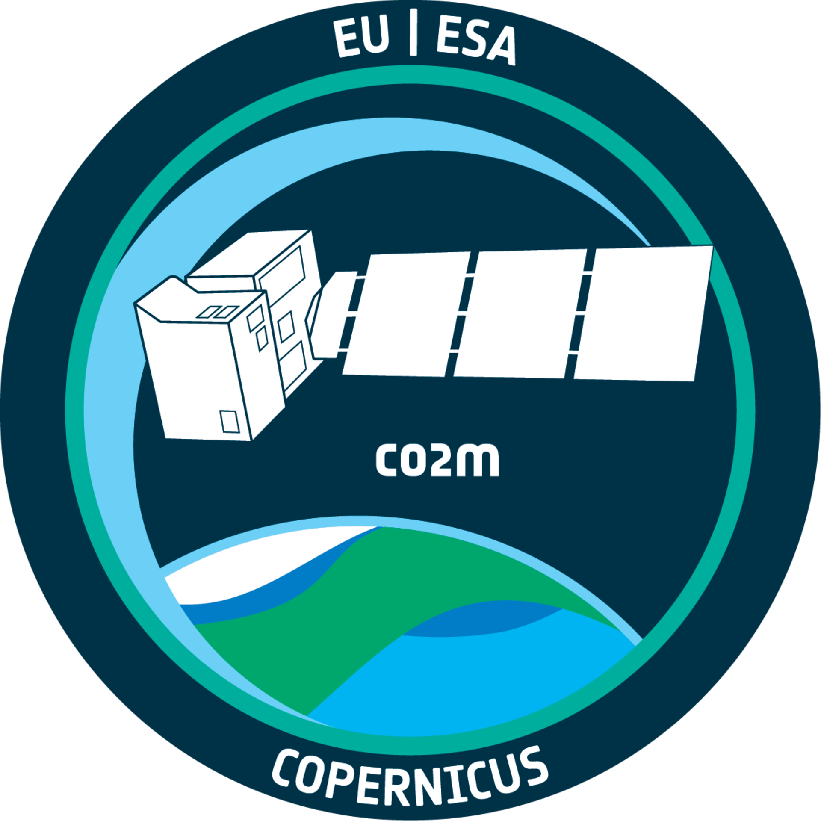
Copernicus CO2M mission
Aerosol observations (3.09)
Dr. Yasjka Meijer
European Space Agency (ESA)
CO2M Mission Scientist
AC-VC 20, Washington, USA

Slide 2
CO₂ Monitoring (CO2M) Mission
Detection of emitting hot spots
Monitoring the hot spot emissions
Assessing emission changes against local reduction targets
Assessing the national emissions and changes
System requirements → Mission Requirements → Implementation → Performance
NB mission requirements need to be met 3-sigma & anywhere in the swath
Today I present on aerosol from CO2M

Slide 3
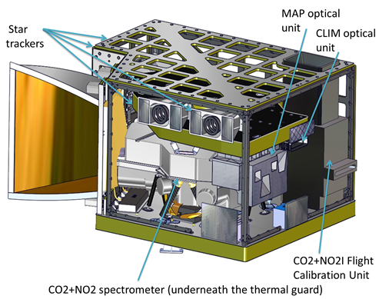
Payload Implementation
Payload Components
CO2 Imager (CO2I): 3 band (1 NIR, 2 SWIR)
co-located push-broom imaging spectrometer
NO2 Imager (NO2I): VIS band implemented as fourth band in CO2I instrument
Multi-Angle Polarimeter (MAP) for aerosol observations
CLoud IMager (CLIM) for low cloud & cirrus detection
Credits: TASiF

Slide 4
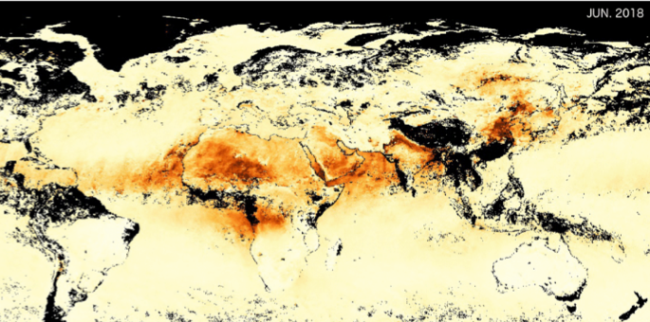

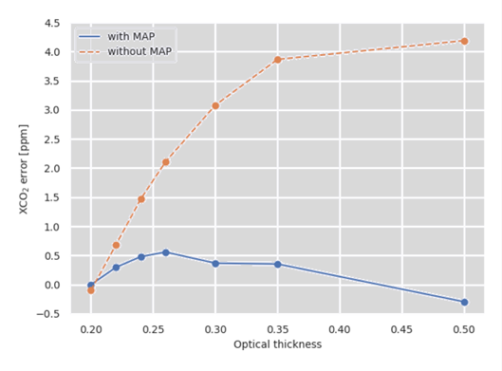
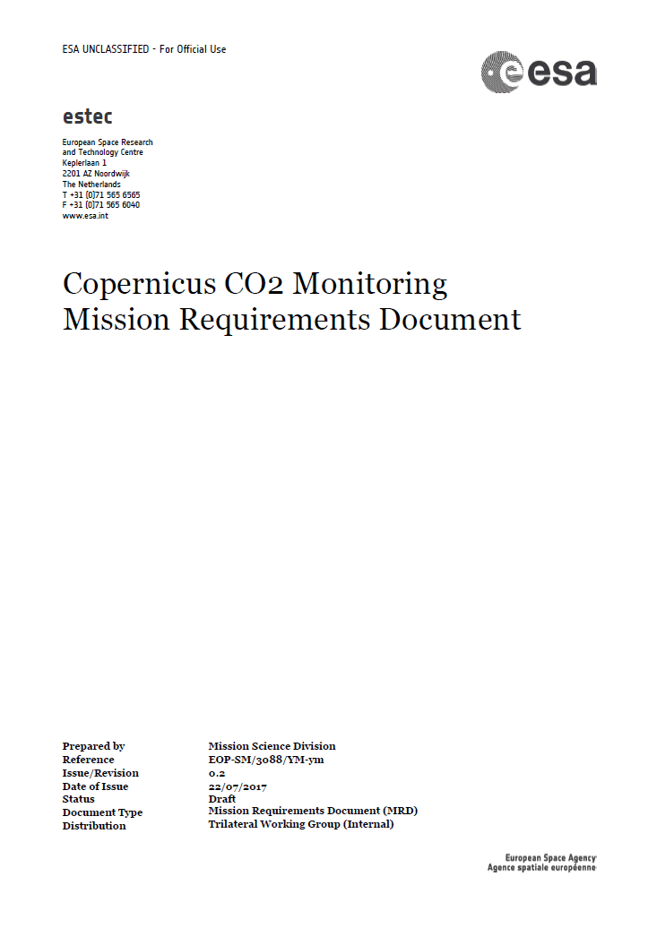
Aerosol for GHG monitoring
Aerosol & cloud scattering:
Light path correction is very important. Heritage missions without MAP
require bias correction and strict quality filtering for AOD<0.3.
Thin cirrus & small cloud fractions also impact the retrieval beyond
the required XCO₂ error budget.
For CO2M, Light path correction by measuring effective aerosol & clouds:
Higher accuracy CO₂ data (less posterior bias correction)
More data and also at higher aerosol loading; up to 0.5 AOD
Cloud cover of CO₂ pixel 1 – 5%
0.0 0.5 1.0
Credits: SRON, Utrecht
Aerosol amount (AOD)
With MAP
Without MAP
MRD
XCO₂ bias (ppm)
Aerosol amount (AOD)

Slide 5

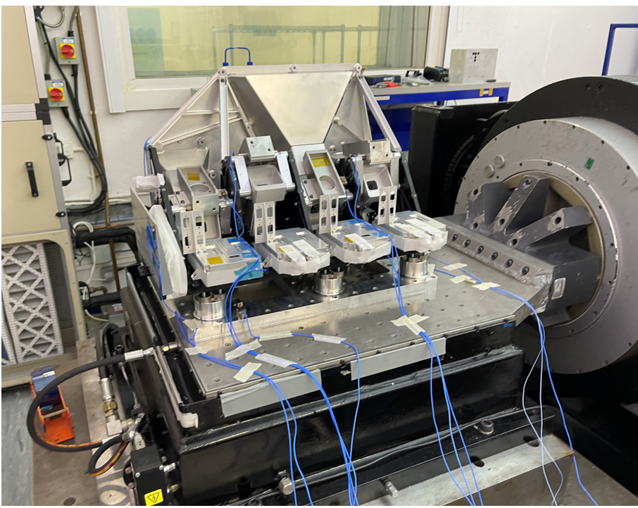
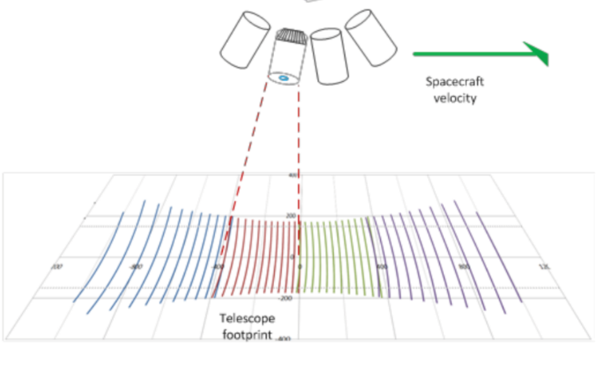
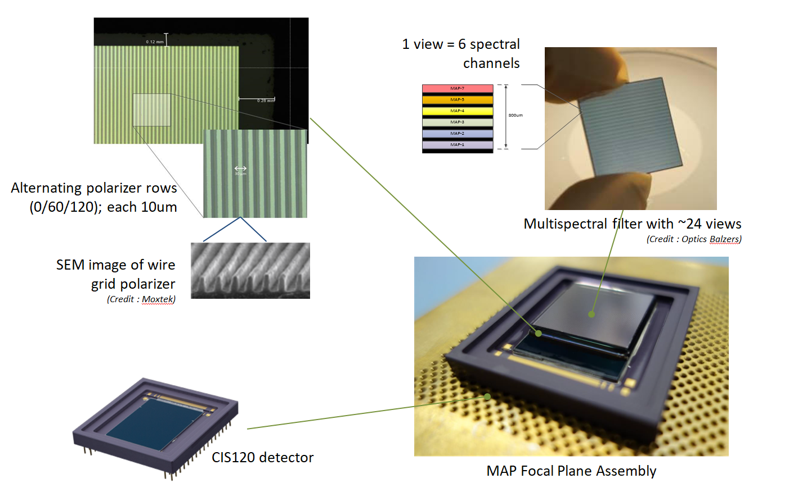

Multi Angle Polarimeter (TASiUK)
MAP Band | Wavelength
VNIR-1 | 410 nm
VNIR-2 | 443 nm
VNIR-3 | 490 nm
VNIR-4 | 555 nm
VNIR-5 | 670 nm
VNIR-6* | 753 nm
VNIR-7 | 865 nm
Multi-angle polarimeter (MAP) implementation:
Compact push broom imager:
40 viewing angles (+/- 60º), plus 8 more @larger angles
Spatial resolution: 4x4 km2 and sampling < 1x1 km2
One focal plane assembly combining polarization & spectral filtering
6 spectral bands in VIS and NIR (+1 for co-reg with CO2I)
3 polarisations (0º, 60º, 120º) sampled by µ-polarizers at detector pixel-level
CDR
Credits:
TAS-UK
Credit © TAS-UK
MAP OU STM in mechanical testing
Required total DoLP error <0.0035

Slide 6
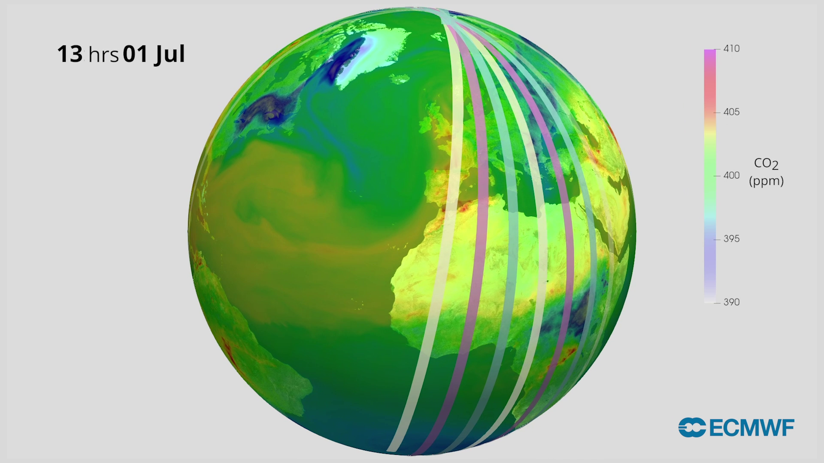
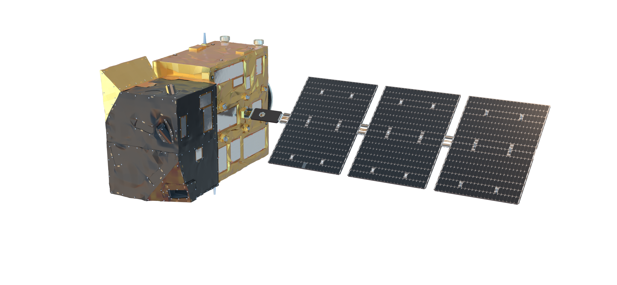
Copernicus CO2M Mission – Status
Project status:
Constellation of satellites
Each satellite >266 km swath
First and second satellite will have their
Flight Acceptance expected mid 2026
Third satellite → APPROVED!!
Product | Spatial | Precision
CO₂ | 4 km² | 0.7 ppm
CH₄ | 4 km² | 10 ppb
NO₂ | 4 km² | 1.5 10¹⁵ molecules cm⁻²
Vegetation SIF | 4 km² | 0.7 mW m⁻² sr⁻¹ nm⁻¹
Aerosol params | 16 km² | 0.05 AOD, 500 m LH
Cloud fraction | 1% | Water clouds & cirrus
Copernicus data is made freely available
to any person and organisation around the world
EUMETSAT performs operational data processing
Credits: EMPA

Slide 7
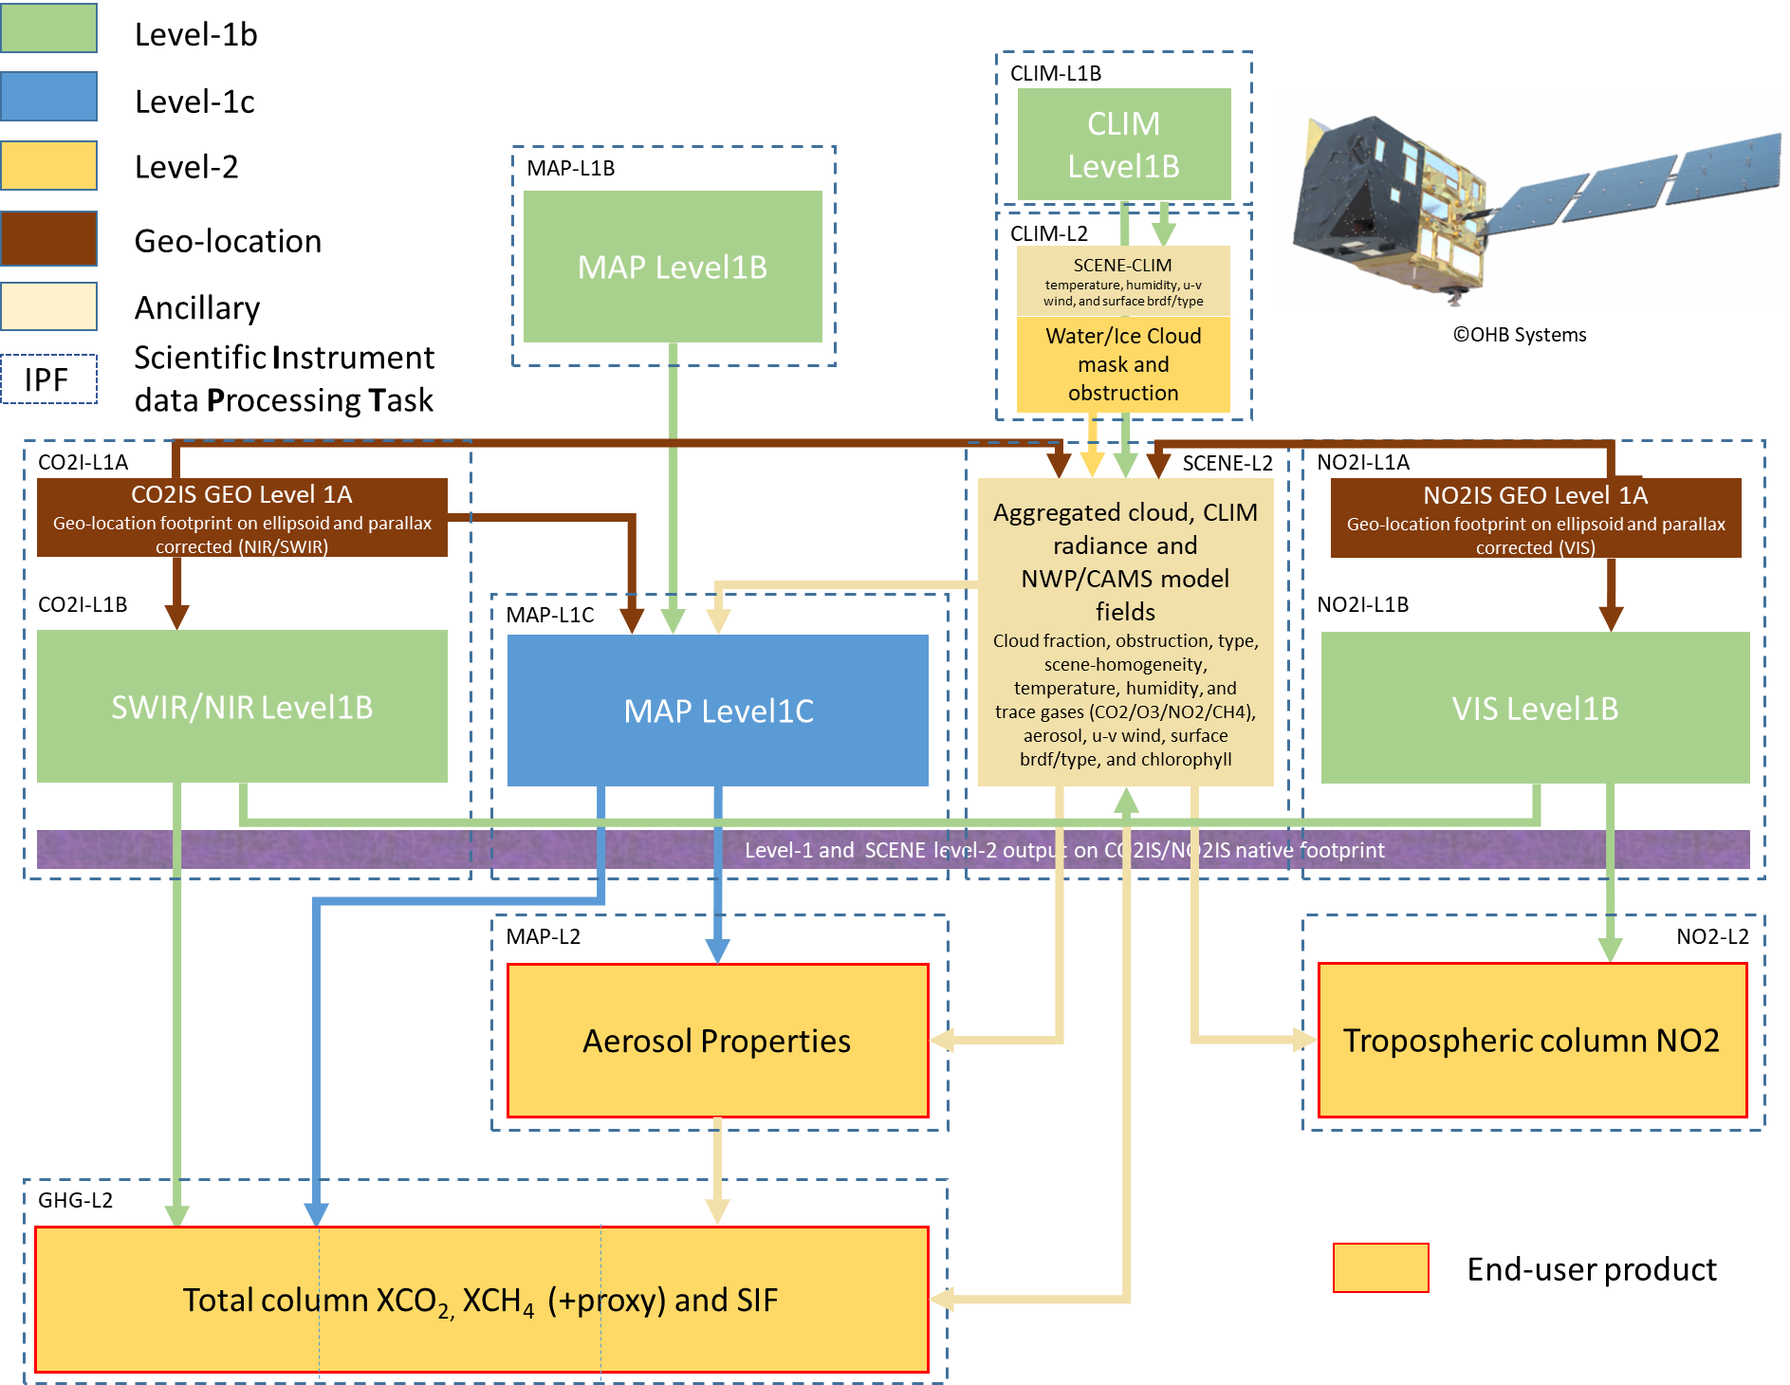
EUMETSAT CO2M MDPS scientific processing tasks
CO2M
Mission Data Processing System
Make one
“hyper-GHG/NO₂-instrument”
out of three!
Below this level: everything is co-registered or provided at the CO2I/NO2I spectrometer footprint

Slide 8
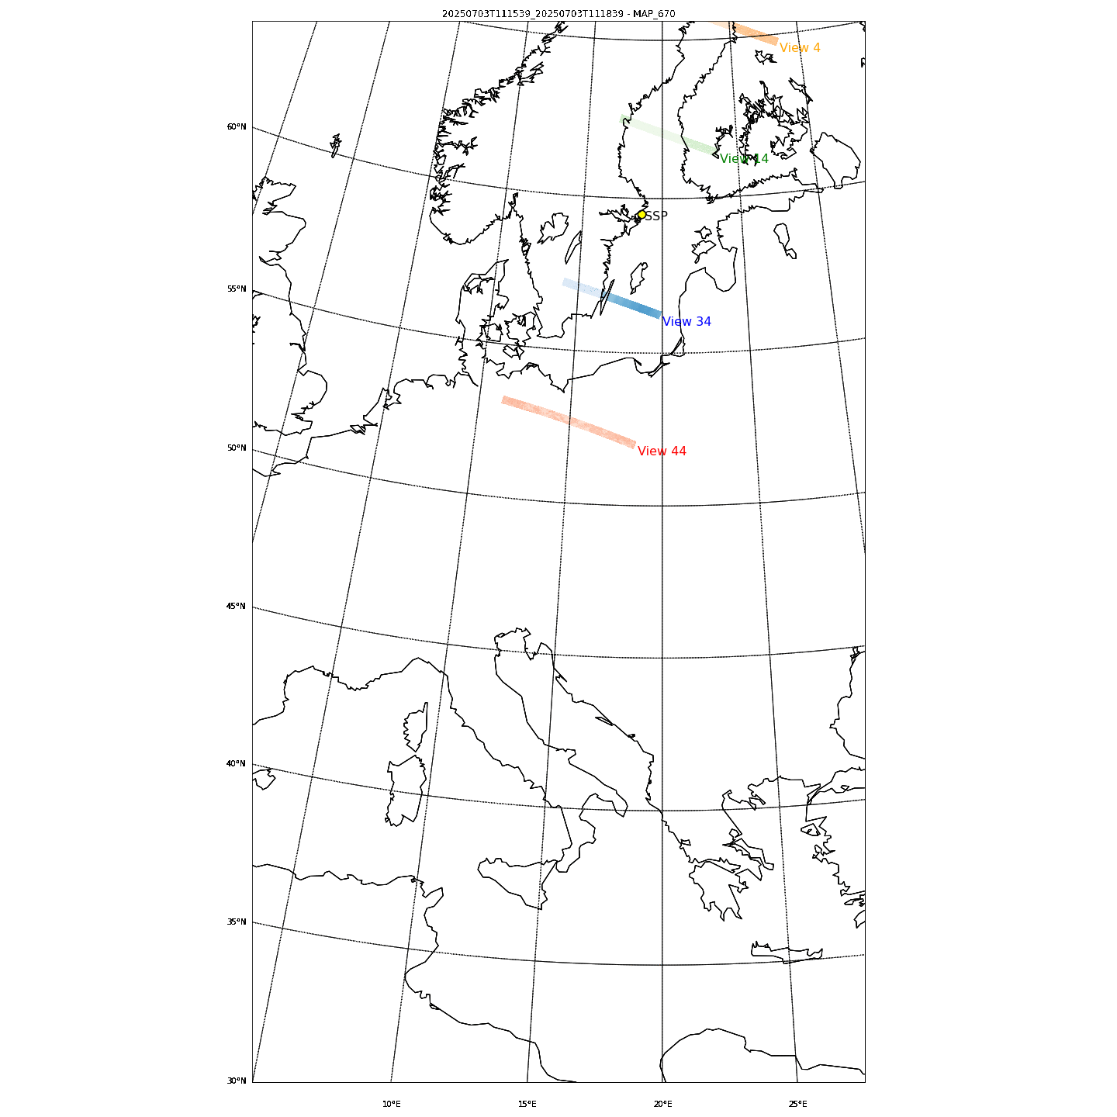
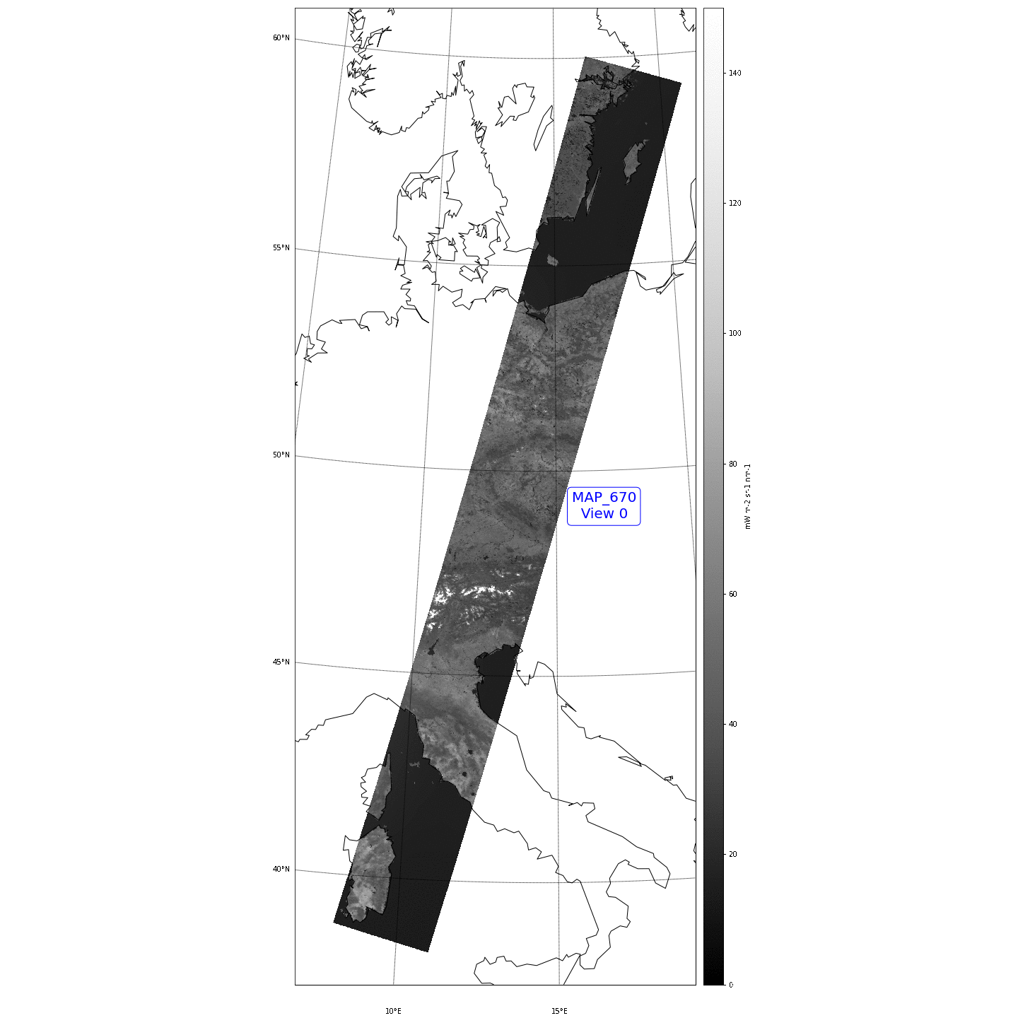
Early results from synthetic data (aerosol L1c)
The CO2M MAP L1B
product
2 granules
(total 6 minutes)
Nadir pointing
4 views out of 48 are shown
The CO2M MAP L1C
2 granules
(total 6 minutes)
Nadir pointing
45 Co-registered views

Slide 9
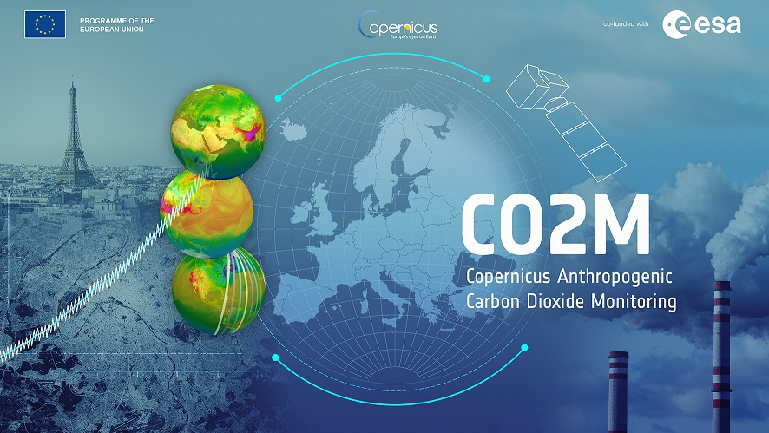
THANK YOU

