Slide 1


CALIGOLA: A New Spaceborne Lidar Mission
(Cloud Aerosol Lidar for Global scale Observations of the ocean-Land-Atmosphere system)
Chip Trepte¹, Paolo Di Girolamo², Davide Dionisi³, Simone Lolli⁴, Donato Summa⁵, Marco Di Paolantonio⁵, Lucia Mona⁶, Rosalia Santoleri³, Chris A Hostetler¹, Tyler Thorsen¹, John A Smith¹, Yongxiang Hu¹, Scott A Braun⁷, Michael Behrenfeld⁸, Gerald G Mace⁹, Robert Holz¹⁰, Simona Zoffoli¹¹, Francesco Tataranni¹¹, Francesco Longo¹¹, Sara Venafra^{11,8}, Francesco Coppola¹², Valentina Sacchieri¹², Alessandro Perna¹², Peter Coppo¹², Guglielmo Landi¹², Emanuele Capuano¹², Gianluca Aroldi¹², Matteo Burresi¹², Paolo Mosciarello¹², Antonio Dattoli¹², Luca Zerilli¹², Alberto Cosentino¹², Pasquale Ferrara¹², Stephen Hall¹, Laura Lorenzoni¹³, Hal Maring¹³
⁽¹⁾NASA Langley Research Center, ⁽²⁾Università della Basilicata, Potenza, Italy, ⁽³⁾CNR Institute of Atmospheric Sciences and Climate, Rome, Italy, ⁽⁴⁾Consiglio Nazionale delle Ricerche, Potenza, Italy, ⁽⁵⁾Institute of Marine Sciences, Italian National Research Council, Rome, Italy, ⁽⁶⁾CNR- IMAA, Potenza, Italy, ⁽⁷⁾NASA/ Goddard Space Flight Center, ⁽⁸⁾Oregon State University, USA, ⁽⁹⁾University of Utah, USA ⁽¹⁰⁾University of Wisconsin-Madison, USA, ⁽¹¹⁾Agenzia Spaziale Italiana, Rome, Italy, ⁽¹²⁾Leonardo S.p.A., Pomezia, Italy, ⁽¹³⁾NASA Headquarters

Slide 2
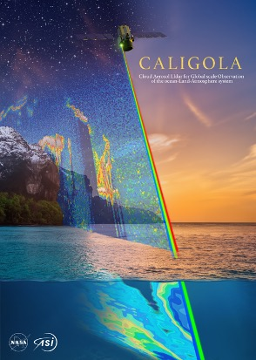
CALIGOLA
Advancing Earth System Science
• CALIGOLA is an interdisciplinary Earth Sciences mission significantly advancing global knowledge on the coupled atmosphere-ocean-land system.
• First spaceborne Raman-elastic-fluorescence lidar enabled through a partnership between ASI and NASA.
• Provides improved vertical profile measurements of atmospheric particles (aerosols) and clouds to better understand their roles in climate, weather, and air quality.
• Provides the first profile observations of the world’s oceans revealing unprecedented insights on the health and productivity of phytoplankton and zooplankton, their impact on fisheries, and role in Earth’s carbon cycle.
• Offers new land measurement capabilities on natural and agricultural plant health and refined estimates of snow depth and snow water content.
Notes:
Image: Courtesy of the CALIGOLA project (NASA)

Slide 3
Multidisciplinary Decadal Survey Science
Notes:
Graphic Courtesy of the CALIGOLA project (NASA)

Slide 4
Measurement Capabilities Beyond CALIPSO
Improved calibrated profile measurements of attenuated backscatter for day/night conditions.
Improved daytime sensitivity (SNR) to identify aerosol layers missed by CALIPSO.
Finer vertical/horizontal resolution in lower atmosphere to better characterize aerosols near the surface and to determine microphysical properties of liquid water clouds.
Improved ability to characterize aerosol typing for air quality assessments and better capability to discriminate between aerosol and clouds.
Wider detector dynamic range capable of quantifying backscatter from liquid clouds and ocean surface reflectance to support more accurate estimates of integrated aerosol optical properties.
Credit NASA
Notes:
Image: Courtesy of the CALIPSO Mission (NASA)

Slide 5
Physics Exploited by CALIGOLA
450 km
Transmitter
Receiver
Raman spectrum: wavelength shifts correspond to the vibrational-rotational energy level structure of the scatterer → unique fingerprint
Allows one to collect backscatter from a specific species of interest
Elastic scattering: change in light’s direction
Depolarization: change in light’s polarization state
Raman scattering: change in light’s direction and an exchange of energy
Fluorescence: emission of light that has been absorbed
Laser pulse
Elastic
Backscatter
Depolarization
Fluorescence
Raman
Altitude
Fluorescence spectrum: specific to a species, only some species fluoresce
→ unique fingerprint
Identifier of the type particle in the volume
0 km
Wavelength
Notes:
Graphic: Courtesy of the CALIPSO Mission (NASA)

Slide 6
CALIGOLA
A multi-wavelength elastic-Raman-fluorescence backscatter lidar
8 receiver channels
Multiple channels often used to derive a single geophysical quantity
Transmitted wavelengths | Receiver Wavelengths [nm]
 | Parallel elastic backscatter | Perpendicular elastic backscatter | N₂+O₂ rotational Raman backscatter | H₂O rotational-vibrational Raman backscatter | Fluorescence
355 nm | 355 nm A O L C | | 355 nm A O L C | | 353.95 nm + 355.7 nm A | | 405 nm A O L C | | 685 nm A O L |
532 nm | 532 nm A O L | | 532 nm A O L |
1064 nm | 1064 nm A L |
Channel Usage:
Atmosphere
Ocean Land
Cryosphere
3 wavelength
laser
Elastic backscatter
with polarization sensitivity
Foundational to nearly all types of retrievals
Raman backscatter
Atmosphere (N₂+O₂) & ocean (H₂O) calibration
Water vapor retrievals
Fluorescence
indicator of organic matter
(e.g. biological aerosols, chlorophyll)
Heritage measurements
CALIOP on CALIPSO (2006 – 2023)
ATLID on EarthCARE (2024 – 2027+)
CALIGOLA’s first-ever measurements
Relatively weak signals that are stimulated more effectively by shorter wavelengths (i.e. 355nm)
Notes:
Image: Courtesy of the CALIPSO Mission (NASA)
All else equal, Raman scattering is ~5x stronger when stimulated by 355nm light rather than 532nm

Slide 7
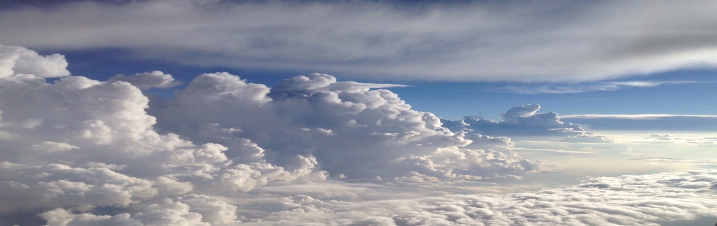
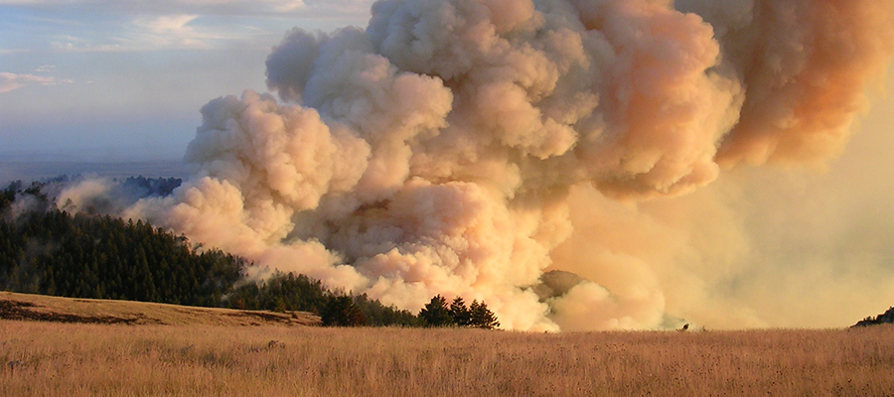

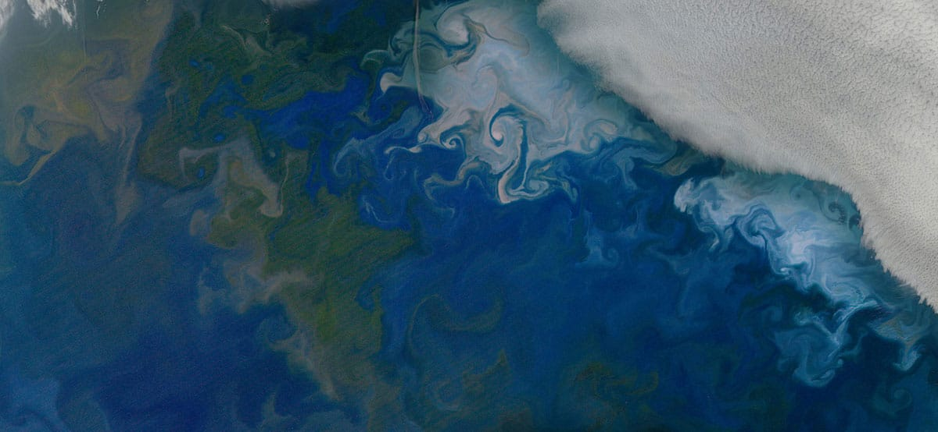
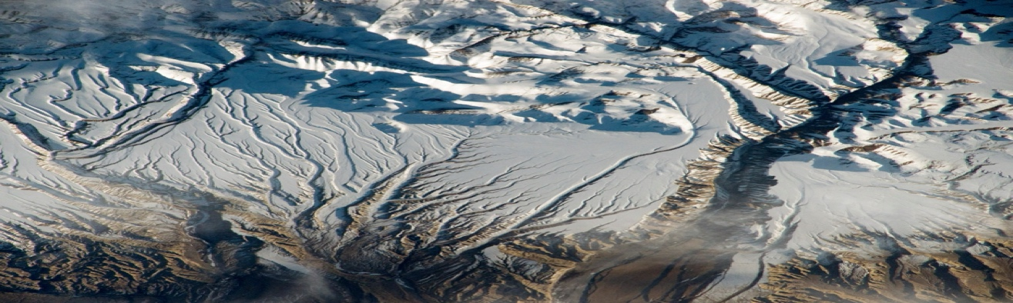
Preliminary Lidar Characteristics
Transmission wavelengths: 354.76, 532, 1064 nm
Average pulse energy: 151, 44, 156 mJ
Pulse repetition rate: 51 Hz, ~150 m between shots
Receiver sampling rate: 120 MHz
Telescope diameter: 1 m
Field of View: 30 µrad; 10 m footprint at sfc
Off-nadir point angle: 10-12 deg
Mean orbit altitude: 455 - 481 km (equator - pole)
Equatorial Cross time: 1:30 pm/am (descending orbit)
8 Detector channels Raman, elastic and fluorescence
Data volume ~4 Tbits/day
Data access NASA and ASI data facilities
Launch (TBD) mid 2032
Notes:
Smoke image from NOAA : https://csl.noaa.gov/projects/firex-aq/
Image with trees from www.pexels.com/royalty-free-images. (pexels-jplenio-1126386.jpg). See license use agreement. https://www.pexels.com/license/
Bottom two images from NASA

Slide 8
Data Downlink Vertical Resolution
Referenced to Mean Sea Level (MSL)
Altitude range [km MSL] |  | Description | Vertical resolution (in air) [m]
 |  |  | Para-Perp 355nm | Para-Perp 532nm | Total 1064nm | Rotational Raman | Water Raman | Fluore-scence
Upper | Lower
90 | 45 | Stratosphere & mesosphere | 360
45 | 32 | Elastic calibration | 180 | 180
32 | 20 | Stratosphere | 90 | 90 | 180 | 180 | 360
20 | 8 | Troposphere | 30 | 30 | 30 | 30 | 120 | 120
8 | 5 | Liquid clouds, coarse resolution | 7.5 | 30 | 30 | 30 | 120 | 120
5 | 0.20 | Liquid clouds, fine resolution | 3.75 | 30 | 30 | 30 | 120 | 120
0.20 | -0.25 | Ocean & ocean surface | 1.25 | 1.25 | 30 | 1.25 | 1.25 | 1.25
-0.25 | -0.50 | Atmosphere below MSL | 30 | 30 | 30 | 30 | 120 | 120
Referenced to Above Ground Level (AGL)
Altitude range (km AGL)AGL] |  | Description | Vertical resolution (in air) [m]
 |  |  | Para-Perp 355nm | Water Raman | Fluore-scence
Upper | Lower
0.20 | -0.05 | Snow & vegetation (land-only) | 1.25 | 1.25 | 1.25

Slide 9
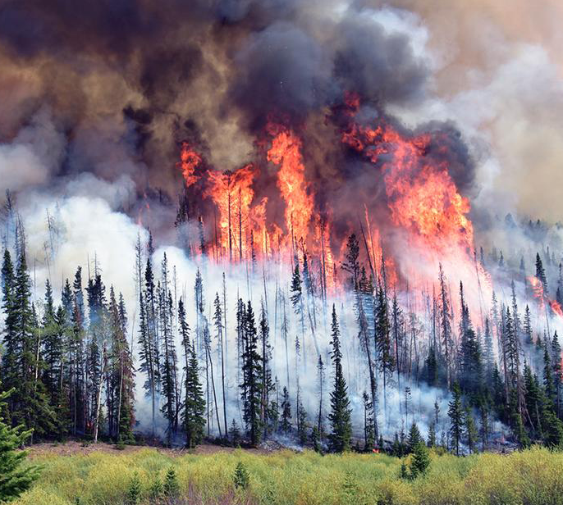
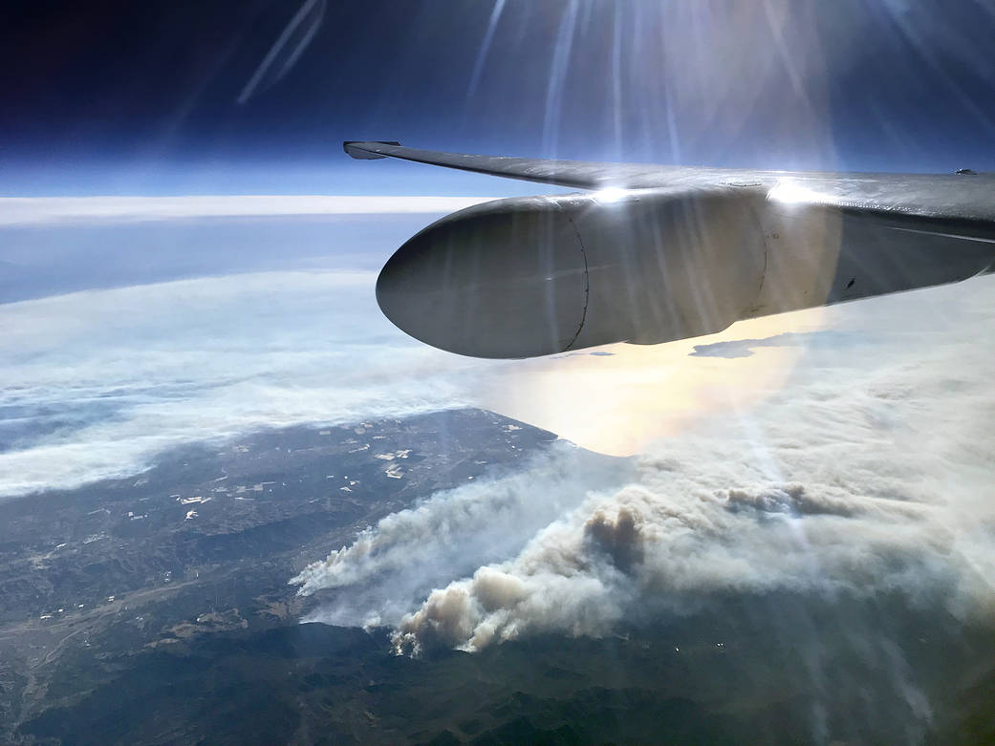
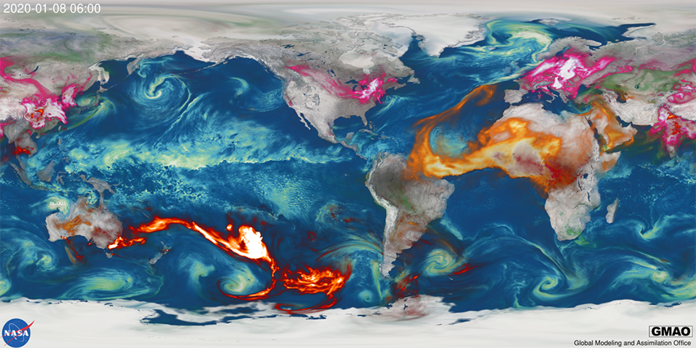
Applications of Science for Societal Benefit
Weather Forecasting by observing cloud distributions & properties to improve retrievals and model assimilation
Water Resource Management by providing satellite-based snow depth/water equivalent estimates in high terrain
Climate Modeling by providing measurements of aerosol, cloud and biological processes improving climate prediction
Air Quality through more precise measurements of aerosols to better forecast impacts on human health
Disaster Monitoring by rapidly conveying observations and predictions of volcanic plumes and wildfire smoke
Notes:
Images collected during NASA field mission.FIRE-AQ and from NASA Global Modeling and Assimilation Office
Image on the Top Left (from NOAA). https://www.google.com/url?sa=i&url=https%3A%2F%2Fcsl.noaa.gov%2Fprojects%2Ffirex-aq%2Fscience%2Fmotivation.html&psig=AOvVaw0SMszQJ2mNBqMejaS3RBjG&ust=1726845178156000&source=images&cd=vfe&opi=89978449&ved=0CBQQjRxqFwoTCJDI_96lz4gDFQAAAAAdAAAAABAJ
IMAGE of Aircraft flight –from NASA:
https://www.nasa.gov/image-article/nasas-science-aircraft-flies-over-thomas-fire-california-4/

Slide 10
Summary
CALIGOLA is an exciting new spaceborne Raman/elastic/fluorescence lidar mission that seeks to provide profile measurements on aerosols, clouds, marine biology as well as new information on vegetation stress and snowpack needed to advance an understanding of the coupled Earth System.
Strong partnership between ASI and NASA.
  ASI: spacecraft, launch vehicle, laser, optics, ground segment and science
  NASA: detector system, downlink support, science
Completed Mission Concept Study (September 2024)
  NASA intends to support a passive measurement mission and active cloud measurement system to fly with CALIGOLA. Details are still under development.

Slide 11
Backup slides

Slide 12
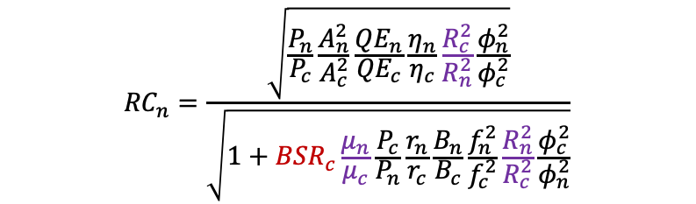
Evaluating Elastic Channels SNR
AOS Target is daytime SNR = CALIOP nighttime SNR
  Satisfying this depends on the variability/magnitude of the daytime background
SNR of new (subscript “n”) lidar relative to CALIOP (subscript “c”) nighttime SNR:
Daylight
CALIGOLA 355 nm
Target
CALIGOLA 532 nm
$${RC}_{n}=\frac{\sqrt{\frac{P_{n}}{P_{c}}\frac{A_{n}^{2}}{A_{c}^{2}}\frac{{QE}_{n}}{{QE}_{c}}\frac{η_{n}}{η_{c}}\frac{R_{c}^{2}}{R_{n}^{2}}\frac{φ_{n}^{2}}{φ_{c}^{2}}}}{\sqrt{1+{BSR}_{c}\frac{μ_{n}}{μ_{c}}\frac{P_{c}}{P_{n}}\frac{r_{n}}{r_{c}}\frac{B_{n}}{B_{c}}\frac{f_{n}^{2}}{f_{c}^{2}}\frac{R_{n}^{2}}{R_{c}^{2}}\frac{φ_{c}^{2}}{φ_{n}^{2}}}}$$
SNR to CALIPSO at night
Minimum
(CALIOP @ 450 km)
CALIOP on CALIPSO
@ 705 km
  Black: lidar instrument parameters (laser power, rep. rate, telescope size, detector efficiency, etc…)
  Purple: Orbit parameters (altitude, crossing time)
  Red: CALIOP-observed background-to-signal ratio
  (i.e. scene brightness)
Notes:
QE, optical efficiency, bandwidth

