Slide 1

Update on some of Goddard’s Aerosol Remote sensing activities
Robert Levy (NASA / GSFC Climate and Radiation Lab),
with contributions from many folks in various Earth Science – ATmosphere labs
Oct 16, 2024

Slide 2
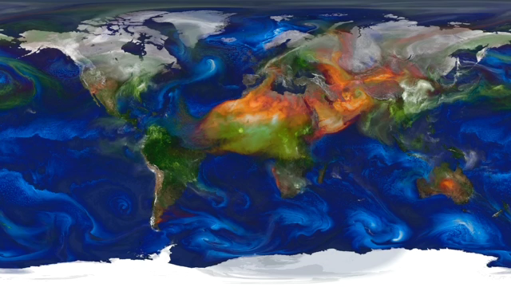

This is a model of aerosols around the world
Model has no “holes”
Single observation mission (e.g. MODIS) has many holes
How do we increase availability of consistent aerosol observations?
We have been trying to get at “loading” (e.g. AOD) for past 20 years
now trying to observe many more properties (shape, size, absorption, height etc.)
For AC/VC of course, surface air quality contribution, is still beyond the direct scope of most retrievals

Slide 3
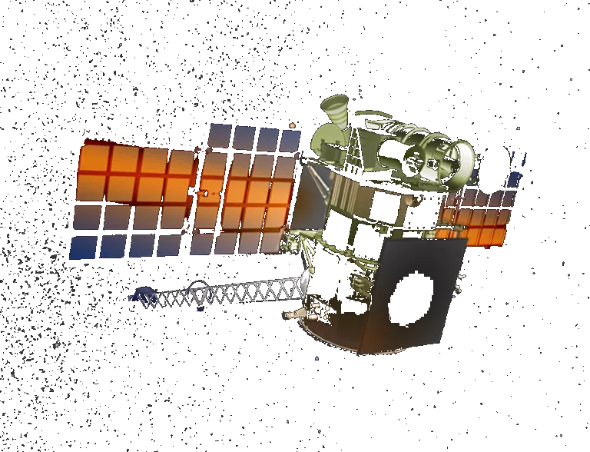
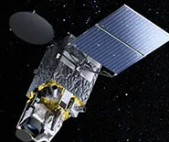
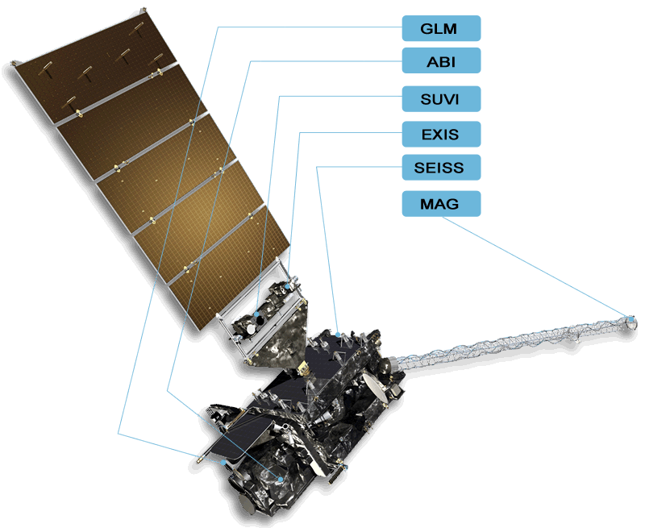

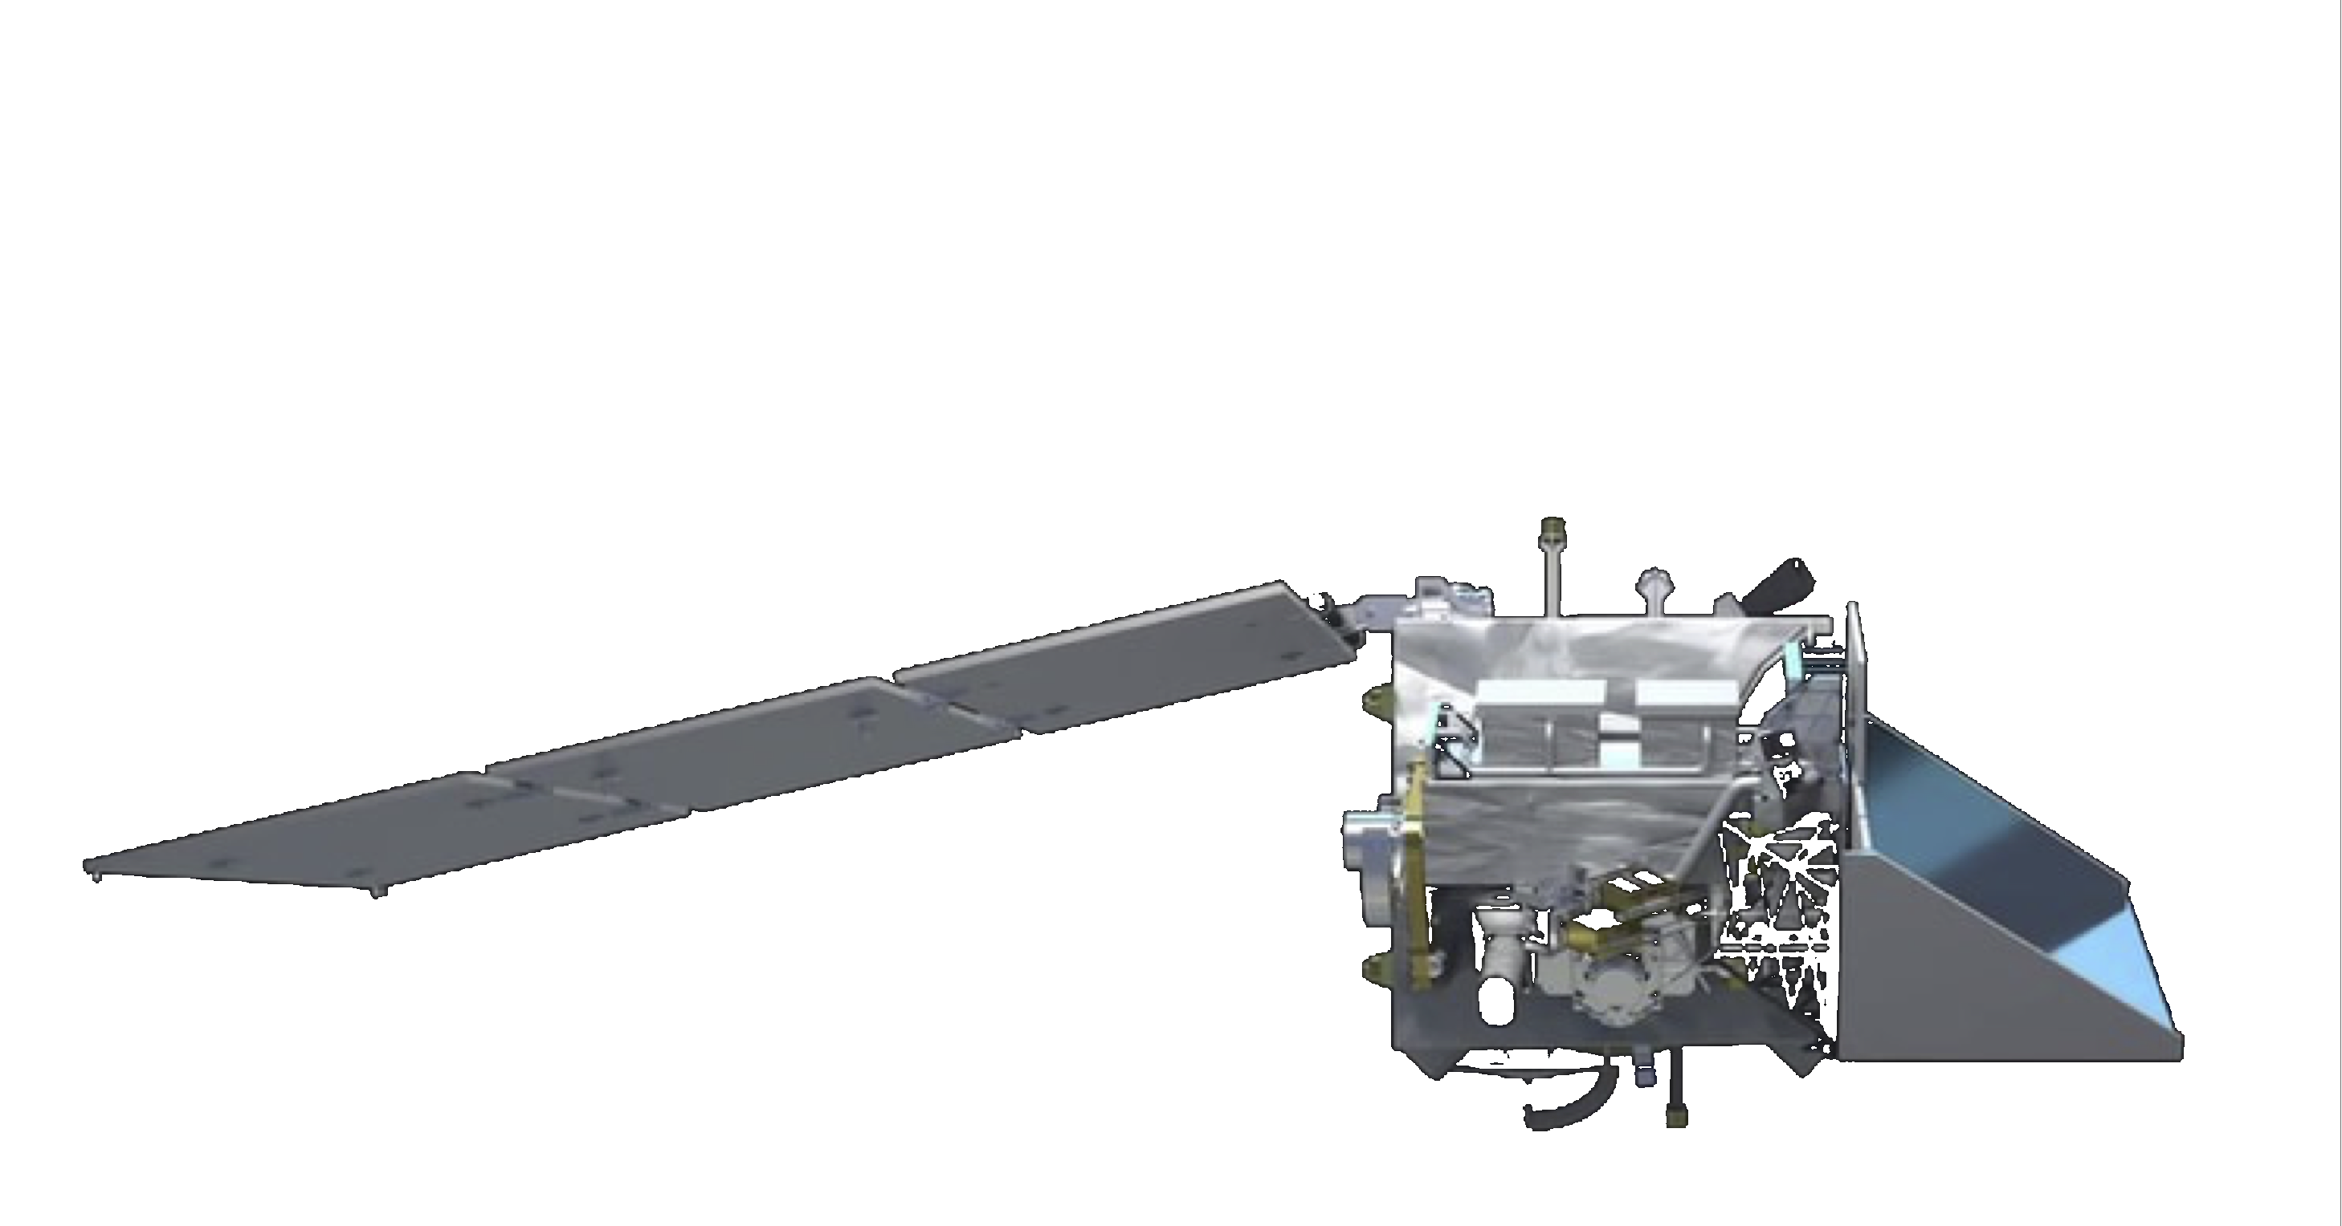
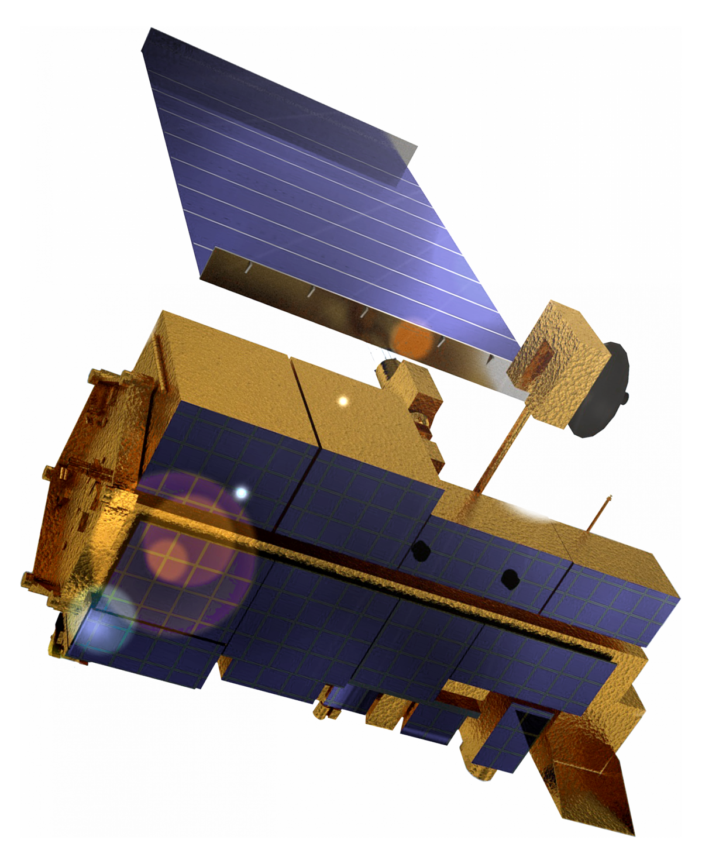
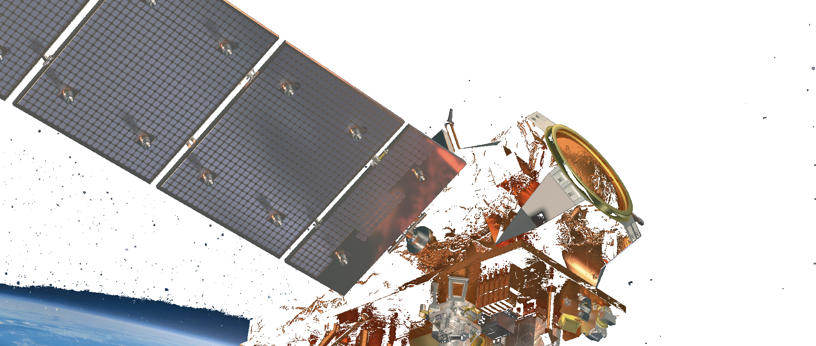
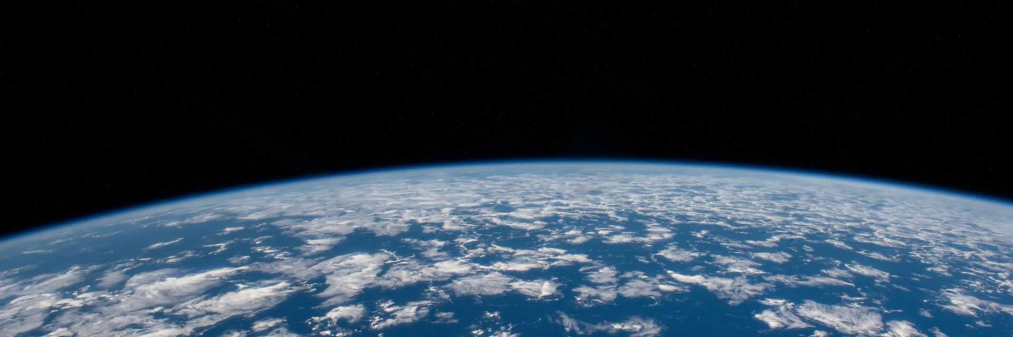
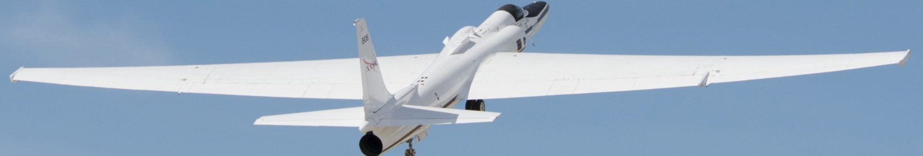
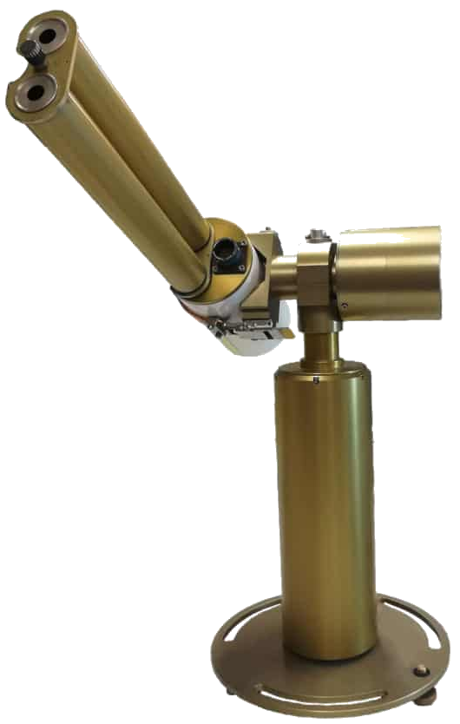
Scope of presentation
Contributions from some of Goddard’s remote sensing algorithm groups
  Many teams’ work on multiple sensors/platforms
  Groups interconnected with each other
  Note decreased funding for almost everyone.
AeroSAT – folks doing aerosol satellite product intercomparison – meeting this week in Lille France
“Task” group at GSFC – outlining aerosol/cloud studies from a disaggregated Aerosol-Cloud Convection Precipitation (ACCP) mission
Some Goddard “strategy”
EPIC (UV → NIR)
Himawari (VIS→TIR)
GOES-W (VIS→TIR)
GOES-E (VIS→TIR)
GEMS (UV/VIS)
TEMPO (UV/VIS)
PACE (UV→SWIR)
Polarization
Terra/Aqua/Aura
(UV→TIR)
SNPP/JPSS etc
(VIS→TIR)
Airborne (UV→TIR)
AERONET & networks

Slide 4
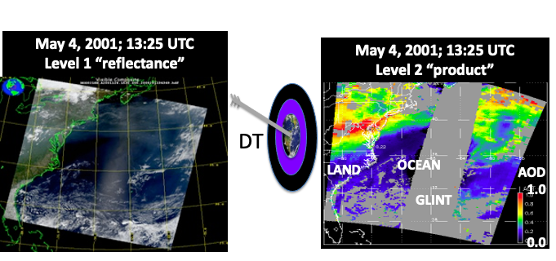
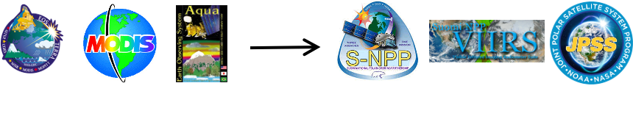
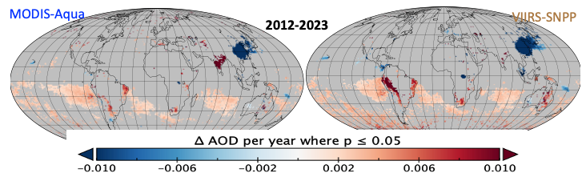
Dark Target team 1: Long Term Data Records/Trends
Levy, Mattoo, Shi, Sawyer, Kim, Remer, etc.
Consistent algorithms on MODIS and VIIRS
Assessing global and regional trends
11 years of both measuring: 1° trends
MODIS
VIIRS

Slide 5
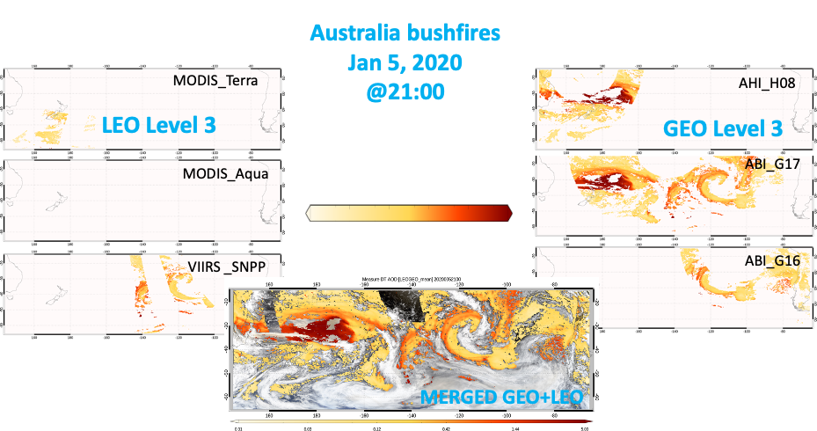
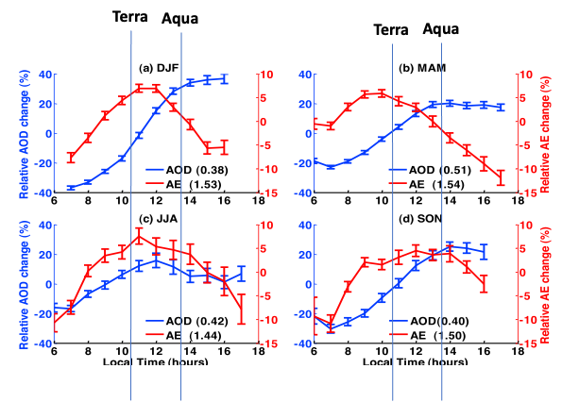
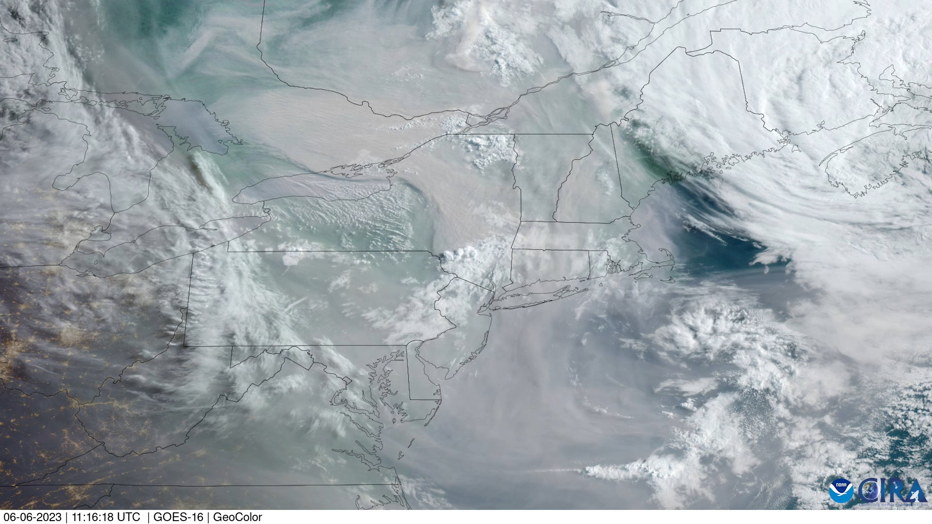
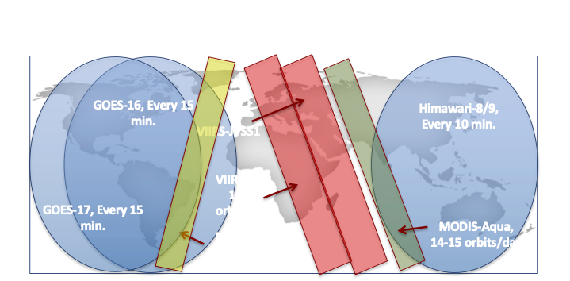
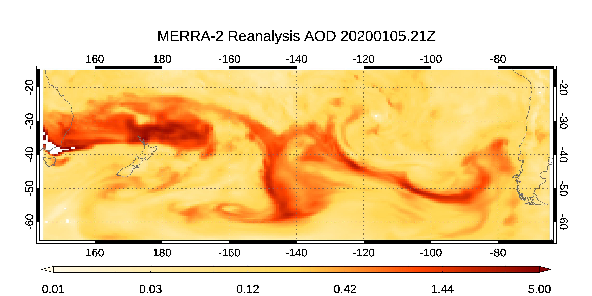
Dark Target team 2: GEO-LEO synergy for global temporal
Levy, Mattoo, Gupta, Shi, Sawyer, Kim, Holz, Oo, Wei, Remer, etc.
diurnal cycle and rapid changes
XAERDT: A joint GEO-LEO product
Diurnal cycle over Mexico
Smoke from GOES-East
https://satlib.cira.colostate.edu/event/western-canada-wildfires/
XAERDT 30 minute product to compare with model
Data 2019-2022 available from NASA LAADS
https://www.youtube.com/watch?v=d2RZNwplJeQ

Slide 6
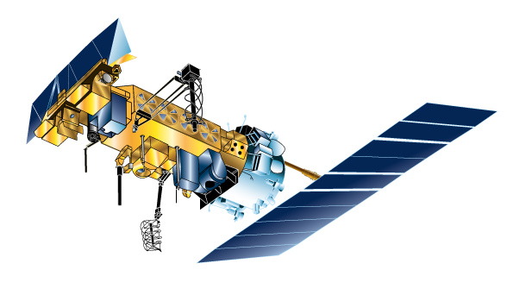
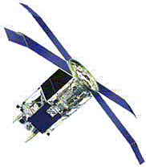
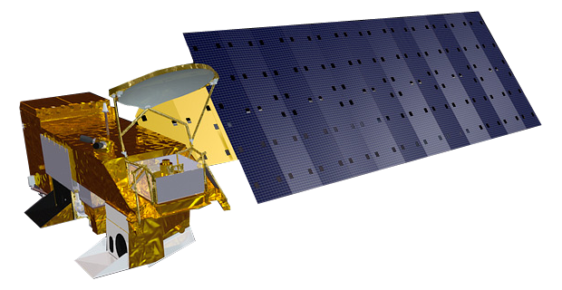

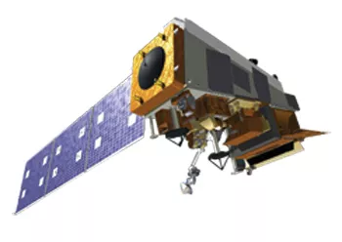
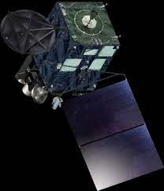
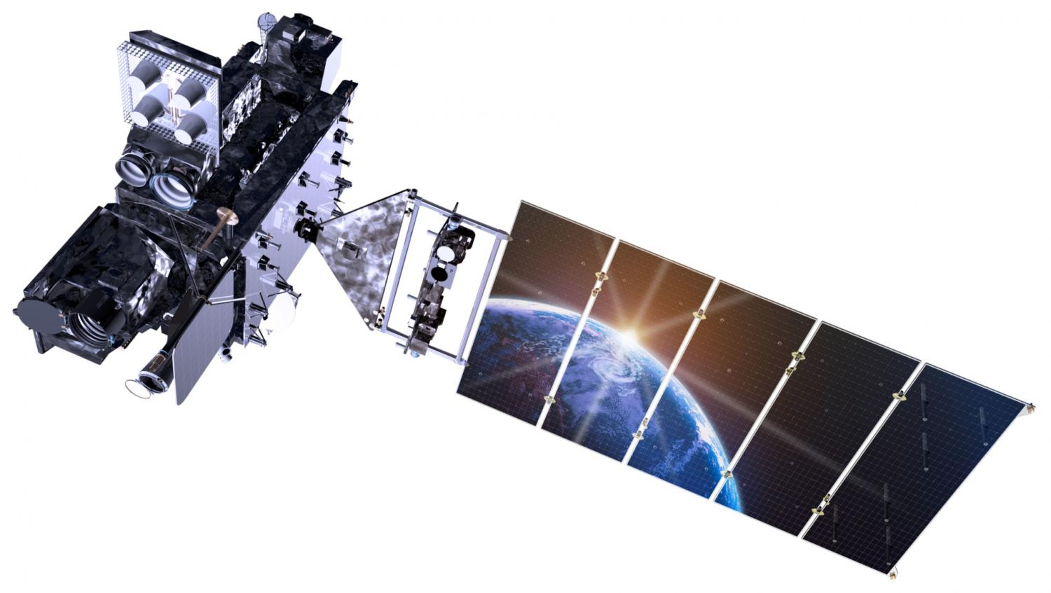
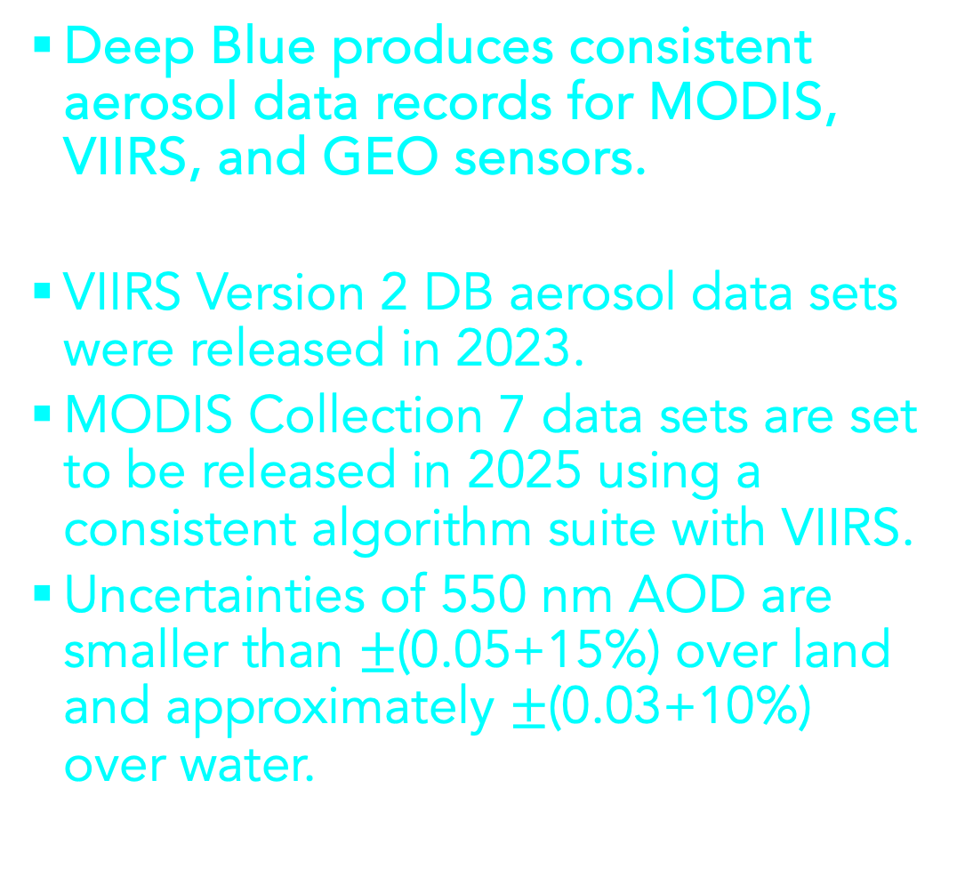
Deep Blue team 1: Long term aerosol data record
Hsu, Lee, Kim, Seftor, Sayer, etc.
Deep Blue Aerosol Data Records
1979
1990
2000
2010
2024+
Deep Blue produces consistent aerosol data records for MODIS, VIIRS, and GEO sensors.
VIIRS Version 2 DB aerosol data sets were released in 2023.
MODIS Collection 7 data sets are set to be released in 2025 using a consistent algorithm suite with VIIRS.
Uncertainties of 550 nm AOD are smaller than $±$(0.05+15%) over land and approximately $±$(0.03+10%) over water.
AVHRR series
1979/6
SeaWiFS
1997/9
Terra MODIS
2000/2
Aqua MODIS
2002/7
SNPP VIIRS
2012/3
NOAA-20 VIIRS
2018/2
NOAA-21 VIIRS
2023/4
GEO sensors
(ABI/AHI+)
H8/9: 2015/7
G16: 2017/12
G17/18: 2019/2
(Note, also includes AVHRR & SeaWiFS)

Slide 7
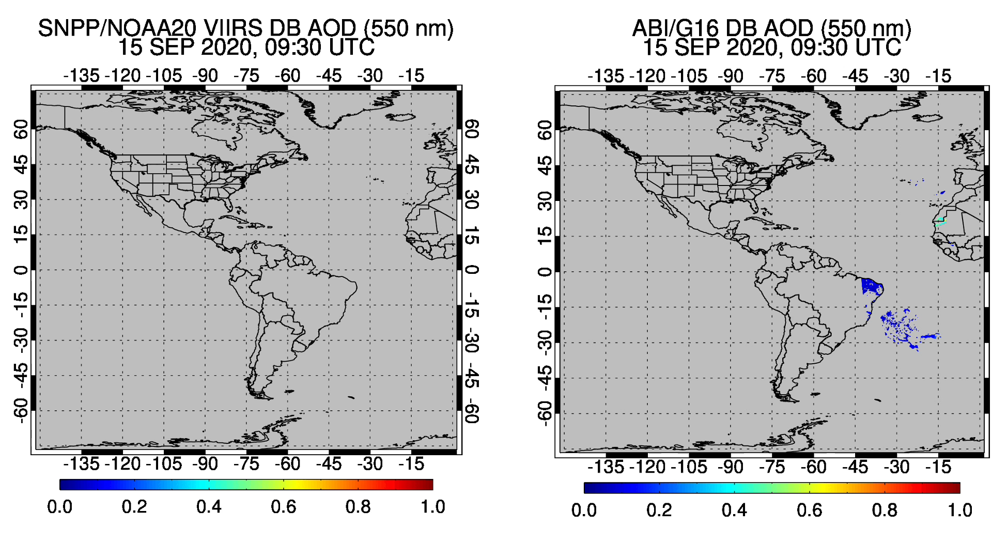
Deep Blue team 2: GEO-LEO synergy as well
Hsu, Lee, Kim, Seftor, Sayer, etc.
The public release of GEO and GEO-LEO combined products is underway.
GEO Level 2 aerosol product
Retrieval parameters
- 550 nm/spectral AOD (primary)
- Ångström exponent
- Fine-mode fraction (ocean only)
- Aerosol type
Half-hourly, 10 x 10 km² resolutions
Consistent netCDF4 format with MODIS (C7) and VIIRS products
Minimal learning curve for users of existing DB aerosol products
Discussion of eventual merge with DT for DT/DB GEO-LEO synergy

Slide 8
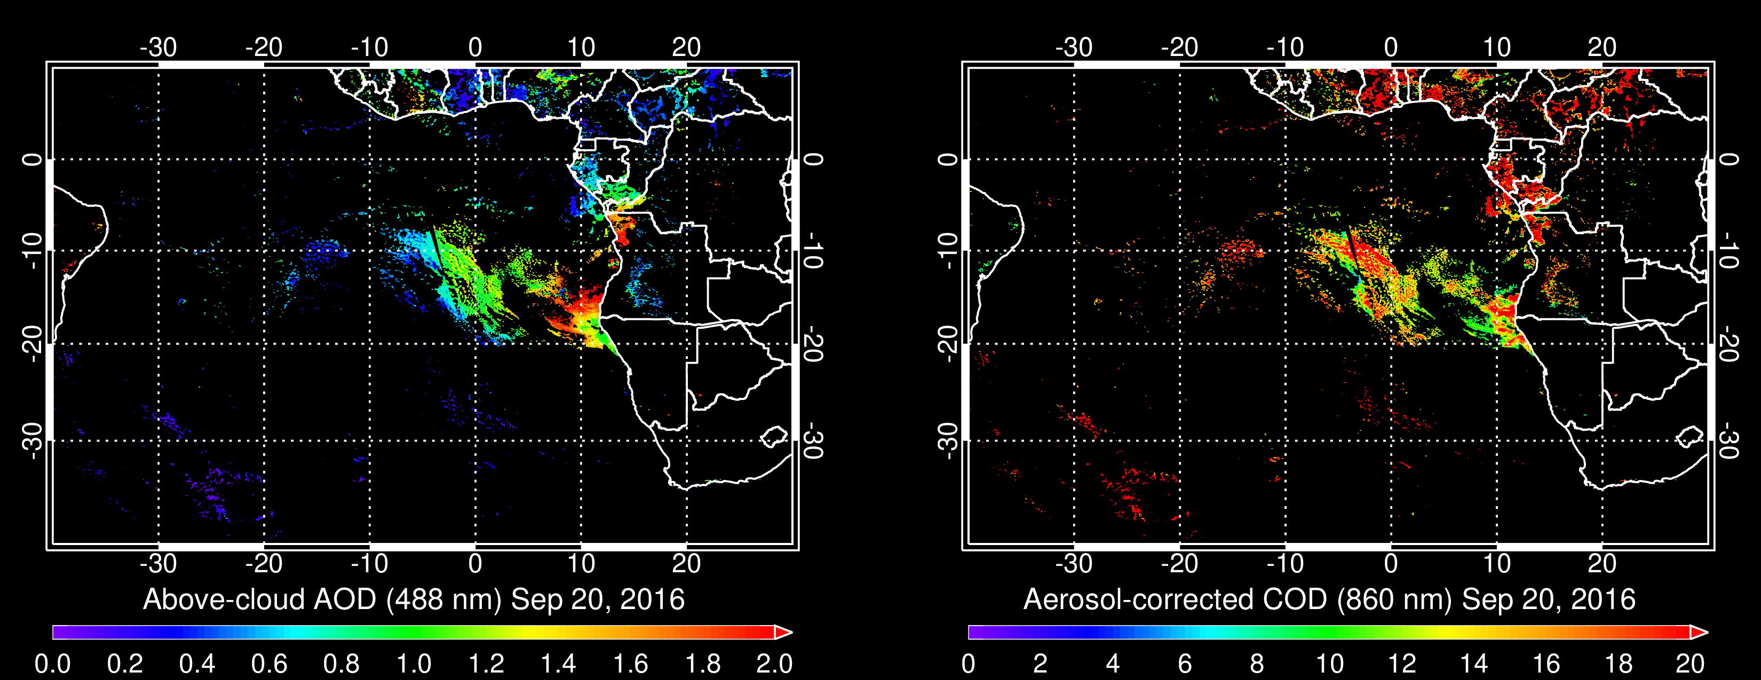
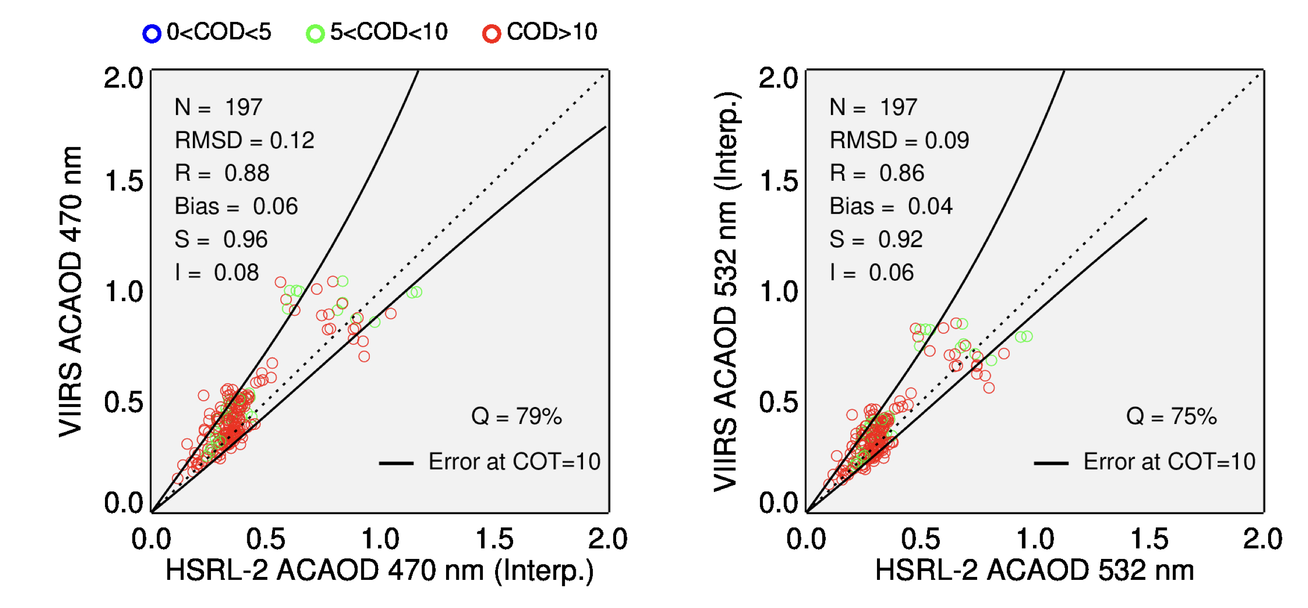
OMI-UV team: Above-cloud Absorbing Aerosol Algorithm in visible
Jethva, Torres, Levy, Mattoo, etc.
Sep 20, 2016
AC-AOD
COD
“Color Ratio” algorithm [Jethva et al., 2013 IEEE]
Exploits strong color ratio effect produced by aerosol absorption between blue and NIR wavelengths
Output: columnar AOD above clouds and aerosol-corrected COD
Initial Validation of VIIRS ACAOD using
ORACLES HSRL-2 Direct Observations
A global, research-level algorithm is developed
Aerosol Models based on AERONET sites in vicinity of ACA hotspot regions
Spectral SSA information from CALIOP-MODIS synergy dataset [Jethva et al., in prep.]

Slide 9
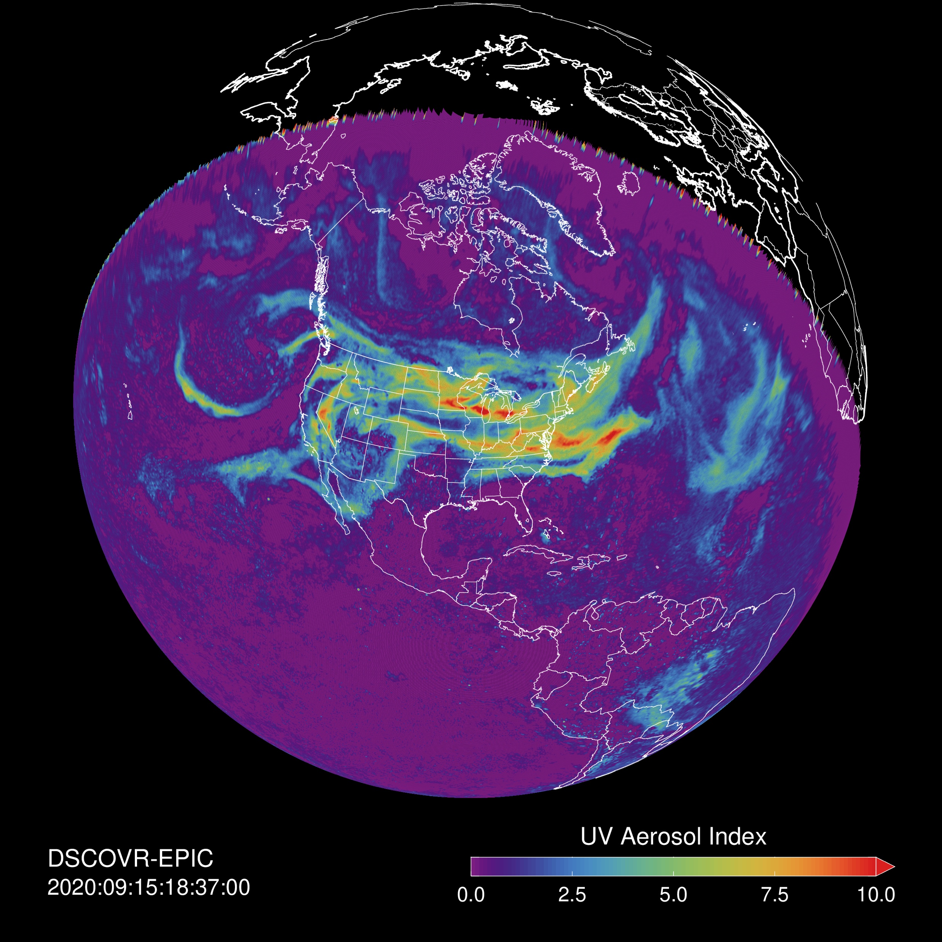
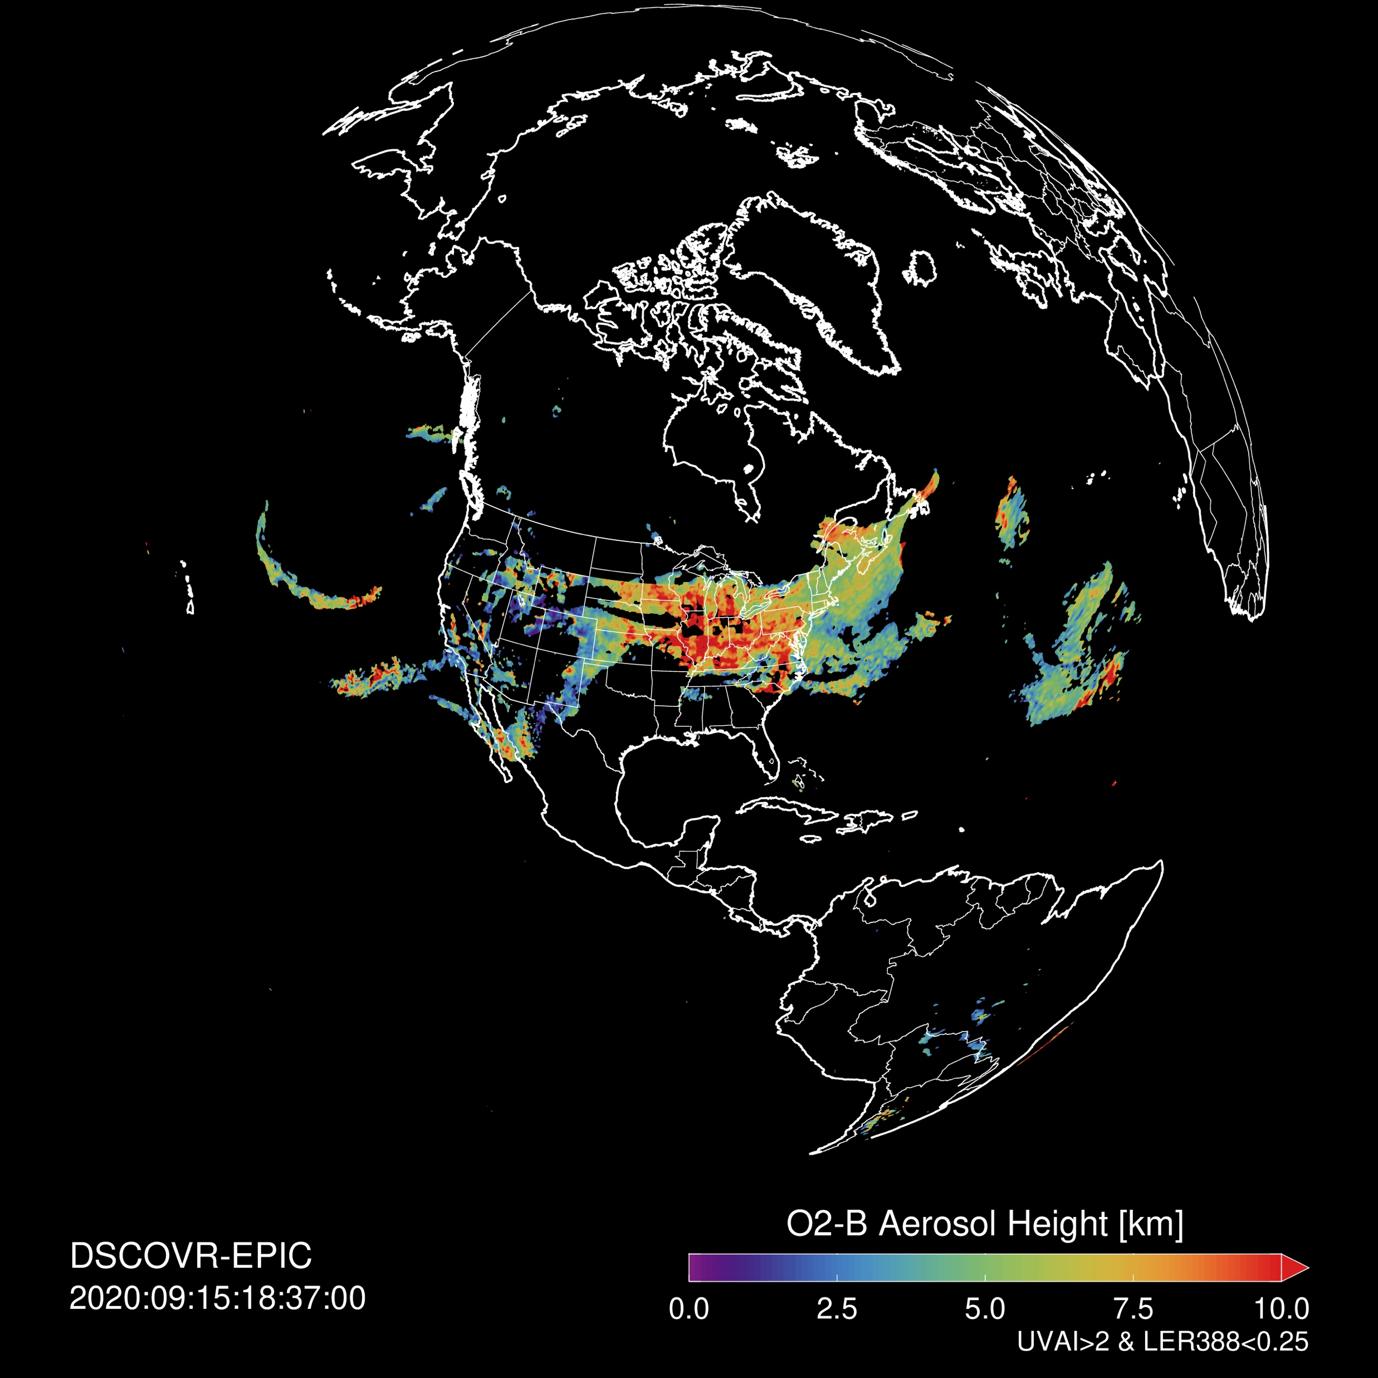
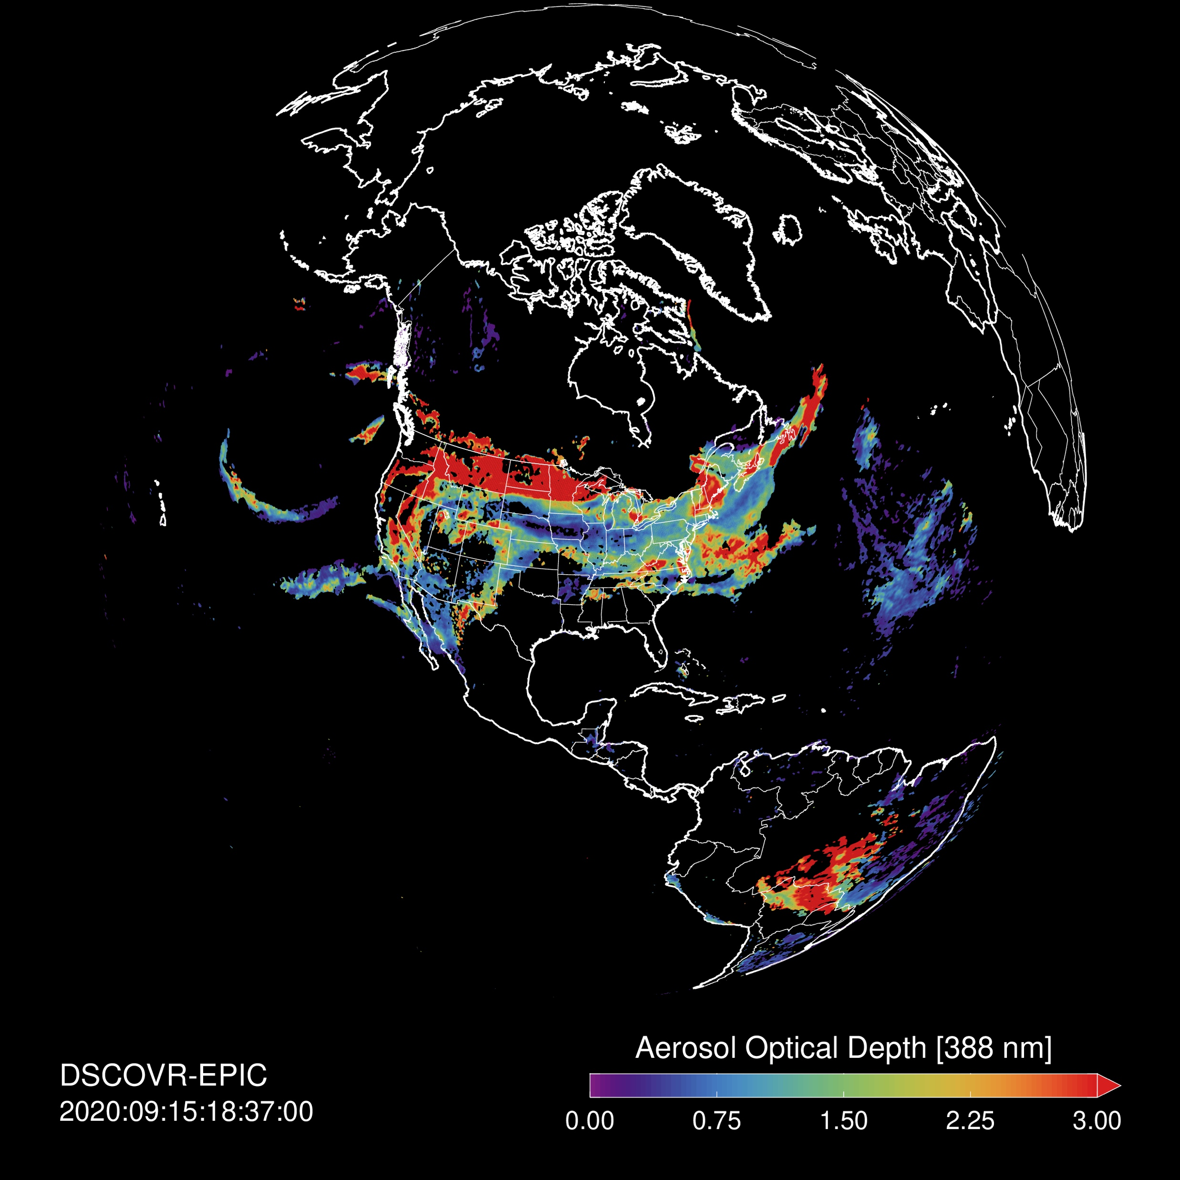
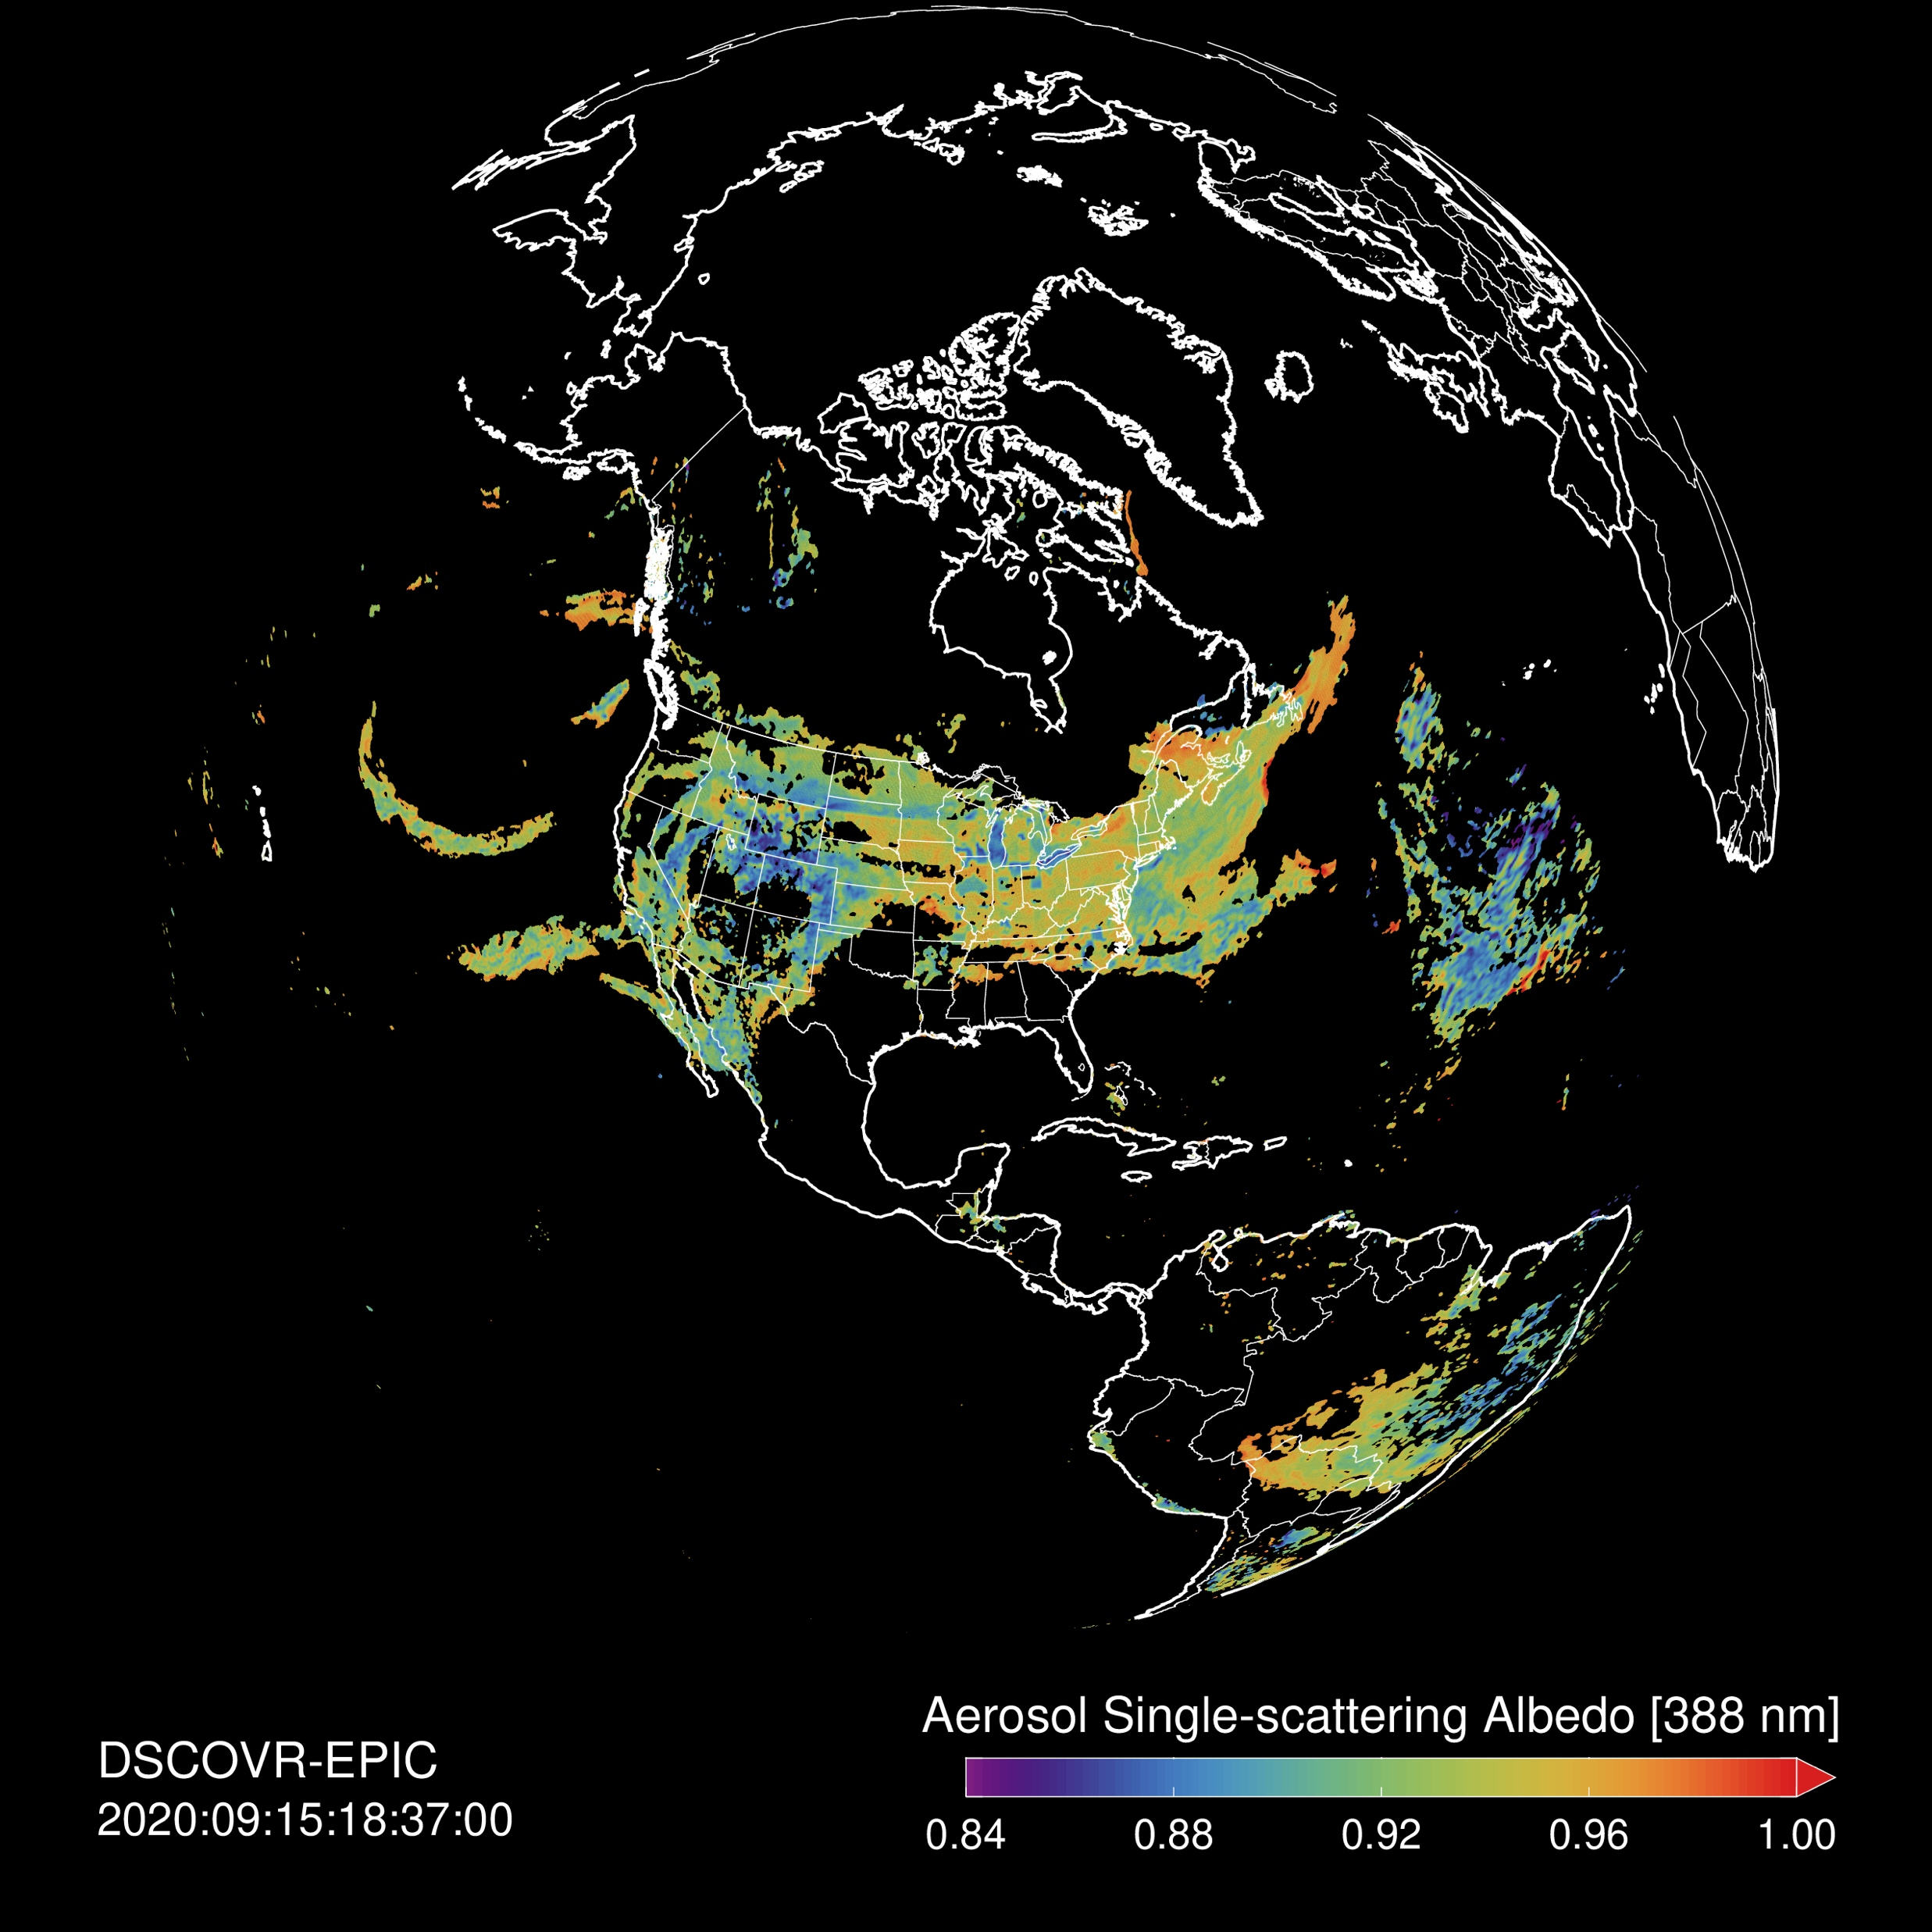
The near-UV aerosol product (on EPIC)
UVAI
O2-B Aerosol Height
Omar Torres’s team at Goddard
Uses 340-388 nm pair to retrieve
  UV Aerosol Index
  Aerosol Optical Depth at 388 nm
  Single-scattering Albedo at 388 nm
  Aerosol Optical Depth over Clouds at 388 nm
Oxygen-B band (688/680 nm) observations for retrievals of Aerosol Optical Centroid Height
Spectral extension of SSA from 388 to 440, 500, & 646 nm using regional-seasonal polynomials
AOD [388 nm]
SSA [388 nm]
Note EPIC science team meeting concurrent this week!

Slide 10
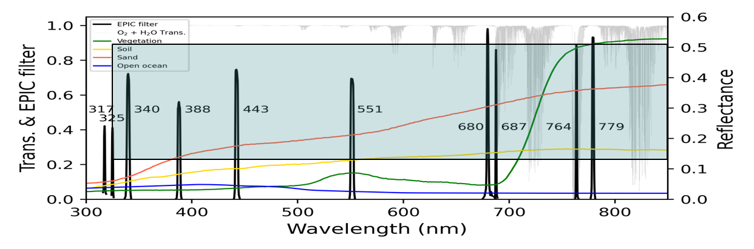
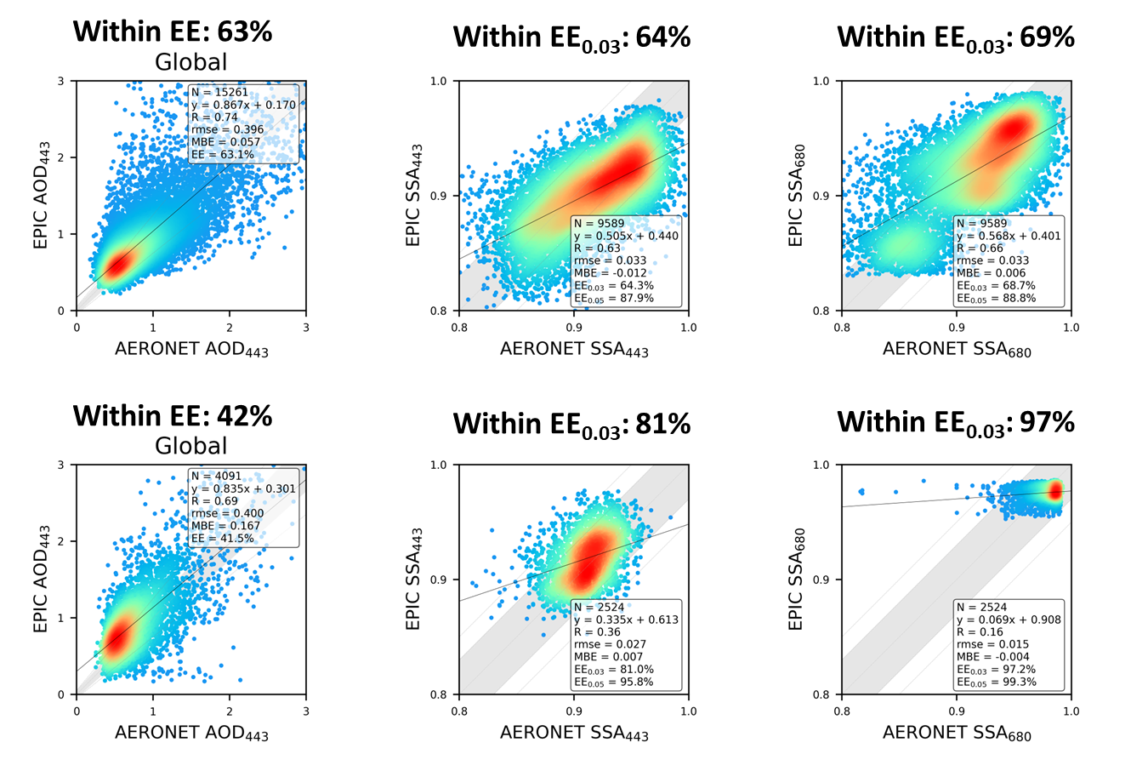
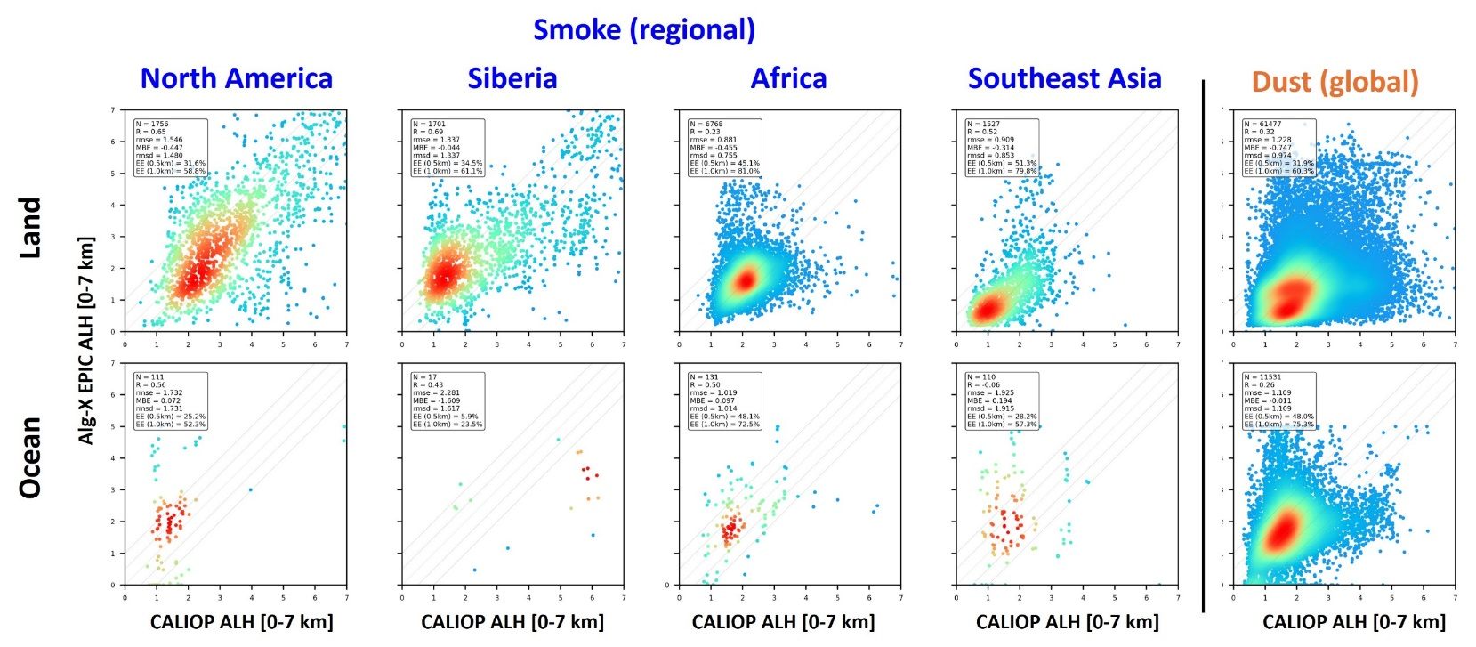
MAIAC EPIC v3 Algorithm
Alexei Lyapustin’s team at Goddard
The v3 MAIAC EPIC algorithm simultaneously retrieves AOD, spectral absorption and ALH using optimal fit to DSCOVR EPIC measurements at {340, 388, 550, 680, 780nm and O₂ A,B-bands}
AOD443
SSA443
SSA680
Smoke
MAIAC ALH [0-7km]
Dust
CALIOP backscatter-weighted height
Bias land: -450m (smoke); -750m (dust)
Bias ocean: No
RMSE: ~1.1km
Global AERONET validation for 2015-2023
EE range of AOD: ±(0.2 × AERONET AOD + 0.05)
EE range of SSA: ±(AERONET SSA + 0.03 (or ±0.05)); only when AERONET AOD > 0.6
Notes:
(Great Spectral Aerosol Absorption) – don’t even mention the AOD.

Slide 11
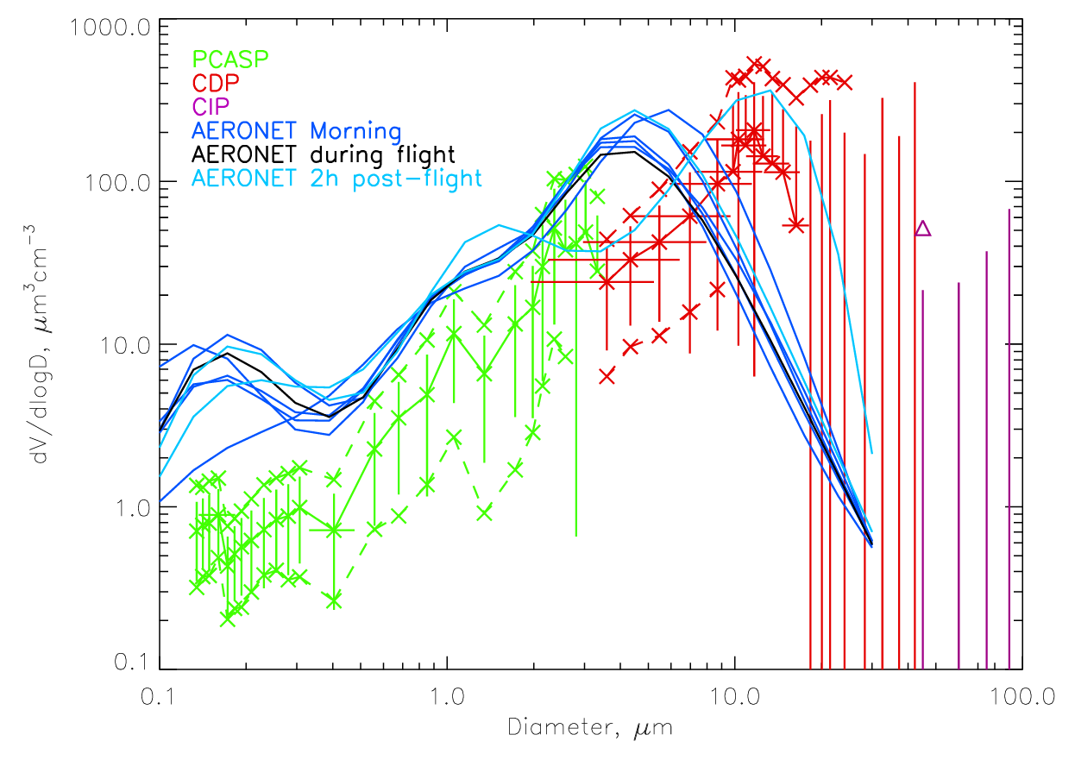
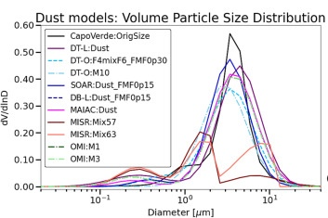
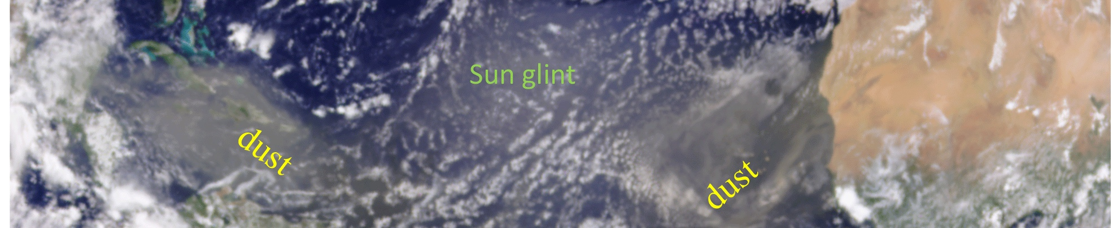
Towards synergy of models and observations for characterizing dust properties
Levy, Espinosa, Colarco, Yu, Lyapustin, Torres, Jevhva, Gupta, Welton, etc
AERONET
In situ
Volume Distribution
Fennec 2011
Ryder et al., 2015
0.1 1 d(μm) 10 100
“Godzilla” dust viewed by EPIC/DISCOVR on 23 June 2023 (from Yu et al., https://doi.org/10.5194/acp-21-12359-2021)
In-situ shows large dust particles transported far away – not accounted for in UV/VIS/NIR.
Is there harmony between dust property assumptions in VIS/NIR and SWIR/TIR dust retrievals?
Goal is measurement-based interoperable approaches for both retrieval and modeling
Each remote sensing team has own assumptions for dust properties
2024/2025 are important years – transition between EOS (Terra/Aqua/Aura) to new stuff
Opportunity to work together (try to find funding!).

Slide 12

Air Quality in AeroSat (Currently meeting in Lille, France)
One-slide Presentation for the AC-VC meeting, October 2024
https://aero-sat.org/
From Ralph Kahn (U Colorado), Andy Sayer (UBC/GSFC), Thomas Popp (DLR/Germany), Larisa Sogechova (FMI/Finland)
• AeroCom & AeroSat are aerosol modeling / measurement expert groups, that meet annually / run (joint) experiments to make progress. The focus is primarily on climate applications, but air quality (specifically, PM_{2.5}) is also discussed.
• The challenges for applying satellite data to air quality modeling include:
-- Deriving the near-surface component from broad-coverage, passive remote-sensing
-- Obtaining adequate spatial resolution from broad-coverage passive remote-sensing
-- Extrapolating the limited coverage of the near-surface component from active sensors
-- Obtaining adequate temporal coverage from low-Earth-orbiting instruments
-- Deriving constraints on particle microphysical properties from remote-sensing observations
--Connecting the particle optical information from satellites with model, speciated aerosol mass
• During AeroCom/AeroSat joint sessions, we have brief introductory presentations, followed by open discussion aimed at brainstorming ways to address these issues and design community experiments
• Air quality discussion to date focused primarily on relating satellite and model particle property constraints /
varying definitions; other aspects of constraining models with measurements are topics for this year’s meeting
• Regarding the spatial and temporal coverage issues, constraining models with measurements / data assimilation, and using the models to fill in where data are lacking has been the main idea discussed.

Slide 13
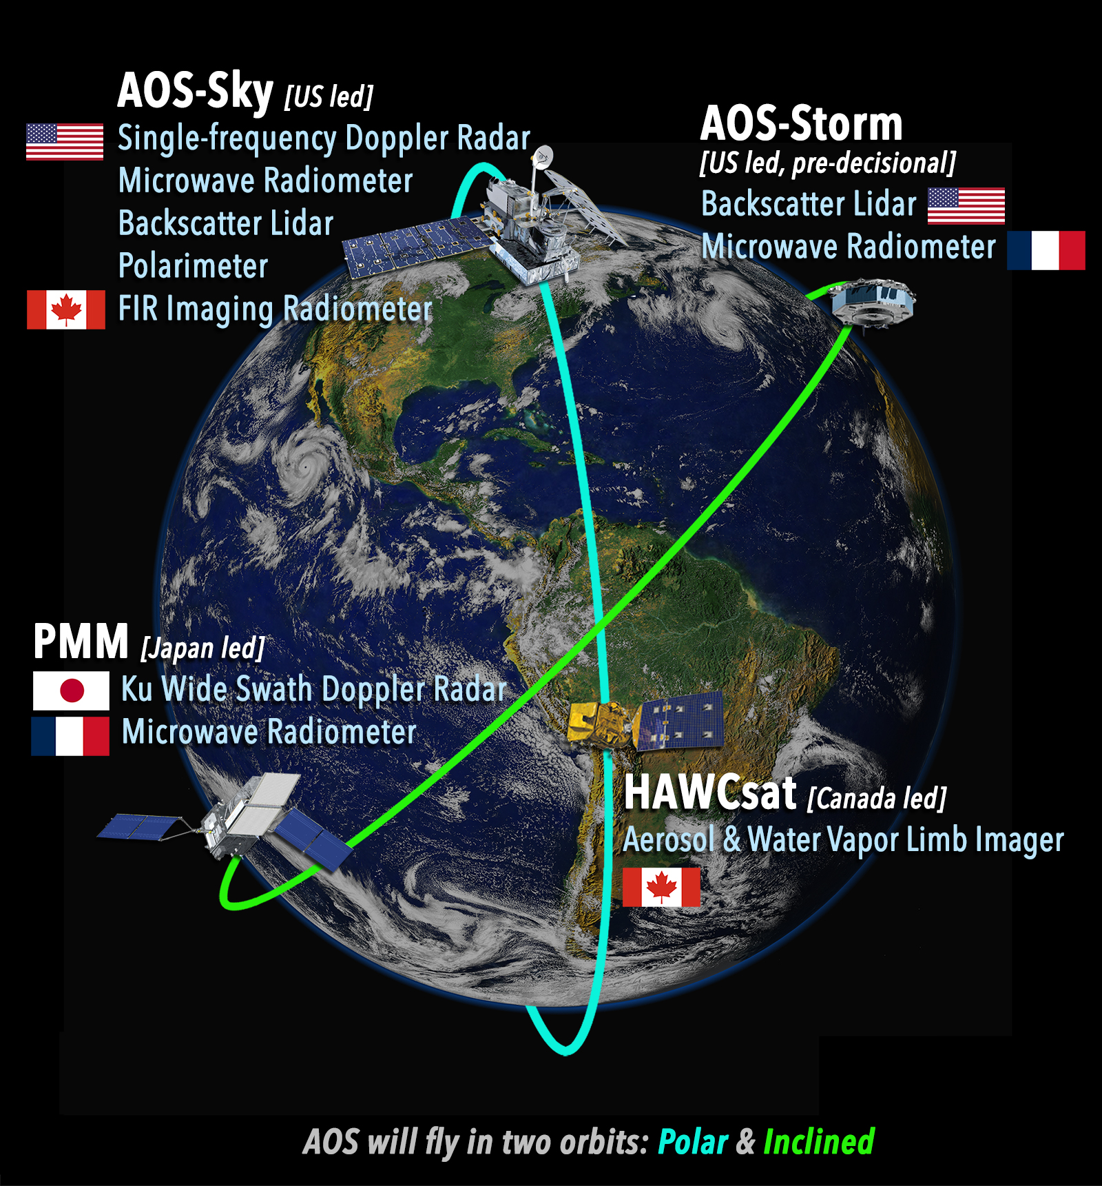
Maintaining Momentum in US Aerosol, Cloud, Convection and Precipitation (ACCP) Science
Kacenelenbogen, Knobelspiesse, Meyer, Espinosa, Levy, Gong, Nowattnick, Ringerud, Colarco, Yorks, DaSilva, Braun, Platnick, Wu
Using Goddard’s internal Science funding, we have one year to:
Identify which ACCP Decadal Survey (DS) science questions might be answerable with the near past, current and planned spaceborne satellites
Identify the science and corresponding hardware gaps needed to fully address the rest of the DS science questions
Work on position paper(s) to influence the next DS in ~2027
Notional Atmospheric Observing System (AOS)
many international partners/orbits
(disaggregated)

Slide 14
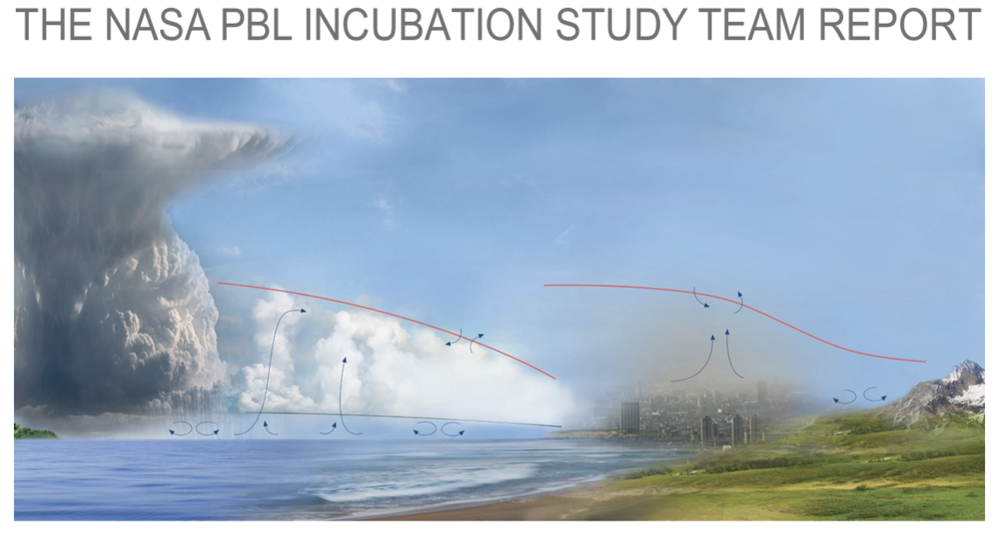
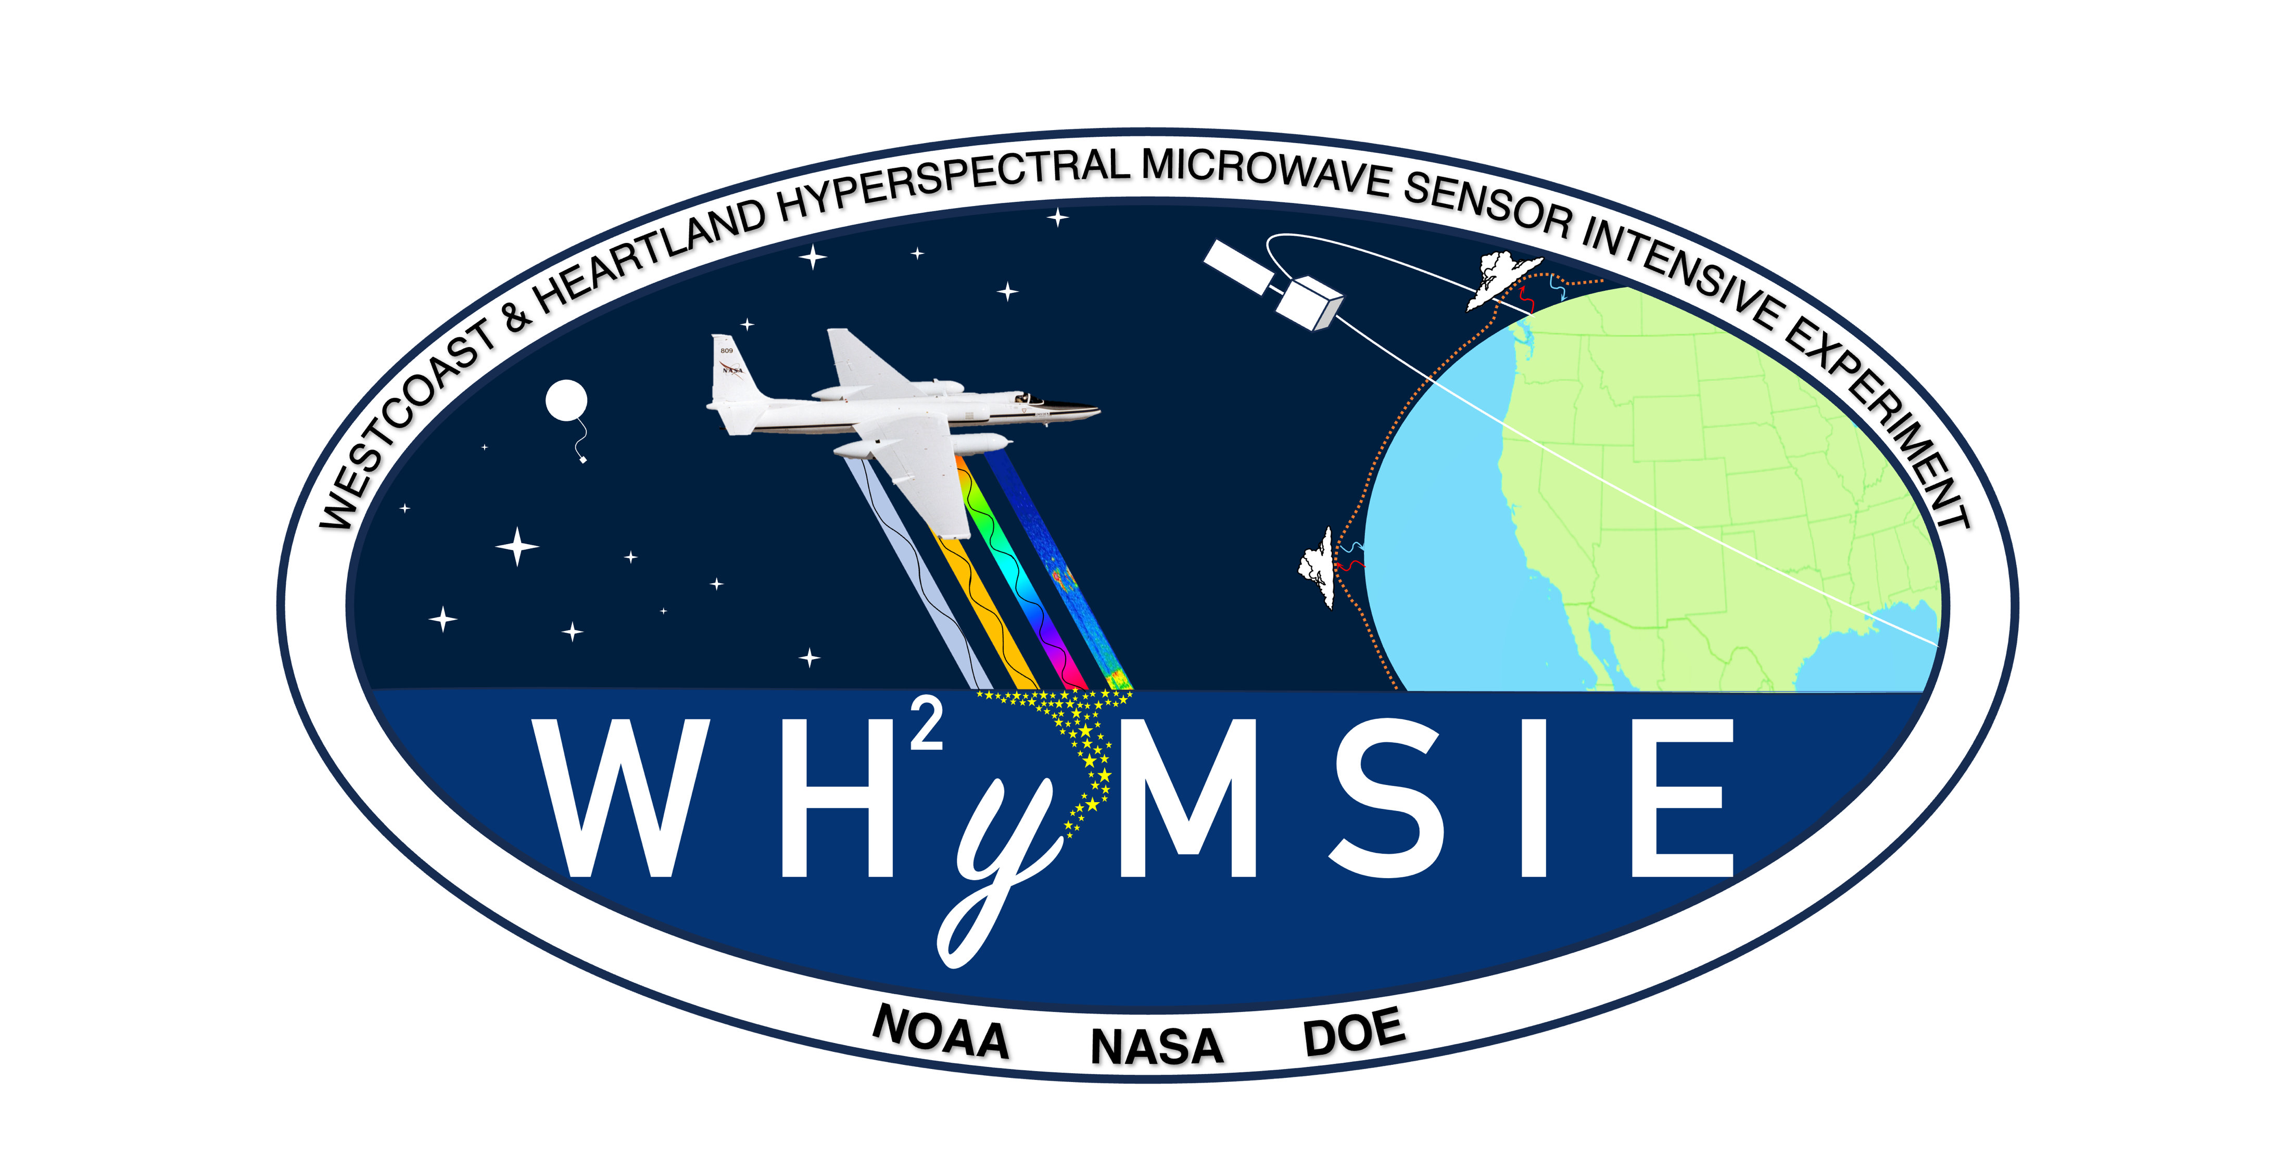
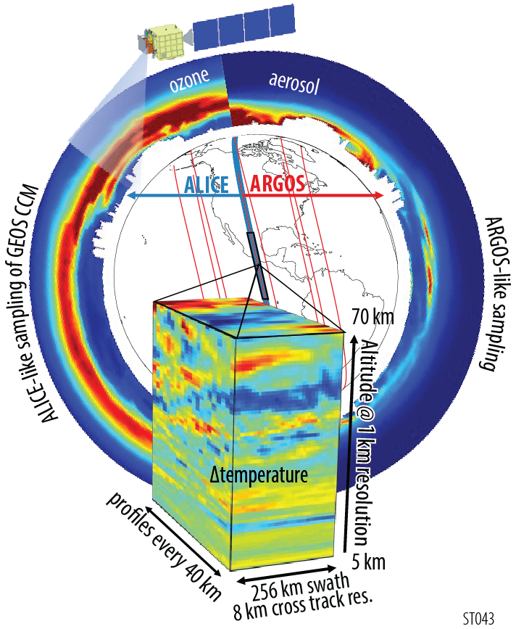
Goddard thinking about next Decadal Survey (Project incubation)
Many different Goddard Pis, Co-I’s, Project Scientists – contributing to explorer-type and concepts
Planetary Boundary Layer (PBL)
Westcoast & Heartland Hyperspectral Microwave Sensor Intensive Experiment (WH²yMSIE)
  Lots of new technology (hyperspectral microwave)
  Fly under NOAA-21, NOAA-20, EarthCare, etc.
  Help demonstrate data fusion for PBL information
  Focus is surface/atmospheric fluxes of water, energy, etc.
  Aerosols/PM/AQ/gases could have more focus.
Tropospheric/Stratospheric activities
Stratosphere Troposphere Response using Infrared Vertically-resolved light Explorer (STRIVES)
  3D view of Atmospheric Composition and temperature (10 km horizontal by 1 km vertical)
  Limb instruments for ozone, water vapor, GHG, gases, aerosols, etc.
  Tropospheric/Stratospheric interaction
  Weather and hazards including Air Quality from fires, dust and volcanoes
From Miguel Román (Deputy Director for Atmospheres)

Slide 15
Conclusion
Goddard Remote sensing groups are very busy!
  Many teams’ work on multiple sensors/platforms
  Groups are interconnected with each other
  Teams thinking about long-term continuity and developing new products to go beyond AOD – better validating existing models and informing future ones.
  In our spare time, we are trying grassroots efforts to begin to homogenize our assumptions.
  Note decreased funding for almost every group.
One important group working on this problem is “AeroSAT”, currently meeting in France. Lots of folks doing aerosol satellite product intercomparison – and comparison to models (AeroCom).
With EOS (Terra/Aqua/Aura) ending, continuity of observations are at risk.
We are trying to be extremely creative about keeping up our cutting-edge work efforts. One example is an internal funded “task” group at GSFC to take a step back regarding ACCP and think about best strategies for doing the science .
Goddard management is working to define strategies for continuity and filling critical observation gaps, including “integrated Earth System Observatory” (iESO) that furthur builds on GEO-LEO synergies.

