Slide 1
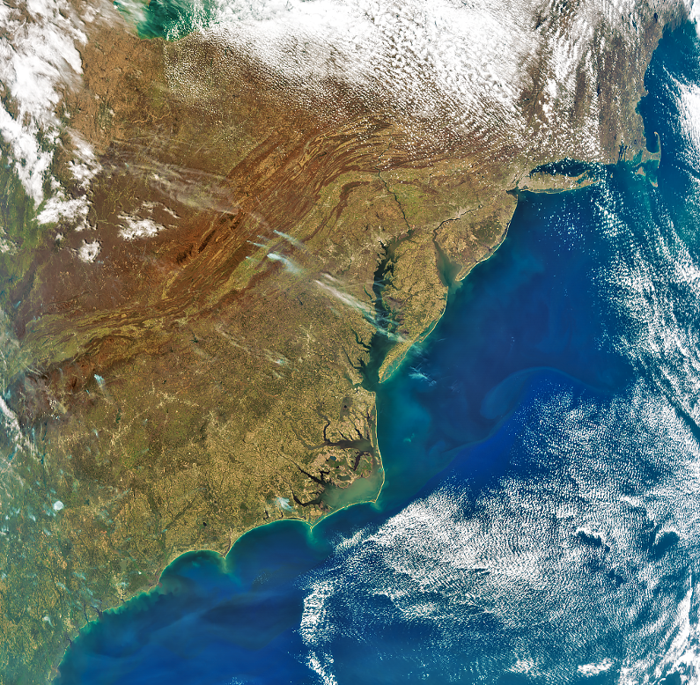


Keeping PACE with Plankton, Aerosol, Cloud, ocean Ecosystem mission:
Aerosol product update
Meng Gao (SSAI/NASA GSFC)
on behalf of the PACE team
(Jeremy Werdell, Andy Sayer, Kirk Knobelspiesse, Bryan Franz, Brian Cairns, Morgaine McKibben, Carina Paulin, James Allen… Vanderlei Martins, Otto Hasekamp, Lorraine Remer, Pengwang Zhai, Snorre Stamnes and many more)
CEOS AC-VC #20, NCWCP, College Park

Slide 2
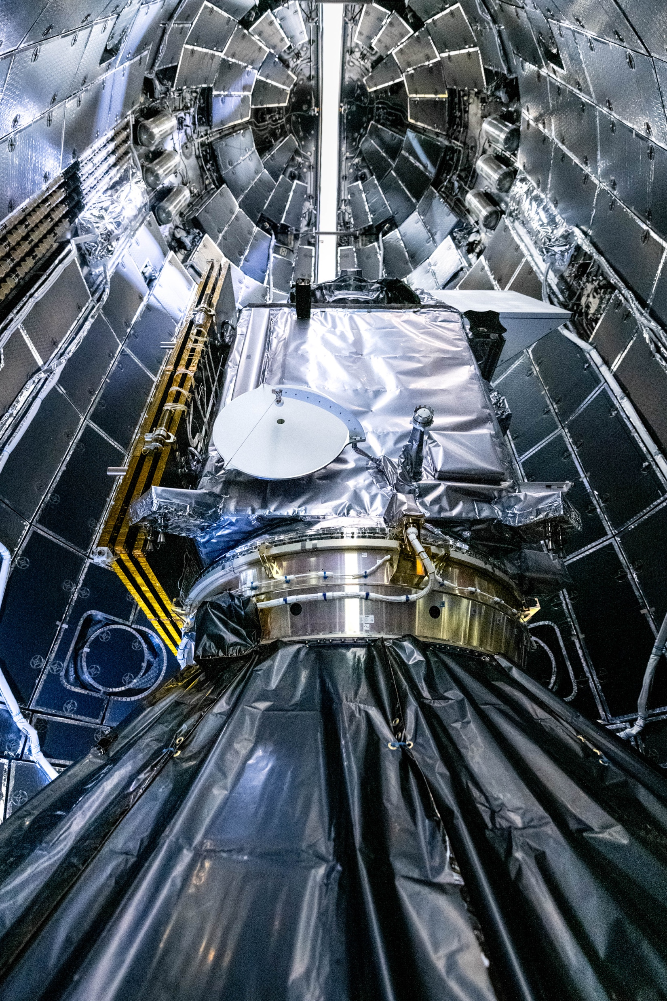
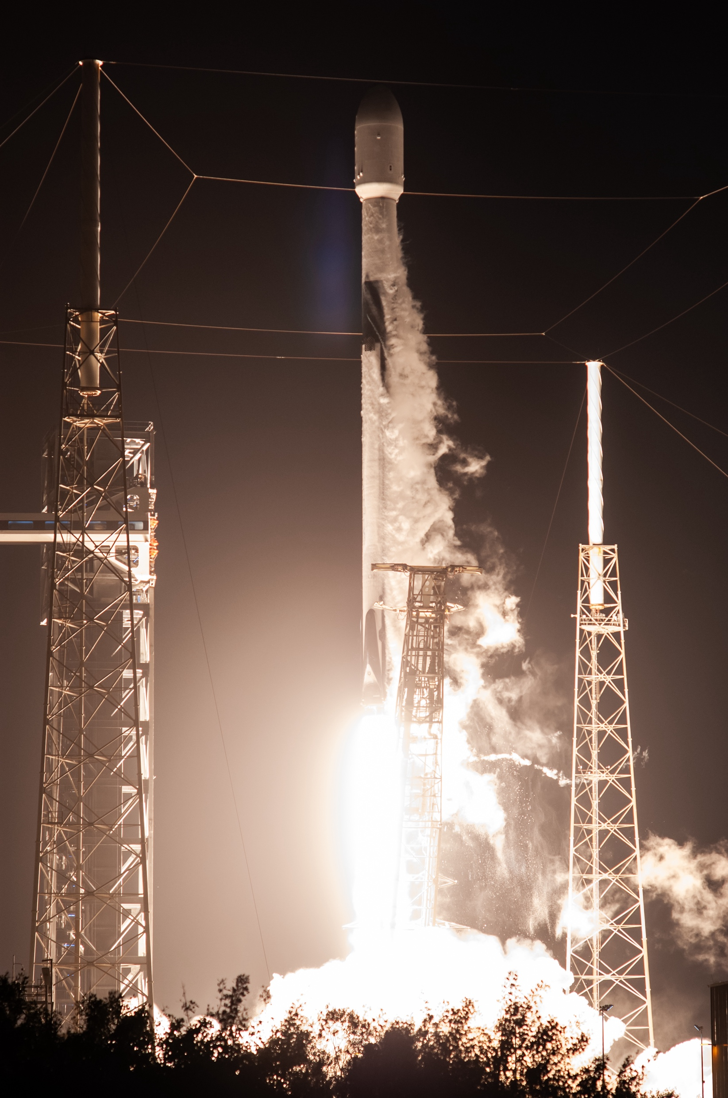
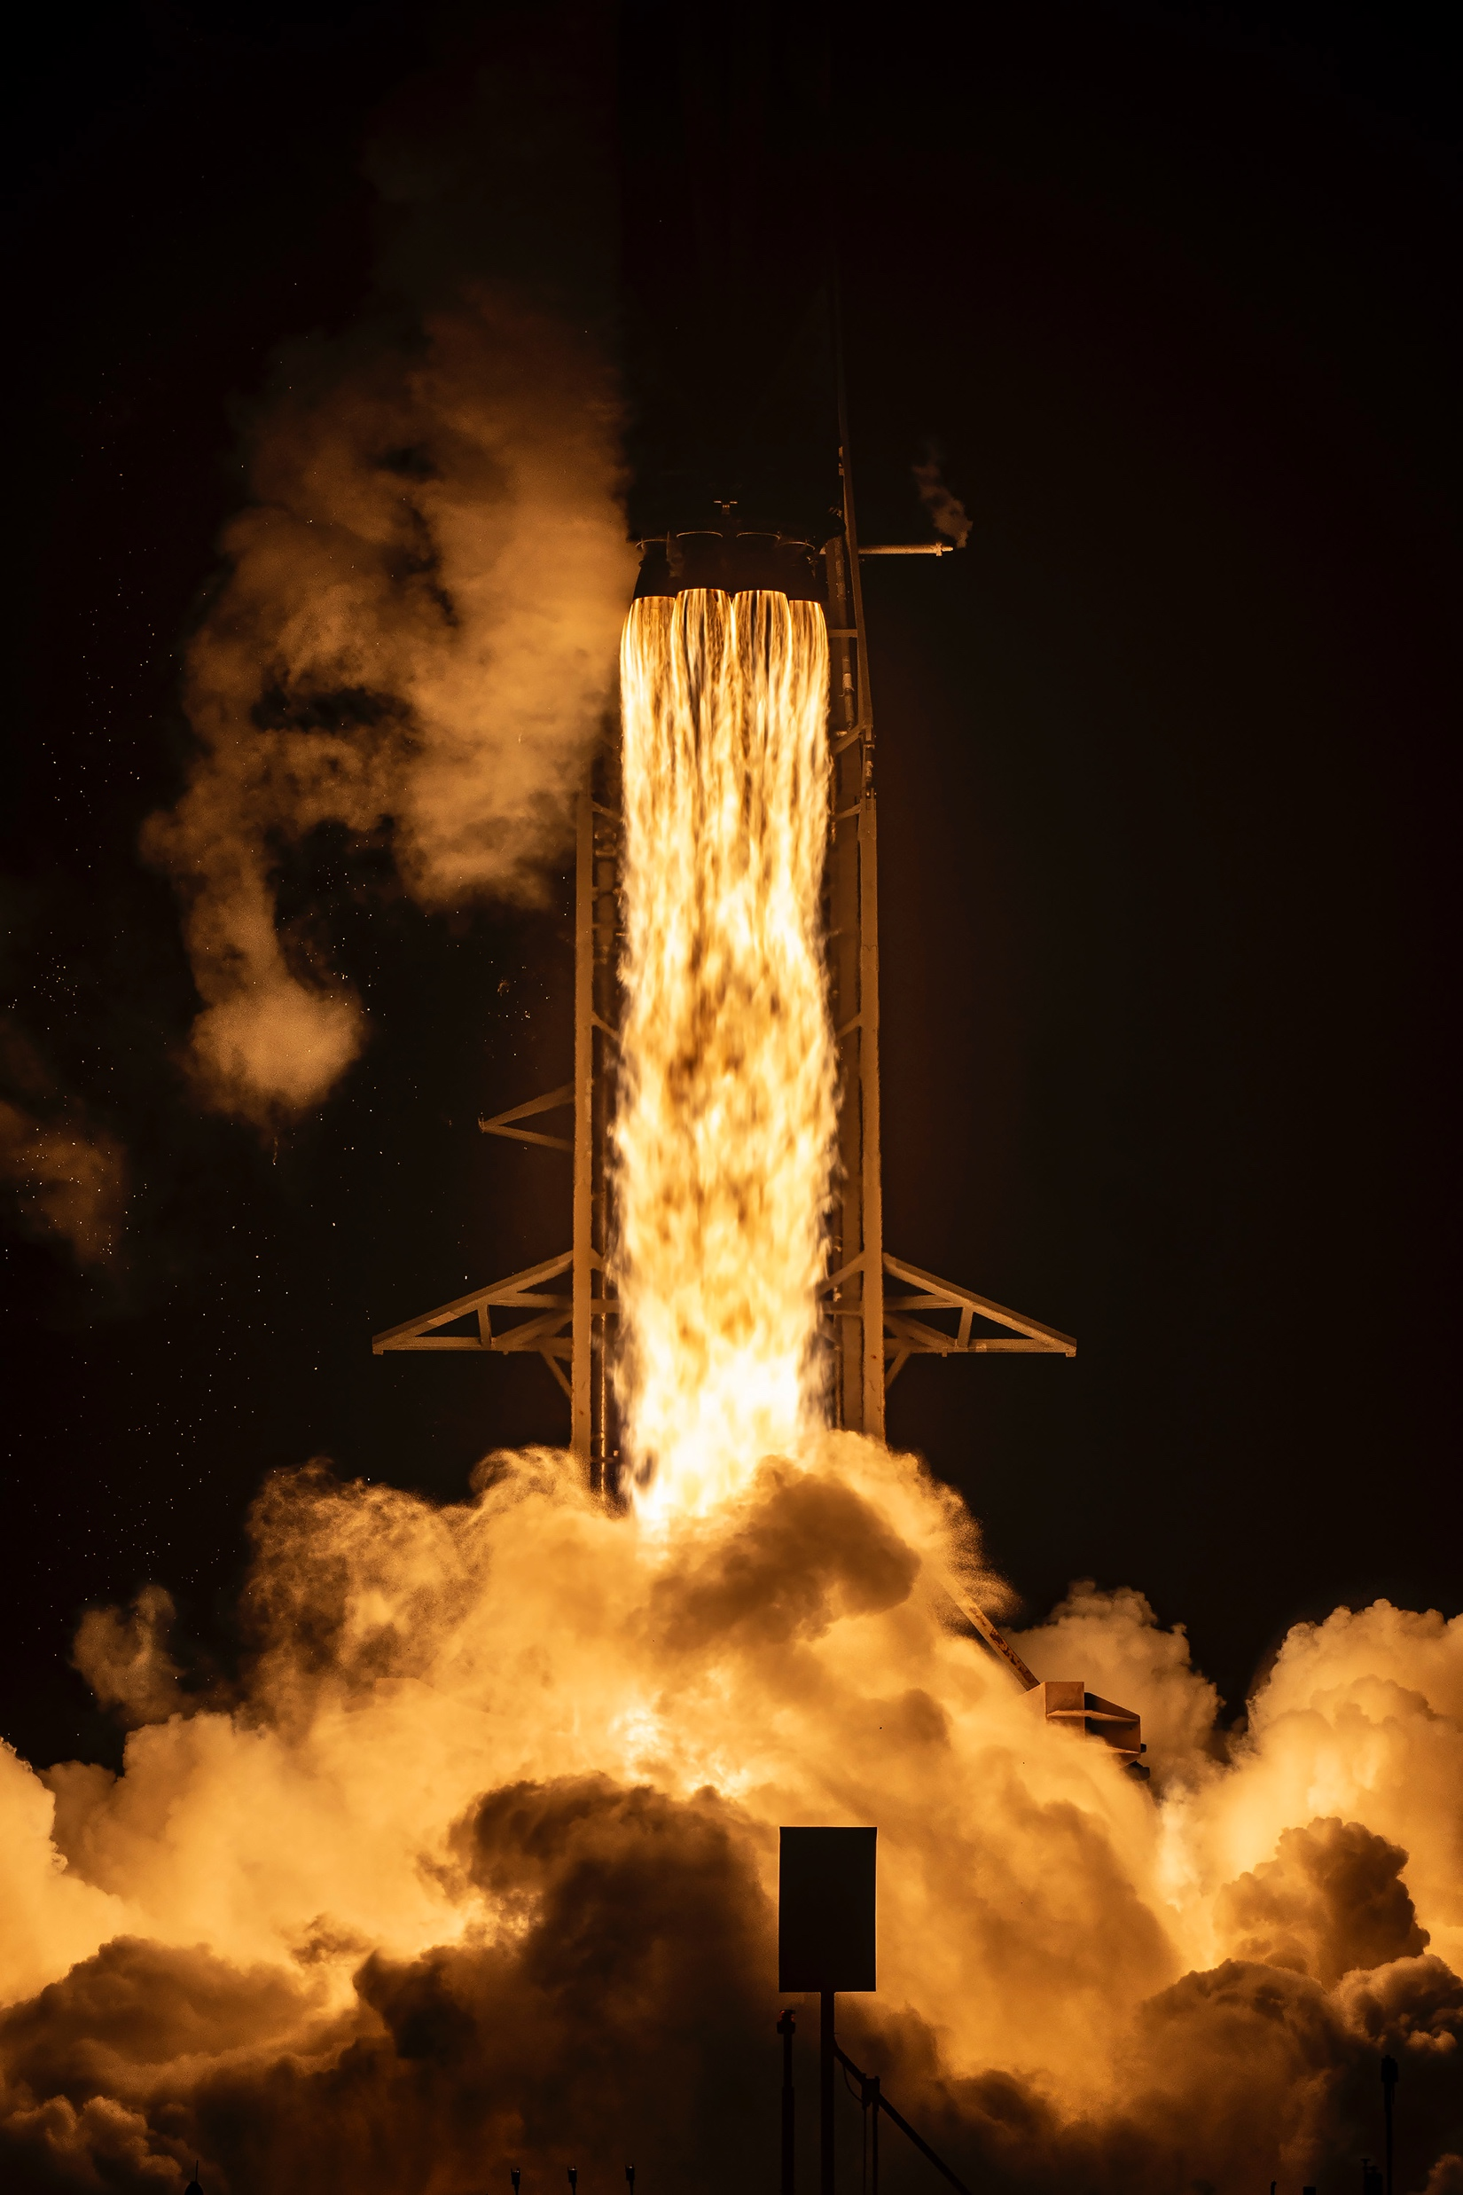
Feb 8 this year

Slide 3
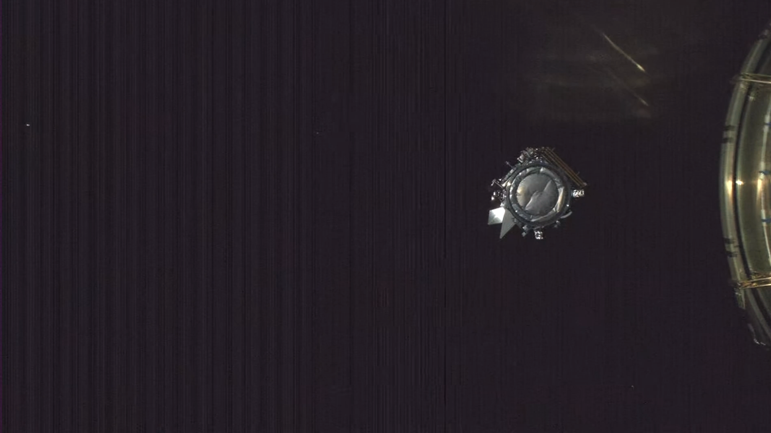
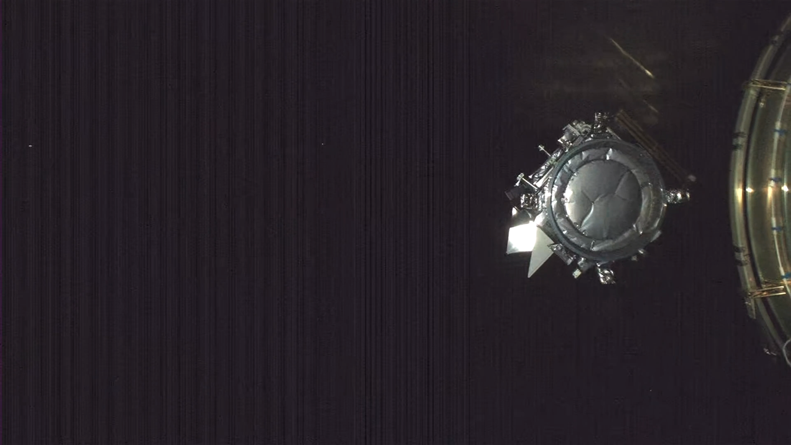
Feb 8 this year

Slide 4


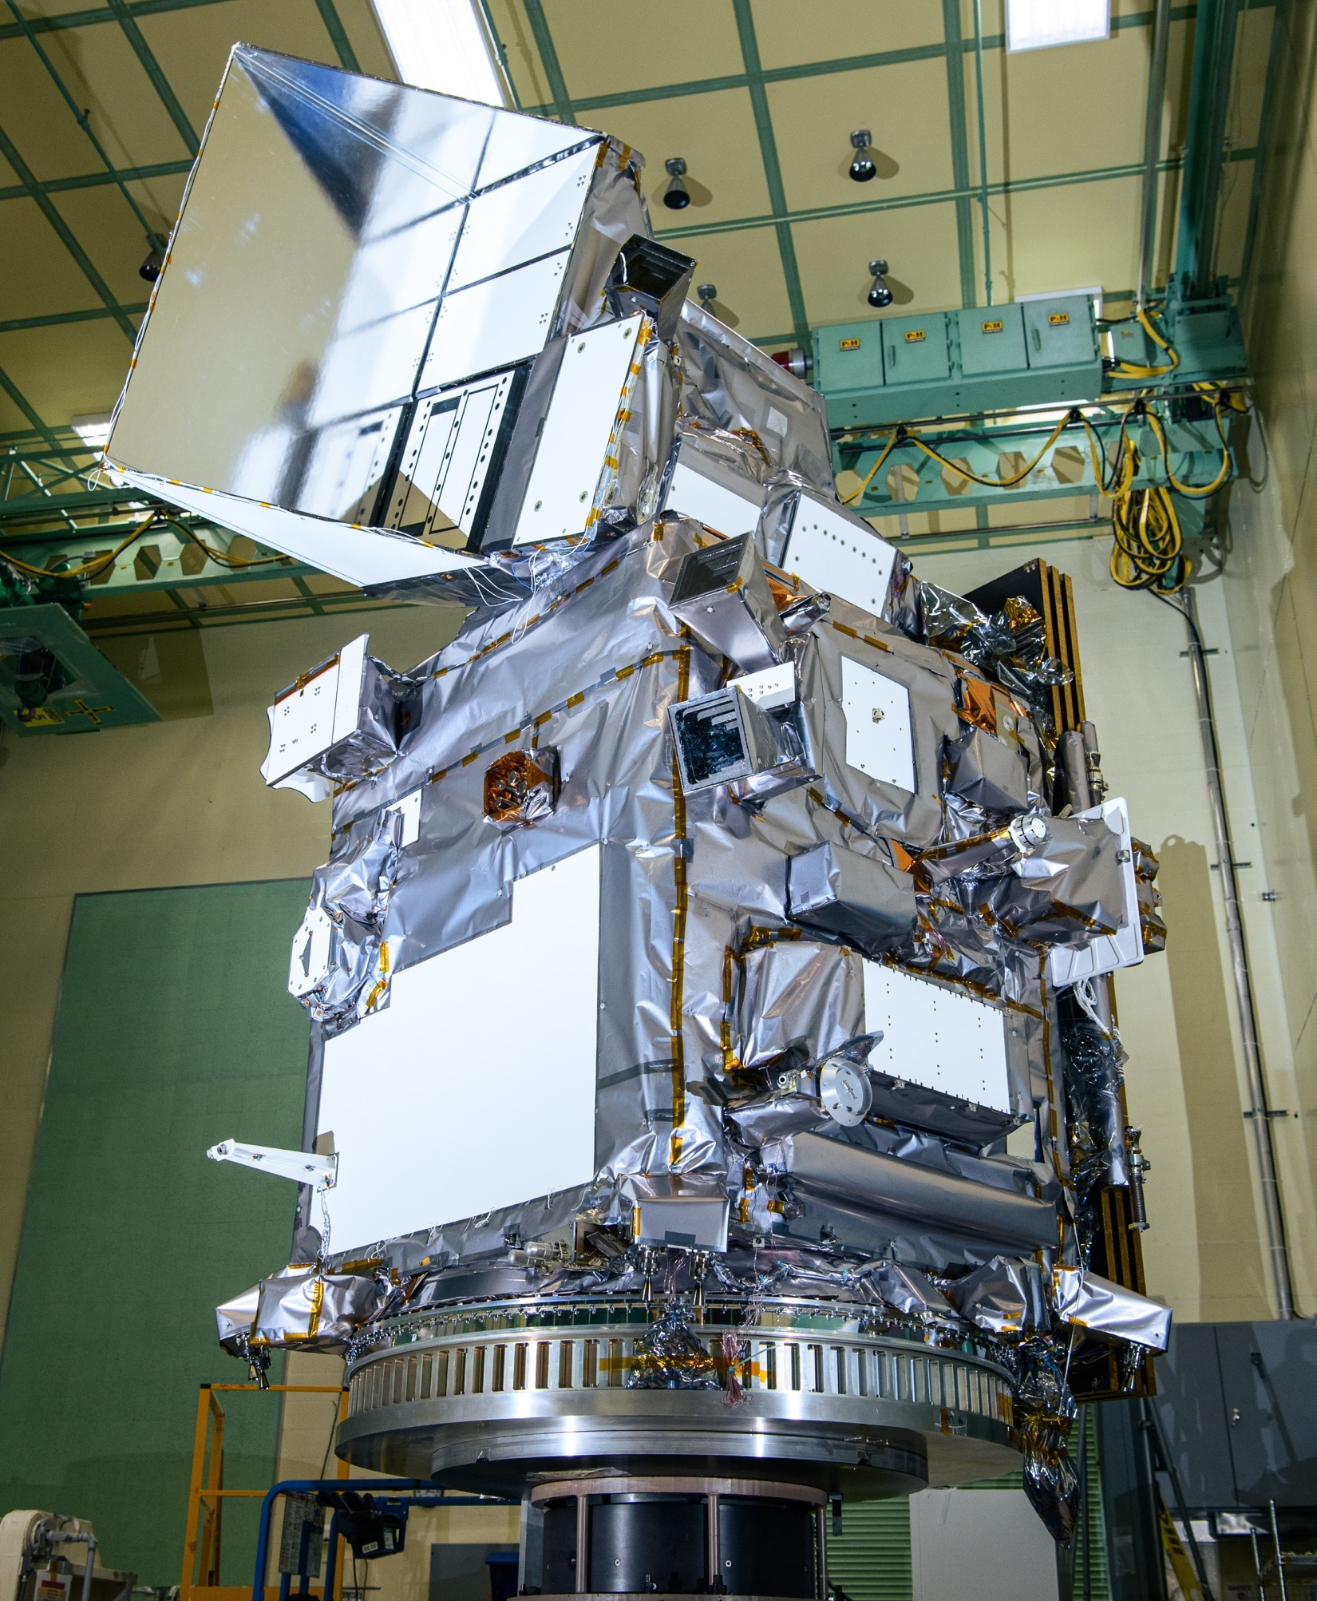


OCI
340-890 nm in 2.5 nm steps
7 discrete SWIR, 940-2260 nm
1-2 day coverage ±20° tilt, 1.2km
Feb 8 this year
HARP2 (UMBC)
440, 550, 670, 870 nm
10-60 viewing angles
wide swath polarimeter, 5.2 km
SPEXone (SRON)
380-770 nm in 2-4 nm steps
5 viewing angles
narrow swath polarimeter, 5.2 km
Notes:
SRON Netherlands Institute for Space Research

Slide 5
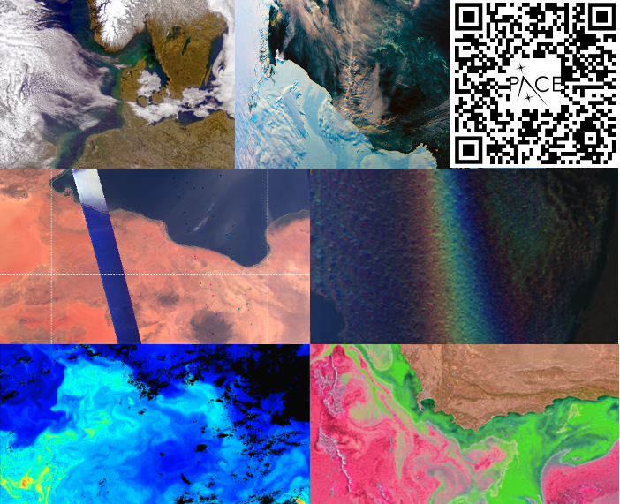
Initial data released on 11 Apr 2024
V1 initial release
Level-1 (radiometry) from all 3 instruments
Heritage suite of Ocean Color products from OCI
V2 reprocessing
Use on-orbit calibration information
Provide science mode data collected during commissioning
Additional science products from OCI (Land and Clouds)​
V3 reprocessing planned
Further calibration updates
More data products to be released pending review by Project and PIs​

Slide 6
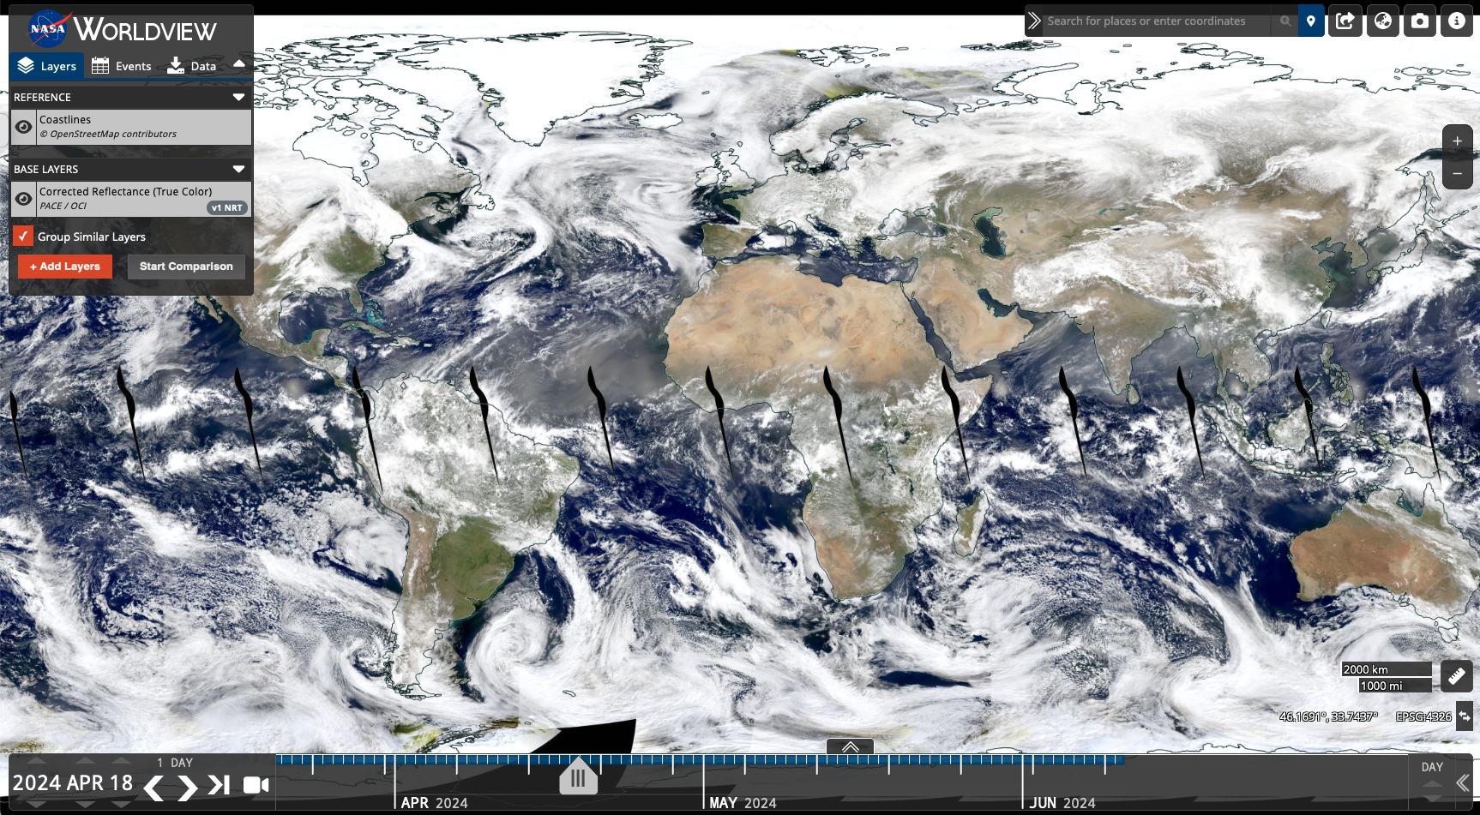
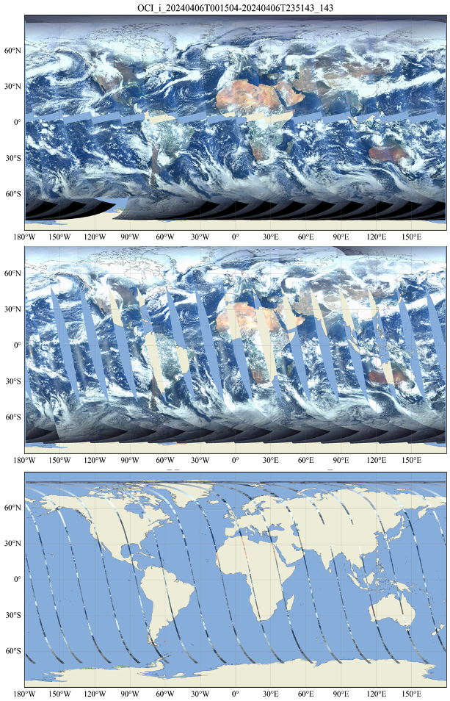
PACE data on NASA Worldview
OCI : L1C
HARP2
SPEXONE
Notes:
(https://worldview.earthdata.nasa.gov/)
L1C data in common grids

Slide 7
Where do aerosols fit into PACE?
PACE Ocean Colour Instrument
PACE polarimeters
Ocean color atmospheric correction
Ibrahim et al. multi-band atmospheric correction (MBAC)
Gordon et al. NIR atmospheric correction
Dedicated aerosol retrieval algorithms
Remer et al. Unified Aerosol Algorithm (UAA)
Lyapustin et al. Multiangle Implementation of Atmospheric Correction (MAIAC)
Simultaneous aerosol and surface retrieval algorithms
RemoTAP
FastMAPOL
MAPP
GRASP
NIR AOD, fine/coarse split, Ångström exponent
Remote sensing reflectance
Water only
Spectral AOD, fine/coarse split, Ångström exponent, absorption and height
Land and water
Detailed aerosol microphysical characterization
Surface BRDF/BPDF
Coming soon
Notes:
Aerosol algorithms are under implementation and evaluation

Slide 8
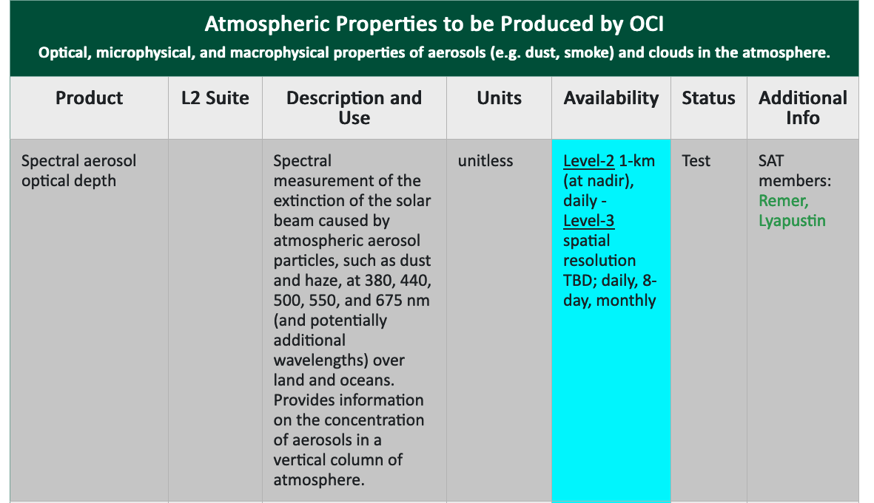
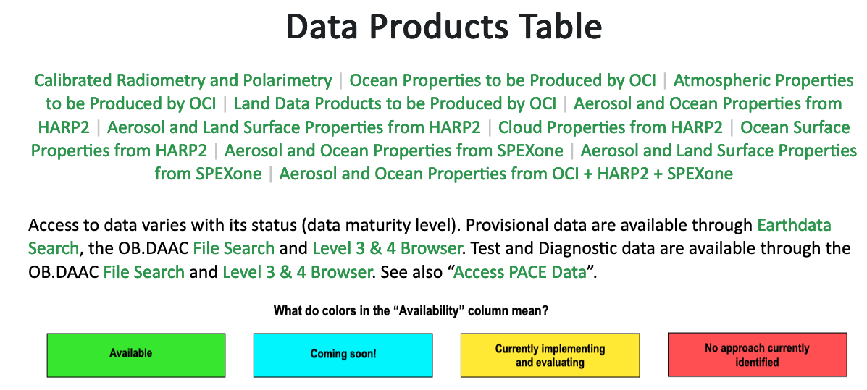
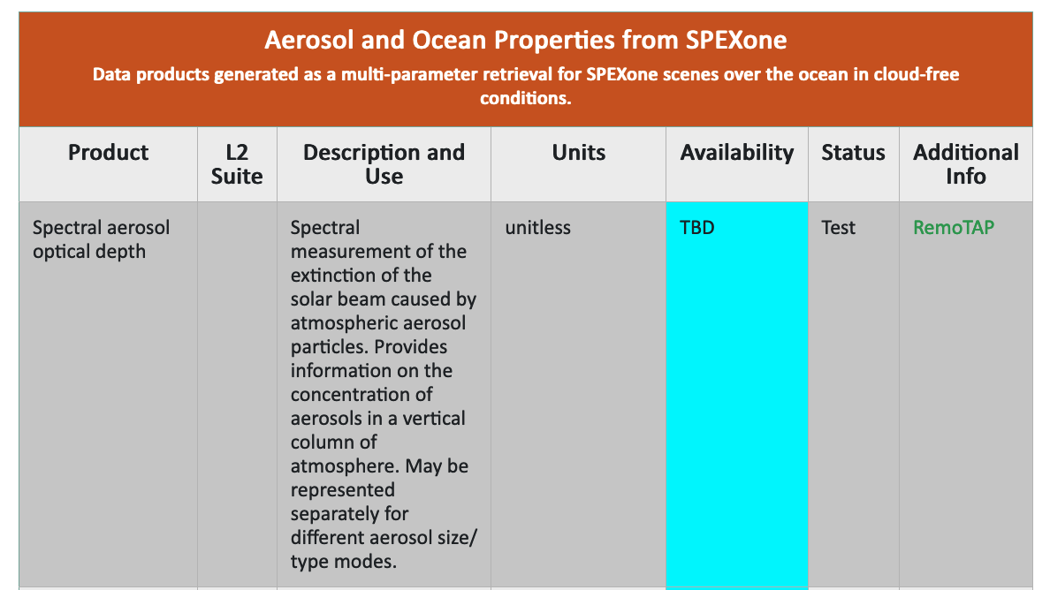
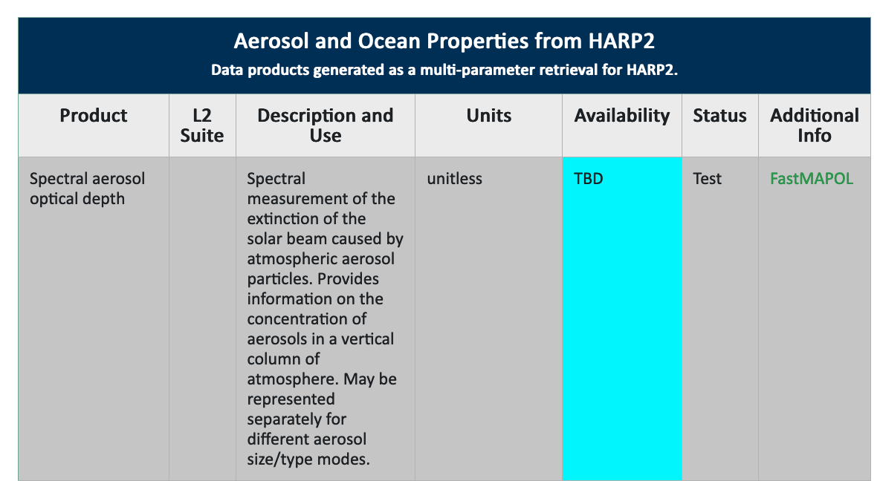
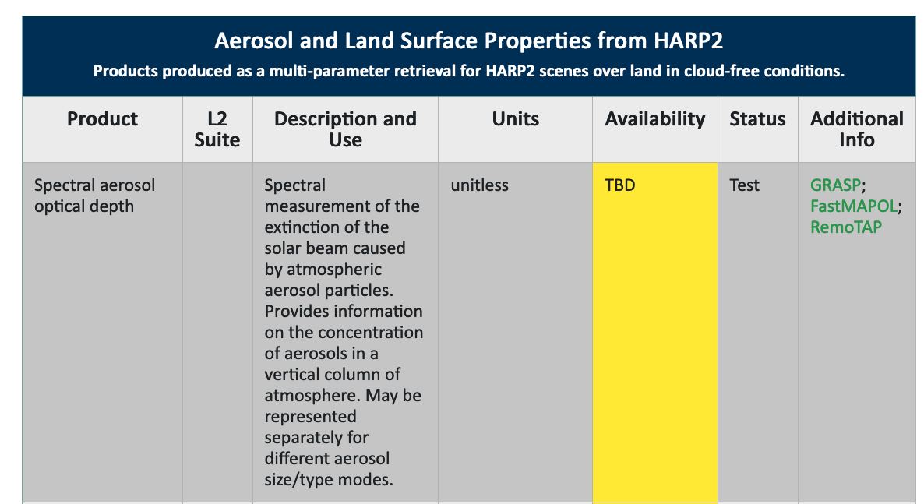
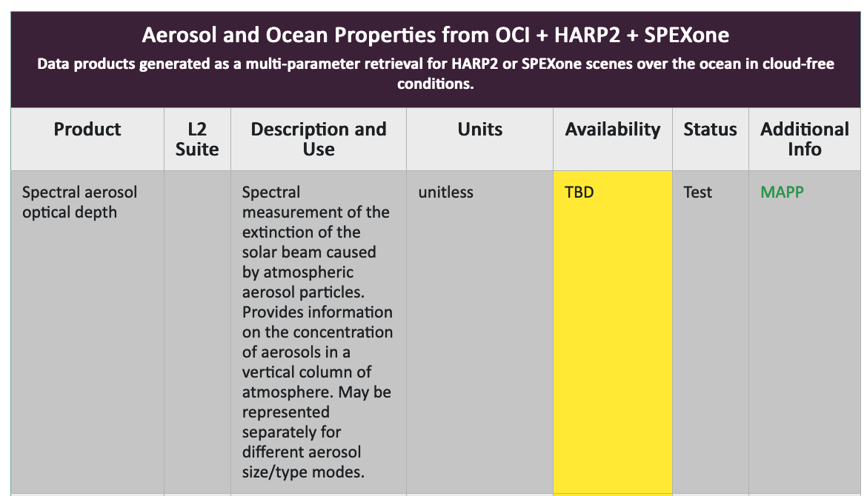
PACE data products table and status
https://pace.oceansciences.org/data_table.htm

Slide 9
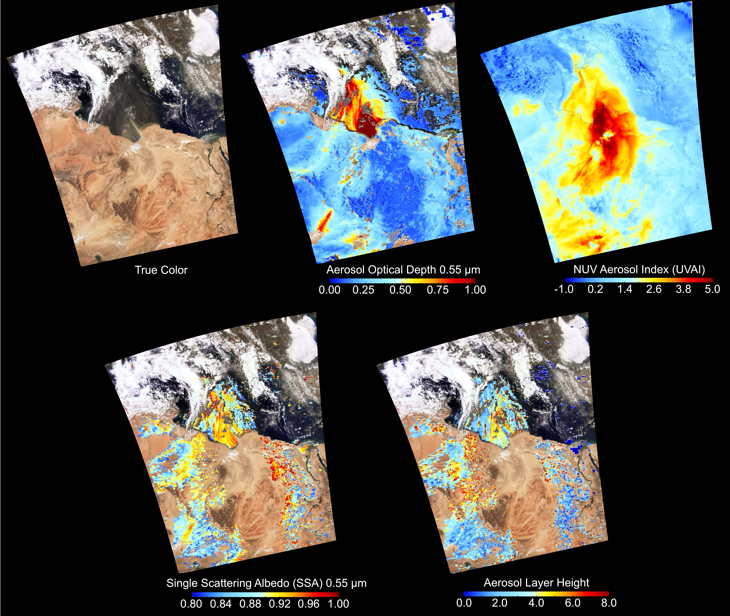
Atmospheric Properties from OCI: UAA
‘First light’ results from “Unified Aerosol Algorithm”
Combination of Deep Blue, Dark Target, and UV
Provides quantification of aerosol optical depth, absorption and altitude
Currently in implementation & testing (along with MAIAC and others)
UAA team: Lorraine Remer, Omar Torres, Robert Levy, Christina Hsu, Shana Mattoo, Hiren Jethva, Vinay Kayetha, Yingxi Rona Shi, Woogyung Vincent Kim, etc

Slide 10
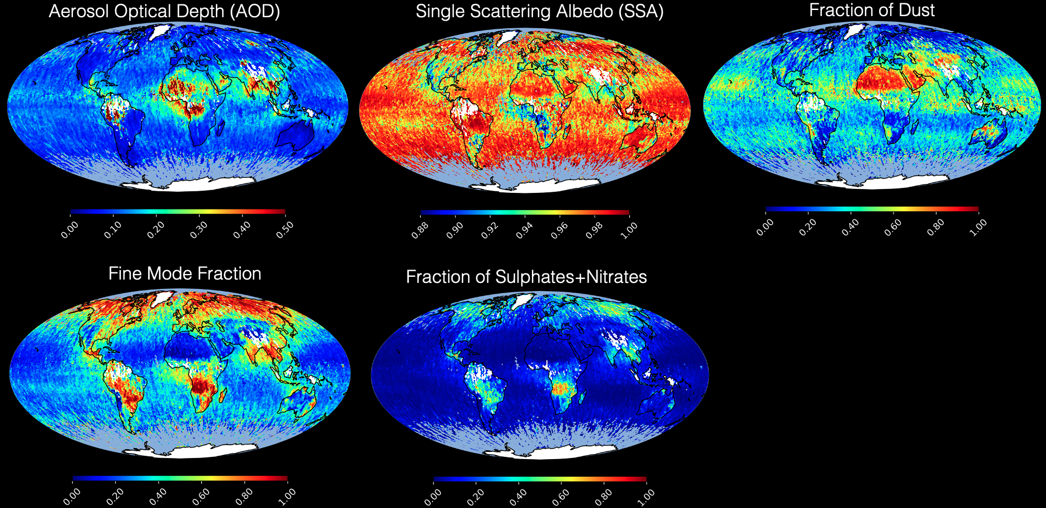
Aerosol properties from SPEXone: RemoTAP
Large AOD over India, SE Asia, Sahara, Equitorial Africa
Anthropohenic pollution and smoke: large fine mode fraction and fraction of Sulphates and/or Nitrates.
Absorbing aerosol (low SSA) for smoke, especially near the source
Dust over desert area and outflow over ocean
Prepared by Otto Hasekamp et al with SRON team

Slide 11
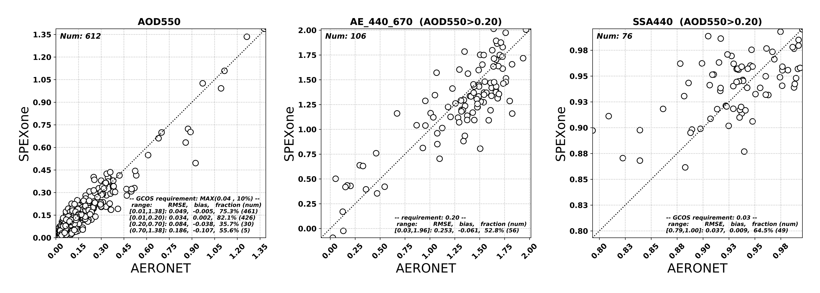

Aerosol properties from SPEXone: validation
Aerosol Optical Depth (550nm)
Angstrom Exponent
Single Scattering Albedo
Good agreement AOD (RMSE 0.049, 75% within GCOS), AE (RMSE 0.255), SSA (RMSE 0.037, 64.5% within GCOS)
Very similar performance over both land and ocean
Further improvements in both level-1 and level-2 data under investigation.
Prepared by Otto Hasekamp et al with SRON team

Slide 12
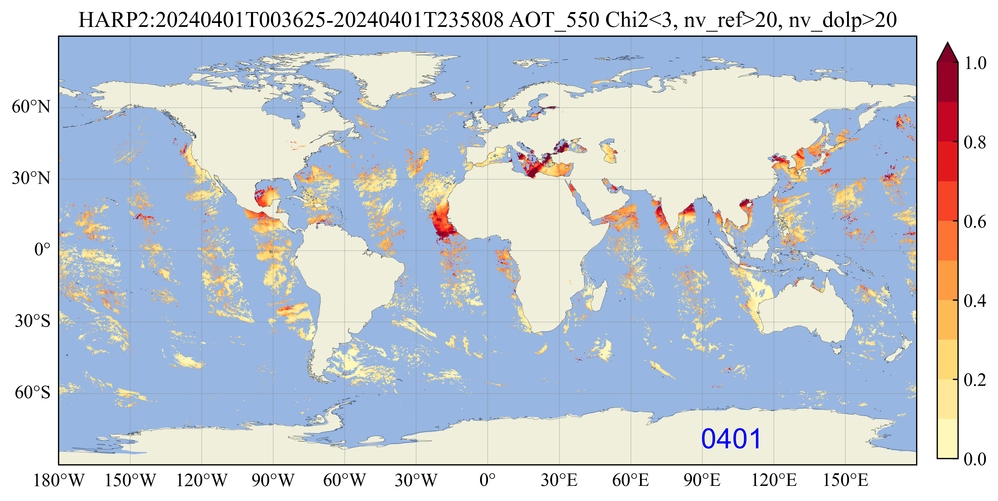
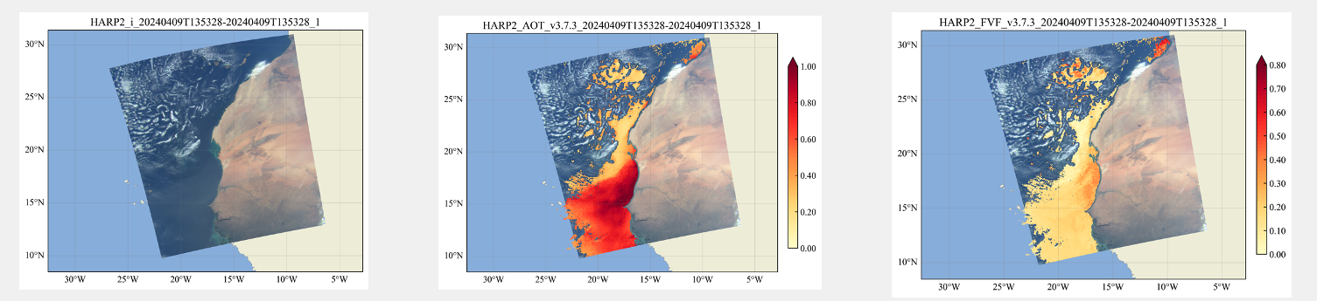

Aerosol properties from HARP2: FastMAPOL
HARP2 aerosol products provide wide spatial coverage.
Fast retrievals using accurate neural network forward models (FastMAPOL, Gao et al, 2021-2023 AMT)
Aerosol and ocean properties are retrieved simultaneously
Further L1/L2 improvements under studies
Lead: Meng Gao @ PACE SDS
HARP2 RGB (near nadir)
Aerosol optical depth (550nm)
Aerosol fine mode fraction
Notes:
April 9
13:53

Slide 13
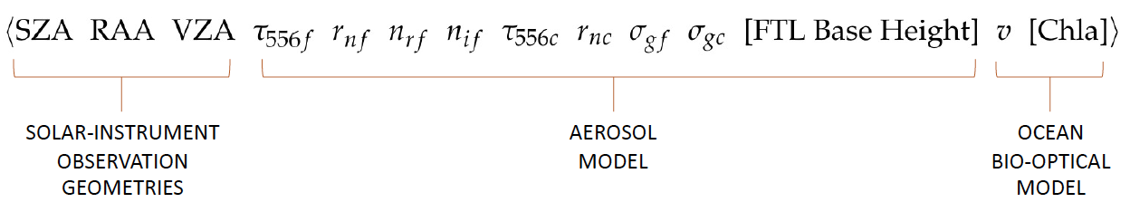
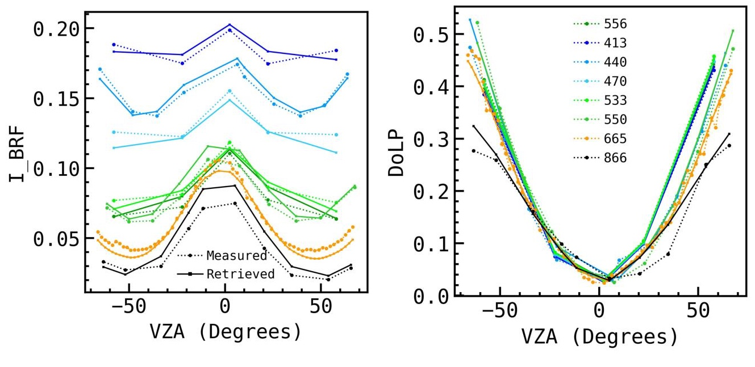
Aerosol from OCI + HARP2 + SPEXone : MAPP
Microphysical Aerosol Properties from Polarimetry (MAPP), the operational aerosol retrieval algorithm for the NASA Research Scanning Polarimeter (RSP), has been adapted for PACE
The PACE-MAPP retrieval algorithm uses optimal estimation, a coupled atmosphere-ocean vector radiative transfer model, neural networks, and inherent optical property lookup tables for the Earth’s aerosol, cloud, and uncoated/coated hydrosol particles
Lead: Snorre Stamnes @ NASA LaRC
Equatorial Atlantic Ocean: 20240410T160650.L1C.V2.5km.nc
S. Stamnes, et al., “The PACE-MAPP algorithm: Simultaneous aerosol and ocean polarimeter products using coupled atmosphere-ocean vector radiative transfer.” Frontiers in Remote Sensing. (2023)
Notes:
Adaptable, 100% Python framework supports different retrieval parameters, processing pipelines, and neural network forward models via a simple config file
Tested using airborne RSP polarimeter data and synthetic PACE data
Support for PACE Level-1C (L1C) data
Combined SPEXone + HARP2 retrieval speed using 11 channels and all available viewing zenith angles: ~5 sec/core
Only planned operational algorithm for both polarimeters and OCI on PACE

Slide 14
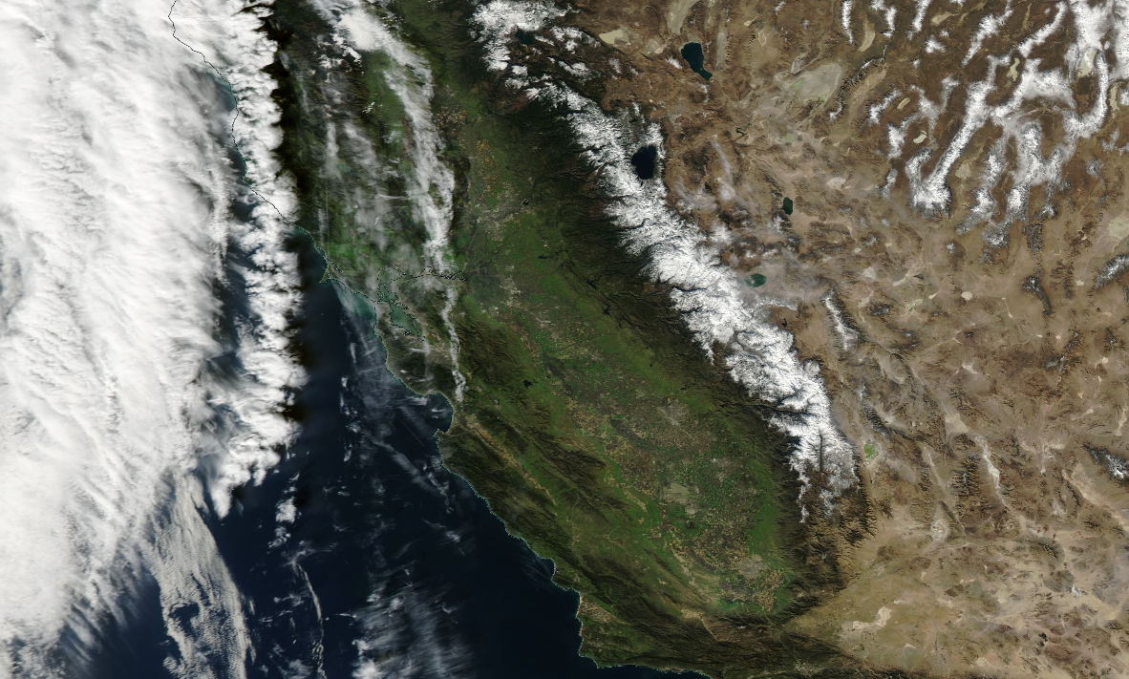
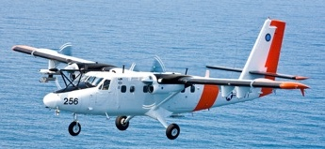

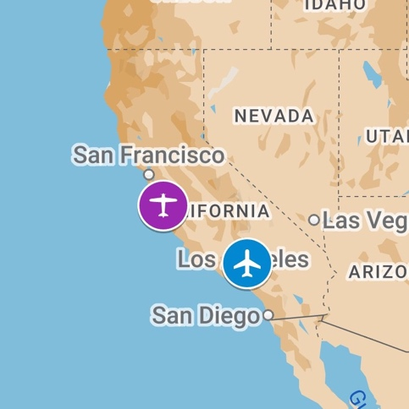
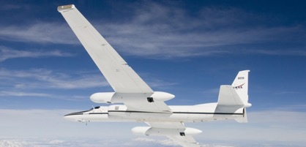










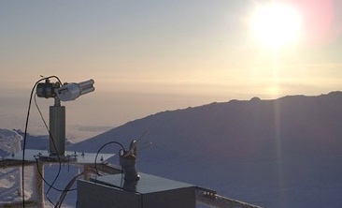
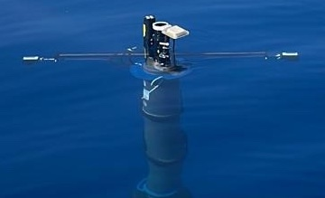
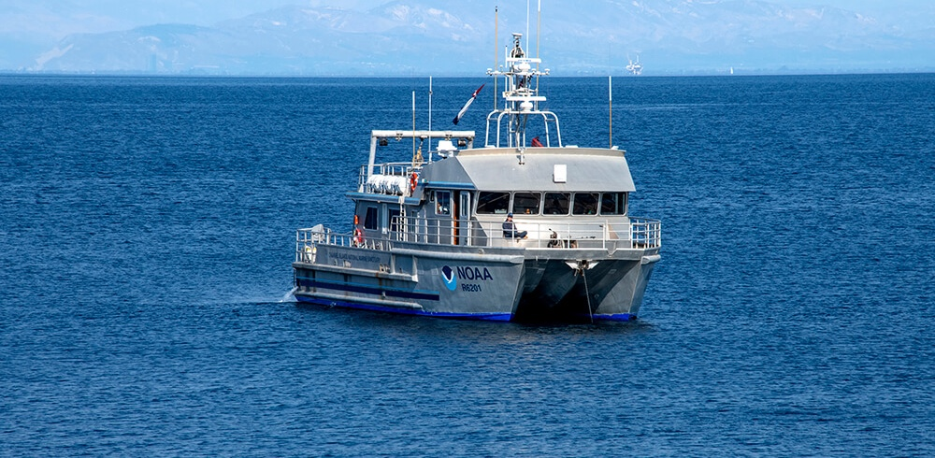
In situ sampling with CIRPAS Twin Otter (60 hours, based in Marina, CA)
PACE Postlaunch Airborne eXperiment (PACE-PAX)
September, 2024
Objective: validate new ocean, atmosphere and land surface products from NASA’s PACE observatory
Lead: Kirk Knobelspiesse, Ivona Cetinić, Brian Cairns
More details at pace.oceansciences.org/campaigns.htm
Remote sensing proxy observations from NASA AFRC ER-2 (60+24* hours)
*supports EarthCARE validation
CIRPAS Twin Otter
NOAA R/V Shearwater
NASA ER-2
Langley
Research
Center
Collaboration with non PACE-PAX funded efforts (e.g. AERONET, PVST)
Coordinated observations
over surface sites & ocean platforms
Day trips from Santa Barbara, NOAA R/V Shearwater

Slide 15
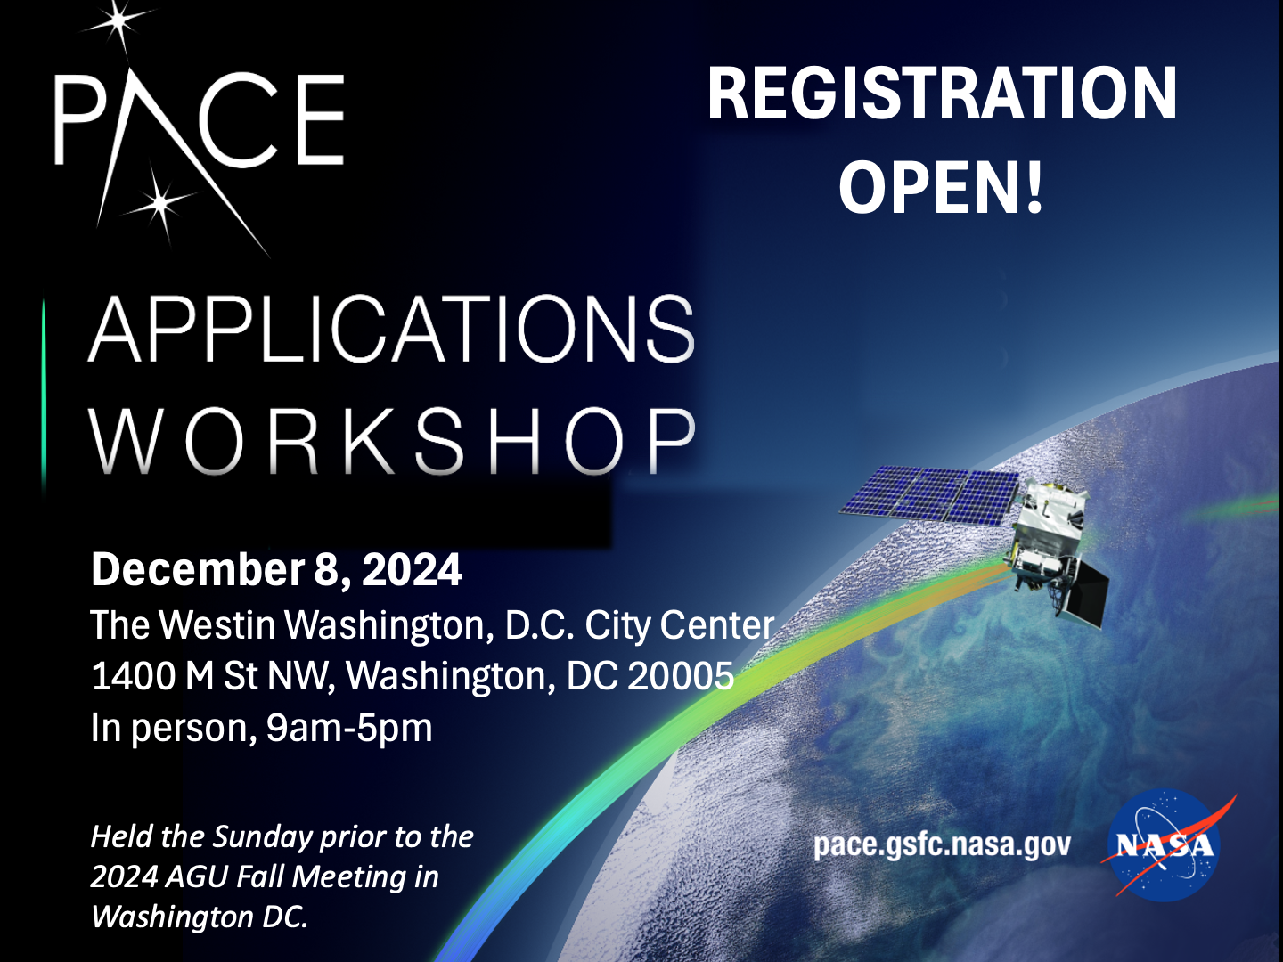
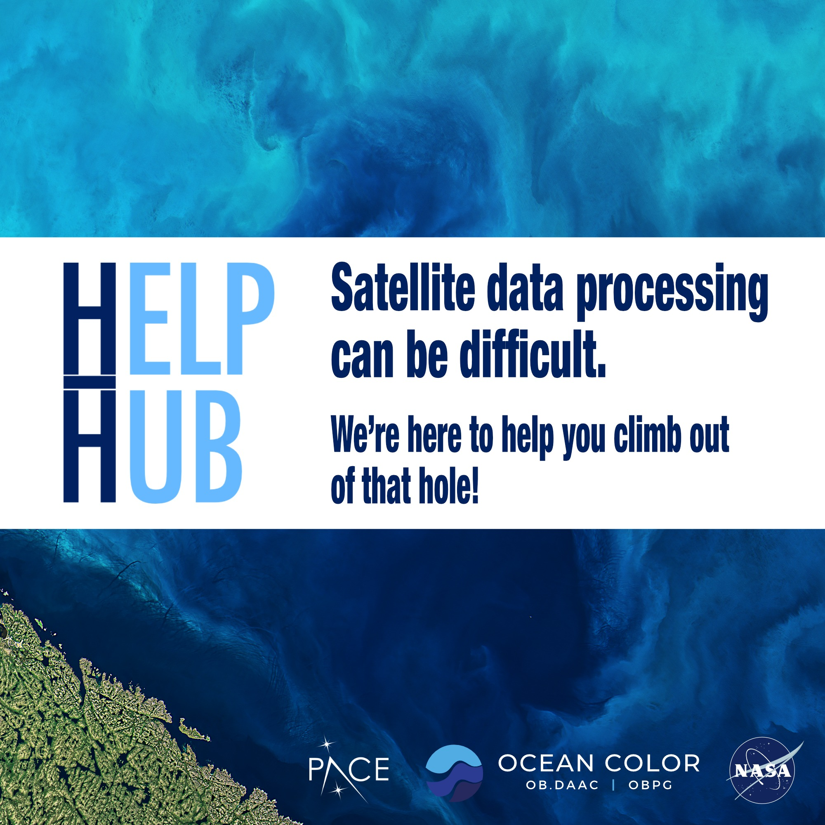


Get involved!
Lead: Morgaine McKibben (morgaine.mckibben@nasa.gov)
Lead: Carina Poulin (carina.poulin@nasa.gov)
Notes:
Putting PACE data to work across the Earth System: aquatic, terrestrial, atmospheric
https://oceancolor.gsfc.nasa.gov/resources/docs/tutorials/
https://pace.gsfc.nasa.gov/
5th Annual PACE Applications workshop, but first in person workshop, and first since PACE’s successful launch
Cross-disciplinary content: attendees interested in aquatic, terrestrial, and atmospheric science & applications of PACE data welcome
Goal: foster and advance putting PACE data to work for societal benefit by informing and engaging with the PACE community
Free to attend, but seats limited. Register to join us *IN PERSON* today!
Visit QR code for workshop details & registration

