Slide 1
GEMS Aerosol Update
Yeseul CHO – NOAA/UMD
Jhoon KIM - Yonsei Univ.
Yujin CHAI - Yonsei Univ.
Sujung GO – NASA GSFC
Mijin KIM – NASA GSFC
Seoyoung LEE – NASA GSFC
Minseok KIM- Yonsei Univ.
Won-Jin LEE - NIER
Dongwon LEE - NIER
Notes:
Good morning, everyone. My name is Yeseul Cho. Thanks for giving me the opportunity to present today. I would like to present about the GEMS aerosol algorithm on behalf of Professor Jhoon Kim in Yonsei University. Let me start to presentation.

Slide 2
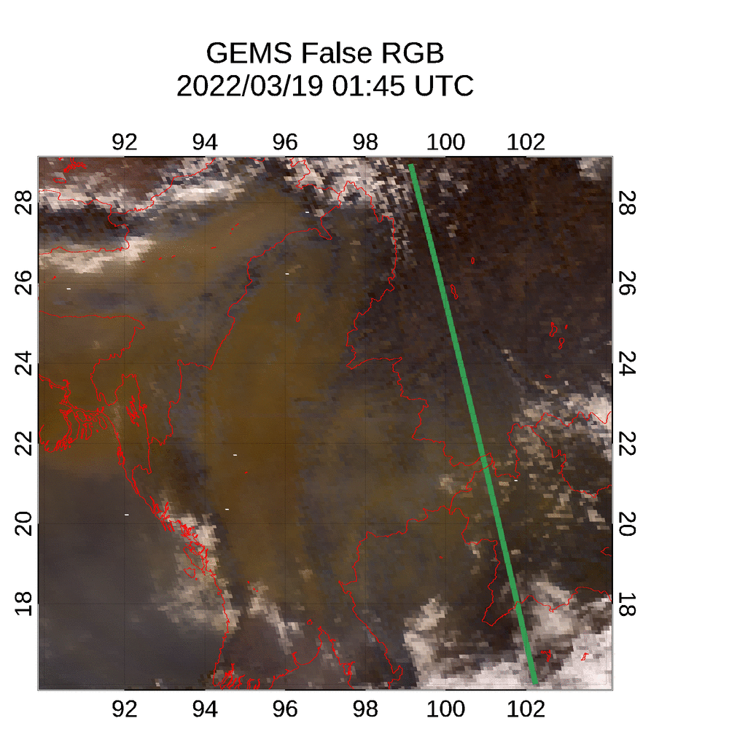
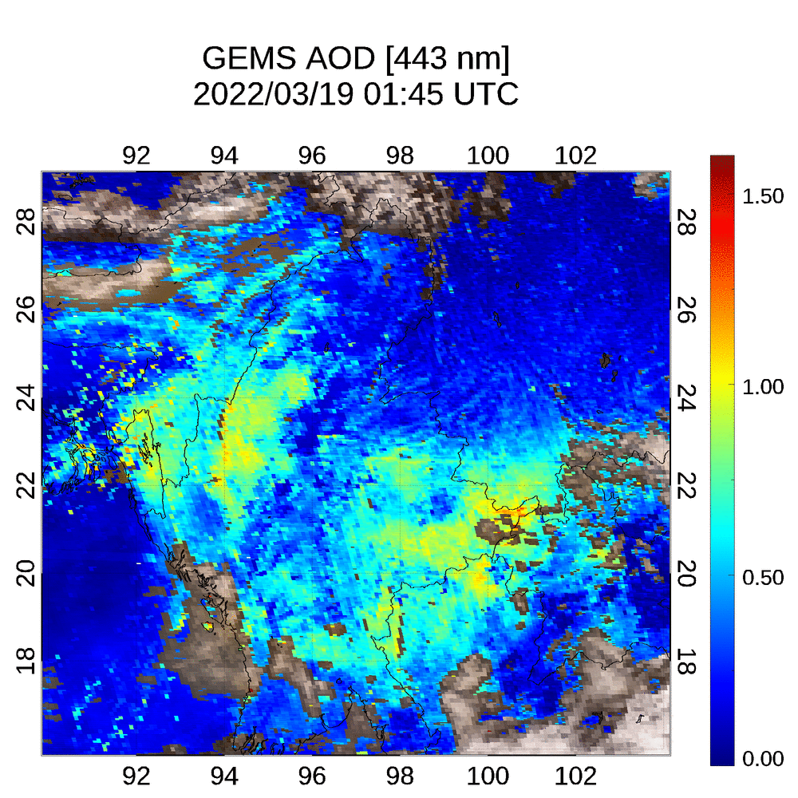
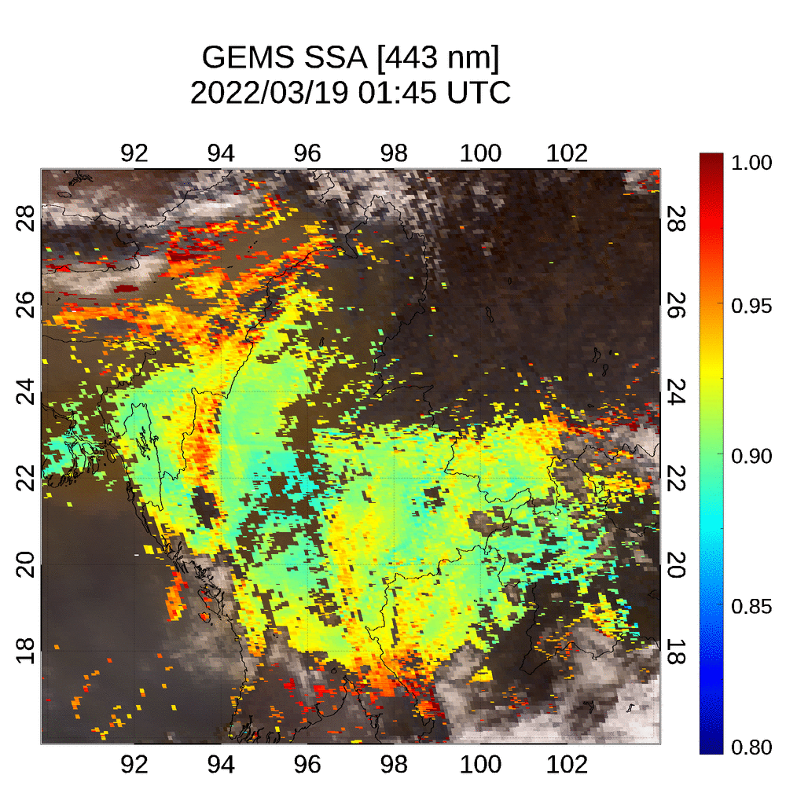
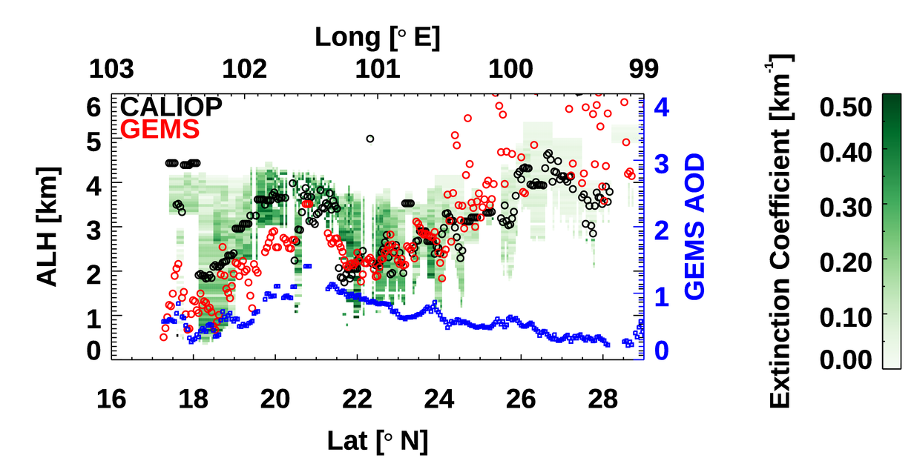
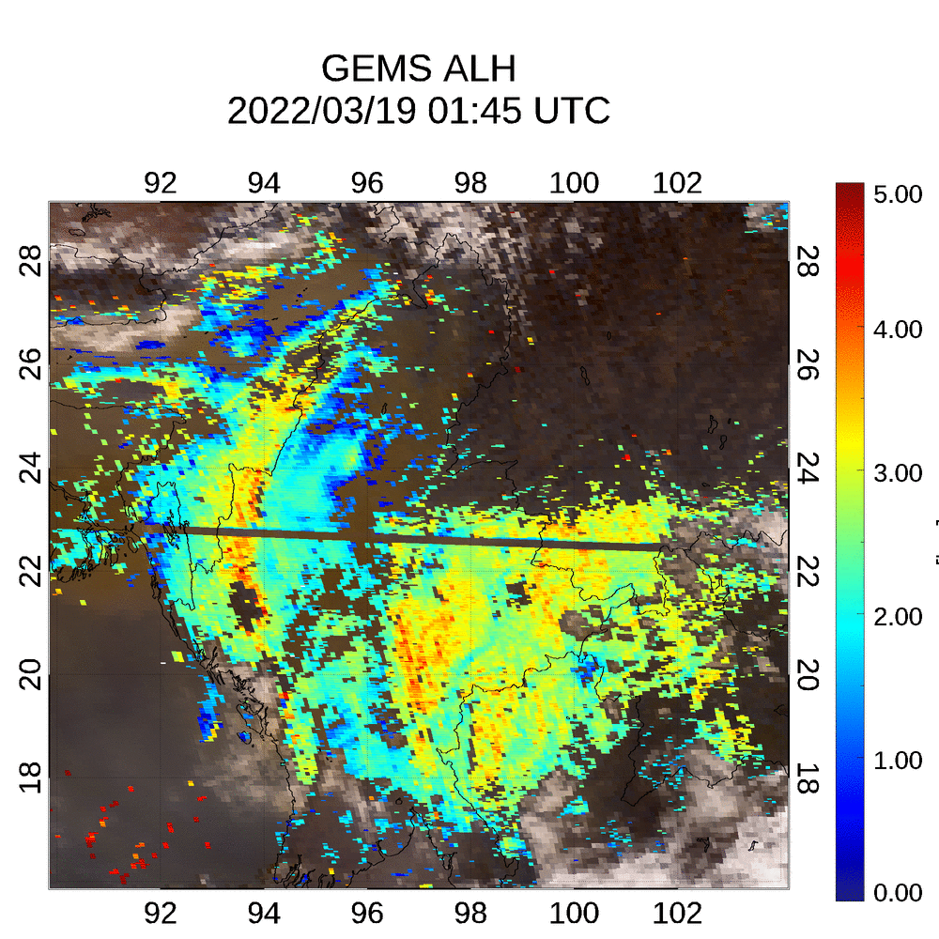
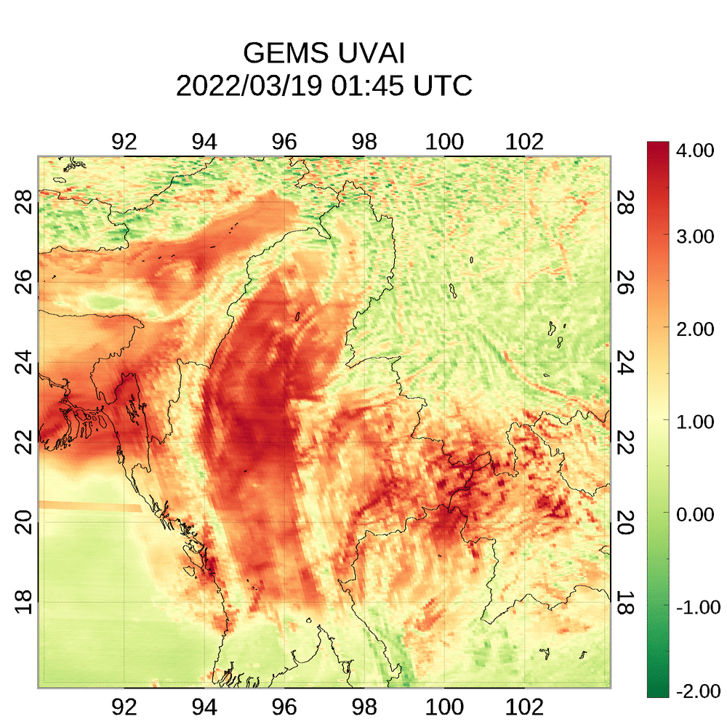
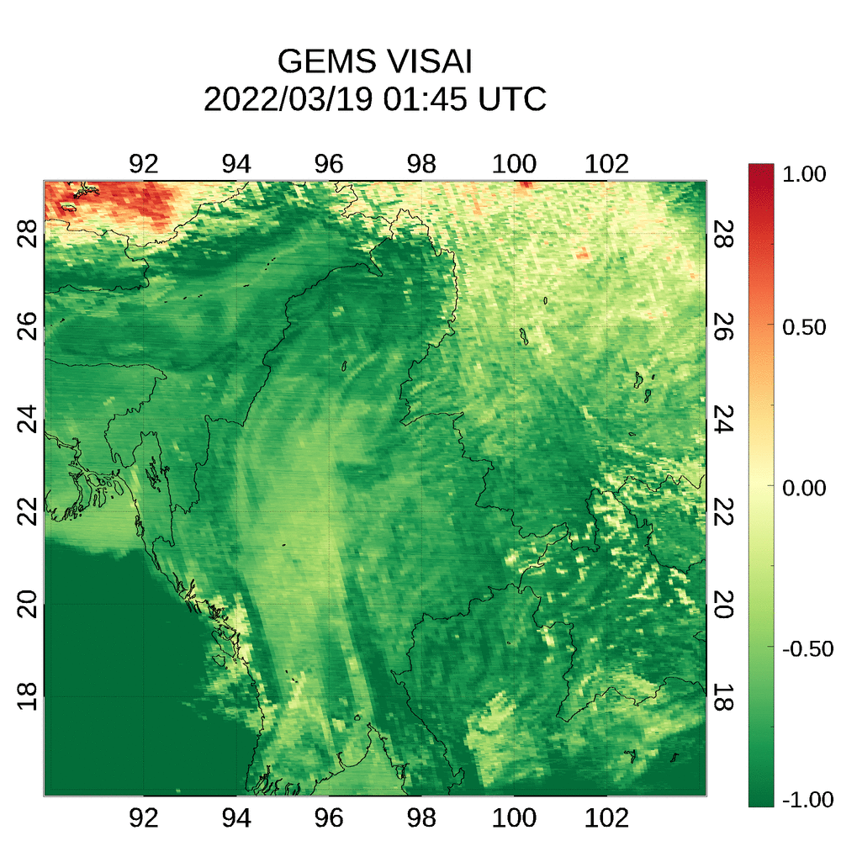
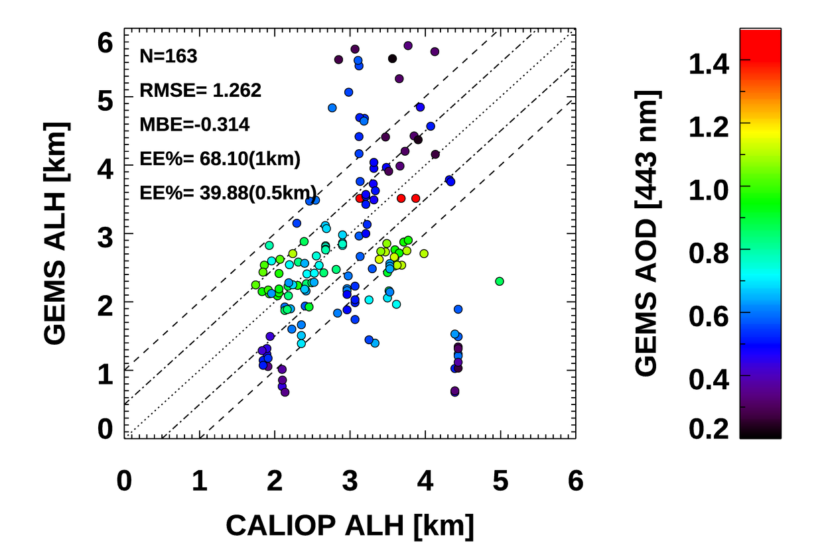
3D-view of aerosol optical properties
CALIOP
Example of highly absorbing fine pollution particles in mainland Southeast Asia
Highly Absorbing Fine (HAF) is selected as GEMS aerosol type in mainland Southeast Asia during the dry season.
Notes:
This slide shows the retrieved results of aerosol optical properties over Southeast Asia from GEMS.
There are GEMS False RGB, AOD, SSA, ALH, UV and VISAI.
highly absorbing fine is selected as GEMS aerosol type over this area during the dry season.
GEMS AOD work well with a thick smoke plume over Myanmar. We can find the smoke plume in GEMS False RGB and GEMS AOD is up to 1.5.
GEMS SSA shows reasonable values for HAF.
Retrieval of ALH can be enabled by GEMS for diurnal variation.
Interestingly, over time, hotspots start to appear in UVAI. Fine-scale features of high UVAI may be due to heavy air pollution caused by biomass burning.

Slide 3
Major Updates in GEMS AERAOD v2.1 (Operational)
Surface
reflectance
Calculation of the surface reflectance considering the background AOD
Aerosol Layer Height (ALH)
The first guess of ALH in OE is based on CALIOP ALH climatology. (v2.0: 2 km)
Retrieval of
high AOD
The node of LUT's AOD have been added at 5.0 and 10.0. (Before maximum node was 3.6)
Change in High AOD Callback Criterion to UVAI > 3 (v2.0: UVAI > 6 )
Inclusion of surface reflectance at 354, 388, 412, 443, 477, 490 nm in the output variables.
Metadata
Updating Metadata (Algorithm Quality Flag)
Notes:
The operational GEMS aerosol algorithm is currently at version 2.0.
However, the reprocessing of version 2.1 is almost finished, so it will be updated soon.
The major updates consist of improvements in surface reflectance, Aerosol Layer Height, retrieval of high AOD, and updating metadata.

Slide 4
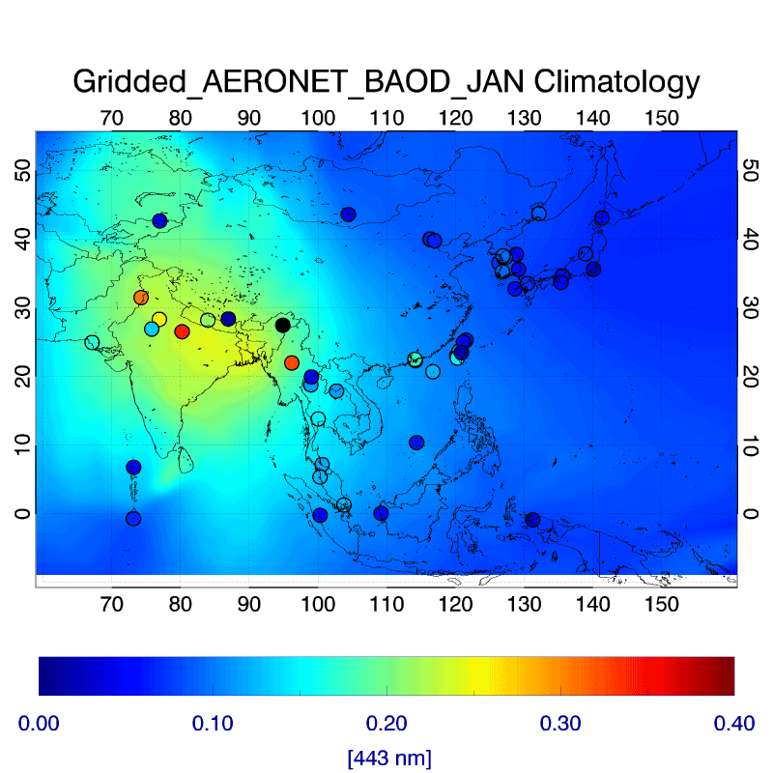
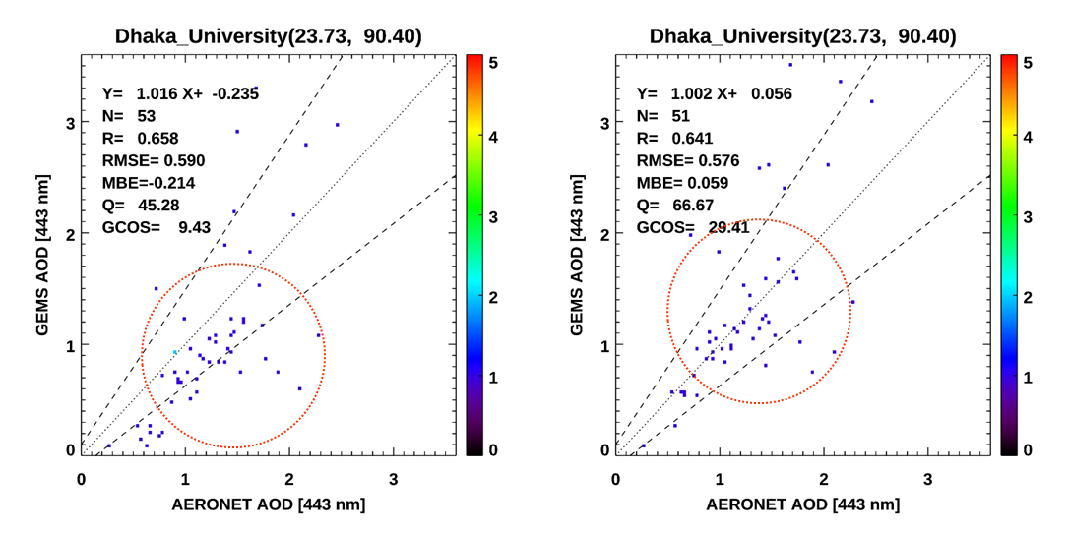
Surface Reflectance
Hourly surface reflectance are calculated using the minimum reflectance method.
The seasonal background AOD (BAOD) are considered in GEMS AERAOD v2.1.
Monthly BAOD at 443 nm from 2-year AERONET AOD and interpolated to 0.1° × 0.1° box.
GEMS AERAOD v2.0
GEMS AERAOD v2.1
negative bias
After update, GEMS AOD has become closer to the 1:1 line when compared with AERONET AOD.
Notes:
First, the seasonal background AOD are considered in GEMS AERAOD v2.1..
Unlike other GEMS algorithms, the surface reflectance used for aerosol retrieval is calculated within the aerosol algorithm itself. Then, Hourly surface reflectance are calculated using the minimum reflectance method.
However, Regions like India and Bangladesh, where there are always a lot of aerosols, it could overestimate surface reflectance and cause an underestimation of GEMS AOD.
Therefore, we interpolated the background AOD from AERONET data using the inverse distance weighting method to calculate monthly BAOD. Then, we consider this data during calculation of surface reflectance .
Therefore, In the validation results at the Dhaka site, GEMS AOD show a negative bias compared with AERONET AOD in the previous version.
After update, GEMS AOD has become closer to the 1:1 line when compared with AERONET AOD.

Slide 5
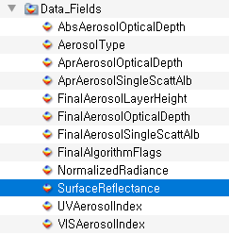
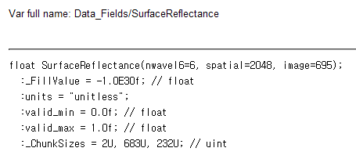
Surface Reflectance
Surface albedo assumptions also cause effects to the retrievals of ALH and AEH. This parameter should be included in the dataset
Inclusion of surface reflectance at 354, 388, 412, 443, 477 and 490 nm in the output variables in GEMS AERAOD v2.1.
Notes:
Until version 2, surface reflectance variable was not provided in netcdf file.
It was impossible to evaluate the retrieval errors of aerosol optical properties according to surface reflectance change.
Then, In version 2.1, the data_fields will contain surface reflectance variable for six wavelengths.

Slide 6
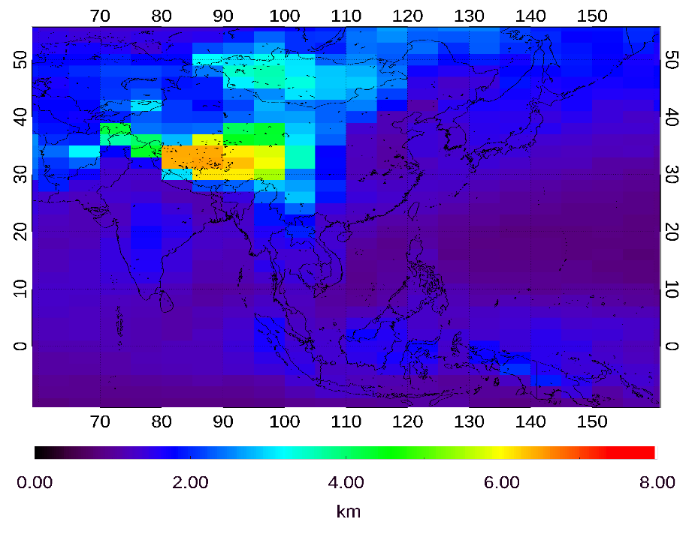
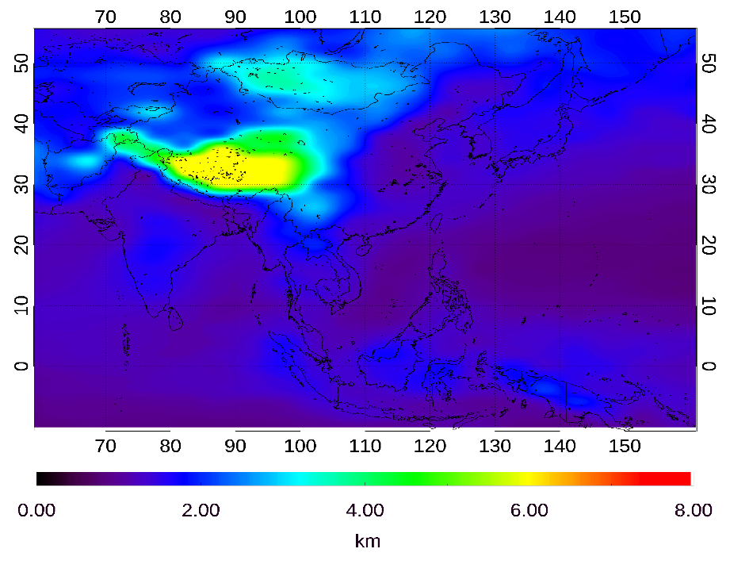
ALH
(v2.0) Optimal estimation (OE) method by finding the optimized values of AOD, SSA, and ALH from normalized radiances at six wavelengths (354, 388, 412, 443, 477, and 490 nm), and a priori states of ALH is assumed to be 2 km in v2.0.
(v2.0) GEMS ALH does not show variability from the initial value of 2 km.
(v2.1) a priori states of ALH based on the climatology of CALIOP ALH.
CAL_LID_L3_Tropospheric_APro_AllSky-Standard-V4
(2006.06 ̶ 2020.07)
a priori states of GEMS ALH
used in GEMS AERAOD v2.1
Cubic convolution interpolation method
(5.0°×2.0°)
(0.1°×0.1°)
Notes:
We retrieve the Aerosol Layer Height using the optimal estimation method.
Optimal estimation (OE) method finds the optimized values of AOD, SSA, and ALH from normalized radiances at six wavelengths
Until version 2, the first guess for ALH was assumed to be 2 km. GEMS ALH does not show variability from the initial value of 2 km.
because the signal of ALH is much weaker compared to signals of AOD and even Single Scattering Albedo (SSA), we need to assume a more realistic first guess value.
For this reason, we calculated the CALIOP ALH climatology to assume a more realistic value than 2 km.
After interpolating to fit the grid size of GEMS, we input this data into the updated algorithm.

Slide 7
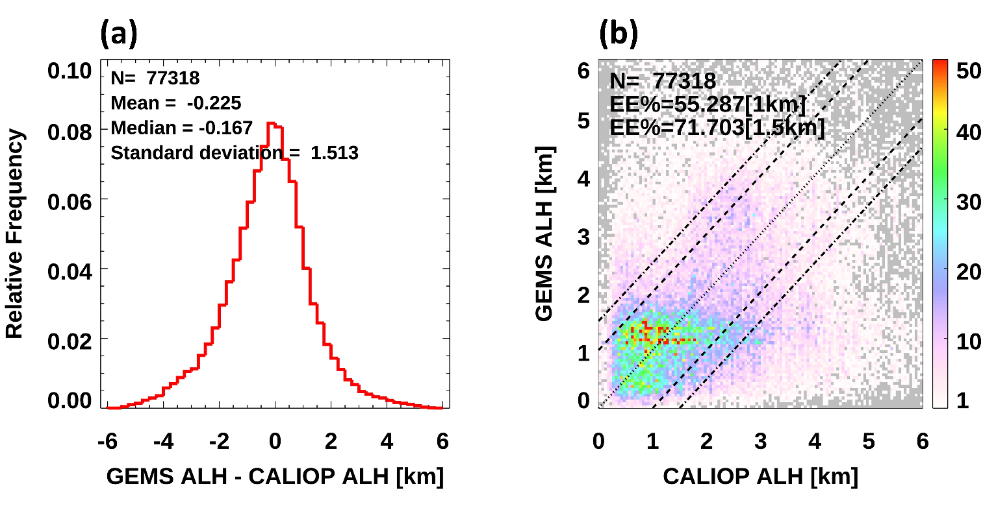
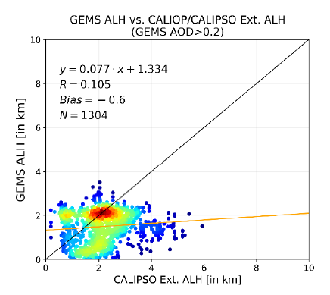
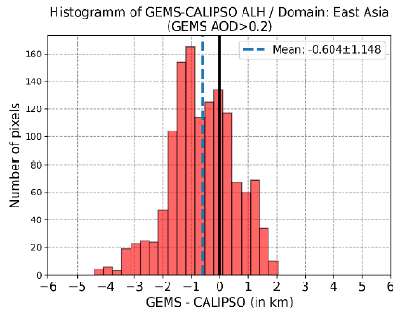
ALH v2.1
a priori states of ALH based on the climatology of CALIOP ALH. (v2.0: 2 km)
Validation results of GEMS ALH v2.0
(PEGASOS-Evaluation Report-Aerosol-v3.0)
(GEMS AOD > 0.2)
(GEMS AOD > 0.2)
Histogram of difference between GEMS ALH v2.1 and CALIOP ALH
Comparison of GEMS ALH v2.1 and CALIOP ALH.
Validation area : GEMS entire area
Validation period : 2021.11.01-2022.10.31
Notes:
This slides shows the updated GEMS ALH validation results.
Before looking the update results, This results shows the validation results of ALH v2.0 in PEGASOS Evaluation report first.
According to the validation results in the report,
the GEMS ALHs were concentrated around 2 km, and there were no pixels exceeding 4 km.
Compared with the previous version, after updates, the GEMS ALH now vary well from 0 to 6 km.
In the histogram of deviations between GEMS and CALIOP, the negative biases have decreased, although there is still a residual negative bias.
However, the distribution now follows a Gaussian distribution more closely than before.

Slide 8
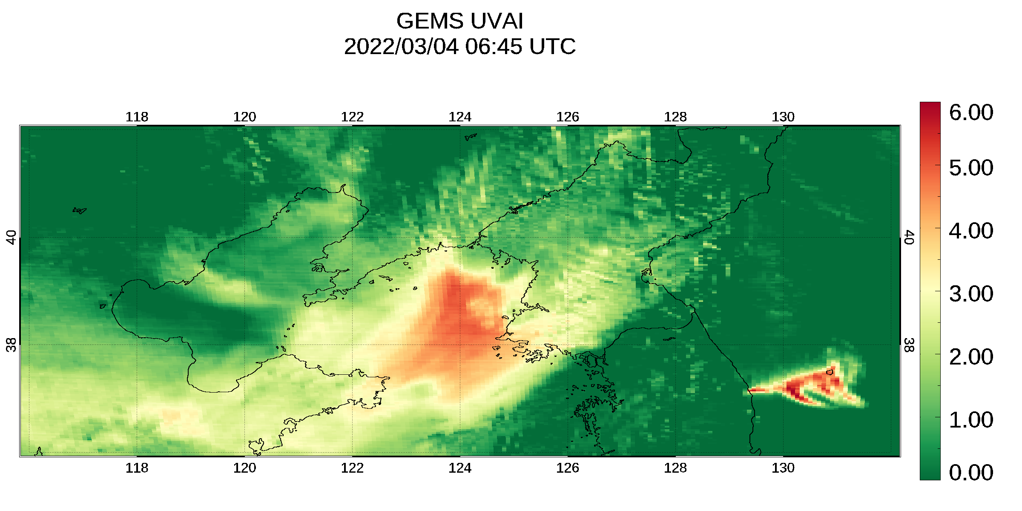
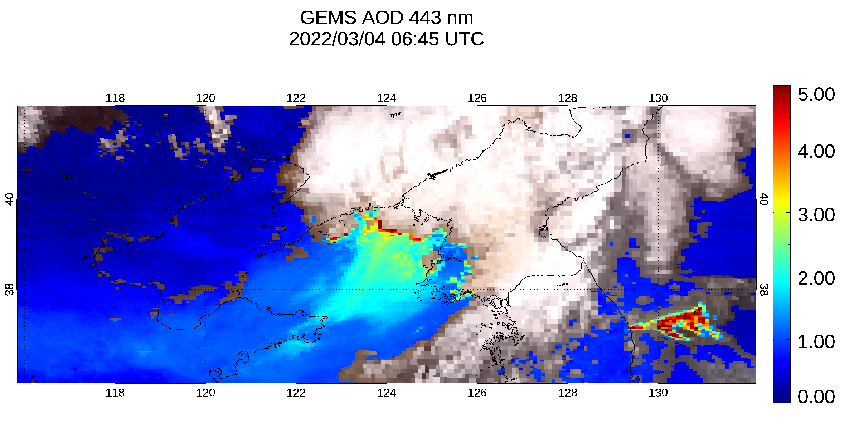
Retrieval of high AOD
The node of LUT's AOD have been added at 5.0 and 10.0.
Change in High AOD Callback Criterion to UVAI > 3 (v2.0: UVAI > 6 )
Dimension of LUT in GEMS AERAOD v2.1
Variable name [unit] | No. of Entries | Entries
Wavelength [nm] | 6 | 354, 388, 412, 443, 477, 490
SZA [º] | 12 | 0.01,5,10,15,20,27,34,41,48,55,62,69
VZA [º] | 12 | 0.01,5,10,15,20,27,34,41,48,55,62,69
RAA [º] | 11 | 0.01,15,30,45,60,80,100,120,140,160,180
Surface reflectance | 4 | 0.0, 0.05, 0.1, 0.2
AOD [443 nm] | 8 | 0.0, 0.1, 0.4, 0.8, 1.2, 2.0, 2.8, 3.6, 5.0, 10.0
SSA [443 nm] | 7 | [0.82, 0.85, 0.88, 0.91, 0.94, 0.96, 0.98, 1.0] for dust and HAF [0.90, 0.92, 0.94, 0.96, 0.97, 0.98, 0.99, 1.0] for NA
Aerosol Layer height above the surface [km] | 5 | 0.5, 1.5, 3, 4.5, 6
Surface elevation [km] | 3 | 0, 3, 6
AOD > 5
Notes:
In the Look-Up Table (LUT), the maximum node value for AOD has been expanded.
In the previous version, if AOD exceeded the maximum node of LUT 3.6, it could not be retrieved.
By adding node values of 5.0 and 10.0, extending from the original 3.6, it is now possible to retrieve AOD in extreme cases.
Moreover, very heavy aerosol plumes are often misidentified as cloud pixels.
We implemented callback method for high AOD based on the UV Aerosol Index.
but until the version 2, the threshold was set too high, then only few pixels were recalled.
therefore, the pixels with a UVAI greater than 3 proceed with the retrieval process without cloud masking from now on.
This case is an example of a severe wildfire in Korea. The UVAI showed very high values, exceeding 6.
The previous version of the algorithm was unable to retrieve the aerosol optical properties in this wildfire plume.
However, after the update, we are now able to retrieve AOD values greater than 5 in the very thick aerosol plumes omitted from by the wildfire.

Slide 9
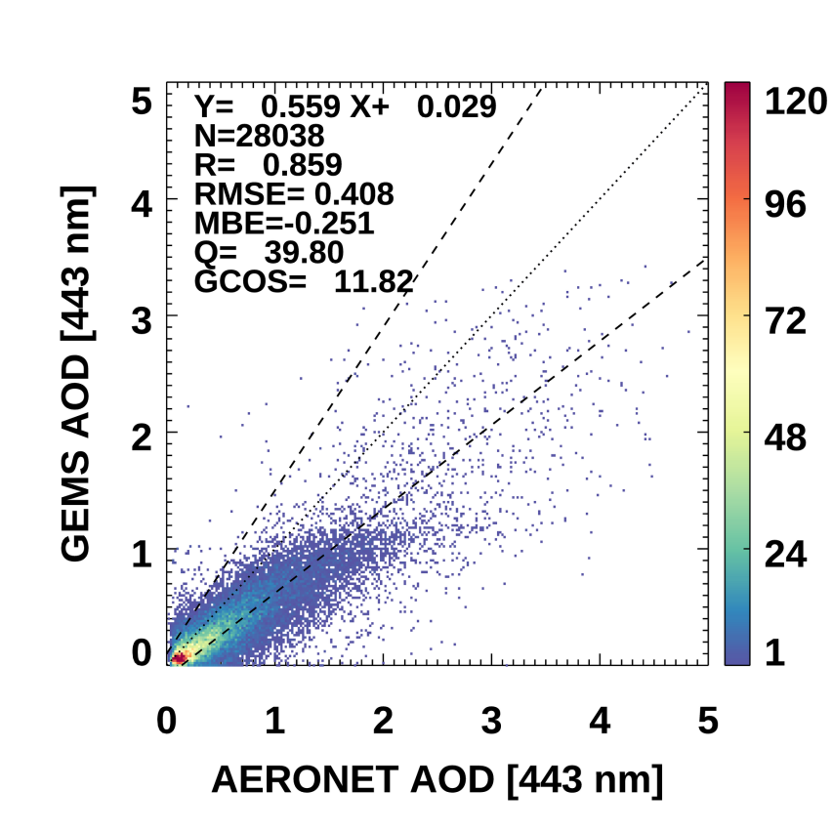
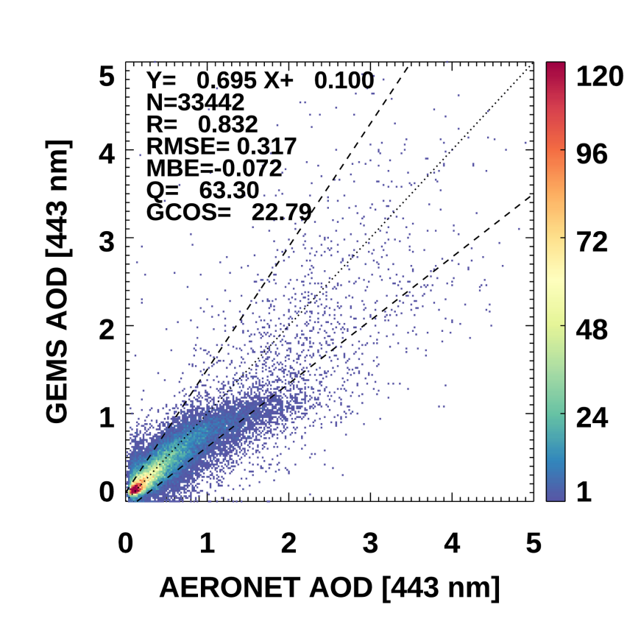
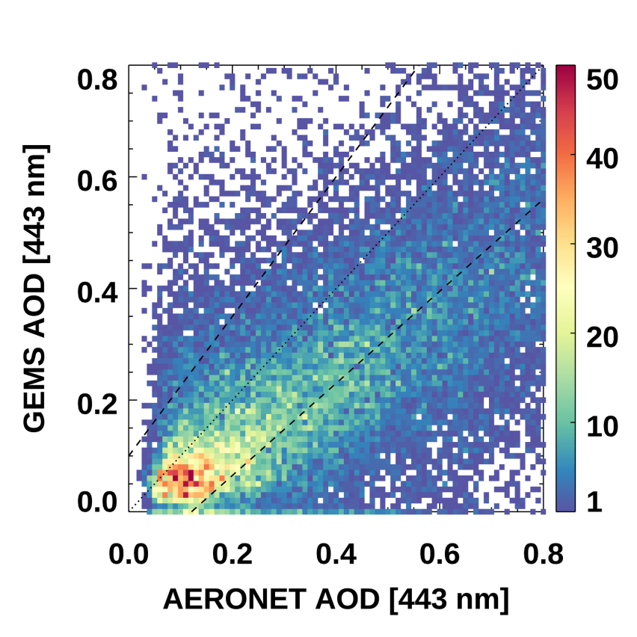
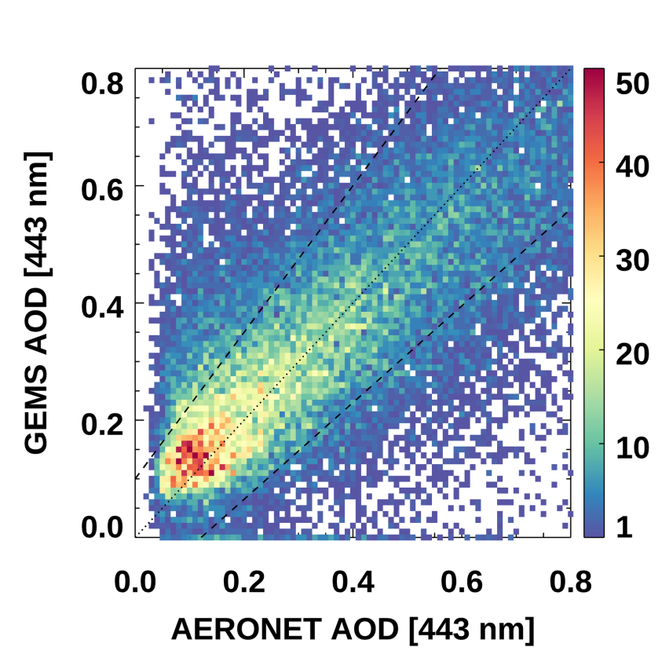
Comparison of GEMS AOD v2.1 (Operational) and AERONET AOD
Comparison of GEMS AOD v2.0/v2.1 and AERONET AOD from January 2023 to May 2024
V2.0
V2.1
Validation is performed only if more than 10% of the pixels within the validation spatial radius are retrieved.
Retrieval of high AOD: GEMS AOD v2.1 is capable of retrievals in very high heavy aerosol events with AOD > 3.6, compared to GEMS AOD v2.0.
The underestimation of GEMS AOD in low AOD cases (AOD < 0.2) has been improved.
Notes:
In this slide, we present the comparison of GEMS AOD v2 and v2.1 with AERONET AOD data from January 2023 to May 2024.
while the correlation coefficient has slightly decreased, the percentage of GEMS AOD data within the expected error range, Q value, has significantly increased.
One of the key improvements in version 2.1 is its capability to retrieve very high AOD values, especially in heavy aerosol events where AOD exceeds 3.6.
Additionally, there is the underestimation in low AOD cases in version 2, because of effect of overestimation of surface reflectance.
The scatter plots demonstrate a much closer alignment with the 1:1 line, indicating that the improvement of calculation of surface reflectance in v2.1 have led to more accurate low AOD retrievals.

Slide 10
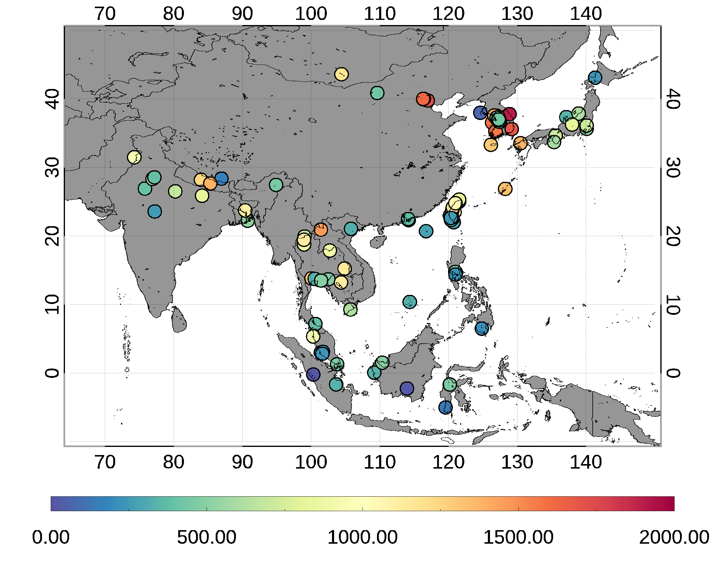
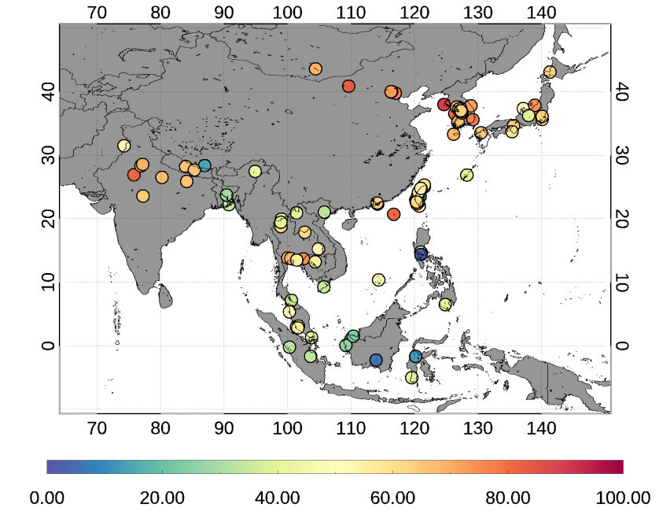
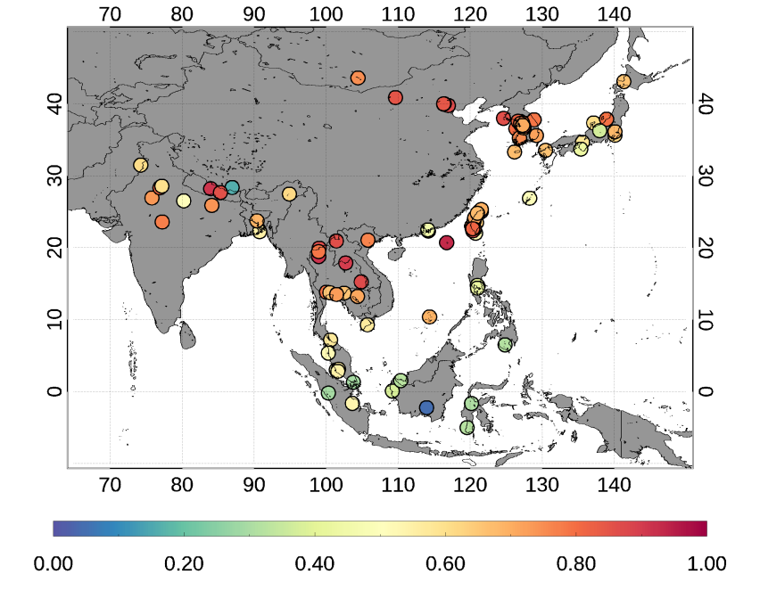
Comparison of GEMS AOD v2.1 and AERONET AOD
Validation Results of GEMS AOD v2.1 Illustrated by Statistic Maps
N
Q
R
AERONET sites located in Korea and China have relatively higher R and Q values (the percentage within the expected error range) compared to other sites.
The accuracy is relatively lower in South Asia due to the remaining cloud pixels.
Notes:
in this slide, we present the statistical validation maps of GEMS AOD v2.1 against AERONET AOD data
For example, in Korea and China, we observe a strong correlation with AERONET AOD and high Q value.
However, challenges remain in South Asia, where cloud contamination continues to impact the accuracy of retrievals.
Overall, these validation results show that GEMS AOD v2.1 provides more reliable data, particularly in Korea and China
However, in Southeast Asia and South Asia, it shows slightly lower Q value compared to Northeast Asia.

Slide 11
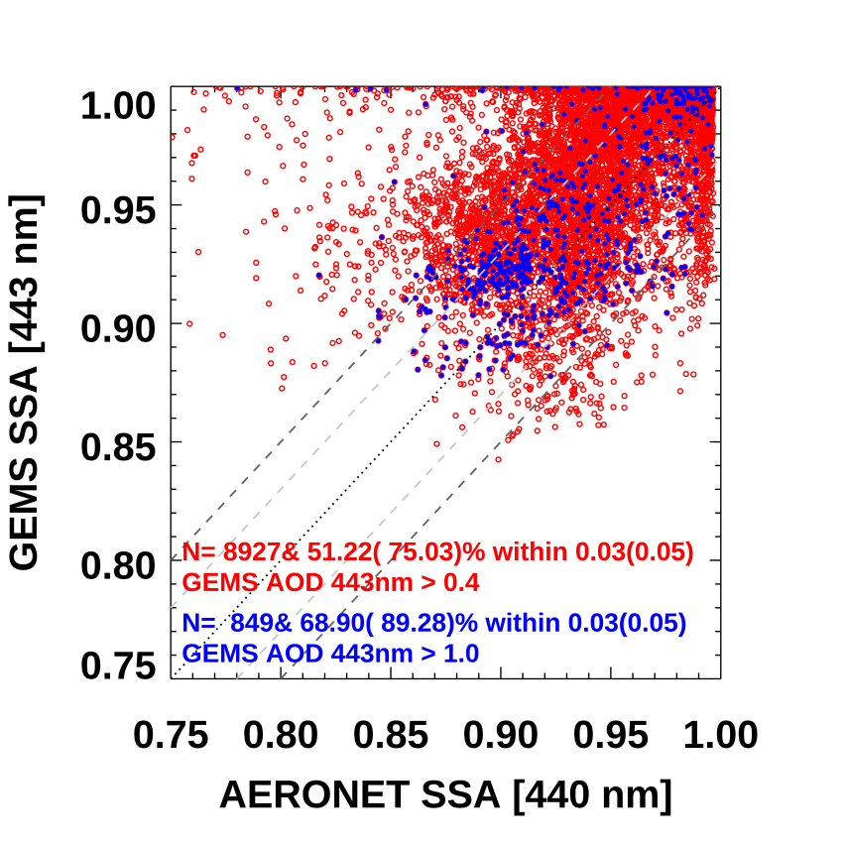
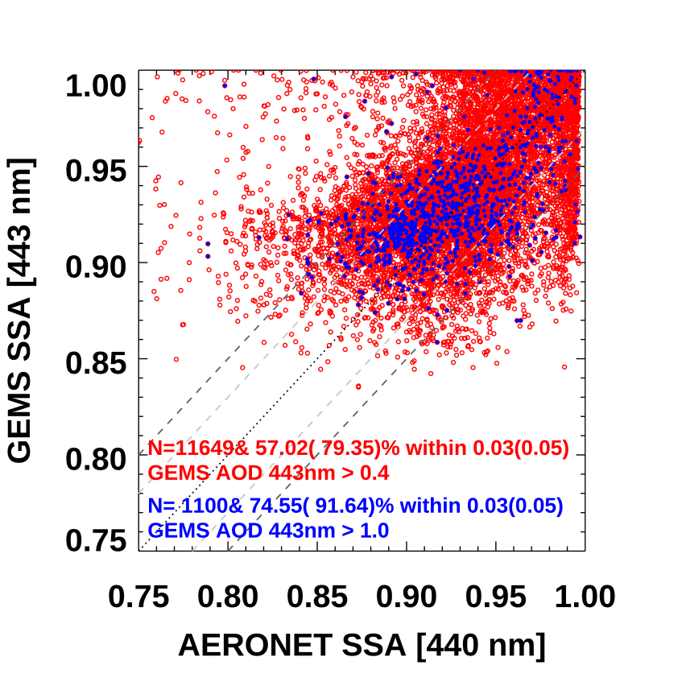
Comparison of GEMS SSA v2.1 (Operational) and AERONET SSA
Comparison of GEMS SSA and AERONET SSA from January 2023 to May 2024
V2.0
V2.1
Gray (black) dashed lines indicate an uncertainty envelope of ±0.03 (0.05) in SSA
The percentage of GEMS SSA v2.1 data falling within the expected error range has increased compared to v2.0. (51.22 % → 57.02 %)
Notes:
Also, we compare the GEMS SSA version 2 and 2.1 with AERONET SSA data.
It is important to note that, in satellite observations, the SSA signal is much smaller compared to the AOD signal, making it more challenging to retrieve.
One of the notable improvements in version 2.1 is the increased percentage of data points falling within the expected error range.
The percentage of GEMS SSA data within the ±0.03 error range has increased from 51.22% in version 2.0 to 57.02% in version 2.1.
When the AOD is above 1.0, which means that aerosol signals in the atmosphere is sufficient,
the percentage of data falling within the expected error range has increased from 68% to 74% in version 2.1.

Slide 12
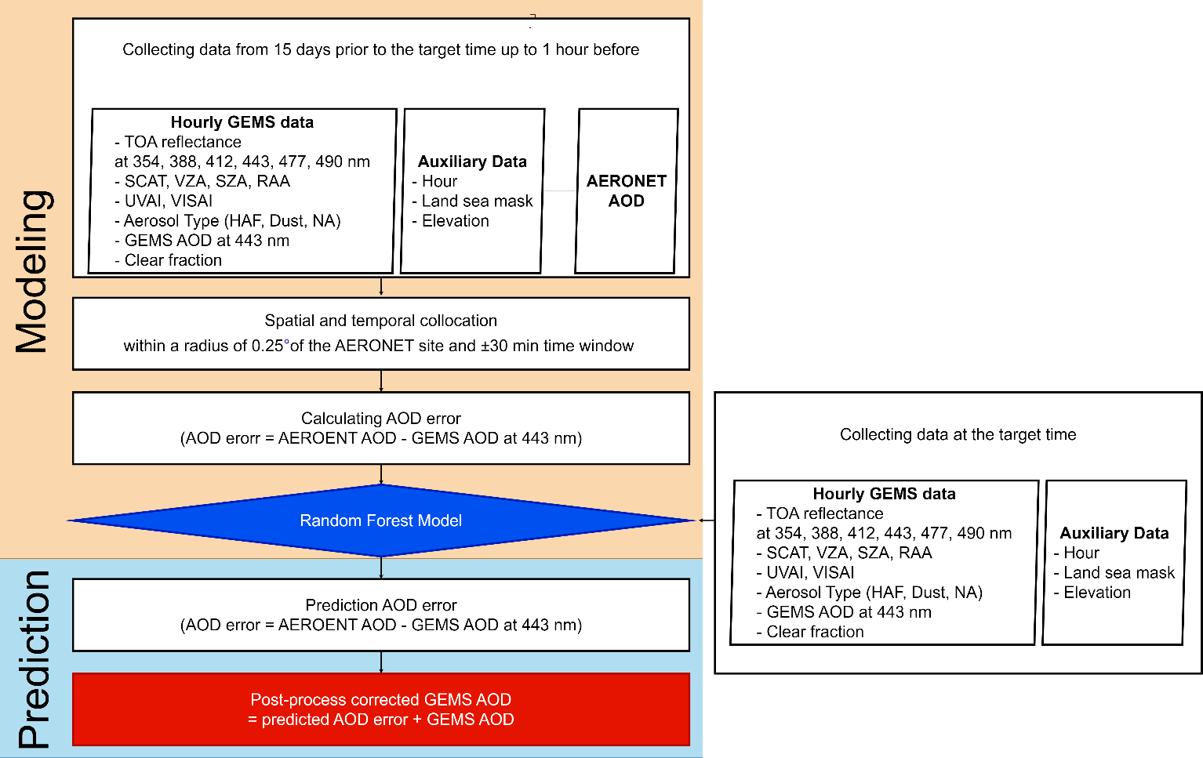
GEMS AOD post-process correction model – version 3.0 (TBD)
Combining the GEMS aerosol retrievals and post-processing from random forest (RF)-based correction model.
Notes:
This slide shows the GEMS AOD post-process correction model.
We combine GEMS aerosol retrievals with a random forest-based correction model to reduce errors.
First, we collect GEMS data and AERONET AOD for the past 30 days to build the model.
We then use this model to predict AOD errors and it used for correcting the GEMS data for near-real time process.
본 방법은 업데이트된 GEMS 에어로졸 알고리즘으로부터 AOD 산출한 뒤 그 산출물의 오차만을 머신러닝 기법을 이용하여 편차 보정을 하는 것을 의미합니다..
준실시간 AOD 오차 보정을 위하여 모델링 부분과 prediction 부분이 분리되었습니다.
Modeling part에서는 30일 이전부터 1시간 이전의 GEMS 데이터와 보조데이터 그리고 AERONET AOD를 수집한 뒤
AERONET 데이터와 GEMS 데이터를 시간, 공간별로 콜로케이션 한 후 AOD의 오차를 계산합니다.
이후 AOD 오차를 target data로 설정한 뒤 GEMS 데이터와 보조자료를 predictor로 사용하여 RF 모델을 구성합니다.
이후 AOD 오차를 예측하기 위하여 해당 시간의 GEMS 데이터 및 보조자료만을 이용, 미리 구현된 RF 모델을 이용하여 AOD 오차를 예측하고
이를 GEMS AOD에 더함으로써 후처리를 수행하게 됩니다.

Slide 13
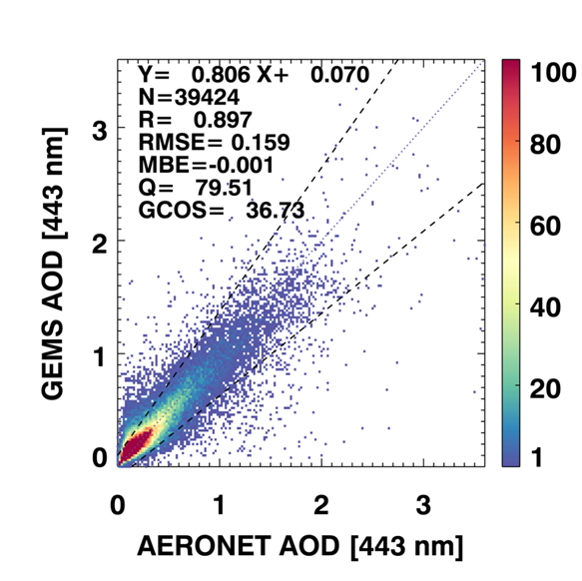
GEMS AOD after post-process correction – version 3.0 (TBD)
Reference dataset: AERONET version 3 level 1.5 data
Validation area & period : GEMS entire area & 2021.11.01−2022.10.31 (1-year)
Comparison of GEMS AOD after post-process correction (PPC) and AERONET AOD
Hourly comparison of GEMS and AERONET AOD
Time | Slope | y-intercept | R | RMSE | MBE | Q (%) | GCOS (%)
22:45 | 0.770 | 0.101 | 0.770 | 0.145 | 0.033 | 77.84 | 37.47
23:45 | 0.797 | 0.077 | 0.883 | 0.136 | 0.017 | 80.35 | 36.83
00:45 | 0.772 | 0.075 | 0.879 | 0.139 | 0.010 | 79.83 | 38.86
01:45 | 0.770 | 0.070 | 0.882 | 0.141 | 0.002 | 80.07 | 36.12
02:45 | 0.816 | 0.065 | 0.899 | 0.151 | 0.004 | 80.38 | 36.59
03:45 | 0.799 | 0.075 | 0.903 | 0.171 | -0.008 | 80.89 | 37.95
04:45 | 0.807 | 0.06 | 0.902 | 0.172 | -0.015 | 80.15 | 36.87
05:45 | 0.829 | 0.064 | 0.893 | 0.162 | -0.003 | 78.48 | 36.38
06:45 | 0.829 | 0.077 | 0.895 | 0.162 | 0.004 | 77.27 | 35.46
07:45 | 0.776 | 0.097 | 0.883 | 0.176 | -0.002 | 76.18 | 33.82
Slopes ≥ 0.77. relatively stable (0.534~0.73 before PPC)
MBEs close ~ 0.0.
R ≥ 0.87 except for 22:45 UTC. relatively stable
Improvement of all statistical metrics.
High AOD values are closer to the 1:1 line.
Notes:
This slide presents the results of GEMS AOD after applying the post-process correction.
First, the left figure shows the validation results of GEMS AOD after the post-process correction.
You can see that the AOD values are close to the 1:1 line when compared with AERONET data, indicating improved accuracy.
the table on the right summarizes the statistical metrics.
All metrics, including slope, y-intercept, R, RMSE, and MBE, have improved.
The slopes of the corrected GEMS AOD data are now mostly above 0.77, which is more stable compared to the previous range of 0.534 to 0.73. The mean bias errors (MBEs) are now close to zero, showing less error. The correlation coefficients (R) are generally above 0.87, except at 22:45 UTC, indicating improved and consistent accuracy.
후처리 이후 GEMS AOD의 검증 결과에 대해 말씀드리면, 우선 AEROENT AOD와 비교시 특히 high AOD에서 1:1 line에 가까워지고, 상관계수또한 높아진 모습을 보입니다.
시간에따른 GEMS AOD의 편차에 대해 살펴보면 붉은색으로 표시된 원은 part1의 개선점을 적용시킨 GEMS AOD이며 파란색 원은 후처리 이후 GEMS AOD를 의미합니다.
후처리 전 GEMS AOD의 편차는 bimodal distribtuon 를 이룹니다. 하지만 후처리 이후 bias 0에 가까워짐, 시간별 bias가 크게 변화하지 않음.
시간별로 검증 결과를 살펴봄. Slope이 기존에 0.5~0.7로 시간별로 다르게 나타나던 것과는 다르게 0.77~0.83으로 상대적으로 안정적인 모습을 보임

Slide 14
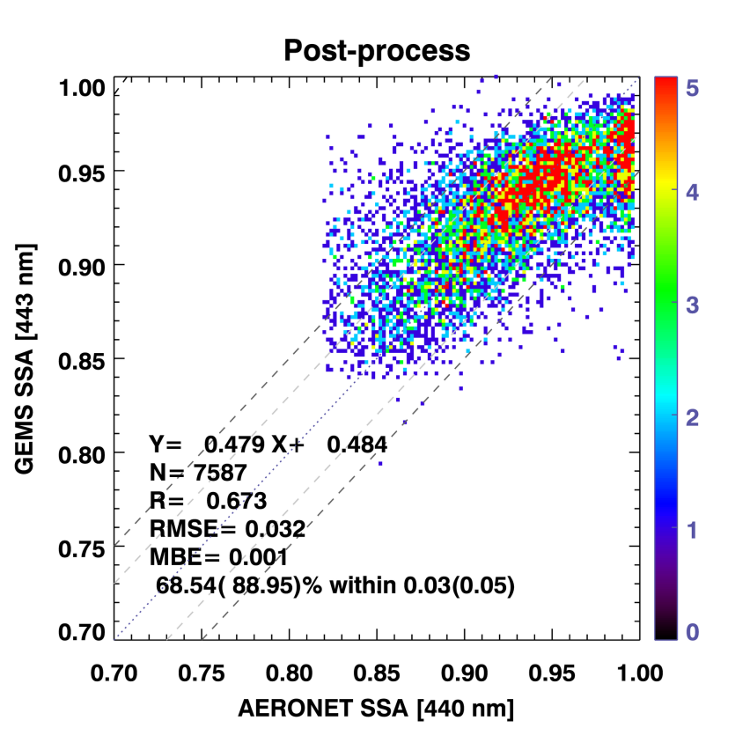
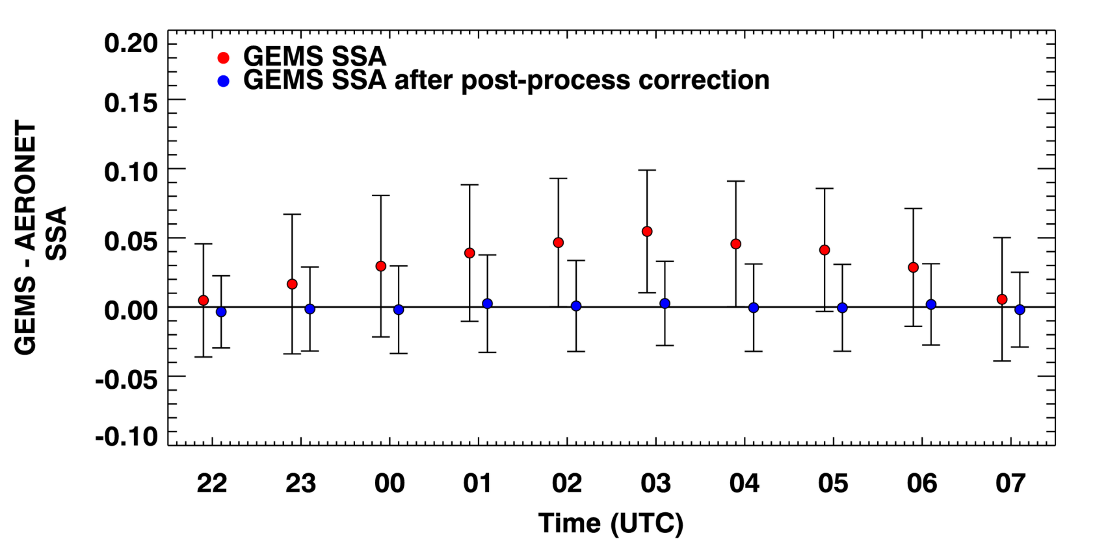
GEMS SSA after post-process correction – version 3.0 (TBD)
GEMS aerosol post-process correction
Reference dataset: AERONET version 3 level 1.5 data
Validation area & period : GEMS entire area & 2021.11.01−2022.10.31 (1-year)
Comparison of GEMS SSA after post-process correction and AERONET SSA
The difference between GEMS SSA and AERONET SSA in terms of time
Hourly comparison of GEMS
and AERONET SSA
Time | EE% ±0.03 (%) | EE% ±0.05 (%)
22:45 | 77.91 | 93.60
23:45 | 73.96 | 90.34
00:45 | 68.03 | 88.47
01:45 | 64.30 | 85.47
02:45 | 66.39 | 87.76
03:45 | 69.32 | 89.72
04:45 | 67.81 | 89.80
05:45 | 69.13 | 88.90
06:45 | 74.40 | 91.77
07:45 | 77.70 | 93.77
The bias of GEMS SSA exhibited a characteristic bias shape, forming a bell shape.
The artifactual diurnal bias has been effectively mitigated with the implementation of the model-enforced post-process correction.
All statistical metrics have been improved.
% of GEMS SSA falling within the expected error of ±0.03 (0.05) is 68.54% (88.95%).
EE% ±0.03 ≥ 64.3. relatively stable
(27.82%~64.96% before PPC)
Notes:
We applied the same post-process correction method to SSA as we did for AOD. In the left figure, you can see the comparison of GEMS SSA after post-process correction. The percentage of GEMS SSA values within the expected error range has increased significantly. The middle figure shows the diurnal variation of the SSA bias, which was bell-shaped before correction iin red circles but is now much more stable in blue circles. The table on the right shows the improvement in statistical metrics. The percentage of SSA values within the error range, EE%, has improved, indicating better consistency with AERONET. EE% ±0.03 is now above 64.3%, compared to the previous 27.82% to 64.96% before post-process correction.
These enhancements show that our correction method effectively reduces biases in not only GEMS AOD but also GEMS SSA.
후처리 이후 GEMS SSA의 검증 결과에 대해 말씀드리면,
예상오차 범위 안에들어오는 SSA가 68%로 성능이 향상되었으며,
특히 GEMS SSA와 AEROENT 1:1 line..
03 UTC에서 최대 0.05의 바이어스를 가졌으나,, 0에 가까워짐..
따라서 머신러닝을 이용한 후처리 방법은 GEMS에서 산출하는 에어로졸의 시간별 산출 에러를 감소시켜 실제 일변화의 signal을 탐지하는데 주요한 역할을 할 수있ㅇ르것.

Slide 15
Conclusion
(v2.1 – Operational) The updates to GEMS AOD v2.1 include the calculation of surface reflectance considering background AOD, the first guess of ALH based on CALIOP ALH climatology, and improved retrievals for high AOD.
(v2.1 – Operational) The GEMS aerosol products were validated against AERONET data for the entire GEMS domain from January 2023 to May 2024. The GEMS AOD showed a good correlation with the AERONET AOD (R = 0.832). The percentage of GEMS SSA v2.1 data falling within the expected error range has increased compared to v2.0. (51.22 % → 57.02 %)
(v3.0 - TBD) Model-enforced post-process correction (PPC) improves GEMS AOD and SSA performance, reducing diurnal variation of bias. All statistical metrics have been improved.
Notes:
In conclusion, Operational GEMS aerosol algorithm version 2.1 includes updates in surface reflectance, ALH, the retrieval of high AOD, and metadata.
We aimed to assume more accurate]surface reflectance and a more realistic first guess value for ALH in aerosol retrieval and derive as many pixels as possible that were previously not retrieved due to misclassification as clouds or being outside the maximum LUT node.
Thanks for your attention.

